Slide 1

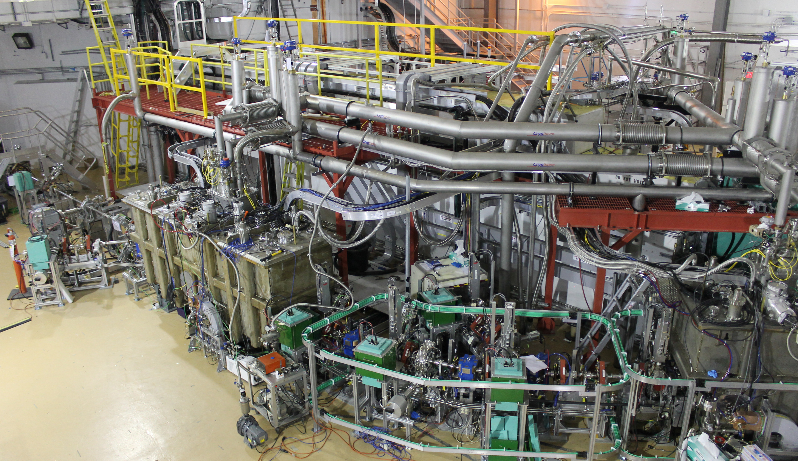
The ARIEL e-Linac and its technical development for user operation
Stephanie Diana Rädel

Slide 2
Outline
TRIUMF – an introduction
ARIEL and its e-Linac (– a love story)
The e-Linac – a new multi-user facility
  ARIEL
  FLASH
  DarkLight
  THz

Slide 3

TRIUMF: Canada’s particle accelerator center
Our multidisciplinary community drives leading-edge research that delivers impact in science, medicine, and industry, positioning Canada as a world leader.
University of Alberta
University of British Columbia
University of Calgary
Carleton University
University of Guelph
University of Manitoba
McGill University
McMaster University
Université de Montréal
University of Northern
British Columbia
Queen's University
University of Regina
Saint Mary's University
Université de Sherbrooke
Simon Fraser University
University of Toronto
University of Victoria
University of Waterloo
Western University
University of Winnipeg
York University

Slide 4
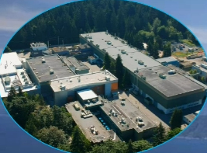

Slide 5
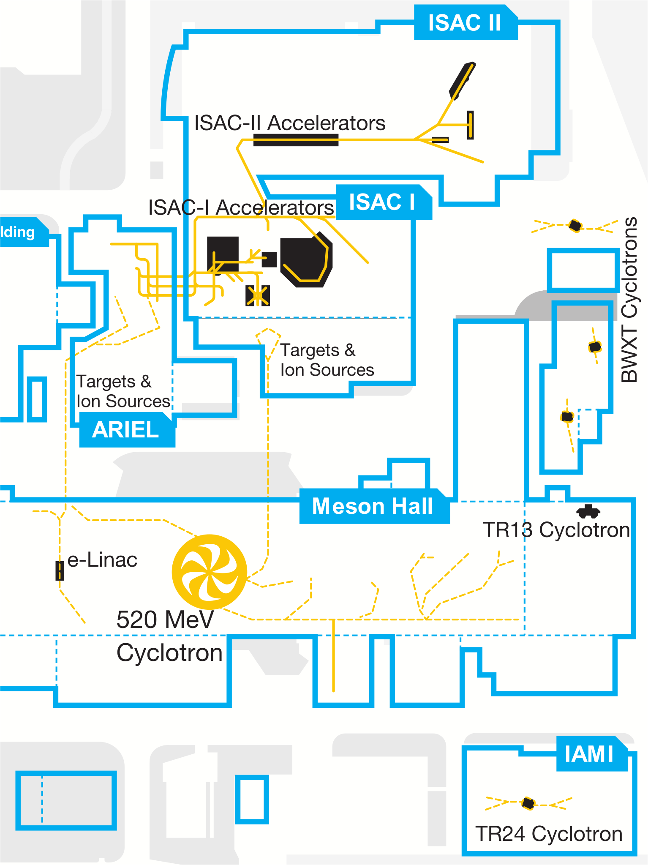
TRIUMF: Canada’s particle accelerator centre
Primary beam driver: cyclotron
  500 MeV H– cyclotron
  Produces rare isotopes, neutrons and muons
Other Cyclotrons
  TR13
  IAMI
  BWXT
Separator Accelerator facility (ISAC)
  Isotope Separator Online (ISOL) facility
  ISAC-I: Normal conducting-linac
  ISAC-II: Superconducting-linac
e-Linac
Advanced Rare Isotope Laboratory (ARIEL)
D. Castaneda

Slide 6
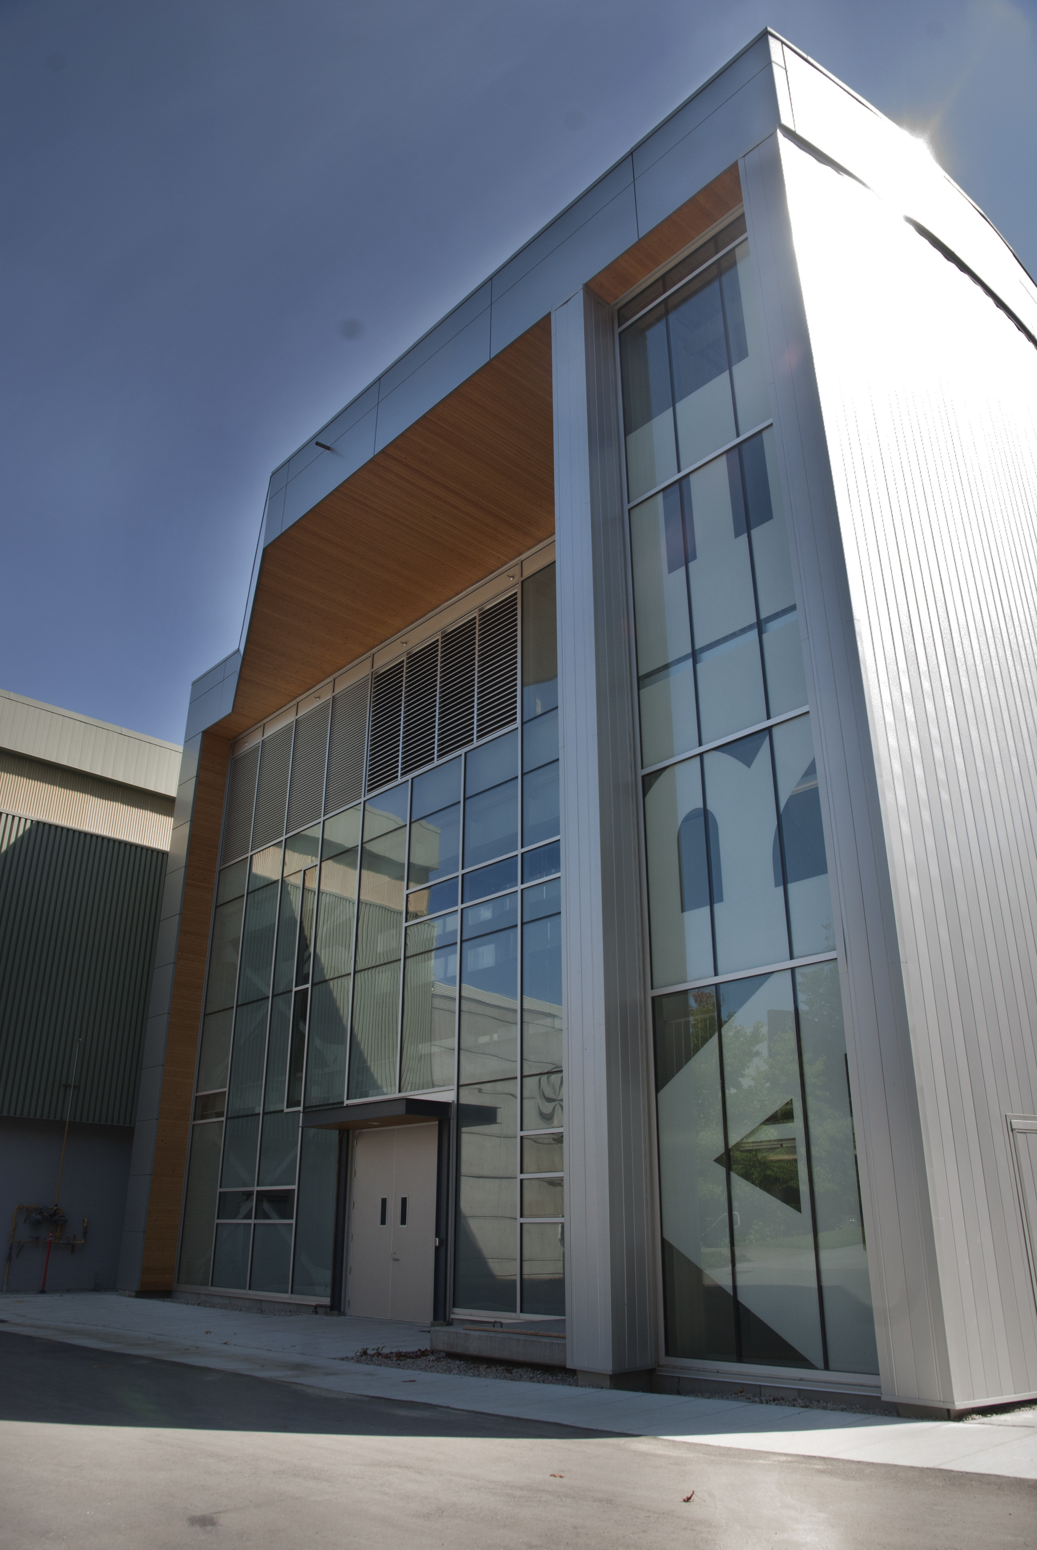
ARIEL: one of the world’s most powerful ISOL complexes
Massively expand our rare isotope research program
  Providing more exotic isotope species with very high intensities
  Adding two production targets in parallel to existing ISAC target stations
Three simultaneous isotope production stations
  Fully exploit numerous existing experimental facilities at ISAC
https://www.flickr.com/photos/triumflab/15148509948/in/photostream/

Slide 7
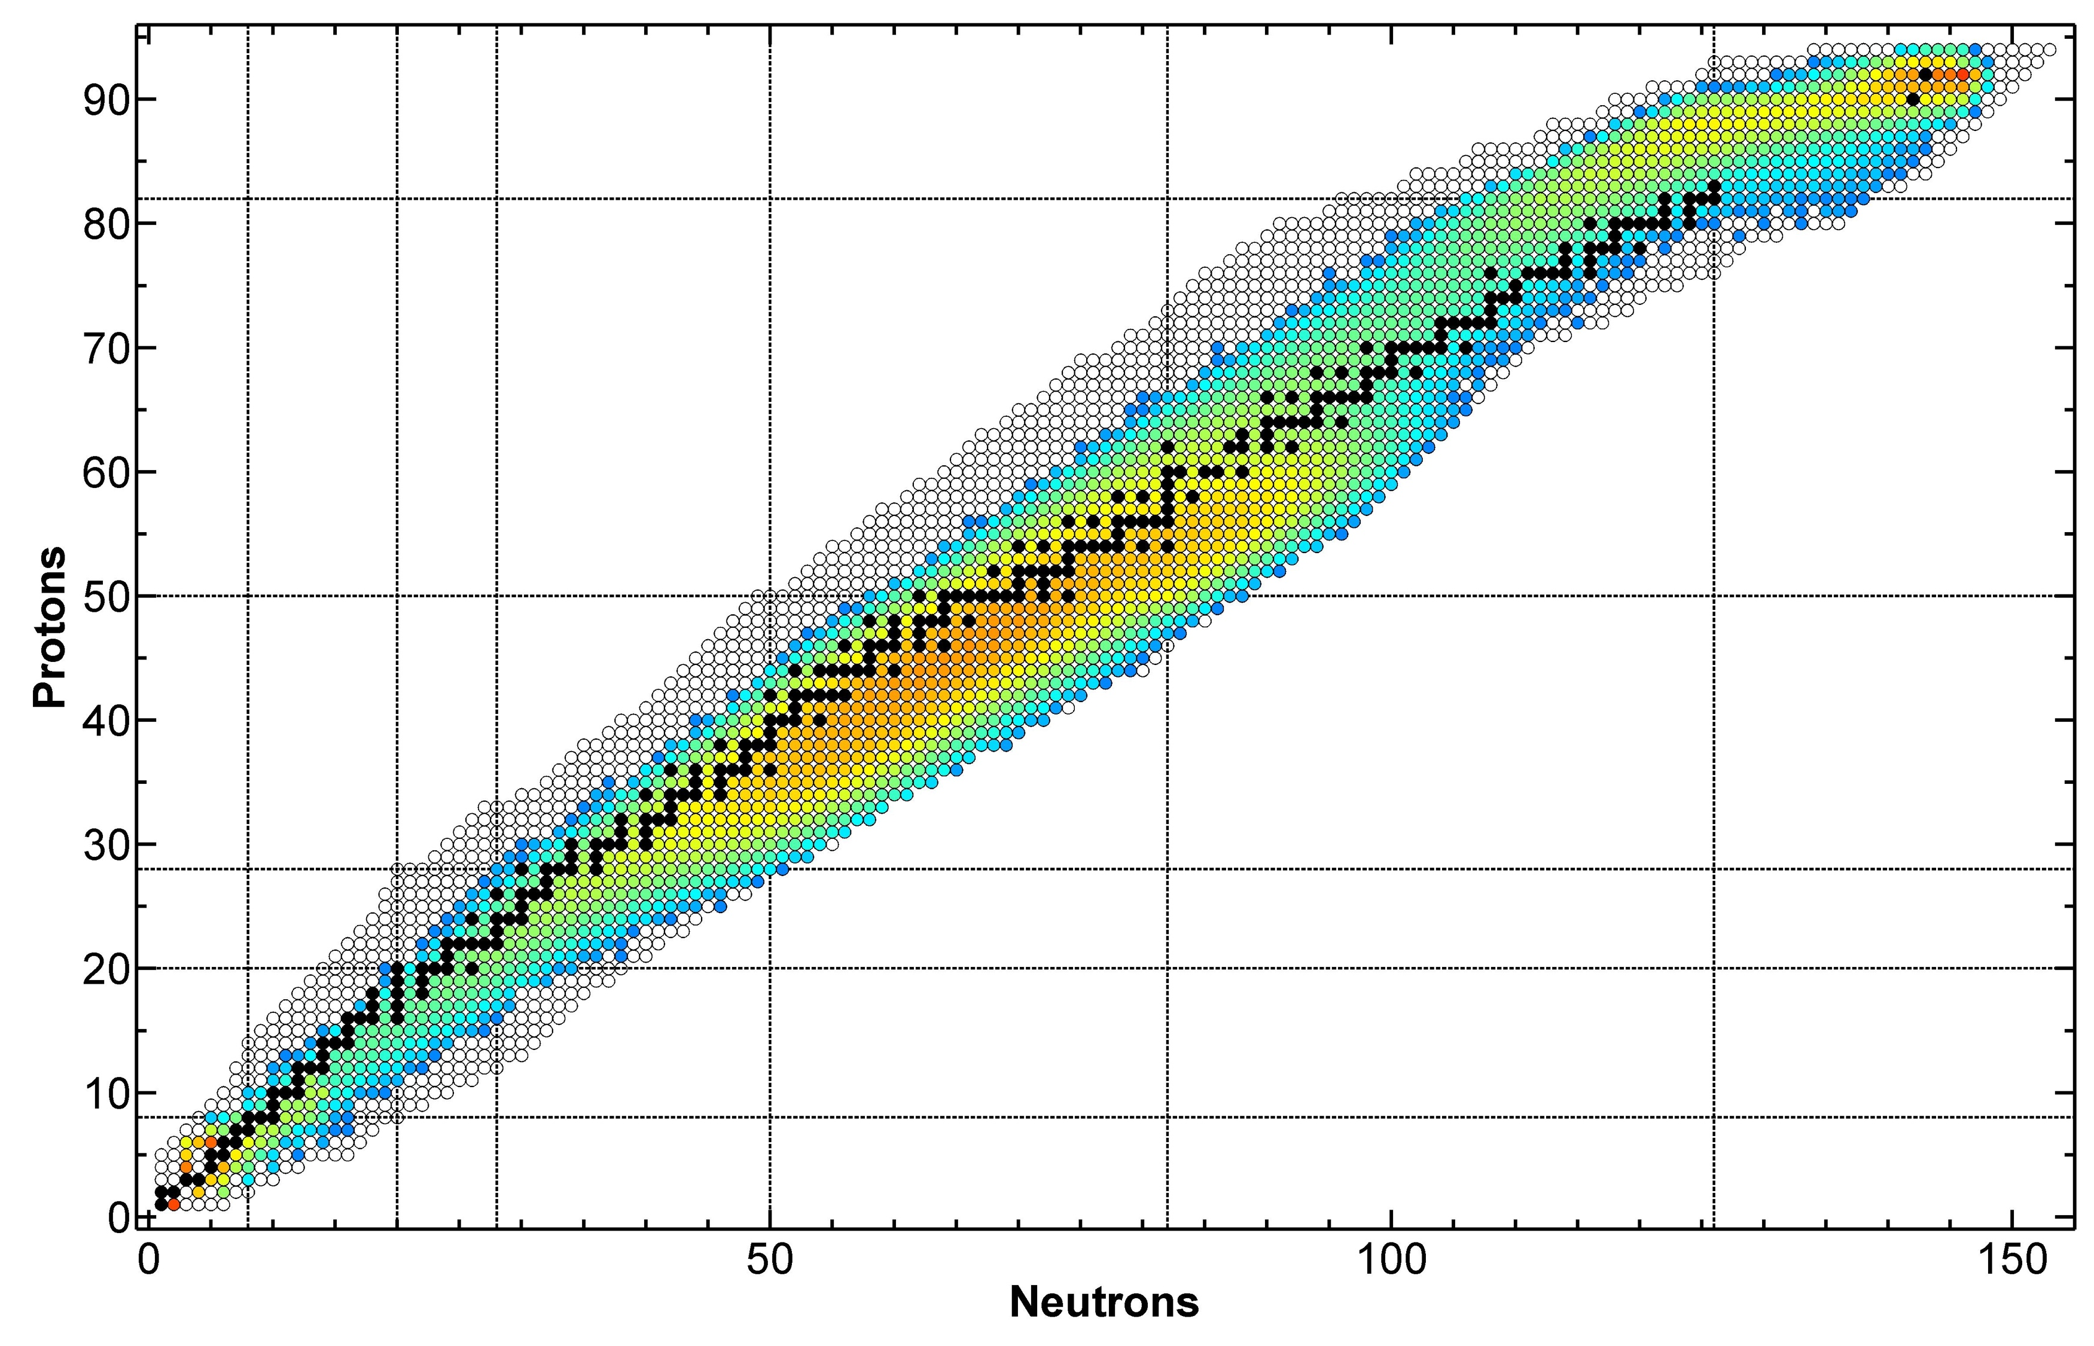
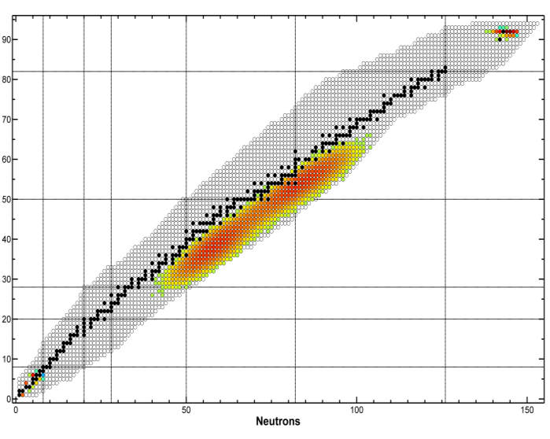
An independent driver for TRIUMF’s Rare Isotope Program
production intensity from ²³⁸UC_{x}
500 MeV x 10 µA protons [1/s]
35 MeV x 10 mA electrons [1/s]
Pure neutron-rich products from photo fission
Production cross section reduced in comparison to hadrons
A. Gottberg

Slide 8
ARIEL target hall location – at TRIUMFs heart
D. Castaneda

Slide 9
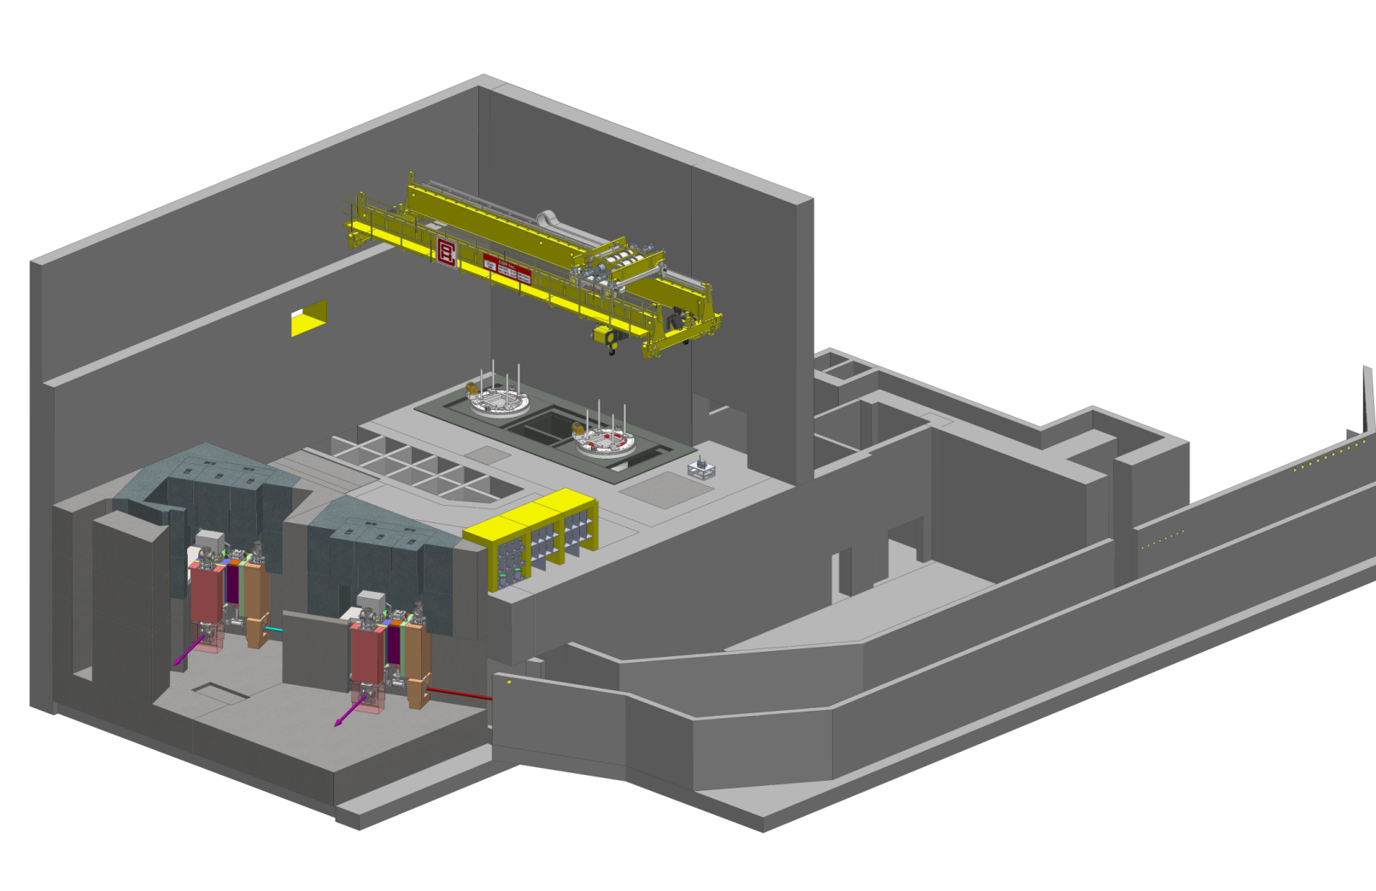
The ARIEL Target Hall
Hot cell facilities (target handling, PIE, waste processing, medical isotope extraction repair and maintenance)
Remote-controlled crane
module storage
Electron beam and
proton beam transport
AETE
target exchange point
spent target storage
APTW
electrons
driver beam tunnel
RIB
protons
RIB
Target pit shielding
A. Gottberg

Slide 10
e-Linac location
D. Castaneda

Slide 11
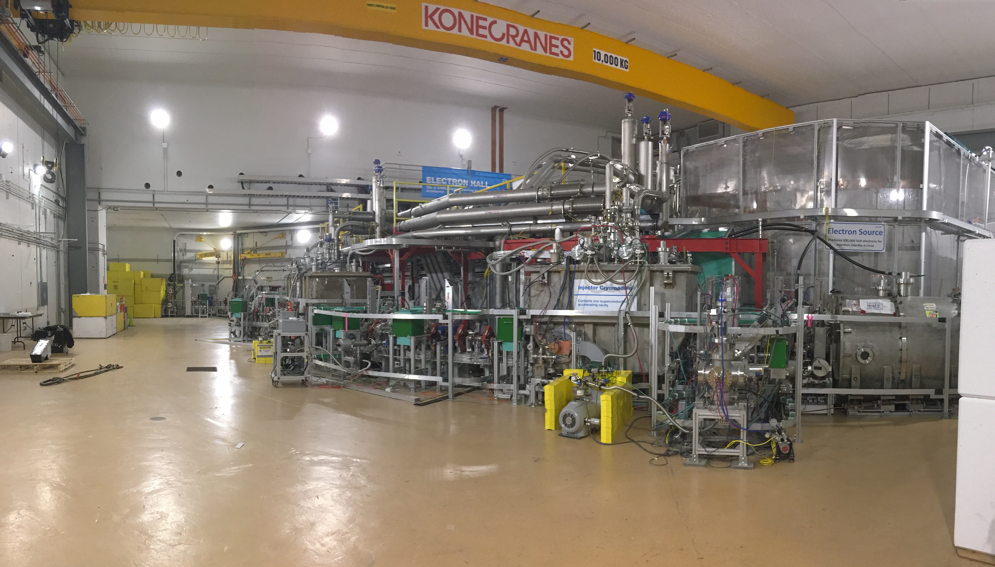
The e-Linac in its hall
tuning dump
EGUN

Slide 12
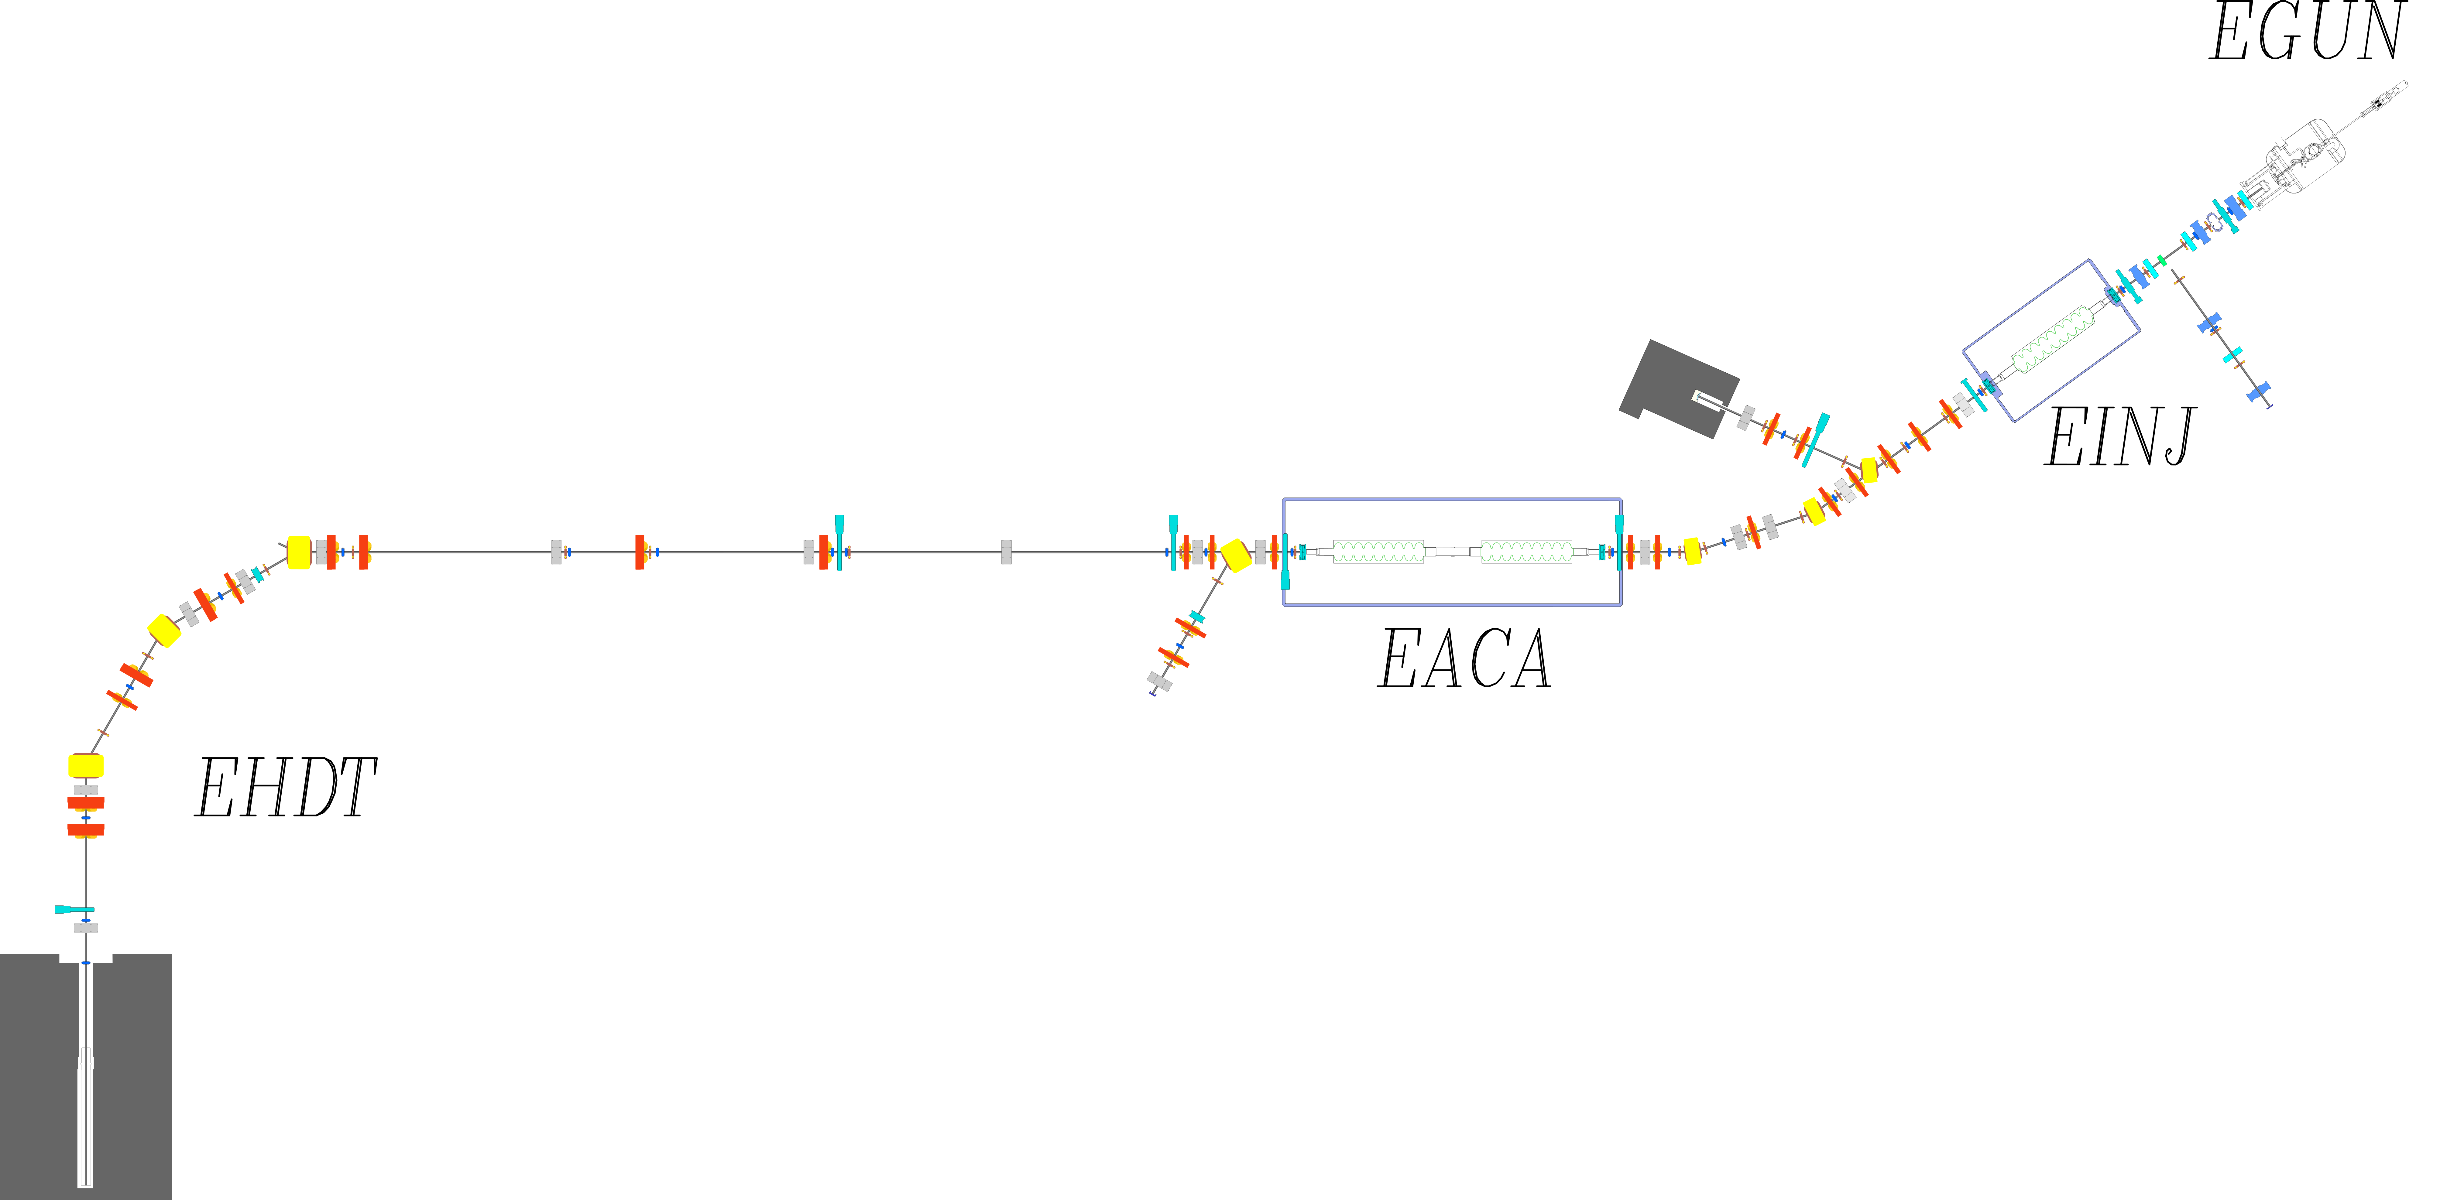
e-Linac overview
Total beam energy | 30 MeV
Maximum beam current | 10 mA
Normalized emittance | 5 μm
Bunch charge | 15.4 pC
Bunch repetition rate | 650 MHz
Power rating of high energy dump | 10 kW
Low-energy section
Electron Beam
Cryomodules
ARIEL
Medium-energy section
High-energy section
High-energy tuning dump

Slide 13
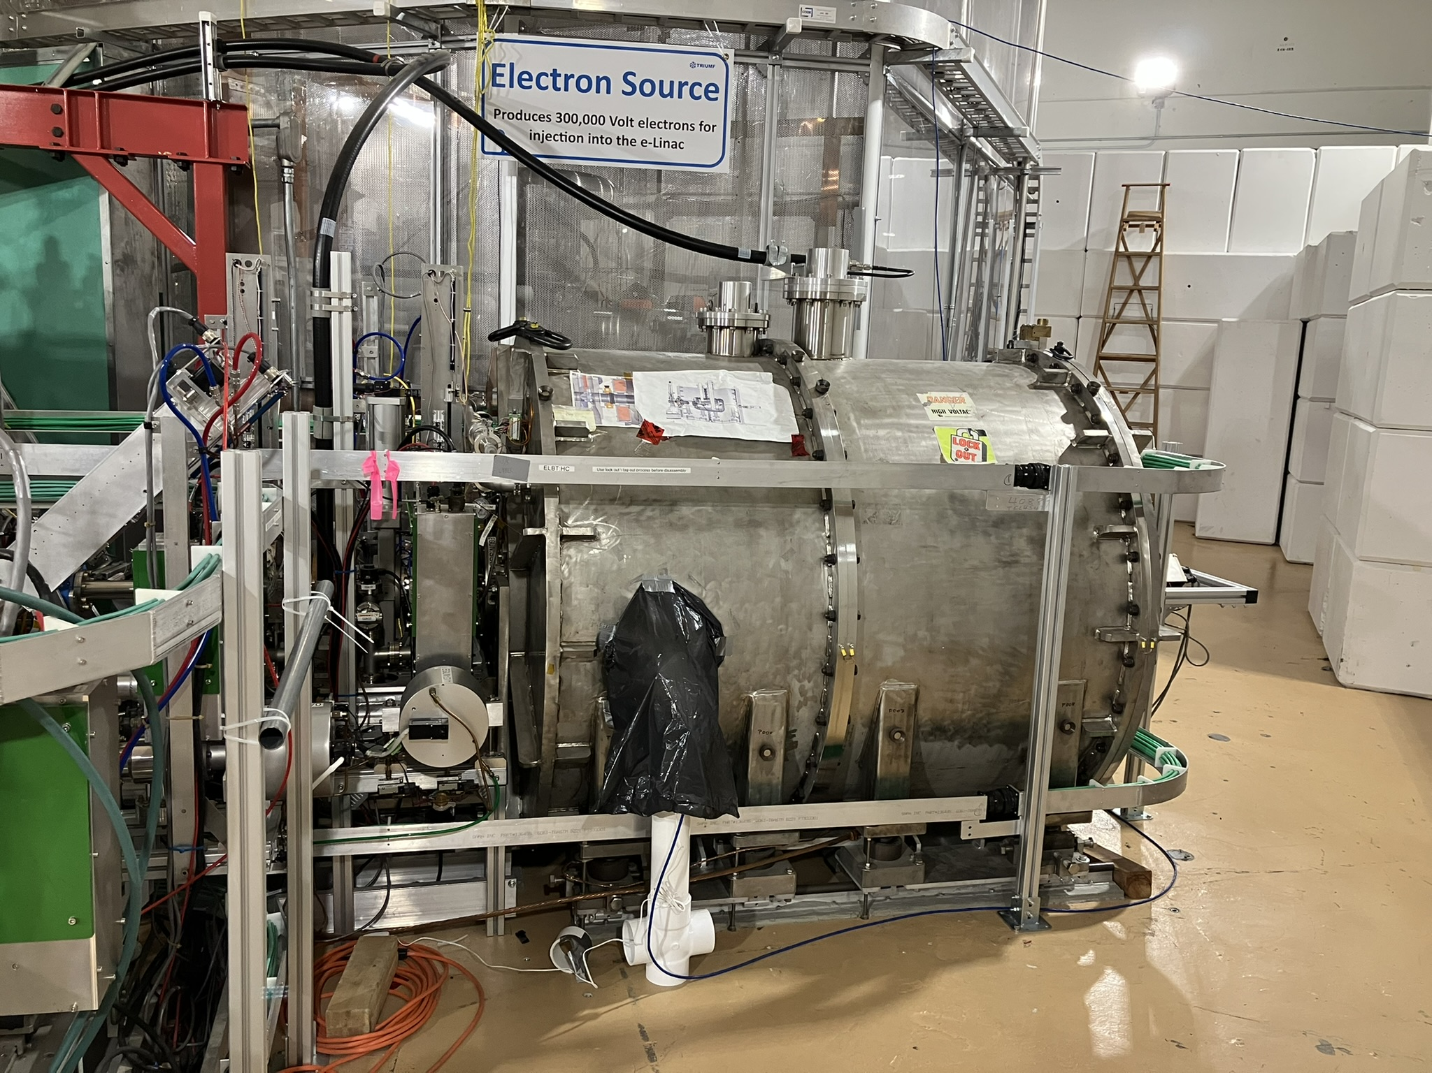
300 kV thermionic electron gun
The electron source is housed inside a pressurized SF₆ vessel to avoid breakdown of the 300 kV voltage
RF is fed into the e-gun using a ceramic waveguide to form bunches at 650 MHz
Allows CW mode

Slide 14
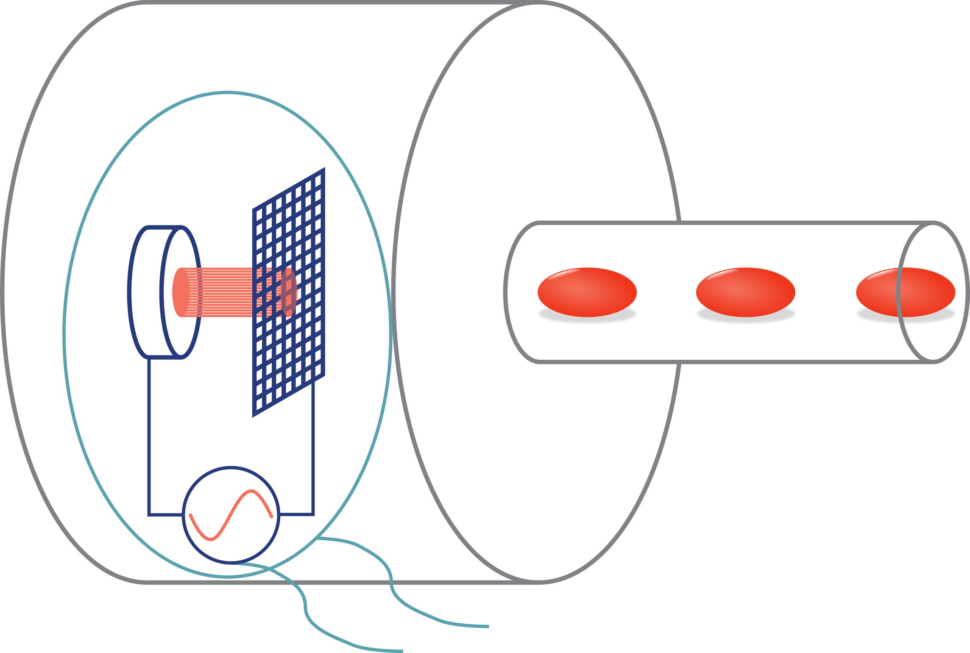
300 kV thermionic electron gun
SF₆ vessel
Cathode
Grid
Beam pipe
e⁻ beam
300 kV bias power supply
RF
Cathode has grid with suppressing voltage and RF modulation
F. Ames et al., “The TRIUMF ARIEL RF modulated thermionic electron source”, 2016

Slide 15
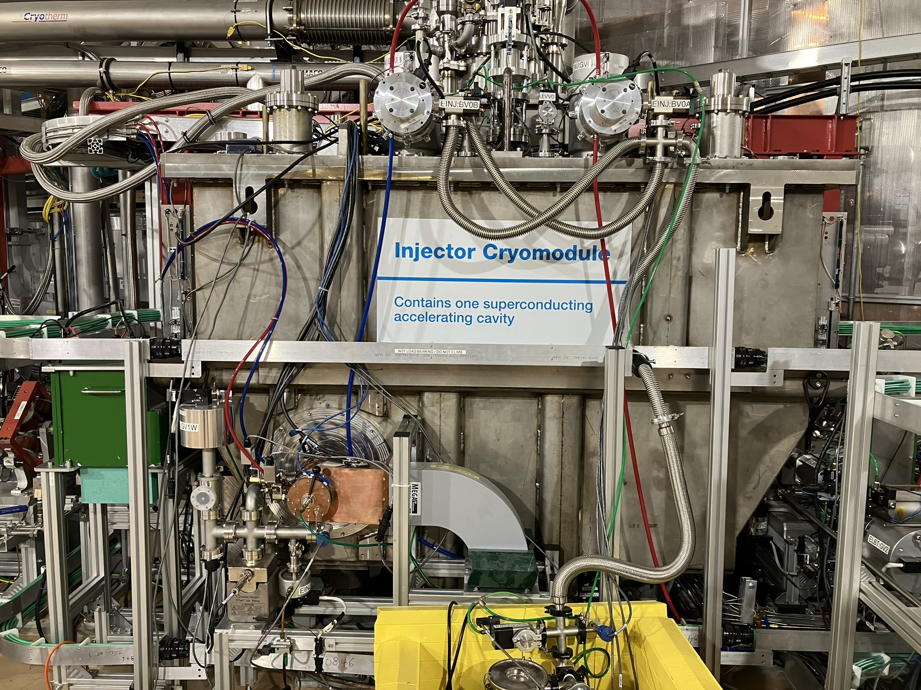
First cryomodule to accelerate beam to 10 MeV
4 K separator
Heat exchanger
EINJ
strongback
2 K separator
Power coupler
Cavity
Tuner
9-cell elliptical superconducting niobium cavity at 1.3 GHz, operating at 2 K
2 power couplers capable of delivering 50 kW each
D. Yosifov et al., “ARIEL’s E-linac and beam transport line vacuum systems”, 2012

Slide 16
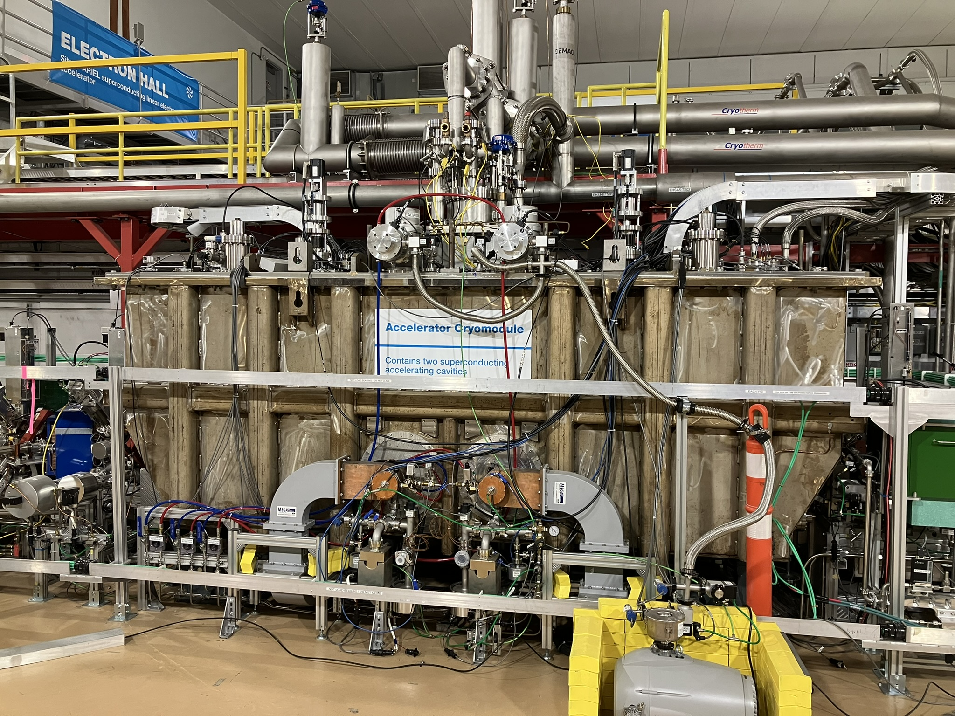
Second cryomodule to accelerate beam to 30 MeV
4 K - 2 K Cryoinsert
4 K phase separator
Support Post
Heat exchanger
Strong- back
EACA
Power coupler
WPM bracket
Two 9-cell elliptical superconducting niobium cavity at 1.3 GHz, operating at 2 K
4 power couplers capable of delivering 50 kW each
Y. Ma et al., “First RF results of two-cavities accelerating cryomodule for ARIEL E-Linac at TRIUMF”, 2018

Slide 17
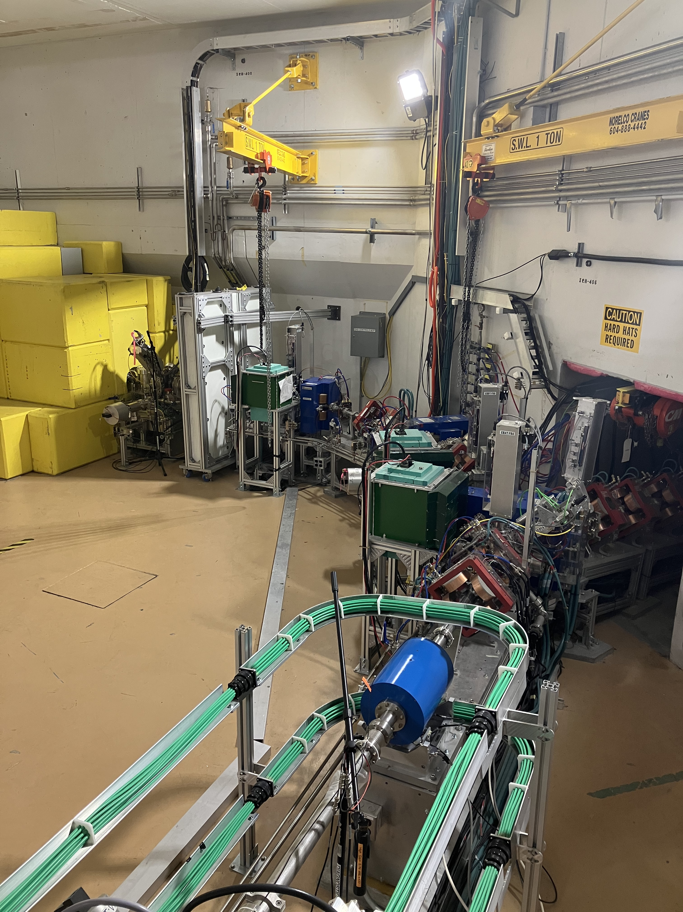
10 kW tuning dump
High energy beam dump
To ARIEL

Slide 18
e-Linac commissioning timeline
Dec. 2019
Feb. 2020
Dec. 2020
Jul. 2018
Sep. 2014
Sep. 2021
25 MeV at low beam power
31 MeV at low beam power
complete
First high-energy beam (20 MeV)
1 kW at 7 MeV
26 MeV at 1 kW

Slide 19
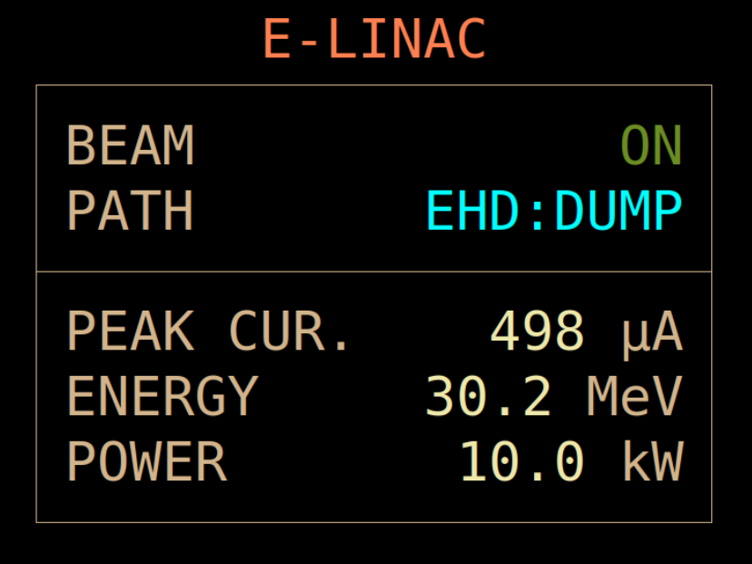
The e-linac commissioning was completed
After multiple years of commissioning, we achieved a 10 kW beam at 30 MeV for the first time
Next milestone: Reliable beam delivery
ARIEL electron target will be ready to receive beam in 2026
https://web.accel.triumf.ca/Elog_Attachments/elinac_elog/2021-09/2021-09-13-14:23:14.grab.h6pRsk.png

Slide 20

Entering a new era: The e-linac as an upcoming multi-user facility

Slide 21
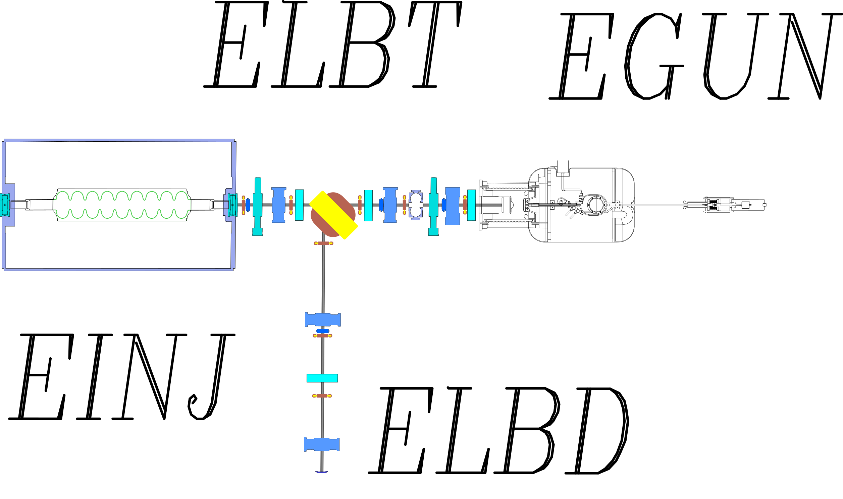
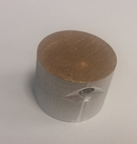
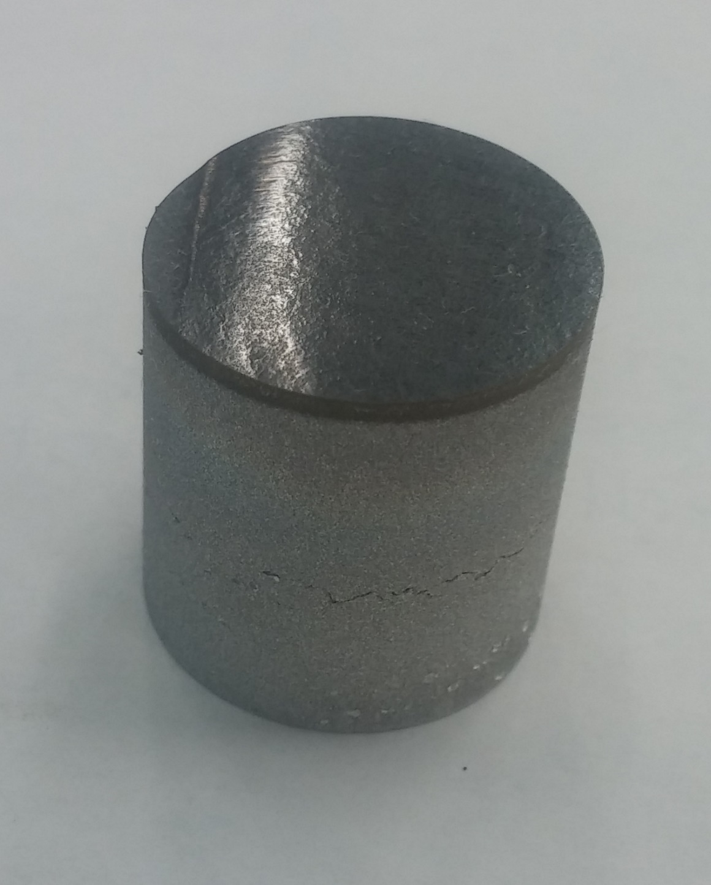
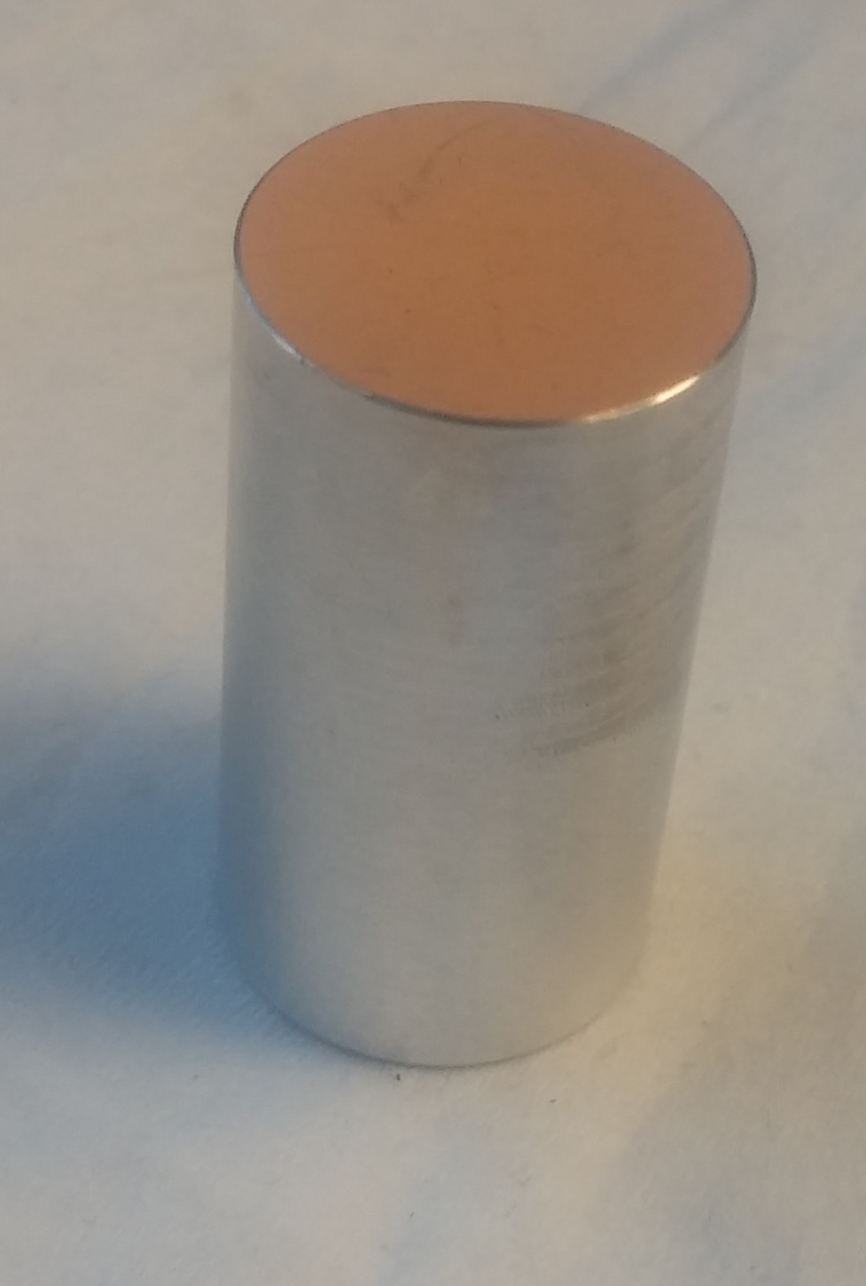
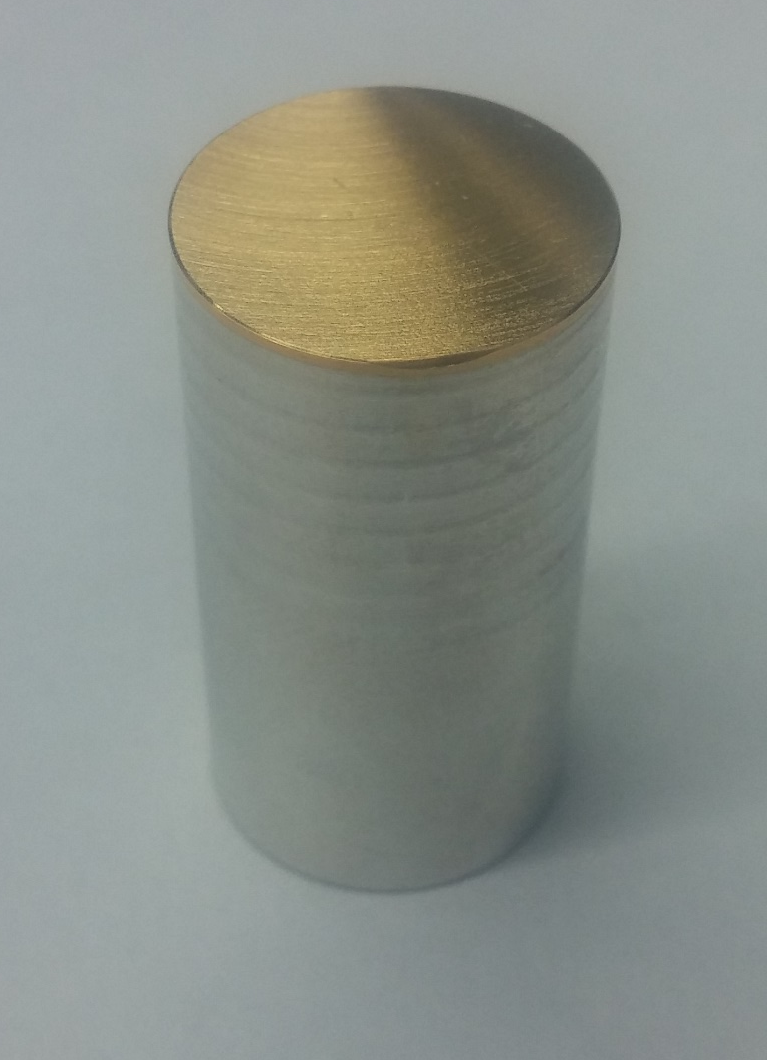

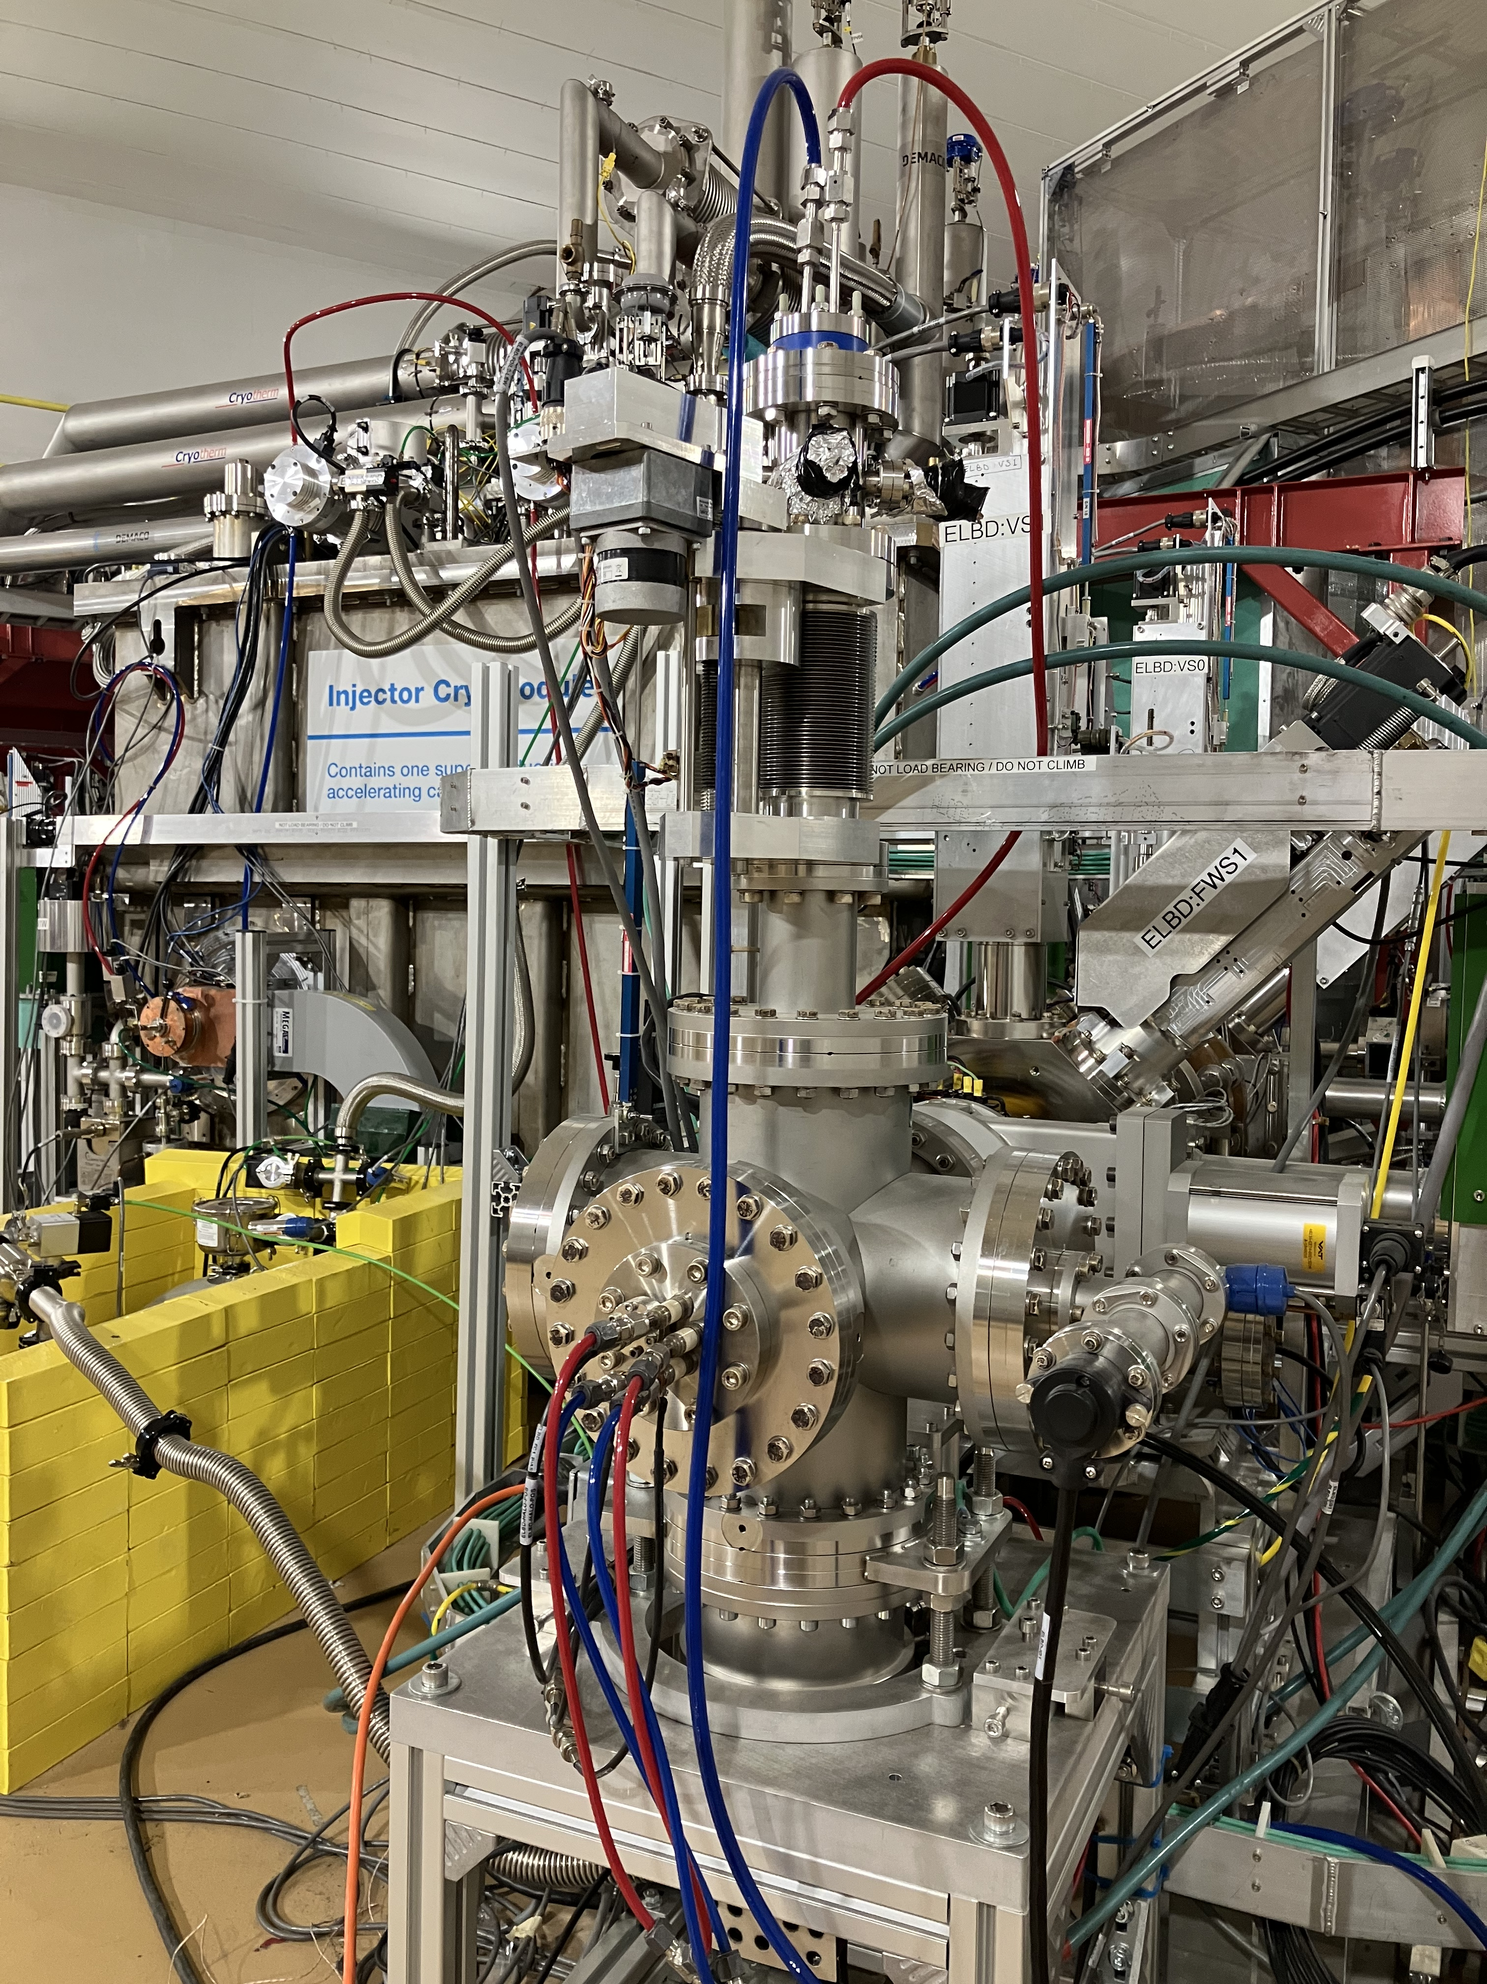
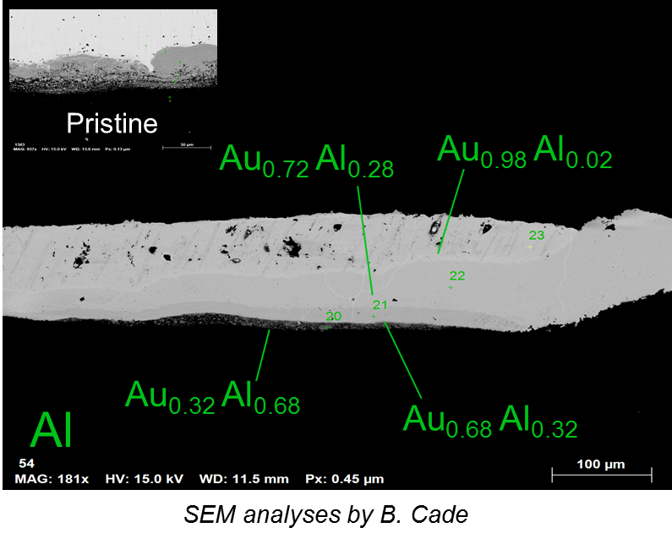
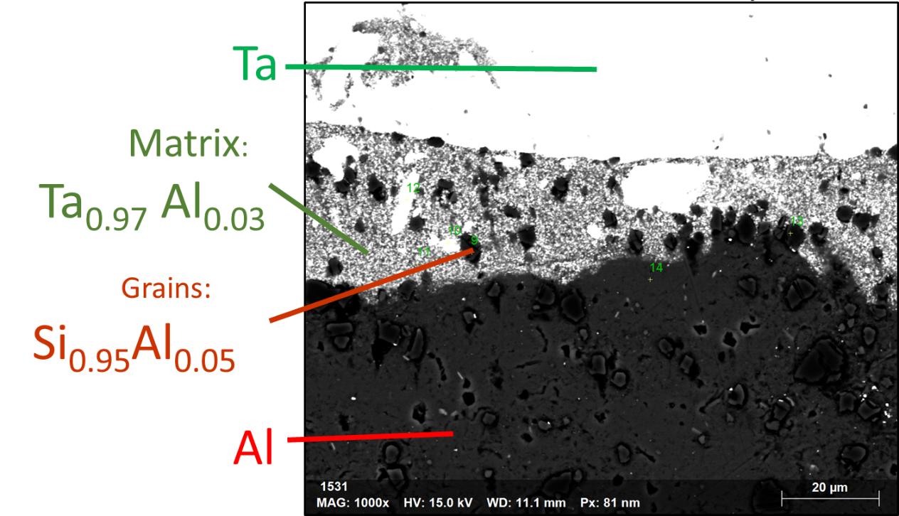
300 keV Converter Test Stand: validated target materials for ARIEL
Au-Al Expl. Weld
Au-Al E.D. + Ni
Au-Al E.D.
Ta-Al Expl. Weld
Beam
L. Egoriti et al., “Material development towards a solid 100 kW electron-gamma converter for TRIUMF-ARIEL”, 2020
A. Gottberg
Notes:
300 keV–3kW test stand that simulate the sort of power density encountered in the future 30MeV–100kW ARIEL targets.
Outcome gold on aluminum:
Temperature increase during irradiation
Radiation-enhanced Au-Al diffusion
Formation of brittle intermetallic
Outcome tantalum on aluminum
Temperature stable over 500 h of irradiation
No change of surface morphology
No major evolution of interface
No-radiation enhanced diffusion

Slide 22
FLASH

Slide 23
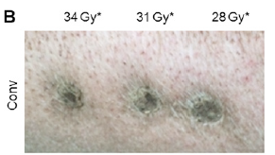
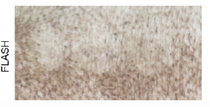
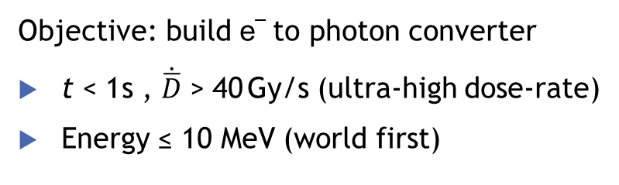
FLASH – Radio Therapy Research
Dose rate
~ 40 Gy/s
FLASH
Dose ~ 40 Gy
~ 0.05 Gy/s
Conventional
Dose ~ 40 Gy
0
1 sec
minutes
t
FLASH dose rates allow for sub-second treatments to reduce normal tissue toxicity compared to low dose rate (conventional) treatments
Objective: build e– to photon converter
t < 1 s , $\dot{\overline{D}}$ > 40 Gy/s (ultra-high dose-rate)
Energy ≤ 10 MeV (world first)
L. Egoriti (2022)

Slide 24
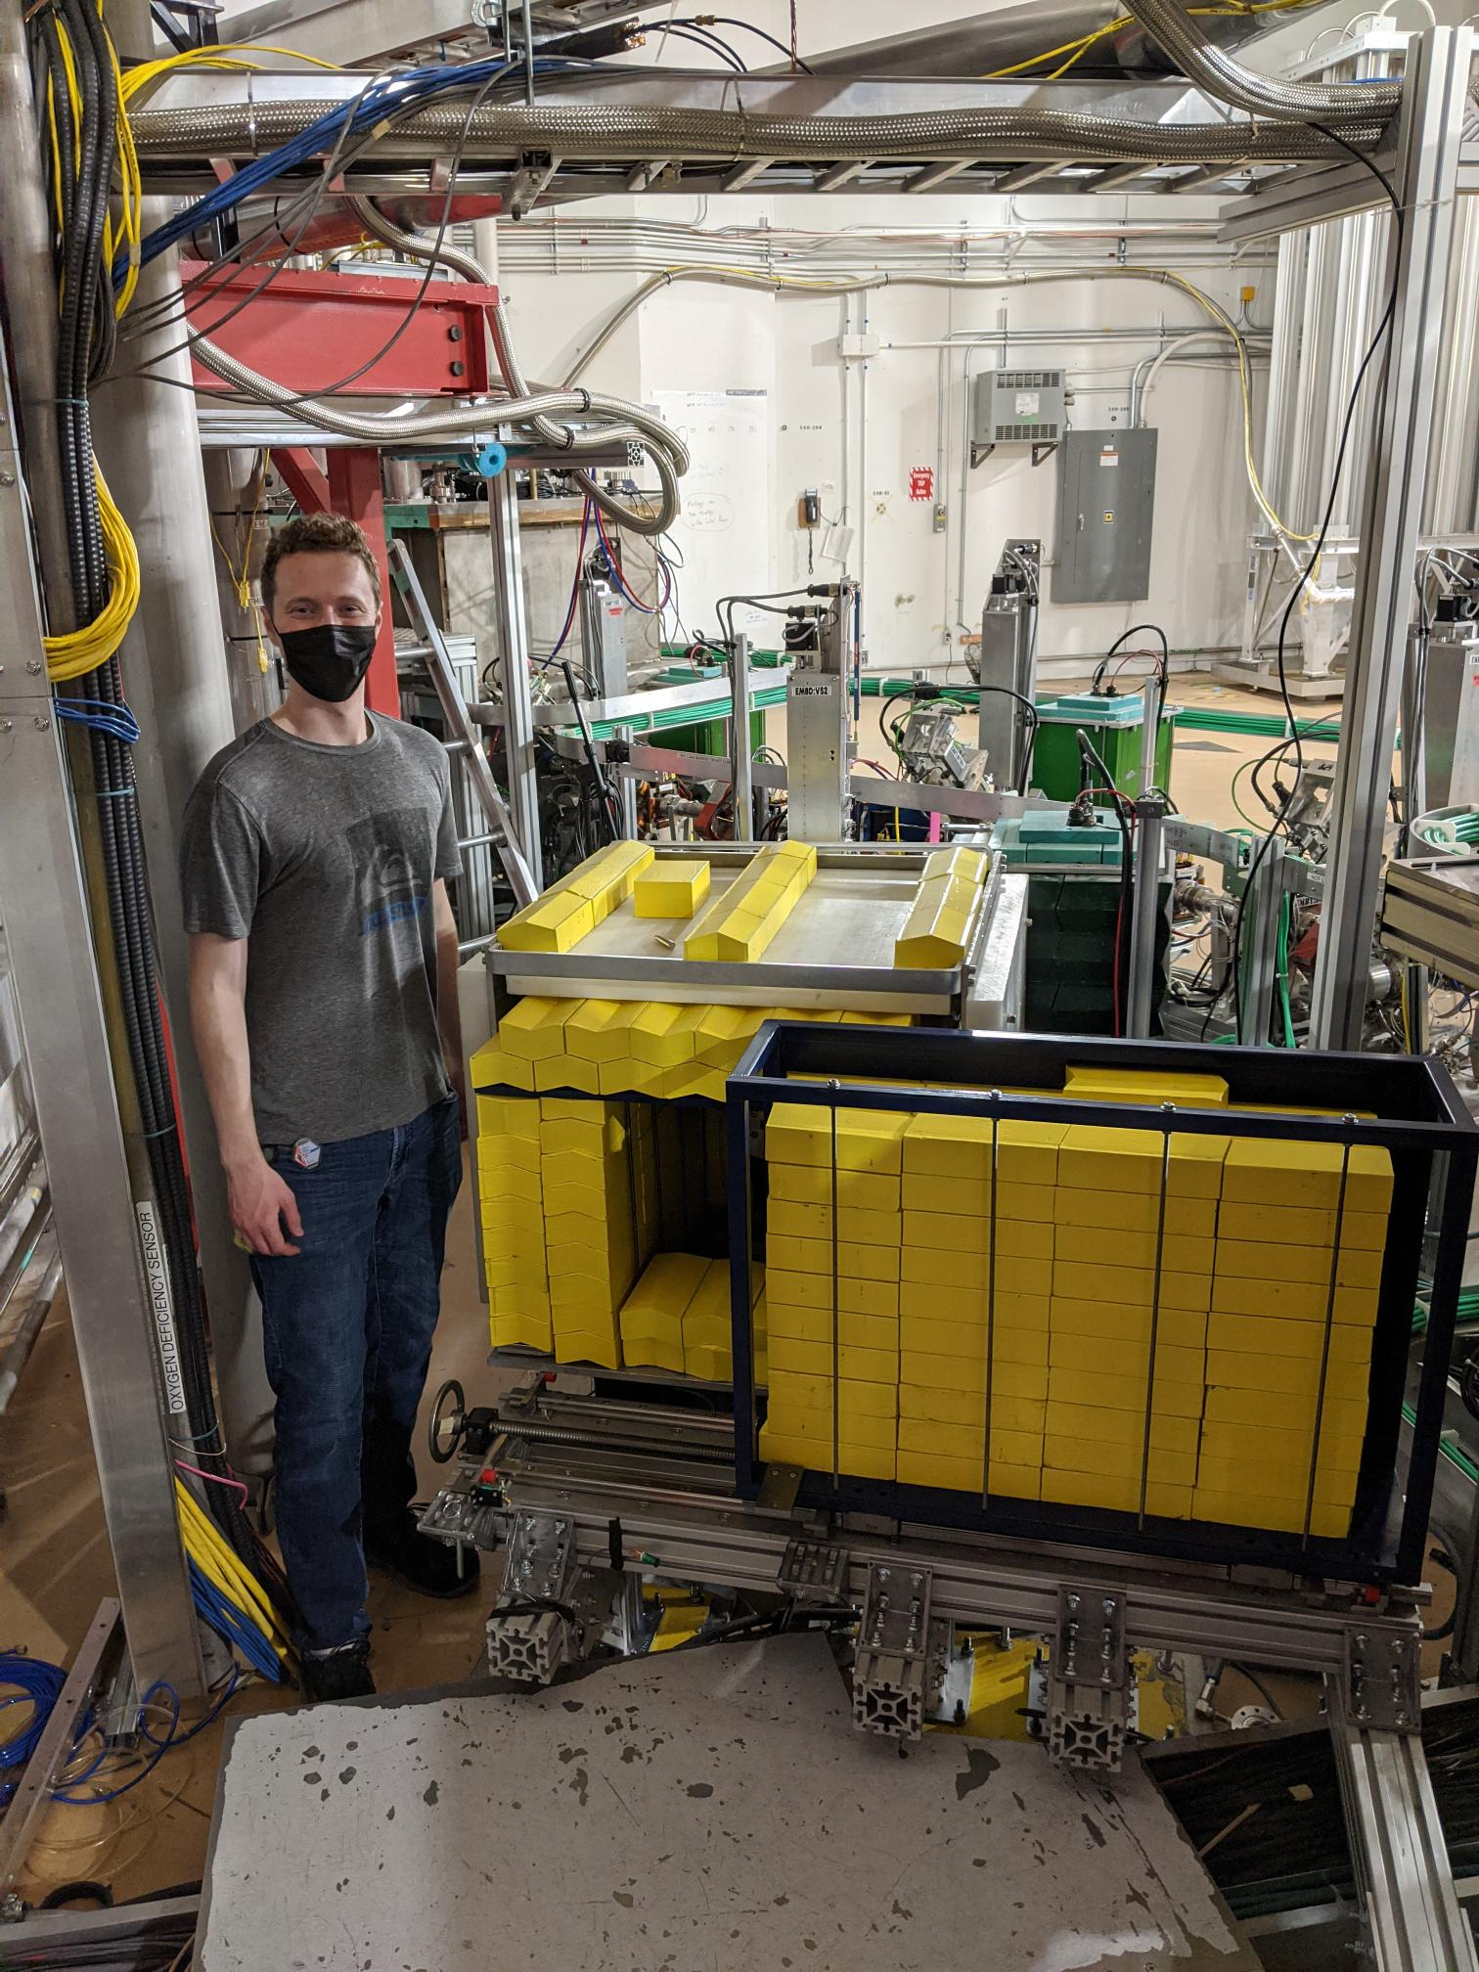
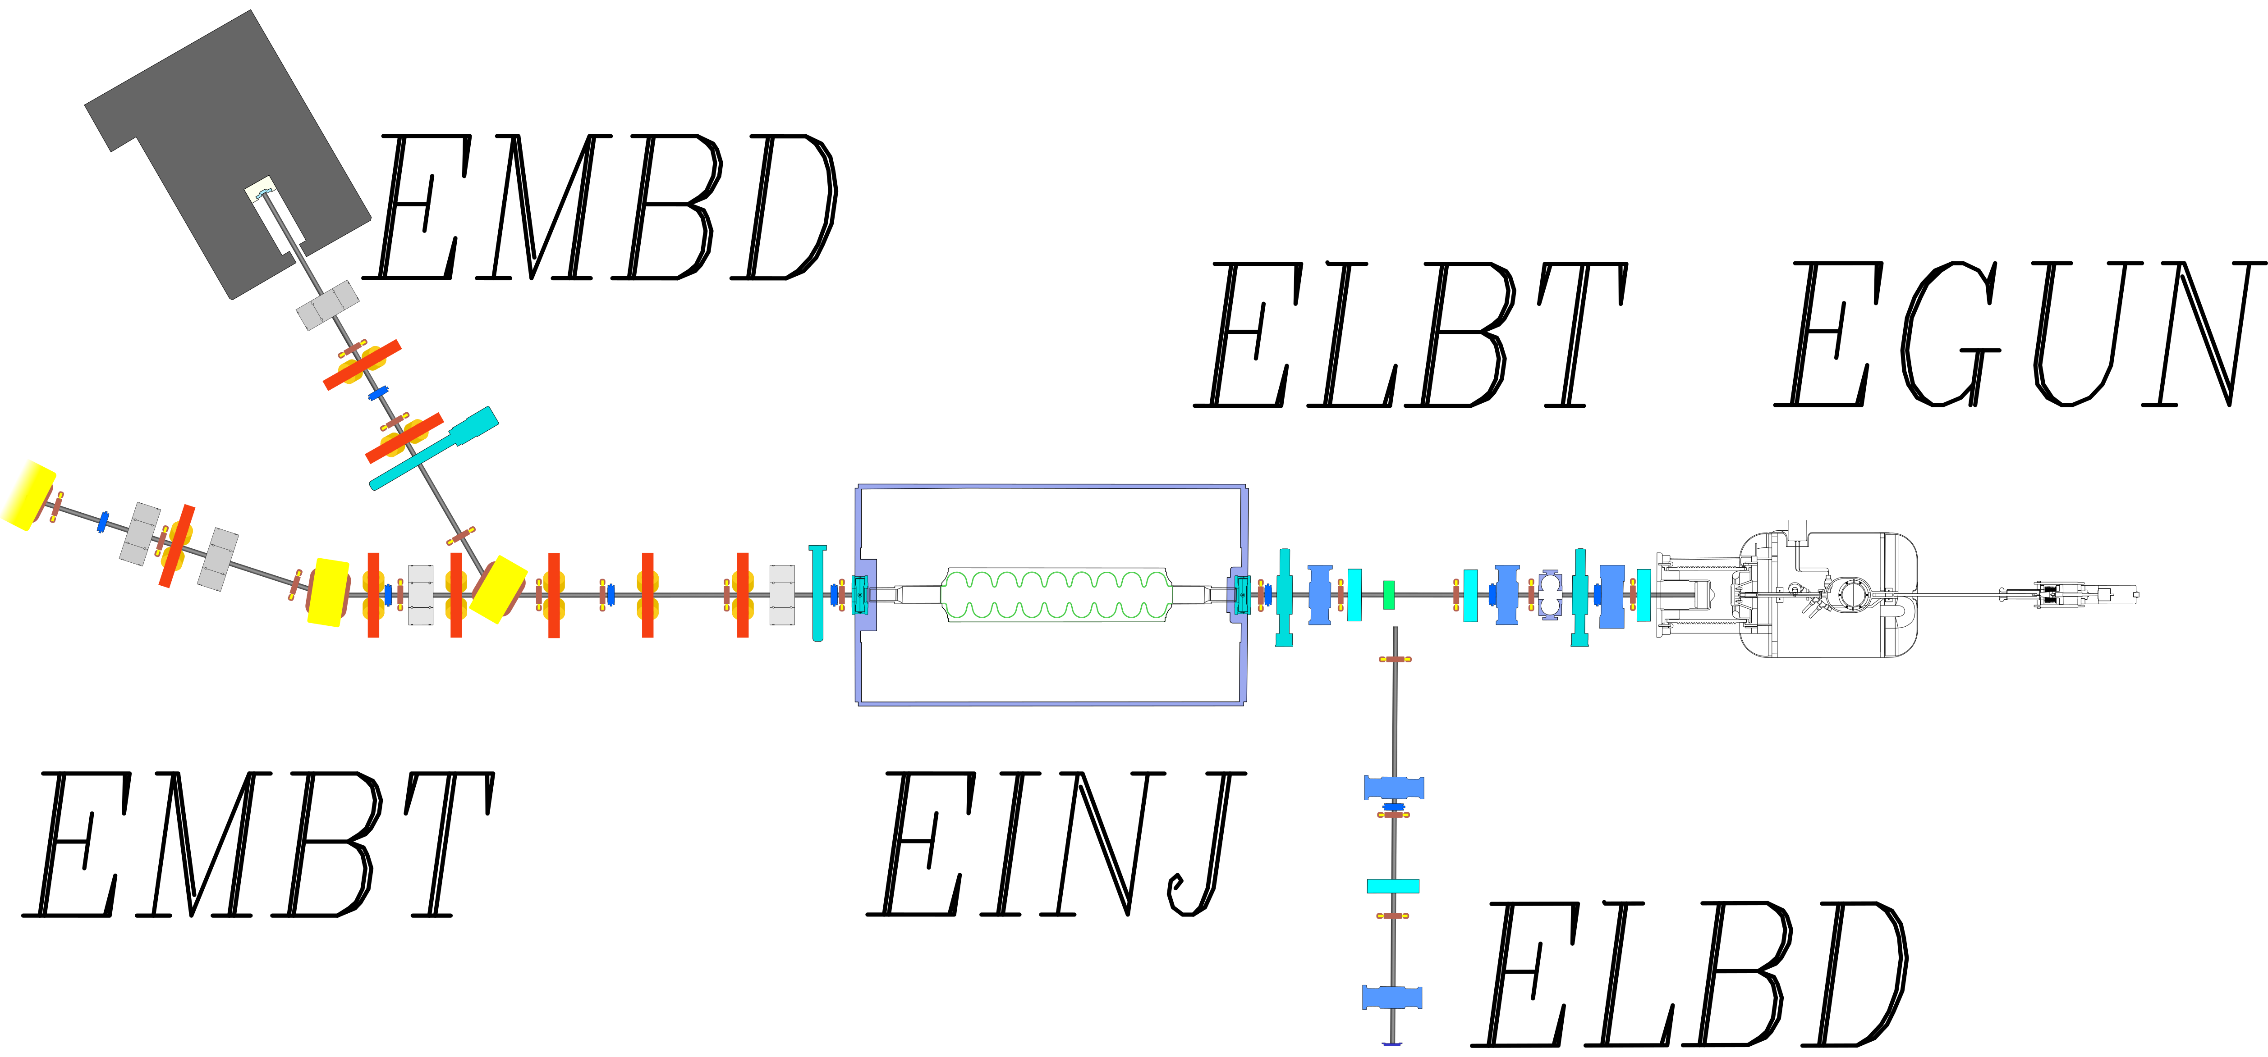
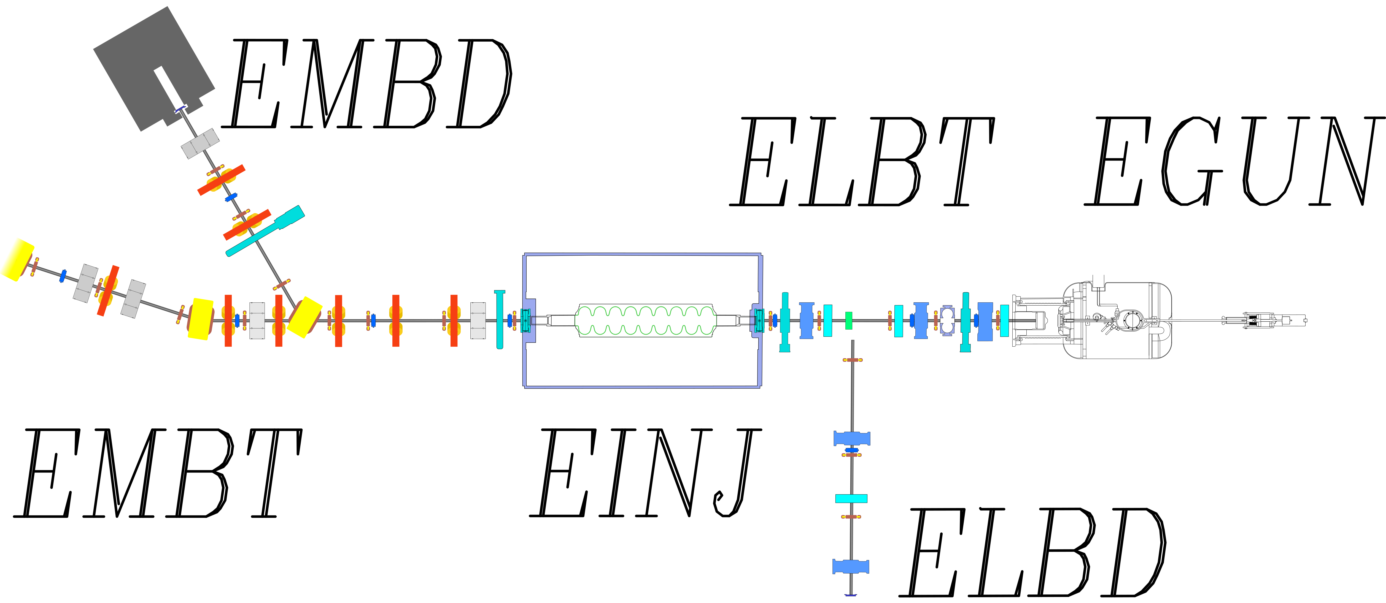
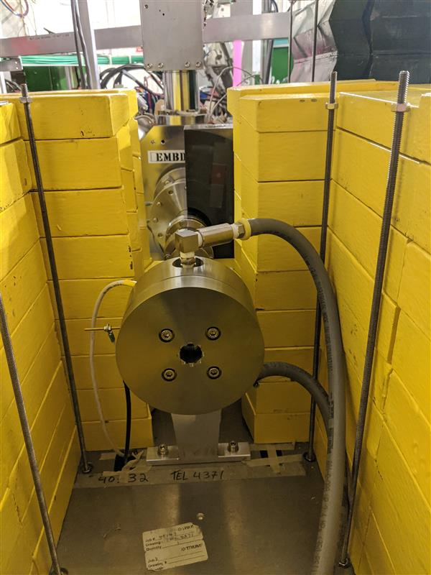
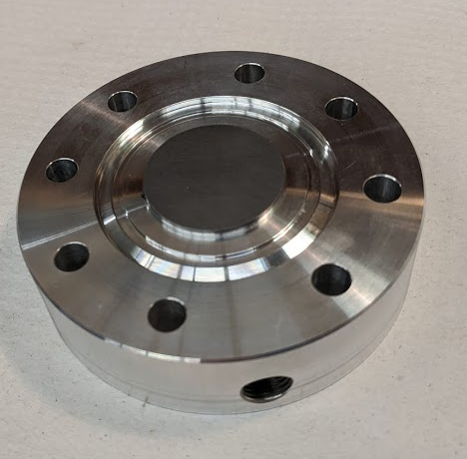
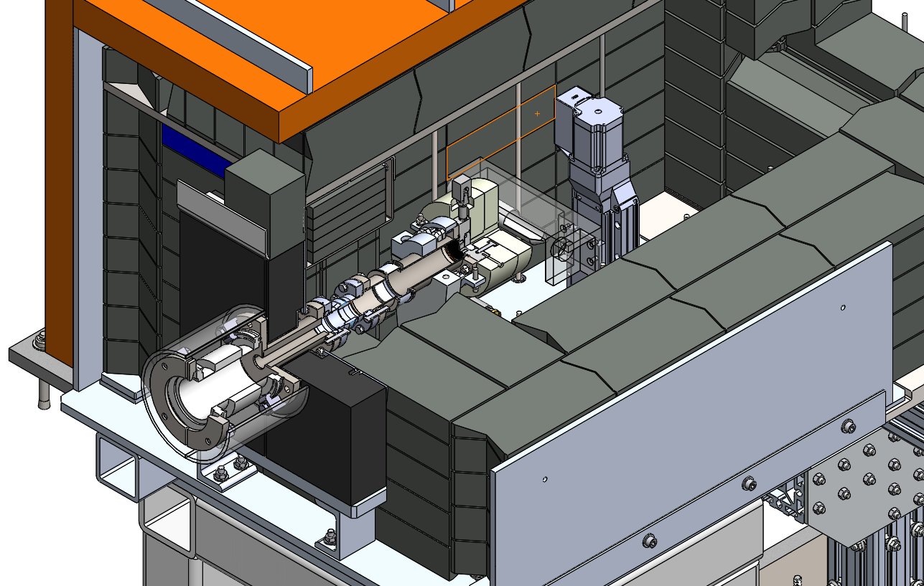
E-Linac medium energy dump modification
ARIEL-inspired converter
N. Esplen et al., “Design optimization of an electron-to-photon conversion target for ultra-high dose rate x-ray (FLASH) experiments at TRIUMF”, 2022

Slide 25
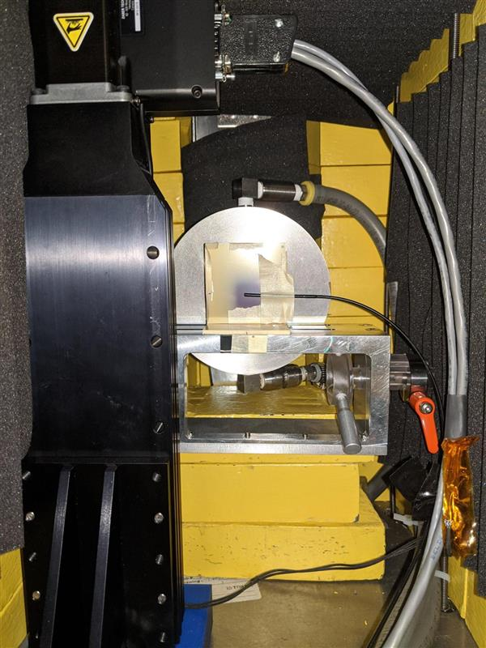
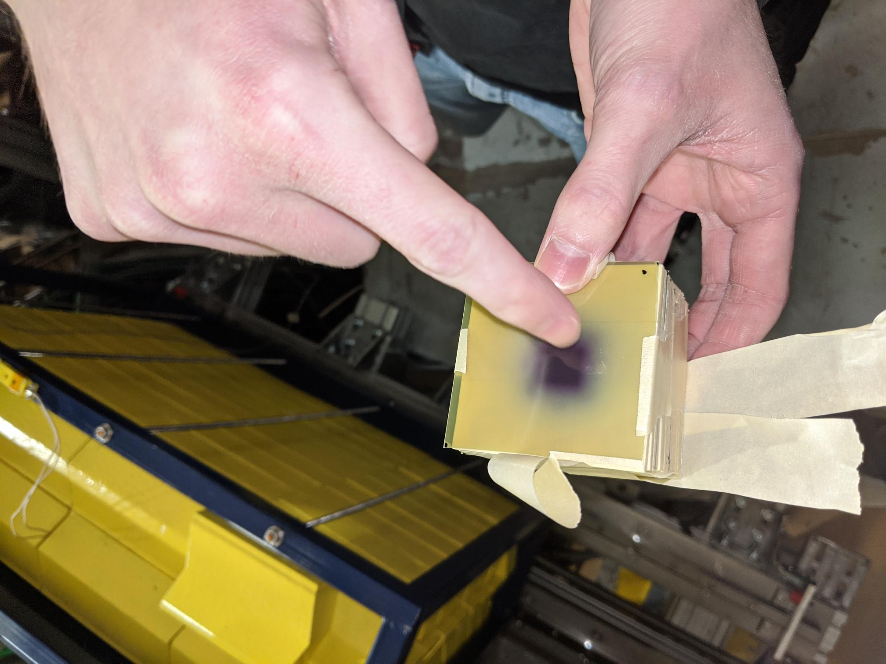
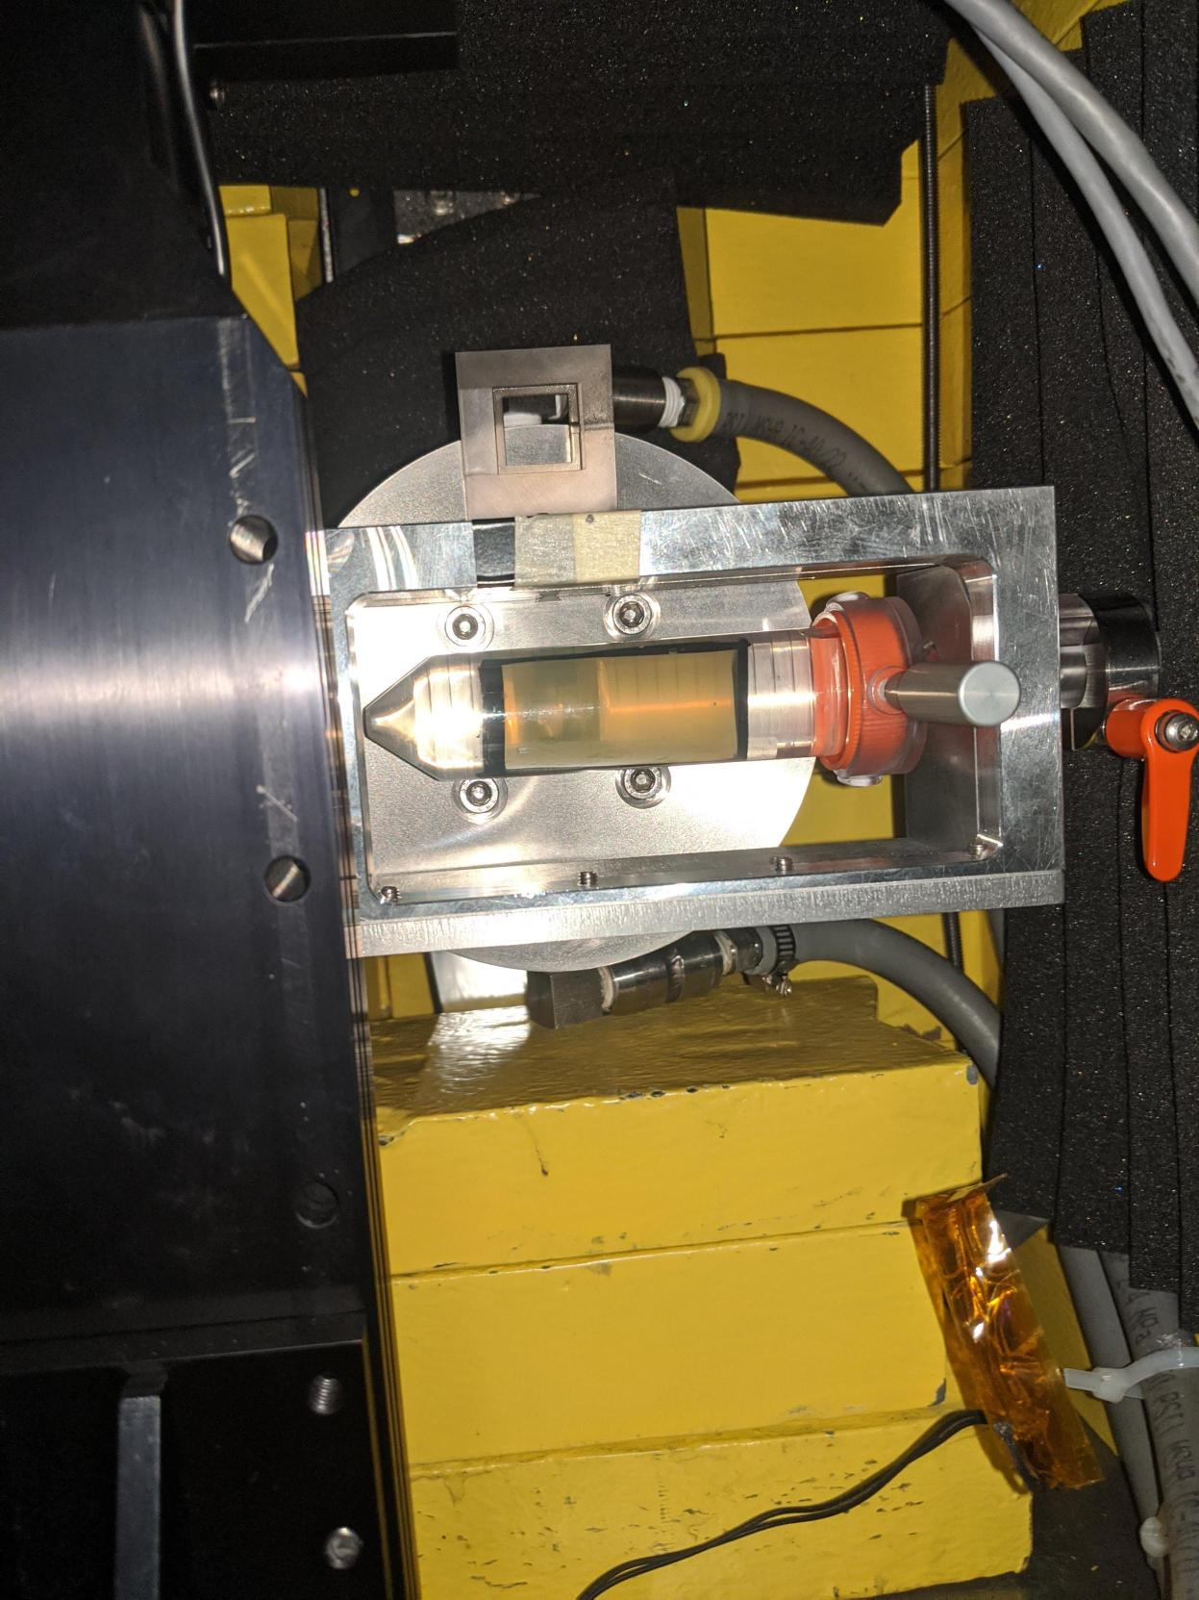

Dosimetry with dosimetry films and water-filled tubes
It is safe to touch this
Notes:
Dosimetric films
Water phantom is the medical term for those water-filled tubes

Slide 26

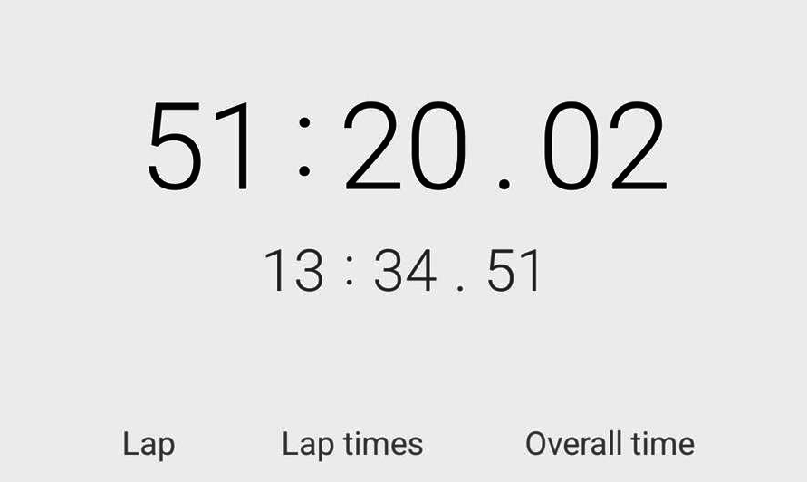

FLASH – a challenging user
Limited time window (1 hr) to accommodate safe animal handling procedures
Key: develop lockup procedure
Lock up e-Hall
Establish all HV connections
Enable all safety stages
Ramp up all devices
Get beam ready
Deliver beam
close
open

Slide 27
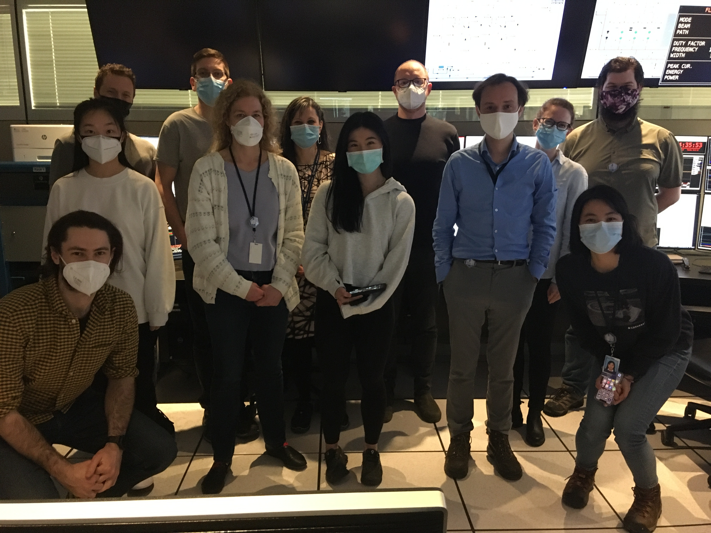
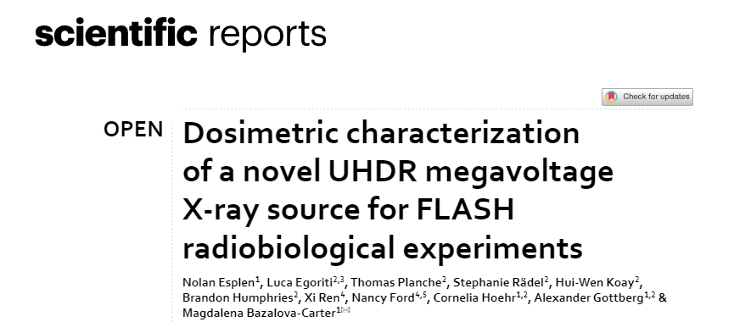

FLASH beamtime
12 in-vivo irradiation in total
  6 FLASH and 6 CONV
8 samples of fruit fly larvae

Slide 28
Dark Light

Slide 29
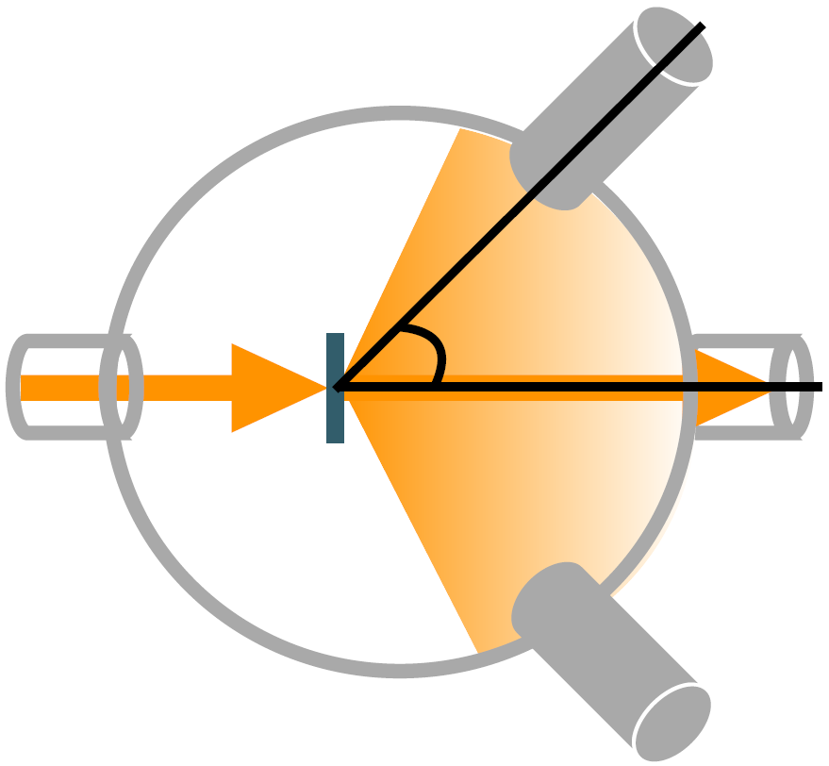
DarkLight – an upcoming experiment
Looking for dark bosons that could interact with dark matter with a thin-target scattering experiment
ATOMKI experiment
  Observed possible boson with mass circa 17 MeV/c2 (“X17”)
Incoming electron interacts with target and created γ rays … and X17?
Measure energy spectrum of electron-positron pairs created by γ or X17
Electron Beam
What can TRIUMF offer for this collaboration?
High intensity electron beam in CW
K. Pachal: “The DarkLight experiment at TRIUMF and the hunt for a new boson”
Notes:
Some anomalies in e+e- invariant mass spectra in 8Be

Slide 30
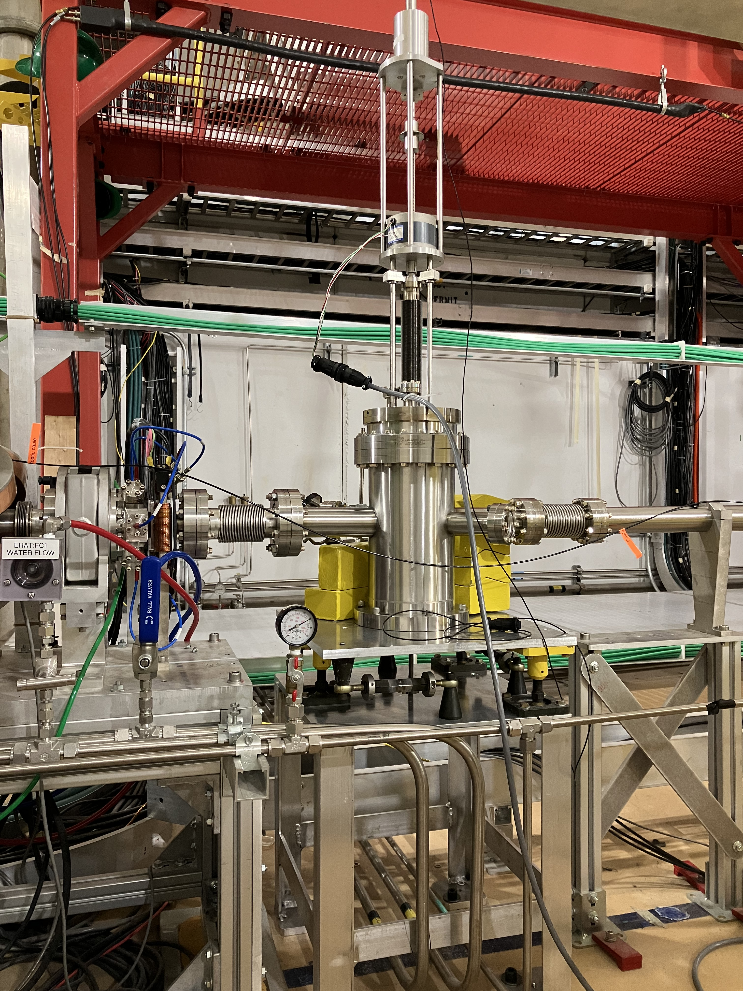
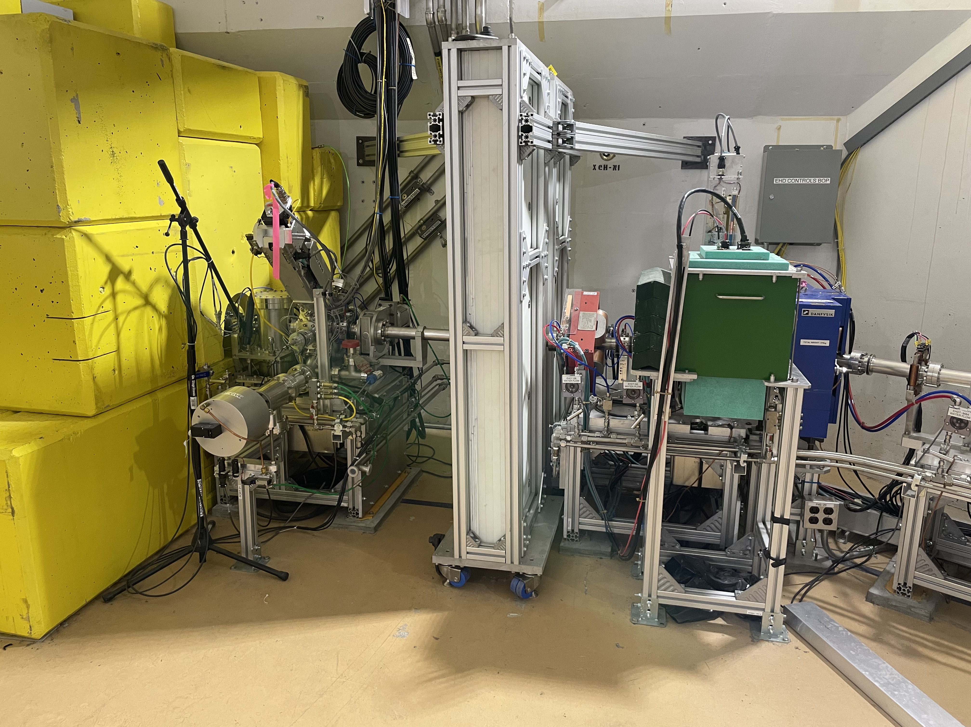


Relocating the DarkLight experiment
2024: directly upstream high energy dump
Now: test chamber downstream of second cryomodule (@ 30 MeV)
Relocation and design experimental chamber for initial round of data taking
T. Planche, “New Scientific Opportunities with the TRIUMF ARIEL e-linac”, 2022

Slide 31
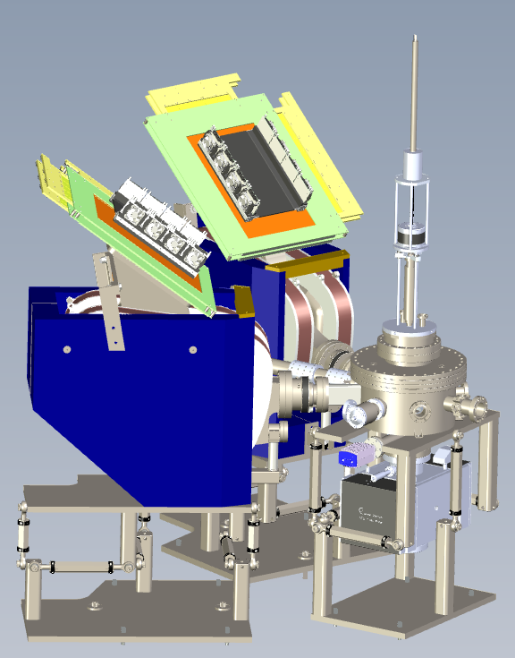
DarkLight and desired beam properties
Expected beam to be delivered:
  30 MeV
  300 μA
  10 kW
  Minimum of 1000 hours beam delivery
https://www.dropbox.com/scl/fo/iuufqqevskmgk00kz6sc2/h?rlkey=7repp8r3kv7f4os79vaiuxzs5&e=2&dl=0 - DARKLIGHT ARIEL EXPERIMENT LAYOUT_01_31_2024 v1

Slide 32
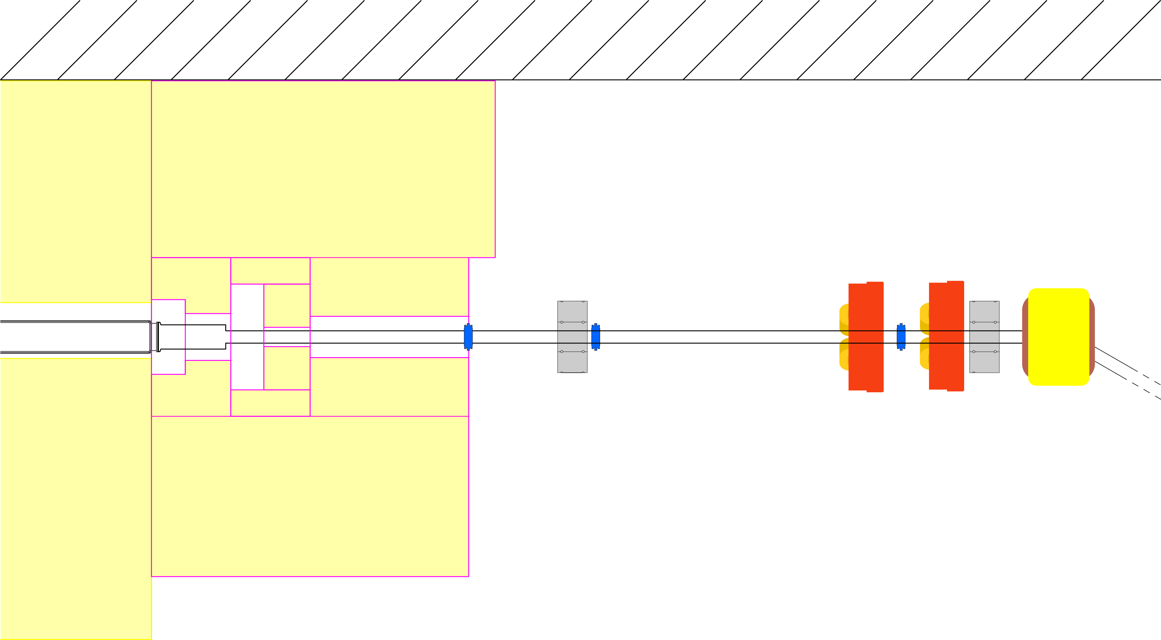
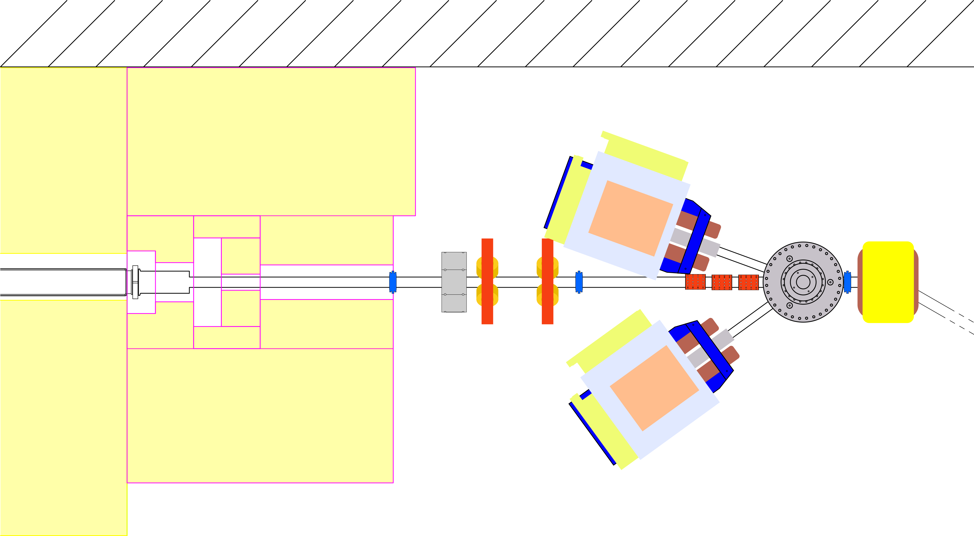
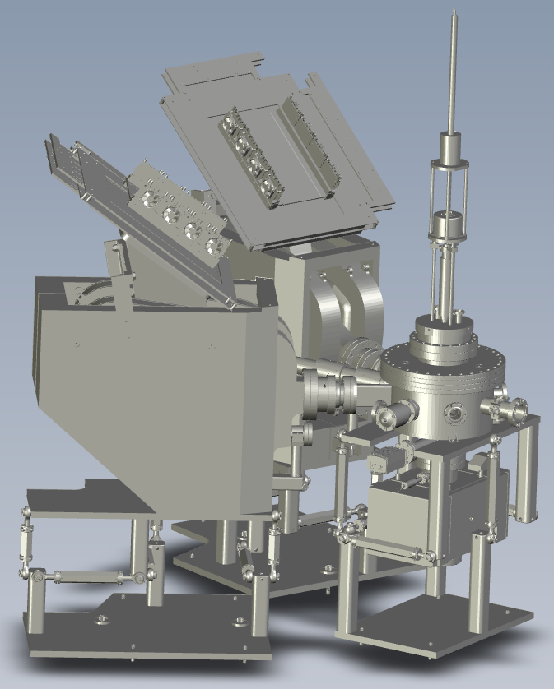
DarkLight integration
To integrate DarkLight the machine needs adaptation to compensate emittance growth
Current machine optics
Machine optics with DarkLight chamber
beam
beam
https://www.dropbox.com/scl/fo/iuufqqevskmgk00kz6sc2/h?rlkey=7repp8r3kv7f4os79vaiuxzs5&e=2&dl=0 - DARKLIGHT ARIEL EXPERIMENT LAYOUT_01_31_2024 v1

Slide 33
THz

Slide 34


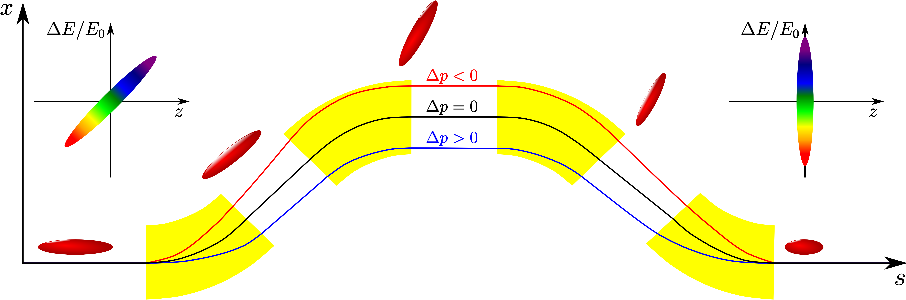
High-Brightness THz/IR Photon Source
Producing THz light requires sub-mm high-charge electron bunches and a THz production station
CFI funded project with objective: demonstrate production of high intensity (~MV/cm) broadband radiation and establish a user community within material science
https://www.nicepng.com/ourpic/u2e6e6o0e6a9w7r5_we-want-you-developer-clipart-youtube-uncle-sam/
S. D. Rädel, “Status and Future Perspective of the TRIUMF E-Linac”, 2019
S. D. Rädel, “On space charge driven microbunching instability in bERLinPro”, 2017
Join our team: JR101115

Slide 35
Summary
Overview of electron linac
Initially e-Linac designed with only ARIEL in mind
The electron linac commissioning was completed in 2021
  Next step reliability
  ARIEL ready for electron beam in 2026
Converter Test Stand (experiment for ARIEL electron target) in low energy section was our first user
FLASH:
  12 in-vivo irradiation in total
    6 FLASH and 6 CONV
  8 samples of fruit fly larvae irradiated
DarkLight introduction and its impact on delivering electron beam
CFI project: e-Linac becoming a THz source

Slide 36
Thank you
Merci
www.triumf.ca
Stephanie Diana Rädel
sradel@triumf.ca

Slide 37
BACKUP SLIDES

Slide 38
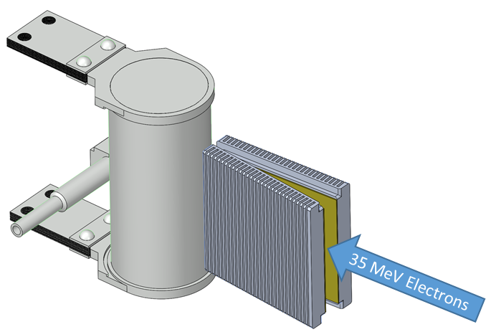
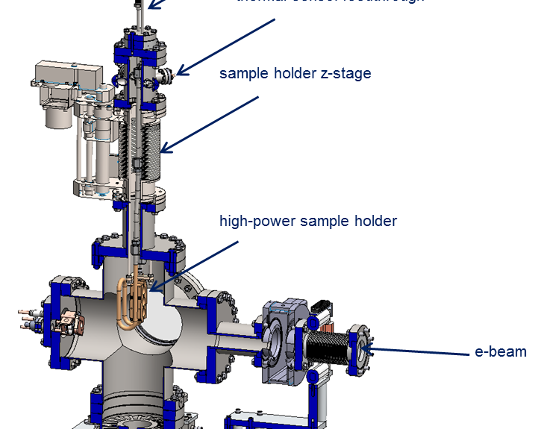
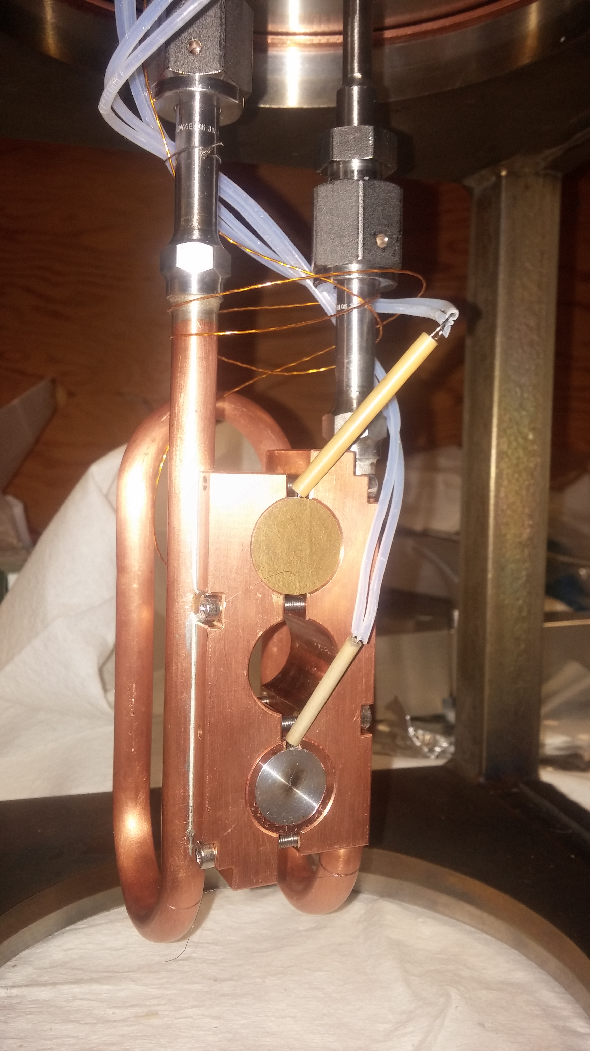
ARIEL e-γ Converter Test Stand (TRIUMF, UBC, UVic, SLAC)
Existing irradiation capability: 300 keV to 35 MeV, up to 1023 electrons/cm²/day
High-Z / aluminum interface at risk:
  Thermal stresses (100 kW beam, thermal cycles)
  Radiation damage / radiochemistry
  Irradiations of up to 3 weeks
Experimental setup:
  Water-cooled sample holder
  Several high-Z materials tested
  Beam power density matching online value
  300 keV beam to avoid activation (online 35 MeV)
AETE
e⁻
A. Gottberg

Slide 39
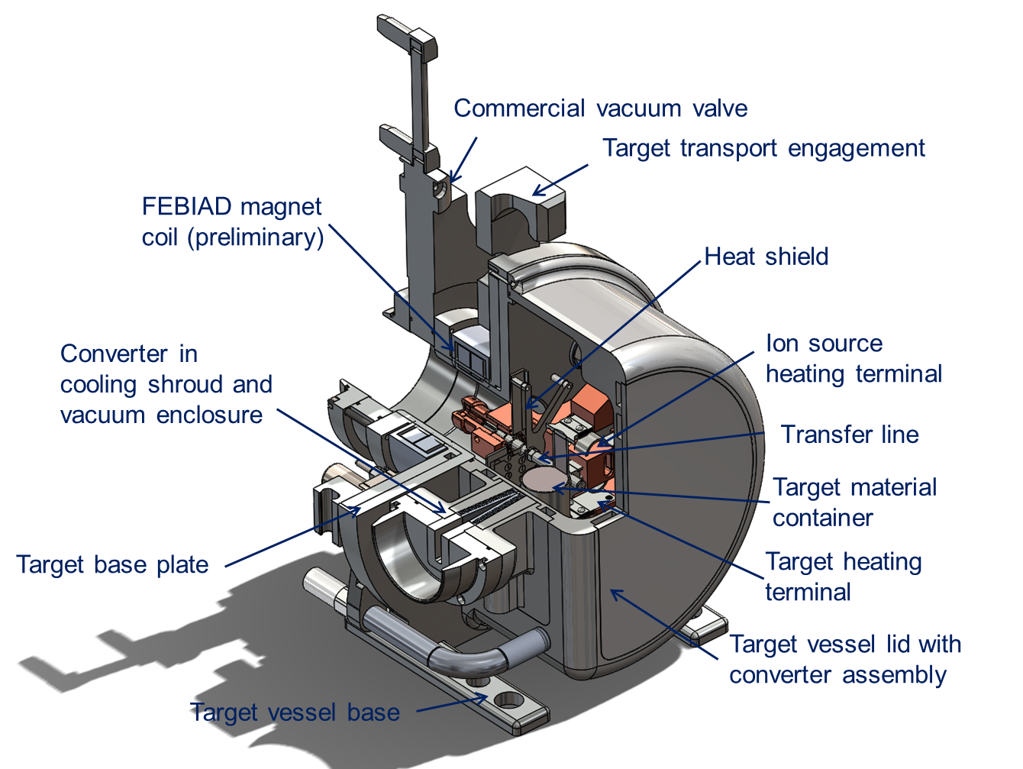
ARIEL Hermetic Target Vessel
Increased development space for new ion source and transfer line concepts (cold transfer line, variable temperature transfer line, quartz transfer line, improved FEBIAD, low work function cavity, IG-LIS2)
Hermetic enclosure allows for the use of air-sensitive target materials
Service connections with provisions for future ion source and target concepts
Converter integrated into target vessel lid allows for routing additional cooling for high power target operation
Vessel volume increased for new target concepts (liquid targets, new converters, etc.)
A. Gottberg

Slide 40
The ARIEL Target Hall
Remote-controlled crane
Hot cell facilities (target handling, PIE, waste processing, medical isotope extraction repair and maintenance)
Hall with two floor
levels (existing)
Electron beam and proton beam transport
module storage
Symbiotic medical target
AETE
target exchange point
ASTM
spent target storage
APTW
drivers beam tunnel (existing)
electrons
RIB
protons
RIB
Storage of expired targets for 3 years before shipment to CNL
Target pit shielding
A. Gottberg

Slide 41

Cryo
ALAT LL Cold Box, KAESER (FSD571SFC) main compressor (112 g/s), Cryotherm - distribution
4 Bush combi DS3010-He pumping units specified and installed (1.4 g/s @ 24mBar each)
T. Planche, “New Scientific Opportunities with the TRIUMF ARIEL e-linac”, 2022

Slide 42
FLASH – a challenging user
Limited time window (1 hr) to accommodate safe animal handling procedures
Key: develop lockup procedure
ethics approval #AUP#21-0060
In accordance with animal care protocol

Slide 43
DarkLight – Experimental apparatus
K. Pachal: “The DarkLight experiment at TRIUMF and the hunt for a new boson”

Slide 44
DarkLight chamber and desired beam properties
Expected beam to be delivered:
  30 MeV
  300 μA
  10 kW
  Minimum of 1000 hours beam delivery
https://www.dropbox.com/scl/fo/iuufqqevskmgk00kz6sc2/h?rlkey=7repp8r3kv7f4os79vaiuxzs5&e=2&dl=0 - DARKLIGHT ARIEL EXPERIMENT LAYOUT_01_31_2024 v1

