Slide 1
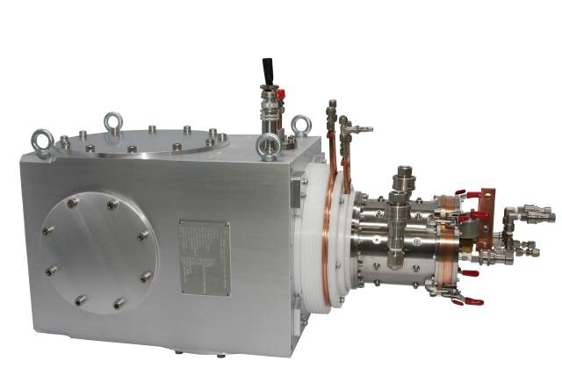
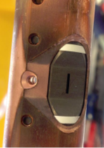
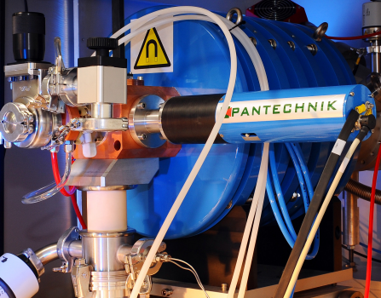
H‾, D‾ & He⁺⁺ Source Developments for Medical Isotope Production Cyclotrons
Volume-Cusp
Accelerator Development and Technology (ADT-1) Tuesday, March 19, 2024.
Thank You Very Much:
• Dr. Oliver Kester
• Dr. Brahim Mustapha
Presenter: Morgan Dehnel, Ph.D., Founder D-Pace, Inc.
Co-Authors: C. Hoehr, TRIUMF; S. Melanson, A. George, N. Savard D-Pace, Inc.
Penning
ECR
[1] https://www.d-pace.com/?e=304
[2] D. Potkins, M. Dehnel, S. Melanson, T. Stewart, P.Jackle, J. Hinderer, N. Jones, L. Williams, “Improvements to Siemens Eclipse PET Cyclotron Penning Ion Source”,
AIP Conference Proceedings, Vol. 2052, No. 1, P. 050016, AIP Publishing, 2018.
[3] https://www.pantechnik.com/wp-content/uploads/2020/07/Supernanogan.pdf

Slide 2
Cyclotron Radioisotope Production: Topic Areas
Category 1: Low Energy Cyclotron (Signpost: Proton 7 – 19 MeV, Typ. PET)
  Internal Penning Ion Gauge (PIG) Ion Sources: H⁺/H‾/D‾
    Present Status & Developments
  External Volume-Cusp Ion Sources: H‾/D‾
    Present Status & Developments
Category 2: Medium Energy Cyclotron (Signpost: Proton 20 – 45 MeV, Typ. SPECT, Therapeutic)
  External Volume-Cusp Ion Sources: H‾/D‾
    Present Status & Developments
  ECR or Penning Source: ⁴He⁺⁺
    Present Status & Developments
Category 3: High Energy Cyclotron (Signpost: Proton 45+ MeV, Typ. SPECT, Therapeutic)
  External Volume-Cusp Ion Sources: H‾/D‾
    Present Status & Developments
  ECR or Penning Source: H⁺, H₂⁺, ³He⁺⁺, ⁴He⁺⁺
    Present Status & Developments

Slide 3
Category 1: Low Energy Cyclotron
PRESENT STATUS
Internal Penning Ion Source
  BEST/ABT: Canada/USA BG-75
  GE: Sweden PETtrace™ 800, MINItrace™ Qilin
  IBA: Belgium KIUBE, Cyclone 18/9, Cyclone 18 HC
  Samyoung Unitech Co. South Korea Kotron-13
  Siemens: USA Eclipse
  SHI: Japan CYPRIS HM12, CYPRIS HM20
External Volume-Cusp Ion Source
  ACSI Canada TR19, TR19/9
  BEST Canada B15P
  PMB-Alcen France iMiTRACE

Slide 4
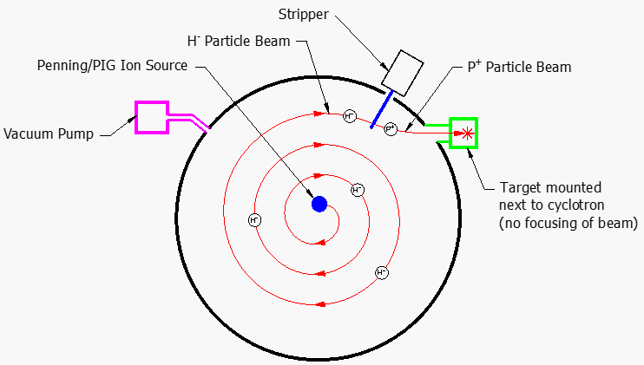
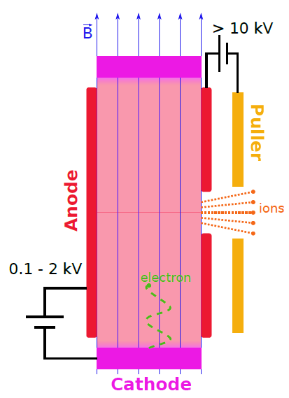
Category 1: Low Energy Cyclotron - Internal Penning Ion Source - Review
Can also be an RF Dee.
[1] Nicolas Savard, “Development and Characterization of a Penning Ion Source Using Helium”, UBC PhD Dissertation, February 2022.

Slide 5
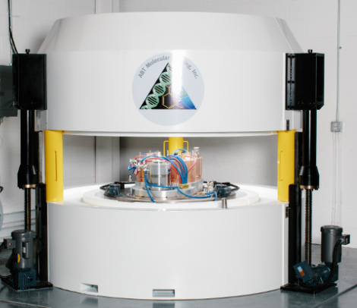
Category 1: Low Energy Cyclotron - Internal Penning Ion Source – Present Status
BEST/ABT
BG-75: Max. Current: H⁺ 5 μA @ 7.5 MeV (internal target)
Cyclotron Parameters for Max. Extracted Current
  Accelerated Particle: H⁺
  Source Bias: Grounded, RF Extraction from Dees
  Source Max. Arc Current: 400 mA
  Steady State Arc Power: 60 W
  Arc Current/Voltage: 72 mA/832 V
  Gas Flow: 4-5 sccm
  Cathode Lifetime: Unreported
[1] http://www.bestabt.com/our-solutions/overview/
[2] Private Communication: Darrell McCroskey, Director – Manufacturing Services, BEST ABT Inc., Data by Email March 14, 2024.

Slide 6
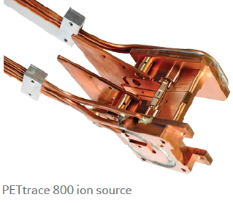
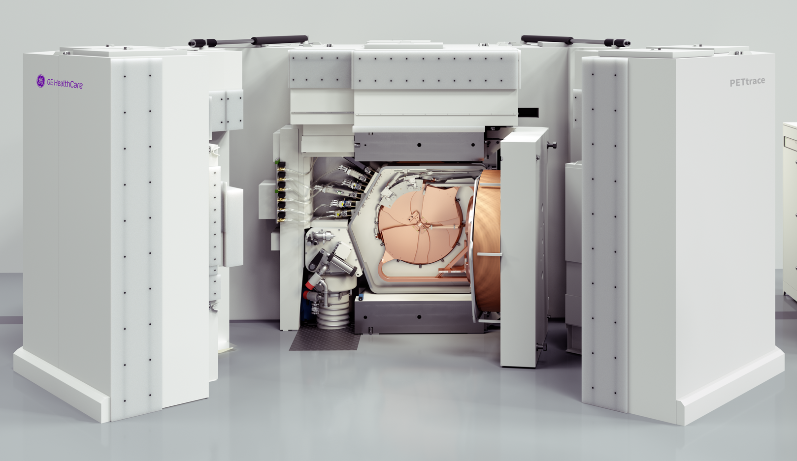
Category 1: Low Energy Cyclotron - Internal Penning Ion Source – Present Status
GE
PETtrace™ 800: Max. Extracted Current: H⁺ 160 μA @ 16.5 MeV; D⁺ 60 μA @ 8.4 MeV
Cyclotron Parameters for Max. Extracted Current
  Accelerated Particle: H‾, D‾
  Source Bias: Grounded, RF Extraction from Dees
  Source Max. H‾/D‾ Current: Not Measured
  Steady State Arc Power: ~100 W
  Arc Current/Voltage: 300 mA/300V
  Gas Flow: H ‾ 5 sccm; D‾ 3.5 sccm
  Cathode Lifetime: 35 mA.hrs on target, >219 hrs @ Max
[1] Private Communication – Tomas Eriksson, Chief Engineer Cyclotrons, GE Healthcare – Data by email February 5, 2024.
[2] Private Communication – Tomas Eriksson, Chief Engineer Cyclotrons, GE Healthcare – Photo by email February 12, 2024.
[3] PT800 Cyclotron System Data Sheet rev6.pdf

Slide 7
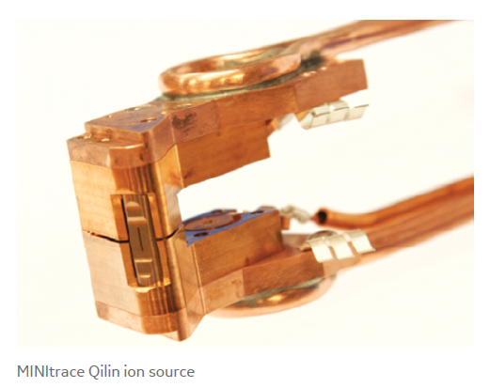
Category 1: Low Energy Cyclotron - Internal Penning Ion Source – Present Status
GE
MINItrace™ Qilin: Max. Extracted Current: H⁺ 50 μA @ 9.6 MeV
Cyclotron Parameters for Max. Extracted Current
  Accelerated Particle: H‾
  Source Bias: Grounded, RF Extraction from Dees
  Source Max. H‾ Current: Not Measured
  Steady State Arc Power: ~125 W
  Arc Current/Voltage: 500 mA/250V
  Gas Flow: 5 sccm
  Cathode Lifetime: 10 mA.hrs on target, >200 hrs @ Max
[1] Private Communication – Tomas Eriksson, Chief Engineer Cyclotrons, GE Healthcare – Data by email February 5, 2024.
[2] MT QILIN Cyclotron System Data Sheet rev4.pdf

Slide 8
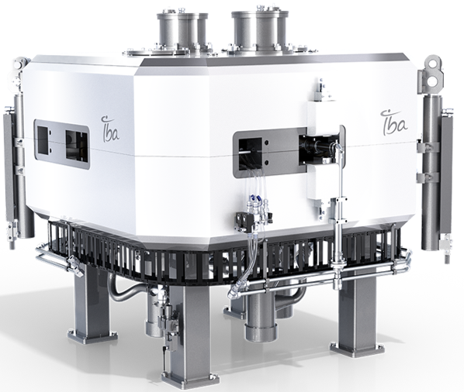
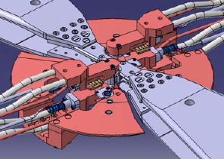
Category 1: Low Energy Cyclotron - Internal Penning Ion Source – Present Status
IBA
Cyclone®KIUBE 300 (Twin Source): Max. Extracted Current: H⁺ 300 μA @ 18 MeV
Cyclotron Parameters for Max. Extracted Current
  Accelerated Particle: H‾
  Source Bias: Grounded, RF Extraction from Dees
  Source Max. H‾ Current: N/A
  Steady State Arc Power: 325W
  Arc Current/Voltage: 1.25A/260V
  Gas Flow: 2.5 -> 3.7 sccm
  Cathode Lifetime: ~600 hrs
[1] Private Communication - Jean-Michel Geets, IntegraLab Business Developer – IBA Fellow, IBA RadioPharma Solutions – Data by email January 17, 2024.
[2] Private Communication – Benoit Nactergal, Director R&D; Eric Kral, Systems Engineer, IBA RadioPharma Solutions, Data received by email March 1, 2024.

Slide 9
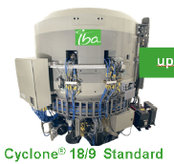
Category 1: Low Energy Cyclotron - Internal Penning Ion Source – Present Status
IBA
Cyclone18/9 (Twin Source): Max. Extracted Current: H⁺ 80 μA @ 18 MeV; D⁺ 40 μA @ 9 MeV
Cyclotron Parameters for Max. Extracted Current
  Accelerated Particle: H‾/D‾
  Source Bias: Grounded, RF Extraction from Dees
  Source Max. H‾ Current: N/A
  Steady State Arc Power: 325W
  Arc Current/Voltage: 1.25A/260V
  Gas Flow: 2.5 -> 3.7 sccm
  Cathode Lifetime: ~600 hrs
[1] Private Communication - Jean-Michel Geets, IntegraLab Business Developer – IBA Fellow, IBA RadioPharma Solutions – Data by email January 17, 2024.
[2] Private Communication – Benoit Nactergal, Director R&D; Eric Kral, Systems Engineer, IBA RadioPharma Solutions, Data received by email March 1, 2024.

Slide 10
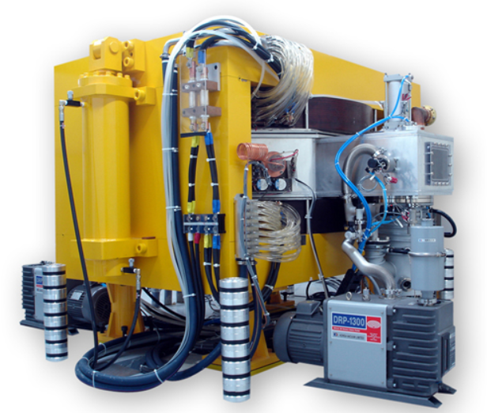
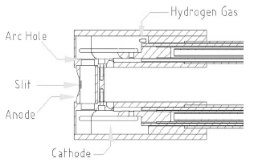
Category 1: Low Energy Cyclotron - Internal Penning Ion Source – Present Status
SAMYOUNG-UNITECH
Kotron-13: Max. Extracted Current: H⁺ 120 μA @ 13 MeV
Cyclotron Parameters for Max. Extracted Current
  Accelerated Particle: H‾
  Source Bias: Grounded, RF Dee Extraction
  Source Max. H‾ Current: Not Known
  Steady State Arc Power: Not Known
  Arc Current/Voltage: 2.8 A/2.5 kV* Ignition
  Gas Flow: 6.5 sccm
  Cathode Lifetime: >83 hours
[#] http://samyoungunitech.com/doc/en/sb2_2.php
[#] B.C. Lee, H.J. Lee, J.H. Park, B.S. Moon, S.E. Kim, W. K. Lee, K.I. Jung, S. K. Chae, J.H. Kim, “Intensification of the KOTRON-13 Cyclotron by Optimizing the Ion Source”, Journal of the Korean Physical Society, Vol. 57, No. 6, December 2010, pp. 1376-1380.

Slide 11
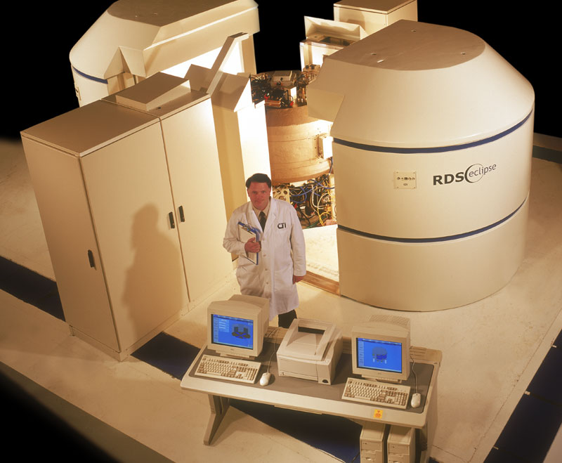
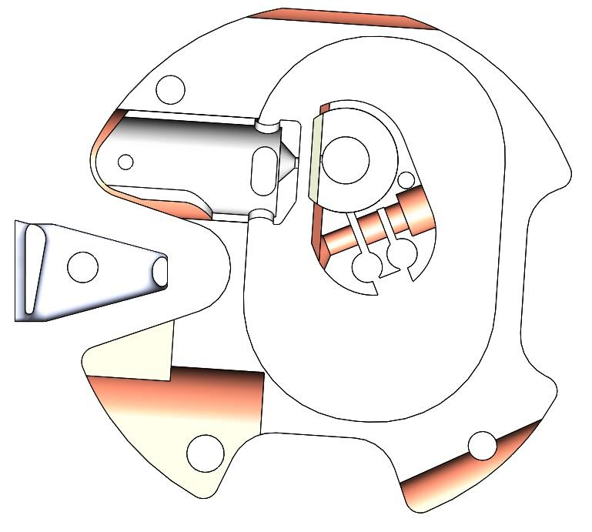
Category 1: Low Energy Cyclotron - Internal Penning Ion Source – Present Status
Siemens
Eclipse: Max. Extracted Current: H⁺ 150 μA @ 11 MeV (Dual 75 μA)
Cyclotron Parameters for Max. Extracted Current
  Accelerated Particle: H‾
  Source Bias: -15 kV, Puller Grounded, then RF Acceleration
  Source Max. H‾ Current: 1.5 mA DC (on Post Beam Stop)
  Steady State Arc Power: 244 W
  Arc Current/Voltage: 325 mA/750V
  Gas Flow: 5 -> 9 sccm
  Cathode Lifetime: >246 hrs
Post
[1] Private Communication – Logan Williams, Cyclotron Engineer, Siemens Medical Solutions USA, Inc., Data provided in email January 29, 2024.
[2] Private Communication – J. Bret Miller, CCS Engineering Manager, Siemens Medical Solutions USA, Inc., Data provided in email January 30, 2024.
[3] D. Potkins, M. Dehnel, S. Melanson, T. Stewart, P.Jackle, J. Hinderer, N. Jones, L. Williams, “Improvements to Siemens Eclipse PET Cyclotron Penning Ion Source”,
AIP Conference Proceedings, Vol. 2052, No. 1, P. 050016, AIP Publishing, 2018.

Slide 12
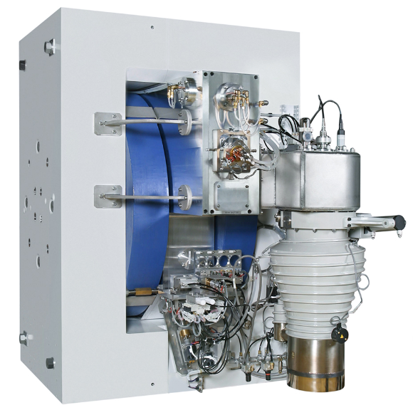
Category 1: Low Energy Cyclotron - Internal Penning Ion Source – Present Status
SHI
Cypris HM12: Max. Extracted Current: H⁺ 50 μA @ 12 MeV; D⁺ 30 μA @ 6 MeV
Cypris HM20: Max. Extracted Current: H⁺ 150 μA @ 20 MeV; D⁺ 50 μA @ 10 MeV
Cyclotron Parameters for Max. Extracted Current
  Accelerated Particle: H‾/D‾
  Source Bias: Grounded, RF Extraction from Dees
  Source Max. H‾ Current: Not Provided
  Steady State Arc Power: Not Provided
  Arc Current/Voltage: Not Provided
  Gas Flow: Not Provided
  Cathode Lifetime: Not provided
[1] CYRIC Annual Report 1998.
[2] https://www.shi.co.jp/industrial/en/product/medical/pet-radiopharmacy/cyclotron-hm12.html
[3] https://www.shi.co.jp/industrial/en/product/medical/pet-radiopharmacy/cyclotron-hm20.html
[4} H. Tsutsui et al, “Current Status of Sumitomo’s Superconducting Cyclotron Development for Proton Therapy”, Cyclotrons 2019 Conference, Cape Town, South Africa.

Slide 13
Category 1: Low Energy Cyclotron - Internal Penning Ion Source
Developments
BEST/ABT BG-75
  Upgrade: H⁺ beam, 20 micro-amperes @ 9.5 MeV internal targets [1].
GE MINItrace™ Qilin the Penning ion source slit location in relation to the puller opening is remotely adjustable [2].
GE PETtrace™
  In-the-field cathode lifetime ranges 16-26 weeks at 55-60 hrs/week (880 hrs – 1560 hrs) [3].
  Cathodes working surface at changeout are normally flat with mirror finish unless there is contamination such as an air leak [3].
  Typical reason for changeout is reduced output due to slit erosion on Penning anode chamber (known as a “chimney”) [3].
  Cathodes at some sites are re-used for 2-3 chimney change-outs. Insulators normally
  reused unless broken from over-tightening [3].
[1] Private Communication: Vasile Sabaiduc, Director of Cyclotron Operations, BEST Cyclotron Systems, Data by Email February 13, 2024.
[2] Private Communication – Tomas Eriksson, Chief Engineer Cyclotrons, GE Healthcare – Data by email March 5, 2024.
[3] Private Communication – Marty Magerl, Director of Cyclotron Services, North America SOFIE – Data by email February 16, 2024.

Slide 14
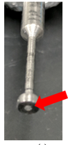
Category 1: Low Energy Cyclotron - Internal Penning Ion Source
Developments
Siemens Eclipse
Recent developments [1]:
  Improved vacuum integrity at the hydrogen line & ion source itself. Improvements in serviceability.
Future developments [1]:
  The focus is on improved heat transfer at the upper cathode.
  Mitigate a glow discharge phenomenon in the hydrogen feed line (at times).
  Long-term goal is still to test for increased, persistent ion production using caesium.
Caesium getters. SAES Group: 2.7mg, Ø1mm x 0.8mm pills (0.6 mg Cs). Released from Cs-Al-Zr salt >550 C [2]
Arc I Arc Power Beam @ Post Beam @ 11 MeV
Baseline 0.27 A 174 W 740 μA 128 μA [2]
Cs Pill in Lower Cathode 0.27 A 116 W 925 μA 155 μA [2]
[1] Private Communication – Logan Williams, Cyclotron Engineer, Siemens Medical Solutions USA, Inc., Data provided in email January 29, 2024 .
[2] D. Potkins, M. Dehnel, S. Melanson, T. Stewart, P.Jackle, J. Hinderer, N. Jones, L. Williams, “Improvements to Siemens Eclipse PET Cyclotron Penning Ion Source”,
AIP Conference Proceedings, Vol. 2052, No. 1, P. 050016, AIP Publishing, 2018.

Slide 15
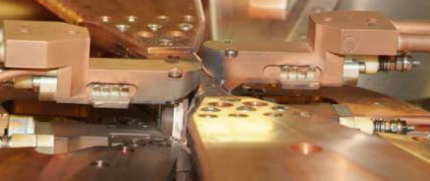
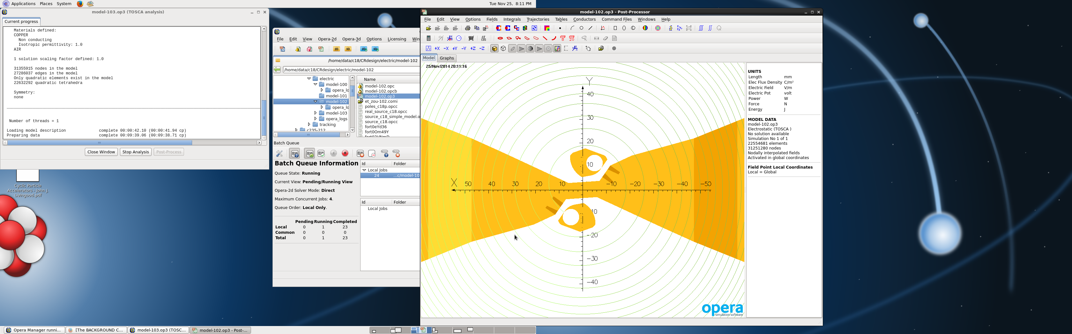
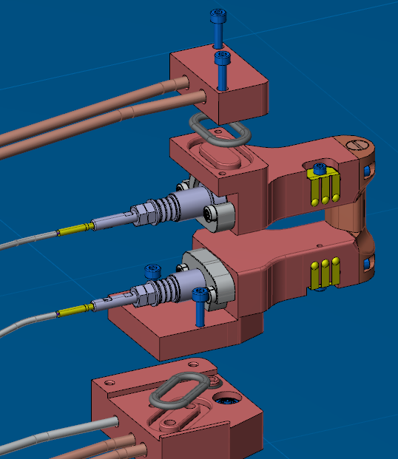
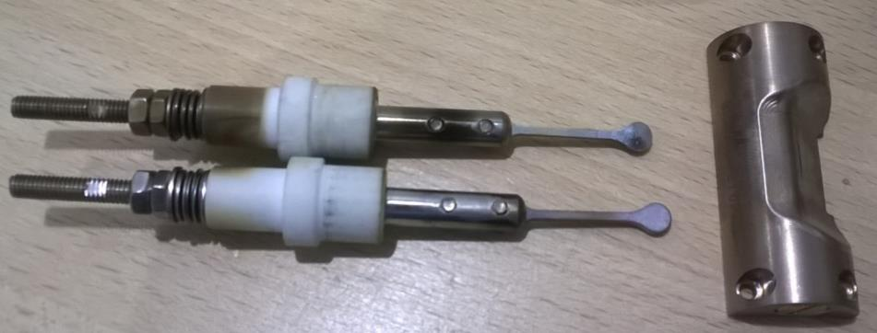
Category 1: Low Energy Cyclotron - Internal Penning Ion Source
Developments
IBA [1]
  Twin Ion Sources:
    Switching to second source is automated.
    Global source lifetime significantly increased.
  Kiube Motorized Source:
    Azimuthal/Radial .
    Global source lifetime significantly increased.
  Kiube Easy Access:
    Source body/cathodes, maintenance.
    300 μA extracted at 18 MeV, H⁺
[1] Private Communication - Jean-Michel Geets, IntegraLab Business Developer – IBA Fellow, IBA RadioPharma Solutions – Data by email January 17, 2024.

Slide 16
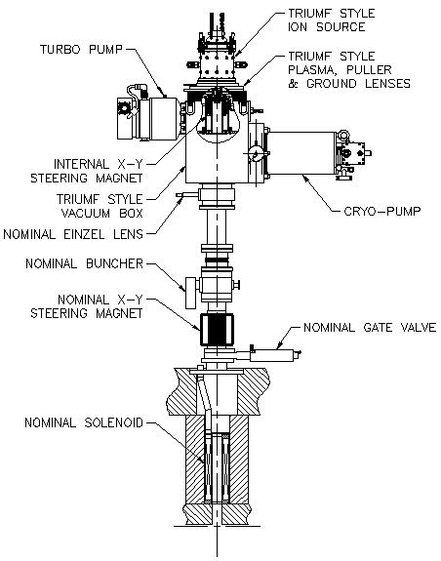
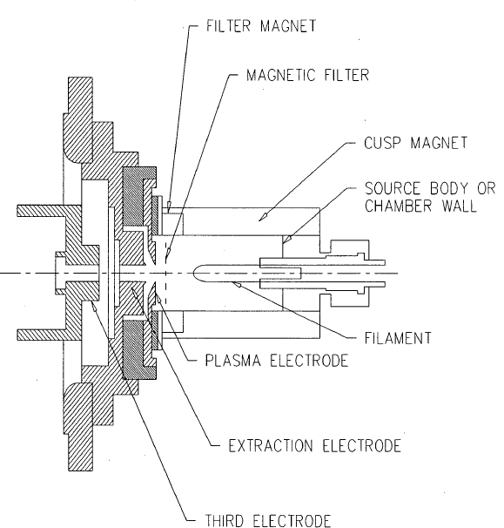
Category 1: Low Energy Cyclotron – External Volume-Cusp Ion Source
External Volume-Cusp Ion Source Review
Cyclotron Yoke
[1] M. Dehnel et al, “An Ion Source Upgrade for an Axial Injection Based Commercial Cyclotron”, NIMB, Vol. 241, Issues 1-4, pp. 896-900, 2005.
[2] M. Dehnel, “The Development of an Injection System for a Compact H- Cyclotron, the Concomitant Measurement of Injected Beam Properties, and the Experimental Characterization of the Spiral Inflector”, UBC, PhD thesis, 1995.

Slide 17
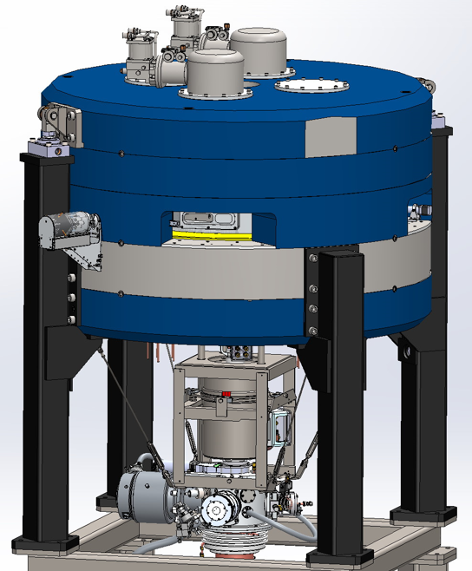
Category 1: Low Energy Cyclotron – External Volume-Cusp Ion Source – Present Status
BEST
B15P: Max. Extracted Current: H⁺ 400 μA @ 15 MeV
Cyclotron Parameters for Max. Extracted Current
  Accelerated Particle: H‾
  Source Bias: −25 kV
  Source Max. H‾ Current: 5 mA
  Steady State Arc Power: 2.8 kW
  Arc Current/Voltage: 20 A/140 V
  Gas Flow: 12 sccm
  Filament Lifetime: >500 hrs
[1] Private Communication: Vasile Sabaiduc, Director of Cyclotron Operations, BEST Cyclotron Systems, Data by Email February 13, 2024.

Slide 18
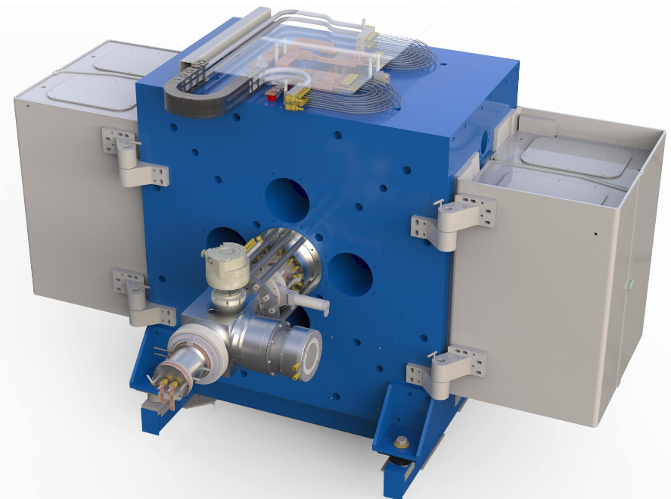
Category 1: Low Energy Cyclotron – External Volume-Cusp Ion Source – Present Status
ACSI
TR-19, TR-19/9: Max. Extracted Current: H⁺ 400 μA @ 19 MeV; D⁺ 75 μA @ 9 MeV
Cyclotron Parameters for Max. Extracted Current
  Accelerated Particle: H‾, D‾
  Source Bias: −28 kV, −13 kV
  Source Max. H‾ Current: 5 mA, 2.6 mA
  Steady State Arc Power: 1.5 kW
  Arc Current/Voltage: 15 A/100 V
  Gas Flow: 10 sccm, 5 sccm
  Filament Lifetime: >1500 hrs
[1] Private Communication: Russell Watt, Chief Cyclotron Engineer, ACSI, Data by Email January 19, 2024.
[2] https://advancedcyclotron.com/our-cyclotrons/tr19/

Slide 19
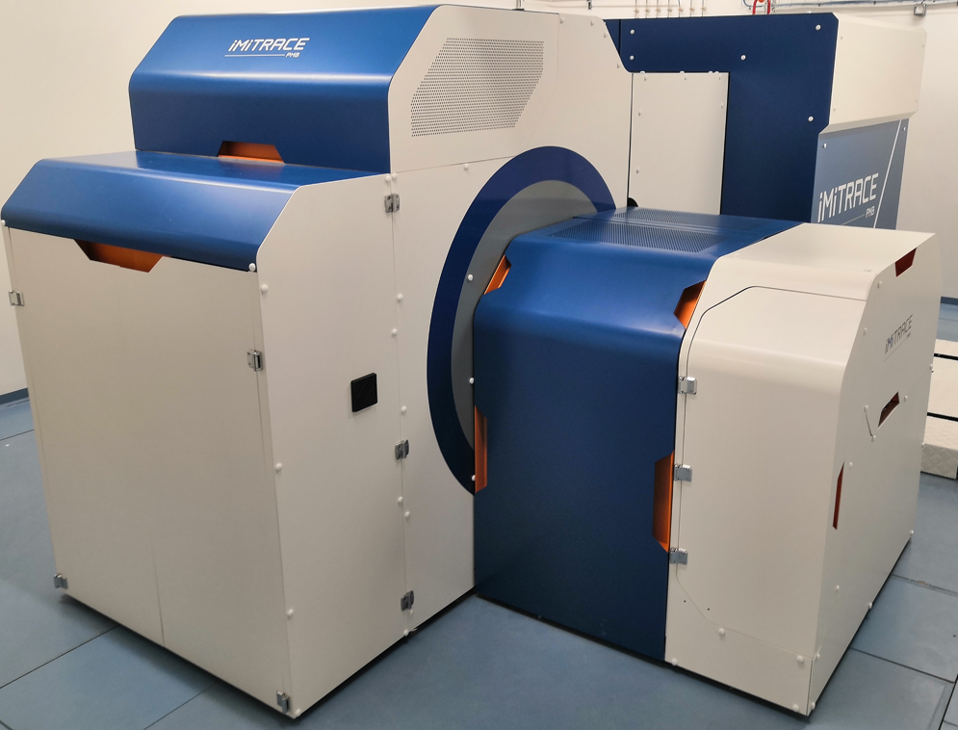
Category 1: Low Energy Cyclotron – External Volume-Cusp Ion Source – Present Status
PMB-Alcen
iMiTRACE: Max. Extracted Current: H⁺ 50 μA @ 12 MeV
Cyclotron* Parameters for Max. Extracted Current
  Accelerated Particle: H‾
  Source Bias: −25 kV
  Source Max. H‾ Current: 1.5 mA
  Steady State Arc Power: 2 kW
  Arc Current/Voltage: 20 A/100 V
  Gas Flow: 10 sccm
  Filament Lifetime: >800 hrs
  *Super-Conducting
[1] Private Communication: Gaëtan Carreno, Cyclotron Engineer, PMB-Alcen, Data by Email January 19, 2024.

Slide 20
Category 1: Low Energy Cyclotron – External Volume-Cusp Ion Source
Developments
PMB-Alcen, iMiTRACE [1]
  Enameling of ceramic parts for easier cleaning.
  Feasibility study on moving to simpler, less expensive Penning System.
ACSI TR19 [2]
  Converted from cryo-pumps to Turbo pumps many years ago (avoids cryo-regeneration).
  Filament failure occurs when filament heating current (not arc current) is ~90A, so filament replacements are scheduled when filament heating current ~120A.
  Source cleaning of only major flakes with lint free cloth. Retain sputtered tantalum surface. If source inner chamber cleaned to copper surface, then it can take a few days to get current production back up to normal.
  Keep source running at low current to source beam stop between runs. Do not “turn off” source as then thermal cycling of the filament will reduce lifetime.
[1] Private Communication: Gaëtan Carreno, Cyclotron Engineer, PMB-Alcen, Data by Email March 7, 2024.
[2] Private Communication: Leonard Popa, Senior Principal Product Engineer, Cardinal Health, March 3, 2024.

Slide 21
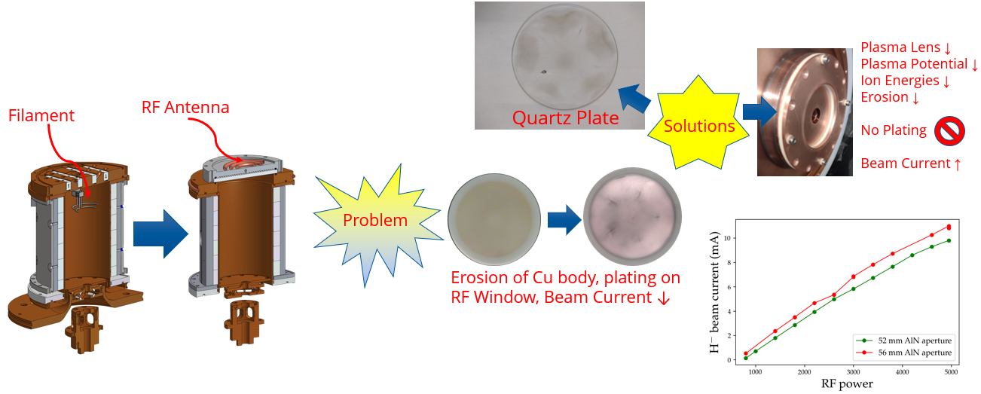
Category 1: Low Energy Cyclotron – External Volume-Cusp Ion Source
Developments
D-Pace RF Ion Source [1] PostDoc with TRIUMF; hybrid TRIUMF & U. Jyväskylä licenses:
  Aim is to avoid filament changeouts, maintenance interval 1-2 years.
[1] A. George et al, “Investigation of Plasma Chamber Erosion in an RF Ion Source”, International Conference on Ion Sources, Victoria BC Canada, September 2023, in press.

Slide 22
Category 2: Medium Energy Cyclotron – External Volume-Cusp/ECR/Penning – Present Status
PRESENT STATUS
External Volume-Cusp Ion Source
  ACSI Canada TR-24, TR-FLEX, TR-30, TR-30/15
  BEST Canada B25P, B35P
  IBA Belgium C30, C30-HC
External Volume-Cusp Ion Source & ECR
  IBA Belgium C30XP
External Volume-Cusp Ion Source & Penning
  SHI Japan MP-30

Slide 23
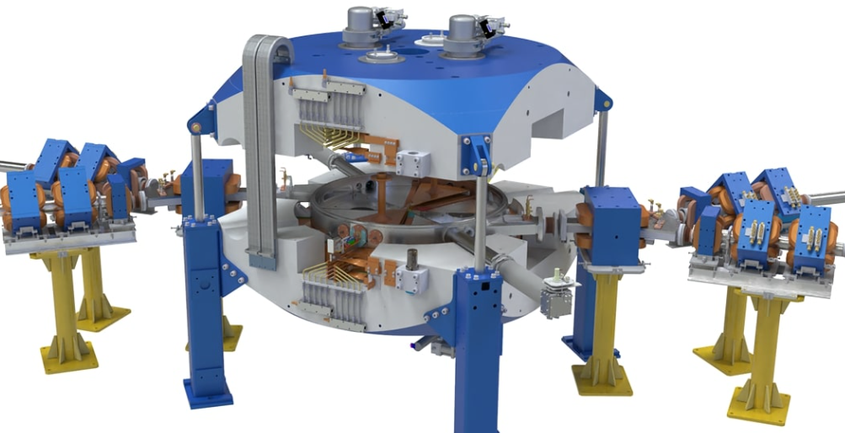
Category 2: Medium Energy Cyclotron – External Volume-Cusp – Present Status
ACSI
    Particle Extraction Max IS IS Bias Arc Power Arc I/V Gas Flow Filament Lifetime
TR-24 H‾→H⁺ 1000 μA/24 MeV 15 mA −28 kV 1.5 kW 15A/100V 8 sccm 1500 hours
TR-FLEX H‾→H⁺ 1000 μA/30 MeV 15 mA −28 kV 1.5 kW 15A/100V 8 sccm 1500 hours
TR-30 H‾→H⁺ 1800 μA/30 MeV 15 mA −28 kV 3.5 kW 35A/100V 12 sccm 1500 hours
TR-30/15 D‾→D⁺ 150 μA/15 MeV 5 mA −13 kV 2.0 kW 20A/100V 7 sccm 1500 hours
[1] Private Communication: Russell Watt, Chief Cyclotron Engineer, ACSI, Data by Email January 19, 2024.
[2] https://advancedcyclotron.com/our-cyclotrons/tr30/

Slide 24
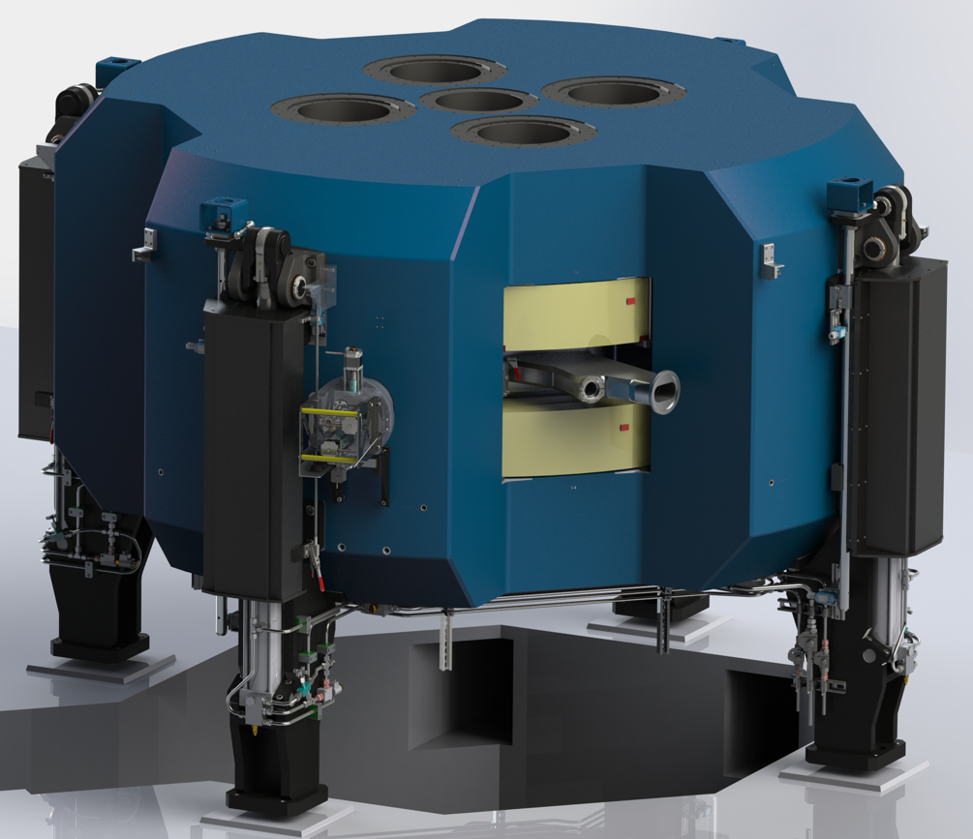
Category 2: Medium Energy Cyclotron – External Volume-Cusp – Present Status
BEST
    Particle Extraction Max IS IS Bias Arc Power Arc I/V Gas Flow Filament Lifetime
B25P H‾→H⁺ 1000 μA/25 MeV 10 mA −28 kV 4 kW 28A/143V 12 sccm >500 hours
B35P H‾→H⁺ 1200 μA/35 MeV 12 mA −28 kV 4 kW 28A/143V 12 sccm >500 hours
[1] Private Communication: Vasile Sabaiduc, Director of Cyclotron Operations, BEST Cyclotron Systems, Data by Email February 13, 2024.

Slide 25
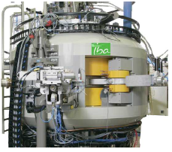
Category 2: Medium Energy Cyclotron – External Volume-Cusp – Present Status
IBA
    Particle Extraction Max IS IS Bias Arc Power Arc I/V Gas Flow Filament Lifetime
C30 H‾→H⁺ 750 μA/30 MeV 5 mA −31 kV 2.0 kW 25A/80V 12 sccm 500 hours
C30-HC H‾→H⁺ 1200 μA/30 MeV 10 mA −31 kV 2.5 kW 20A/120V 12 sccm 800 hours
IKON H‾→H⁺ 1200 μA/30 MeV 10 mA −40 kV 2.5 kW 25A/100V 12 sccm 800 hours
[1] Private Communication: Jean-Luc Delvaux, Honorary Fellow, IBA, Data by Email January 18, 2024.
[2] Private Communication - Jean-Michel Geets, IntegraLab Business Developer – IBA Fellow, IBA RadioPharma Solutions – Data by email March 4, 2024.

Slide 26
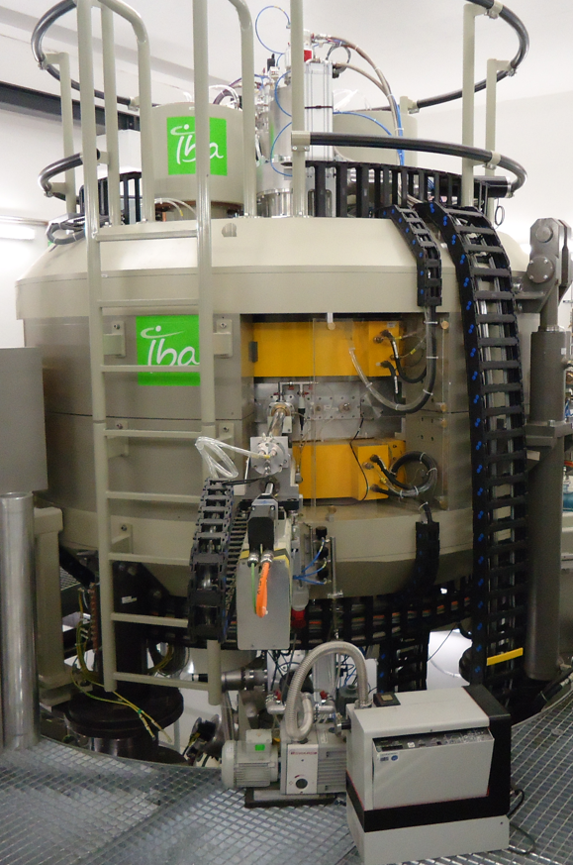
Category 2: Medium Energy Cyclotron – External Volume-Cusp & ECR – Present Status
IBA
    Particle Extraction Max IS IS Bias Arc Power Arc I/V Gas Flow Filament Lifetime
C30xp H‾→H⁺ 350 μA/30 MeV 5 mA −40 kV 2.0 kW 25A/80V 12 sccm 500 hours
C30xp D‾→D⁺ 100 μA/15 MeV 1.2 mA -20 kV 2.5 kW 15A/167V 12 sccm 500 hours
C30xp* ⁴He⁺⁺ 50 μAe/30 MeV 1.2 mAe +20 kV 0.5 kW RF N/A 12 sccm 15000 hours
* ECR for ⁴He⁺⁺
[1] Private Communication: Jean-Luc Delvaux, Honorary Fellow, IBA, Data by Email January 18, 2024.
[2] Private Communication - Jean-Michel Geets, IntegraLab Business Developer – IBA Fellow, IBA RadioPharma Solutions –
Data by email March 4, 2024.

Slide 27
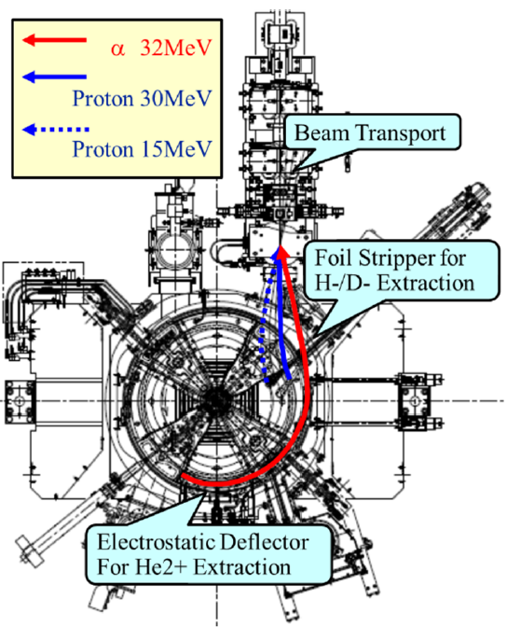
Category 2: Medium Energy Cyclotron – External Volume-Cusp & Penning – Present Status
SHI
    Particle Extraction Max IS IS Bias Arc Power Arc I/V Gas Flow Filament Lifetime
MP-30 H‾→H⁺ 400 μA/30 MeV N/A −30 kV N/A N/A N/A N/A
MP-30 D‾→D⁺ 100 μA/15 MeV N/A -16 kV N/A N/A N/A N/A
MP-30* ⁴He⁺⁺ 30 μAe/32 MeV N/A +16 kV N/A N/A N/A N/A
*Penning for ⁴He⁺⁺
[1] M. Taniguchu et al, “Sumitomo Multi-Purpose Cyclotron MP-30”, Proceedings of the 14th Annual Meeting
of Particle Accelerator Society of Japan, August 1-3, 2017, Sapporo, Japan.

Slide 28
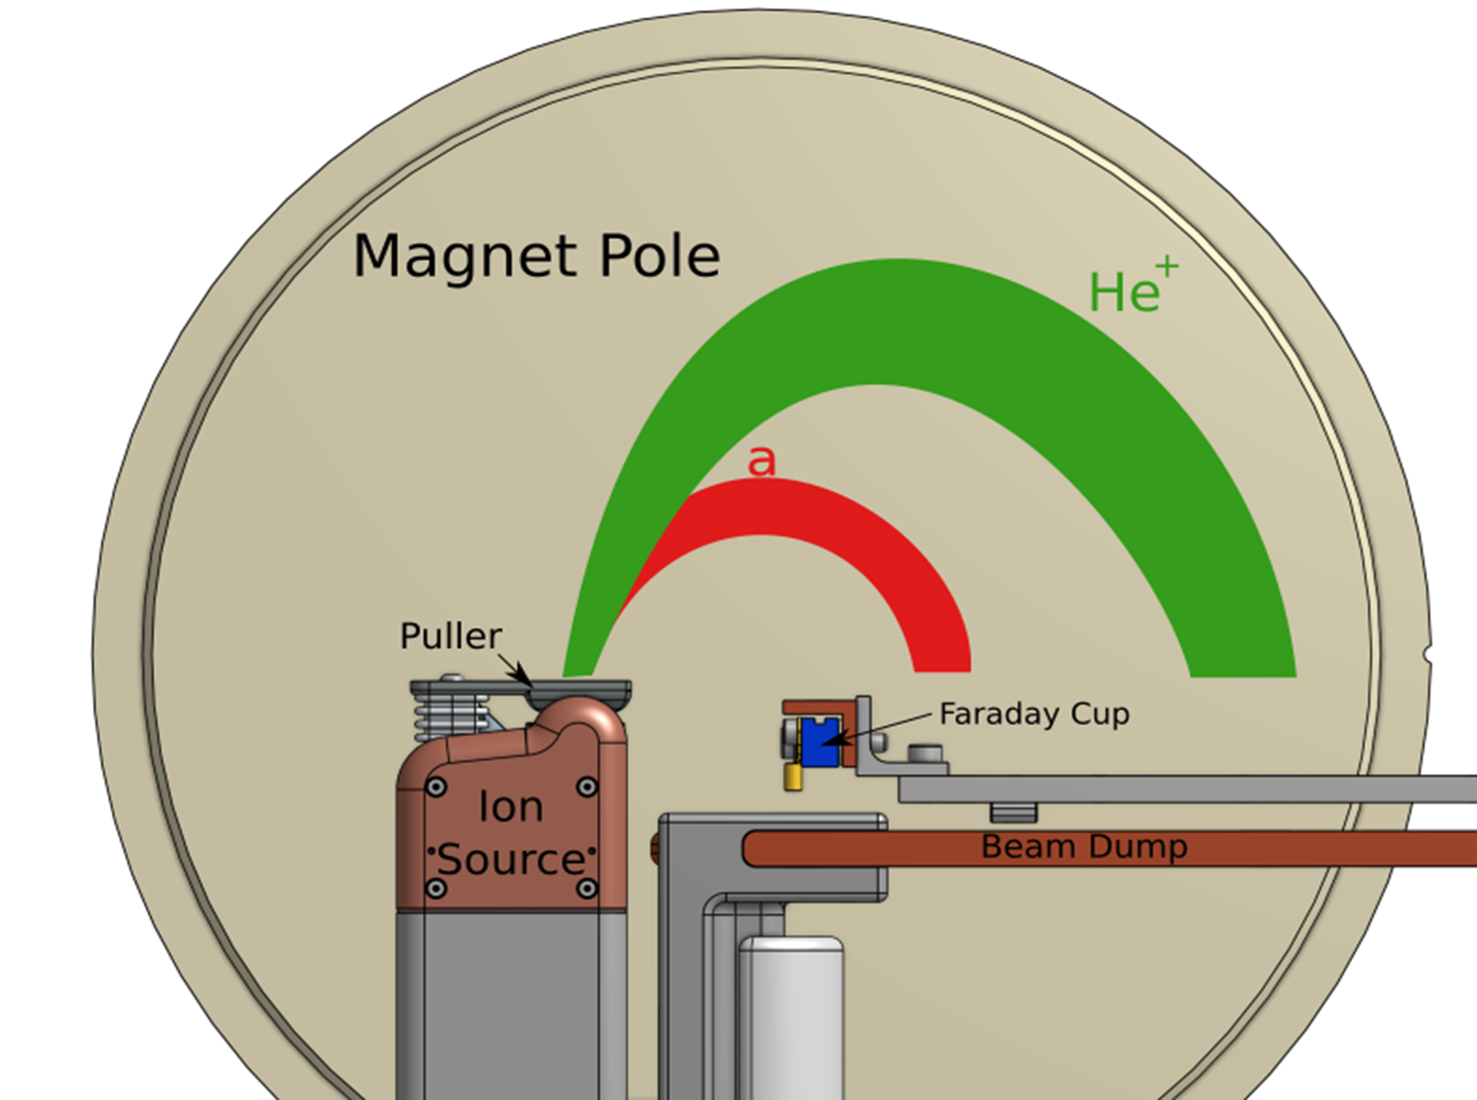
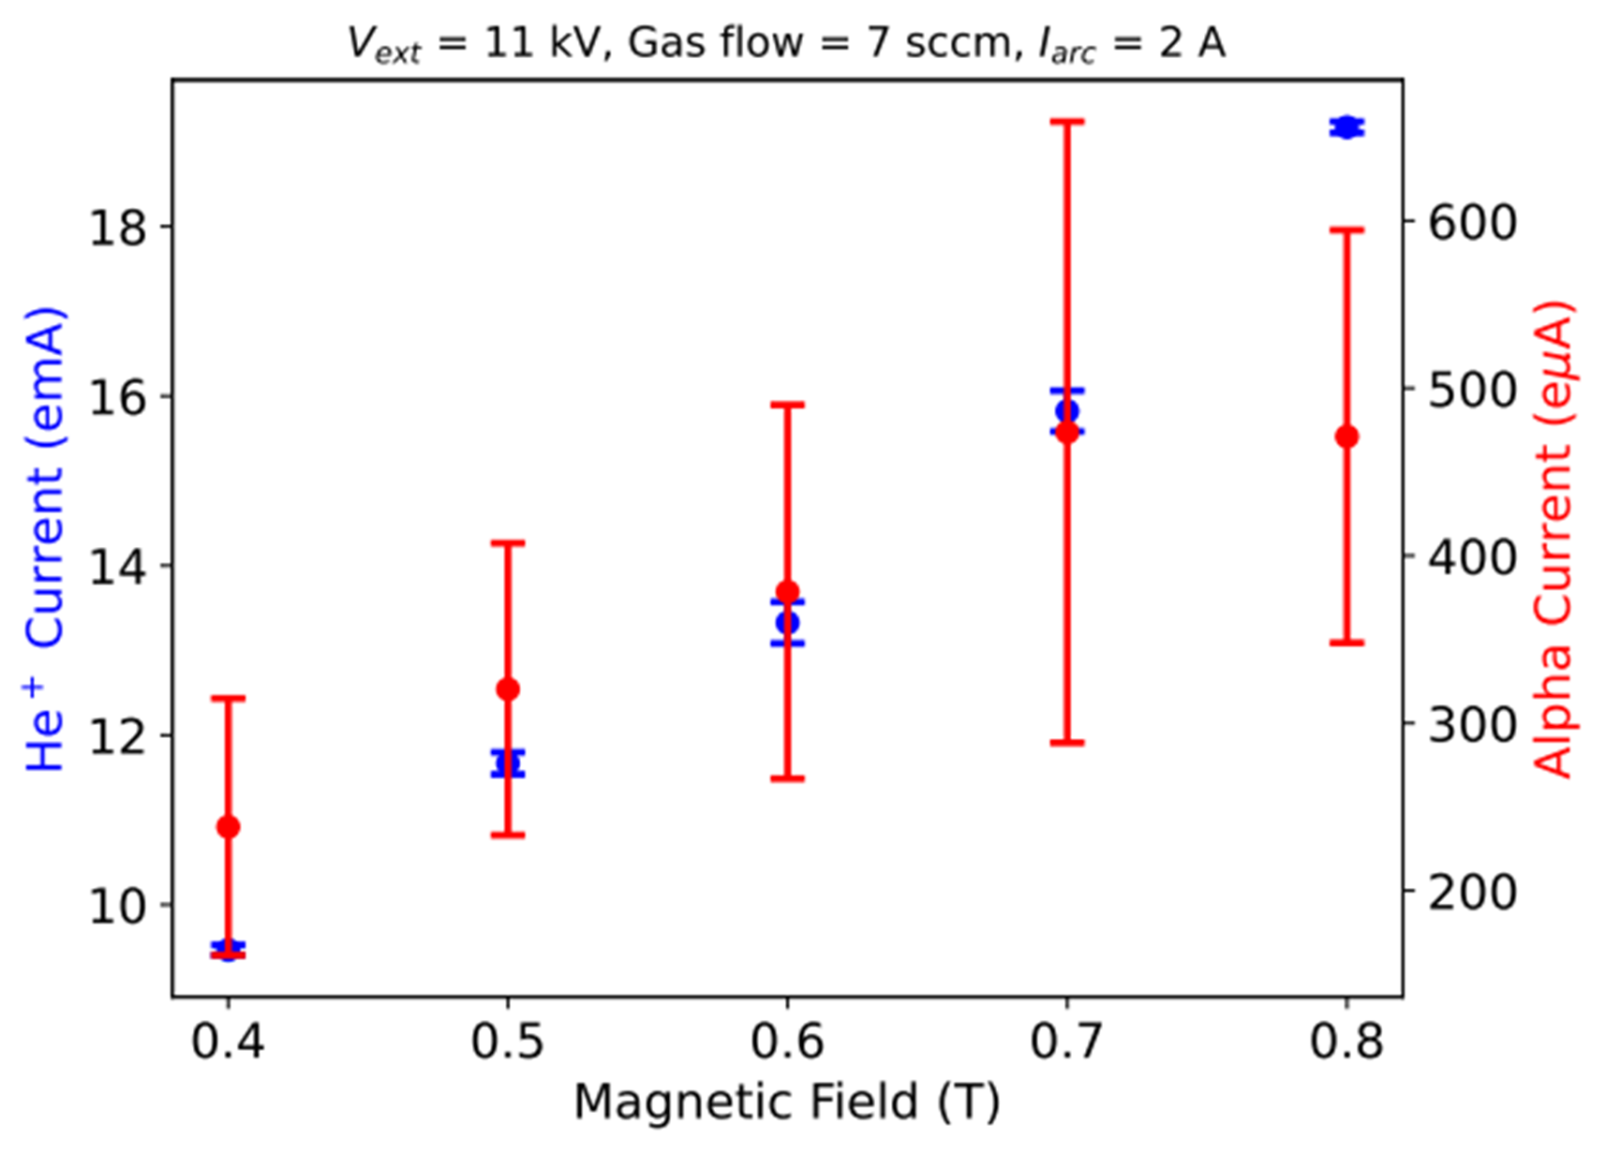
Category 2: Medium Energy Cyclotron – External Volume-Cusp/ECR/Penning
Developments
    Source Particle Extraction Max IS IS Bias RF Power Gas Flow Lifetime
TR-Alpha [1] ECR ⁴He⁺⁺ NA/30 MeV* N/A 30 kV N/A N/A N/A
C30-Alpha [2] PIG ⁴He⁺⁺ 150 eμA/29 MeV 150 eμA RF ext. N/A N/A 100 hours
* Internal Target
D-Pace Penning [3,4]
[1] Private Communication: Russell Watt, Chief Cyclotron Engineer, ACSI, Data by Email March 13, 2024.
[2] Private Communication: Jean-Luc Delvaux, Honorary Fellow, IBA, Data by Email January 18, 2024.
[3] N. Savard et al, “Extraction of High-Charge State Argon and Alpha Particles from D-Pace Penning Ion Source Test Stand”, Proc. 13th IPAC, Bangkok, 12-17 June 2022. JACoW Publishing, 2022 pp. 1816-1818.
[4] N. Savard, “Development and Characterization of a Penning Ion Source Using Helium”, UBC PhD, Thesis, 2022.

Slide 29
Category 3: High Energy Cyclotron – External Volume-Cusp/ECR/Penning – Present Status
PRESENT STATUS
External Volume-Cusp Ion Source
  BEST Canada B70P
  IBA Belgium C70P
External Volume-Cusp & ECR Ion Source
  IBA Belgium C70XP
Internal Penning Ion Source
  Scanditronix Sweden MC50

Slide 30
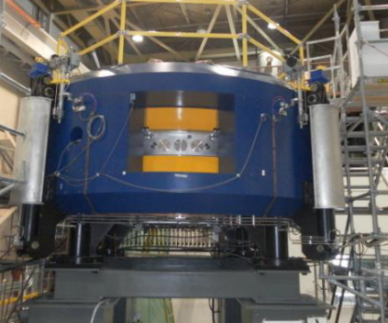
Category 3: High Energy Cyclotron – External Volume-Cusp – Present Status
BEST
    Particle Extraction Max IS IS Bias Arc Power Arc I/V Gas Flow Filament Lifetime
B70P H‾→H⁺ 1000 μA/70 MeV 12 mA −40 kV 4.0 kW 28A/143V 12 sccm 500 hours
[1] Private Communication: Vasile Sabaiduc, Director of Cyclotron Operations, BEST Cyclotron Systems, Data by Email February 13, 2024.

Slide 31
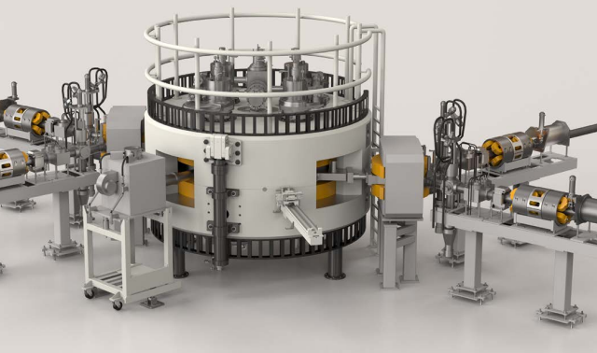
Category 3: High Energy Cyclotron – External Volume-Cusp – Present Status
IBA
    Particle Extraction Max IS IS Bias Arc Power Arc I/V Gas Flow Filament Lifetime
C70p H‾→H⁺ 350*μA/70 MeV 5 mA −40 kV 2.0 kW 25A/80V 12 sccm 500 hours
* Did 700 μA 35-70 MeV, and also
750 μA in single beam mode with
D-Pace’s TRIUMF licensed multi-
cusp, filament-powered H‾ source
10 mA.
[1] Private Communication: Jean-Luc Delvaux, Honorary Fellow, IBA, Data by Email January 18, 2024.
[2] https://hm-offload.s3.eu-west-3.amazonaws.com/iba/2023/04/cyclone_70_web.pdf
[3] Private Communication - Jean-Michel Geets, IntegraLab Business Developer – IBA Fellow, IBA RadioPharma Solutions –
Data by email March 4, 2024.

Slide 32
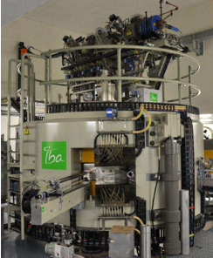
Category 3: High Energy Cyclotron – External Volume-Cusp & ECR – Present Status
IBA
    Particle Extraction Max IS IS Bias Arc Power Arc I/V Gas Flow Filament Lifetime
C70xp H‾→H⁺ 1000*μA/70MeV 10 mA −40 kV 2.0 kW 25A/80V 12 sccm 500 hours
C70xp D‾→D⁺ 100 μA/35 MeV 1.2 mA -20 kV 2.5 kW 15A/167V 12 sccm 500 hours
C70xp ⁴He⁺⁺ 70 eμA/70 MeV 1.2 mAe +20 kV 0.5 kW RF* N/A 12 sccm 15000 hours
C70XP H₂⁺ 50 μA/15 MeV 1 mAe +20 kV 0.5 kW RF* N/A 12 sccm 15000 hours
Volume-Cusp ECR
* Did 750 μA 35-70 MeV at Arronax.
[1] Private Communication: Jean-Luc Delvaux, Honorary Fellow, IBA, Data by Email January 18, 2024.
[2] Private Communication - Jean-Michel Geets, IntegraLab Business Developer – IBA Fellow, IBA RadioPharma Solutions –
Data by email March 4, 2024.

Slide 33
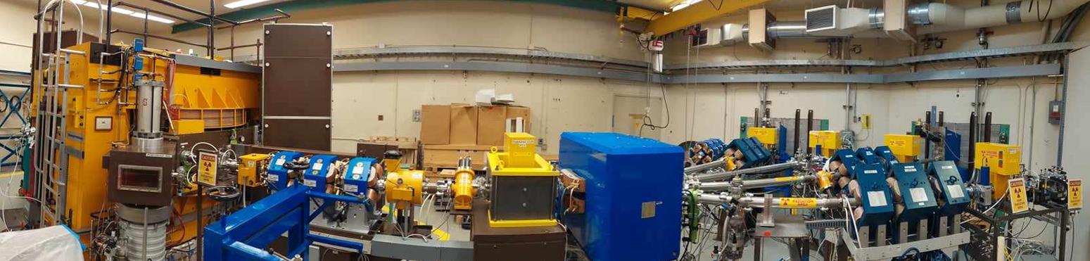
Category 3: High Energy Cyclotron – Penning – Present Status
Scanditronix (UWMCF)
    Particle Extraction Max IS IS Bias ArcPower Arc I/V Gas Flow Cathode Lifetime
    (r17 cm) (buttons)
MC50 H⁺ 50 μA/50.5 MeV 70 μA Ground 106 W 85mA/1.25kV 3 sccm >120 hours
MC50 ⁴He⁺⁺ 70μAe/47.3 MeV 80 μA Ground 750 W 0.5A/1.5 kV 3 sccm 4-8 hours
MC50 D⁺ 35 μA/23.8 MeV N/A Ground 45 W 50mA/0.9kV 3.7 sccm >120 hours
MC50 ³He⁺⁺ 2 μAe/35.7 MeV N/A Ground 280 W 0.2A/1.4kV 3.5 sccm 4-8 hours
[1] Private Communication: Marissa Kranz, Facility Director, University of Washington Medical Cyclotron Facility, Data by Email February 29, 2024.
[2] Private Communication: Marissa Kranz, Facility Director, University of Washington Medical Cyclotron Facility, Photo by Email March 13, 2024.

Slide 34
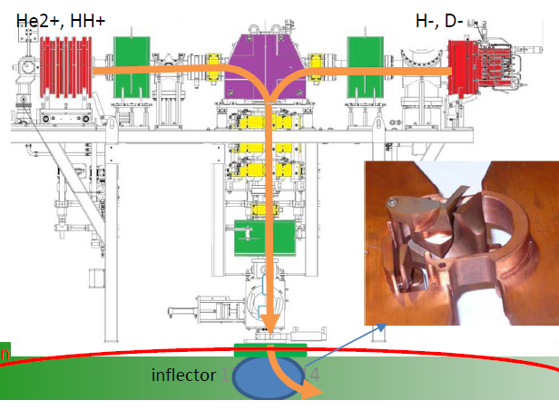
Category 3: High Energy Cyclotron – External Volume-Cusp/ECR/Penning
Developments
IBA C70P [1]
[1] Private Communication: Jean-Luc Delvaux, Honorary Fellow, IBA, Data by Email January 18, 2024.
[2] https://www.pantechnik.com/wp-content/uploads/2020/07/Supernanogan.pdf
[3] https://www.d-pace.com/?e=304

Slide 35
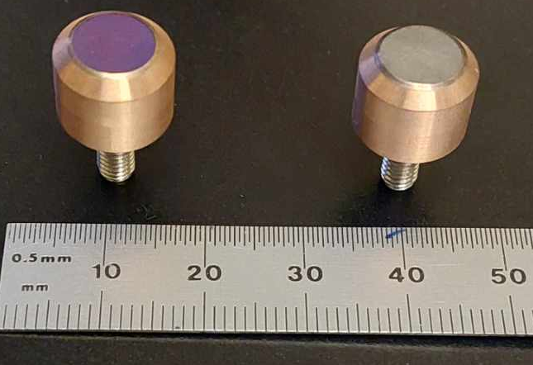
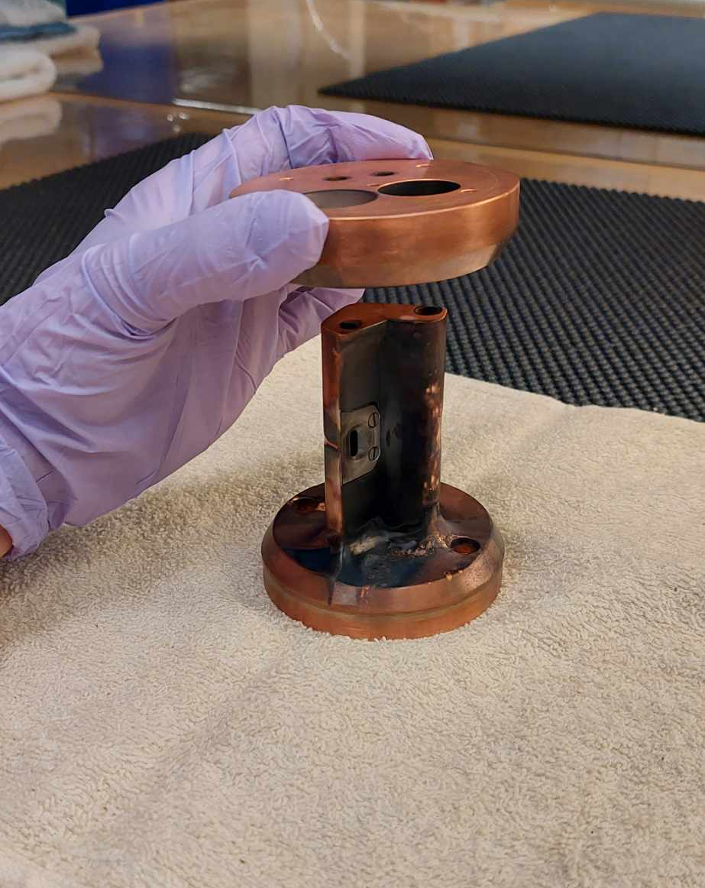
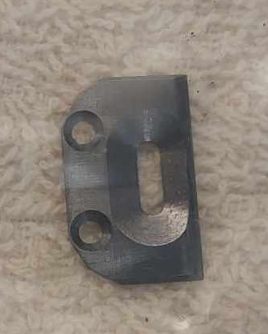
Category 3: High Energy Cyclotron – External Volume-Cusp/ECR/Penning
Developments
Scanditronix MC50 UWMCF [1]
  2 Cu pieces form two chimneys. Replace every 150-200 hrs. Cathode material shorts.
  Chimney 1: Purple Button Cathode LaB₆ used for proton and deuteron source, 120+ hrs
  Chimney 2: Grey Button Cathode HfC used for Alpha and He-3, 4-8 hours
  Molybdenum Penning Exit slits known as windows were Molybdenum,
  but are now tungsten, for much reduced slit widening due to erosion.
  Especially important in Chimney 2 with the more massive particles.
[1] Private Communication: Marissa Kranz, Facility Director, University of Washington Medical Cyclotron Facility, Data by Email February 29, 2024.

Slide 36
H‾, D‾ & He⁺⁺ Source Developments for Medical Isotope Production Cyclotrons
Volume-Cusp
Accelerator Development and Technology (ADT-1) Tuesday, March 19, 2024.
QUESTIONS?
Penning
ECR
[1] https://www.d-pace.com/?e=304
[2] D. Potkins, M. Dehnel, S. Melanson, T. Stewart, P.Jackle, J. Hinderer, N. Jones, L. Williams, “Improvements to Siemens Eclipse PET Cyclotron Penning Ion Source”,
AIP Conference Proceedings, Vol. 2052, No. 1, P. 050016, AIP Publishing, 2018.
[3] https://www.pantechnik.com/wp-content/uploads/2020/07/Supernanogan.pdf

