Slide 1
Upgrades to the Photoinjector and ICS Interaction Point Chamber of the CXLS
This material is based on work supported by the National Science Foundation under Grants No. 2153503 and 1935994.
March 19th, 2024
Taryn Brown
1

Slide 2
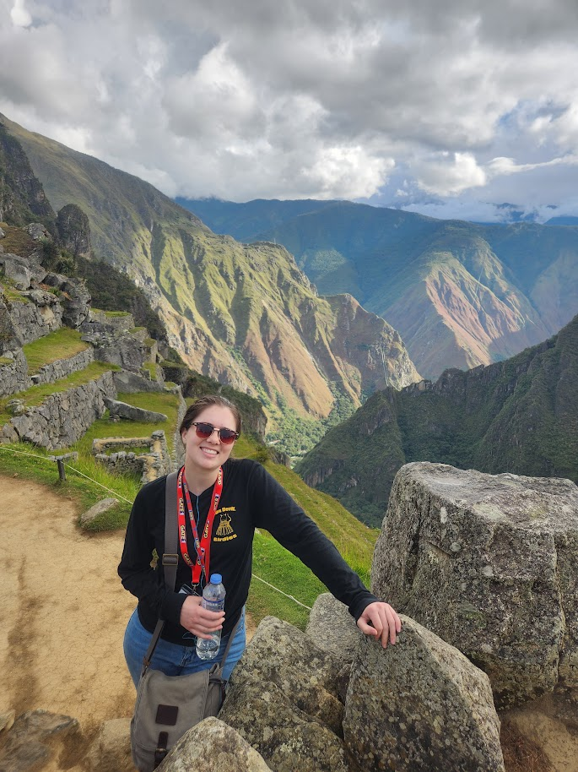
Who am I?
BS in Physics in 2022
MS in Materials Science & Engineering expected in August 2024
Certificate in Nuclear Power Engineering
Research/Lab Assistant at the Beus CXFEL Lab at ASU Biodesign Institute since May 2022
2
Notes:
Mention how I am interested in Nuclear Power at a national lab as a career.

Slide 3
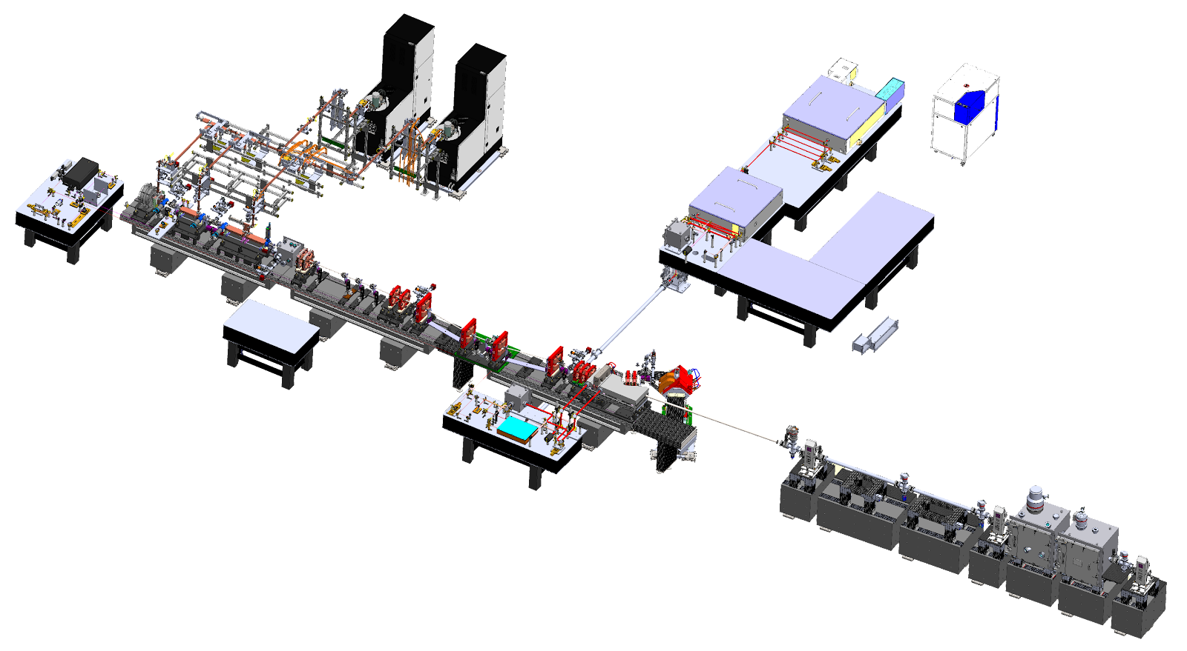
What is CXLS?
LightConversion Yb:KGW
1030/515/258 nm
1.5 mJ/shot at 1030
0.15 mJ/shot at 258
200 fs, 1 kHz
Scandinova K1 modulators Stellant (L3) L6145 klystrons
9.3 GHz
1 kHz rep rate
6 MW for 1 us
Trumpf Yb:YAG
1030 nm
200 mJ/shot
1 ps
1 kHz
M^2 = 1.2
diagnostics and matching quads
chicane compressor
ASU-Tibaray
photoinjector
9.3 GHz
1 kHz
120 MV/m
4.5 cell
4 MeV energy
200 pC
1 ps
X-ray chambers
1e8 photons/shot
2-20 keV
300 fs
1 kHz
Tibaray linac
9.3 GHz standing wave
1 kHz
25-30 MV/m
20 cells/section X 3 sections
30 MeV final energy
Final focus and interaction point
CXLS length is 10 m from cathode to beam dump.
Notes:
Reason it can be compact - since electrons are excited by IR laser, able to undulate in such a small space
Smaller size = cheaper, more affordable
Yb: KGW = Ytterbium: Potassium Gadolin ium Tungstate crystal (gain material for scattering)
Yb:YAG = Ytterbium: Yttrium Aluminum Garnet crystal
1030 fundamental, 515 second harmonic, 258 4th harmonic

Slide 4
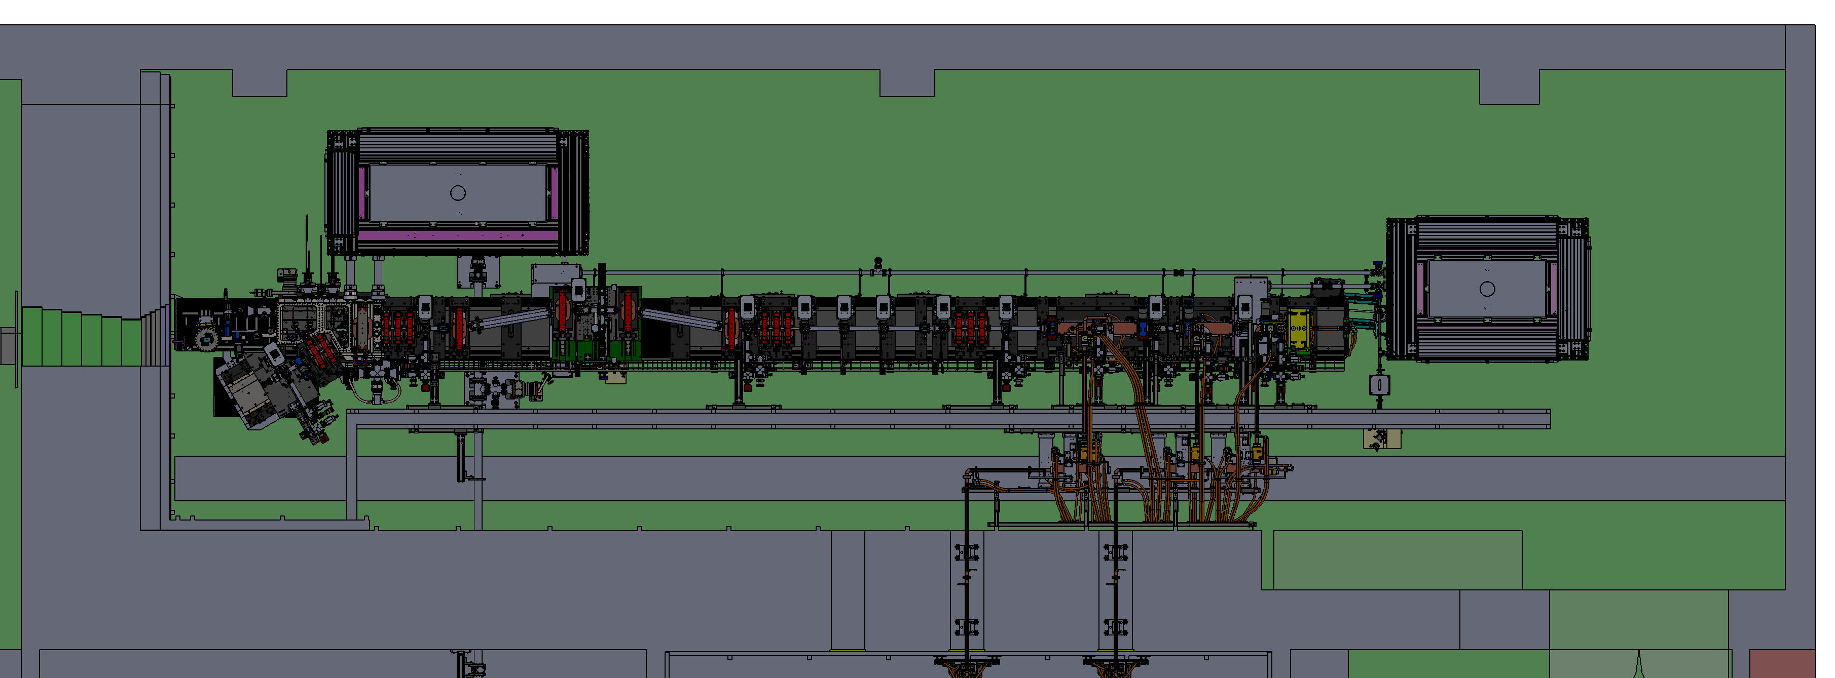
Why automation?
ICS IP Chamber
Photoinjector Laser Enclosure
Remote control of systems in a radiation environment.
Allows all controls to be integrated into EPICS.
Enables faster optimization of beam parameters.
Minimizes down time.
Notes:
Photoinjector laser is in vault so that we can have a short path length for the best stability possible.
Full automation of laser operations is necessary.
Want to keep from shutting down as often as possible.
Controlling beams in real time helps makes overlap possible.

Slide 5
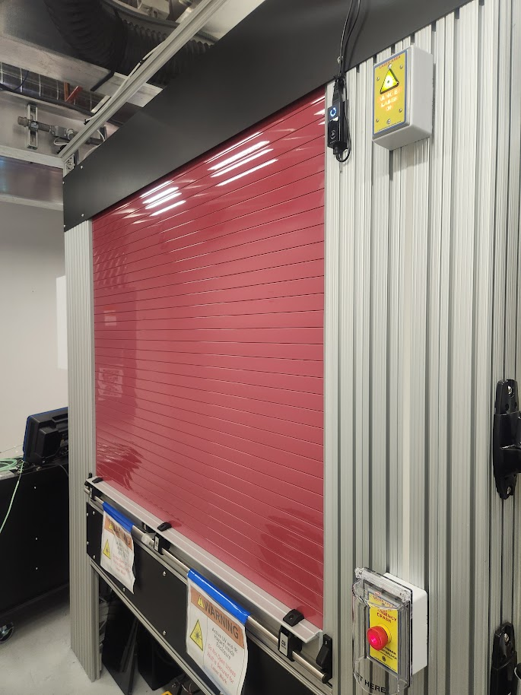
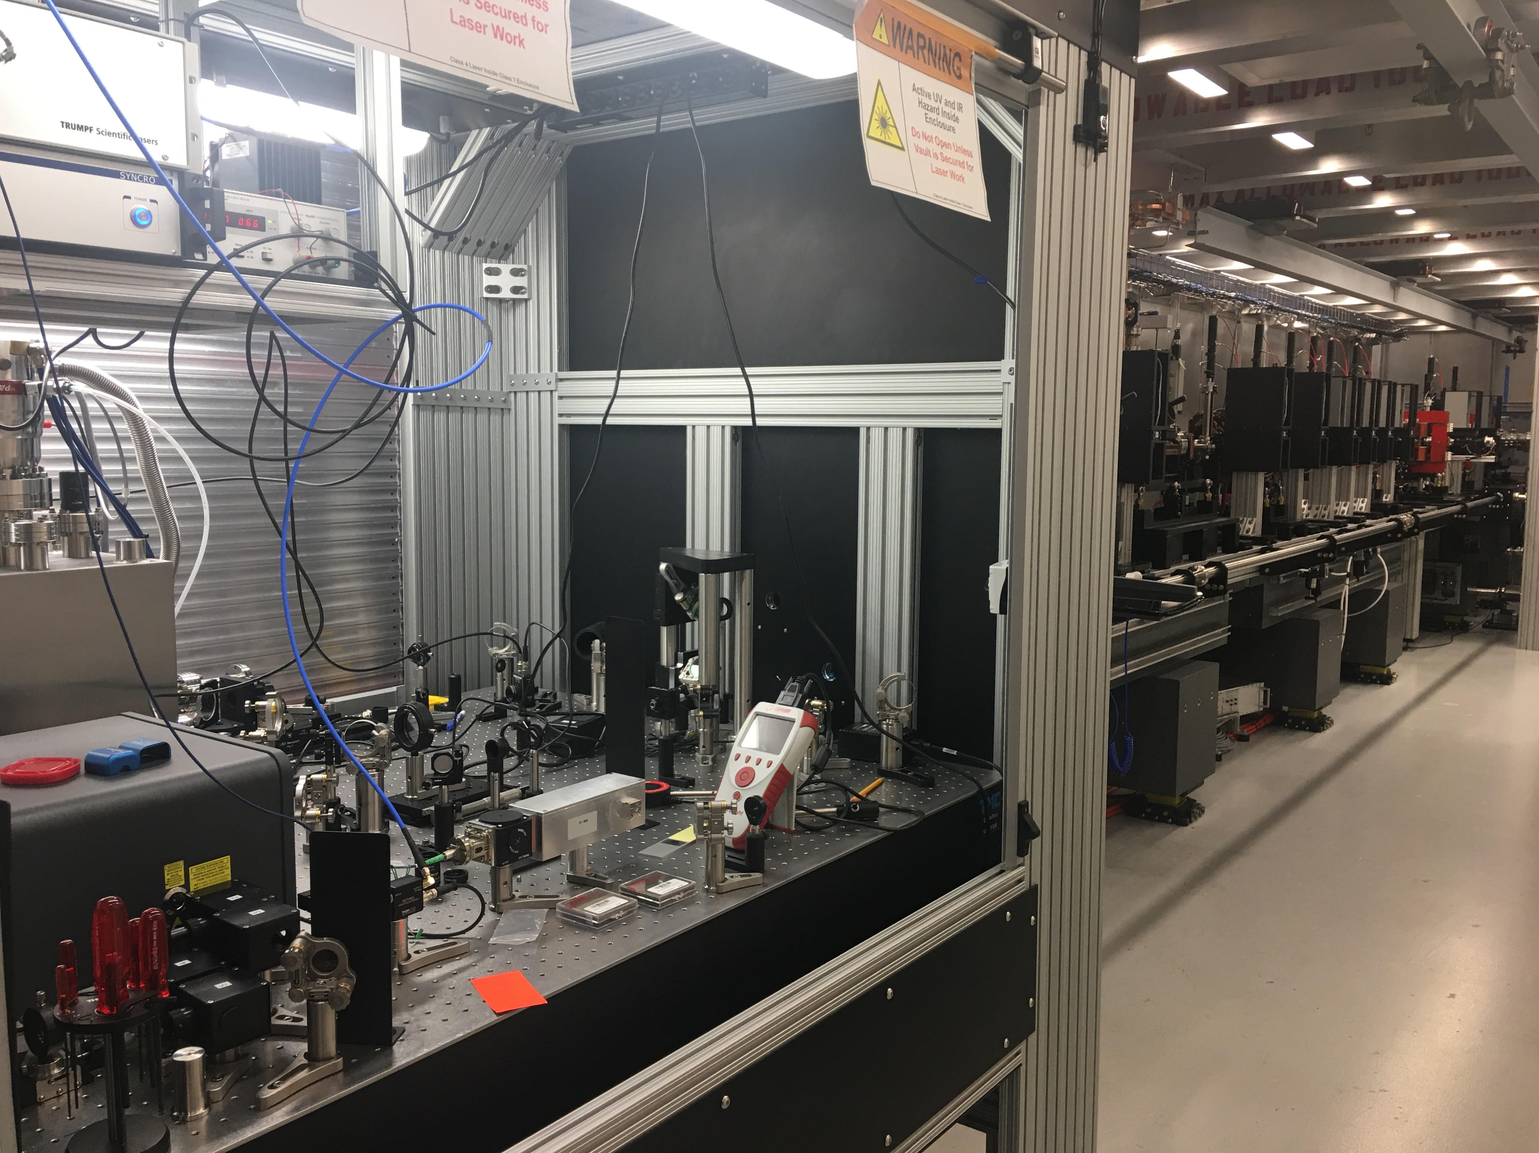
Another benefit – laser safety!
Pharos – Photoinjector laser, 1030/515/258 nm
DIRA – Undulator, 1030 nm
Notes:
2 (main) lasers in vault – Pharos (UV) and DIRA (IR) – both class 4
Pharos fundamental wavelength – 1030 nm, 4th harmonic – 258 nm
The less often the vault needs to be in class 4 mode, the better.
Allows other work to be done at the same time as laser adjustments.

Slide 6
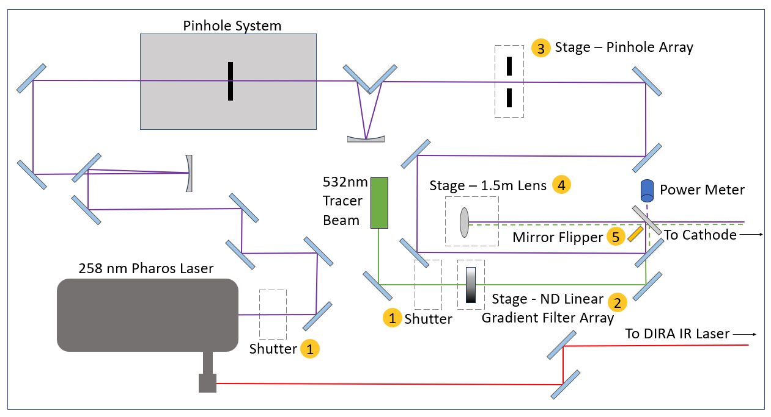
Photoinjector Laser Upgrades
UV optics improvements
Picomotors
Mirror flipper
Shutters
Galil stages
Lens for imaging system
Pinholes
ND Gradient Array
Notes:
Binary devices like mirror flipper for power diagnostics, LEDs.
Picomotors (Piezo motors) for adjustment of Pharos profile.
Galil motors control stages with lenses, pinholes, and an ND array.
UV optics improvements – Brewster optics, replaced chevrons, reflective optics, 4f → single lens.
Allows for much more precision than just adjusting by hand.

Slide 7
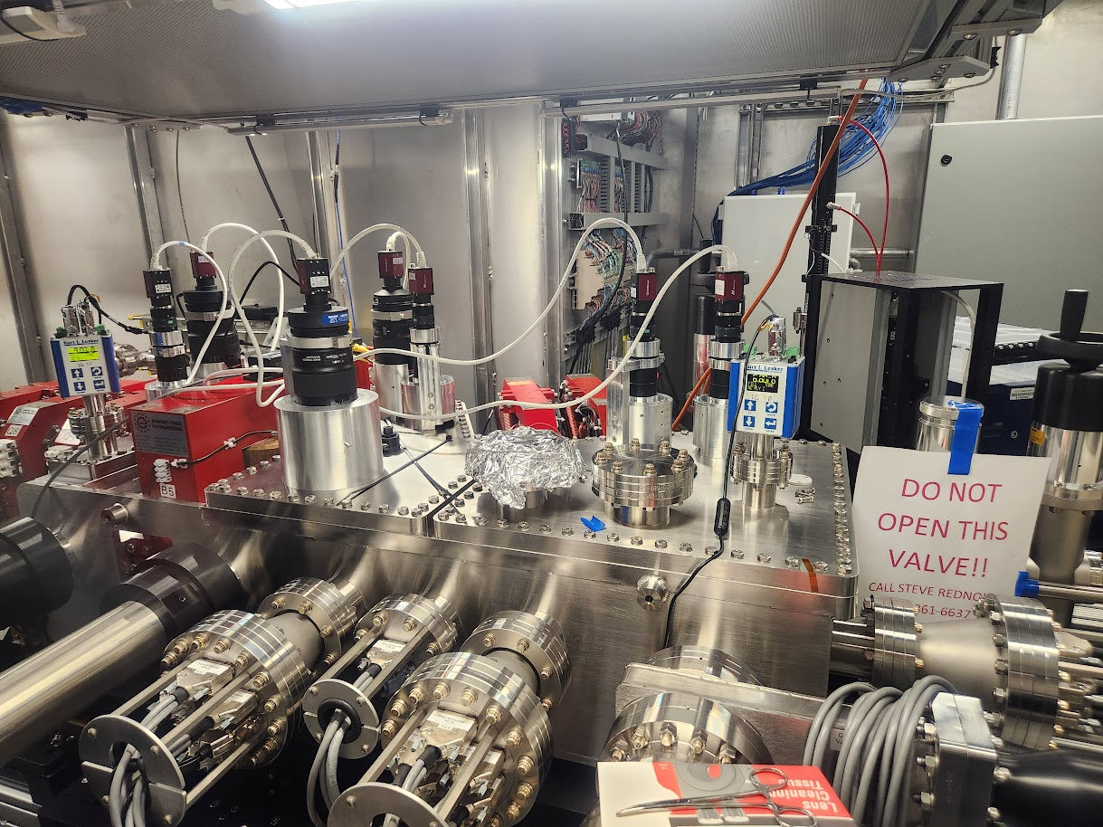
ICS IP Chamber Automation
26 motors
Lenses
Mirrors
YAG screens
7 cameras with 3 lens controllers
Montel optic
Nanopos (6 axis positioner)
Notes:
26 motors with nanometer precision, controlling lenses, mirrors, and YAGs.
Cameras with lens controllers to see beam profile.
Montel optic collimates x-rays.
Nanopos holds Montel and positions it with 6 axis of freedom.

Slide 8
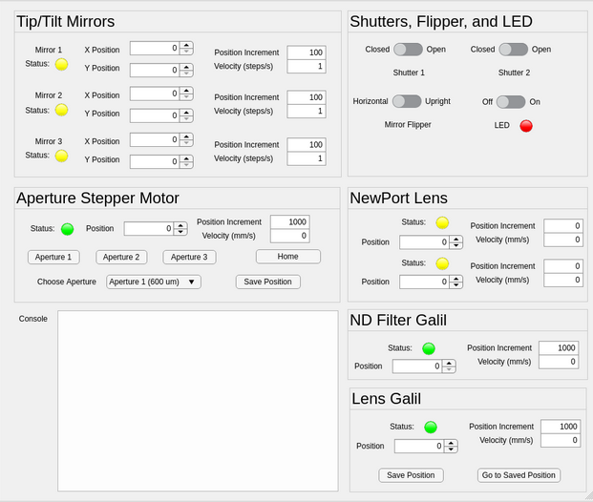
Motor control with EPICS
EPICS = Experimental Physics and Industrial Control System
IOCs
LabCA
MATLAB
Notes:
Easier for operators.
Allows monitors of PV’s to be running, any changes are seen without needing to seek it out.
Some functionality can be locked behind passwords.
Uses LabCA (channel access) to bridge the gap between EPICS IOCs and MATLAB

Slide 9
First x-rays February 2023
Initial experiments produce ~3e5 15 keV photons/shot at 1 kHz operating at 80 mJ ICS laser energy and Q = 20 pC.
Notes:
Pharos is almost entirely able to be controlled remotely. Only big changes need opening the enclosure.
ICSIP is entirely automated. X-rays were achieved in Feb 2023.
300,000 15 keV photons/shot.
As of Wednesday:
E-beam energy = 32.7 MeV
90% charge transmission from gun to beam dump.
25 pC charge from 8.2 uJH energy at 40% transmission.
QE 2.2e-5
We’ve been working on making xrays more repeatable.
Slow Pharos drop in energy over time.
Next steps – Install Montel in experimental chamber & start filling that out.

Slide 10
Thank you!
This material is based on work supported by the National Science Foundation under Grants No. 2153503 and 1935994.
Contact: Taryn Brown at tjbrow33@asu.edu

Slide 11
CXLS Hard X-ray Design Parameters
Parameter | 0.1% Bandwidth | 5% Bandwidth | Units
Photon energy range | 2 – 20 | 2 – 20 | keV
Average flux | 5x10⁹ | 1x10¹¹ | photons/s
Average brilliance | 2x10¹² | 5x10¹² | photons/(s .1% mm²mrad²)
Peak brilliance | 3x10¹⁹ | 9x10¹⁸ | photons/(s .1% mm²mrad²)
RMS horizontal size | 3.0 | 3.0 | microns
RMS vertical size | 3.0 | 3.0 | microns
RMS horizontal angle | 4.0 | 4.0 | mrad
RMS vertical angle | 4.0 | 4.0 | mrad
Photons per pulse | 5x10⁶ | 1x10⁸
RMS pulse length | <500 | <500 | fs
RMS timing jitter | <50 | <50 | fs
Repetition rate | 1000 | 1000 | Hz

Slide 12
Pharos Information
The Pharos is UV (fourth harmonic) and emits at 257 nm. It does have some IR (Fundamental) leakage at 1030 nm and can also emit at 532 nm (which is the second harmonic!) but we usually don't use this.
Optics Upgrades
We installed MgF2 Brewster windows on the clean up pinhole vacuum system. These are essentially regular MgF2 windows mounted at an angle to improve transmission. These replaced CaF2 windows which damaged more easily
We replaced all of our lenses with reflective optics. This helps us reduce nonlinear effects that occur when the UV travels through glass
We went from a 4f imaging system to a single lens imaging system
We replaced the original Beryllium chevron mirrors with coated aluminum mirrors to improve reflectivity write before the cathode

Slide 13
Issues with Photoinjector
Started with using Beckhoff as Boolean controller, had issues with mirror flipper. Moved to EDIO24 and it is working well and we plan to use it often in future (even using temperature version)
ESP302 cannot be controlled through EPICS, if we want the two-axis lens we need to use XPS-8 or be okay with just an HTTP connection

Slide 14
Issues with GUIs
MATLAB was slowing down computers so much that we used Bash scripts for a while even though we had completely finished GUIs in MATLAB
CEF Helper was slowing down MATLAB a lot, but AppDesigner barely needs to use it
Figured out that running MATLAB without the desktop application didn’t start CEF helper
Everything is run through MATLAB No Desktop now

Slide 15
Issues with ICSIP
Micronix motors would sometimes just freeze and have to be restarted from inside the vault
We figured out it was an issue with the controllers, we sent them back to Micronix
Controllers were split in half (went from controlling 16 axis each to controlling 8 axis each) and problems were solved
Nanopos would get stuck, but only sometimes
We figured out it was because the load on top was too heavy [? I forgot exactly, will need to ask Alex once he’s less busy]

