Slide 1
Compact Liquid-Nitrogen-Cooled High-Gradient Linacs
Emilio Nanni
2024 International Topical Meeting on Nuclear Applications of Accelerators
3/20/2024
Notes:
Compact Liquid-Nitrogen-Cooled High-Gradient Linacs
Mar 20, 2024, 10:20 AM
30m
4th Floor - Claremont (Sheraton Waterside Hotel)
Invited Talk Design and Technology Accelerators Design and Technology - 4
Speaker
Emilio Nanni (SLAC National Accelerator Laboratory / Stanford University)
Description
Achieving high accelerating gradient and the benefit of compactness, improved transport, and high brightness beams is limited by the onset of rf induced breakdown and reduced rf to beam efficiency. The operation of normal conducting accelerators at cryogenic temperatures provides a pathway to addressing both of these principle challenges by increasing material strength, reducing susceptibility to breakdown, improving rf to beam efficiency and reducing pulsed/average thermal effects in the accelerating structure. The benefits of cryogenic operation can be achieved with a closed-cycle cryocooler or immersion in cryogenic fluids. Operation in a liquid nitrogen environment provides access to commercial solutions, while capturing the majority of the benefits of cryogenic operation. In this talk, we will provide an overview of the underlying mechanisms and benefits of cryogenic operation and highlight recent results in the development of compact liquid-nitrogen-cooled high-gradient linacs.

Slide 2
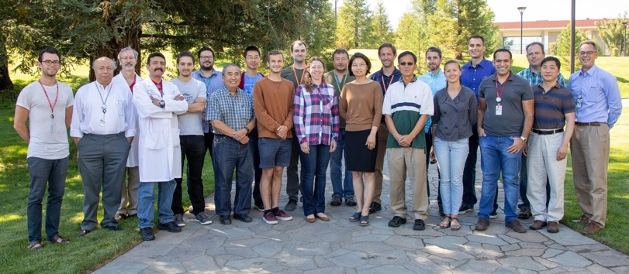
Acknowledgements
SLAC
LANL
Radiabeam
Supported by:
Muhammad Shumail
Xueying Lu
Greg Le Sage
Mitchell Schneider
Emma Snively
Sami Tantawi
Valery Dolgashev
Zenghai Li
Dennis Palmer
Garrett Mathesen
Charlotte Wehner
Julian Merrick
Bradley Shirley
Mamdouh Nasr
Ankur Dhar
Evgenya Simakov
Muhammed Zuboraj
Ryan Fleming
Dmitry Gorelov
Mark Middendorf
Ronald Agustsson
Robert Berry
Amirari Diego
Alex Murokh
RF Accelerator Technology Team

Slide 3
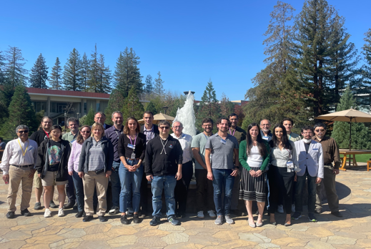
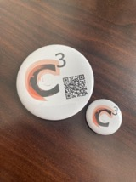
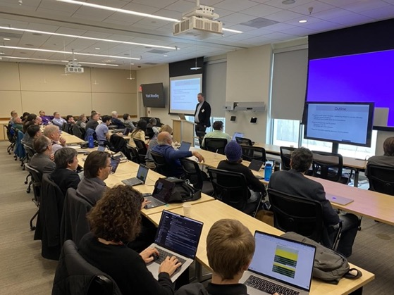
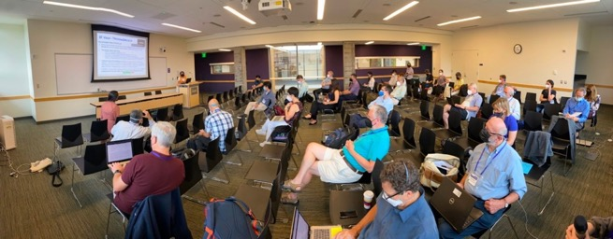
Acknowledgements – C³ Enthusiasts
Community Events
https://sites.google.com/view/ec4c3
Fermilab, SLAC, LANL, Cornell & Snowmass Session in Seattle
Next Meeting LCWS 2024:
https://agenda.linearcollider.org/event/10134/overview
2023 PRX Energy 2, 04700 - Sustainability Strategy for the Cool Copper Collider
2023 JINST 18 P09040 - R&Datus and future plans for C ³ R&D
2023 JINST 18 P07053 - A "Cool" route to the Higgs boson and beyond. The Cool Copper Collider
2307.07981 - The alignment of the C3 Accelerator Structures with the Rasnik alignment system
More Details Here (Follow, Collaborate):
https://web.slac.stanford.edu/c3/
AccelApp'24

Slide 4
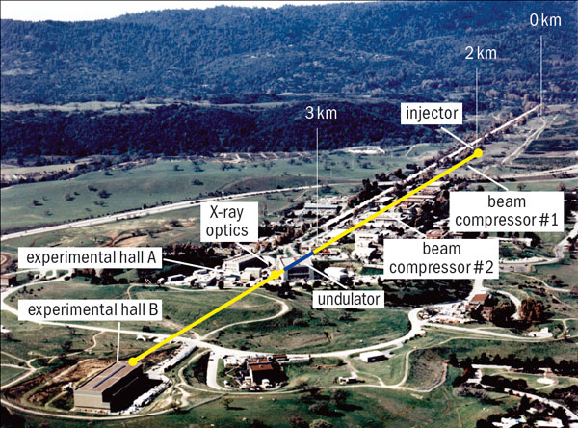
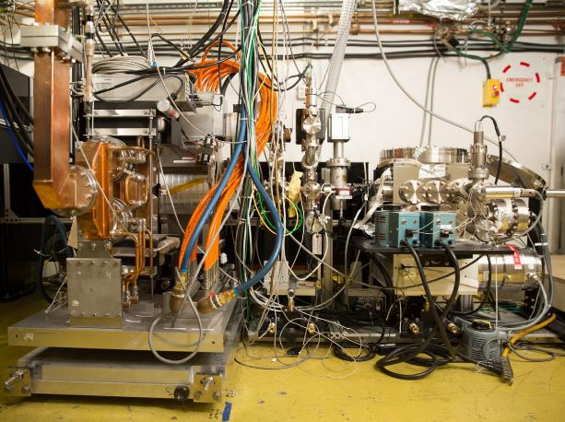
Accelerator Technology Drives Scientific Discovery
Coherent X-rays from LCLS (2009)
Ultrafast Electron Diffraction (2015)
How do we develop the next generation of accelerators and what new science does this enable?
AccelApp’24

Slide 5
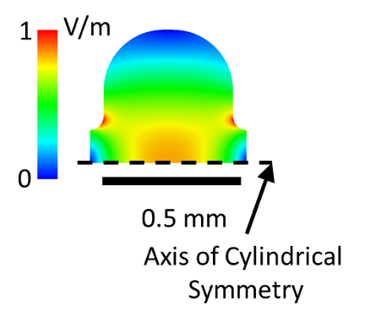
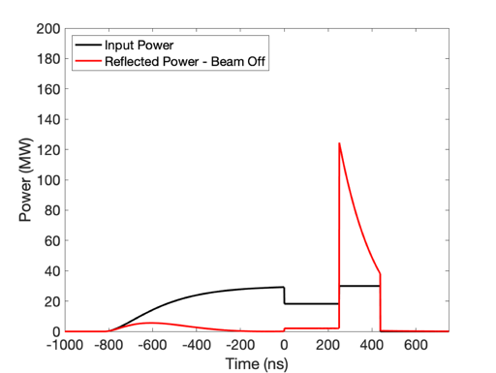
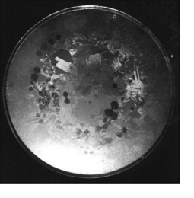
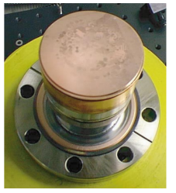
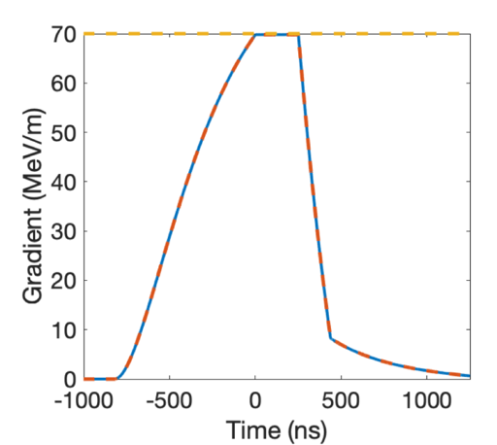
Limits of High Gradient Performance – Power and Heat
Parameters for 100 MeV/m Gradient
Over-Coupled Designs for Fast Fill and High Beam Loading
Frequency | 3 GHz
Stored Energy [mJ] | 8450
Temp [K] | 300 | 77
Q-value [x1000] | 18 | 50
Shunt Impedance [MOhm/m] | 55 | 150
Max. Mag. Field [MA/m] | 0.3
Max. Electric Field [MV/m] | 210
Loss in 1 meter [MW] | 181 | 67
C-Band 1 m Struc.
5 cm
Damage from RF Induced Heating
AccelApp'24
Pritzkau, et al., Phys. Rev. STAB 2002
Laurent, et al. PRSTAB 14.4 (2011): 041001

Slide 6
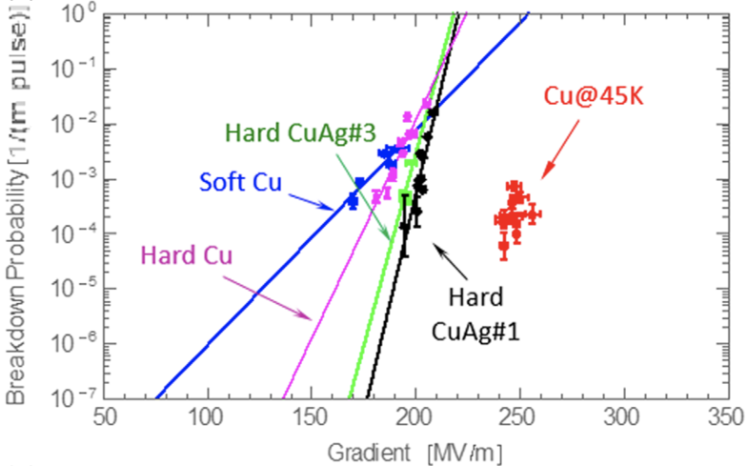
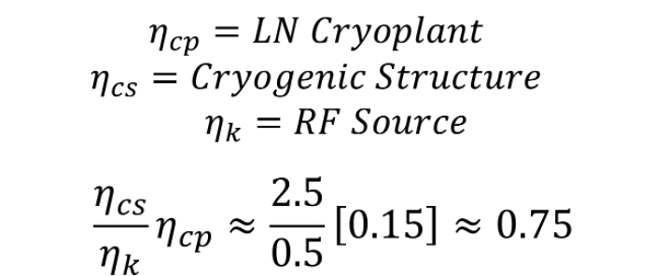
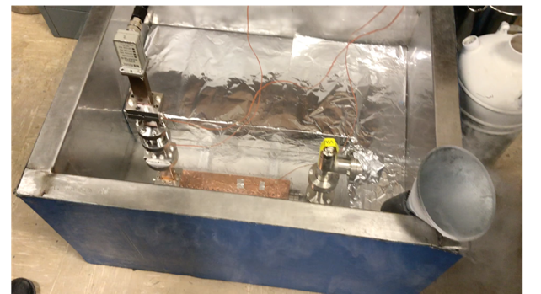
Cryo-Copper: Enabling Efficient High-Gradient Operation
Cryogenic temperature elevates performance in gradient
Material strength is key factor
Impact of high fields for a high brightness injector may eliminate need for one damping ring
Operation at 77 K with liquid nitrogen is simple and practical
Large-scale production, large heat capacity, simple handling
Small impact on electrical efficiency
Cryogenic temperature elevates performance in gradient
Increased material strength is key factor
Increase electrical conductivity reduces pulsed heating in the material
Cahill, A. D., et al. PRAB 21.10 (2018): 102002.
AccelApp'24

Slide 7
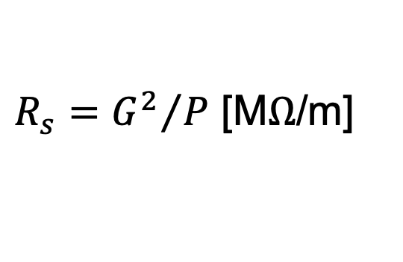
Breakthrough in the Performance of RF Accelerators
RF power coupled to each cell – no on-axis coupling
Full system design requires modern virtual prototyping
Electric field magnitude produced when RF manifold feeds alternating cells equally
Optimization of cell for efficiency (shunt impedance)
Control peak surface electric and magnetic fields
Key to high gradient operation
AccelApp'24
Tantawi, Sami, et al. PRAB 23.9 (2020): 092001.

Slide 8
Cold-Copper High Gradient Testing

Slide 9
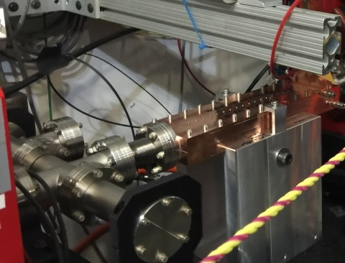
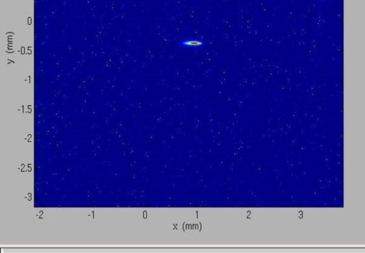
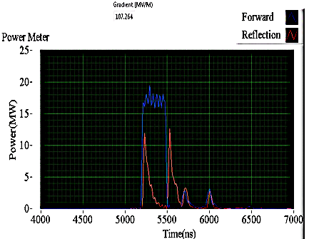
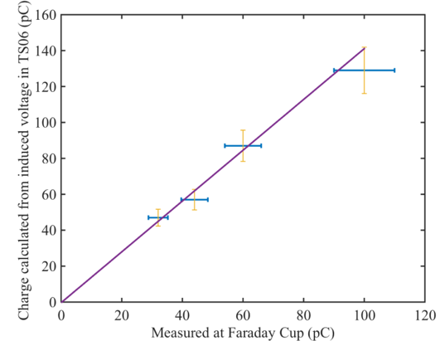
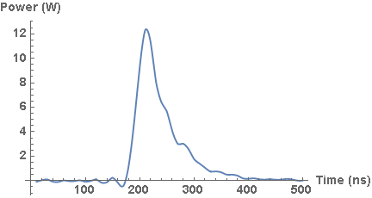
Split Structure Accelerator Topology Accelerates Beam and Operates at High Gradient at X-band
Forward and Reflected Power
Beam Energy
85.6MeV
87.5MeV
89.4MeV
26 cm structure installed at XTA
Confirmation of gradient by measuring 24 MeV energy gain
Operating with ~100 MeV/m gradient with 16.5 MW of input power and 300 ns pulse length
Wakefield measurement matches expected RF structures performance
Structure processed to 160 MeV/m
Power in Wakefield
Measured Charge with Faraday Cup and Calculated from Induced Wakefield
AccelApp'24
Tantawi, et al. PRAB 23.9 (2020): 092001.

Slide 10
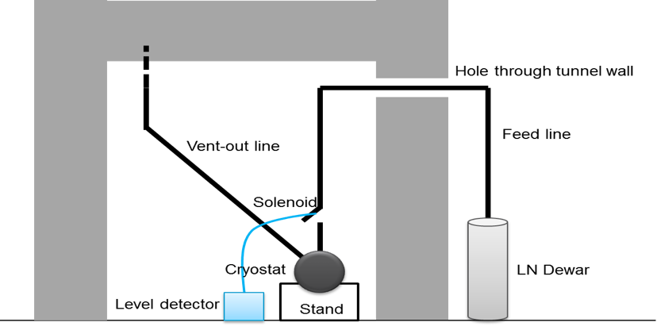
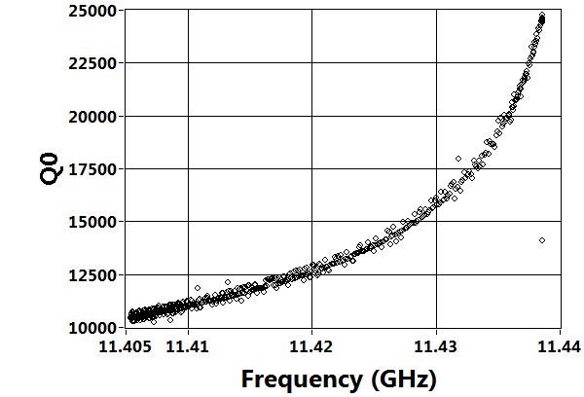
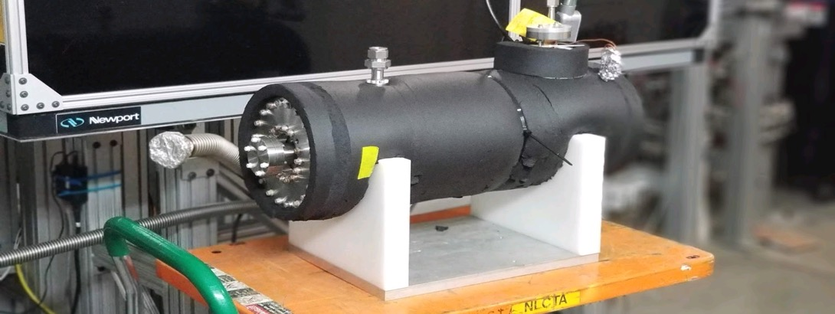
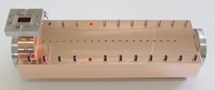
Cryogenic-Copper Accelerating Structures: New Frontier for Beam Brightness, Efficiency and Cost-Capability
Increased conductivity and hardness enables higher gradients
Dramatic reduction in cost of system including cryogenics at 77K
2.5X less power establishing gradient allows for heavy beam loading even at high gradient – improving system efficiency
T decrease
Cryostat w/ Structure
Increase in $Q_{0}$ by a factor of 2.5
AccelApp'24
Bane et al., ArXiv 1807.10195 (2018)

Slide 11
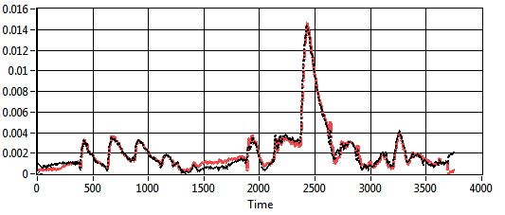
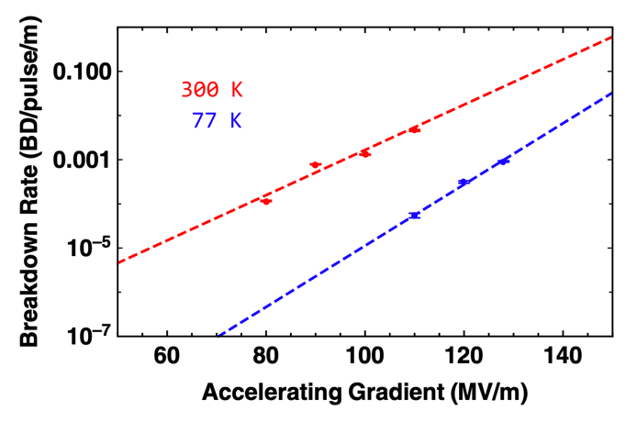
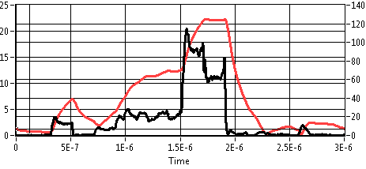
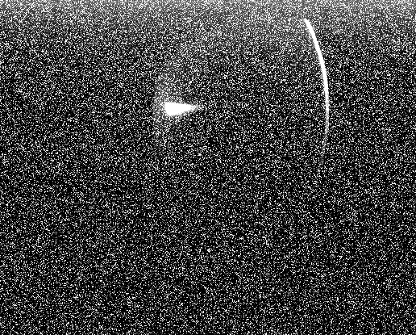
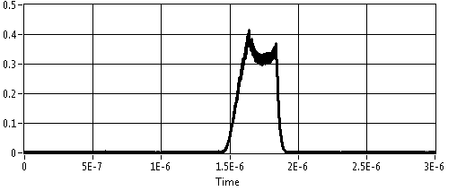
Cryogenic X-band Structure in High Power Test to Confirm RF Performance and Measure Breakdown Statistics
Reflected RF Power Matched Molded Cavity Performance
Best fit parameters
$$\frac{1−β}{1+β}=−0.3472 \\ Q_{tot}=6788.32$$
Expected parameters
$$\frac{1−β}{1+β}=−0.4286 \\ Q_{tot}=7142$$
40X Improvement in Breakdown Rate
Modeled Structure Gradient Confirmed with Dark Current
120 MV/m
Forward Power (MW)
Gradient (MV/m)
Dark current
Energy Gain=28MeV
Gradient=107MV/m
Arbitrary Units
AccelApp'24
Nasr, et al. PRAB 24.9 (2021): 093201.

Slide 12
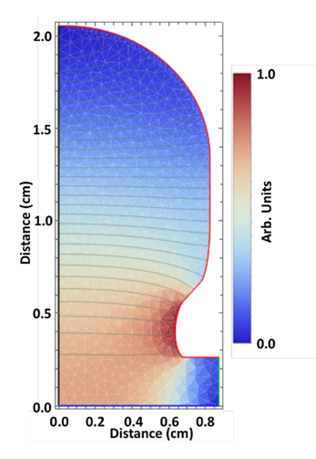
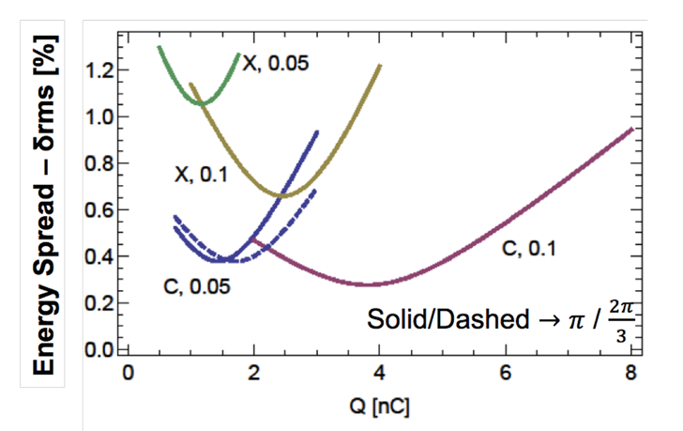
What’s the Optimal Frequency for High Charge Beams?
Linear collider: high beam power
$→$ 1 nC per bunch, 0.3 A during rf pulse
$→$ Most challenging design parameters
Pursue broad array of applications
$→$ Medical, x-ray sources, gamma-ray sources,….
1 nC, 150 micron, 25 deg.
arXiv:1807.10195 (2018)
C3 2024

Slide 13
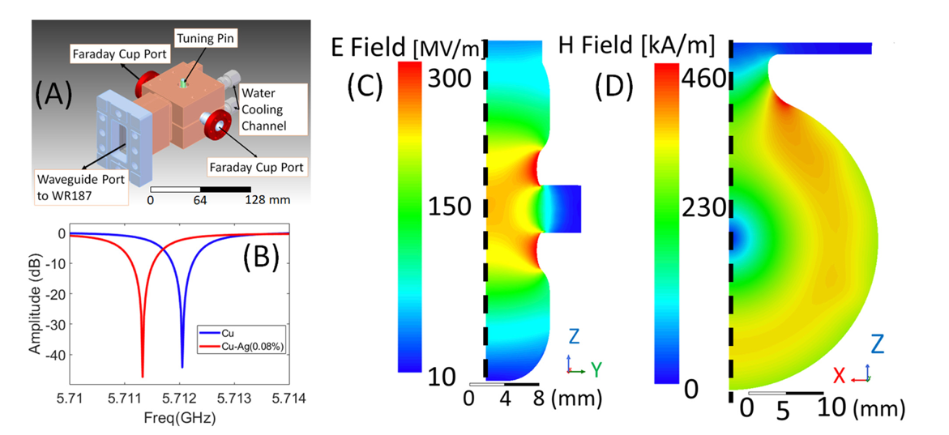
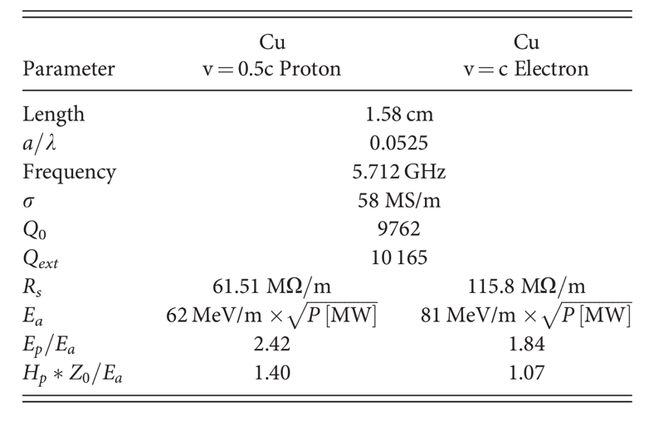
Scaled Design of Low-Beta or Reduced Phase Adv. Struc.
Original design was for low-beta protons – efficient with relativistic electrons and appropriate cell to cell phase advance
RF power coupled to each cell can lead to a local hot spot in H-field
Tailoring coupler profile limits enhancement to 15-20% (vs. 230%)
Schneider, Mitchell, et al. "High gradient off-axis coupled C-band Cu and CuAg accelerating structures." Applied Physics Letters 121.25 (2022).
AccelApp'24

Slide 14
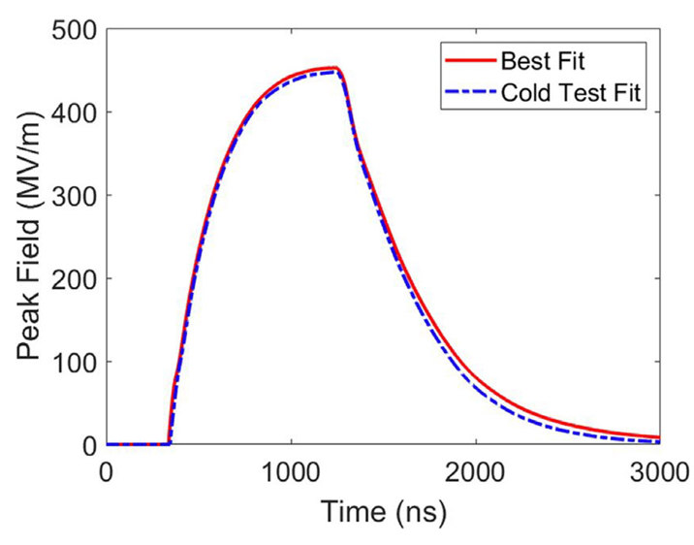
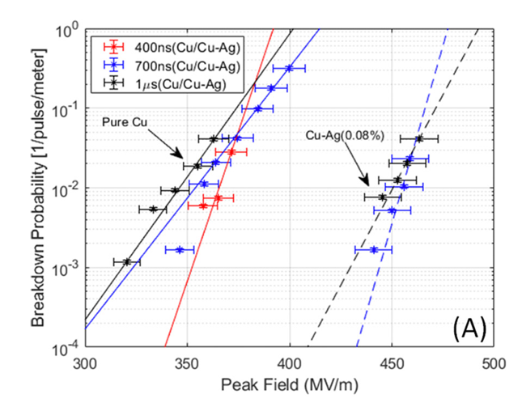
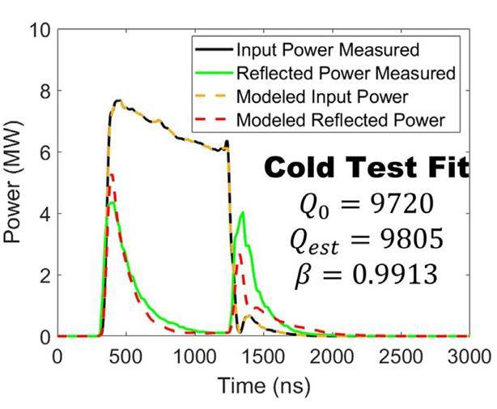
High Gradient Performance of Cu and CuAg Cavities
Utilized C-band test stand at LANL
Each structure processed for O(100M) pulses
How does this behavior extend to cryogenic temperatures?
AccelApp'24

Slide 15
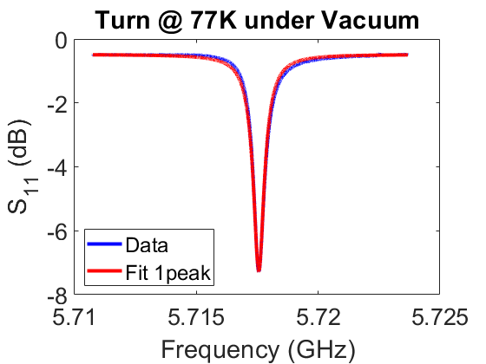
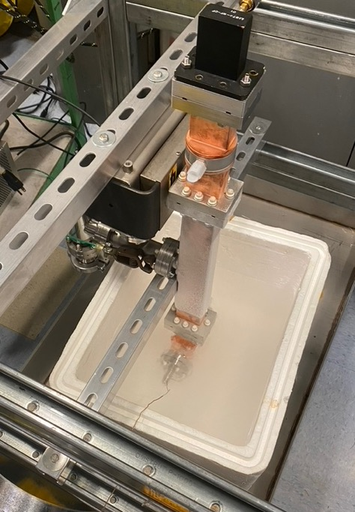
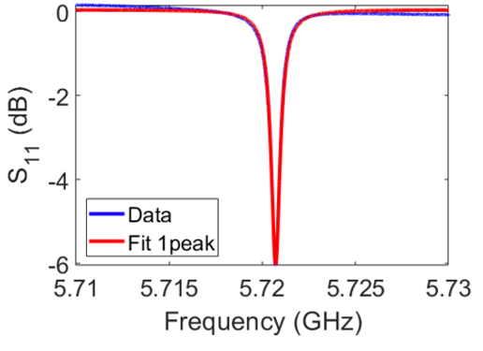
Characterization at 77K
Improvement of 2.5 X for Cu and 2.9X for CuAg(!)
2.9 is consistent of Cu sample measurements at UCLA (may be material batch specific)
Parameter​ | CuAg​ | Cu​
Temp​ | 77K​
Frequency​ | 5.71455 GHz​
Length | 1.58 cm​
$$β$$ | 2.97​ | 2.683​
Q_{0​} | 29,695​ | 25,697​
Rs​ ($MΩ/m$) | 352 | 305 ​
Ea MeV/m/$\sqrt{MW}$​ | 141 | 131
Cu
Preliminary
CuAg
AccelApp'24

Slide 16
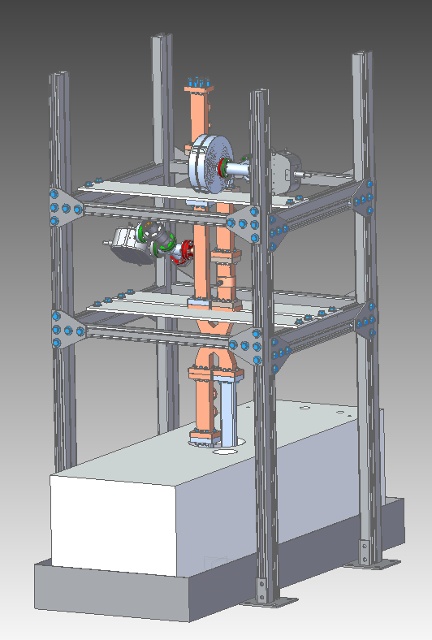
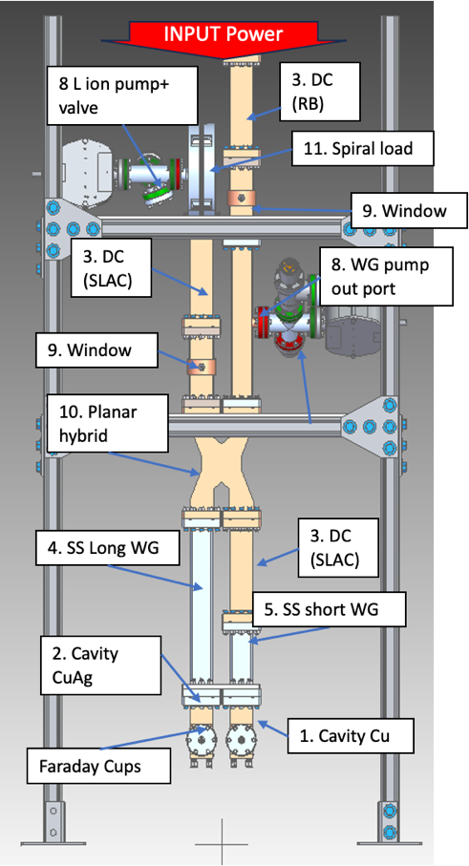
Two Cell Assembly for High Power Test
AccelApp'24

Slide 17
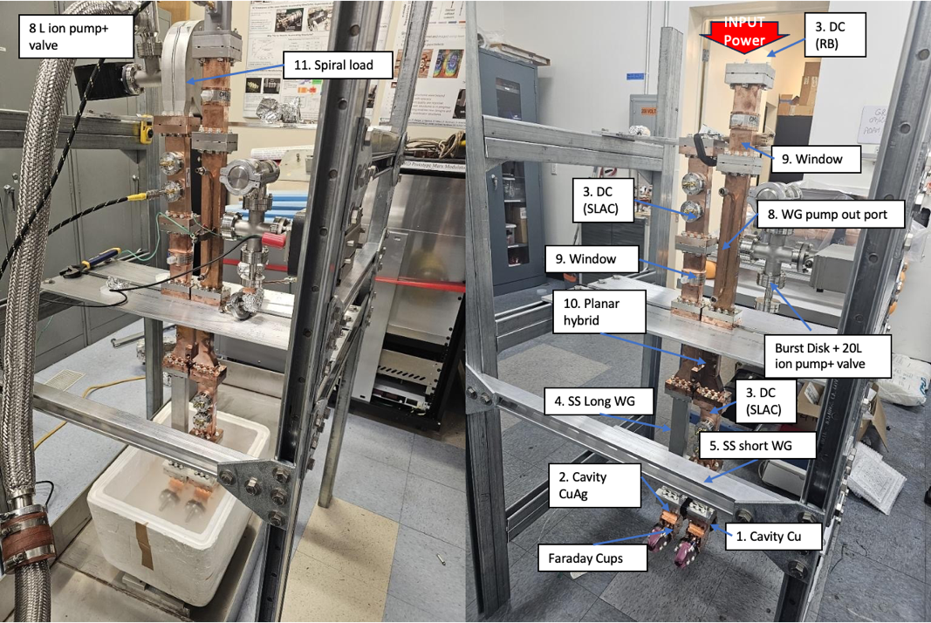
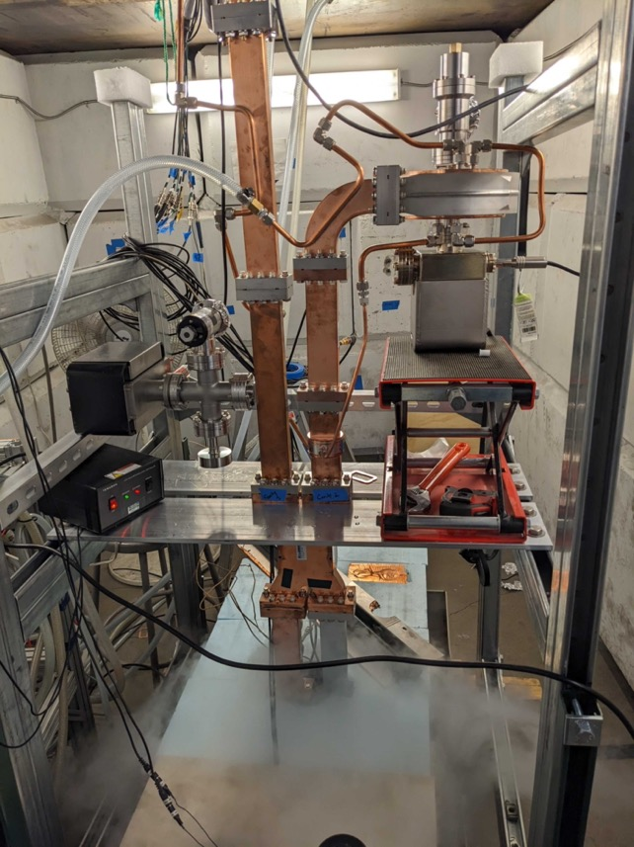
Two Cell Assembly for High Power Test
SLAC
Radiabeam
AccelApp'24

Slide 18
Typical High Gradient Performance
Measured and modeled response for CuAg Cavity
C³ - 550
C³ - 250
AccelApp'24

Slide 19
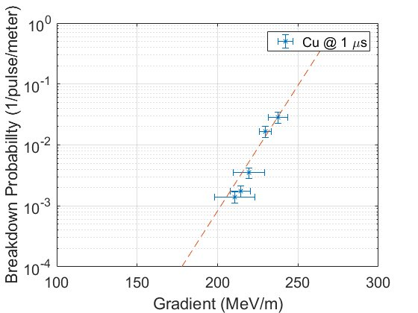
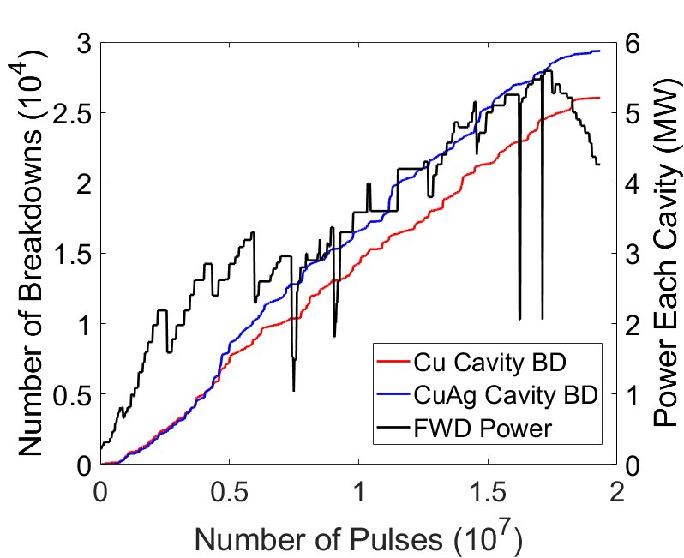
Structure Processing
~20M Pulses (two weeks)
Increased pulse length – 400 ns, 700 ns, 1 microsecond
Preliminary
C3 2024
A. Diego, M. Schneider, M. Boyce and A. Dhar

Slide 20
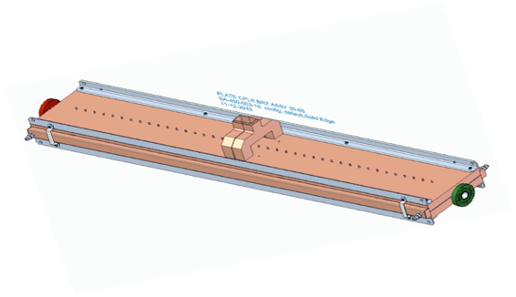
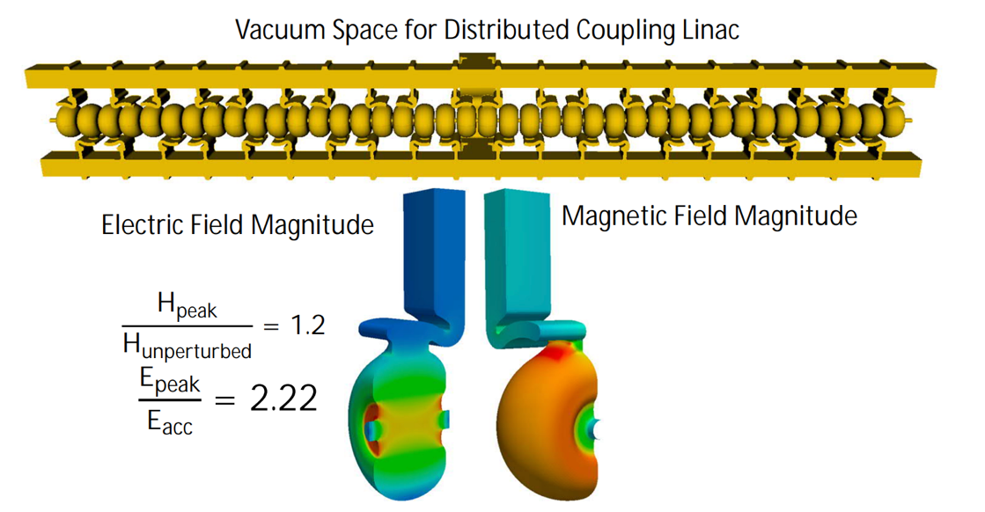
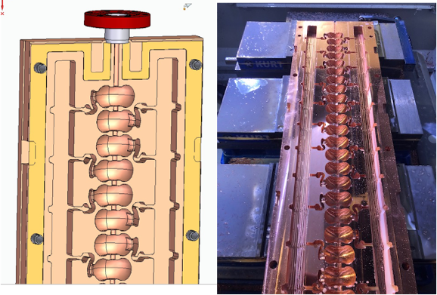
40 Cell Pi-Mode Distributed Coupling Structure
Incorporate the two key technical advances: Distributed Coupling and Cryo-Copper RF
Main linac utilizes meter-scale accelerating structures, technology demonstration underway
Implement optimized rf cavity designs to control peak surface fields
Scaling fabrication techniques in length and including controlled gap
AccelApp'24

Slide 21
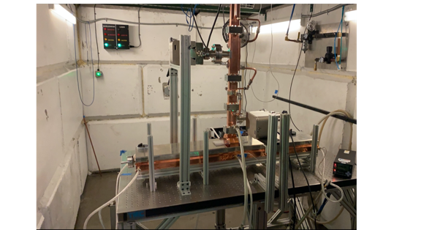
High Power Test of Meter-Scale Distributed Coupling Structure
Tested at Radiabeam
Up to 15 MW, 1 microsecond delivered to structure, no measurable breakdowns after reaching max power
Structure Destroyed in Tuning Attempt for Cryogenic Operation
Structure for Cryogenic Operation in Production
AccelApp'24

Slide 22
Outlook

Slide 23
C3 Cool Copper Collider
C³ Prototype One Meter Structure
C³ is based on a new rf technology
Dramatically improving efficiency and breakdown rate
Distributed power to each cavity from a common RF manifold
Operation at cryogenic temperatures (LN₂ ~80-K)
Robust operations at high gradient: 120 MeV/m
Scalable to multi-TeV operation
Cryogenic Operation at X-band
High Gradient Operation at 150 MV/m
High power Test at Radiabeam
Snowmass
Nasr, et al., PRAB 24.9 (2021): 093201.

Slide 24
Accelerator Complex
8 km footprint for 250/550 GeV CoM ⟹ 70/120 MeV/m
Large portions of accelerator complex compatible between LC technologies
Beam delivery / IP modified from ILC (1.5 km for 550 GeV CoM), compatible w/ ILC-like detector
Damping rings and injectors to be optimized with CLIC as baseline
C³ Main Linac Cryomodule
9 m (600 MeV/ 1 GeV)
C³ Parameters
C³ - 8 km Footprint for 250/550 GeV (to scale)
Snowmass

Slide 25
The Complete C³ Demonstrator
Demonstrate fully engineered cryomodule
~50 m scale facility
3 GeV energy reach
Answer technical questions needed for CDR
AccelApp'24

Slide 26
Power Consumption and Sustainability
Compact footprint <8 km for both underground and surface sites
Underground – less constraints on energy upgrade
Surface – lower cost and faster to first physics
Sustainability - construction + operations CO₂ emissions per % sensitivity on couplings
Polarization and high energy to improve sensitivity
Construction CO₂ emissions → minimize excavation and concrete
Operations → limit power, decarbonization of the grid and dedicated renewable sources
250 GeV CoM - Luminosity - 1.3x10³⁴
Parameter | Units | Value
Reliquification Plant Cost | M$/MW | 18
Single Beam Power (125 GeV linac) | MW | 2
Total Beam Power | MW | 4
Total RF Power | MW | 18
Heat Load at Cryogenic Temperature | MW | 9
Electrical Power for RF | MW | 40
Cryoplant Electrical Power | MW | 60
Accelerator Complex Power | MW | ~50
Site Power | MW | ~150
Surface-Site Mockup
Precision-Weighted Carbon Footprint
Accepted PRX Energy, https://arxiv.org/abs/2307.04084
Notes:
Sustainability lcws talk and paper

Slide 27
Synergies with Future Colliders
RF Accelerator Technology Essential for All Near-Term Collider Concepts
C³ Demo is positioned to contribute synergistically or directly to all near-term collider concepts
CLIC - components, damping, fabrication techniques
ILC - options for electron driven positron source based C³ technology
Muon Collider - high gradient cryogenic copper cavities in cooling channel, alternative linac for acceleration after cooling
AAC - C³ Demo utilized for staging, C³ facility multi-TeV energy upgrade reutilizing tunnel, 𝛾𝛾 colliders
FCC-ee - common electron and positron injector linac from 6 to 20 GeV
reduce length 3.5X OR reduce rf power 3.5X
90% seeds < 8 um-rad with lattice errors
Planned test at Argonne
Tracking with Lucretia includes longitudinal and transverse wakes, chromatic effects etc
Error study is 100 seeds, 100 μm element offsets, 300 μrad element rolls (rms)
No corrections applied
Vibrant International Community for Future Colliders is Essential
AccelApp'24

Slide 28
Cornell
AccelApp'24

Slide 29
UCLA
AccelApp'24
Rosenzweig et al., https://www.mdpi.com/2410-390X/8/1/19

Slide 30
Conclusions
Cold-copper’s achievable gradient, breakdown rate and pulse length at C-band have transformative potential
How do we incorporate damping?
How improve manufacturing of structures?
How do meter scale structures perform?
What is the optimal aperture and phase advance?
How do we support and align structures in cryogenic environment?
Wide-Aperture Reduced Phase Adv.
Damped Cavities
M. Shumail
Cryogenic Pi-Mode
H. Xu + LANL
S-Band
Large Aperture
A. Dhar
AccelApp'24

Slide 31
Questions?

Slide 32
Optimized RF Feed for Distributed Coupling Structure
RF power coupled to each cell can lead to a local hot spot in H-field
Tailoring coupler profile limits enhancement to 15-20% (vs. 230%)
Built and tested on an S-band structure
Lu, et al., Review of Scientific Instruments 92.2 (2021).
C3 2024

Slide 33
Ongoing Technological Development
Modern Manufacturing
Prototype One Meter Structure
Preliminary Alignment and Positioning
High Accelerating Gradients
Cryogenic Operation
Integrated Damping with NiChrome Coating
C³ Main Linac Cryomodule
9 m (600 MeV/ 1 GeV)
C3 2024

Slide 34
Implementation of Slot Damping
Kick Factor * Q
Need to extend to 40 GHz / Optimize coupling / Modes below 10⁴ V/pC/mm/m
NiCr coated damping slots in development
Kick Factor
Vacuum Space Model
Tapered Slot
Two Cell Prototype
H. Xu, NCRF W 17th May 13:30
NiCr Tested at 80K
ILC Update

Slide 35
Additively Manufactured Spiral Load
Tested at Radiabeam
3D printed in stainless steel (inspired by CERN)
First version is only air cooled
Tested to 8 MW, 20Hz, 700ns
Water Cooled Design for V2 (now in use)
AccelApp'24

Slide 36
Structure Processing
~10M Pulses to Date
Operating with human supervision
Max Power End of Day
Cavities: Max 3.37 MW into Cu Cavity
Pulse Width: 700 ns
Rep Rate: 80 Hz
Freq: 5714.3 MHz
Preliminary
AccelApp'24

Slide 37
What’s Next for the Energy Frontier?
Physics goals beyond HL-LHC:
1. Establish Yukawa couplings to light flavor ⟹ precision & lumi
2. Search for invisible/exotic decays and new Higgs ⟹ precision & lumi
3. Establish self-coupling ⟹ > 500 GeV e+e- operations
The Energy Frontier 2021 Snowmass Report
AccelApp'24

Slide 38
Linear vs. Circular
Linear e⁺e⁻ colliders: ILC, C³, CLIC
Reach higher energies (~TeV), and can use polarized beams
Relatively low radiation
Collisions in bunch trains
Circular e⁺e⁻ colliders: FCC-ee, CEPC
Highest luminosity collider at Z/WW/ZH
limited by synchrotron radiation above 350 – 400 GeV
Beam continues to circulate after collision
AccelApp'24

Slide 39
Alignment and Vibrations
Two-Phase Fluid Simulations
System level optimization essential for achieving performance
RF Structure Optimization
Vibration Measurements and Analysis
3.55 mm iris radius
2.0=E_{max}/E_{acc}
1.23=H_{coup}/H_{wall}
K. Shoele
Electric Field
Precision Short and Long Range Alignment
Magnetic Field
Z. George, V. Borzenets, A. Dhar, D. Palmer
H. Van Der Graaf
M. Shumail, Z. Li
Main Linac Beam Dynamics
Alignment Parameters | Units | Value
Raft Components | μm | 5
Short Range (~10m) | μm | 30
Long Range (>200m) | μm | 1000
Structure Vert. Vibration | μm | 9
Quad Vert. Vibration | nm | 15
BPM Resolution | μm | 0.1
BPM-Quad Alignment | μm | 2
100 nm resolution
Approved effort to test cold
White (C³), Schulte (CLIC)
https://arxiv.org/pdf/2307.07981.pdf
AccelApp'24

Slide 40
Table of Parameters
AccelApp'24

Slide 41
Full Parameters
AccelApp'24

Slide 42
Further Cavity Optimization Possible
Single side coupling iris induces dipole and quad fields
Coupling hole symmetrization and racetrack shape incorporated to minimize dipole and quad fields
dipole, quad calculated at 50MV/m
Dipole
Quad
✅
w/o symmetrization
Dipole
Quad
V1-simple-stub
(not ideal cancellation)
V2-symm-stub
(good cancellation)
AccelApp'24
with symmetrization 100X reduction
Zenghai Li

Slide 43
Distributed Coupling Structures Provide Natural Path to Implement Detuning and Damping of Higher Order Modes
Individual cell feeds necessitate adoption of split-block assembly
Perturbation due to joint does not couple to accelerating mode
Exploring gaps in quadrature to damp higher order mode
Detuned Cavity Designs
Quadrant Structure
AccelApp'24

