Slide 1
Compact, Energy Efficient Neutron Source: Enabling Technology for Thorium Breeder and Accelerator Waste Transmutation
Ady Hershcovitch, William Horak, Brant Johnson, Michael Todosow, Thomas Roser, Brookhaven National Laboratory
and
Michael Driscoll, Massachusetts Institute of Technology

Slide 2
Compact, Versatile, Energy Efficient Neutron Source: Enabling Technology for Accelerator Transmutation of Waste and Uranium Free Thorium Breeder Reactor
In this novel neutron source, a deuterium beam (energy of about 100 keV) is to be injected through a Plasma Window into a tube filled with tritium gas or tritium plasma to generate D-T fusion reactions whose products are 14.06 MeV neutrons and 3.52 MeV alpha particles. At the opposite end of the tube, the energy of deuterium ions that did not interact is recovered. Energy recovery can be close to 100%. Beryllium walls of proper thickness will absorb 14 MeV neutrons and release 2 – 3 low energy neutrons. Each ion source and tube forms a module. Larger systems can be formed from multiple units. Beam propagation can be further enhanced with vortex stabilized discharges, electron beams in opposite direction (with energy recovery) or magnetic fields where possible. Beam attenuation by electrons results in their heating, which in turn reduces ion beam attenuation. Equilibrium electron temperature exceeding 200 eV can be achieved, resulting in energy efficient neutron generation. Concept description and basic calculation will be presented. Among possible applications for this neutron source concept are sub-critical nuclear breeder reactors and accelerator transmutation of radioactive waste. Advantage over spallation sources DC versus RF acceleration. Possibility of energy recovery! Very inexpensive proof of principle test.

Slide 3
Basic idea is to have125 keV deuterium slowing down to 75 keV, before energy recovery, since the fusion cross section σ, which is well known, has a broad peak of 6 barns in the energy range of about 75-125 keV.

Slide 4
Advantages
Energy Efficient (much more than spallation neutron sources)
Compact
Modular; multi-embodiments possible
Neutron injected isotropically
Flexible: works horizontal & Vertical
Inexpensive and easy to test
Low cost to implement
Wide neutron energy spectrum possible

Slide 5
Novel Features
Energy Recovery
Vortex Stabilized Discharges (or HCA) for ion beam propagation.
Self-heating warm electrons for reducing ion energy loss.
Possible use of e-beams with energy recovery for enhanced ion beam propagation.
Possible use of e-beams with energy recovery for pure tritium plasma.
Neutron multiplication walls (spallation by 3.52 MeV alphas)
Dense internal targets to enhance neutron yield.

Slide 6
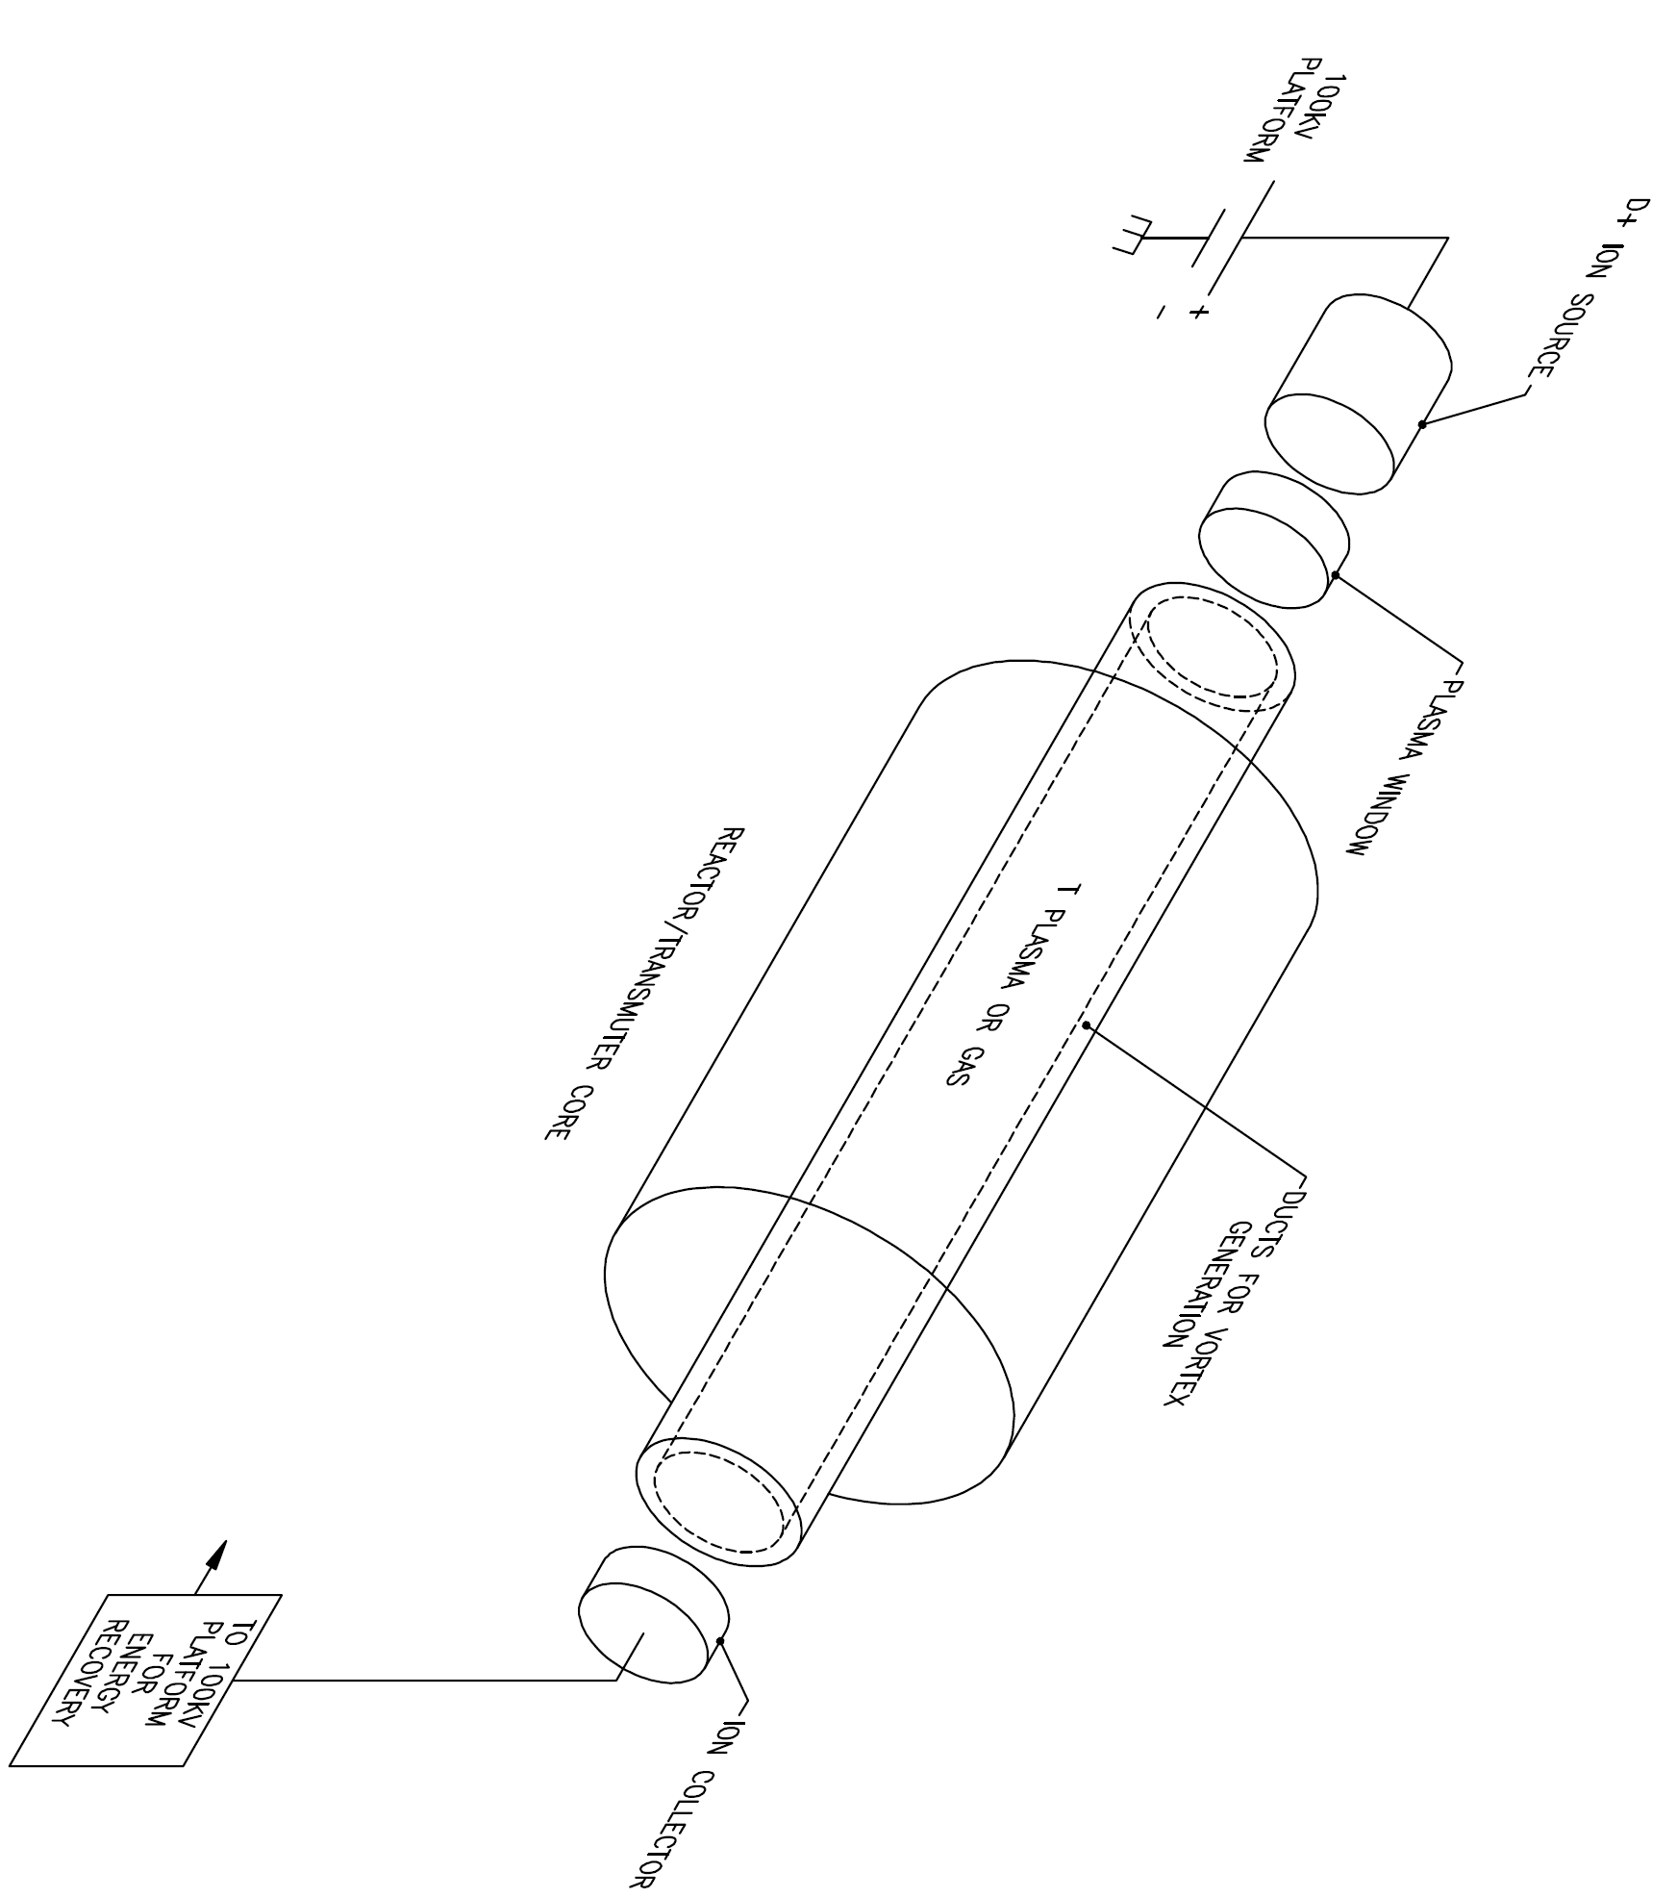
Embodiments

Slide 7
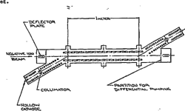
Experimentally Achieved Plasma Targets
25 cm long target
1-meter long steady state [many hours 3 shifts] hydrogen target generated: plasma density 10¹⁴ cm⁻³ with background density of 10⁻⁶ Torr (set on MP6 BNL Van de Graff beamline)

Slide 8
Preliminary computations of 3 scenarios
Basic concept comprises of a DC deuterium beam (energy of about 100 keV) injected through a Plasma Window into a tritium gas or tritium plasma filled tube to generate D-T fusion reactions: 14.06 MeV neutrons and 3.52 MeV alpha particles.
D-T fusion power P_{f} = I_{d} (1- exp {-[n_{t}σx]}) Q, where σ is the D-T fusion cross section, I_{d} = I_{d}/1.6x10⁻¹⁹ (i.e. particle current), x is the interaction length and energy generated per reaction Q = 17.58 MeV/fusion reaction. Without Q this equation yields neutrons/sec. Next formalism for computing number of neutrons generated per deuterium beam power is shown for various target scenarios. Computations are the ratio of the above equation and beam power loss (un-recovered power). The unrecovered power is computed from ion slowing down. For all cases we consider 1 A of 125 keV deuterium slowing down to 75 keV, before energy recovery. The fusion cross section σ, which is well known, has a broad peak of 6 barns in the energy range of about 75-125 keV. For energy loss estimation, ion energy of 100 keV, which the average, is considered.
Deuterium Beam in Tritium Gas
Energy loss can be computed from CSDA (continuous-slowing-down approximation). The NIST website http://physics.nist.gov/PhysRefData/Star/Text/ But, this CSDA range is smaller than the fusion interaction length for the following reasons: first, the CSDA is a penetration length. At energies below 6 GeV, particle attenuation process is dominated by multiple small angle scattering. Thus, a particle travels a path, which is larger than the range (and hence the fusion interaction length) due to this random walk process. Second, intense particle beams have substantially longer ranges than single particles of the same energy due to various collective effects. For example, 100 keV electrons have a CSDA range in dry air of 1.6x10⁻² g/cm², and dry air density near sea level is 1.2 x10⁻³ g/cm³, therefore, the CSDA range for a single electron is 13 cm. Nevertheless, electrons from 100 keV electron beam of only a few mA, which enter atmosphere, can be observed well over a meter down stream.
In T gas target reducing 1 A D⁺ beam from 125 to 75 keV (recovering 75 kW; generating 11.5 kW in fusion), yields 4x10¹⁵ neutrons/sec @ 1x10¹¹ neutrons/sec/Watt
Using basic principles the gas scenario computation results can duplicated. The total power lost due to the interaction of the deuterons with the electrons of the tritium gas, either by ionization or scattering, is given by the stopping power dE/dx of deuteron in hydrogen times the number of electrons per cm³: P_{loss} = I_{d} (1- exp {-[dE/dx n_{e} x]}) Q ≈ I_{d} dE/dx n_{e} x. The ratio of fusion power to the lost power is then: P_{f}/P_{loss} = (Q n_{t} σ) / (dE/dx n_{e}) Or for a neutral tritium gas where n_{t} = n_{e} P_{f}/P_{loss} = (Q σ) / (dE/dx). For an average deuteron energy of 100 keV we have: Q ≈ 17.6 MeV, σ ≈ 6 x 10⁻²⁴ cm², and dE/dx ≈ 4.5 x 10⁻²¹ MeV cm² and then P_{f}/P_{loss} = 0.023. This simple single particle calculation gives a rather low efficiency of 2.3 %. Similarly the neutron flux per lost beam power is: dn/dt/P_{loss} = n/ΔE = σ / (dE/dx) = 0.0013 MeV⁻¹ = 0.8 x 10¹⁰ neutrons/sec/WattNote that the interaction with the electrons can be substantially suppressed as discussed below. For example, the propagation of 100 keV electrons in air was shown to be about 10 times more than expected from the stopping power. A similarly reduced effective stopping power for 100 keV deuteron in tritium gas would increase the efficiency to 23% and the neutron flux would increase to 0.013 MeV⁻¹ or 0.8 x 10¹¹ neutrons/sec/Watt.

Slide 9
Other Possible Scenarios
Deuterium Beam in Cold Electron Tritium Plasma
Computing deuterium ion slowing down in plasma can performed using the test particle model, which was originated by Norman Rostoker. Next a case of deuterium ions in 100% ionized plasma like from a hollow cathode arc with a temperature of about 10 – 15 eV, and densities exceeding 1x10¹⁴ cm⁻³. Electron thermal velocity and ion beam velocity are given by & respectively, where µ is ion mass expressed in units of proton mass T and E are in eV. Ion slowing down by electrons rate ν^{i/e} is defined as Hence
When parallel and perpendicular diffusion in velocity space can be neglected, which is the correct assumption for all the cases to be considered, the resultant energy loss is solely due to beam velocity reduction. At this level of computations, we can approximate that E_{i} is roughly constant at 100 keV. For ions faster than thermal electrons ν^{i/e} (in sec⁻¹) is given by
where n is density in cm⁻³, λ is Coulomb logarithm, which in this case is about 10 (from the NRL formulary), and Z is ion charge state. Unless otherwise noted all other units are cgs, E and T are in eV.
Without considering plasma heating (by the D⁺ beam) the yield is1.5x10⁹ neutrons/second/Watt of beam power loss. Even with anomalous propagation, it is still worse than the gas case For plasma density of 3x10¹⁴ cm⁻³ ν^{i/e} is 2.28x10⁴ sec⁻¹. But ν^{e/i} is 5.5x10⁴ sec⁻¹ for 15 eV electrons, and it decreases as T_{e} increases. Basically elaborate calculations must be done to determine equilibrium electron temperature. Significant plasma heating (especially electron heating) occurs, if energy loss is due to bremsstrahlung and classical/empirical energy loss 31 eV/meter (but not Bohm 42kW/m!), since energy deposition from deuterium is 752.4 eV/meter.
Deuterium Beam in Hot Electron Tritium Plasma
Finally the case where the deuterium ions have velocity lower than the electron thermal velocity is explored. Ion velocity of 3x10⁸ cm/sec is matched by electrons whose thermal energy is 54 eV, thus requiring an electron temperature larger than 55 eV. A possible scenario is to start with low density HCA, heat electrons with ECRH, and build up density (at this temperature). Under these conditions, significant plasma heating (especially electron heating) occurs, if energy loss is indeed due to bremsstrahlung and classical/empirical energy loss (but not Bohm!), since energy deposition from deuterium will be higher. When ions are slower than thermal electrons, ν^{i/e} (in sec⁻¹) is given by Equilibrium temperature computation that involves transition from V_{D} > V_{the} to V_{D} < V_{the} is extremely difficult to compute analytically, since. the analytical formulas are for asymptotic cases, and since heated cold electrons also heat tritium ions rapidly. So it is assumed that electron temperature is above 60 eV. Consider plasma density of 3x10¹⁴ cm⁻³ (1-inch diameter) and 1 A ion beam, bremsstrahlung power loss is Watt/cm⁻³ or. Watt/meter of tritium target length
semi-empirical expression for power loss of plasma neutralizer target confined in D-shaped solenoid due to diffusion is 3.355x10⁵xT^{1/2}/B² Watt/meter (T in eV, B in G). Expressions include a factor of (1+π/2) to account for plasma around a core. Thus equilibrium temperature can be computed from
Which for 1 kG, T_{e} = 268 eV, no chance to reach “breakeven” conditions even if the magnetic field is raised to 3.5 kG (electron temperature will reach only 315 eV).

Slide 10
Summary of Computations
Deuterium Beam in Tritium Gas
Without anomalous propagation, can obtain up to 1.1x10¹⁰ neutrons/sec/Watt of beam power lost. With enhanced propagation, can obtain 1.0x10¹¹ neutrons/sec/Watt of beam power lost.
Deuterium Beam in “Cold” Electron Tritium Plasma
Here D ions are slower than thermal electrons of 10 – 15 eV, in this case one can obtain 1.5x10⁹ neutrons/sec/Watt of beam power lost.
In the above computations, relatively high tritium plasma and/or gas densities are possible. Density is to be determined by tube (interaction) length (until D beam is slowed down to 75 keV. In this case up to 10¹⁶ neutrons/sec/tube is possible.
Deuterium Beam in Warm Electron Tritium Plasma
Condition is met by 55 eV electrons. Assume electron temperature of 60 eV, plasma electron will heat. Electron temperatures can exceed 200 eV, with efficiency of neutron generation of 6.2x10¹⁰ neutrons/sec/Watt!
If a stainless steel interaction tube is to be surrounded by beryllium (or other metal like Nb) for neutron multiplication (works with 14 MeV neutrons, but not with spallation neutrons); factor 2 multiplication can be achieved (though it could be even higher).

Slide 11
Comparison
GA concept (Rodriguez and Baxter ICONE 9, 2001) is based on a spallation neutron source for transmutation based on 1 GeV 15 mA proton beam, which generates 40 neutrons/proton. And it’s 15 MW of incident proton beam power!
GA concept could generate 3.75x10¹⁸ neutrons/sec. Hence it could generate 2.5x10¹¹ neutrons/sec/Watt of proton beam power.
Given that maximum efficiency of RF acceleration is no more than 30%. Usually RF acceleration is only 10 – 20%. Superconducting cavities can reach 80% but require large refrigeration power overall 30% efficiency. This factor alone reduces power cost of neutron generation to 7.5x10¹⁰ neutrons/sec/Watt
Since DC acceleration and DC power supplies are extremely efficient 80%! (e.g. over 80% of electric wall power required to generate welding electron beams is deposited in weld! Some electrons are reflected), D⁺ ion beam power cost for generating neutrons (considering 80% acceleration efficiency with neutron multiplication of 2.5) can reach 1.24x10¹¹ neutrons/sec/Watt (or even close to 2x10¹¹ neutrons/sec/Watt with higher magnetic fields).
Comparison does not even address the difference in complexities and cost
Based on SNS experience, a spallation neutron source is a major project, costing billions of dollars has yet to reach peak performance goals
Nevertheless, SNS gets 25 neutrons/1 GeV proton (in liquid Hg target; depletion). European (ADS) is based on a 350 MeV proton beam and a liquid Pb-Bi target yielding 6 neutrons per proton, which is equivalent to 17 neutrons per 1 GeV proton, i.e., a factor of about 3 lower yield than that of the GA concept. Only W or U targets, which cannot be effectively cooled, yield 40 neutrons per 1 GeV proton.

Slide 12
Additional Comments; Conclusion
D-T fusion with energy recovery can exceed neutrons/sec/Watt compared GA concept, especially when whole systems are considered.
Needed power supplies, ion sources and energy recovery systems are practically table top.
Although the GA concept was the system to “beat”, it is based on a 40 neutrons per 1 GeV proton yield. But, only solid tungsten or uranium targets, which cannot be effectively cooled, can yield 40 neutrons per 1 GeV proton. More realistic is the European accelerator driven system based on a Pb-Bi target yielding equivalent to 17 neutrons per 1 GeV proton, which is a factor of 3 lower than in the GA concept.
Further studies of deuterium beam propagation in various internal targets and with a contrastreaming electron beam are needed.
Though intuitively seems favorable, the benefits of large spectrum of neutron energy (fast burner) and uniformity of injected neutrons need to be studied.
Overall the concept is worthy of further considerations, especially since proof-of-principle experiment with 62.5 KeV protons & hydrogen plasma is inexpensive.
Table top experiment can determine electron temperature & ion propagation.

