Slide 1
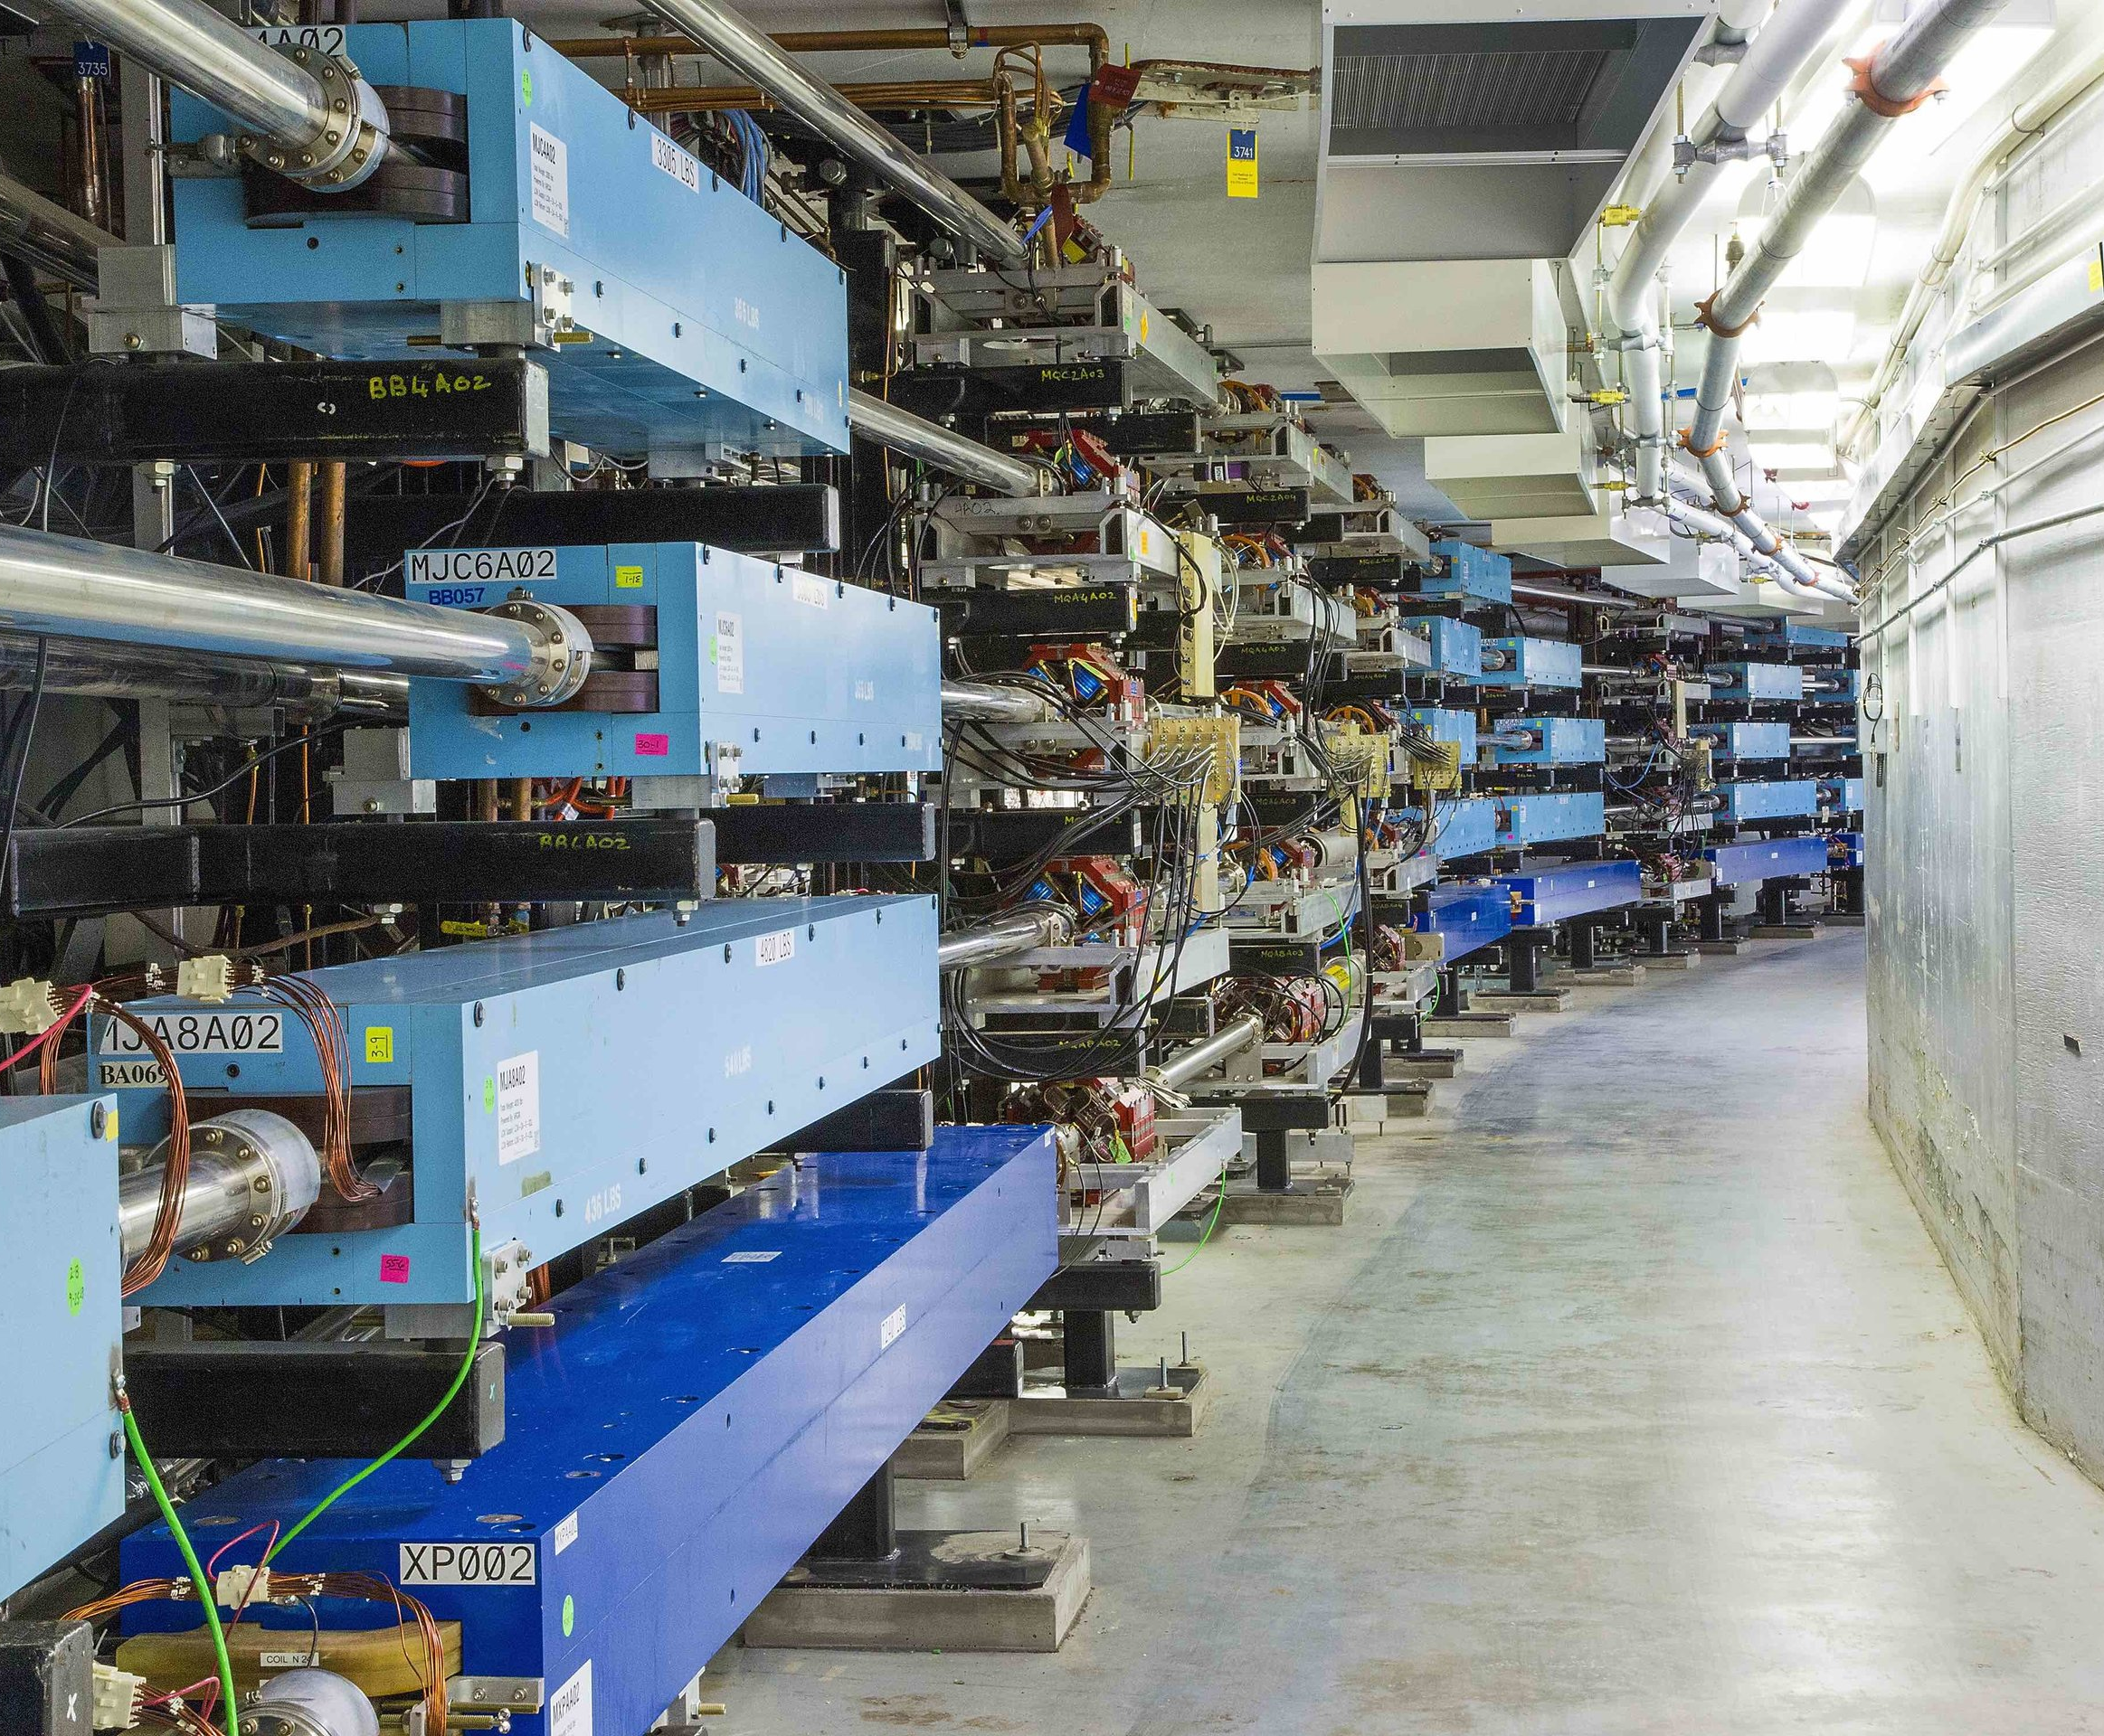
Status of the Ce+BaF project
Motivation
Layout
Expected beam properties
Positron production modes
Transport to CEBAF
Spin transport
Polarity reversal
Ongoing work
Future Work
Yves R. Roblin

Slide 2
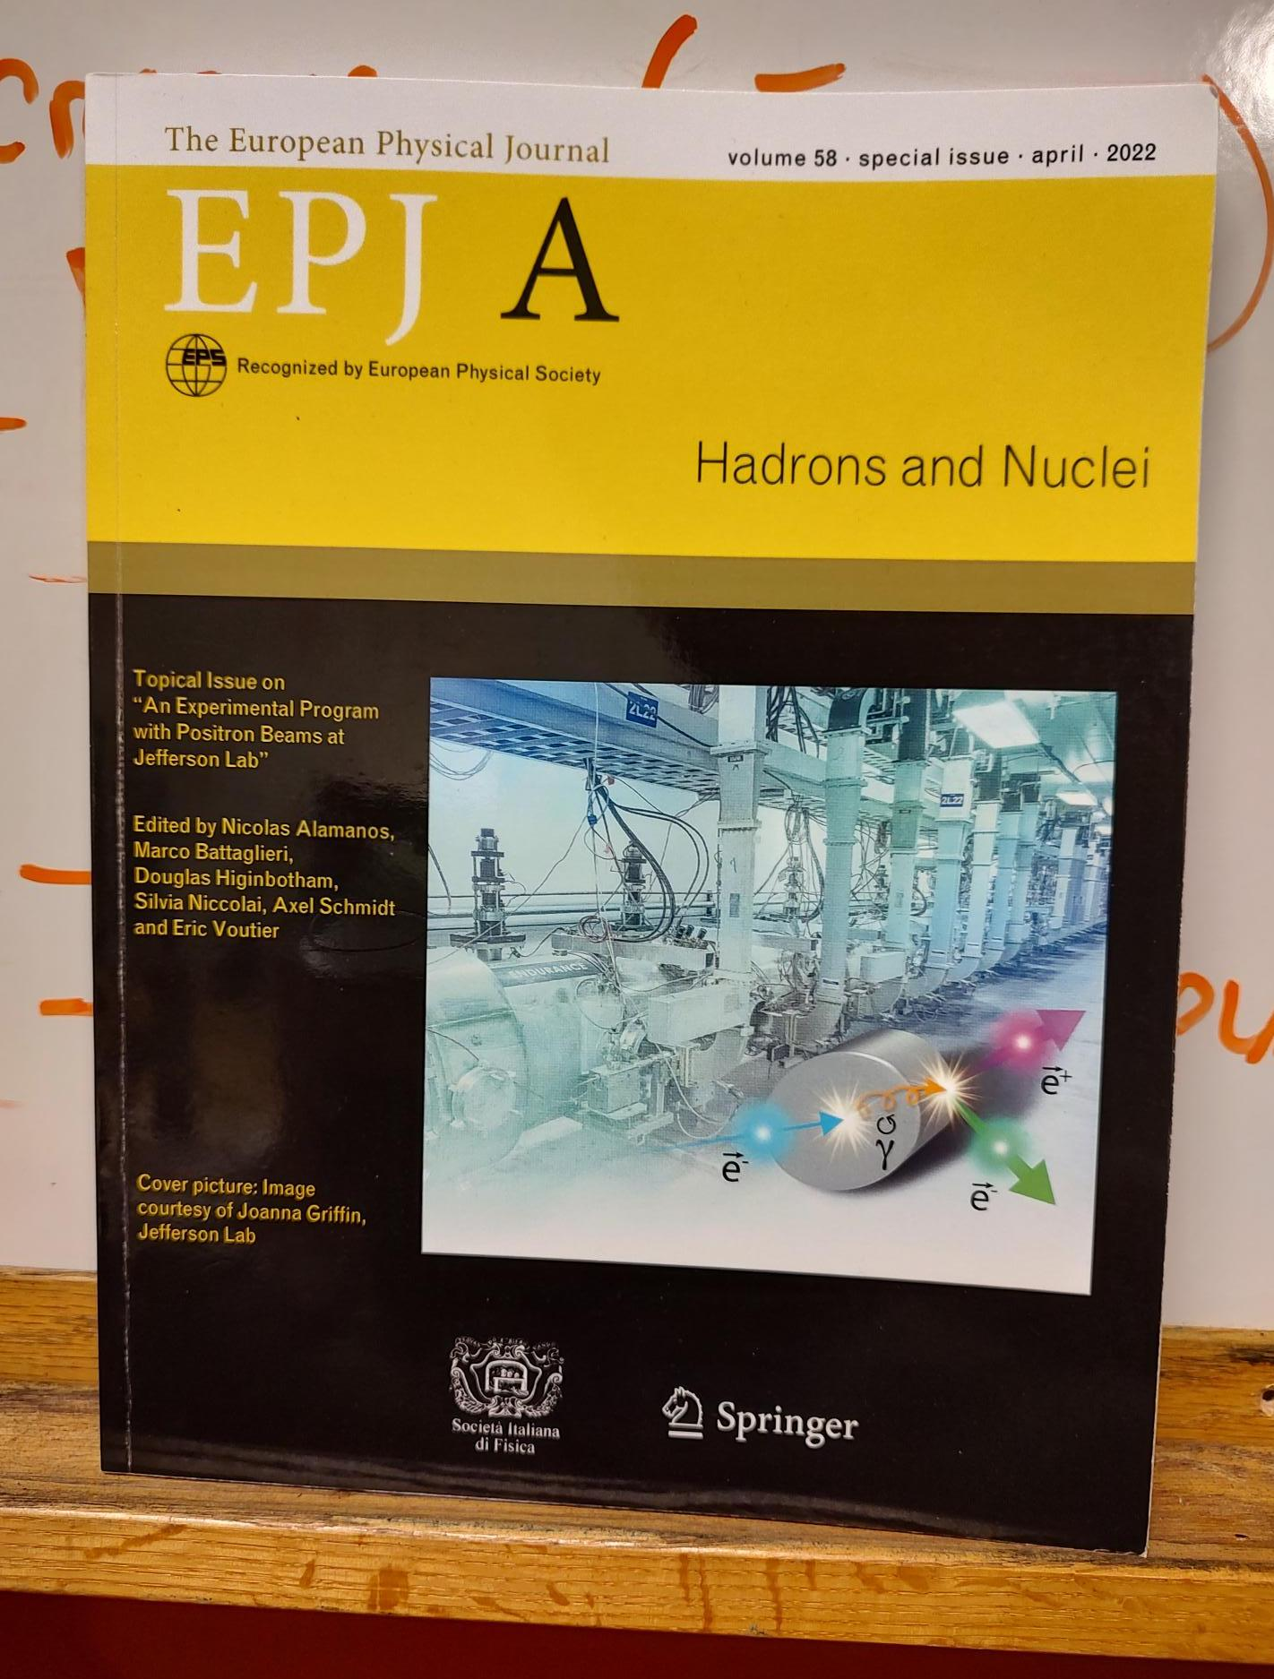
Jefferson Lab Positron Users Group
Jefferson Lab Users have made a strong case for positron beams at CEBAF 12 GeV
Complementary charge and spin of e⁺ would provide a new probe at Jefferson Lab
  2018 – 7 letters of intent to PAC
  2020 – 2 conditionally approved PAC proposals
    Hall B ~ 100 nA polarized (>60%)
    Hall C ~ 3 μA unpolarized
  2023 6 new proposals and 5 new letters of intent
Ce+BAF project status. Y. Roblin 6/14/2023

Slide 3

12 GeV CEBAF : Polarized Electron or Polarized Positron Beams
Capability | Electrons | Positrons
Hall Multiplicity | 4 | 4
Max Energy | 12 GeV | 12 GeV
Beam Frequencies | 249/499 MHz – cw | 249/499 Mhz – cw
Unpolarized intensity | 170 uA (limit) | >1 uA
Polarized intensity | 170 uA (limit) | >50 nA
Polarization | > 85% | > 60%
Fast/Slow Helicity Reversal | Yes | Yes
Ce+BAF project status. Y. Roblin 6/14/2023

Slide 4




Exploit electron spin polarization to produce polarized positrons
When a longitudinally polarized e⁻ beam strikes matter, e⁺ produced in the shower carrying >50% of the e⁻ beam energy are significantly longitudinally spin polarized…
Polarized Bremsstrahlung
Polarized Pair Creation
P_{circ}(γ) / P_{z} (e⁻)
P_{z} (e⁺) / P_{circ} (γ)
…so why not take advantage of this?
E_{γ} / T_{e-}
T_{e+} / (E_{γ} – 2m_{e+})
E.A. Kuraev, Y.M. Bystritskiy, M. Shatnev, E.Tomasi-Gustafsson, PRC 81 (2010) 055208
Ce+BAF project status. Y. Roblin 6/14/2023

Slide 5
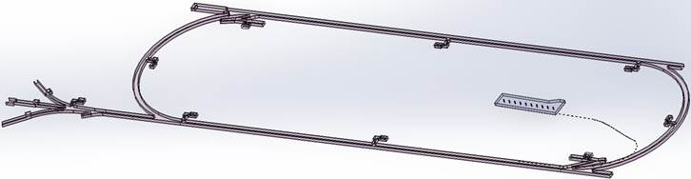
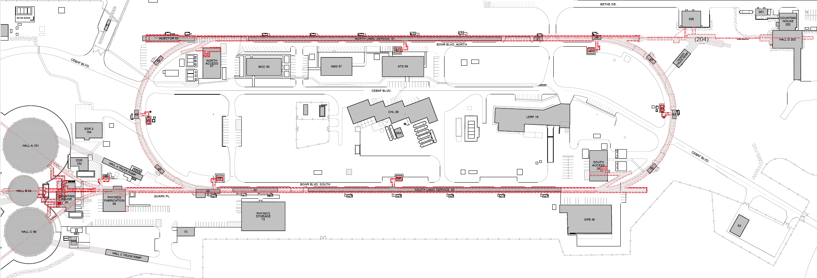

Turning the LERF into a Positron Injector Facility
123 MeV
At the last JLAAC we were exploring e+ production at 10, 100, 1000 MeV…
Today we are focused on producing 123 MeV e⁺ utilizing the Low Energy Research Facility
Inject e⁺ into North Linac to usual 12 GeV (w/ magnets reversed)
Build e⁺ injector at the LERF
Build new LERF to CEBAF tunnel
123 MeV
Build new transport line along South Linac and West Arc
CEBAF positron beam upgrade
Ce+BAF project status. Y. Roblin 6/14/2023

Slide 6
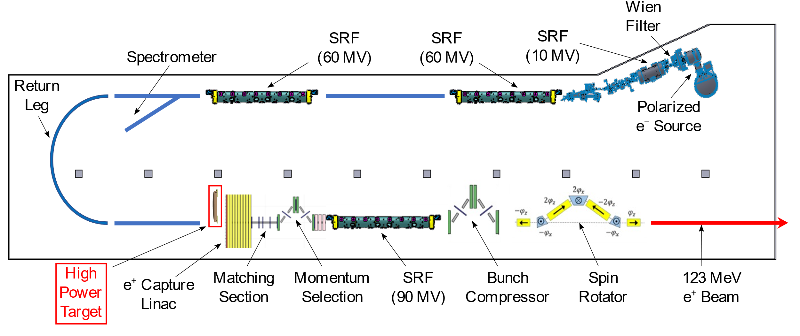
Current layout under study
Ce+BAF project status. Y. Roblin 6/14/2023

Slide 7
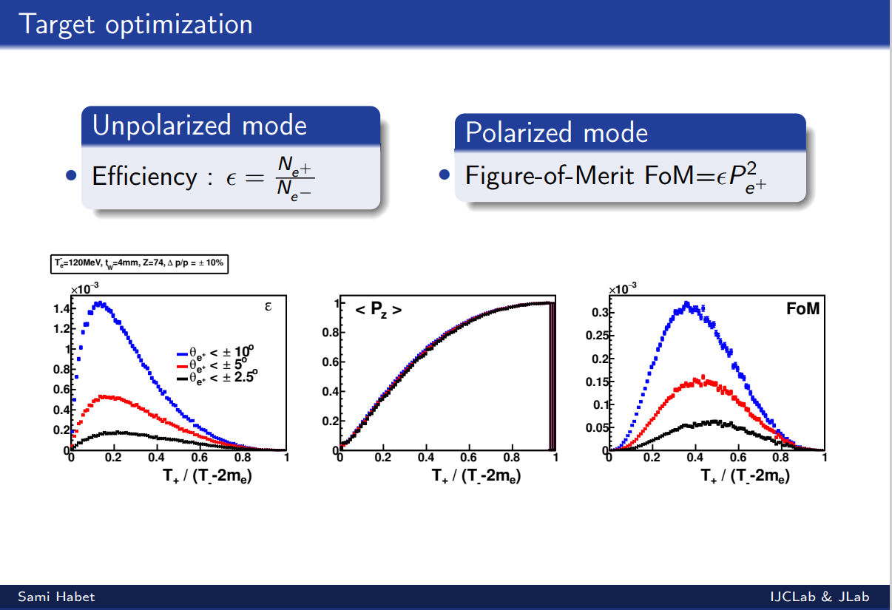
Ce+BAF project status. Y. Roblin 6/14/2023

Slide 8
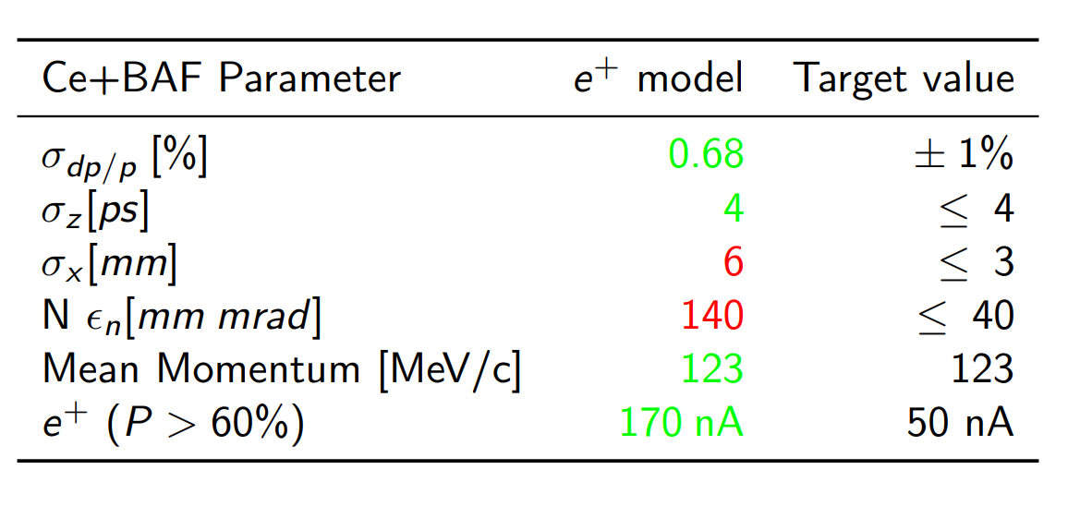
Beam parameters for polarized e+ beam at exit of the positron injector
Optimization will affect the partitioning between the two
Courtesy: Sami Habet
Can reduce this at the expense of the yield
Ce+BAF project status. Y. Roblin 6/14/2023

Slide 9
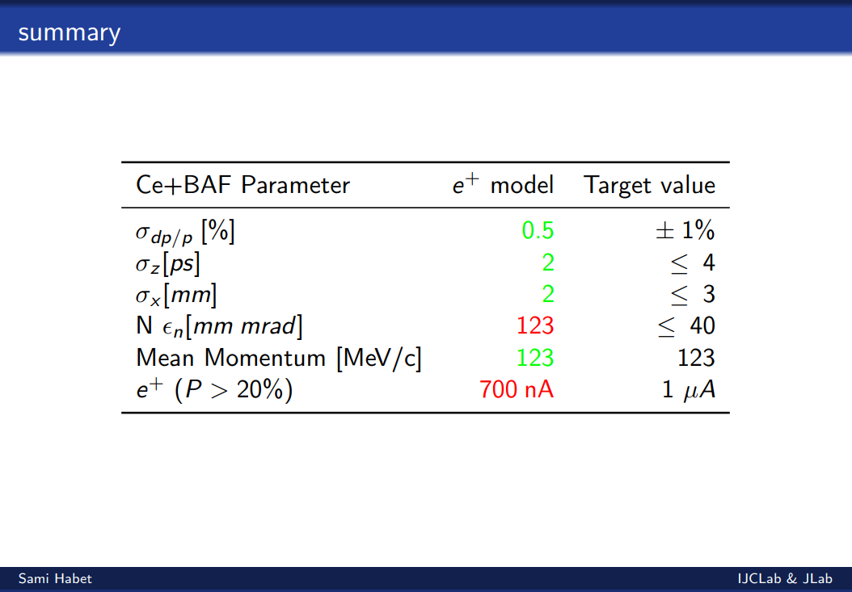
Beam parameters for unpolarized e+ beam at exit of the positron injector
Ce+BAF project status. Y. Roblin 6/14/2023

Slide 10
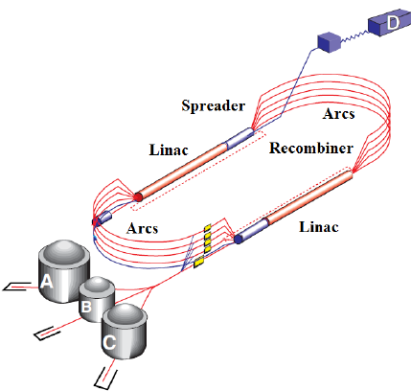
CEBAF 12 GeV : Transverse Emittance* and Energy Spread†
Large e+ initial dp/p and emittance damped adiabatically until SR in upper arcs
Whereas e- parameters grow, e+ parameters improve to 10-12 GeV (sim to e-)
Values are provided at the end of each segment. For positron this is up to pass 5 extraction, for electrons it goes all the way to hall D.
* Emittances are geometric
† Quantities are rms
Ce+BAF project status. Y. Roblin 6/14/2023

Slide 11
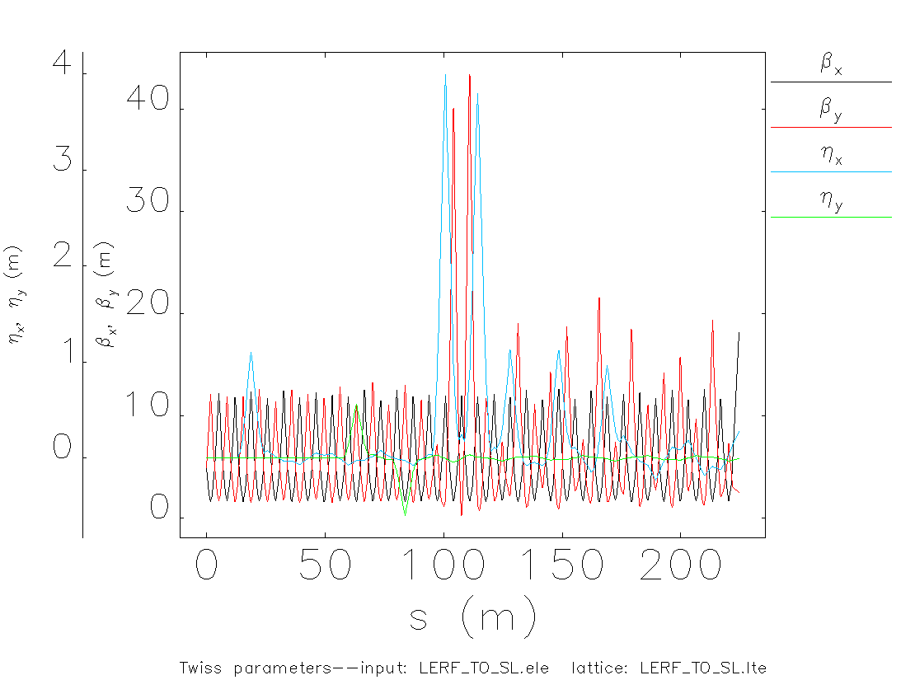
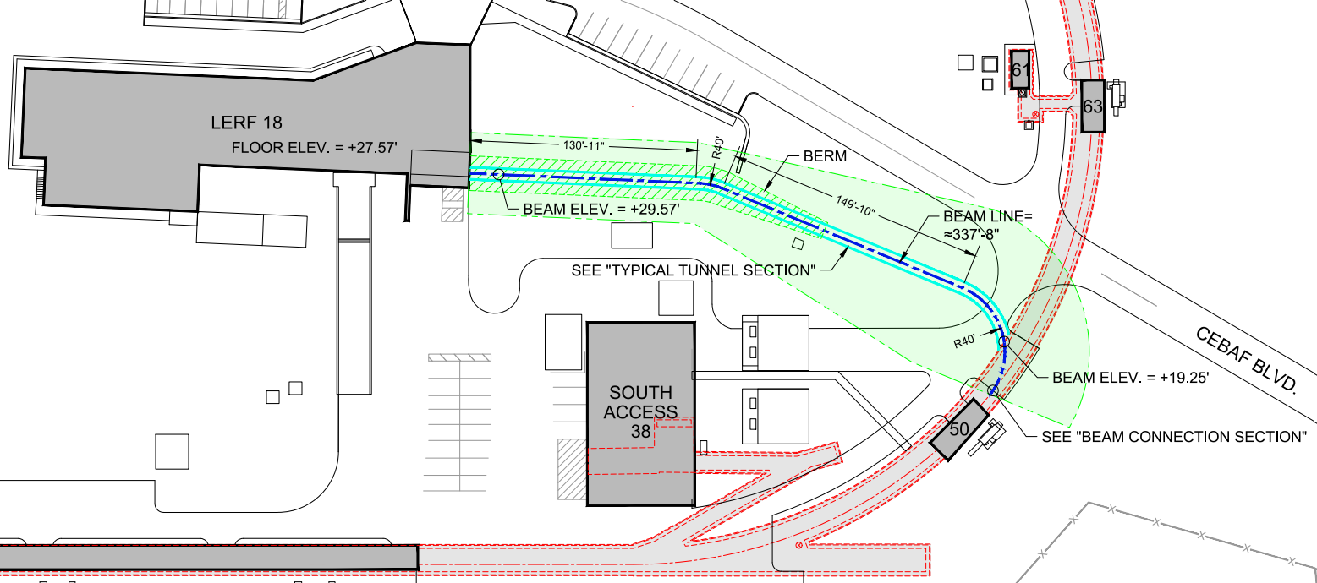
Tunnel from LERF to CEBAF East Arc
Beam transport from the exit of the LERF to the entrance of the South Linac
Ce+BAF project status. Y. Roblin 6/14/2023

Slide 12
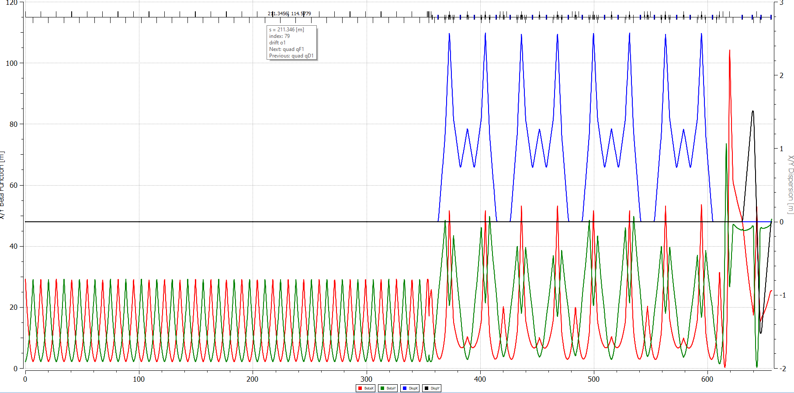
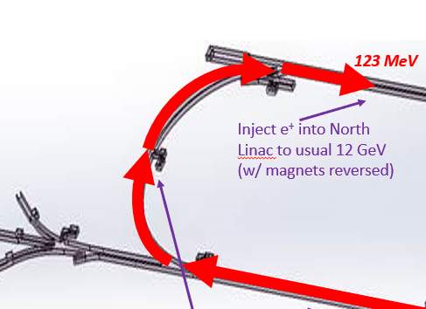
Optics layout for SL->NL positron/e- line
XFER LINE VERSION 2 from 2L01-> front of MBL0R04.
Ce+BAF project status. Y. Roblin 6/14/2023

Slide 13
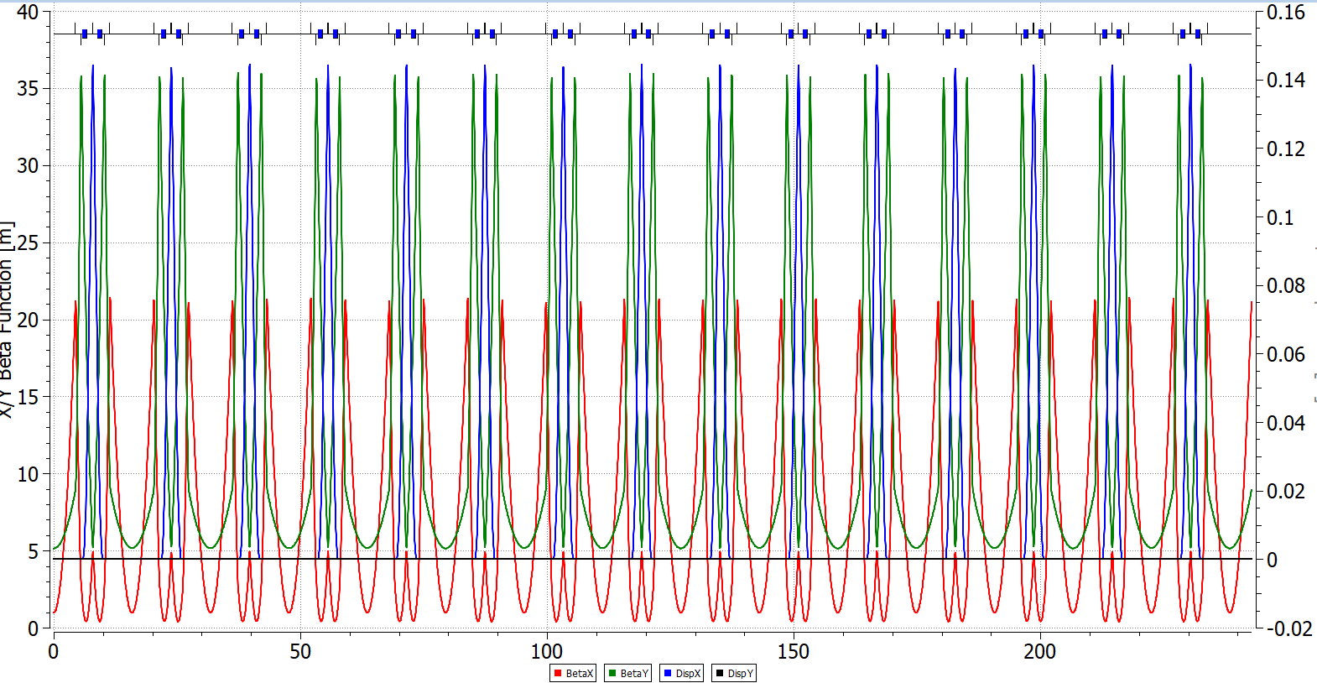
Recent development: Using a DBA structure
Ce+BAF project status. Y. Roblin 6/14/2023

Slide 14
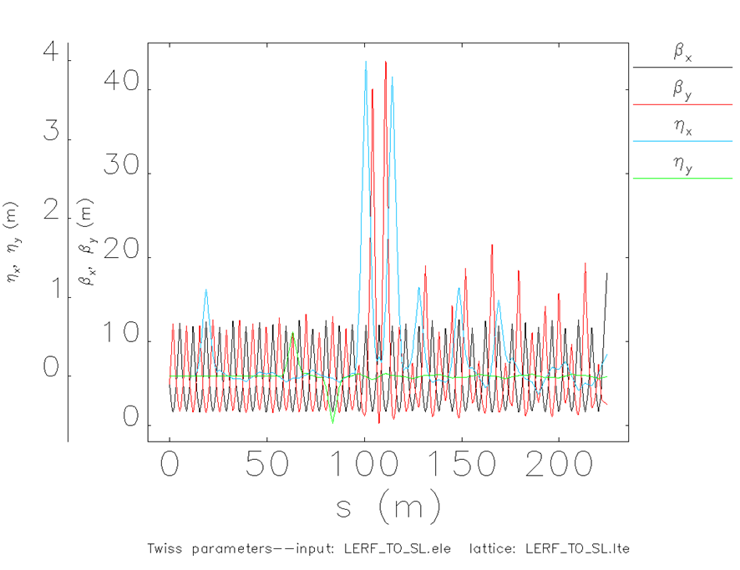
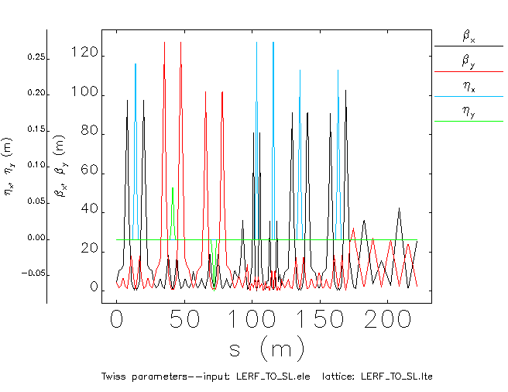
Recent Development lerf to SL transfer line
Dispersion went from 4m to 0.25 m
Ce+BAF project status. Y. Roblin 6/14/2023

Slide 15
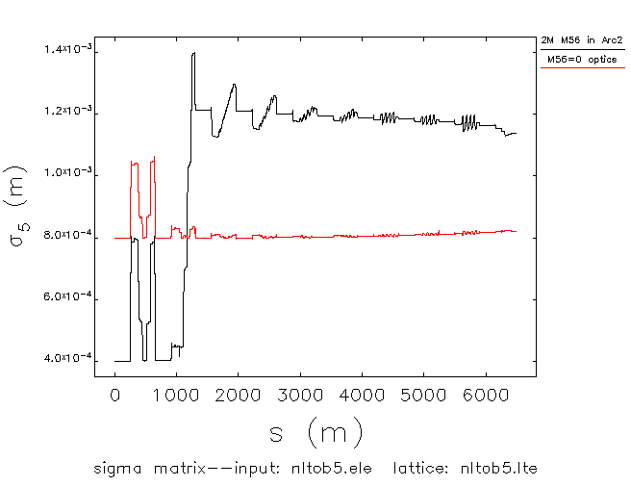
Effect of optics on long bunch beams
New optics allow for bigger
incoming bunchlength
Ce+BAF project status. Y. Roblin 6/14/2023

Slide 16
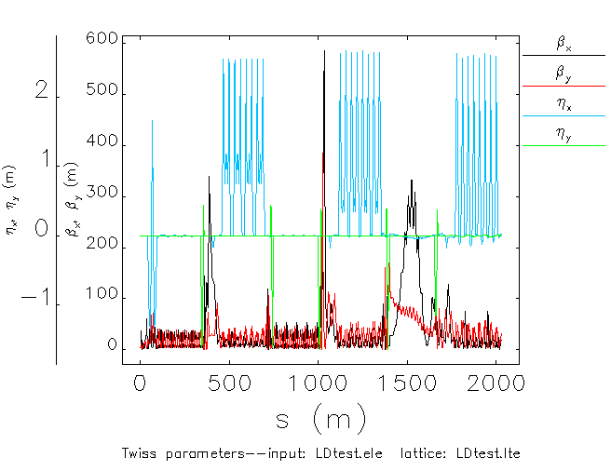
New design for ARC1 and ARC2, tested at CEBAF
Low dispersion optics, zero M56, tested with existing machine on 03/15/2023
Optics:Isurumali Neththikumara
Ce+BAF project status. Y. Roblin 6/14/2023

Slide 17
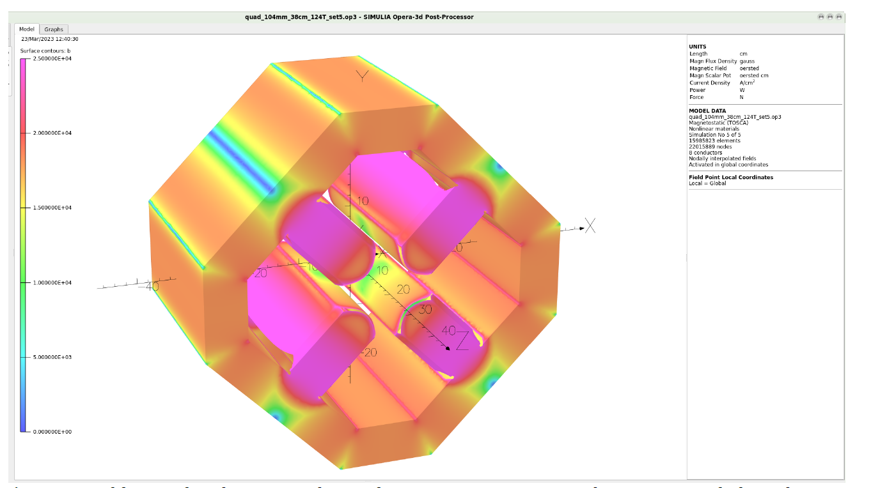
Large bore quadrupoles
JLAB TN-06-029 (Benesch). Designed to accommodate the 60mm.mrad normalized emittance expected in 22 GeV hall lines
40 to 50 mm.mrad normalized is
what we expect in the LERF
to CEBAF transport.
104 mm ID. Can be made 35.56 cm or longer. More than enough field for our needs.
Will need custom power supplies
but it can be ganged together
in the LERF->SL line
Ce+BAF project status. Y. Roblin 6/14/2023

Slide 18
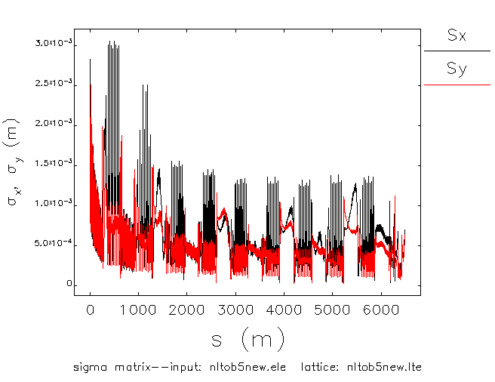
Beam sizes along CEBAF for e+ beam to pass 5
Ce+BAF project status. Y. Roblin 6/14/2023

Slide 19
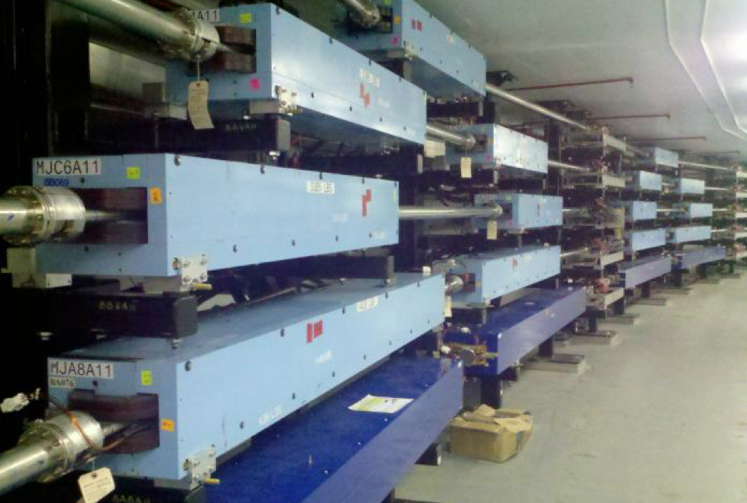
Reversing polarity in magnets, how fast can we go ?
Reversing polarity of 2100 CEBAF magnets (S. Philip Head DC Power group)
>1900 (correctors & quads) already bipolar operation
39 (recirculation/transport dipoles) will require engineered solution
  21 recirculation & dog-leg
  12 extraction units
  6 end-station transport/dump
$485k + 3 FTE – Remote switches for PS, shunt modules, firmware, PSS integration
Hall D is only permanent magnet – would have to be rotated
Magnetic Field Integrity (M. Tiefenback CEBAF magnet systems integrator)
Unipolar dipoles would need to be deliberately tested
  demonstrate field restores after polarity inversion
  quantify possible systematic effects
Soft iron steel are expected to perform well under polarity reversal
Two decades of operation suggest remnant fields <20 G tolerable
  Sudden power supply trips introduce uncontrolled flux
  Modifications to power supplies or field maps
Technote JLAB-TN-23-043
Ce+BAF project status. Y. Roblin 6/14/2023

Slide 20
Spin Transport
We will have a Wien filter after the new injector to set the e- polarization before e+ production target.
We are exploring adding a spin rotator in the long straight in the LERF.
This should allow us to maximize the e+ polarization in any hall.
Open question as of if we will want to deliver positron beams to more than one hall (two) at a time. If so, we can choose appropriate beam energies and pass combinations to maximize polarization in both.
Ce+BAF project status. Y. Roblin 6/14/2023

Slide 21
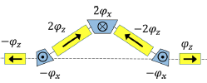
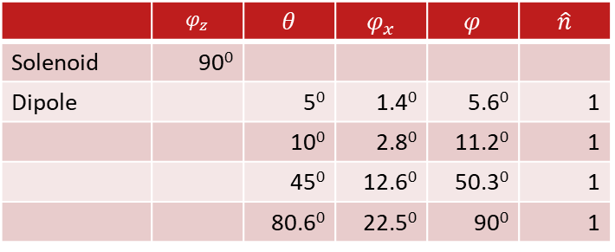
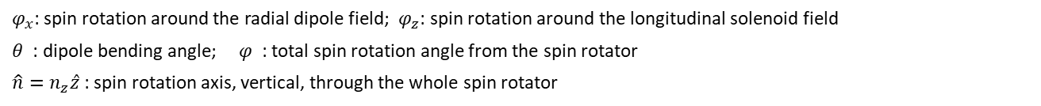
Positron Spin Rotator (cont.)
Possible solution: interleaved dipole and solenoid fields
  Solenoid is preferable, considering its effective spin rotation at low energies and negligible effect on the orbit excursion
  Dipole is needed to help to produce a desired spin rotation axis
 | $$φ_{z}$$ | $$θ$$ | $$φ_{x}$$ | $$φ$$ | $$\hat{n}$$
Solenoid | 90⁰
Dipole |  | 5⁰ | 1.4⁰ | 5.6⁰ | 1
 |  | 10⁰ | 2.8⁰ | 11.2⁰ | 1
 |  | 45⁰ | 12.6⁰ | 50.3⁰ | 1
 |  | 80.6⁰ | 22.5⁰ | 90⁰ | 1
Side view
Yu.N. Filatov et al., Eur. Phys. J.C, 81:986 (2021)
$φ_{x}$: spin rotation around the radial dipole field; $φ_{z}$: spin rotation around the longitudinal solenoid field
$θ$ : dipole bending angle; $φ$ : total spin rotation angle from the spin rotator
$\hat{n}=n_{z}\hat{z}$ : spin rotation axis, vertical, through the whole spin rotator
Courtesy: Fanglei Lin
Ce+BAF project status. Y. Roblin 6/14/2023

Slide 22
Injection energy into NL
Constraints:
Because of geometry (layout of spreaders and recombiners), the ratio between the linac injection and the linac acceleration has to be kept at roughly 1090/123 .
Polarized positrons generated at around 60 Mev/c (1/2 driver beam momentum)
Unpolarized positrons generated at around 20 MeV/c
Not accelerating the e+ prior to injection to NL will imply having to transport larger transverse beams. Likely will lead to beam loss. Exact limitations are going to be simulated.
Ce+BAF project status. Y. Roblin 6/14/2023

Slide 23
Currently ongoing efforts
Unpolarized e+ beam production optimization
Spin transport assessment
Target design
  JLAB (S. Covrig, A. Ushakov) rotating Tungsten target
  XELERA (SBIR) Ga-In-Sn liquid jet target
Beam transport optimization
Aperture/Acceptance studies (LDRD A. Sy)
Ce+BAF project status. Y. Roblin 6/14/2023

Slide 24
Near term and longer term efforts
Delivering 60-120 MeV e- or e+ from LERF to CEBAF
-Quads with large bore and large range 60-600 MeV
-Reversing polarity of magnets w/ bulk PS
Evaluating CEBAF unipolar magnets w/ reversal
Strategic roadmap for diagnostics for tuning and transporting secondary e+/e- beams
Evaluation of radiation shielding for >100 kW target
Strategic roadmap for LERF cryomodules and energy reach of primary e- and secondary e+/e- beams
Ce+BAF project status. Y. Roblin 6/14/2023

Slide 25
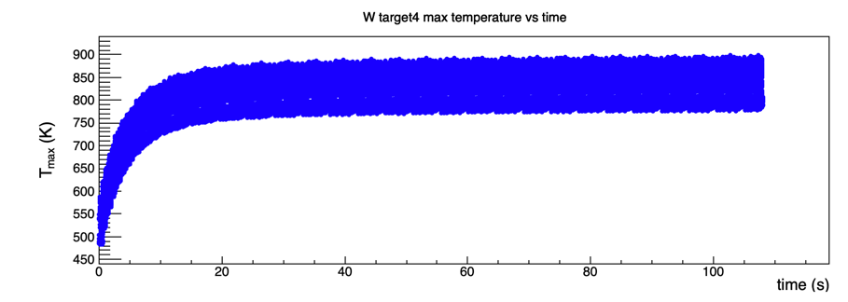
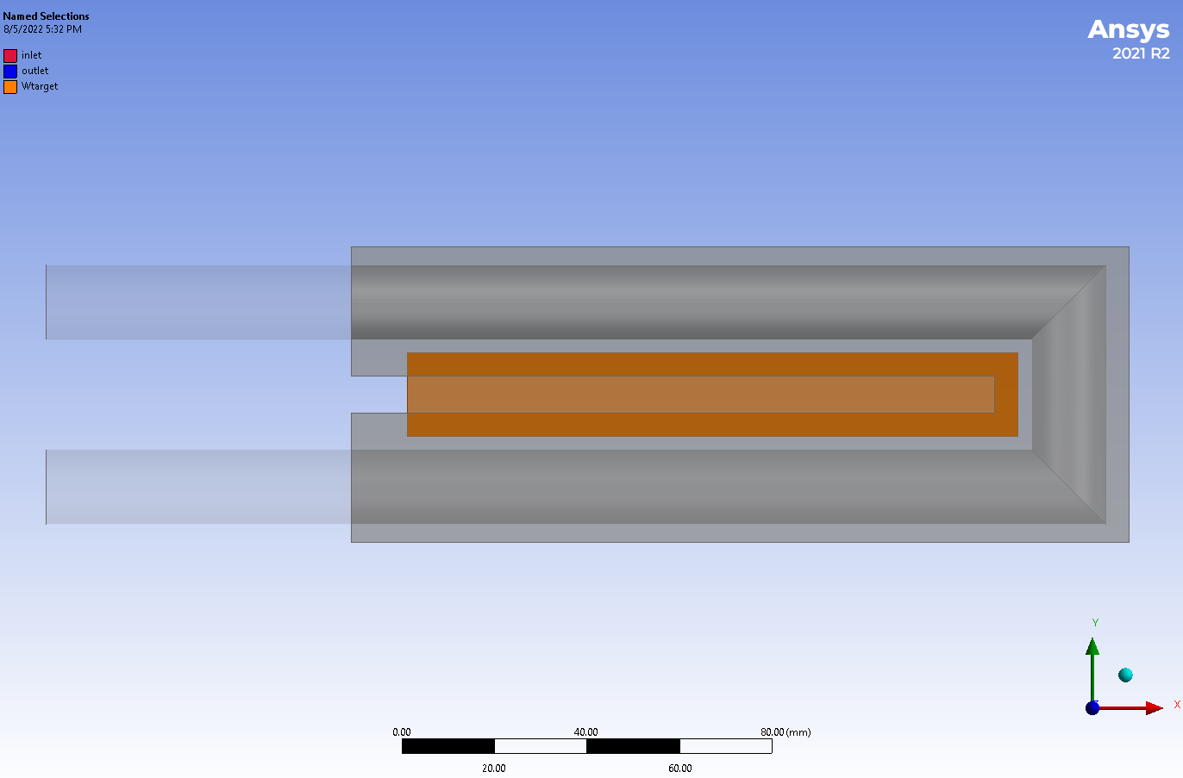
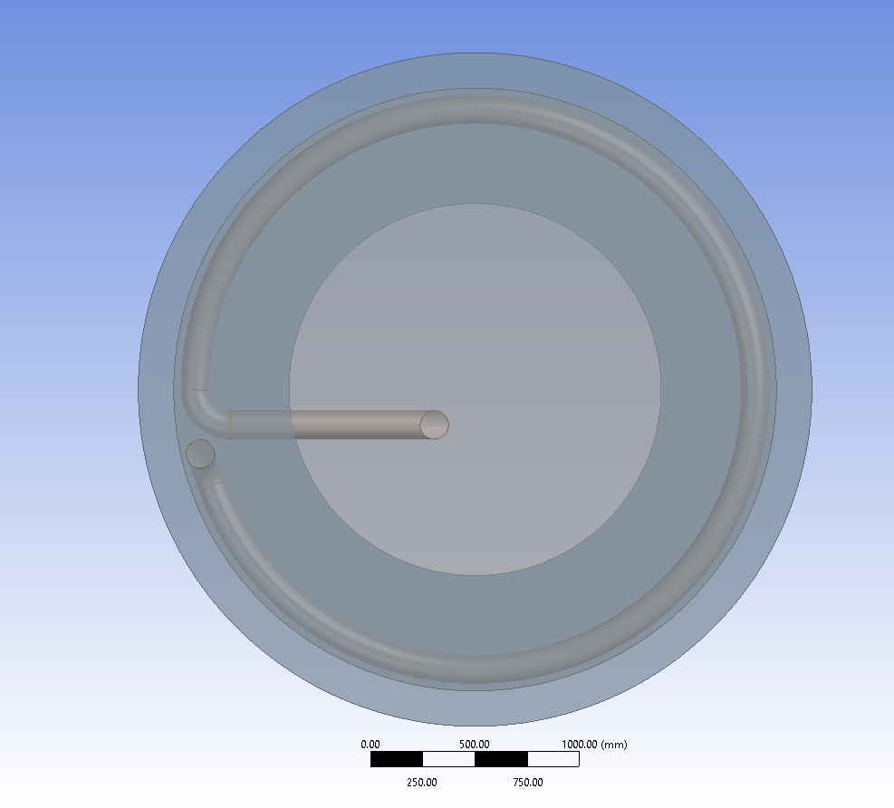
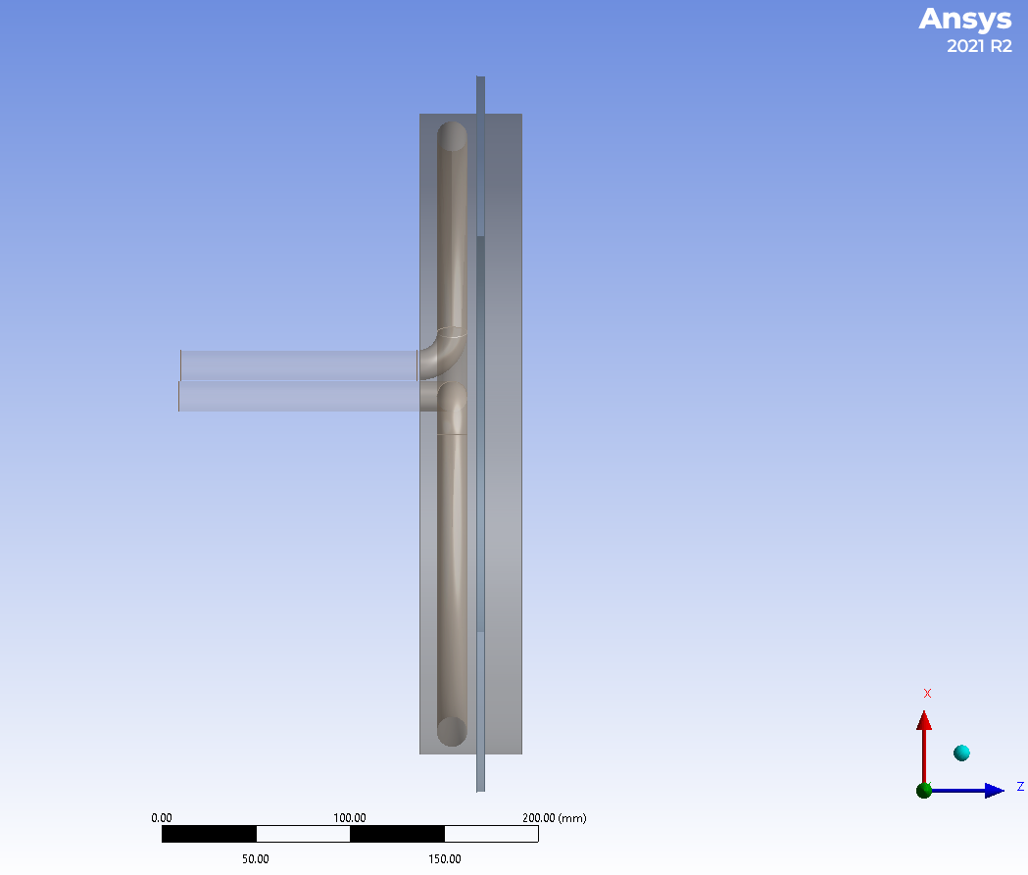
LERF e+ production target design (S. Covrig, Physics)
Building up team of target experts to study various target materials & geometries
  prototype/proof-of-principle (3-4 kW)
  full power design (17-20 kW)
W target rotating 2 Hz with 4x4 mm² beam area at radius of 18 cm; water flow is 0.3 kg/s, water pressure loss is 1.5 psi.
Linear moving W target in Cu frame with RT water
  Rotating W target in a Cu frame cooled with RT water
Beam axis
Cu frame
W target
Cu frame
Target motion
Water pipe
Water pipe
W target, 4mm thick
Ce+BAF project status. Y. Roblin 6/14/2023

