Slide 1
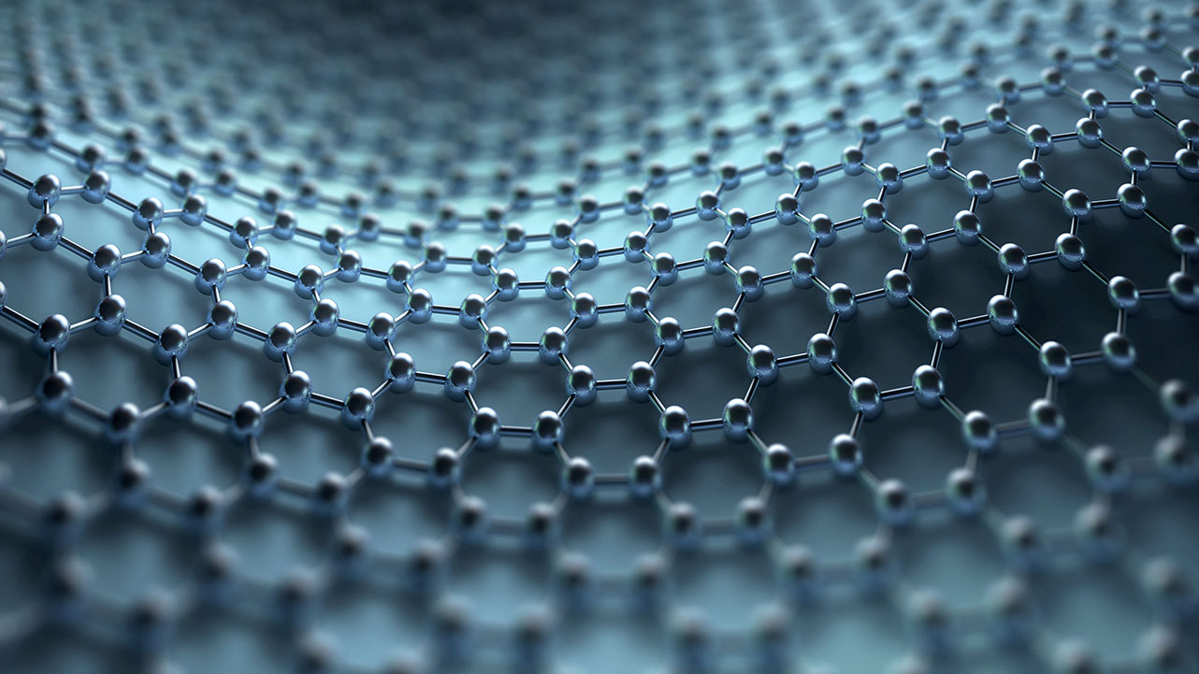
Using Tensor Networks to Probe Quantum Systems
Jake Montgomery
Department of Physics, Old Dominion University
Email: jmont034@odu.edu

Slide 2
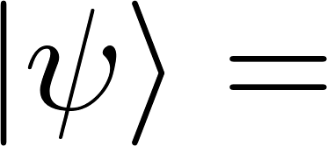
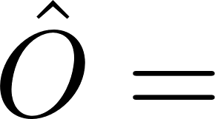
What is an MPS Tensor Network?
“It’s a network of Tensors”
Decomposing a rank N tensor into a contraction of N tensors
Penrose Graphical Notation

Slide 3
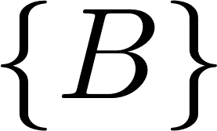
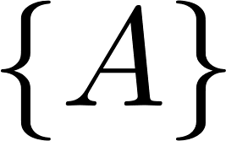
What is an MPS Tensor Network?
Inner products of MPS can offer polynomial scaling
Scales as $d^{N}$
Scales as $Nm^{3}d!$
Sum left to right

Slide 4
What is an MPS Tensor Network?
We can take expectation value of operators
Kinematic calculations are speed up greatly by summation algorithm and SVD

Slide 5
Physics in Low Dimensions
QFT at finite temperature and finding ground states
MPS + Operators
Real-Time Dynamics
[1]

Slide 6
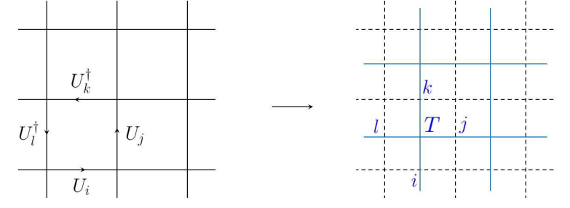
2D Yang Mills
Treat Lattice Yang Mills at finite temperature
T
[2]

Slide 7
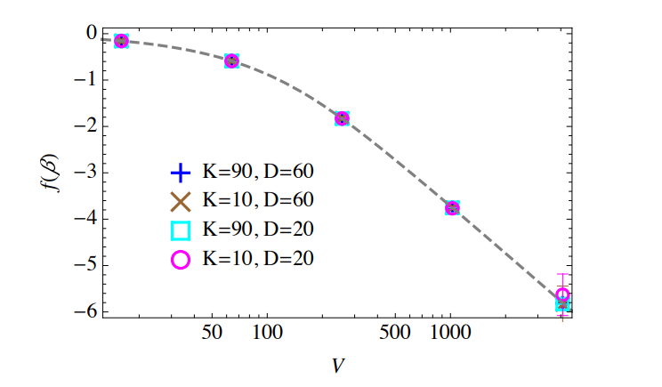
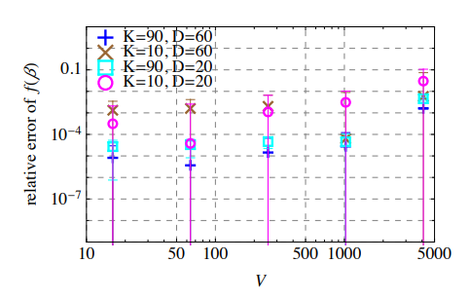
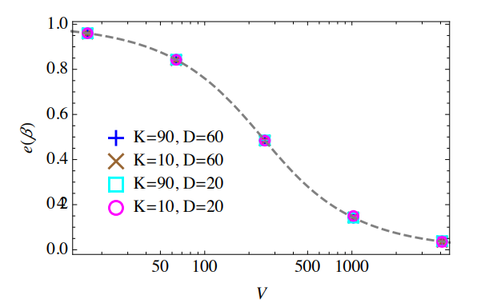
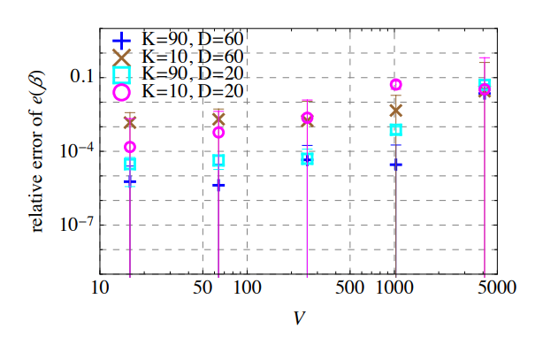
2D SU(2) Yang Mills
We can acquire thermodynamic quantities from the partition function
[2]

Slide 8
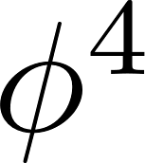
Scalar Field Theory
Consider the basic theory. We can use DMRG to calculate the ground state(s).

Slide 9
Density Matrix Renormalization Group
DMRG is an algorithm for acquiring the ground state energy of a system. The process is streamlined by ITensors
Generate Random State
Construct the Hamiltonian
DMRG algorithm
Acquire Ground State
Repeat DMRG to acquire degenerate and excited states

Slide 10
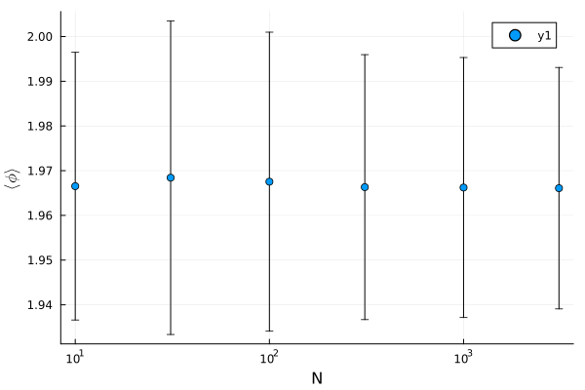
Scalar Field Theory
Field configuration shouldn’t depend on volume of box
L

Slide 11
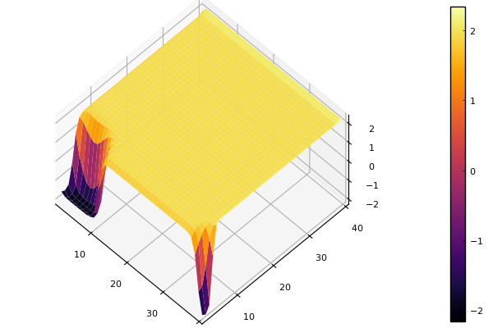
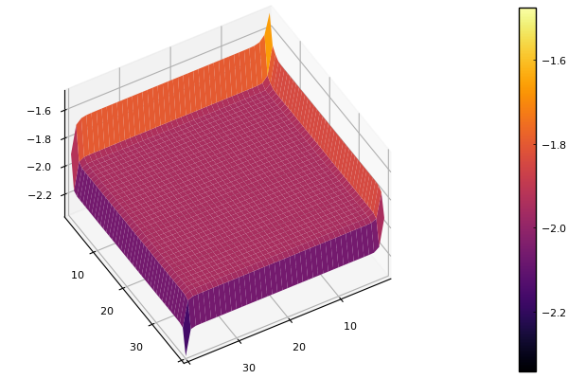
Scalar Field Theory in 2D
Scaling is not as good, and ground states can be left with artifacts.

Slide 12
Limitations and Frontier
Limited to 2+1 Dimensions
Real Time calculations for deep
IR behavior [3]
Monte Carlo + Tensor Networks
O(P(n))

Slide 13
Summary
Tensor Networks offer great speed up for low dimensional numerical calculations
Struggle with acquiring excites states for degenerate systems
Application to gauge theories becoming more realized!

Slide 14
References:
[1] Itensor. ITensor · ITensors.jl. (n.d.). https://itensor.github.io/ITensors.jl/dev/ITensorType.html
[2] Fukuma, M., Kadoh, D., & Matsumoto, N. (2021, July 29). Tensor network approach to 2d yang-mills theories. arXiv.org. https://arxiv.org/abs/2107.14149
[3] Banuls, M. C., Heller, M. P., Jansen, K., Knaute, J., & Svensson, V. (2020, August 25). From spin chains to real-time thermal field theory using tensor networks. arXiv.org. https://arxiv.org/abs/1912.08836

