Slide 1

Neutron Elastic Form Factor Ratio from Recoil Polarization
Sarashowati Dhital
Hampton University
Department of Physics
For the SBS Collaboration
This work is supported by DOE DE-SC0013941 and JSA

Slide 2

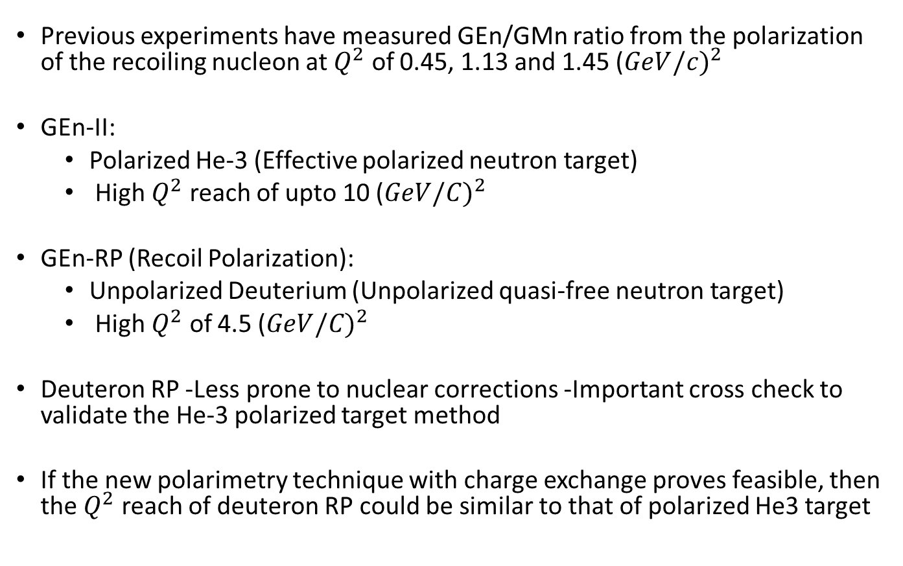
Motivation
Previous experiments have measured GEn/GMn ratio from the polarization of the recoiling nucleon at $Q^{2}$ of 0.45, 1.13 and 1.45 (${GeV/c)}^{2}$
GEn-II:
  Polarized He-3 (Effective polarized neutron target)
  High $Q^{2}$ reach of upto 10 (${GeV/C)}^{2}$
GEn-RP (Recoil Polarization):
  Unpolarized Deuterium (Unpolarized quasi-free neutron target)
  High $Q^{2}$ of 4.5 (${GeV/C)}^{2}$
Deuteron RP -Less prone to nuclear corrections -Important cross check to validate the He-3 polarized target method
If the new polarimetry technique with charge exchange proves feasible, then the $Q^{2}$ reach of deuteron RP could be similar to that of polarized He3 target

Slide 3
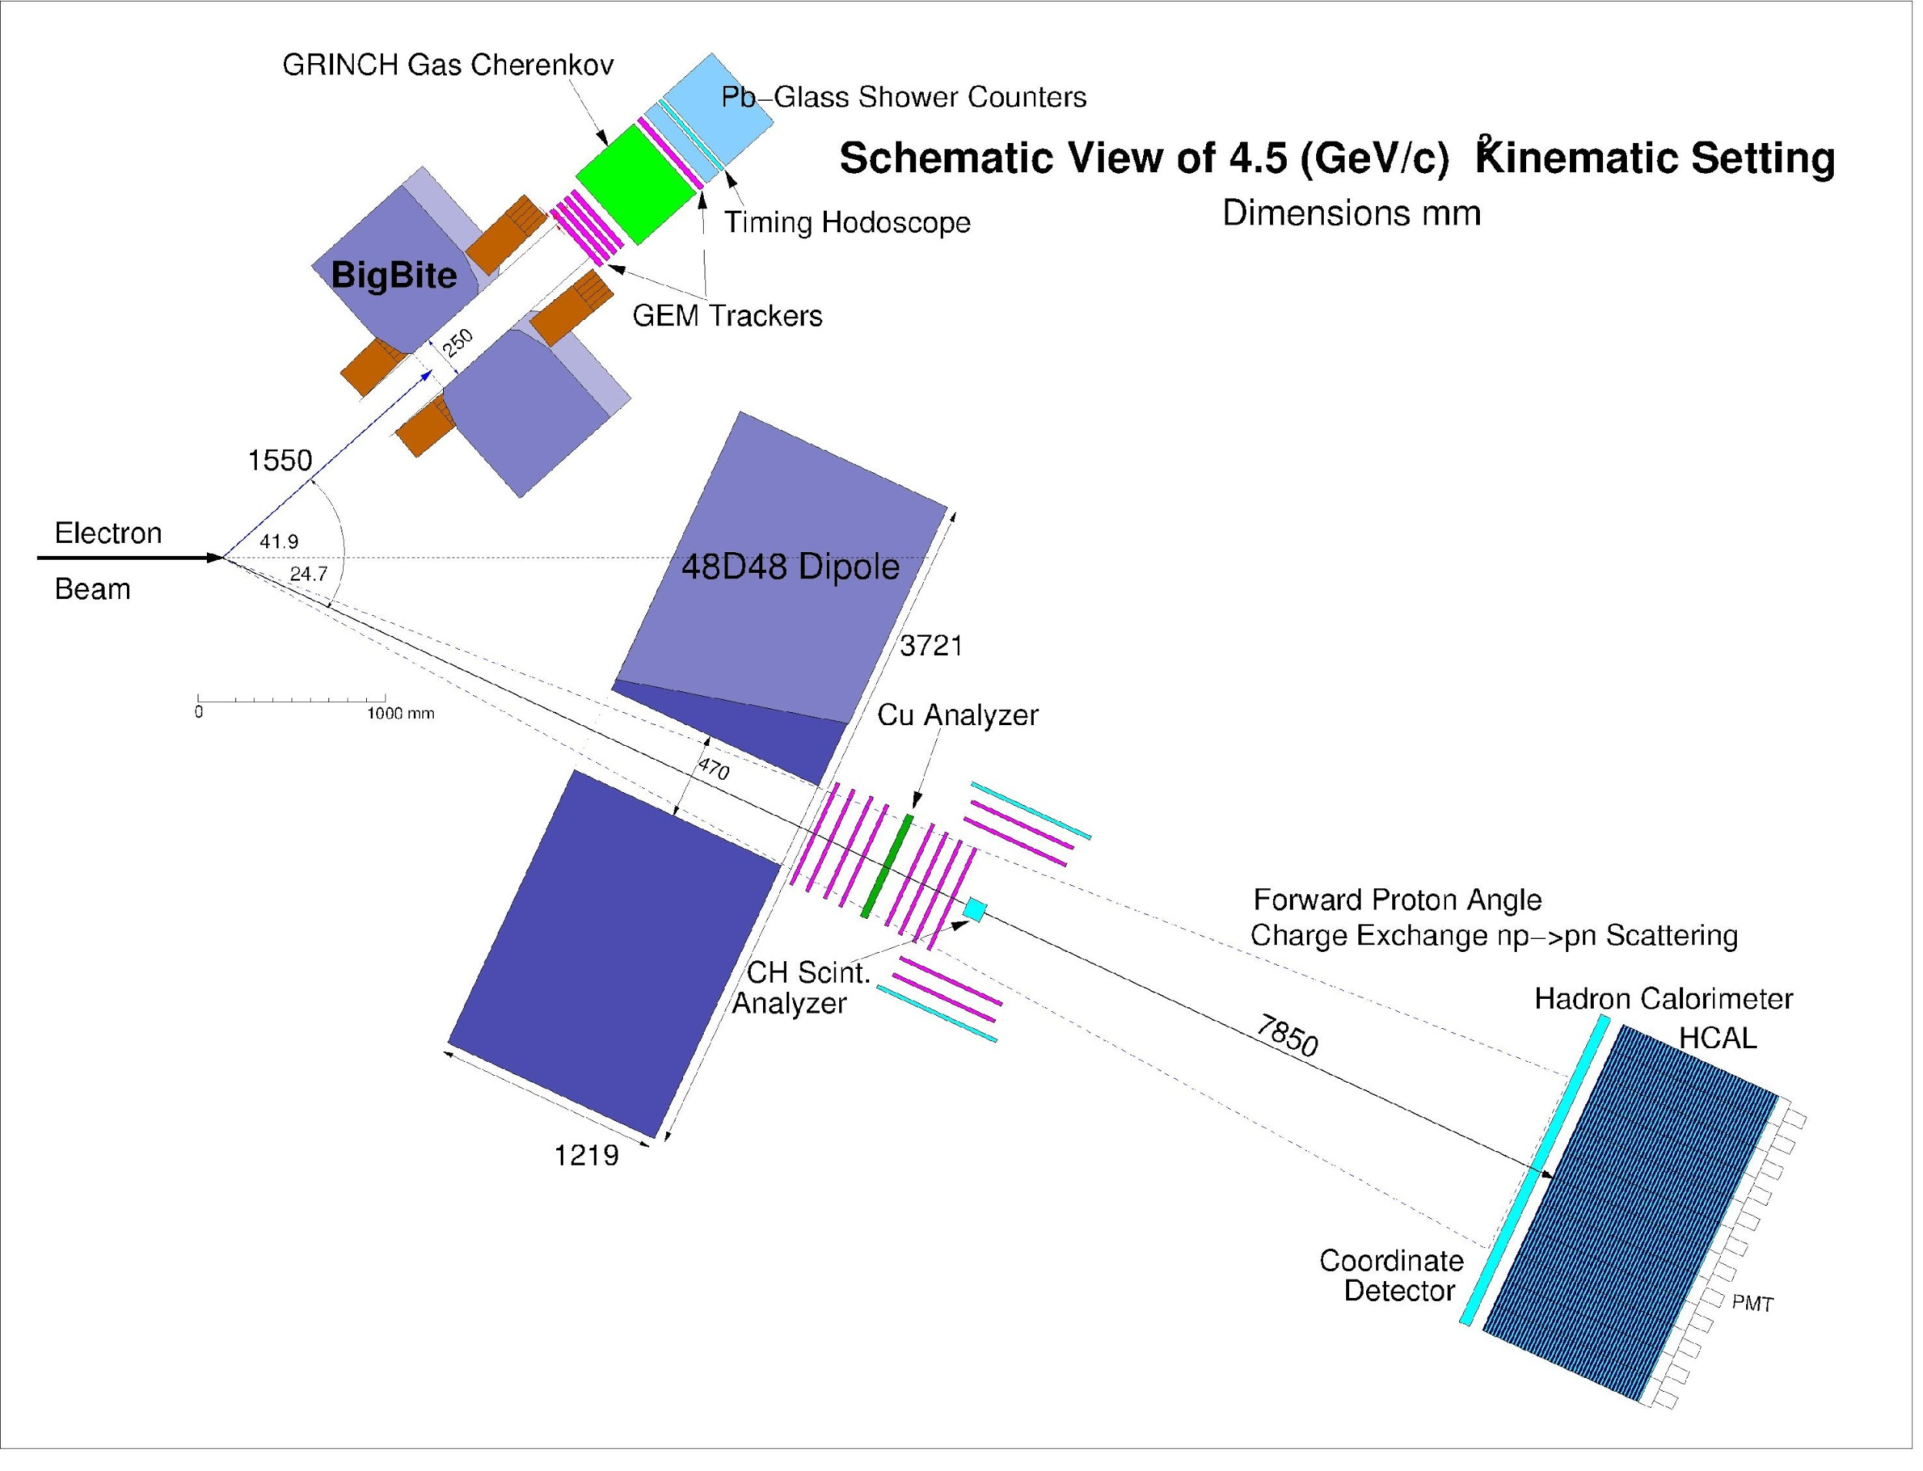
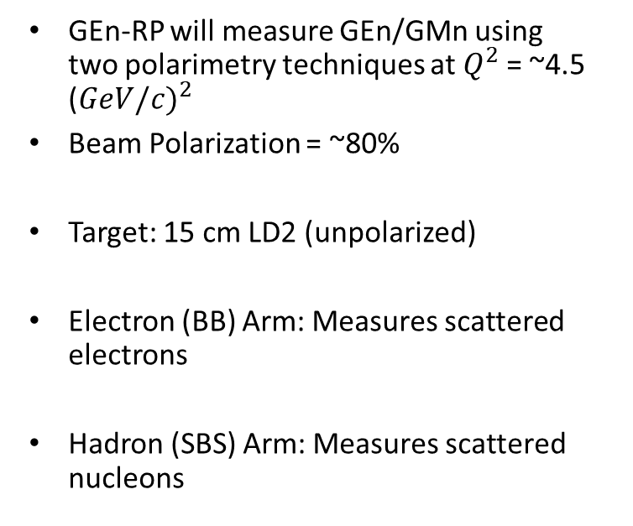
Experimental Layout
GEn-RP will measure GEn/GMn using two polarimetry techniques at $Q^{2}$= ~4.5 (${GeV/c)}^{2}$
Beam Polarization = ~80%
Target: 15 cm LD2 (unpolarized)
Electron (BB) Arm: Measures scattered electrons
Hadron (SBS) Arm: Measures scattered nucleons
.

Slide 4
Recoil Polarization Technique
Kernphysik, Eine Einführung
Von Prof. Dr. rer. nat. Theo Mayer-Kuckuk Universität Bonn
Applicable to both protons & neutrons
Recoil Polarization components related to form factor.
Nucleon polarimetry : strong LS coupling connects nucleon polarization to spatial asymmetry

Slide 5
Recoil Polarization Technique
Incoming proton swept up by the dipole magnet
Precession of the longitudinal polarization component occurs within the plane of deflection, perpendicular to magnetic field
Analyzing power: Quantity that converts polarization of nucleon to the asymmetry observed
Can calibrate analyzing power against polarization
If analyzing power is known, polarization can be measured
Ratio of Pt/Pl directly probes FF ratio, even without knowing of analyzing power

Slide 6
Analyzing Power For Elastic n-p Scattering
Ay for n-p scattering (forward neutron) falls rapidly with increasing neutron momentum
• Ay for n-p charge-exchange (forward proton) is large at sufficiently large neutron momentum(θp~ few degrees)
• No apparent strong incident momentum dependence for charge-exchange Ay

Slide 7
Figure of Merit of Analyzing Power
Acceptance-weighted integral of squared analyzing power determines statistic error
Simulated figure of merit of polarimeter as a function of θn and pn by monte carlo
FOM of np- np declines
FOM for np-pn stays up
Gen-RP kinematics near crossing region

Slide 8
SBS Neutron Polarimeter
Charge Exchange (CE) Polarimeter High momentum forward protons towards HCAL after CE np→pn
8 UVa GEM planes
1 Fe Analyzer
Proton Recoil (PR) Polarimeter,
Low momentum large angle recoiling,
protons after np→np
Active CH Analyzer
2 Sections, one each side of CE Polarimeter
Each section has 2 UVa GEM planes & Plastic Scintillators
Descoping of beamline –side setup is now considered

Slide 9
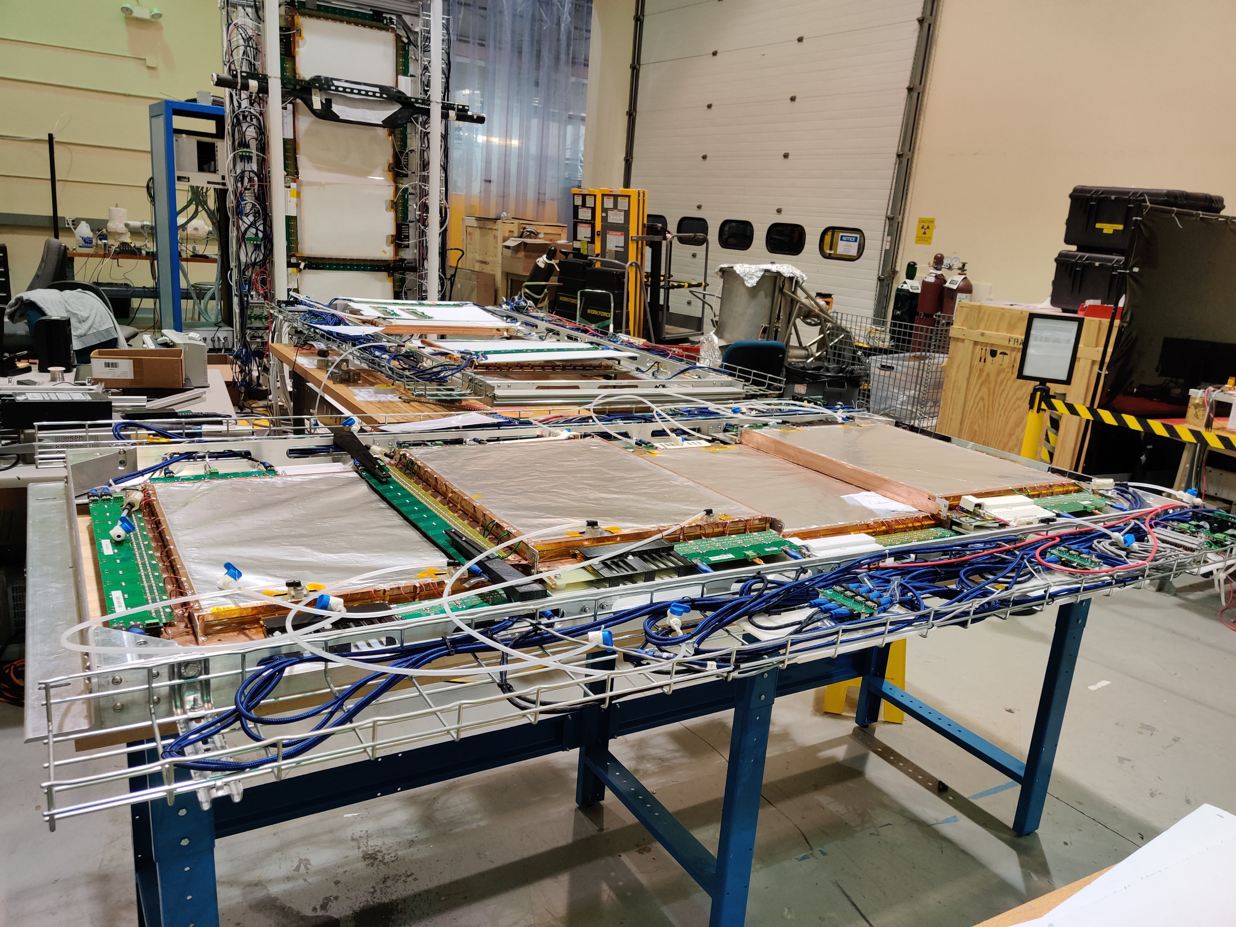
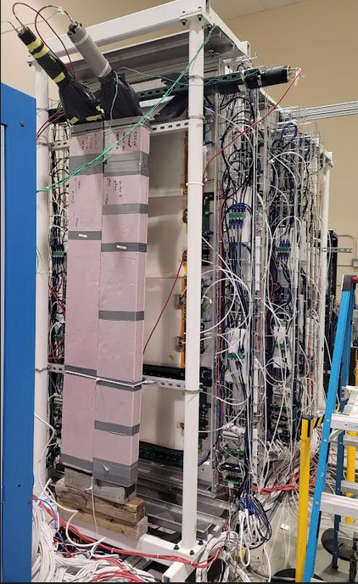
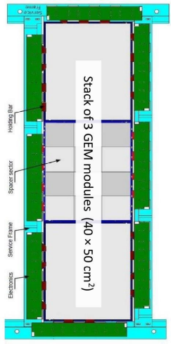
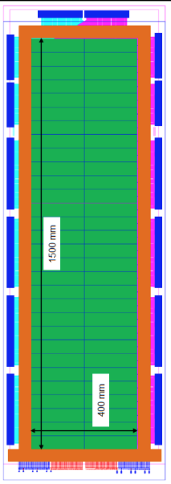
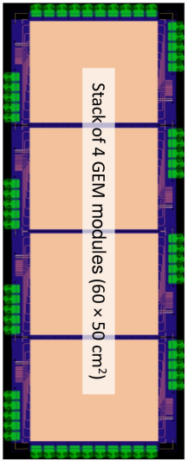
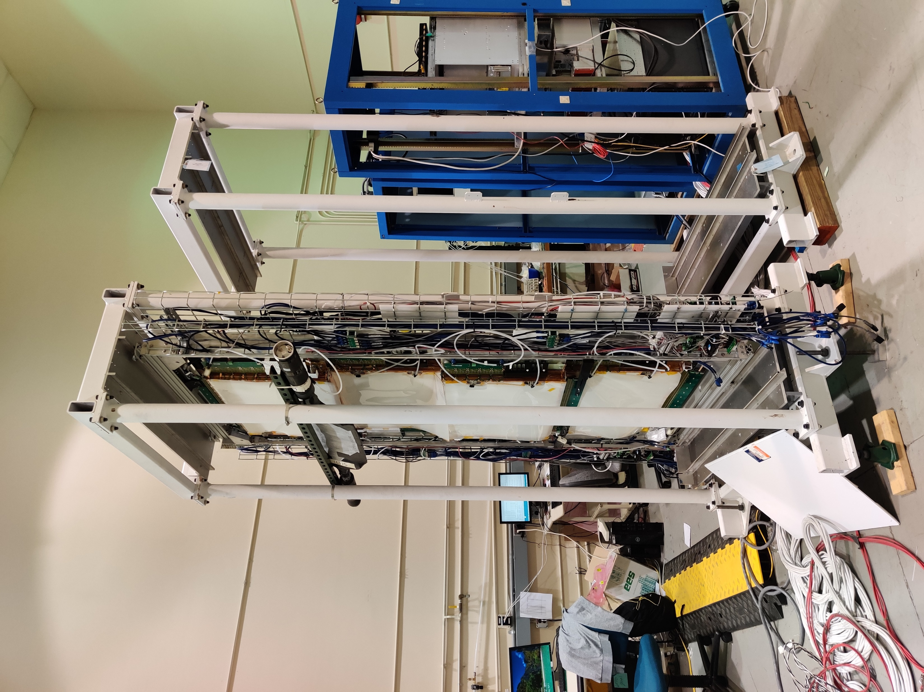
SBS GEMS Commissioning for Gen-RP

Slide 10

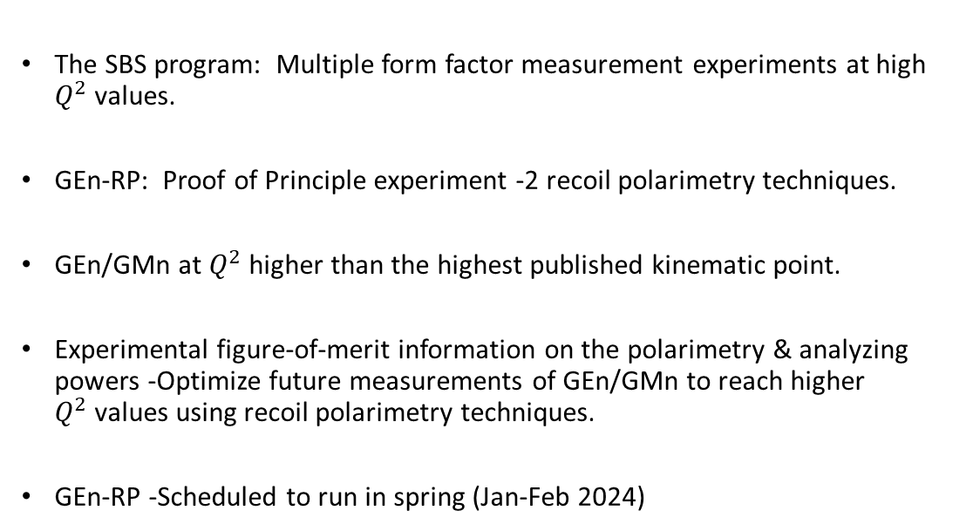
Summary
The SBS program: Multiple form factor measurement experiments at high $Q^{2}$values.
GEn-RP: Proof of Principle experiment -2 recoil polarimetry techniques.
GEn/GMn at $Q^{2}$higher than the highest published kinematic point.
Experimental figure-of-merit information on the polarimetry & analyzing powers -Optimize future measurements of GEn/GMn to reach higher $Q^{2}$values using recoil polarimetry techniques.
GEn-RP -Scheduled to run in spring (Jan-Feb 2024)

Slide 11
Acknowledgements
My advisor Dr. Michael Kohl
Staff Scientists: Dr. Holly Szumila-Vance, Dr. Brad Sawatzky
Postdocs: Dr. Xinzhan Bai (UVa), Dr. Thir Narayan Gautam (HU)
Graduate Students: Ezekiel Wertz (W&M), Anuruddha Rathnayake, John Boyd, Sean Jeffas (UVa), ManjuKrishna Suresh(HU)
The SBS Collaboration
The Department of Energy and Jefferson Science Associates

Slide 12


