Slide 1
Characterizing integrating detector PMTs for the MOLLER Experiment
Sagar Regmi
Idaho State University
HUGS 2023

Slide 2
Outline
Parity Violating Asymmetry
MOLLER Introduction
PMT and Systematic Error
Non-Linearity measurement setup
Calculations, Observed Graphs
Summary and Future work
sagarregmi@isu.edu
1

Slide 3
Parity Violating Asymmetry
Scattering of polarized incident electron (Spin S) and unpolarized target
Under Parity Transformation there is inversion of spatial vector $\vec{v}=\vec{−v}$ , no change in $\vec{s}$
Keeping spatial vector unchanged with spin reversed
The scattering rate under parity transformation is invariant in all interactions except the weak interaction.
The asymmetry can be calculated as,
$$A_{PV}=\frac{σ_{R}−σ_{L}}{σ_{R}+σ_{L} }$$
where $σ_{R}$ and $σ_{L}$ are scattering cross section for right- and left-hand helicity window.
sagarregmi@isu.edu
2

Slide 4
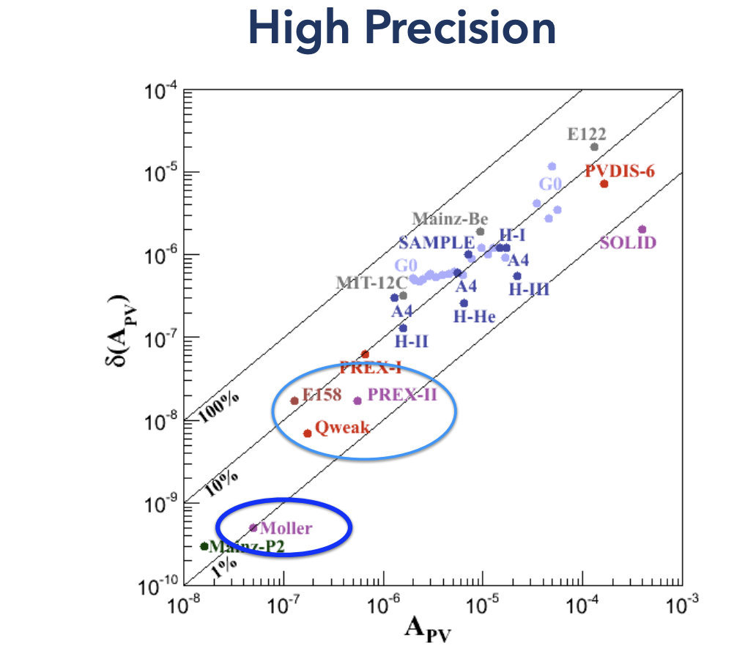
MOLLER INTRODUCTION
Measurement Of Lepton-Lepton Electroweak Reaction.
Measures weak charge of electron using Parity Violating electron Scattering (PVeS); measurement precision allows for significant test of electroweak physics and search for physics beyond the standard model
Prediction
A_{PV} = 35.6 ppb
δ(Q_{W}^{e}) = ± 2.1 % (stat) ± 1.0 % (syst)
δ(A_{PV}) = 0.73 parts per billion, δ($sin^{2}θ_{w}$ ) = ±0.00028
signal rate: 135 GHz run time: 8200 hours
The parity violating asymmetry in the scattering is:
$$A_{PV}=\frac{σ_{R}−σ_{L}}{σ_{R}+σ_{L} }=mE \frac{G_{F}}{\sqrt{2}πα}\frac{4\sin^{2}{θ}}{{\left(3+\cos^{2}{θ}\right)}^{2}}Q_{w}^{e}$$
$A_{PV}∝$ $Q_{w}^{e}$
The weak charge of electron is:
$Q_{w}^{e}=1−4sin^{2}θ_{w}$ (electroweak theory prediction at tree level)
Where$sin^{2}θ_{w}$ is the electroweak mixing angle..
sagarregmi@isu.edu
3

Slide 5
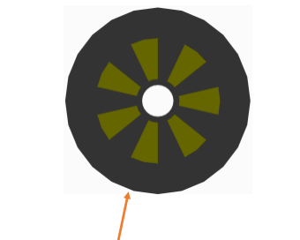
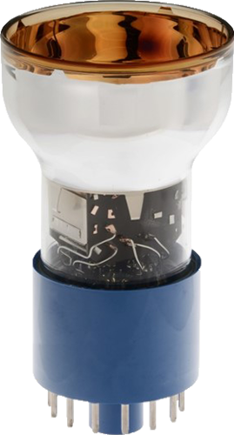
MOLLER Intro… and PMT
Components
CEBAF beam: ~90% longitudinally polarized, 11 GeV, Helicity reversal @ 960 Hz
Toroidal Spectrometer: Upstream and downstream, focuses the full momentum range of scattered particles ranging 2-8 GeV.
Tracking Chambers
Integrating detector: Main int det, Shower-max detector, Pion background detector
Aux detectors: SAMs, LAMs, Scanners
The photomultiplier tube (PMT) converts a continuous stream of photons into a steady anode current during a helicity window, which is then converted to a voltage signal using a preamplifier and digitized by an 18-bit ADC for integration over the same window.
PMT
sagarregmi@isu.edu
4

Slide 6
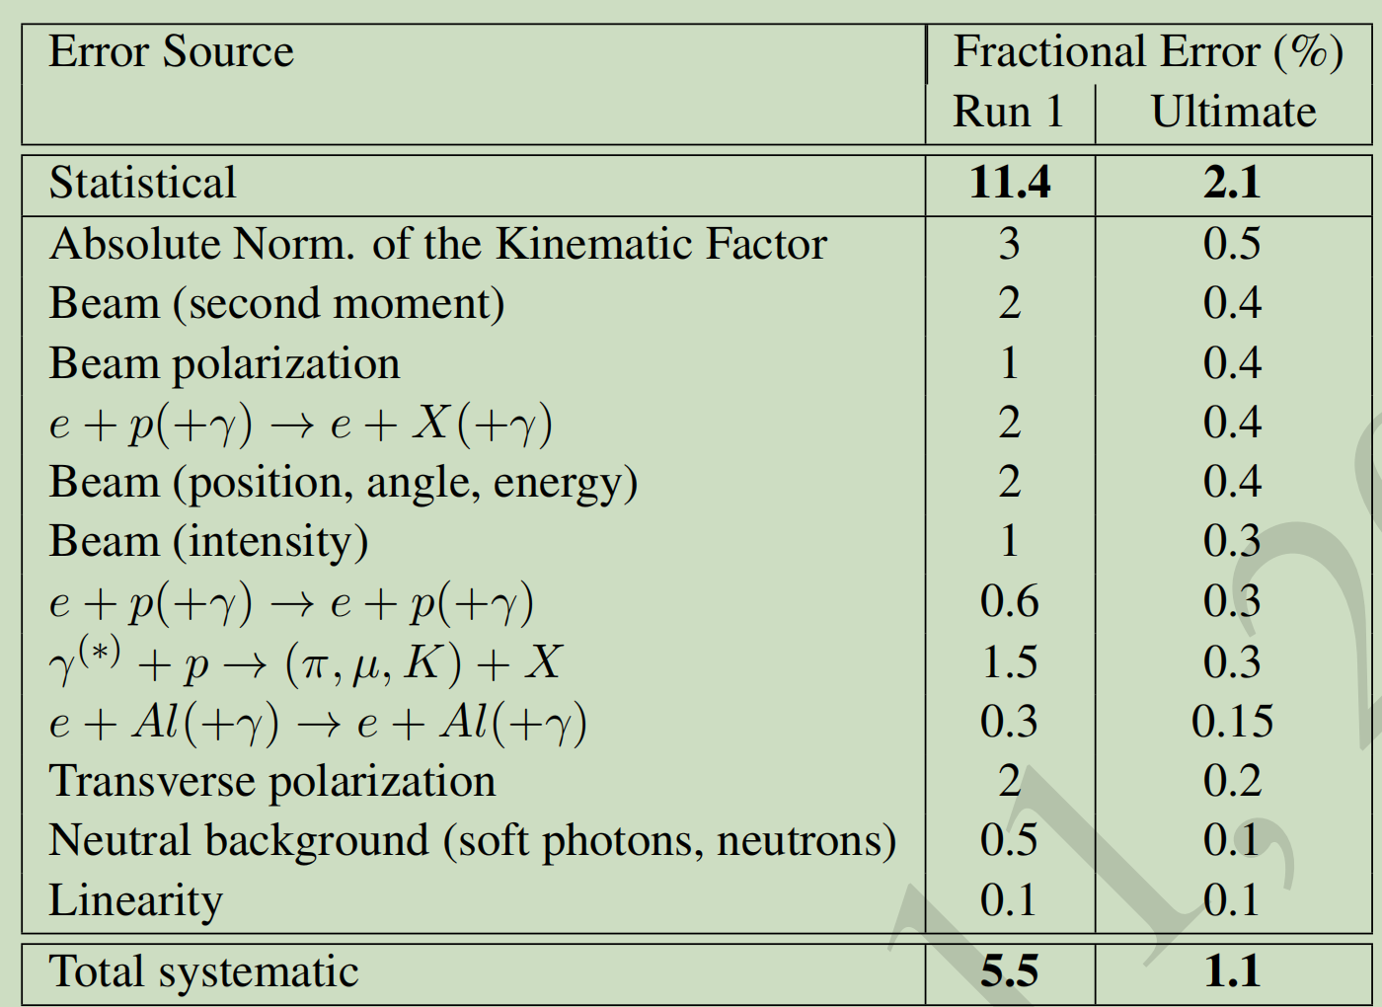
Systematic Error
There are many source of systematic error like kinematic factor, Beam(second moment, polarization, Beam intensity, radioactive corrections, background radiations and PMT non-linearity
The non-linearity of the detector is mainly caused by the PMT gain's non-linear response to its cathode current.
PMT non-linearity is an important systematic error and needs to be understood well before experiment
Summary of projected fractional statistical and systematic errors on the parity-violating asymmetry.
sagarregmi@isu.edu
5

Slide 7
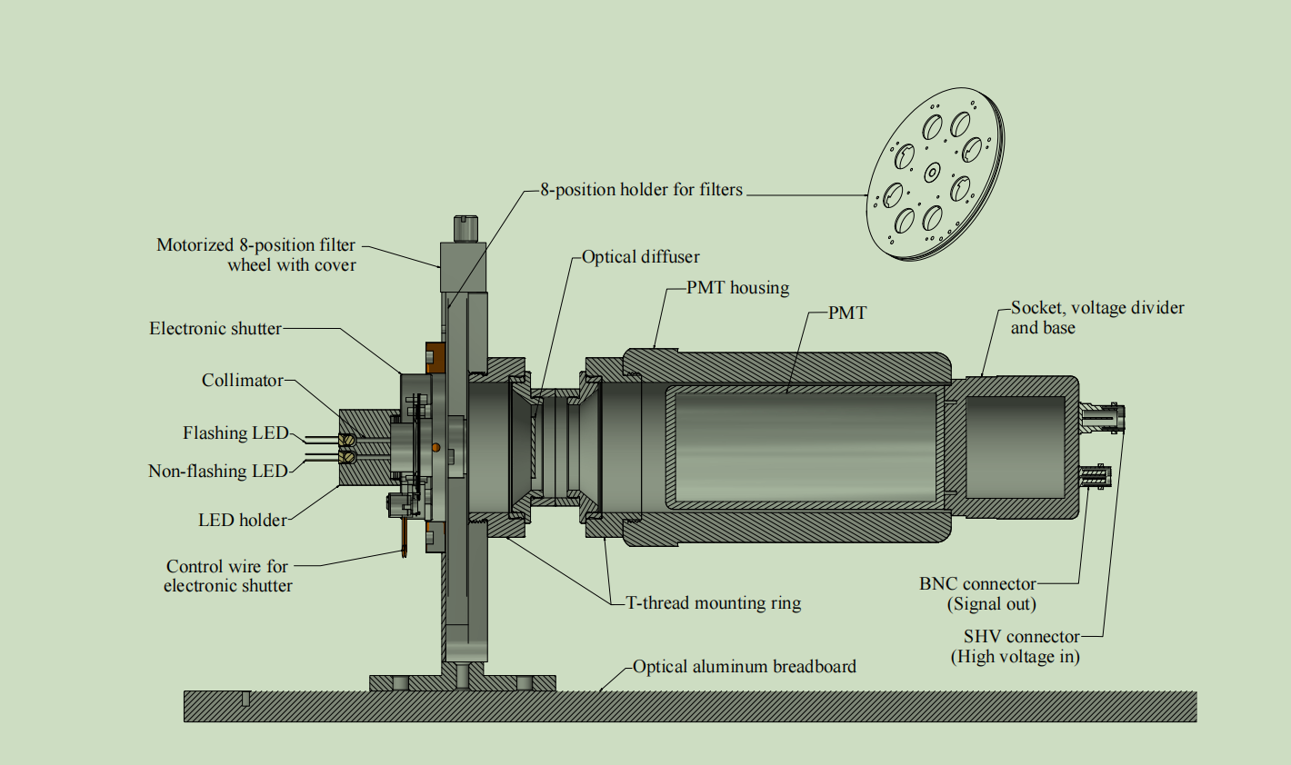
Non-Linearity Measurement setup
Non-Flashing LED provides overall Light Level (Cathode Current) and Flashing LED operated at helicity reversal frequency 960Hz provides small LED asymmetry.
The filter transmission settings are: 1, 10, 25, 40, 50, 63, 79, and 100 %. These were pseudo randomly arranged around the wheel
The synchronized square wave from an arbitrary function generator is used to control both the intensity and frequency of the flashing LED, as well as the DAQ frequency.
The DAQ records ON and OFF state of LED.
The CODA (CEBAF Online Data Acquisition) software package is used for data collection.
Fig : CAD view of bench-test setup used for PMT non-linearity calibration. This assembly is kept in a light-tight box while taking data.
sagarregmi@isu.edu
6

Slide 8
Calculations
The first order non-linearity of the measured PMT signal asymmetry is given by
$A_{LED}=\frac{N_{PMT}^{+}−N_{PMT}^{−}}{N_{PMT}^{+}+N_{PMT}^{−}}$ ≈ Atrue(1 + βNavg), With $N_{avg}=\frac{N_{PMT}^{+}+N_{PMT}^{−}}{2}$
$$N_{PMT}^{±}=N^{±}\left(1+βN^{±}\right) \text{Is} \text{the} \text{PMT} \text{response} \text{for} \text{the} \text{signal} N^{±}\text{. }$$
$$N^{+} →when both LED is ON \&$$
$$N^{−} →when flashing LED is OFF$$
$$β parameterizes the non linearity$$
Fits to A_{LED} vs. N _{avg} or V_{adc} plot give A_{true} and A_{true}β and hence the non-linearity.
sagarregmi@isu.edu
7

Slide 9
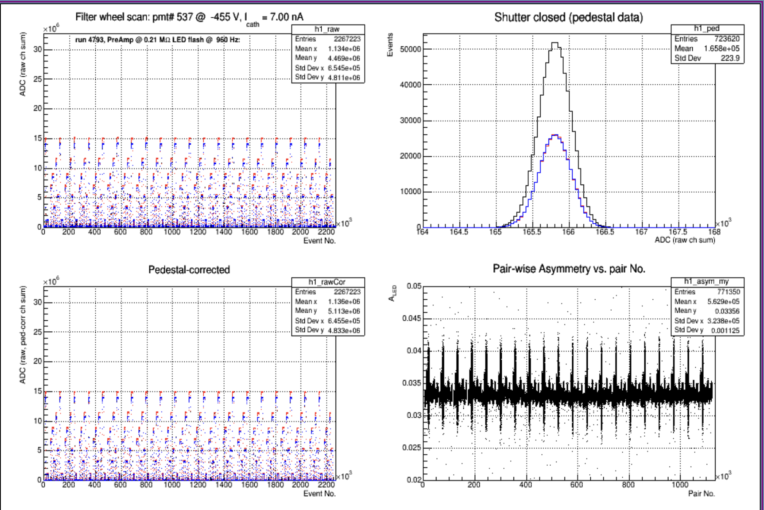
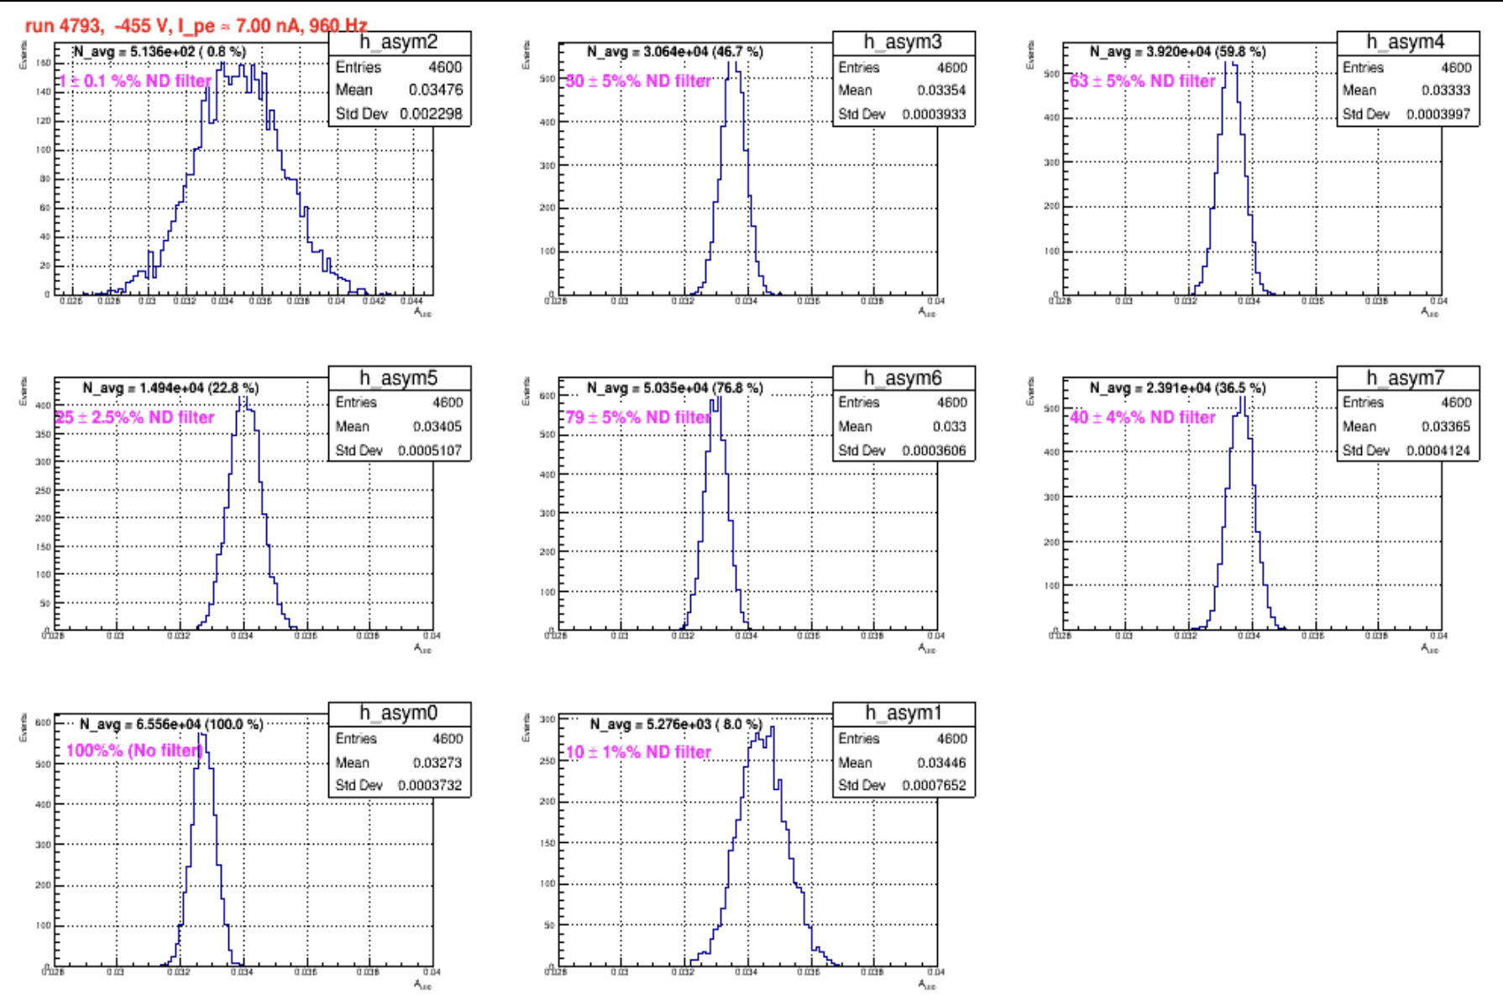
Results and Observed Graphs
Plot: Raw, Pedestal, Corrected and Asymmetry Distributions(7.0 nA LL)
Plot: Filterwise Asymmetry Distributions for 1st filter cycle(7.0 nA LL)
sagarregmi@isu.edu
8

Slide 10
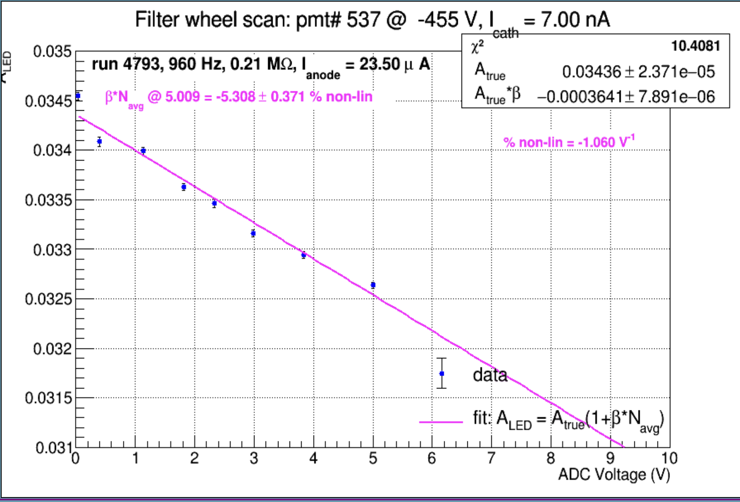
Summary and Future works
We developed a bench-test setup to characterize the PMT non-linearity, which mimicked the same technique of asymmetry measurement as in the precision electroweak experiments like PREX-2 and CREX.
We have different pmt base for MOLLER compared to PREX/CREX, in which the preamplifier is embedded in it. We are also using different ADC.
We are also trying to use a different software package then CODA to record the events.
However, the technique of measuring non-linearity has not changed with the new setup.
Plot: A_{LED} vs V_{ADC} plots and non-linearity calculation(7.0 nA LL)
Other Works: Designing of Shower Max Detectors, Radiation hardness Testing
sagarregmi@isu.edu
9

Slide 11
Acknowledgement
Prof. Dr. Dustin E. McNulty, Chair of Department of Physics, Idaho State University
Dr. Devi L. Adhikari, Research Associate, Virginia Tech
Sudip Bhattarai, Graduate Student, Idaho State University
MOLLER collaborators
HUGS Program 2023 organizers and participants
sagarregmi@isu.edu
10

Slide 12
Thank you
Thank You!!
sagarregmi@isu.edu
11

Slide 13
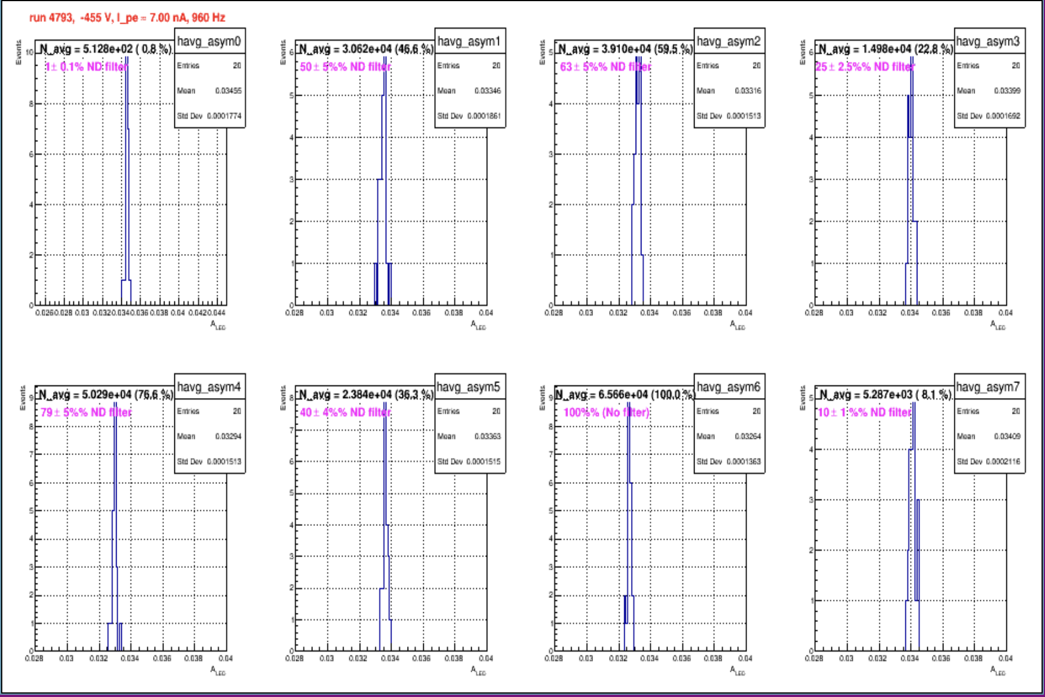
Extra Slides
The New ADC Board
Plots: Filterwise Average Asymmetry Distributions for 20 filter cycle(7.0 nA LL)
sagarregmi@isu.edu
12

Slide 14
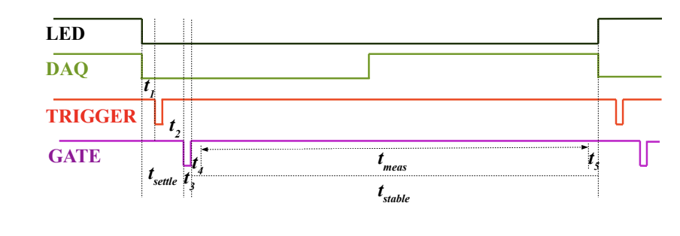
Timing Setup
Timing diagram for PMT non-linearity bench tests. The ADC samples the data only during the t_{meas} time window
sagarregmi@isu.edu
13

Slide 15
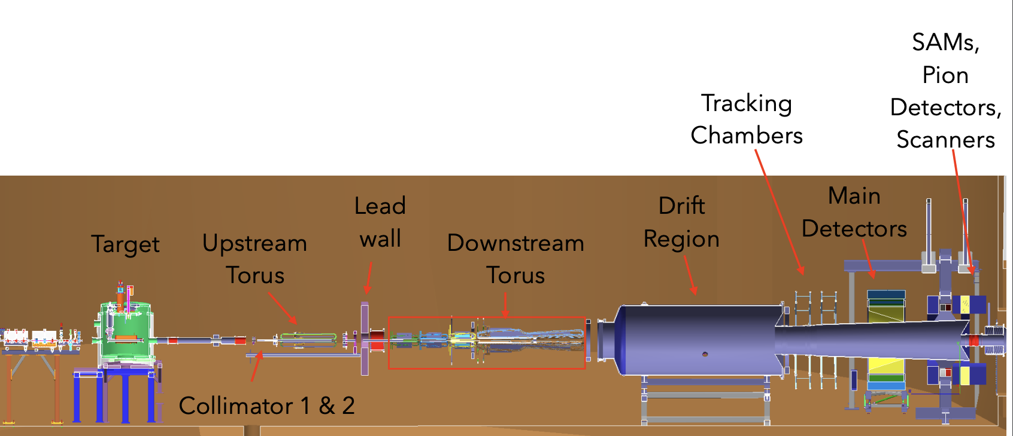
MOLLER Intro…
Components
CEBAF beam: ~90% longitudinally polarized, 11 GeV, Helicity reversal @ 960 Hz
Toroidal Spectrometer: Upstream and downstream, focuses the full momentum range of scattered particles ranging 2-8 GeV.
Tracking Chambers
Integrating detector: Main int det, Shower-max detector, Pion background detector
Aux detectors: SAMs, LAMs, Scanners
sagarregmi@isu.edu
14

Slide 16
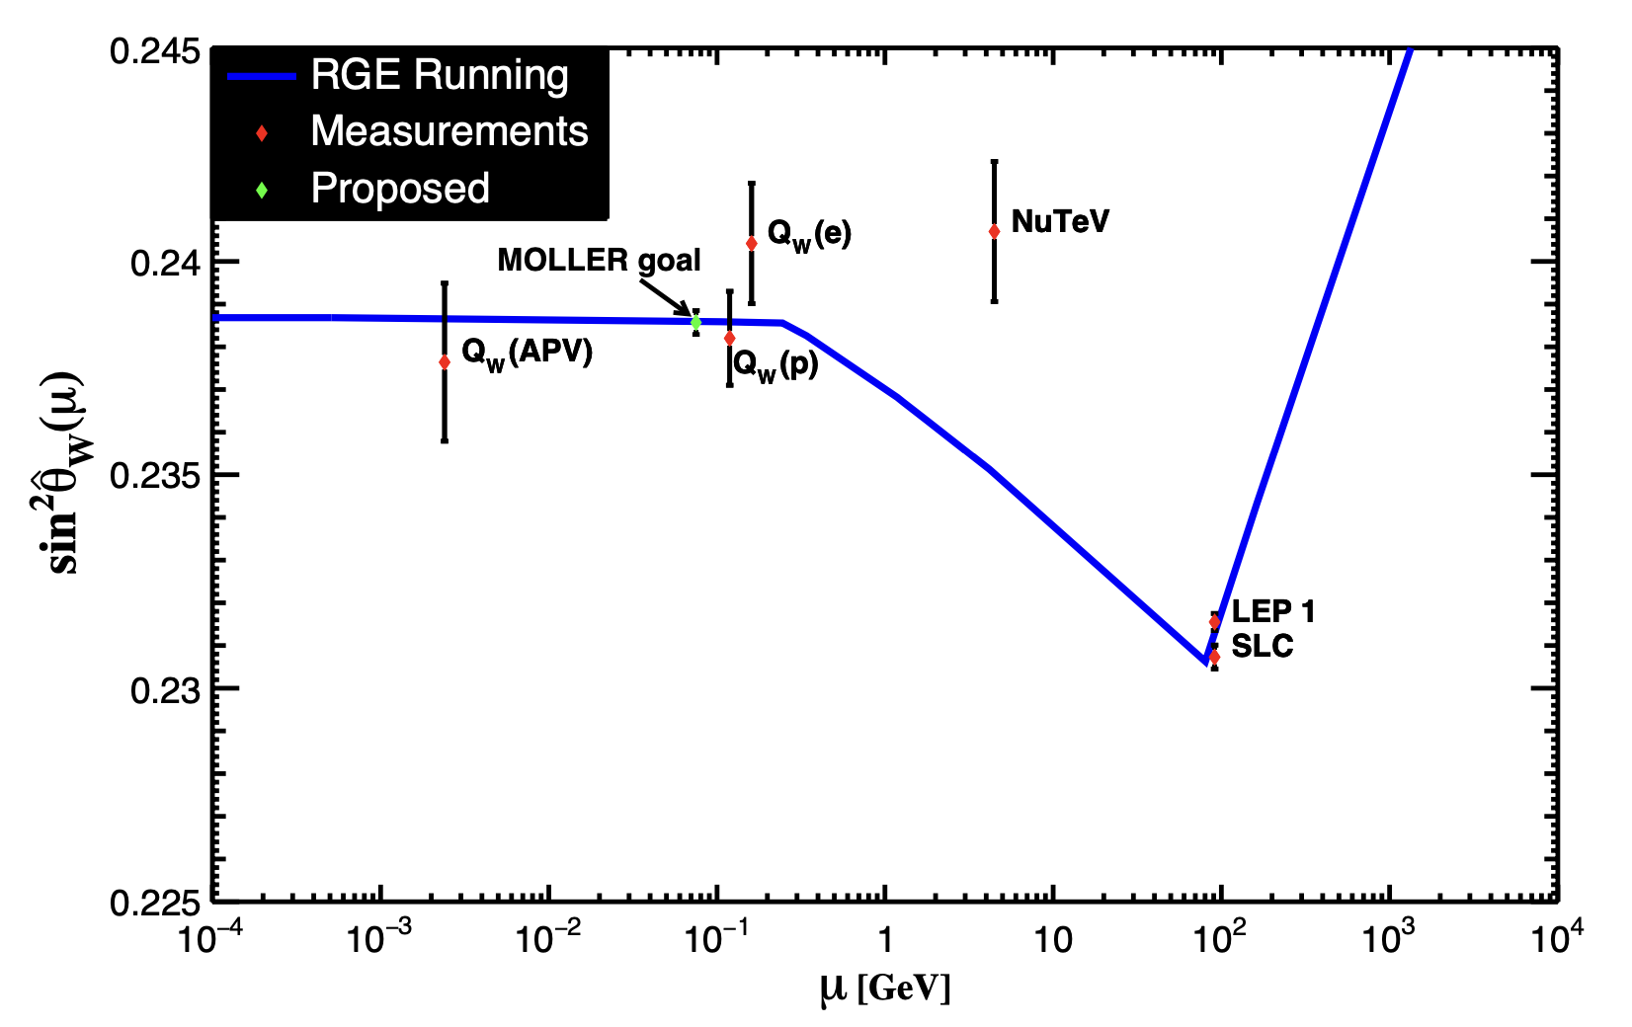
The weak mixing angle
Fig: The weak mixing angle from the various experiments vs the energy scale. The running blue curve is the standard model prediction. The proposed MOLLER experiment is shown with the expected error bar.
sagarregmi@isu.edu
15

Slide 17
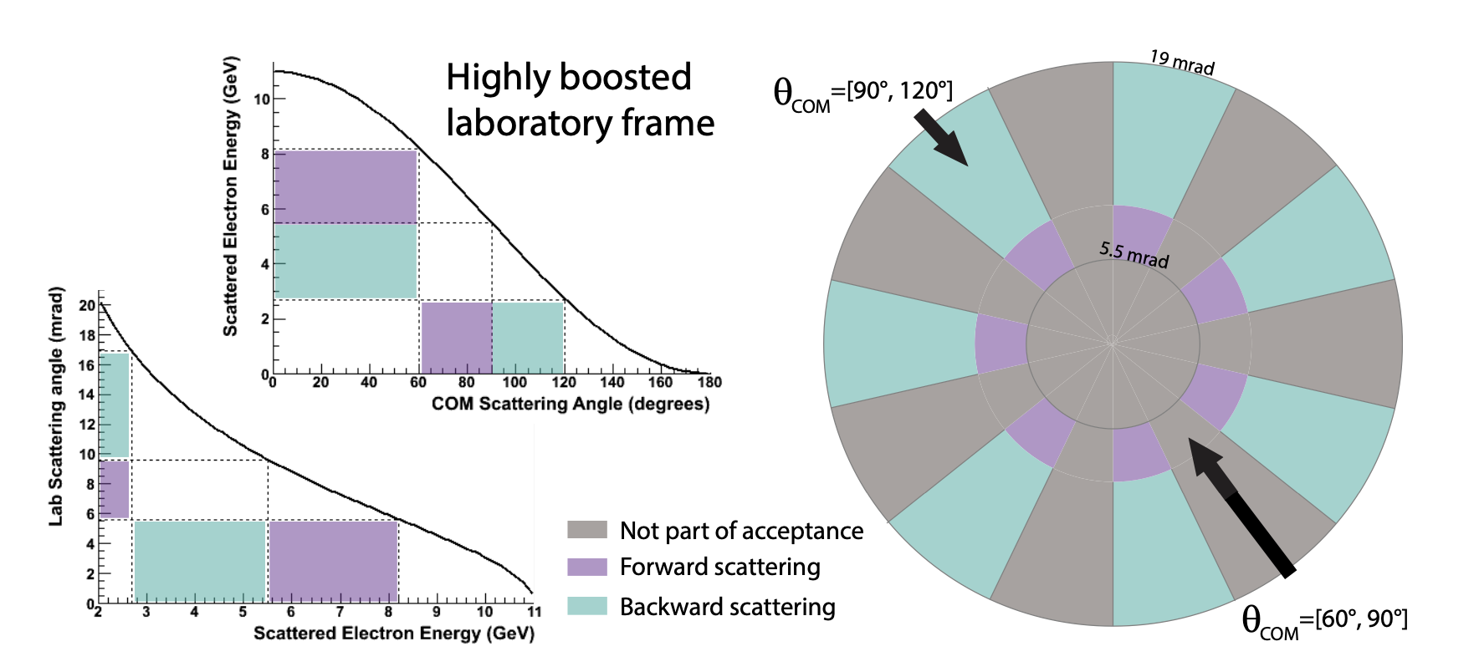
Spectrometer
Left 2 plots: Relationship between the lab and COM angles for E_{beam}=11 GeV
Right plot: Primary acceptance for Moller electrons
sagarregmi@isu.edu
16

