Slide 1
On Extraction of TMDs from SIDIS
Fidele J. Twagirayezu
UCLA

Slide 2
Motivation and objective
Importance of TMDs
information about the nucleon structure, i.e the 3-D imaging of the nucleon in momentum space
help to understand some important aspects of QCD such as gauge invariance and universality properties
help to Learn about confinement and hadronization
Extraction of TMDs such as transversity function and Collins fragmentation function from SIDIS with global fits

Slide 3
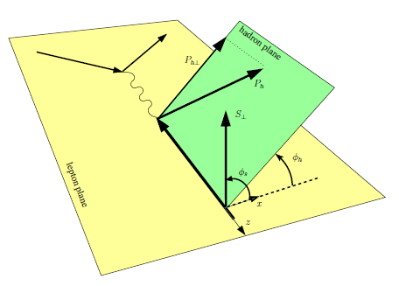
Extraction of TMDs
Semi-inclusive DIS process:
Factorization : a tool for separating effects from short-distance (s.d) scales and long-distance (l.d) effects and parametrizing (l.d) effects in universal quantities

Slide 4
Extraction of TMDs
Structure functions:
The Y- term dominates If . In the region of low
Collins azimuthal asymmetry :

Slide 5
Extraction of TMDs
Structure functions are expressed in b-space, e.g.
Light-cone singularity if the gauge link is along the light-cone direction and energy divergence due to the soft factor
A choice of regularization defines a TMD scheme, for e.g in Ji-Ma-Yuan scheme:
so the gauge link is slightly off-light cone

Slide 6
Extraction of TMDs
Unpolarized structure function in b-space
where
After solving evolution eq., the final expressions for TMDs are obtained by considering
In the new Collins-11 scheme, the subtraction of the soft factor leads to the absence of both light-cone singularity and energy divergences, e. g:

Slide 7
Extraction of TMDs
Divergence and evolution
Divergences lead to evolution:
Ultraviolet divergence : renormalization group equation, e.g. running of coupling constant
Collinear divergence : DGLAP evolution of collinear parton distribution function (PDF), fragmentation function (FF)
DGLAP evolution = resummation of single logs in the higher
-order corrections
Rapidity divergence (light-cone singularity): TMD evolution
TMD evolution = resummation of double logs in the higher
-order corrections
single logs: double logs:

Slide 8
Extraction of TMDs
How to make sense of divergences:
Ultraviolet (UV) divergence : renormalization (redefine coupling constant)
Collinear divergence : redefine the PDFs and FFs
Soft divergence : usually cancel between real and virtual diagrams for collinear PDFs/FFs; do not cancel for TMDs, leads to new evolution equations

Slide 9

Extraction of TMDs
Collins-Soper (CS) equation gives the rapidity evolution with resp. to $ς$
where is CS kernel. The dependence on $μ$ scale is given by RGE for
At low values of , becomes a hard scale, then one defines an new scale,
The b-dependence of TMDs can be computed in terms of collinear PDF and FF in the region

Slide 10
Extraction of TMDs
The energy evolution of TMDs from $μ$b to Q is encoded in the Sudakov factor:
The perturbation breaks down for large value of b, and
reaches the Landau pole which indicates non-perturbative Physics. In the CSS approach, the b* prescription introduces a cutoff
The b* prescription allows a smooth transition from the perturbative region to the non–perturbative region

Slide 11
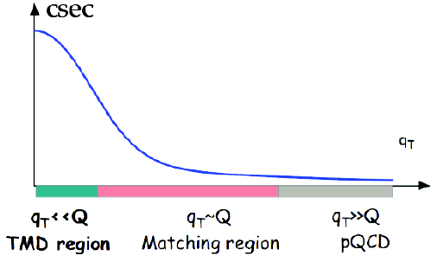
Extraction of TMDs
Matching in SIDIS
In the perturbative region, TMDs are matched onto their collinear counterparts with perturbatively calculable C-functions

Slide 12
Extraction of TMDs
Un-polarized PDF and FF with TM evolution:
are scheme-dependent. In the standard CSS formalism, they are absorbed in the C-functions
Convolution integrals are evaluated using the Mellin transformation

Slide 13
Extraction of TMDs
Collins structure functions:
With TMD evolution
are absorbed in C-functions

Slide 14
Extraction of TMDs
Twist-3:
The evolution equations for and are

Slide 15
Extraction of TMDs
Parametrization of transversity:
is unpolarized PDF and is helicity PDF
Parametrization of Collins function:
is unpolarized FF,
and then one solves DGLAP equations both for h1 and Collins FF to the scale
Free parameters:

Slide 16
Extraction of TMDs
Parametrization of non-pertubative Sodakov factors for all TMDs:
Some parameters:
fixed parameters:
free parameters:

Slide 17
Extraction of TMDs
Fitting procedure:
One minimize
is the theoretical estimate for a set of free parameters
data sets each containing Ni data points
is the experimental measurement of each data point
is the experimental uncertainty
Rough idea of a good fit, for N points:
In principal, the model describes the data:
Noise:

Slide 18
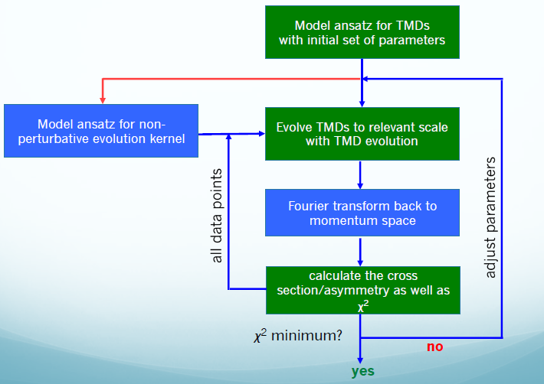
Extraction of TMDs
Credits: Prof. Zhongbo Kang (UCLA)

Slide 19
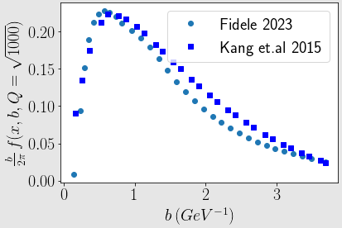
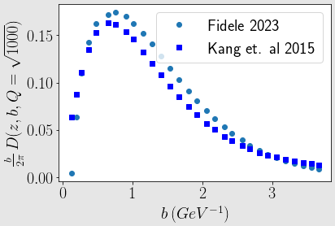
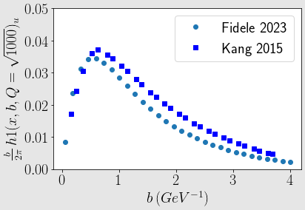
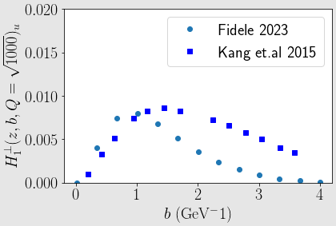
Extraction of TMDs
Benchmark with Kang et. al 2015

Slide 20
Extraction of TMDs
Summary and future work:
TMDs are important tools to investigate structure of the nucleon and QCD dynamics, and much more
The benchmark of Fidele 2023 with Kang et al. 2015 is done for the scale Q^2 =1000, and there are some minor discrepancies
The future work will consist of finding the source and physical meaning of these discrepancies. Also, there is a need for benchmarking for different scales, and finally the extraction of h1 and Collins FF will follow

Slide 21
Thank you for your hospitality

