Slide 1
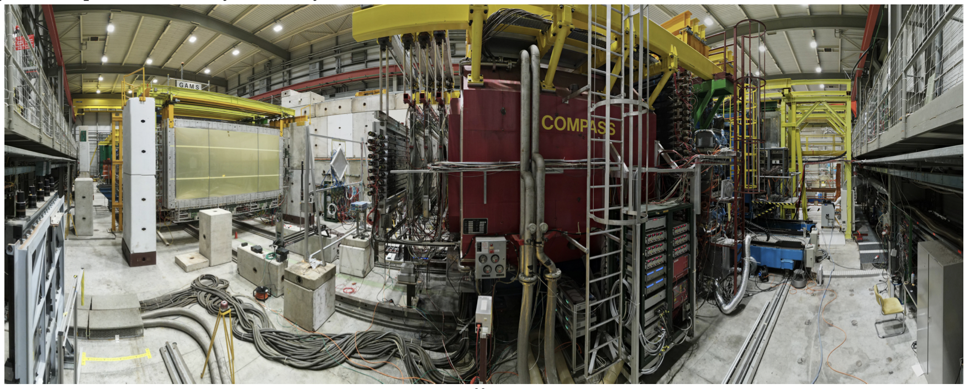
Semi-Inclusive DIS at COMPASS
Athira Vijayakumar
HUGS Summer School 2023

Slide 2
OVERVIEW
Motivation
What are PDFs, TMD PDFs, TMD FFs?
What is SIDIS? Why SIDIS?
COMPASS - Muon Run 2022
Future prospects in TMD Physics

Slide 3
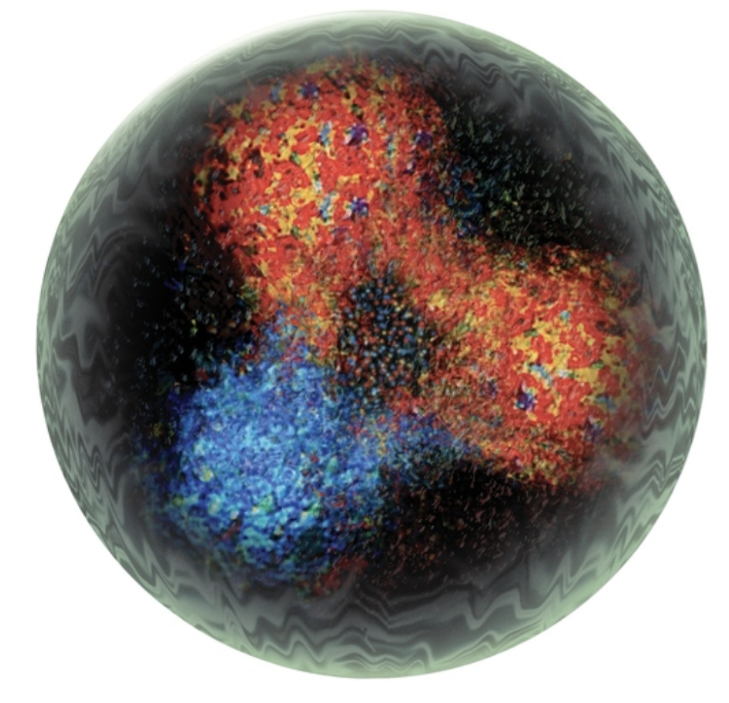
MOTIVATION
Curious to know about the fundamentals of the universe?
Look at the building blocks - protons and neutrons!
Understand how they are held together - the strong nuclear force!
Investigate what is inside them - complex internal structure!
Plenty of theoretical and experimental evidence for transverse motion of partons within nucleons
Nucleon Tomography!

Slide 4
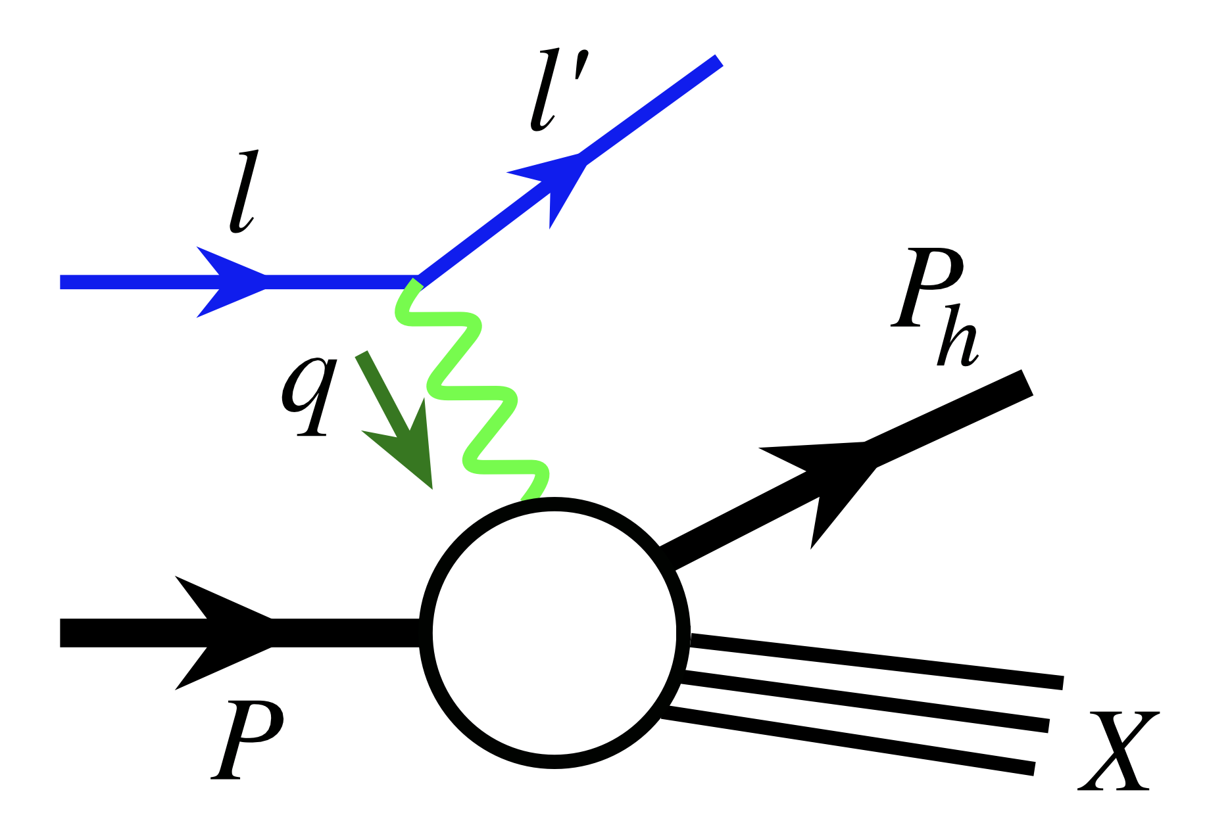
PDFs, TMD-PDFs and TMD-FFs
Parton Distribution Functions describe the longitudinal momentum distributions of partons (quarks and gluons) inside the nucleon.
Transverse momentum extensions of longitudinal momentum– dependent parton distribution functions are called transverse momentum–dependent (TMD) PDFs.
x_{i}P
P
x_{i} - fraction of the proton’s longitudinal momentum (P) carried by the parton
Access TMD PDFs through Semi Inclusive Deep Inelastic Scattering (SIDIS).
TMD-PDFs encode transverse momentum and transverse spin of the partons and their correlations (also with the nucleon spin) as a function of Bjorken x, Q² and the parton transverse momentum k_{T.}

Slide 5
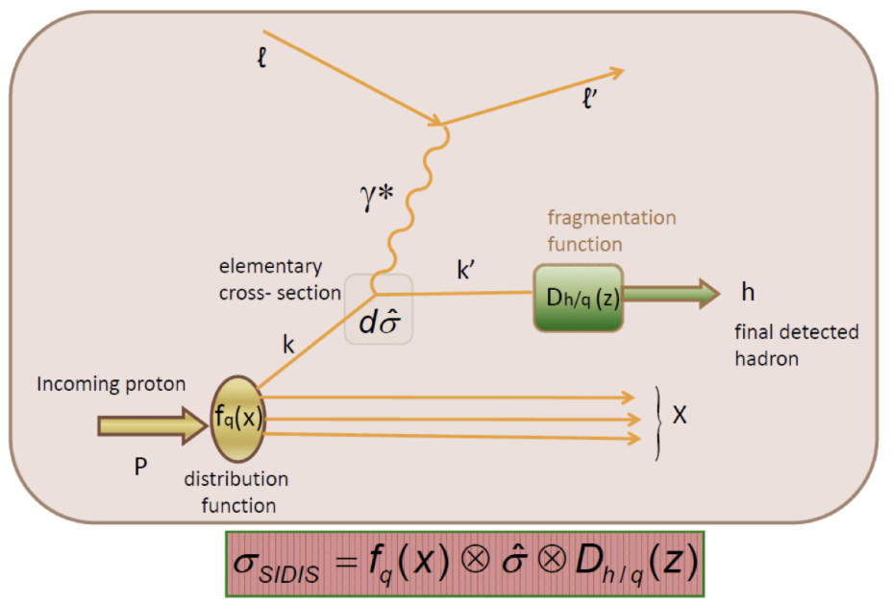
PDFs, TMD-PDFs and TMD-FFs
At leading twist, a complete description of the nucleon structure is given by eight independent TMD-PDFs.
Analogously, TMD-FFs (Fragmentation Functions) encode the probability of a hadron to arise from a fragmenting parton with a certain fraction of the parton’s longitudinal momentum and a small transverse momentum relative to the parton.
In today’s talk, we will discuss the Transversity and Sivers PDF and Collins FF

Slide 6
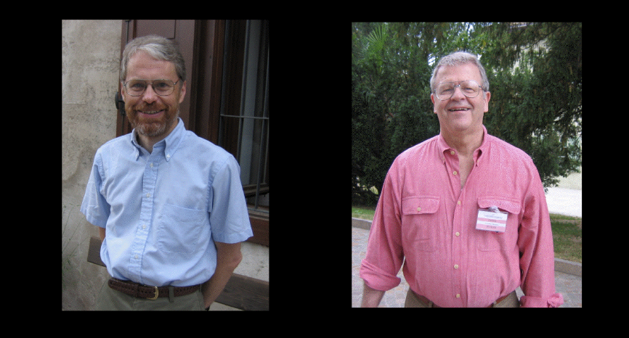
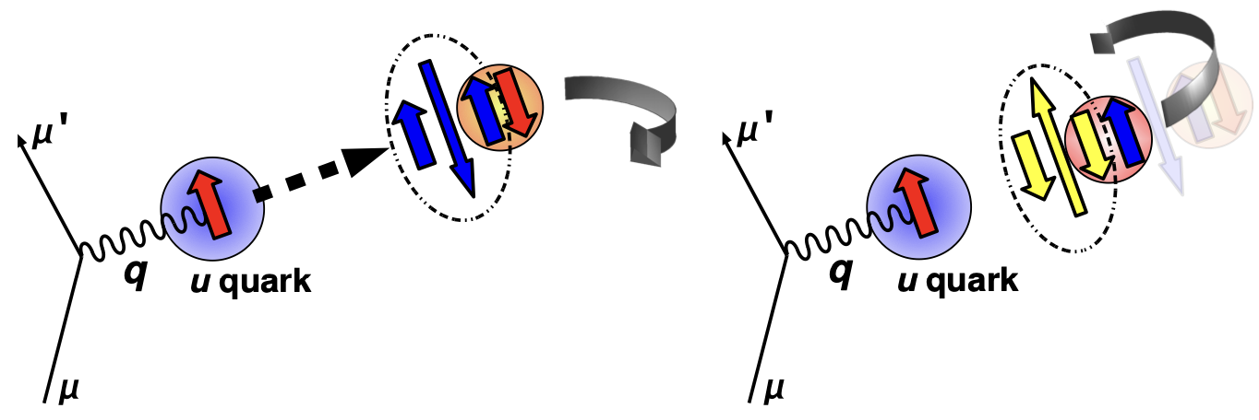
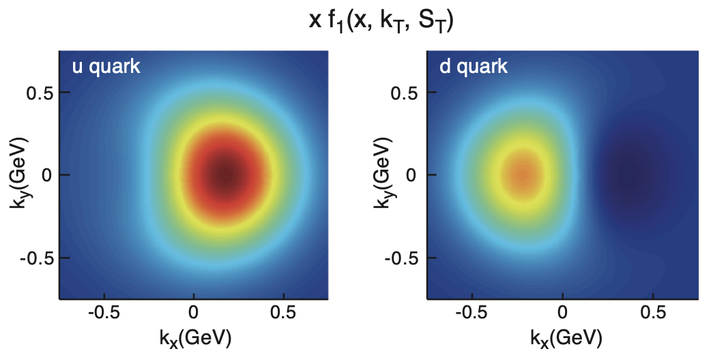
Collins and Sivers Effects
Collins function: unpolarized hadron from
a transversely polarized quark
Sivers function: unpolarized quark distribution inside a transversely polarized nucleon
TMD FF
TMD PDF
Eur. Phys. J. A (2016) 52: 154

Slide 7
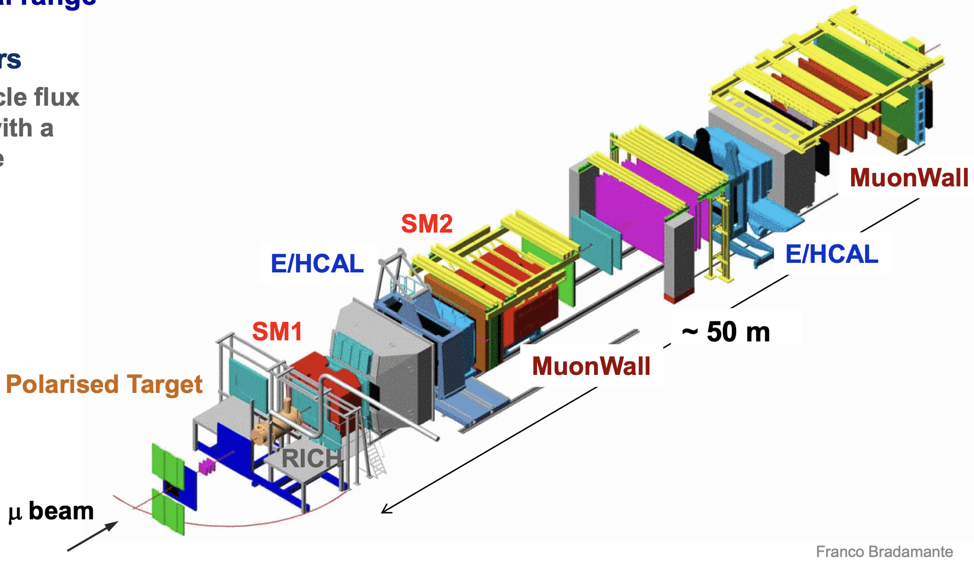
COMPASS Muon Run 2022
(COmmon Muon Proton Apparatus for Structure and Spectroscopy)
Located at SPS at CERN in Geneva
Fixed target experiment, Consists of two spectrometers
2022 Run is aimed at SIDIS of muons off transversely polarised ⁶LiD target
2022 muon beam at 160 GeV
Variety of tracking detectors to cope with different particle flux with a good azimuthal and angular acceptance
Calorimeters and Muon Identification
The 2022 data-taking campaign was the last run of the COMPASS experiment, and the last of the experiment’s exploratory study of the nucleon structure.

Slide 8
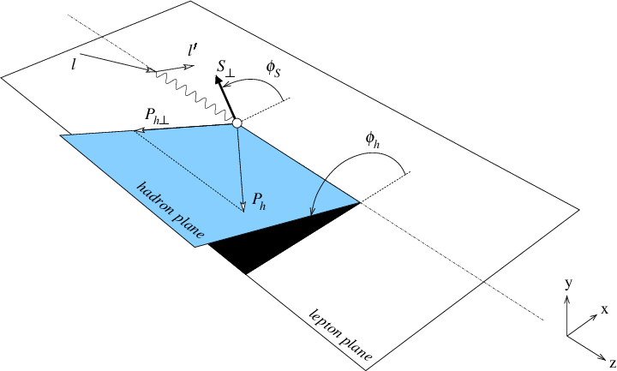
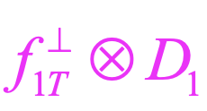
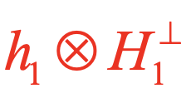
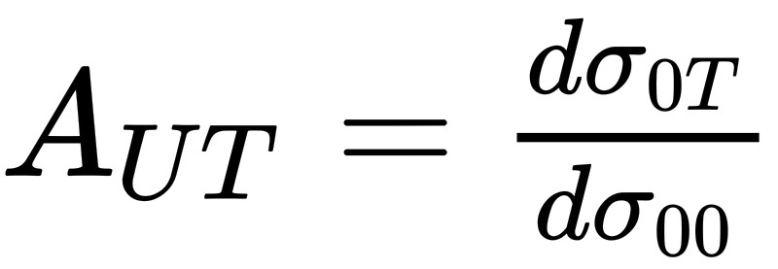
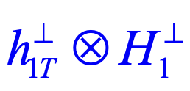
What we measure at COMPASS
Experimental Observable:
The differential cross-section of SIDIS can be expressed as;
Sivers D1
The scattering cross-section can be broken down as ~
transversity Collins
pretzelosity Collins
M. Anselmino et al., PRD 83, 114019 (2011)

Slide 9
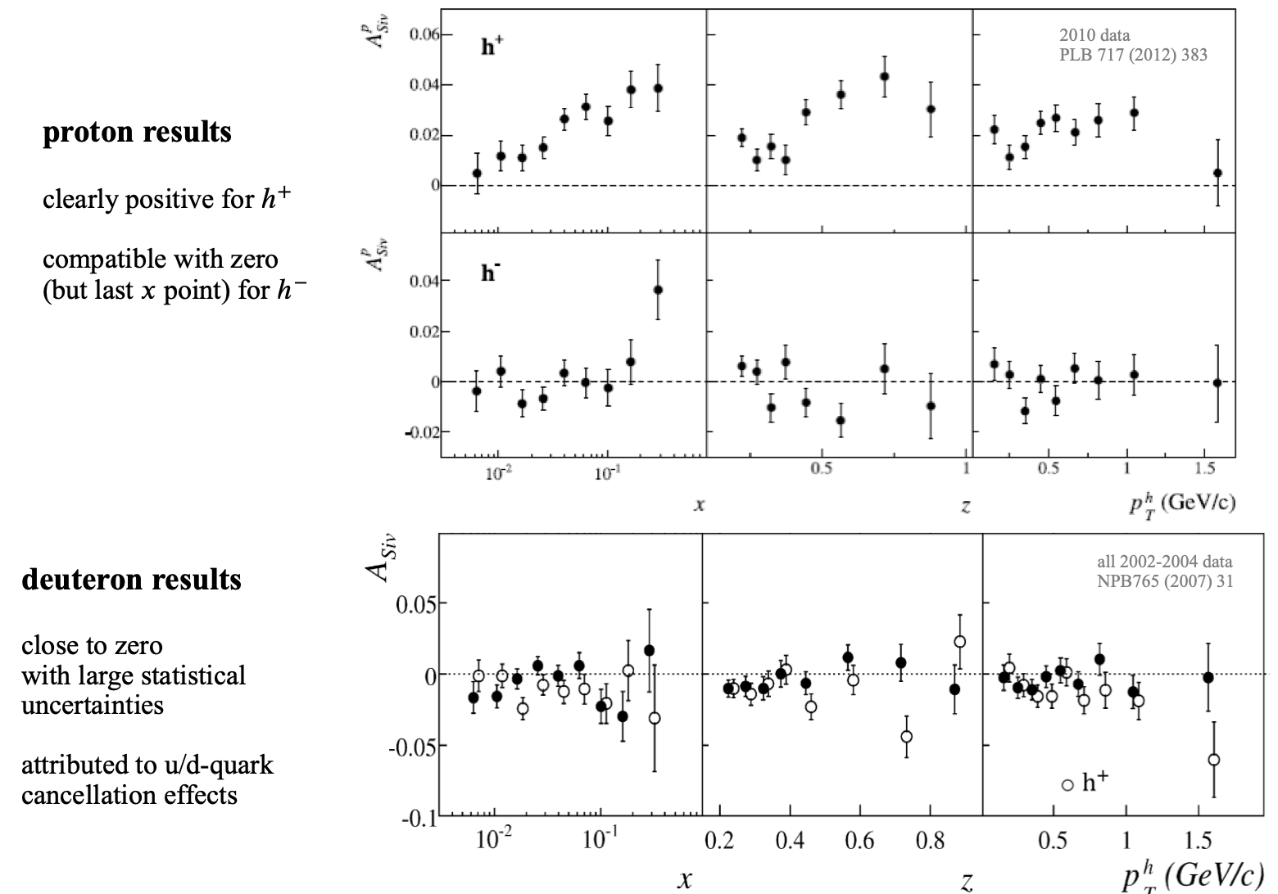
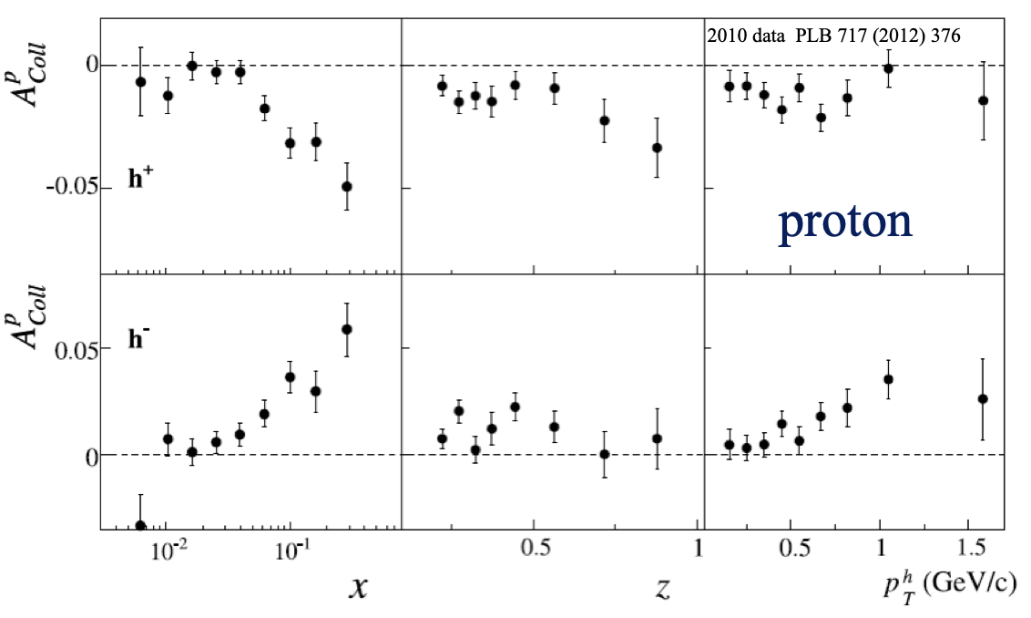
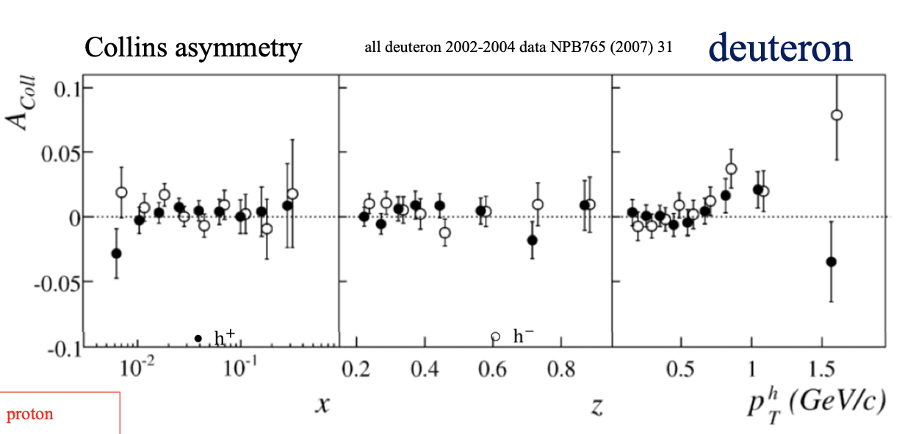
Previous Results from COMPASS
Sivers asymmetry
Collins asymmetry
proton
deuteron
Proton: Clearly positive for positive hadrons
Compatible with zero for negative hadrons(?)
Deuteron: Compatible with zero but large uncertainties
Attributed to u/d - quark cancellation effects
Proton: Clear signal in the valence region
Opposite signs for h+ and h-
Deuteron: Compatible with zero
Maybe a signal at high Pt?
Indication of u and d quarks cancellation?

Slide 10
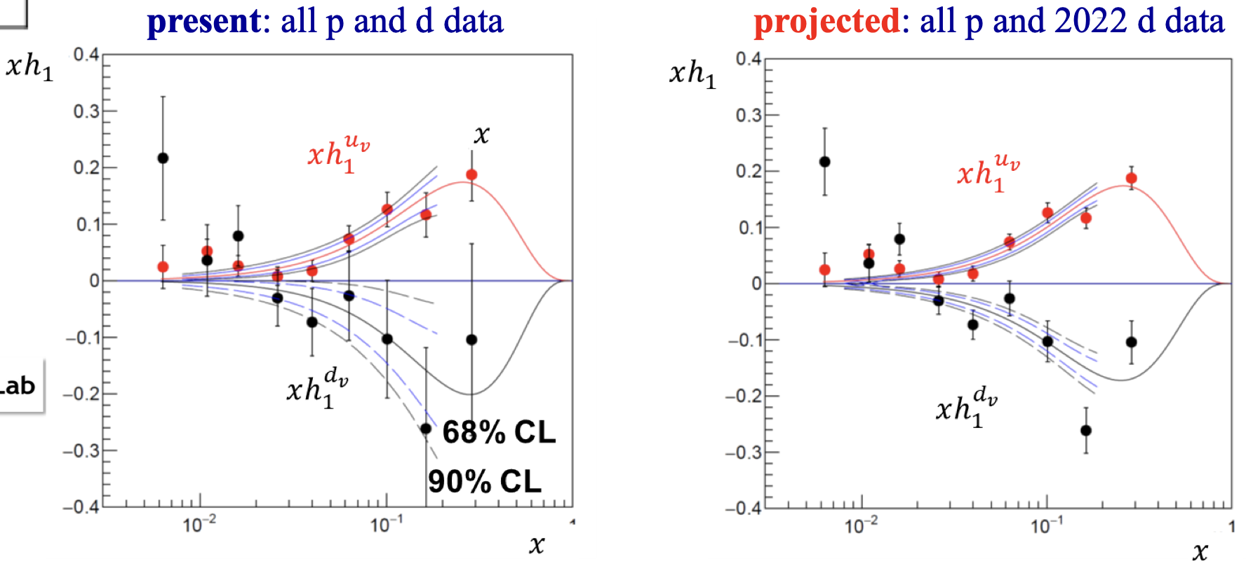
What more in 2022 Run
Reduce the uncertainties!
Impact on transversity TMD PDFs and tensor charge
Phys. Rev. D 102, 054002 (2020)
The 2022 run on transversely polarized deuteron target is expected to improve the d quark distributions significantly!
The analysis has begun.
Exciting results coming soon!!
CERN–SPSC–2017–034

Slide 11
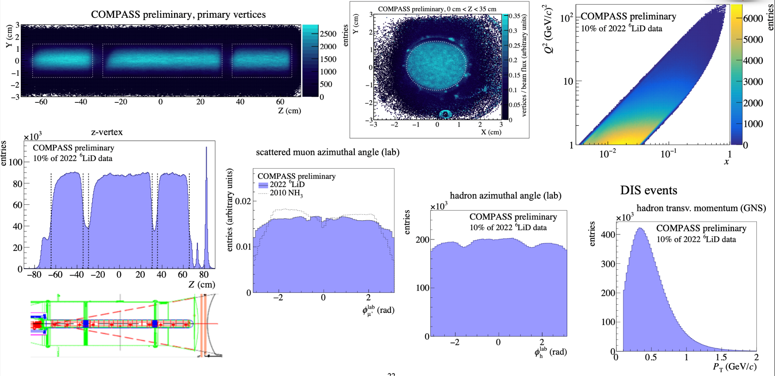
Initial look at 2022 data

Slide 12
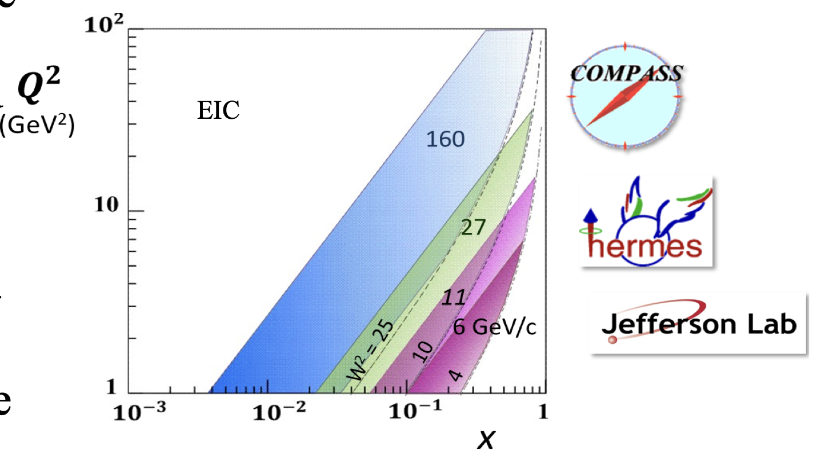
Future prospects
Precise measurements are needed in particular at larger 𝑥.
The complementary measurements at Jlab 12 and 20+ will allow for a more precise measurement of the tensor charge and, in the farther future, the EIC.

Slide 13
Backup

Slide 14
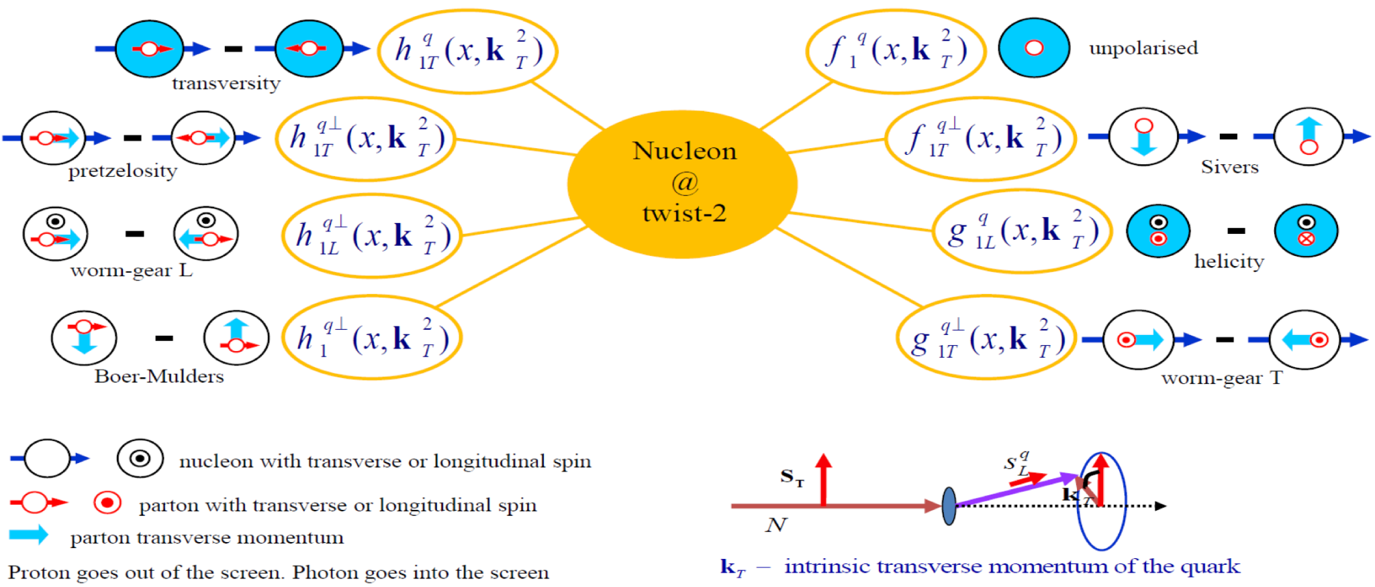

Slide 16
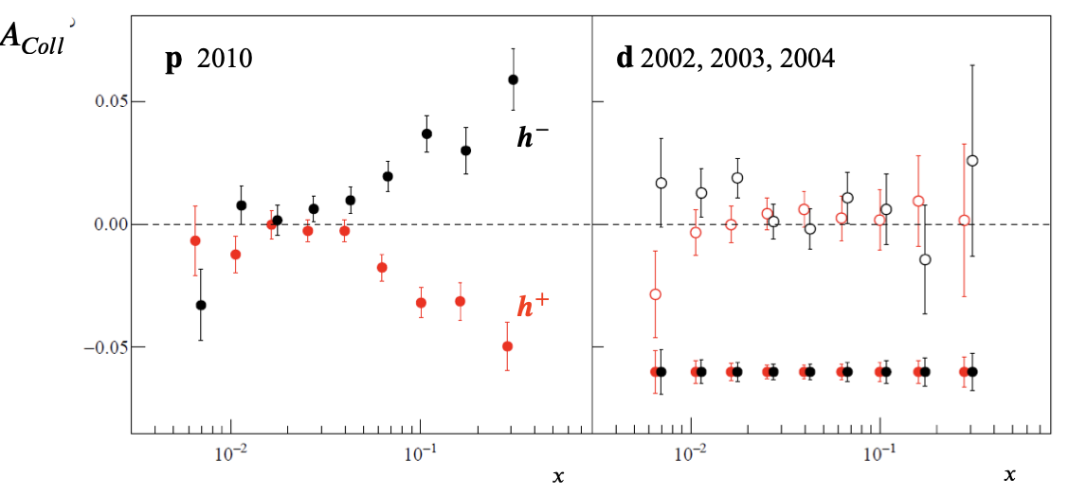
The deuteron asymmetries will have statistical uncertainties (relative to proton 2010 data)
𝝈_{𝒅} ≅ 𝟎.𝟔 𝝈_{𝒑} ²⁰¹⁰

Slide 17
Data taking period in 2022
Divided into two sub-periods(a week each)
Sub-period 1
Sub-period 2

