Slide 1
History and Project Status
Election-Ion Collider
Douglas W. Higinbotham
8 June 2023

Slide 2
Fixed Target and Collider Beam Electron Scattering Facilities
CEBAF at Jefferson Lab
  Decade long physics program with 12GeV beams
    Lots of exciting new results and fantastic new experiments
    Outstanding new ideas still being developed!
    PAC51 will be held last week of July
      Eight Electron Experiments submitted
      Six Positron Experiments submitted
      For more information about positron see: https://link.springer.com/journal/10050/topicalCollection/AC_e1e21fcfbc06a710672e7faf53314693
  Very exciting ideas for increasing Jefferson Lab’s energy https://indico.jlab.org/event/503/contributions/9273/attachments/7474/10393/FFA_Hall_A_mtg_11Feb_rev2.pdf
Focus of this lecture will be on what science (in general) the EIC can do, what questions will it address, and the timeline.
You will get two more lectures with details on the science (F.-X.) and on the latest plans for the detector system (Yulia).

Slide 3
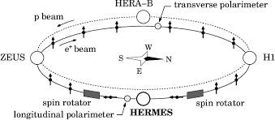
HERA
HERA (German: Hadron-Elektron-Ringanlage, English: Hadron-Electron Ring Accelerator) was a particle accelerator at DESY in Hamburg.
318 GeV center of mass energies: 27.5 GeV e, 920 GeV p
Electron-proton collider ran from 1992 – 2007
Electron polarization by Sokolov – Ternov effect.
Amazing machine and publications are still coming out from the data.
Luminosity and some design choices limited the physics reach which now naturally lead to next generation machine: the EIC.

Slide 4
Key Science Questions For The EIC To Answer
How do the nucleonic properties such as mass and spin emerge from partons and their underlying interactions?
How are partons inside the nucleon distributed in both momentum and position space?
How do color-charged quarks and gluons, and jets, interact with a nuclear medium? How do the confined hadronic states emerge from these quarks and gluons? How do the quark-gluon interactions create nuclear binding?
How does a dense nuclear environment affect the quarks and gluons, their correlations, and their interactions? What happens to the gluon density in nuclei? Does it saturate at high energy, giving rise to a gluonic matter with universal properties in all nuclei and even nucleons?
https://www.nap.edu/login.php?record_id=25171&page=https%3A%2F%2Fwww.nap.edu%2Fdownload%2F25171 and download as guest for a free copy of the National Academy of Science pdf

Slide 5
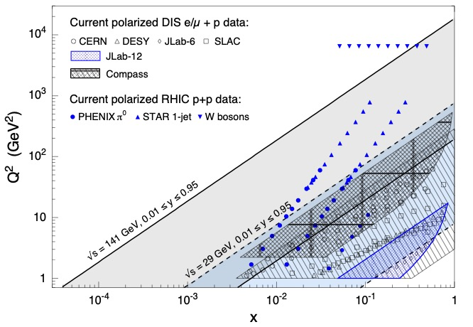
Kinematic Coverage Of The Electron Ion Collider
Q² is the Lorentz invariant four-momentum transfer and x = Q²/(2m(E-E’))
NOTE: Jefferson Lab is also very high luminosity >10³⁸ cm⁻²s⁻¹ while the proposed
EIC would be ~10³³ to 10³⁴ cm⁻²s⁻¹ so kinematic coverage alone isn’t the whole story!

Slide 6
Deep Inelastic Electron Scattering
Inclusive DIS
Semi-Inclusive DIS
Exclusive DIS

Slide 7
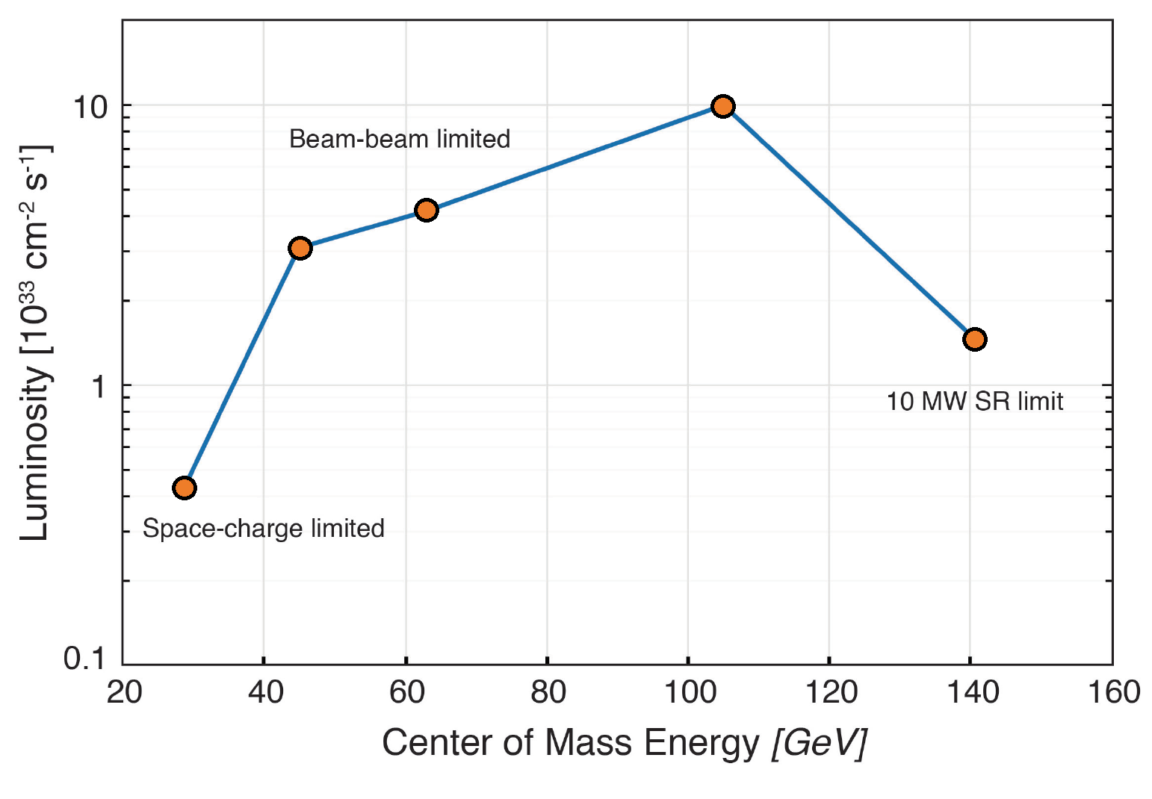
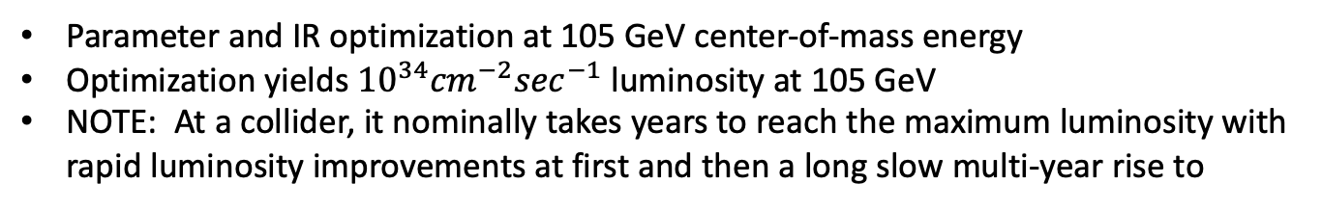
Luminosity vs Center of Mass Energy at the EIC
Parameter and IR optimization at 105 GeV center-of-mass energy
Optimization yields ${10}^{34}{cm}^{−2}\sec^{−1}$luminosity at 105 GeV
NOTE: At a collider, it nominally takes years to reach the maximum luminosity with rapid luminosity improvements at first and then a long slow multi-year rise to

Slide 8
October 2019 Review of Two Competing EIC Designs
For e-N collisions:
  Polarized beams: e, p, d/³He (effective neutron)
  e beam 5-10(20) GeV
  Luminosity ~ 10³³⁻³⁴ cm⁻²sec⁻¹
  100-1000 times HERA
  20-100 (140) GeV variable center of mass energy
For e-A collisions:
  Wide range in nuclei
  Luminosity per nucleon same as e-p
  Variable center of mass energy
Key Supporting Documents
  EIC White Paper
  National Academy of Science Report
JLEIC

Slide 9
Site Selection & Intellectual Ownership of the Physics
CD0 was approved 19 Dec. 2019 with an announcement from the DOE department of energy on 9 Jan. 2020 https://www.energy.gov/articles/us-department-energy-selects-brookhaven-national-laboratory-host-major-new-nuclear-physics
While JLab scientists were understandably disappointed, Tim Hallman came here after site selection and encouraged us to continue to develop our intellectual ownership of the physics.
This idea really resonated with many of us and a very positive partnership and commitment to the EIC has taken root.
This commitment to the EIC was formalized with the BNL-JLAB Partnering Agreement, signed May 7, 2020.
Informally, this flourishing partnership can be seen online almost day of the week at the numerous EIC meetings, workshops, and discussions.

Slide 10
Critical Decision Process
PED: Project Engineering & Design

Slide 11
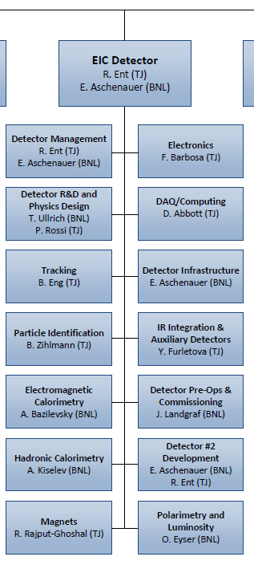
EIC Detector Project – joint JLab and BNL responsibility
Co-associate directors for Experimental Program: Rolf Ent (JLab) and Elke Aschenauer (BNL)
  6.10 Detectors
  6.10.01 Detector Management
  6.10.13 Detector #2 Development
We also heavily utilize Walt Akers (Jlab) who is a Systems Engineer
R&D scope has both a BNL and JLab person
  6.10.02 Detector R&D Thomas Ullrich (BNL), Patrizia Rossi (JLab)
Some scope has a BNL person
  6.10.05 EM Calorimetry Alexander Bazilevsky (BNL)
  6.10.06 Hadronic Calorimetry Alexander Kiselev (BNL)
  6.10.10 Detector Infrastructure Rahul Sharma (BNL)
  6.10.12 Detector Pre-Ops Elke Aschenauer – acting (BNL)
  6.10.14 Polarimetry & Luminosity Oleg Eyser (BNL)
  (L4 electron polarimetry is David Gaskell (JLab))
Some scope has a JLab person
  6.10.03 Tracking Brian Eng (JLab)
  6.10.04 Particle Identification Beni Zihlmann (JLab)
  6.10.07 Magnets Renuka Rajput-Ghoshal (JLab)
  6.10.08 Electronics Fernando Barbosa (JLab)
  6.10.09 DAQ/Computing David Abbott (JLab)
  6.10.11 IR Integration, Aux. Detectors Yulia Furletova (JLab)

Slide 12
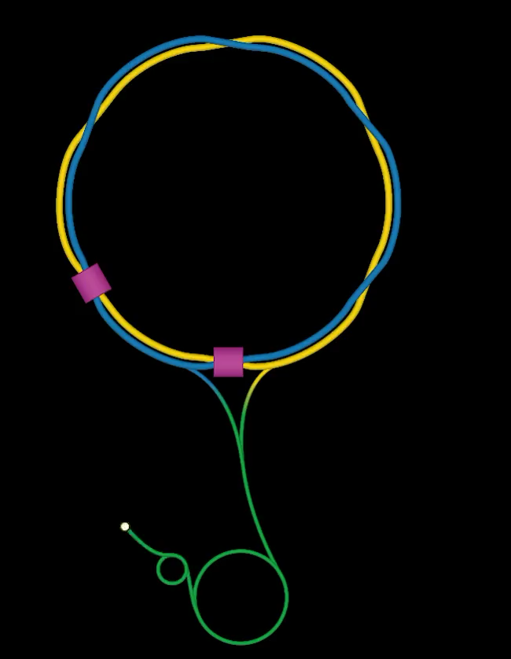
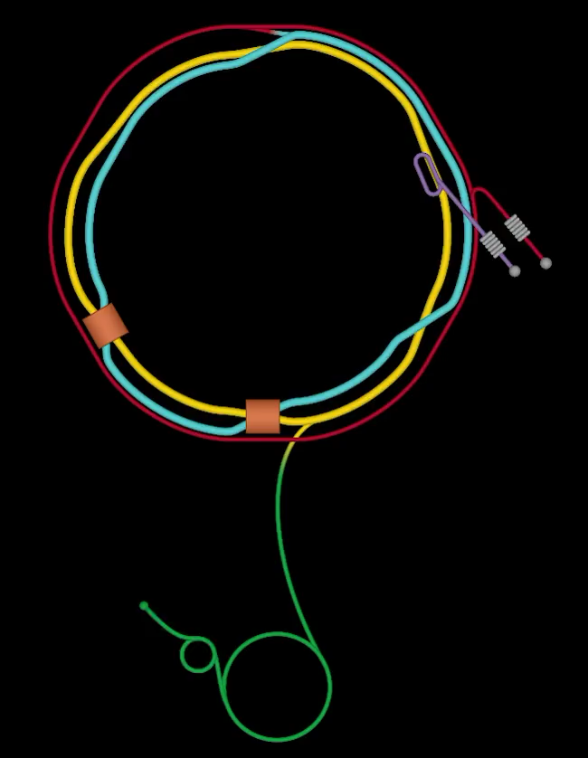
From RHIC to Electron Ion Collider @ BNL

Slide 13
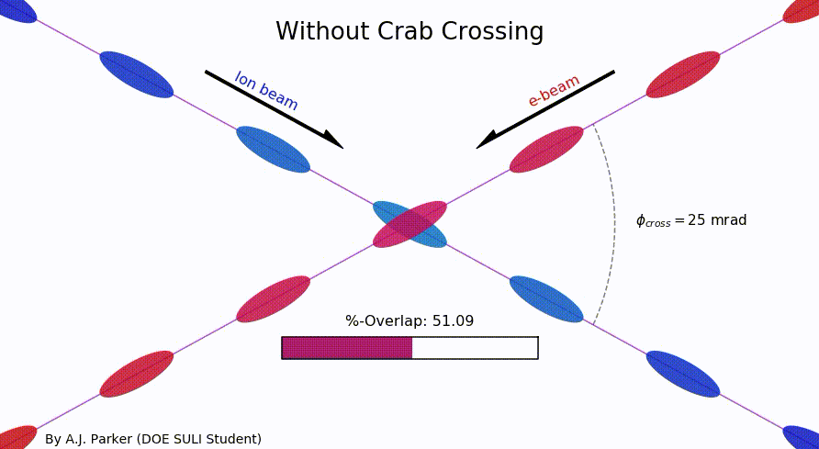
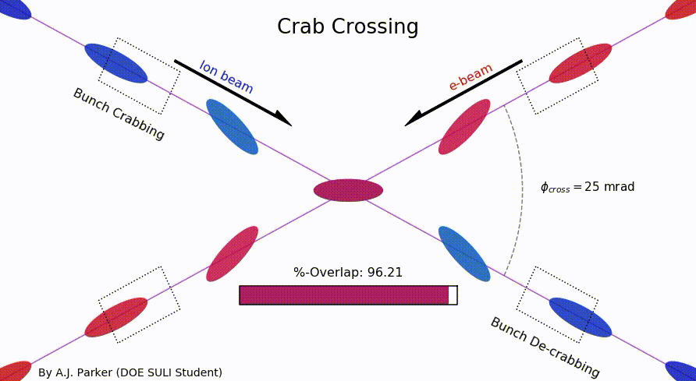
SULI Student Project To Visualize The Colliding Beams
As an exercise to learn Python, SULI summer student Asia Parker (Duquesne University) took a static image of the EIC’s crab crossing and made an animation.
https://github.com/sherwberry/SULI2020_CrabCrossingAnimation

Slide 14
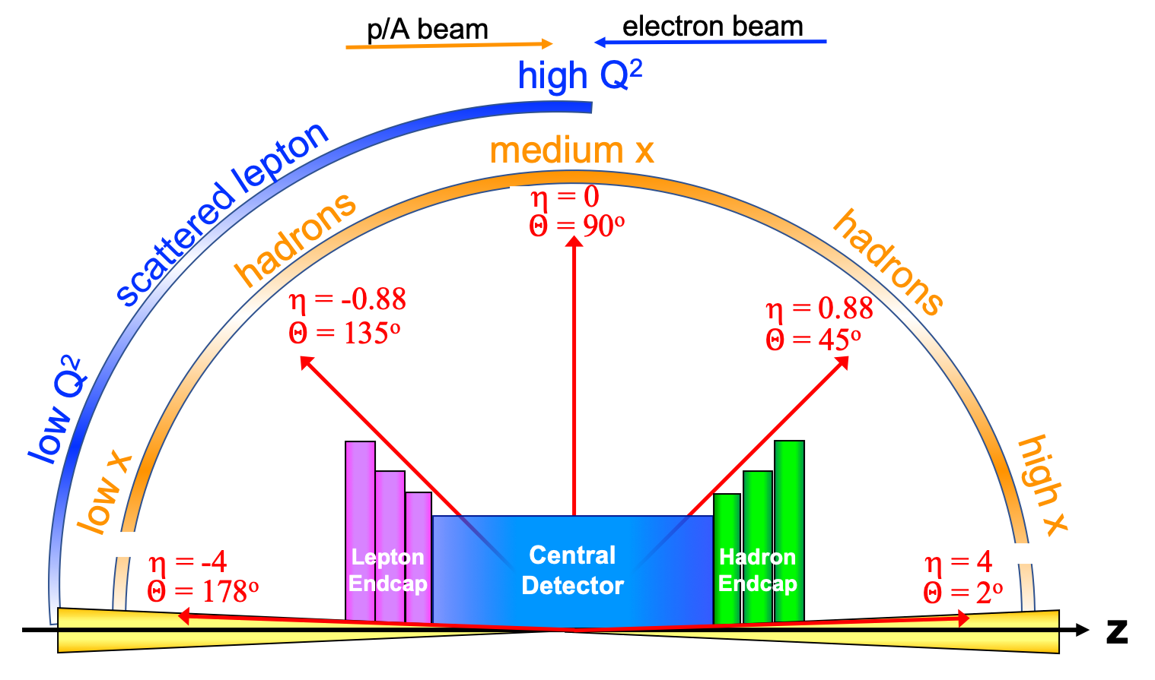
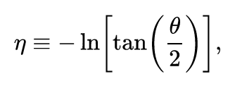
Detector polar angle / pseudo-rapidity coverage

Slide 15
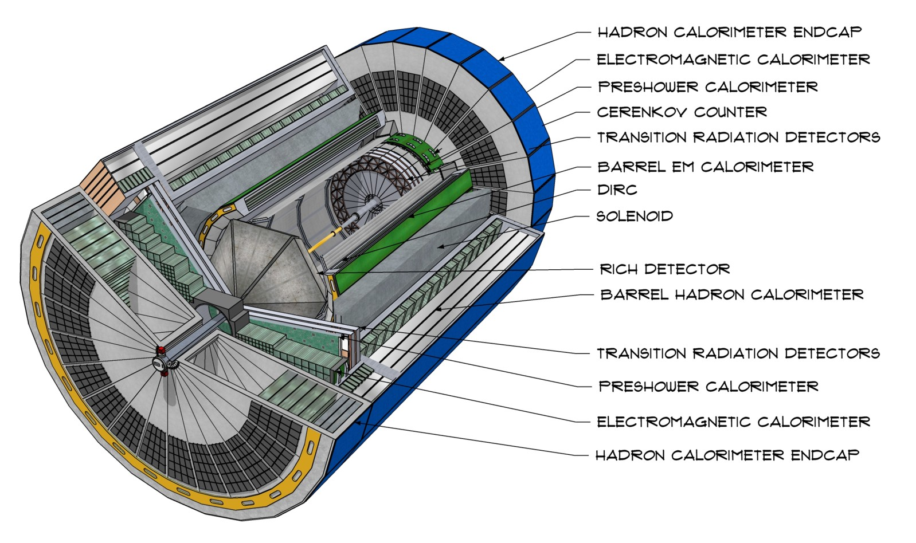
CAD Model of Generic EIC Detector

Slide 16
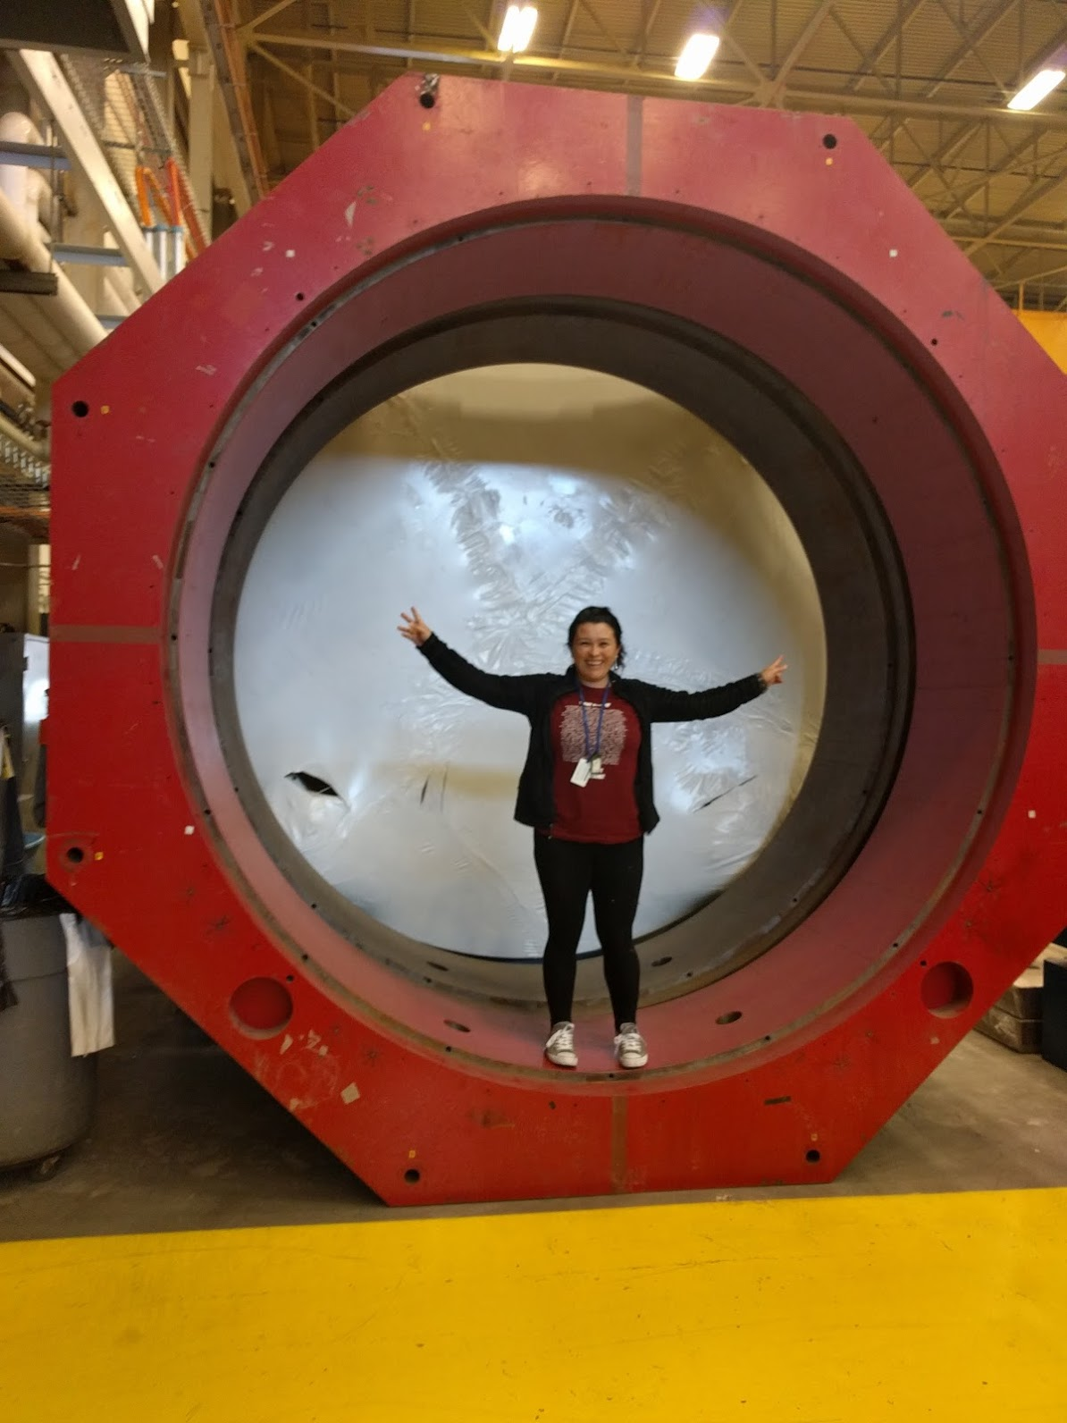
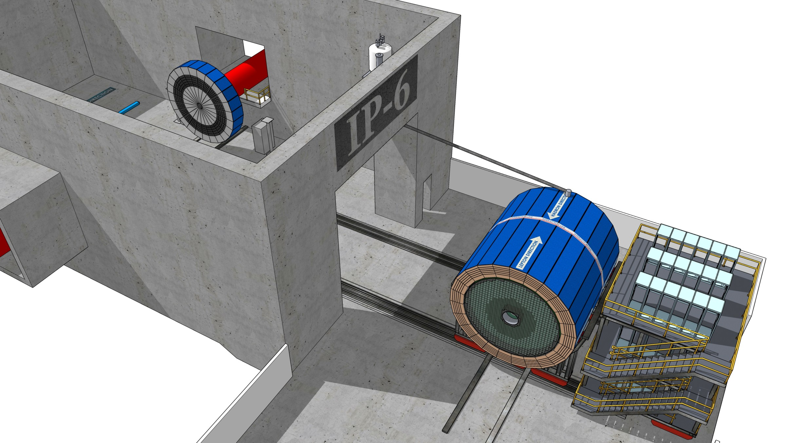
Size and Planned Location of the First EIC Detector
Image show how such a detector could be
moved out of IP-6 at the EIC.

Slide 17
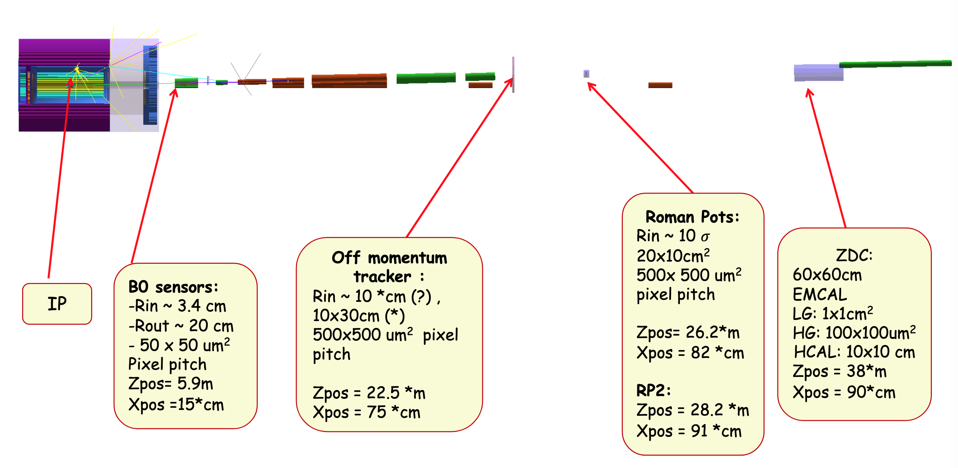
Far Forward Detection Systems ( my favorite part of the EIC)
Detectors located tens of meters from the main EIC detector and are small in size.

Slide 18
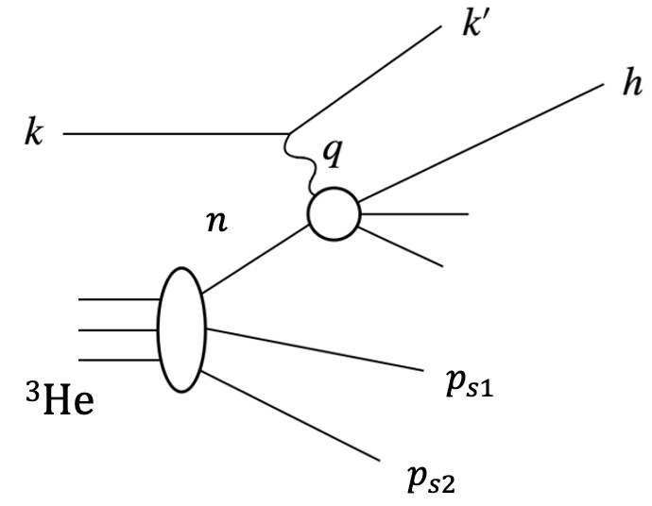
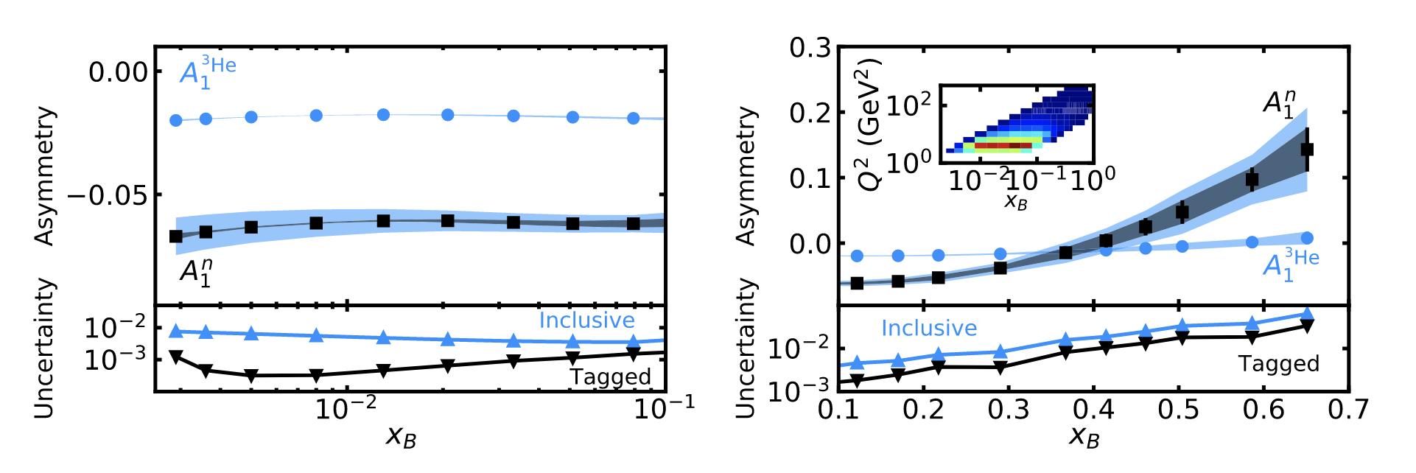
EIC ³He Physics with Tagging
Frišcic, D. Nguyen, J.R. Pybus, A. Jentsch, E.P. Segarra, M.D. Baker, O. Hen, D.W.H., R. Milner, A.S. Tadepalli, Z. Tu, J. Rittenhouse West, Phys. Lett. B (2021) 136726 https://doi.org/10.1016/j.physletb.2021.136726
Physics Goals:
Nucleon structure function F₂^{n}, F₂^{p} and study medium modifications
Neutron spin structure study on A₁^{n}, g₁^{n} for polarized PDFs
TMD measurements: Flavor and spin dependence of the Transverse Momentum Distribution.
DIS & SIDIS
Tagging

Slide 19
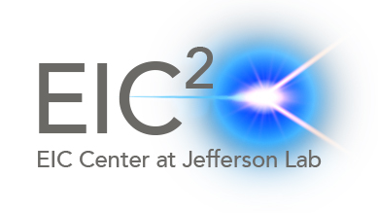
EIC Yellow Report
Posted to the arXiv on 8 March 2021:
https://arxiv.org/abs/2103.05419
902 pages, 415 authors, and 151 institutions
LaTeX Source Code On The arXiv
Now also published in a refereed journal:
Nucl.Phys.A 1026 (2022) 122447
As of 8 June 2023 has 544 citations.
The document is broken into three volumes:
Executive Summary
Physics
Detectors

Slide 20
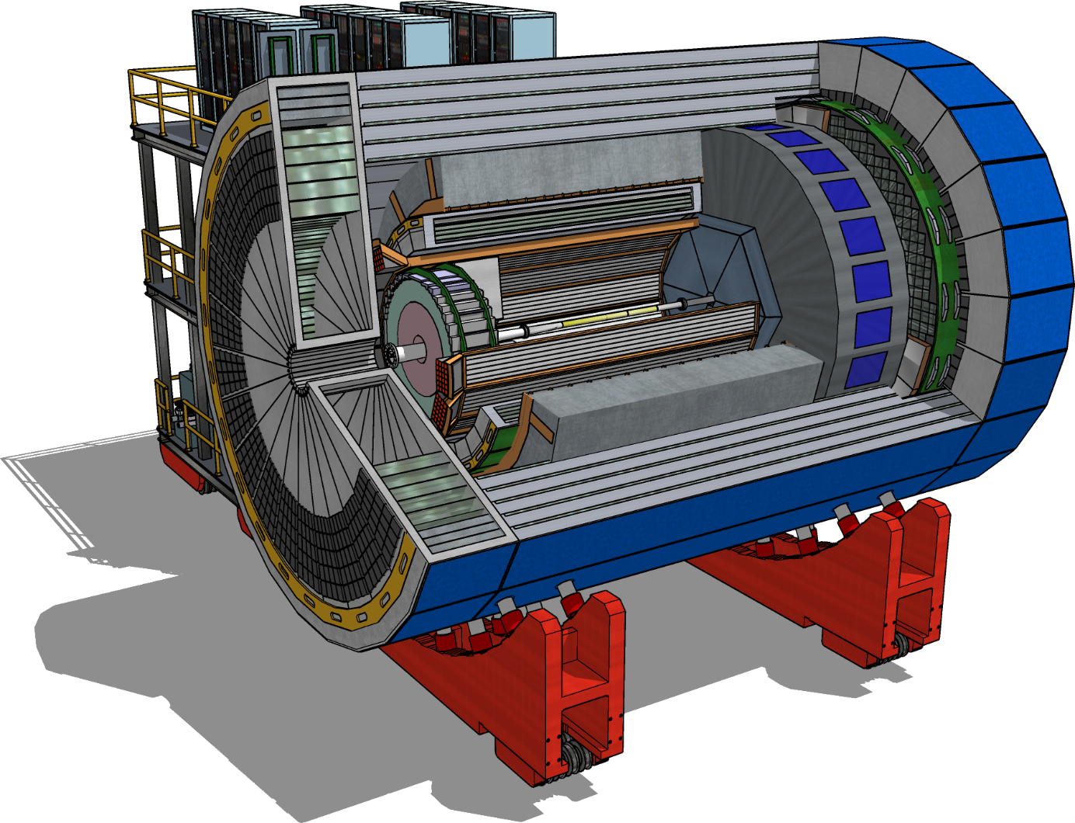
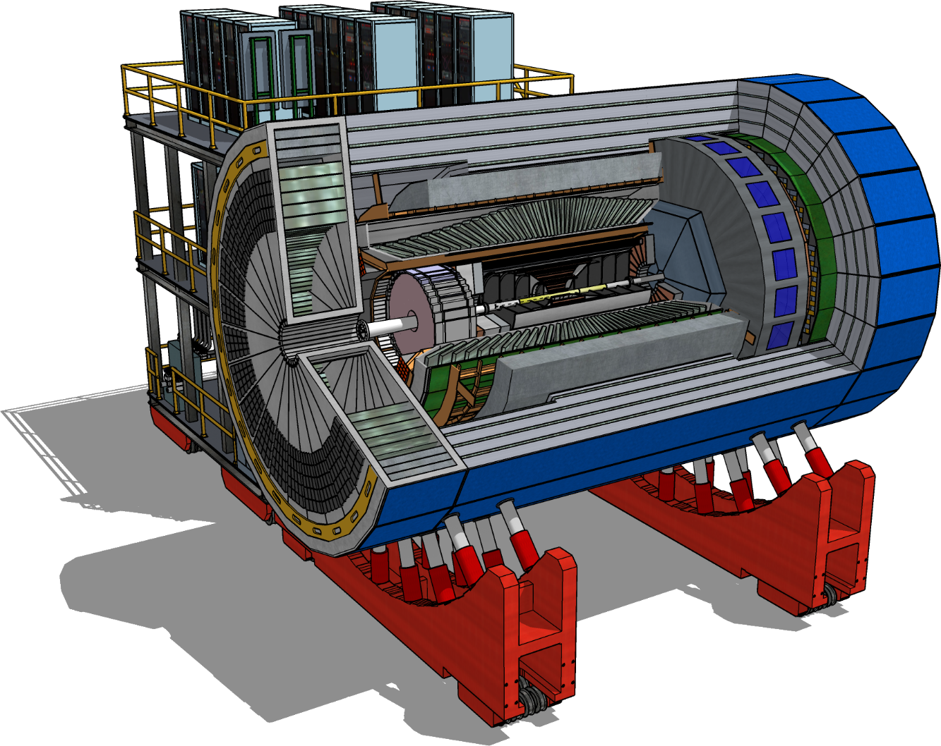
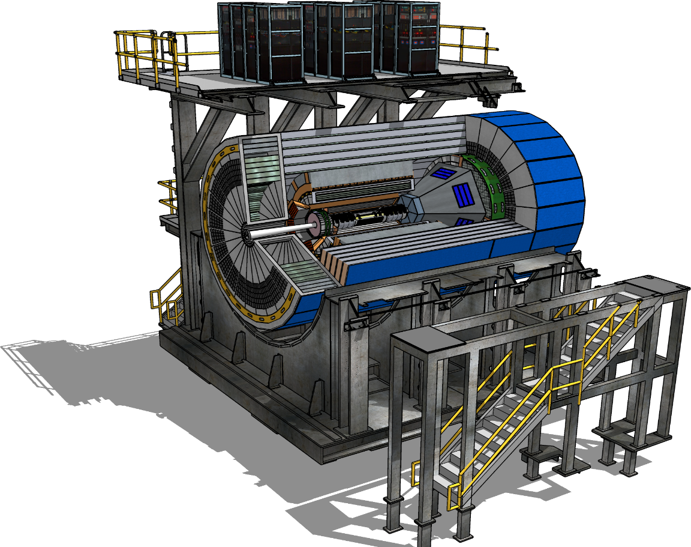
ATHENA, ECCE, and CORE Proto-Collaborations
https://www.bnl.gov/dpapanelmeeting/
CORE
COmpact detectoR for the EIC
ATHENA
A Totally Hermetic Electron-Nucleus Apparatus
ECCE
EIC Comprehensive Chromodynamics Experiment
21 March 2022 the ECCE concept was selected to be the baseline and now we are coming
back together to take those ideas (improve them) into what is presently called detector one.

Slide 21

Path to EIC Project Detector Collaboration
Silvia Dalla Torre, Or Hen, Tanja Horn, John Lejoie, Bernd Surrow
Consolidation of ATHENA and ECCE and formation of a new scientific collaboration for the first EIC detector
The ePIC Collaboration!
  Evolution of the ECCE reference design to a Detector‐1 technical design
  New Working Groups
    Taking advantage of the strength in both the ATHENA and ECCE collaborations
  Prepare for CD‐2/3A
  Julia will go into details about the latest design of the ePIC detector tomorrow.
Many members of the CORE team are now focused on a 2nd detector for the EIC.

Slide 22
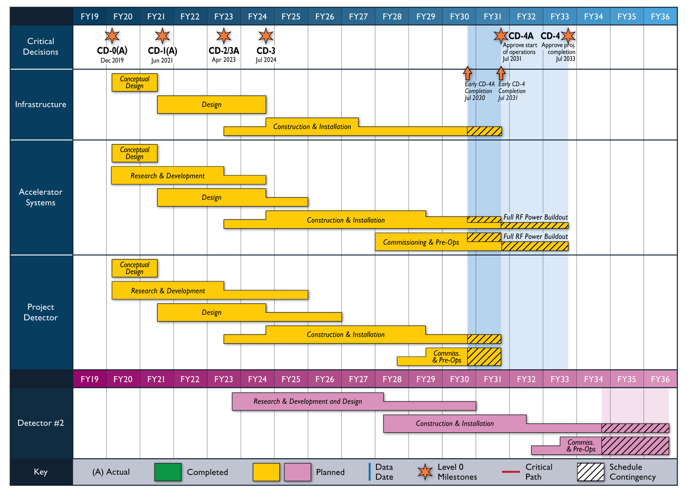
Reference Schedule (Oct. 2021)
Notional Schedule
2nd IR and
Schedule
Generic Detector R&D

Slide 23
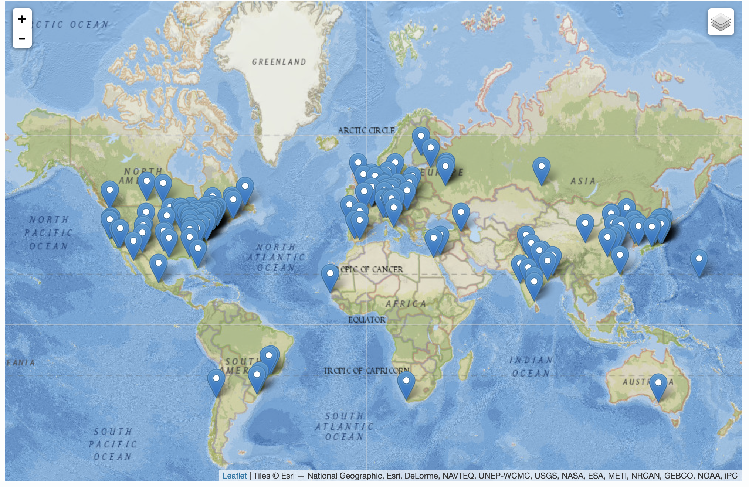
International Interest in EIC Science
The EIC User Group: EICUG.ORG, Formed 2016
8 June 2023:
1384 collaborators
275 institutions
36 countries
You are all welcome to join the EICUG by contacting your institutional representative: https://phonebook.sdcc.bnl.gov/eic/client/
( or email me and I will help you! )
Institutions

Slide 24
2023/24 EIC Center Fellowships
Fellowships will be awarded for a period of one year to fund EIC related research
The goals of this program include:
  Highlight JLab’s deep involvement in the EIC project
  Increase the direct involvement of an inclusive group of young JLab-related scientists in synergistic EIC research which will be a career focus of many over the next decades.
  Increase the direct involvement of university faculty in advancing the EIC scientific program and its advanced computing synergy through a supervisory role of the fellowship grantees.
The areas of research include theory, simulations, detectors, computing and accelerator science.
Each graduate fellowship provides the awardee’s home institution with a $13,000 stipend and for postdoctoral fellows $36,000 will be provided. Fellows will be expected spend approximately half their time at Jefferson Lab.
The applications will be evaluated by a committee according to the following criteria:
  Merit and quality of proposed research
  Relevance of the proposed research to the Electron-Ion Collider and Jefferson Lab
  Likelihood that the proposed research can be successfully accomplished within the fellowship period.
  Letters of recommendation.
https://www.jlab.org/eiccenter/jefferson-lab-eic-fellowships

Slide 25
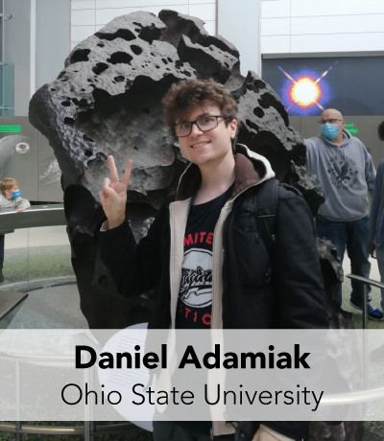

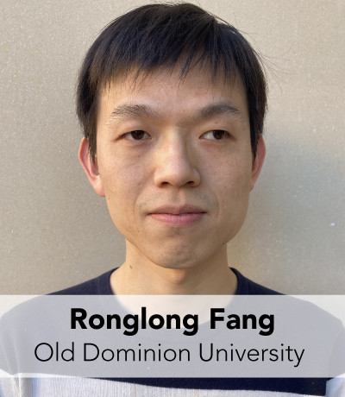
2022/23 JLab EIC Center Graduate Student Fellows
Daniel work on efforts to help resolve the proton spin puzzle by determining how much spin is hiding in the small-x quarks and gluons.
Adviser: Prof. Yuri Kovchegov
Joshua will focus on the Electron-Ion Collider’s barrel Electromagnetic Calorimeter (EMCal), one of the largest components of the EIC detector systems.
Adviser: Prof. Tanja Horn
Ronglong will develop a scalable algorithm to monitor online data for the Electron-Ion Collider, with the goal of being able to do real-time, autonomous detector calibrations.
Advisers: Prof. Yuesheng Xu & Dr. Diefenthaler

Slide 26
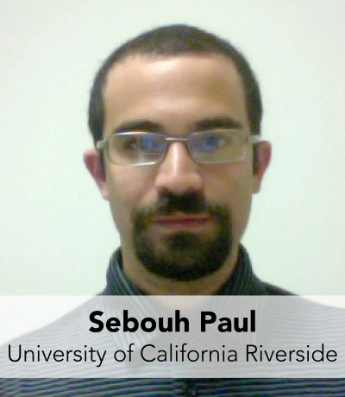
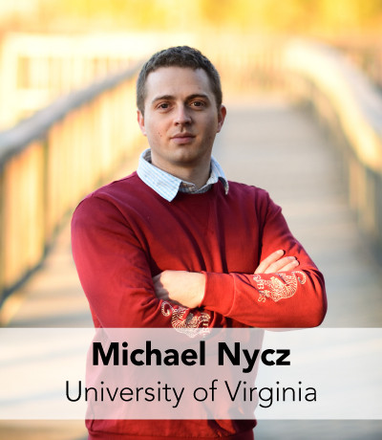
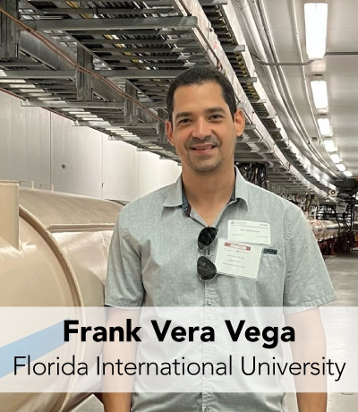
2022/23 JLab EIC Center Postdoctoral Fellows
Dr. Paul will conduct research & development to optimize the design of a proposed high-granularity hadronic calorimeter insert for the EIC.
Adviser: Miguel Arratia
Dr Nycz will investigate Neutral-Current Electroweak Standard Model and Beyond the-Standard Model physics, with a focus on performing a thorough projection study of the extraction of the weak mixing angle at the EIC.
Adviser: Prof. Xiaochao Zheng
Dr. Vega will develop a unified implementation
of physics models for coherent processes
on light nuclei that will enable systematic
study of nuclear structure.
Adviser: Prof. Wim Cosyn

Slide 27
Detector Testing Program
Jefferson Lab users have a long history of its users setting up small parasitic detector tests in the experimental halls to ensure successful experiments.
With a focus on detectors for the EIC, the EIC center coordinates between outside groups and the experimental Halls to facilitate testing.
Presently Four Parasitic Testing Areas On Site
  High Luminosity Tests: Hall A and Hall C
  Low Luminosity Tests: Hall B and Hall D
Presently One Area For Dedicated Testing
  10 MeV Upgraded Injector Test Facility
Testing requires approval by hall leader and work coordinator as well as appropriate training and safety documentation
More details found at: https://www.eiccenter.org/detector-testing

Slide 28
Test Setup in Hall D
Photon beam
Electrons

Slide 29

Summary
Due to a very strong overlap in the physics interests, the EIC project has turned into a very nice joint project with BNL and JLab.
Just as the two labs were able to come together after site selection, now the detector teams ECCE and ATHENA have nicely come together to build what is presently known as detector one.
Many that were in the CORE team are now pushing for a second detector.
This machine will turn on for science in the early 2030’s, so some of you in this room will likely be part of the scientific team running the experiments!
EIC

