Slide 1
Dissecting Hadrons in
Continuum QCD Approach
Adnan Bashir
Institute of Physics and Mathematics
University of Michoacán, Morelia, Michoacán, Mexico
Fulbright Visiting Scientist
Jefferson Laboratory, Newport News, Virginia, USA

Slide 2
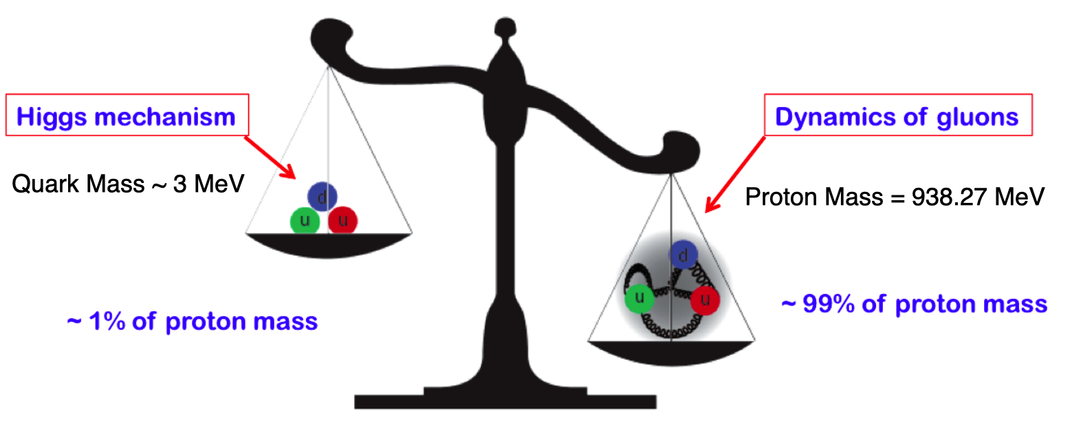
QCD: Facts and Challenges
QCD is characterized by two emergent phenomena:
confinement and dynamical generation of mass (DGM).
Quarks and gluons do not reach detectors.
Emergence of hadron masses (EHM) from QCD dynamics
Formation of color-singlet bound states: “Hadrons”
mesons, baryons, tetraquarks, molecules

Slide 3
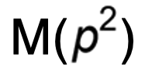
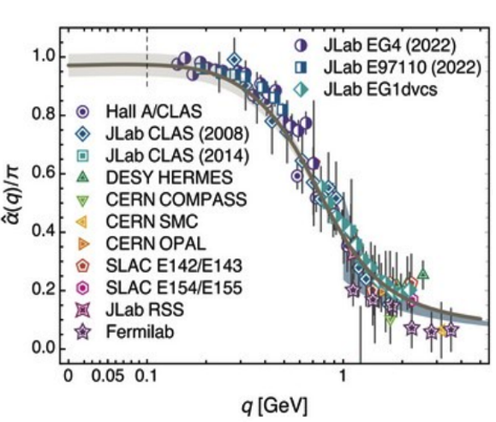
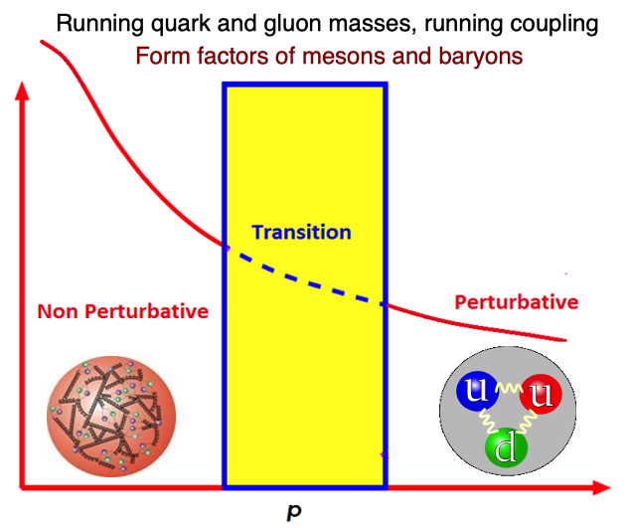
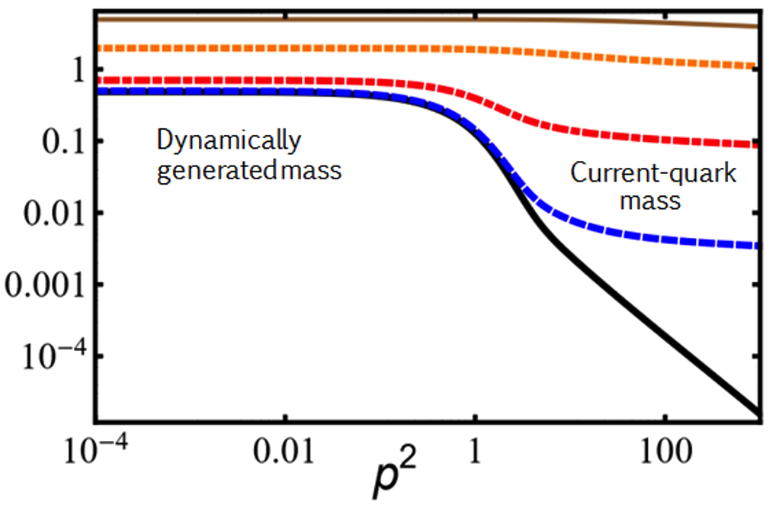
QCD: Current Understanding and Challenges
Origins of confinement and dynamical mass generation can be traced back to the Green
functions of quarks and gluons.
These emergent phenomena of QCD, non-existent in perturbation theory are naturally linked to the infrared enhancement of the strong running coupling.
The effects of of the pattern of dynamical mass generation are traceable in the Q² evolution of the meson and baryon form factors explored and planned in the JLab and the EIC.

Slide 4
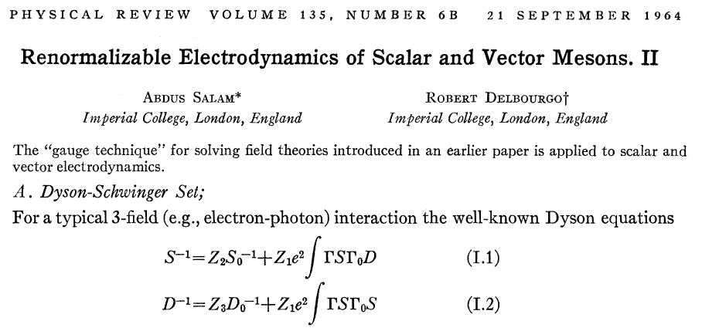
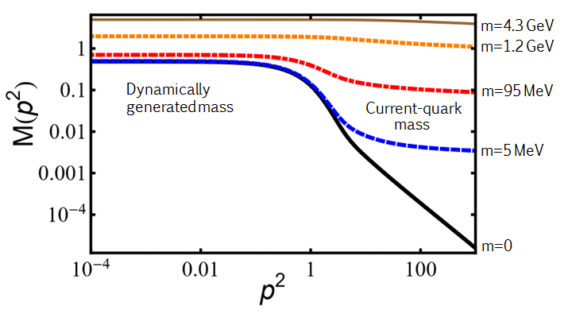
QCD – Schwinger-Dyson Equations
Gauge Technique – Non Perturbative Solutios
A. Salam, R. Delbourgo, Phys. Rev. 135 (1964) 6, B1398-B1427.
DCSB - Non-perturbative QED
P.I. Fomin, V.A. Miransky, Phys. Lett. B64 (1976) 166-168.
DCSB – Non-abelian Gauge Theories
V. Miransky, V. Gusynin, Y. Sitenko, Phys. Lett. B100 (1981) 157-162
DCSB – MT Model - Vector Mesons
P. Maris, P. Tandy, Phys. Rev. C60 (1999)
SDE: electron propagator

Slide 5
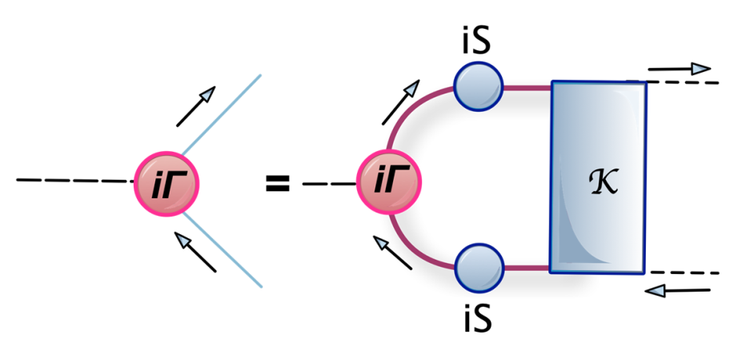
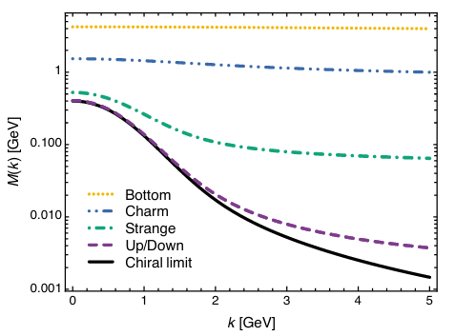
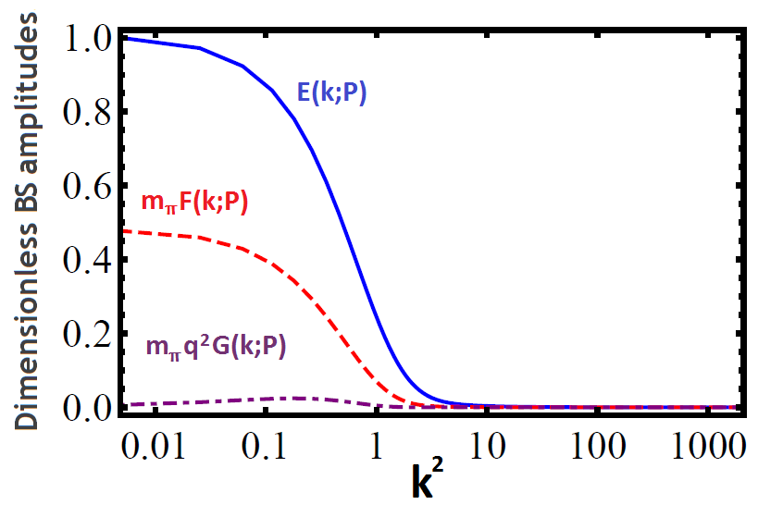
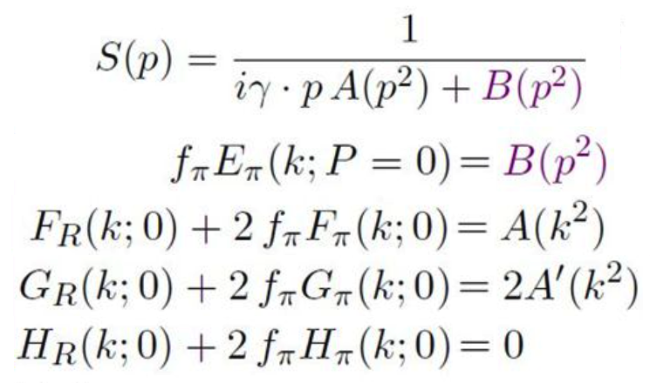
𝜋: Bound State and Goldstone Boson
The pattern of dynamical chiral symmetry breaking and the Bethe-Salpeter amplitude to be computed by solving the Bethe-Salpeter equation.

Slide 6
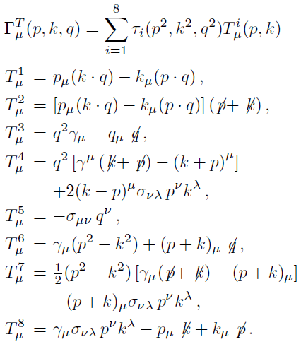
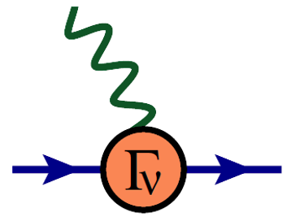
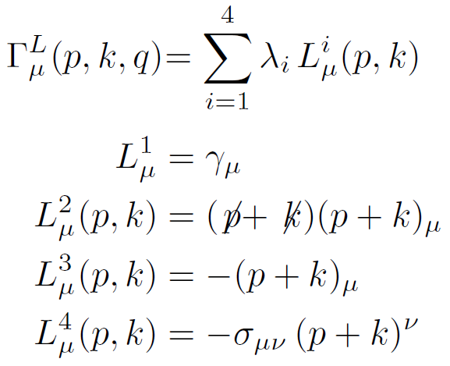
𝜋: Probing Quarks with Photons
In studying the elastic form factors, it is the photon which probes the dressed quarks inside the bound states, highlighting the importance of the quark-photon vertex.
Gauge covariance
(WTI,TTI, LKFT),
kinematic singularities,
perturbation theory, multiplicative
renormalizability
AB, R. Bermudez, L. Chang, C.D. Roberts
Phys. Rev. C85, 045205 (2012)
L. Albino, AB, L. Gutiérrez, B. El Bennich, E. Rojas
Phys. Rev. D100 054028 (2019) V. Banda, AB, Phys. Rev. D 107 (2023) 7, 073008
J. Roberto Lessa, F. Serna, B. El-Bennich, AB,
O. Oliveira, Phys. Rev. D 107 (2023) 7, 074017

Slide 7
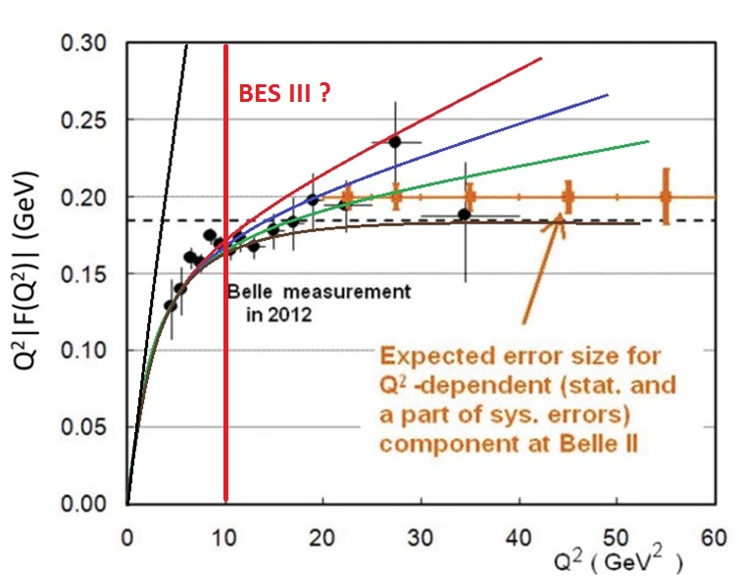
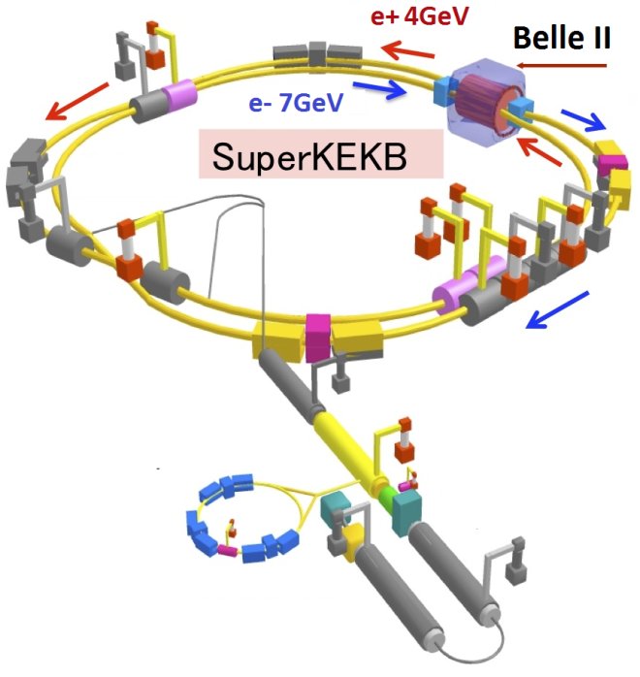
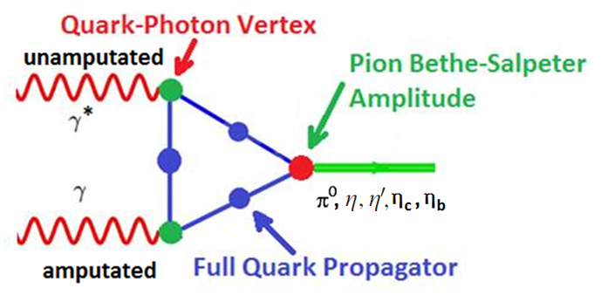
𝜋⁰ → 𝛾*𝛾 Transition Form Factor
The pattern of dynamical chiral symmetry breaking dictates the Q² evolution of the transition form factor. Experiment and asymptotic QCD for largest Q² provide verifications.
𝜶=0
𝜶=1
M(p²) ~ (p²)^{-𝜶}

Slide 8
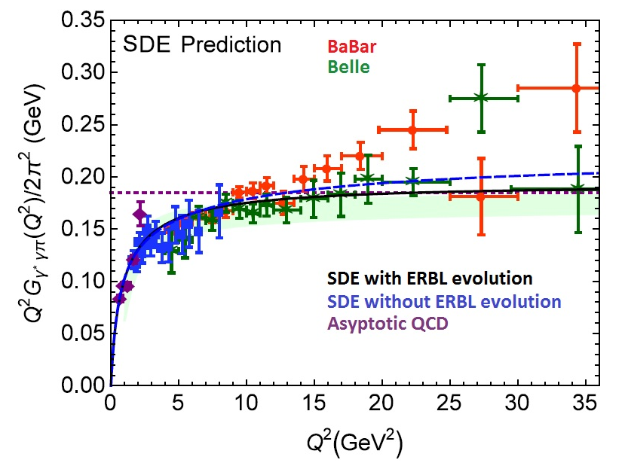
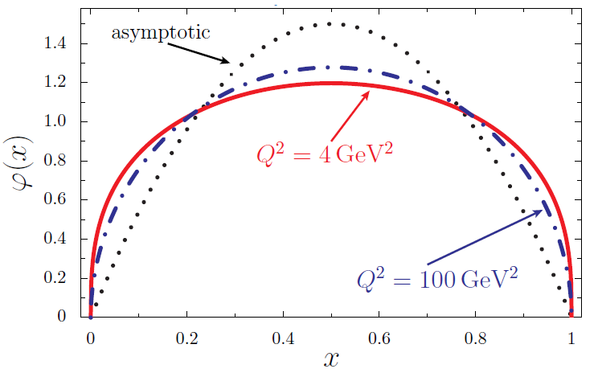
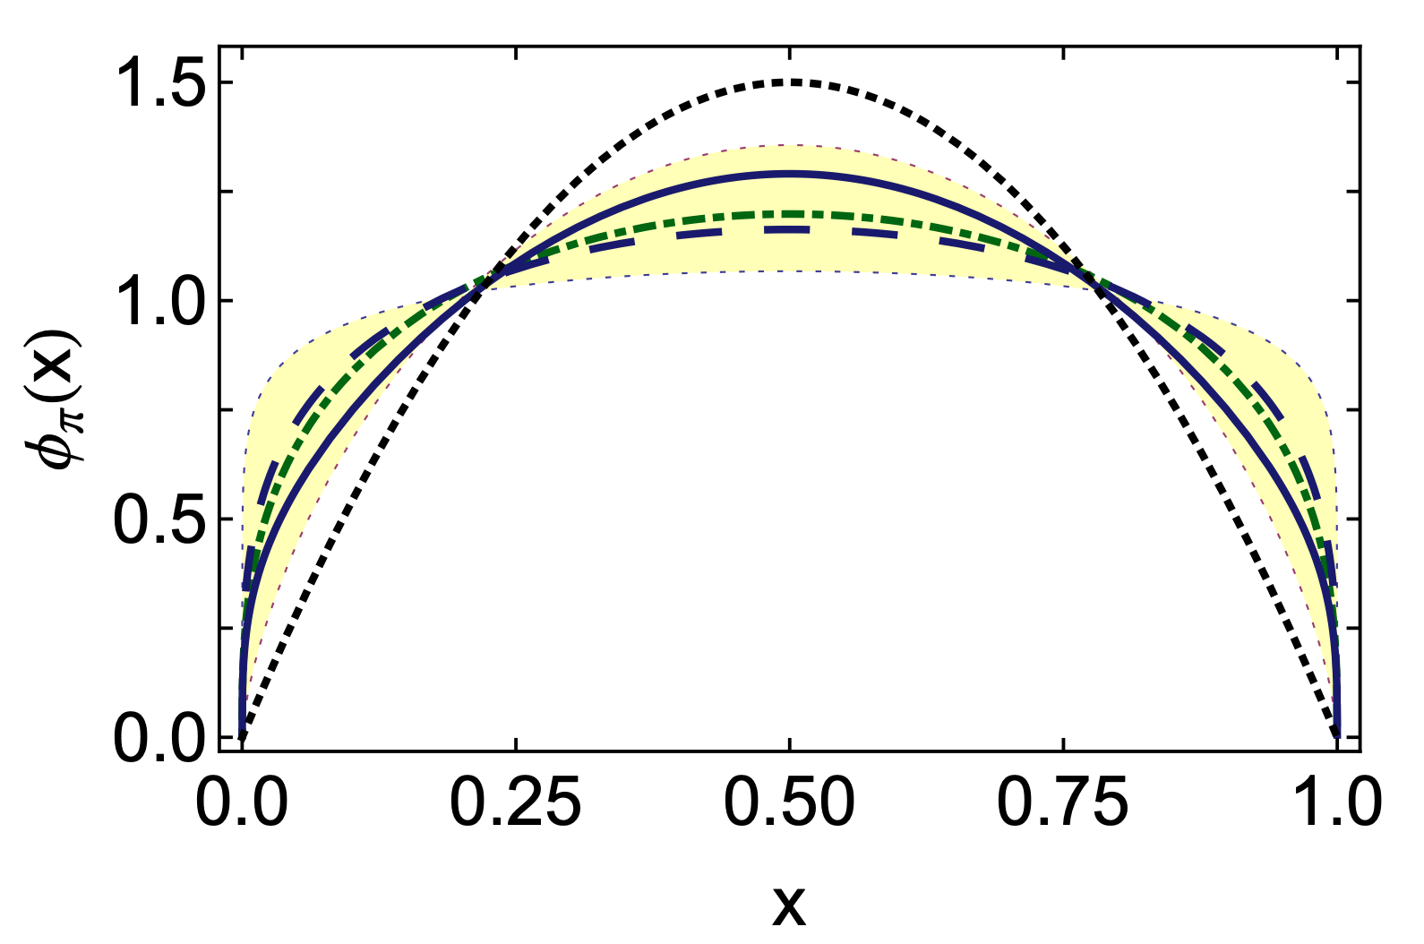
𝜋⁰ → 𝛾*𝛾 Transition Form Factor
Conformal limit
Satisfies abelian anomaly and agrees with the prediction of asymptotic QCD.
Agrees well with experiment from low to intermediate range of momenta and favors Belle results.
The distribution amplitude (PDA) is broad and concave at the hadronic scale.
Within an error band stemming from the construction of the PDA from the lattice moments, it is
in good agreement.
K. Raya, et. al. Phys. Rev. D 93 (2016) 7, 074017, L. Chang, et. al., Phys. Rev. Lett. 110 (2013) 13, 132001,
I.C. Cloet, et. al. Phys. Rev. Lett. 111 (2013) 092001, RQCD collaboration, JHEP 08 (2019) 065, JHEP 11 (2020) 037

Slide 9
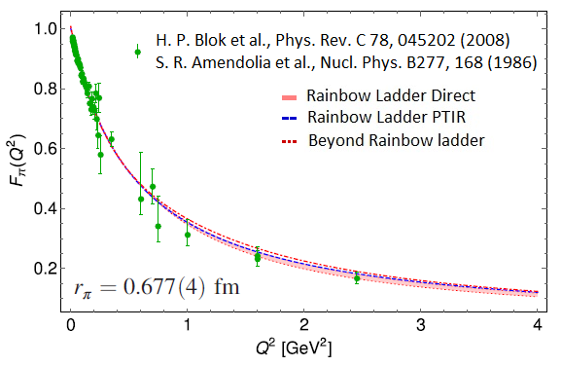
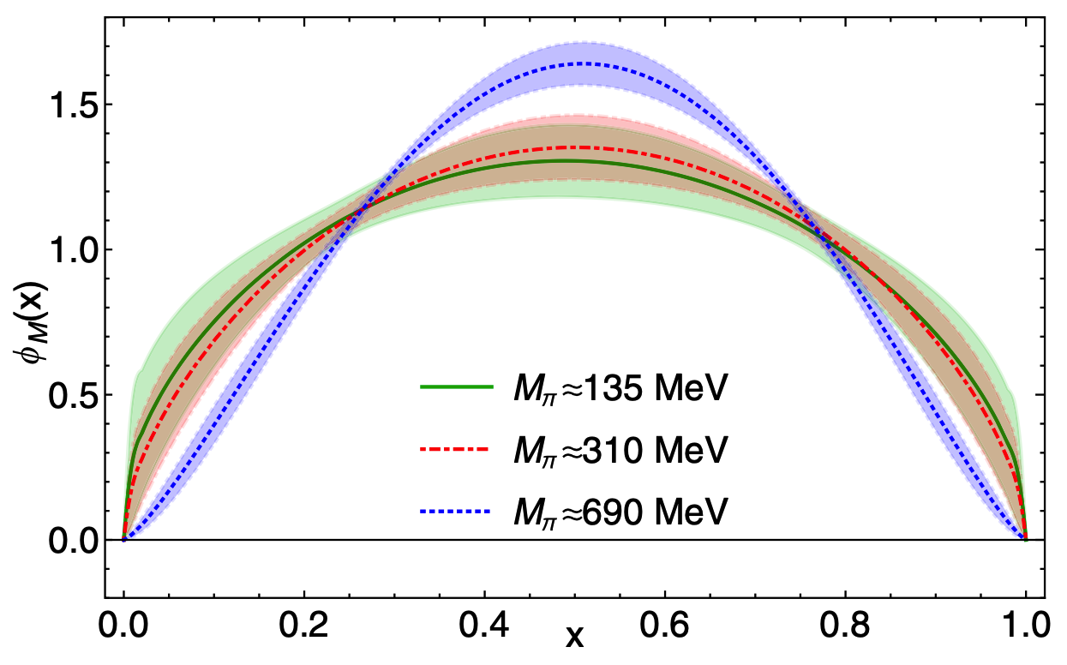
𝜋 Electromagnetic Form Factor
A. Miramontes et. al., Phys. Rev. D 105 (2022) 7, 074013
I.C. Cloet, et. al.
Phys. Rev. Lett. 111 (2013) 092001
R. Zhang, et. al.,
Phys. Rev. D 102 (2020) 9, 094519
The electromagnetic form factor of 𝜋 is central to the Jlab and planned EIC research.
Jefferson Lab:
Lattice Hadron Physics Collaboration, Frederic D.R. Bonnet, et. al. Phys. Rev. D 72 (2005) 054506
Our computation is consistent with the valence quark distribution amplitude (PDA) which is
broad and concave at the hadronic scale.
The results agree with earlier computation of the electromagnetic form factors of 𝜋.
L. Chang, I.C. Cloet, C.D. Roberts, S.M. Schmidt, P. Tandy, Phys. Rev. Lett. 111 (2013) 14, 141802

Slide 10
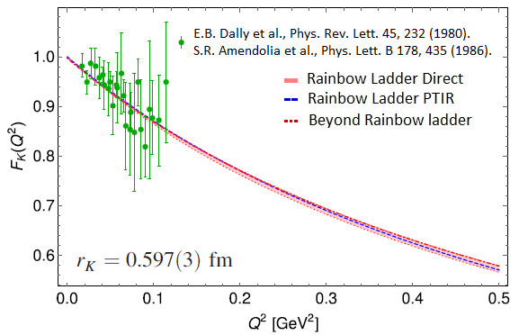
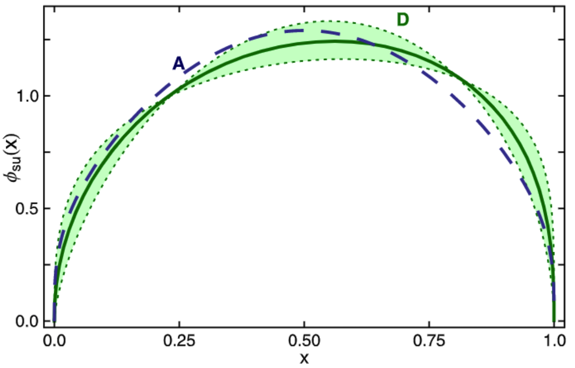
K Electromagnetic Form Factor
A. Miramontes et. al., Phys. Rev. D 105 (2022) 7, 074013
J. Segovia et. Al. , Phys. Lett. B 731 (2014) 13-18
The electromagnetic form factors of 𝜋 and K can be measured till Q² ~ 8 GeV² (10-40 GeV²)
and 5 GeV² (10-20 GeV²) respectively in the 12 GeV upgrade of JLab (EIC).
A. Aguilar, Eur. Phys. J. A55 (2019) 10, 190
The results obtained from the Schwinger-Dyson equations appear robust under the calculational
scheme employed and ingredients used as in the computation of the transition form factors and
the distribution amplitudes of mesons.

Slide 11
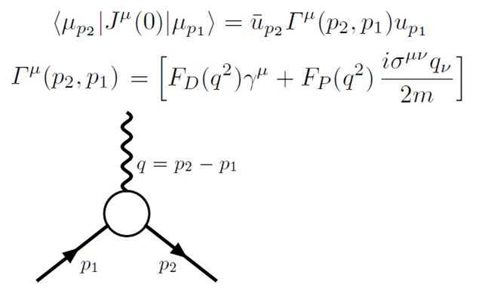
𝜋 and K Form Factors: Probing the Standard Model
A muon with spin s has a magnetic moment:
The factor g is called the gyro-magnetic factor. The Dirac equation for a charged elementary fermion with spin 1/2 implies g = 2.
The anomalous magnetic moment is the deviation from g = 2, parameterized by a_{𝛍} = (g−2)/2.
It appears due to radiative corrections. Renormalization of QED was established in 1943 and
1947-1948 by Tomonaga, Schwinger and Feynman.
The leading contribution to a_{𝛍}, calculated
by Schwinger in 1949, is:
The amplitude of a muon scattering off an external electromagnetic field A is: (q=p₂-p₁):

Slide 12
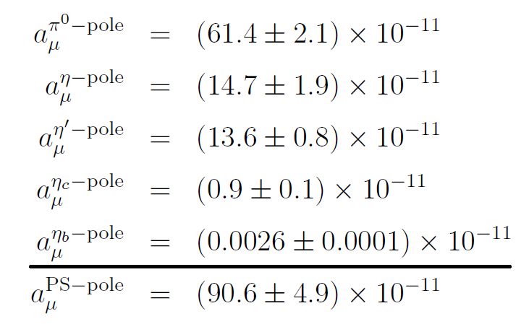
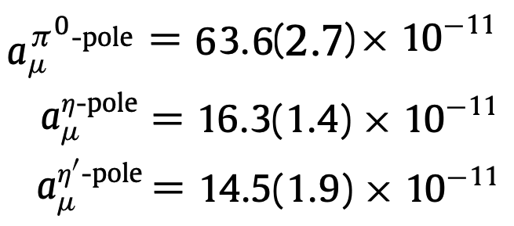
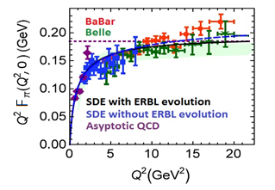
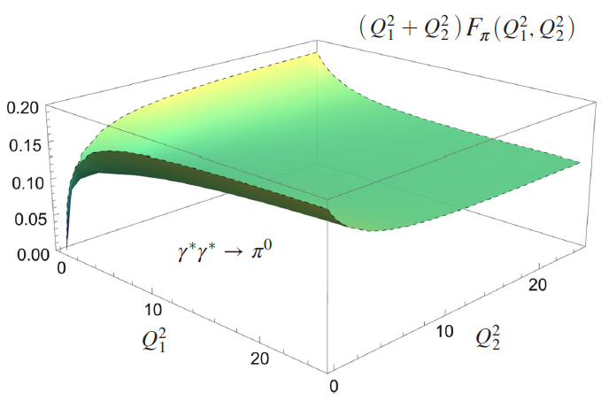
Neutral Pseudoscalar Pole Contributions
The transition form factor 𝜋⁰ → 𝛾*𝛾 extended to 𝜋⁰ → 𝛾*𝛾*.
Dispersive
methods:
Lattice:
K. Raya, AB, P. Roig,
Phys. Rev. D 101 (2020) 7, 074021

Slide 13
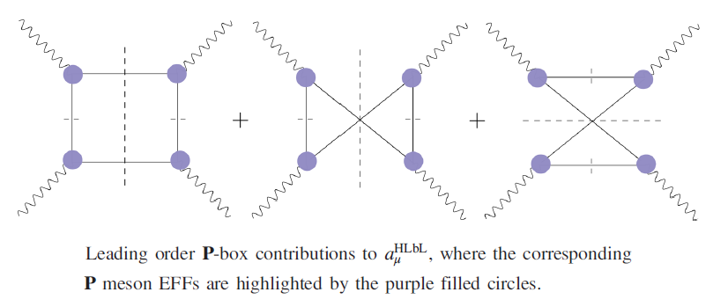
𝜋 and K Form Factors : Probing the Standard Model
A. Miramontes, AB, K. Raya, P. Roig, Phys. Rev. D 105 (2022) 7, 074013
Radial excitations of 𝜋 and K:
A. Miramontes, et. al. in preparation
(Preliminary)
Dispersive methods:
Eichmann, et. al. Phys.Rev.D 101 (2020) 5, 054015

Slide 14
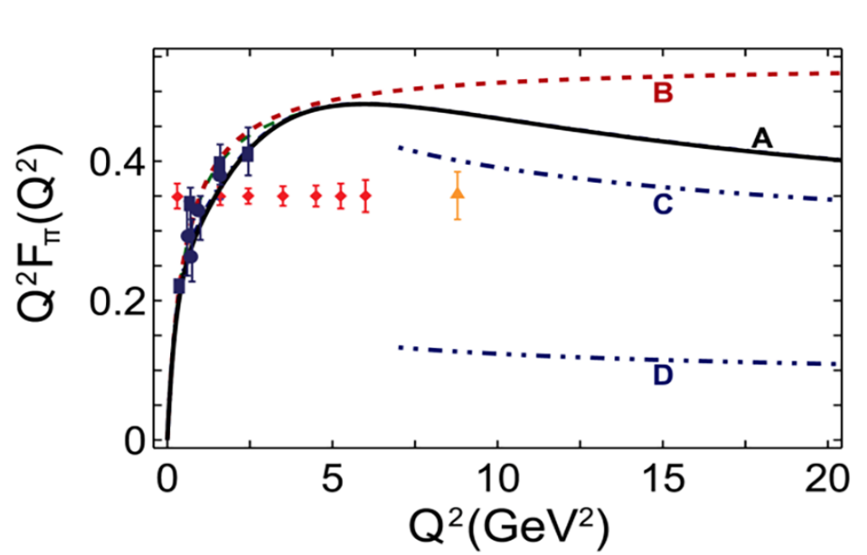
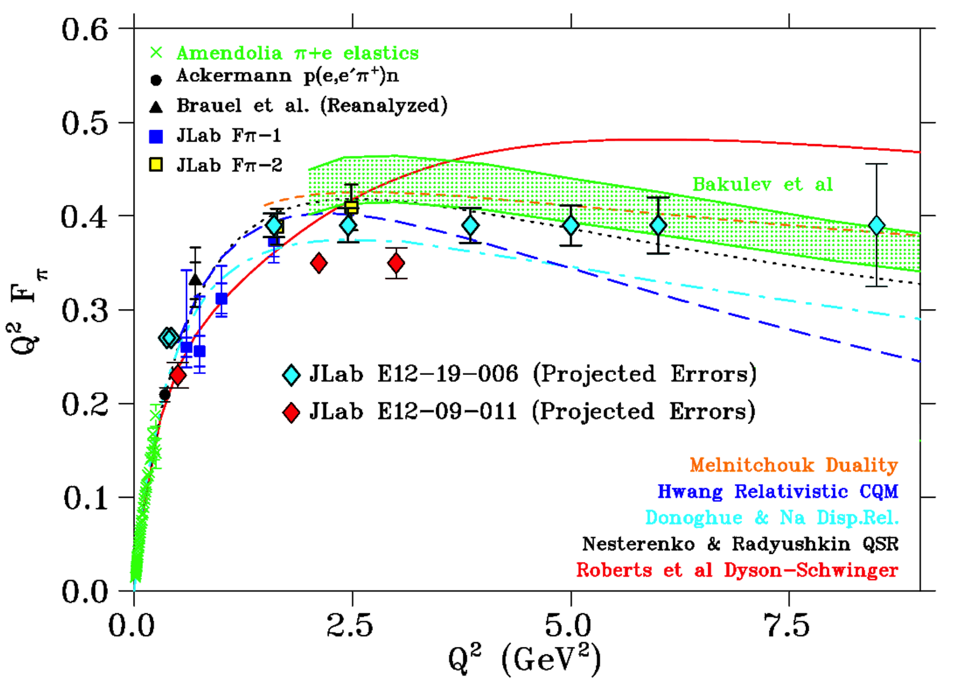
𝜋 Form Factor at Large Q²
The study of the pion form factor is one of the flagship goals of the JLab 12-GeV upgrade… regime in which the phenomenology of QCD begins a transition from large- to short-distance scale behavior.
The pion form factor can
potentially be measured till
Q² ~ 6-8 in the 12 GeV
upgrade of the JLab.
Courtesy Garth Huber

Slide 15
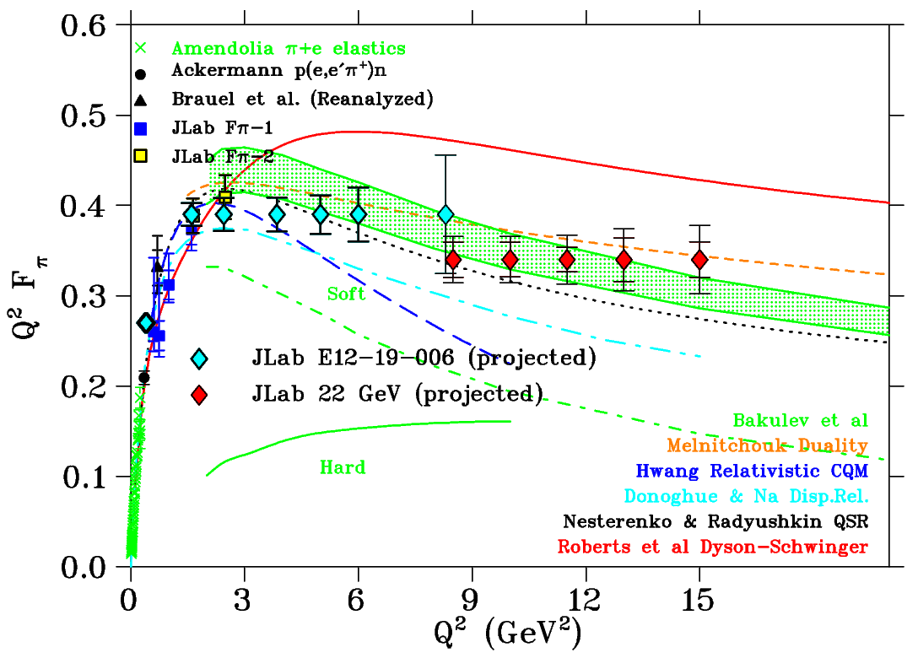
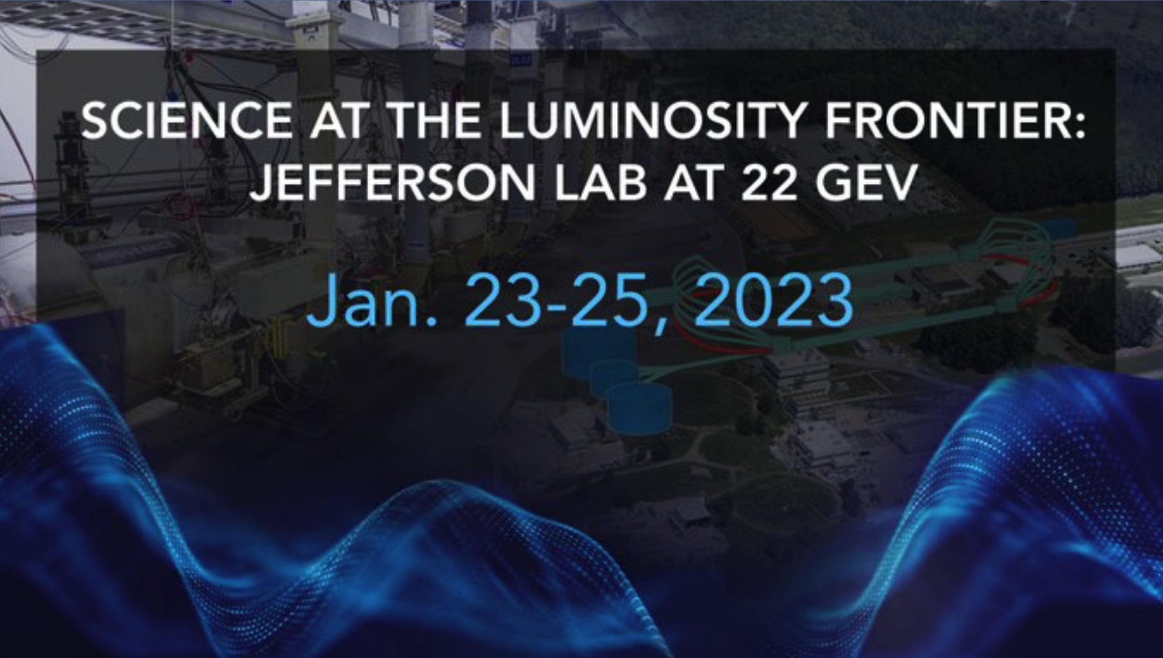
𝜋 Form Factor at Large Q²
With a potential and desirable next
22-GeV upgrade of the JLab, the pion
electromagnetic form factor could be measured till Q² ~ 15 GeV².
Courtesy Garth Huber

Slide 16
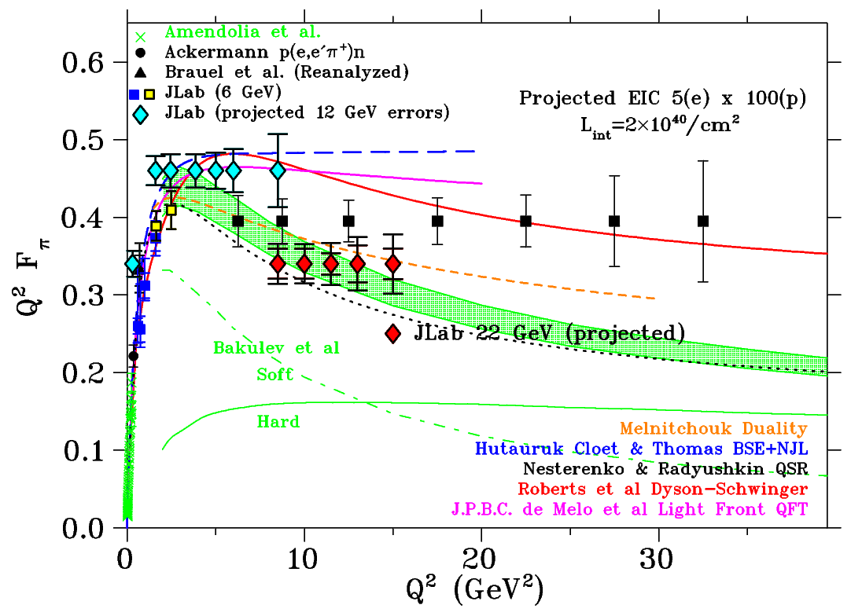
𝜋 and K Form Factor at Large Q²
Science Question: Can we get quantitative guidance on the emergent pion mass mechanism?
Key measurement: Pion form factor data for Q²: 10-40 GeV².
Science Question: How much interference is between emergent and Higgs mass mechanism?
Key measurement: Kaon form factor data for Q²: 10-20 GeV².
Courtesy Garth Huber

Slide 17
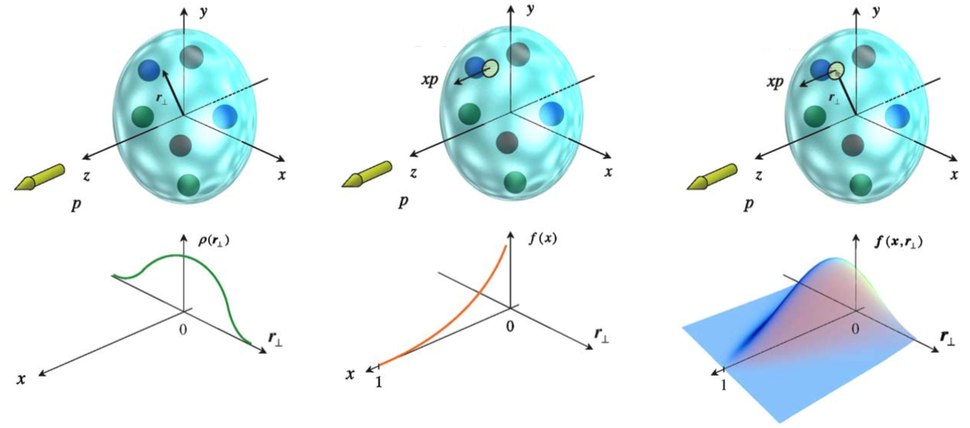
𝜋 and K: Towards a 3-Dimensional Picture
Fourier transform of the
elastic form factor
Parton Distribution
Skew-less Generalized
Parton Distribution

Slide 18
Towards Algebraic Models
Sophisticated Truncations
Numerically Demanding
QCD Predictions
QCD Green Functions
Mesons – Static, FFs, PDAs, PDFs
Baryons – Static, FF
Schwinger-Dyson Equations
Most Observables
Mesons, Baryons
Moderate Simplicity
QCD-like Predictions
Contact Interaction
Algebraic Models
Simple Implementation
Insightful - Mindful
LFWFs, GPDs, TMDs,
PDFs, FFs

Slide 19
The Algebraic Model (AM)
It retains the constant term from original models, setting it to M_{q}.
There is a term linear in w with the coefficient (M_{h}² − M_{q}²). For same flavored quarks, it ceases to contribute by construction.
There is a quadratic term w² with coefficient m_{M}². The condition
It guarantees the positivity of
The quark propagator:
Bethe-Salpeter Amplitude:

Slide 20
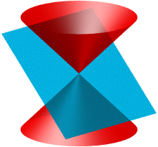
The Light Front Wavefunction
For a quark in pseudo-scalar meson M, the leading twist (2-particle) light front wave function, ψ_{M} , can be obtained via the light front projection of the meson’s BSWF.
Bethe-Salpeter Wavefunction:
Light Front Wavefunction:
BSA:
The Algebraic Model:

Slide 21
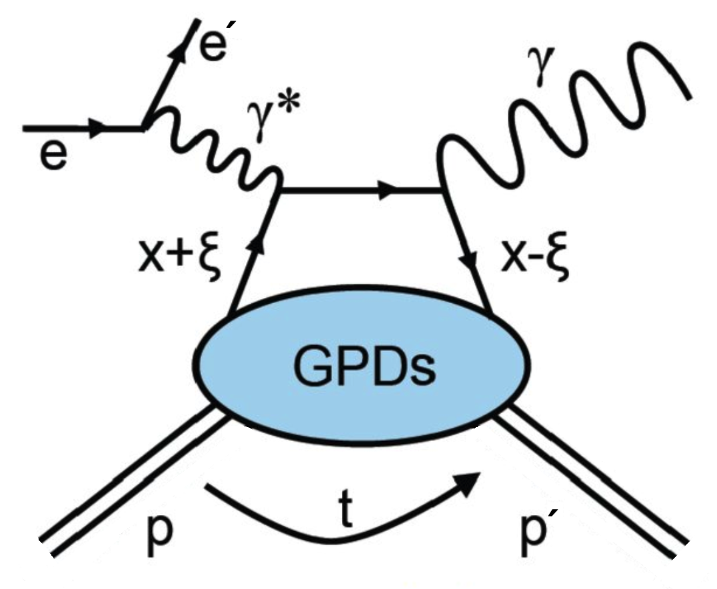
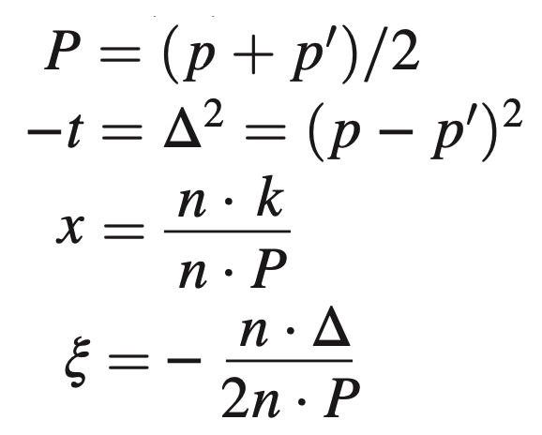
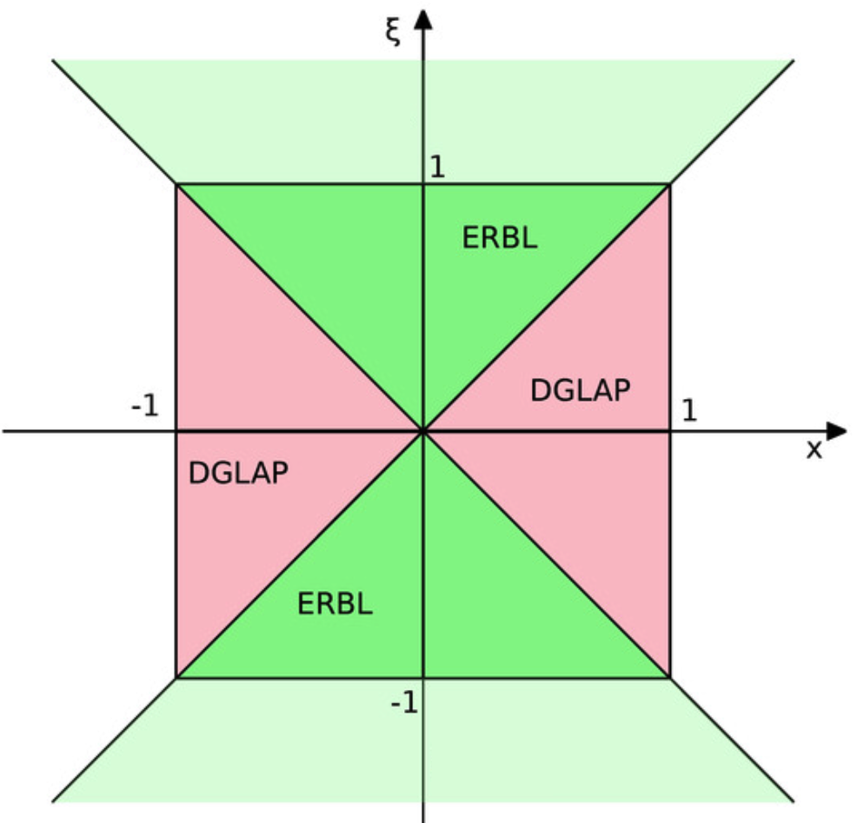
The GPDs from the overlap representation
Valence quark GPD from the overlap representation of the LFWF.
Both x and ξ have support on [−1,1].
The overlap representation is only valid in the DGLAP region, |x|>ξ.

Slide 22
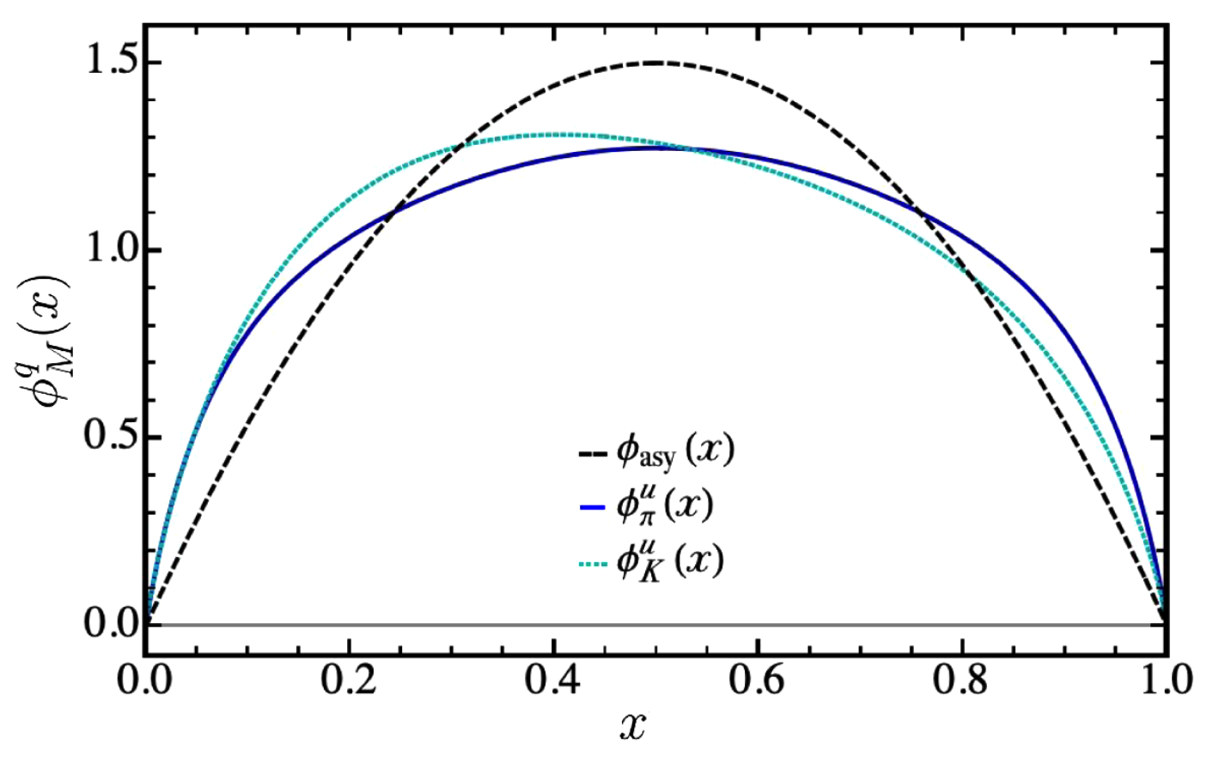
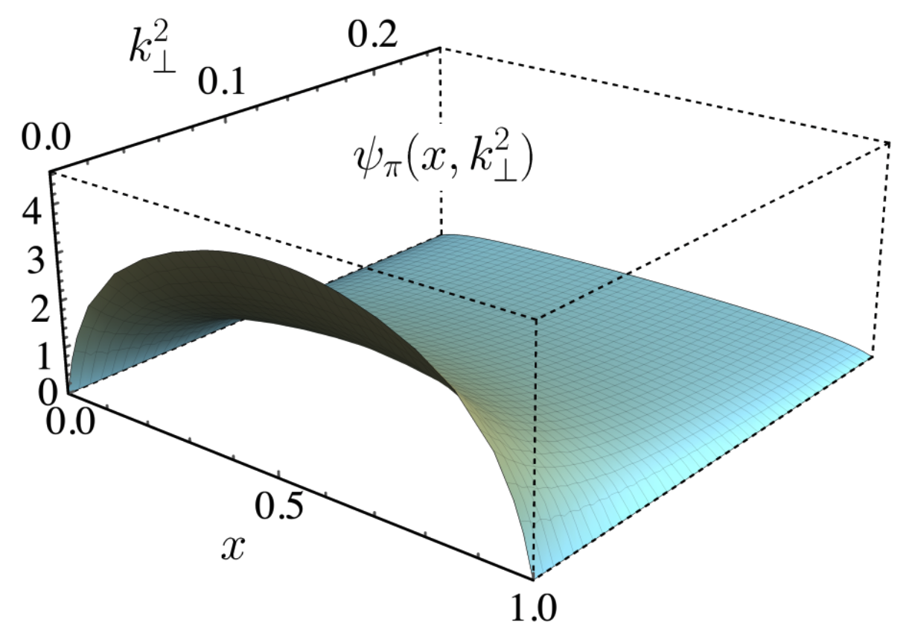
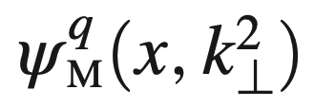
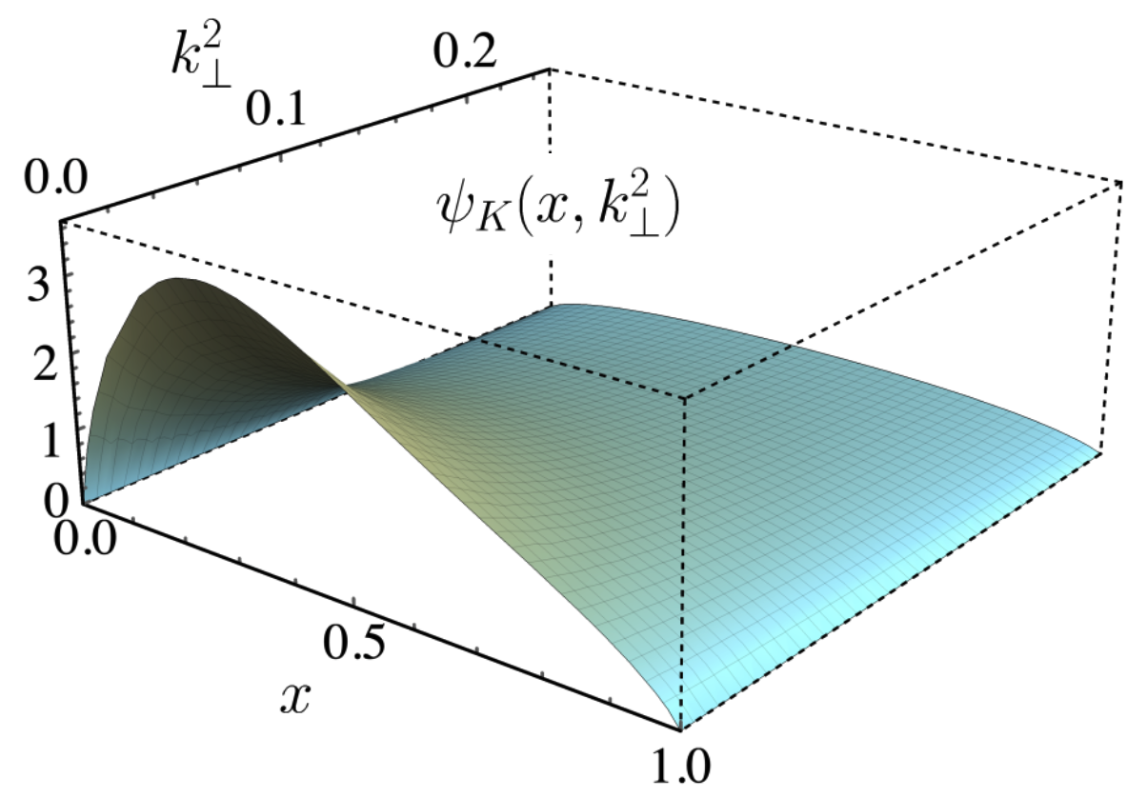
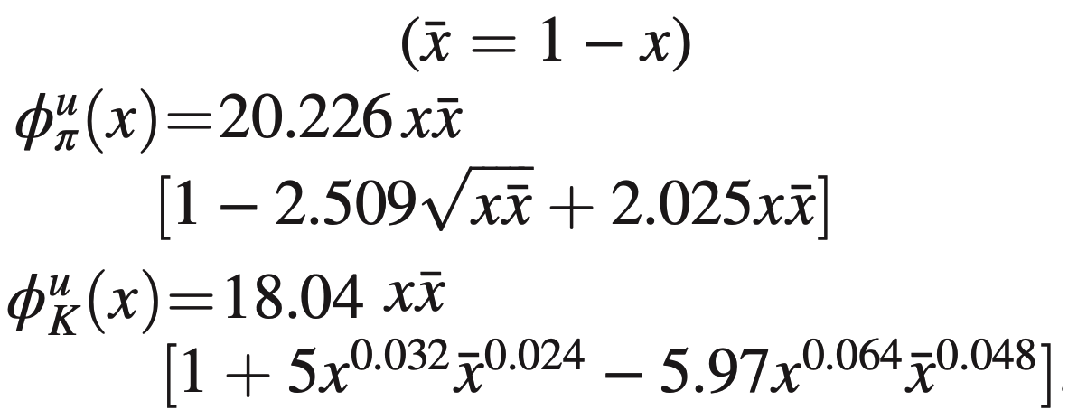
From the PDAs to the LFWFs
Drawing upon accumulated information on the PDAs of 𝜋 and K, we parameterize them as corrections to the asymptotic PDA form on the hadronic scale.
LFWF
𝜋 and K PDAs
Z.-F. Cui, et. al.,
Eur. Phys. J. C 80, 1064 (2020).
PDA

Slide 23
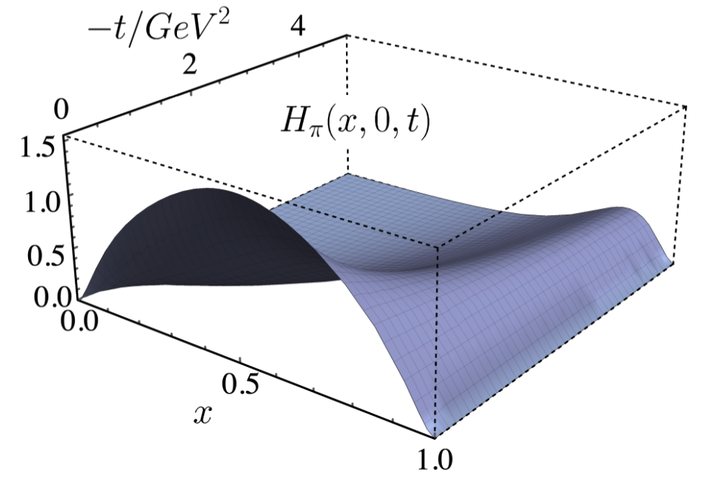
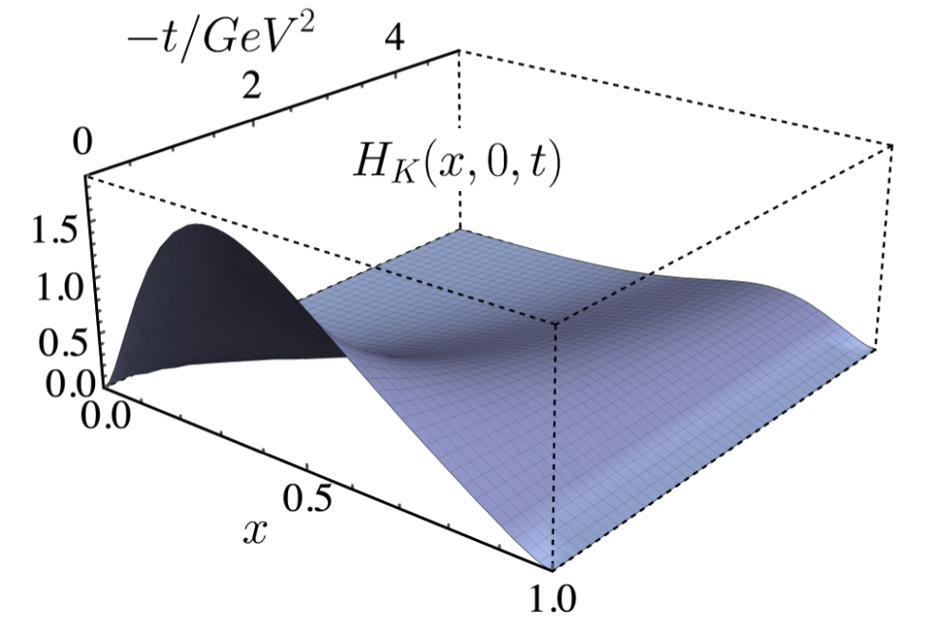
From the LFWFs to the GPDs
𝜋 LFWF
Overlap Representation of the GPDS
L. Albino, M. Higuera, K. Raya, AB
Phys. Rev. D 106 (2022) 3, 034003
K LFWF

Slide 24
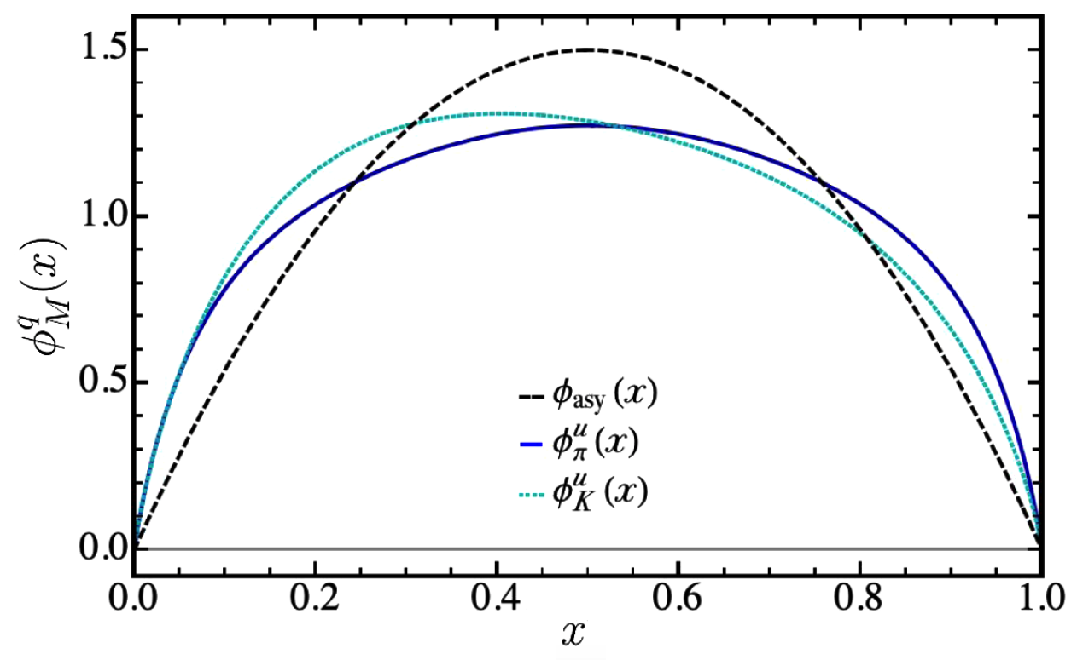
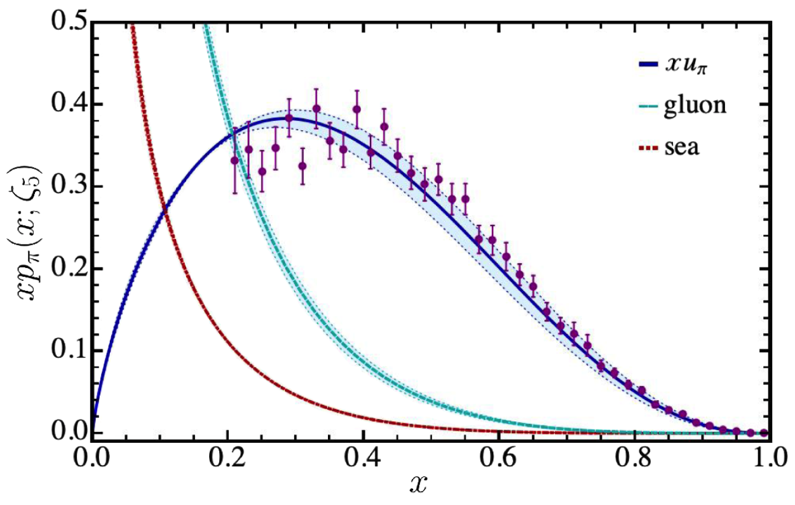
From the GPDs to the PDFs
DGLAP Evolution Equations
L. Albino, M. Higuera, K. Raya, AB
Phys. Rev. D 106 (2022) 3, 034003

Slide 25
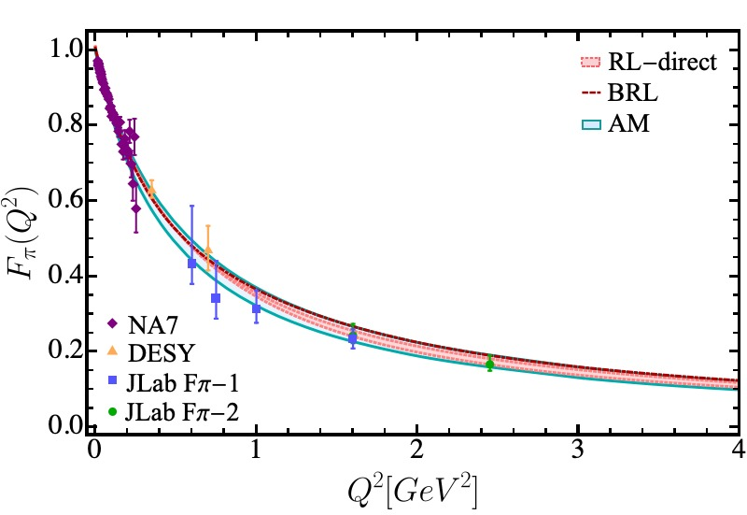
Completing the Cycle – Back to Form Factors
The electromagnetic form factors using our algebraic model can be obtained either through the knowledge of the GPDs or the direct evaluation of the triangle diagram.
Such an exercise provides stringent constraints on the efficacy of the algebraic model we have constructed by direct comparison with the refined calculation of these form factors.

Slide 26
Completing the Cycle – Back to Form Factors
We can extend this analysis of the Algebraic Model to compute the pion electromagnetic form factors to larger Q² range: 0-40 GeV² which would likely cover the photon virtualities accessible to the JLab12, JLab22 and EIC programs:

Slide 27
Completing the Cycle – Back to Form Factors
There is an analysis underway of the kaon electromagnetic form factor till 5.5 GeV² of the data obtained in JLab E12-09-011 experiment.
Courtesy Garth Huber
Algebraic Model results

Slide 28
Summary and Outlook
The interplay of QCD akin truncations of Schwinger-Dyson equations and algebraic model based upon these studies shed important light on the internal structure of pion and kaon.
QCD akin refined computation of pion and kaon electromagnetic form factors at low and intermediate virtualities of the probing photon in electroproduction processes:
A. Miramontes AB, K. Raya, P. Roig, Phys. Rev. D 105 (2022) 7, 074013
L. Chang, I.C. Cloët, C.D. Roberts, S.M. Schmidt, P.C. Tandy, Phys. Rev. Lett. 111 (2013) 14, 141802
Results for the pion electromagnetic form factor at large photon virtualities accessible to the potential 22GeV upgrade of the JLab and EIC are also available:
L. Chang, I.C. Cloët, C.D. Roberts, S.M. Schmidt, P.C. Tandy, Phys. Rev. Lett. 111 (2013) 14, 141802 J. Arrington, et al. (Feb 23, 2021, J.Phys. G 48 (2021) 7, 075106
More recently, pion and kaon form factors have been computed in the the time-like region
A.S. Miramontes, H. Sanchis Alepuz, R. Alkofer, Phys. Rev. D 103 (2021) 11, 116006
A.S. Miramontes, AB, Phys. Rev. D 107 (2023) 1, 014016

Slide 29
Summary and Outlook
Carefully constructed Algebraic Models can enable computation of the GPDs, PDFs and EFF
with relative ease which is reminiscent of a contact interaction while mimicking the reliability
of QCD akin refined truncations of Schwinger-Dyson equations.
L. Albino, M. Higuera, K. Raya, AB Phys. Rev. D 106 (2022) 3, 034003
Despite these encouraging results and synergy with experimental endeavors at JLab and EIC, further improvements and extensions in the continuum QCD approach are desirable.
Deeper research into the theoretical foundations of the truncations involved at the level of the Green functions of the fundamental degrees of freedom, i.e., quarks, gluons, as well as quark-gluon and gluon-gluon interactions continues vigorously.
Schwinger-Dyson equations have also been of substantial success in the studies of baryons such as the transition form factors of nucleon to its excited states which is a hallmark of CLAS, CLAS12 and CLAS22 programs at JLab and hold the promise to offer a reliable tool for the future JLab and EIC era research into the heart of hadronic matter.
N → N*(1520) Transition Form Factors

Slide 30
Thank you for your attention

