Slide 1
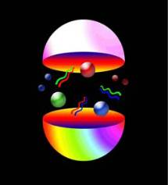
Schwinger-Dyson Equations
Symmetries of a QFT
Institute of Physics and Mathematics
University of Michoacán, Morelia, Michoacán, Mexico
Jefferson Laboratory,
Newport News, Virginia, USA

Slide 2
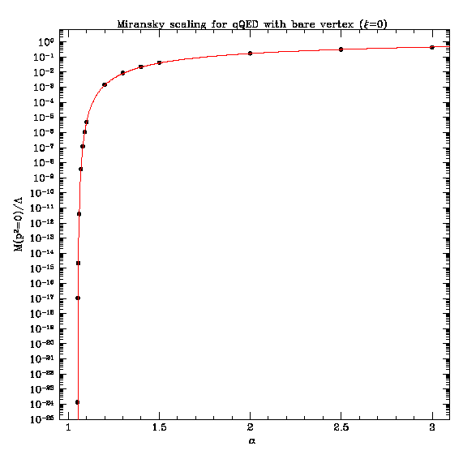
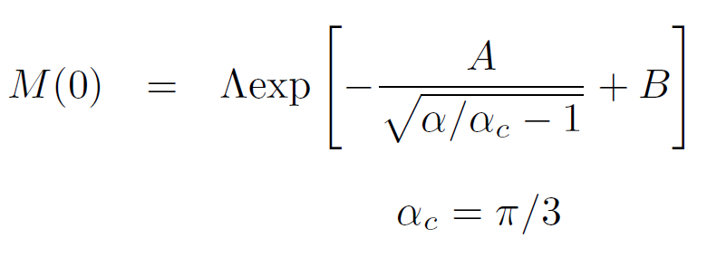
Dynamical mass generation in QED
Rainbow approximation
in the Landau gauge:
Miransky scaling
𝛼_{c} is a physical observable

Slide 3
Dynamical mass generation in QED
Rainbow approximation beyond the Landau gauge:
This system of equations decouples in the Landau gauge but in
practice we can solve it in any gauge numerically.

Slide 4
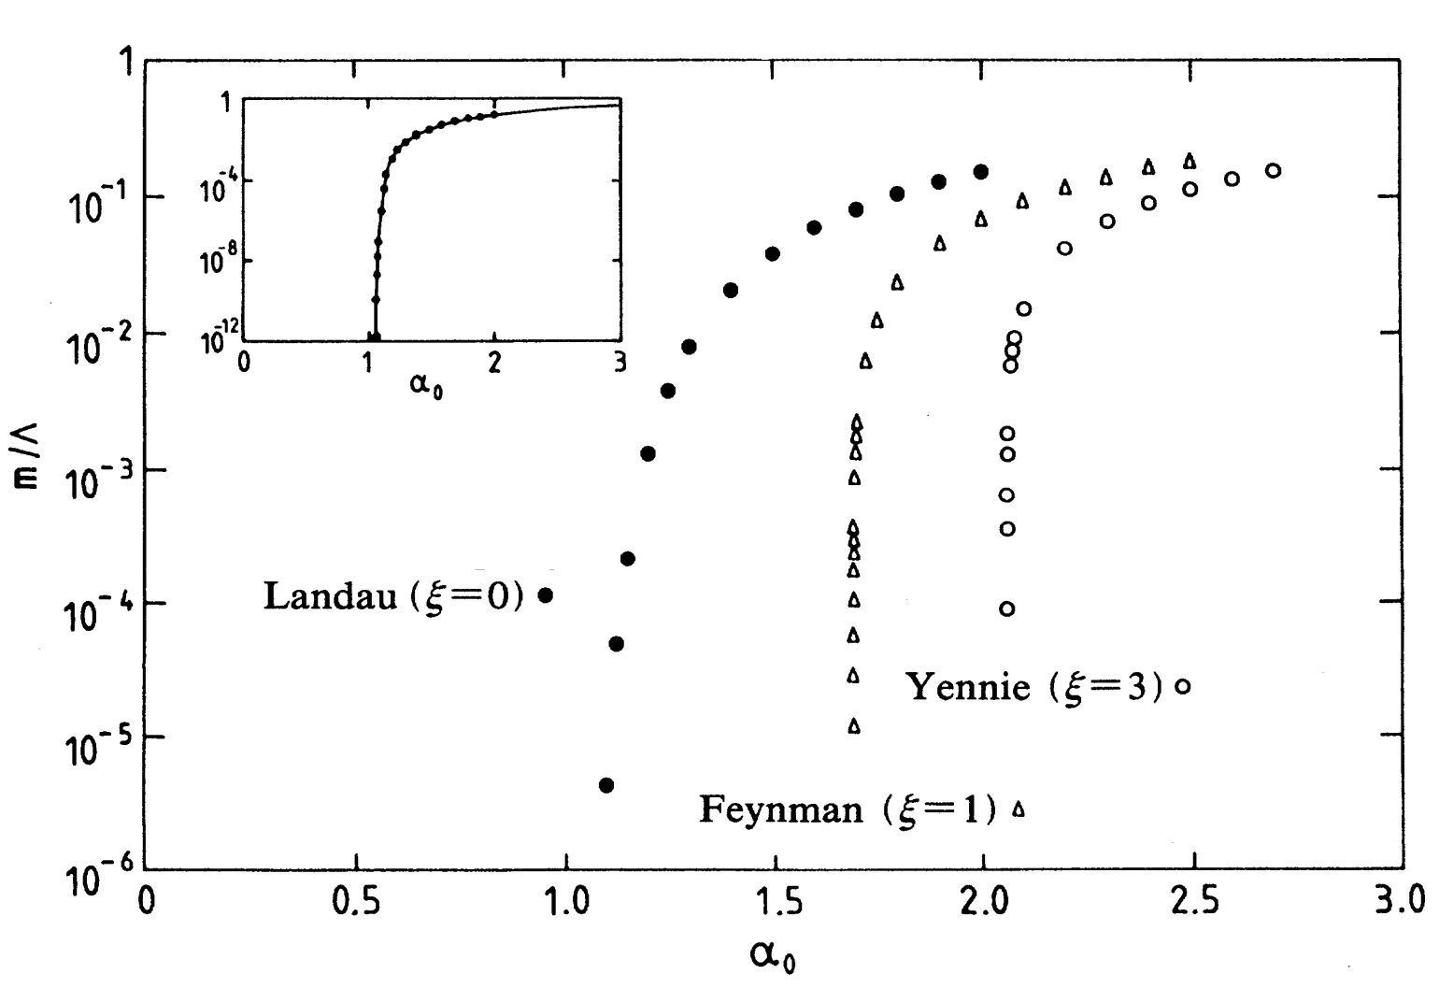
Dynamical mass generation in QED
The bifurcation of dynamical mass takes place at a different
value of the gauge parameter:
The photon dressing function does not depend upon the gauge
parameter. Need to focus on the fermion-photon interaction.

Slide 5
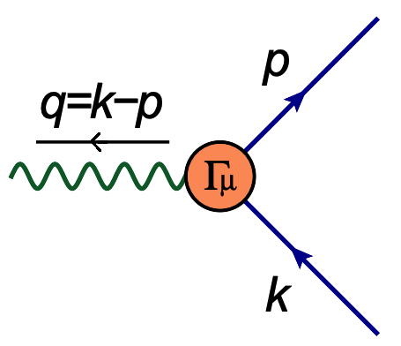
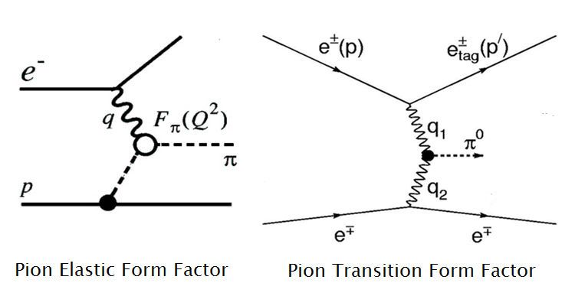
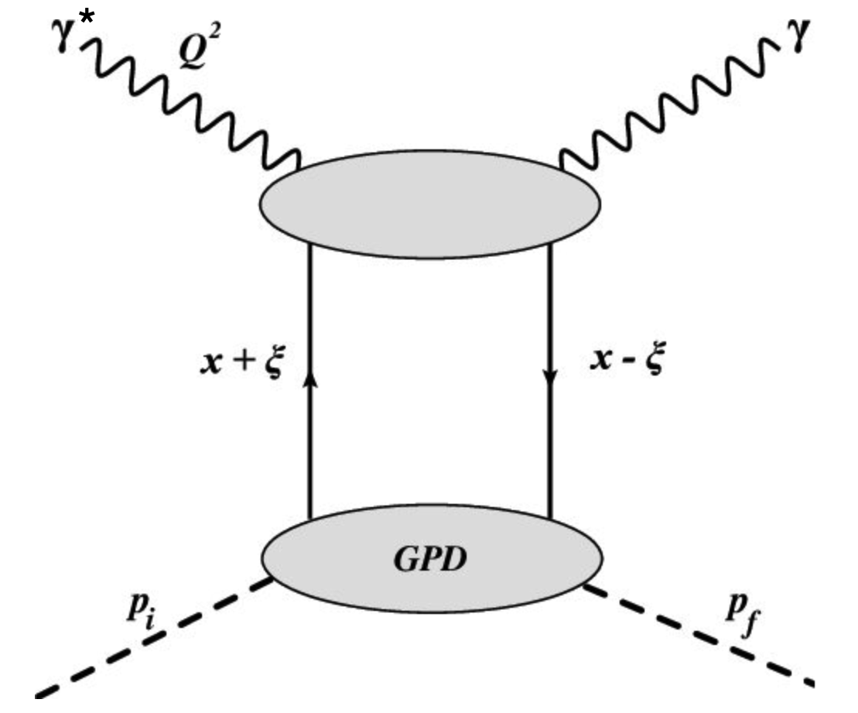
The fermion-photon interaction
The electron-photon interaction plays a key role in unraveling
the internal structure of hadrons in laboratories like the JLab.
The photons interact with electrically
charged quarks inside hadrons to study
their internal structure which stems
primarily from QCD.

Slide 6
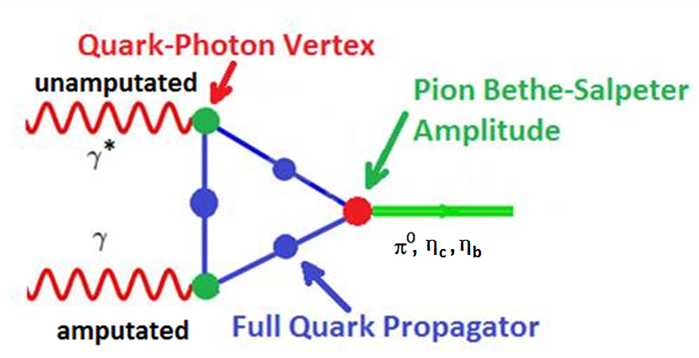
Meson to γγ* transition form factor

Slide 7
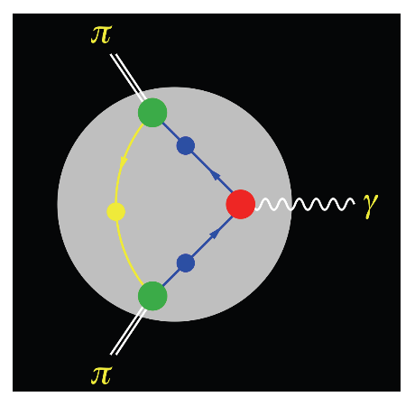
Pion electromagnetic form factor
Quark-Photon Vertex
Gluon
Propagator
Quark
Propagator
Quark-Gluon
Vertex
Bethe-Salpeter Amplitude

Slide 8
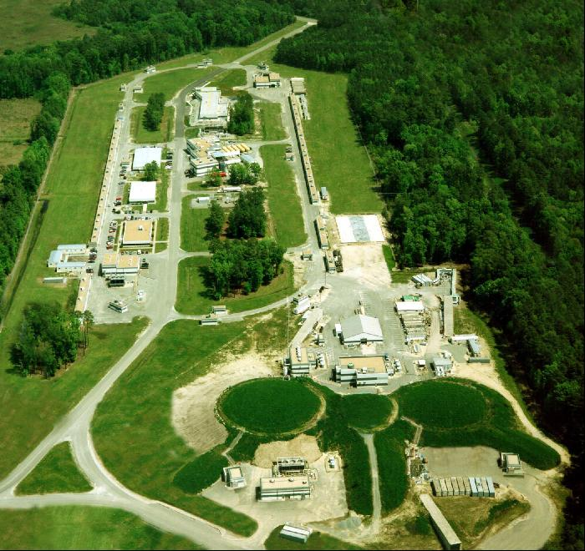
Photon-quark interaction & hadron structure
D
Continuous
Electron
Beam
Accelerator
Facility
LINAC
LINAC
Jefferson Laboratory,
New Port News,
Virginia,
USA
Injector
A
B
C
Experimental Halls

Slide 9
Truncating the SDEs
The fermion-photon vertex must satisfy the key features of
the associated quantum field theory, i.e., QED.
Phenomenology
Gauge
Covariance
Multiplicative
Renormalization
Perturbation
Theory
Fermion-photon vertex
Solve the
vertex SDE

Slide 10
Be mindful of the projections

Slide 11
The transverse vertex
There are numerous implications of gauge covariance which
need to be respected.
LKF Transformations
Transverse Takahashi
Identities
Perturbation Theory
Gauge Independent
Observables
Gauge Covariance
WT Identities

Slide 12
Ward Takahashi identities

Slide 13
Ward-Takahashi identity
The Ward and Ward-Takahashi identities:
In the Landau gauge F(k)=F(p) and M(k)~M(p) at and below the pole mass.
The WTI is almost satisfied in the Landau gauge for
momenta of interest for non-perturbative mass generation.

Slide 14
Ward-Takahashi identity
The structure of the Ward-Takahashi identity:
is such that we can divide it into two components, longitudinal
and transverse to the photon momentum.
The WTI only provides information on the longitudinal part
of the vertex. We can think of the following ansatz:
but it has a kinematic singularity at q² → 0.

Slide 15
Constructing the longitudinal vertex
Let’s start from the Ward identity and the general form of
the fermion propagator:
To generalize it to k ≠ p, we can symmetrize it:

Slide 16
The longitudinal vertex
We can thus write the longitudinal vertex as follows which is attributed to the work of Ball and Chiu:
It has no kinematic singularities at k² → p².
It satisfies the Ward-Takahashi identity.
It obeys the CP symmetry of the fermion-photon vertex.
Is it the complete vertex? Is there a transverse part?
The bare vertex does not satisfy WTI beyond Landau gauge.

Slide 17
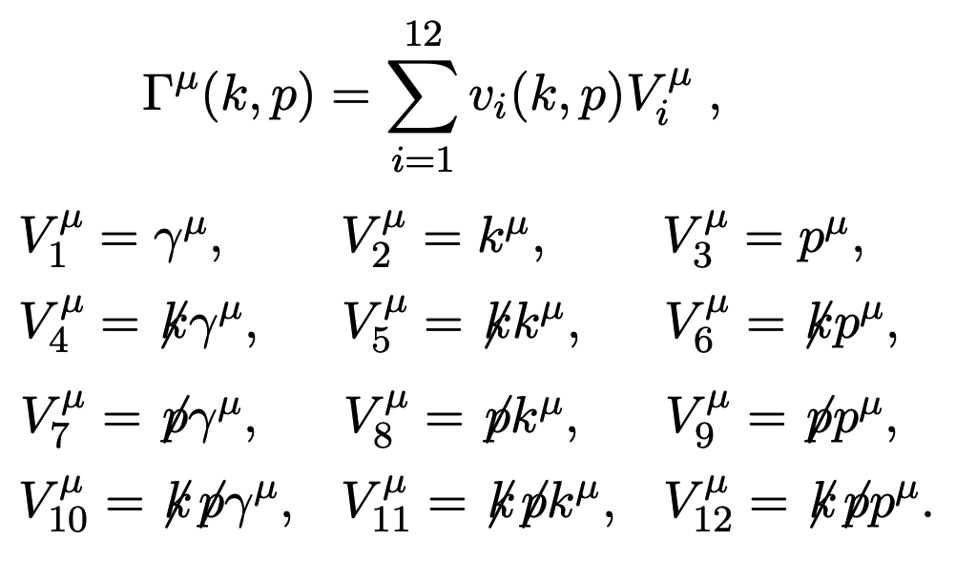
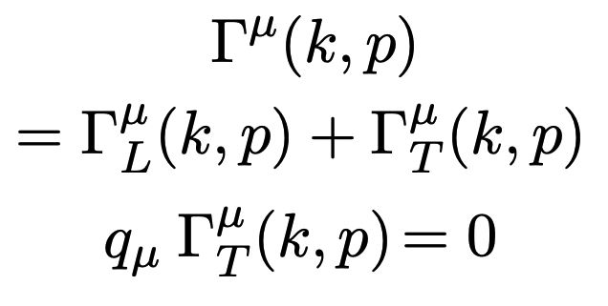
The vertex – its complexities
What is the complete structure of the fermion-photon
vertex we can construct with 3 vectors and 4 independent
scalars.

Slide 18
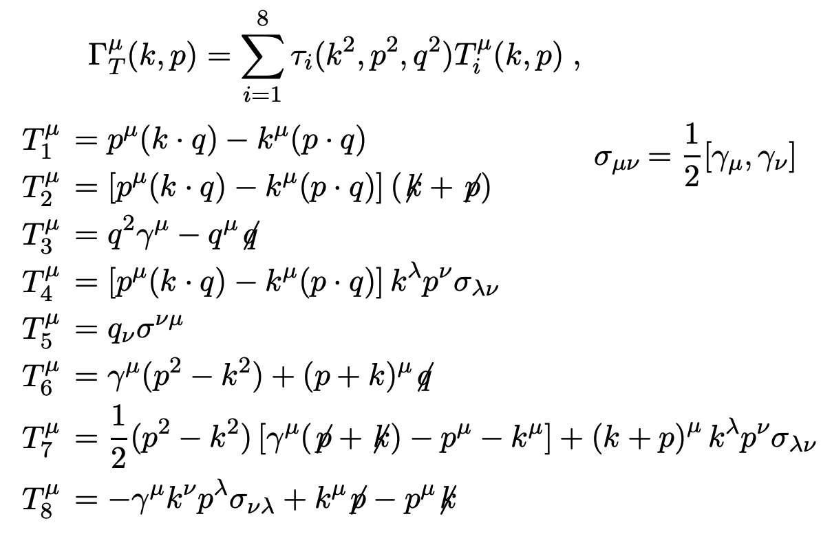
The transverse vertex
Longitudinal vertex consumes 4 basis vectors. The other 8
allow us to expand out the transverse vertex systematically:

Slide 19
Transverse Takahashi identities

Slide 20
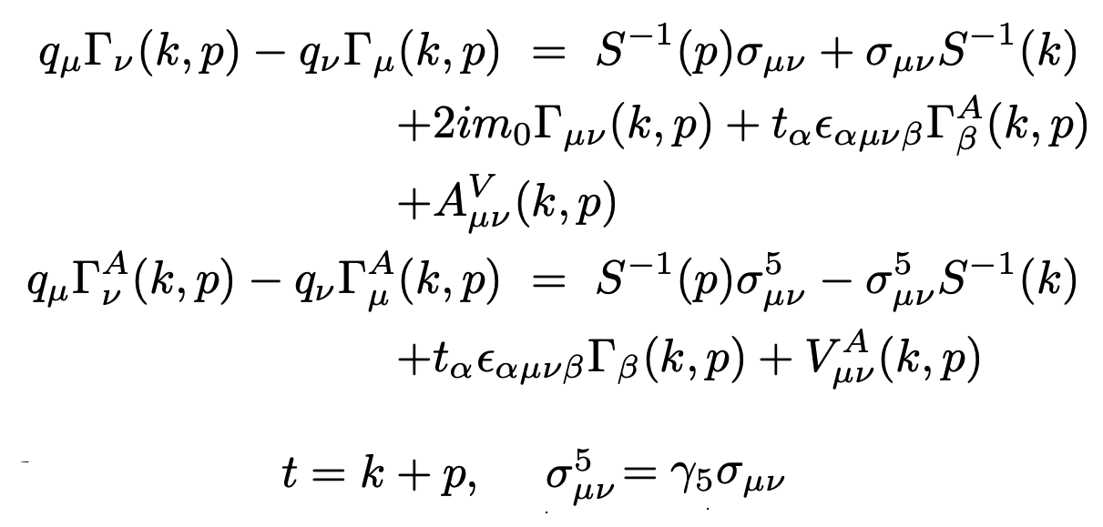
Transverse Takahashi identities
To know a vector completely, we need to know its divergence
as well its curl. Note that for the bare vertex:
Transverse Takahashi
identities

Slide 21
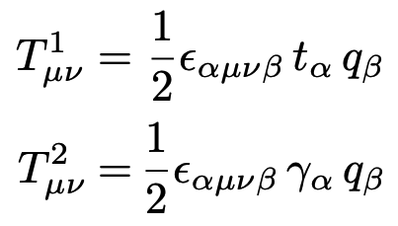
Transverse Takahashi identities
In order to project out transverse form factors from the
TTIs, it is convenient to introduce the following projectors:
Contract the first TTI with both these projection operators and simplify the results:

Slide 22
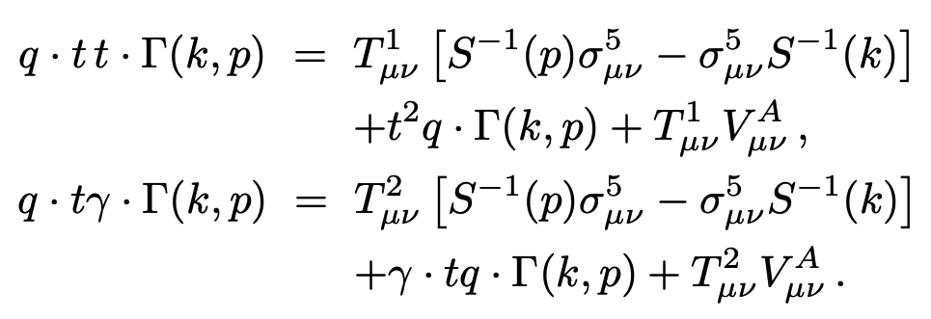
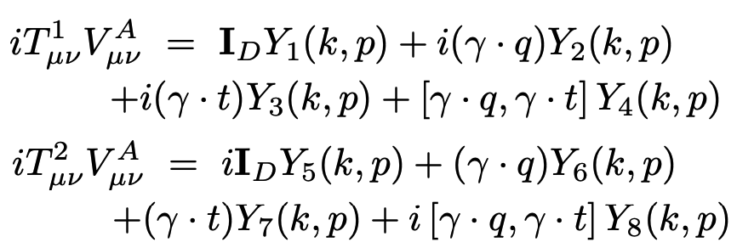
Transverse Takahashi identities
The result can be written in the following form:
These Lorentz scalar objects can be expressed:
and implemented into the gap equation.

Slide 23
Landau-Khalatnikov-Fradkin
Transformations

Slide 24
Landau-Khalatnikov-Fradkin transformations
Ward-Takahashi identities relate different Green functions
to each other.
Landau-Khalatnikov-Fradkin transformations tell us how a
Green function will change under a variation of gauge.
These transformations are non-perturbative and most
compactly written in the coordinate space.
In QED, for the fermion propagator:

Slide 25
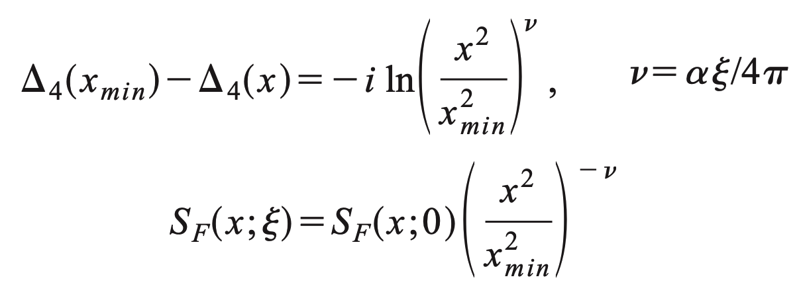
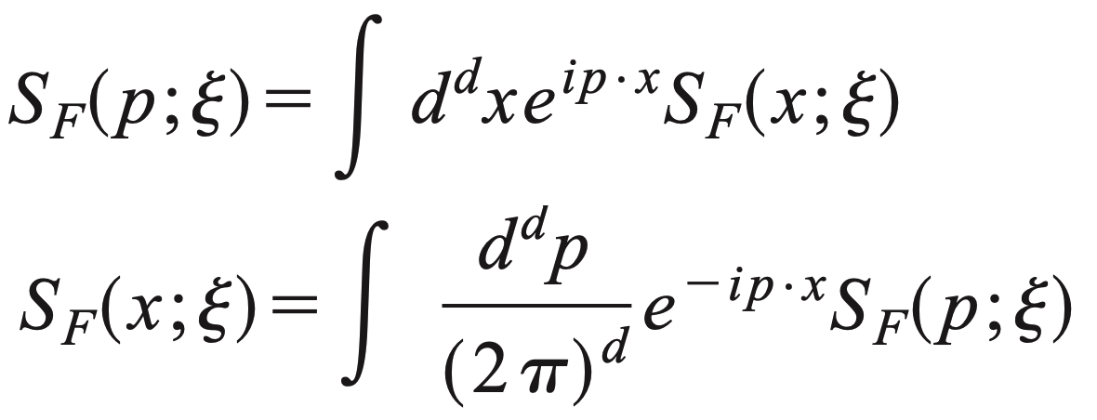
LKFT for the fermion propagator
In 4-dimensions, we can calculate:
We work with momentum space fermion propagator generally:

Slide 26
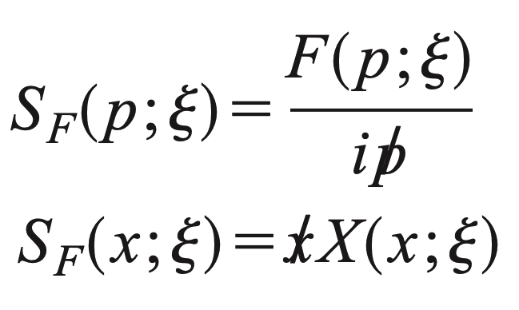
LKFT for the fermion propagator
The general form of massless
fermion propagator is
Based upon our one-loop perturbation theory calculation
Fourier transform
LKFT

Slide 27
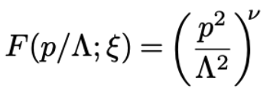
LKFT for the fermion propagator
Inverse Fourier transform yields:
The renormalized wavefunction renormalization is:
These are not at a given order in perturbation theory.
These are an all order re-summation of leading logarithms.

Slide 28
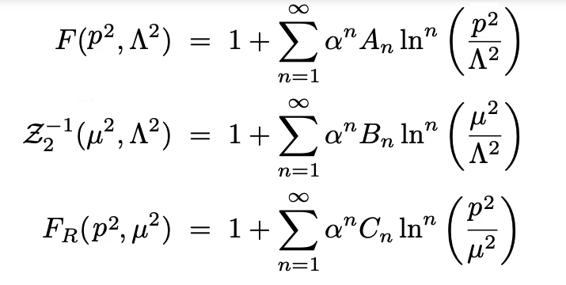
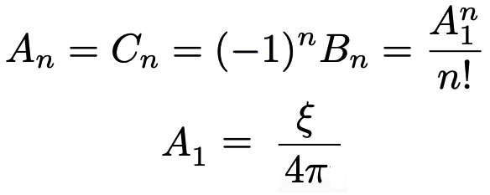
LKFT for the fermion propagator
The bare vertex truncation or even the Ball-Chiu longitudinal
vertex do not respect it in all gauges.
This requirement puts tight constraint on the choice of the
transverse vertex.
“The momentum space Landau-Khalatnikov-Fradkin transformation of
interaction vertices in quantum electrodynamics”,
AB, J. P. Edwards, U.D. Jentschura, J. Nicasio, in progress.

Slide 29
Perturbation Theory

Slide 30
Perturbation Theory
In perturbation theory, all the key properties of a gauge
field theory are maintained order by order.
So it is natural to demand all Green functions to reproduce
perturbation theory in the weak coupling regime.
At tree level, the fermion-photon vertex is merely 𝛾^{μ}.
At one-loop, it already becomes very complicated. However,
for the asymptotic values of fermion momenta: k >> p:

Slide 31
The transverse vertex
Recall the numerous implications of gauge covariance which
need to be respected.
LKF Transformations
Transverse Takahashi
Identities
Perturbation Theory
Gauge Independent
Observables
Gauge Covariance
WT Identities

Slide 32
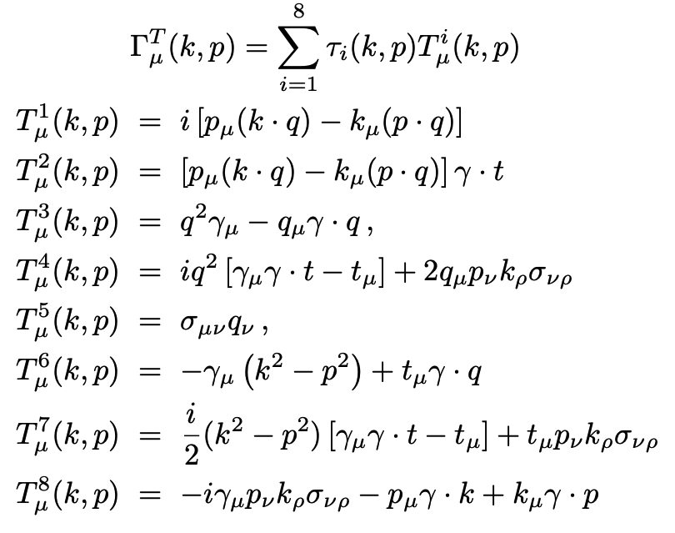
The transverse vertex
Coefficients 𝜏_{i}(k,p) are constrained by symmetries of QED.

Slide 33
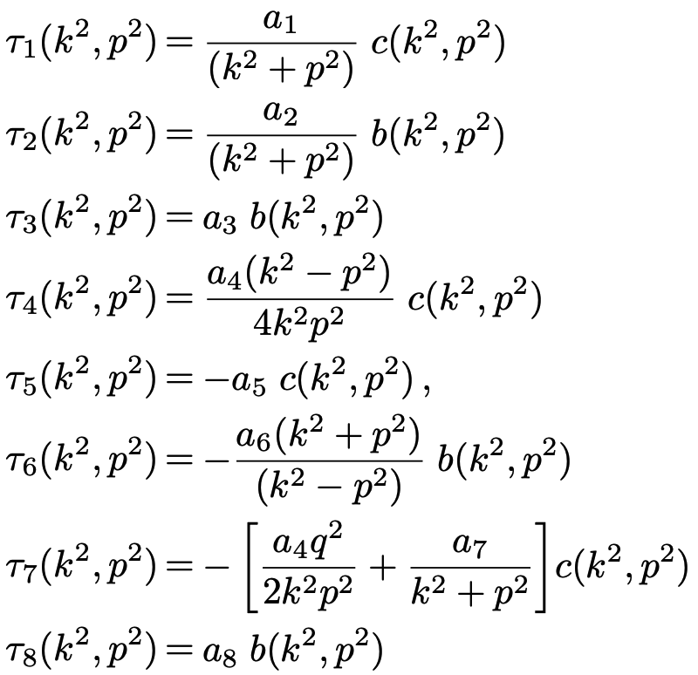
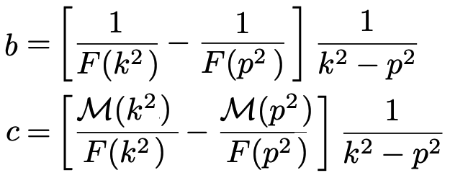
The transverse vertex
Transverse vertex
consists of the same
structures as the
longitudinal vertex.
Coefficients a_{i} are
constrained by the
symmetries of QED.

Slide 34
The bare vertex in different gauges
Recall the bifurcation of dynamical mass takes place at a
different critical value of the coupling in gauge parameter:

Slide 35
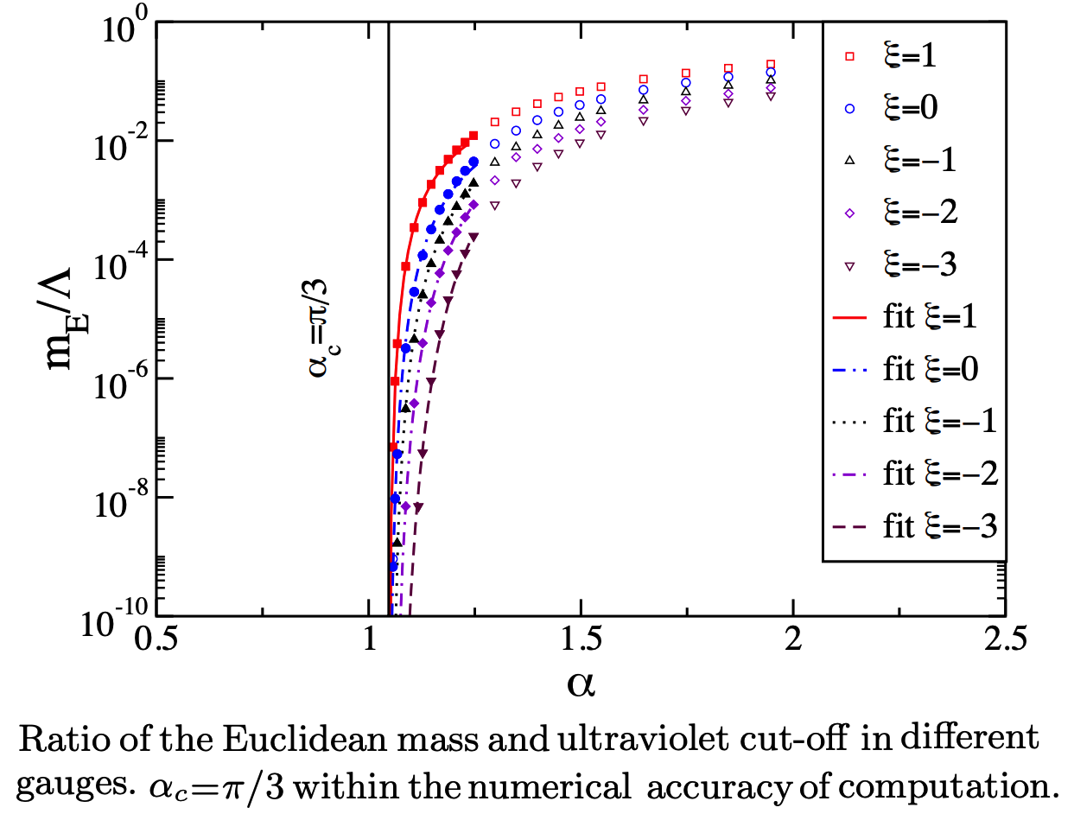
Constrained vertex in different gauges
L. Albino, AB, L.X. Gutiérrez-Guerrero, B. El Bennich, E. Rojas,
Phys. Rev. D100 054028 (2019)

Slide 36
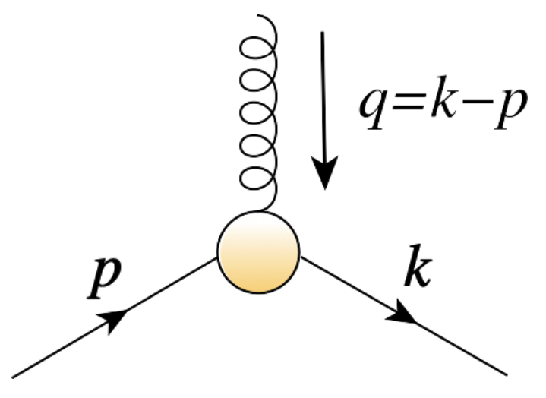
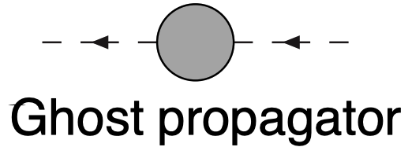
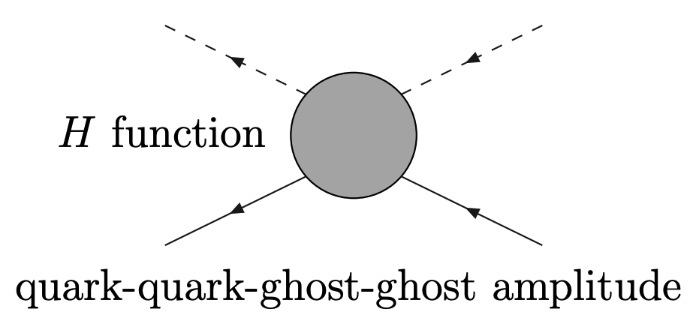
Salvnov-Taylor identities
For the quark-gluon vertex,
Slavnov-Taylor identity replaces
the Ward-Takahashi identity.

Slide 37
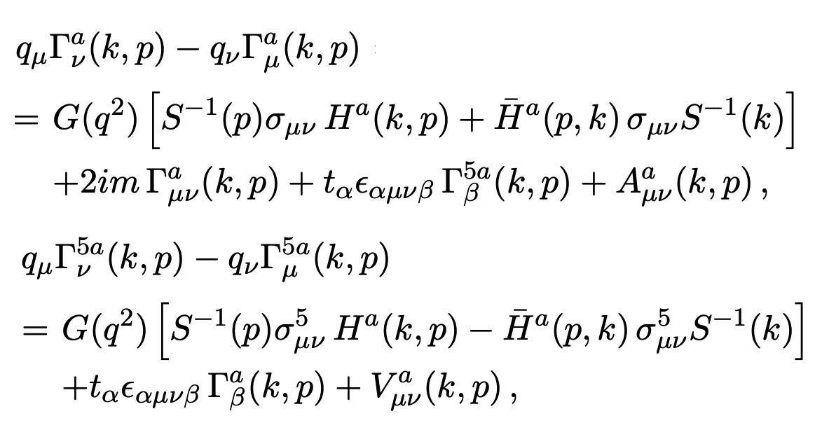
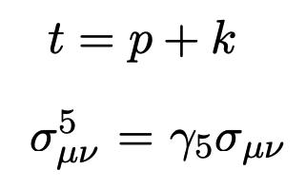
Transverse Slavnov-Taylor identities
In analogy to QED, the transverse part of the quark-gluon
vertex can be constrained by the TSTI relate to its curl.
The Dirac structure of these identities is identical to that in
QED but they also involve the ghost dressing function and
quark-ghost scattering kernel in QCD.

Slide 38
Perturbation theory
At 1-loop, in the asymptotic limit of incoming and outgoing
fermion momenta: k>>p, QED result can be extended to QCD:
R. Bermudez, L. Albino, L.X. Gutiérrez, M. Tejeda, AB
Phys. Rev. D95 034041 (2017)
The QED result can be readily inferred .

Slide 39
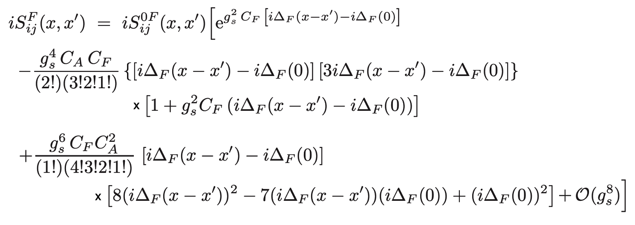
Local gauge transformation
The expression for these transformations is not closed in
QCD due to its non-abelian nature.
M.J. Aslam, A. Bashir, L.X. Gutierrez-Guerrero,
Phys. Rev.D 93 (2016) 7, 076001.
The QED result is recovered for C_{A}=0, C_{F}=1.

Slide 40
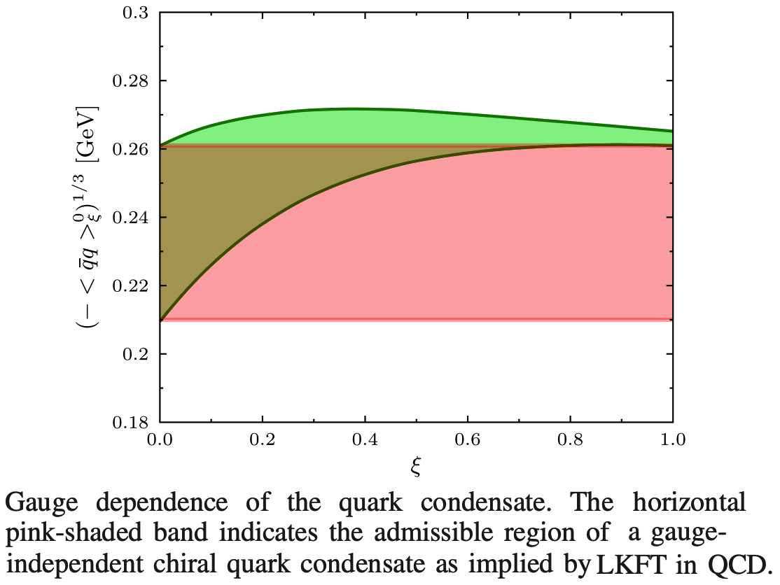
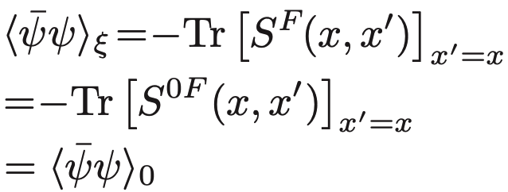
Condensate – exploratory study
The chiral quark
condensate is
explicitly gauge
invariant.
H.R. Lessa, F.E. Serna, B. El Bennech, AB, O. Oliveira Phys. Rev. D107 074017 (2023)

Slide 41
What next?
What role does chiral symmetry and its dynamical breaking
play in QCD and hadron physics?
Can we start from a simple illustrative example of how we
can start from SDEs of QCD and from their extract
physical observables of hadron physics laboratories?
How do we study bound states, mesons, baryons?
How do we improve upon our studies?

