Slide 1
Nuclear Science at Jefferson Lab
Understanding the building blocks of matter.

Slide 2
3000 years AGO, what did the great Philosophers Think WERE the Building blocks of MATTER?

Slide 3
The Five Elements (Aristotle ~300BC )
And the Aether, the divine substance that makes up the heavenly spheres and heavens (what we now call the stars and planets, which Aristotle could see easier then we can in Newport News).

Slide 4
In the late 1800’s, what did The GREAT Scientists Think WERE the Building blocks OF matter?

Slide 5
Periodic Table (Mendeleev 1868)
Water is no longer a building block, it is made up of Hydrogen (H) and Oxygen (O).

Slide 6
But isn’t this getting really complicated…
We started with five building blocks
Earth
Wind
Fire
Water
Aether
Now I have learn the an entire periodic table?!
Are those really the building blocks of matter?!

Slide 7
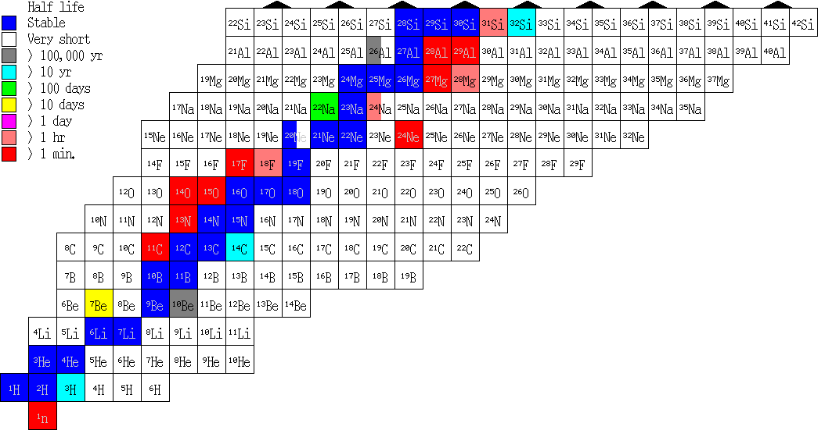
Chart of the Nuclides
Elements on the periodic table can have different numbers of neutrons.
Protons
Neutrons
Electrons

Slide 8
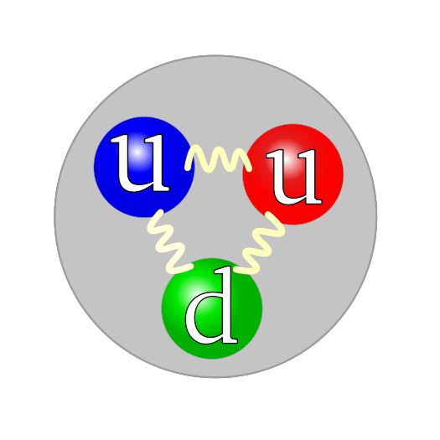
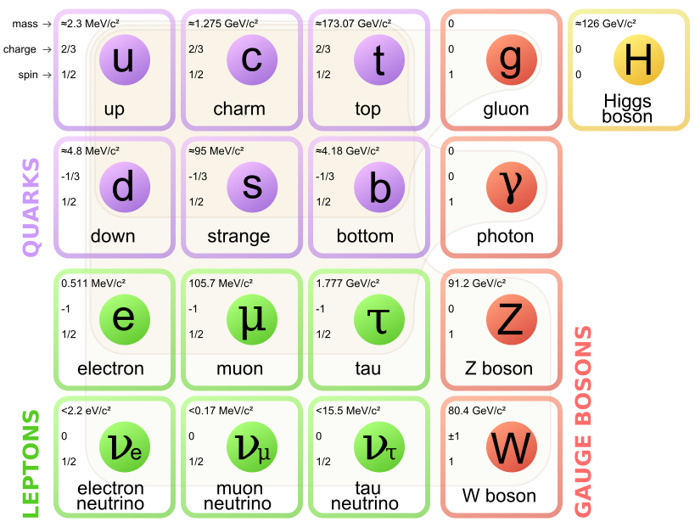
The 21st Century Building Blocks
Proton
Jefferson Lab’s mission is to understand the transition from hadronic to partonic degrees of freedom.

Slide 9
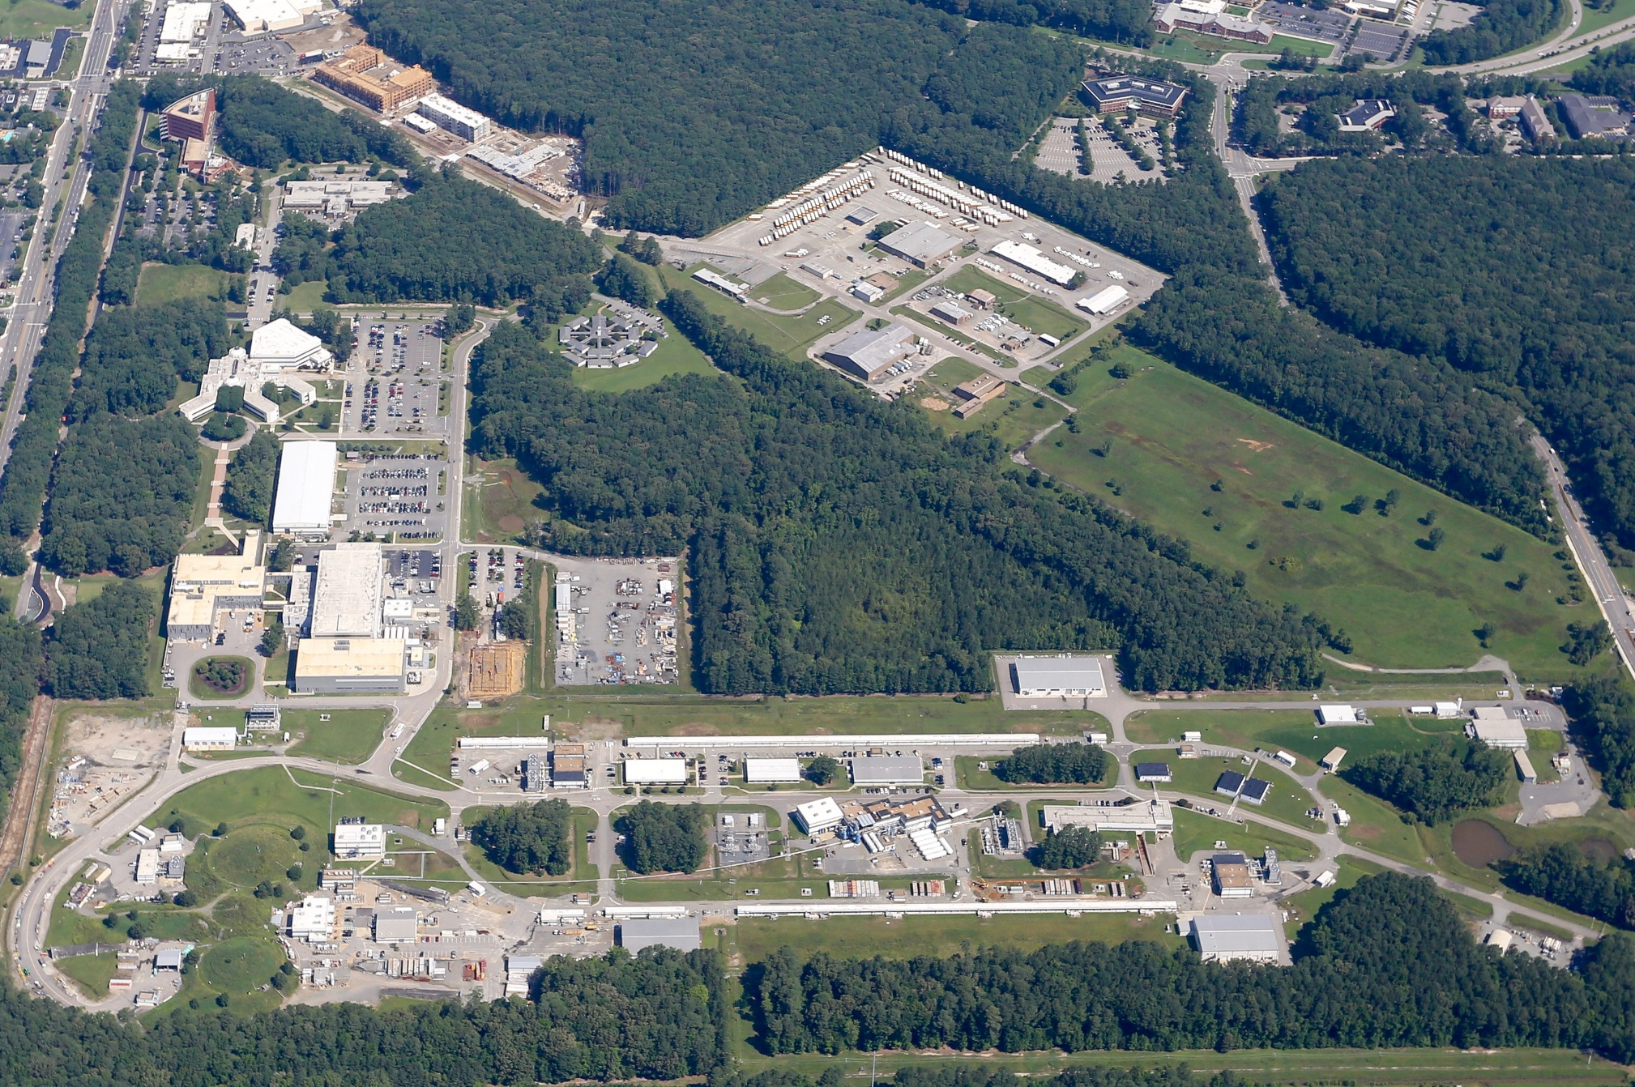
Thomas Jefferson National Accelerator Facility

Slide 10
Thomas Jefferson National Accelerator Facility
United States Department of Energy National Lab (Primary Focus Nuclear Physics)
2000 Scientists
U.S. Universities
International
Train Next Generation
10 Ph.D.’s/Year
College Programs
High School Programs
Primary Mission is to understand transition from nuclear matter (protons and neutrons) to quarks and gluons.
Quarks are (to the best of our knowledge) a fundamental building block of matter.
Can never find only one.

Slide 11
Heisenburg’s Uncertainty Principle
Δx Δp ≥ ħ/2 ~ 0.2 GeV fm
Proton is ~1 fm in size (10⁻¹⁵m).
Thus to “see” 0.02 fm one needs approx. 10 GeV momentum

Slide 12
Virtual Tour of Jefferson Lab’s Accelerator

Slide 13
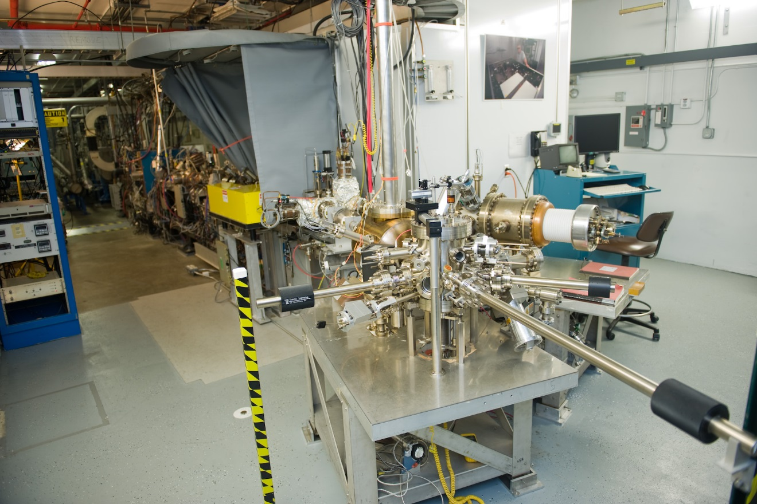
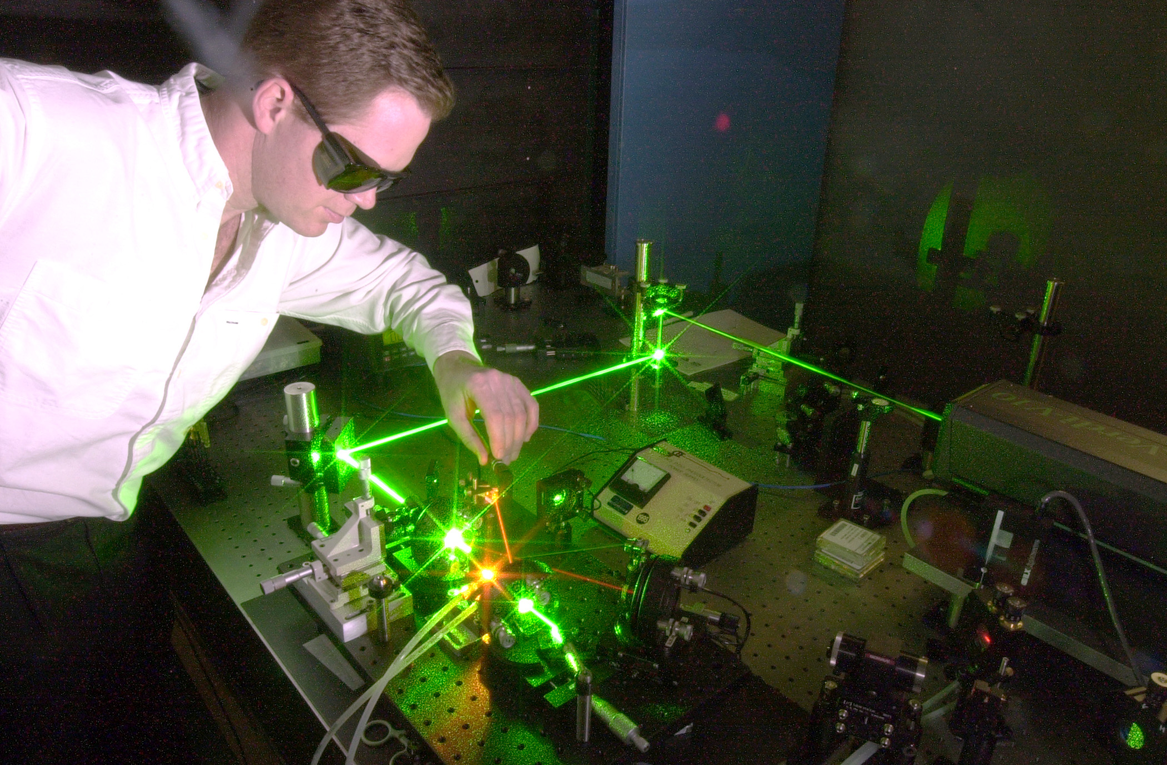
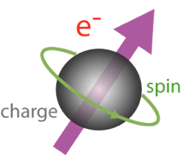
Injector: Photoelectric Effect
Albert Einstein won his Nobel prize for explaining this effect in 1921.
By using polarized laser light and special photocathode materials, we can make electrons whose spin is all in the same direction.

Slide 14
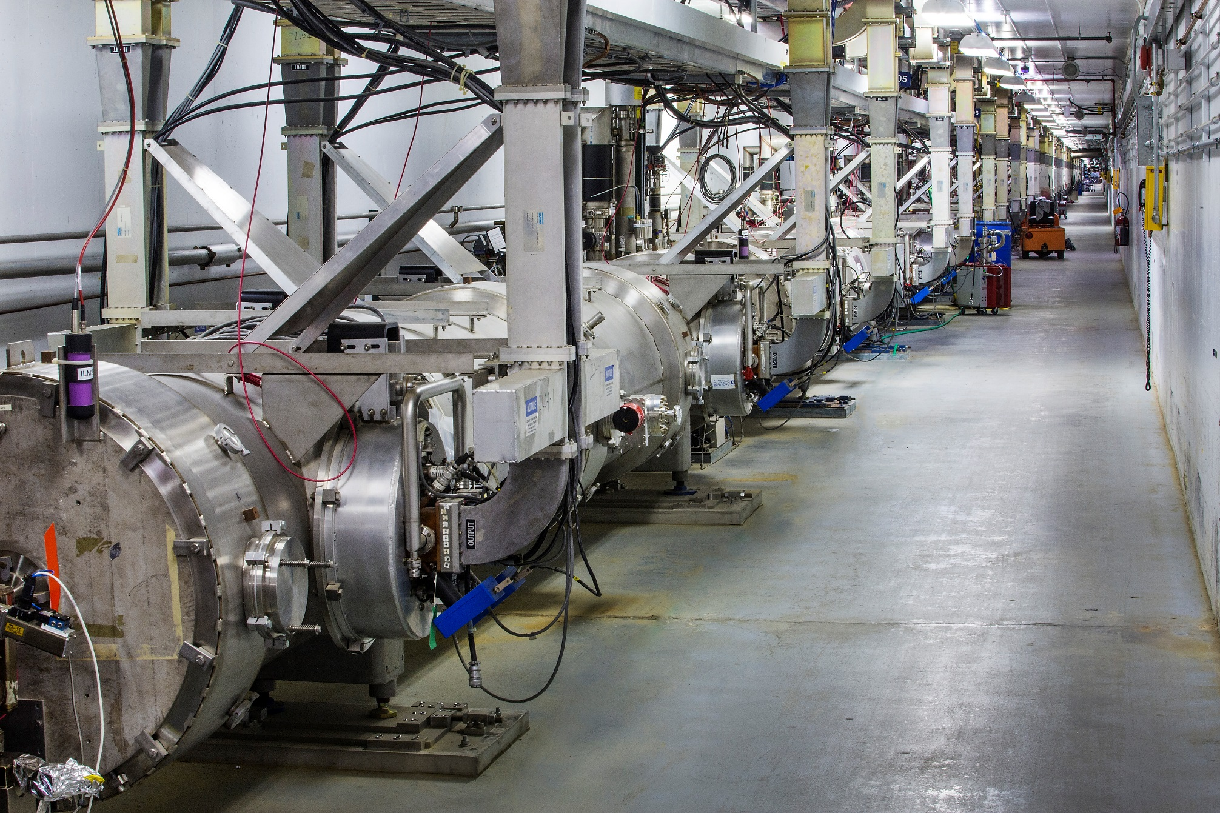
Linear Accelerator
We take 0.511 MeV particles and accelerate them to energies of 12,000 MeV and it still
doesn’t go faster then the speed of light in vacuum!

Slide 15
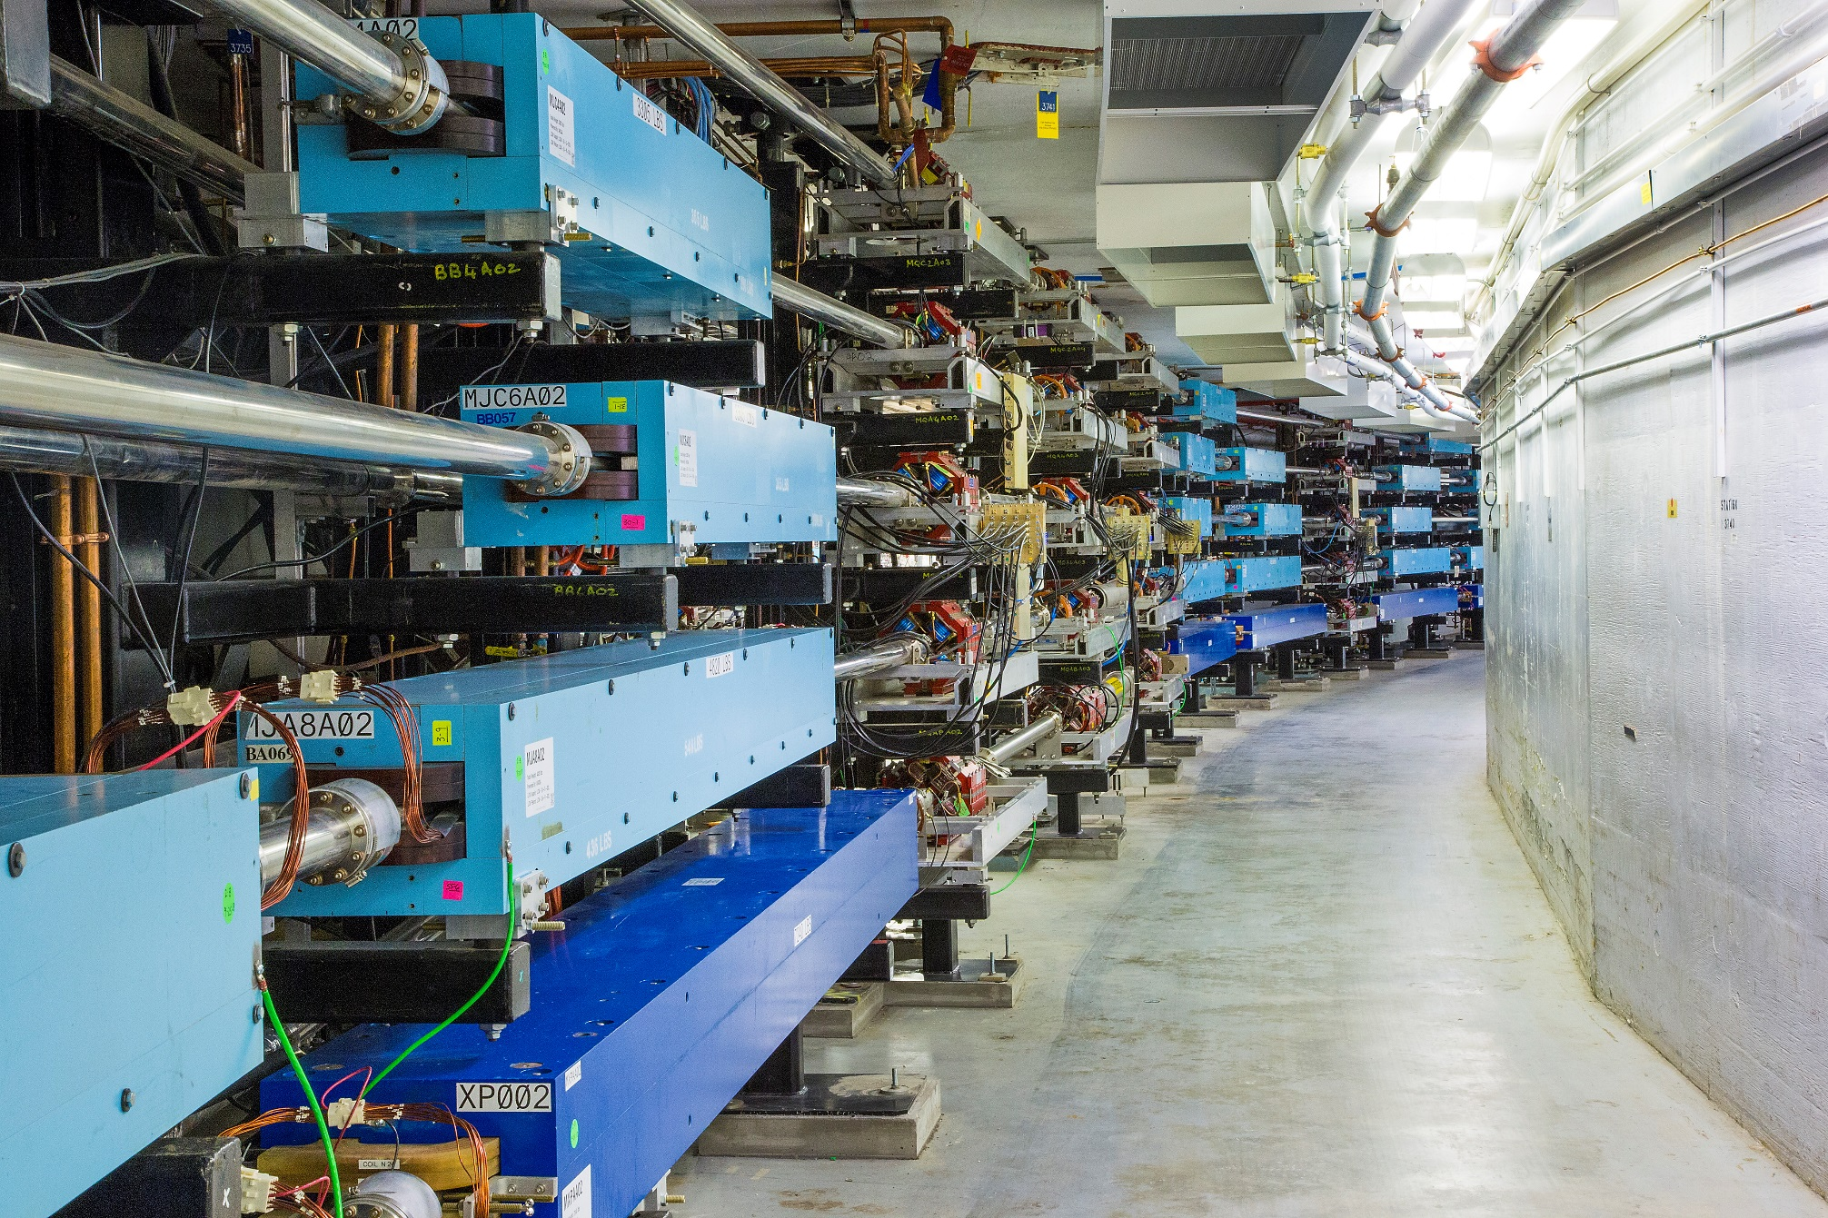
Race Track Design
Accelerators are expensive (>100 million dollars) while bending magnets are cheap.

Slide 16
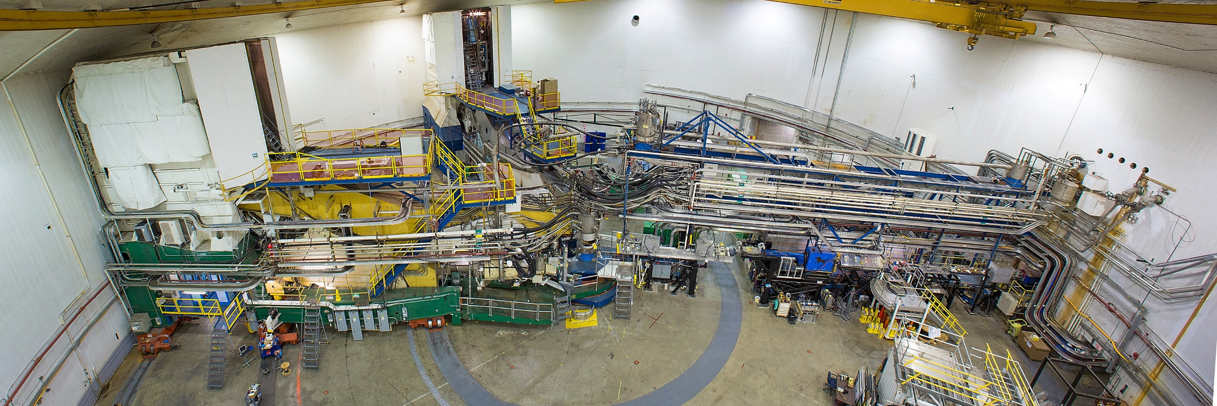
Jefferson Lab’s Experimental Hall A

Slide 17
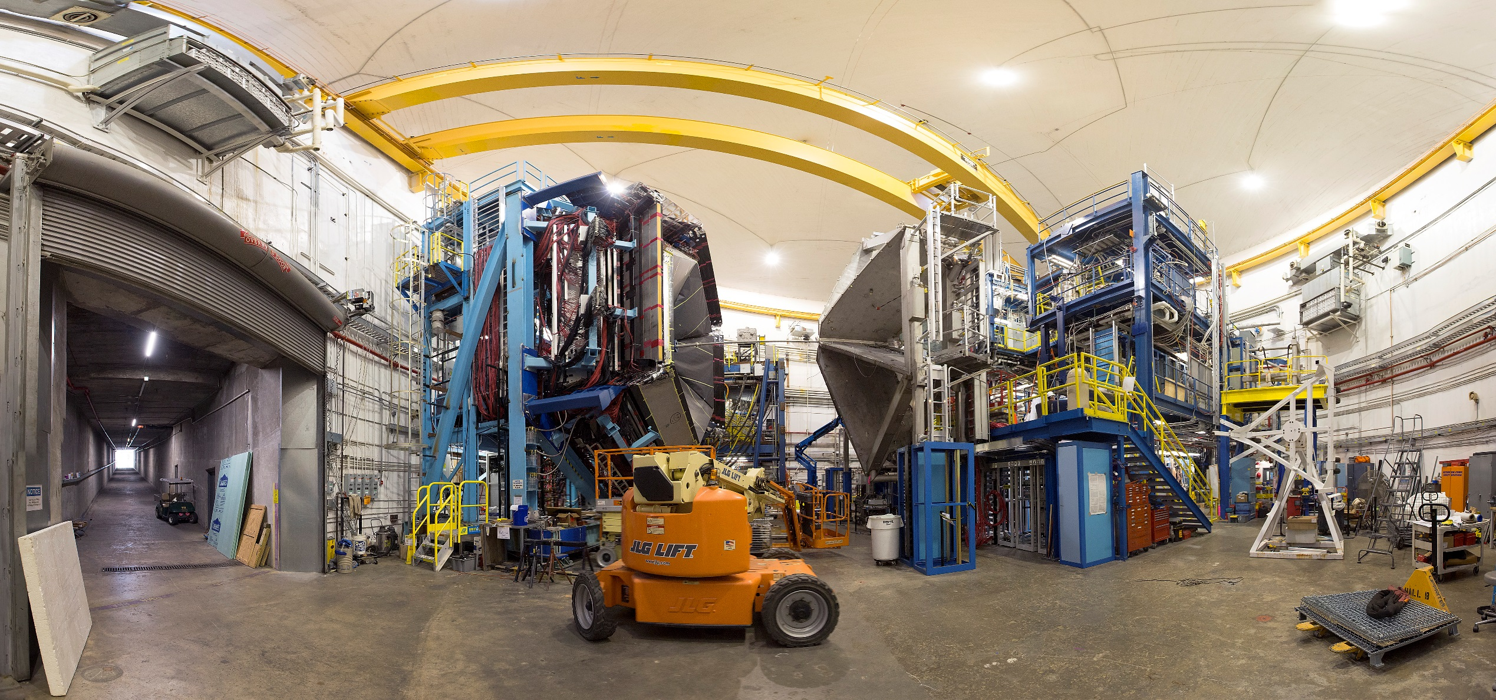
Jefferson Lab’s Experimental Hall B

Slide 18
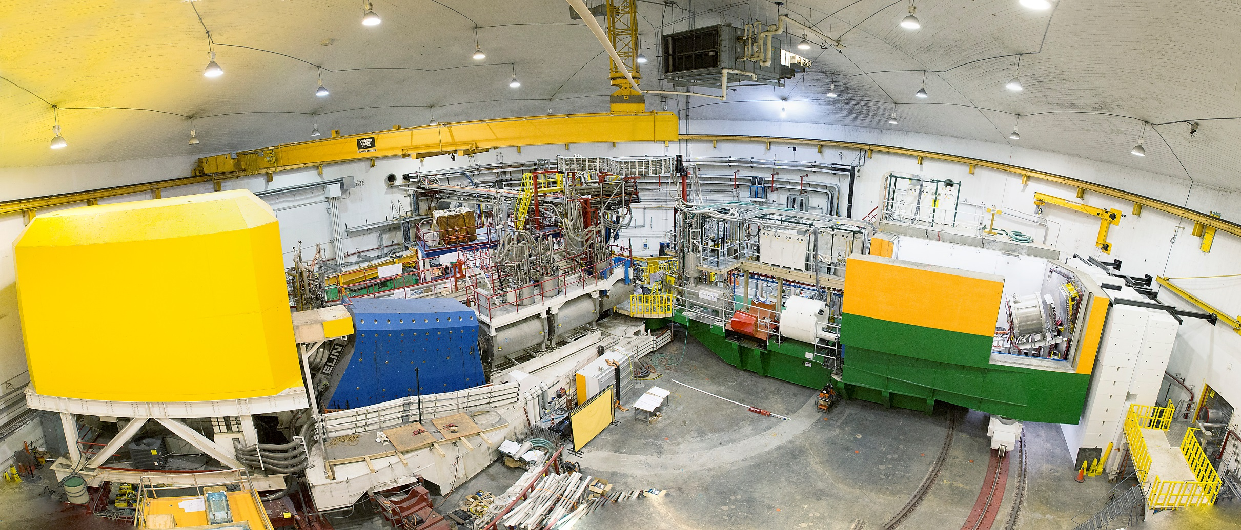
Jefferson Lab’s Experimental Hall C

Slide 19
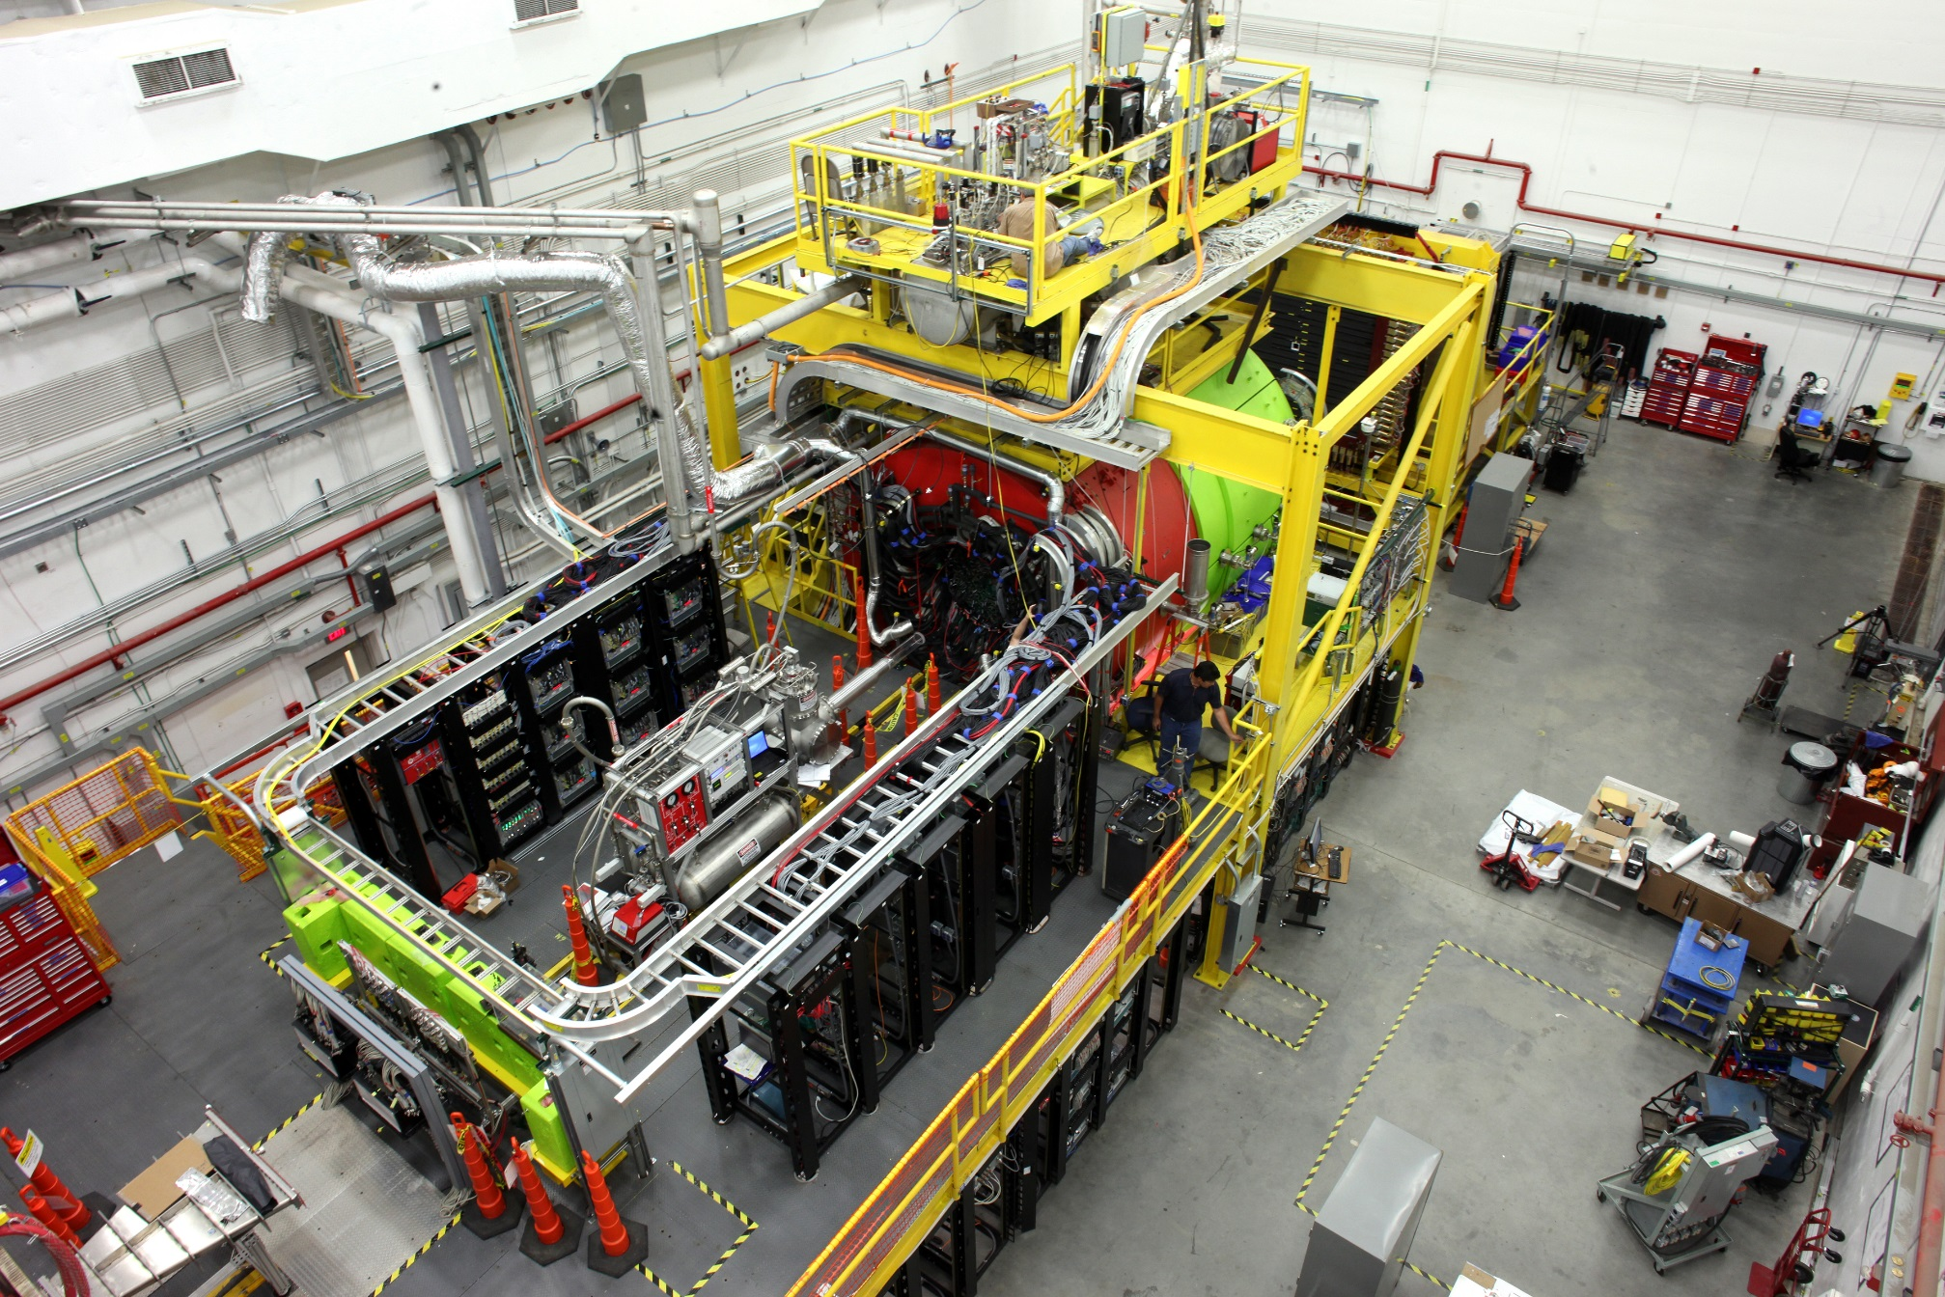
Jefferson Lab’s Experimental Hall D

Slide 20
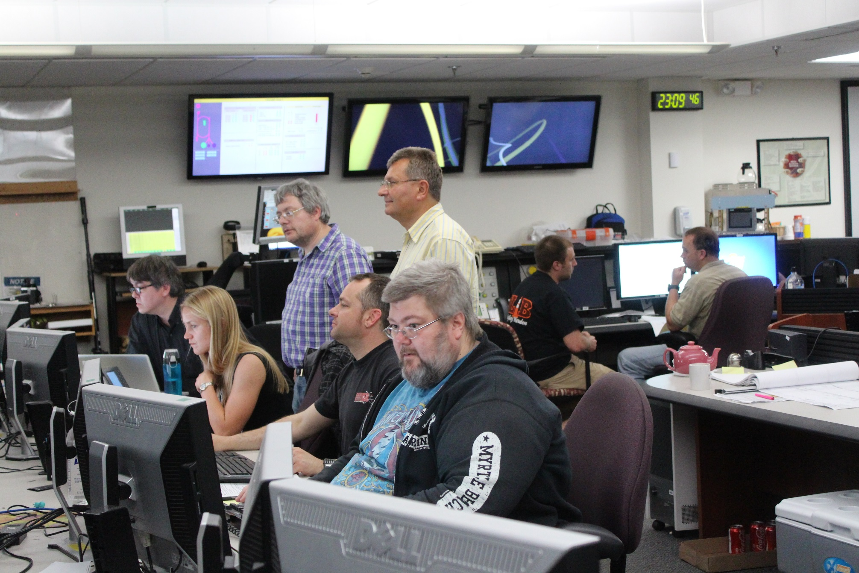
Control Rooms (24/7 operation)

Slide 21
Jefferson Lab Physics Experiments
Idea (questions)
Proposal (written document ~30 pages)
Collaboration (i.e. a team of approx. hundred scientists)
Defense (only 1/3 of proposals past this point)
Jeopardy after 3 years (i.e. defend again)
Funding (no money, no experiment)
Construction
Readiness & Safety Reviews
Running The Experiment
Analysis (generates Ph.D.’s in nuclear physics)
Publication (new questions)
Approximately Five to Ten Years From Start to Finish

Slide 22
Program Physics Topics
1. Hadron spectra as probes of QCD (GlueX and heavy baryon and meson spectroscopy)
2. Transverse structure of the hadrons (Elastic and transition Form Factors)
3. Longitudinal structure of the hadrons (Unpolarized and polarized parton distribution functions)
4. 3D structure of the hadrons (Generalized Parton Distributions and Transverse Momentum Distributions)
5. Hadrons and cold nuclear matter (Medium modification of the nucleons, quark hadronization, N-N correlations, hypernuclear spectroscopy, few-body experiments)
6. Low-energy tests of the Standard Model and Fundamental Symmetries (MOLLER, PVDIS, PRIMEX, etc.)

Slide 23
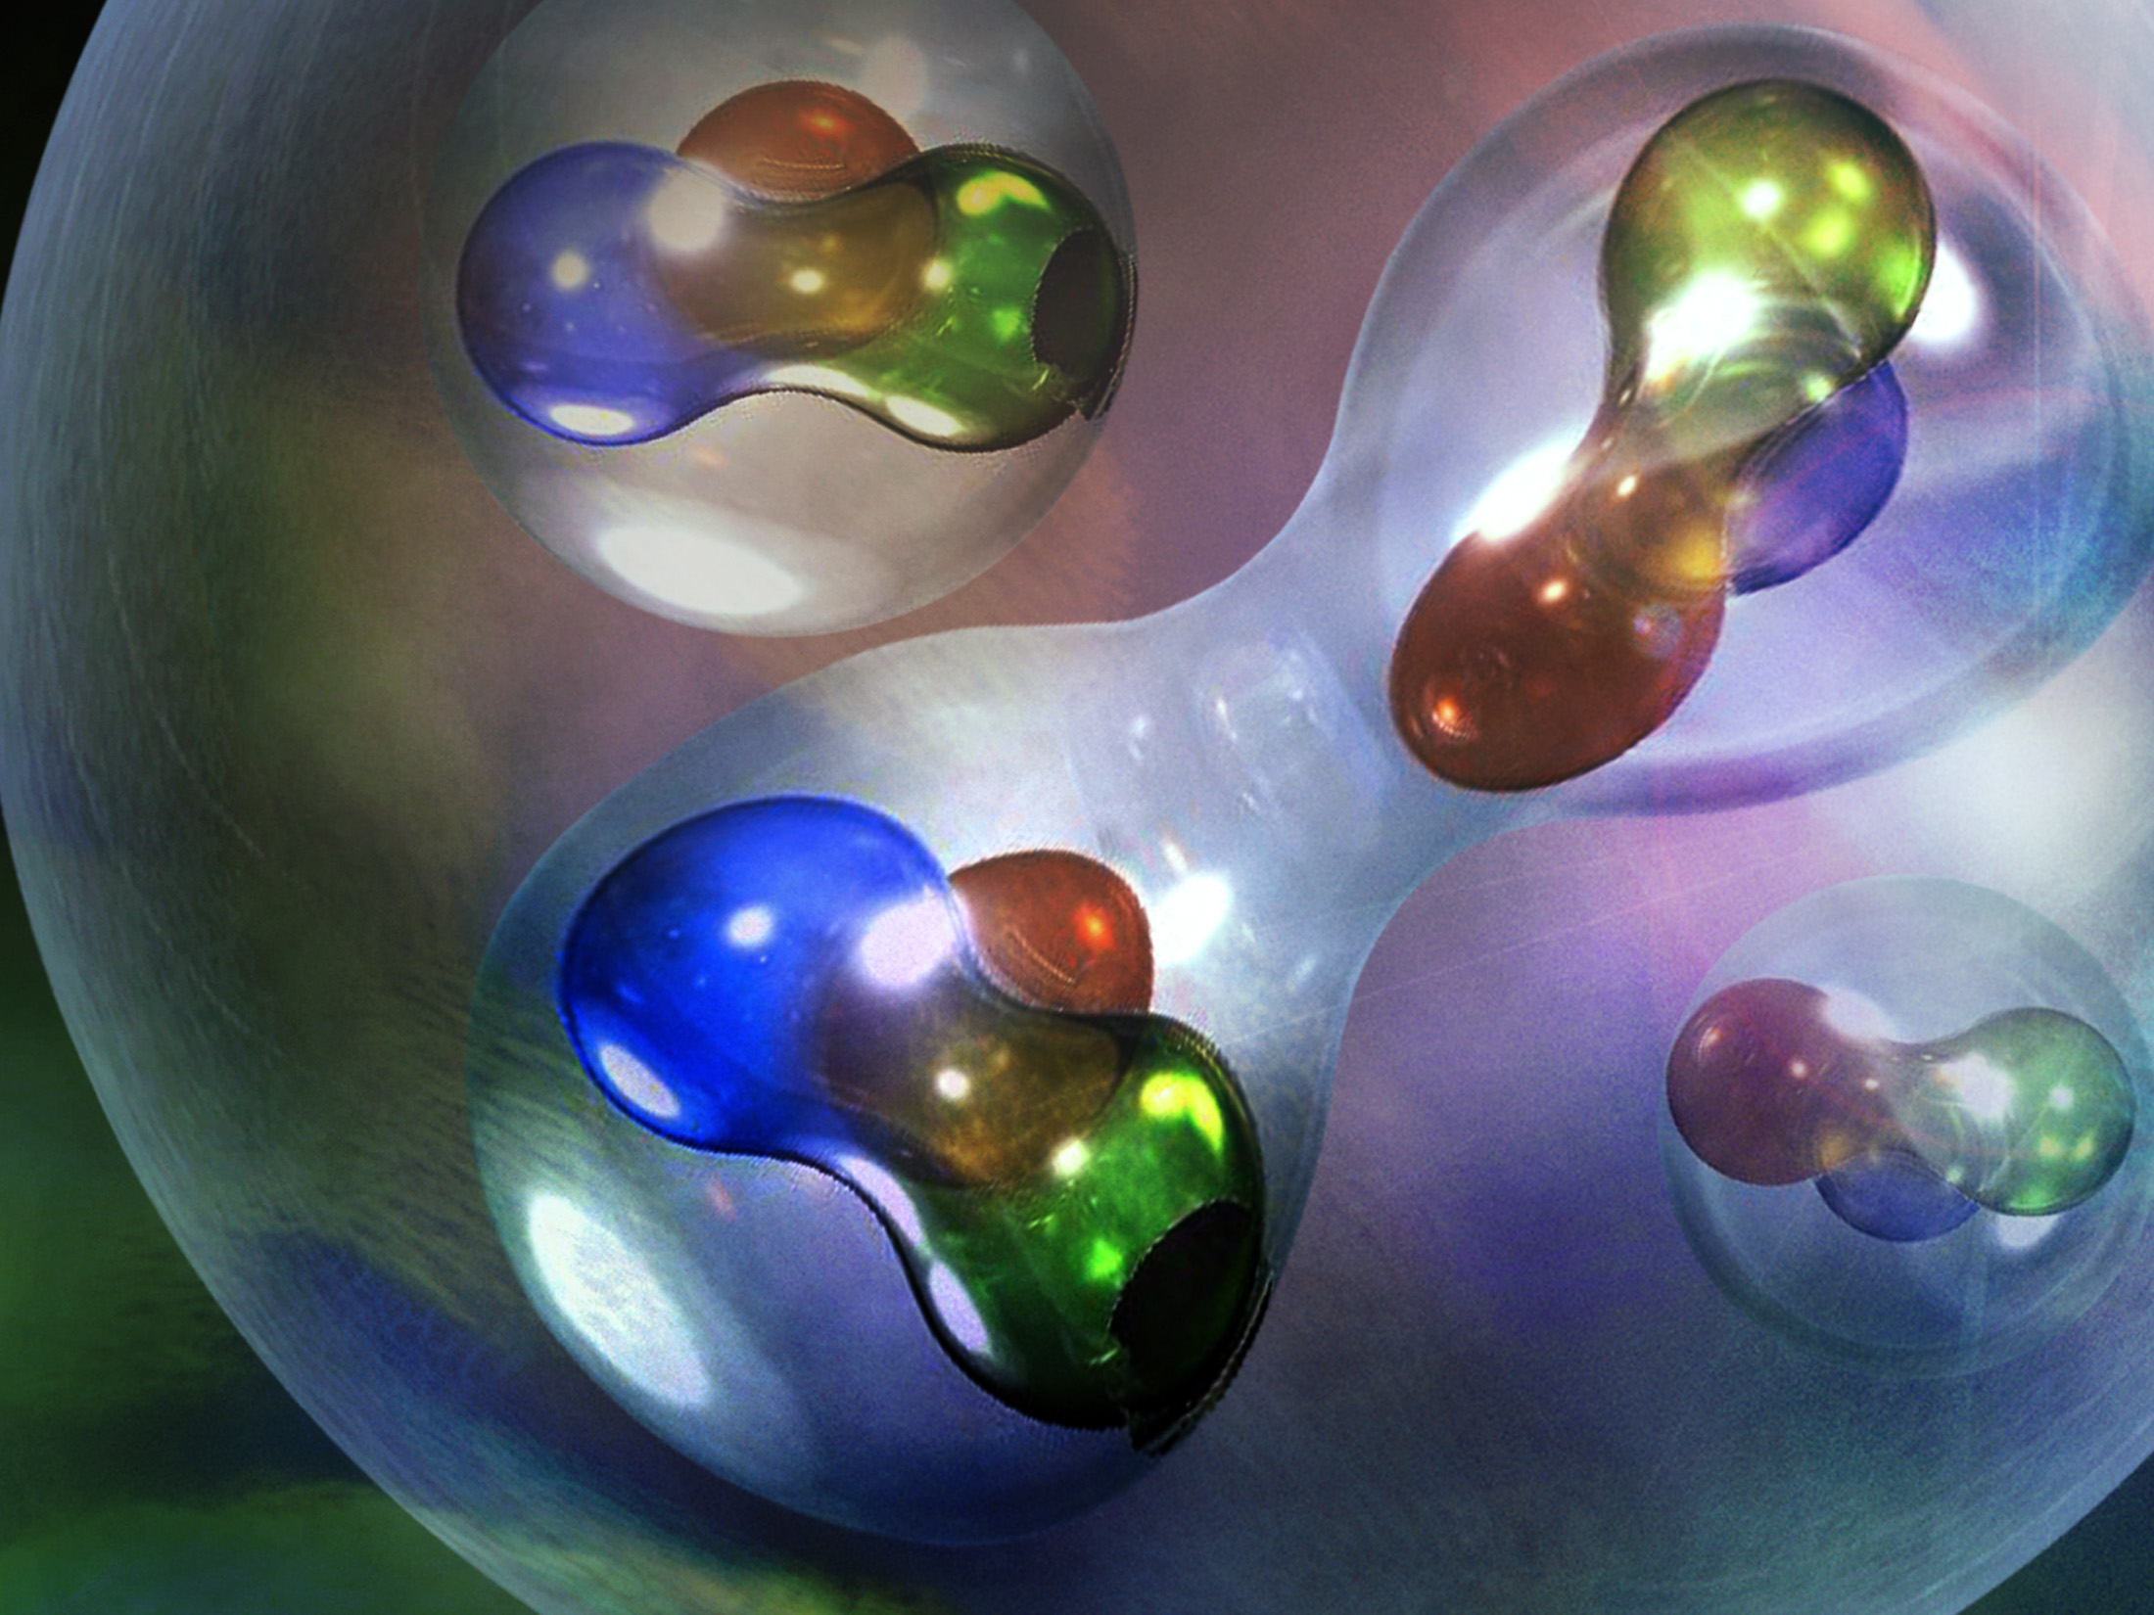
An example: What happens when a proton and neutron get close together?

Slide 24
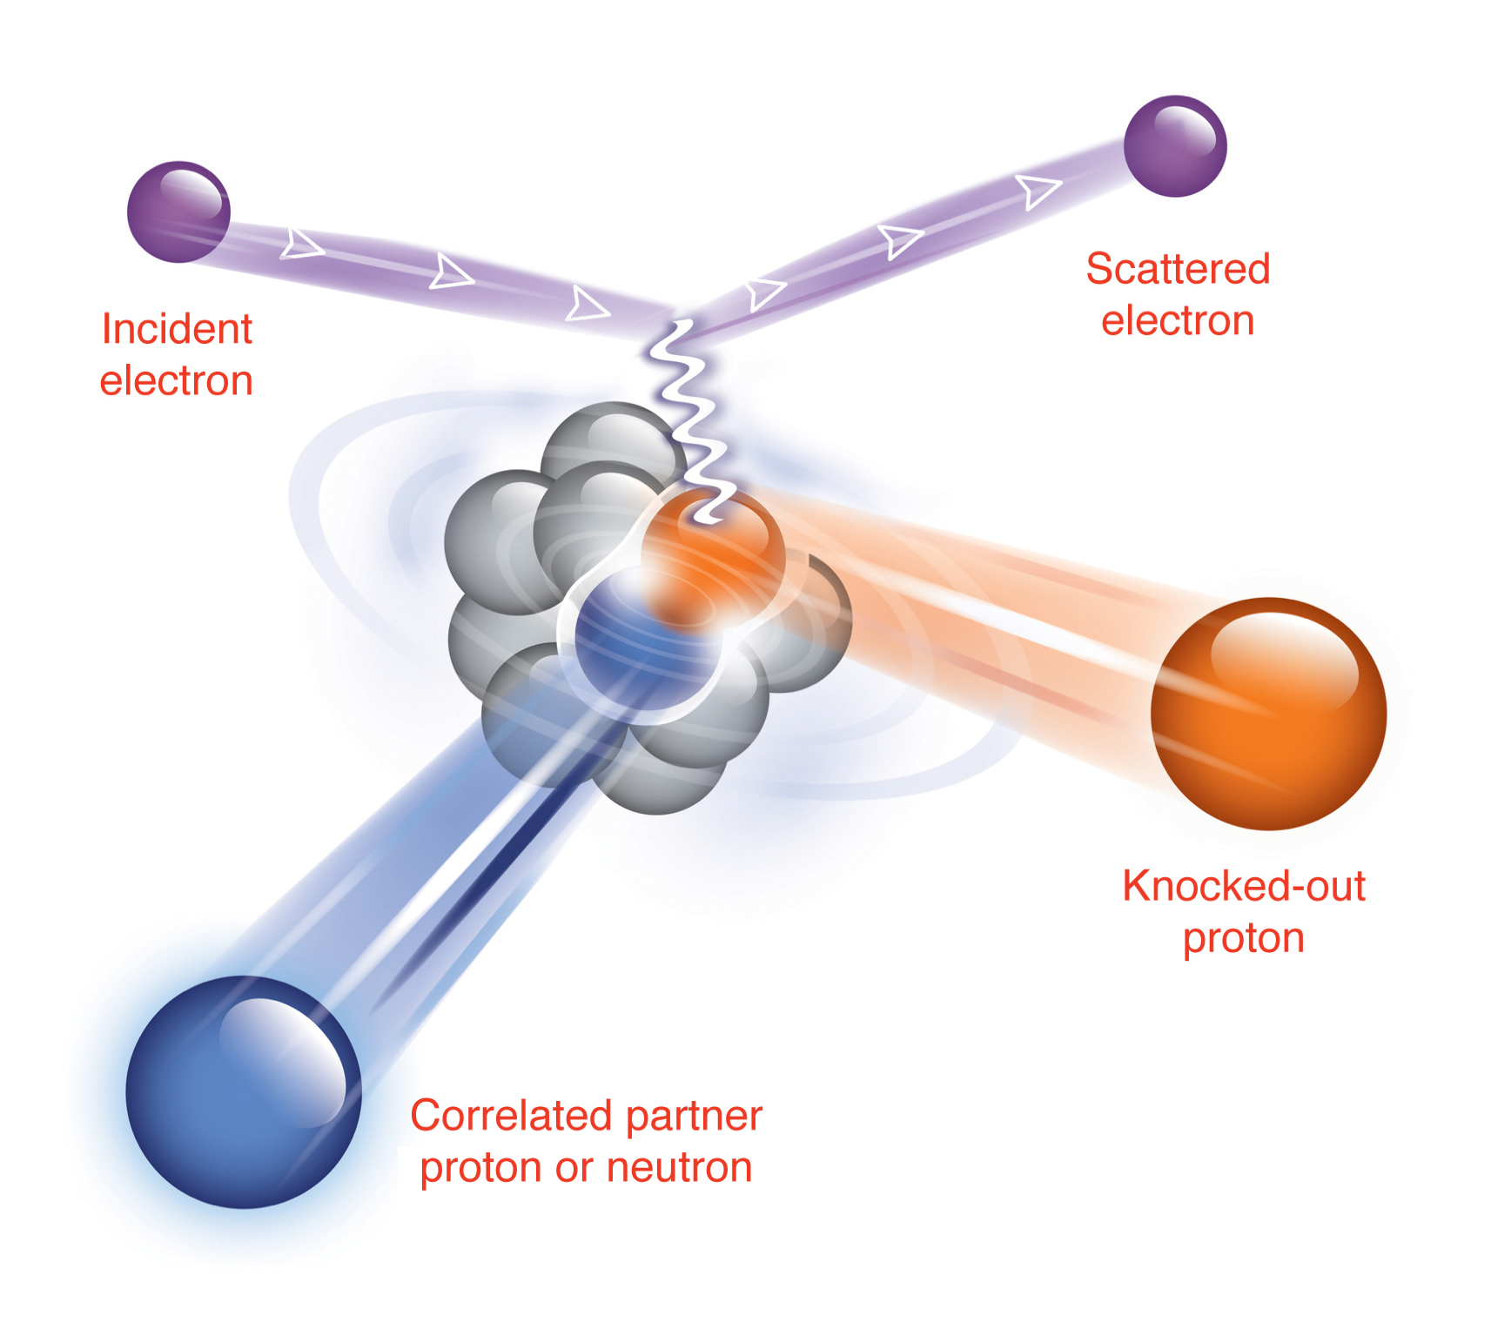
Example Jefferson Lab Experiment
Studying if protons and neutrons strongly overlap in the nucleus.
The Nuclear Physics Equivalent to a Pool Table Trick Shot

Slide 25
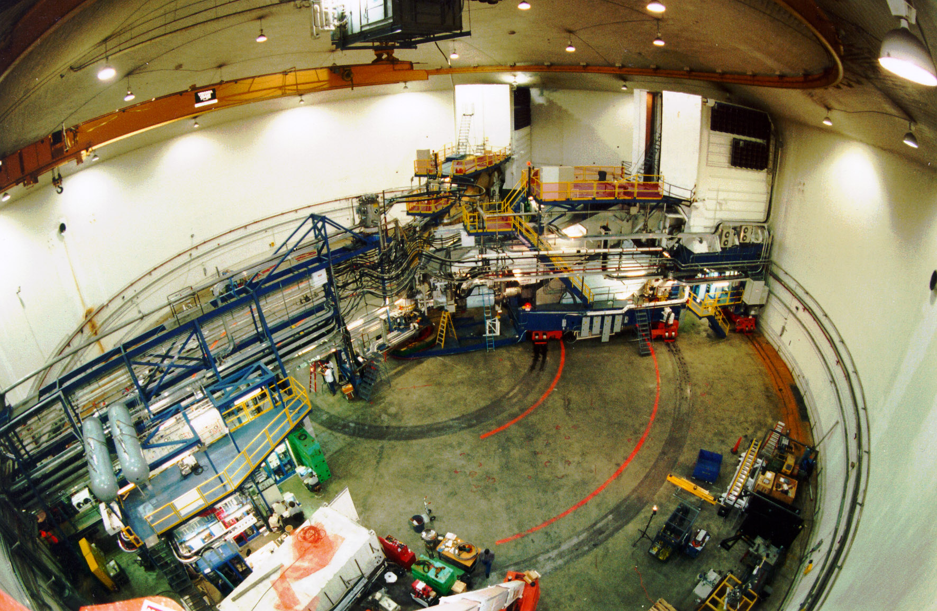
Jefferson Lab’s Hall A

Slide 26
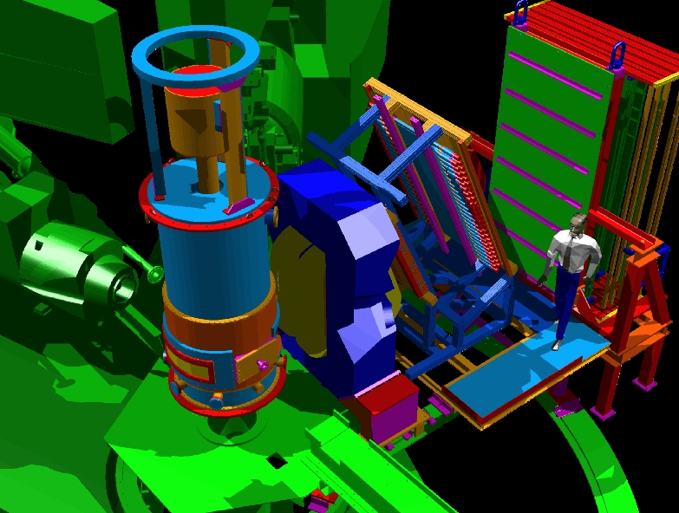
Design The New Equipment

Slide 27
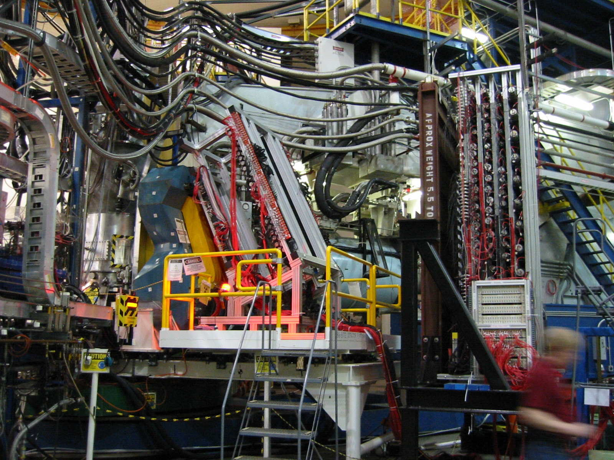
Final Assembly

Slide 28
Observation of Proton-Neutron Pairs!
Science Article
Physical Review Letter
Ph.D. Theses
Peter Monaghon (MIT)
Ran Shneor (Tel Aviv)
Ramesh Subedi (KSU)
News Stories
Physics Today
CERN Courier
And then new questions!
While explaining your work to others is the last step,
in many ways it is the most important!

Slide 29
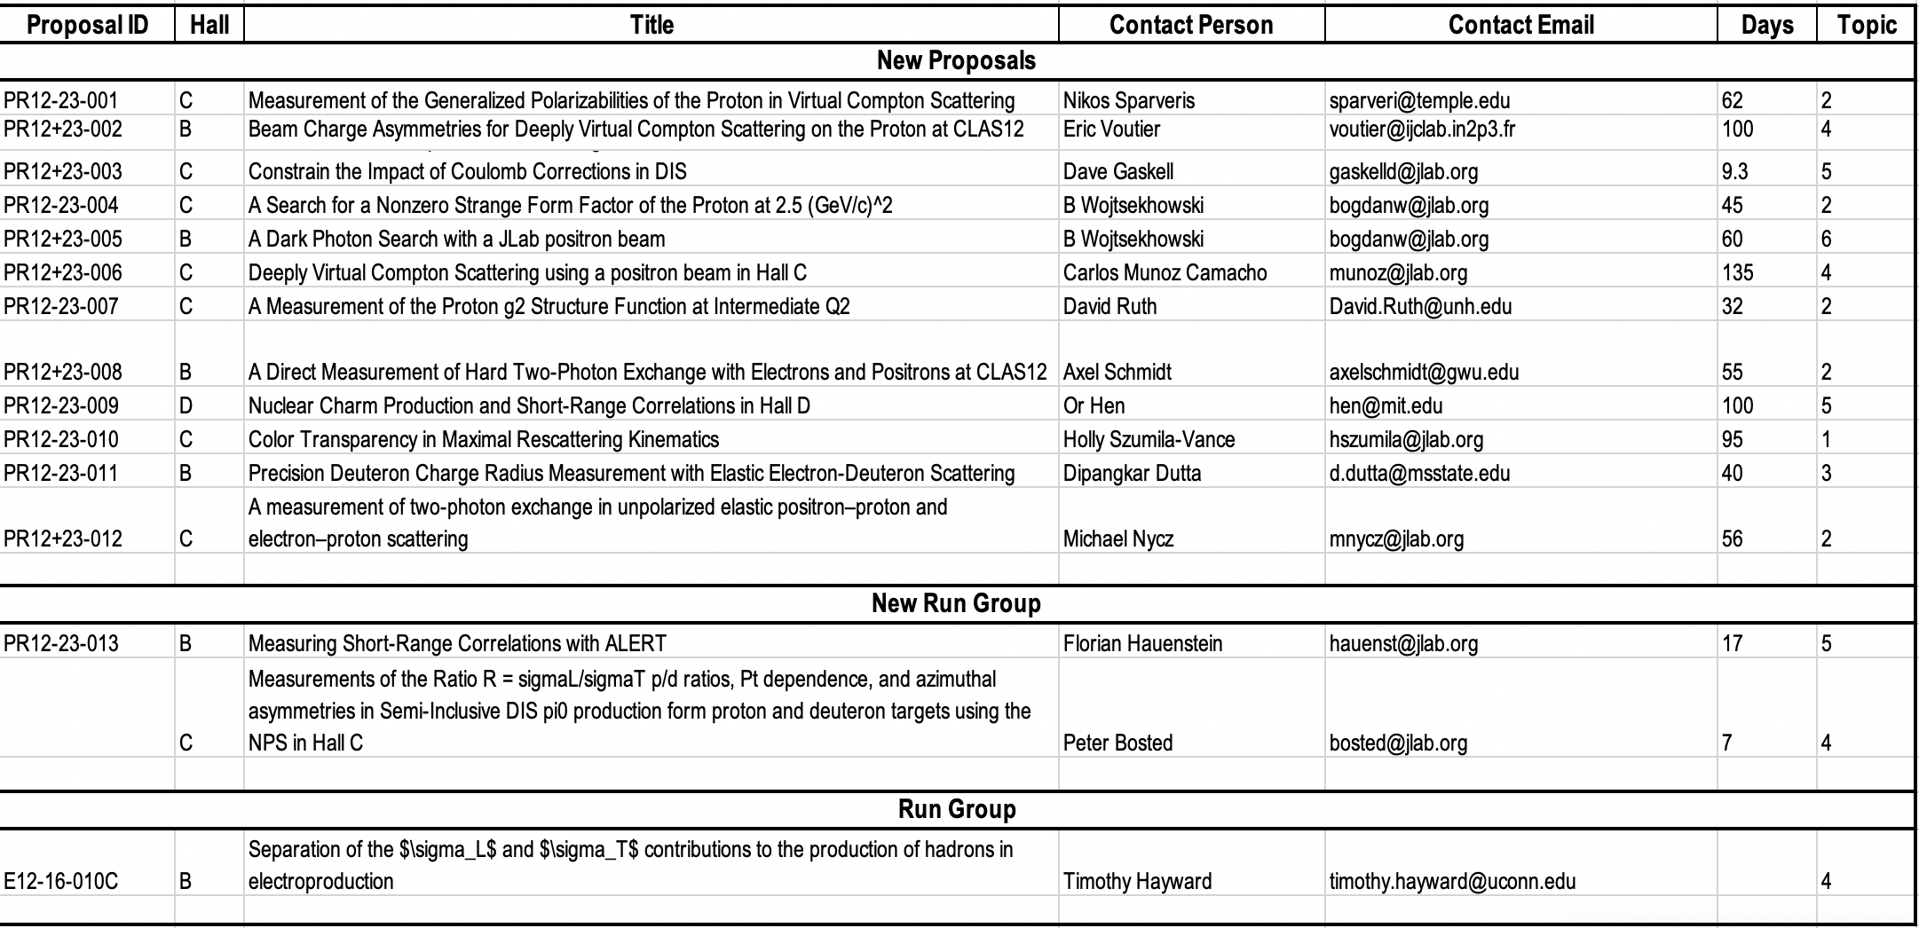
PAC51 Proposals

Slide 30
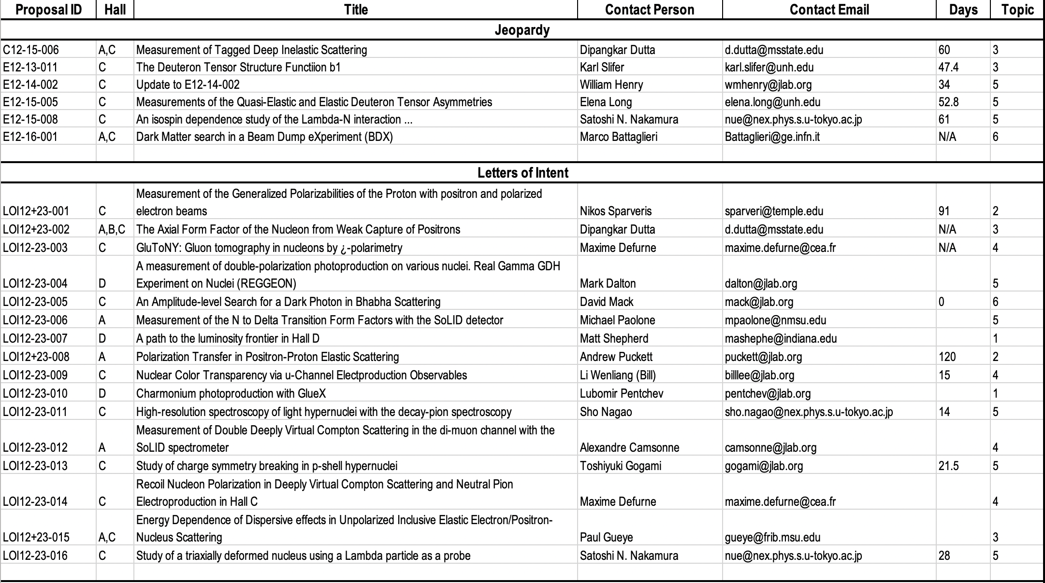
PAC51 Proposals

Slide 31
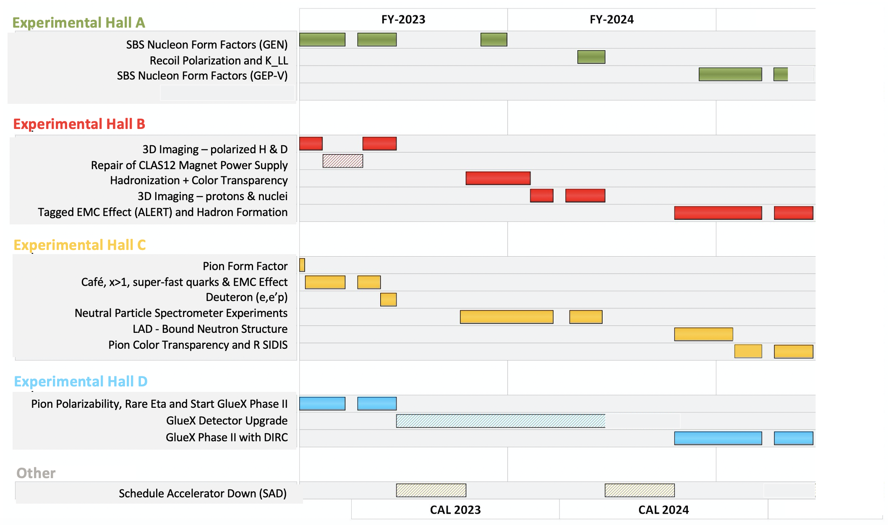
Upcoming JLab CEBAF Schedule

Slide 32
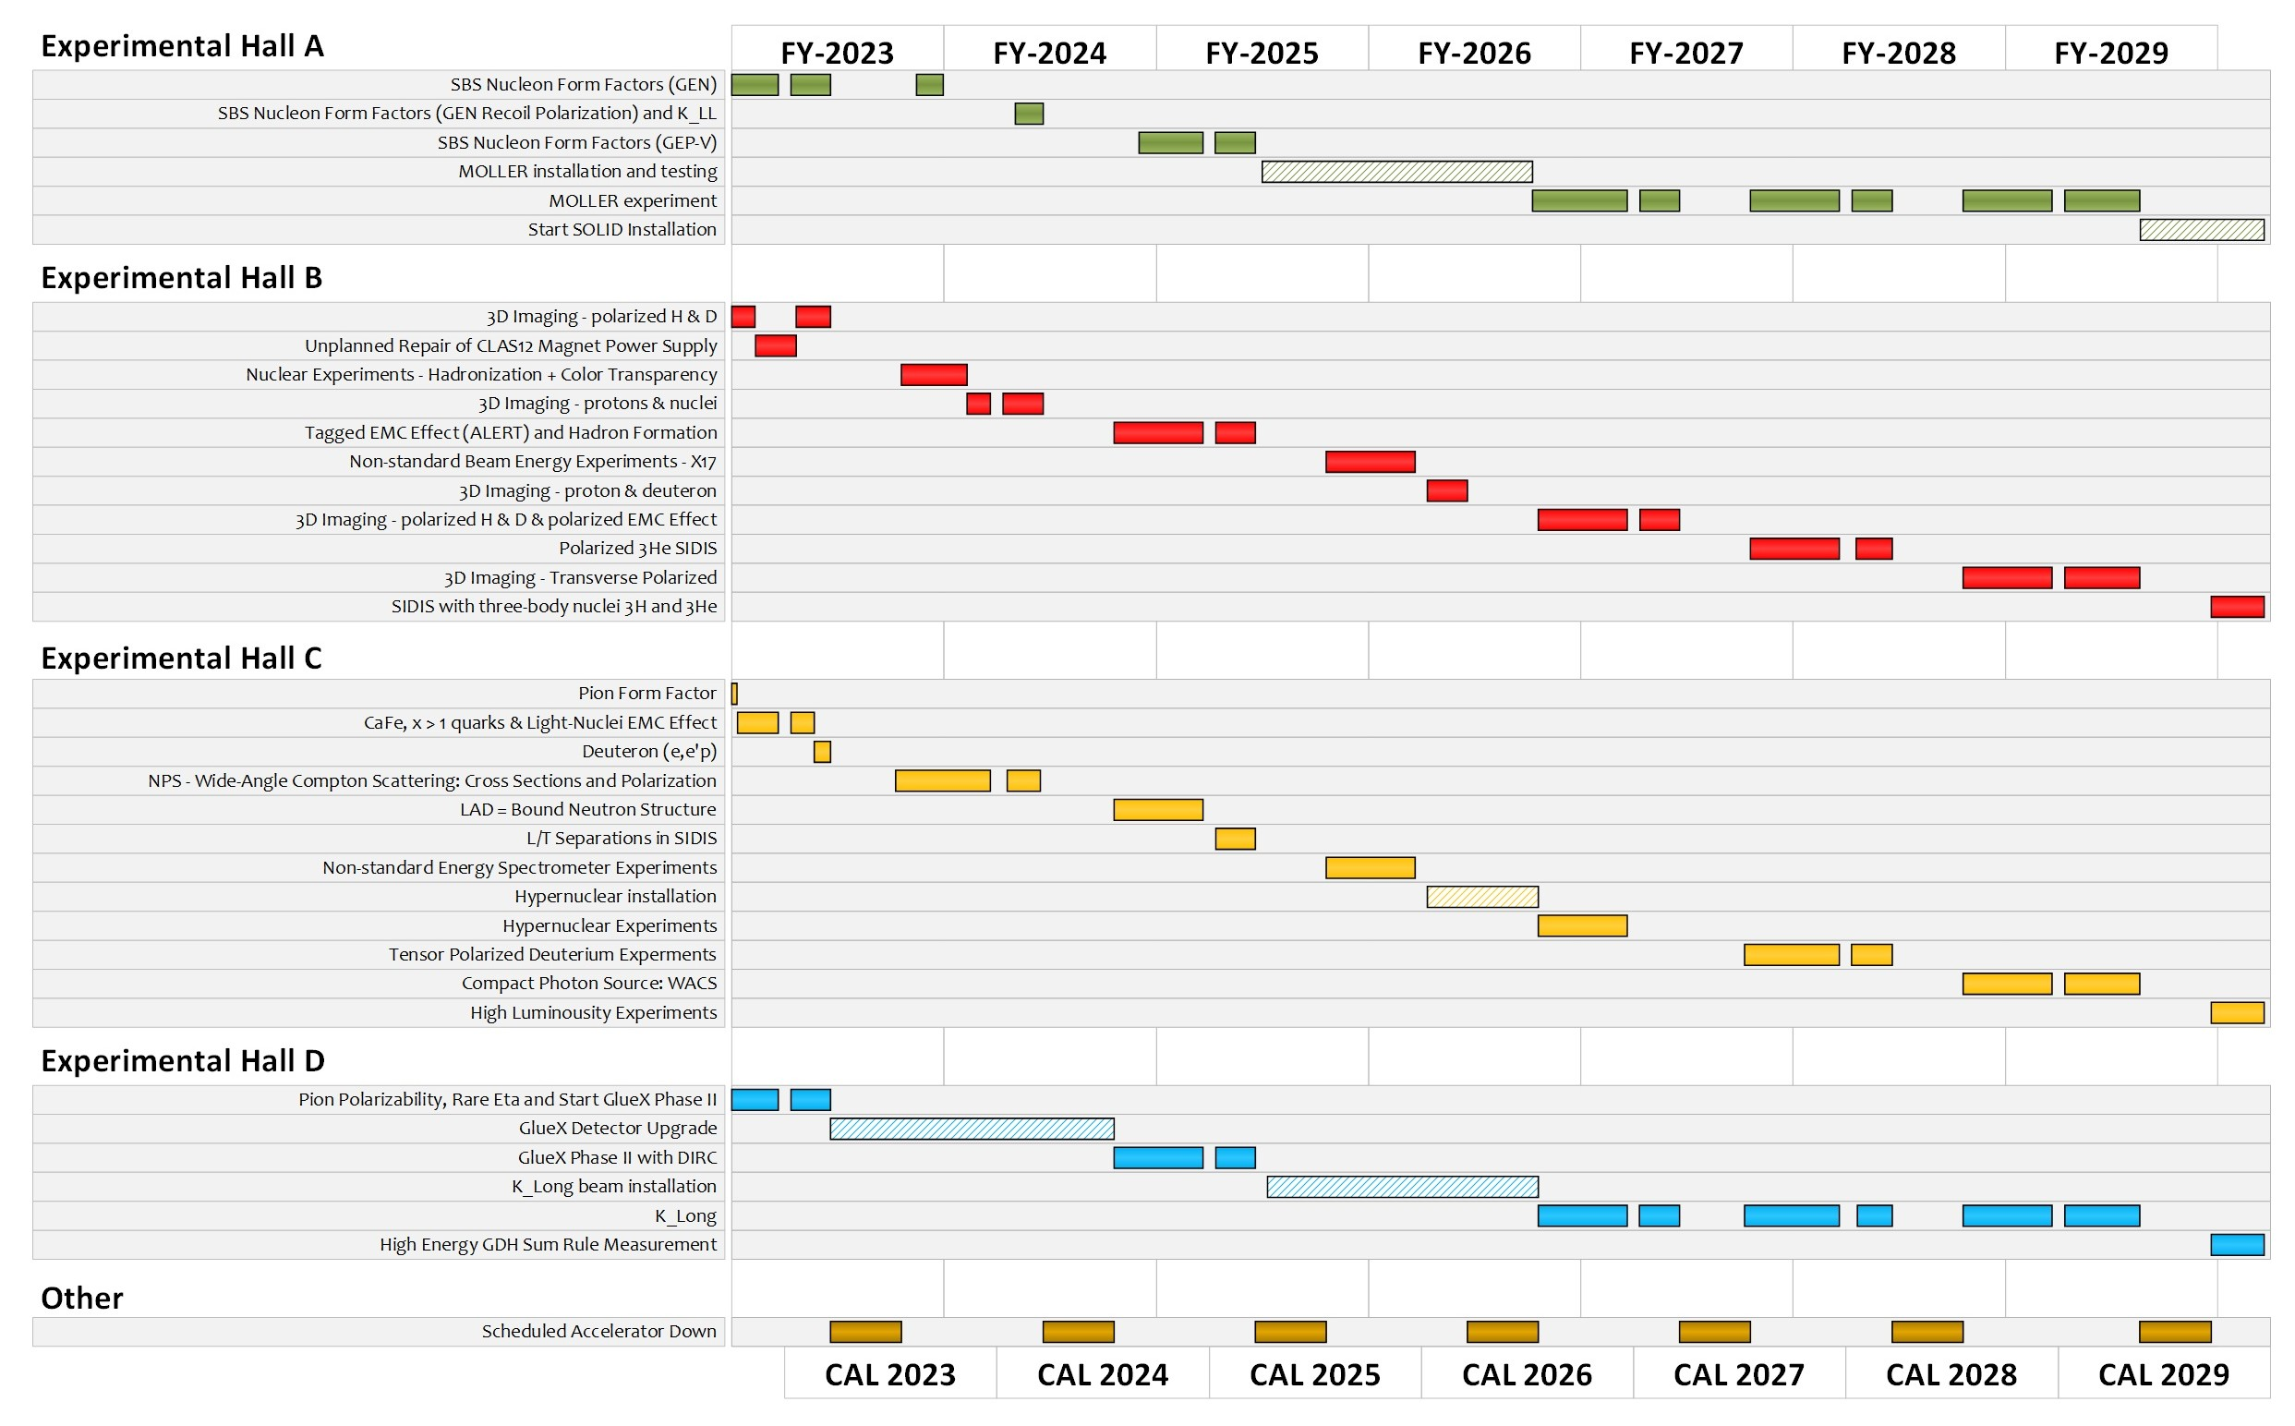
Tentative Experimental Schedule
205 completed experiments to-date (28 full; 28 partial in 12 GeV era)
51 experiments remaining
~7 years at ~30 weeks/year
…not including SoLID
…not including new proposals

Slide 33
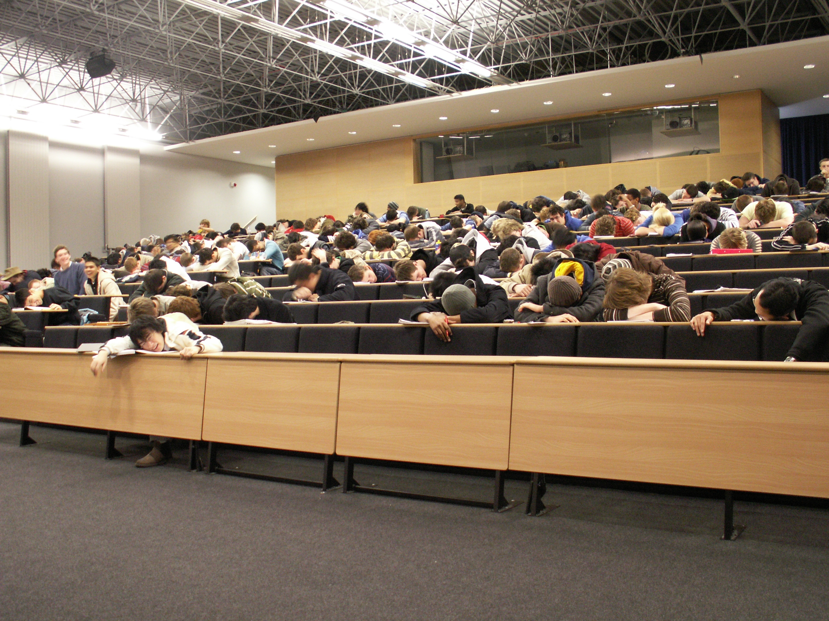
Who Cares?!

Slide 34
Or for those who like remote work:

Slide 35
Kathy McCormick Cares
Homeland Security

Slide 36
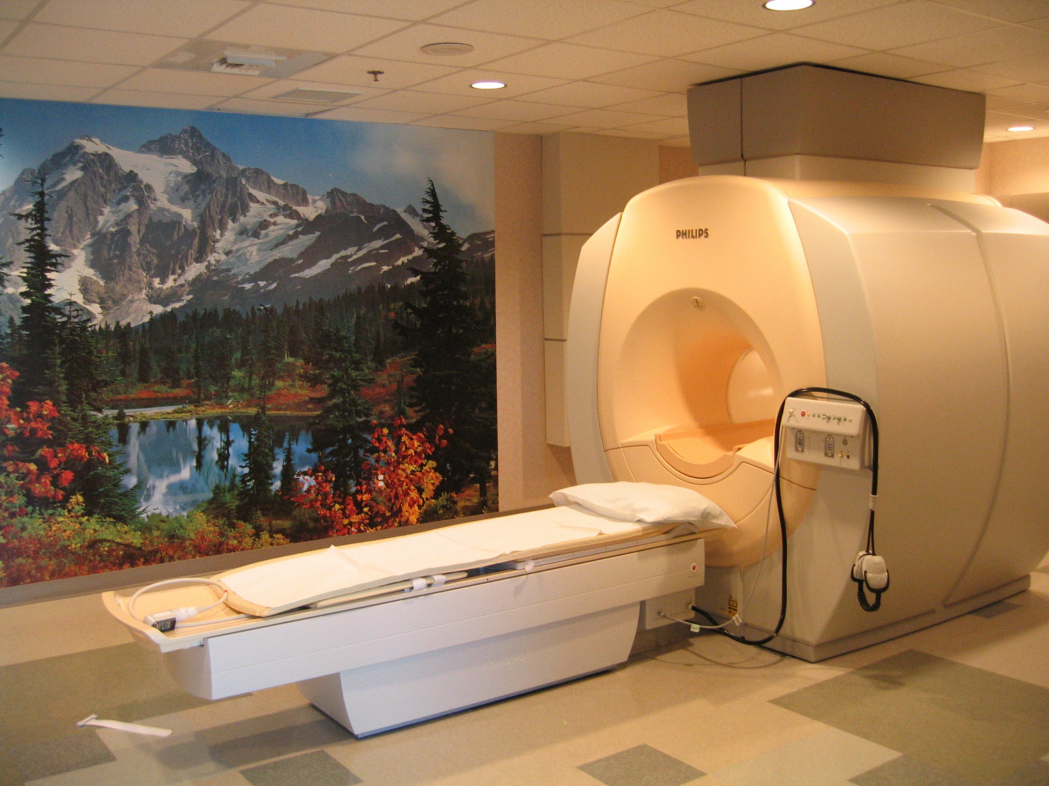
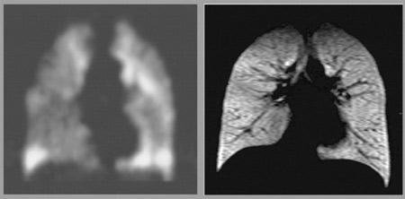
Gordon Cates cares
MRI Imaging The Lungs

Slide 37
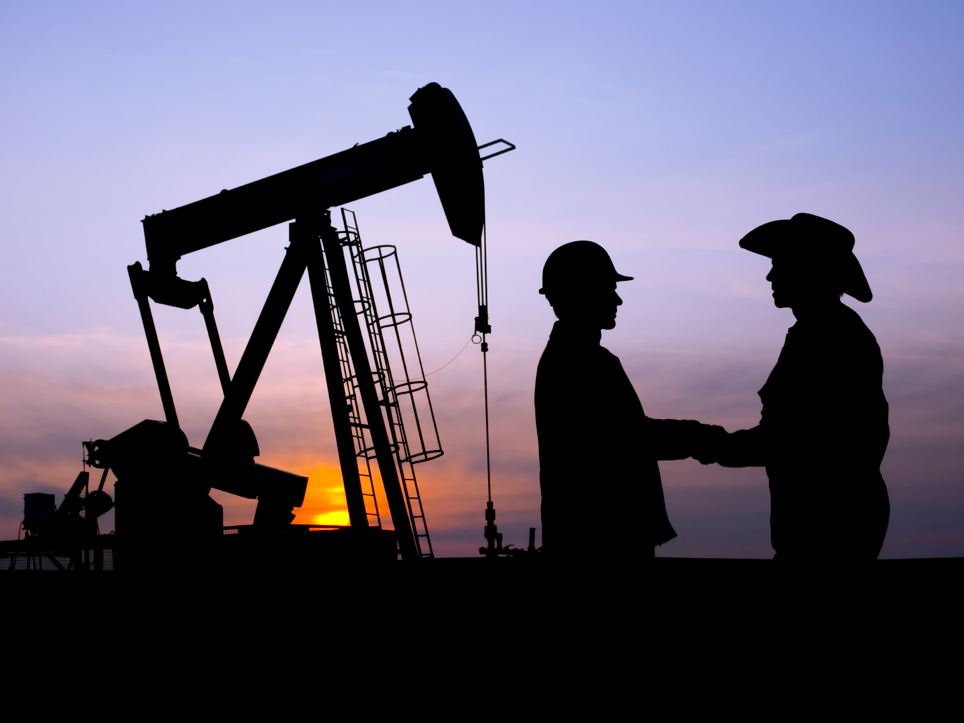
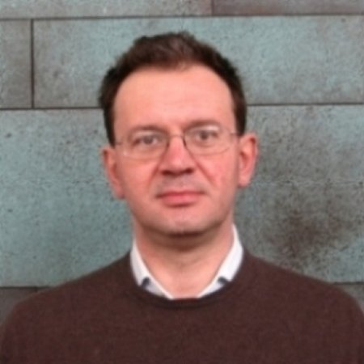
Tancredi Botto Cares
Schlumburger Oil Exploration

Slide 38
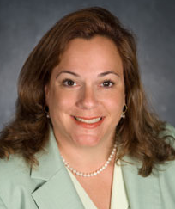
Cynthia Keppel Cares
Proton Therapy

Slide 39
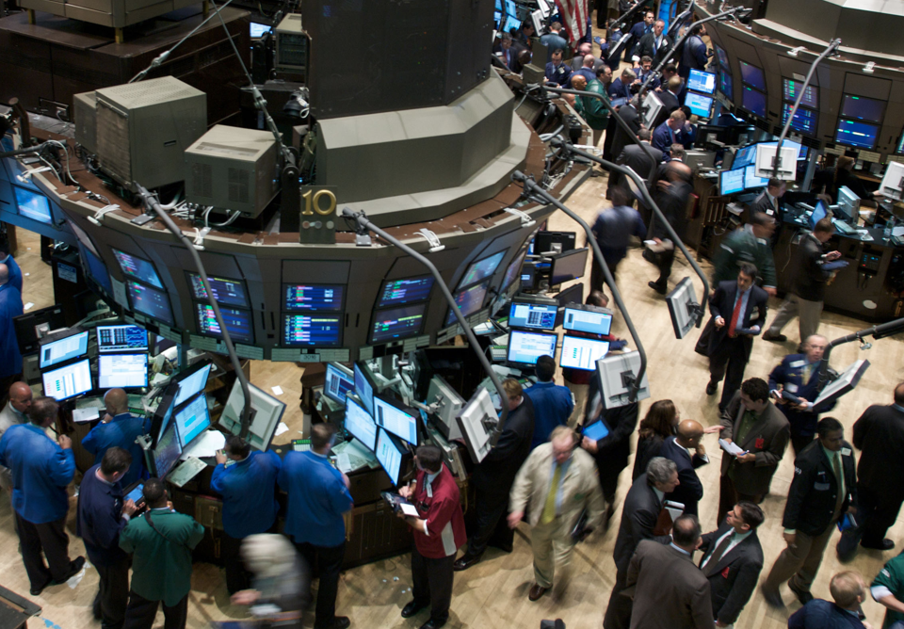
James Simons Cares 88th Richest Person In The World
Renaissance Technologies
Notes:
Renaissance Technologies,

Slide 40
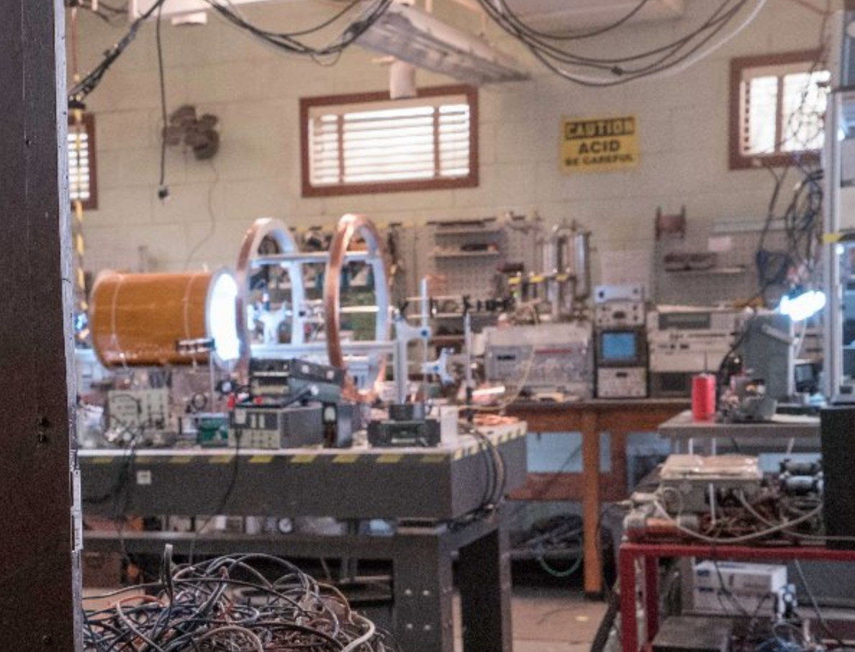
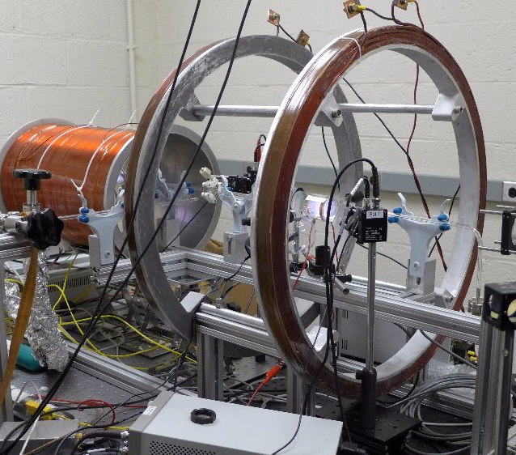
James Maxwell Cares
Movie Consulting: Ghostbusters

Slide 41
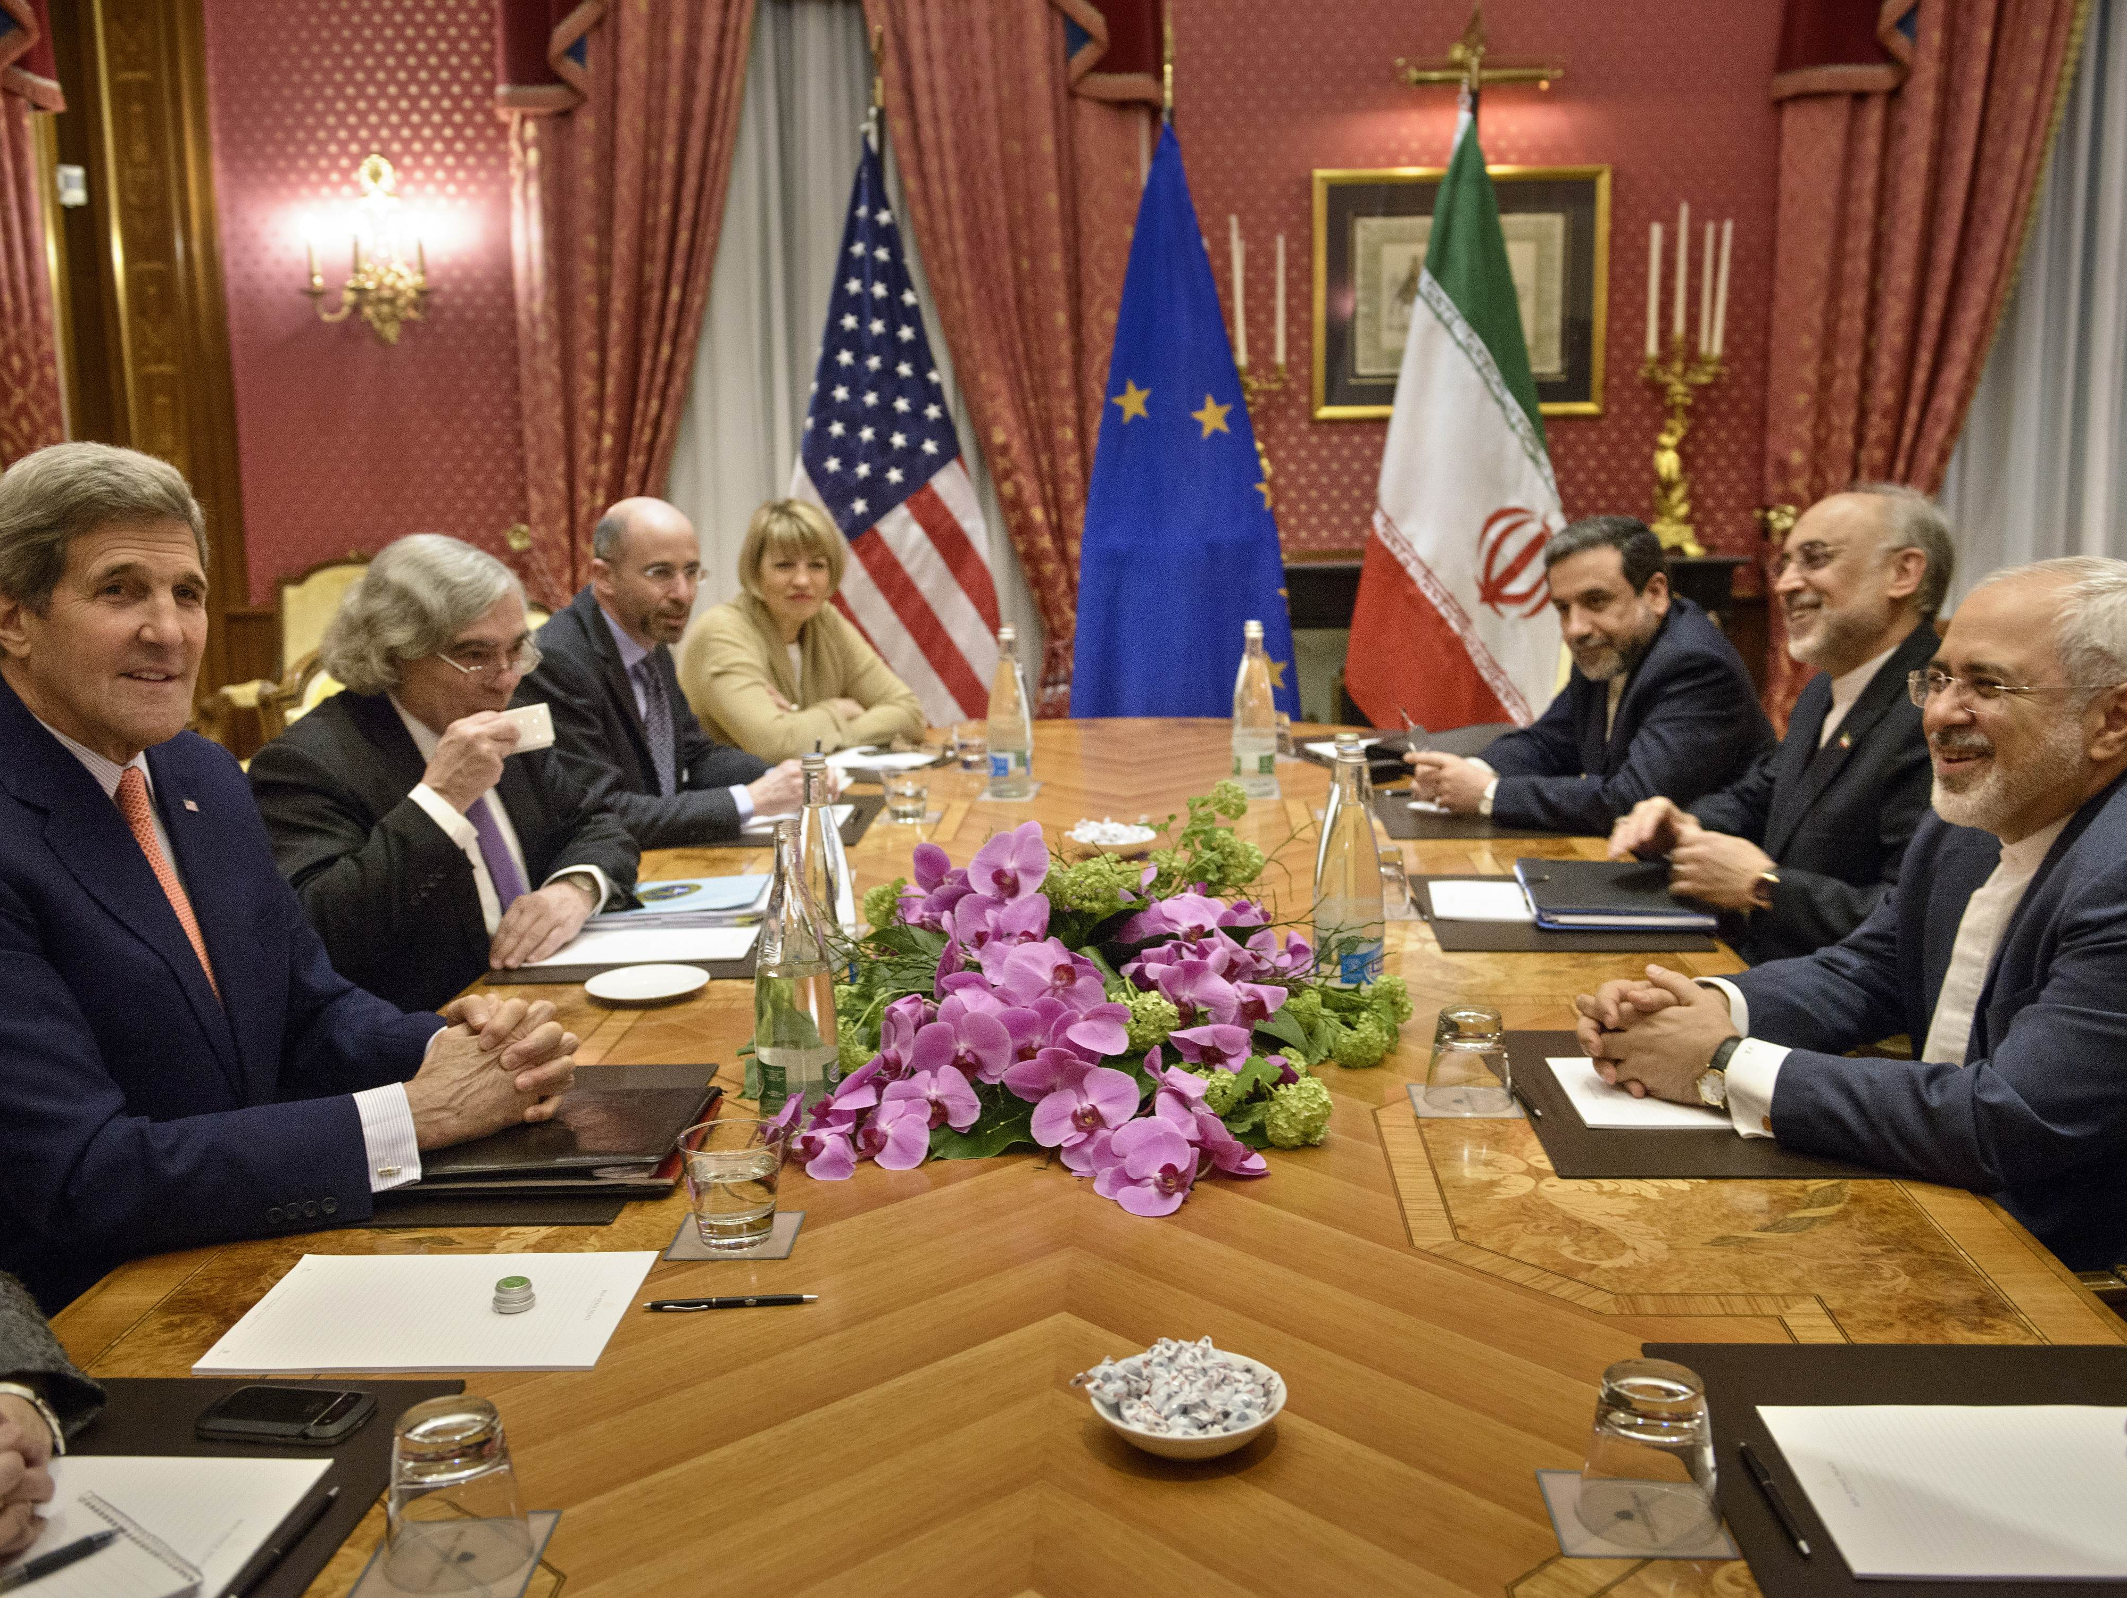
Ernest Moniz Cares!
Former United States Secretary of Energy

