Slide 1


Deep Exclusive Reactions
Lecture 1: Nucleon structure studies with the electromagnetic probe
Elastic scattering: form factors
DIS: structure function
Exclusive reactions: Generalized Parton Distributions
Lecture 3: DVCS and beyond
DVMP
New DVCS experiments@12 GeV
TCS
Lecture 2: Deeply Virtual Compton Scattering
GPDs and DVCS
DVCS on the proton with JLab@6 GeV
Extraction of GPDs from data
Proton tomography and forces in the proton
Lecture 4: Perspectives
Upgrades at JLab
GPDs at the EIC
Lecture 5: Tutorial
Data analysis techniques for exclusive reactions
Silvia Niccolai, IJClab Orsay & CLAS Collaboration
HUGS, JLab, June 2023

Slide 2
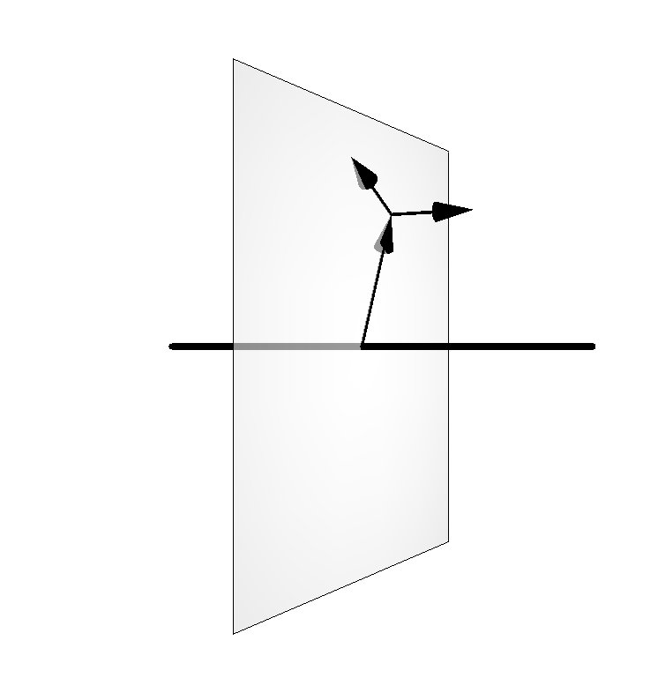



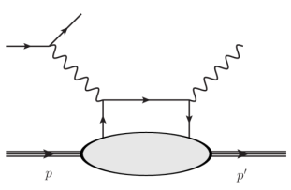
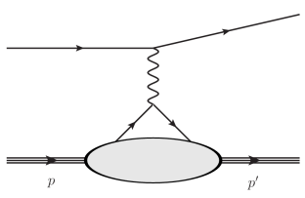
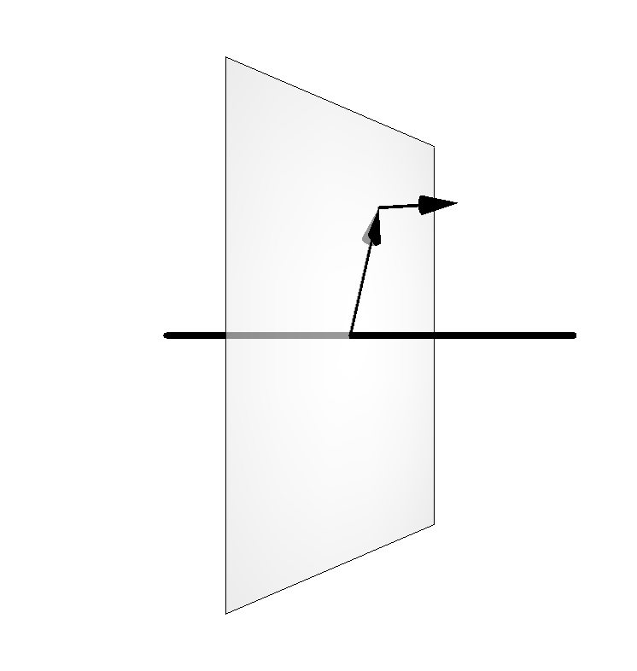
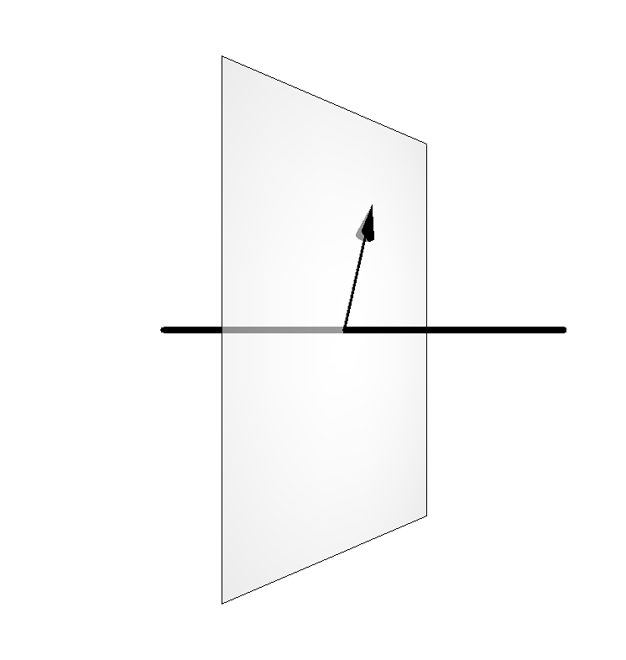

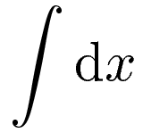

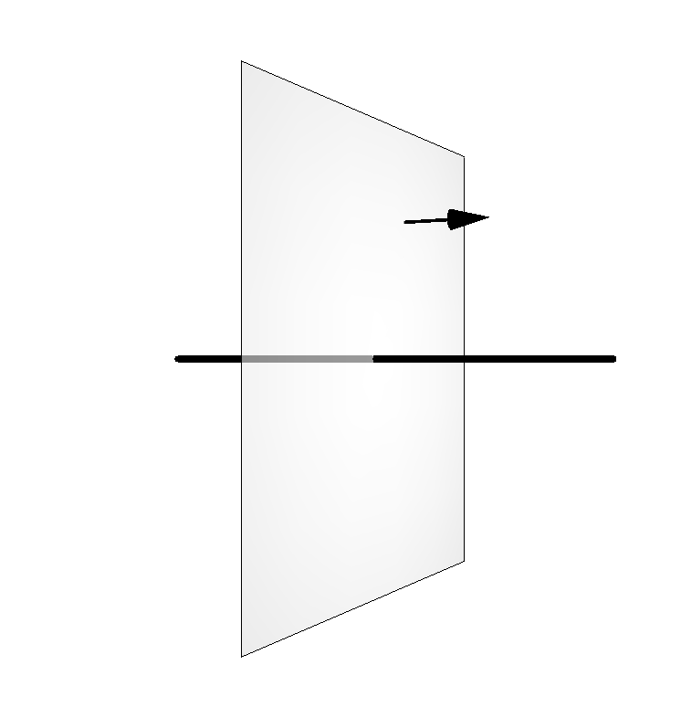
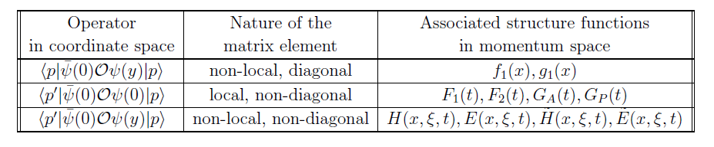
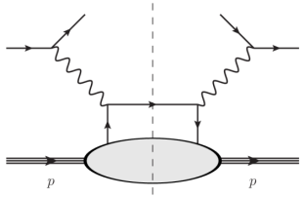
Longitudinal momentum
Multi-dimensional mapping of the nucleon
Transverse momentum
Impact parameter
Elastic Scattering
DVCS et al.
GPDs
FFs
GTMDs
PDFs
DIS

Slide 3
DVCS: the most direct road to access GPDs
e’(k)
ep→e’p’γ
γ
t
e(k)
Q²= - (k-k’)²
x_{B} = Q²/2Mν ν=E_{e}-E_{e’}
x+ξ, x-ξ longitudinal momentum fractions
t = Δ² = (p-p’)²
ξ ≅ x_{B}/(2-x_{B})
γ*
(Q²)
x+ξ
x-ξ
~
~
H, E, H, E (x,ξ,t)
N(p)
N(p’)
Notes:
BH is well known and calculable from FF. Real part accessible with DSA as well.

Slide 4
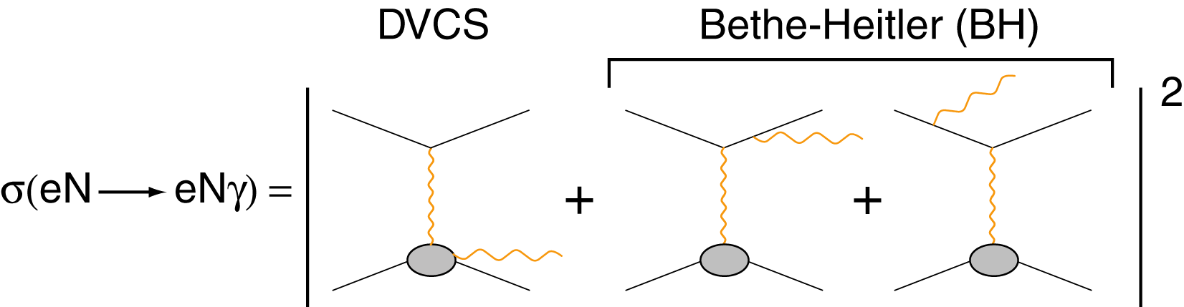

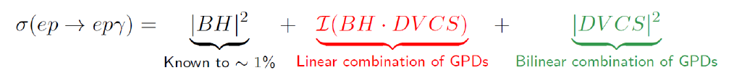
DVCS and Bethe-Heitler: friends or enemies?
e’
t
γ
GPDs
No GPDs
e
γ*
(Q²)
x+ξ
x-ξ
~
~
H, E, H, E (x,ξ,t)
N(p)
N(p’)
Calculable in QED thanks to our ~1% knowledge of form factors at low momentum transfer
In certains kinematics, the BH cross section dominates the DVCS one by orders of magnitude
Notes:
BH is well known and calculable from FF. Real part accessible with DSA as well.

Slide 5
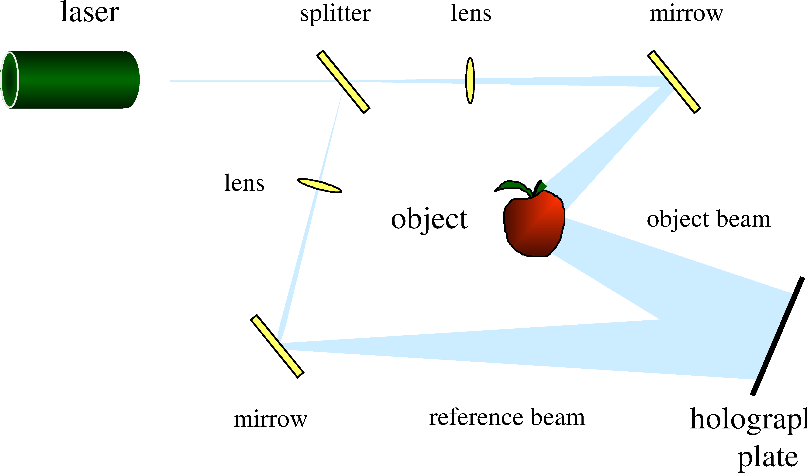
DVCS and Bethe-Heitler: nucleon holography
e’
t
γ
GPDs
No GPDs
e
γ*
(Q²)
x+ξ
x-ξ
~
~
H, E, H, E (x,ξ,t)
N(p)
N(p’)
The interference of the reference light with the light reflected by the apple projects a 3 dimensional image of the apple on the screen
Notes:
BH is well known and calculable from FF. Real part accessible with DSA as well.

Slide 6
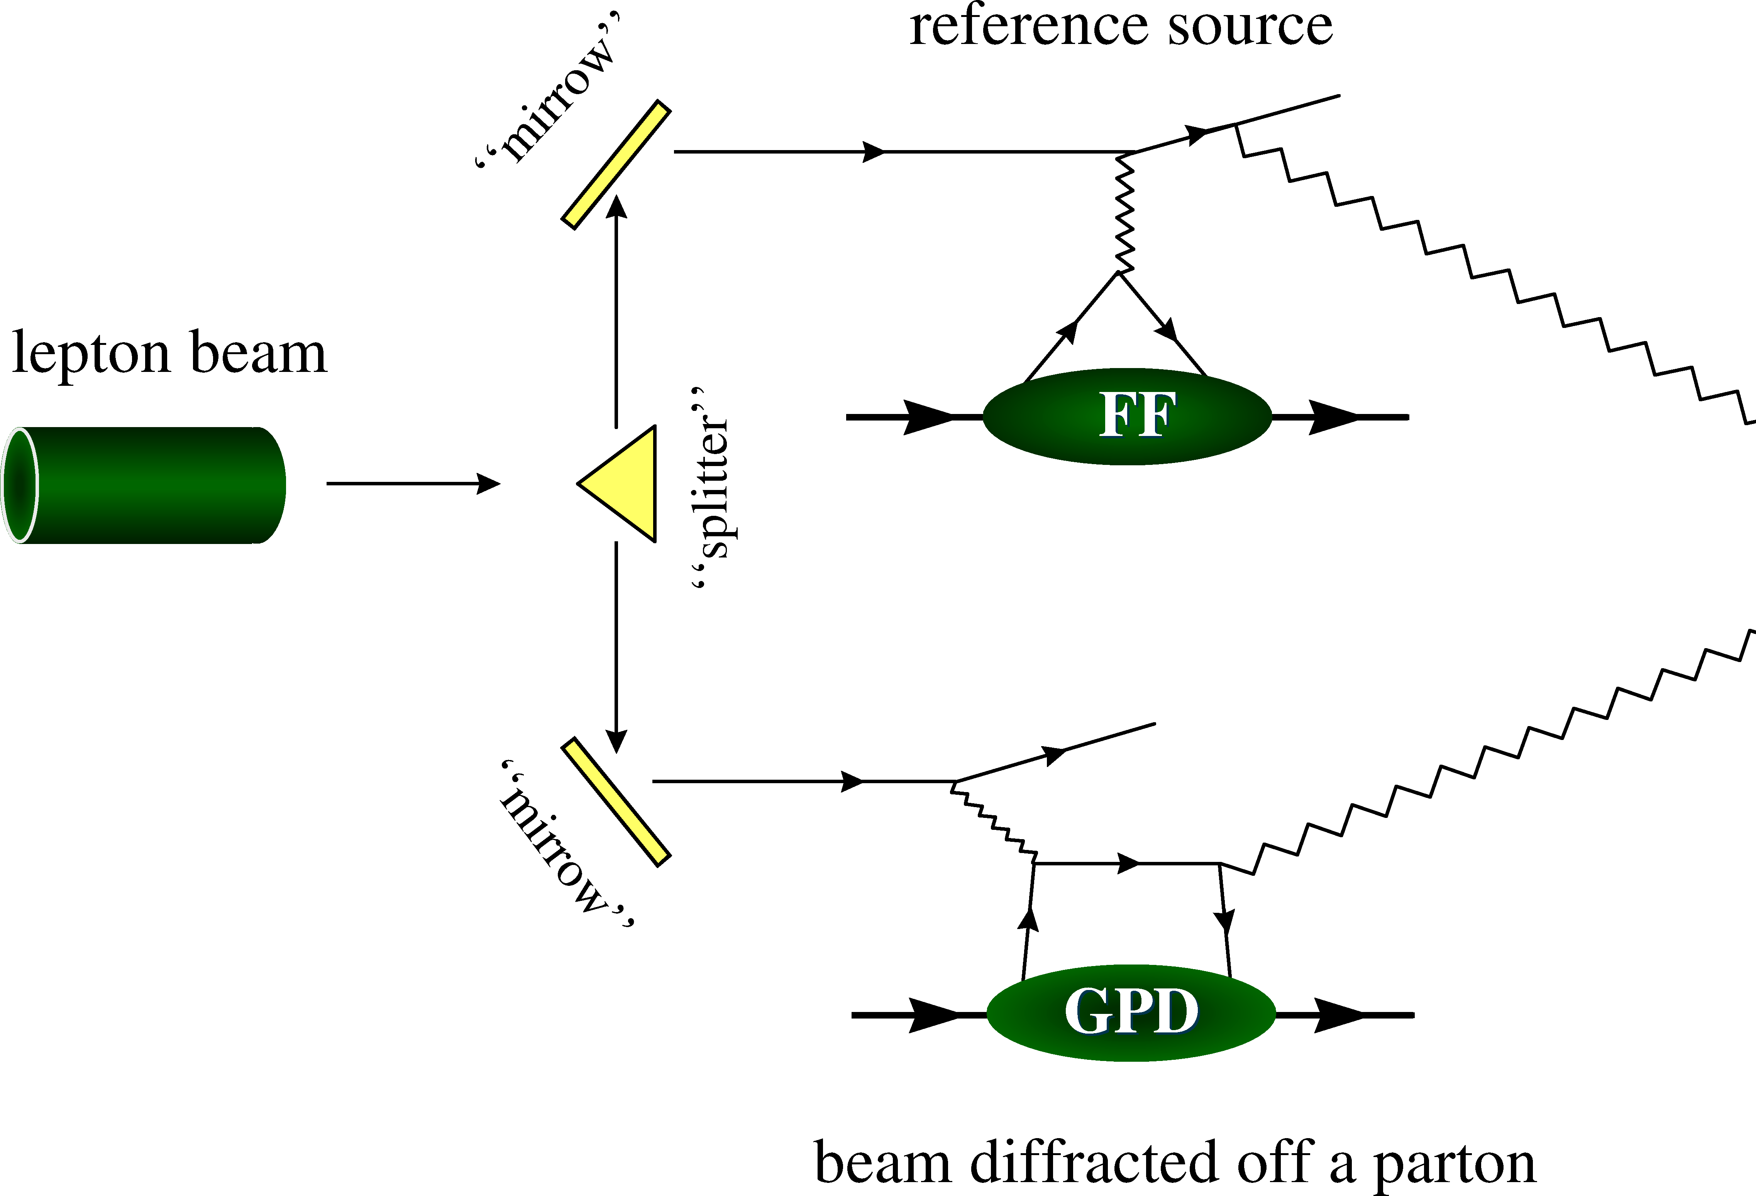
DVCS and Bethe-Heitler: nucleon holography
e’
t
γ
GPDs
No GPDs
e
γ*
(Q²)
x+ξ
x-ξ
~
~
H, E, H, E (x,ξ,t)
N(p)
N(p’)
detector
The interference of the Bethe Heitler and DVCS processes produces sizeable asymmetries that can be measured experimentally, giving access to GPDs
Notes:
BH is well known and calculable from FF. Real part accessible with DSA as well.

Slide 7
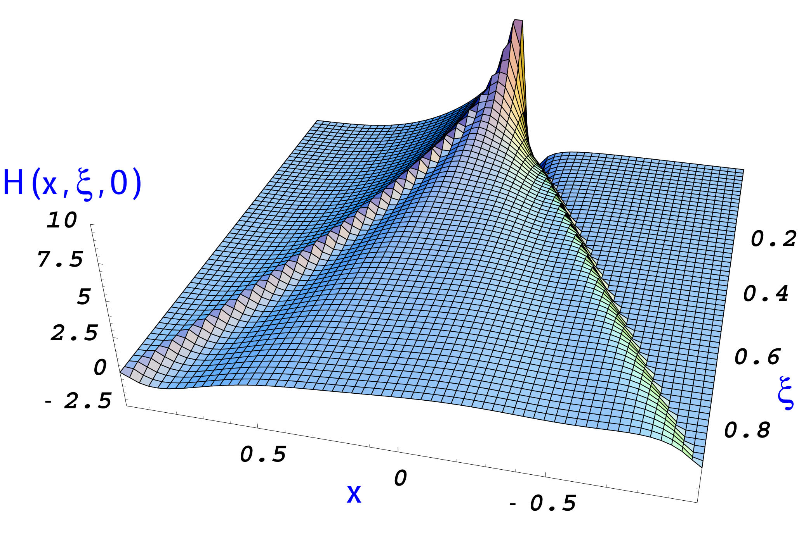
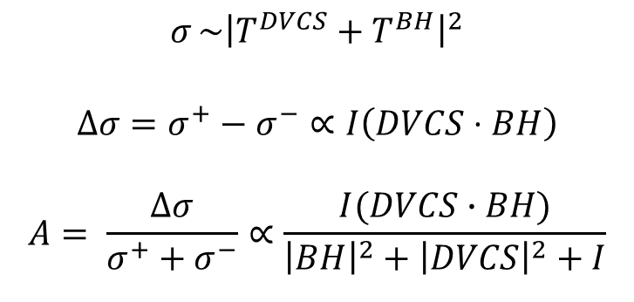
Accessing GPDs through DVCS
Real and imaginary parts of Compton Form Factors
Only ξ and t are accessible
experimentally by DVCS
Δσ
$$σ{\sim\left|T^{DVCS}+T^{BH}\right|}^{2}$$
$$Δσ=σ^{+}−σ^{−}∝I\left(DVCS⋅BH\right)$$
$$A= \frac{Δσ}{σ^{+}+σ^{−}}∝\frac{I(DVCS∙BH)}{{\left|BH\right|}^{2}+{\left|DVCS\right|}^{2}+I}$$
σ, DSA
Notes:
BH is well known and calculable from FF. Real part accessible with DSA as well.

Slide 8
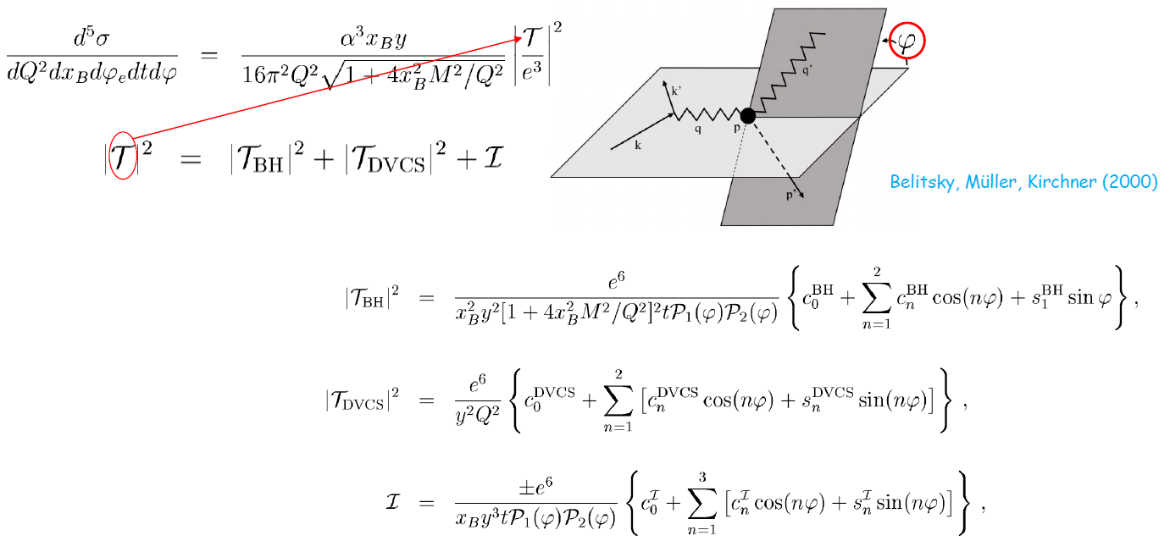
Azimuthal dependence of the ep→epγ cross section
Belitsky, Müller, Kirchner (2000)

Slide 9
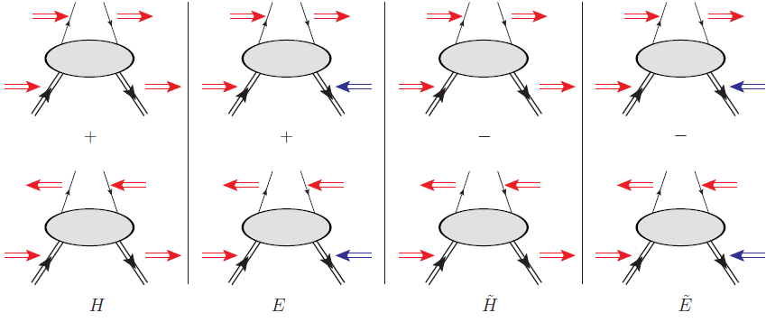
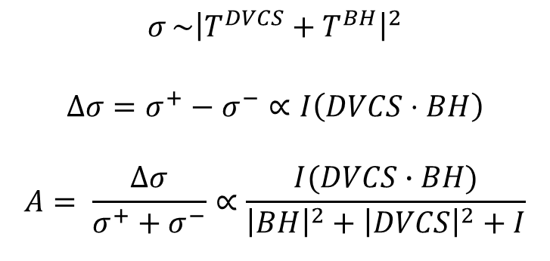
Accessing GPDs through DVCS polarization observables
Proton Neutron
Polarized beam, unpolarized target:
~
~
Im{H_{p}, H_{p}, E_{p}}
~
$$σ{\sim\left|T^{DVCS}+T^{BH}\right|}^{2}$$
$$Δσ=σ^{+}−σ^{−}∝I\left(DVCS⋅BH\right)$$
$$A= \frac{Δσ}{σ^{+}+σ^{−}}∝\frac{I(DVCS∙BH)}{{\left|BH\right|}^{2}+{\left|DVCS\right|}^{2}+I}$$
Δσ_{LU}~ sinφ Im{F₁H + ξ(F₁+F₂)H -kF₂E+…}
Im{H_{n}, H_{n}, E_{n}}
~
Unpolarized beam, longitudinal target:
Im{H_{p}, H_{p}}
~
~
Δσ_{UL} ~ sinφIm{F₁H+ξ(F₁+F₂)(H + x_{B}/2E) –ξkF₂E}
Im{H_{n}, E_{n}}
Polarized beam, longitudinal target:
~
Re{H_{p}, H_{p}}
~
Δσ_{LL} ~ (A+Bcosφ)Re{F₁H+ξ(F₁+F₂)(H + x_{B}/2E)+…}
Re{H_{n}, E_{n}}
Unpolarized beam, transverse target:
Im{H_{p}, E_{p}}
Δσ_{UT} ~ cosφsin(φ_{s}−φ)Im{k(F₂H – F₁E) +… }
Im{H_{n}}
Unpolarized beam and target, different lepton charges:
~
Re{H_{p}, H_{p}, E_{p}}
~
~
Δσ_{C} ~ cosφ Re{F₁H + ξ(F₁+F₂)H -kF₂E+…}
Re{H_{n}, H_{n}, E_{n}}
γ
e’
φ
e
N’
Notes:
The DVCS amplitude is proportional to a linear combination of 4 complex GPD-related quantities, which are called Compton Form Factors. The real part of the CFF is an integral over x of a GPD, while the imaginary one is the GPD computed at the x=+-csi points. So, measuring DVCS allow us to only obtain the csi and t dependence of GPDs, while x is integrated over.
The DVCS final state is the same as the BH one. BH is well known and calculable from the electromagnetic FF.
If we measure cross sections or DSA we are sensitive to the real part of the CFFs. If we measure single-spin asymmetries we are sensitive to the DVCS/BH interference, which is linked to the imaginary part of the CFFs.
By looking at the phi dependence of the epg observables, the various terms of the epg amplitude can be singled out.

Slide 10
GPDs through DVCS: experimental and theoretical challenges
GPDs can offer insights in many aspects of nucleon structure: nucleon tomography, partons’ angular momentum, distribution of forces in the nucleon
At the highest level of approximation, there are 4 GPDs for each quark flavor that need to be constrained
Each GPD depends on 3 kinematic variables
DVCS allows access to CFF, which depend only on 2 of those 3 kinematic variables
DVCS interferes with BH, mixed blessing: BH dominates the cross section, interference depends linearly on CFFs and is accessed in polarization asymmetries
DVCS is an exclusive final state with a small cross section: high intensity lepton beam and high luminosity are needed
Polarization observables are needed to single out the contributions of the various GPDs: polarized beams and targets
Wide phase-space coverage is needed to sample the rich kinematic dependence of the GPDs
Jefferson Lab is the ideal facility for DVCS measurements

Slide 11
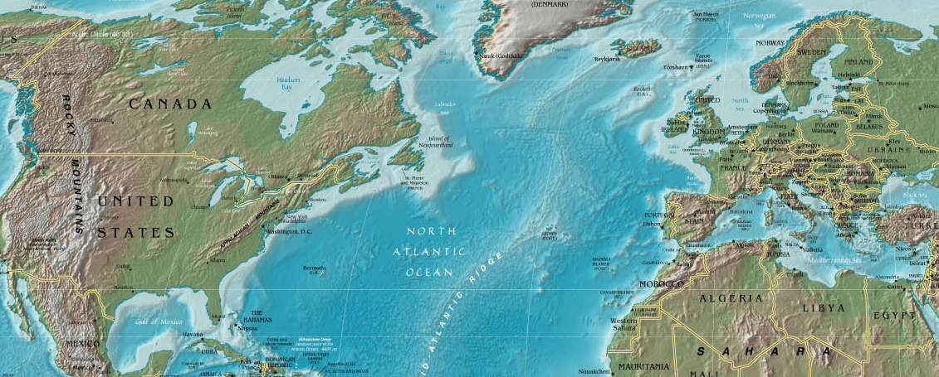
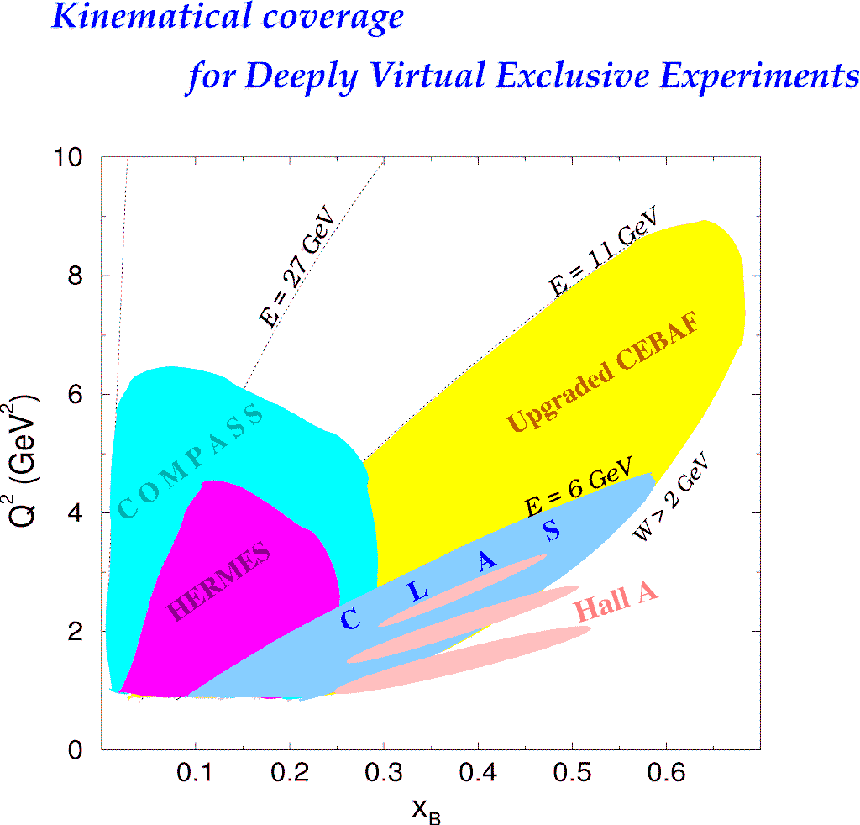
DVCS experiments worldwide
DESY
HERMES
H1/ZEUS
p-DVCS
BSA,BCA,
tTSA,lTSA,DSA
p-DVCS
X-sec,BCA
CERN
COMPASS
p-DVCS X-sec,BSA,BCA, tTSA,lTSA,DSA
JLAB
Hall A
Hall B
p,n-DVCS
(Bpol.) X-sec
p-DVCS
BSA,lTSA,DSA,X-sec

Slide 12
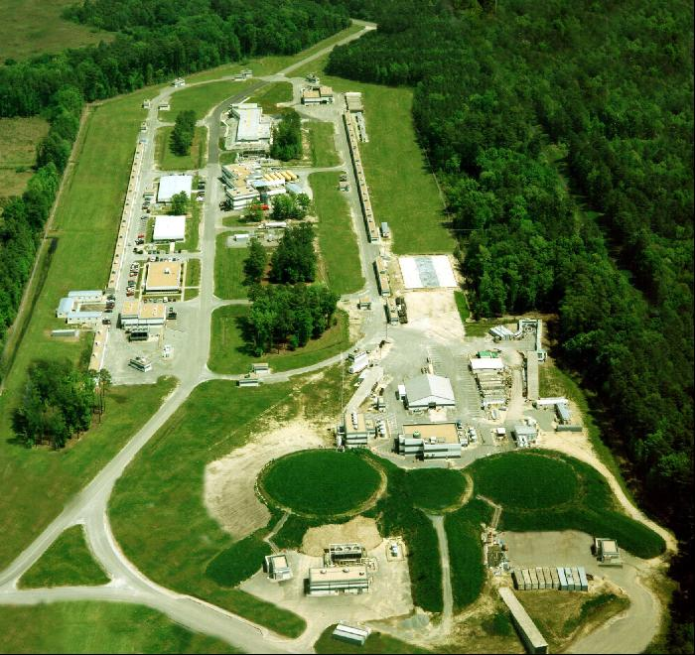
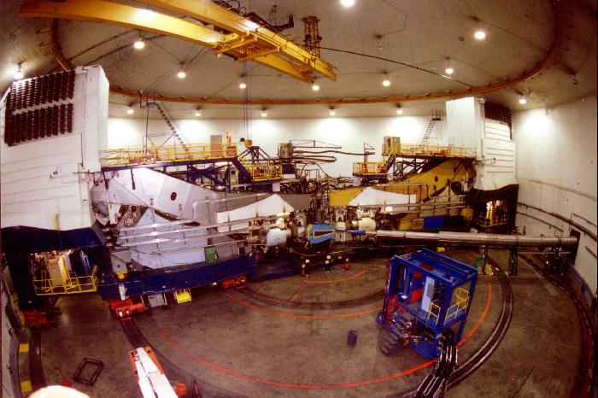
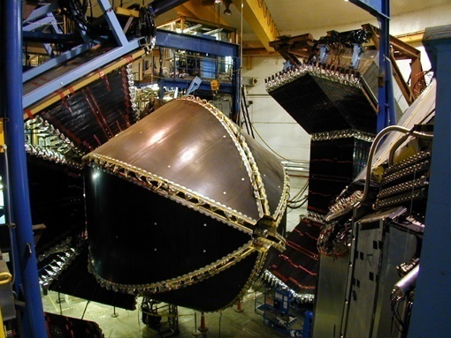
JLab@6 GeV
Continuous
Electron
Beam
Accelerator
Facility
Hall A: 2 HRS
High resolution
High luminosity (L~10³⁷)
Limited coverage
Hall B: CLAS
Large acceptance
Suited for multi-particle final states
L~10³⁴
A
B
C
E_{max} ~ 6.0 GeV
I_{max}~200 mA
Polarization 85%
Simultaneous delivery to 3 halls
Shutdown in May 2012
Hall C (SOS/HMS)
Notes:
HRS: momentum resolution 10⁻⁴ - CLAS: momentum resolution 10⁻²

Slide 13
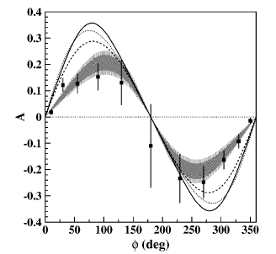
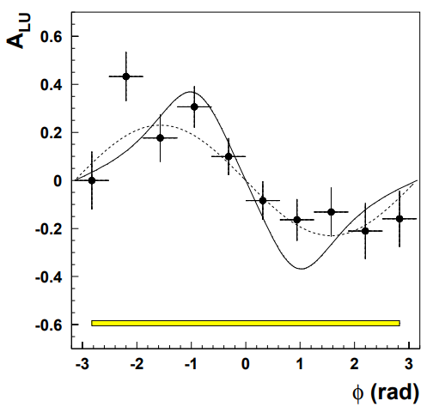
DVCS @ CLAS and HERMES: first pioneering results
NON-DEDICATED experiments
ep→epX
ep→eγX
S. Stepanyan et al., PRL 87 (2001)
A. Airapetian et al., PRL 87 (2001)
ep→epγ
S. Chen et al., PRL 97 (2006)
E_{e}=4.3 GeV
HERMES
E_{e}=5.75 GeV
<Q²>=1.25 GeV²
<x_{B}> = 0.19
<-t> = 0.19 GeV²
<Q²> = 2.6 GeV²
<x_{B}>= 0.11
<-t> = 0.27 GeV²
<Q²> = 1.82 GeV²
<x_{B}> = 0.16
<-t> = 0.31 GeV²
~
~
TSA ~ Im{H_{p}, H_{p}}
BSA ~ Im{H_{p}, H_{p},E_{p}}
A(φ) = αsinφ + βsin2φ
BSA, BCA and TSA (T & L) at HERMES:
handbag dominance confirmed
β/α << 1 → twist-2 (handbag) dominance
Low statistics
Integrated over all kinematics
Uncertainties on determination of epγ final state

Slide 14
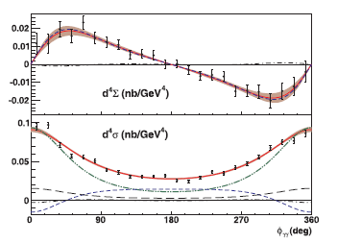
Hall A (JLab): first dedicated DVCS experiment
ep→eγX
Polarized cross
section difference
C.M. Camacho et al., PRL 97 (2006)
Q² evolution→ evidence for scaling
(small Q² range)
Unpolarized cross section
<Q2, -t> = (2.3,-0.28)
Formalism of Belitsky, Mueller, Kirchner
Fit
High resolution→exclusivity
High luminosity→precision
Limited phase space
|BH|²
Inteference BH-DVCS

Slide 15
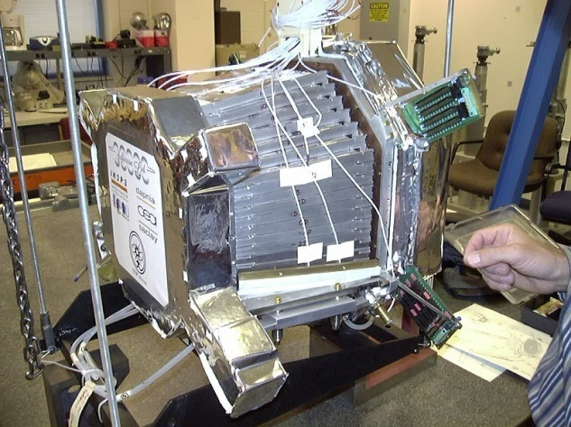
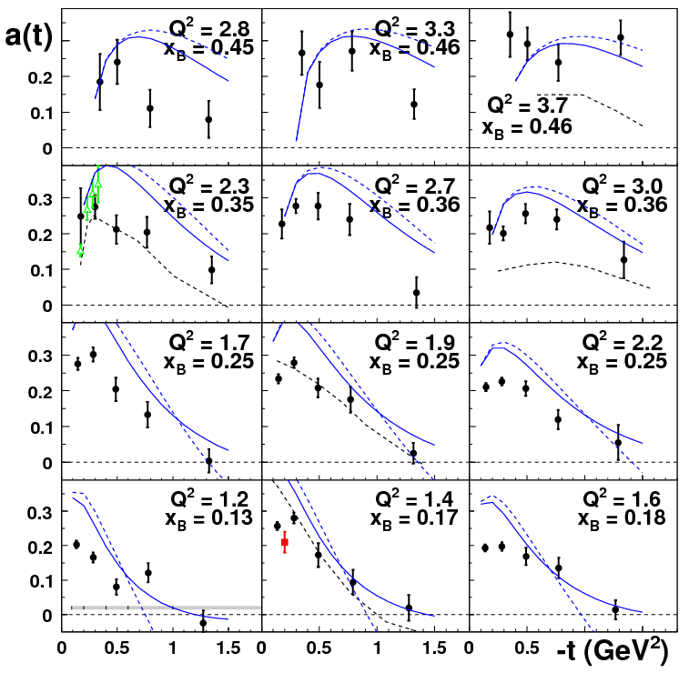
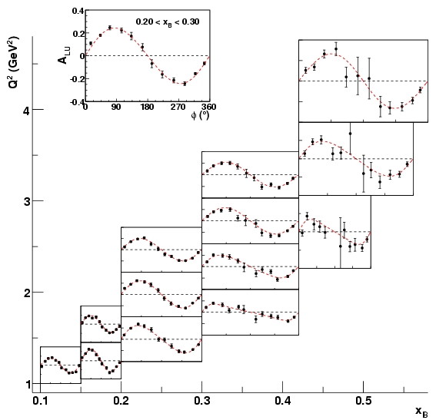
The CLAS e1-DVCS experiment
Data taken in the spring 2005
Beam energy ~ 5.75 GeV
Beam polarization ~ 80%
Target LH₂
Added to the standard CLAS
Solenoid magnet +
IC (inner calorimeter):
424 lead-tungstate crystals + APD readout
~
BSA ~ Im{H_{p}, H_{p},E_{p}}
→
ep→epγ
BSA
Fit = a sinφ/(1+b cosφ)
CLAS e1-dvcs
VGG(*) twist-2
Hall A
VGG(*) twist-2 and 3
CLAS @ 4.3 GeV²
Regge model (Laget)
F.X. Girod et al., PRL 100 (2008)
(*) Vanderhaegen, Guichon, Guidal

Slide 16
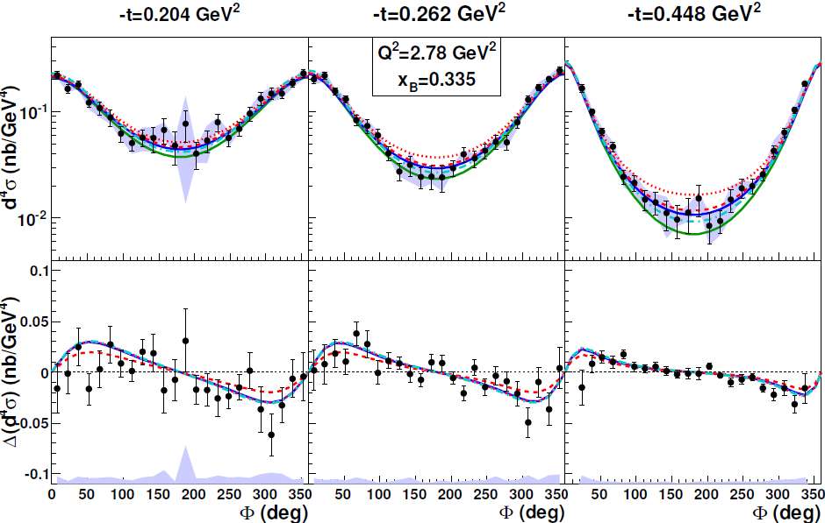
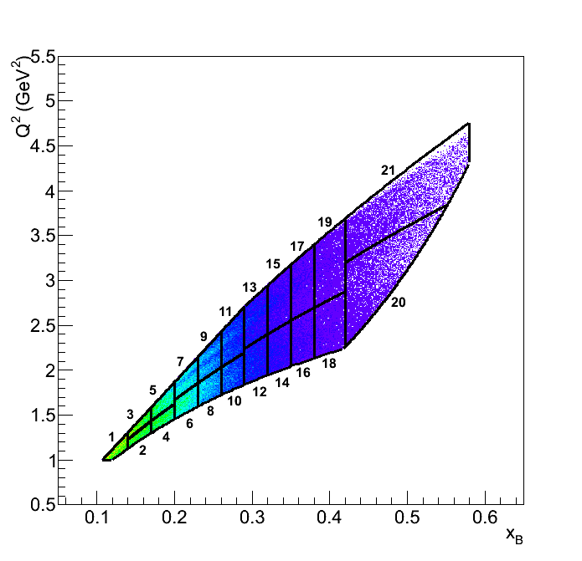
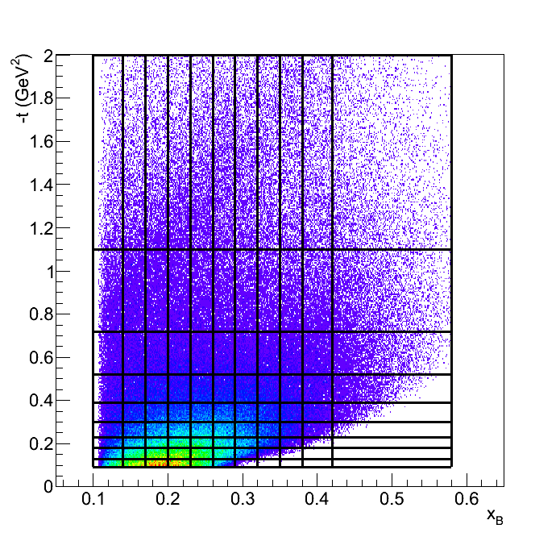
CLAS: unpolarized and beam-polarized cross sections
→
ep→epγ
H.S. Jo et al., PRL 115 (2015)
Beam energy ~ 5.75 GeV
Beam polarization ~ 80%
Target LH₂
CLAS+Inner Calorimeter
~
Δσ_{LU} ~ sinφ Im{F₁H + ξ(F₁+F₂)H -kF₂E}
BH VGG
KM10 KM10a
Two observables extracted
Largest kinematics ever covered for DVCS
21 Q²-x_{B} bins, 9 t bins, 24 φ bins
Notes:
~4500 4D bins.
KM10: in this version, the four GPDs are considered: H and ˜H are modeled for
their valence part by Eq.( 116), the E contribution is only through the D-term
and ˜E by the pion pole (like in VGG and GK). There are fifteen free parameters.
They are b (val), r (val) and M (val) for the valence part of H (see Eq.( 116)),
three similar ones ˜b (val), ˜r (val) and ˜M (val) for the valence part of ˜H , C and MC
for the D-term (see Eq.( 117)), two for the pion pole (one for the normalization
and one for the t-dependence) and five for the small x behavior of H: M (sea)
which controls the t-dependence trough a dipole ansatz, s2 (sea), s2 (gluon) , s4
(sea) and s4 (gluon) which control the normalization and evolution flow of the sea
and gluon contributions. One should however note that the five latter parameters
are determined by the collider experiments which are then just propagated to the
valence region. In other words, the JLab and HERMES data that we discuss in this
review only impact the first ten parameters and the KM10 model can effectively be
considered as having 10 free parameters in this framework. These parameters are
determined by fitting the JLab Hall A, CLAS beam spin asymmetries and HERMES
data, excluding the polarized target data. The values of the free parameters and
more details in the ingredients of the model are given explicitely in Ref. [111]. In
the following figures, this version will be described by the black dot-dashed curves.
• KM10a: compared to the KM10 version, this version sets ˜H to zero and fixes
the pion pole, which removes five free parameters and therefore reduces the total
number of free parameters to five. These are determined by fitting only the
HERMES (without the polarized target data) and CLAS data, i.e. excluding the
JLab Hall A data of the fit. The JLab Hall A cross sections are indeed notoriously
difficult to describe, as was illustrated by the comparison of the VGG, GK and
dual models with data shown in the previous sections. We will see shortly that
this “minimal” version of the KM model is indeed unable to describe or predict the
JLab Hall A cross sections. In the figures, this version will be described by the red
solid curves.

Slide 17
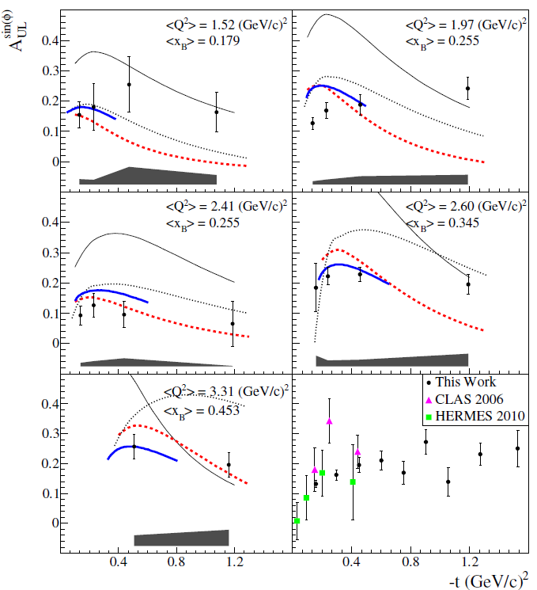
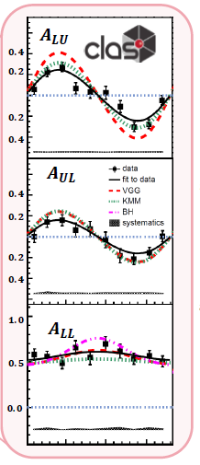
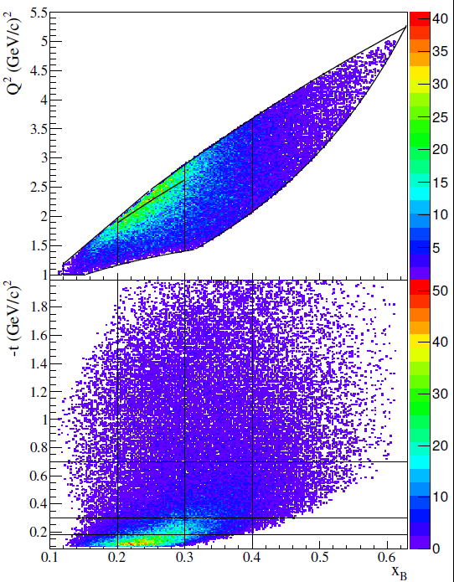

CLAS: DVCS on longitudinally polarized target
Beam energy ~5.9 GeV
CLAS + IC to detect forward photons
~
→
→
TSA ~ Im{H_{p}, H_{p}}
ep→epγ
Target: longitudinally polarized NH₃ (P~80%)
3 DVCS observables
Beam asymmetry
Target asymmetry
Double asymmetry
5 Q²-x_{B} bins
4 t bins
10 φ bins
E. Seder et al., PRL 114 (2015)
Improved statistics x10 at low –t
Extended kinematic coverage
S. Pisano et al., PRD 91 (2015)

Slide 18
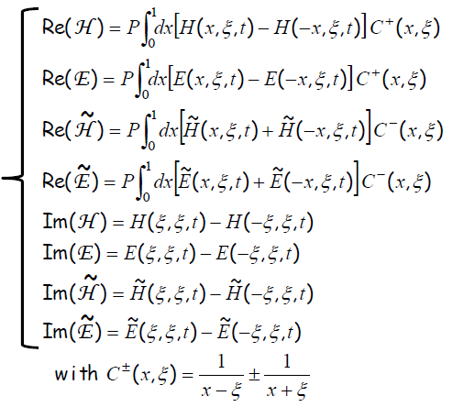
Extraction of Compton Form Factors from DVCS observables
Various possible techniques/strategies:
Local fits: each kinematic bin is treated independently. Each CFF (ImH, ReH, ImE…) is a free fit parameter (M. Guidal)
Global fits: all kinematic bins are taken at the same time. Parametrizations of the GPDs or CFFs are used (G. Goldstein et al., K. Kumericki and D. Mueller)
Hybrid local/global fits: combination of the two methods above, that allows to estimate systematic uncertainties (H. Moutarde)
Neural networks: already extensively used for PDF fits. Recently started for GPDs (K. Kumericki)
8 CFF
M. Guidal: Model-independent fit, at fixed Q², x_{B} and t of DVCS observables; 8 unknowns (the CFFs), non-linear problem, strong correlations. Bounding the domain of variation of the CFFs with model (5xVGG)
M. Guidal, Eur. Phys. J. A 37 (2008), and other articles

Slide 19
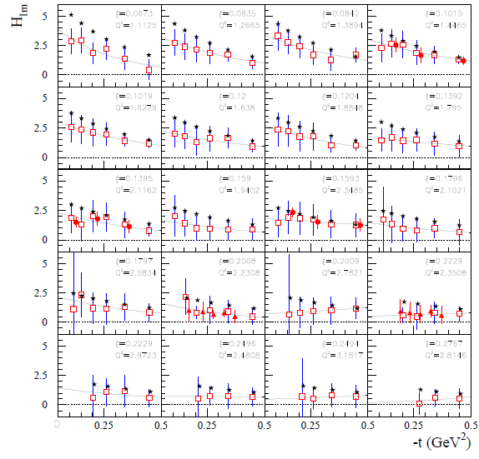

~
Results for H_{Im} and H_{Im} from the fits of JLab 2015 data
CFFs fitting code by M. Guidal
ImH, flatter t slope at high x_{B}: faster quarks (valence) at the core of the proton, slower quarks (sea) at its periphery
→ PROTON TOMOGRAPHY
~
ImH, steeper t-slope than ImH : the axial charge is more “concentrated” than the electric charge
Fit to CLAS c.s. and beam pol. c.s.
Fit to CLAS c.s., beam pol. c.s., lTSA, DSA
Fit to Hall A c.s. and beam pol. c.s.
VGG model

Slide 20
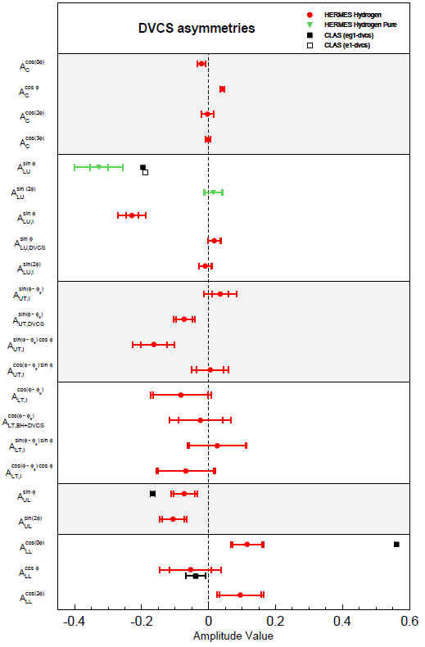
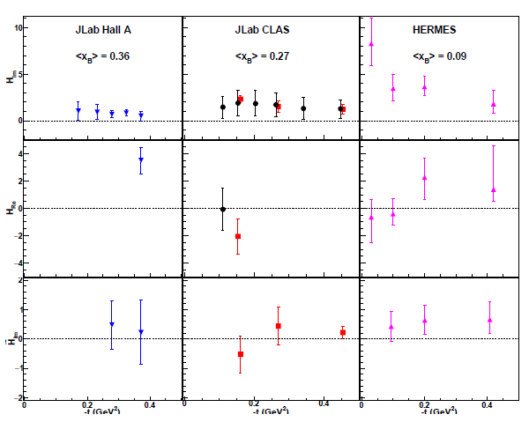
Summary of proton-DVCS spin observables and GPDs extraction
Beam charge
asymmetry
Beam spin
asymmetry
Transverse target spin asymmetry
Beam-spin and tr. target spin asymmetry
CLAS C.S.
CLAS C.S.
+TSA+DSA
Longitudinal target spin asymmetry
Hall A (2015)
HERMES
Beam-spin and long. target spin asymmetry
BCA: strong constraint on H_{re}
→ Motivation for positron beam at JLab
N. d’Hose, S.N., A. Rostomyan, EPJA 52 (2016)

Slide 21
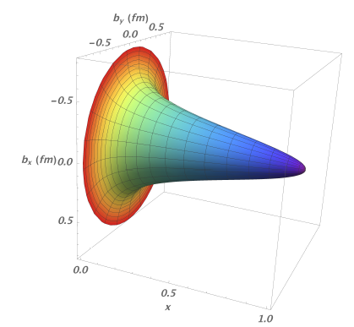
Visualization of proton tomography
Proton tomography obtained from local fits to HERMES, CLAS, and Hall-A data (ImH + model dependent assumptions for x dependence)
High-momentum quarks (valence) are at the core of the nucleon, low-momentum quarks (sea) are at its periphery
R. Dupré, M. Guidal, M.Vanderhaeghen, PRD95 (2017)

Slide 22
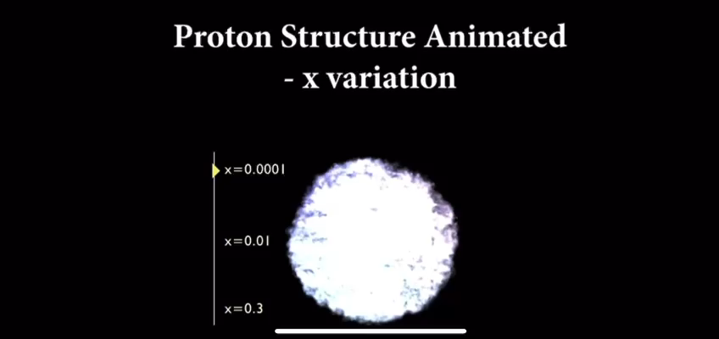
« Visualizing the proton » (R. Milner, R. Ent, R. Yoshida)
Filmmaking by Chris Boebel, Joe McMaster, and James LaPlante
https://www.youtube.com/watch?v=G-9I0buDi4s (published on April 13, 2022)

Slide 23





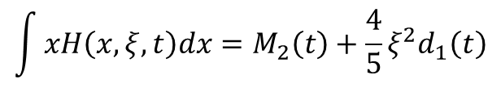
Distribution of forces in the proton
$$\int{xH\left(x,ξ,t\right)dx=M_{2}\left(t\right)+\frac{4}{5}ξ^{2}d_{1}\left(t\right)}$$
Second Mellin moment of H in x: gravitational form factor of the energy-momentum tensor → shear forces and pressure (d₁)
Dispersion relation
d₁(t) is the first coefficient in the Gegenbauer expansion of the D-term
CLAS6 uncertainties
Projected CLAS12 uncertainties
Uncertainties using previous data
From H-only fit of DVCS BSA and cross section from CLAS@6 GeV
(model dependent)
3
V. Burkert, L. Elouadrhiri, F.X. Girod, Nature 557 (2018)

Slide 24
High-precision DVCS: JLab Hall A at 6 GeV
→
ep→eγ(p)
High precision DVCS cross sections from Hall A (E07-007):
sensitivity to higher twist (HT) or LT-NLO contributions (gluon exchange)
DVCS²
E_{beam} = 4.455 GeV
E_{beam} = 5.55 GeV
BH-DVCS interference
Different beam energies used to separate BH-DVCS interference (~E_{b}³) and DVCS² (~E_{b}²) contributions
M. Defurne et al., Nature Communications 8 (2017)
14

Slide 25
Interest of DVCS on the neutron
A combined analysis of DVCS observables for proton and neutron targets is necessary for flavor separation of GPDs
Moreover, the beam-spin asymmetry for nDVCS is the most sensitive observable to the GPD E
→ Ji’s sum rule for Quarks Angular Momentum
Polarized beam, unpolarized target:
~
Im{H_{n}, H_{n}, E_{n}}
Unpolarized beam, transversely polarized target:
Neutron
Proton
Im{H_{p}, E_{p}}
The BSA for nDVCS:
is complementary to the TSA for pDVCS on transverse target, aiming at E
depends strongly on the kinematics → wide coverage needed
is smaller than for pDVCS → more beam time needed to achieve reasonable statistics

Slide 26
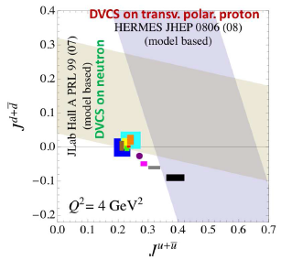
→
DVCS on the neutron in Hall A at 6 GeV
ed→eγ(np)
~
Q²=1.9 GeV² x_{B}=0.36
Δσ_{LU}~ sinφ Im{F₁H + ξ(F₁+F₂)H -kF₂E}
S. Ahmad et al., PR D75 (2007) 094003
VGG, PR D60 (1999) 094017
E03-106: First-time measurement of Δσ_{LU} for nDVCS
Model-dependent extraction of J_{u}, J_{d}
M. Mazouz et al., PRL 99 (2007)

Slide 27
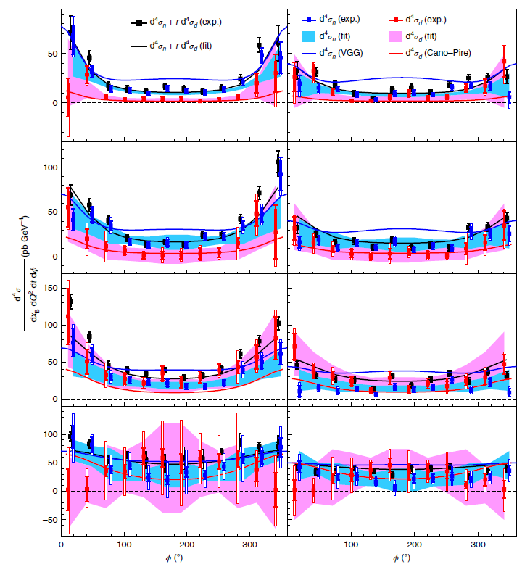
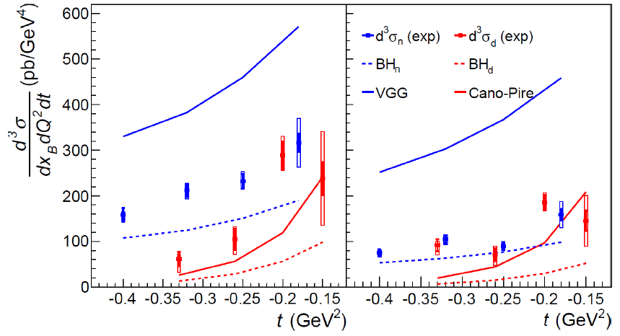
→
DVCS on the neutron in Hall A at 6 GeV
ed→eγ(np)
nDVCS and coherent dDVCS separated through MM²_{X} shift:
large correlations at low –t
good separation at larger -t
Q²=1.9 GeV² x_{B}=0.36
E=4.45 GeV
E=5.55 GeV
Hall-A experiment E08-025 (2010)
Beam-energy « Rosenbluth » separation of nDVCS CS (two beam energies)
First observation of non-zero nDVCS CS
M. Benali et al., Nature 16 (2020)
E=4.45 GeV
E=5.55 GeV

Slide 28
Summary
DVCS is the reaction more directly interpretable in terms of GPDs
The interference of DVCS with Bethe Heitler depends linearly on the Compton Form Factors (linked to GPDs) and can be accessed experimentally measuring spin asymmetries
CLAS and HERMES provided the first observation of DVCS-BH interference
Since then, a wealth of dedicated experiments were carried out, in particular at JLab@6 GeV (Halls A and B):
  BSA, TSA, DSA for pDVCS
  Cross sections for pDVCS, high precision (Hall A) and wide coverage (CLAS)
  → first tomographic image of the proton
  → first glance at the pressure distribution in the proton
  First measurements of DVCS on the neutron (Hall A):
  → First model-dependent extraction of J_{u}, J_{d}
  → First observation of non-zero cross section for nDVCS

