Slide 1
QCD as a Gauge Theory
Institute of Physics and Mathematics
University of Michoacán, Morelia, Michoacán, Mexico
Fulbright Visiting Scientist
Jefferson Laboratory, Newport News, Virginia, USA

Slide 2
The Gauge Principle

Slide 3
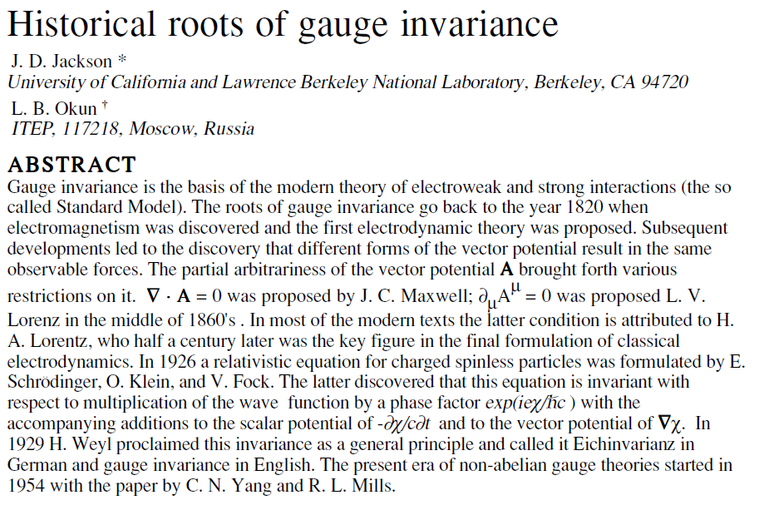
The Gauge Principle

Slide 4
The gauge principle
Maxwell’s formulation of electrodynamics was perhaps the
first field theory and a gauge theory in physics.
In 1929, Weyl showed that electrodynamics was invariant
under the gauge transformation of the gauge field and
the wave-function of the charged field.
In 1954, Yang and Mills studied the gauge principle in
non-abelian field theories.

Slide 5
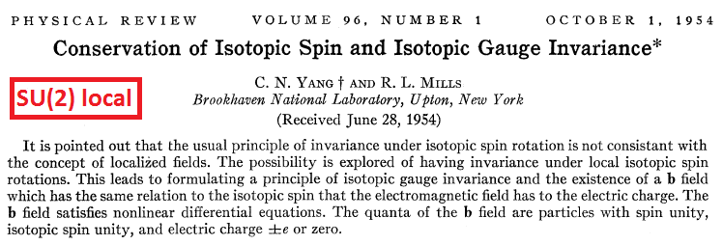
The gauge principle
U(1) and SU(2) local gauge invariance:

Slide 6
Quantum electrodynamics
The free Dirac Lagrangian is:
It is invariant under abelian global U(1) gauge transformation:
where α is a real constant. Find conserved current.
We demand generalizing it into a local gauge symmetry by
demanding the invariance even if α=α(x). The mass term
is still invariant but not the kinetic energy term.

Slide 7
Quantum electrodynamics
The invariance can be reinstated by introducing a gauge field
and a gauge covariant derivative:
e is the fermion coupling to the gauge field.
The starting point now is:
This is invariant under simultaneous gauge transformations
of the fermion and the gauge fields:

Slide 8
Quantum electrodynamics
This invariance is achieved because:
and hence:
The gauge field A = vector potential of Maxwell equations.

Slide 9
Quantum electrodynamics
The wave-function of an electron carries a phase with it.
In global gauge transformation, this phase is changed by the
same amount at every space-time point and the Lagrangian is
invariant.

Slide 10
Quantum electrodynamics
In local gauge transformation, this phase is changed by
arbitrarily different amounts at every space-time point.
Gauge field with compensating transformation is introduced
to obtain local gauge invariance.

Slide 11
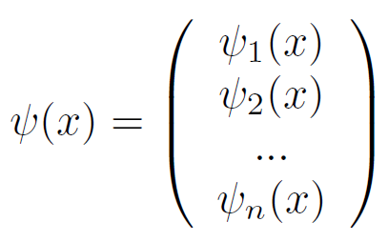
SU(N) gauge theory
The free field is described by the Dirac Lagrangian:
It is invariant under the SU(N) transformations, with θª real constants. Find conserved current.

Slide 12
SU(N) gauge theory
Here ½ 𝜏ª (a=1,2,3, … , N²-1) are n x n matrices in n-dimensional
representation of the SU(N) group.
These matrices obey the following Lie algebra:
The structure functions f_{abc} uniquely determine the group
SU(N) in operation.

Slide 13
SU(3) gauge theory
There are different color phases associated with quarks
In global gauge transformations, they are transformed
independently of x and hence the Lagrangian is invariant.

Slide 14
SU(N) gauge theory
We want to enforce the invariance of the Lagrangian under
local gauge transformations:
We now need (N²-1) gauge fields & the covariant derivative is:

Slide 15
SU(N) gauge theory
The gauge fields must transform as:
so that:
which ensures the invariance of the Lagrangian.

Slide 16
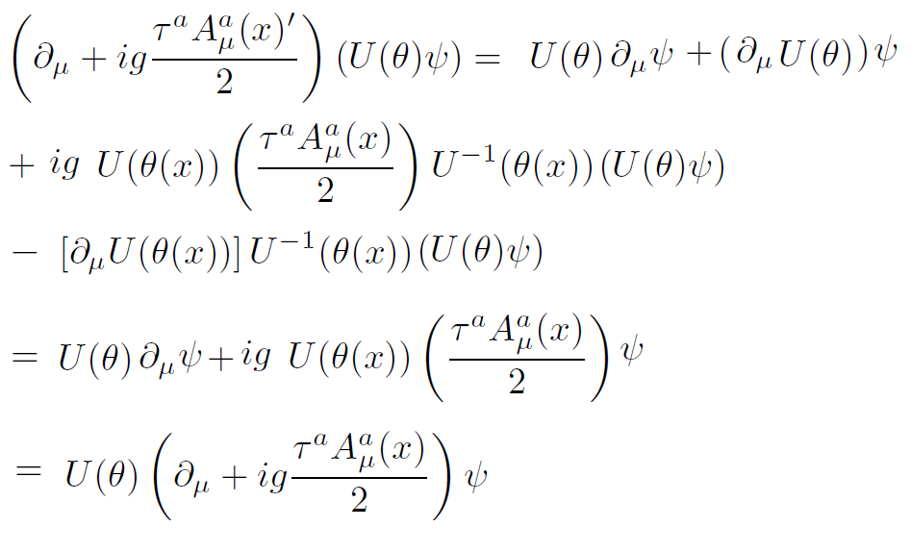
SU(N) gauge theory
proof:

Slide 17
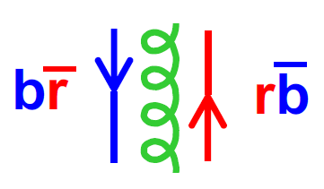
SU(3) gauge theory
Initially:
Compensating
fields restore
gauge invariance
Local Gauge
transformation:

Slide 18
Recalling quantum electrodynamics
A candidate for the dynamics of the gauge field A in QED is the vector potential of the Maxwell’s equations:
F_{μν} is invariant under the gauge transformations:

Slide 19
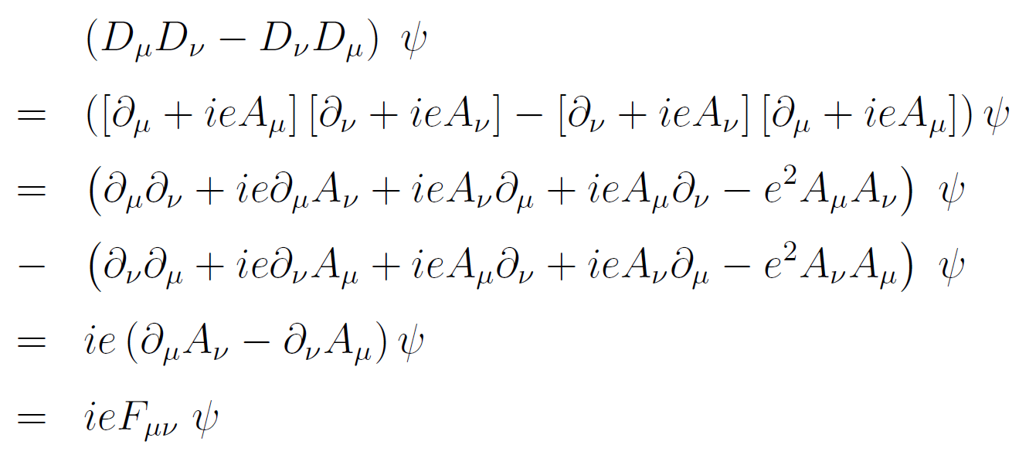
Recalling quantum electrodynamics
We can easily check the following:
It goes beyond U(1):

Slide 20
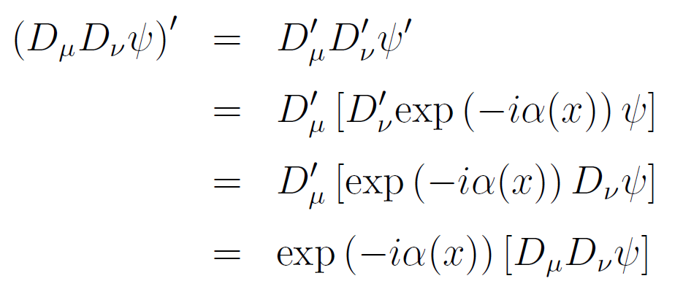
Recalling quantum electrodynamics
We now want to show the following:
We start from:
This proves the above identity.

Slide 21
Recalling quantum electrodynamics
The two identities are:
Combining these expressions:

Slide 22
Recalling quantum electrodynamics
As ψ is an arbitrary spinor and exp(-iα(x)) & F_{μν} commute,
the later being a function, we obtain the gauge invariance
of the field tensor:
So we construct the Lorentz invariant quantity:
And the Lagrangian is:

Slide 23
Dynamics of the field tensor
How do we define F_{μν} for SU(N)?
The following definition does not work:
We can check that with this definition,
is not gauge invariant.
Thus we follow the procedure just outlined. Use the
definition of F_{μν} as follows and deduce what it is:

Slide 24
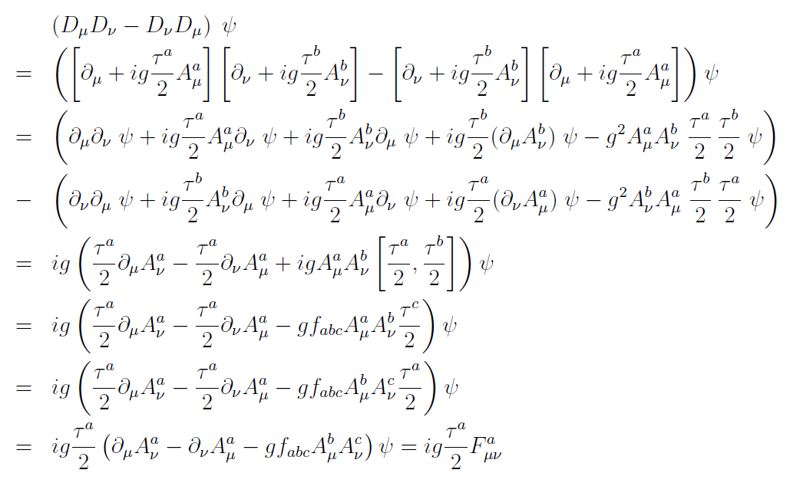
Non abelian field tensor

Slide 25
Dynamics of the field tensor
Is F_{μν}ª gauge invariant? No.
Show:
Show that F_{μν}ª F^{μνa} is gauge invariant.
SU(N) Lagrangian:
These terms correspond to self coupling of the gauge field,
triple and quartic gluon interactions.

Slide 26
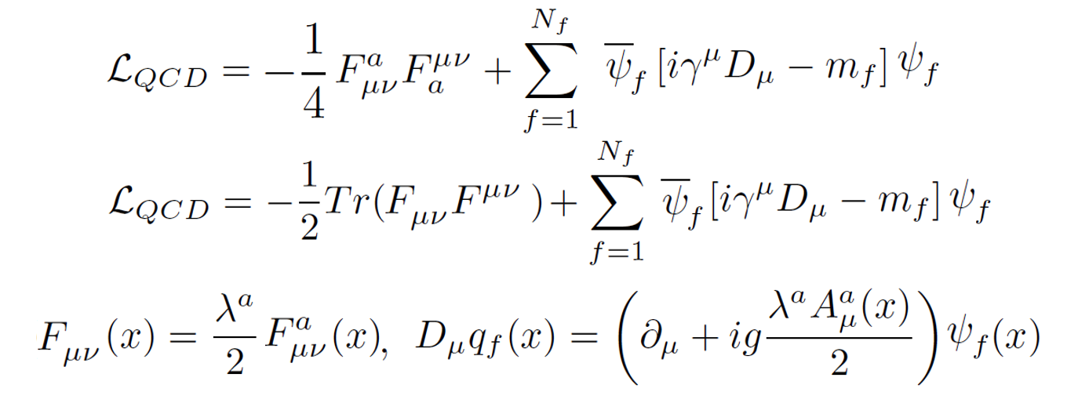
The QCD Lagrangian
Thus the QCD Lagrangian can be written as (modulus gauge
fixing term and ghosts)
Gluon Fields: Massless, spin 1 bosons, color octet because
the group contains eight generators, flavor singlet (i.e.,
gluons are flavor blind, not distinguishing between flavors
of whatever they interact with).

Slide 27
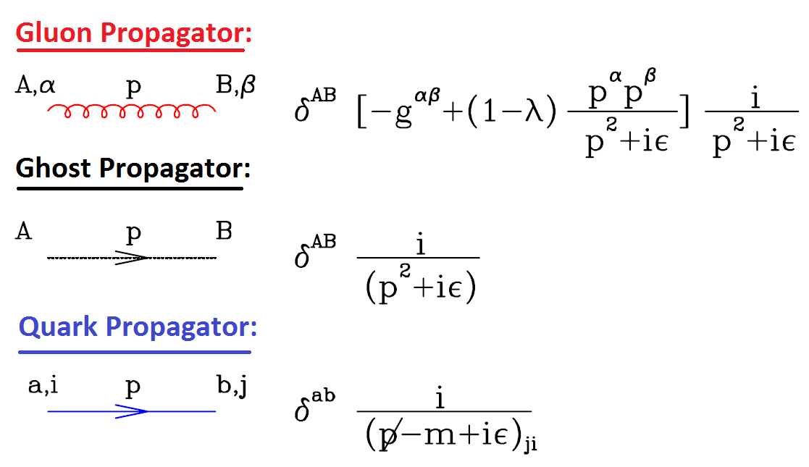
Feynman rules in covariant gauges
The propagators:

Slide 28
Feynman rules in covariant gauges
The gluon self interactions:

Slide 29
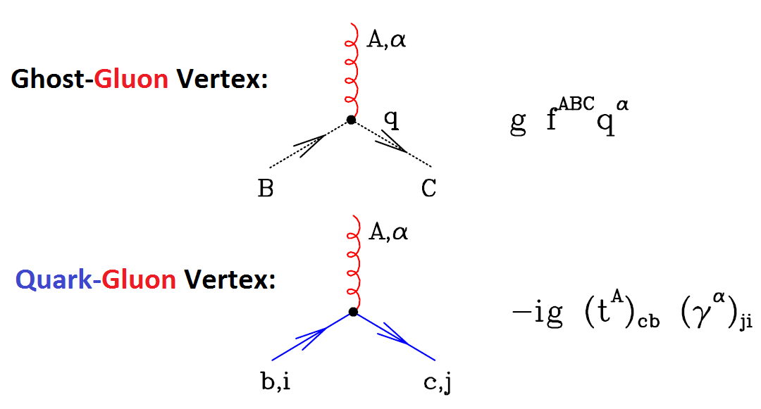
Feynman rules in covariant gauges
The gluon vertices with ghosts and quarks:

Slide 30
Higher orders and infinities
Electrodynamics was born in 1920s through the works of
Born, Heisenberg, Dirac, Pauli, Feynman, Schwinger, etc.
Works of F. Bloch, A. Nordsieck (1937) and V. Weiskopf
(1939) revealed QED calculations worked only at first
order in perturbation theory. Infinites emerged at higher
orders.
In 1940s, precise measurements of the levels of Hydrogen
atom, Lamb shift and the magnetic moment of the
electron exposed discrepancies between experiment and
tree level theory.
Works of Feynman, Schwinger and Tomonaga [1943-1949]
introduced the concept of renormalization to solve the
problems of QED. Nobel prize of 1965.

Slide 31
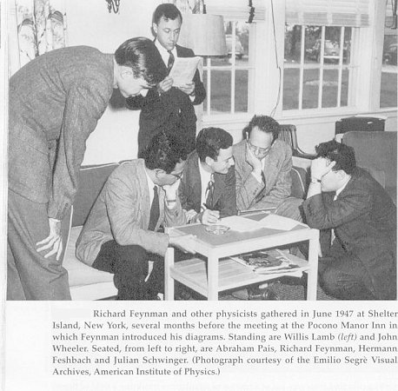

Slide 32
Higher orders and infinities
Lamb Shift:
According to Dirac and Schrodinger, the atomic states
with the same n and j quantum numbers but different l
quantum numbers ought to be degenerate.
A famous experiment of Retherford and Lamb in 1947
showed that the states
of the Hydrogen atom were not degenerate.
This effect is explained by perturbative QED.

Slide 33
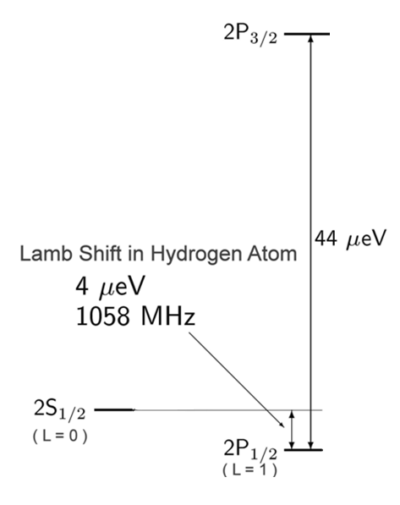
Higher orders and infinities
Lamb Shift:

Slide 34
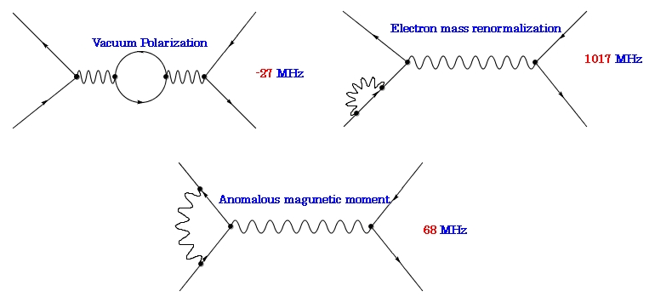
Higher orders and infinities
Lamb Shift:

Slide 35
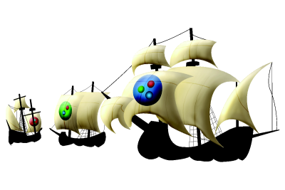
Renormalization in One Hour

Slide 36
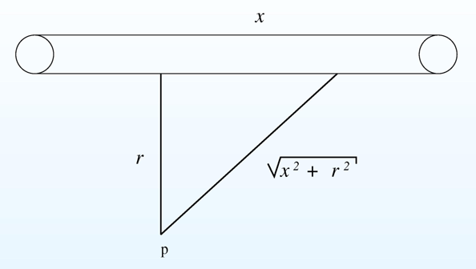
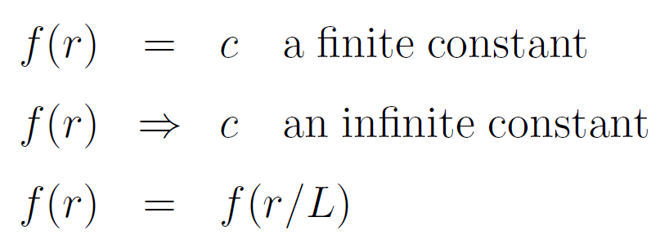
Infinities in electromagnetism
Electric potential due to an infinite line charge:
This function U does not
have dimensions. Such f
functions have possibilities:
L is a problem related scale.

Slide 37
Infinities in electromagnetism
Regularize potential: (i) Cut off method
Electric field intensity:
Repeat steps for potential difference between two points.
This regularized potential has following properties:.
V_{reg}(r/L) is convergent
V_{reg}(r/L) is NOT translation invariant

Slide 38
Infinities in electromagnetism
Regularize potential: (i) Dimensional Regularization
Evaluate integral in D dimensions:
Substitute:

Slide 39
Infinities in electromagnetism
Regularize potential: (i) Dimensional Regularization
Electric field is:
This regularized potential has the following properties:
V_{reg}(r/μ) is convergent
V_{reg}(r/μ) IS translation invariant

Slide 40
Infinities in electromagnetism
“Renormalization Schemes”
Expand V_{reg}(r/μ) in powers of ε:
In MS (minimal subtraction) scheme (Electric potential?)
In MS (modified minimal subtraction) scheme
V depends on an additional length scale!

Slide 41
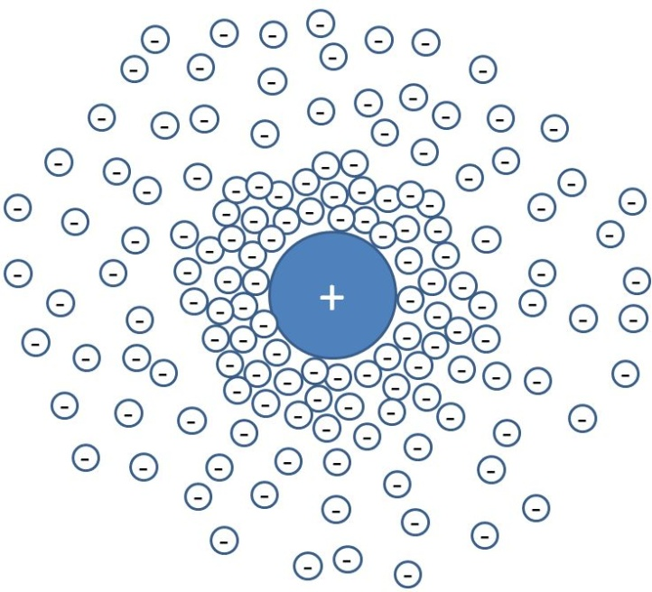
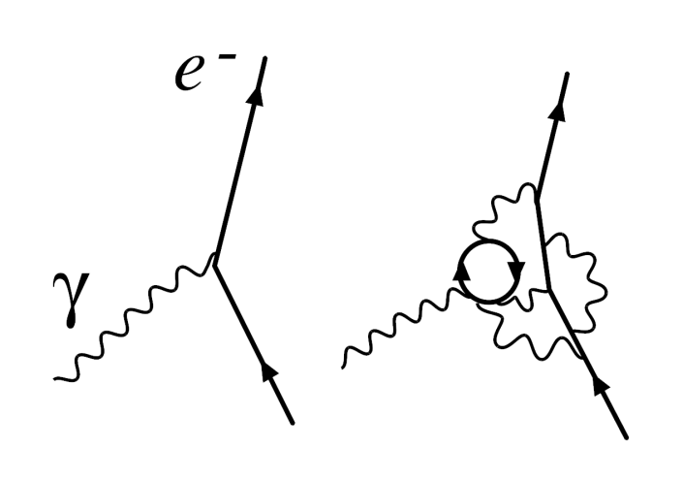
Infinities in QED
Charge or coupling renormalization:
Bare
charge
Physical
Charge
Loops introduce divergences which need to be regularized
and renormalized.
Quantities such as coupling run with momenta.

Slide 42
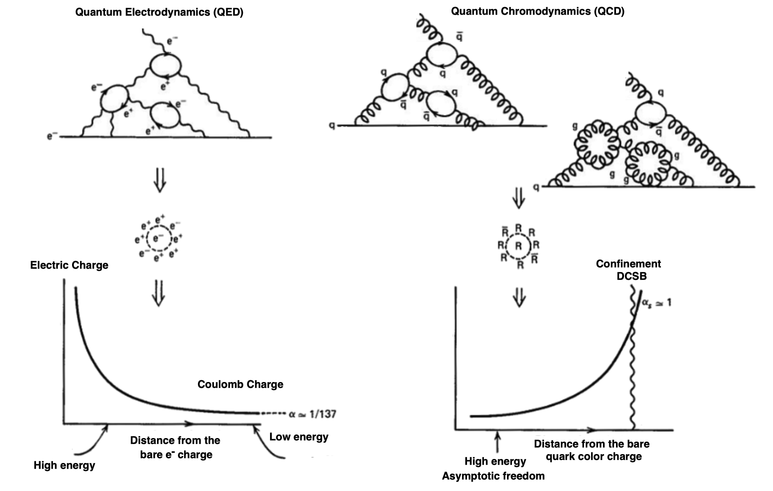
QED vs QCD

Slide 43
Dimensional regularization
One-loop calculations in QED and QCD involve integrals
which diverge. An example of a divergent integral is:
Introduce some regulator. Regularized diagrams converge.
There exist many regularization methods. Cut-off, Pauli-
Villars, lattice and dimensional regularization.
The regularization should preserve as many symmetries of
the theory as possible, ensuring manipulating regularized
Feynman integrals are simple, etc.
The best choice is the dimensional regularization. Nobel
Prize 1999 (t’Hooft and Veltman).

Slide 44
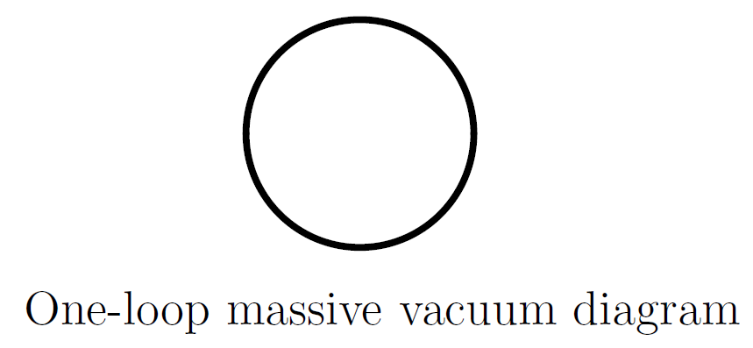
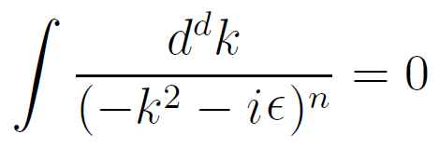
Massive vacuum diagram
1-loop massive integral with
dimensional regularization
Divergence!
Massless integrals with no
external momentum scale

Slide 45
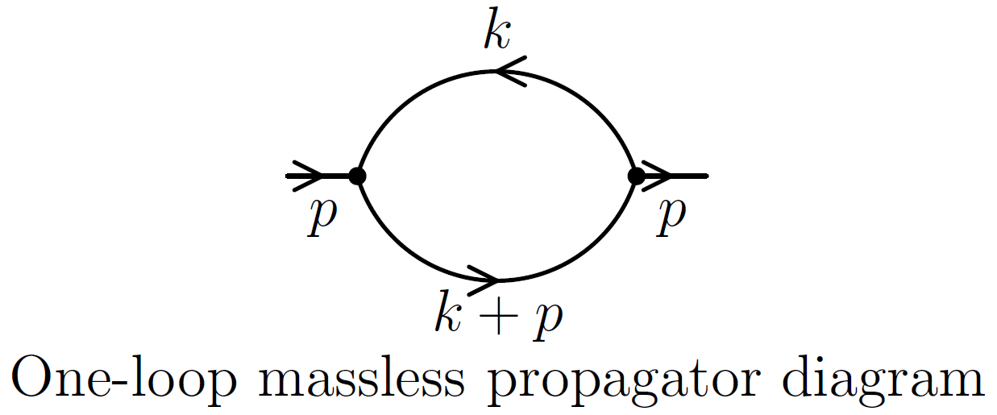
Massless bubble diagram
The massless propagator
diagram with arbitrary
powers:
Expression:
Finally:

Slide 46
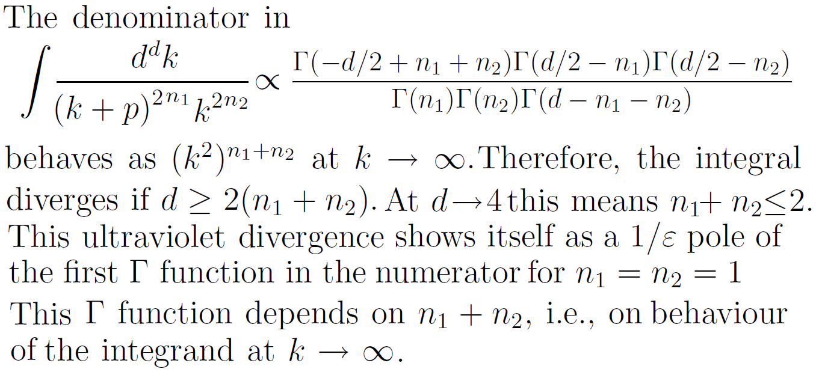
Massless bubble diagram
Ultraviolet divergences:

Slide 47
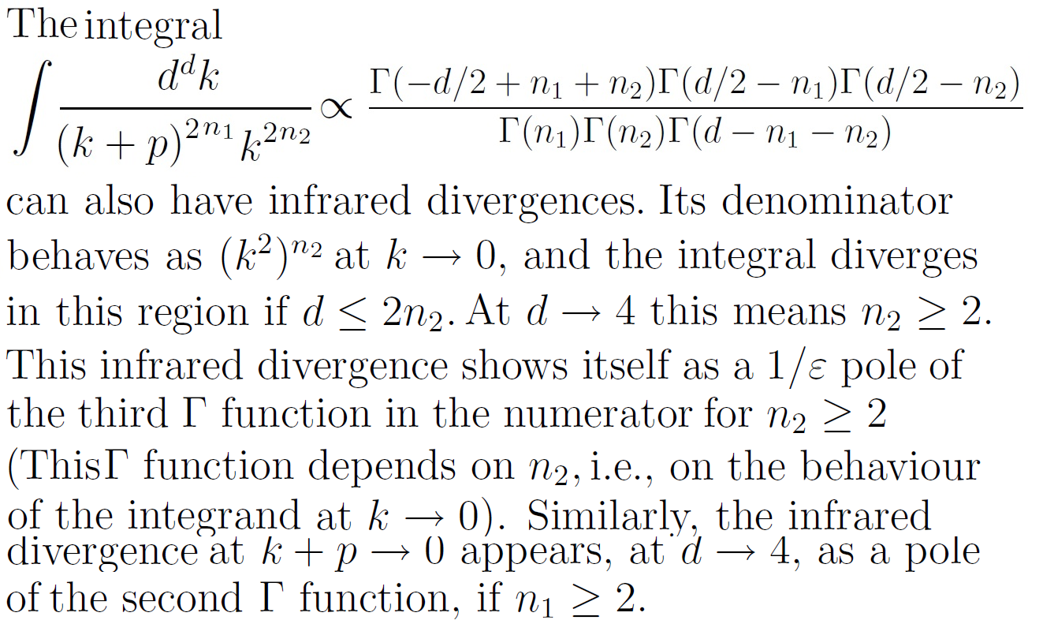
Massless bubble diagram
Infrared divergences:

Slide 48
What next?
How can we regularize & renormalize QED at one loop?
How does the coupling run in QED?
How can we answer the same questions in QCD?
What are the consequences of running coupling in QCD and
its infrared enhancement and what are its implications for
hadron physics?

