Slide 1


Deep Exclusive Reactions
Lecture 1: Nucleon structure studies with the electromagnetic probe
Elastic scattering: form factors
DIS: structure function
Exclusive reactions: Generalized Parton Distributions
Lecture 3: DVCS and beyond
DVMP
New DVCS experiments@12 GeV
TCS
Lecture 2: Deeply Virtual Compton Scattering
GPDs and DVCS
DVCS on the proton with JLab@6 GeV
Extraction of GPDs from data
Proton tomography and forces in the proton
Lecture 4: Perspectives
Upgrades at JLab
GPDs at the EIC
Lecture 5: Tutorial
Data analysis techniques for exclusive reactions
Silvia Niccolai, IJClab Orsay & CLAS Collaboration
HUGS, JLab, June 2023

Slide 2
Deep Exclusive Reactions
Lecture 1: Nucleon structure studies with the electromagnetic probe
Elastic scattering: form factors
DIS: structure function
Exclusive reactions: Generalized Parton Distributions
Lecture 3: DVCS and beyond
DVMP
New DVCS experiments@12 GeV
TCS
Lecture 2: Deeply Virtual Compton Scattering
GPDs and DVCS
DVCS on the proton with JLab@6 GeV
Extraction of GPDs from data
Proton tomography and forces in the proton
Lecture 4: Perspectives
Upgrades at JLab
GPDs at the EIC
Lecture 5: Tutorial
Data analysis techniques for exclusive reactions
Silvia Niccolai, IJClab Orsay & CLAS Collaboration
HUGS, JLab, June 2023

Slide 3
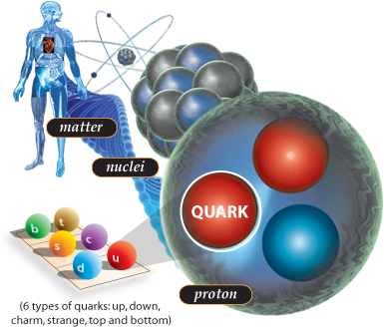
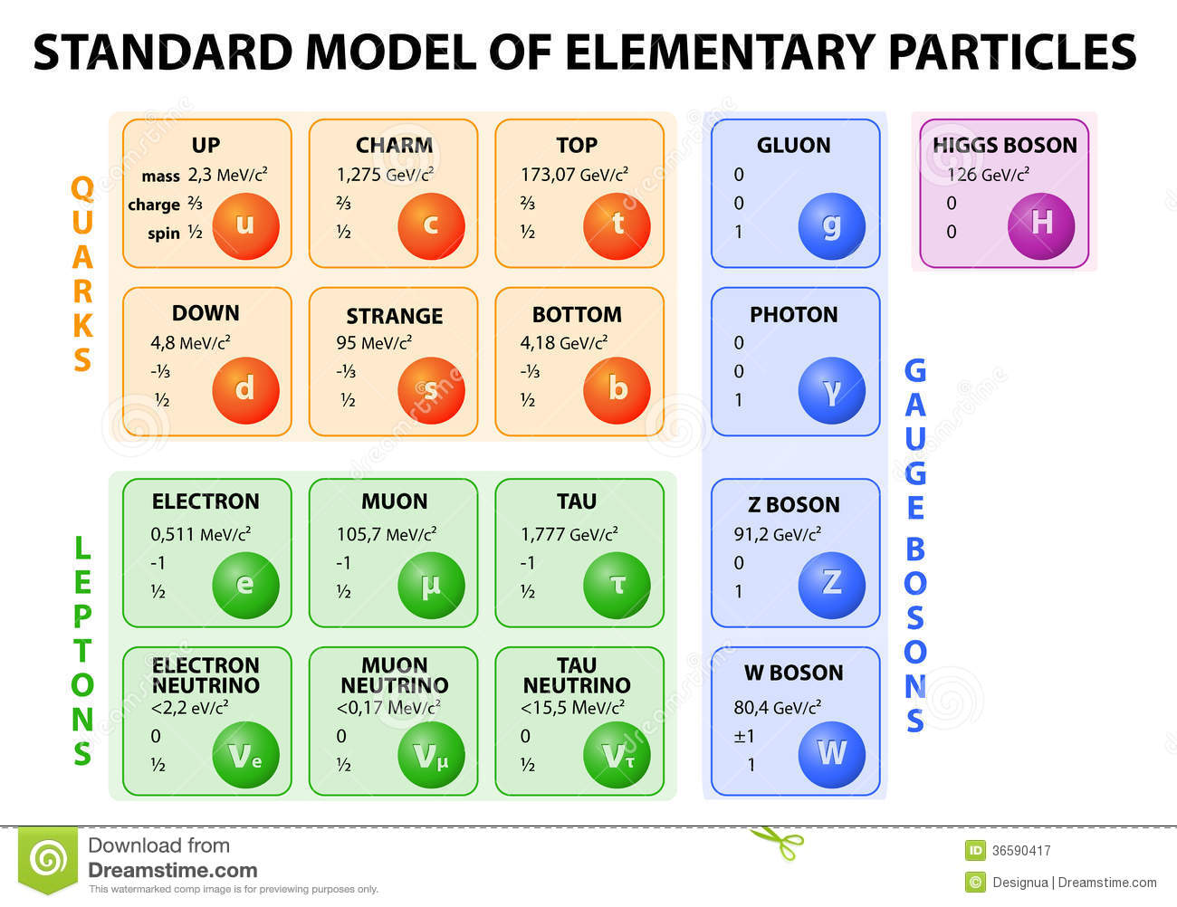

QCD at the heart of matter
Protons and neutrons are the building blocks of atomic nuclei
Nucleons provide ~99% of the mass of the visible universe
~99% of nucleon mass arises from the dynamics and interactions between its constituents (quarks and gluons)
Matter
Nuclei
Quantum Chromodynamics (QCD)
GLUONS
Nucleon
QCD contains in principle all the answers
BUT…
QCD is still not unsolvable in non-perturbative regions
Insights into “soft” phenomena, such as the structure of hadrons, exist through qualitative models and quantitative numerical calculations (lattice)
Notes:
Matter is made of nuclei, which are in turn made of nucleons. Nucleons constitue the vast majority of the mass of the visible universe. Their elementary constituents are the quarks and the gluons, which you see here listed among the Standard Model elementary particles. The gluons are the vectors of the strong interaction. Quarks are very light, so 99% of the mass of nucleons comes from the dynamics and the interactions of its constituents. These interactions are encoded in the theory of the strong interaction, which is QCD. QCD has various peculiar properties. At long distances there is confinement, which implies that quarks cannot be found alone, but always confined into hadrons. At the other edge, very short distances, the coupling constant becomes very small, so the quarks are very little interacting with each other (asymptotically free).
Chiral symmetry breaking is what allows that small and basically massless quarks generate the mass of nucleons.
A very peculiar property of QCD is its non linearity, the fact that gluons can interact with themselves.

Slide 4
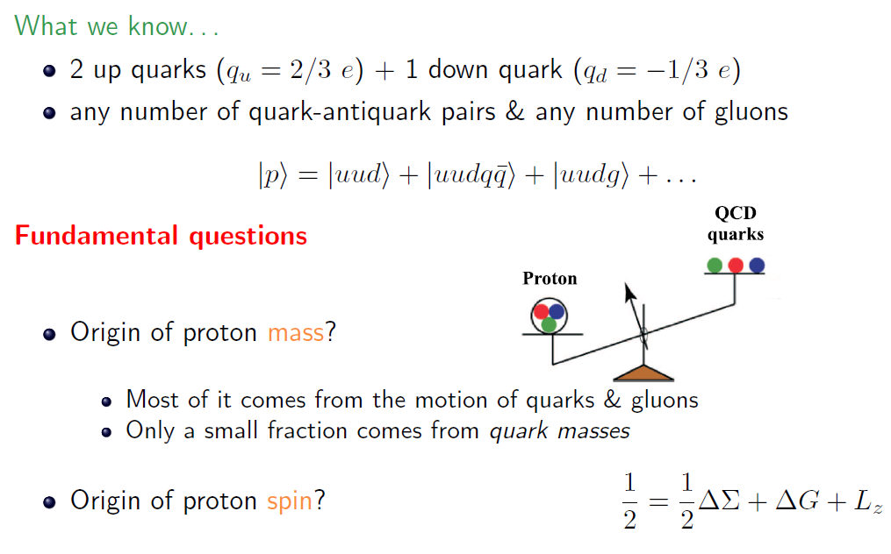
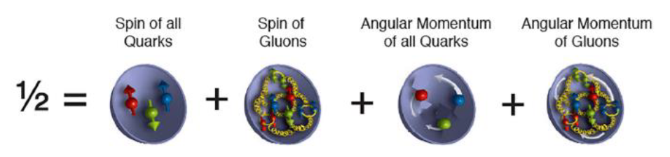
The proton: QCD at work!
What we know about the content of the proton:
2 up quarks (q_{u} = 2/3 e) + 1 down quark (q_{d} = -1/3 e)
Any number of quark-antiquark pairs (sea)
Any number of gluons
Fundamental questions:
Origin of proton mass?
→ Only a small fraction comes from the actual quark masses
→ Most of it comes from the motion of quarks and gluons
Origin of proton spin?
Notes:
The proton is made up of 3 quarks, 2 up and 1 down, a « sea » of pairs of quarks antiquarks, and gluons. There are various open questions about the proton structure : its mass is much bigger than the sum of the quarks’ masses ; its spin is not merely the sum of the quark’s spin, as was originally highlighted in the EMC experiment, that gave rise to the so called « spin crisis ».

Slide 5
Electron scattering: the ideal tool to study nucleon structure
Electrons are structureless and interact only electromagnetically via the exchange of virtual photons
Resolution of the probe (in the one-photon exchange approximation): Q² = -(k-k’)²
  1956: Elastic scattering ep→e’p’ (Hofstadter, Nobel Prize 1961)
Low
Q²
e(k)
e’(k’)
The proton is not a point-like object
Measurement of charge distributions of the proton: Electromagnetic form factors F₁(t), F₂(t)
γ∗ (t=Q²)
p
p’
  1967: Deep inelastic scattering (DIS) ep→e’X
  (Friedman, Kendall, Taylor, Nobel Prize 1990)
e(k)
e’(k’)
Discovery of the quarks (or “partons”)
Measurement of the momentum and spin distributions of the partons: Parton Distribution Functions (PDF) q(x), Δq(x)
γ∗ (Q²)
High
Q²
x
X
p
Notes:
Electron scattering is the instrument that allows us, since more than 60 years, to understand the internal structure of the nucleon.
Increasing the transfered momentum Q2 we increase our resolution power to see more and more in detail what is inside the nucleon.
With the elastic scattering, that brought the Nobel Prize to Hofstadter, we discovered that the proton is not pointlike, and we then measured its spatial charge and current distribution in the transverse plane, extracting form factors.
With DIS, thanks to which Friendman, Kendall and Taylor obtained the Nobel Prize, the existence of the quarks was revealed and it was possible to measure their distributions of longitudinal momentum and of their spin.

Slide 6
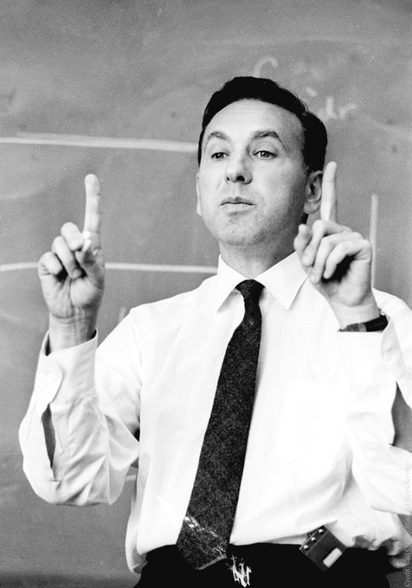
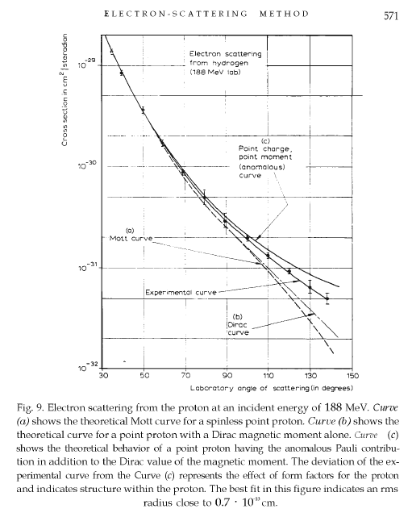




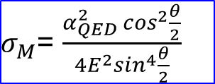
Elastic scattering: the origins
Robert Hofstadter
$σ_{M}$= $\frac{α_{QED}^{2}\cos^{2}{\frac{θ}{2}}}{4E^{2}\sin^{4}\frac{θ}{2}}$
Mott cross section: scattering off a point-like object
Rosenbluth’s formulas for elastic cross section:
F₁, F₂: Dirac and Pauli FFs
G_{E}, G_{M}: electric and magnetic FF (Sachs FFs)
κ nucleon anomalous magnetic moment

Slide 7
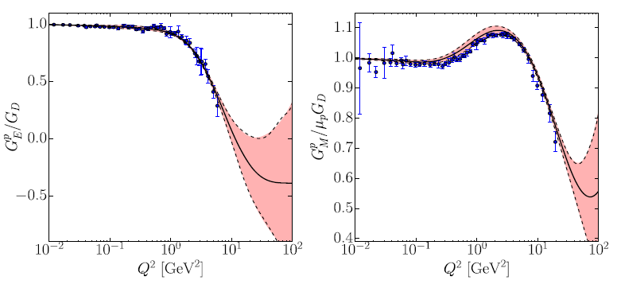
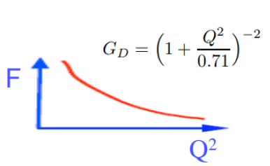
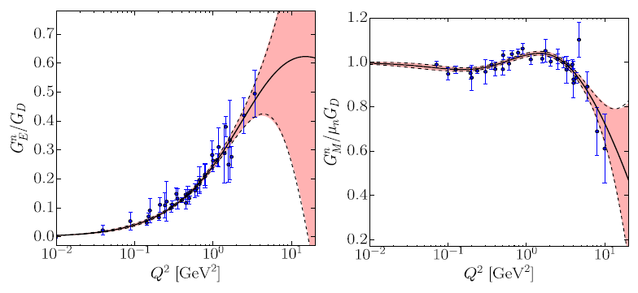
Elastic scattering: today
Point charge: F(Q²)=constant
photon always sees all of the proton’s charge
Elastic ep scattering:
“dipole” form factor, photon sees less charge as Q² increases
Proton
Measurements done in: LAL Orsay, Cambridge, Bonn, SLAC, Desy, Mainz, CEA-Saclay, NiKHEF, MIT-Bates, MAMI@Mainz, CEBAF@JLab
Neutron

Slide 8

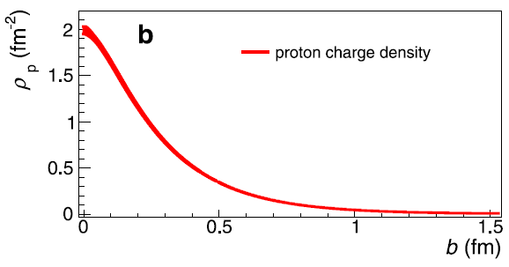
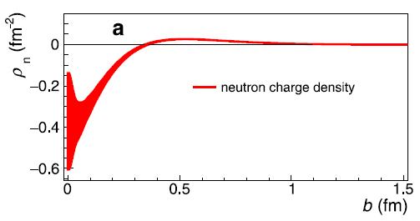
Nucleon charge densities from elastic scattering
C. Carlson, M. Vanderhaeghen PRL 100, 032004 (2008)
H. Atac, et al., Nature Communication 12, 1759 (2022)
Proton
Neutron
Negative inner core
Positive outer surface

Slide 9
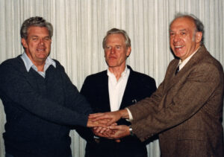
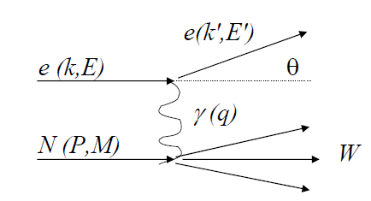
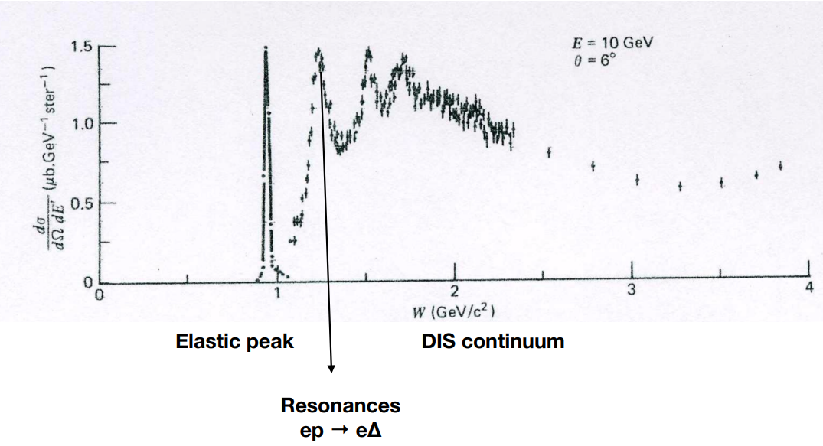


Deep Inelastic Scattering: the origins
Taylor, Kendall, Friedman
$$q^{2}=−4EE′\sin^{2}\frac{θ}{2}$$
$$υ=\frac{p∙q}{M}=E−E^{′}$$
$$W={\left(P+q\right)}^{2}=P^{2}+2P∙q+q^{2}=M^{2}+2Mυ−Q^{2}$$

Slide 10
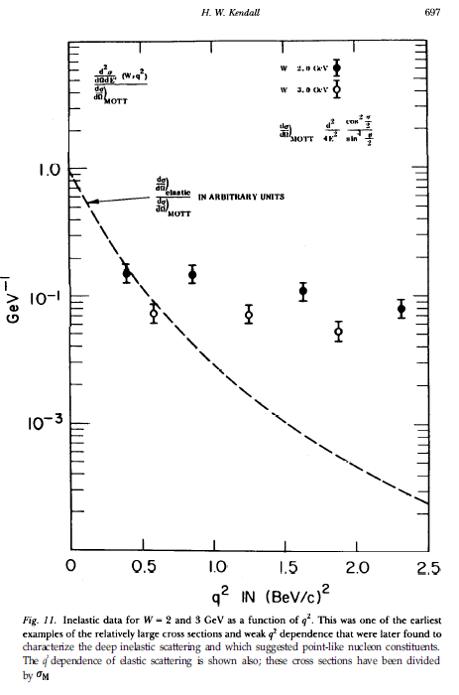
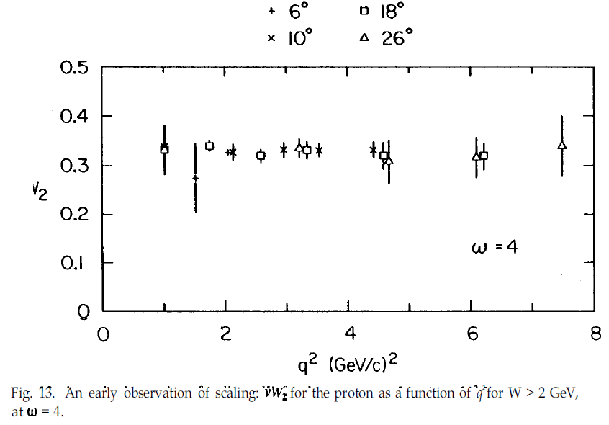
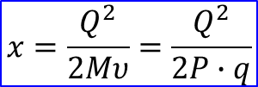

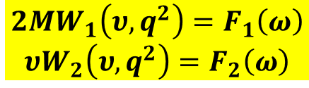
Deep Inelastic Scattering: the origins
Taylor, Kendall, Friedman
$$q^{2}=−4EE′\sin^{2}\frac{θ}{2}$$
$$υ=\frac{p∙q}{M}=E−E^{′}$$
$$W={\left(P+q\right)}^{2}=P^{2}+2P∙q+q^{2}=M^{2}+2Mυ−Q^{2}$$
$\frac{d^{2}σ}{dΩdE^{′}}\left(E,E^{′},θ\right)$= $σ_{M}\left(W_{2}\left(υ,q^{2}\right)+2W_{1}\left(υ,q^{2}\right)\tan^{2}\frac{θ}{2}\right)$
Bjorken scaling
$$2MW_{1}\left(υ,q^{2}\right)=F_{1}\left(ω\right)$$
$$υW_{2}\left(υ,q^{2}\right)=F_{2}\left(ω\right)$$
σ/σ_{M} has no q² dependence:
scattering against a point-like particle
νW₂
$$ω=\frac{1}{x}=\frac{2Mυ}{Q^{2}}$$
$$x=\frac{Q^{2}}{2Mυ}=\frac{Q^{2}}{2P∙q}$$

Slide 11
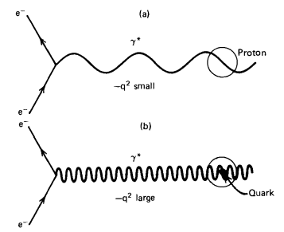
Deep Inelastic Scattering: the origins
Taylor, Kendall, Friedman
$$q^{2}=−4EE′\sin^{2}\frac{θ}{2}$$
$$υ=\frac{p∙q}{M}=E−E^{′}$$
$$W={\left(P+q\right)}^{2}=P^{2}+2P∙q+q^{2}=M^{2}+2Mυ−Q^{2}$$
$\frac{d^{2}σ}{dΩdE^{′}}\left(E,E^{′},θ\right)$= $σ_{M}\left(W_{2}\left(υ,q^{2}\right)+2W_{1}\left(υ,q^{2}\right)\tan^{2}\frac{θ}{2}\right)$
Elastic scattering
Bjorken scaling
$$2MW_{1}\left(υ,q^{2}\right)=F_{1}\left(ω\right)$$
$$υW_{2}\left(υ,q^{2}\right)=F_{2}\left(ω\right)$$
σ/σ_{M} has no q² dependence:
scattering against a point-like particle
Deep Inelastic scattering
$$ω=\frac{1}{x}=\frac{2Mυ}{Q^{2}}$$
$$x=\frac{Q^{2}}{2Mυ}=\frac{Q^{2}}{2P∙q}$$

Slide 12
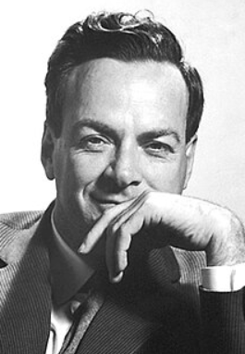
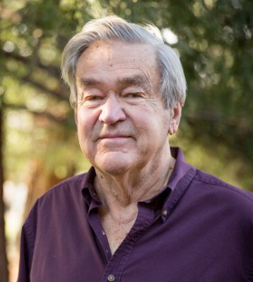
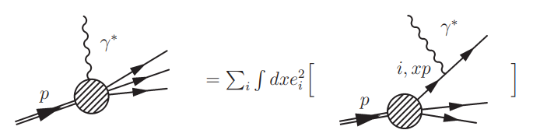
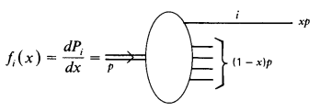




The parton model
Parton model (Feynman, 1969)
Proton composed of point-like partons, from which the electrons scattered incoherently
In an infinite momentum frame of reference, time dilation slows down the motion of constituents
Partons are assumed not to interact with one another while the virtual photon is exchanged (impulse approximation)
In this theory, electrons scatter off “free” constituents and the scattering reflects the properties and motion of the constituents
The assumption of near-vanishing parton-parton interaction during electron scattering at high Q² was later shown to be a property of QCD known as asymptotic freedom
Richard Feynman
James Bjorken
Richard Feynman
In the infinite momentum frame, parton momentum: xP
Energy-momentum conservation in the virtual photon-quark elastic scattering process:
negligible
$${\left(xP+q\right)}^{2}=x^{2}M^{2}+2xP∙q+Q^{2}$$
$$=m_{q}≈0$$
→ In the infinite momentum frame, the fraction of the proton’s momentum carried by the struck quark is equal to the Bjorken scaling variable x_{B}
f_{i}(x): probability that the struck parton i carries a fraction x of the proton’s momentum
$$→x=\frac{Q^{2}}{2P∙q}=x_{Bjorken}$$
Callan-Gross relation:
Verified experimentally, it reflects the fact that partons inside the proton are spin-1/2 particles
$$2xF_{1}\left(x\right)=F_{2}(x)$$
$2xF_{1}\left(x\right)=F_{2}(x)=\sum_{i}{e_{i}^{2}xf_{i}(x)}$

Slide 13
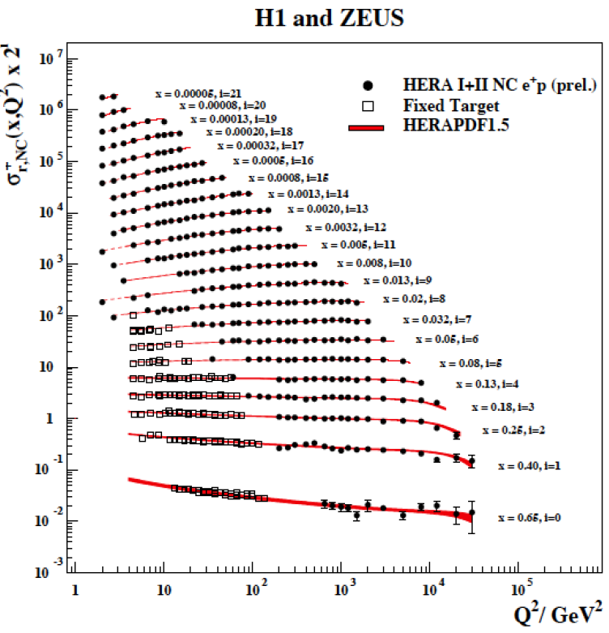

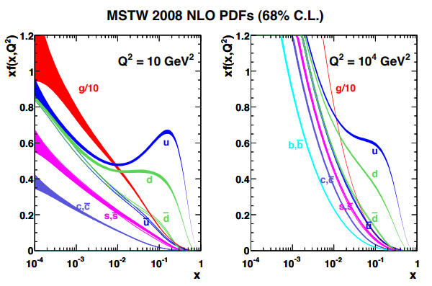
Deep Inelastic Scattering: today
Proton SF F₂
Momentum distributions of the valence u and d quarks, quark-antiquark sea and gluons
Notes:
QCD in its asymptotic regime has been a great success so far. The structure function F2 was measured via DIS at HERA at 0.3 TeV, it was then used to extract the longitudinal momentum distributions of quarks and gluons in the nucleon. Using these pdfs in perturbative QCD calculations, the cross sections of pp and proton-antiproton are well described all the way up to 7 TeV.
However, in the non-perturbative region QCD cannot be solved. One has to resort to either models or lattice calculations.

Slide 14
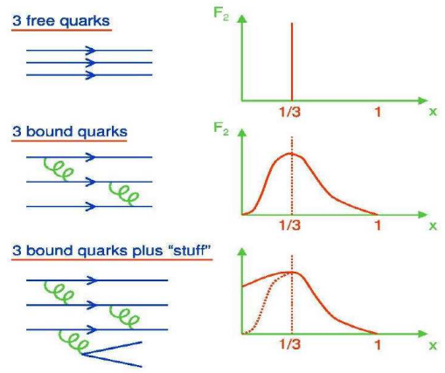
Deep Inelastic Scattering: today
Momentum distributions of the valence u and d quarks, quark-antiquark sea and gluons
Valence quarks: x>0.1; sea quarks and gluons: x<0.1
Notes:
QCD in its asymptotic regime has been a great success so far. The structure function F2 was measured via DIS at HERA at 0.3 TeV, it was then used to extract the longitudinal momentum distributions of quarks and gluons in the nucleon. Using these pdfs in perturbative QCD calculations, the cross sections of pp and proton-antiproton are well described all the way up to 7 TeV.
However, in the non-perturbative region QCD cannot be solved. One has to resort to either models or lattice calculations.

Slide 15
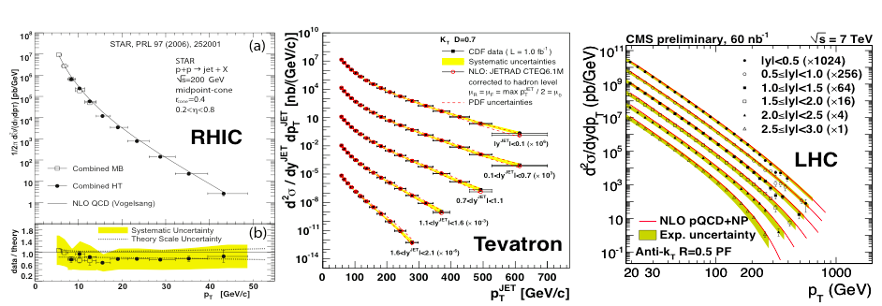
DIS: Successes…
Measurements of F₂ in e-p at 0.3 TeV (HERA)
→ extraction quark and gluon PDFs
→ pQCD fits for p-p and p-p at 0.2, 1.96, and 7 TeV
Notes:
QCD in its asymptotic regime has been a great success so far. The structure function F2 was measured via DIS at HERA at 0.3 TeV, it was then used to extract the longitudinal momentum distributions of quarks and gluons in the nucleon. Using these pdfs in perturbative QCD calculations, the cross sections of pp and proton-antiproton are well described all the way up to 7 TeV.
However, in the non-perturbative region QCD cannot be solved. One has to resort to either models or lattice calculations.

Slide 16
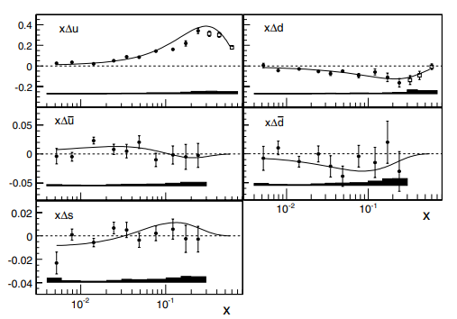
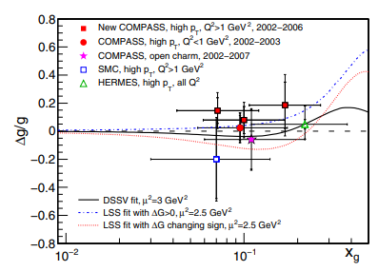
…and open questions
Nucleon spin: ½ = ½ ΔΣ + L + ΔG + L_{g}
Intrinsic spin of the quarks ΔΣ ≈ 30%
Intrinsic spin on the gluons ΔG ≈ 20%
Orbital angular momentum of the quarks L?
Notes:
QCD in its asymptotic regime has been a great success so far. The structure function F2 was measured via DIS at HERA at 0.3 TeV, it was then used to extract the longitudinal momentum distributions of quarks and gluons in the nucleon. Using these pdfs in perturbative QCD calculations, the cross sections of pp and proton-antiproton are well described all the way up to 7 TeV.
However, in the non-perturbative region QCD cannot be solved. One has to resort to either models or lattice calculations.

Slide 17
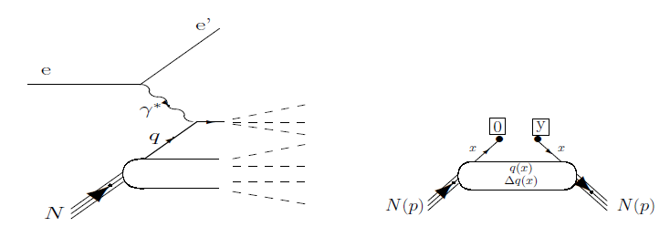
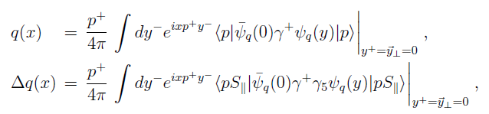


Deep Inelastic Scattering: the QCD perspective
QCD factorization: at high virtuality Q² of the exchanged photon, the photon interacts with a single quark of the nucleon.
The complex, non-perturbative quark-gluon structure of the nucleon is encoded in the structure functions (PDFs).
Illustration of the associated non-local diagonal matrix element accessed in DIS
The PDFs are QCD operators depending on spacetime coordinates. They are obtained as one-dimensional Fourier transforms in the lightlike coordinate y⁻ (at zero values of the other coordinates) as:
Ψ_{q} : quark field of flavor q; p: initial and final nucleon momentum (it is the same for DIS by virtue of the optical theorem)
x: momentum fraction of the struck quark; S║ is the longitudinal nucleon spin projection
$$a^{±}=\left(a^{0}±a^{3}\right)/\sqrt{2}$$
Light-front frame: the initial and final nucleons are collinear along the z-axis and the light-front components are:
$$a_{⊥ }=\left(a^{1}, a^{2}\right)=a^{i}$$
Non-local: the space-time coordinates of the initial and final quark are different
Diagonal: the momenta of the initial and final nucleon are the same

Slide 18
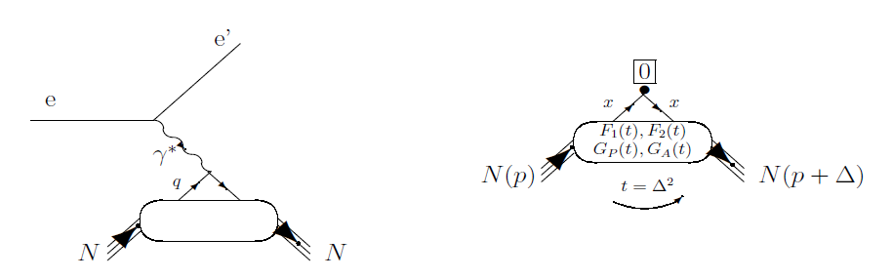
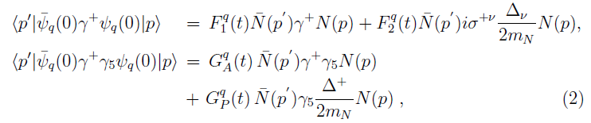
Elastic scattering: the QCD perspective
Elastic scattering: the struck quark remains in the nucleon. The nucleon has changed its momentum in the process but it remains a nucleon
Illustration of the associated local non-diagonal matrix element accessed in elastic lepton-nucleon scattering.
The long-distance “soft” physics is factorized in the Form Factors (FF) F₁^{q}(t), F₂^{q}(t), G_{A}^{q}(t) and G_{P}^{q}(t), where t = (p_{N} − p′_{N})² = −Q².
In the light-front frame, the squared momentum transfer t is the conjugate variable of the impact parameter (= transverse position)
→ the FFs reflect, via a Fourier transform, the spatial distributions of quarks in the plane transverse to the nucleon direction.
The FFs are related to the following vector and axial-vector QCD local operators in space-time coordinates:
Local: the space-time coordinates of the initial and final quark are the same
Non-diagonal: the momenta of the initial and final nucleon are different
G_{A}, G_{P}: weak interaction; accessed in neutrino scattering

Slide 19
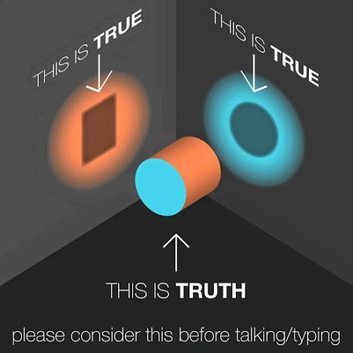
Electron-proton scattering: beyond the one-dimensional picture

Slide 20
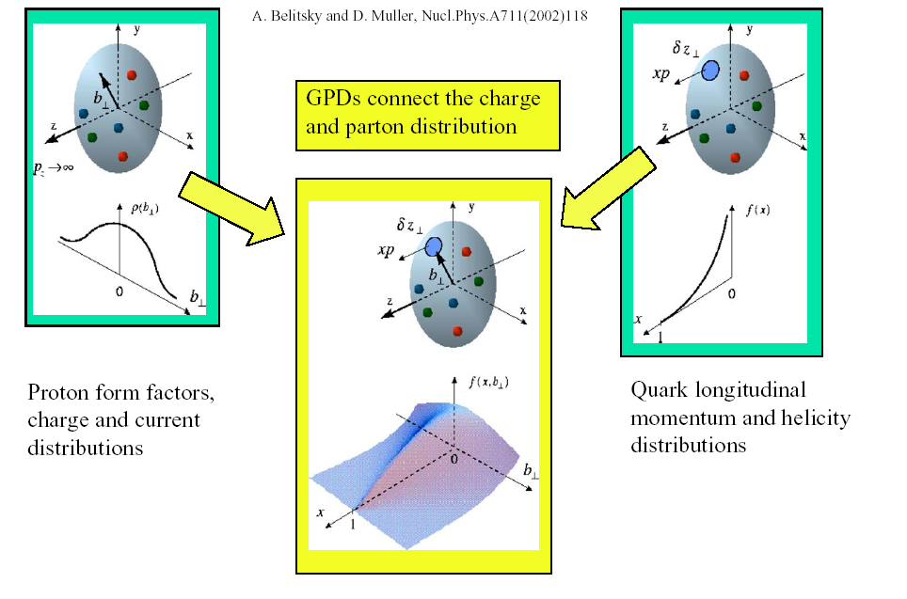
Electron-proton scattering: beyond the one-dimensional picture
?
Form factors:
transverse quark
distribution in
coordinate space
Parton distributions:
longitudinal
quark distribution
in momentum space
Elastic scattering
DIS
x
Notes:
So today we know the spatial transverse distributions of the quarks, via the form factors, and their longitudinal momentum and spin distributions, via the PDFs. But what happens between these two visions? Can we correlate these two scenarios and give a unified vision of the dynamics of partons in the nucleon?

Slide 21
Electron-proton scattering: beyond the one-dimensional picture
~
~
GPDs: H, E, H, E
Fully correlated quark distributions in both coordinate and momentum space
Form factors:
transverse quark
distribution in
coordinate space
Parton distributions:
longitudinal
quark distribution
in momentum space
Elastic scattering
DIS
Accessible in
hard exclusive processes
x
∫ H(x,ξ,t)dx = F₁(t) (∀ ξ)
At high Q²
H(x,0,0) = q(x), H(x,0,0) = Δq(x)
∫ E(x,ξ,t)dx = F₂(t) (∀ ξ)
~
The final state is fully known
Notes:
Generalized Parton Distribution allow us to make this link, because they descrive the correlations between the transverse position and the longitidunal momentum of the quarks in the nucleon.
Such distributions are accessible in hard (high enough Q2 to « see » the quarks) exclusive reactions (where we fully know the final state)

Slide 22
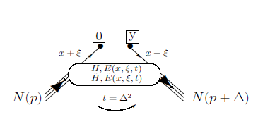
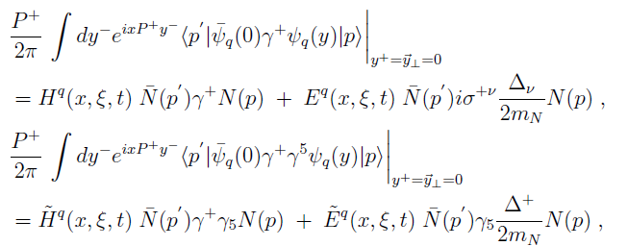
Generalized Parton Distributions (GPDs)
e’(k’)
γ (or meson)
Q²= - (k-k’)²
x_{B} = Q²/2Mν ν=E_{e}-E_{e’}
x+ξ, x-ξ longitudinal momentum fractions
t = Δ² = (p-p’)²
ξ = −Δ⁺/2P⁺ ≅ x_{B}/(2-x_{B})
t
e(k)
γ*
(Q²)
factorization
x+ξ
x-ξ
~
~
« Handbag » factorization, valid in the Bjorken regime (high Q² and ν, fixed x_{B}), t<<Q²
H, E, H, E (x,ξ,t)
N(p)
N(p’)
GPDs: Fourier transforms of non-local, non-diagonal QCD operators
Notes:
The channel more directly interpretable in the terms of GPDs is DVCS, which is the electroproduction of a real photon on a quark of the nucleon. You see it here represented by the « handbag » diagram. It shows the virtual photon that interacts with one of the quarks of the nucleon, which propagates and then radiates a real photon, before « going back » in the nucleon. The handbag implies the factorization of this reaction in two parts: the top one, describing the virtual-photon/quark interaction, which is calculable in perturbative QCD; and the bottom one, which describes the partonic structure of the nucleon, and is encoded in the generalized parton distributions. The handbag factorization holds in the so-called Bjorken regime, which requires to be at high Q2 with respect to the momentum transfered to the proton (t).
At leading order and twist in QCD, considering only quark-helicity conserving quantities and the quark sector, there are 4 GPDs, H, Htidle, E, Etilde, and they depend on three variables: x, the momentum fraction carried by the struck quark, csi, the difference of the quark momentum between initial and final state (which is linked to the Bjorken variable xB) and t, the momentum transfered to the proton. There are 4 GPDs to describe different combinations of nucleon spin with respect to the quark’s helicity.

Slide 23
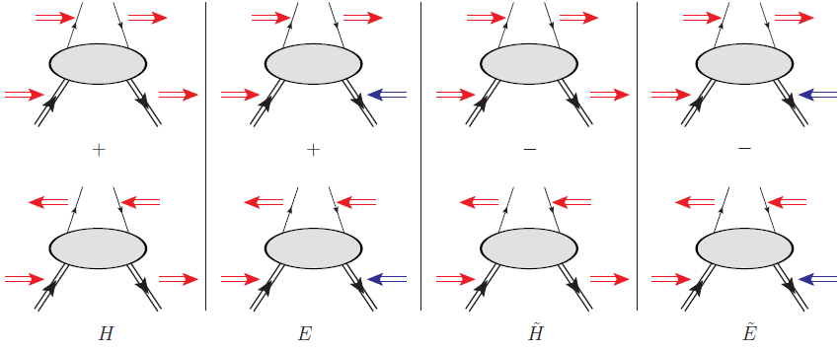
Generalized Parton Distributions (GPDs)
e’(k’)
γ (or meson)
Q²= - (k-k’)²
x_{B} = Q²/2Mν ν=E_{e}-E_{e’}
x+ξ, x-ξ longitudinal momentum fractions
t = Δ² = (p-p’)²
ξ = −Δ⁺/2P⁺ ≅ x_{B}/(2-x_{B})
t
e(k)
γ*
(Q²)
factorization
x+ξ
x-ξ
4 GPDs for each quark flavor
(leading order, leading twist, quark-helicity conservation)
~
~
H, E, H, E (x,ξ,t)
conserve nucleon spin
N(p)
N(p’)
flip nucleon spin
Vector
Tensor
Axial-vector
Ps.scalar
Notes:
The channel more directly interpretable in the terms of GPDs is DVCS, which is the electroproduction of a real photon on a quark of the nucleon. You see it here represented by the « handbag » diagram. It shows the virtual photon that interacts with one of the quarks of the nucleon, which propagates and then radiates a real photon, before « going back » in the nucleon. The handbag implies the factorization of this reaction in two parts: the top one, describing the virtual-photon/quark interaction, which is calculable in perturbative QCD; and the bottom one, which describes the partonic structure of the nucleon, and is encoded in the generalized parton distributions. The handbag factorization holds in the so-called Bjorken regime, which requires to be at high Q2 with respect to the momentum transfered to the proton (t).
At leading order and twist in QCD, considering only quark-helicity conserving quantities and the quark sector, there are 4 GPDs, H, Htidle, E, Etilde, and they depend on three variables: x, the momentum fraction carried by the struck quark, csi, the difference of the quark momentum between initial and final state (which is linked to the Bjorken variable xB) and t, the momentum transfered to the proton. There are 4 GPDs to describe different combinations of nucleon spin with respect to the quark’s helicity.

Slide 24
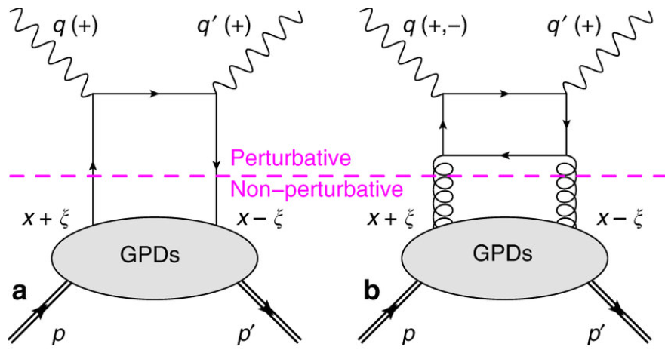
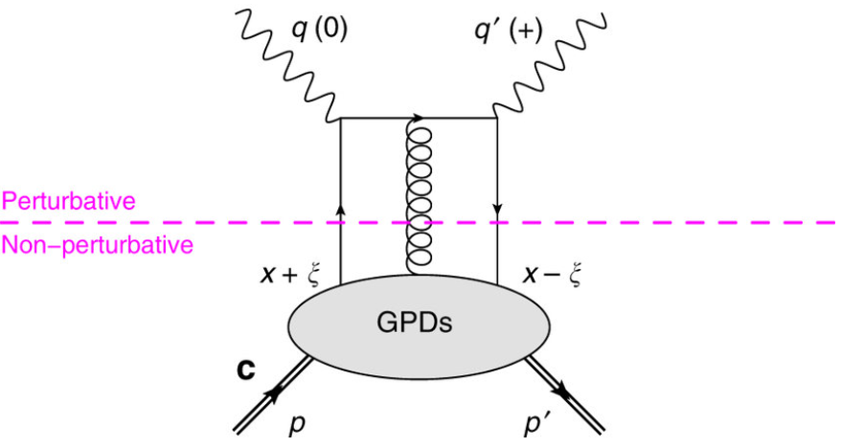
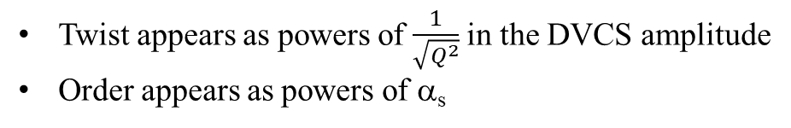
Order, twist: examples for DVCS
Leading order, leading twist
Next-to-leading order, leading twist
Leading order, twist 3
Twist appears as powers of $\frac{1}{\sqrt{Q^{2}}}$ in the DVCS amplitude
Order appears as powers of α_{s}
General definition of twist of an operator: difference between the operator’s dimension d and its spin s: τ = d-s
Leading twist: twist = 2

Slide 25
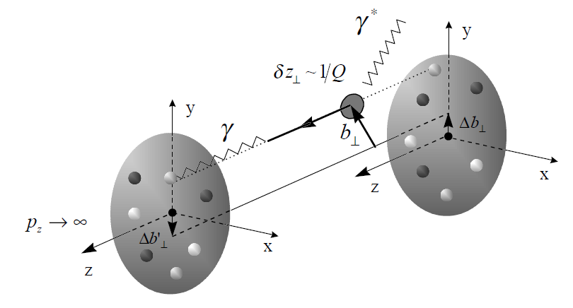
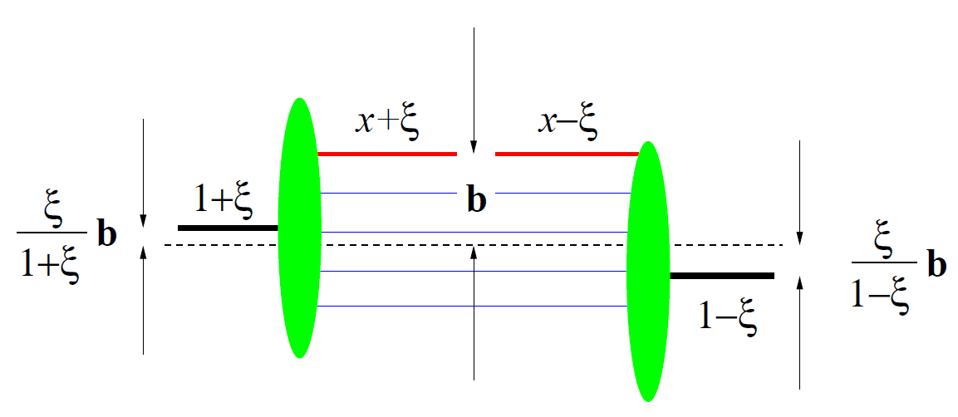
Physical interpretation of GPDs
x: Average momentum of the parton
Impact parameter b:
Fourier-conjugate of GPD variable t
ξ determines the transverse shift of the proton between initial and final state
The ‘blobs’ represent the light-cone wave functions of the incoming or the outgoing proton
→ GPDs correlate wave functions for different parton configurations and thus are quantum-mechanical interference terms
Notes:
The electric field of lepton’s virtual fluctuation ℓ → ℓ ′γ ∗ accelerates a quark localized in the transverse area (δz⊥) 2 ∼ 1/Q2 at the impact parameter b⊥ and carrying a certain momentum fraction of the parent nucleon. The accelerated parton tends to emit the energy via electromagnetic radiation and fall back into the nucleon, see Fig. 4. The incoming-outgoing nucleon system is localized at the center of coordinates b⊥ = 0, however, due to non-zero longitudinal momentum exchange in the t-channel the individual transverse localizations of incoming and outgoing nucleons are shifted in the transverse plane by amounts1 ∆b⊥ ∼ η(1 + η)b⊥ and ∆b ′ ⊥ ∼ η(1 − η)b⊥, respectively

Slide 26
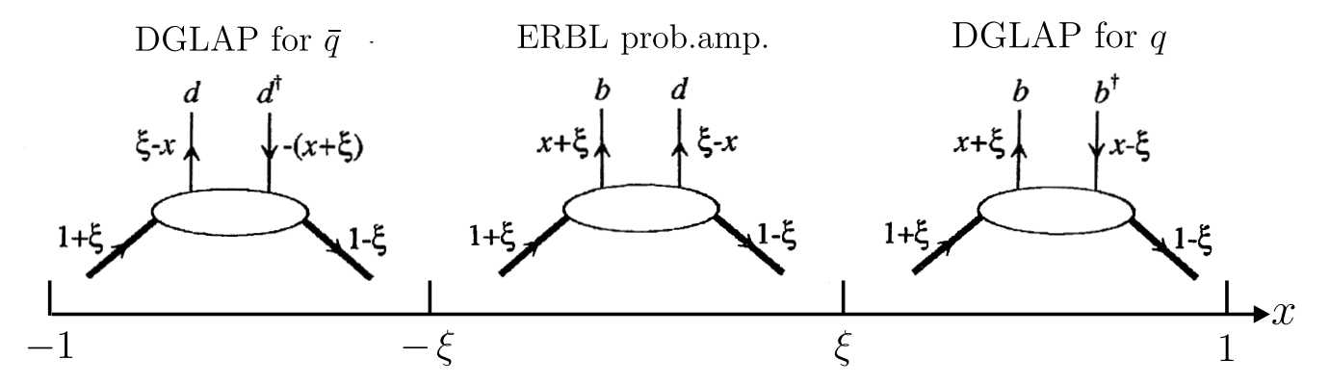
Properties of GPDs
Forward limit: PDFs
(not for E, E)
~
Link with FFs
$\int_{−1}^{1}{dx x^{n}H\left(x,ξ,t\right)=a_{0}+a_{2}ξ^{2}+a_{4}ξ^{4}}$+…+ $a_{n}ξ^{n}$
Polinomiality
DGLAP region: scattering from quarks (x>ξ>0) or anti-quarks (x<ξ<0)
ERBL region (-ξ<x<ξ): scattering results in a qq pair
DGLAP: Dokshitzer, Gribov, Lipatov, Altarelli, Parisi
ERBL: Efremov, Radyushkin, Brodsky, Lepage
Notes:
The GPDs are not completely unknown, there are some relations linking integrals of GPDs and their limits to the E-M FF and to the PDF measured in DIS.
Among the information that GPDs can bring, a very important one is that they can allow us to compute the quark angular momentum, which is given by, according to Ji’s sum rule, the second moment in x of the sum of the GPDs H and E calculated at t=0. The GPDs can also provide us a tomography of the nucleon, as I will show you in the following.

Slide 27
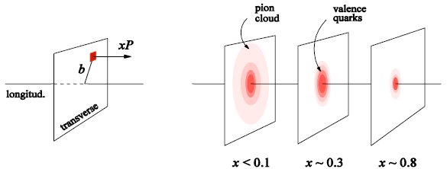
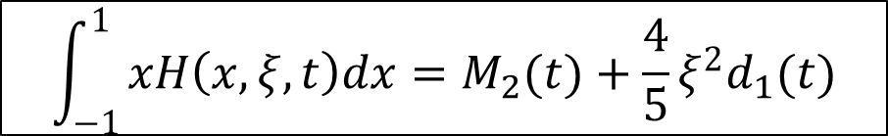
What we can learn from GPDs
Nucleon tomography
M. Burkardt, PRD 62, 71503 (2000)
Probability to find a quark of a given momentum fraction at a given position in the transverse plane
Quark angular momentum (Ji’s sum rule)
Nucleon spin: ½ = ½ ΔΣ + ΔL + J_{G}
J
X. Ji, Phy.Rev.Lett.78 (1997)
$$\int_{−1}^{1}{xH\left(x,ξ,t\right)dx=M_{2}(t)+{\frac{4}{5}ξ}^{2}d_{1}(t)}$$
Gravitational form factor → shear forces and pressure
Notes:
The GPDs are not completely unknown, there are some relations linking integrals of GPDs and their limits to the E-M FF and to the PDF measured in DIS.
Among the information that GPDs can bring, a very important one is that they can allow us to compute the quark angular momentum, which is given by, according to Ji’s sum rule, the second moment in x of the sum of the GPDs H and E calculated at t=0. The GPDs can also provide us a tomography of the nucleon, as I will show you in the following.

Slide 28
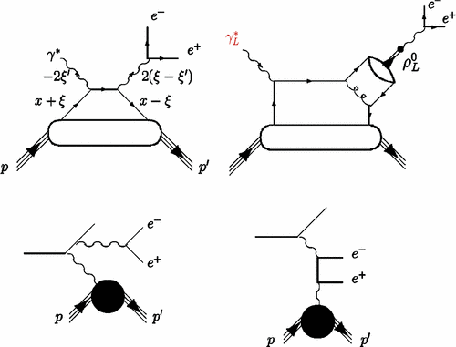
Exclusive reactions giving access to GPDs
(γ)
DVCS
Quark GPDs
x dependence
Quark GPDs
Gluon GPDs
(TCS), DDVCS
M
Universality of GPDs
DVMP
Quark GPDs,
Transversity GPDs
Gluon GPDs
Notes:
Depending on the reaction and on the kinematics one can sample different kinds of GPDs

Slide 29
Summary and sources
Electron scattering on nucleons is one of the main tools to study nucleon structure
Form factors, measured in elastic scattering, give us information on the transverse charge distribution of the partons
Structure functions, measured in deep inelastic scattering, give us information on the longitudinal momentum distribution of the partons
Generalized parton distributions correlate information on transverse position and longitudinal momentum of the partons
The can give access to: OAM of the quarks, tomography, distribution of forces
They can be measured in exclusive reactions, where the full final state in knows, at high virtuality of the exchanged photon
« Quarks and leptons: an introductory course on modern particle physics », F. Halzen, A. D. Martin
Nobel Lecture, R. Hofstadter
Nobel Lecture, H. Kendall
Articles by: A. Radyuskin, X.D. Ji, D. Mueller, M. Diehl, M. Burkardt, M. Guidal and M. Vanderhaeghen, J. Arrington, H. Atac, C. Mezrag, C. Lorcé, …
HUGS lectures of my predecessors and colleagues: C. M. Camacho, D. Sokhan

Slide 30
Back-up slides

Slide 31
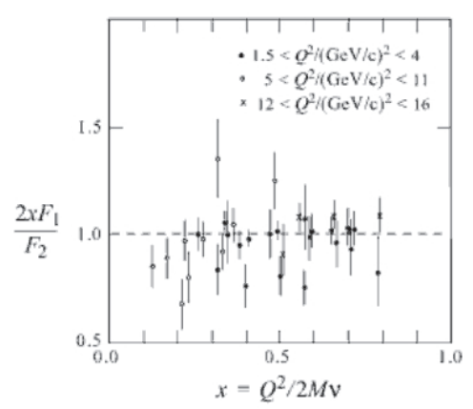
Quarks’ spin discovery
The Callan-Gross relation
Bjorken scaling established that DIS must be described in terms of parton-photon processes.
But what are the properties of these point-like constituents?
In 1969 Callan and Gross suggested that the two Bjorken’s scaling functions are related: 2xF₁(x) = F₂(x).
This reflects the assumption that the partons inside the proton are spin-1/2 particles (spin-0 would lead to 2xF₁(x)/F₂(x) = 0)
(It can be derived by comparing the e−p and e−µ differential cross sections)
spin ½
spin 0

Slide 32
