Slide 1
Quantum Computing: status and motivation
David J. Dean
Deputy Director
Presented To:
Quantum Computing Bootcamp
June 20, 2023

Slide 2
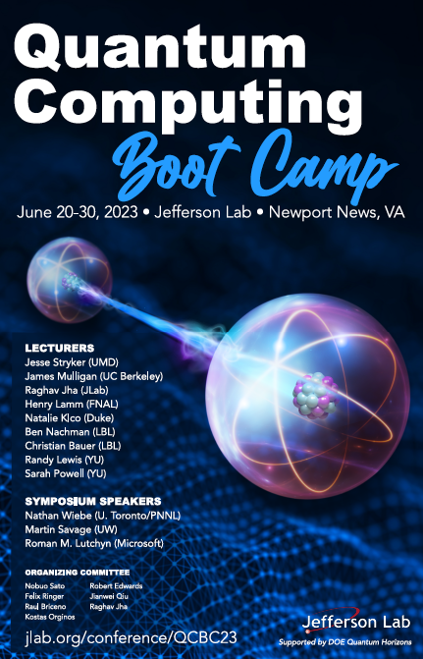
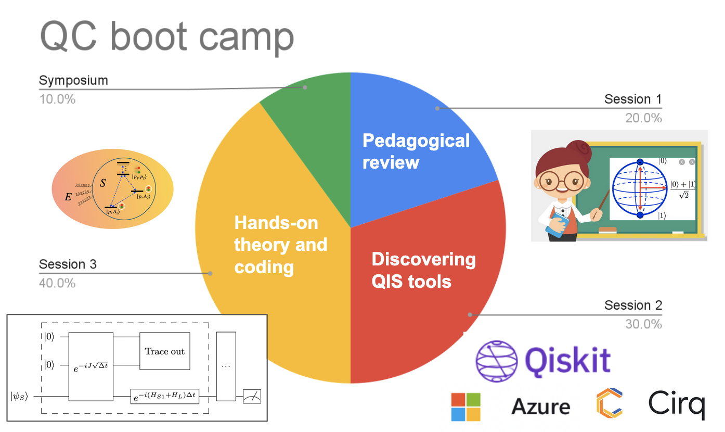
Welcome to JLab and the Quantum Computing Boot Camp

Slide 3
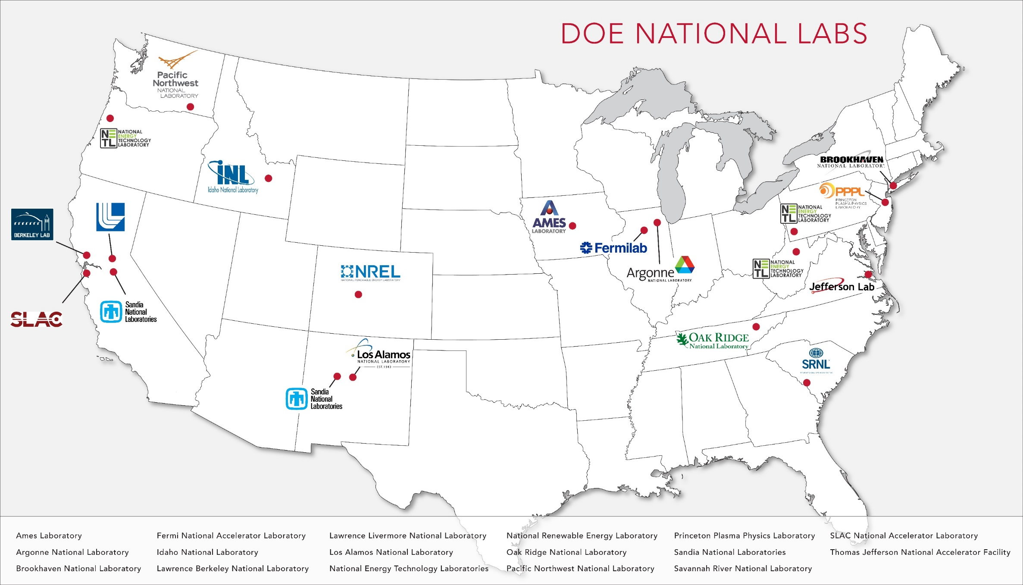
U.S. Department of Energy National Labs

Slide 4
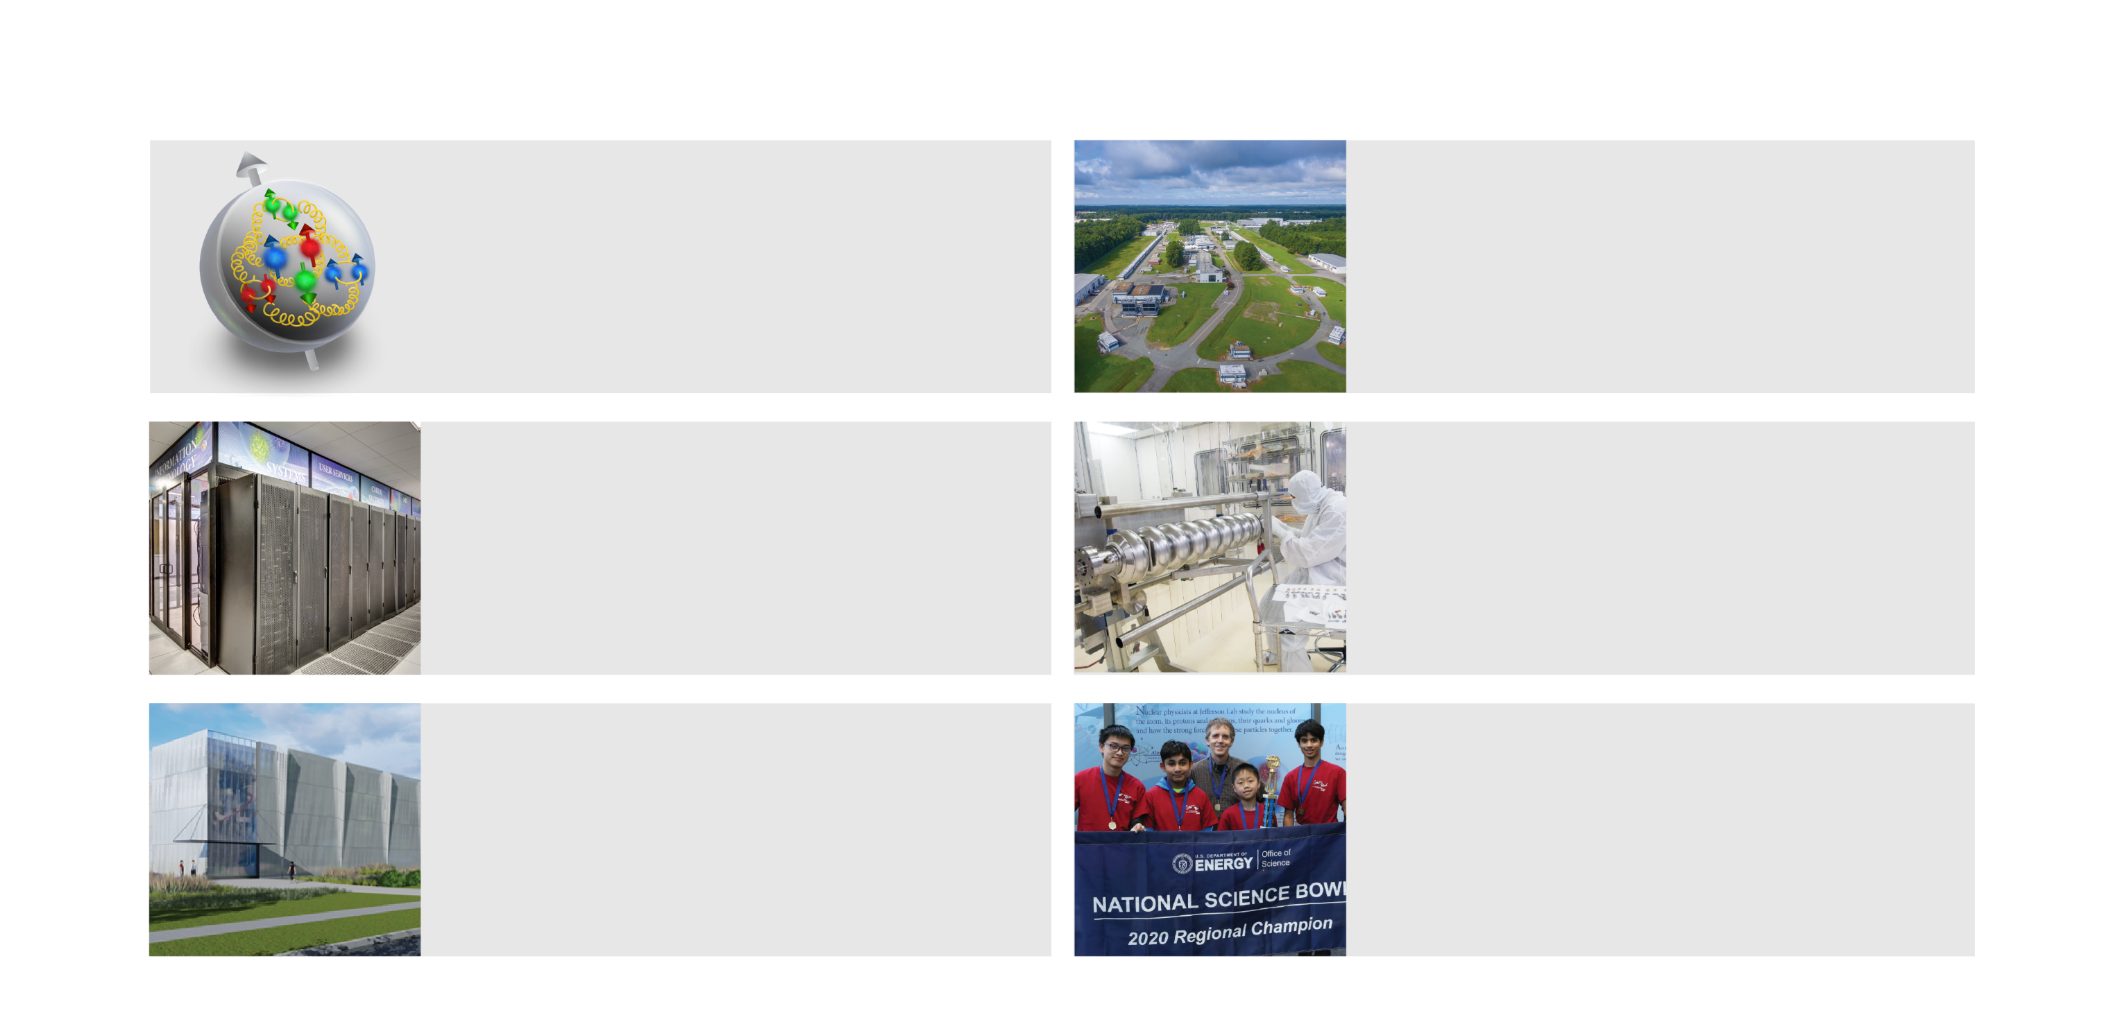
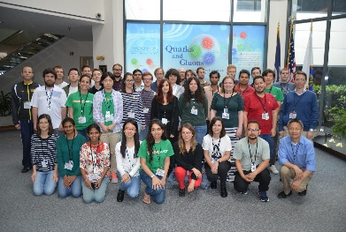
Jefferson Lab Is…
A single-program DOE-SC Lab with a mission of scientific discovery in the fundamental science of protons, neutrons and atomic nuclei
Home to CEBAF, the preeminent
high-energy electron-microscope for nuclear physics, hosts the largest nuclear physics user community in the world, numbering nearly 1,900
Nation’s preeminent capability for concept to delivery of advanced particle accelerator and cryogenic systems
A leader in the field of the study of the nuclear force via high performance computing
A Lab with ambition to evolve from single-purpose to multi-program, via strategy centered on developing the High Performance Data Facility
A vital S&T workforce development asset regionally and nationally, and an important community partner
Hampton University
Graduate Studies Program
Notes:
Approx. 1/3 of domestic Ph.D.s in nuclear physics based on Jefferson Lab research
More CMs produced than any other lab in the world
Regional hub for innovation, attracting Tech Center investment amounting to $XXM

Slide 5

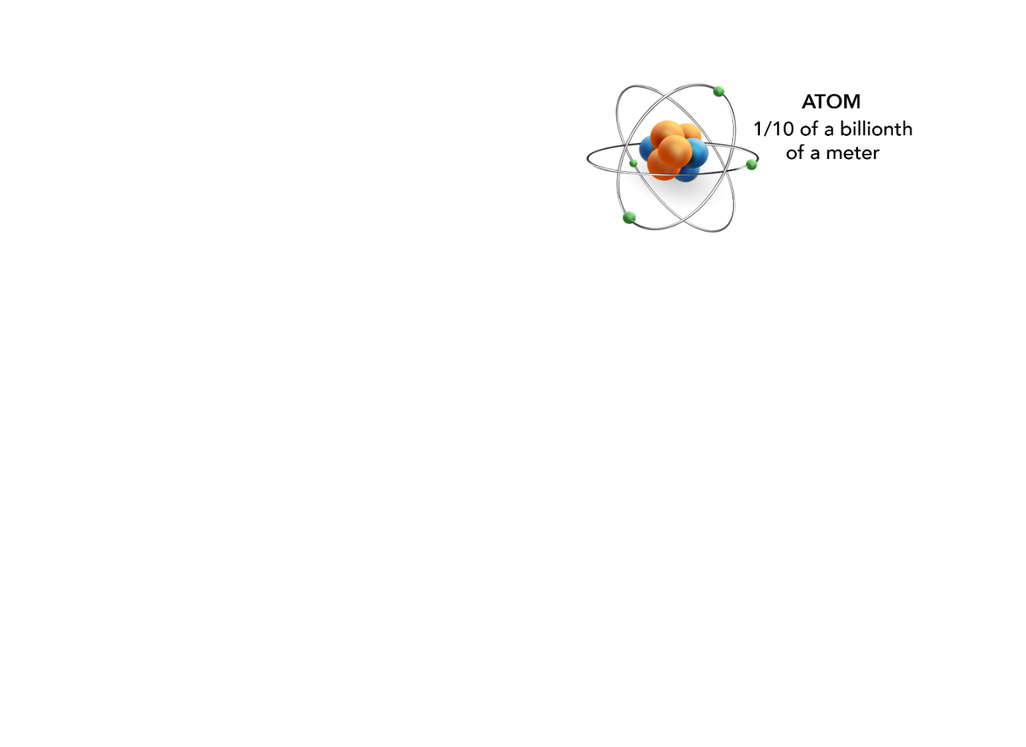
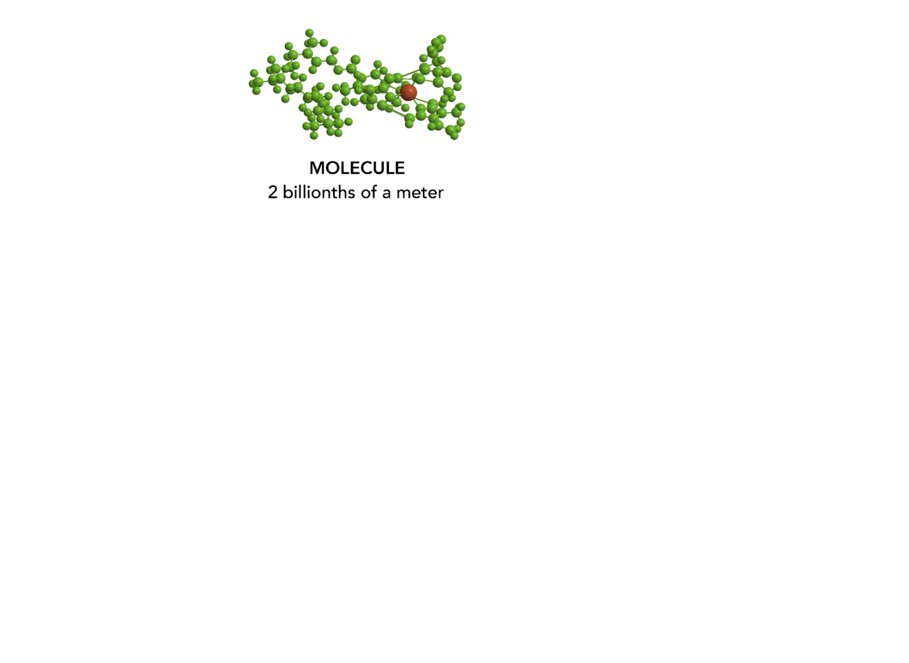

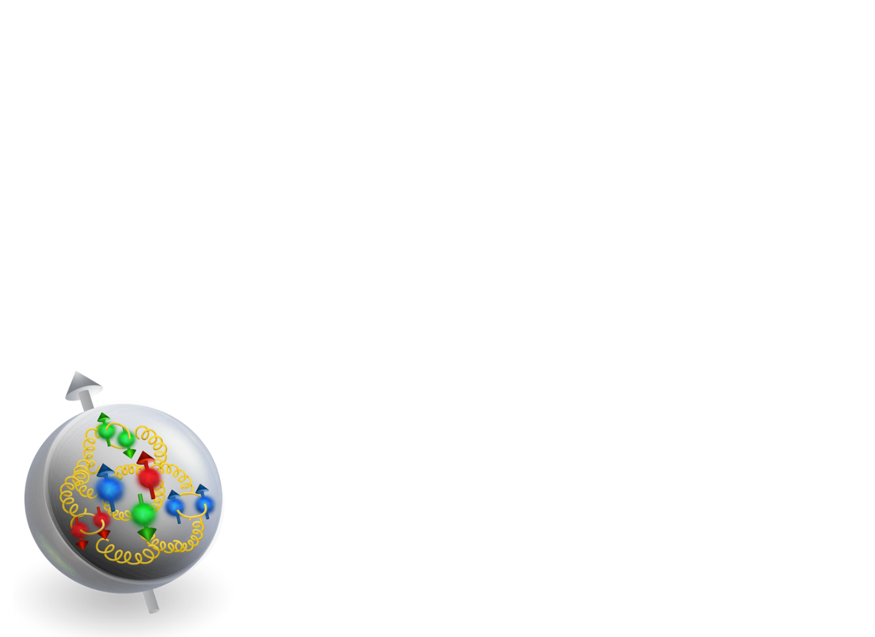
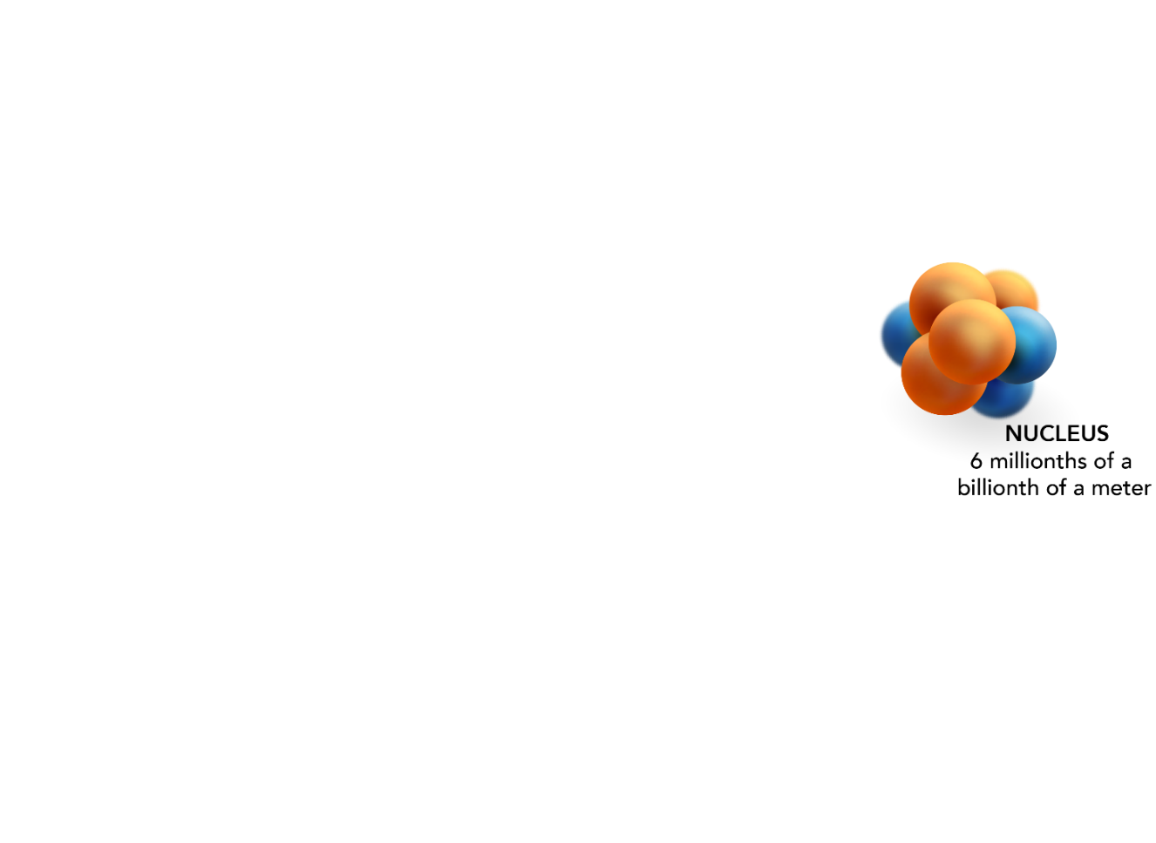
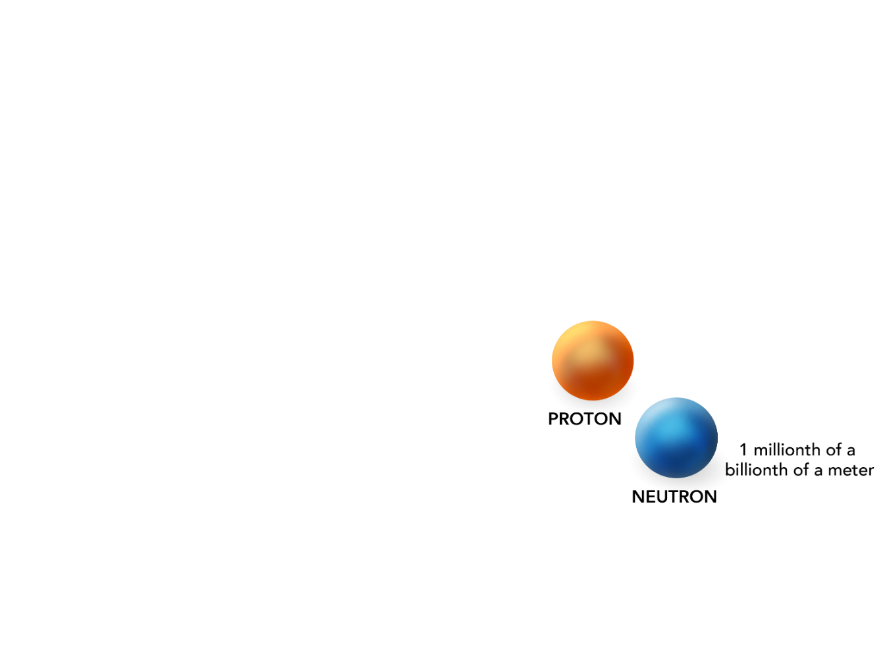
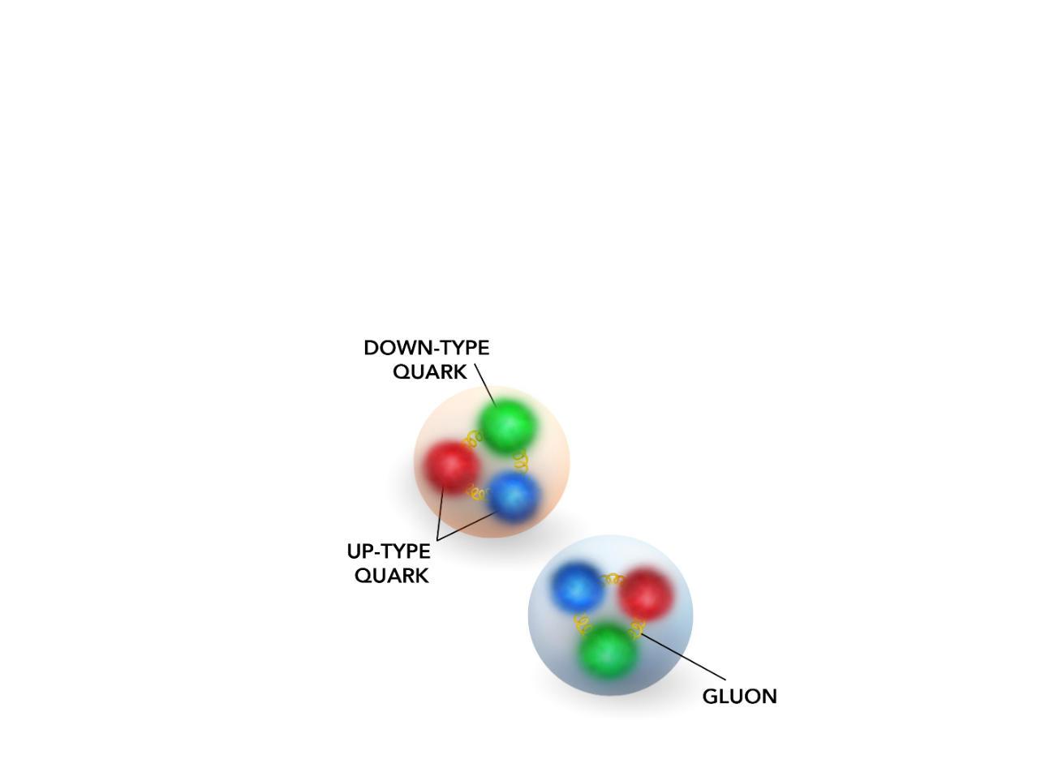
We Explore Matter at the Most Fundamental Level
We seek answers to fundamental questions:
Why is no quark ever found alone?
What does the interior of a proton “look” like?
Why is the proton mass so much greater than its “parts”?
How does the force that holds protons and neutrons together arise from the force between quarks?

Slide 6
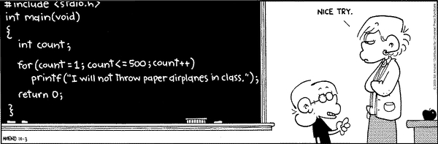
Why do we compute?
Saves time
Solves equations
Analyzes data
Generates science
Performs logistics
Runs Excel
Plays movies
Talks to you (Chat-GPT)

Slide 7
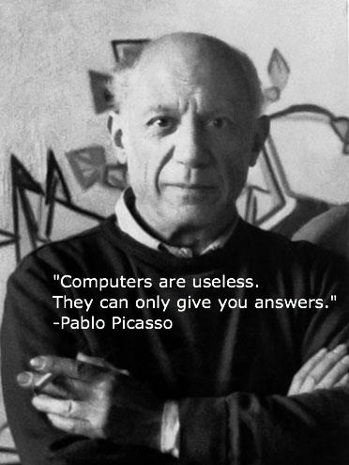
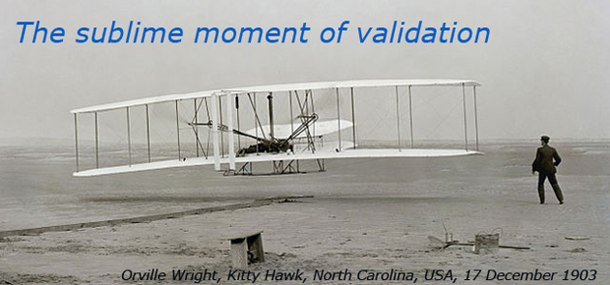
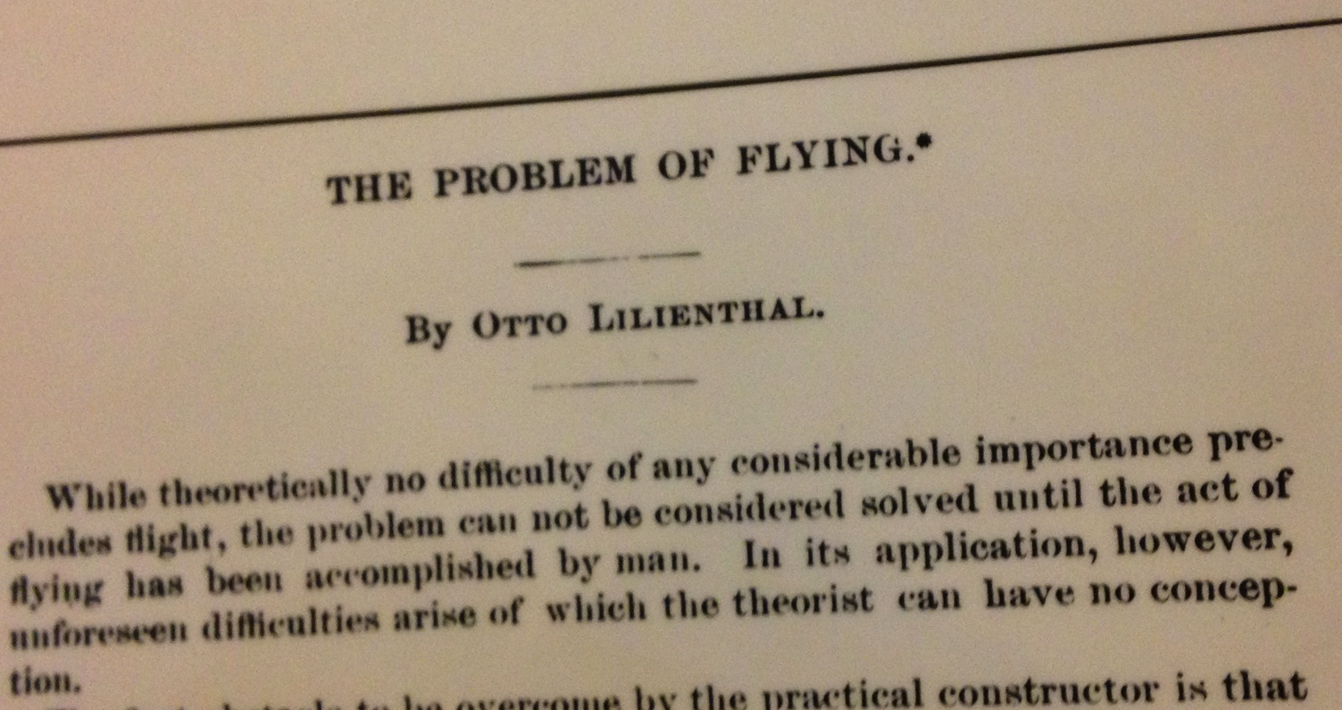
Questions drive science…and lead to discovery tools

Slide 8
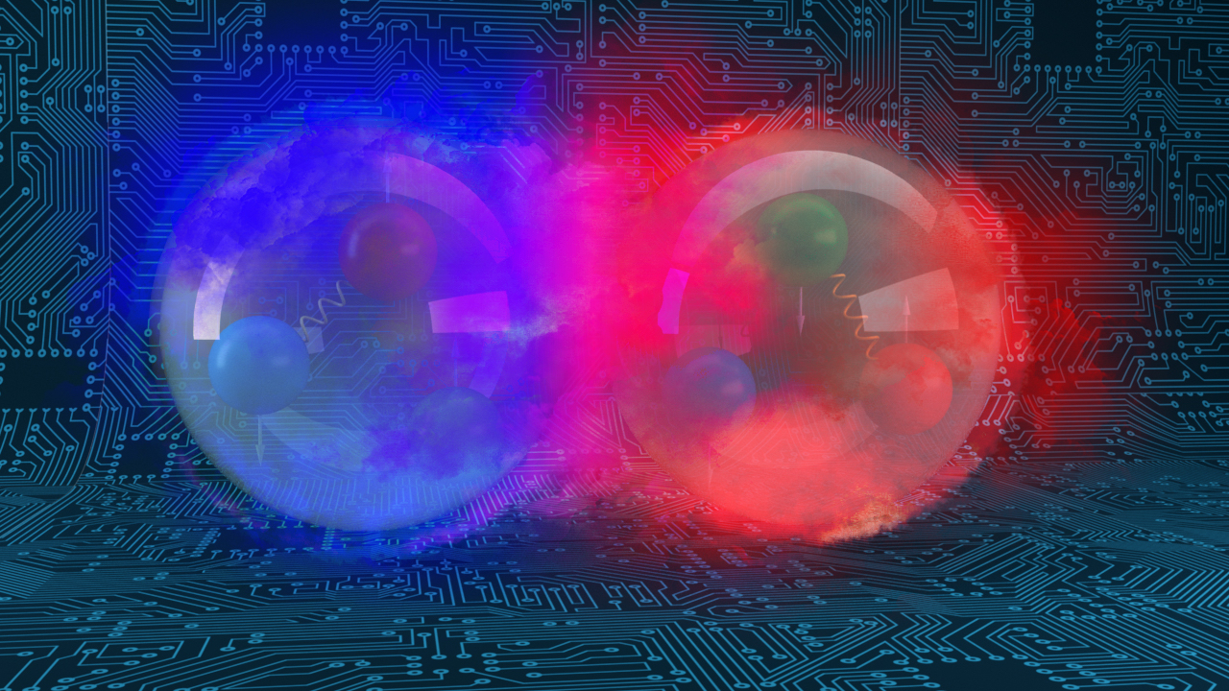
Outline
Computing: reaching maturity, and…

Slide 9
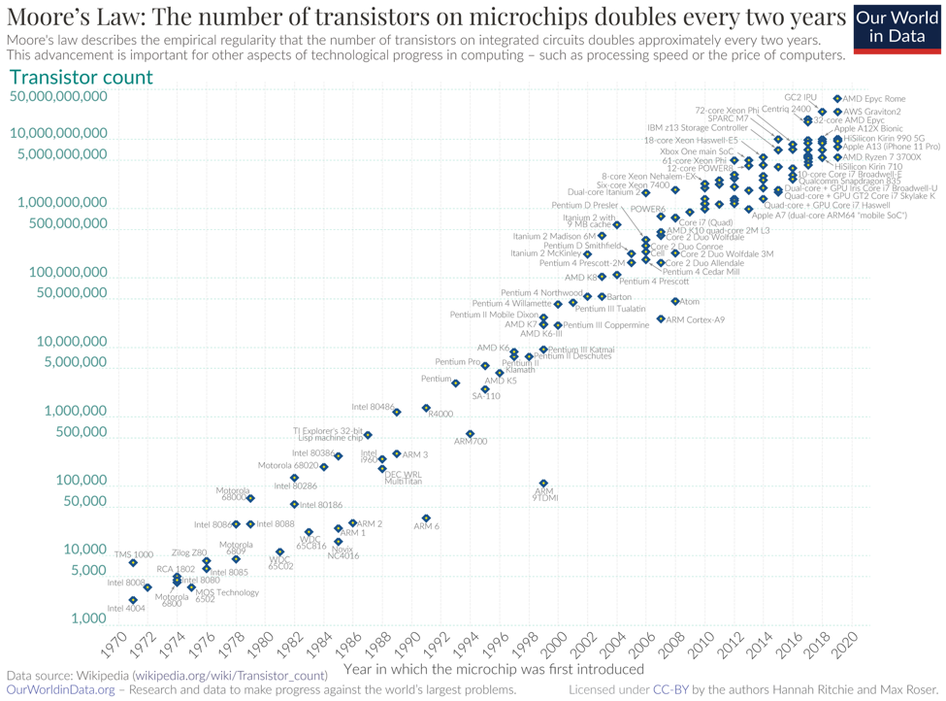
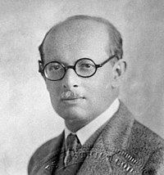
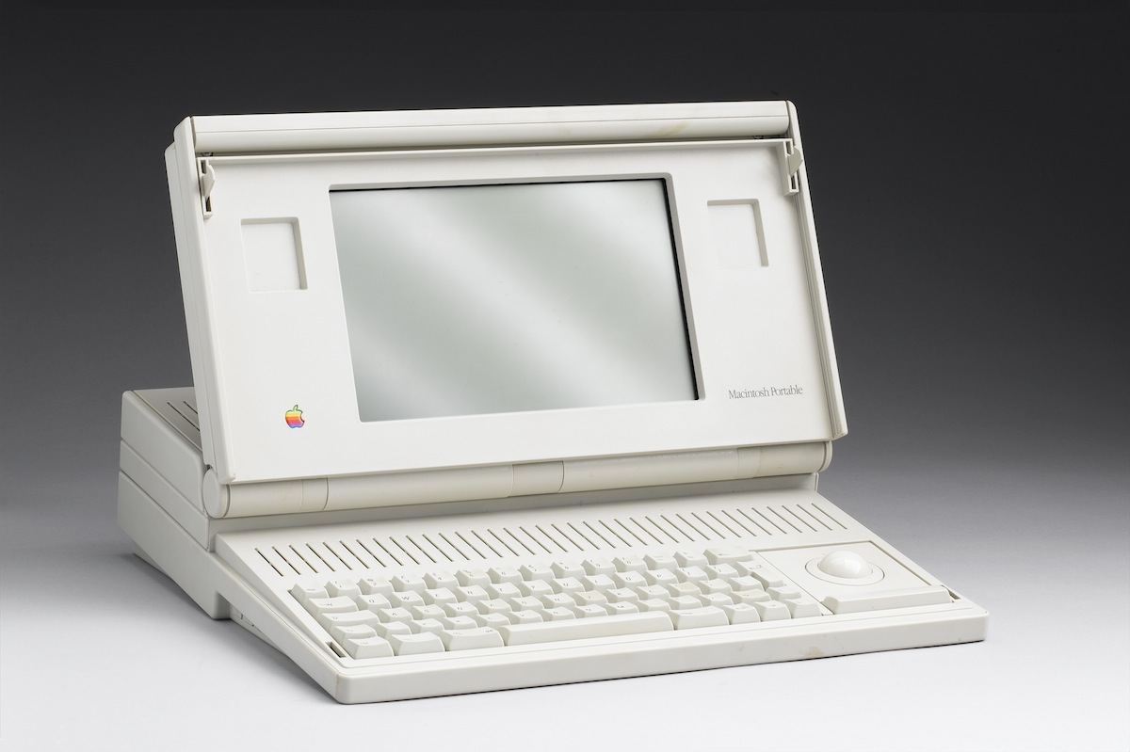
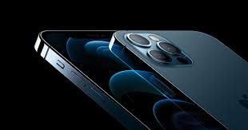
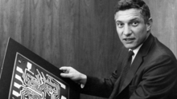
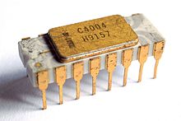
Lillenfeld
Transistor theory
1926
Bell labs
1947
16 MHz
200k transistors
9 MB ram
16 pounds
$15k (today)
Bardeen, Shockley, Brattain
First Si IC
Fairchild
A14, 3.1 GHz 6 core, neural engine; 11.8 billion transistors; 256 GB ram
4.76 ounces; ~$1,000.00
A16: 16 billion transistors; 5 nm; 16 core neural engine
Robert Noyce
1957
2,250 transistors

Slide 10
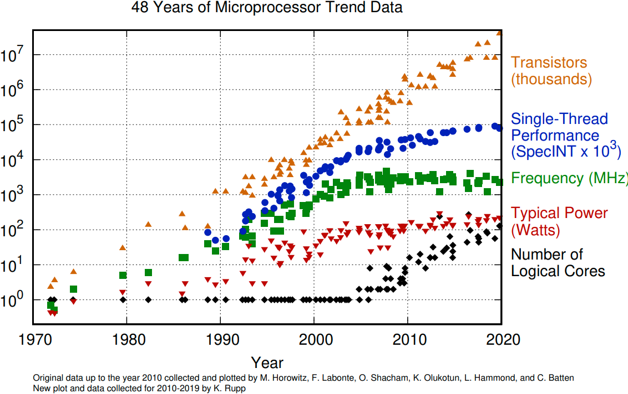
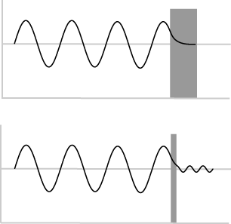
Moore’s Law and other trends
Moore’s Law must end…
free Si diameter is 0.2 nm
Quantum tunneling increasingly hampers transistor density below about 5 nm.
2020: 5nm
2025: 2nm
Dennard Scaling ends in the mid-2000s (as transistors get smaller their power density stays constant…)

Slide 11
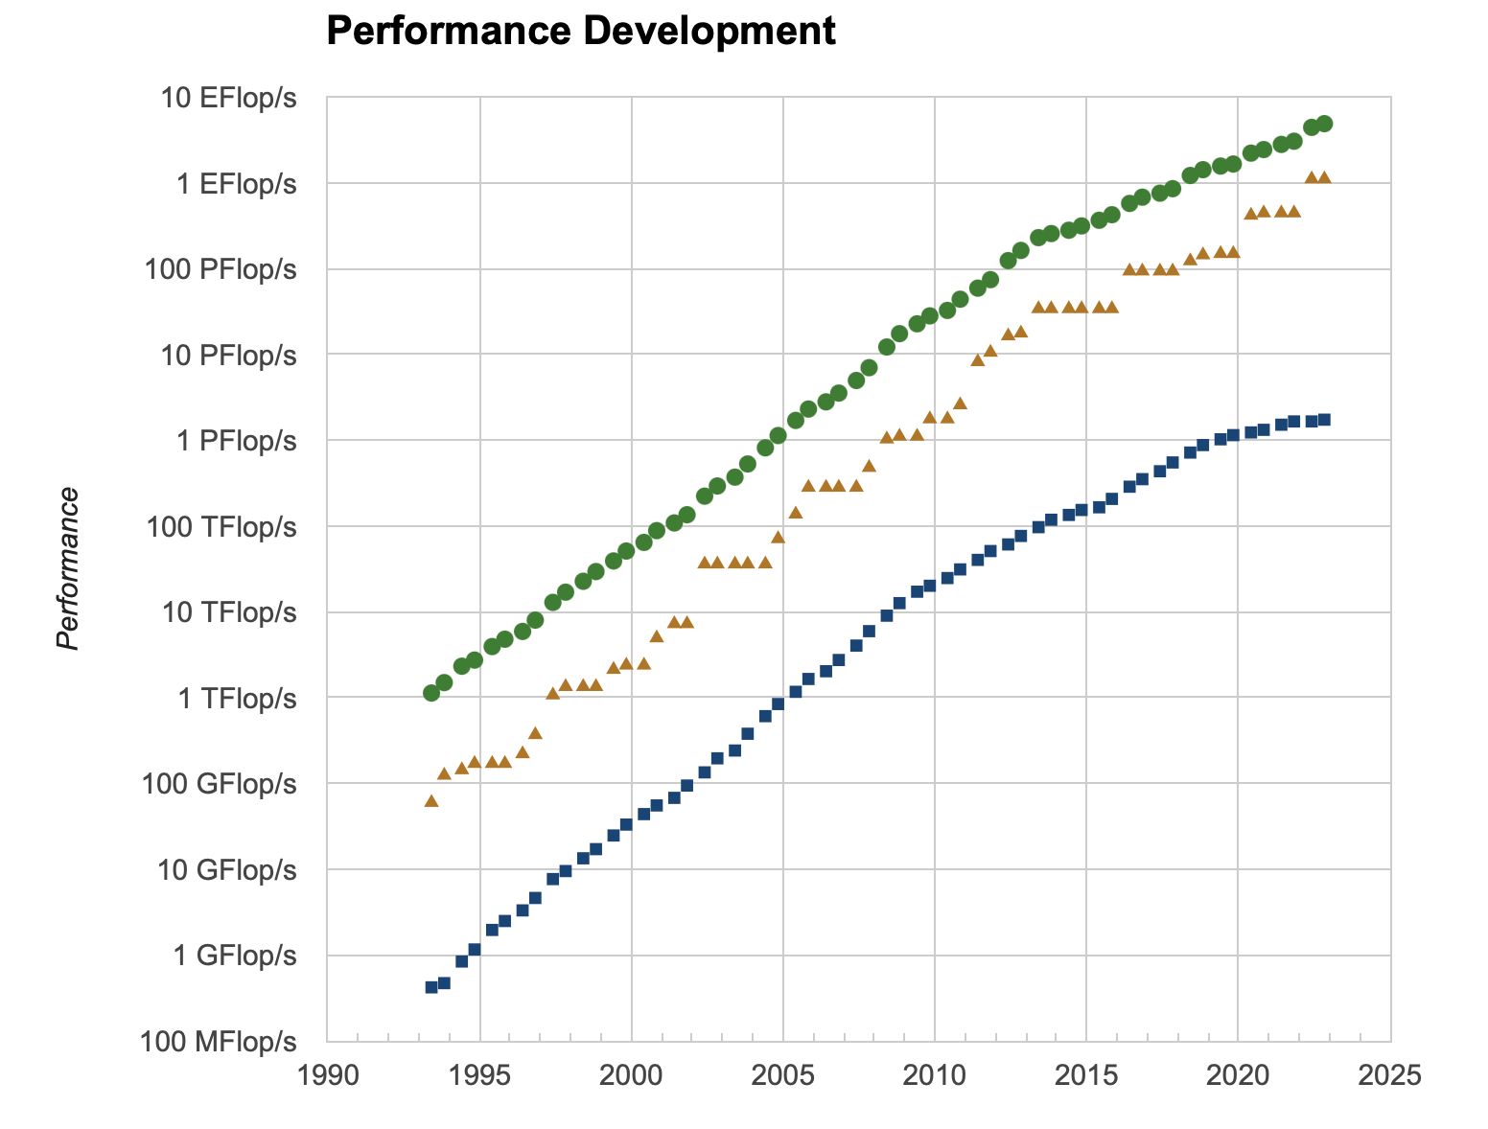
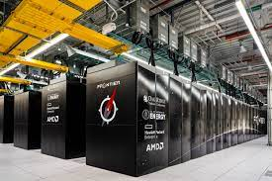
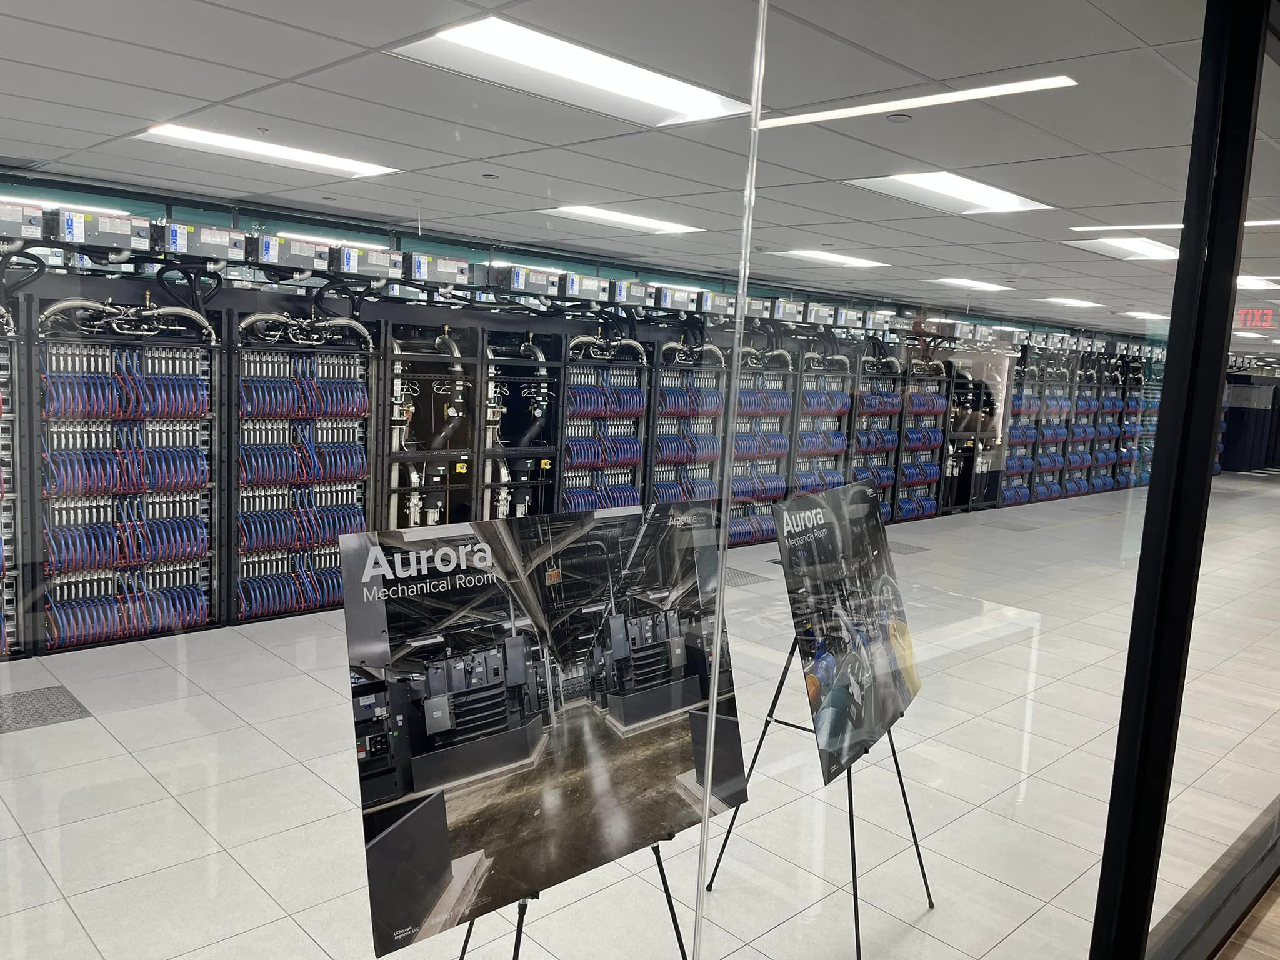
The world’s fastest computers do amazing science
Rank | System | Rmax (PFlop/s) | Power (kW)
1 | Frontier (DOE ORNL) United States | 1,102.00 | 21,100
2 | Fugaku - RIKEN Japan | 442.01 | 29,899
3 | LUMI - HPE Cray Finland | 309.1 | 2,942
4 | Leonardo, Italy | 174.7 | 5,610
5 | Summit (DOE ORNL) United States | 148.60 | 10,096
6 | Sierra - IBM DOE LLNL United States | 94.64 | 7,438
7 | Sunway TaihuLight - China | 93.01 | 15,371
8 | Perlmutter UCB United States | 70.87 | 2,589
9 | Selene NVIDIA Corporation United States | 63.46 | 2,646
10 | Tianhe-2A - China | 61.44 | 18,482
Curves appear to go linear around position 100…
Compute intensive: solving PDEs (requires fast FLOPs)
Most of the execution time goes to floating-point operations

Slide 12
Computer saturation
Systems 100-500 indicate linear increase in capability
The ‘top’ system lifetime is about 5 years
Limits to Top500 analysis
  China no longer submits information
  Workflows on machines are changing with time
Overall interesting article: Reed, Gannon, Dongarra, “Reinventing HPC: Challenges and Opportunities”

Slide 13
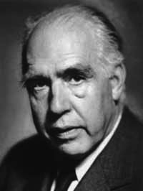

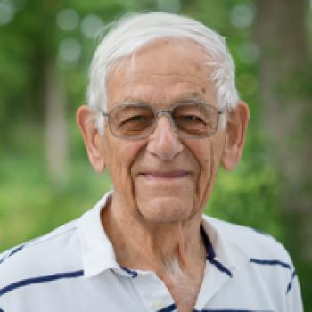
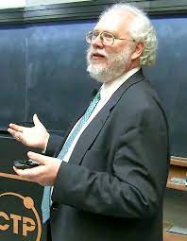
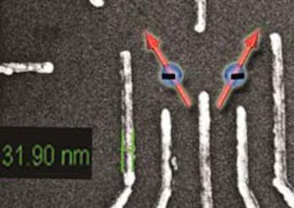
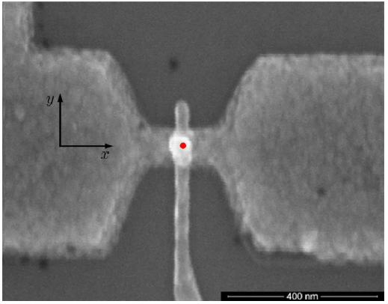
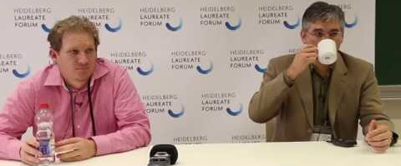
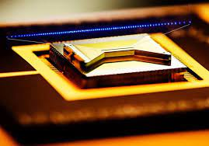
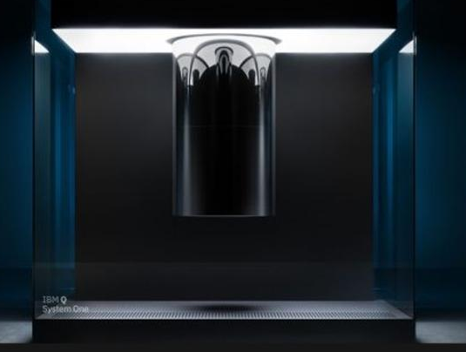
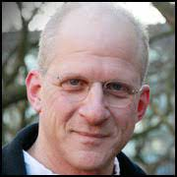
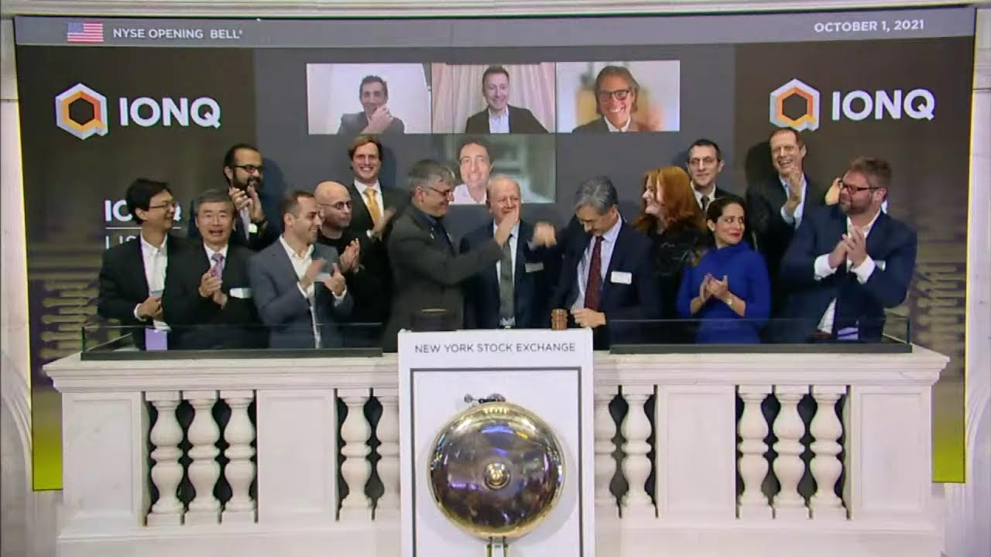
Using Quantum to affect a Revolution
In the sciences
If quantum mechanics hasn’t profoundly shocked you, you haven’t understood it yet. – Niels Bohr
1980s– 1990s
  A curious idea; first quantum algorithms
2000s
  Proof-of-principle demonstrations
  Initial QC hardware
  Error correction and control theory
2010s
  Focus on practicality and improving quality and control
  Circuit synthesis
Si Ge qubits
Julich
Phosphorous donor
Sydney
2015s
  Qubit fragility presents tremendous challenges; first commercial systems
  Attempt to broaden suite of applications
Significant increases in federal funding for R&D…leading to the NQI Act in December 2018, and the establishment of the National Quantum Information Science Research Centers.
Significant development of Noisy Intermediate Scale Quantum Algorithms
Significant development of hardware (IBM, Google, Honeywell, IonQ, ColdQuanta, Rigetti…)

Slide 14
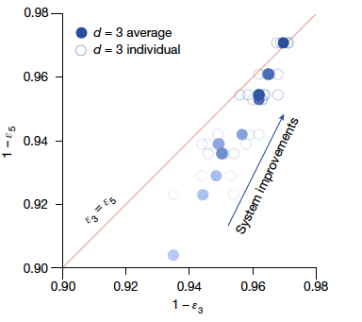
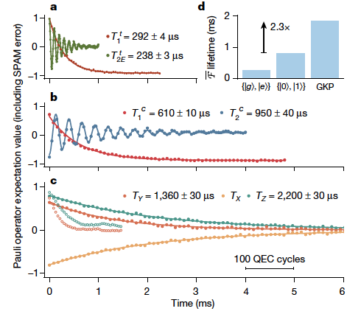
From NISQ to Quantum Error Correction
Google Quantum AI (Acharya et al.), Suppressing quantum errors by scaling a surface code logical qubit, Nature 614 (2023)
Sivak et al., Real-time quantum error correction beyond break even, Nature 616 (2023) G=2.27+/-0.07 [gain beyond natural qubit lifetime]
Experiment: QEC begins to improve performance with increasing qubit number
Component performance must improve by at least 20% to move below threshold, and substantially improve beyond that to achieve practical scaling

Slide 15
Summary and Outlook
Computing technology, built on silicon, has enabled a revolution in almost every facet of life and science; this 70-year trend will continue although the underlying technology is reaching maturity (linear growth)
Quantum Computing requires further innovation to become mission relevant…and that’s part of the fun!!
QUESTIONS?

