Slide 1





Search for Non-Abelian Majorana modes as a route to topological quantum computation
Jefferson Lab, June 2023
Jay D Sau
CMTC, JQI and Dept of Physics,
University of Maryland, College Park

Slide 2
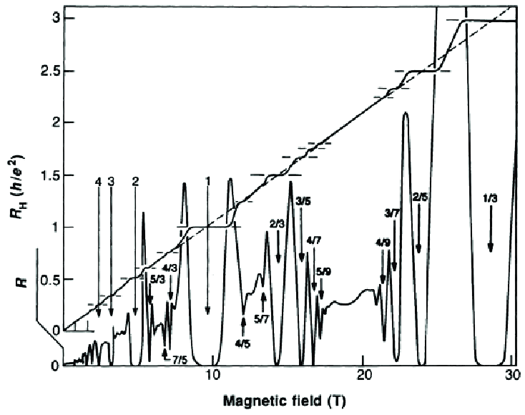
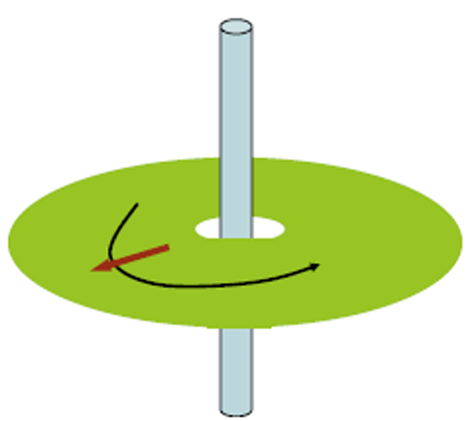
Motivation: Topological states in fractional quantum Hall
Amazing fact: Two dimensional electron gases in magnetic
fields support a Hall conductance at a fraction of a quantum
i.e. the Fractional Quantum Hall effect Tsui, Stormer, Gossard PRL 1982
Φ
Gedanken experiment:
Adiabatically insert flux quantum depletes charge ΔQ from
the hole but cannot affect microscopic Hamiltonian.
This flux insertion into an FQH state creates a fractionally
charged quasiparticle excitation with charge
ΔQ “attached” to the flux quantum
ΔQ
E=∂_{t}Φ
Notes:
Pointer at fractional Hall plateau in figure.
Pointer at center of hole

Slide 3
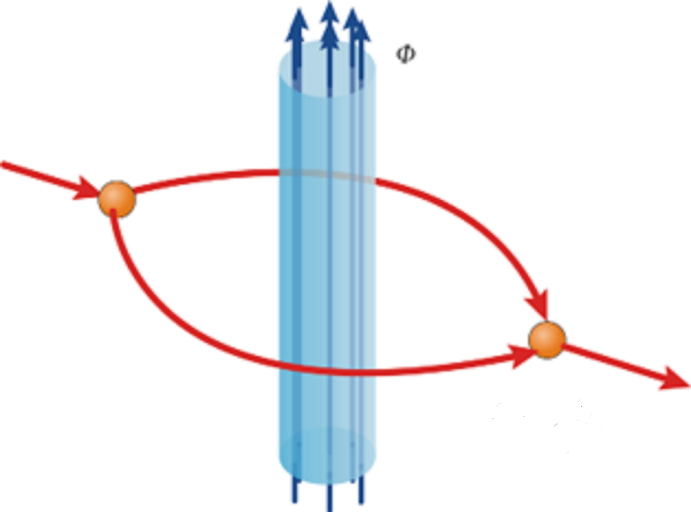


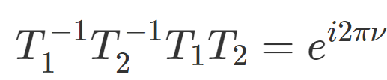
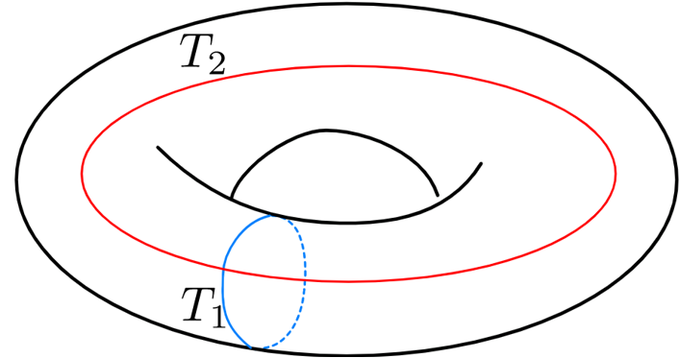
Motivation: Topological states and quantum computation
The Aharonov-Bohm (AB) phase of a fractional charge
quasiparticle going round a flux quantum is fractional
Quasiparticle encircling quasiparticle has fractional phase
AB phase is twice the exchange phase – so quasiparticle has fractional statistics – anyons
Leinaas, Myrheim(1977), Wilczek (1982), Halperin (1984)
Took 40 years to get convincing experiments in 2020 at Purdue Manfra group Nat. Phys. (2020)
Creating and annihilating quasiparticle pairs on a torus (loops) in different orders differ by
the AB phase.
The ground state manifold on which the unitary operators T_{1,2} act
is forced to be multidimensional by the non-trivial phase.
Topological quantum computation uses this manifold as a qubit
2
1
=
1
+
1
2
2
Notes:
Pointer to encircle the flux tube
Pointer traces circle for 2.
Pointer shows exchange phase
Pointer shows loops on torus

Slide 4
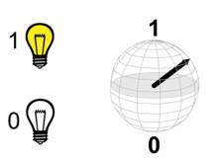
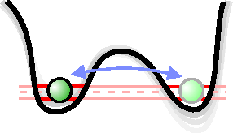
Why care about topological Quantum computation
Classical bit has two states :
and
Quantum bit is described by the state :
Environment decoheres the quantum state
Current qubit platforms superconducting/ion traps/spin qubits have 20/20/4 physical qubits with two-qubit gate fidelities 98-99%
TQC Majorana wire devices are expected to be small and have smaller errors allowing for more efficient error correction
TQC: provides the possibility of hardware error correction

Slide 5

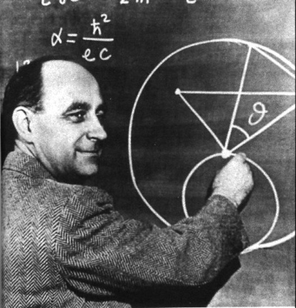
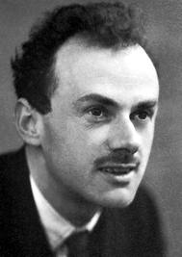
Majorana Fermions : particle + hole
Dirac fermions as elementary
particles
Majorana fermions as elementary
particles
Possibly neutrinos ≡ anti-neutrinos (particle+hole)
Electrons (particles), positrons (holes)
Solid state emergent Majorana fermions:
Ordinary Dirac Fermions (in analogy with quantum
Harmonic oscillators):
c†|n=0>=|n=1> (particles) and c|n=1>=|n=0> (holes)
Solid state Majorana Fermion representation:
Majorana fermions: ½ quantum state
Majorana fermions => “fractionalized” fermionic state

Slide 6
Topological degeneracy and
Majorana zero modes
c†
γ₁
γ₂
Vacuum (empty)
Quasiparticle (filled)
$$γ_{1}\left|n=0\right\rangle =\left|n=1\right\rangle \begin{matrix} & \end{matrix}γ_{1}\left|n=1\right\rangle =\left|n=0\right\rangle$$
Since γ_{j} are zero-energy operators (i.e. [γ_{j},H]=0) the states n=0,1 are degenerate
The degeneracy of states with different number of electrons requires contact with a superconducting reservoir
Majorana fermions => locality protected degeneracy
Read and Green PRB 2000, Kitaev, Phys. Uspekhi (2001)
Notes:
Point to end Majorana operators
Point to Vacuum quasiparticle
Point to number toggle equation

Slide 7
Physical system

Slide 8
Ingredients: superconductivity,
Zeeman and spin-orbit coupling
Degeneracy between different number of electrons is only possible if there is a background sea of Cooper pairs i.e. in a superconductor
Pair of Majoranas = Fermion => Single Fermi surface (i.e. w/o spin degeneracy) superconductivity needed
Zeeman + Rashba SO coupling
Zeeman
X
X
Semiconductor
Spin singlet Cooper pair
tunneling blocked
Superconductor
Spin singlet Cooper pair
tunneling allowed
Critical ingredients for Majorana modes: Superconductivity, Spin-orbit coupling and magnetic field

Slide 9
MajoranaS in semiconductors
(b)
E
Tunnel
probe
k
(a)
nanowire
Magnetic field
Superconductor
End majorana mode
Majorana condition:
JS, Tewari, et al. PRB (2010); Lutchyn, JS, Das Sarma, PRL(2010), Oreg et al PRL(2010)
Notes:
Work done at Maryland more than a decade ago
Continues to be scene of extensive experimental and theoretical activity
Describe this as background for more recent work

Slide 10
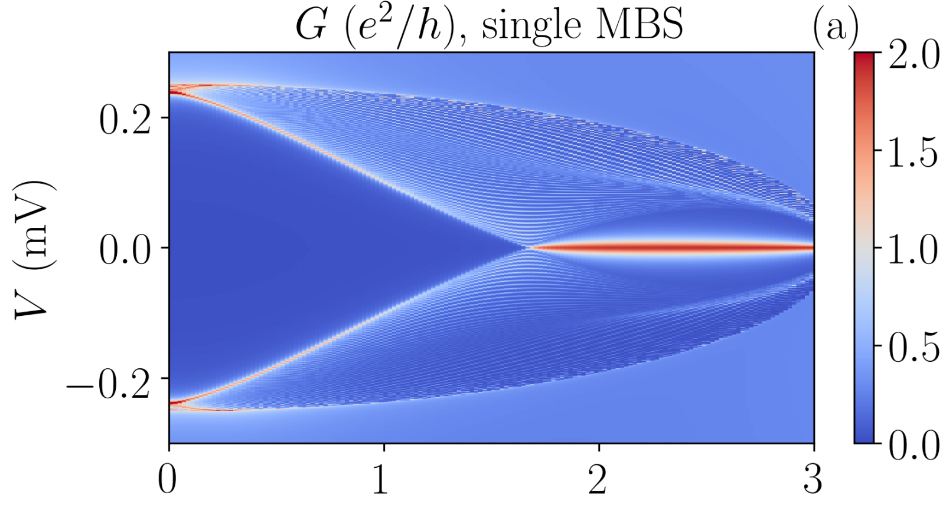
Quantitative aspects
Quasiparticle gap versus magnetic field
End conductance versus bias voltage
V_{z} (mV)
Zero bias conductance peak into neutral Majorana
Tanaka et al (‘95), Sengupta et al (‘01)
Quantized (2 e²/h) conductance at T=0 into point contact
Sengupta et al PRB(‘01), Lee et al PRL(‘09), Flensberg PRB(‘10), Wimmer et al NJP(‘11)
Bulk and end tunneling provide strong signatures of Majorana zero modes and topological superconductivity
JS, et al. PRB(2010)
Notes:
Point to gap closure as signature of bulk gap closing
Click and point to conductance peak

Slide 11
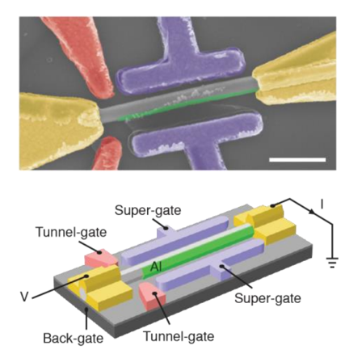
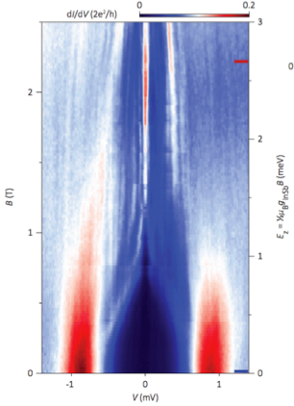
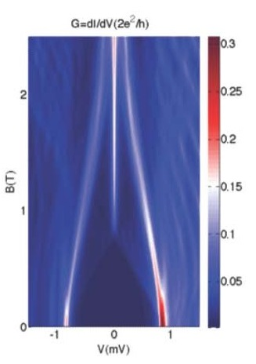
Experimental evidence
Expt Zhang et al (Kouwenhoven group; 2016)
theory
End conductance versus bias voltage
Mourik, Zuo, Frolov, Plissard, Bakkers,
Kouwenhoven Science(2012);
See also Heiblum, Marcus group and
H. Q. Xu group
Liu, JS, Das Sarma PRB 2017
Tunneling conductance measurements in proximitized semiconductors have shown zero-bias conductance peaks appear at finite magnetic field
Zero-bias conductance peak in high quality device is nearly quantized
Notes:
First experiments in 2012
Experimental device is from qualitatively advanced sophisticated effort
Comment on unfortunate experimental controversy

Slide 12
Road-map to tqc
Central challenge – Majorana versus Andreev
Likely approach – reduce disorder

Slide 13
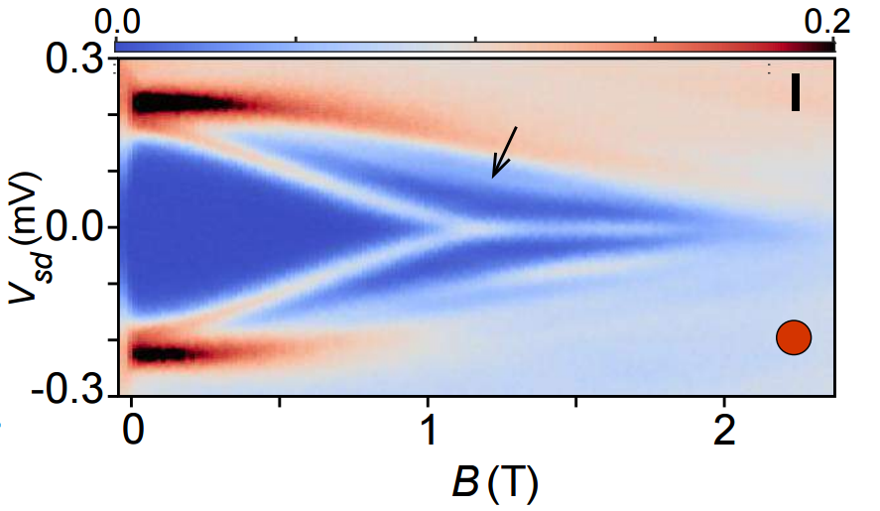
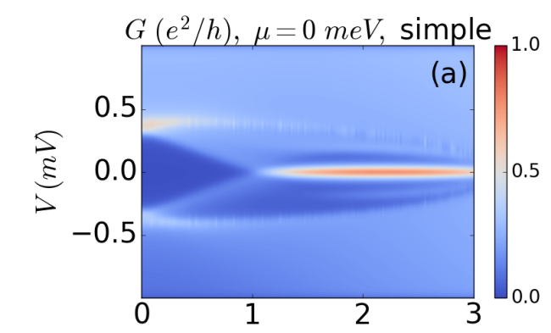
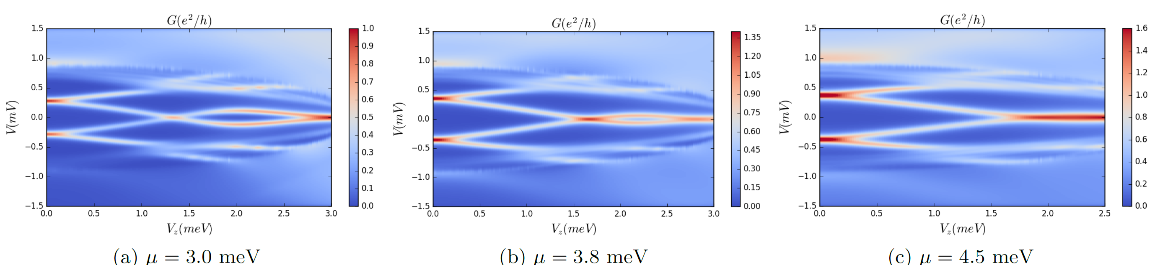
Andreev versus majorana States
Experimentally MZMs seem to appear when
Andreev Bound states (ABSs) come together.
Deng et al Science 2016(Copenhagen)
This contradicts appearance of MZMs at phase transitions
Conductance simulation in the Majorana nanowire model where ABS sticking typically occurs at large μ
Large chemical potential quantum dot seems to produce
non-topological zero-energy ABSs
Liu, JS, Stanescu, Das Sarma PRB (2017)
ee
Notes:
Point to experimental plot
Point to left panel as typical phase transition
Point to higher mu data – matches experiment better

Slide 14
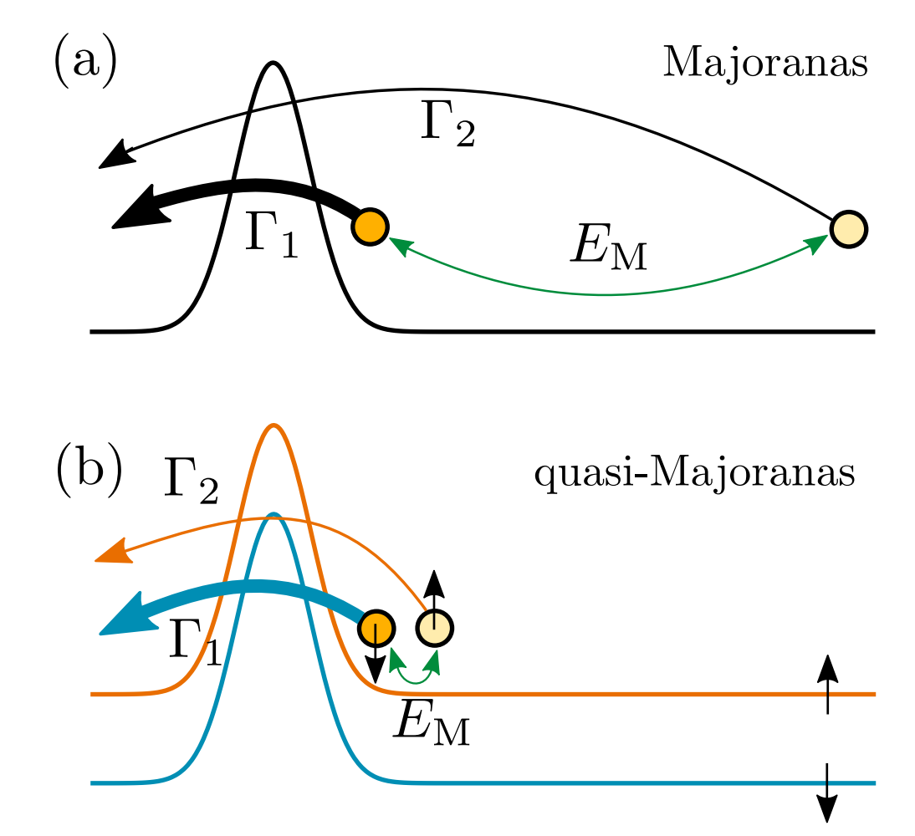
Why do these modes stick to zero?
Large Zeeman naturally generates
pair of MZMs (equivalent to ABS) at zero energy
Prada, San Jose, Aguado PRB 2012
Kells, Meidan, Brouwer, PRB 2012
Vuik, Nijholt, Akhmerov, Wimmer, arxiv 2018
Notes:
Point to lower panel with quasi-Majorana or Andreev Bound state – effectively Majorana for each spin

Slide 15
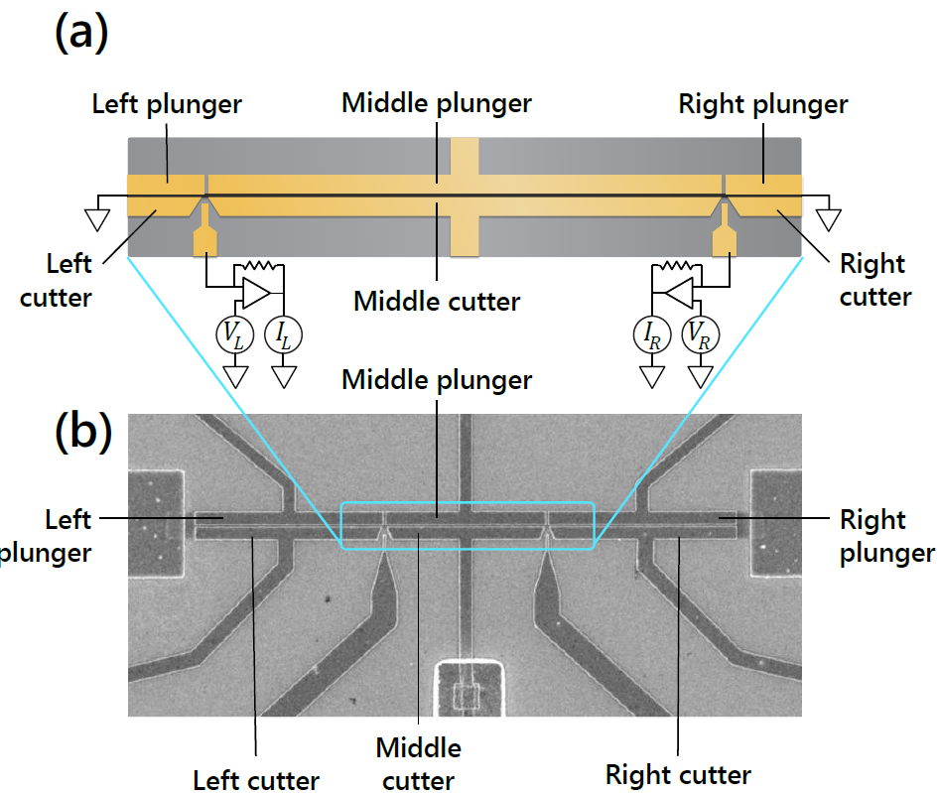
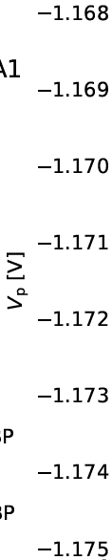
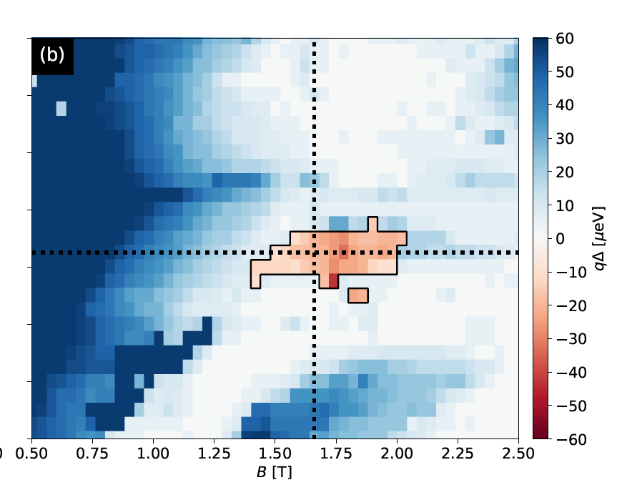
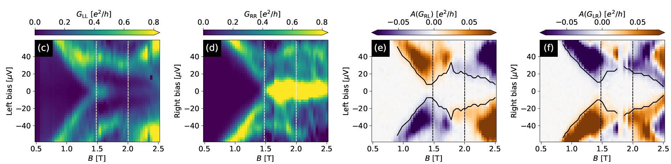
Recent progress from microsoft
Last year Microsoft combined their expertise and staff to design a low disorder device
Aghaee et al (Microsoft) PRB 2023
Result was they could combine non-local & local conductance
to map topological
phases using a
“protocol”
calibrated from
simulations.
ee

Slide 16
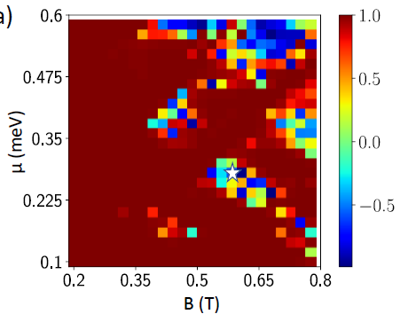
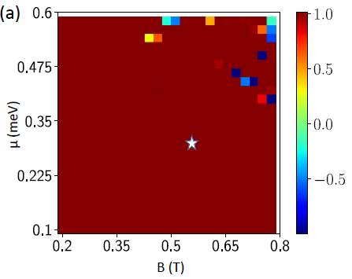
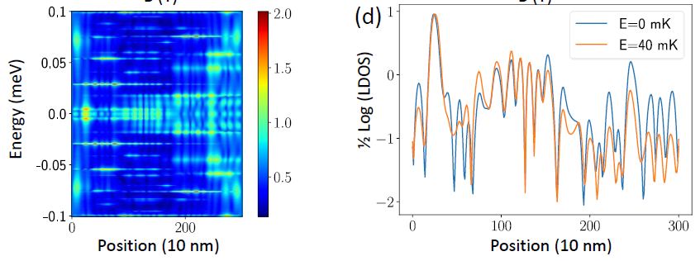
Are small topological patches “really” topological?
Topological invariant Q’=sign(Q)=sign(Det(r)) for a
L= 3 μm wire
shows patches similar to expt
Q can be quite small in the patch even when it is technically topological – is it still topological?
L= 40 μm wire at same disorder is non-topological
Zero-energy local density of states shows delocalized Majorana
Topological invariant might not be a sufficient criterion for
Topological Majoranas Das Sarma, JS, Stanescu 2023

Slide 17
Future - braiding
Majorana qubit measurement
Majorana qubit braiding i.e. topological gate

Slide 18
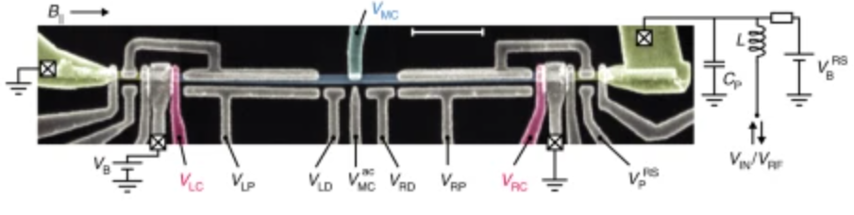
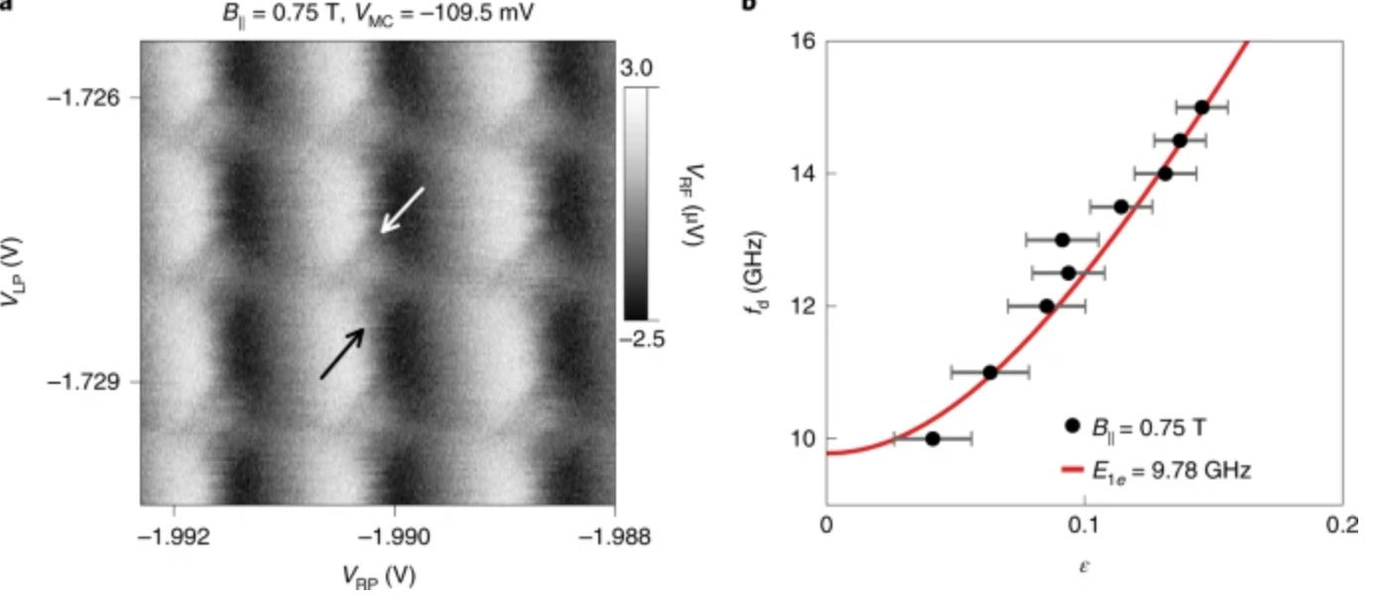
Demonstrating Majorana “qubits”
Measurement of a pair of Majoranas γ₁γ₂ is achieved by measuring charge
c_{L}†
c_{R}†
γ₁
γ₂
γ₃
γ₄
Preliminary tuning of pair of Majorana wires shows “Majorana qubit” transitions
Plugge et al NJP (2016); van Zanten et al (Copenhagen) Nat. Phys. (2020)

Slide 19
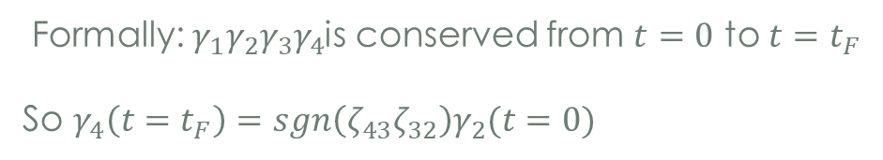

measurement-induced transport of Majorana fermions
Does particle statistics make sense in 1D?
Alicea et al (Nat. Phys. (2011)) proposed a set of operations
to produce braids
Variant to generate braid using tunneling
=> can explicitly derive the braid matrix from Heisenberg e.o.m
Projective measurements can also perform operations
Step 1: ${iγ_{4}γ_{3} |Ψ(t=0)〉=ζ}_{43}|Ψ(t=0)〉=±|Ψ(t=0)〉$
Step 2: ${iγ_{3}γ_{2} |Ψ(t=0)〉→ζ}_{32}|Ψ(t=t_{F})〉$
Formally: $γ_{1}γ_{2}γ_{3}γ_{4}$is conserved from $t=0$ to $t=t_{F}$
So $γ_{4}\left(t=t_{F}\right)=sgn\left(ζ_{43}ζ_{32}\right)γ_{2}(t=0)$
Bonderson, Nayak,Freedman PRL2008; Sau, Clarke, Tewari PRB(2011); Kitaev (private communication)

Slide 20
Majorana exchange example A
A₁
A₂
B₂
B₁
1
2
C₂
C₁

Slide 21
Summary
Majorana systems are a platform for interesting
fundamental physics and quantum computation
Signatures in semiconductor
nanowire are promising
Distinguishing Majorana and Andreev as well as
understanding role of disorder are key challenges
Other platforms are emerging as contenders
though they are more preliminary
Topology is continuing to play a dominant role in predicting new phenomena
in condensed matter systems…
Thanks for your attention!

Slide 22
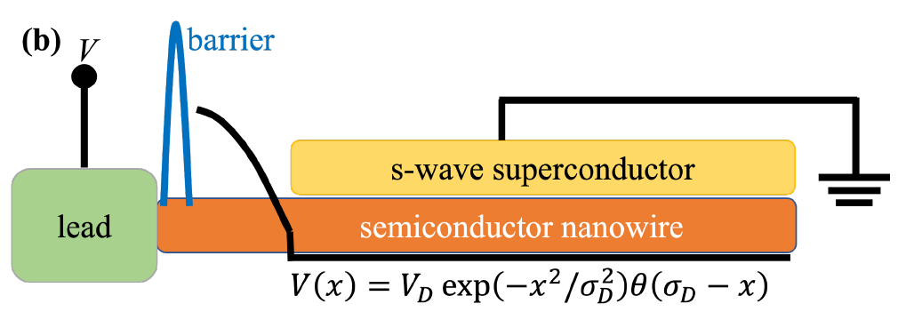
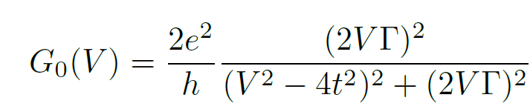
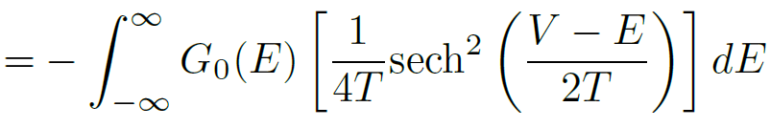

Conductance quantization approach to distinguish Majorana and Andreev
Computational
model
Tunnel Gate pinches to single channel
Top gate
For a single spinful channel the conductance into a topological superconductor with arbitrary channels is quantized Wimmer et al NJP (2011)
Conductance into a single Majorana through a single channel contact is quantized in a way that is independent of how high the tunnel barrier is
Flensberg PRB (2010)
How does the tunnel robustness of MZM ZBCPs compare to “Bad” and “Ugly” ZBCPs?
Notes:
Coming to more recent work.
Robust quantization of conductance into a Majorana is one of the key and counter-intuitive signatures
Point to theoretical model of device

Slide 23
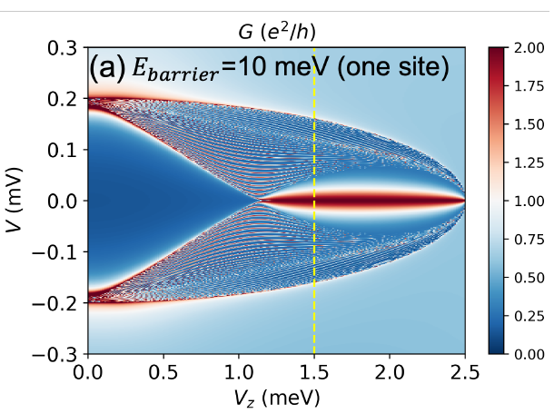
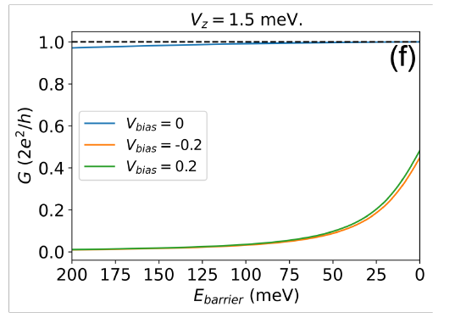
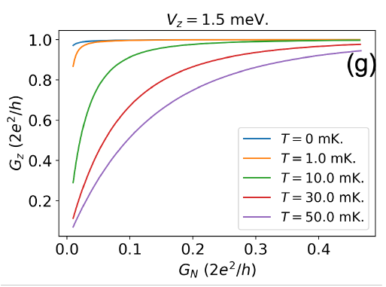
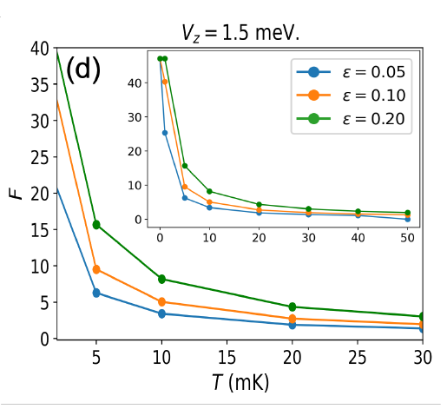


Results for an ideal wire (good case)
Basic measurement (top left) of ZBCP versus Zeeman let’s us choose a magnetic field etc for Majorana
Vary tunnel barrier (top right) varies “normal” conductance G_{N} and to a lesser extent zero-bias conductance G_{Z}
is the range of G_{N} over which G_{Z} (bottom left) is within a tolerance ε of quantization
Robustness of ZBCP is quantified by a Quality Factor (bottom right)
Topological Majorana wires have an F exceeding 30 at low T, but
an F of about 2.7 for ε=0.1 Lai, Das Sarma, JS PRB 2022
Notes:
Point to top left at yellow dashed line
Next point to top right. These are line cuts of the top left
Point to bottom left – this is derived from top right by eliminating Ebarrier
Finally get to bottom right

Slide 24
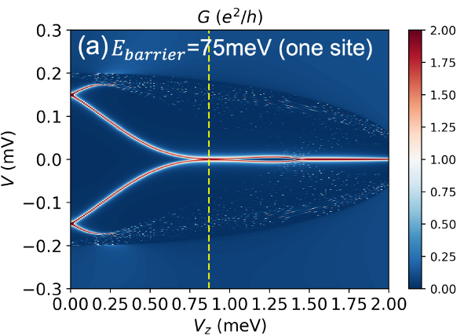
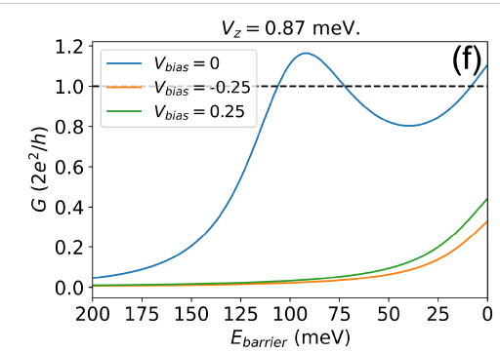
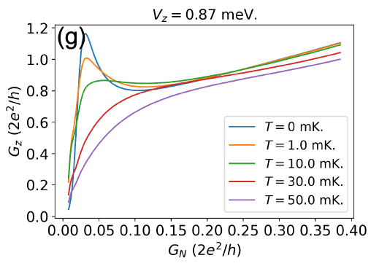
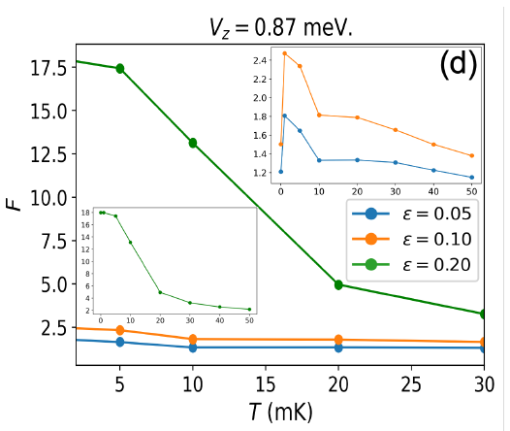
Results for an quasi-MZM (“bad” case)
Basic measurement (top left) of ZBCP versus Zeeman let’s us choose a magnetic field etc with a nearly quantized ZBCP
Vary tunnel barrier (top right) varies “normal” conductance G_{N} while G_{Z} in a non-monotonic way
Relatively small range of G_{N} over which G_{Z} is within a tolerance ε of quantization (bottom left)
Quality factor F (bottom right) is actually quite large for large tolerance ε, because of quasi-MZM
Quasi-Majorana wires have an F of about 1.8 for ε=0.1, so a threshold of 2.5 for these parameters separates MZMs okay
Lai, Das Sarma, JS PRB 2022
Notes:
Point to top left.
Now we follow the same data analysis assuming there is an Andreev Bound state or ABS.
Non-monotonic variation of conductance is a result of ABS splitting
Point to bottom right
F factor for correct tolerance is significantly different from Majorana
Yi-Hua analyzed models with several hundred parameter combinations – the result is….
Point to the red line

Slide 25








majorana fermions in condensed matter
Hamiltonian for a low density spin-polarized superconductor:
m is the chemical potential that controls electron density. Δ is the Cooper pairing potential
The Cooper pair potential contains a derivative factor because of Pauli exclusion i.e.
The equation of motion for the electron creation operator (setting Δ=1) is
Combining electrons and holes into a particle-hole symmetric Nambu spinor
This is exactly Majorana’s equation in 1+1D (also applies beyond 1D)
Read, Green PRB 2000; JS, Tewari, Semiconductors and Semimetals, Elsevier 2021
Broad class of superconducting excitations satisfy Majoranas
constraint
Beenakker PRL 2014
Notes:
Point to Hamiltonian
Point to equation of motion
Point to Majorana equation
Point to equation of motion
Point to Majorana equation

Slide 26







Majorana zero modes
Switching to the Majorana representation of the Majorana equation, the spinor is “real”
A mass domain-wall (topological defect) where yields a
(0+1)D Majorana zero (energy) mode localized at the boundary
Jackiw, Rebbi PRD 1976
We second quantize Majorana zero modes to operators in field theory
The notation ambiguity with gamma matrices is intentional because they satisfy the same
operator algebra
This specifically includes which is opposite to the Pauli exclusion principle
Hermitean Majorana operators can be thought of as real and imaginary parts of a fermion
A Fermion is a two-level system
Majorana zero mode => “fractionalized” two-level qubit!
Notes:
Point to m(x) equation
Point to (0+1)D i.e. Majorana condition in this dimension means real
Point to spinor – real spinor means zero energy
Point to gamma^2=1
Point to c=*** equation

