Slide 1
EIC Accelerator Design
Todd Satogata, Jefferson Lab
For the EIC Project and EIC Collaboration
JLUO Annual Meeting
28 June 2023
satogata@jlab.org
EIC:
Notes:
Kierkegaard book, but Descartes!

Slide 2
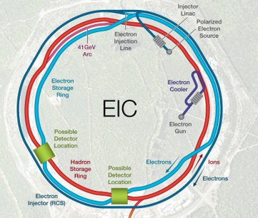
Overview: EIC Accelerator Design
Project and scope
  Review of project overview, parameters
  Achieving high luminosity
  Organization and team
JLab EIC accelerator design
  Beam-beam simulations
  TCBI/beam-beam instability analysis
  (Primary IR design)
  Second IR design
JLab R&D highlight
  Crab cavities
Summary
(ESR)
(ERL)
Future 2nd
Detector
Location
Primary
Detector
Location
(HSR)

Slide 3
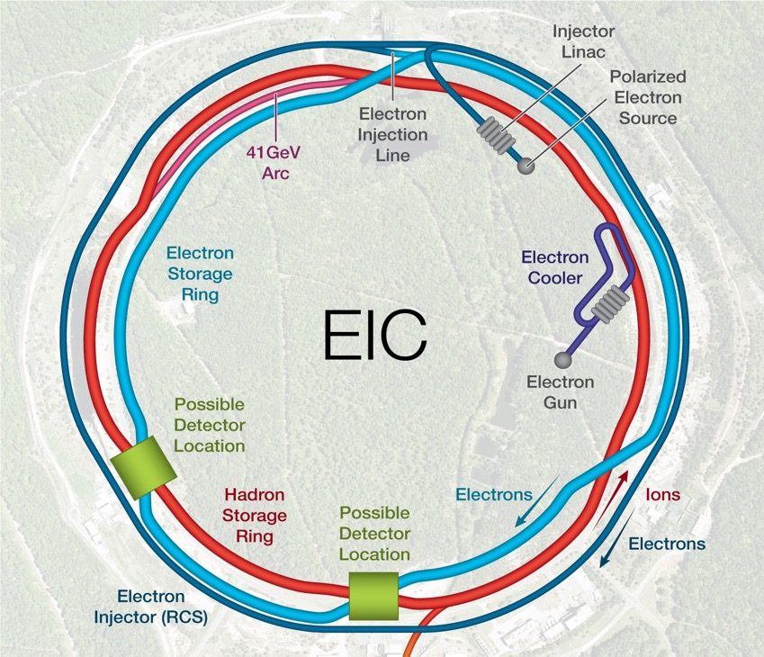
EIC Accelerator Design overview
Hadron storage ring (HSR): 40-275 GeV (existing)
  up to 1160 bunches, 1A avg beam current (3x RHIC, polarized)
  bright vertical beam emittance (1.5 nm); new vac sleeves
  hadron beam cooling
Electron storage ring (ESR): 2.5–18 GeV (new)
  up to 1160 polarized bunches
    high polarization by continual reinjection from RCS
  2.5 A avg beam current ➔ 9 MW sync rad power
  superconducting RF cavities
Rapid cycling synchrotron (RCS): 0.4-18 GeV (new)
  2 bunches at 1 Hz; spin transparent due to high periodicity
High luminosity IR (new; future 2nd IR)
  L = 10³⁴ cm⁻²s⁻¹ = 10 kHz-uba, superconducting magnets
  25 mrad crossing angle with crab cavities/crab crossing
  spin rotators (produce longitudinal polarization at IP)
Comparable to new mature
B-factory, e.g. SuperKEKB
Current 6x NSLS-II
Future 2nd
Detector
Location
Primary
Detector
Location

Slide 4
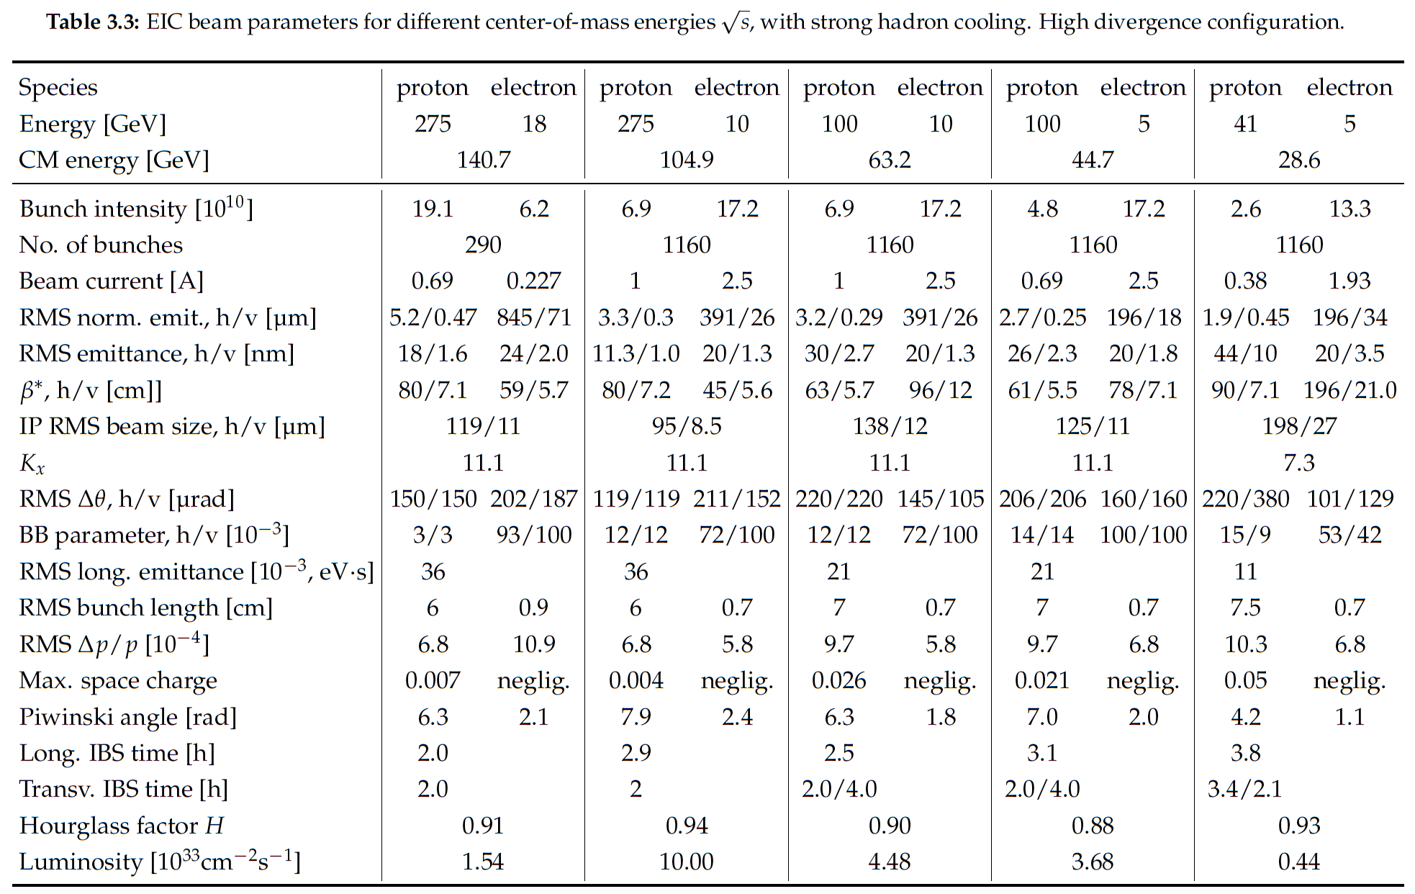

EIC Parameters

Slide 5
Luminosity (Lumi) Limits In One Slide™
Maximize collision frequency (~90 MHz)
  Limited by kicker rise times
  Limited by parasitic collisions (crabbing)
  Limited by instabilities
Maximize particles per bunch (~10¹¹)
  Limited by sources, space charge
  Limited by collective effects
    Interaction of beam with impedances
    Also total currents: I_{1,2}=q_{1,2}N_{1,2}f_{coll} ~1-3A
Minimize beam sizes at IP (~250/25 um)
  Limited by IR focusing, magnets
  Limited by chromatic dynamic aperture
  Limited by emittance growth (IBS)
Every parameter optimized
separately and collectively in the
EIC design
Try multiplying out the given numbers –
should be very close to 10³⁴ cm⁻²s⁻¹

Slide 6
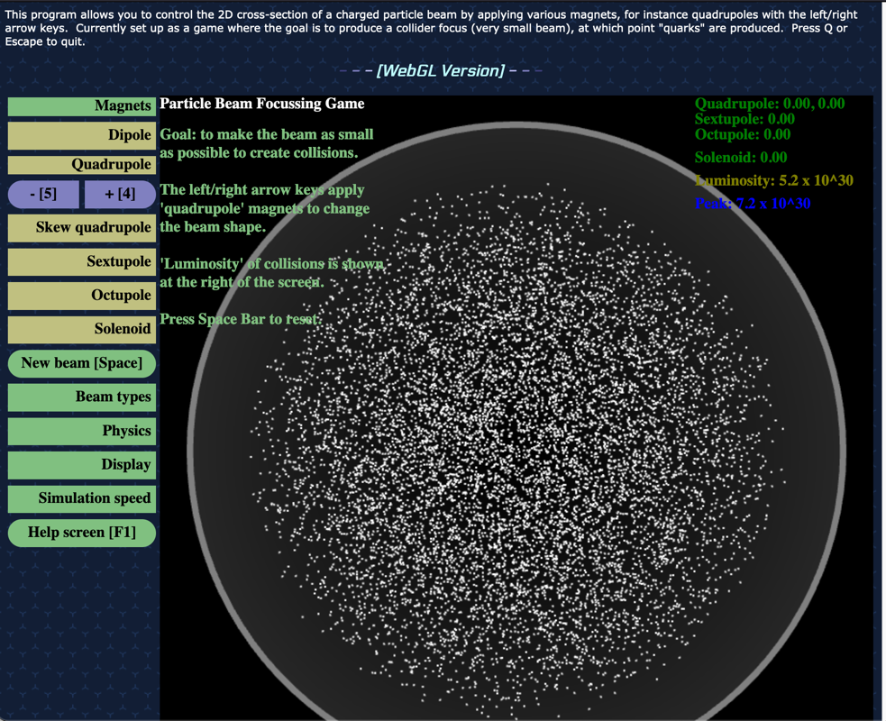
Final Focus/Luminosity Game
http://stephenbrooks.org/ap/beam2d/
Can you achieve a peak luminosity of
10³⁴ cm⁻² s⁻¹?
(NB: You may have to click on up/down rather than using the arrow keys)

Slide 7
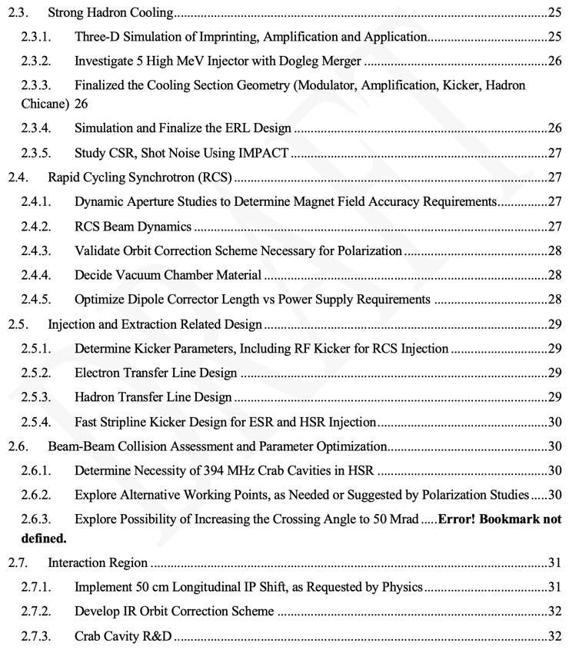
JLab EIC Partner Project Organization, Design Scope
Excerpt from Design Plan TOC
JLab Involvement
JLab EIC Partner Project (EICPP)
  Jim Fast: new EICPP manager/director
  JLab staffing growth: FY23 => ~70
Design resources identified for CD-3A/2
  Contained in the EIC Design Plan
  Developed by C. Montag, T. Satogata, and M. Blaskiewicz (L2/3 design leads)
  Updated per project schedule/priorities
JLab involved in many design activities
  Driven by activities, critical decisions

Slide 8
FY23+ Schedule and Activities
FY23 planning is well-established towards CD-3A/2
JLab accelerator design activities
  Management activities: costing, reviews...
  Accelerator design activities towards design maturity
  Beam-beam dynamics studies
  Instability analysis
    Specifications for feedback systems
  Second IR
    Global/local chromatic compensation and tracking
  ERL hadron cooler requirements
  ESR polarization development, spin matching
  RF beam physics and beam dynamics
EIC Project Event | Date
Beam Dynamics Workshop | Nov/Dec 2022
DOE OPA CD-3A Readiness Review | January 2023
Technical Reviews | through 2023
Proposed CD-3A (LLP) | January 2024
Proposed CD-2 (Design Maturity) | January 2025
Beam Dynamics Workshop: Nov 29-Dec 1 2022
Identify critical EIC intersectional areas between beam-beam, collective effects, dynamic aperture, and polarization.
EIC + Non-EIC conveners for each area
6 intersectional breakout sessions
64 participants, 15 institutions
Report used to organize/prioritize beam dynamics studies aligning with CD-3A/2 maturity needs

Slide 9
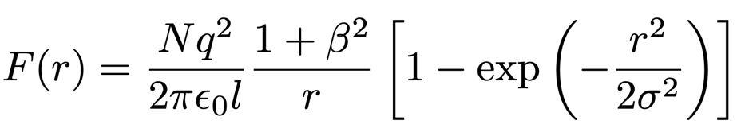
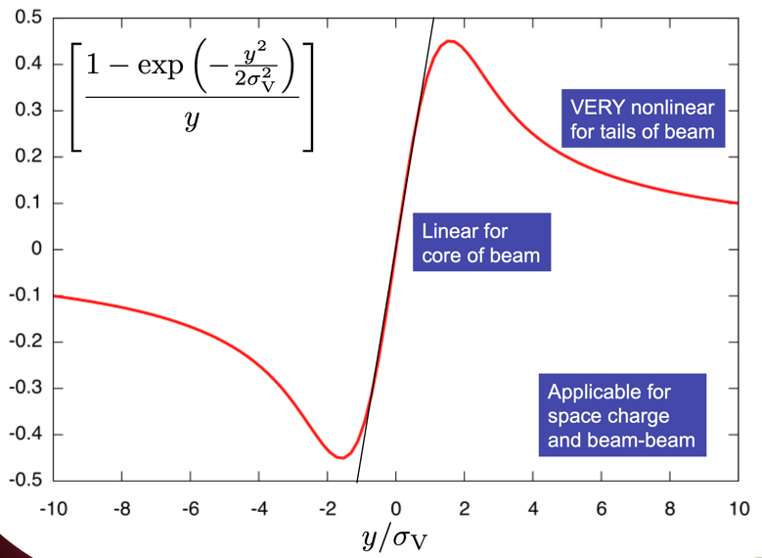
EIC Beam-beam and Luminosity
Colliding beams see each other’s collective charge distributions
Creates nonlinear beam-beam force
  NO benefit of relativistic scaling
    Compared to space charge
  Force applies at every collision point/IR
Tolerable “beam-beam tune spead” of 0.015 for hadrons limits highest EIC luminosity

Slide 10
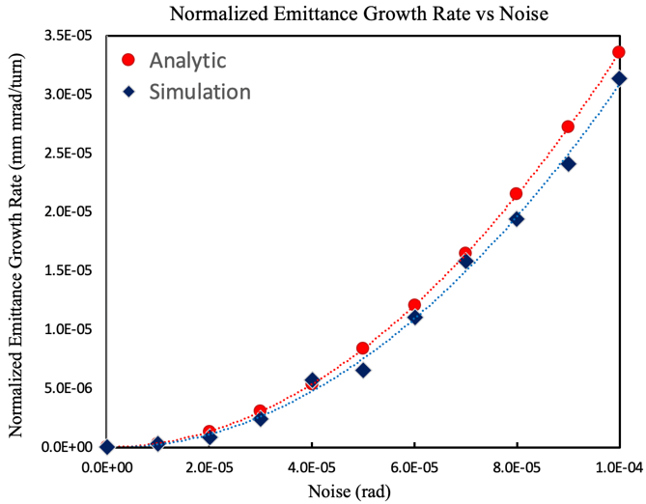

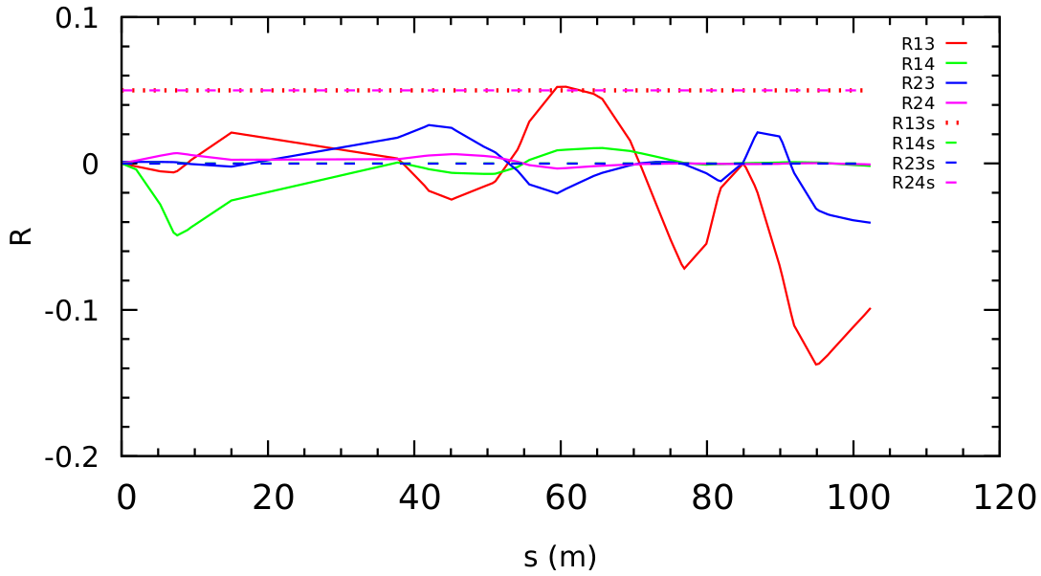
Beam-Beam Simulations
Complicated beam-beam tune shifts
  p: 0.012-0.015 e: ~0.1
  ”Flat” beams: σ_{x}/σ_{y} = 7-10
  Crabbing, coupling/solenoid dynamics
Beam-beam activities are a large team (~10 people) led by Y. Luo (BNL)
  JLab: E. Nissen, Y. Zhang, H. Huang
  V. Morozov (ORNL interlab agreement)
  One focus area of dynamics workshop
JLab focus areas:
  Crab cavity phase noise emittance growth (reqs for feedback, LLRF control)
  Solenoid compensation
  Crab bump leakage/compensation
  Using JLab ifarm cluster computing
Solenoid compensation/
IR decoupling using
projection method
Crab cavity

Slide 11
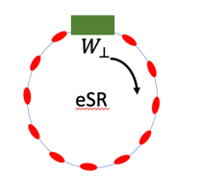
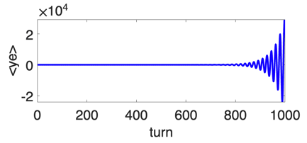
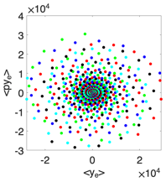
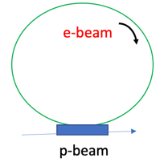
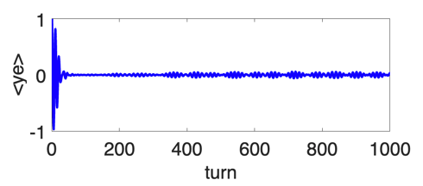
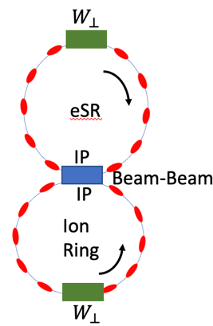
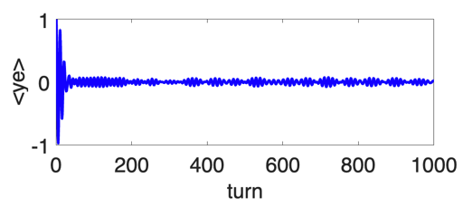
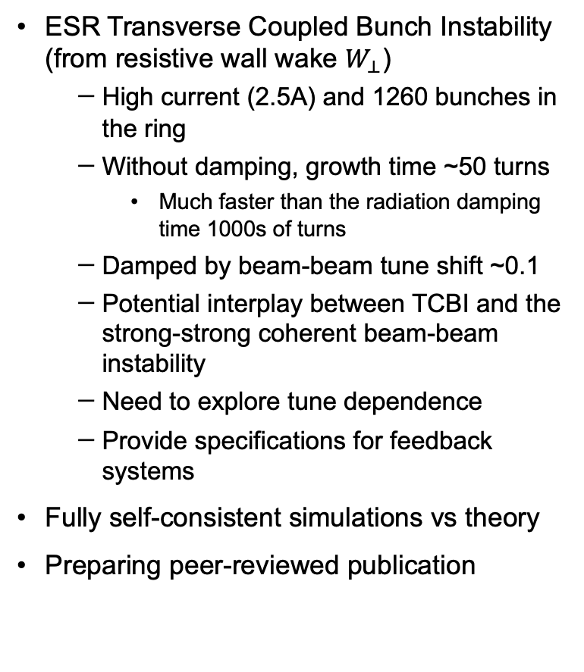


Instability Analysis: TCBI and Beam-Beam
R. Li (JLab)
ESR Transverse Coupled Bunch Instability (from resistive wall wake $W_{⊥}$)
  High current (2.5A) and 1260 bunches in the ring
  Without damping, growth time ~50 turns
    Much faster than the radiation damping time 1000s of turns
  Damped by beam-beam tune shift ~0.1
  Potential interplay between TCBI and the strong-strong coherent beam-beam instability
  Need to explore tune dependence
  Provide specifications for feedback systems
Fully self-consistent simulations vs theory
Preparing peer-reviewed publication
Multi-bunch TCBI Simulation ($W_{⊥}$ only)
$\left\langle y_{e}\right\rangle$vs$.$turn
Fast TCBI
growth
Bunch 1
Weak-strong beam-beam decoherence (beam-beam only)
Initial offset
Is damped
by nonlinear WS
beam-beam force
Bunch 1
Strong-strong beam-beam + TCBI (beam-beam and $W_{⊥}$ )
Initial offset
Is damped
by nonlinear SS
beam-beam force.
Bunch 1
Bunch 1

Slide 12
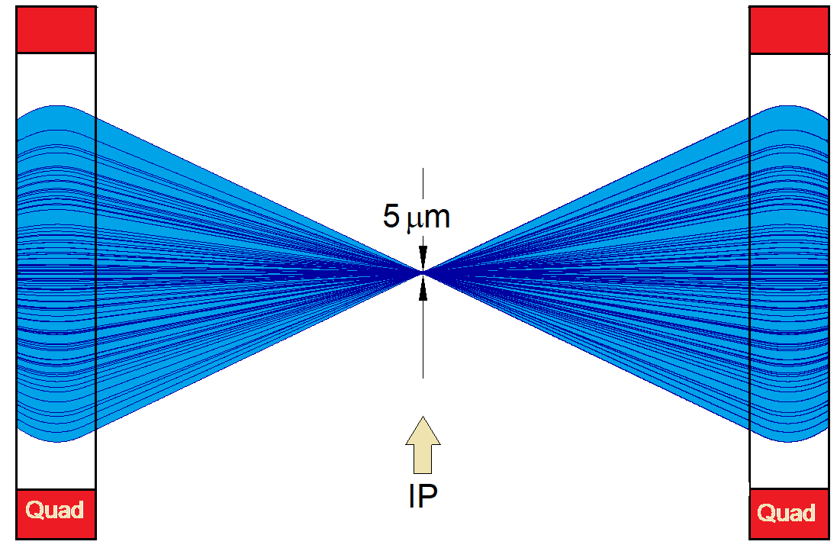
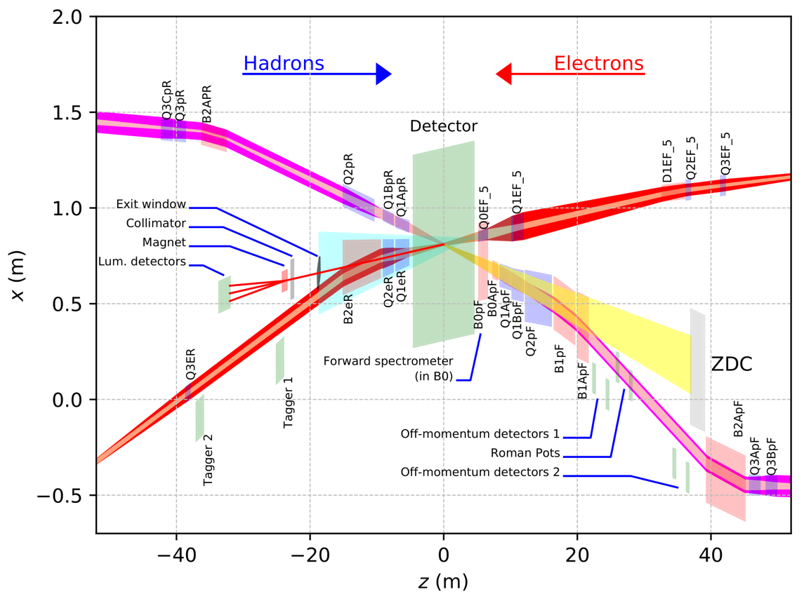
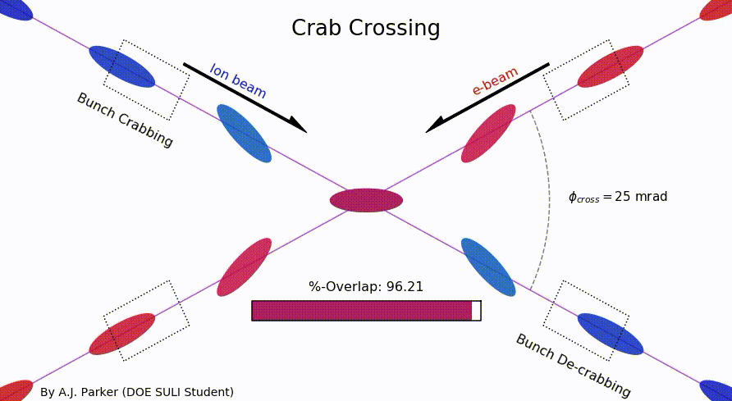
EIC Primary Interaction Region
Existing tunnel and
experiment halls
Focusing (quads)
as close to IP as
possible (~5m!)
Tensions in magnet
requirements:
high field
large apertures
e/p magnet
proximity near IP
Chromaticity:
focusing dependence
on particle energy
”Rear side”
Different
axis scales!
”Forward side”
25 mrad crab crossing
A. Parker (SULI)
D. Higinbotham

Slide 13
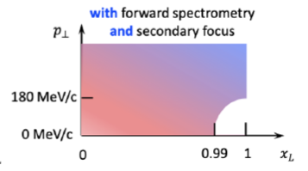
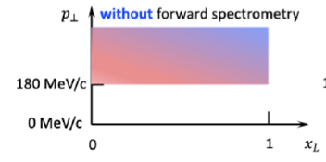
Second IR Design
B.R.P. Gamage (JLab)
Low energy lattices for 100 and 41 GeV with similar beam parameters as IR6
Low-energy precision tagging science case white paper published in Progress in Particle and Nuclear Physics Jul 2023 https://doi.org/10.1016/j.ppnp.2023.104032
Optimized to use existing RHIC magnets and/or magnets using conventional technologies (NbTi).
  Nb₃Sn for improved acceptance/luminosity published in NAPAC’22 (paper WEPA15) and IPAC’23 submission “Large-aperture High-Field Nb₃Sn magnets for the 2nd EIC Interaction Region”
Improved clearances for areas that had interferences from other beamlines, detector components (ZDC) and hall walls.
Met space requirements for beamline components such as RHIC CQS cryo modules, ZDC and for additional crab cavity modules needed for the larger crossing angle.
Optimized IP position for shared luminosity design
First EIC 2nd Detector Workshop (May 2023)
IR8 Accelerator Talk (R. Gamage)
dipoles
quads
Ring radial distance from hall center [m]
Hadrons
Electrons
Distance around beam trajectories [m]

Slide 14
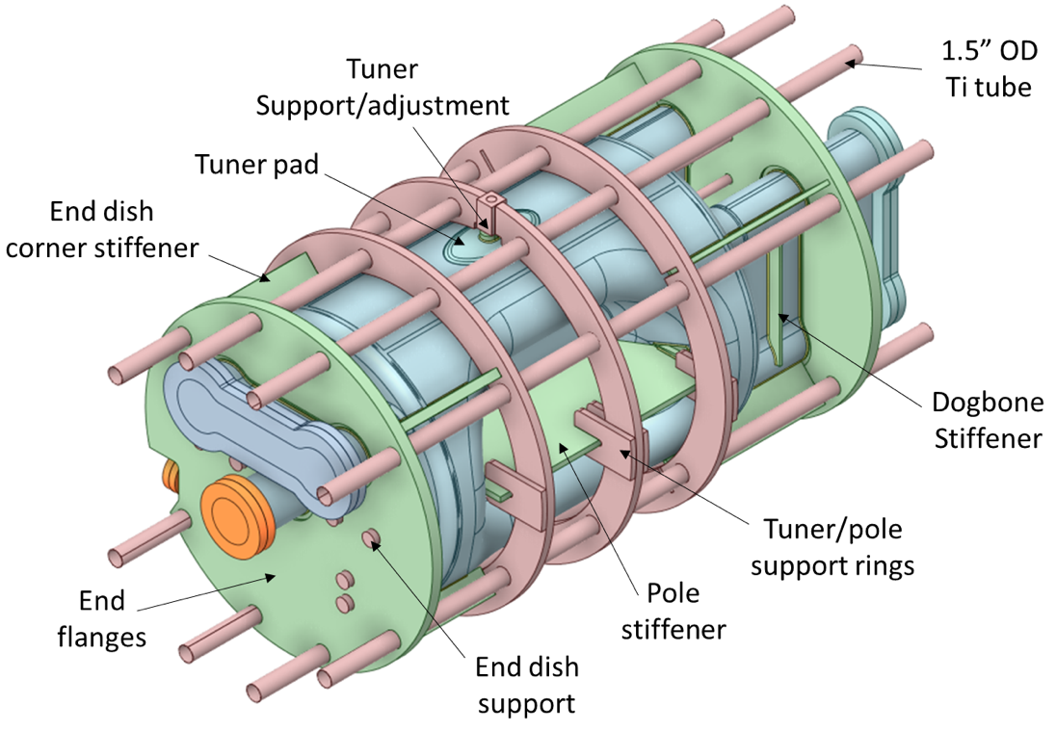
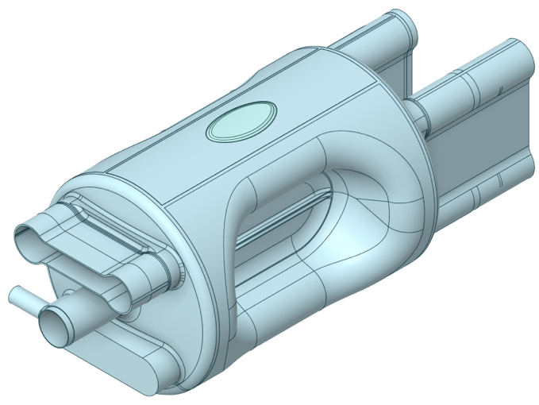
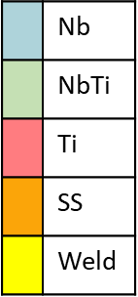
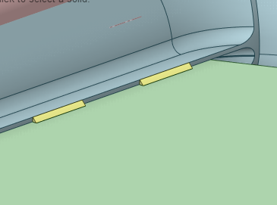
197 MHz Prototype Crab Cavity
S. de Silva (ODU)
Cavity body is comprised of 4 mm Nb with some regions thicker than 4 mm
Stiffeners are needed to maintain stress at acceptable level
Welds modeled at all NbTi to Nb joints

Slide 15
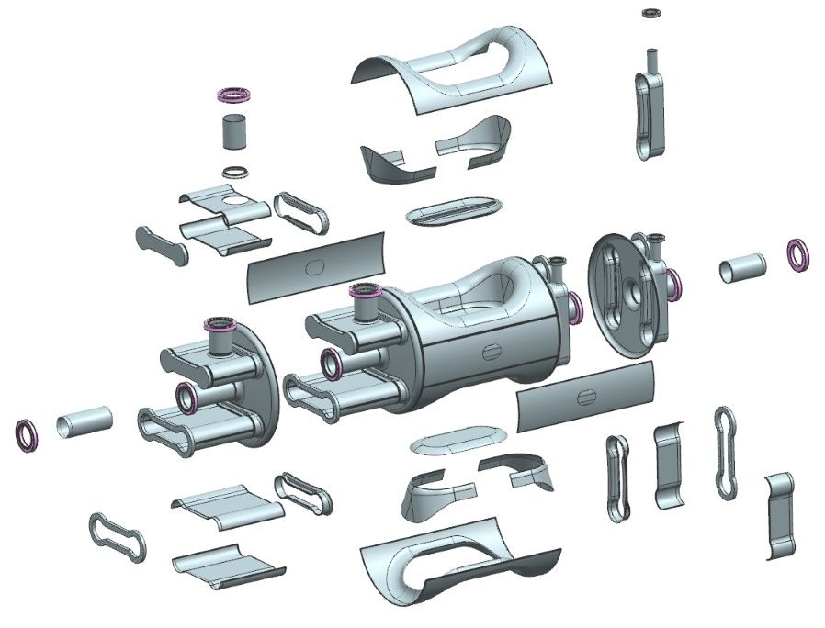
Prototype Cavity Fabrication
S. de Silva (ODU)
Majority of the cavity body is deep drawn from 4.17 mm Nb sheets
  A full Cu cavity will be fabricated to understand and verify the fabrication process
  Also, to perform room temp measurements
Flanges:
  Dogbone flanges – Nb with Indium seals
  All other flanges – 316 LN SS CF flanges with Cu gaskets
All material procurements are placed and most of the material have been received

Slide 16
Conclusions
The EIC project is well on its way to CD-3A (early FY24) and CD-2 (early FY25)
  IRA funding and improved funding profiles have supported needed staffing ramp-up
The JLab/BNL EIC partnership is highly functional, flexible, and strong
  January 2023 OPA review success/teambuilding; ongoing regular travel between labs
    Many members of JLab team at BNL this week for CD-3A Cost Review, Cooler Review
  JLab accelerator design activities focus in areas of technical responsibility and strength
  Sufficient resources to address emerging beam dynamics/design challenges
JLab has participation and visibility in the project at all levels
  Intellectual engagement towards CD-3A/2, focus on JLab scope ownership areas
  Engaged through project lifetime
    IR design for physics program including future second IR
    SRF scope and R&D including crab cavities
    (Commissioning/pre-operations)

Slide 17
Backup slides

Slide 18
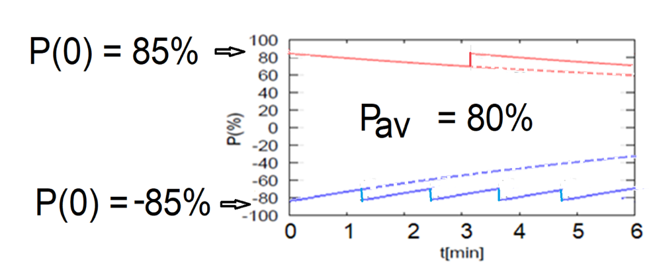
ESR Polarization: Continuous Injection
~1Hz injection of new highly polarized (~85%) electron bunches
  Will have to learn how to minimize backgrounds
Initial polarization decays towards P∞ < ~50%
  Equilibrium of self-polarization and synchrotron radiation stochastic excitation
  At 18 GeV, every bunch replaced in a few minutes
  Need both polarization directions present at the same time
Re-injection
B P
Refilled every 1.2 minutes
P_{av}=80%
Asymmetric polarizations P
with respect to dipole field B
P_{av}=80%
B P
Refilled every 3.2 minutes
Re-injections

Slide 19
Recent EIC Photocathode R&D Success
E. Wang (BNL)
Distributed Bragg reflector (DBR) layer was added to the GaAs photocathode, resulting in a Fabry-Perot resonance in between the surface-vacuum interface and DBR layer that significantly enhances the QE.
ODU/Jlab/BNL: GaAs/GaAsP SL with AlGaAs/GaAsP DBR
Best performance: QE=2.35%, ESP=92%
Satisfies EIC electron photocathode requirements

Slide 20
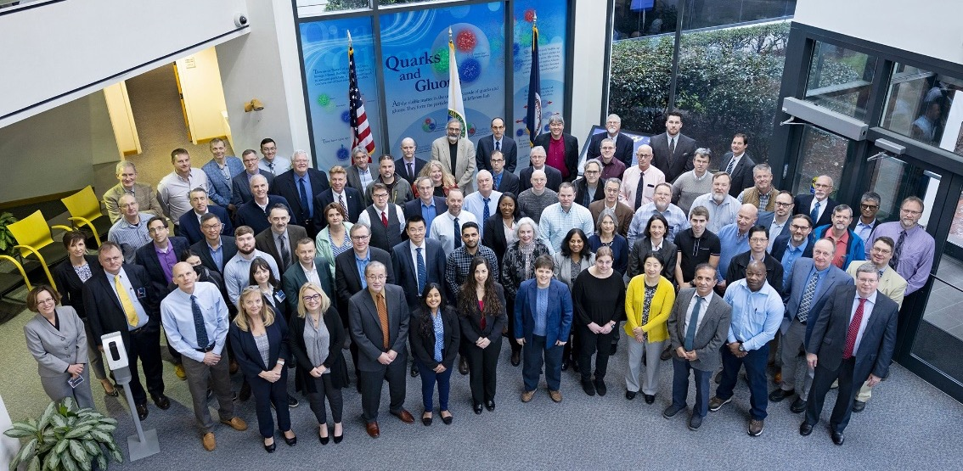
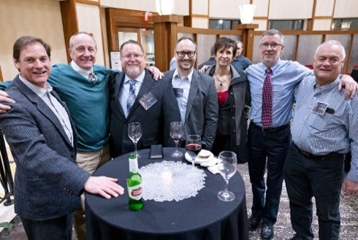
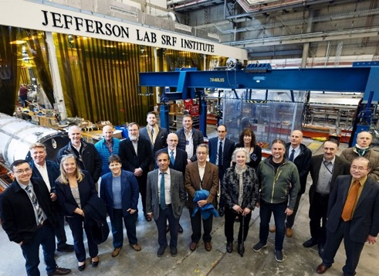
DOE EIC OPA Status Review – Jan 31st to Feb 2nd 2023
Hosted by JLab; 42 members of BNL team traveled for event, toured JLab facilities
  Opportunity to share JLab accelerator facilities/expertise with BNL/DOE colleagues
Assessed readiness for CD-3A in early FY24
  Committee complimented significant progress and made 17 Recommendations

