Slide 1
EIC News
Rolf Ent (JLab)
Co-Associate Director for the EIC Experimental Program
EIC Group Leader
JLUO Annual Meeting
Jefferson Lab, Newport News, VA
June 28, 2023
Electron Ion Collider

Slide 2
Outline
“EIC News”:
EIC Group and EIC Project Detector - Organization
EIC Scope – Uniqueness of EIC
Schedule & Funding Profile
Planning Perspective
EICUG Meeting and EIC Resource Review Board Meeting(s)
EIC Status: Take-Away Messages
Note that you will after this talk hear about:
  EIC Accelerator Design – Todd Satogata
  The ePIC Detector – John Lajoie
  Opportunities with a 2nd EIC Interaction Point – Pawel Nadel-Turonski

Slide 3
EIC Group
(EIC Group: Diefenthaler, Ent, Furletova, Girod, Romanov, and (partial) Higinbotham and Weiss, and integrated support from other JLab staff scientists, joint affiliates, JLab/EIC users, EIC fellowships, etc., etc.)
The mission of Jefferson Lab’s Electron-Ion Collider (EIC) Group is to advance the science program of the EIC, to support the EIC project, and to provide a regional hub for analyzing future EIC data.*
The primary research goals of the EIC Group are to:
  Accelerate femtoscale microscopy of atomic nuclei and the understanding of the underlying quark-gluon dynamics. To achieve this, leverage the synergy between nuclear science at Jefferson Lab and the EIC, as well as the triad of advanced detector technologies, scientific computing and theory.
  Provide scientific guidance for the EIC project using a modular simulation, reconstruction, and analysis toolkit for detector and physics studies to guide detector design, construction, and commissioning.
  Maintain and promote a close connection between the EIC and the Users community at Jefferson Lab. Mentor the future nuclear physics workforce towards the co-hosted EIC science program.
*Adjusted from last year’s version

Slide 4
EIC Group
EIC Detector (Project):
Rely on new hires (e.g., EE-I with FEG, MD-I with MG) but mainly help from others, like some dedicated ME’s and MD’s from Engineering Division, and some part-time help from many friends in Physics Division (and other).
Physics Division
Cynthia Keppel
Patrizia Rossi
EIC Partner Project
Jim Fast
EIC Hires in Physics:
(Magnet Group)
Rachel Fulda (ME)
Kaiyi Hall (MD)
(Fast Electronics Group)
Steve Titus (EE)
Gabby Beddard (EE)
(Detector Support)
Joel Watkins (CST, Comp. Sci.)
Arshak Asaturyan (soon)
(Searches)
Detector scientist
Work coordinator + Techs
EIC Detector support from Engineering Div.:
Alex Eslinger (ME)
Chinmay Andhare (ME)
Ron Lassiter (MD)
Jonathan Smith (MD)
Also help from Marcy Stutzman (Accelerator)
EIC
Rolf Ent
EIC Detector
David Abbott*
Walt Akers*
Fernando Barbosa*
Brian Eng*
Yulia Furletova*
David Gaskell*
Renuka Rajput-Ghoshal*
Beni Zihlmann*
EIC Group
Markus Diefenthaler
Yulia Furletova
F-X Girod
Dmitry Romanov
Christian Weiss*
EIC Science:
Small EIC Group, with help from many (part-time) interested others in various JLab Divisions and the user community, like for work on the Yellow Report, detector proposals and now ePIC.
In addition, much help from EIC fellowships coming in through EIC2 Center.
EIC Center
Doug Higinbotham*

Slide 5
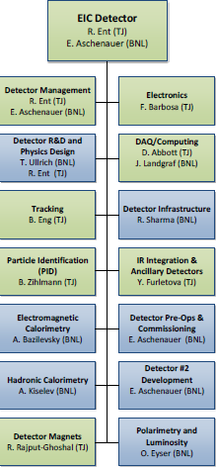
EIC Detector Project – joint JLab and BNL responsibility
Slide from last year, with one sub-bullet added
Do not use this CAM responsibility organization as Black and White
We plan to support user efforts where it makes sense
  L4 Electron Polarimetry “in the blue” does have a JLab CAM, Detector R&D and DAQ/Computing is joined
  The Si sensor design is much more natural to BNL
  The Si sensor QA or Si tracker integration we/JLab does have valuable expertise
  The PbWO4 and Sci-Glass Electromagnetic Calorimetry is much more aligned with JLab user experience
  On the other hand, the experience in Hadronic Calorimetry is very limited at JLab and much more so at BNL
We plan to use synergy with JLab’s 12-GeV science program and Advanced Computing efforts as much as possible
  Natural for nuclear femtography science goal
  Natural synergy with HPDF ambition, and with JLab’s acknowledged leadership in streaming readout and AI/ML
  Also natural synergy in certain detector technologies and user interests (RICH, DIRC, PbWO4, MPGDs)

Slide 6

Next Stage (ongoing) – Integrating the ePIC Collaboration
6.10.04 Particle
Identification
Level-3
L4 CAM from Project
+
DSTC from
L3 CAM from Project
6.10.04.01 Backward RICH
Level-4
6.10.04.02 Barrel DIRC
Level-4
6.10.04.03 dRICH
Level-4
6.10.04.04 Time-of-Flight
Level-4
Work Package lead
from
6.10.04.04.01
bToF
Level-5
6.10.04.04.02
fToF
Level-5
Work Package lead
from
Work Package lead
from
Work Package lead
from
Work Package lead
from
Work Package lead
from
Here a bit trickier as we have
to think how to roll up at L5 and
the collaboration suggested to
add a common system at L5

Slide 7

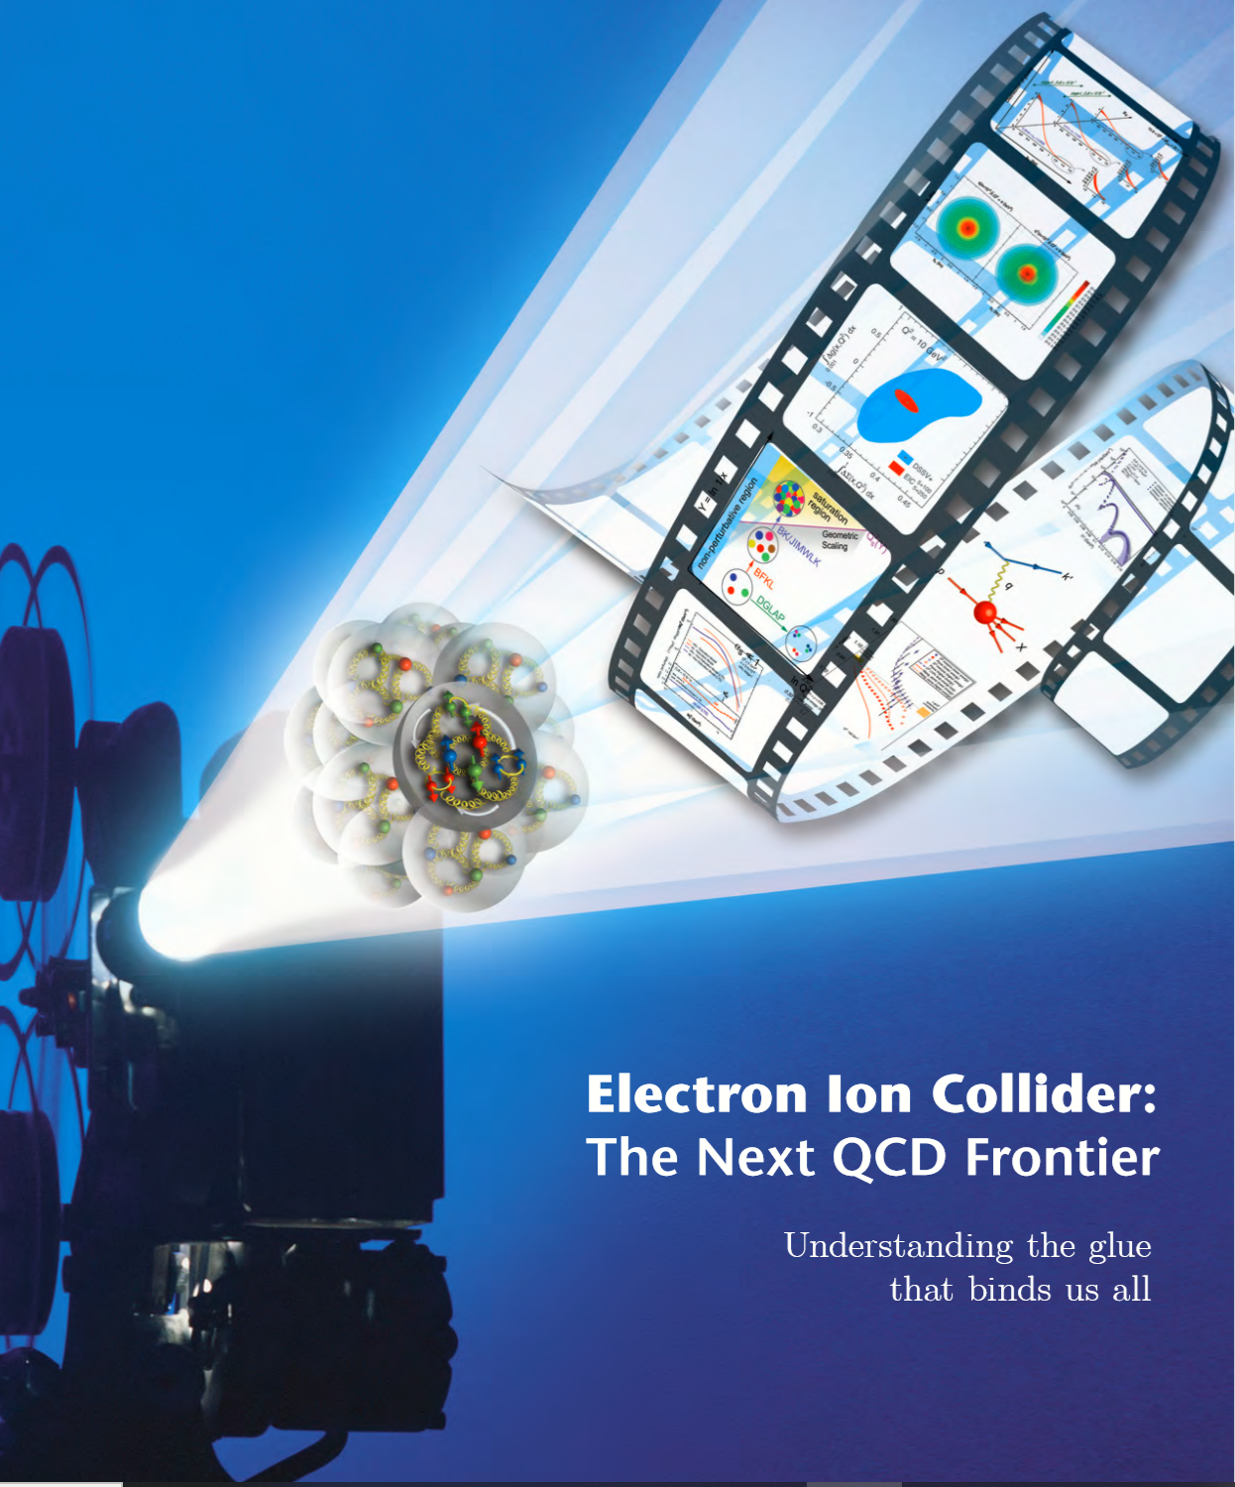
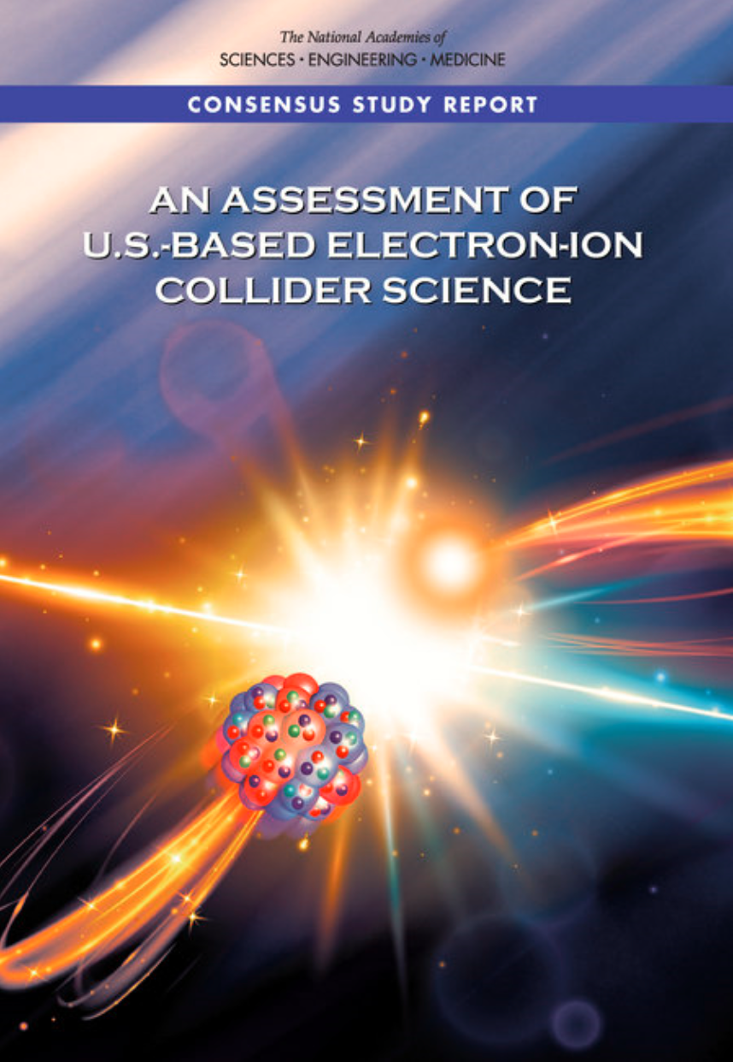

EIC Scope
Project Design Goals
High Luminosity: L= 10³³ – 10³⁴cm⁻²sec⁻¹, 10 – 100 fb⁻¹/year
Highly Polarized Beams: 70%
Large Center of Mass Energy Range: E_{cm} = 29 – 140 GeV
Large Ion Species Range: protons – Uranium
Large Detector Acceptance and Good Background Conditions
Accommodate a Second Interaction Region (IR)
IR-8
IR-6, ePIC Detector
IR-8
p/A beam
e beam
p: 41 GeV, 100 to 275 GeV
e: 5 GeV to 18 GeV

Slide 8
EIC Experimental Program Preparation
Year-long EIC User Group driven EIC Yellow Report activity (December 2019 – February 2021)
  Science Requirements and Detector Concepts for the EIC
  arXiv:2103.05419 & Nucl. Phys. A 1026 (2022) 122447 – 555 citations (06/26/2023)
BNL and TJNAF Jointly Leading Efforts Towards Experimental Program | BNL and TJNAF Jointly Leading Process to Select Project Detector
2020 | Call for Expressions of Interest (EOI) https://www.bnl.gov/eic/EOI.php | May 2020
 | EOI Responses Submitted | November 2020
 | Assessment of EOI Responses | On-going&
2021 | Call for Collaboration Proposals for Detectors https://www.bnl.gov/eic/CFC.php | March 2021
 | BNL/TJNAF Proposal Evaluation Committee | Spring 2021
 | Collaboration Proposals for Detectors Submitted | December 2021
2022 | Decision on Project Detector – baseline “ECCE” | March 2022
 | Process to consolidate ECCE & ATHENA to the EIC Project Detector | Spring 2022
 | ePIC Collaboration* Formed – 160 institutions | July 2022
2023 | ePIC Charter ratified & elected Leadership Team | February 2023
 | 1st Resources Review Board Meeting | April 2023
 | ePIC Detector remaining technology choices made | April 2023
&Remains ongoing until formal agreements are in place – it originally led to confirmation that in-kind level assumed for the EIC detector was in range.
8
*Merger of two large ATHENA and ECCE proposals

Slide 9
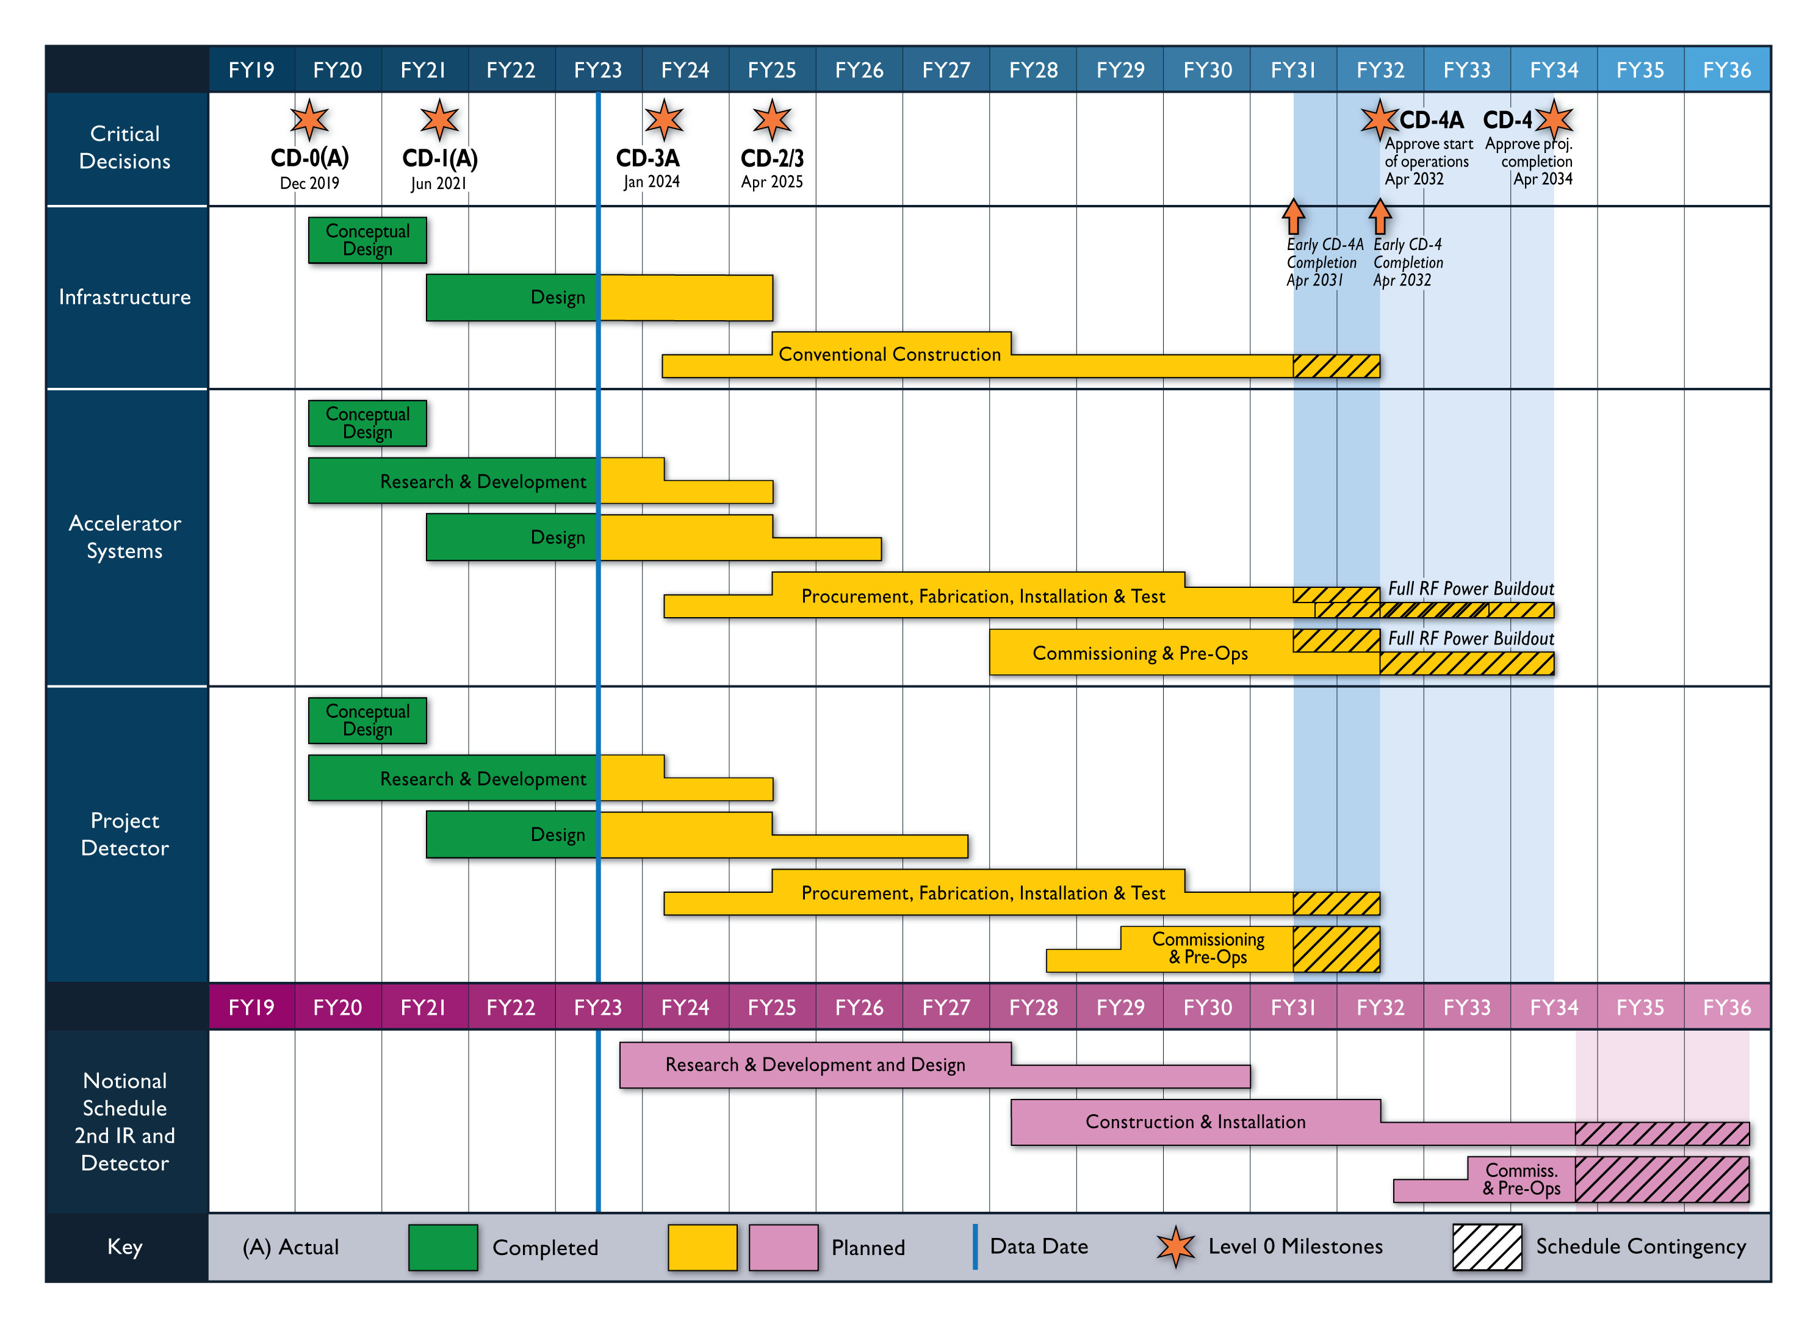
High Level EIC Reference Schedule
Construction Phase
Science Phase
The thinner bars indicate that R&D and design
can continue at a small level beyond CD-2 and CD-3
for LLP construction
starts at CD-3A
Generic Detector R&D
Schedule

Slide 10
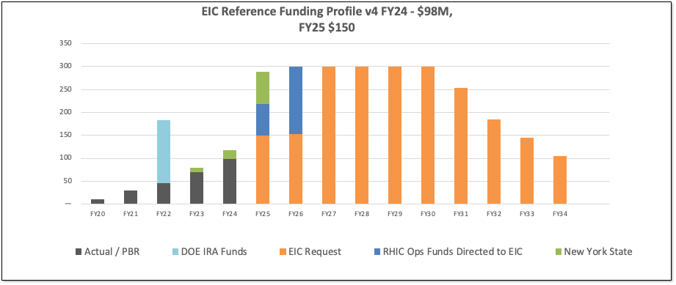
DOE Reference Funding Plan
☺
DOE Inflation Reduction Act funding of $138M allocated in September 2022. Actual FY2023 funding is $70M. DOE request for FY2024 is $98M.
RHIC shut down planned for June 2025. Significant RHIC Operations funding will be redirected to EIC construction starting in FY2025 and reaching ~$150M/year in FY2026.
Current funding supports DOE CD-3A, Long Lead Procurement Approval, in January 2024. Long lead procurement mitigate risks: technical, supply chain, inflation, and schedule.
In-kind contributions anticipated at 5% of accelerator and 30% of the detector, in addition to $100M from NY State (in green).

Slide 11
EIC Project – Path to CD-3A and CD-2/3
DOE OPA Status Review (Remote) October 19-21, 2021(A)
Funding Discussion at DOE ONP (In-Person) April 26, 2022 (A)
FPD Status Update at BNL (Hybrid) June 28-30, 2022 (A)
Cost and Schedule Scrutiny Meetings July - September 2022 (A)
Project Detector Meetings 2022
  Technical Subsystem Reviews Feb. – Dec. 2022
  Pre-Resource Review Board Kickoff Meeting October 2022
DOE OPA Status Review - Confirm CD-3A Plans Jan. 31 – Feb. 2, 2023 (A)
Subsystem Preliminary and Final (LLP) Design Reviews 2023
DOE CD-3A Design Reviews (MAC, DAC) August/September 2023
DOE CD-3A ICR (Independent Costing Review) October 10-12, 2023
DOE CD-3A IPR (Independent Project Review) November 14-16, 2023
DOE CD-3A ESAAB Approval ~January 2024
DOE CD-2/3 OPA Review, requires TDR ~January 2025
DOE CD-2/3 ESAAB Approval ~April 2025
OPA = Office of Project Assessment
FPD = Federal Project Director
ICR = Independent Cost Review
ESAAB = Energy Systems Acquisition Advisory Board
TDR = Technical Design Report

Slide 12
EIC Planning Perspective
EIC is a unique high-energy, high-luminosity polarized beam collider that will be one of the most challenging and exciting accelerator complexes ever built.
There is international interest in the EIC, and DOE and the host labs are promoting the EIC as a facility that is “fully international in character.”
EIC facility will ultimately include a second interaction region (2nd IR) and detector. The R&D required for the 2nd IR and detector has started at a modest level.
DOE project, safety performance, and diversity, equity and inclusion goals and culture are valued by stakeholders.
Time between the conclusion of RHIC operations and the start of EIC operations should be as short as possible.

Slide 13
The EIC – A Unique Collider
EIC
LHC /RHIC
collide different beam species: ep & eA
consequences for beam backgrounds
  hadron beam backgrounds,
  i.e. beam gas events
  → synchrotron radiation
asymmetric beam energies
boosted kinematics
  high activity at high |η|
Small bunch spacing: 10 ns
crossing angle: 25 mrad
wide range in center of mass energies
factor 6
both beams are polarized
→ stat uncertainty: ~ 1/(P₁P₂ (∫L dt )^{1/2})
collide the same beam species: pp, pA, AA
→ beam backgrounds
  hadron beam backgrounds,
  i.e. beam gas events, high pile up
symmetric beam energies
kinematics is not boosted
  most activity at midrapidity
moderate bunch spacing: 25 ns
no significant crossing angle yet (150 μrad now)
LHC limited range in center of mass energies
factor 2
RHIC wide range in center of mass energies :
→ factor 26 in AA and 8 in pp
no beam polarization
→ stat uncertainty: ~1/(∫L dt )^{1/2}
Differences impact detector acceptance and possible detector technologies

Slide 14
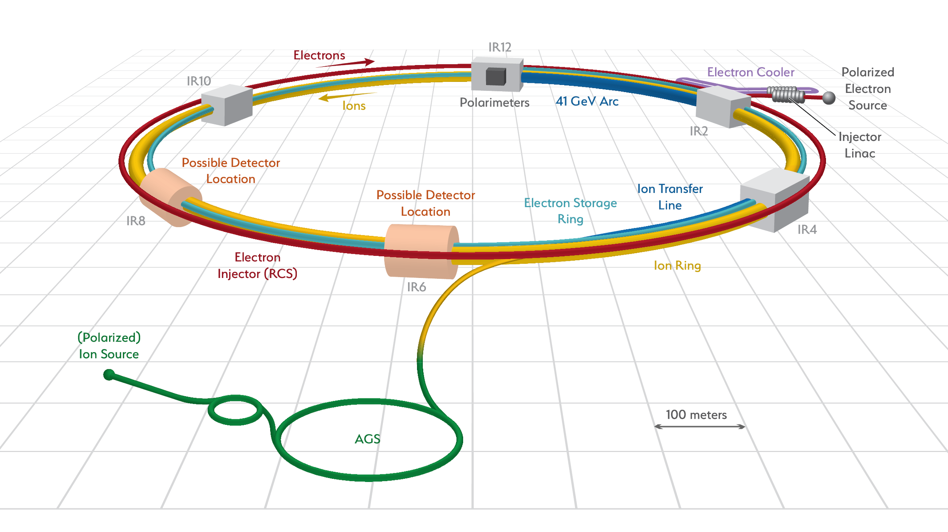
Accelerator Science and Technology – Ongoing EIC R&D
Cooler Electron Source
ESR
Vacuum R&D
Electron Injection
Fast Kicker
Strong Cooling
Polarized e⁻ Source
ESR Cavity
Prototype
HSR Vacuum Upgrade
ESR RF 500kW FPC
2nd IR
ePIC
Hadron Polarimetry
ESR RF HOM Damper
Crab Cavity
Prototype
Proton Injection
Fast Kicker
IR Design and Magnet Prototyping
IR Vacuum Chamber
Existing tunnel and
experiment halls
EIC is the ONLY new collider in foreseeable future! Allows to remain at frontier of Accelerator S&T

Slide 15
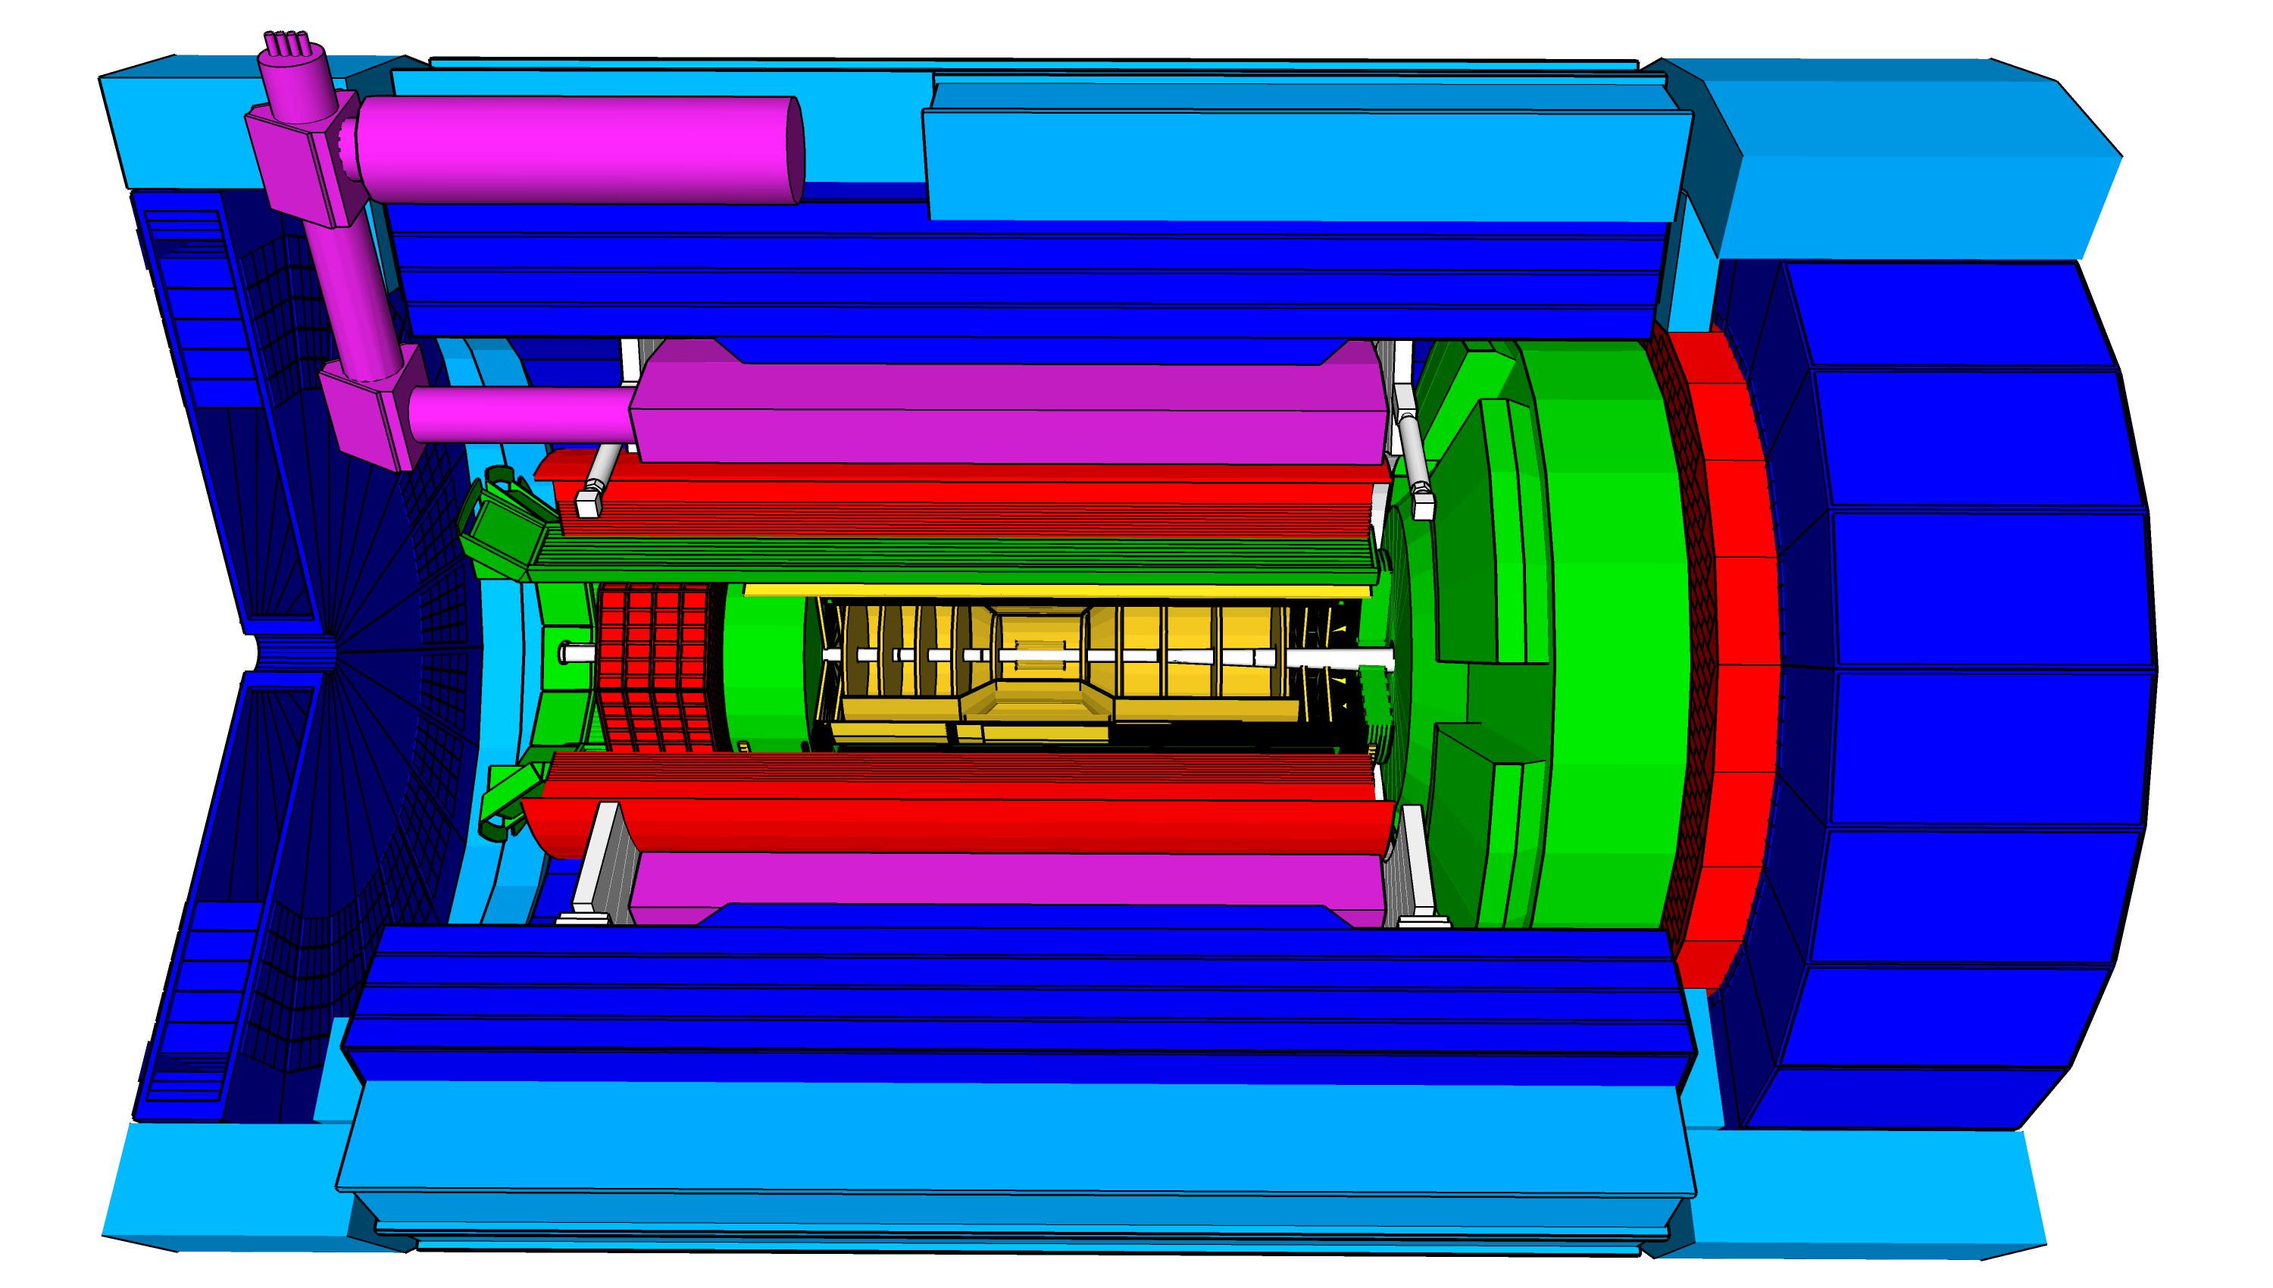
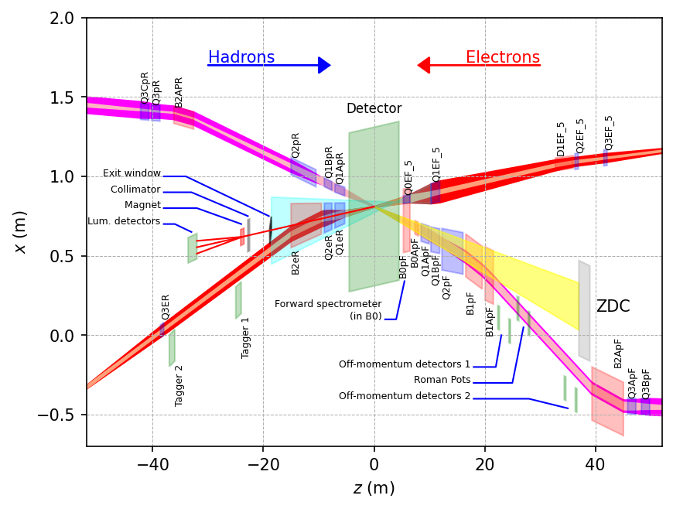
ePIC Detector
hadronic calorimeters (HCAL)
Asymmetric beam energies
→ require an asymmetric detector Barrel
with electron and hadron endcap
→ 9.5 m
→ Tracking, particle identification, EM
calorimetry and hadronic calorimetry
functionality in all directions
→ very compact Detector Integration
will be key
Imaging science program with protons and nuclei
→ requires specialized detectors
integrated in the Interaction Region
over 80 m
Science program required momentum resolution
→ requires a large bore 2T magnet
(1.7 T magnet operation point, stretch goal 2T)
that has same geometry as the BaBAR magnet.
Streaming readout electronics model
→ highest scientific flexibility
Solenoidal Magnet
e/m calorimeters (ECal)
Time.of.Flight (ToF), DIRC,
RICH detectors
MPGD trackers
MAPS tracker
23 Subdetectors
incl. Polarimeters
+ Data Acquisition
9.5 m

Slide 16
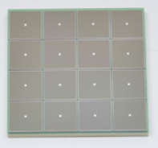
Electronics
We have 23 different detector technologies in the ePIC detector
It would be intractable if all have different readout electronics
→ the goal is to minimize the number of different ASICs and use common readout solutions
→ yet all ASICs need to be consistent with the EIC-adopted streaming readout architecture
Global Timing Unit (GTU)
-Interfaces to
Collider Run Control & DAM
-Config & Control
-Clock & Timing
Electronics Readout Chain
On Detector
SMT BGA
Sensor
Adapter
Front End Board (FEB)
Readout Board (RDO)
Data Aggregation Module (DAM)
Computing
Detector Group | Channels | AC-LGAD | SiPM/PMT | MPGD
 | MAPS | AC/DC-LGAD | SiPM/PMT | MPGD
TOTAL | 32 B | 7.1M-54M | 370k | 100k
ASIC | ITS-3 | EICROC FCFD HPsOC ASROC FAST | Discrete/COTS HGCROC3 ALCOR-EIC | SALSA
We expect to need ITS-3, Astropix, Timepix, and 4 different ASICs
Based on existing ASICs → reduce cost & time
Much synergy with international efforts

Slide 17
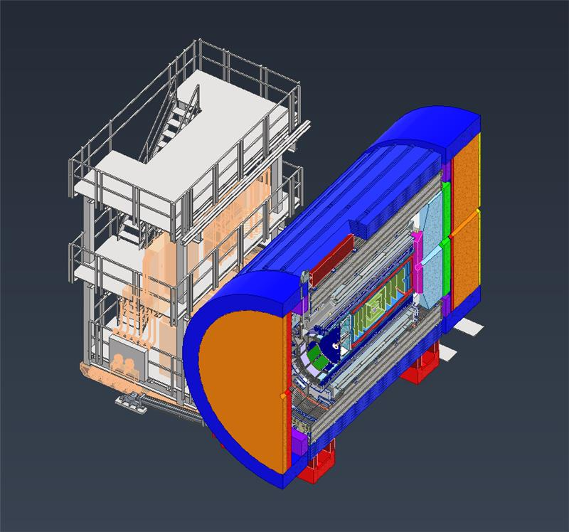
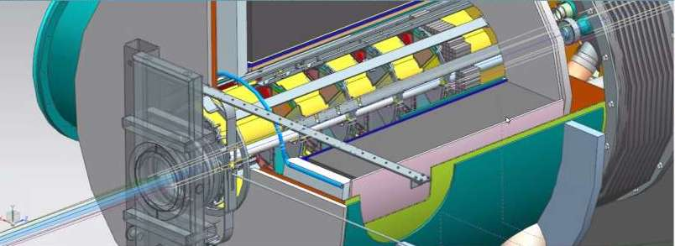
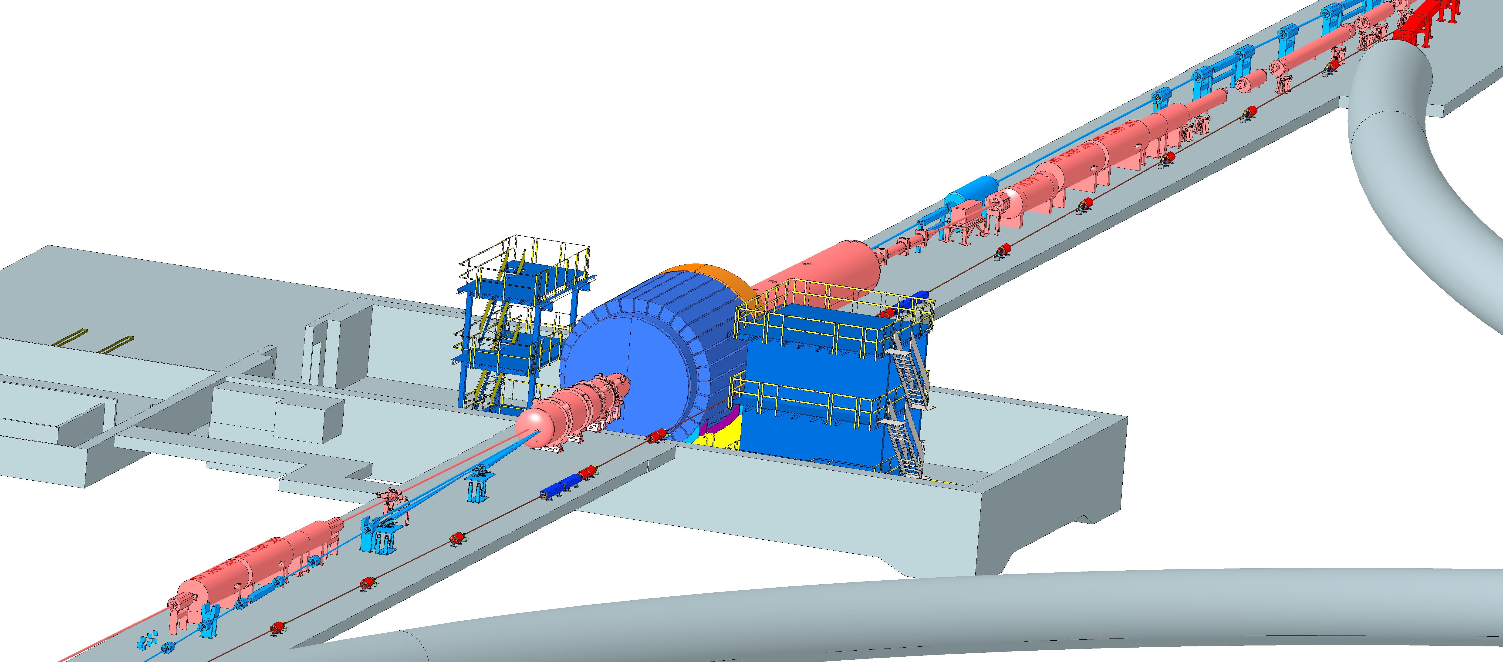
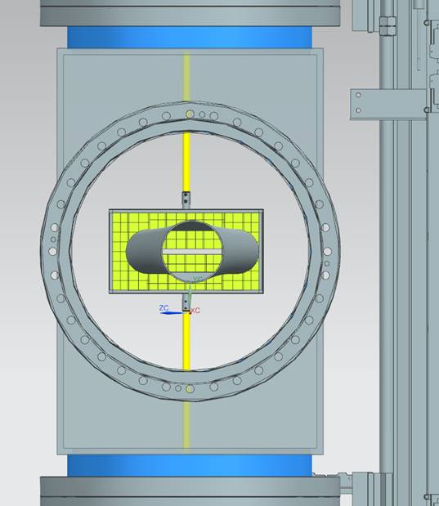
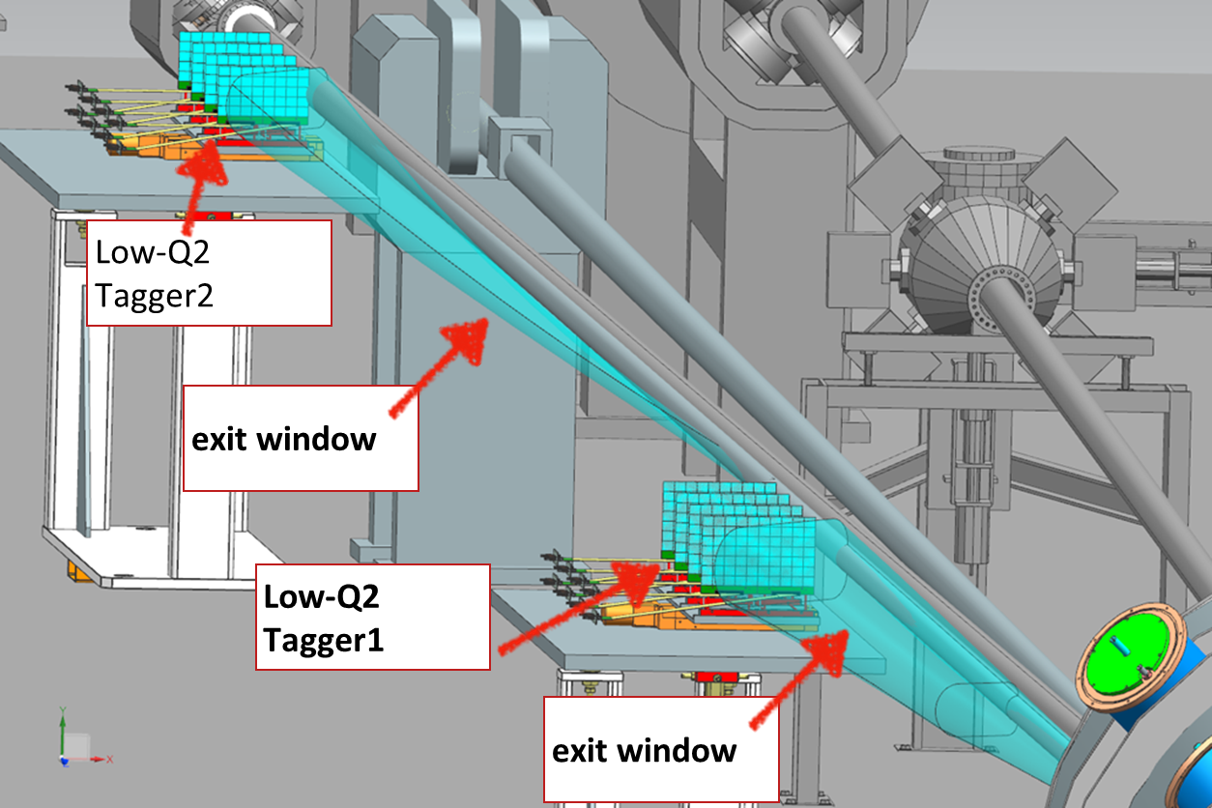
Interaction Region Layout
Central Detector
ESR Forward side
Detectors in B0 magnet
Roman Pots
Forward Side
SC Magnet Cryostat
HSR Injection Line
Central Detector
Rear Side
SC Magnet Cryostat
HSR Forward Side
HSR: Hadron Storage Ring
ESR: Electron Storage Ring
RCS: Rapid Cycling Synchrotron
SC: Superconducting
HSR
Rear Side
RCS
With Detector Bypass
Low-Q2 Detectors
ESR Rear side
every cm counts… → integration and communication with accelerator team is crucial

Slide 18
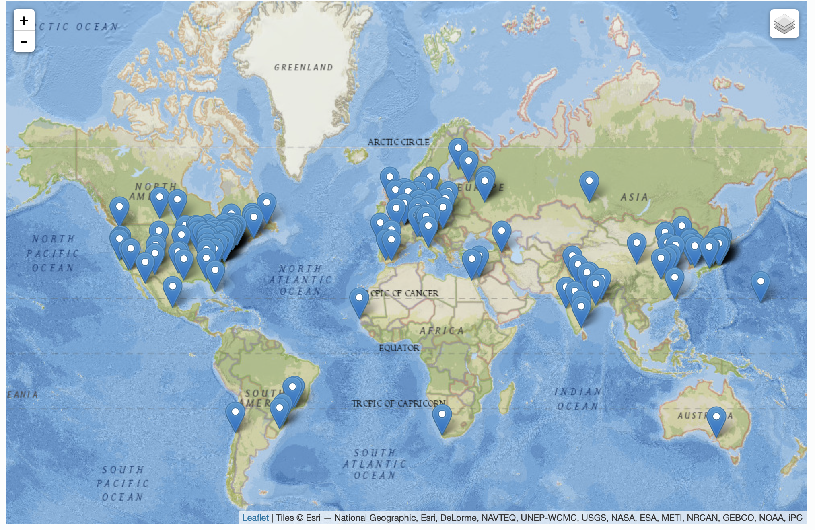
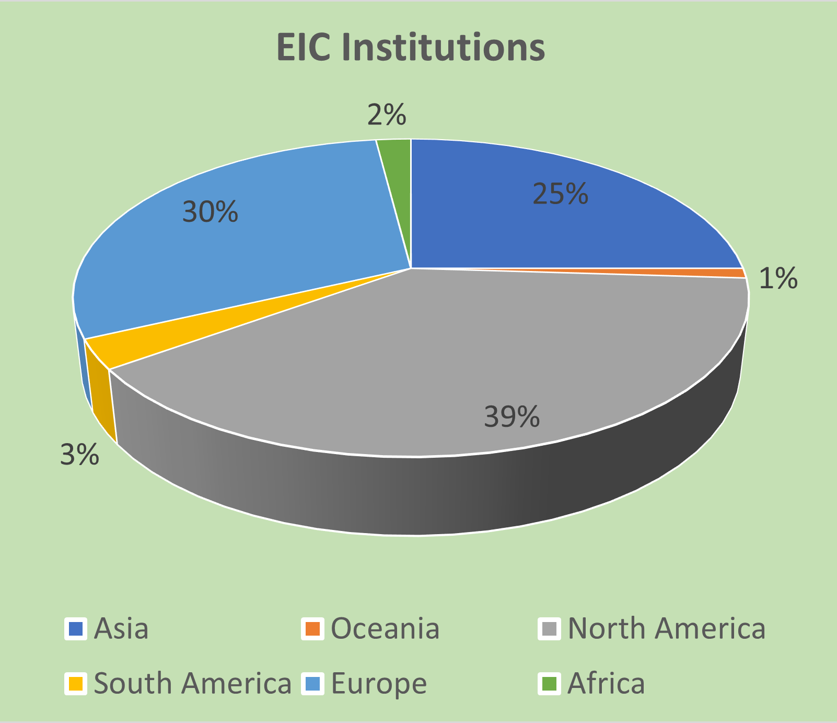
Worldwide Interest in EIC
The EIC User Group: https://eicug.github.io/
Map of institution’s locations
Formed 2016 –
1386 collaborators,
36 countries,
275 institutions as of June 26, 2023.
Strong and Growing International Participation.
Annual EICUG meeting
2016 UC Berkeley, CA
2016 Argonne, IL
2017 Trieste, Italy
2018 CUA, Washington, DC
2019 Paris, France
2020 Miami, FL
2021 VUU, VA & UCR, CA
2022 Stony Brook U, NY
2023 Warsaw, Poland
18

Slide 19
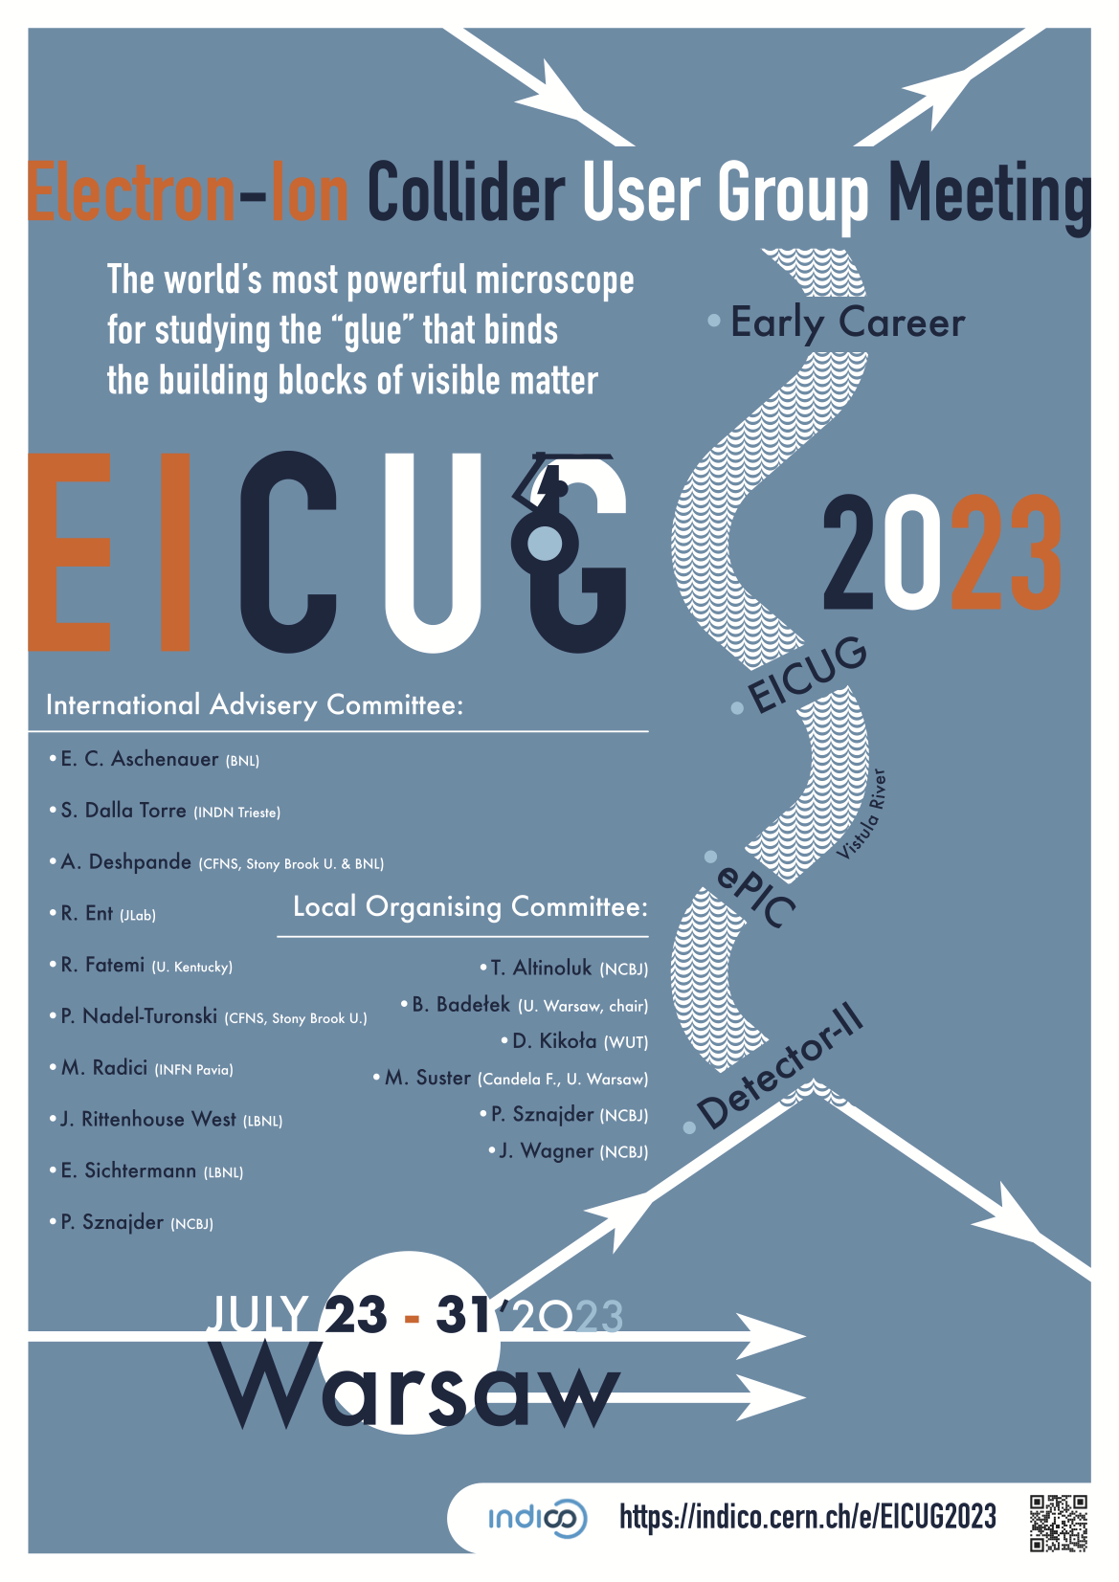
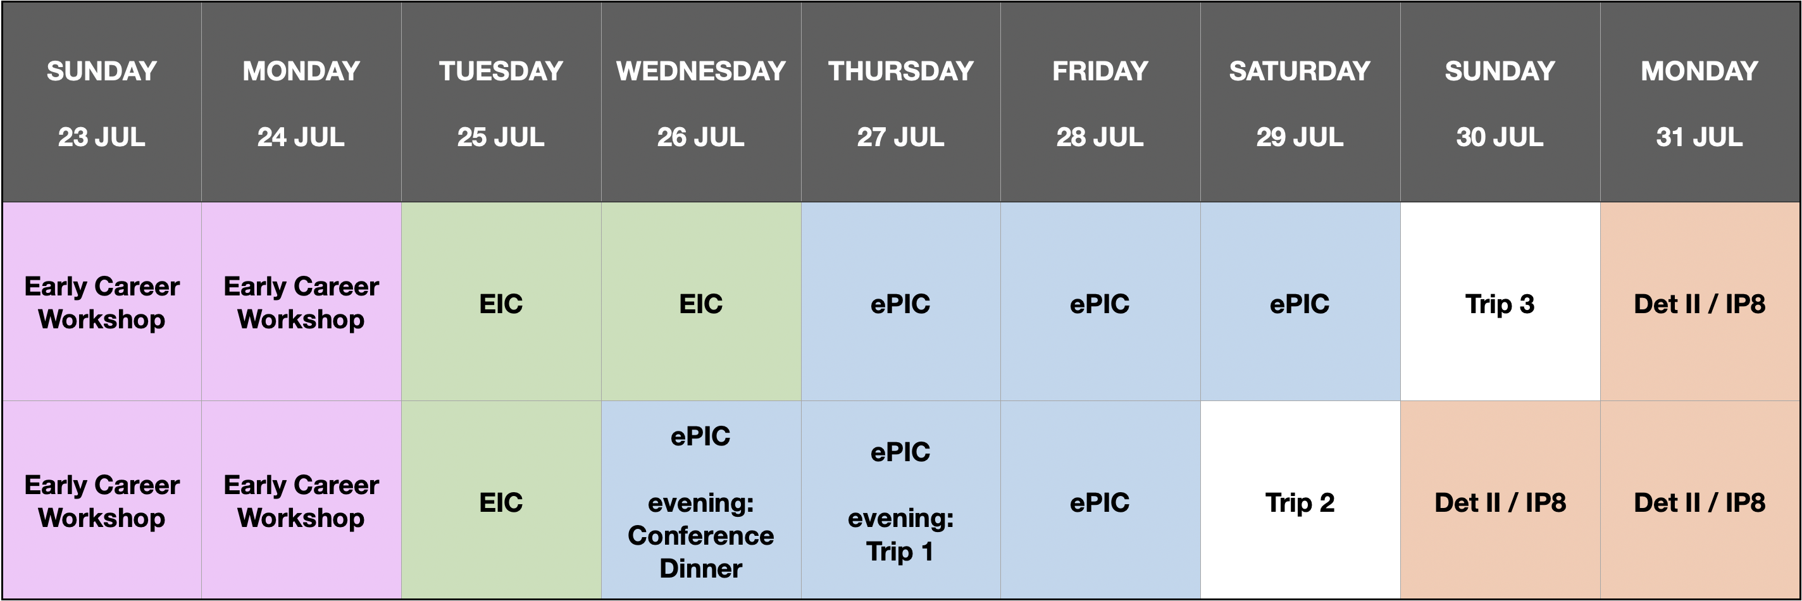
EIC User Group Meeting
EICUG Summer Meeting
July 24-31, University of Warsaw, Warsaw, Poland.
https://indico.cern.ch/e/EICUG2023
Early Career Workshop: https://indico.jlab.org/event/696
Tuesday morning: DOE/NP talk, Project update talk
Wednesday morning: RRB (Resource Review Board) talk

Slide 20
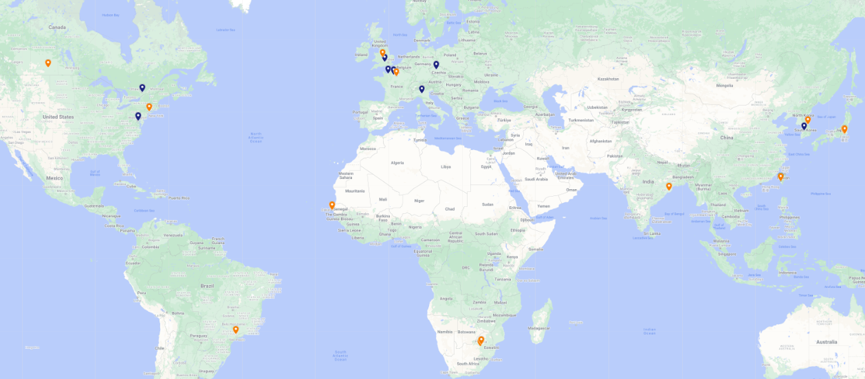
1st Resource Review Board (RRB) Meeting
First meeting on April 3-4, 2023, at Stony Brook University.
DOE and the host labs promoting the EIC as a facility “fully international in character.”
12 countries participating: Blue markers: RRB members; Orange markers: Observers
Agenda reflected what we expect to have in future RRB meetings.
RRB Charter ratified at 1st meeting. Initial Co-Chairs: Haiyan Gao (BNL), Diego Bettoni (INFN).
2nd meeting planned for December 7 + 8 in Washington, DC.
  Topics will include: Common Fund (or not) discussion, Computing (What is expected from partners), Governance (How does change control work for in-kind contributions), Quality Assurance (how does that get folded in reviews and planning documents), International agreements.

Slide 21
Non-DOE Interest & In-Kind - Updated
Entity | Interest and Important Facts
NSF | NSF-MSRI pre-proposal submitted by 10 US universities – aims at full scope of backward EM calorimetry (eECal). Armenia, Czech, France/IN2P3 as unfunded contributors. Invited to submit proposal. Final NSF review is ongoing.
Armenia | Contributions, mainly labor to eECal and many EM calorimetry and particle id detectors component tests.
Canada | EIC included in 2022 Canadian Subatomic Physics Long-Range Plan; Interested in Compton Polarimetry, Barrel Electromagnetic Calorimetry and Software
China | Forward EM Calorimeter
Czech | Working with funding agency; Interested in eECal (PbWO4 crystals and glass) and Silicon
France/IRFU | Interested in MPGD/racking, electronics. Provided in-kind contributions to SC magnet design and interested to continue labor oversight during magnet construction.
France/IN2P3 | International contribution to backward EM calorimetry (including in-kind design) and to readout electronics (two ASICs for AC-LGAD detectors and Calorimetry). IRFU & IN2P3 discussing together for higher-level contributions.
India | Consortium is working with Funding agency; Interested in detector software (non-project scientific contribution), contributions to DAQ/slow controls. Investigating further hardware contributions (including possible links with Si plants).
Italy/INFN | Aims at major scope of forward particle identification detector (dRICH), at (part of) the Si/MAPS tracker scope, and at photo-sensor contributions. Further investigating possible interest in EIC detector magnet scope.
Israel | B0 Detectors (Si tracking and PbWO4)
Japan | Interested in a US-Japan agreement; Aims at full scope of Zero-Degree Calorimeter in collaboration with Taiwan/Korea. Pursuit of full scope of barrel AC-LGAD detector as EIC-Asia consortium. Contribution to DAQ/streaming. Possible aerogel.
Korea | Aims at major scope for fiber-based barrel EM calorimeter, Also work packages for barrel AC-LGAD and Si-based hadronic calorimetry for ZDC.as part of EIC-Asia consortium (includes also Japan,Taiwan), Collaboration on Si tracking detector.
Poland | Actively working with ministry/funding agency; Interested in detectors along the beam line (luminosity detector, Roman Pots)
Taiwan | Pursuit of full scope of barrel AC-LGAD as part of EIC-Asia consortium. LYSO-based EM calorimeter for ZDC, Also optical readout/fiber. Possible later interest in PCBs. Computing.
UK | STFC seed funding for UK detector R&D (3M£). Interest in Si/MAPS tracker, polarimetry and detectors along the beams (Low-Q2/TimePix). Follow-up STFC/UKRI request for 5-7 years submitted early 2023 (includes accelerator part).

Slide 22
EIC Status: Take-Away Messages
“Now is the time to realize the EIC in the U.S.” (LRP 2015).
  The NAS Report concluded: “EIC science is compelling, timely and fundamental.”
  The EIC Science Case is as strong as, if not stronger than, before.
  EIC has strong DOE support and increasing international engagement.
  The EIC is executed as a partnership of BNL and JLab, with growing interest from ANL, LBNL, ORNL, …
There is strong science interest in EIC
  The EIC User Group currently stands at 1386 members in 36 countries.
  This is a strong community that has delivered on the EIC Science White Paper, the Yellow Report, and three detector proposals now culminating in ePIC.
  Efforts towards the ePIC detector and a path to a 2nd detector (augmented by the DOE/NP support for a generic EIC detector R&D program) are ongoing.
Excellent progress on the detector – designs are maturing with help of our many friends.
  This constitutes a ~$5M in-kind non-DOE PED contribution.
  The past and present EIC detector R&D program similarly has benefitted from large in-kind contributions.
  Various possible in-kind contributions to detector construction further maturing with funding agencies worldwide.
IRA funding resulted in a phase change – the schedule for EIC to CD-2/3 (~2025) becomes mature.
  The IRA funding underscores DOE/SC is committed to EIC as a top priority
  The immediate focus of the EIC Project will be to reach CD-3A (Early 2024).
The EIC is foreseen as international facility
  This is reflected in the governance and advisory boards
  1st Resource Review Board meeting was held April 3-4 at Long Island
  2nd Resource Review Board meeting scheduled for December 7-8 at Washington, DC
There will be one EIC with this high level of performance in the world.

Slide 24
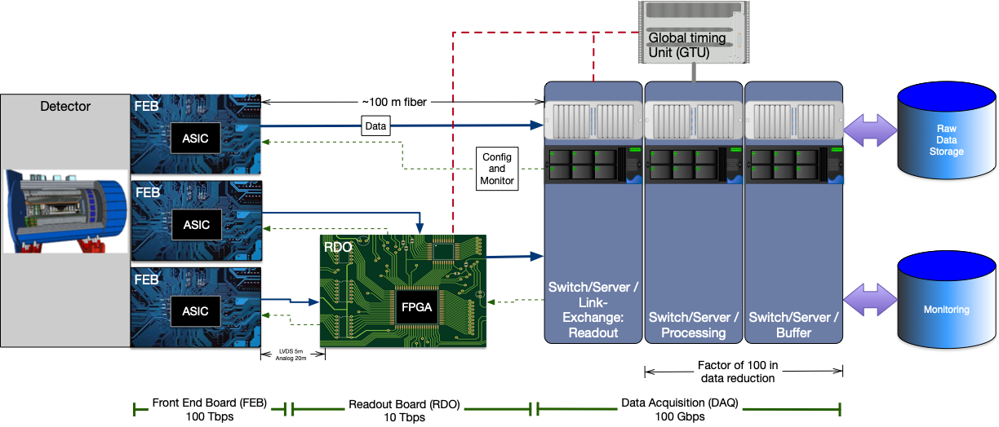
Streaming Readout Architecture
Triggerless streaming architecture gives much more flexibility to do physics
Rates quoted are at output of each stage
Integrate AI/ML as close as possible to subdetectors → cognizant Detector

Slide 25
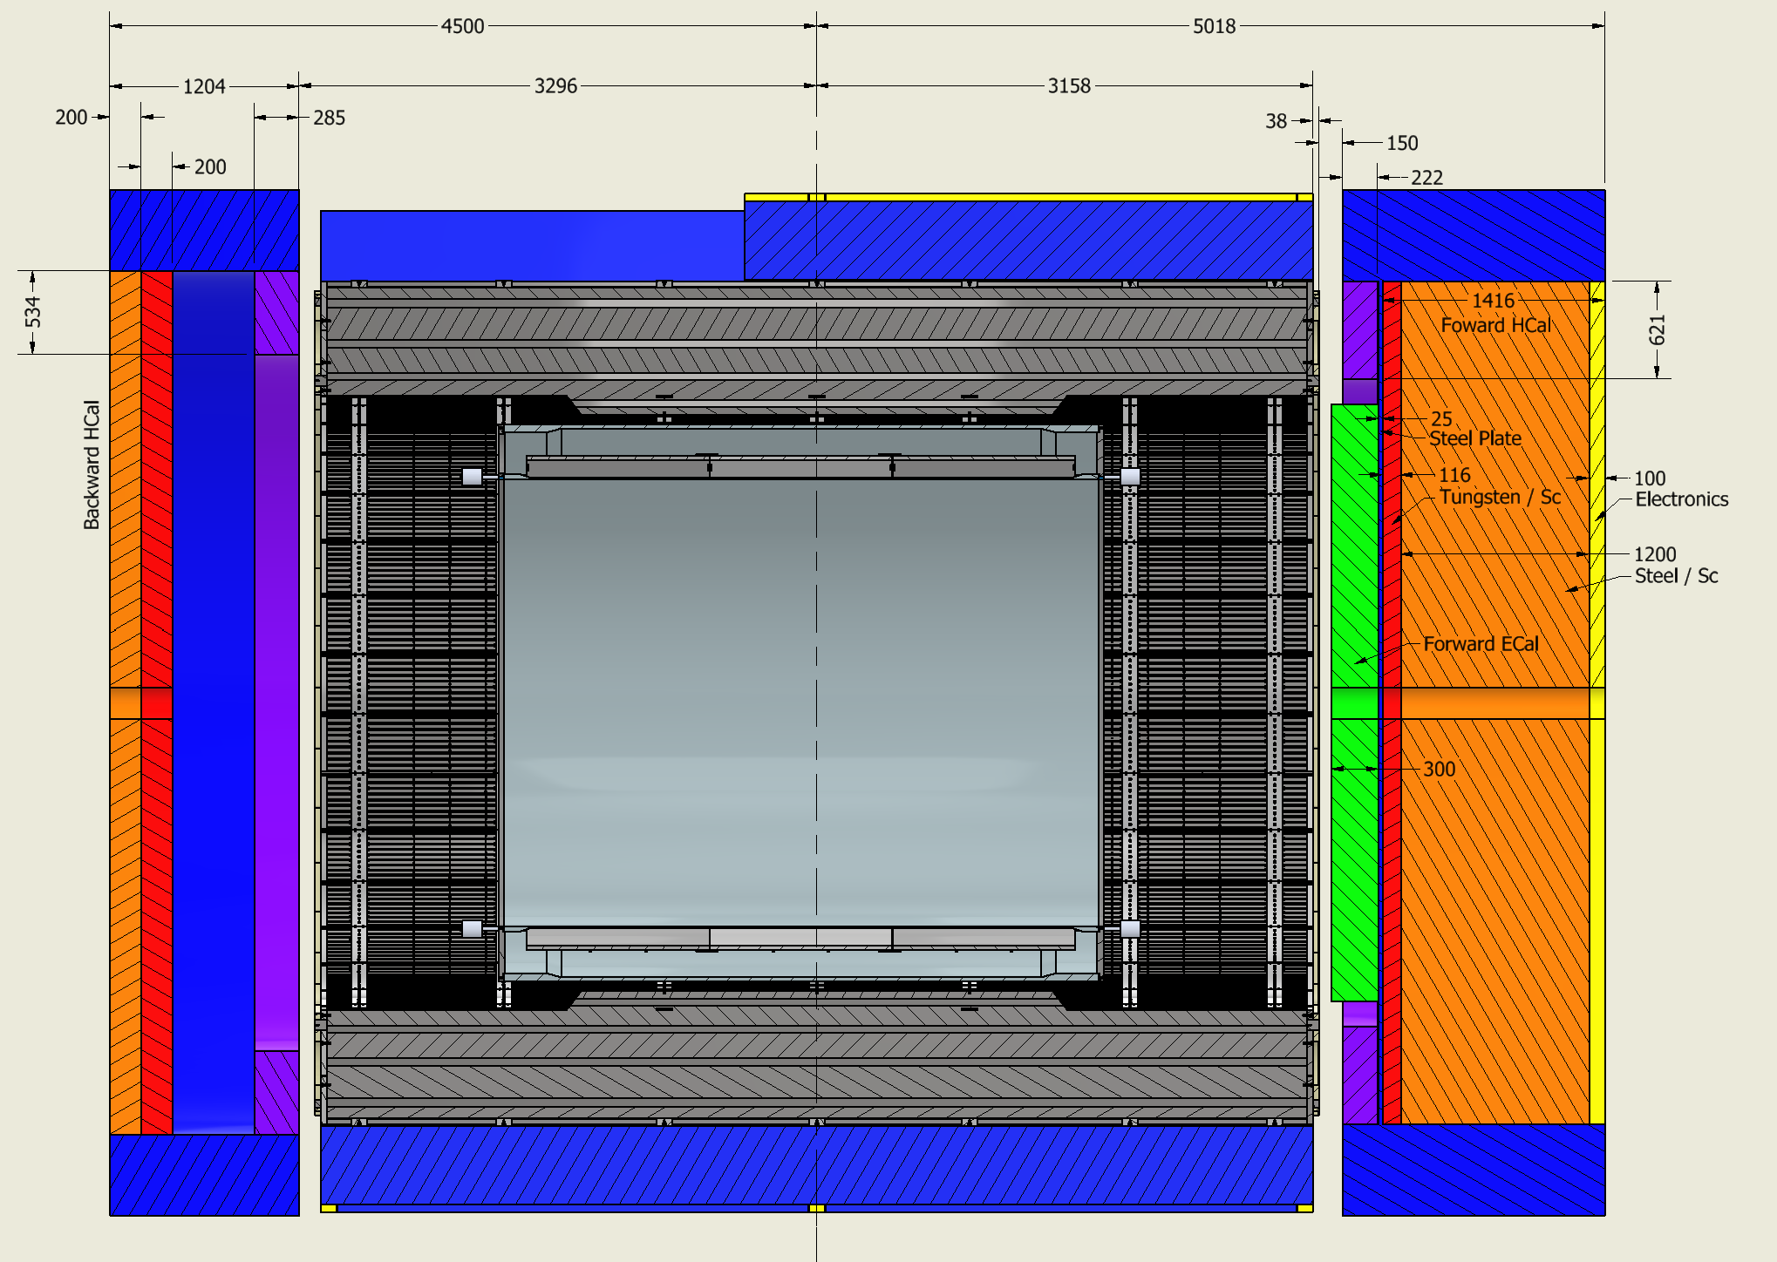
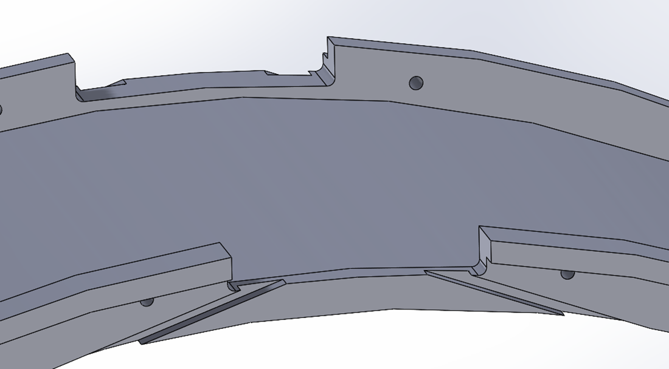
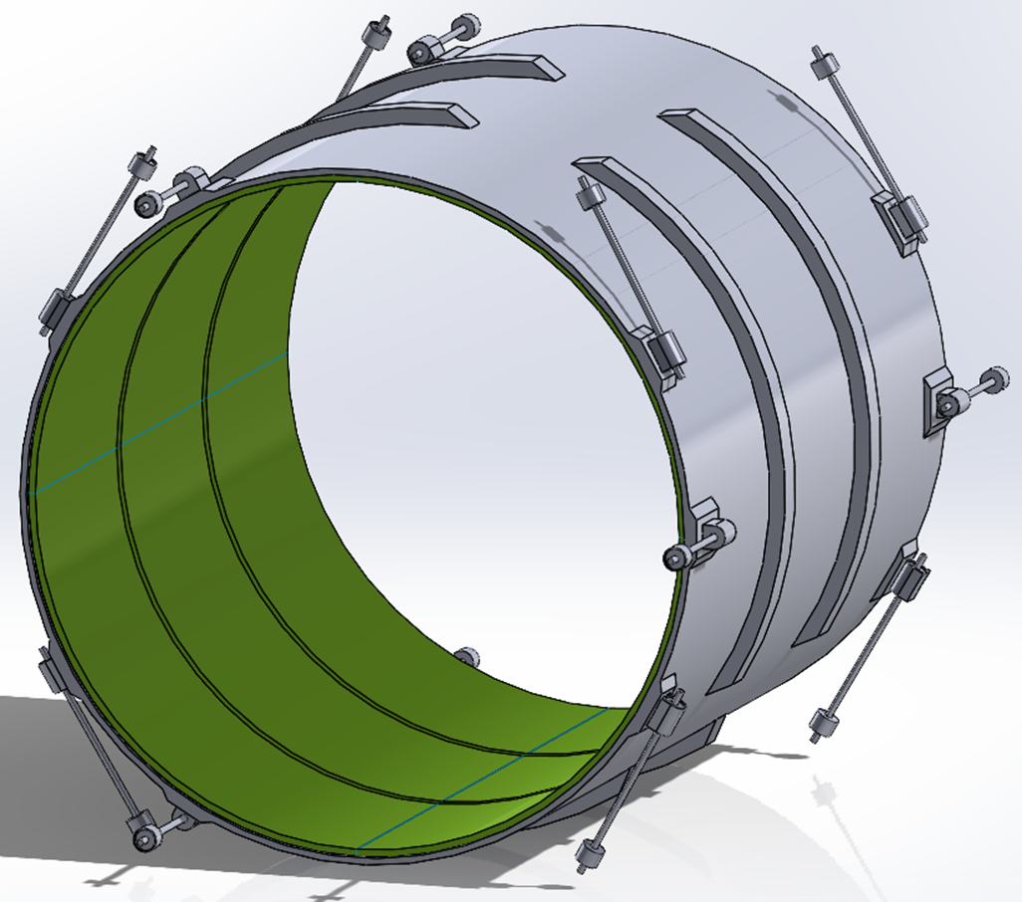
MARCO Magnet Design Details
Steel
Conductor is based on CEA-Saclay experience as used for previous magnets.
Contract for conductor test samples in place with viable vendor.
Coil is divided in 3 modules with 557 Turns each. This is done mainly to accommodate possible conductor length.
Flux return steel layout fully defined to minimize forces and fringe fields (~10G)
The two most important design parameters are conservative: large temperature margin and large critical current margin
Conductor exits
Mechanical analysis undergoing final checks

