Slide 1
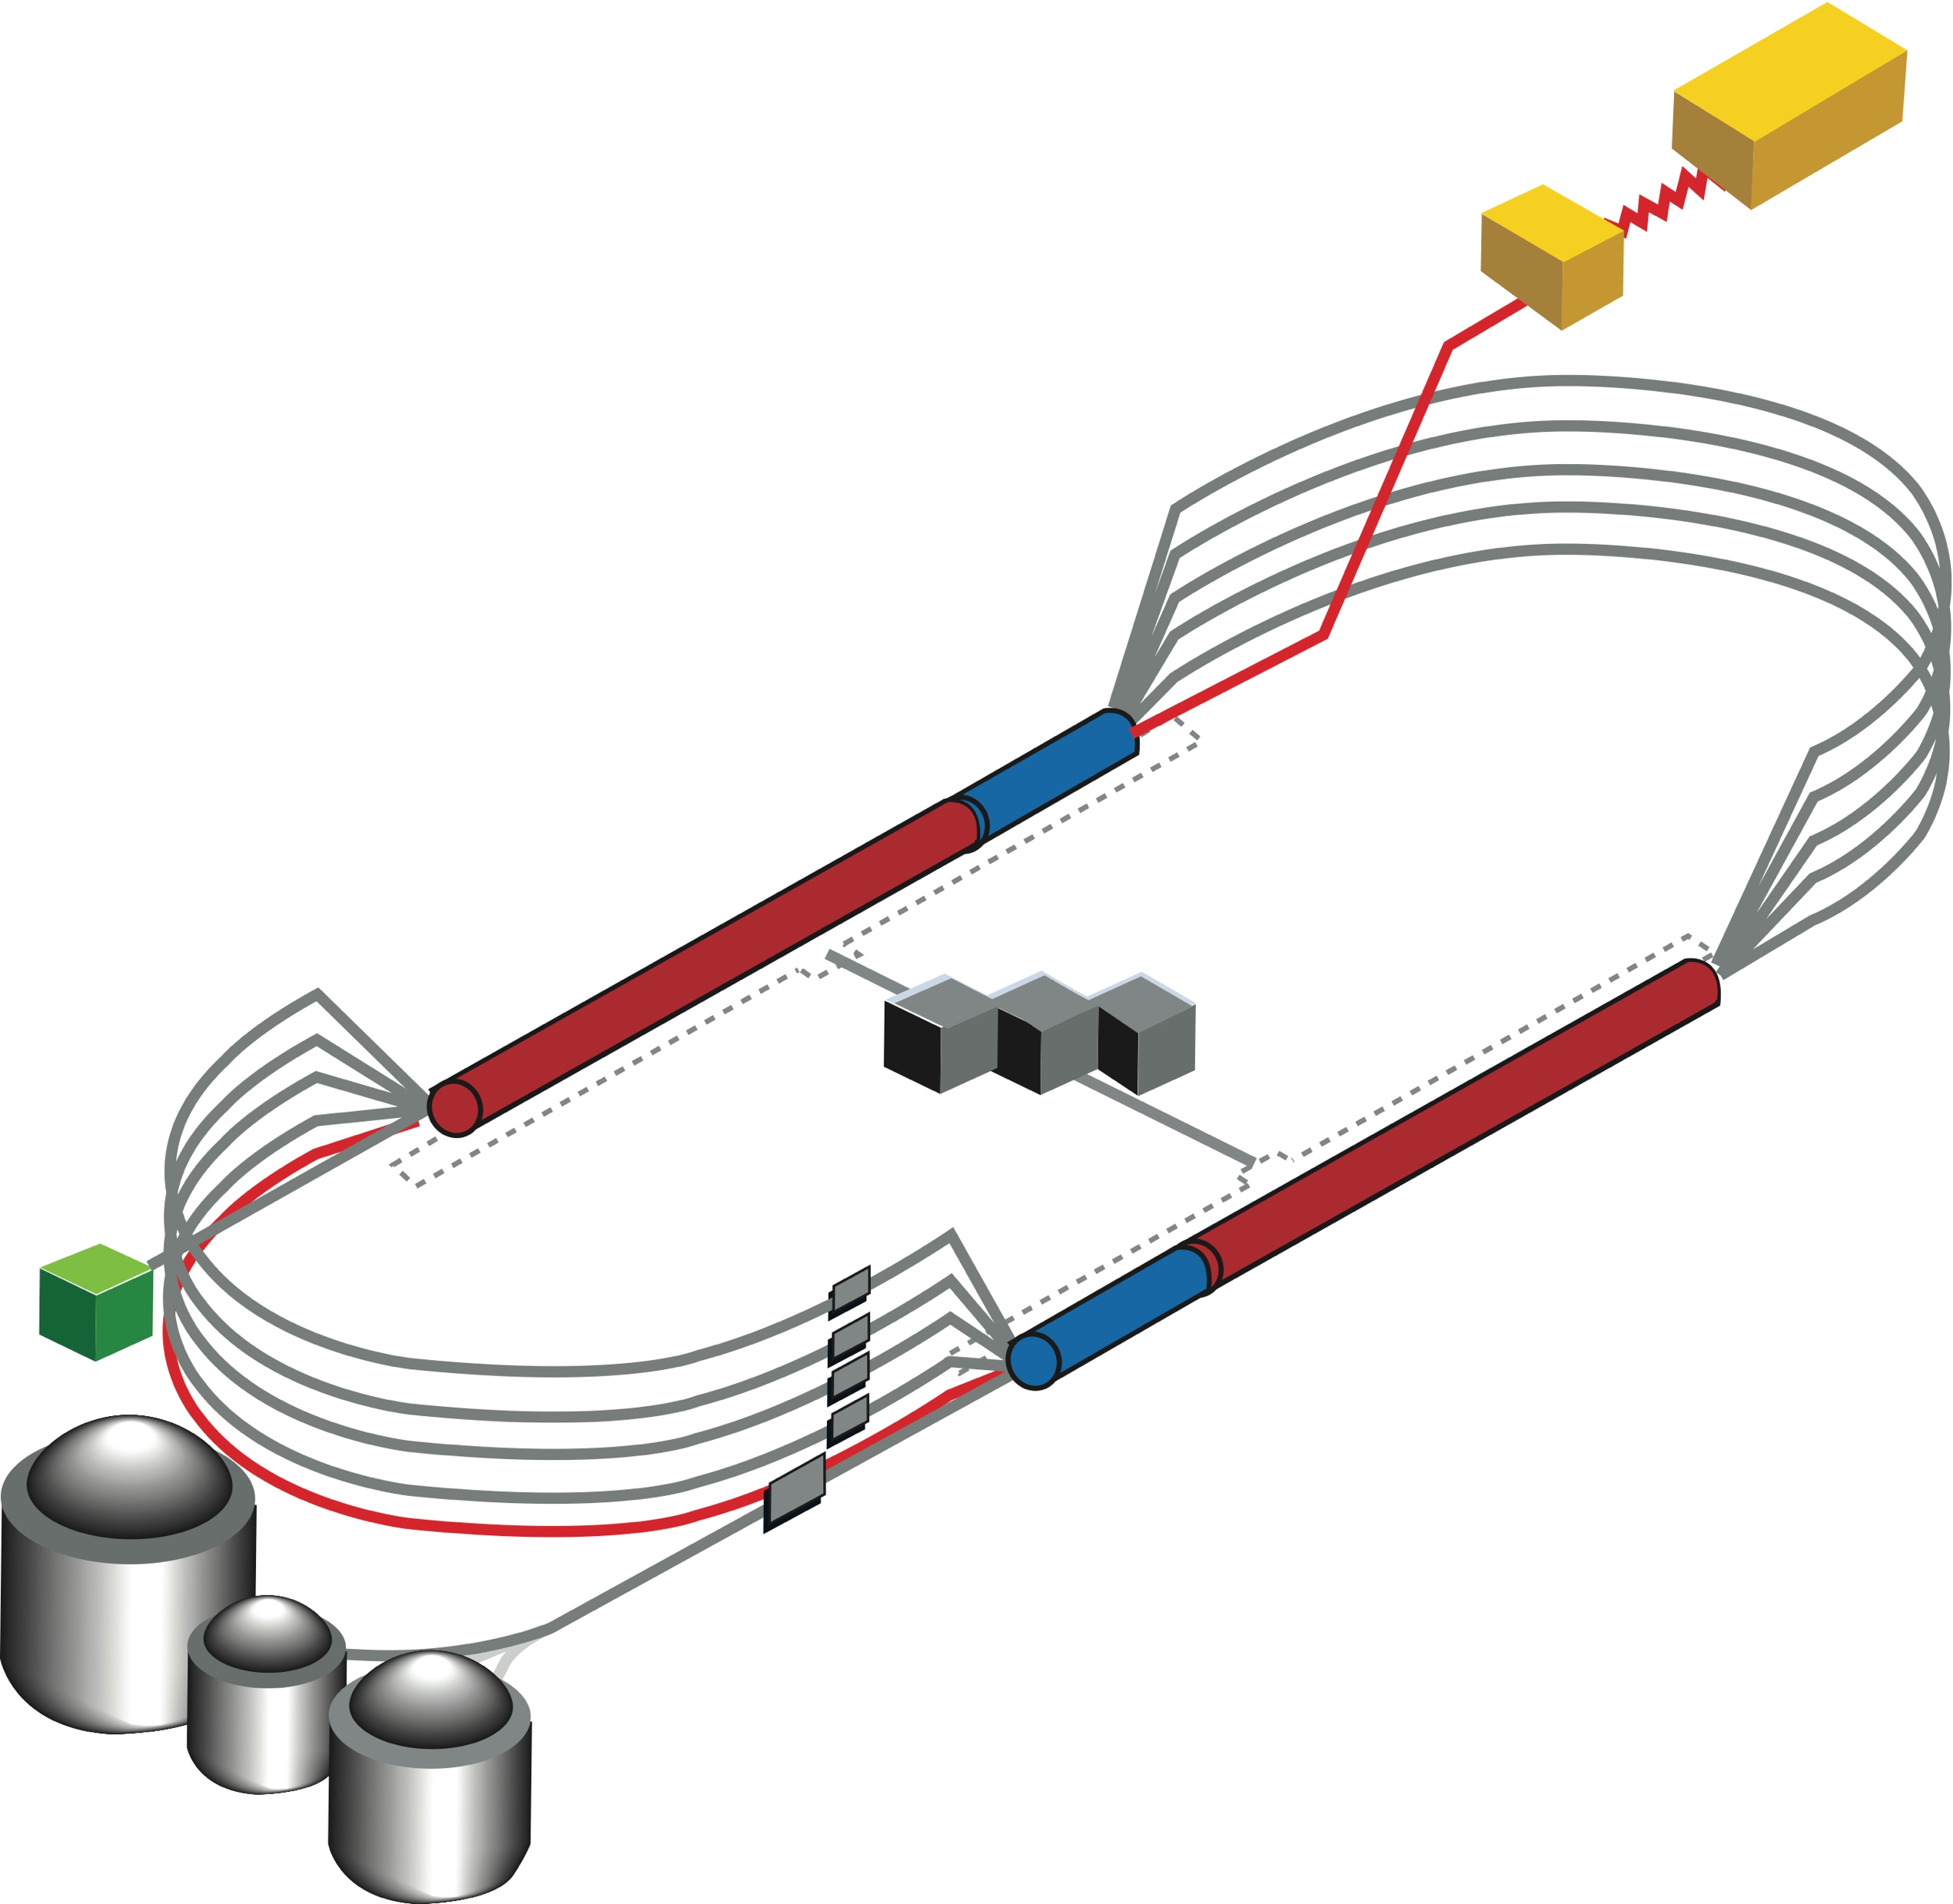
22 GeV CEBAF FFA* Energy Upgrade − State of the Concept
Feasibility study for additional FFA* racetrack in the existing CEBAF tunnel to reach the top energy of about 22 GeV
TOF
*FFA (Fixed Field Alternating-Gradient)
650 MeV
Todd Satogata
on behalf of FFA@CEBAF Working Group
TOF

Slide 2
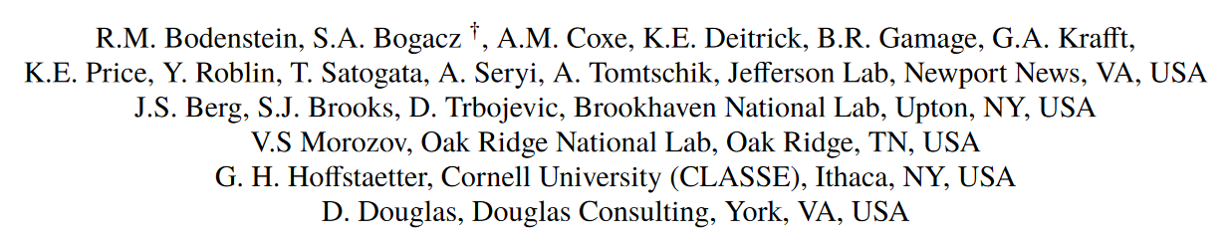




The FFA@CEBAF Collaboration

Slide 3

CEBAF FFA Upgrade – Baseline under Study
  Starting with 12 GeV CEBAF
  NO new SRF (1.1 GeV per linac)
  New 650 MeV recirculating injector
  Remove the highest recirculation pass (Arc 9 & A) and replace them with two FFA arcs including time-of-flight chicanes
  Recirculate 4 + 6.5 times to get to 22 GeV
TOF
650 MeV
TOF
Enabling Technology:
Novel permanent magnets, -like used for power and cost savings
Pass Arithmetic: 5 -1 + 6.5 = 10.5

Slide 4
Overview
Current baseline: 650 MeV inj + 4-pass CEBAF + 6.5-pass FFA
FFA Arc Architecture – -style
  Non-scaling FFA based on high-gradient permanent magnets
  Compact merger to control orbits, beta functions and dispersion at arc ends
  Error sensitivity studies
Multi-pass linac optics
  650 MeV injector upgrade
  Periodic triplet lattice for lower passes transitioned to ‘drift linac’ for FFA passes
Modified CEBAF ‘switchyard’, Arcs 1-8 and TOF correction ‘splitters’
Synchrotron radiation impact on beam quality, mitigations
Summary, Outlook

Slide 5
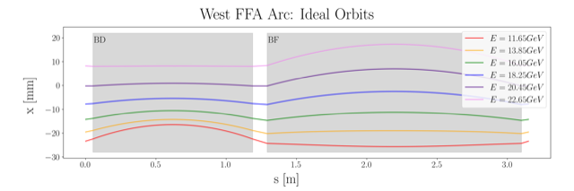
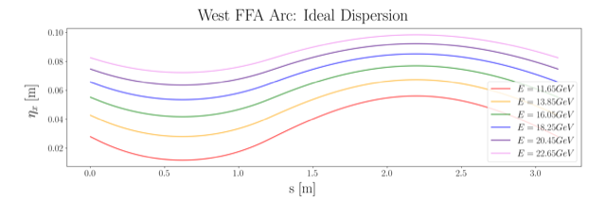
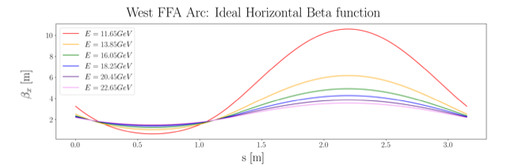
Non Scaling FFA Arc − Compact FODO Cell
orbits
Large momentum acceptance FFA cell, configured with combined function magnets capable of transporting six beams with energies spanning a factor of two
Arc composed of 75 cells, L_{cell} = 3.15 m
Closely spaced orbits for all six beams (~ 4 cm)
Low betas (~ a few m)
Extremally low dispersions (a few cm) - Virtue of combined function FFA magnets
dispersions
beta functions

Slide 6
Permanent Magnet Design – Open Mid-plane Geometry
S. Brooks (BNL)
10 cm
10 cm
10 cm
10 cm
Focusing Magnet BF
G_{F}= -41.13 T/m
L_{QF}= 1.67 m
B_{F}= -0.812 T
Defocusing Magnet BD
G_{D}= 43.44 T/m
L_{BD}= 1.24 m
B_{D}= -0.593 T
magnets: from 38cm² to 78cm²

Slide 7
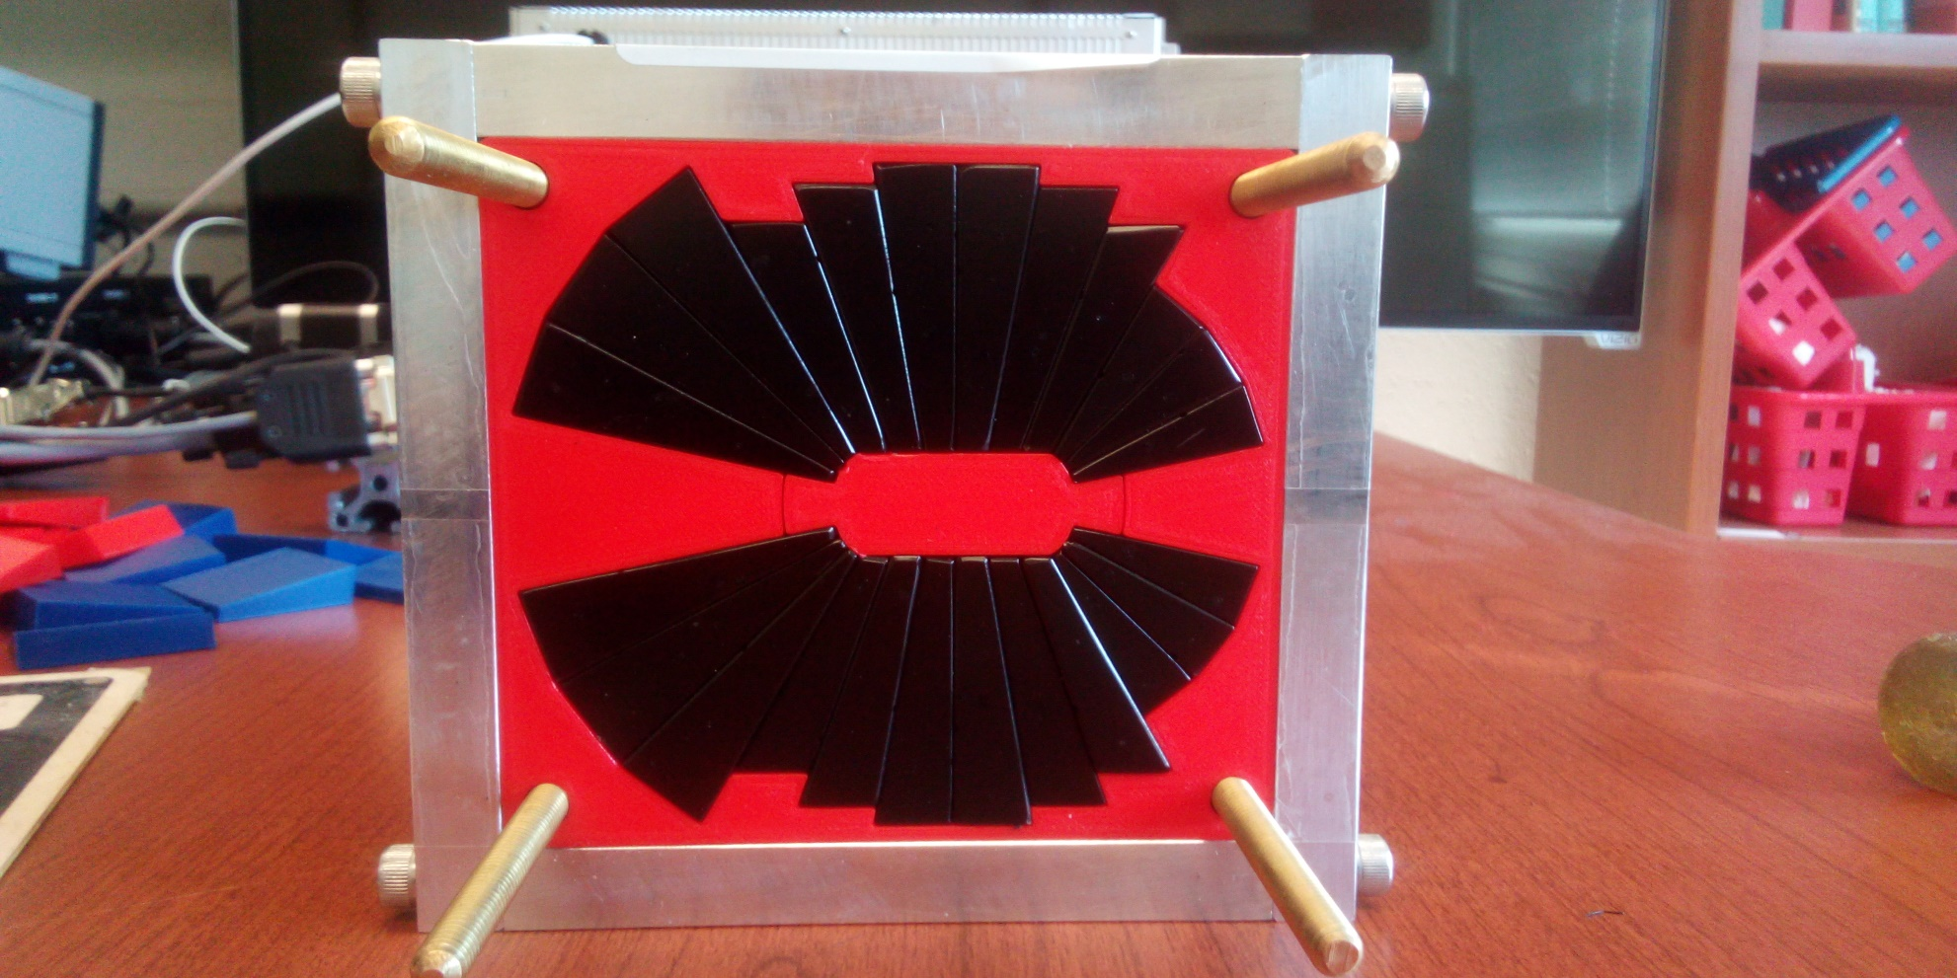
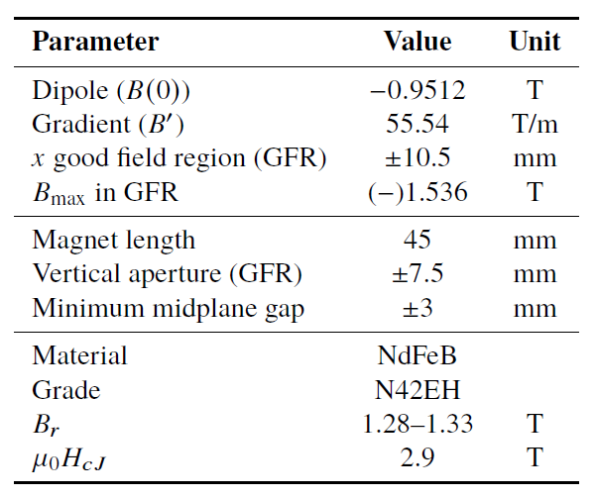
Assembled Prototype Magnet
S. Brooks (BNL)
A prototype open midplane BF magnet was built and evaluated for mechanical integrity. Magnetic measurement confirmed a robust design with >1.5 Tesla in good field region, 10⁻³ field accuracy. JLab LDRD submitted for radiation resilience tests in CEBAF.
Open midplane design with >1.5 Tesla in good field region, 10⁻³ field accuracy

Slide 8
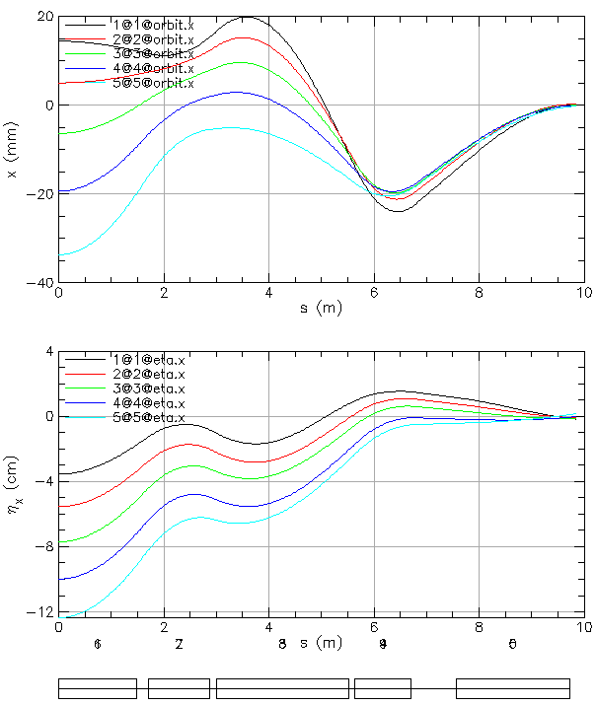
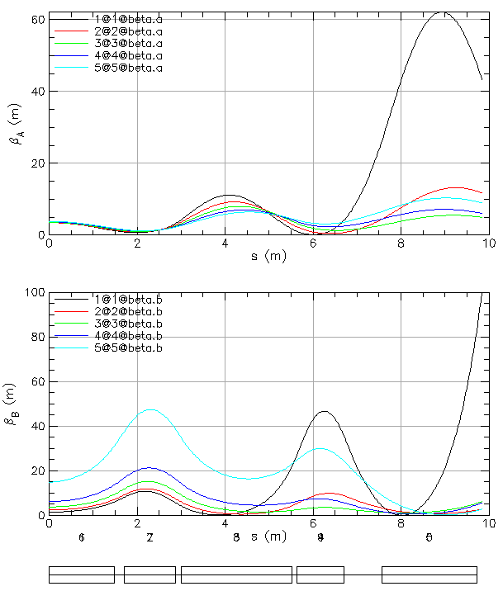
FFA Arc to Straight – Compact Merger
Breaking cell symmetry by altering (length, bend) of a few magnets to merge different energy orbits at arc ends.
Simultaneously, the dispersion and its derivative are suppressed at arc ends.
Furthermore, beta functions need to be matched to higher-bets of the linacs (~250 meter betas).
This simplifies switchyard and reduces its functionality to pathlength and momentum compaction adjustment.

Slide 9
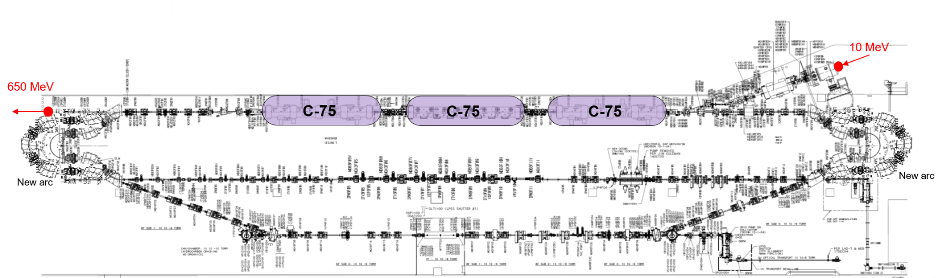
Injector Upgrade − 650 MeV Recirculating Injector
With the present 123 MeV injector, the difference in the first and final pass energies in the North Linac is too large (1:175) to effectively control the beam.
650 MeV recirculating injector (3-pass) based on LERF will allow a manageable difference in energies (1:33)

Slide 10
Electron/positron injector vault is required for 12 GeV e⁺ and 22 GeV e⁻
123 MeV e⁺ and 650 MeV e⁻
J. Grames
‘Green beamline’ is a cost effective option for staging positron and energy upgrades:
123 MeV e⁺ for 12 GeV CEBAF
650 MeV e⁻ for 22 GeV CEBAF Energy Upgrade

Slide 11
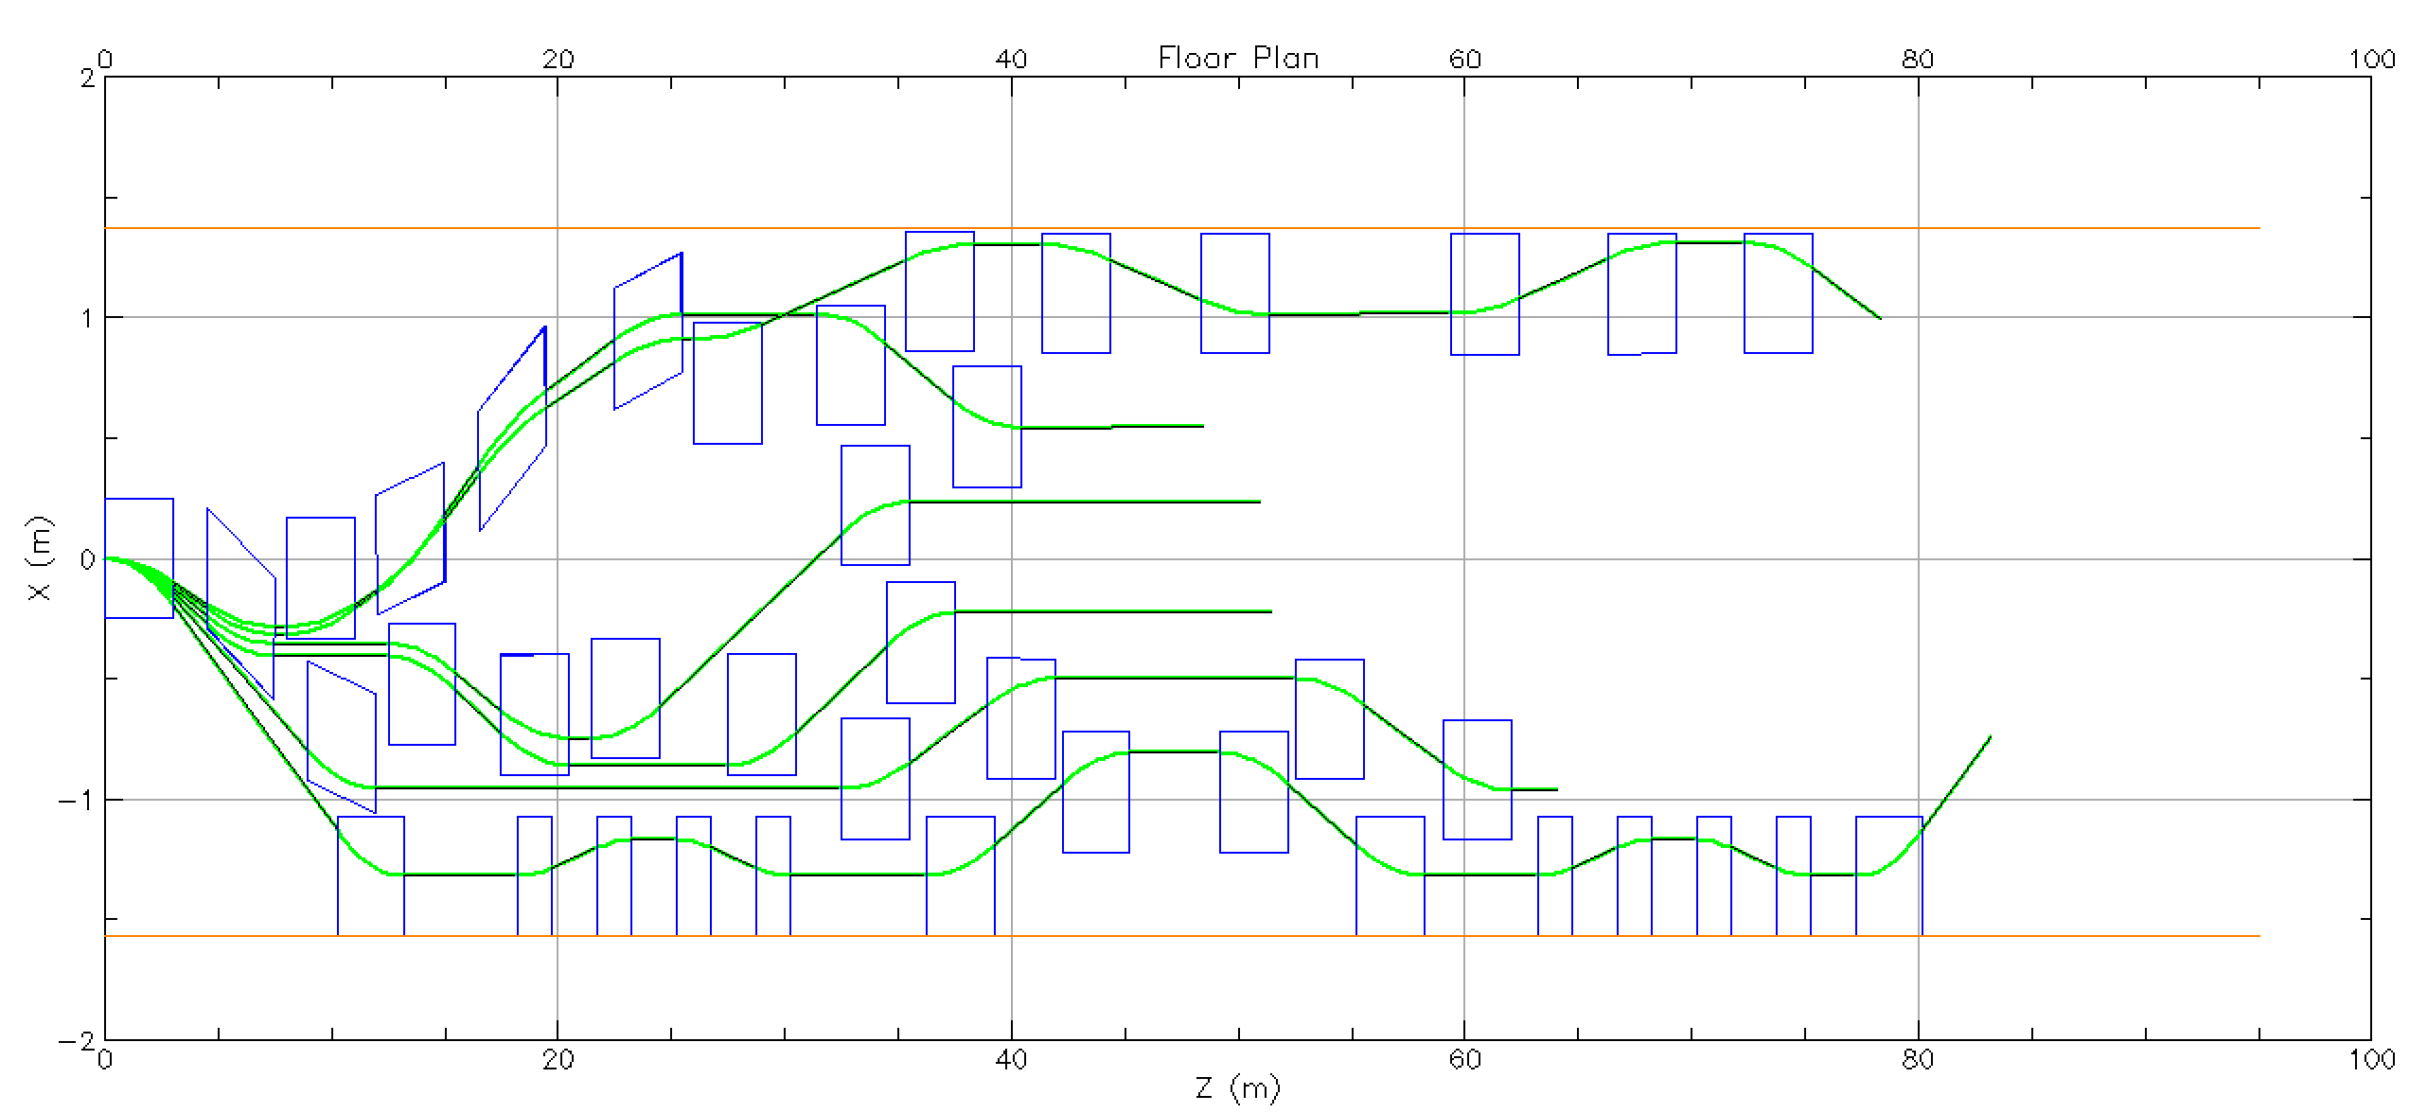
Splitter Layout
Partial dipole layout for a splitter. Tunnel is 3.96 m wide. Orbit closure, optics and pathlength compensation not yet completed. Raised floor and ramps will be required for cryomodule transport.

Slide 12


Energy loss, Emittance dilution and Energy spread
  Doubling the energy, while staying within current CEBAF footprint, makes the synchrotron radiation effects of paramount importance.
  Quantum nature of a ‘recoil’ effect on electrons due to photon emission makes significant impact on both the transverse and longitudinal beam dynamics, leading to cumulative emittance growth (transverse and longitudinal).
Energy loss
Emittance dilution
Natural energy spread
Maximize $ρ$, minimize H
  Cumulative emittance dilution (transverse and longitudinal) at 22 GeV (4 CEBAF + 6 FFA passes)
Projected value from the Spr/Rec contribution

Slide 13

Summary
Present Baseline (1.1 GeV per linac):
  650 MeV Recirculating Injector (additional three C-75 cryomodules)
  Recirculate 4 passes with the current CEBAF
  Plus Additional 6 passes via a single FFA: 10 – 22 GeV
Non Scaling FFA Arc Architecture configured with compact FODO cells
  Beta and dispersion matching to the linacs through cell-by-cell variation (length, bend)
  Open mid-plane permanent magnet design: B-field ≤ 1 T, Gradient ≤ 50 T/m
Synchrotron Radiation impact on beam quality:
  Net transverse emittance dilution (normalized): 80 mm mrad
  Net natural energy spread: 1.5×10⁻³
  Net synchrotron radiated energy: 1 GeV
$$σ=\sqrt{β\frac{ε_{N}}{γ}}$$
at 22 GeV, β = 20 m → σ = 175 microns
at 22 GeV → ΔE = 33 MeV

Slide 14
Outlook
The Working Group is converging on a complete end-to-end lattice design
Engaging with user community and user leadership on design priorities
Emittance dilution budget provided here
  Includes contributions from the FFA arcs and the new spreader/recombiner
  Future: include horizontal splitter emittance dilution, iterate with ongoing design
Magnets cannot be enlarged because fields are at the limit for NdFeB.
  Radiation damage may be amplified by choosing higher fields.
  Permanent magnets have good field region sufficient for only six passes at exactly 1100 MeV/linac and not lower.
  JLab LDRD proposal submitted for permanent magnet radiation testing in CEBAF
Extraction to A/B/C will occur in SW splitter and may require physically moving magnets (Halls A/B/C get same energy).
  Electromagnet and optics designs for 22 GeV to A/B/C exist. D will copy B. 20 GeV would reduce saturation (JLab Tech Notes).
  Extraction will take place from NE splitter to D at a half-pass below the other halls.

Slide 15
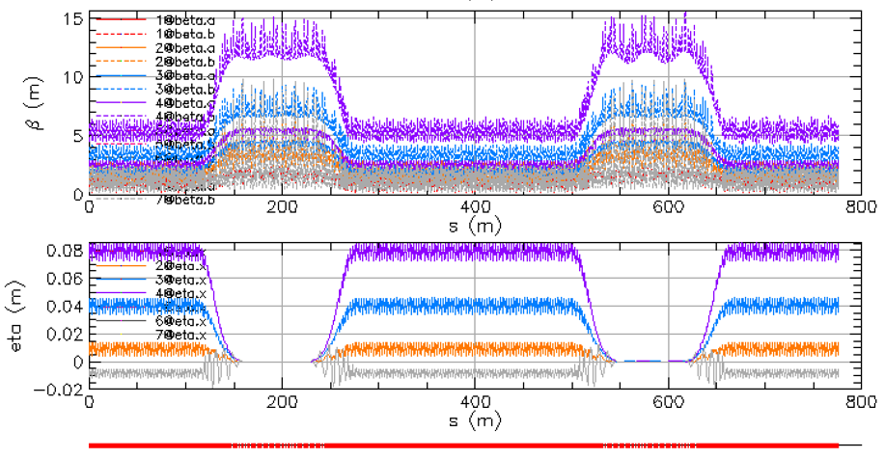
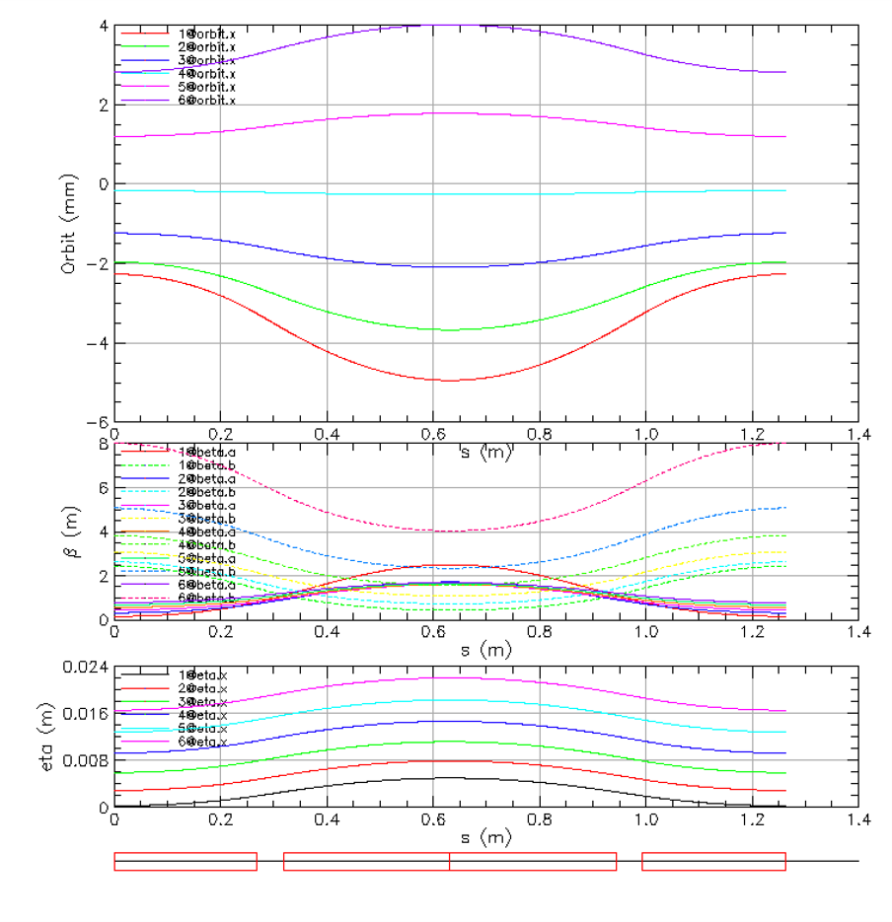
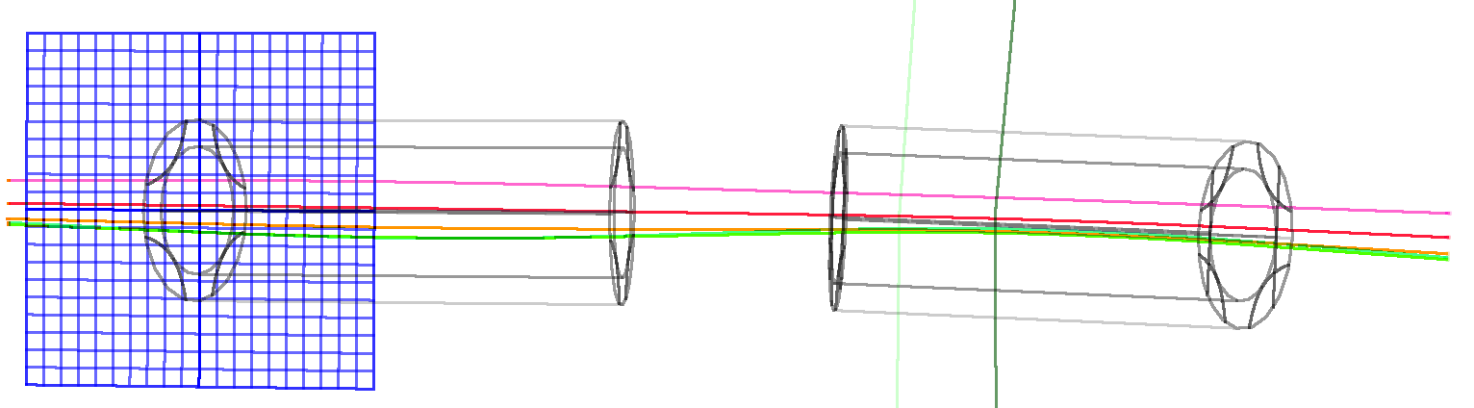

Thanks for your attention!

Slide 16
Backup Slides

Slide 17
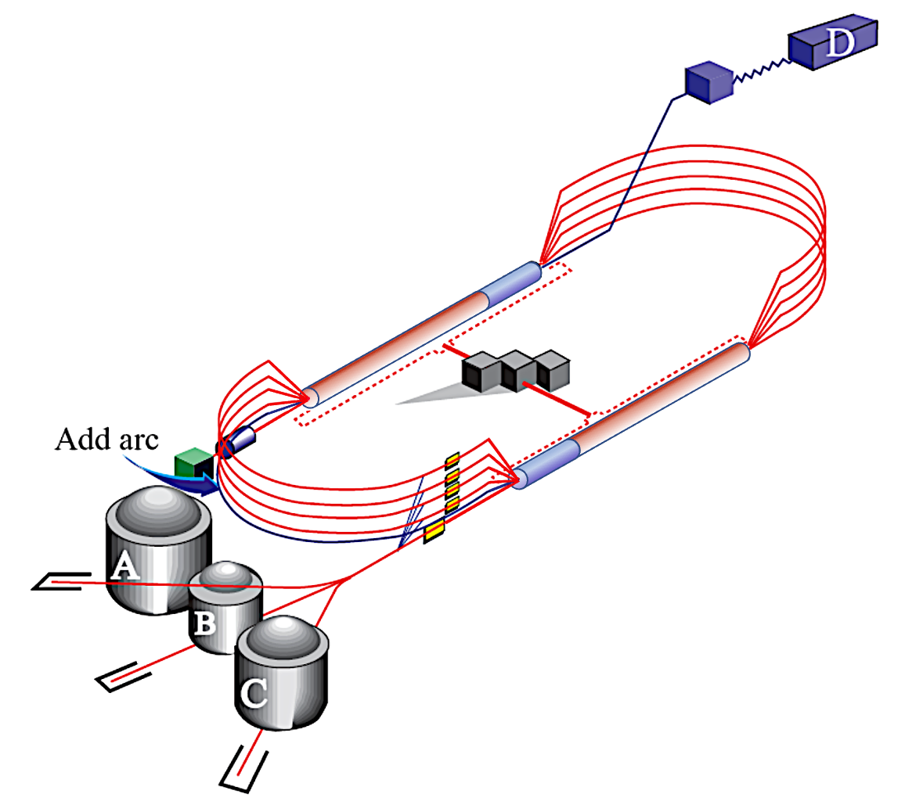
CEBAF Energy Upgrade 10.55 → 23.75 GeV
4 existing lines + 6 FFA turns
12 GeV
23.75 GeV
Injector at 650 MeV
1.75 GeV
3.95 GeV
6.15 GeV
23.75 GeV
8.35 GeV
EAST FFA
Energy range
80.6 m
#1-10.55 GeV
#2-12.75 GeV
#3-14.95 GeV
#4-17.15 GeV
#5-19.35 GeV
#6-21.55 GeV
1.75
3.95
6.15
1.1 GeV
8.35
0.65 GeV
2.85 GeV
5.05 GeV
7.25
1.75 GeV
9.45
1.1 GeV
0.650
80.6 m
2.85 GeV
Energy range
5.05 GeV
7.25 GeV
22.65 GeV
9.45 GeV
WEST FFA
#1-11.65 GeV
#2-13.85 GeV
#3-16.05 GeV
#4-18.25 GeV
#5-20.45 GeV
#6-22.65 GeV
22 GeV CEBAF FFA Energy Upgrade
17

