Slide 1
Status of the Ce+BAF project
Motivation
Timeline
Expected beam properties
LERF layout for e+ facility
Transport to CEBAF
Ongoing work
Future Work
Conclusion
Yves R. Roblin and the Ce+BAF working group

Slide 2
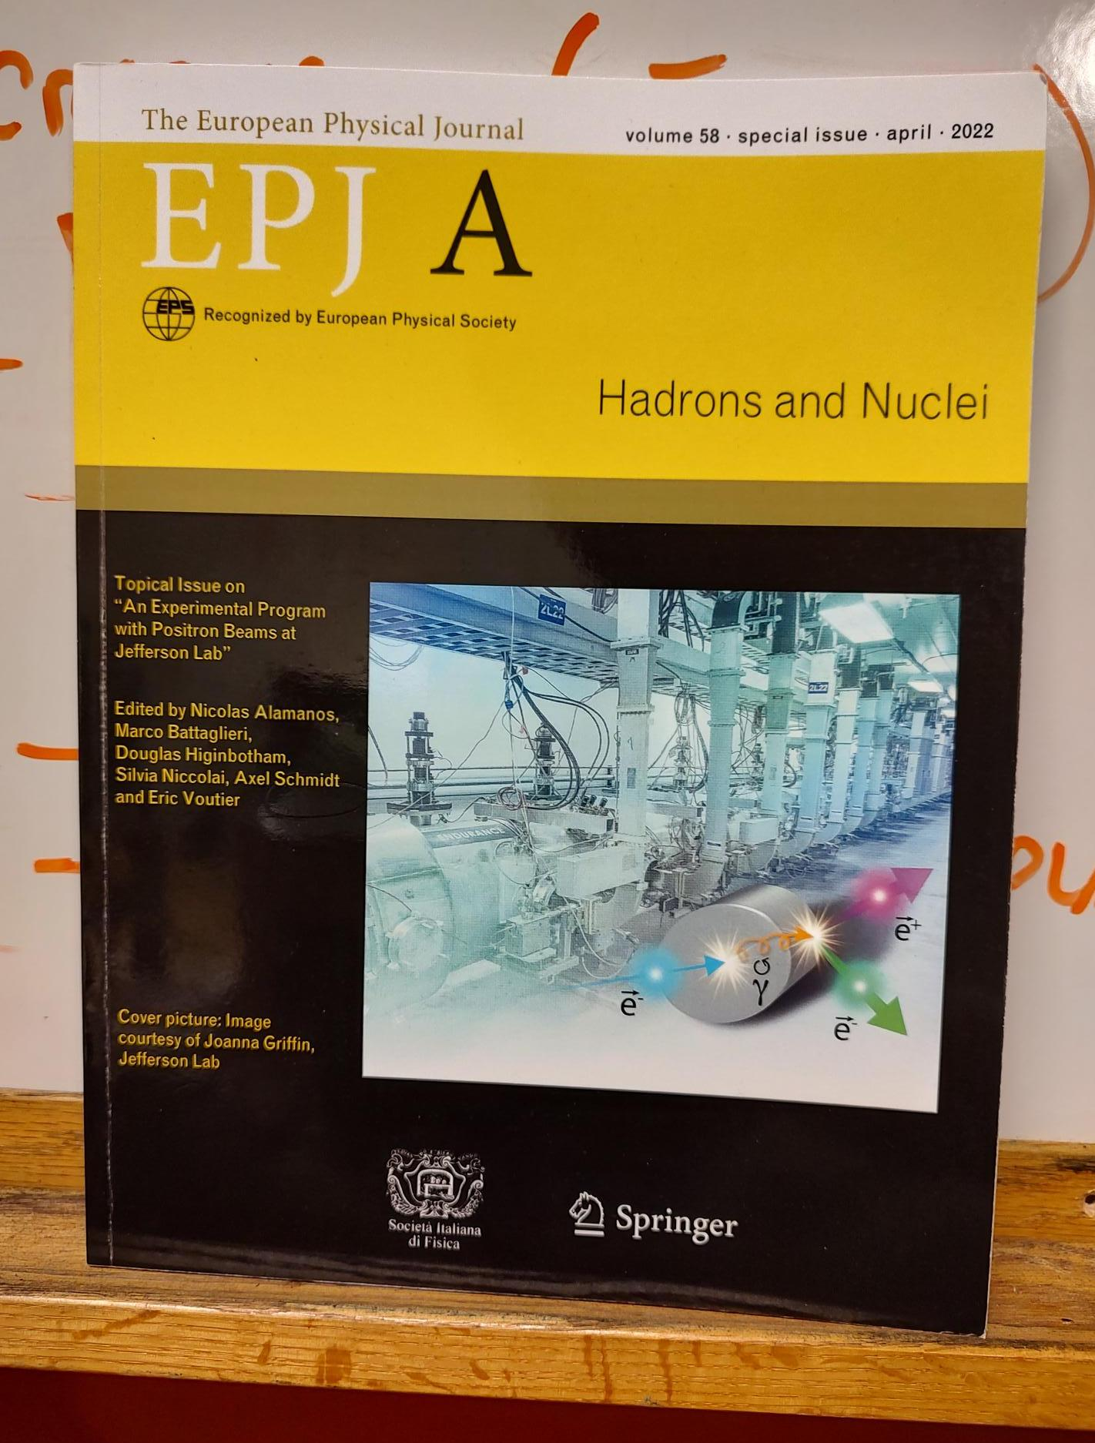
Jefferson Lab Positron Working Group
Physics Motivation
Jefferson Lab Users have made a strong case for positron beams at CEBAF 12 GeV
Complementary charge and spin of e⁺ would provide a new probe at Jefferson Lab
2018 – 7 letters of intent to PAC
2020 – 2 conditionally approved PAC proposals
Hall B ~ 100 nA polarized (>60%)
Hall C ~ 3 μA unpolarized
2023 6 new proposals and 5 new letters of intent
See Talk By E. Voutier

Slide 3
Proposed Timeline
Gantt chart to give a rough idea when these project could become a reality.
Phase 1 includes building the positron source and the tunnel & beamline connecting the source to main machine.
Phase 2 includes the new permanent magnets to allow 22 GeV within current CEBAF footprint.
NOTE: Plan was formulated so that these projects are ramping up as the EIC project cost is ramping down.
Patrizia Rossi, HADRON 2023

Slide 4
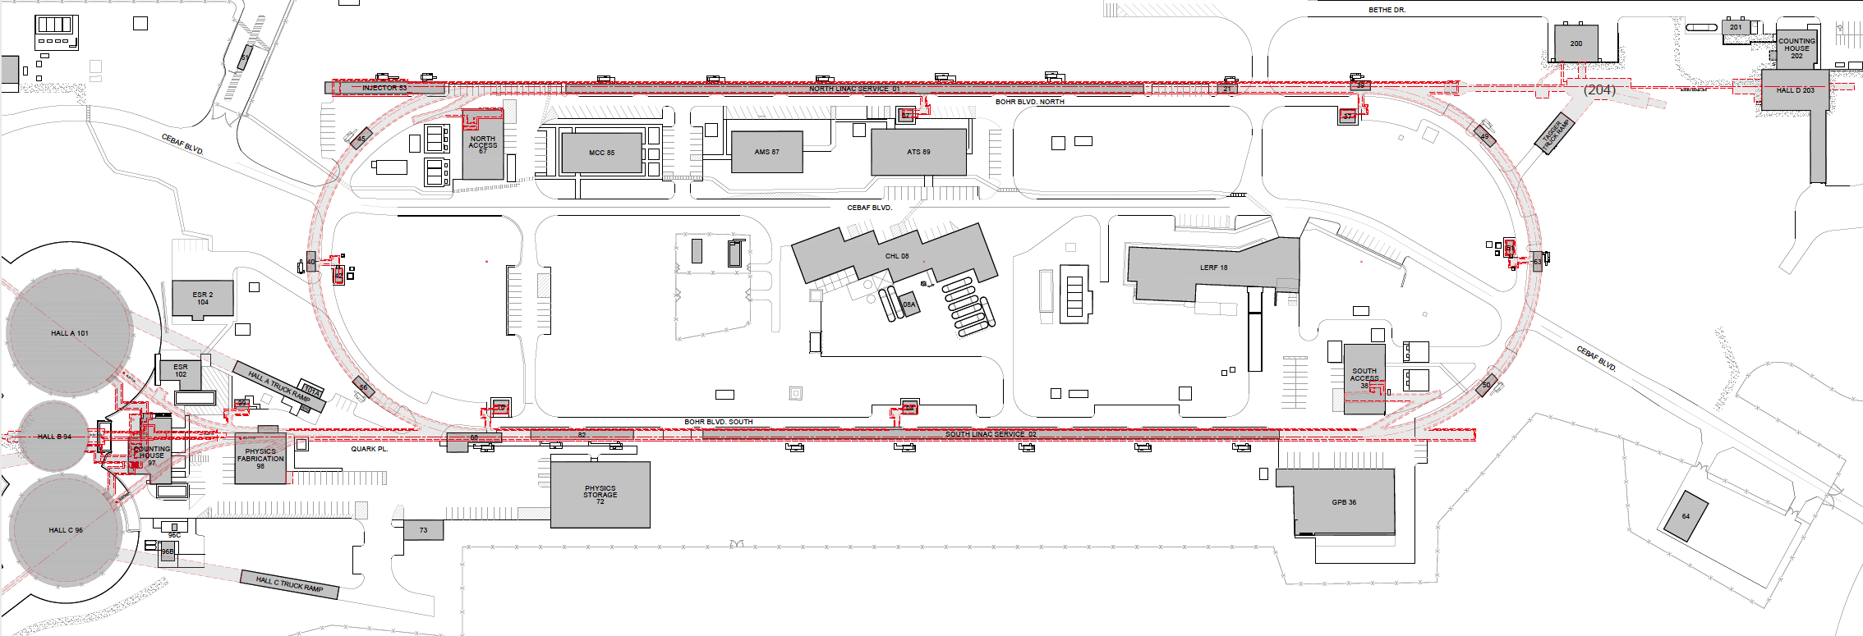
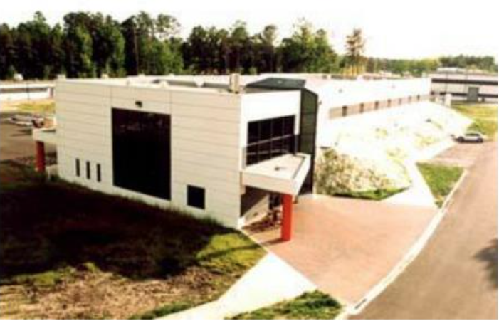
Turning the LERF into a Positron Injector Facility
123 MeV
At the last JLAAC we were exploring e+ production at 10, 100, 1000 MeV…
Today we are focused on producing 123 MeV e⁺ utilizing the Low Energy Research Facility
Inject e⁺ into North Linac to usual 12 GeV (w/ magnets reversed)
Build e⁺ injector at the LERF
Build new LERF to CEBAF tunnel
123 MeV
Build new transport line along South Linac and West Arc

Slide 5
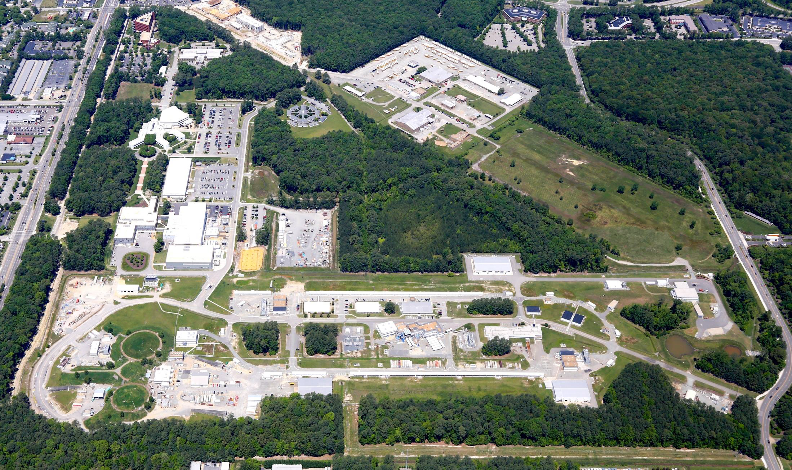
Polarized Electron or Polarized Positron Beams
Capability | Electrons | Positrons
Hall Multiplicity | 4 | 4
Max Energy | 12 GeV | 12 GeV
Beam Frequencies | 249/499 MHz – cw | 249/499 Mhz – cw
Unpolarized intensity | 170 uA (limit) | >1 uA
Polarized intensity | 170 uA (limit) | >50 nA
Polarization | > 85% | > 60%
Fast/Slow Helicity Reversal | Yes | Yes

Slide 6
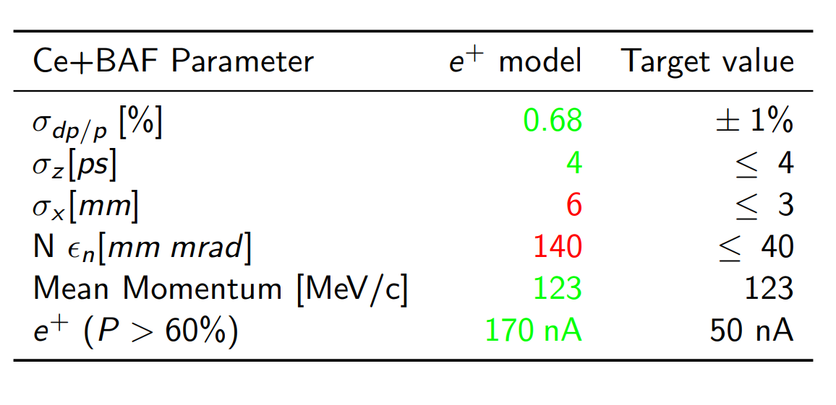
Beam parameters for polarized e+ beam
Optimization will affect the partitioning between the two
Courtesy: Sami Habet (IJClab)
Can reduce this at the expense of the yield or with better collection

Slide 7
Layout under study

Slide 8
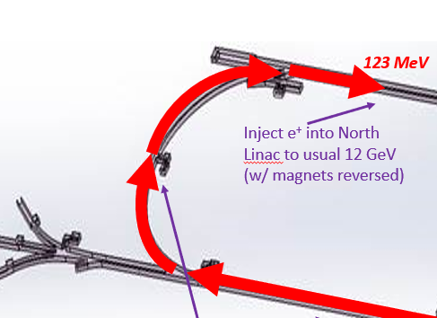
Recent development: Using a DBA structure

Slide 9
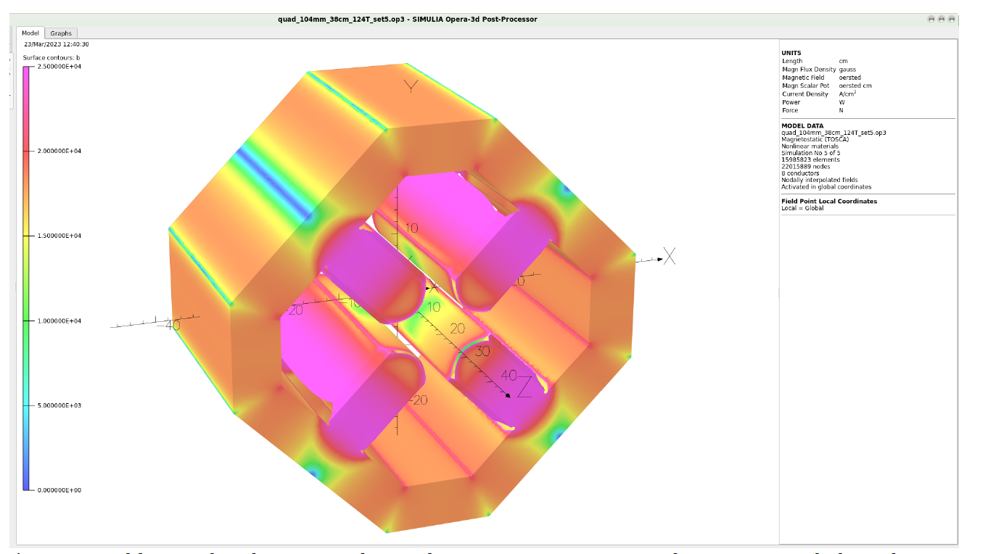
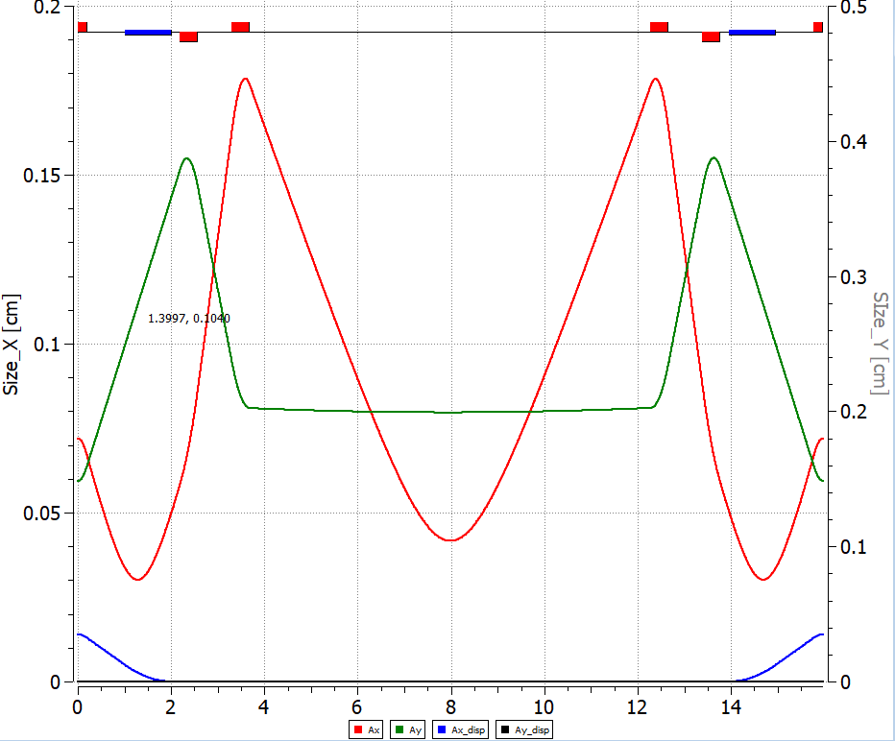
Large bore quadrupoles
JLAB TN-06-029 (Benesch). Designed to accommodate the 60mm.mrad normalized emittance expected in 22 GeV hall lines
40 to 50 mm.mrad normalized is what we expect in the LERF to CEBAF transport.
104 mm ID. Can be made 35.56 cm or longer. More than enough field for our needs and eliminate considerations of chromatic effects.
Will need custom power supplies but it can be ganged together in the LERF->SL line

Slide 10
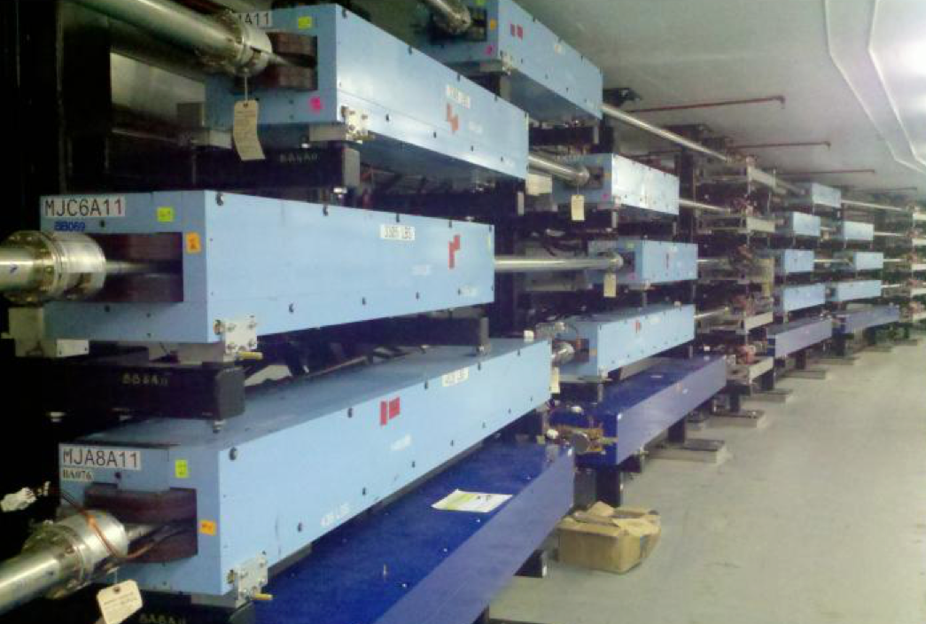
Reversing polarity in magnets, how fast can we go ?
Reversing polarity of 2100 CEBAF magnets (S. Philip Head DC Power group)
>1900 (correctors & quads) already bipolar operation
39 (recirculation/transport dipoles) will require engineered solution
21 recirculation & dog-leg
12 extraction units
6 end-station transport/dump
Hall D is only permanent magnet – would have to be rotated
Magnetic Field Integrity (M. Tiefenback CEBAF magnet systems integrator)
Unipolar dipoles would need to be deliberately tested
demonstrate field restores after polarity inversion
quantify possible systematic effects
Soft iron steel are expected to perform well under polarity reversal
Two decades of operation suggest remnant fields <20 G tolerable
Sudden power supply trips introduce uncontrolled flux
Modifications to power supplies or field maps
Technote JLAB-TN-23-043

Slide 11
Currently ongoing efforts
polarized e+ beam production optimization
Design of 123 MeV spin rotator
Target design
JLab,IJCLab (S. Covrig, A. Ushakov) rotating Tungsten target
XELERA research (SBIR) Ga-In-Sn liquid jet target
1 % demonstration target (Max Bruker, JLab, LDRD proposal)
HEP funding for collaborating with SLAC and KEK on e- and e+ source topics
Beam transport optimization
Aperture/Acceptance studies (LDRD A. Sy. JLab)

Slide 12
Ramping up new efforts
Work with Physics magnet group and SRF designers for e+ injector design
Work with DC power and magnet coordinator on reversing polarity of magnets w/ bulk PS
Strategic roadmap for diagnostics for tuning and transporting secondary e+/e- beams
Work with RCG for evaluation of radiation shielding
Work with SRF operations for strategic roadmap for LERF cryomodules and energy reach

Slide 13
Recent publications, presentations
Technote JLAB-TN-23-043, magnet polarization reversal
Sep 24-29, SPIN2023 - https://indico.jlab.org/event/663/J. Grames, 'A positron beam at CEBAF”
J. Grames et al., (poster) "Status of Ce+BAF: Polarized Positron Beam Capability at CEBAF 12 GeV“,IPAC2023
R. Kazimi et al., "Polarized Electron Injector for Positron Capability at CEBAF 12 GeV“. IPAC2023
A. Sy et al., "Degrader beamline design at the CEBAF injector for machine acceptance studies“,IPAC2023
A. Ushakov et al, "Conceptual Design of a High-Power Target for Positron Production at CEBAF“,IPAC2023
A. Ushakov, "Positron target design and fatigue studies“, UVA PWG meeting, Charlottesville
D. Turner,"Delivering e+ beams from LERF through Ce+BAF”, UVA PWG meeting, Charlottesville
S. Habet, “Concept of a polarized positron injector for CEBAF”, UVA PWG meeting, Charlottesville
Y. Roblin, "Positron beam: technical aspects“, International workshop on CLAS12 Physics
C. Hernandez-Garcia, "Building the next high voltage dc photogun polarized source for the ILC at JLab“, LCWS2023
Snowmass 2022 White paper, Positron Sources for Future High Energy Physics Colliders https://arxiv.org/pdf/2204.13245
A. Accardi et al., "e+@JLab White Paper: An Experimental Program with Positron Beams at Jefferson Lab", https://arxiv.org/abs/2007.15081 (2020)

Slide 14
Conclusion
Significant R&D effort ongoing at Jefferson Lab and collaborating institutions
Feedback and requests from user community for specific e+ capabilities welcome
Keep proposing great e+ experiments
For further information, contact Joe Grames (grames@jlab.org)

