Slide 1
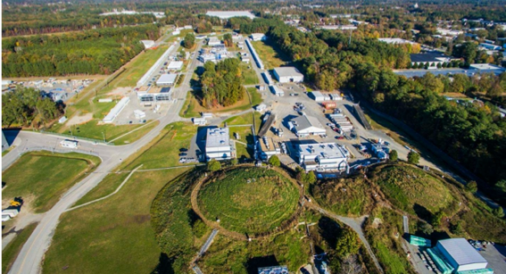
Overview of Jefferson Lab 22 GeV Upgrade
Cynthia Keppel
Jefferson Lab Users Organization Annual Meeting
June 26-28, 2023

Slide 2
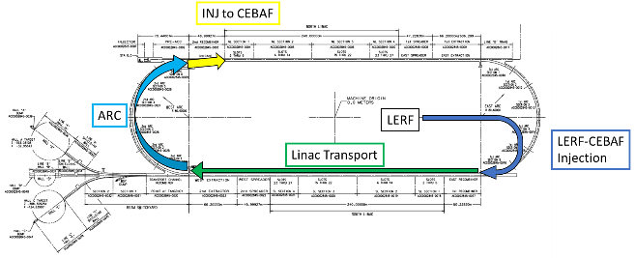
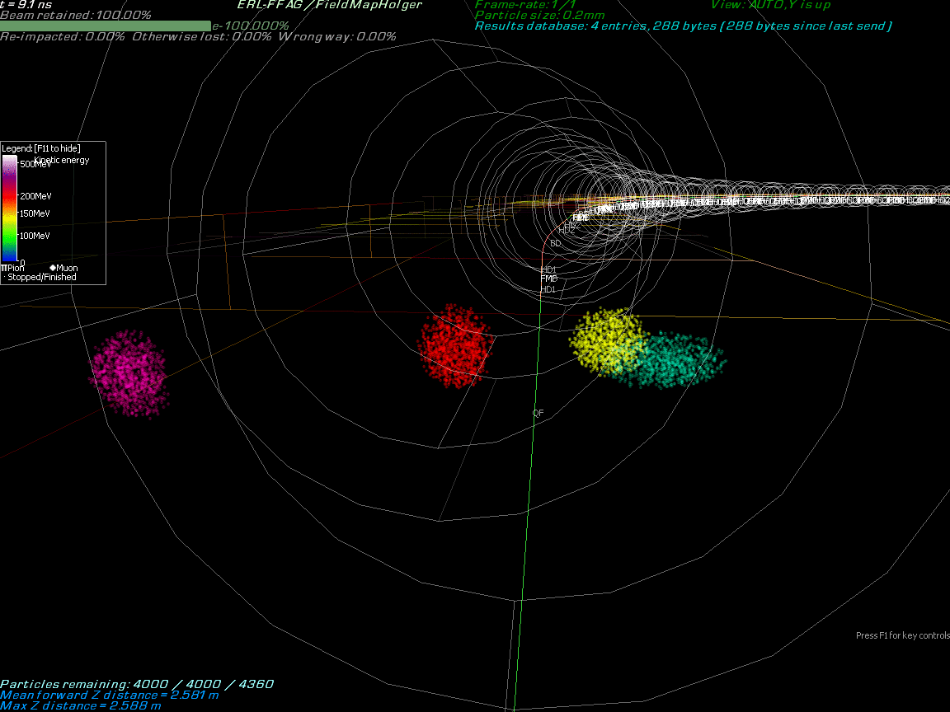
Technically feasible, cost effective, and innovative path to 22 GeV
Jefferson Lab Accelerator Upgrades, the ‘Big Picture’
Capitalizing on recent science insights from accelerator science and technology, develop a staged program at the luminosity frontier
Positrons (e+) in the LERF (former FEL) with transport to CEBAF (proposed 12 GeV science program)
Injection energy Upgrade for 650 MeV Electron (e-) in LERF [see Afanasev et al., EPJ A 57, 188 (2021)]
Replace arcs on each side with new FFA permanent magnet arcs to upgrade to 22 GeV

Slide 3
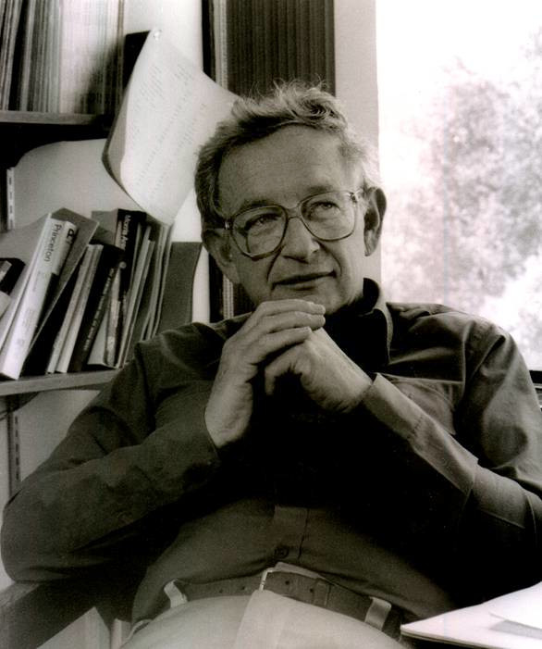
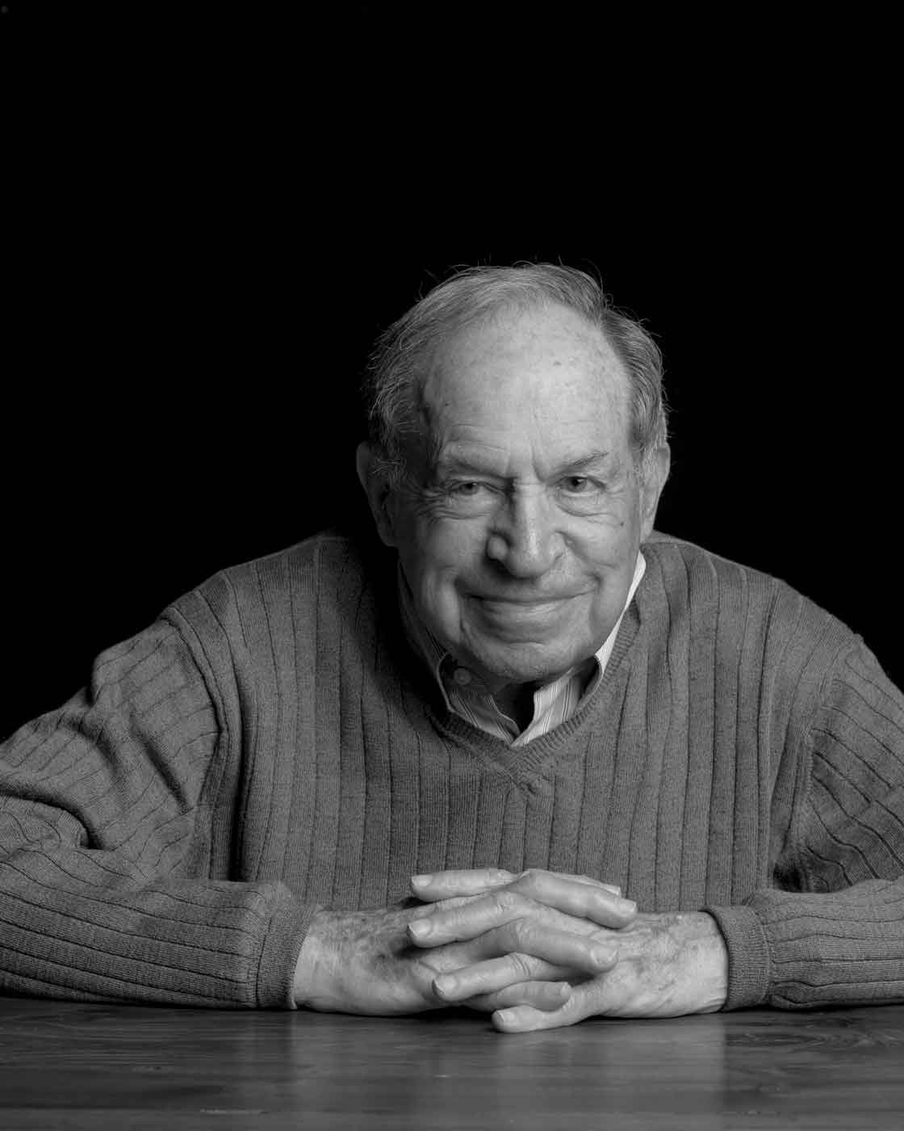
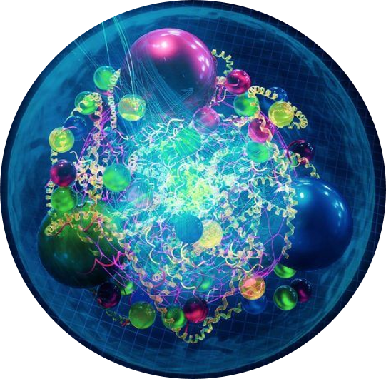
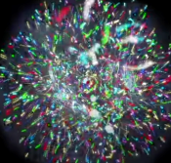
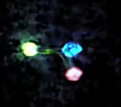
Emergent Phenomena in QCD
“The ability to reduce everything to simple fundamental laws does not imply the ability to start from those laws and reconstruct the universe.” -- More is Different, P. W. Anderson [Science 177, 393 (1972)].
“Emergence refers to collective phenomena or behaviors in complex adaptive systems that are not present in their individual parts.” -- Foundations & Frontiers in Complexity, D. Pines (2014)
A fascinating and mysterious aspect of QCD is the broad variety of phenomena that emerge from the underlying theory and the scales at which this emergence occurs.
x

Slide 4
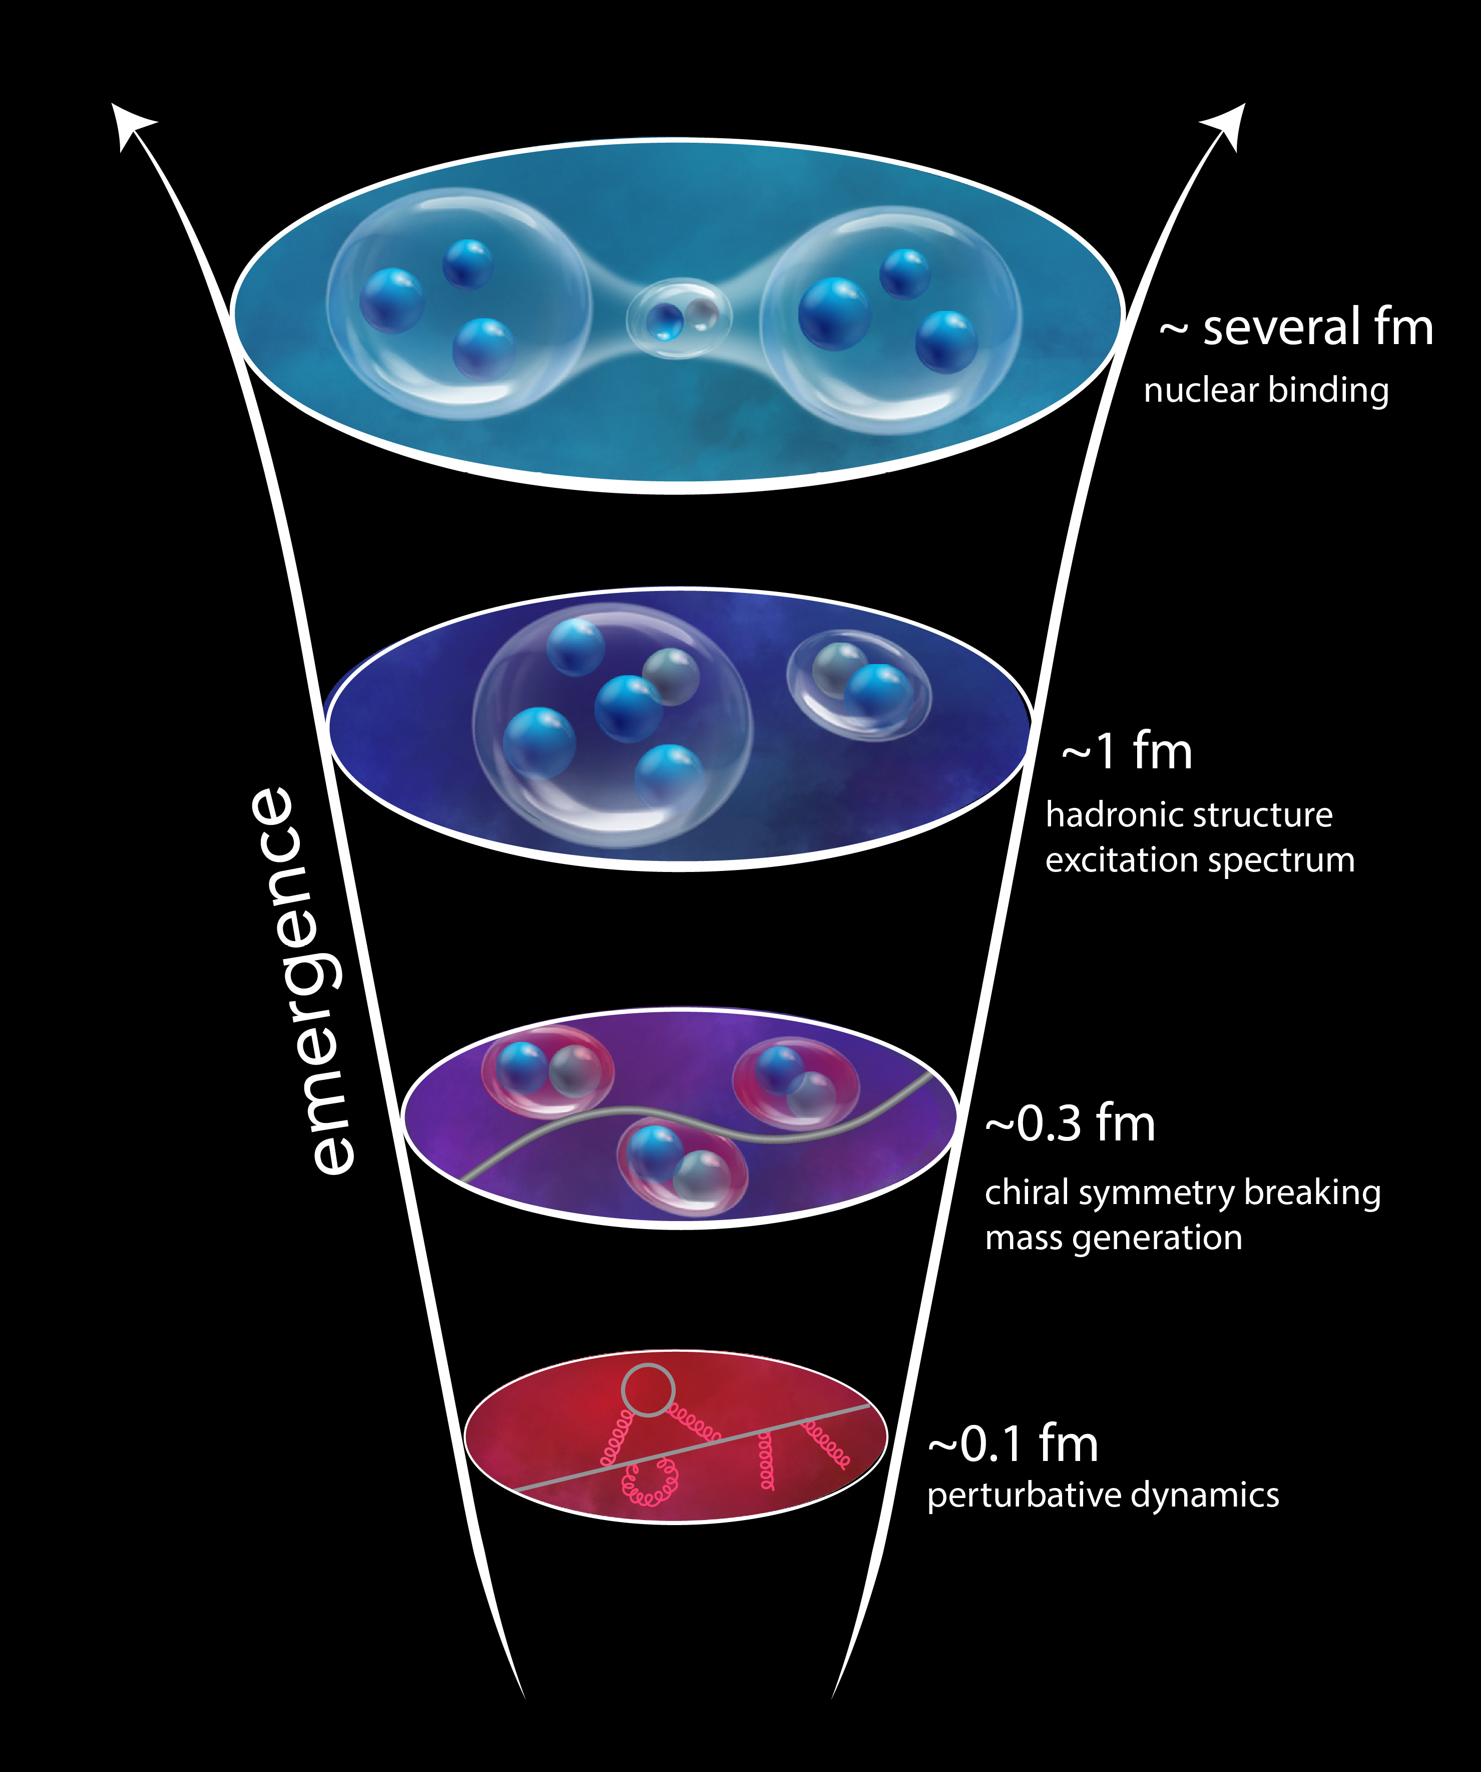

Why CEBAF @ 22 GeV?
How do hadrons/nuclei emerge from fundamental QCD principles?
➜ understanding strong interaction dynamics
➜ understanding confinement
Complex non-pQCD problem which demands different approaches and measurements to access multiple observables
What a 22 GeV upgrade will bring:
Some important thresholds would be crossed ➜ charm, nuclear distances, in fundamental symmetries, etc..
An energy window which sits between JLab @ 12 GeV and the EIC
➜ test and validation of our theory from the basic to the complex
A rich physics program is under development, leveraging existing or already-planned infrastructure and on the uniqueness of CEBAF HIGH LUMINOSITY
4
4

Slide 5
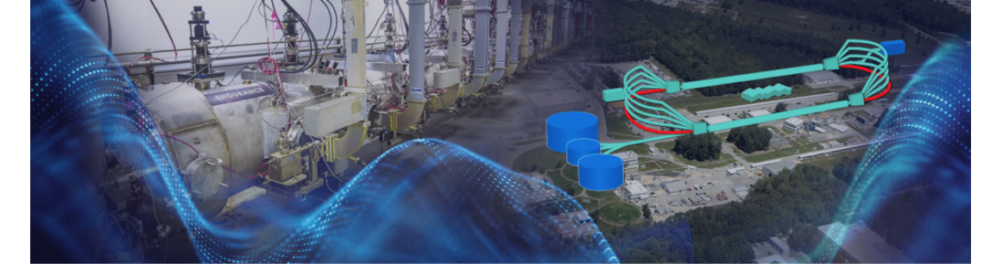
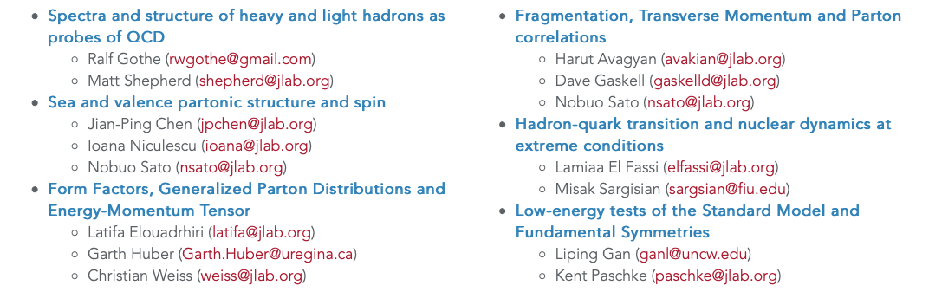
Science at the Luminosity Frontier: Jefferson Lab at 22 GeV
On the continuing development of the scientific case for a 22 GeV upgrade to CEBAF
https://www.jlab.org/conference/luminosity22gev
January 23-25, 2023
1 Introductory Session (D. Dean, A. Bogacz, J. Qiu , R. Ent) + 6 Sessions/WGs
There have been other workshops as well
5
5

Slide 6
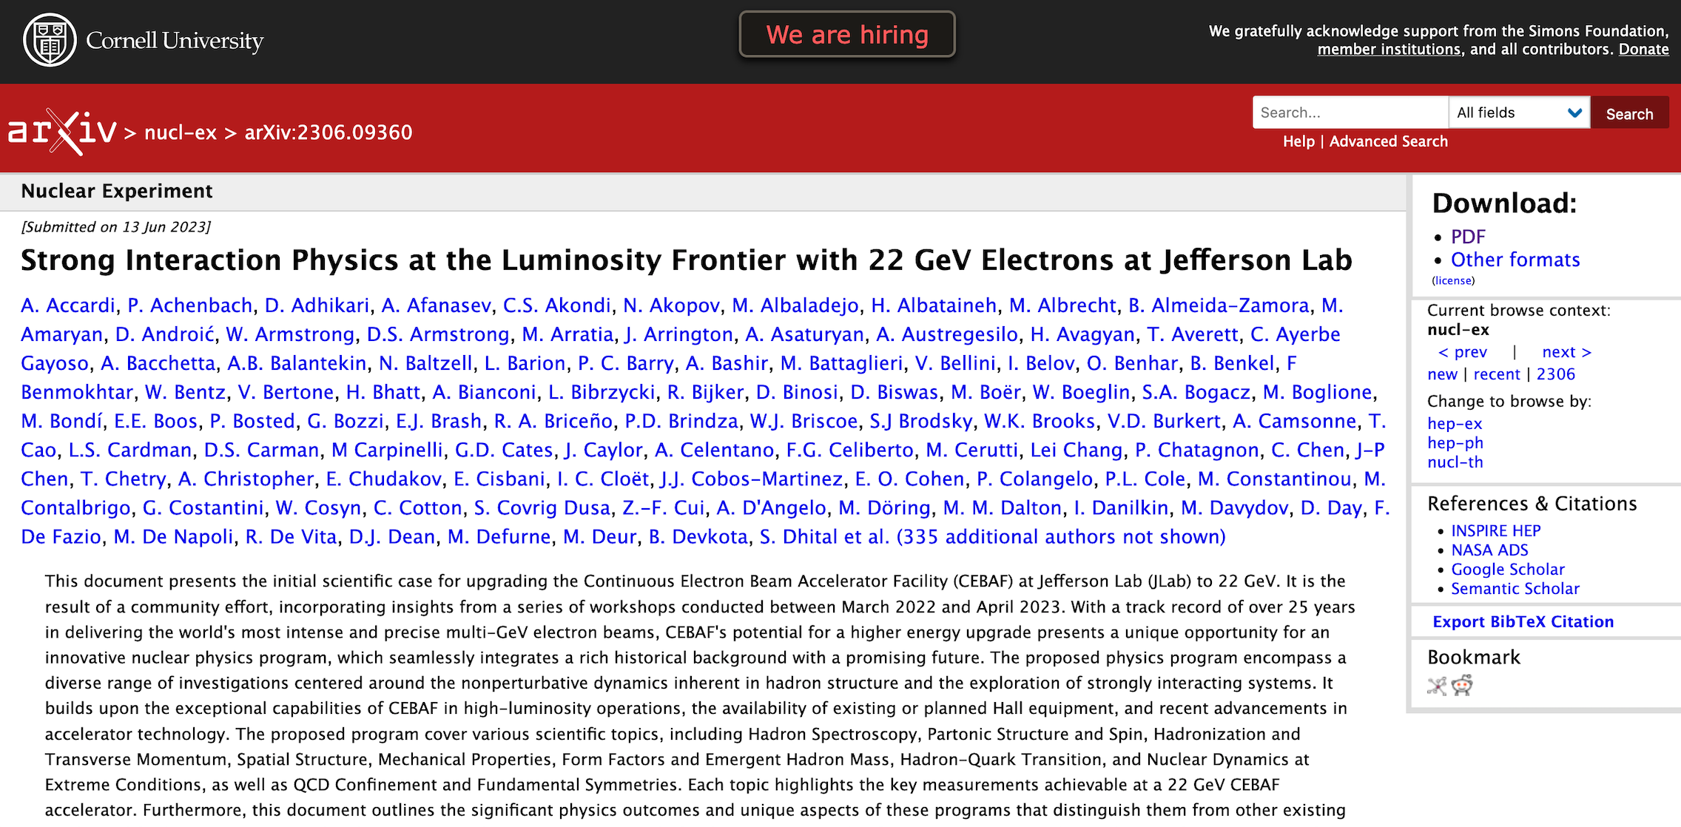
Now in a white paper with 435 authors (or more)

Slide 7
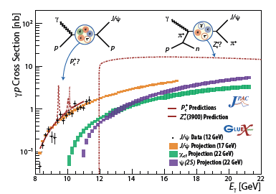
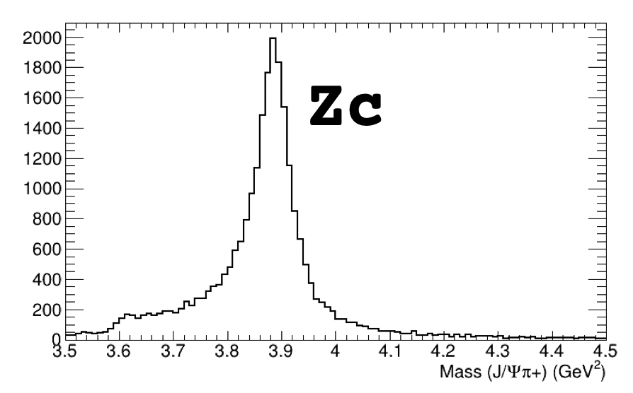
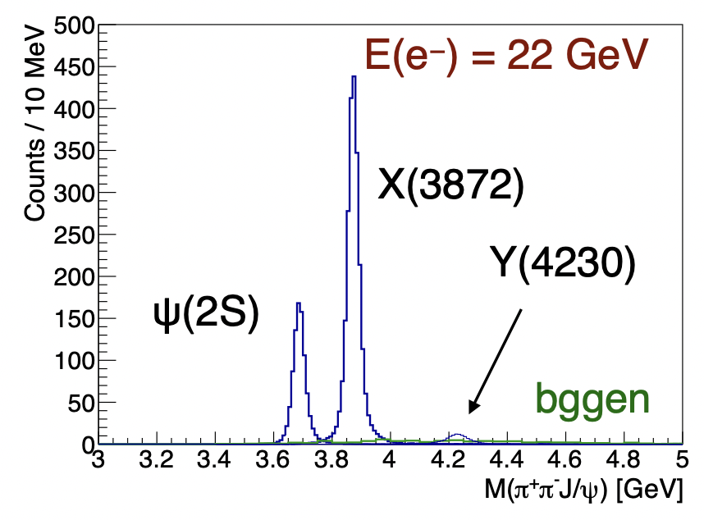
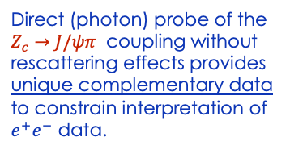

Spectroscopy of Exotic States with c-cbar
Photoproduction of hadrons with charm quarks: new tool for discovery in QCD
  ➜ potentially decisive information about the nature of some 5-quark and 4-quark candidates
  ➜ a unique method to probe the structure of the proton
Tetraquark candidates, XYZ states, observed in B decays, e⁺e⁻ colliders but their internal structure not yet understood
Never direcly produced using γ/lepton beams ➞ Photoproduction alternative mechanism to study such states
Direct (photon) probe of the $Z_{c}→J/ψπ$ coupling without rescattering effects provides unique complementary data to constrain interpretation of $e^{+}e^{−}$ data.
$$γp→Jψπ^{+}n$$
Initial simulations from GlueX and CLAS12 demonstrate the capabilities of the existing detectors to measure these reactions
Full CLAS12 signal MC simulation

Slide 8
Spectroscopy of Exotic States with c-cbar
Photoproduction of hadrons with charm quarks: new tool for discovery in QCD
  ➜ potentially decisive information about the nature of some 5-quark and 4-quark candidates
  ➜ a unique method to probe the structure of the proton
Tetraquark candidates, XYZ states, observed in B decays, e⁺e⁻ colliders but their internal structure not yet understood
Never direcly produced using γ/lepton beams ➞ Photoproduction alternative mechanisms to study such states
Photoproduction tool already used at 12 GeV to validate the existence of charmed pentaquark.
With an energy upgraded CEBAF, this line of investigation can be extended to other exotic candidates.
Direct (photon) probe of the $Z_{c}→J/ψπ$ coupling without rescattering effects provides unique complementary data to constrain interpretation of $e^{+}e^{−}$ data.
$$γp→Jψπ^{+}n$$
Initial simulations from GlueX and CLAS12 demonstrate the capabilities of the existing detectors to measure these reactions
Full CLAS12 signal MC simulation

Slide 9
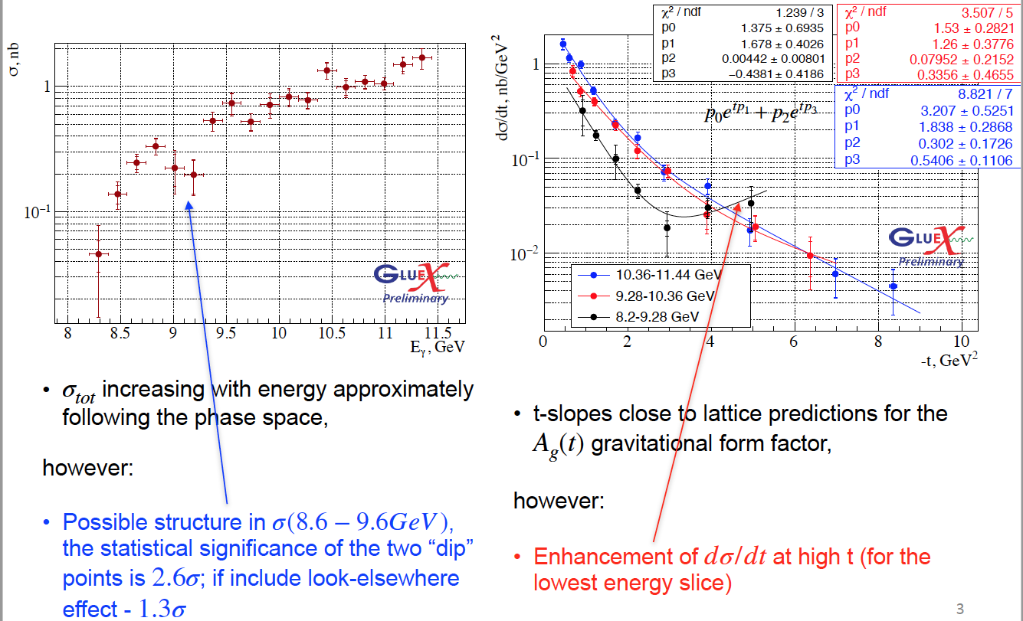
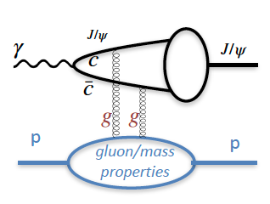
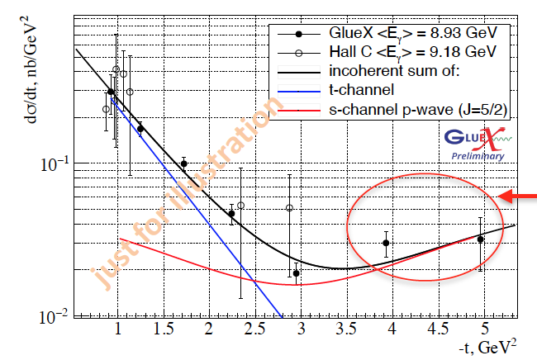
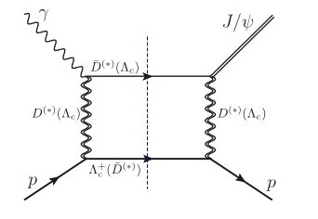

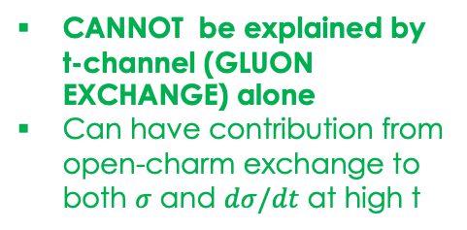
J/ψ photoproduction near threshold
Used to study important aspects of the gluon structure of the proton
  gluon GPD
  mass radius of the proton,
  anomalous contribution to the proton mass.
..based on some assumptions (mainly 2-g exchange)
GlueX final results to be submitted to PRC
Possible structure at $Λ_{c}{\overline{D}}^{(∗)}$threshold σ(8.6-9.6) GeV
Enhancement of dσ/dt at high t for the lowest energy slice
CANNOT be explained by t-channel (GLUON EXCHANGE) alone
Can have contribution from open-charm exchange to both $σ$ and $dσ/dt$ at high t
Can we interpret this as a possible evidence for a s-channel resonance (?) Pc
9

Slide 10
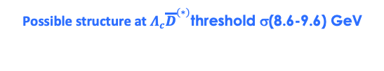

J/ψ photoproduction near threshold
Used to study important aspects of the gluon structure of the proton
  gluon GPD
  mass radius of the proton,
  anomalous contribution to the proton mass.
Need precise measurements (high statistics) to develop accurate theoretical models to understand the mechanism
..based on some assumptions (mainly 2-g exchange)
possible with GlueX at 17+ GeV
Possible structure at $Λ_{c}{\overline{D}}^{(∗)}$threshold σ(8.6-9.6) GeV
Enhancement of dσ/dt at high t for the lowest energy slice
CANNOT be explained by t-channel (GLUON EXCHANGE) alone
Can have contribution from open-charm exchange to both $σ$ and $dσ/dt$ at high t
Can we interpret this as a possible evidence for a s-channel resonance (?) Pc
10

Slide 11
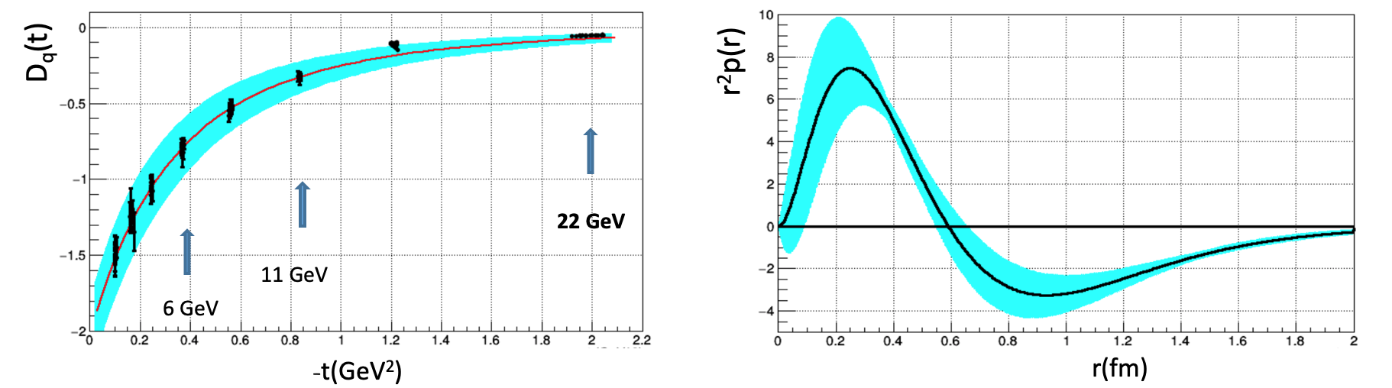
Spacial q/g Structure & Mechanical Properties of the Proton
Form Factors: source of information on hadron structure
Gluonic FFs : describe how energy, spin, and various mechanical properties of hadrons are carried by q/g constituents.
GFF D(t): describes the pressure distribution in the nucleon. It is accessible through measurements of the Compton FFs measured in Deeply Virtual Compton Scattering
Simulation @ 22 GeV
data @ 6 GeV
A large -t range is required to perform the Fourier transform with controlled uncertainties ➜ high luminosity
➜
The 22 GeV beam energy is crucial to this program
11
11

Slide 12
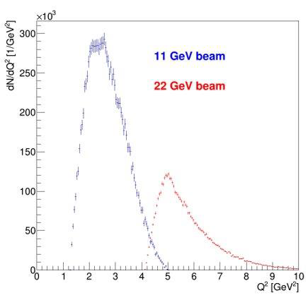
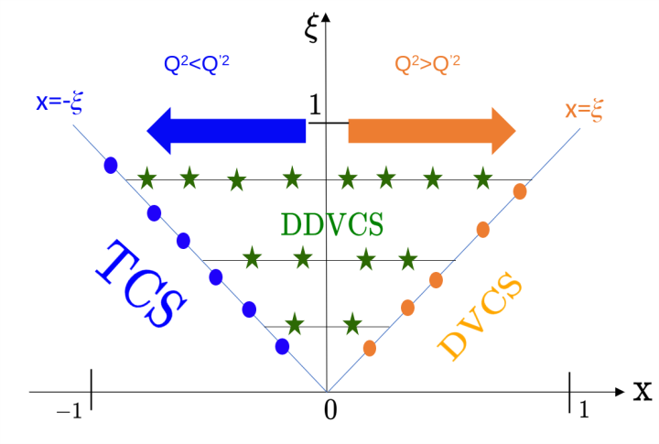
Spacial q/g Structure & Mechanical Properties of the Proton
FFs: source of information on the hadron structure
GFFs : encode the matrix elements of the EMT of QCD and describe how energy, spin, and various mechanical properties of hadrons are carried by q/g constituents.
D-term: describes the pressure distribution in the nucleon, accessible through measurements of the CFFs of DVCS
Simulation @ 22 GeV
data @ 6 GeV
A large -t range is required to perform the Fourier transform with controlled uncertainties ➜ high luminosity
➜
The 22 GeV beam energy is crucial to this program
Double DVCS (DDVCS)
Direct probe of GPDs away from the x=±𝜉 line
NEVER been measured (very small cross section).➜ JLAB with high luminosity will be the only place to measure this reaction.
22 GeV upgrade allows to reach higher Q²
  * Test evolution and scaling of GPDs
  * Study higher twist effects
12
12

Slide 13
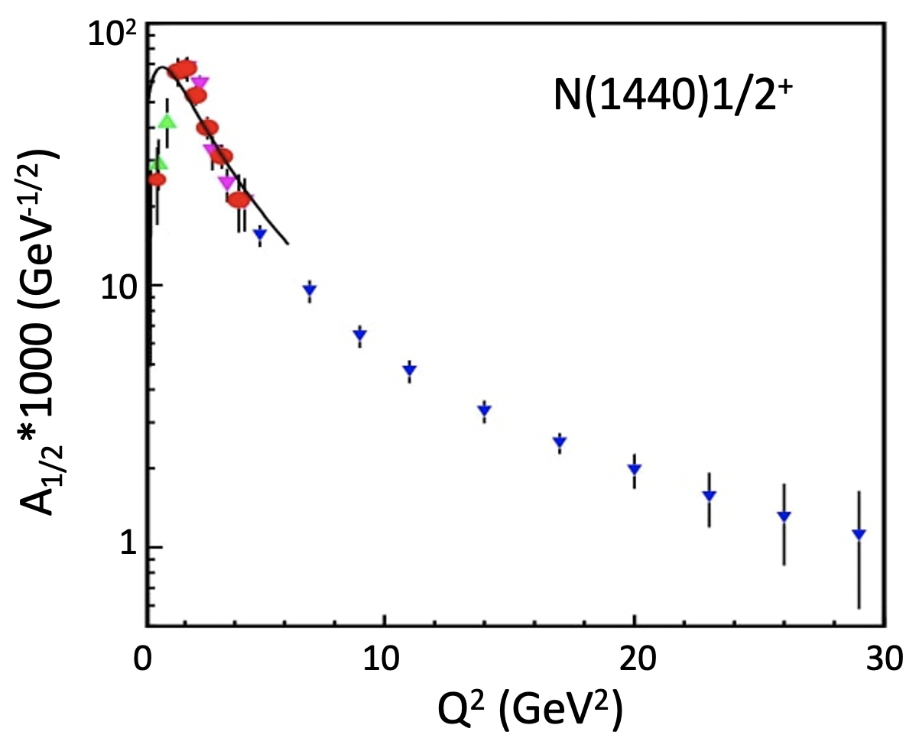
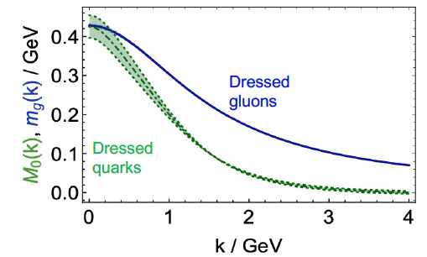
Bound 3 Quark Structure of N∗s and Emergence of Mass
Continuum Schwinger Method
  the solution of the QCD equations of motion for q/g fields reveals existence of dressed q/g with momentum-dependent masses.
Q² evolution of the γ_{v}pN* electrocouplings could offer an insight into hadron mass generation and the emergence of the N* structure from QCD
Simulations indicate JLab22 is the only foreseeable facility to extend these measurements up to 30 GeV²
13
13

Slide 14
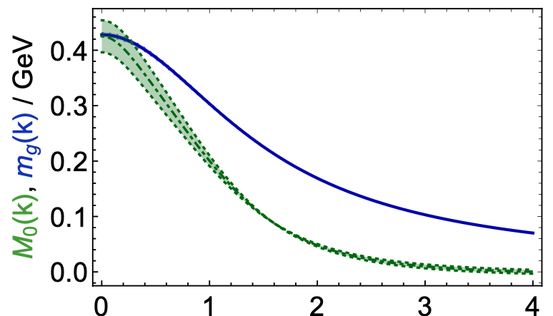
Bound 3 Quark Structure of N∗s and Emergence of Mass
Continuum Schwinger Method
  the solution of the QCD equations of motion for q/g fields reveals existence of dressed q/g with momentum-dependent masses.
Dressed gluons
Dressed quarks
p _{quark} (GeV)
Q² evolution of the γvpN* electrocouplings could offer an insight into hadron mass generation and the emergence of the N* structure from QCD
15-20%
40-50%
>80%
CLAS
CLAS12
CLAS22
Simulations indicate JLab22 is the only foreseeable facility to extend these measurements up to 30 GeV²
Q² range(<35 GeV²) where the dominant portion of hadron mass is expected to be generated
14
14

Slide 15
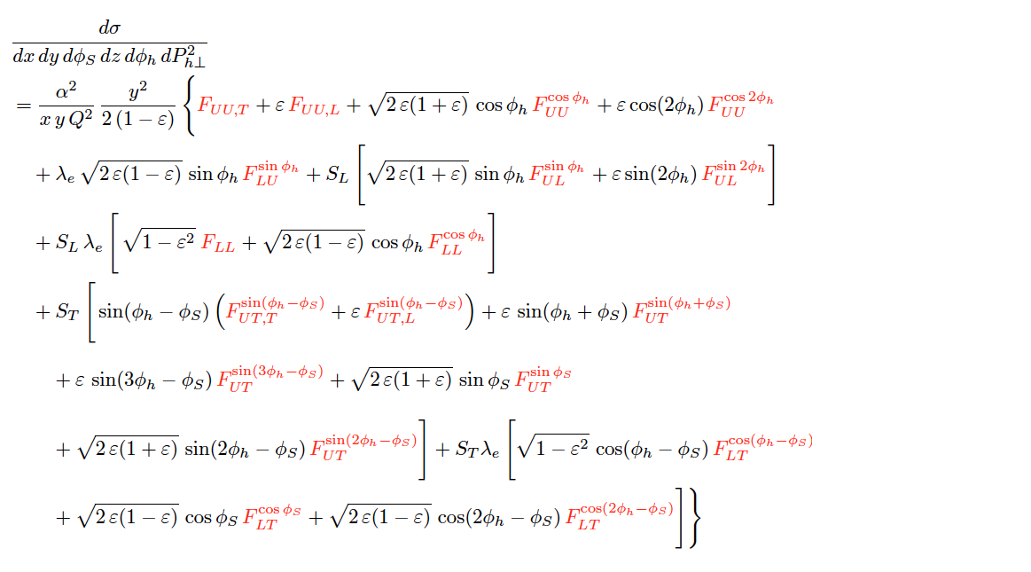
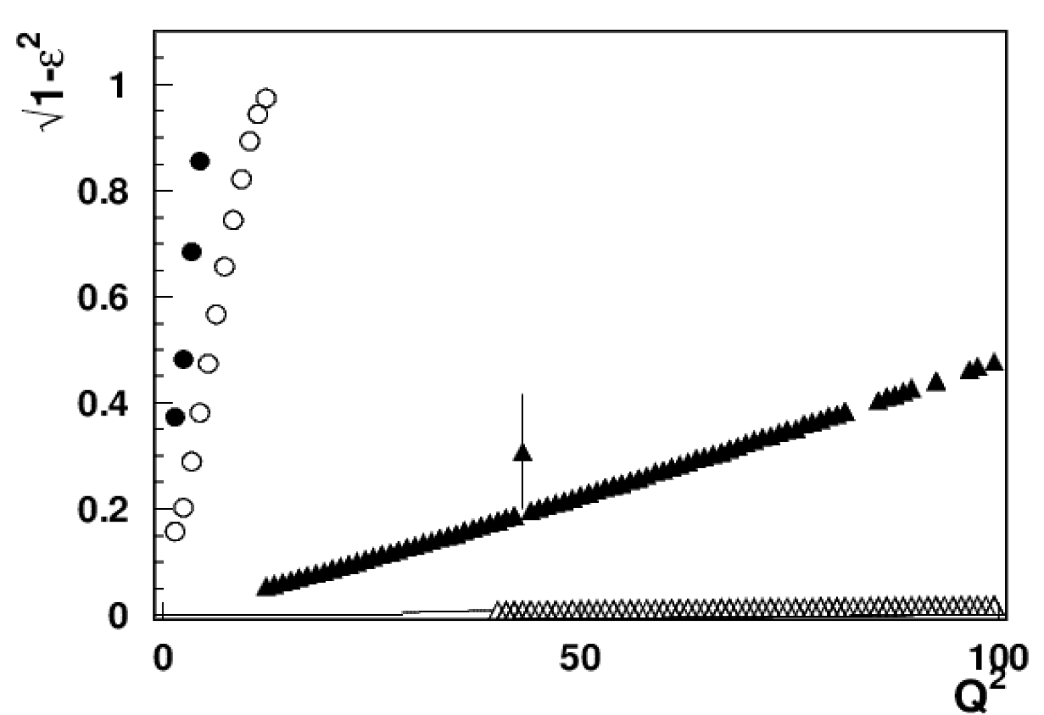
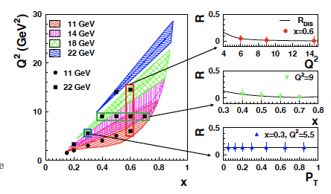
Fragmentation, Transverse Momentum & Parton Correlations
SIDIS cross section
CLAS12
CLAS24
X=0.3
Separation of SFs highly non-trivial !
At large x and high energies
ϵ → 1 ➜ certain SFs are suppressed (i.e.helicity dep.)
EIC 5x41
EIC 18x275
A combined 11 and 22 GeV SIDIS program
will increase our ability to measure a variety of SIDIS SFs across an enhanced multidimensional phase space allowing test and validation of our understanding and interpretation of SIDIS reactions.
A combined 11 and 22 GeV SIDIS program
will provide a unique determination of the ratio of longitudinal to transverse photon SIDIS cross sections essential to properly understand SIDIS multiplicities, Sivers and Collins effects,…
R is assumed to be similar to that of DIS but never been thoroughly checked
15
15

Slide 16
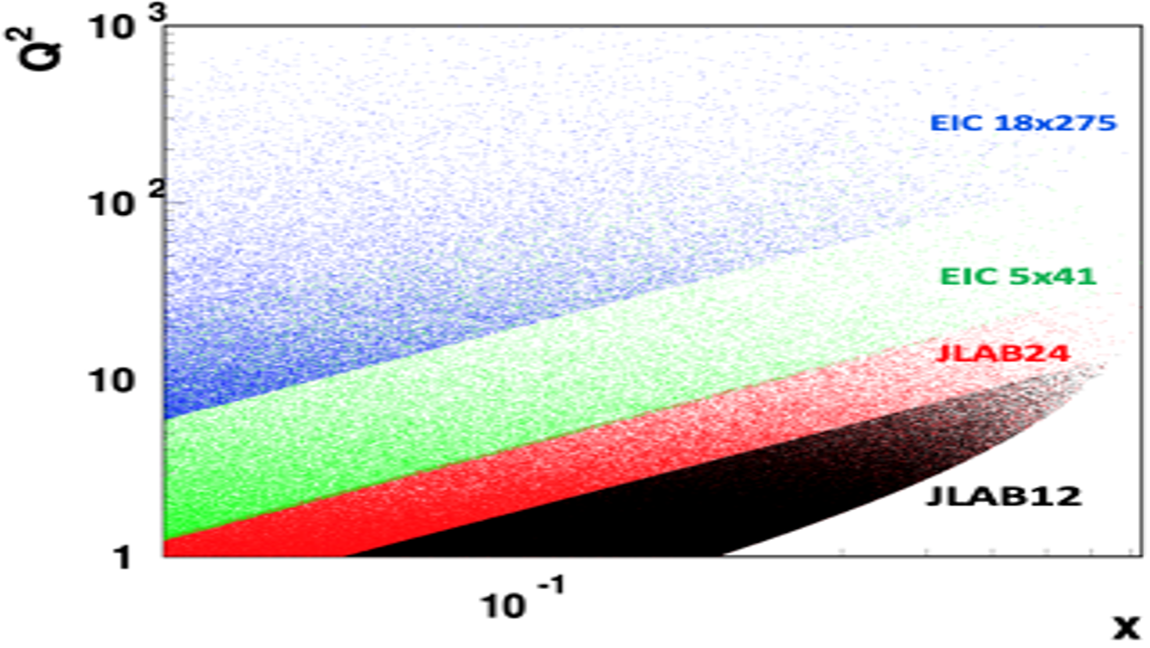
Fragmentation, Transverse Momentum & Parton Correlations
Interpretation of SIDIS data in terms of TMD??
The connection of SIDIS
data with TMDs is only within one of the mechanisms known as TMD current region.
Multiple physical mechanisms contribute to the production of hadrons in the final state depending on the involved energy
Large acceptance, high precision measurements in multi-dimensional phase space will allow evaluation of different contributions and analysis of different systematics
With an extended Q² coverage, the 22 GeV upgrade offers a new complementary window that sits in-between the 12 GeV program and the EIC and allow us to validate the measurements of leading contributions and explore sub-leading contributions
16
16

Slide 17
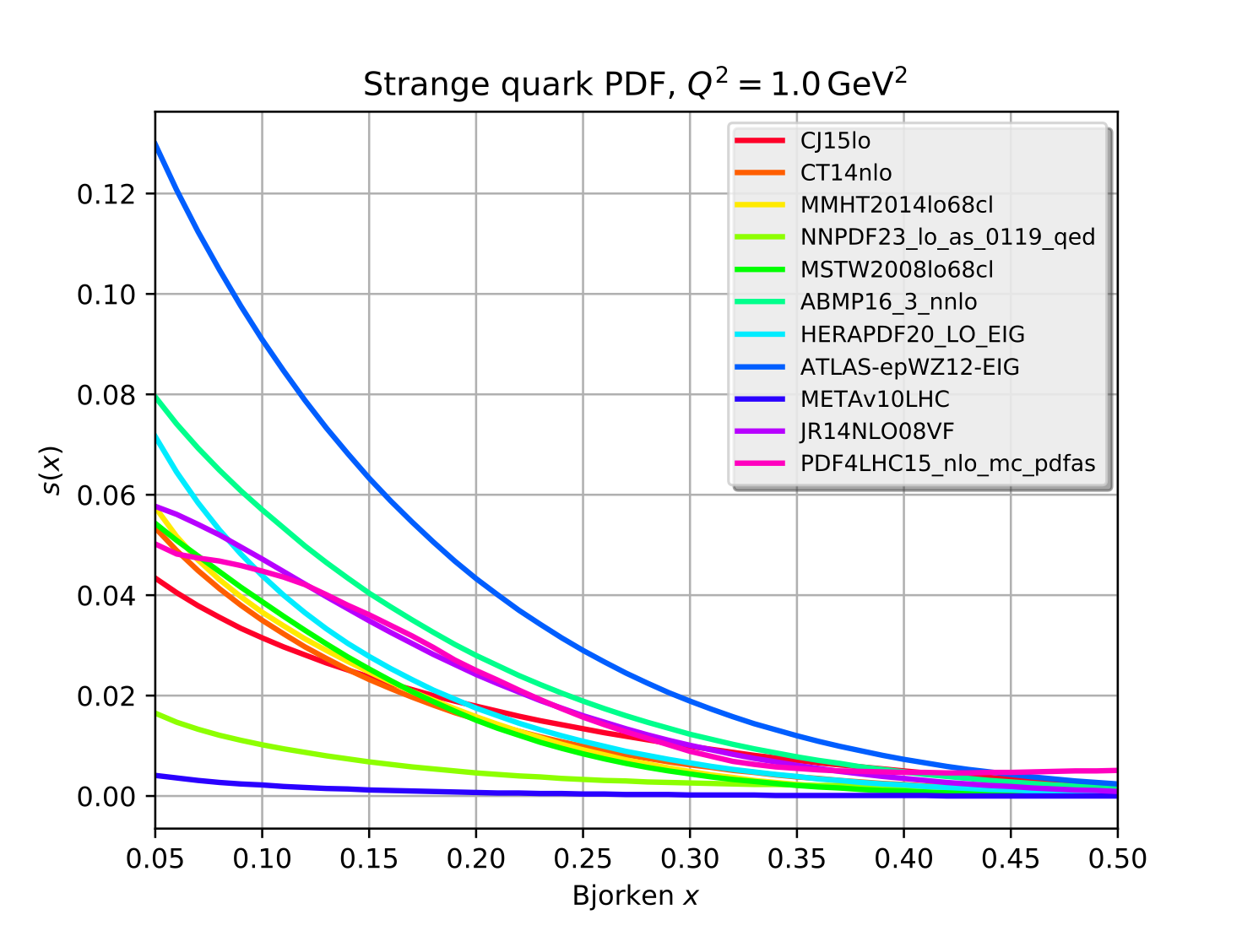
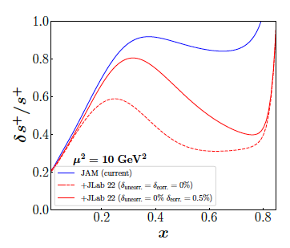
Unambiguous Access to Strange Quarks
Current Situation
Parity-violating DIS
di-muon production in neutrino-nucleus scattering – nuclear corrections introduce significant uncertainty
W and Z rapidity distributions
W+c production
Semi-inclusive K production: choice of fragmentation function negates inclusion in nearly all global fits
JLab12 Q² too low for PDF analysis
Parity-violating DIS allows for a large contribution of the strange
Valence regime provides strength and shape
Substantial improvement with a reduction in the s+ uncertainty that can reach more than a factor of two at large-x
LO
LHC results inconclusive
Order of magnitude differences!
~100 days, 40 μA beam split between 40 cm D and H targets
x
17

Slide 18
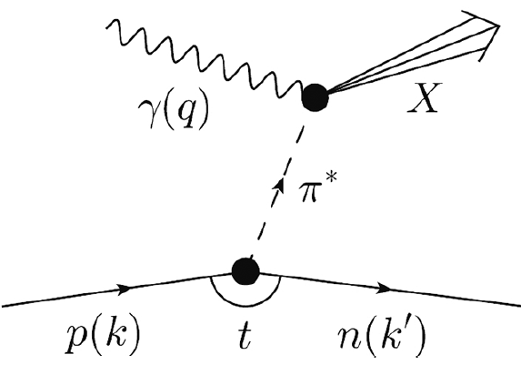
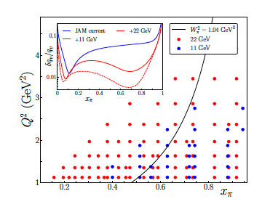
Partonic Structure and Spin
Meson structure
Tagged deep inelastic scattering (TDIS) provides a mechanism to access the meson structure via the Sullivan process .
A cut of W² π > 1.04 GeV² (to avoid contributions from resonances in a pion analysis,) eliminates most of the data at 11 GeV.
At 22 GeV:
Available phase space significantly increased
➔ determination of the valence structure of the pion
➔ kin. coverage to smaller x_{π} region to probe the sea content of mesons
Overlap the existing π induced DY data
➔ test the universality of PDFs in the mid to large x_{π} region
➔ pion PDF predicted to be broader than the proton PDF – test in valence regime
18
18

Slide 19
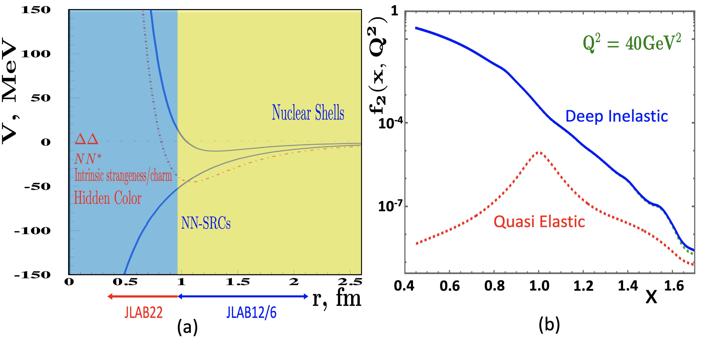
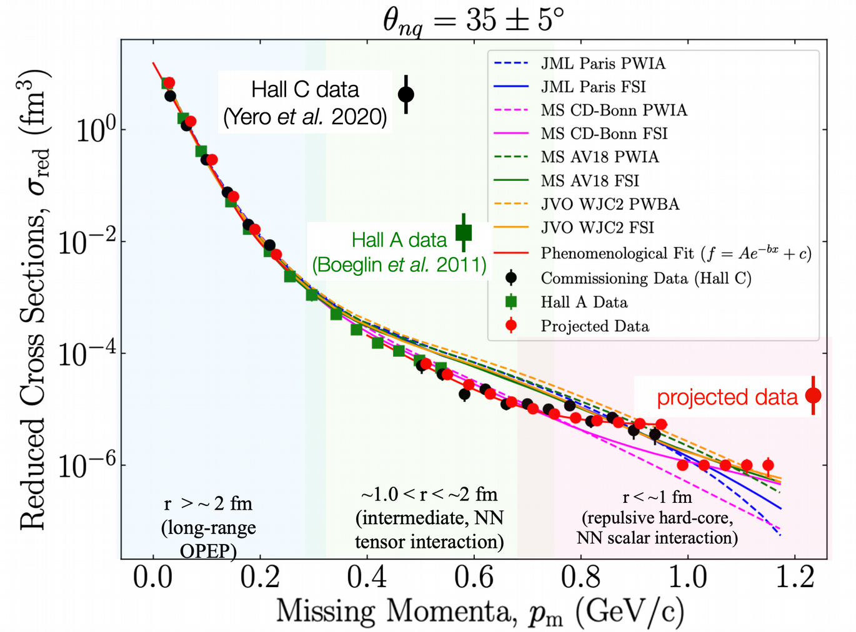
Nuclear Dynamics at Extreme Conditions
The dynamics of the nuclear repulsive core is still poorly understood
A 22 GeV upgrade will provide reach to the nuclear forces dominated by nuclear repulsion
Superfast Quarks
The high Q² reach will allow
  the suppression of quasi-elastic contributions,
  the first-ever study of nuclear DIS structure function at Bjorken x > 1.2 (r∼ 0.5 fm,)
Luminosity is key to access tiny cross sections
Exploring Deuteron at Very Large Internal Momenta (> 800 MeV/c – non-nucleonic & hidden color components)
non-relativistic theory reproduce data up to pm ∼ 0.7 GeV/c
no model reproduces data (non-nucleonic degrees of freedom?, quarks?) pm > 0.7 GeV/c
19
19

Slide 20
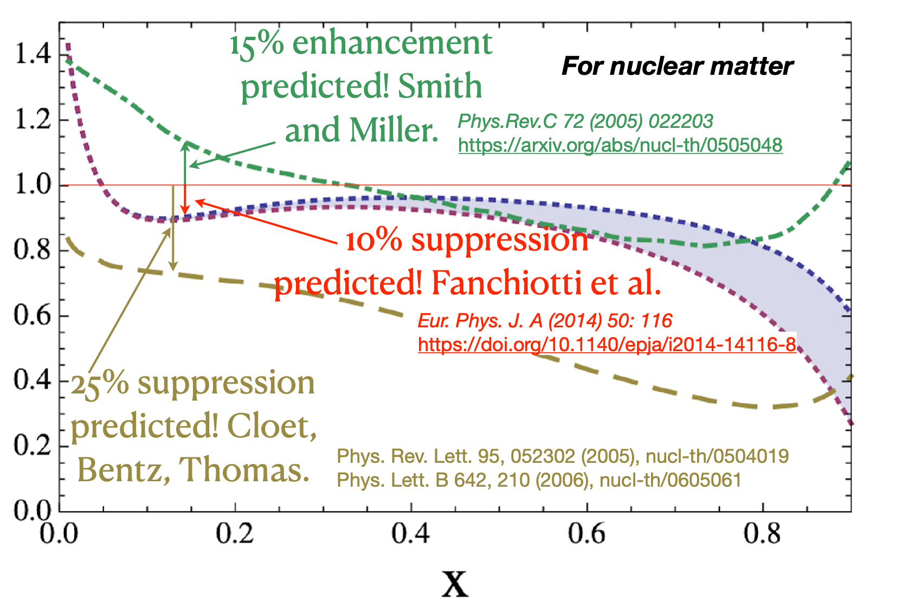
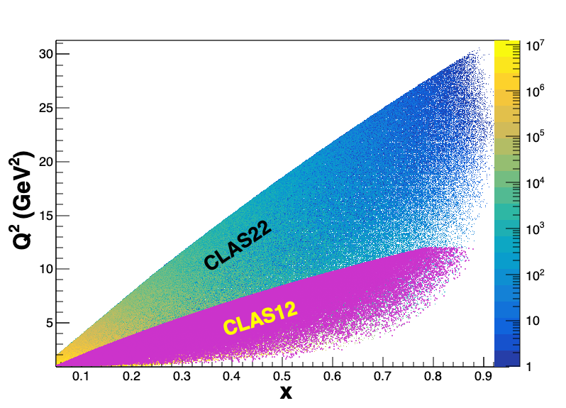
Hadron–Quark Transition in Nuclear Medium
Predictions for polarized structure function A/D ratios
With a 22 GeV e- beam JLab can access the anti-shadowing region (x~0.1-0.3)
Region extremely interesting, near-equally dominated by valence quarks, sea-quarks, and gluons → many many models!!
Anti-Shadowing is the least studied nuclear structure function effect experimentally
  flavor and spin dependence essentially uncharted
  no tagged measurements
  no L/T separations
  SMALL effect
The transition between shadowing and the EMC regimes → a testing ground
  Models which survive testing in the EMC regime may still be eliminated in the anti-shadowing region, where new interference phenomena will emerge
20
20

Slide 21
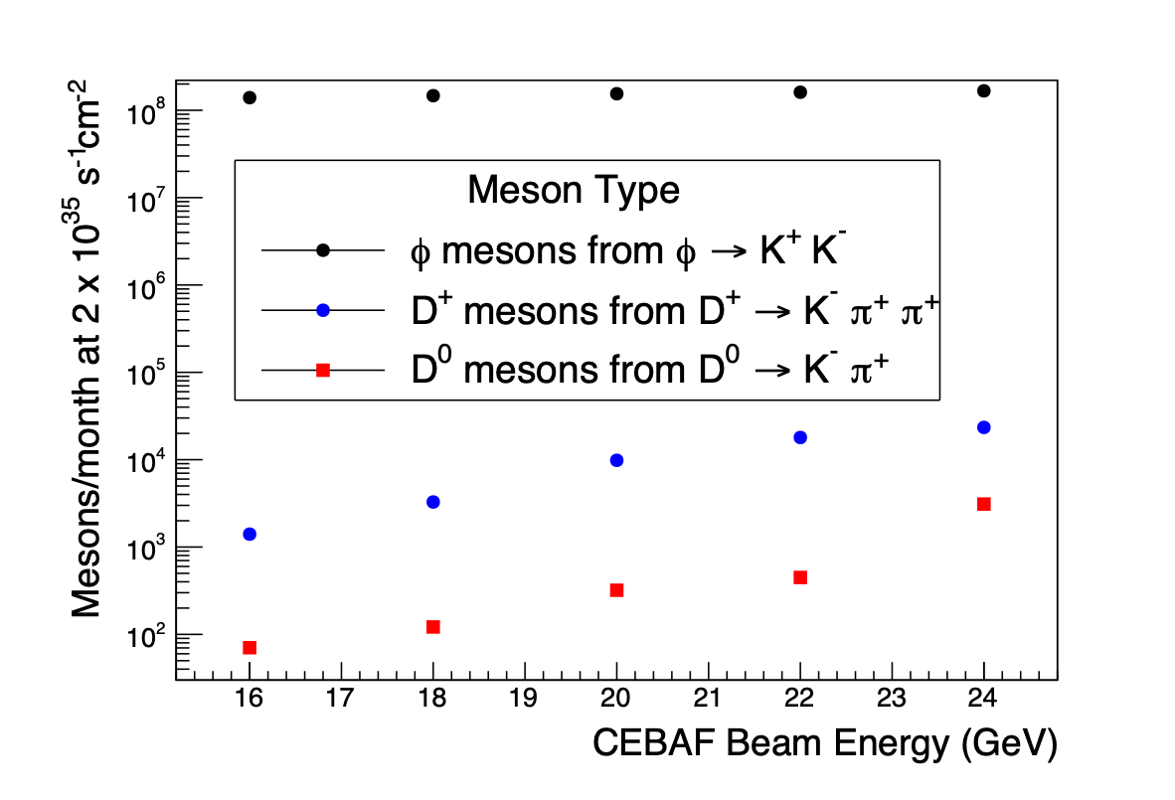
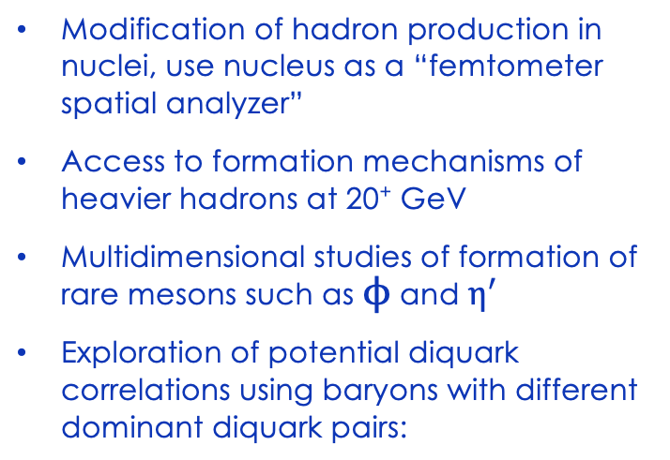
Understanding Hadron Formation using Nuclei
Modification of hadron production in nuclei, use nucleus as a “femtometer spatial analyzer”
Access to formation mechanisms of heavier hadrons at 20⁺ GeV
Multidimensional studies of formation of rare mesons such as $ϕ$ and $η^{′}$
Exploration of potential diquark correlations using baryons with different dominant diquark pairs:
Arrington et al., Progr. Part. Nucl. Phys. 127 2022, 103985
Color lifetime of struck quark from p_{T} broadening (HERMES data)
Yin et al., https://doi.org/10.1103/PhysRevD.100.034008
Brooks and Lopez, https://doi.org/10.1016/j.physletb.2021.136171

Slide 22
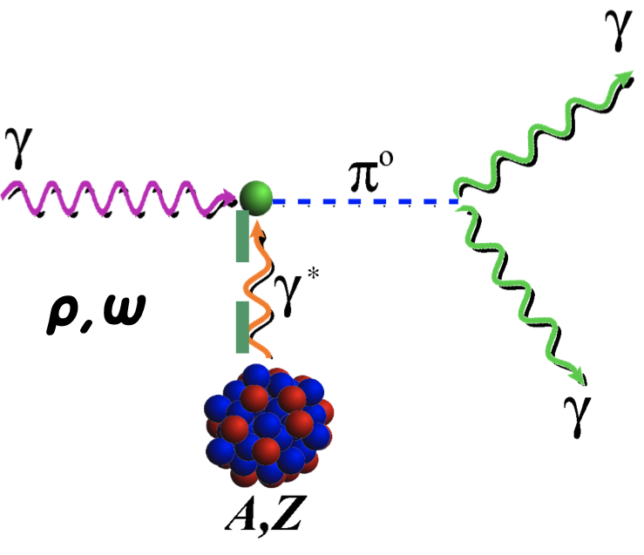
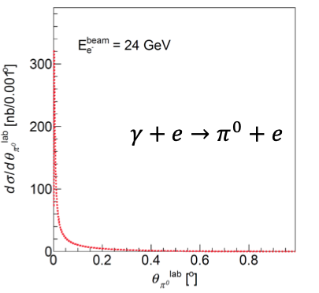
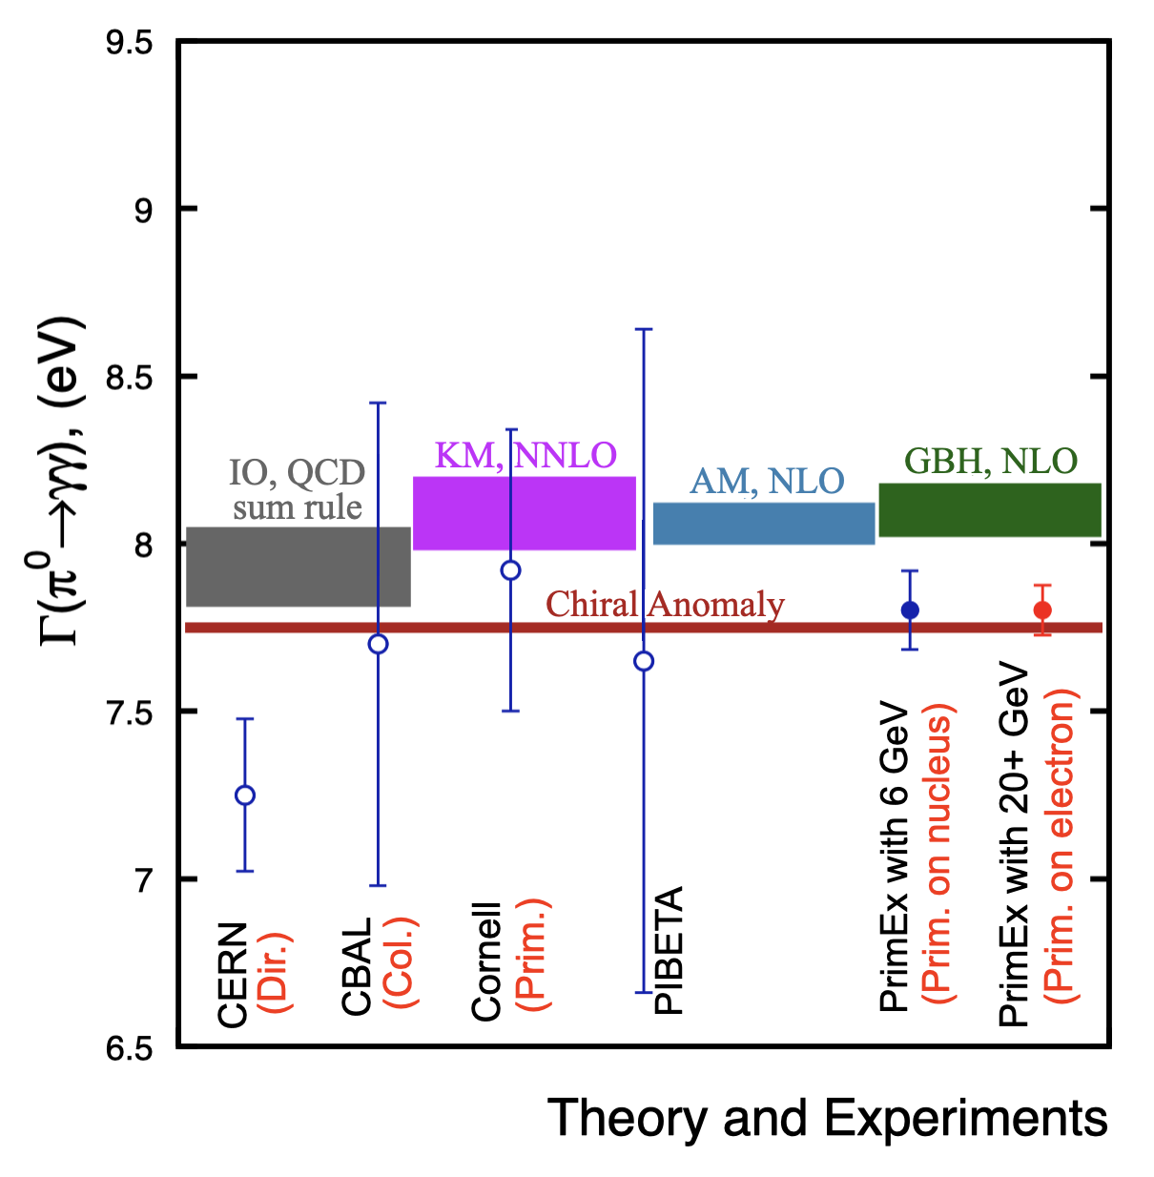
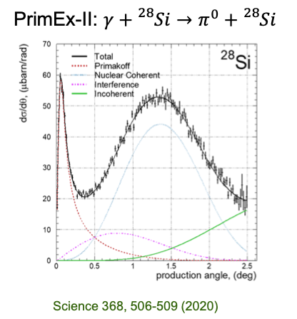
QCD Confinement and Fundamental Symmetries
π⁰ Primakoff production off an electron target
Γ(π⁰ → γγ) can be predicted at ≈ 1% precision
Higher energy will allow for η’
Higher energy will allow for measurements off atomic electrons
Stringent test of low-energy QCD
Primakoff Productions off Nuclear Target
A 22 GeV upgrade will greatly enhance the Primakoff experiments for more massive mesons off nuclear target
first Primakoff measurement of Γ(η′ → γγ) with ∼3.5% precision to study the U(1)A anomaly coupling to the gluon field,
improve the measurement of Γ(η → γγ) to a 2% accuracy to determine the light-quark mass ratio
22
22

Slide 23

Current Plans
Short document submitted to the NSAC Long Range Plan writing Committee
  Presentation at meeting July 10
Work on scientific publication of longer document material
  Initial v2 will allow more author requests
Accelerator and engineering
  Successful retreat at JLab in May, workshop planned for September focusing on FFA approach
  Planning for prototype high energy FFA magnet design, construction and small beamline test
23
23

Slide 24
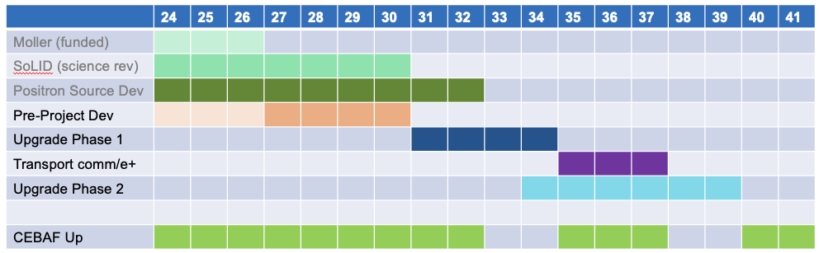
Notional CEBAF & upgrade schedule (FY24 – FY42)
Accelerator and engineering team have worked up an early schedule and cost estimate
  Schedule assumptions based on a notional timing of when funds might be available (near EIC ramp down based on EIC V3 profile)
  For completeness, Moller and SoLID (part of 12 GeV program) are shown; positron source development also shown
24

Slide 25

Conclusions and Outlook
Understanding the strong interaction dynamics of non-pQCD and ``how'' hadrons/nuclei emerge from fundamental QCD principles, is a complex problem
This complexity requires observation of the chromodynamic fields ``at work’’ through multiple observables using different approaches and measurements
With CEBAF at higher energy some important thresholds would be crossed and an energy window which sits between JLab @ 12 GeV and the EIC would be available. This, together with CEBAF uniqueness to run electron scattering experiments at the luminosity frontier, can provide a unique insight into the non-pQCD dynamics.
A very strong science case for such an upgrade is emerging and it will be presented at the upcoming LRP
Support for an energy upgrade development – thank you!
      Users
      Lab support, including LDRD investment
      DOE encouragement to continue development of the science reach and technical aspects of an upgrade
25
25

Slide 26
Thank you!
26

Slide 27
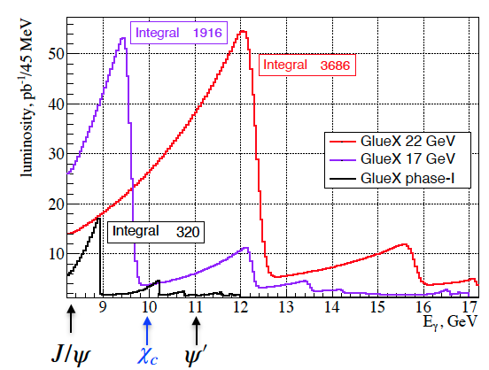
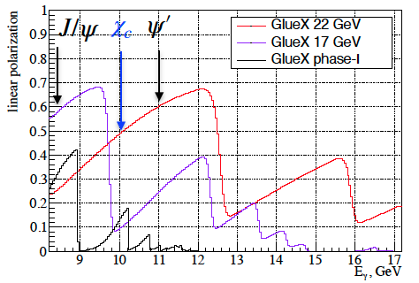

J/ψ photo-production and other charmonium states in Hall D
higher fluxes
Increased γ linear polarization
27

Slide 28

J/Ψ SOLID
28

Slide 29


SIDIS at Large x : JLab domain
x-section from Bacchetta et al, 1703.10157
Counts / year
29
29
29
29

Slide 30


Slide 31



Enhancement of the Q² range - DVMP
Hall C – HMS-SHMS
Hall B – CLAS12
The relevant Q² range for the Q^{n} scaling test significantly increase with 18/22 GeV beam
Needed to test GPD formalism applicability
31

Slide 32

Pion and Proton Unpolarized PDFs

