Slide 1
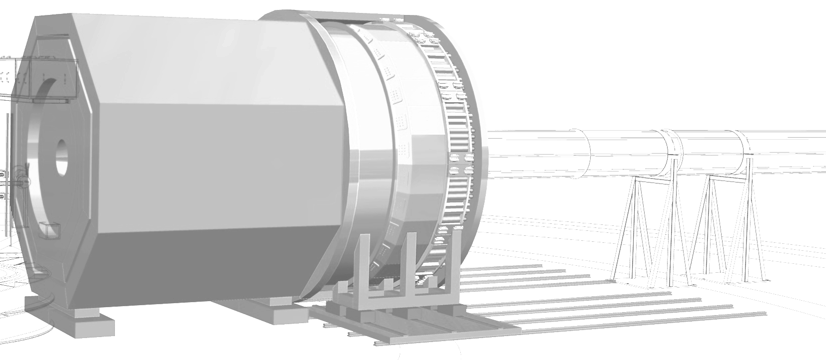
SoLID – The Next-Gen Spectrometer at JLab
JLUO Annual Meeting
June 26-28, 2023
Xiaochao Zheng
University of Virginia
(for the SoLID Collaboration)
solid.jlab.org
2022 SoLID white paper:
https://arxiv.org/abs/2209.13357
(accepted by J. Phys. G)

Slide 2
Outline
Motivation – Why SoLID ?
The Physics Program of SoLID
Current Status and Outlook

Slide 3
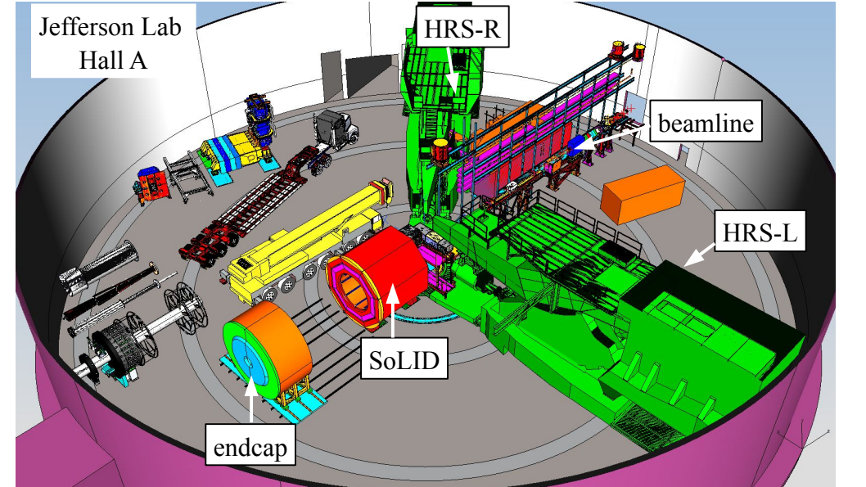
Outline
Motivation – Why SoLID ?
The Physics Program of SoLID
Current Status and Outlook

Slide 4
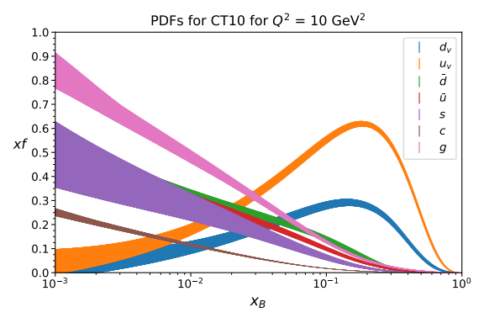
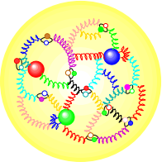
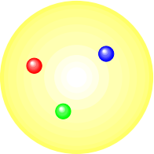
Experimental Frontier of QCD Studies
Proton’s 1D structure after four decades of study
x

Slide 5
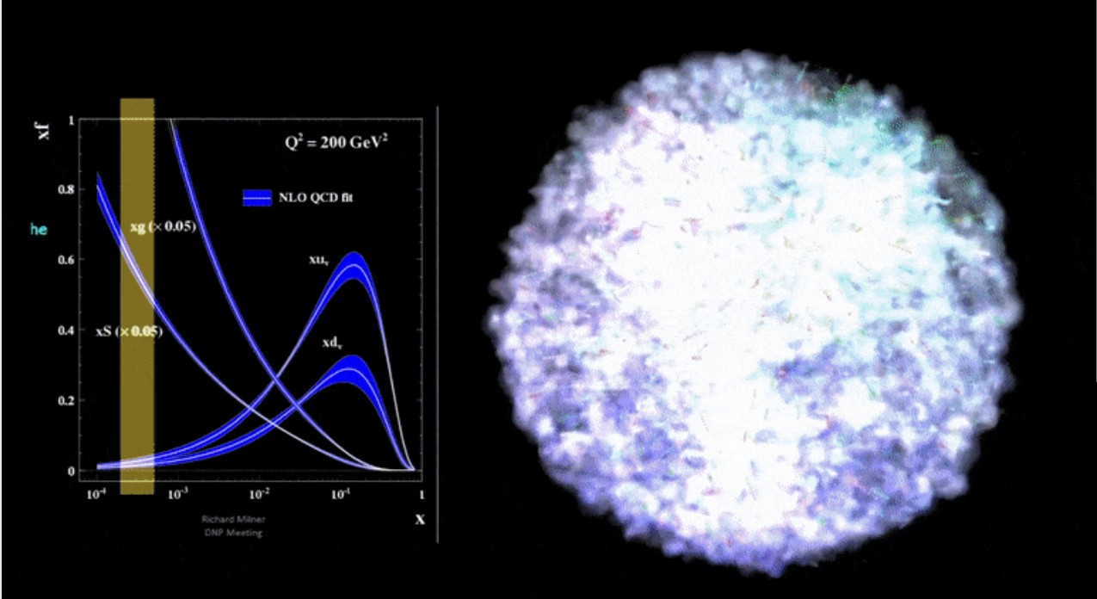
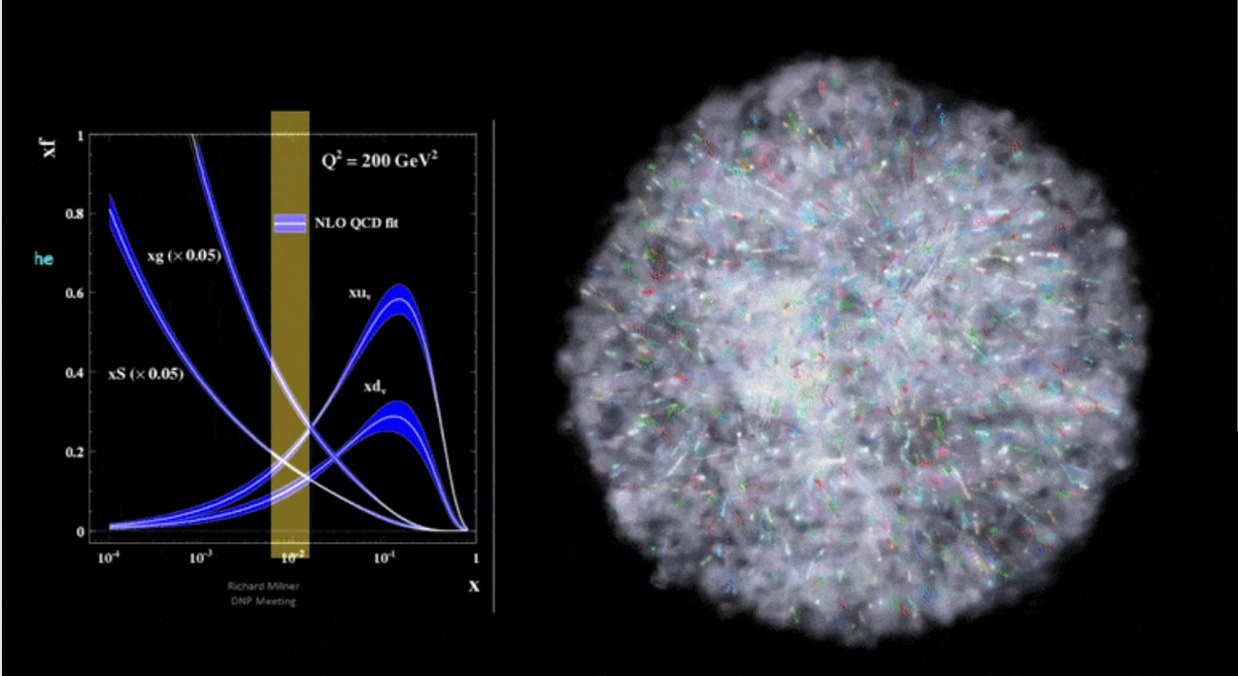
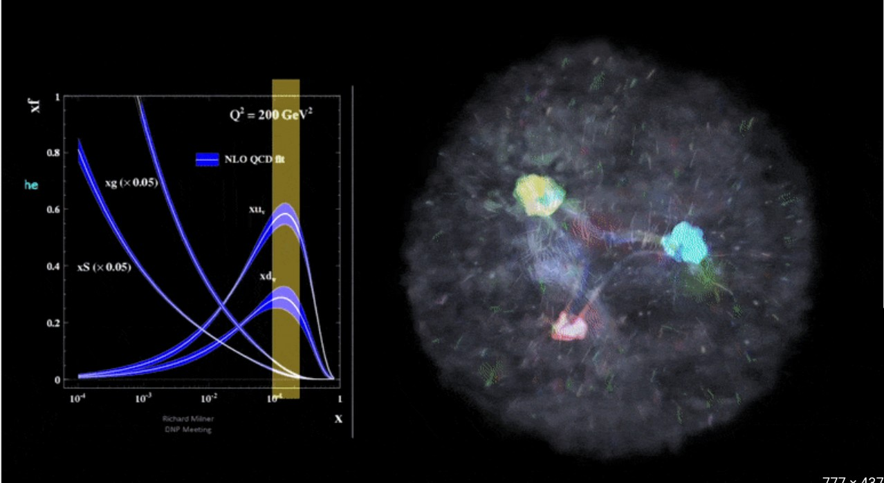
Experimental Frontier of QCD Studies
x
https://www.youtube.com/watch?v=Dt8FZ4ksWiY
https://arts.mit.edu/visualizing-the-proton/

Slide 6
Experimental Frontier of QCD Studies
SoLID will measure small cross sections and asymmetries with high or meaningful precision:
Imaging the proton from 1D (PDF) to 3D or more (TMD with SIDIS, GPD with DVCS, TCS, DEMP etc.)
Threshold studies to probe the proton mass and gluonic field
High precision parity-violating electron scattering (PVES) and test of the SM
SoLID will measure processes never measured before:
Deep exclusive processes – DDVCS, etc.

Slide 7
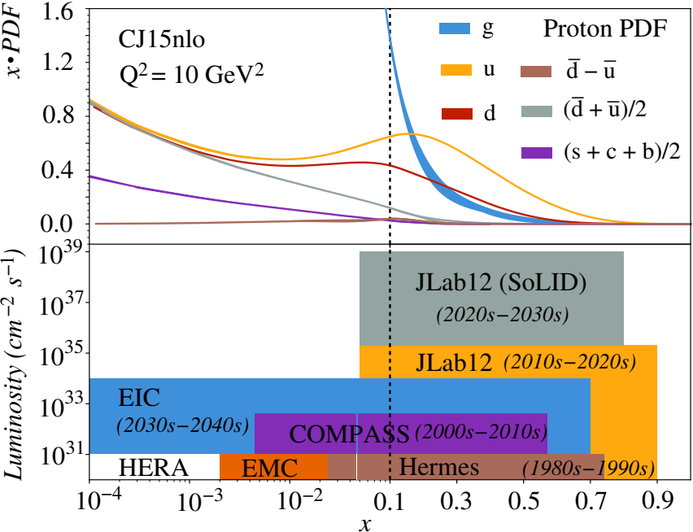
Experimental Frontier of QCD Studies
SoLID will measure small cross sections and asymmetries with high or meaningful precision:
Imaging the proton from 1D (PDF) to 3D or more (TMD with SIDIS, GPD with DVCS, TCS, DEMP etc.)
Threshold studies to probe the proton mass and gluonic field
High precision parity-violating electron scattering (PVES) and test of the SM
SoLID will measure processes never measured before:
Deep exclusive processes – DDVCS, etc.
Figure from JLab12 GeV WP, J. Arrington et al., Prog. Part. Nucl. Phys. 127 (2022) 103985, adapted for SoLID 2022 white paper.

Slide 8
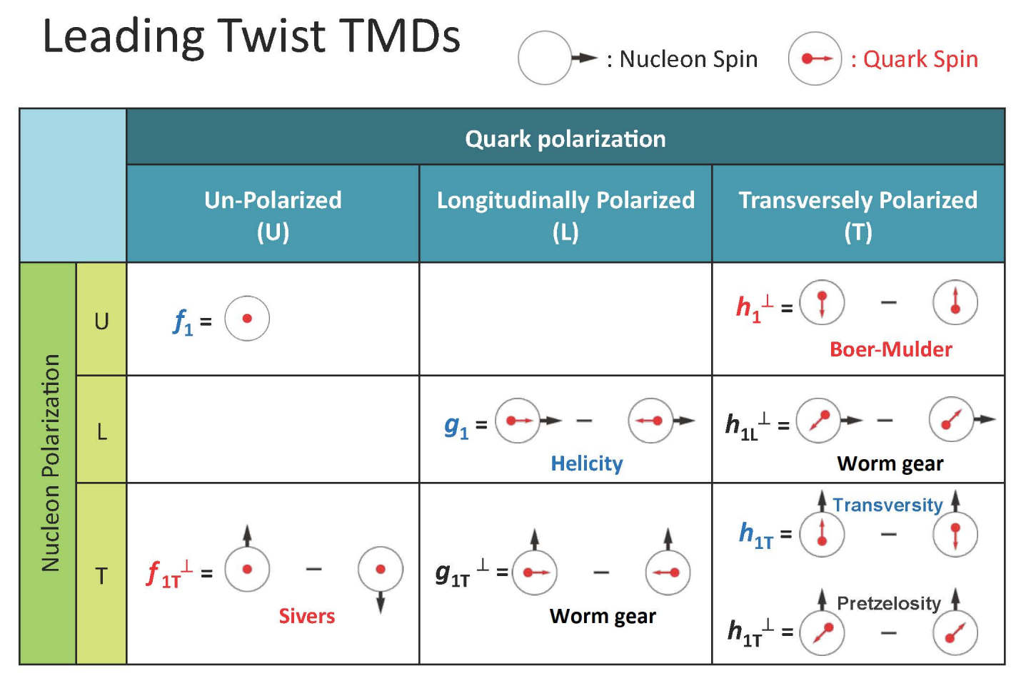
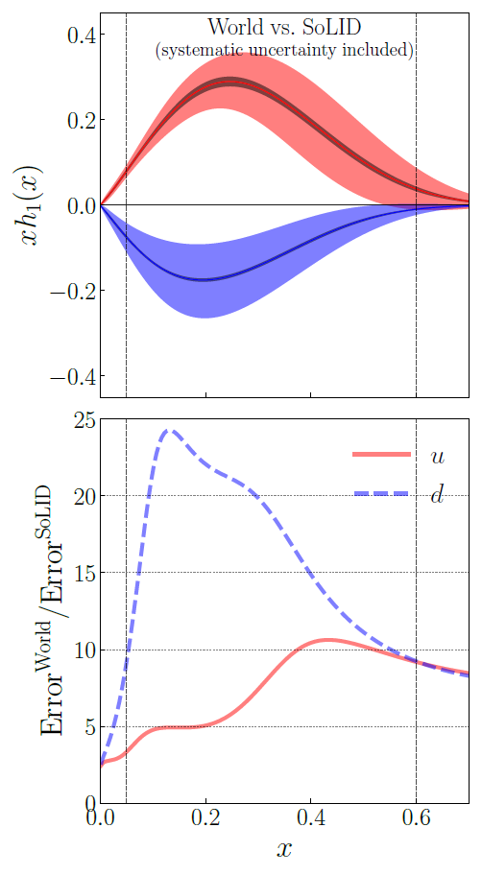
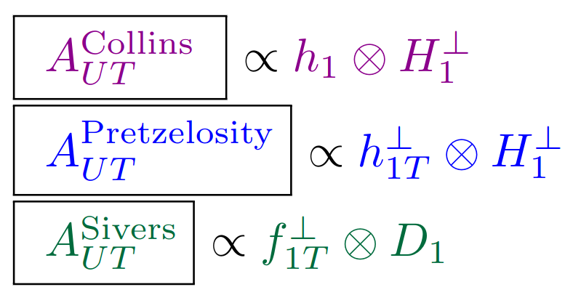
SoLID for JLab Hall A – SIDIS and TMDs
$\vec{p}\left(e,e'π^{±}\right)X$
${}^{3}\vec{He}\left(e,e'π^{±}\right)X$
– hadron in final state “tags” transverse motion of quarks inside the proton/neutron
Collins fragmentation function from e⁺e⁻ collisions
Good momentum and angular resolutions in 4-D binning over the kinematic variables (x, z, Q², P_{T})
Unpolarized fragmentation function
Slide from H. Gao, PAC50 talk

Slide 9
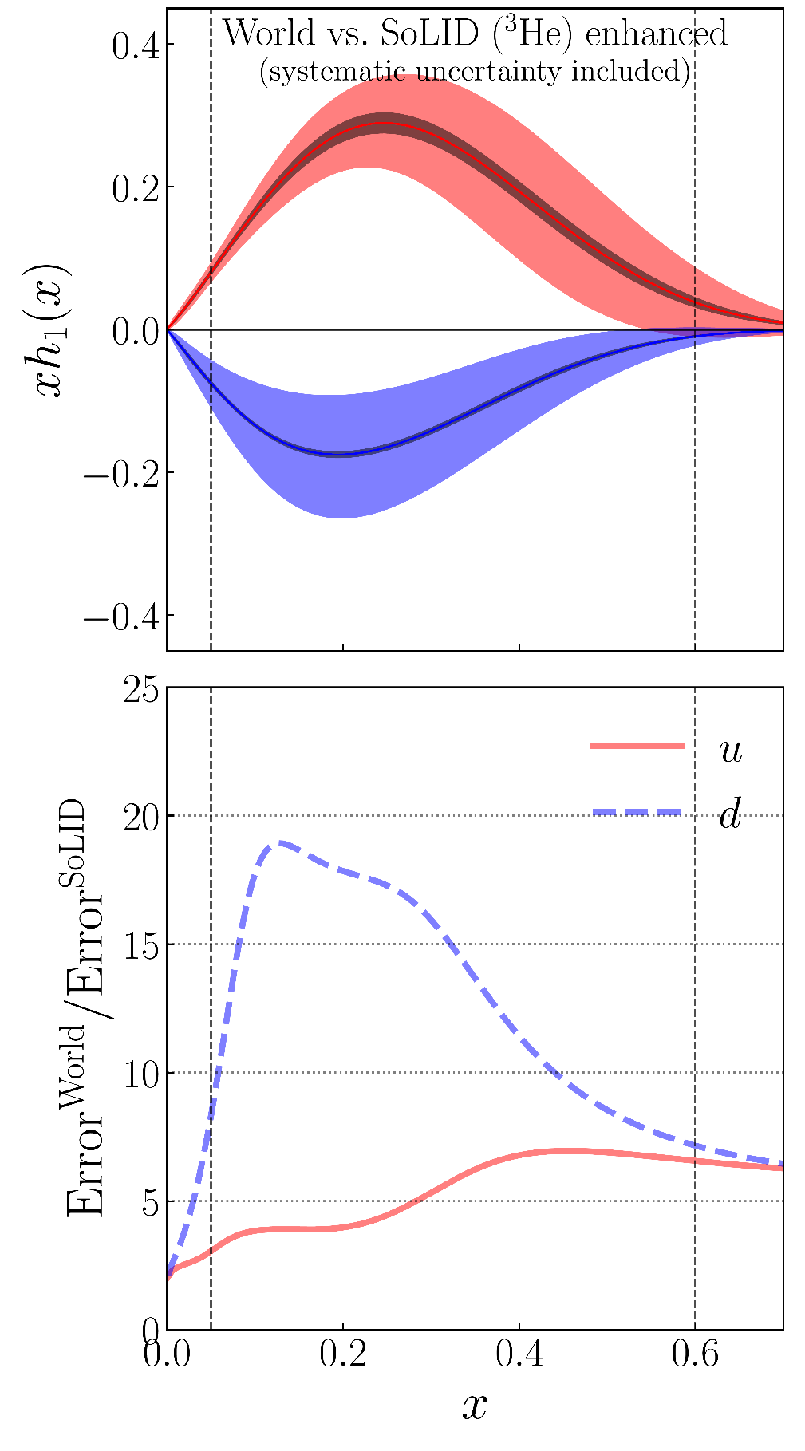
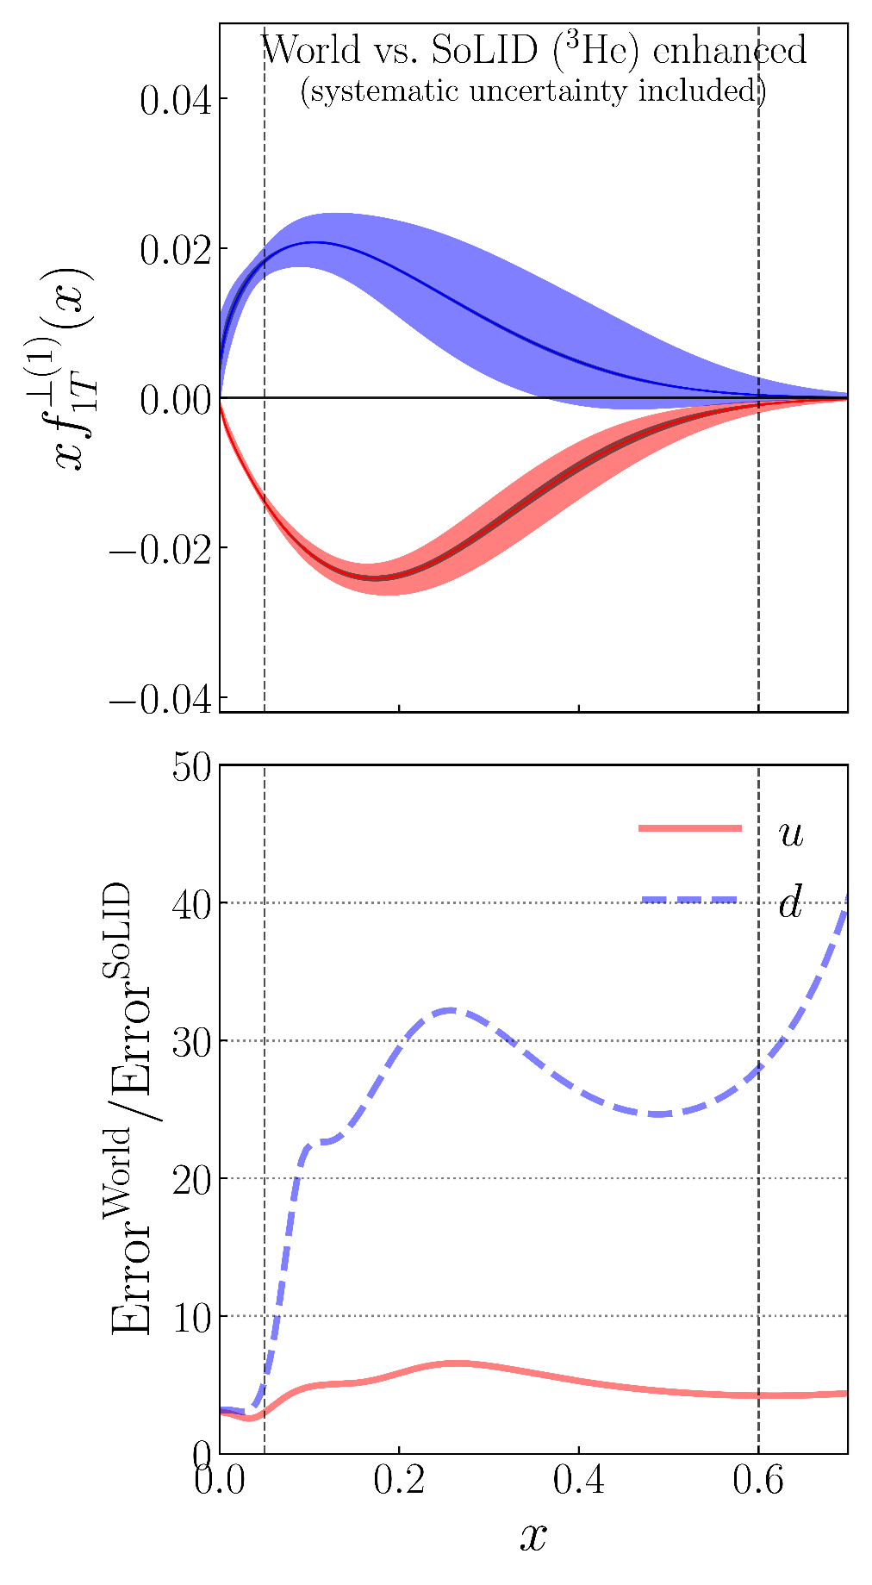
SoLID for JLab Hall A – SIDIS and TMDs
Compare SoLID
3
He with
Transversity
Sivers
World Data
Fit Collins and Sivers asymmetries in SIDIS and e+e- annihilation
World data from HERMES, COMPASS
e+e- data from BELLE, BABAR, and BESIII
Monte Carlo method is applied
Including both systematic and statistical uncertainties
SoLID enhanced = SoLID approved
by the PAC
also see
Z. Ye et al., Phys. Lett. B767 (2017) 91-98
Slide from H. Gao, PAC50 talk

Slide 10
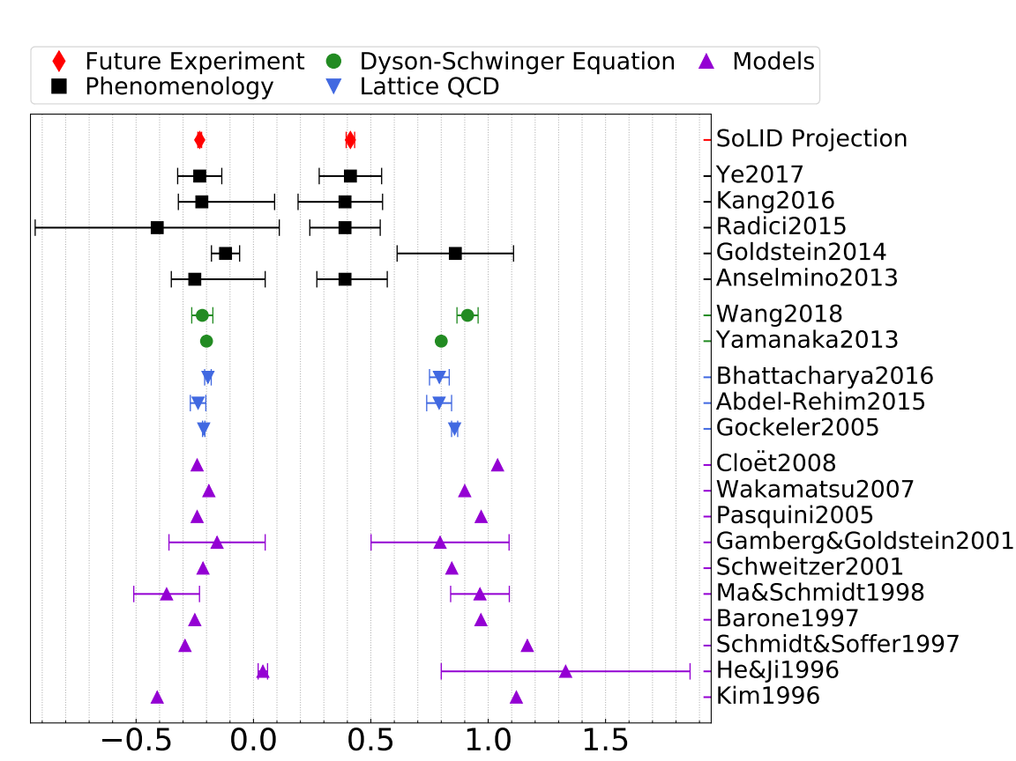
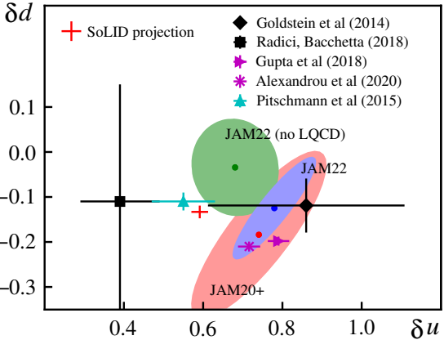
SoLID for JLab Hall A – SIDIS and TMDs
Nucleon tensor charge as important as its other static properties – electric charge, mass, spin
can be compared with Lattice QCD predictions
provide inputs to extraction of quark EDM from proton EDM measurements

Slide 11
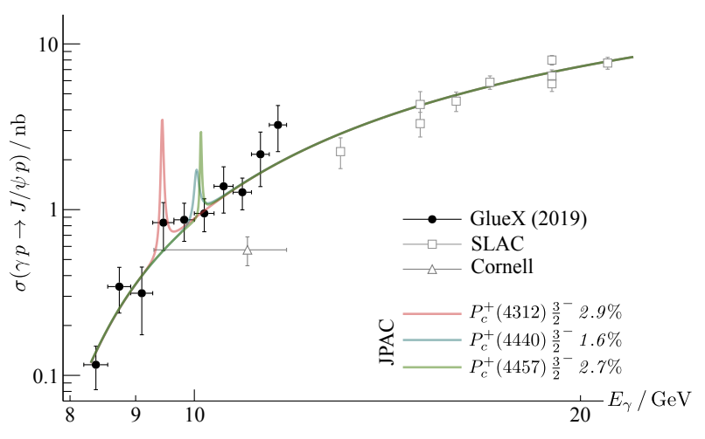
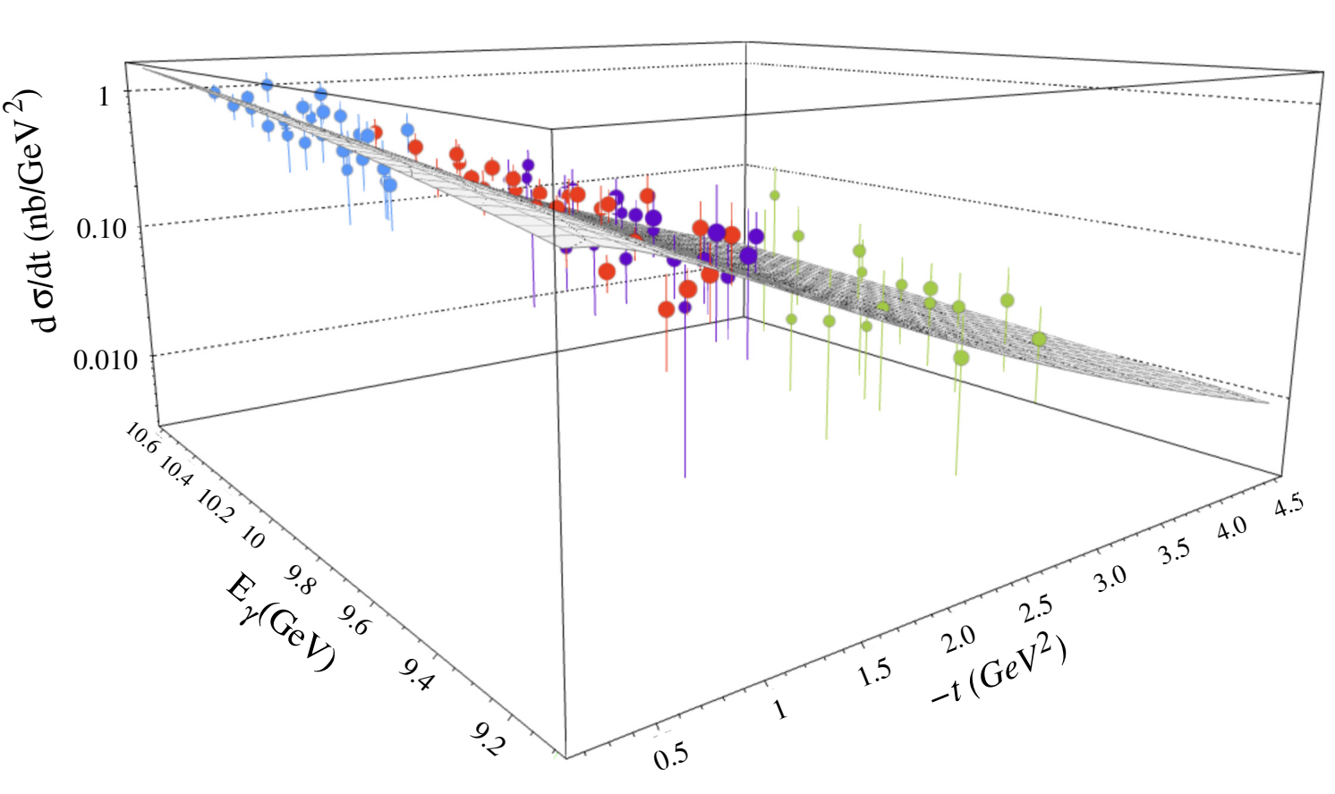
SoLID for JLab Hall A – J/Psi Threshold Production
Origin of the proton mass – a prominent topic in contemporary hadronic physics
Quarkonium production near threshold uniquely sensitive to the non-perturbative gluonic structure of the proton
Existing measurement by GlueX and Hall C J/psi E12-16-007, probing gluonic gravitational form factors (GFF) of the proton
E12-16-007 see: B. Duran et al., Nature 615, 813-816 (2023)
Figure provided by S. Joosten, see P. Achenbach et al., https://arxiv.org/abs/2303.02579
GlueX: A. Ali et al., Phys. Rev. Lett. 123, 072001(2019)

Slide 12
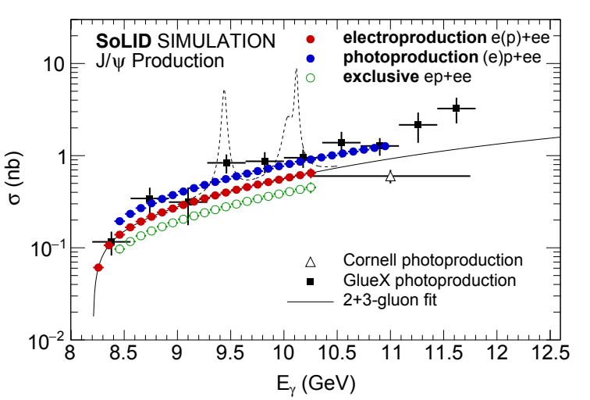
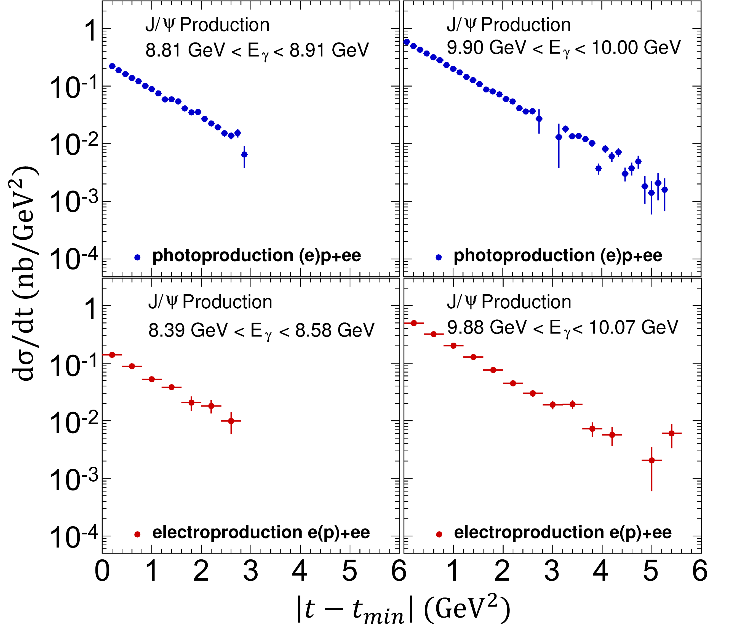
SoLID for JLab Hall A – J/Psi Threshold Production
50 (+10) days of 3uA beam on a 15-cm LH2 target
SoLID allows for study of J/psi production in more than 1D;
Each graph corresponds to one point on the left
Figures from arxiv.org/abs/2209.13357

Slide 13
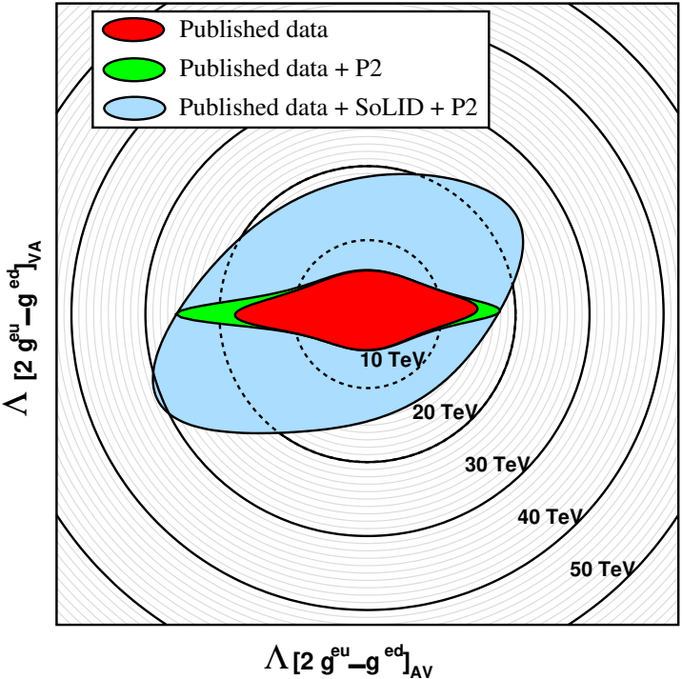
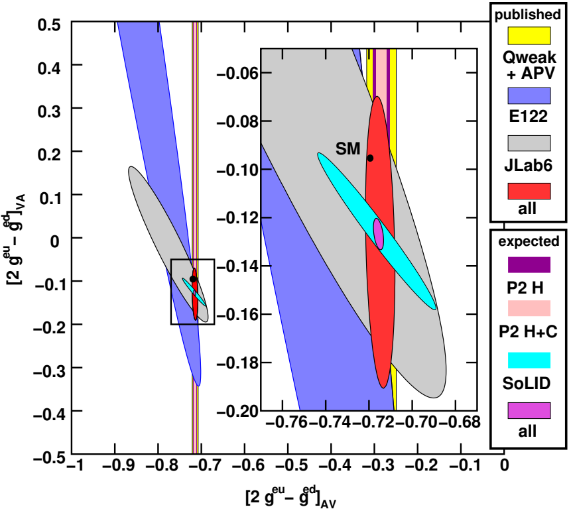
SoLID for JLab Hall A – Parity-Violating DIS
BSM Physics has large phase space, precision measurements would point the way
PVDIS deuteron measurement access effective electron-quark couplings
BSM physics probed: leptophobic Z’, dark Z, strong PV (https://arxiv.org/abs/2306.04704)
Slide from P. Souder, PAC50 talk

Slide 14
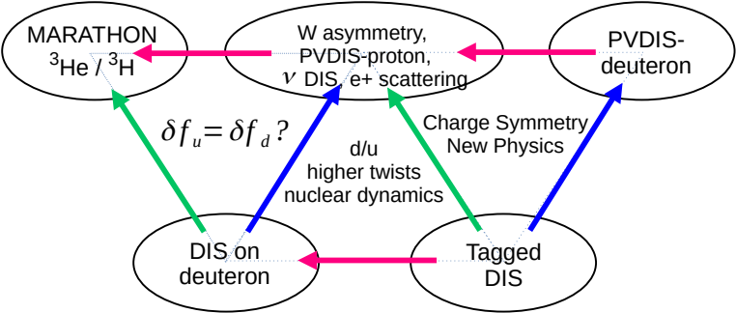
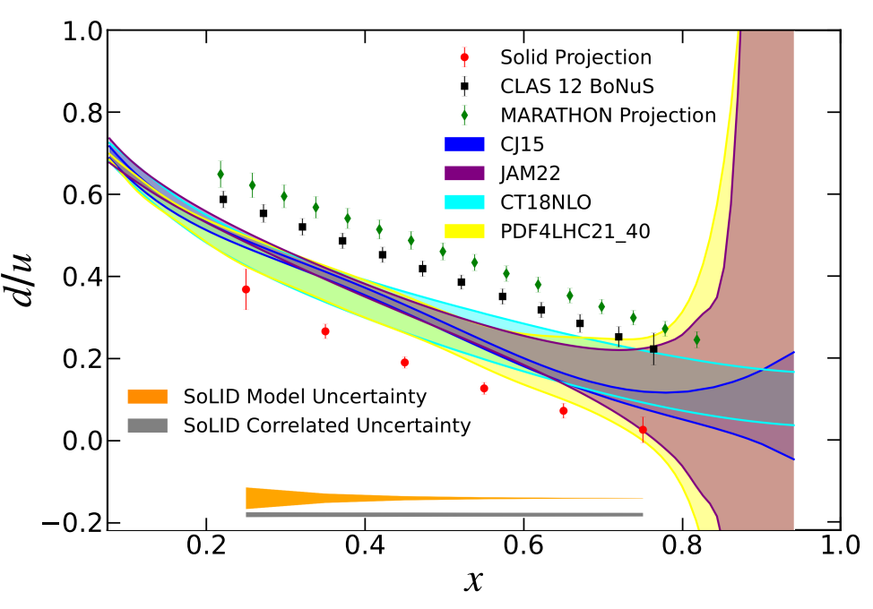
SoLID for JLab Hall A – Parity-Violating DIS
PVDIS proton measurement access PDF d/u at high x, without the need of nuclear model
Figure from A. Accardi, INT workshop on PVDIS at JLab 12 GeV (2022)
PVDIS ⁴⁸Ca access flavor dependence of EMC effect
Figures from arxiv.org/abs/2209.13357

Slide 15
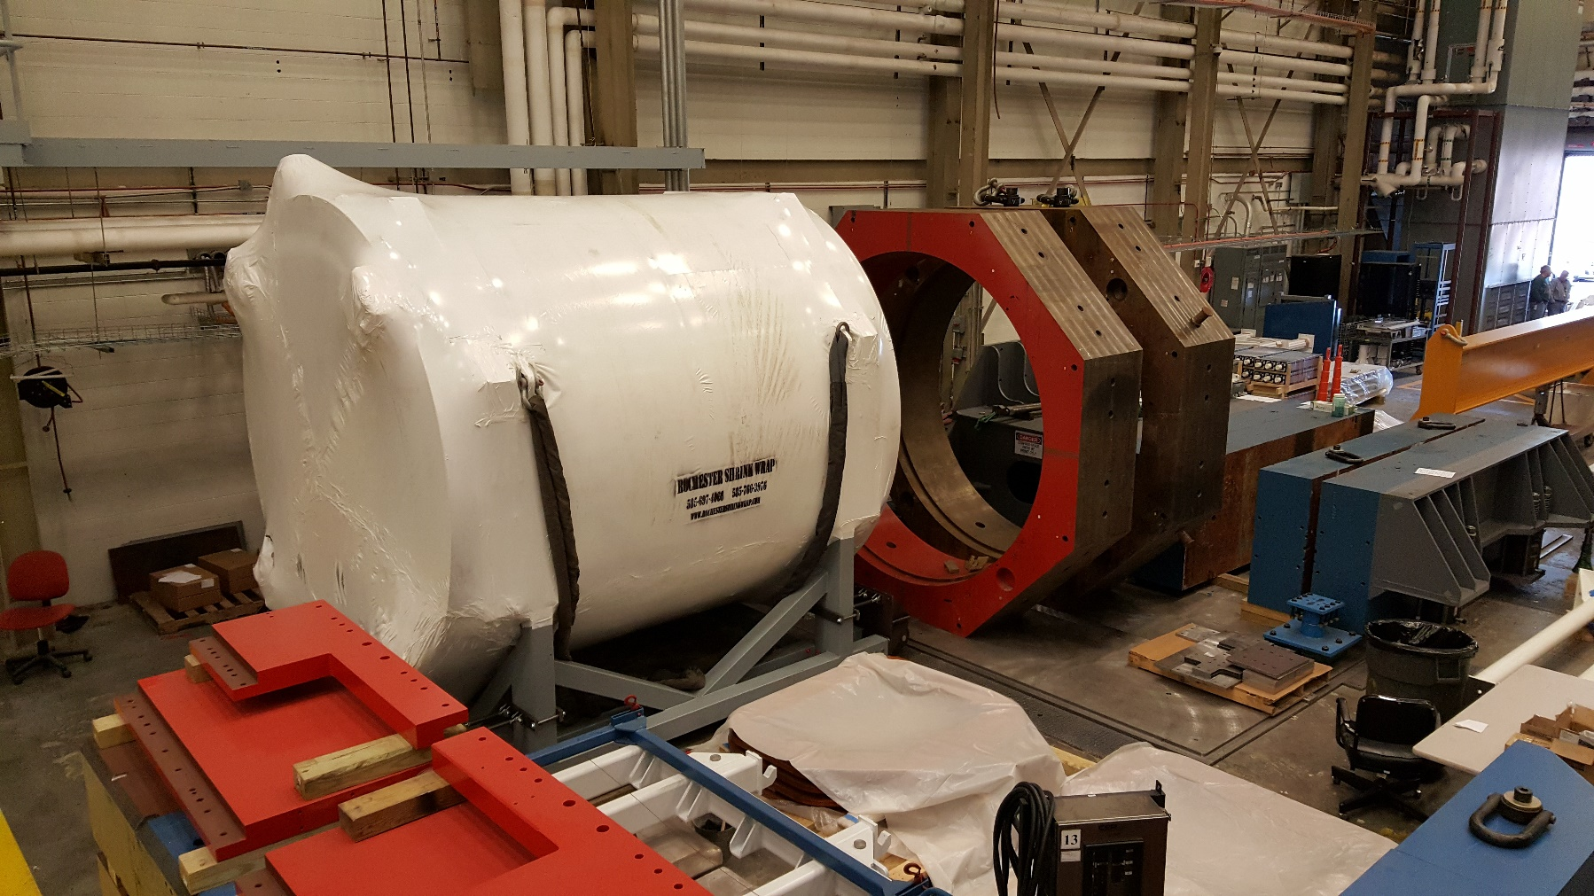
Latest – CLEO-II Magnet Cold Test at JLab

Slide 16
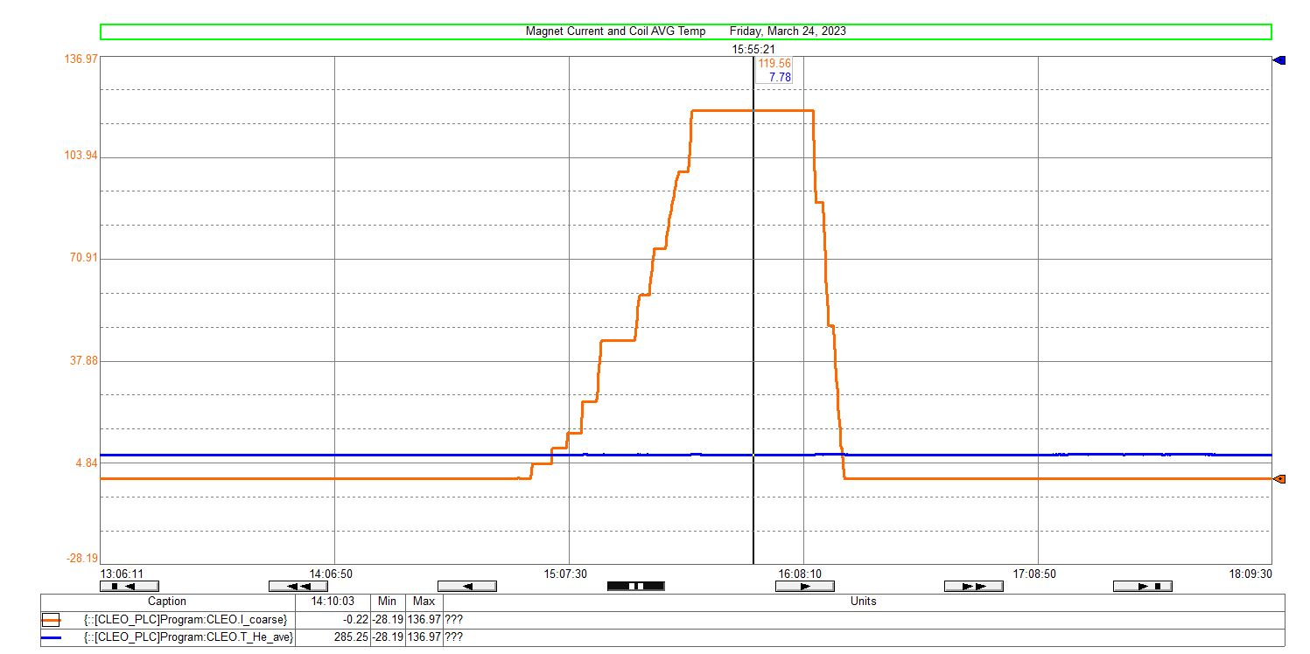
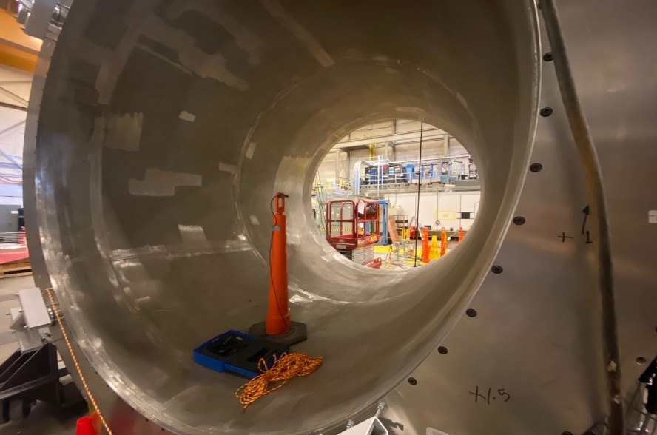
Latest – CLEO-II Magnet Cold Test at JLab
A low current test conducted on March 24th. The current for this test was ramped up to 120A and was held for 30 mins.
PSU output voltage ~ 1.15V during ramp up at 0.5A/s.
No increase in coil voltages observed during ramp up or while at 120A for 30 minutes.
Coil believed to be superconducting with flat lined nature of temp curves during test.
A 3 axis Hall probe was installed in the bore of the magnet for each of the tests. Data matched TOSCA model well.
Coil average temperature remained constant during test.
slide from W. Seay
Notes:
Bottom left pic: Hall probe on a stand inside the bore of the magnet.
Bottom right: Orange line shows the magnet power supply current ramped up from 0A to 125A and then back down. It was held for 30 mins a 125A. The blue line is coil average temp (4K)
Upper right: Is the measured field vs TOSCA model. Not all measured points were uploaded.

Slide 17
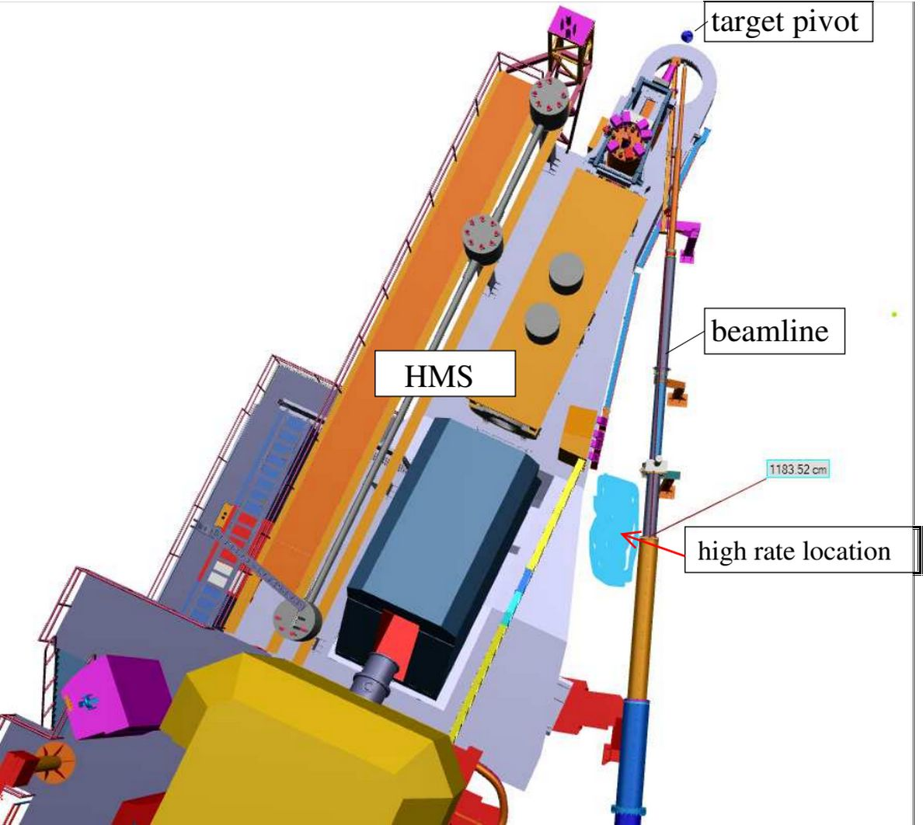
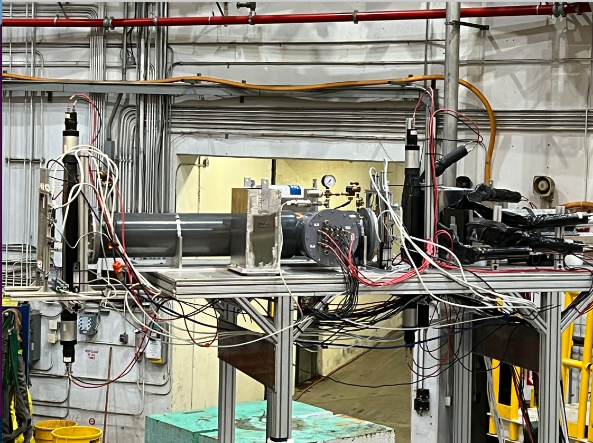
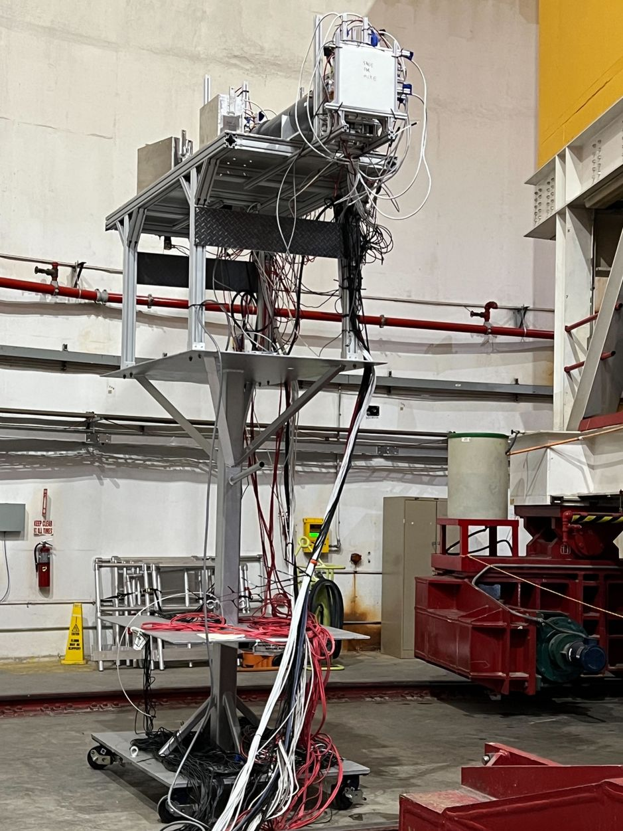
Latest pre-R&D – Detector Beam Test (2022-23 Hall C)
slide from M. Nycz
slide from M. Nycz
frontview
sideview
prelead
Preshower
GEM1,2
GEM3,4
top
Cherenkov
Shower
left
right
SC-C
SC-D
SC-B
SC-A
LASPD
Three stages:
June 2022: install at (L) 82º
X’mas 2022: cosmic
Jan 2023: moved to (R) 7º
Feb 2023: moved to (R) 18º
Similar detector setup as SoLID (1/600), no magnet, ~10² krad
Extensive simulation, PID study with both classical and AI/ML
Collective effort of: X. Bai, A. Camsonne, J. Caylor, C. Hedinger, T. Holmstrom, M. Nycz, C. Peng, Y. Tian, D. Upton, Z. Ye, J. Zhang, Z. Zhao, JLab DAQ group, and Hall C(A) tech/staff

Slide 18
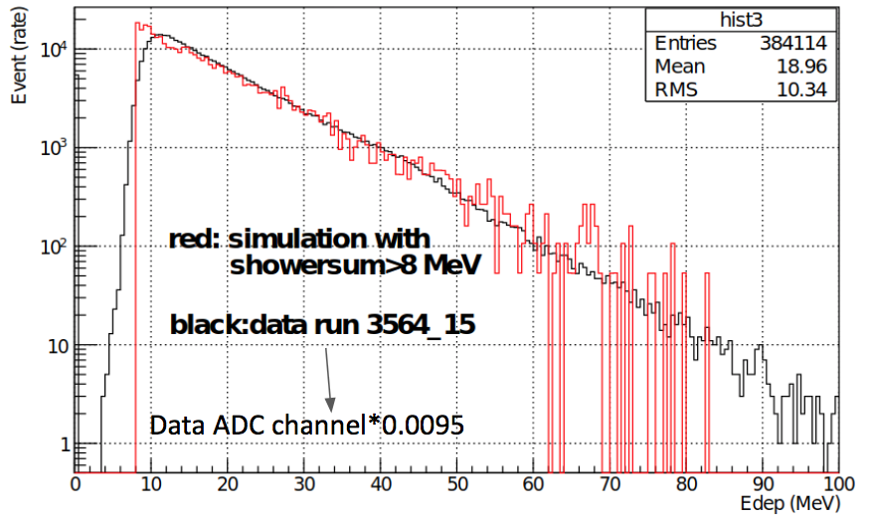
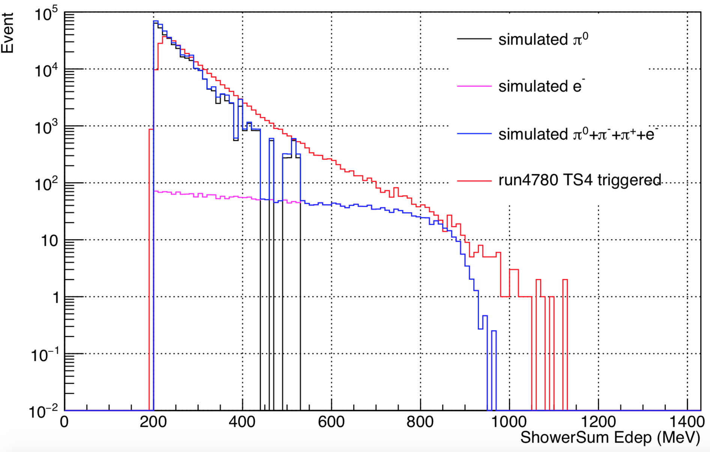
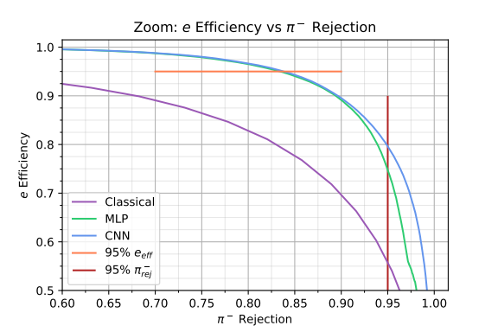
Latest pre-R&D – Detector Beam Test (2022-23 Hall C)
82 deg: Shower MIP not visible, calibrate sim/data using spectrum slope
slide from Y. Tian & D. Upton
7 and 18 deg:
detectors calibrated with sim using MIP location
rates agree with simulation to within (10-15)%
ML vs. classical PID with “pencil sim”:
LASPD photon rej ~ (6-7):1

Slide 19
SoLID Timeline
E12-10-007 PVDIS (169 days, A)
E12-10-006 SIDIS
(90 days, A)
SIDIS dihadron
PR12-22-002
PVEMC (C2)
${}^{3}\vec{{He}_{⊥}}$
Ay
TCS
DEMP
E12-11-007 SIDIS
(35 days, A)
TCS
SIDIS kaon
E12-22-004
BNSSA
(38 days, A-)
${}^{3}\vec{{He}_{∥}}$
g2n, d2n
g2n, d2n
E12-11-008 SIDIS
(120 days, A)
$\vec{p_{⊥}}$
E12-12-006 J/Psi
(60 days, A)
2010 2011 2012 2013 2014 2015 2016 2017 2018 2019 2020 2021 2022 2023

Slide 20
SoLID Timeline
E12-10-007 PVDIS (169 days, A)
E12-10-006 SIDIS
(90 days, A)
SIDIS dihadron
PR12-22-002
PVEMC (C2)
${}^{3}\vec{{He}_{⊥}}$
Ay
TCS
DEMP
E12-11-007 SIDIS
(35 days, A)
TCS
SIDIS kaon
E12-22-004
BNSSA
(38 days, A-)
${}^{3}\vec{{He}_{∥}}$
g2n, d2n
g2n, d2n
E12-11-008 SIDIS
(120 days, A)
$\vec{p_{⊥}}$
LRP2015
LRP2023
E12-12-006 J/Psi
(60 days, A)
2010 2011 2012 2013 2014 2015 2016 2017 2018 2019 2020 2021 2022 2023
preCDR
(1st draft)
Director’s Review + 2015 white paper
Director’s Review
Director’s+ Science Review
2022
white paper
(J. Phys. G)
preCDR
(to DOE)

Slide 21
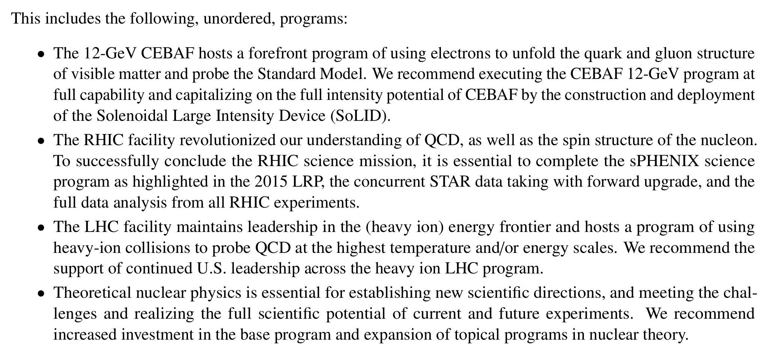
https://indico.mit.edu/event/538/
NSAC 2023 LRP Town Meetings – QCD
https://arxiv.org/abs/2303.02579

Slide 22
NSAC 2023 LRP Town Meetings – FSNN
https://indico.phy.ornl.gov/event/209/

Slide 23
Summary and Outlook
SoLID will fully capitalize on the 12 GeV CEBAF at the intensity frontier, allowing precision studies of a number of modern topics central to hadronic physics and test of the SM:
SIDIS, J/psi, PVDIS, TCS, DEMP (DVCS, DDVCS, CLFV … …)
complementary to existing facilities and the EIC
The SoLID collaboration, currently consists of 240 collaborators from 69 countries, worked tirelessly on the physics program and conceptual design since the early 2010’s.
SoLID is of high priority:
successful first magnet cold test at JLab
DOE-funded pre-R&D activities on Cherenkov, GEM readout, and detector beam tests recently completed or well underway
Timely realization of SoLID is essential for the US nuclear science program

Slide 24
Back up Slides

Slide 25
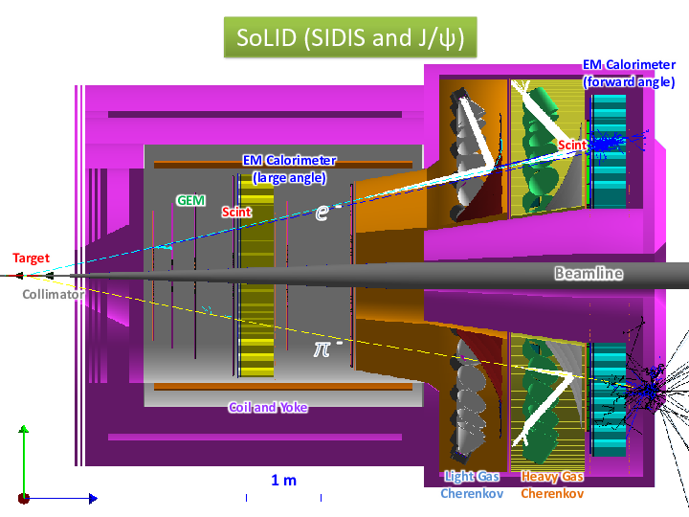
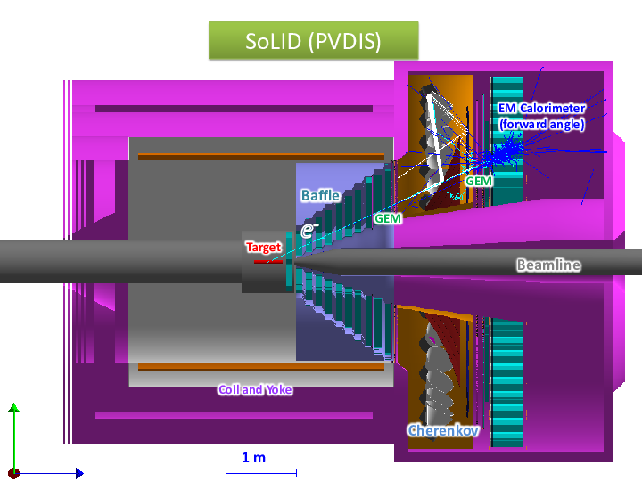
Outline
Motivation – Why SoLID ?
The Physics Program of SoLID
Current Status and Outlook

Slide 26
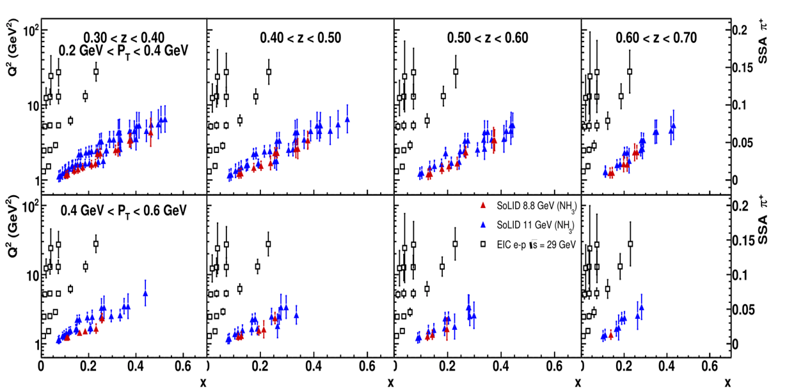
SoLID for JLab Hall A – SIDIS and TMDs
Example: E12-10-006 (SIDIS on Transversely Polarized 3He)
SoLID SIDIS projections of A_{UT} in various 4-D bins at 11/8.8 GeV beam energies
Projections at EIC kinematics for the same observable at 29 GeV CM energy
SoLID and EIC synergistic towards each other, by covering different x and Q² ranges
Slide provided by V. Khachatryan, PAC50 talk

