Slide 1

The MOLLER Experiment
Caryn Palatchi
Indiana University
JLUO Meeting June 28, 2023

Slide 3
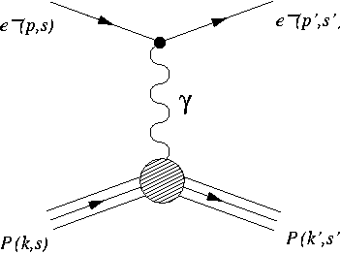
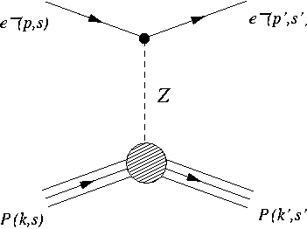
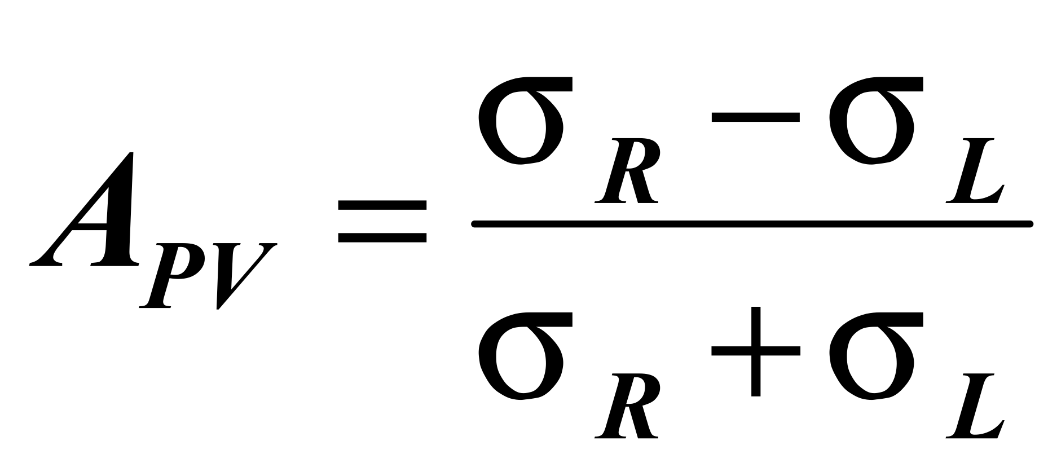
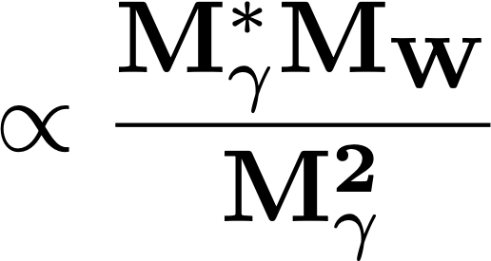
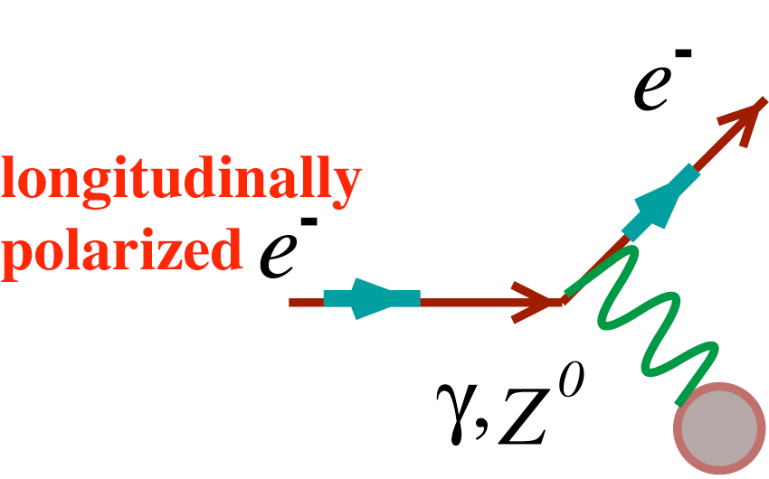
Parity-Violating Electron Scattering
e
e
e
e
σ ∝ |Mγ + Mweak|²
~ |Mγ|² + 2Mγ(Mweak)* +…
Z⁰
PVES measures Apv
Incident beam is longitudinally polarized
Change sign of longitudinal polarization
Measure fractional rate difference
unpolarized target
New physics: measure fundamental coupling constants to test completeness of standard model
MOLLER: measure fundamental constant Cee in electron-electron scattering

Slide 4
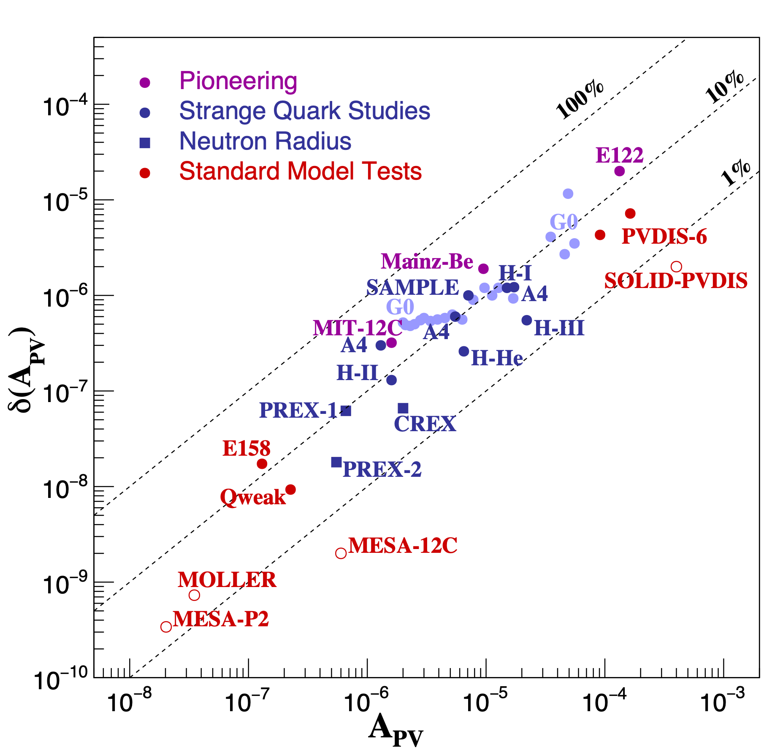
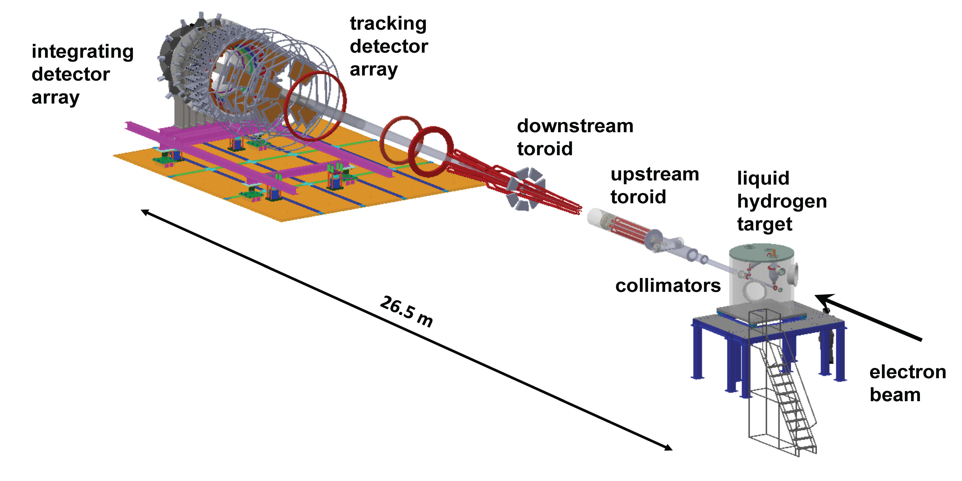
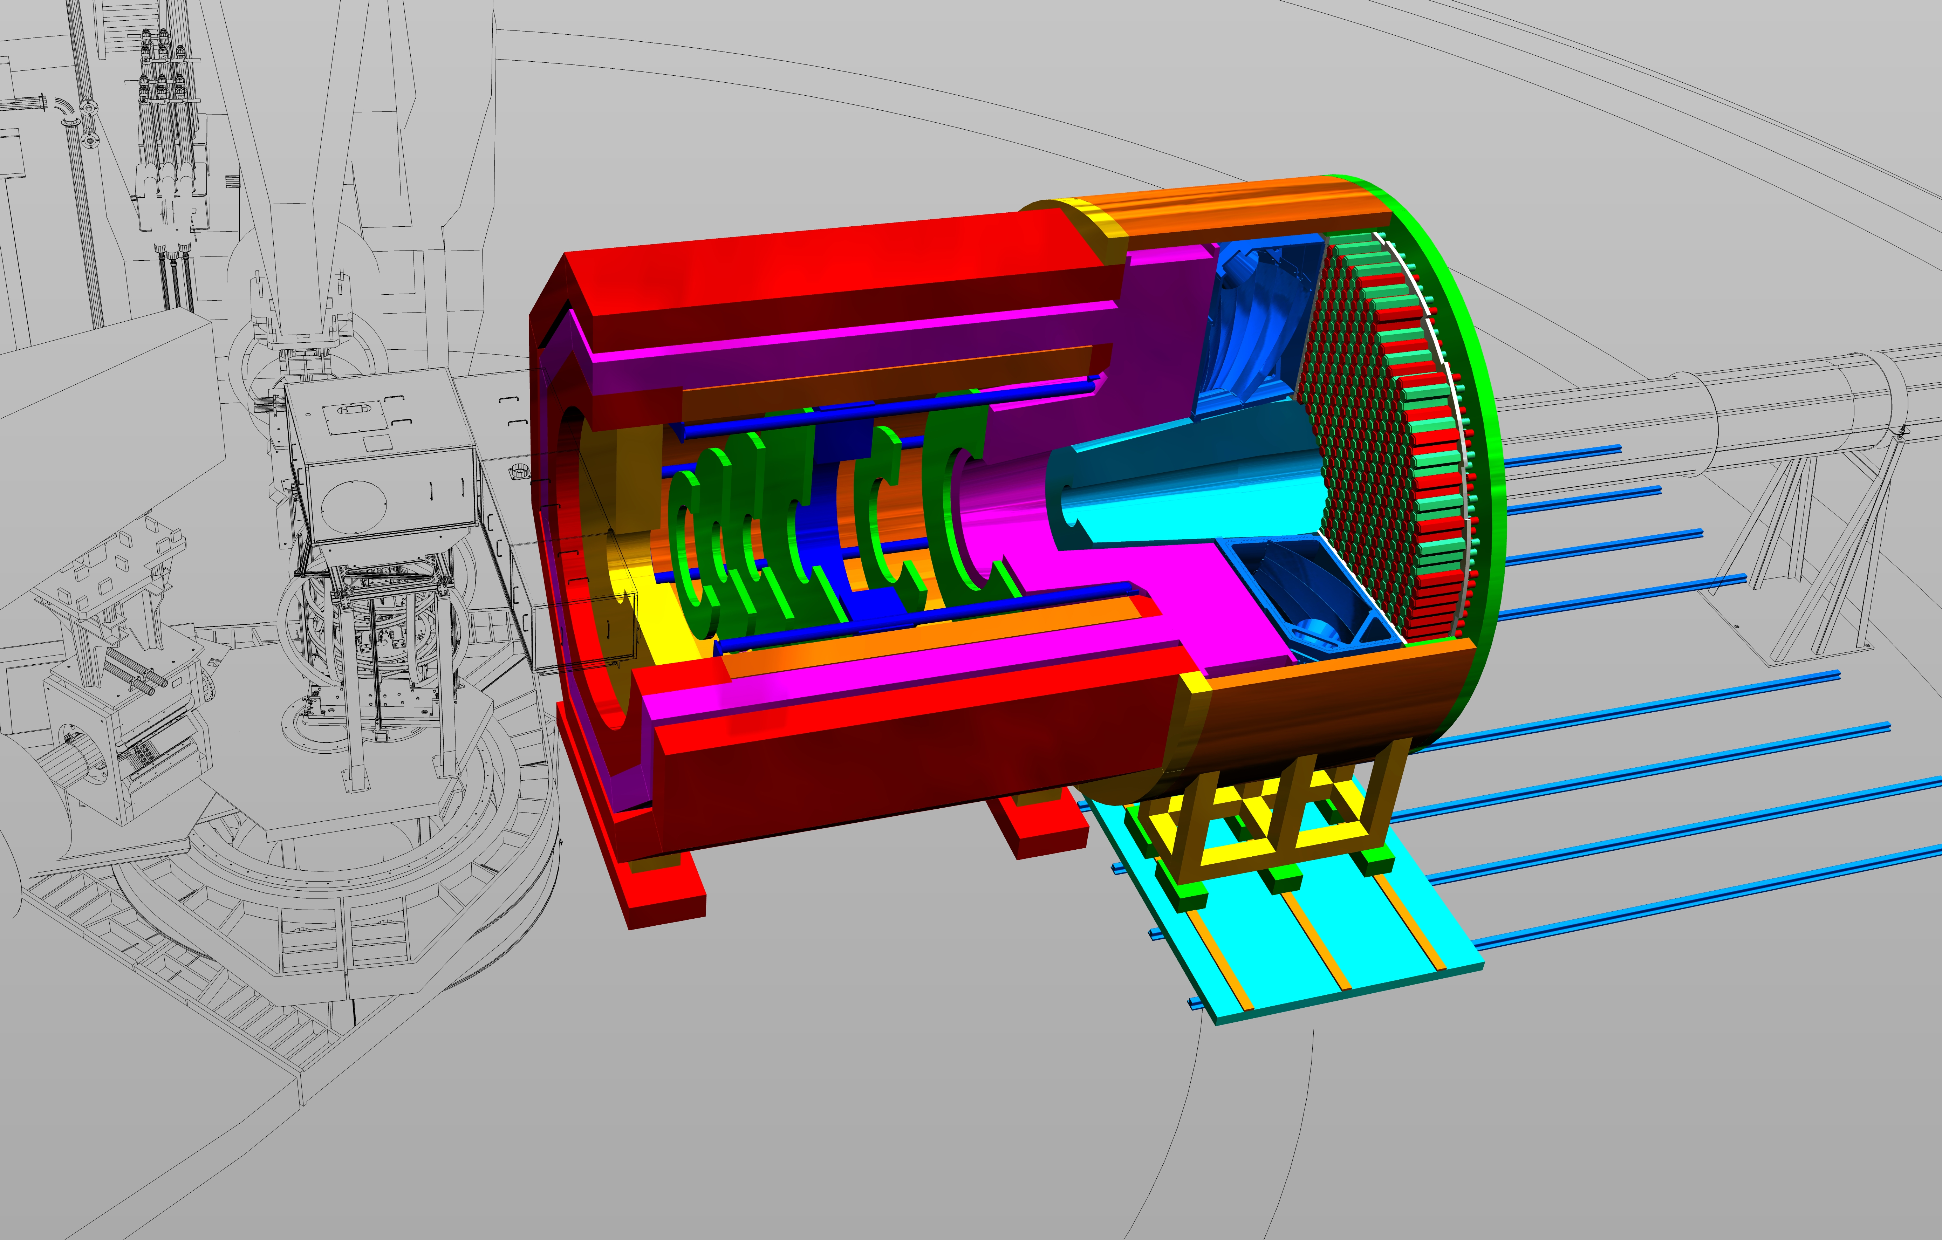
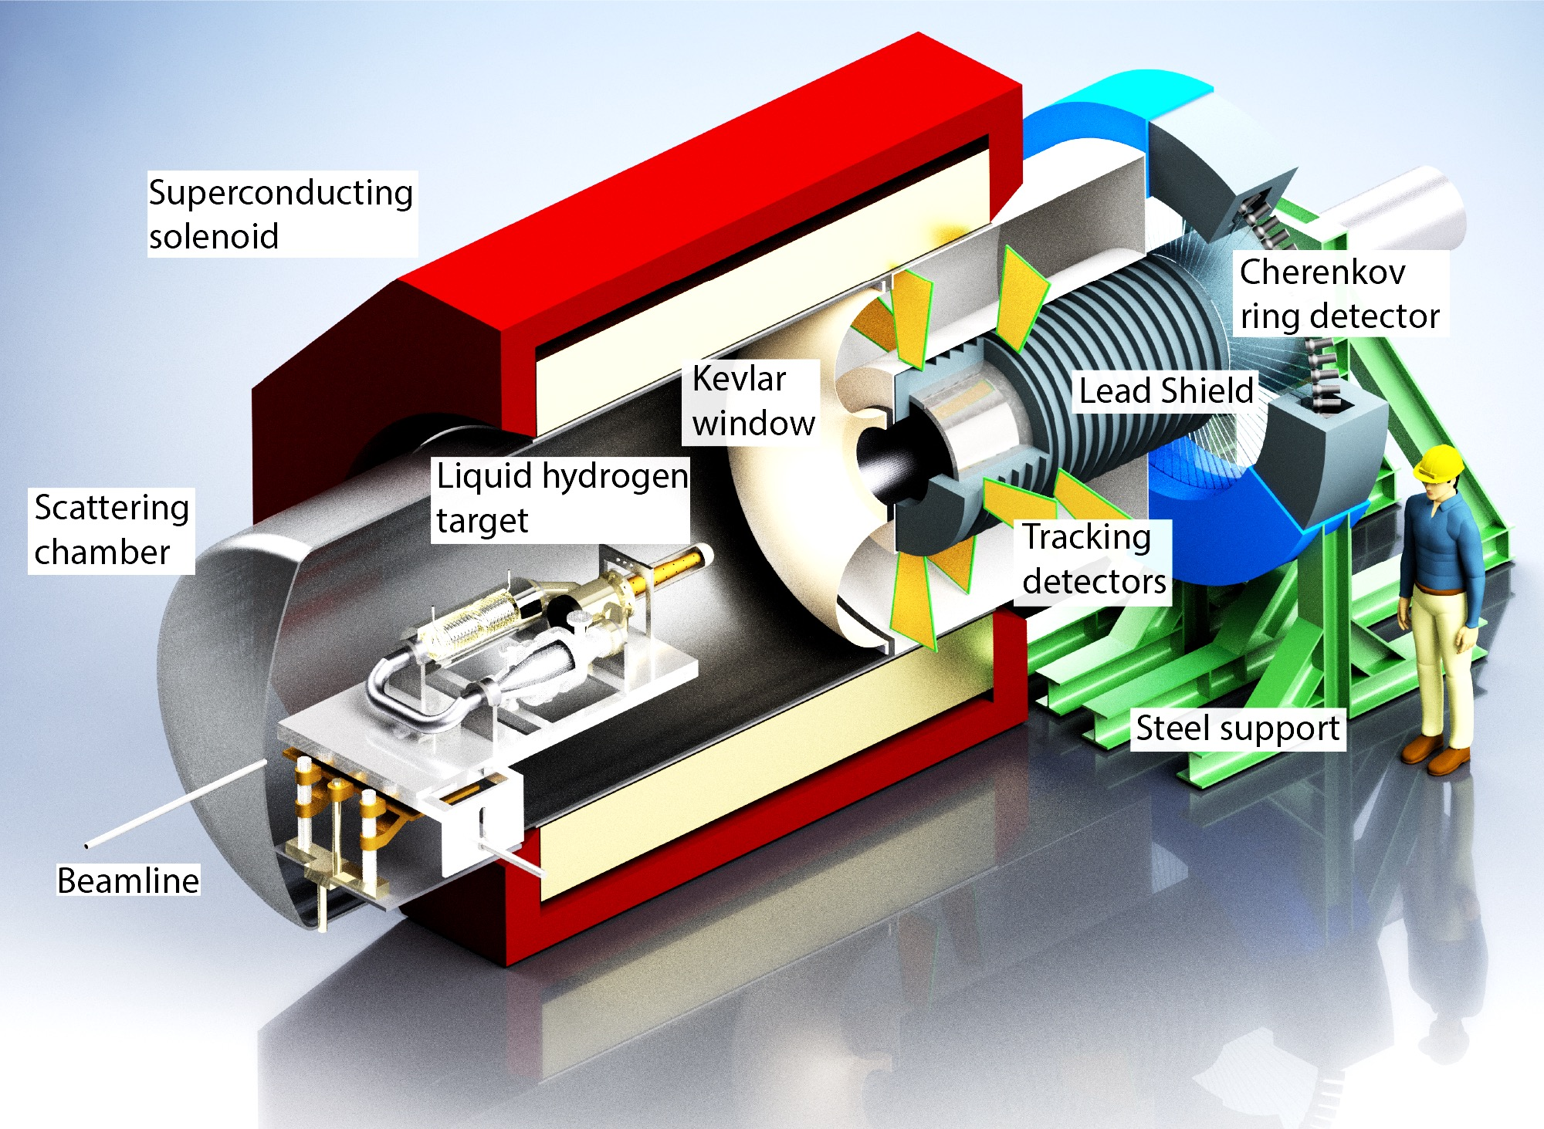
Next-generation Experiments will provide precise BSM probe
Broad program studying the structure of protons and nuclei, and searching for new (beyond Standard Model) physics
Experiments measure increasingly smaller Apv
SOLID@JLab
MOLLER@JLab
Searches for New Neutral Currents
P2@MESA
 | APV | δ(APV) | δ(APV)/APV
MOLLER | 35 ppb | 0.8 ppb | 2.2%

Slide 5
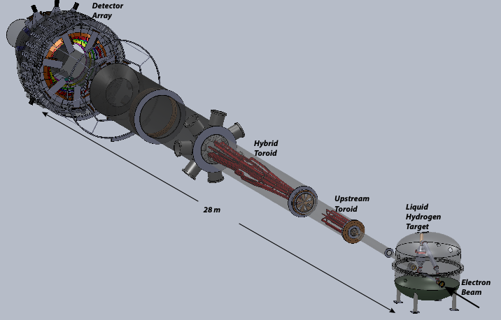
Moller Experiment Overview
134 GHz Møller rate
signal rate: 135 GHz
run time: 8200 hours
~3x10¹⁸ electrons detected
Downstream
4kW LH2 cryotarget
A_{PV} 35.6ppb to 0.72ppb precision
APV = 35.6 ppb
δ(APV) = 0.72 parts per billion
δ(Q^{e}W) = ± 2.1 % (stat) ± 1.0 % (syst)
65uA

Slide 6
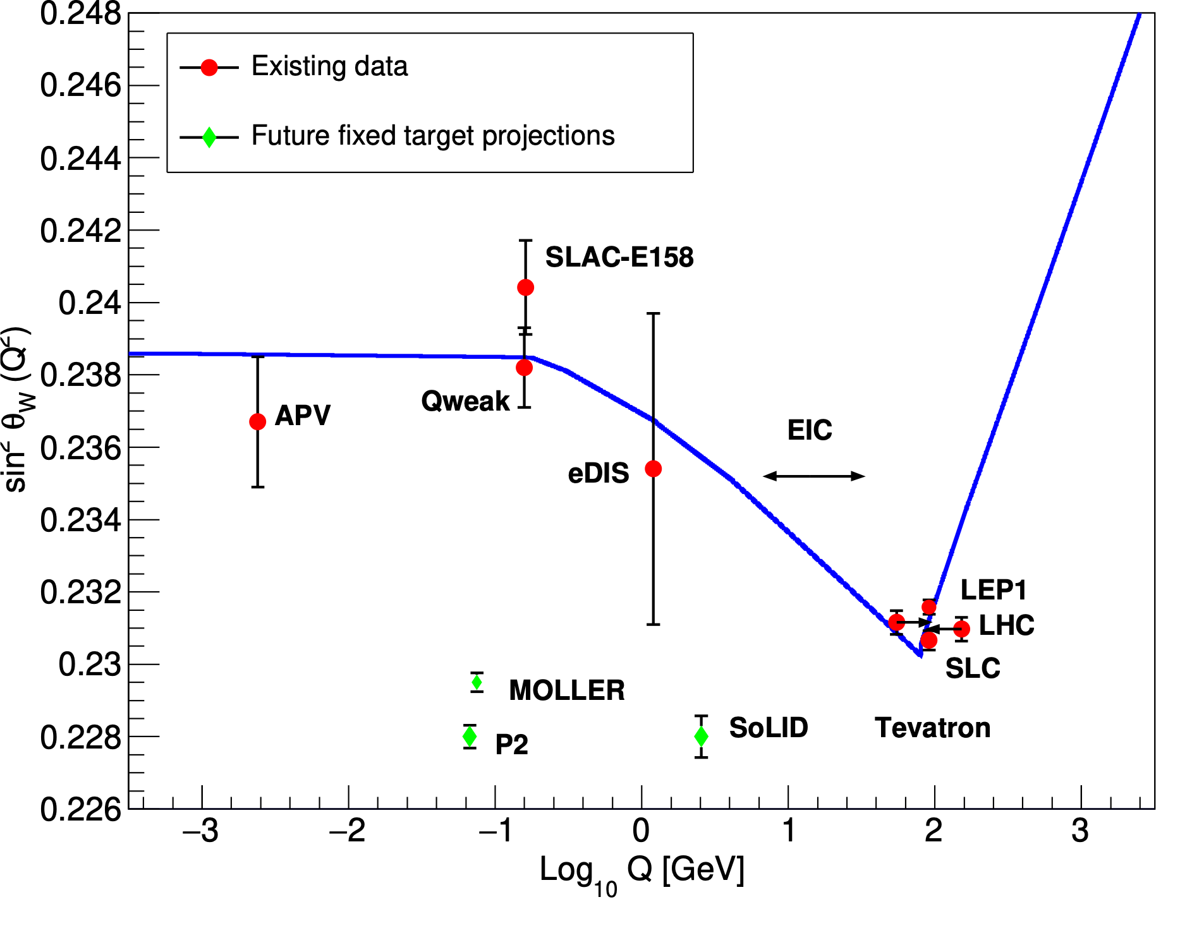
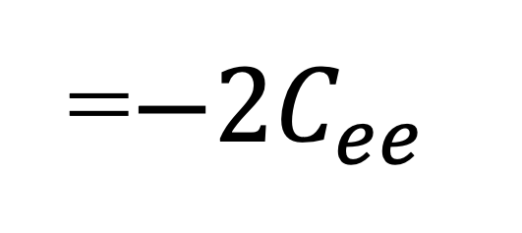
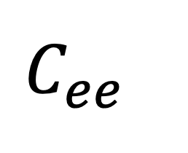
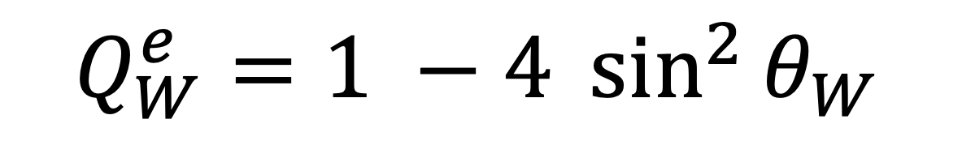
MOLLER Purpose
Measure the weak charge of the electron to extremely high precision
Constrains coupling coefficient Cee
Extend the reach of new physics beyond the Standard Model
Interference term between the electro-magnetic and weak amplitudes gives rise to parity-violating asymmetry,
$$C_{ee}$$
$$Q_{W}^{e}=1 −4 \sin^{2}{θ_{W}}$$
=$−2C_{ee}$
which relates directly to the electron weak charge, weak mixing angle, and ee coupling coefficient
MOLLER
δ(Q^{e}W) = ± 2.1 % (stat) ± 1.0 % (syst)
sin²θ_{W} :±0.00026(stat) ±0.00013(syst)
Ultra-precise measurement sensitive to new parity-violating interactions
$$Q^{2}={(p−p′)}^{2}≈4 E E^{′}\sin^{2}{(θ/2)}$$

Slide 7
The Standard Model Prediction: Remarkably Well-Known
Theory: Standard Model prediction is tight and MOLLER measurement will constrain BSM theories
Radiative Corrections
2-loop Calculations
SM:
MOLLER: δ(Q^{e}W) = ± 2.1 % (stat.) ± 1.1 % (syst.)

Slide 8
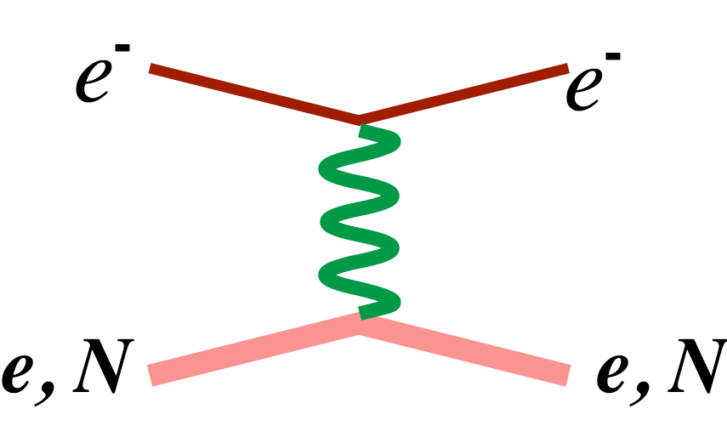
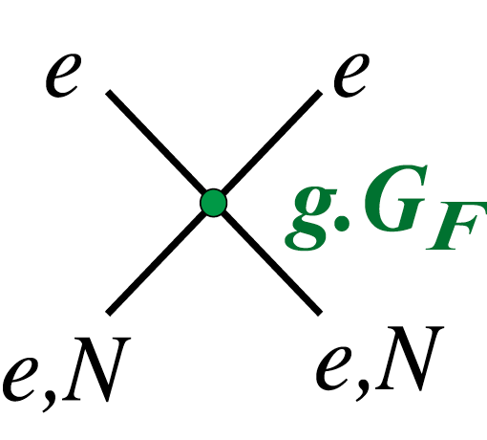
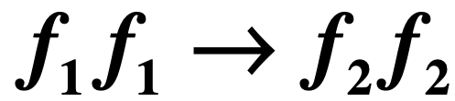
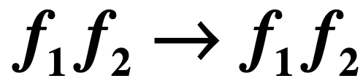
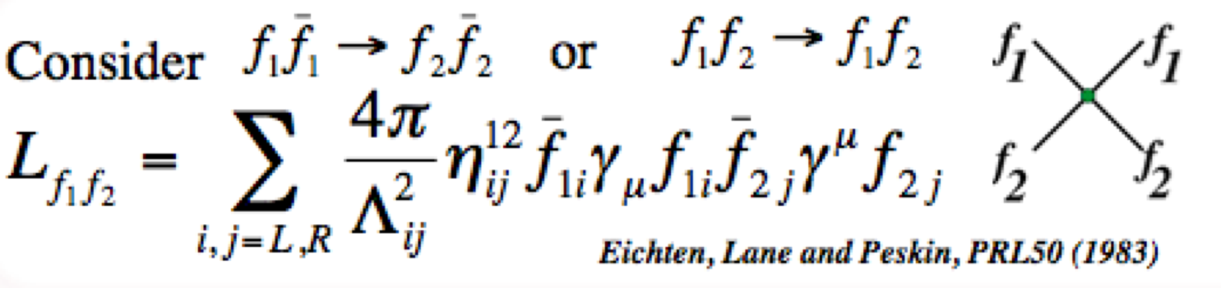
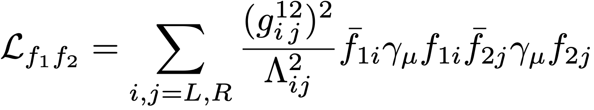
Quantifying Discovery Potential: Mass Reach
Low energy WNC interactions (Q²<<M_{Z}²)
Heavy mediators = contact interactions
Zo
Measurements test for small deviations from precisely calculated SM processes ⟶ new possible couplings
Consider or
Eichten, Lane and Peskin, PRL50 (1983)
mass scale Λ, coupling g
for each fermion and handedness combination
δ(Q^{e}W) = 2.3%
Mass Reach scale ~ 38TeV
Erler et al., Ann.Rev.Nucl.Part.Sci. 64 (2014)
New
Physics
$\sqrt{\text{|}\text{gRR}\text{2}\text{− }\text{gLL}\text{2} \text{|}}$ = 2π Λ = up to 47 TeV

Slide 9
Quantifying Discovery Potential: Weak mixing angle precision
BSM: The Dark Z
Interpreting each result as an independent measure of sin²θW provides a quick way to put these all one one plot, but:
  interference in precision PVES measurements away from the Z resonance enhances new physics sensitivity
  Room for 10sigma discovery potential
  But additionally…

Slide 10
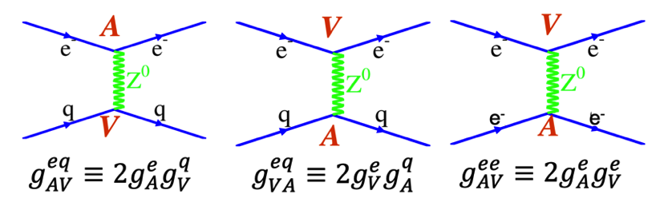
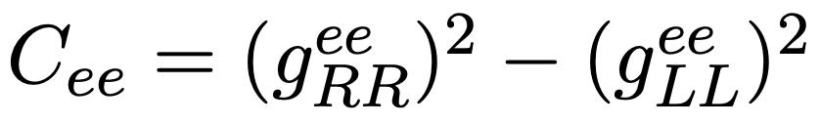
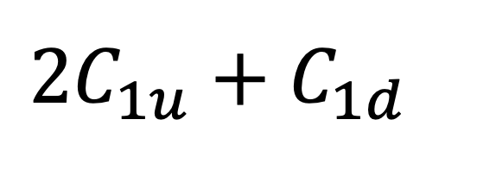
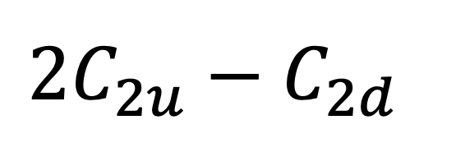
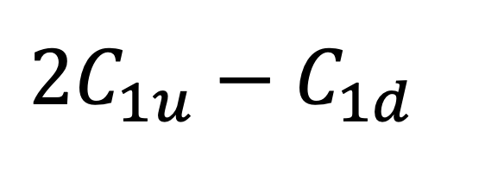
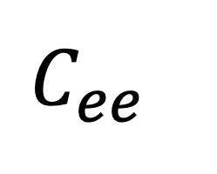
Quantifying Discovery Potential : Coupling coefficients phase space
ee and ep elastic and e-D DIS are all unique phase space - the precision on sin²θ_{W} is not the story
Constraining the space of BSM physics is the story
MOLLER
$$C_{ee}$$
Qweak, P2
$$2C_{1u}+C_{1d}$$
,
SoLID
$$2C_{1u}−C_{1d}$$
$$2C_{2u}−C_{2d}$$
Standard model PV e-q or e-e couplings

Slide 11
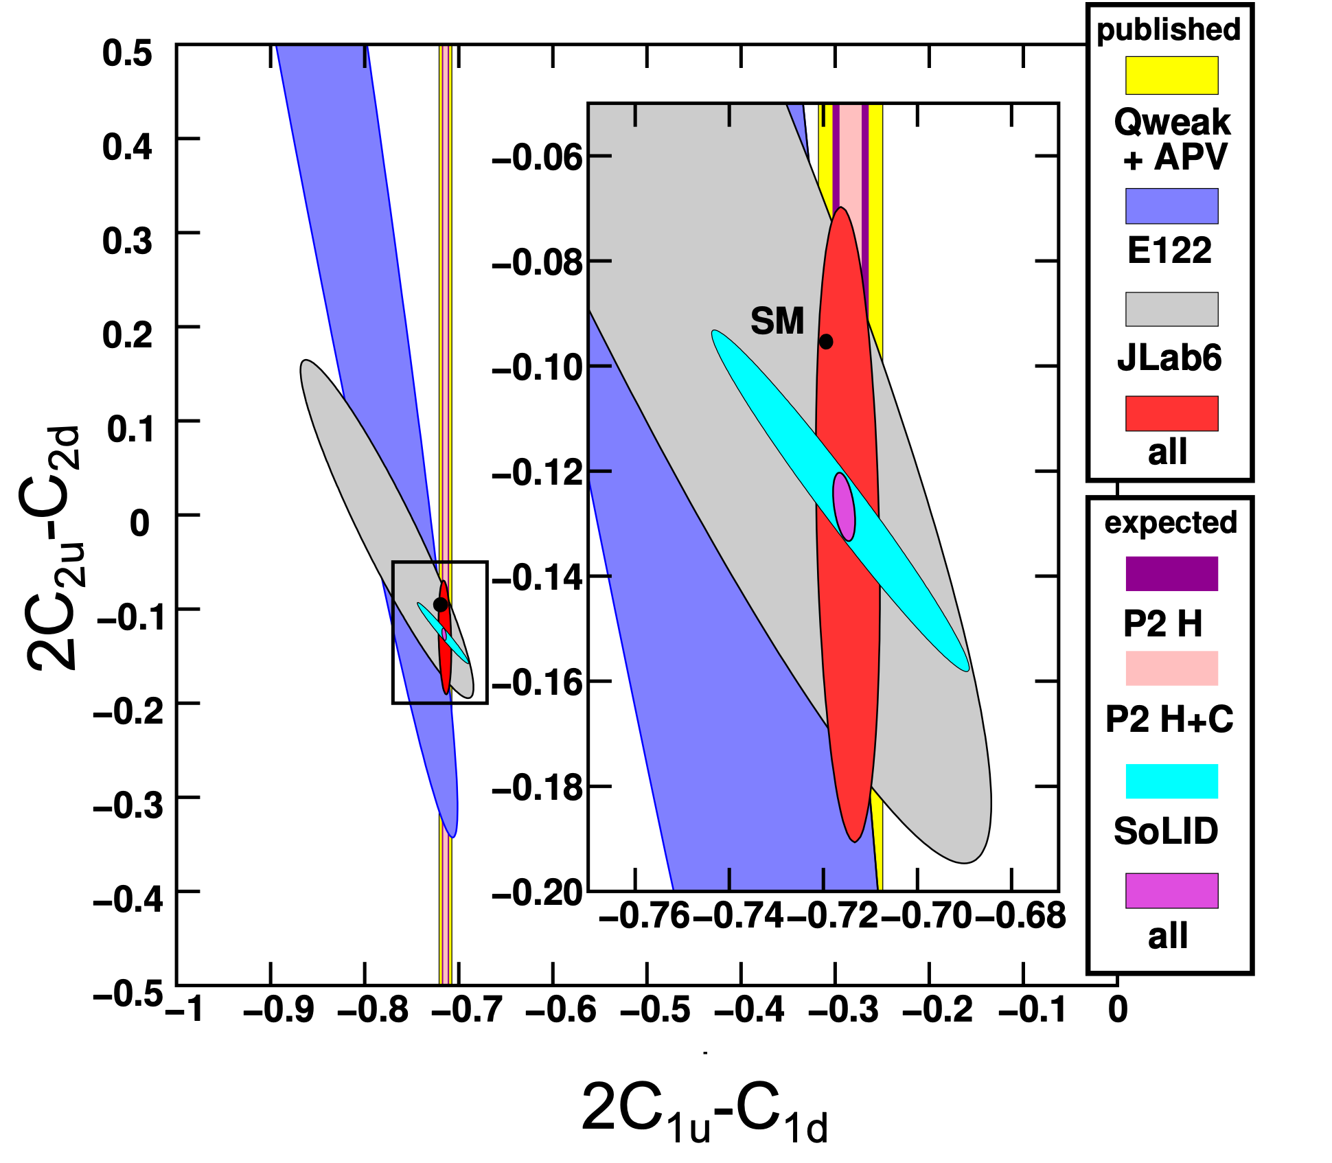
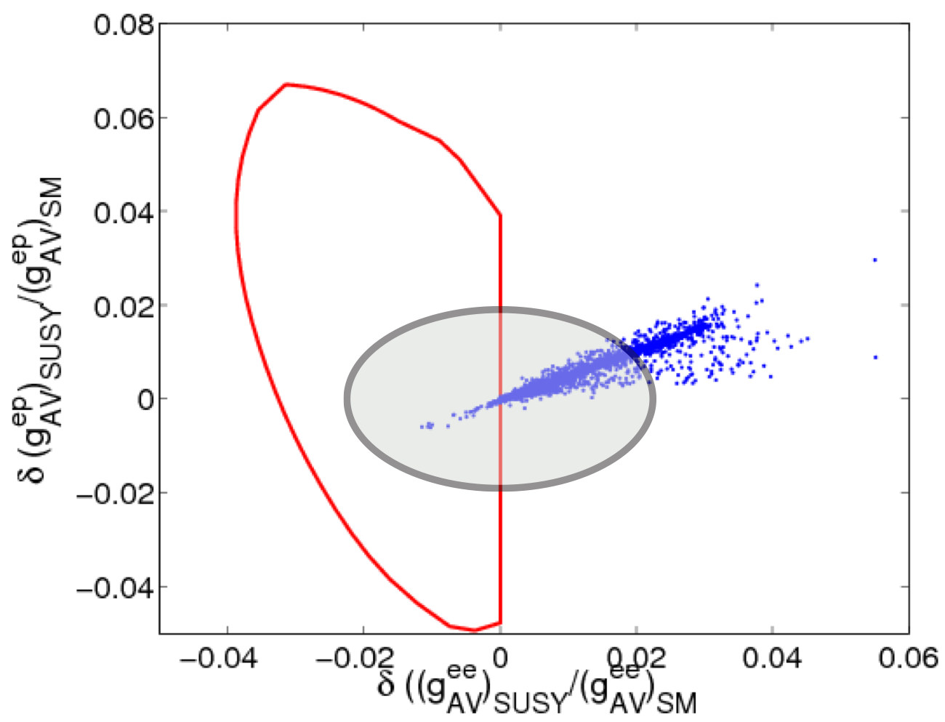
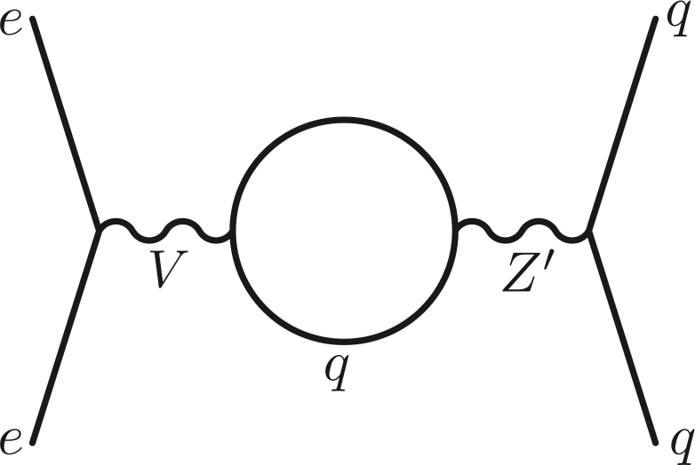
Constraining the space of BSM physics: Complimentary Measurements
Many new physics models give rise to new neutral current interactions
Heavy Z’s and neutrinos, technicolor, compositeness, extra dimensions, SUSY…
Coupling Coefficients Space
SUSY: – RPV and RPC
Allowed region: R-Parity-violating Supersymmetry
R-Parity-conserving Supersymmetry
Erler and Su,
arXiv:1303.5522
Includes
LHC
constraints
Future constraints:
MOLLER & P2
Ramsey-Musolf and Su, Phys. Rep. 456 (2008)
SOLID: Leptophobic Z’
SOLID: 100-200 GeV range
Buckley and Ramsey-Musolf Phys.Lett. B712 (2012) 261-265

Slide 12
MOLLER: BSM and Sensitivity to New Physics
Complimentary Measurement with LHC
LHC observes an anomaly
LHC agrees with the Standard Model to 14TeV
MOLLER will help provide constraints to choose between various BSM theories
ex) TeV scale 𝑍′bosons
MOLLER: provide access to hidden weak scale BSM physics scenarios that could escape LHC detection
ex) MeV-scale “Dark” Z⁰_{d}

Slide 13
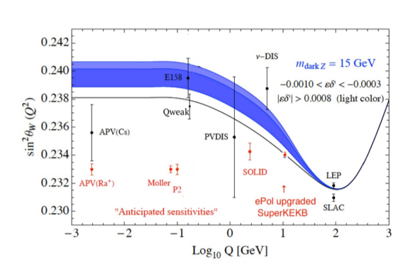
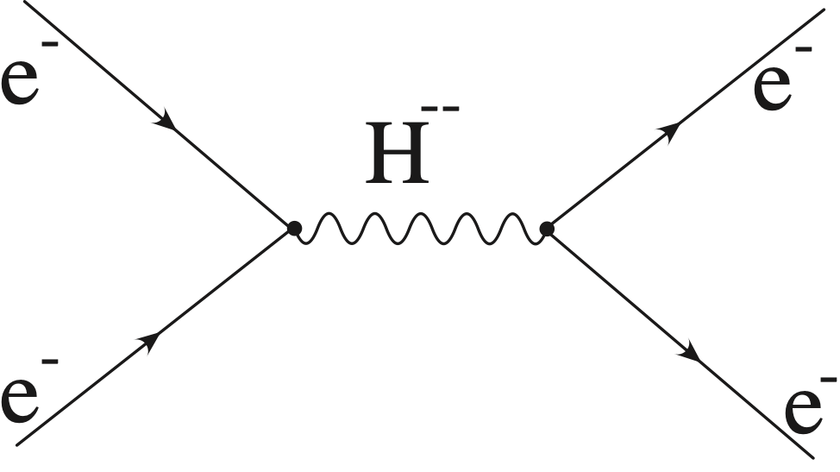
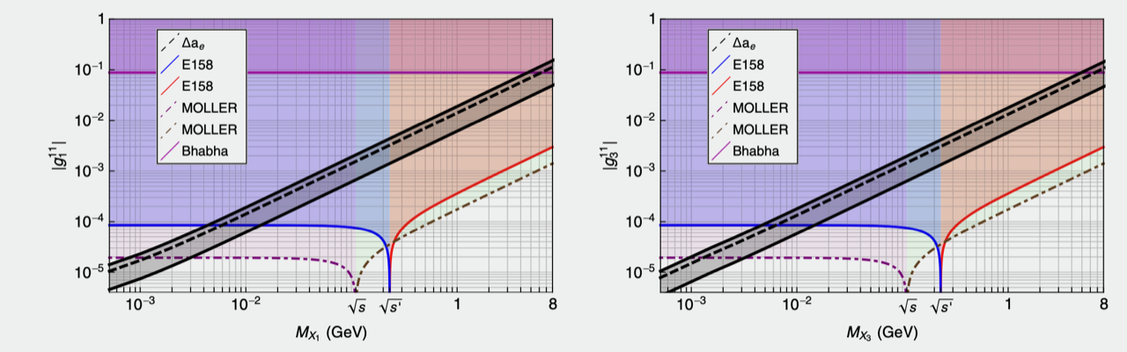
MOLLER: BSM and Sensitivity to New Physics
Many new physics models give rise to new neutral current interactions
Heavy Z’s and neutrinos, technicolor, compositeness, extra dimensions, SUSY, dark Z…
Dark Z
Doubly Charged Scalars
dark Z: mass mixing with Z⁰
Davoudiasl, Lee, Marciano
PRD89 (2014), 095006
PRD92 (2015) 055005
MOLLER: e⁻e⁻ scattering
Lepton Number Violation
Λ > 5 TeV Doubly-Charged Scalars
Significant reach beyond LEP-200
Susan Gardner and Xinshuai Yan†,PHYSICAL REVIEW D (2020)

Slide 14
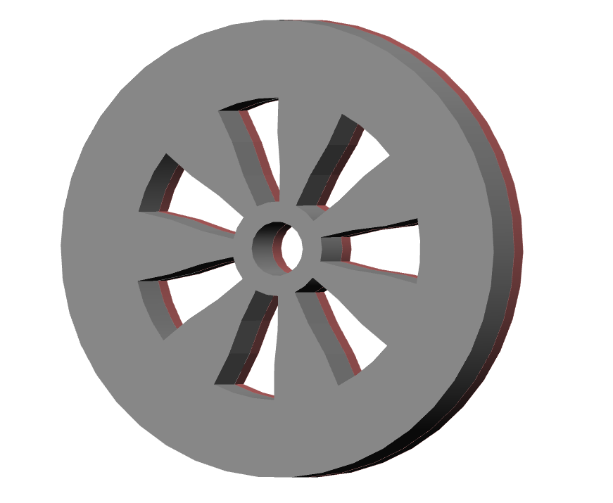
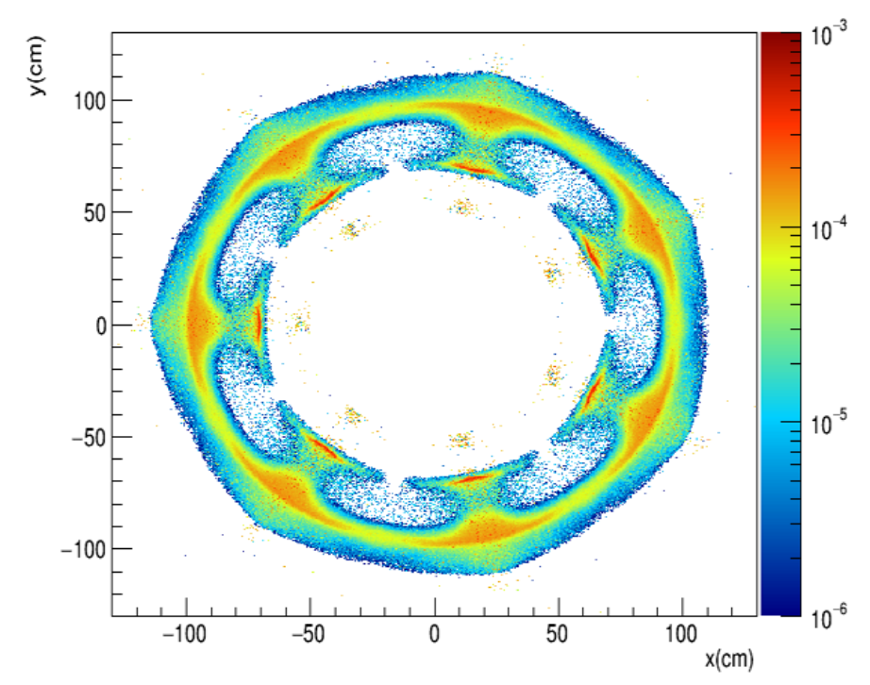
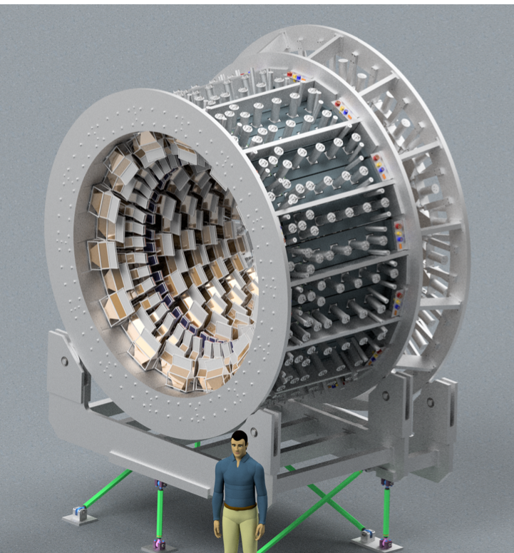
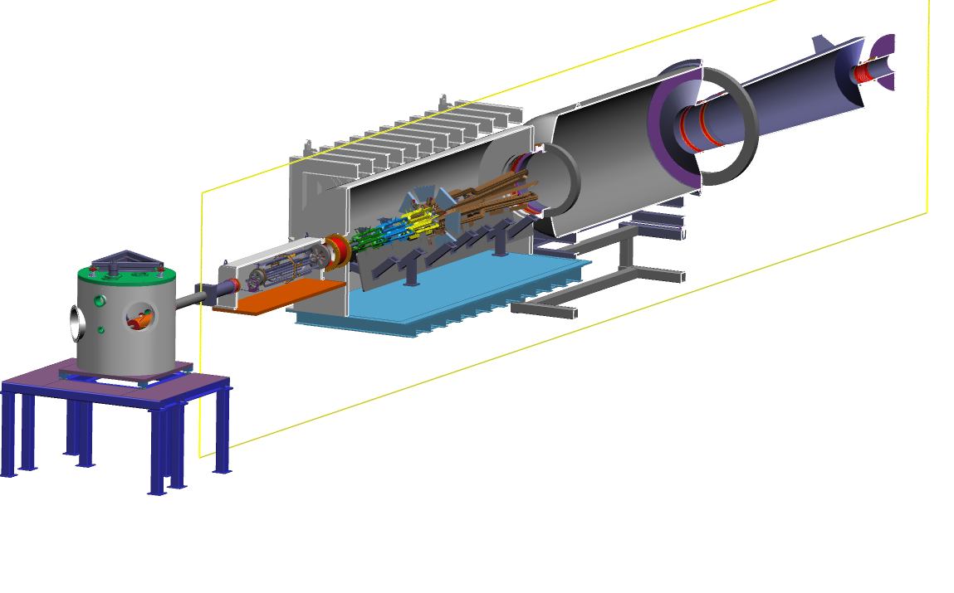
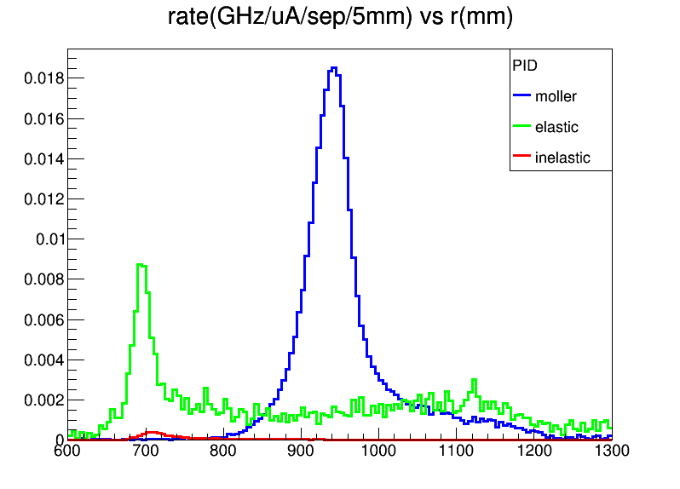
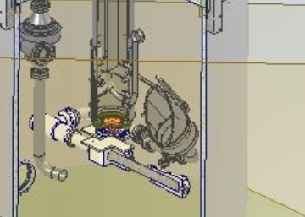
MOLLER Apparatus
Focal plane instrumented with array of thin quartz detectors
Unique, 7-sector design, to optimize acceptance for identical particles
Acceptance-defining collimator
Accepted particles spread over full azimuth at the detector
Møller elastic
θ_{lab} ~ 5-18 mrad, E’ = 2-8 GeV
134 GHz Møller rate
Low noise beam with 1nm control of average beam position on target
rate
ep elastic
4kW LH2 cryotarget
high power, high stability
Five separate toroids, no iron
inelastic
r [cm]
Møller scattered electrons localized at a radial distance, separated from ep elastic, photons

Slide 15
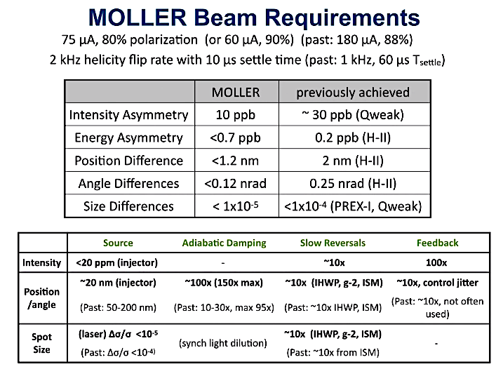
Moller Uncertainty Requirements
65uA, ~90% polarization, 344 PAC days
35ppb Apv
Stringent Uncertainty Goals
Statistical goal is <1ppb !
Total Systematic <0.5ppb!
Each indiv. systematic is <1% of Apv
Minimal Beam Asymmetries
Well measured & controlled polarization
Minimal and well characterized backgrounds

Slide 16
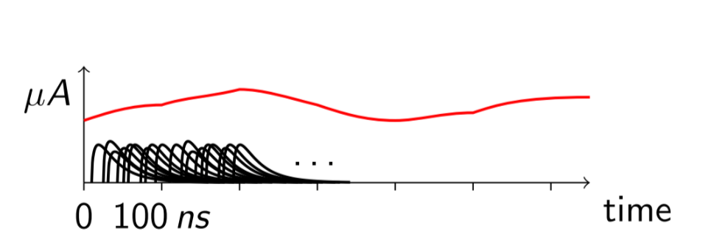
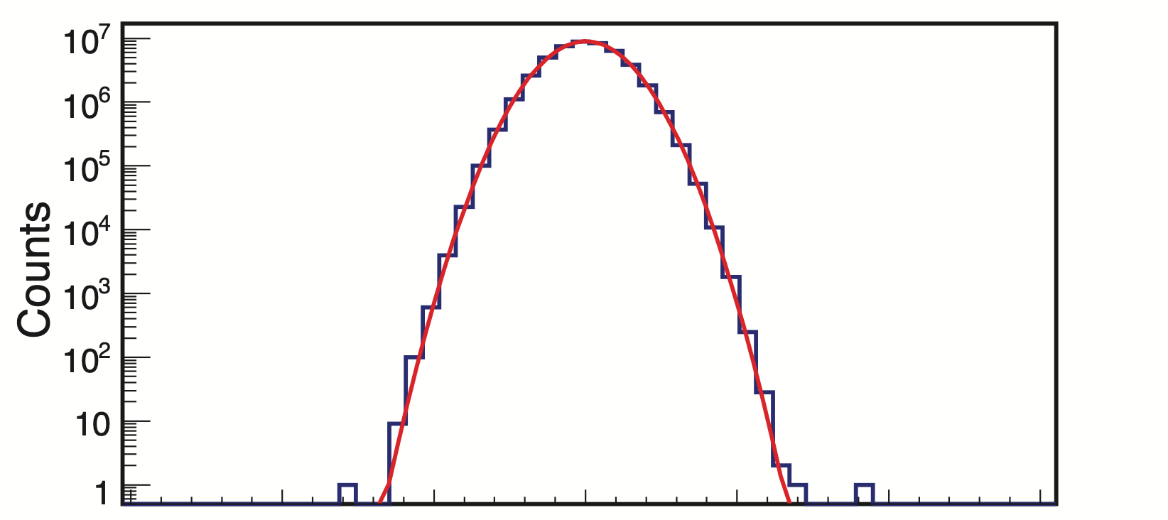
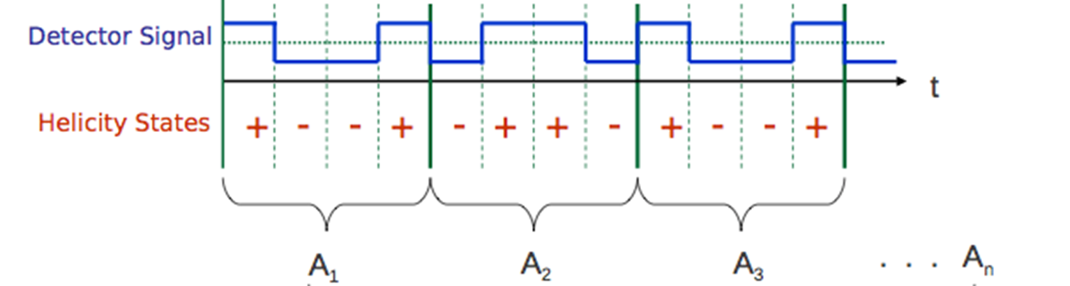
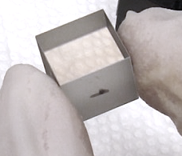
Measuring this small asymmetry
Target Boiling
Place a detector where it sees the Møller scattered electron
4kW LH2 cryotarget
high power – Bubbles!
Analog integrate detector current
Form an asymmetry over the helicity reversal
Rapid (2kHz) helicity reversals
Measure to 0.01% at 1 kHz, repeat for a year straight
Specialized experimental techniques
Precise spectrometer to separate signal
Low noise electronics
Precise beam control and measurement
…
RTP Pockels Cell (Rubidium Titanyle Phosphate) currently in operation in Cebaf capable of fast ~10us switching for 2kHz

Slide 17
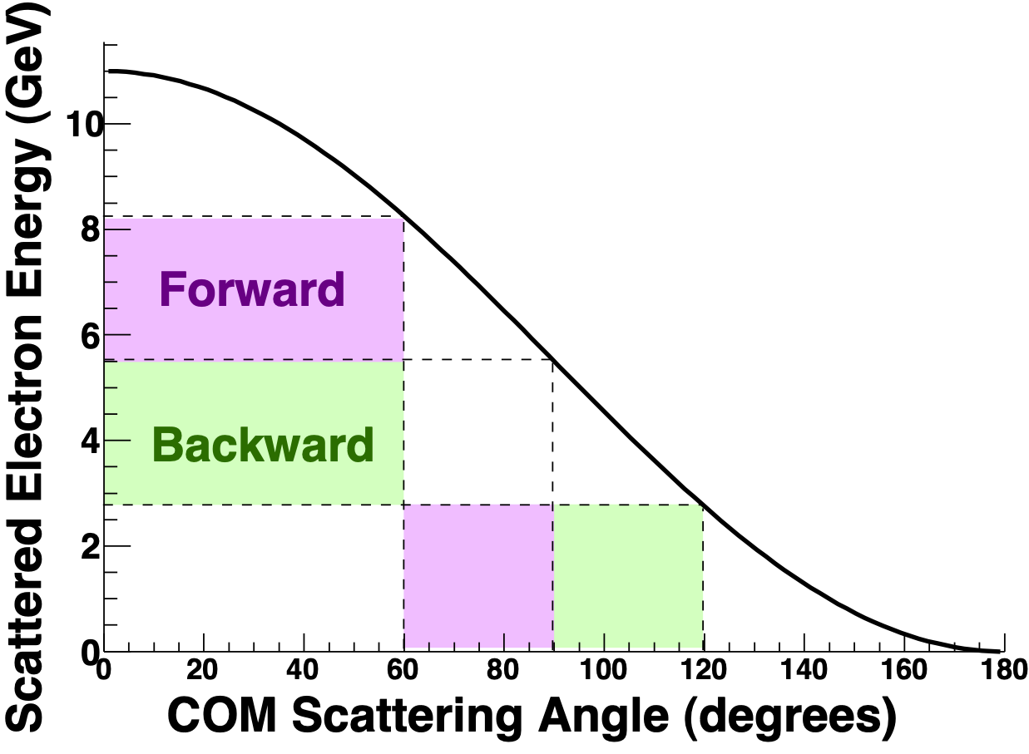
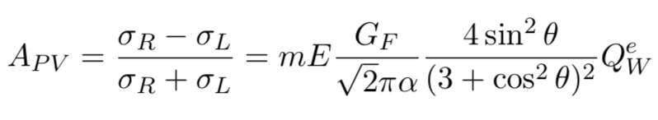
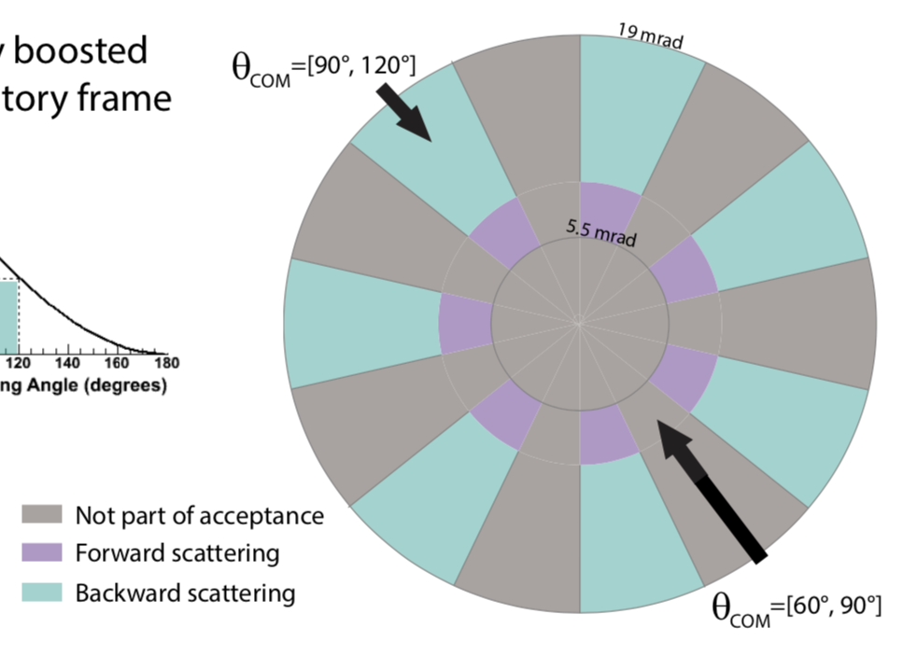
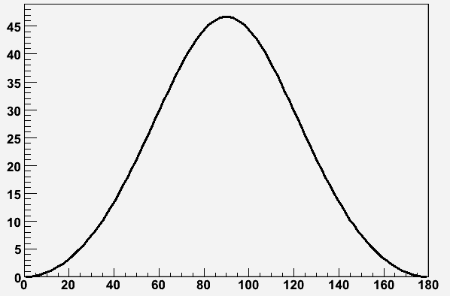
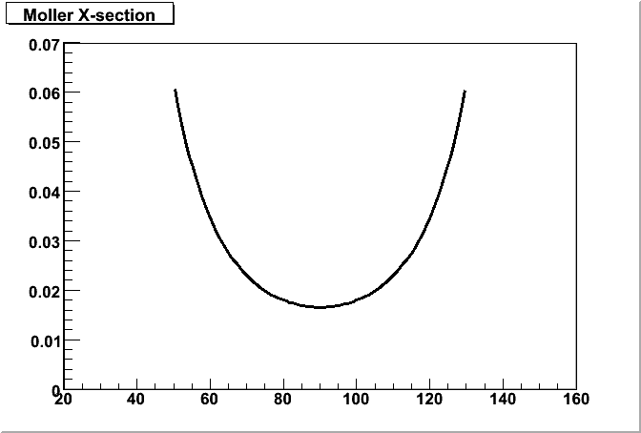
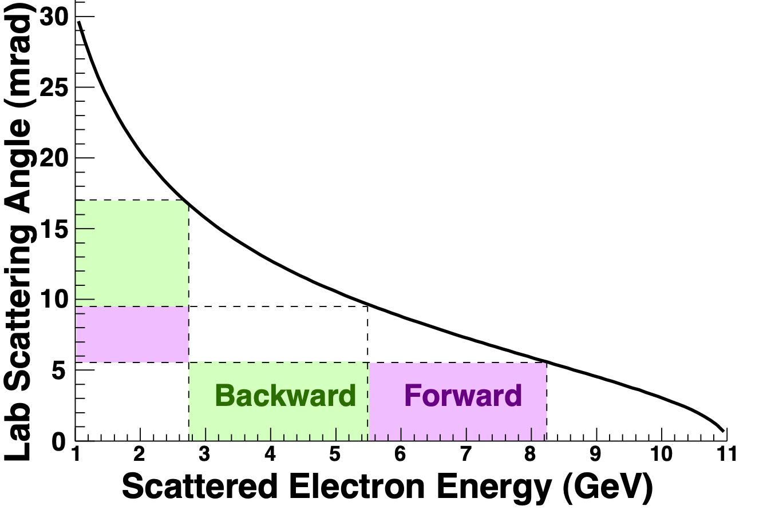
Full Azimuthal Coverage: Identical Particles
Since you only need either the forward or the backward scatter, accept forward+backward for half the azimuth
highly boosted laboratory frame
Identical particles.
Measure either forward or backward scattering.
boost
Highest figure of merit at θ_{CM} = 90º
Center of mass
Lab
dσ/dΩ
Asymmetry (ppb)
CM angles 60º -120º
11 GeV in: 2.75 to 8.25 GeV out
Lab angles ~5 mrad - 17 mrad
APV
Center of Mass Angle
  Unique concept allows for full azimuthal acceptance (effectively) even leaving space for coils but makes for a challenging design

Slide 18
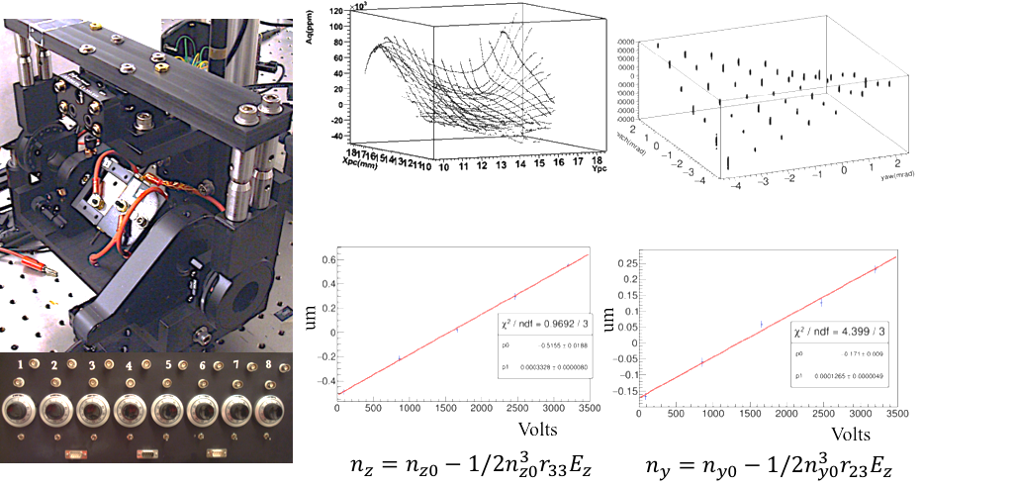
Types of HCBA that contribute to PVES systematics
  Achieving HCBA goals all depends on the laser and Pockels Cell
Any change in the polarized beam, correlated to helicity reversal, can be a potential source for a false asymmetry
Polarized Beam Source
RTP Cell fast switching for 2kHz
(Rubidium Titanyle Phosphate)
HCBA contributions
 | Error
Systematic | 0.2ppb
Intensity | 0.1ppb
Position, E, angle | 0.1ppb
Spot-size | 0.12ppb

Slide 19



Magnet Concept
long and skinny
Bend scattered particles, separate ee from ep and photons
Small angles and high beam power
Large energy range (3-8 GeV)
Focus both back & forward scattered electrons
Two toroidal magnets (Upstream and Downstream)
leaving USTorus
0.5 x 2m
0.9 x 6.5m
rad
leaving DSTorus
cm
at Detector
cm
19

Slide 20





Main Detector
ee
ep
ep
ee
Illustration with each septant a different fundamental background
open
transition
closed
Segmented detector plane deconvolutes signal from backgrounds

Slide 21

Collimation & More Detectors
Pb absorber
GEMS
pion detectors
SAMs
Collimator 1: long snout, collimates primary beam so what remains can go to the dump. ~3200 W
Collimator 2: wedges define the acceptance of the 7 septants
Walls, collars, and lintels supplement the collimation

Slide 22
MOLLER status
Prototyping/construction/installation (2022-25)
  Final Design Reviews now complete
  Plan for Fall 2023 CD-2/3 review followed by approval
  Technically driven schedule is then ~15 months construction and ~18 months installation
  Now fully funded!
  Project currently on track to be ready to start installation as early as Fall 2024/Q1 2025 or when the hall becomes available
  (*details beyond that depend on performance of CEBAF and delivery of luminosity to SBS program)
  Project itself currently on track to be ready to start commissioning as early as Spring 2026 subject to scheduling/installation start date
MOLLER Collaboration
~ 160 authors, 37 institutions, 6 countries
K. Kumar: Contact
J. Fast: Project Manager
Includes experience from E158, PREX, Qweak, PVDIS, HAPPEX, G-Zero
MOLLER MIE Project Schedule

Slide 23
Summary
Thank you collaboration, Jlab staff, engineers, project team!
MOLLER represents an outstanding opportunity to take advantage of the unique instrument (11 GeV CEBAF beam) enabled by the 12 GeV upgrade
Electroweak physics with PVES are a powerful component of the low energy fundamental symmetries program
The science case remains compelling and the plan is to run physics at about the time that precision results from high luminosity phases of 14 TeV LHC are becoming available
MOLLER will search for new interactions with reach into new physics phase space that cannot otherwise be accessed
Now we just have to do is build it and do it (construction and execution of MOLLER)

Slide 24
Backup

Slide 25
Outline
Collaboration
PVES measure Apv
Next-generation Experiments will provide precise BSM probe – experiments measure increasingly smaller Apv
MOLLER experiment Design
MOLLER is precise and measures Qwe and constrains Cee
Theory: Standard Model prediction is tight and MOLLER measurement will constrain BSM theories
Quantifying Discovery Potential: Mass Reach Scale
Quantifying Discovery Potential : sin2thetaW precision
Quantifying Discovery Potential : Coupling coefficients phase space
New Physics Complementarity
MOLLER Apparatus
MOLLER measuring the asymmetry – integration at 2kHz
MOLLER full azimuthal coverage
MOLLER complex magnets/collimation
MOLLER Main detector: segmented for backgrounds
MOLLER Beam Control??
MOLLER Uncertainty Requirements
MOLLER Status
Conclusion

Slide 26

MOLLER status
DOE MIE (Office of Nuclear Physics)
Prototyping/construction/installation (2022-25)
  Final Design Reviews now complete
  Plan for Fall 2023 CD-2/3 approval
  Technically driven schedule is then ~15 months construction and ~18 months installation
  Now fully funded!
  Project currently on track to be ready to start installation as early as Fall 2024/Q1 2025 or when the hall becomes available
  (*details beyond that depend on performance of CEBAF and delivery of luminosity to SBS program)
  Project on track to be ready to start commissioning as early as Spring 2026 subject to scheduling
MOLLER Collaboration
~ 160 authors, 37 institutions, 6 countries
K. Kumar: Contact
J. Fast: Project Manager
Includes experience from E158, PREX, Qweak, PVDIS, HAPPEX, G-Zero
MOLLER MIE Project Schedule

Slide 27
MOLLER schedule – CD-3a and beyond
Working on completing final procurement packages for CD-3a scope
  Intent is to have all requisitions in motion by July
Completing planning (Performance Measurement Baseline) for CD-2/3
  Data freeze in May – no changes until we set baseline at end of CY2023
Plan remains to complete fabrication/assembly/test outside Hall A by end of Q1 FY25
  Details beyond that depend on performance of CEBAF and delivery of luminosity to SBS program

Slide 28
Figure of Merit
highly boosted laboratory frame
Highest figure of merit at θ_{CM} = 90º
dσ/dΩ
Asymmetry (ppb)
APV
CM angles 90º-120º
11 GeV in: 2.75 to 5.5 GeV out
Lab angles ~9 mrad - 17 mrad
Center of Mass Angle
boost
Center of mass
Lab
Identical particles.
Measure either forward or backward scattering.
Kent Paschke - UVa
Simulation Workship - Experiment Overview

Slide 29
Identical Particles
Since you only need either the forward or the backward scatter, accept forward+backward for half the azimuth
CM angles 60º -120º
11 GeV in: 2.75 to 8.25 GeV out
Lab angles ~5 mrad - 17 mrad
  Unique concept allows for full azimuthal acceptance (effectively) even leaving space for coils but makes for a challenging design
Kent Paschke - UVa
Simulation Workship - Experiment Overview

Slide 30


MOLLER

Slide 32




PV-DIS at EIC
Measurement of $A_{PV}^{DIS}$ modeled with ECCE detector
Proton or deuterium, PDF uncertainty is under control
Average over nuclear polarization
1% precision of e-beam polarimetry competes with statistics
Int. Lumi. ~100 fb⁻¹ (~1yr@10³⁵)

Slide 34












Electroweak Structure Functions
e⁻
¹H, ²H, ³He
polarized electron, unpolarized hadron
proton
deuteron
unpolarized electron, polarized hadron
Assuming integrated luminosity ~500 fb⁻¹
“Non-small x”
few % on
10% on
Simulations from Yuxiang Zhao, SBU

Slide 36
Spectrometer Concept
Bend scattered particles, separate ee from ep and photons
Small angles and high beam power
Large energy range (3-8 GeV)
Long target
26.5 m target to detector
Two toroidal magnets (Upstream and Downstream)
Collimation + “shields” or “blockers”
vacuum pipe to take beam to dump
Kent Paschke - UVa
Simulation Workship - Experiment Overview

Slide 37






Switching faster – Use New Crystal
KD*P Cell
RTP Cell
(Potassium Dideuterium Phosphate)
(Rubidium Titanyle Phosphate)
transition + ringing ~ 100μs
transition ~ 12μs
ZOOMED IN
No piezoelectric ringing up to 100kHz
At 2kHz helicity switching, 12μs transition,
Deadtime reduced by ~10x
Suffers from piezoelectric ringing
At 2kHz helicity switching,
70-100μs deadtime is 20% loss of data

Slide 39
Design for Moller experiment
Improve E158 by a factor of 5
At 11GeV, Jlab high luminosity and stability make large improvement possible
Matches best collider (Z-pole) measurement!
HCBA contributions
 | Error
Systematic | 0.39ppb
Intensity | 0.1ppb
Position | 0.14ppb
Spot-size | 0.14ppb
A_{PV} 35.6ppb to 0.72ppb precision
sin²θ_{W} :±0.00026(stat) ±0.00013(syst)
Mass Reach scales up to 47TeV
Mass Reach is ~600X the mass of the W mediator, ~400X the Higgs Mass

Slide 41





MOLLER at JLab
Elastic ee (Møller) scattering
$$A_{PV}=Q_{W}^{e}\frac{Q^{2}G_{F}}{\sqrt{2}πα}\left(\frac{1−y}{1+y^{4}+(1−y)^{4}}\right)$$
$$Q_{W}^{e}=−2C_{ee}$$
Search for new flavor diagonal
neutral currents
Unique (purely leptonic) new physics reach
APV ~ 32 ppb
δ(APV) ~ 0.8 ppb
δ(Q^{e}W) = ± 2.1 % (stat.) ± 1.1 % (syst.)
Only existing ee measurement:
δ(sin²θW) = ± 0.00024 (stat.) ± 0.00013 (syst.)
~ 0.1%
Matches best collider (Z-pole) measurement!
MOLLER Reach
best contact interaction reach for leptons at low OR high energy
Improve $Q_{W}^{e}$ by a factor of 5
To do better for a 4-lepton contact interaction would require:
Giga-Z factory, linear collider, neutrino factory or muon collider

Slide 43

Target Boiling
Qweak
data
Fast helicity flipping = high speed camera
Target boiling is a noise source that can’t be filtered out using correlations with beam monitors, it must be suppressed by taking data faster than the bubbles form
Moller is designed around a flip rate of at least 2 kHz
The electron beam must switch back and forth very quickly between helicity states

