Slide 1
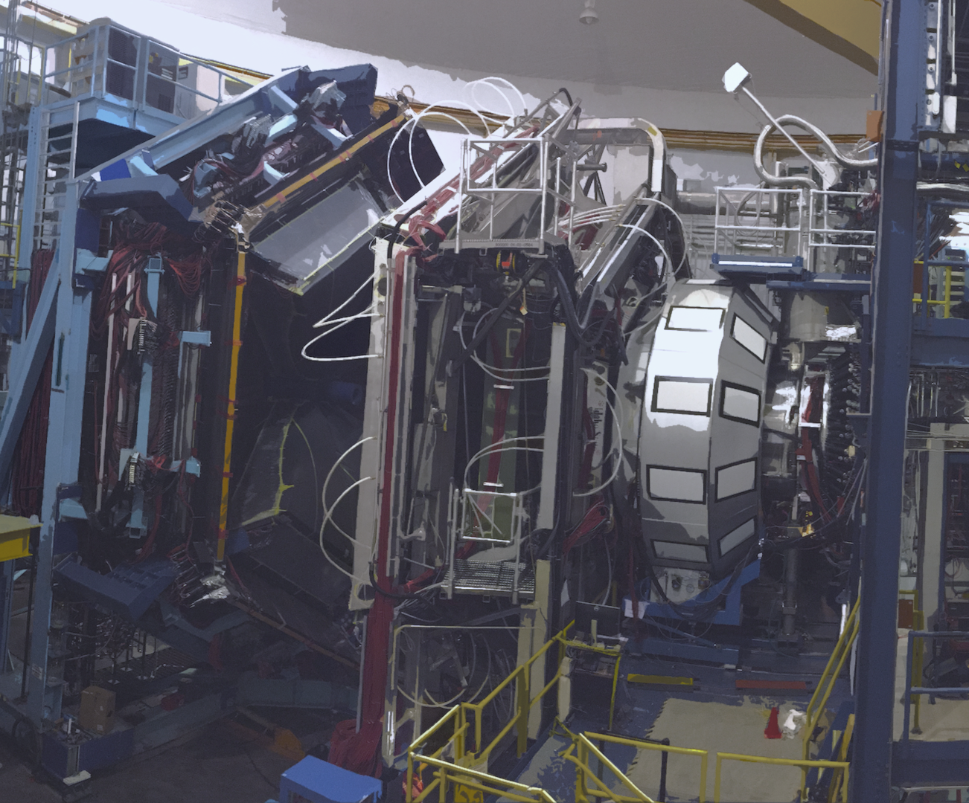


Selected topics of the deep exclusive reactions program of CLAS12: highlights and perspectives
Pierre Chatagnon,
for the CLAS collaboration
2023 JLUO annual meeting
27th of June 2023

Slide 2
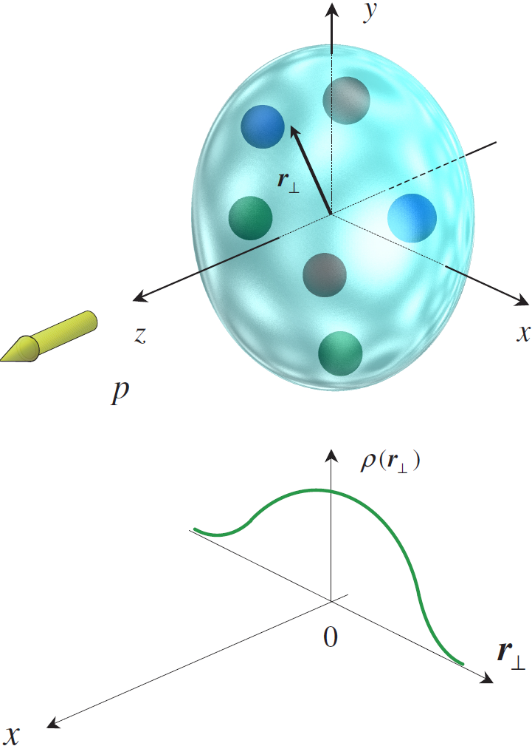
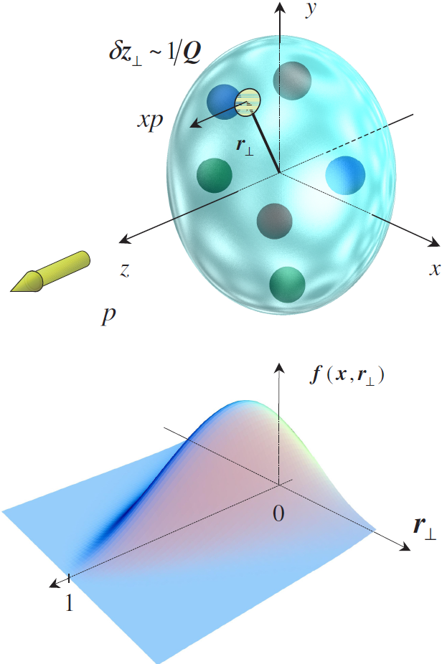
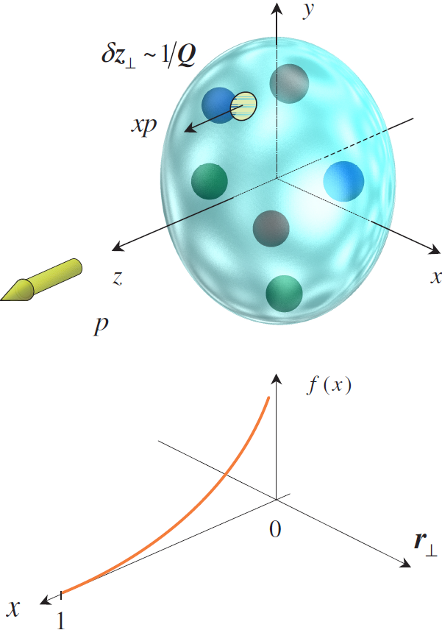
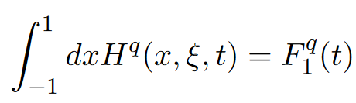
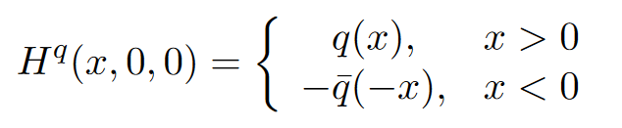
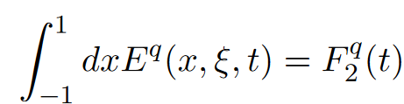
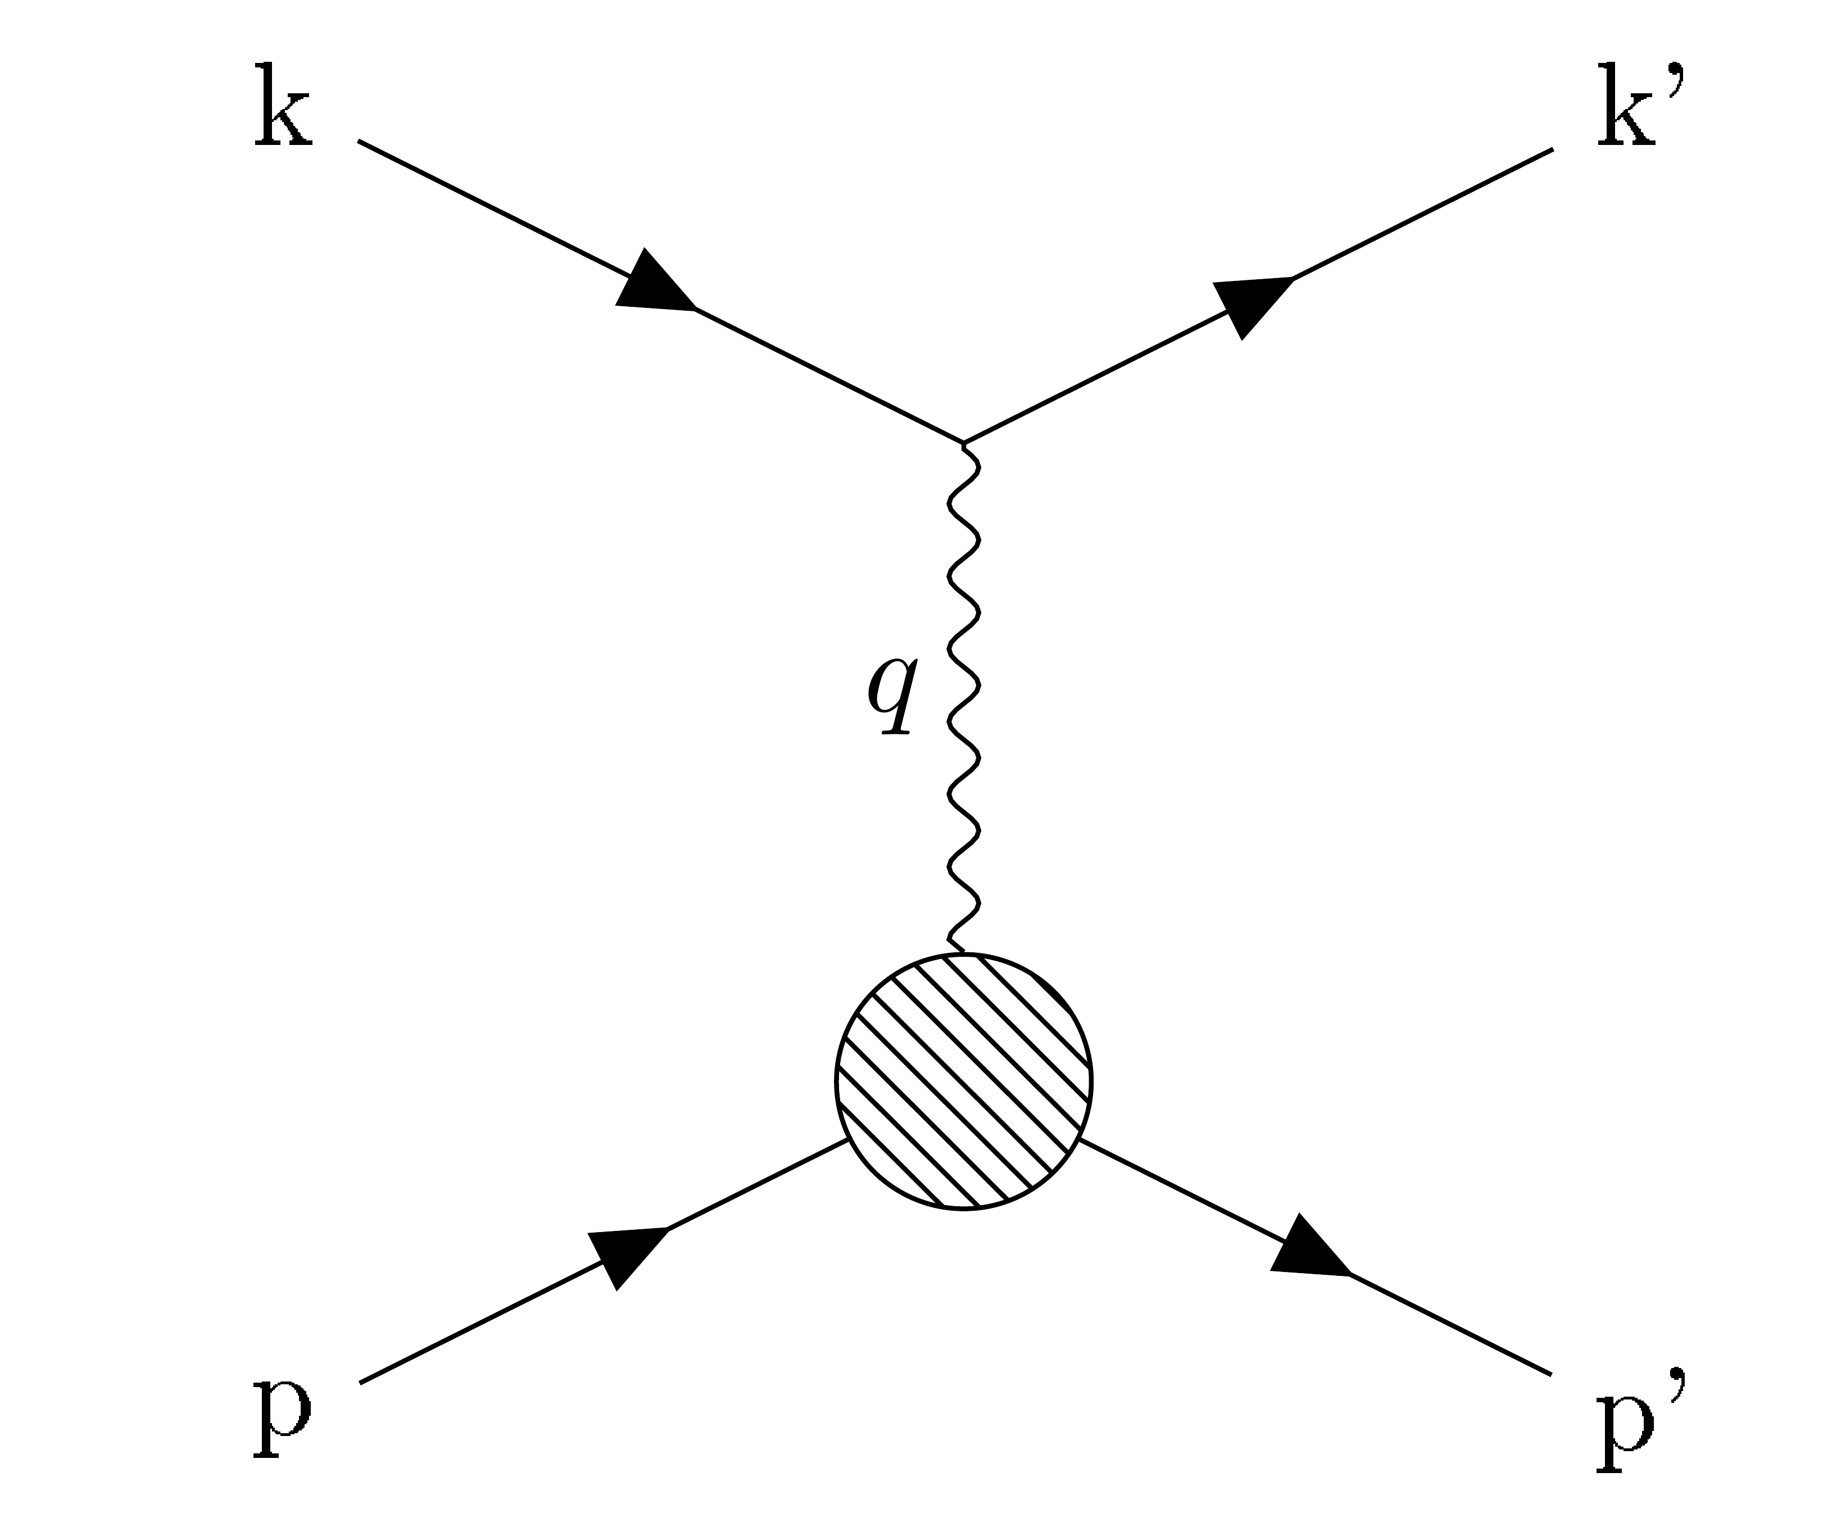
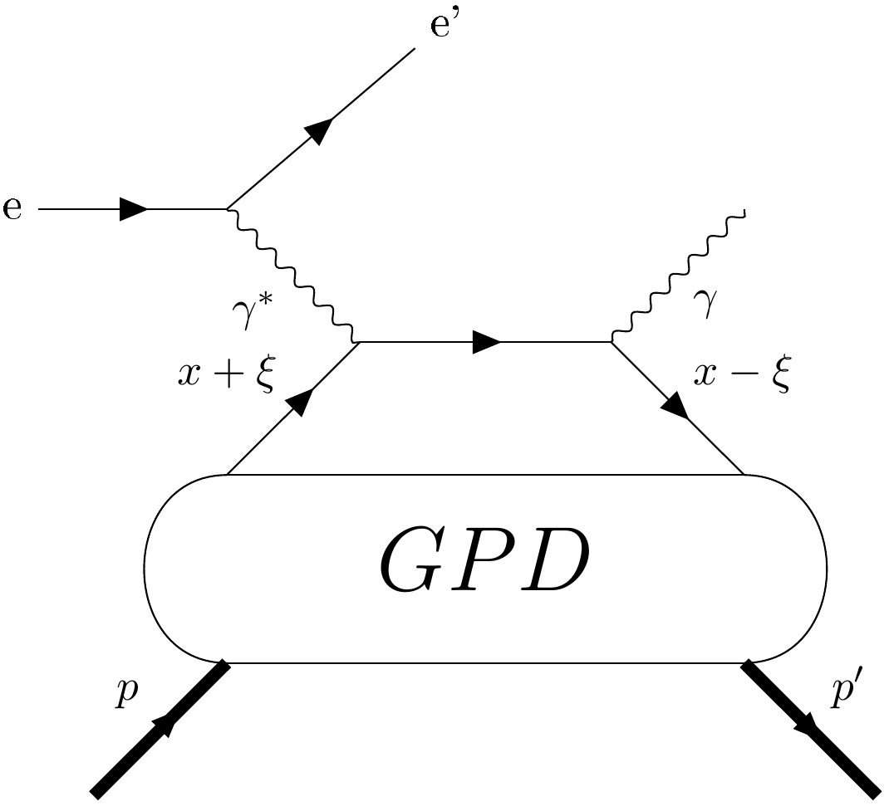
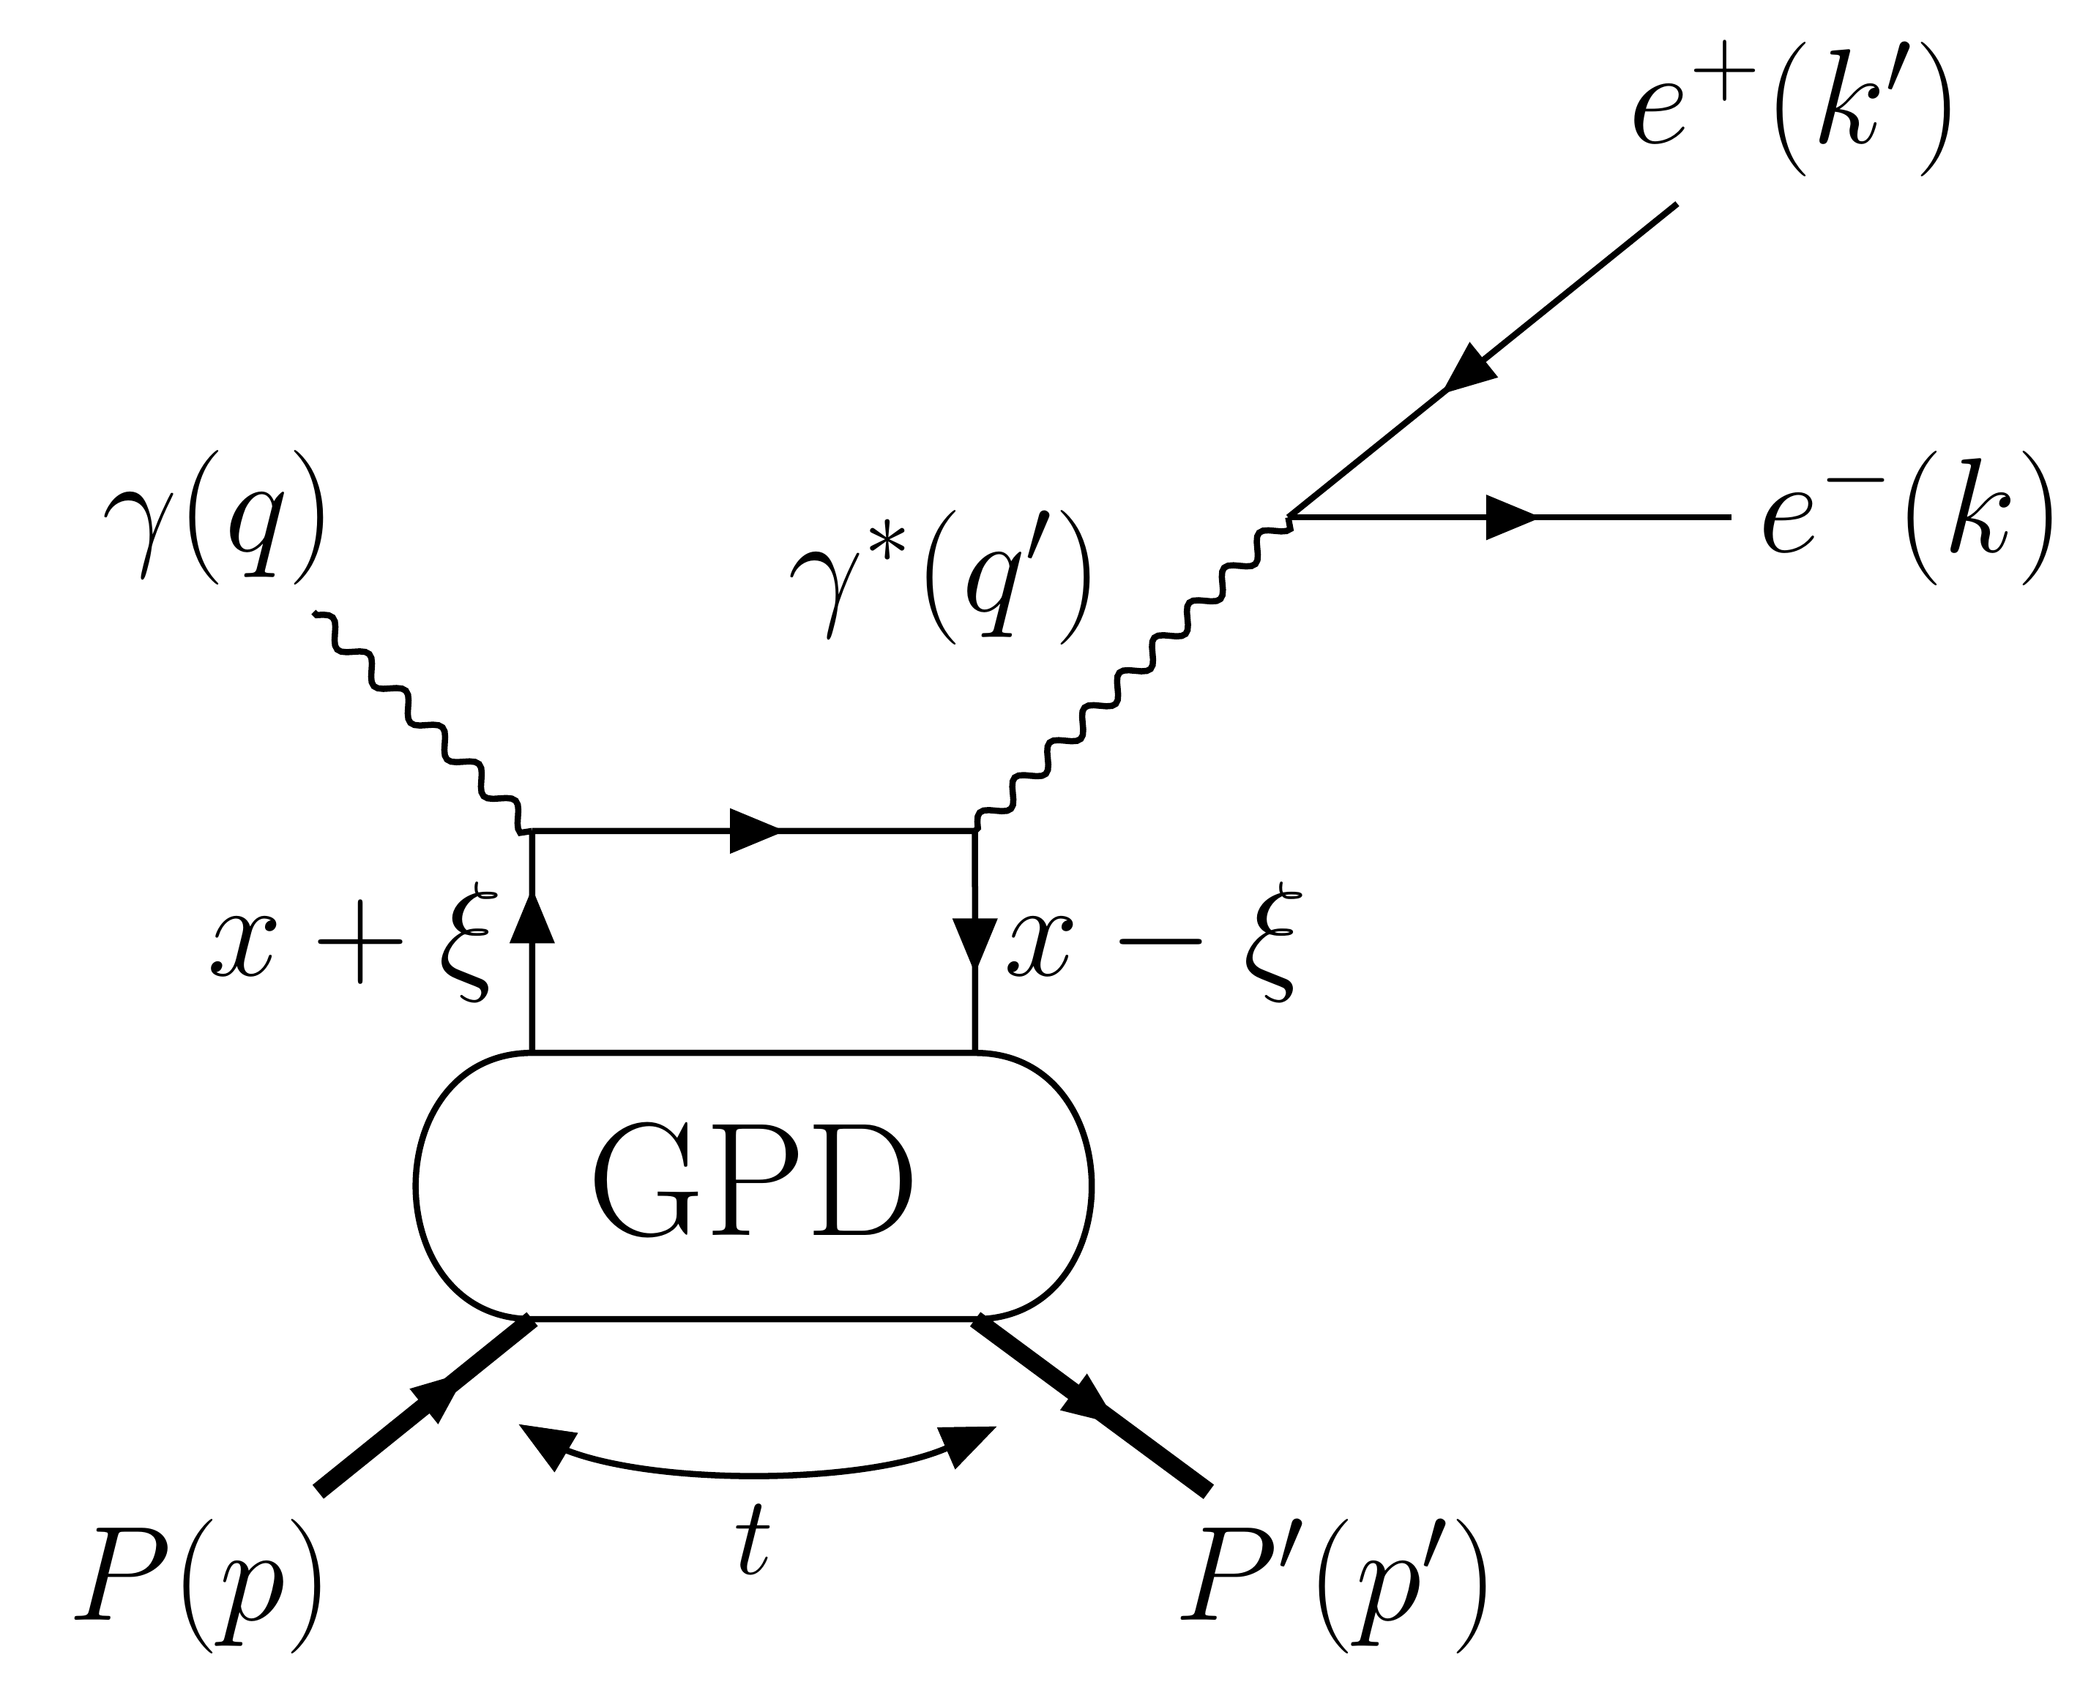
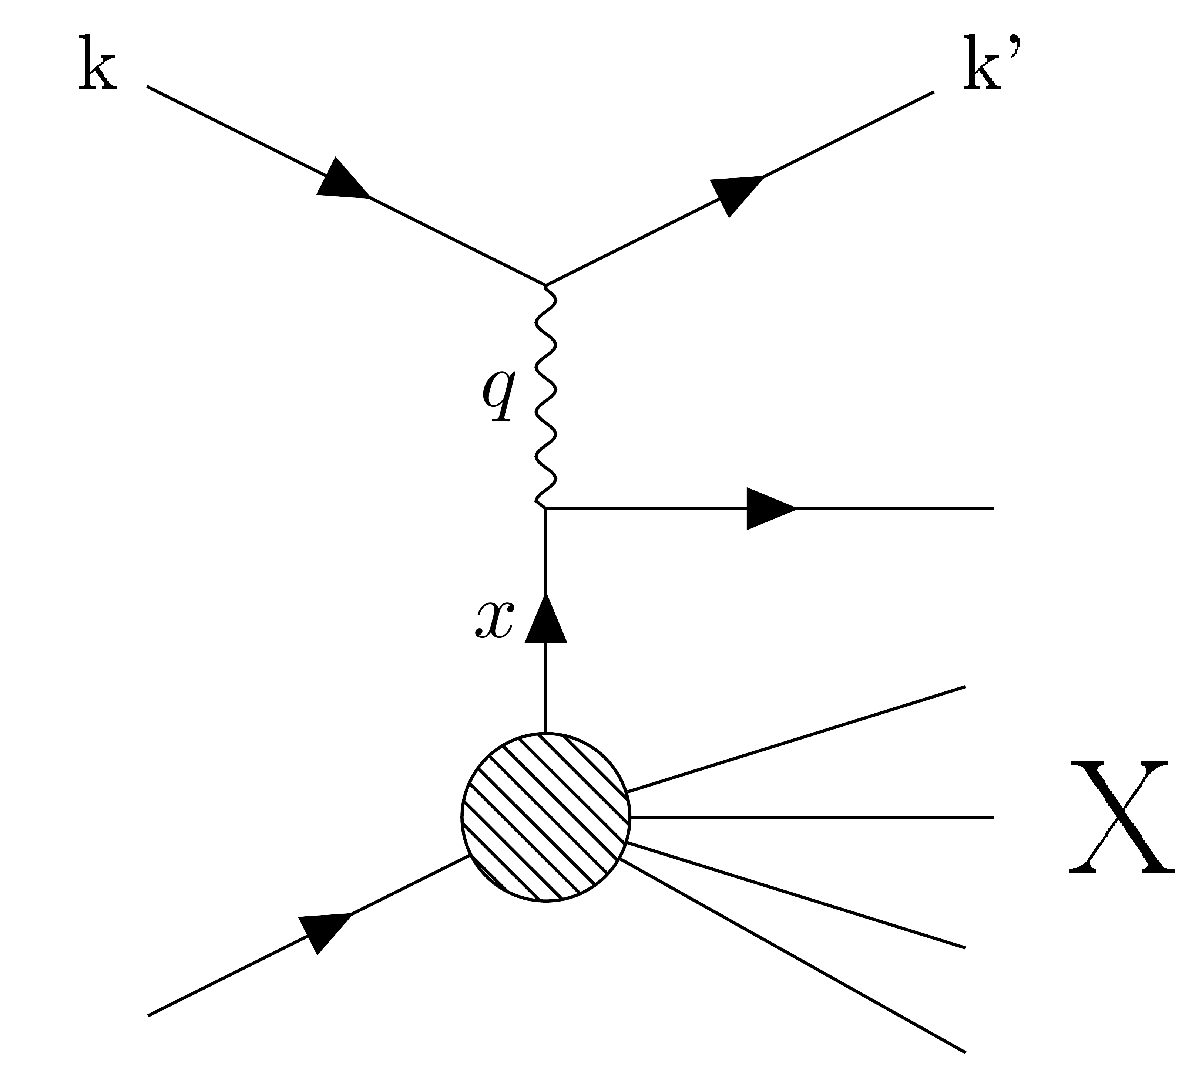
The Generalized Parton Distributions…
Generalized Parton Distributions ●● ● ●● ●●●●● ●● ●●●●● ●●● ●
Form Factors
Position in the transverse plane
GPDs
Momentum in the longitudinal direction
PDFs
Accessed via elastic
scattering
… and their correlations
Accessed via Deep Inelastic
Scattering
Accessed via exclusive reactions
Figures in A.V. Belitsky, A.V. Radyushkin, Unraveling hadron structure with generalized parton distributions, Physics Reports, Volume 418, Issues 1–6 2005

Slide 3
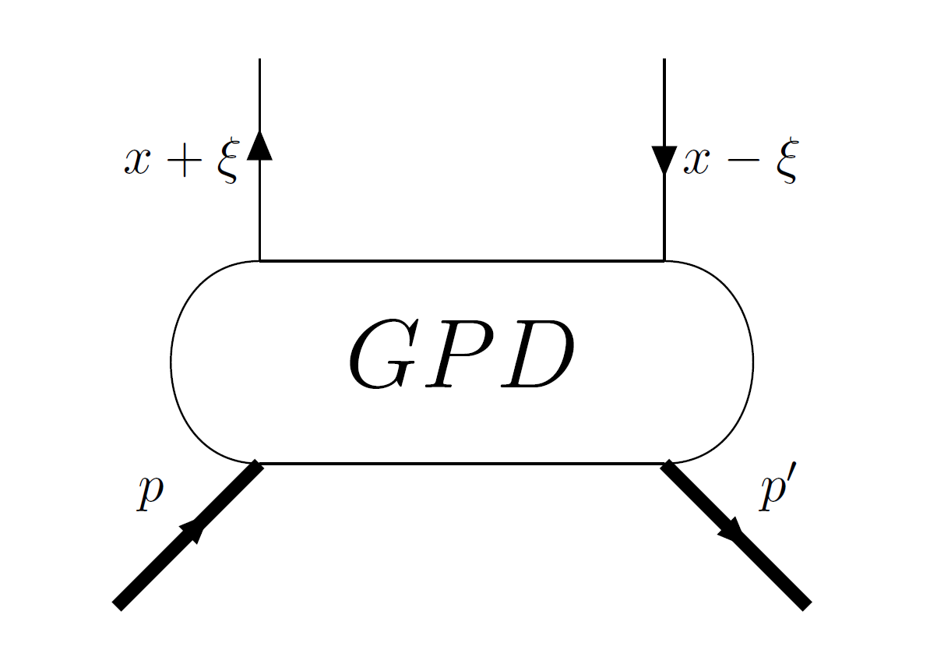
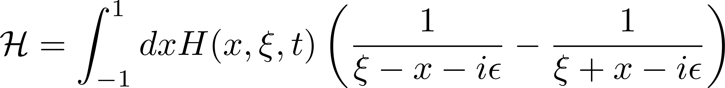
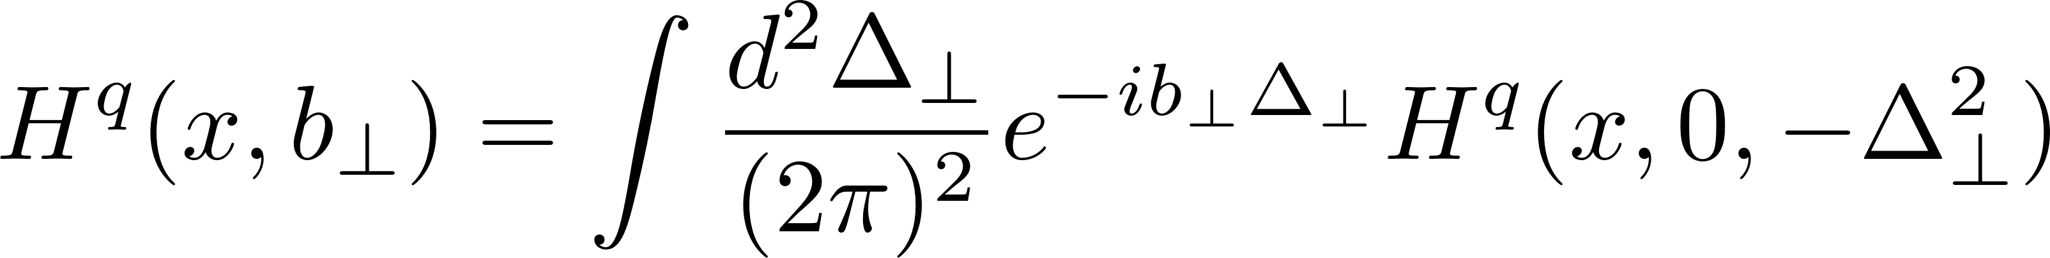
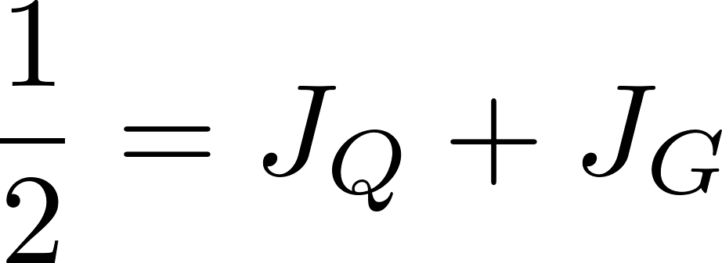
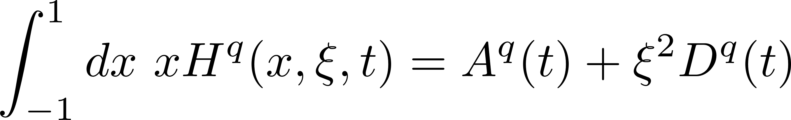
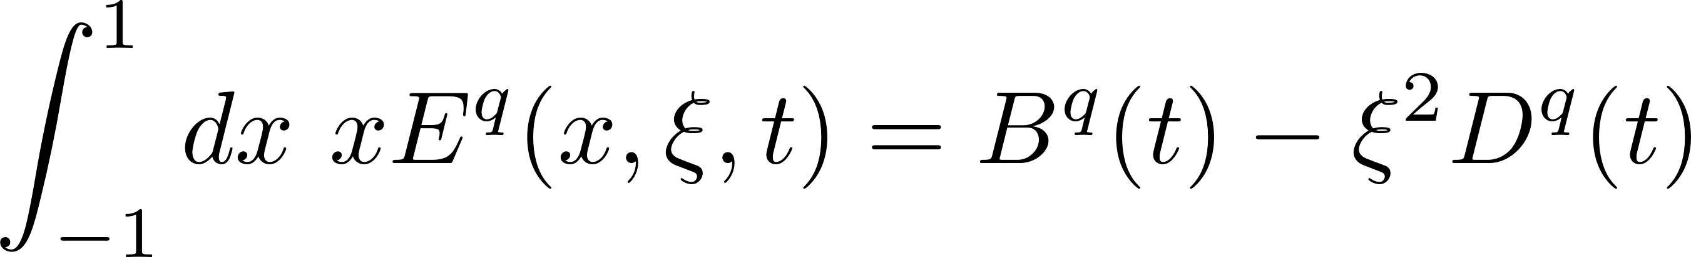
…and their properties
Generalized Parton Distributions ●● ● ●● ●●●●● ●● ●●●●● ●●● ●
Some properties of GPDs
Compton Form Factors
8 GPDs for spin ½ particles at leading twist:
  4 chiral-even GPDs: H, E, H̃, Ẽ
  4 chiral-odd GPDs: H_{T}, E_{T}, H̃_{T}, Ẽ_{T}
They depends on three variables:
  x, the average momentum of the struck quark,
  ξ, the transferred longitudinal momentum fraction,
  the Mandelstam variable t.
GPDs are usually not accessible directly, but through complex quantities, the Compton Form Factors:
What can we learn from the GPDs ?
Tomography of the nucleon: the Fourier transform of the GPDs can be interpreted as a probability density:
Understanding the spin composition of the nucleon (aka the “spin puzzle”) using the Ji’s sum rule:
Accessing Gravitational Form Factors by mimicking a spin-2 interaction:

Slide 4
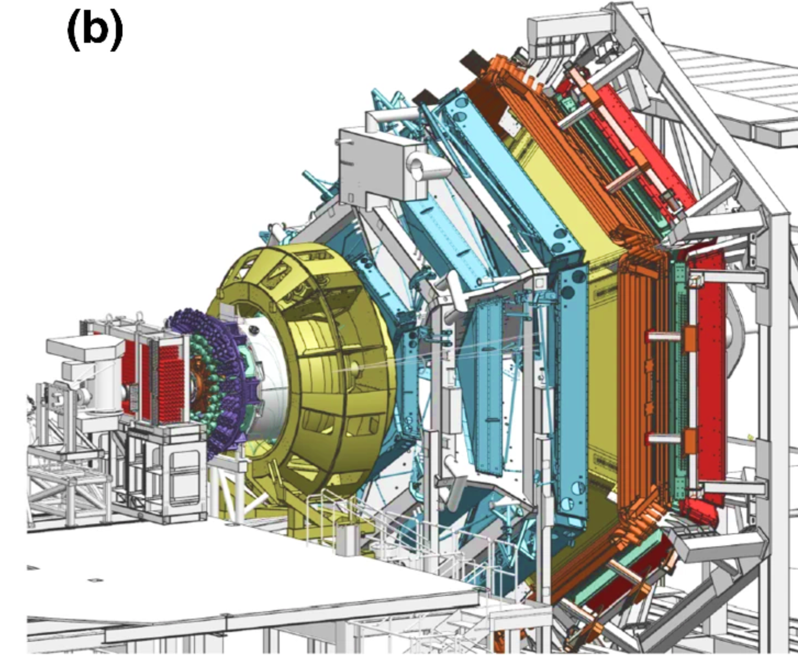
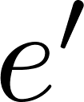



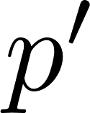
The CLAS12 detector
The CLAS12 detector ●● ● ●● ●●●●● ●● ●●●●● ●●● ●
Forward Detector
  Torus magnet
  Drift Chambers
  Forward Time-of-Flight
  Calorimeters
  Cherenkov counters
Central Detector
  Solenoid magnet
  Central Vertex Tracker
  Central Time-of-Flight
  Central Neutron detector
Forward Tagger
  Calorimeter
  Hodoscope
  Tracker
Beam
  85% longitudinally polarized electrons
  Max. luminosity: 10³⁵ s⁻¹cm⁻²
  Energy: 6.5 / 7.5 / ~10.6 GeV
Target
  Proton
  Deuterium
  Longitudinally pol. H/D

Slide 5
Deep exclusive reactions program of CLAS12
Overview ●● ● ●● ●●●●● ●● ●●●●● ●●● ●
Reaction | Observable | Experimental configuration | Lead analyzer (Affiliation) | Status
DVCS on proton | BSA | RG-A (Proton target) | G.Christiaens/M. Defurne (CEA Saclay) | Published (PRL)
DVCS on proton | Cross-section | RG-A | S. Lee (ANL) | Internal review
DVCS on bound neutron | BSA | RG-B (Deuterium target) | A. Hobart/S. Niccolai (IJCLab Orsay) | Internal review
DVCS on bound proton | BSA | RG-B | A. Hobart/S. Niccolai (IJCLab Orsay) | Internal review
Coherent DVCS on deuterium | BSA | RG-B | A. Biselli (Fairfield U.) | Ongoing
DVCS on proton | BSA | RG-K (Proton target, 6.5 and 7.5 GeV beam) | J.A. Tan (Kyungpook National U.) | Ongoing
DVCS on proton | BSA/TSA/DSA | RG-C (Longitudinally polarized target) | S. Polcher (CEA Saclay) | Ongoing
DVCS on neutron | BSA/TSA/DSA | RG-C | N. Pilleux (IJCLab Orsay) | Ongoing
Tagged DVCS on neutron | BSA | RG-F (BONuS12) | M. Ouillon (IJCLab) / M.Hattawy (ODU) | Ongoing
TCS on proton | BSA/AFB | RG-A | P. Chatagnon (JLab) | Published (PRL)
TCS on proton | BSA/TSA/DSA | RG-C | K. Gates (Glasgow) | Ongoing
DVMP π⁰ | BSA | RG-A | A. Kim (UConn) | To be submitted to PLB
DVMP π⁰ | Cross-section | RG-A | R. Johnston (MIT) | Ongoing
DVMP π⁺ | BSA | RG-A | S. Diehl (Giessen/UConn) | Published (PLB)
DVMP ρ | BSA | RG-A | N. Trotta (UConn) | Ongoing
DVMP φ | Cross-section | RG-A | P. Moran (MIT) | Ongoing
DVMP φ | BSA | RG-B | N. Ram (CEA Saclay) | Ongoing
DVMP π⁻ on Δ⁺⁺ | BSA | RG-A | S. Diehl (Giessen/UConn) | Just accepted in PRL
J/ψ photoproduction on proton | Cross-section | RG-A | P. Chatagnon (JLab) | Ongoing
J/ψ photoproduction on neutron | Cross-section | RG-A | R. Tyson (Glasgow) | Ongoing
Tagged J/ψ photoproduction on proton | Cross-section | RG-A | M. Tenorio Pita (ODU) | Ongoing

Slide 6
Deep exclusive reactions program of CLAS12
Overview ●● ● ●● ●●●●● ●● ●●●●● ●●● ●
Reaction | Observable | Experimental configuration | Lead analyzer (Affiliation) | Status
DVCS on proton | BSA | RG-A (Proton target) | G.Christiaens/M. Defurne (CEA Saclay) | Published (PRL)
DVCS on proton | Cross-section | RG-A | S. Lee (ANL) | Internal review
DVCS on bound neutron | BSA | RG-B (Deuterium target) | A. Hobart/S. Niccolai (IJCLab Orsay) | Internal review
DVCS on bound proton | BSA | RG-B | A. Hobart/S. Niccolai (IJCLab Orsay) | Internal review
Coherent DVCS on deuterium | BSA | RG-B | A. Biselli (Fairfield U.) | Ongoing
DVCS on proton | BSA | RG-K (Proton target, 6.5 and 7.5 GeV beam) | J.A. Tan (Kyungpook National U.) | Ongoing
DVCS on proton | BSA/TSA | RG-C (Longitudinally polarized target) | S. Polcher (CEA Saclay) | Ongoing
DVCS on neutron | BSA/TSA | RG-C | N. Pilleux (IJCLab Orsay) | Ongoing
Tagged DVCS on neutron | BSA | RG-F (BONuS12) | M. Ouillon (IJCLab) / M.Hattawy (ODU) | Ongoing
TCS on proton | BSA/AFB | RG-A | P. Chatagnon (JLab) | Published (PRL)
TCS on proton | BSA/TSA | RG-C | K. Gates (Glasgow) | Ongoing
DVMP π⁰ | BSA | RG-A | A. Kim (UConn) | To be submitted to PLB
DVMP π⁰ | Cross-section | RG-A | R. Johnston (MIT) | Ongoing
DVMP π⁺ | BSA | RG-A | S. Diehl (Giessen/UConn) | Published (PLB)
DVMP ρ | BSA | RG-A | N. Trotta (UConn) | Ongoing
DVMP φ | Cross-section | RG-A | P. Moran (MIT) | Ongoing
DVMP φ | BSA | RG-B | N. Ram (CEA Saclay) | Ongoing
DVMP π⁻ on Δ⁺⁺ | BSA | RG-A | S. Diehl (Giessen/UConn) | Just accepted in PRL
J/ψ photoproduction on proton | Cross-section | RG-A | P. Chatagnon (JLab) | Ongoing
J/ψ photoproduction on neutron | Cross-section | RG-A | R. Tyson (Glasgow) | Ongoing
Tagged J/ψ photoproduction on proton | Cross-section | RG-A | M. Tenorio Pita (ODU) | Ongoing
Disclaimer:
1) I did my best to mention all analysis and involved analyzers. I might have missed some.
2) Each of these analysis is worth a 20-minutes presentation (at least). Apologies for only flashing some of the results.

Slide 7
Outline
Overview ●● ● ●● ●●●●● ●● ●●●●● ●●● ●
I Deeply Virtual Compton Scattering measurements
II Timelike Compton Scattering measurements
III Deeply Virtual Meson Production measurements
V Selected perspectives

Slide 8
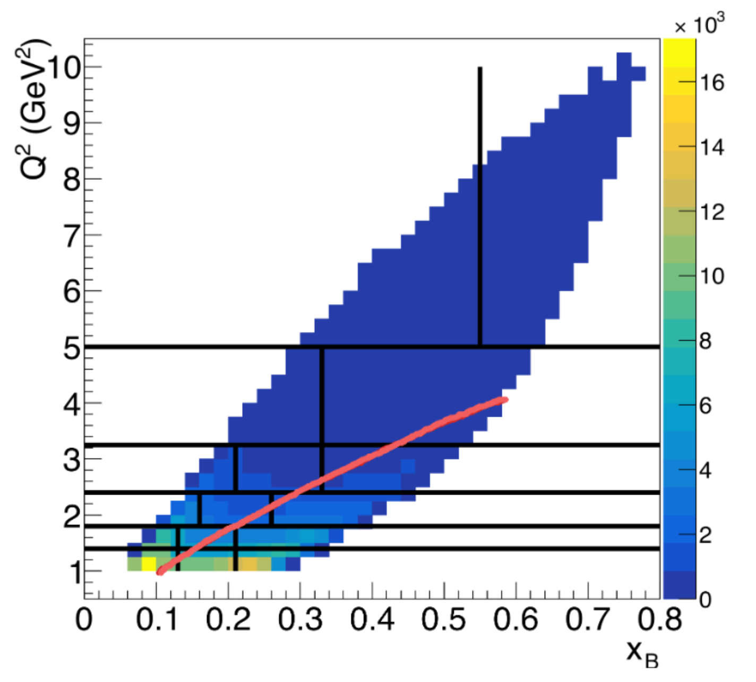
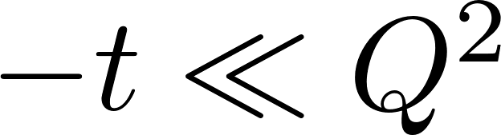
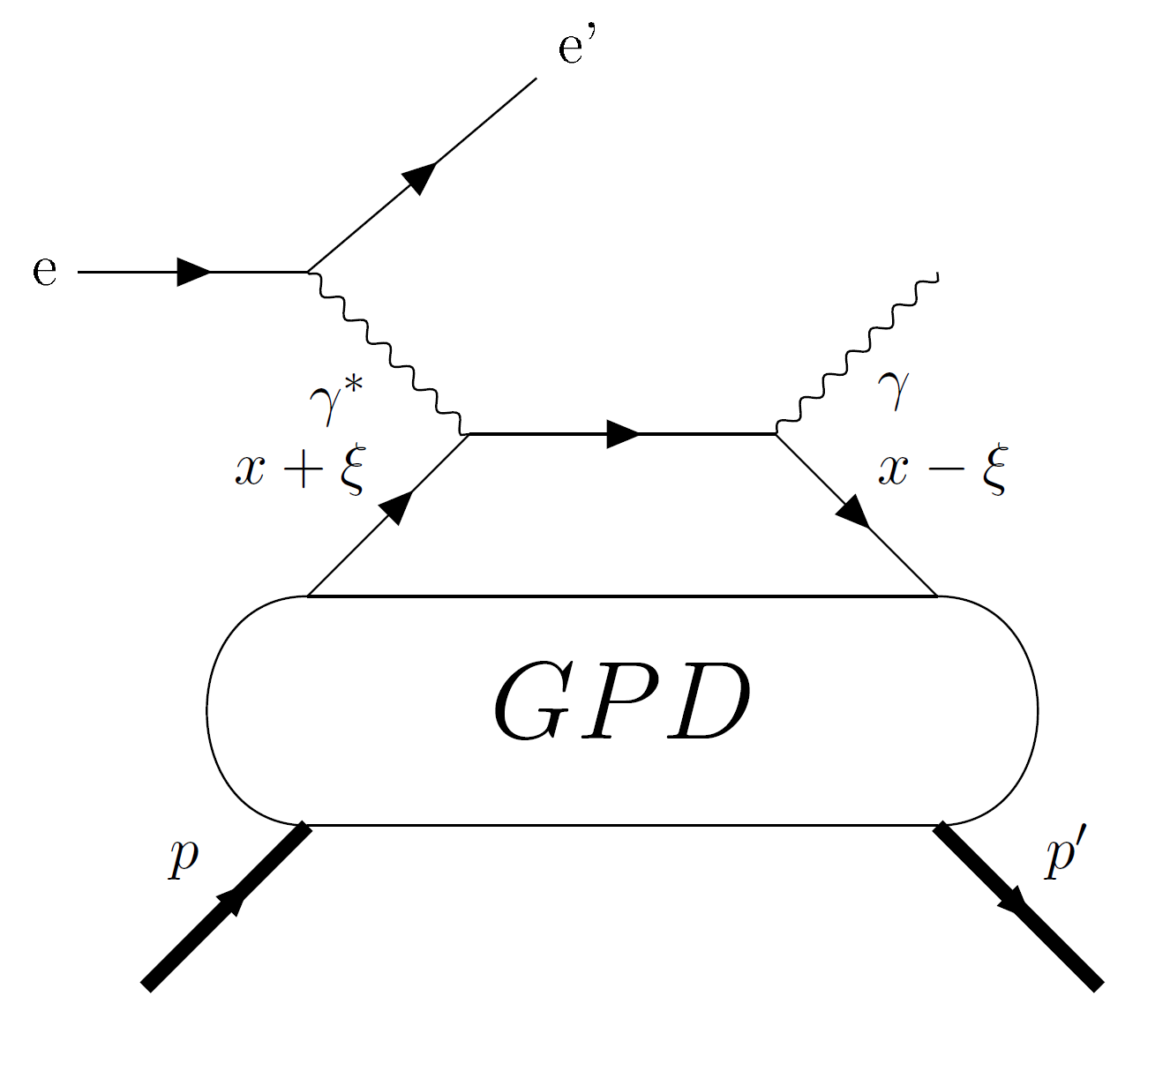
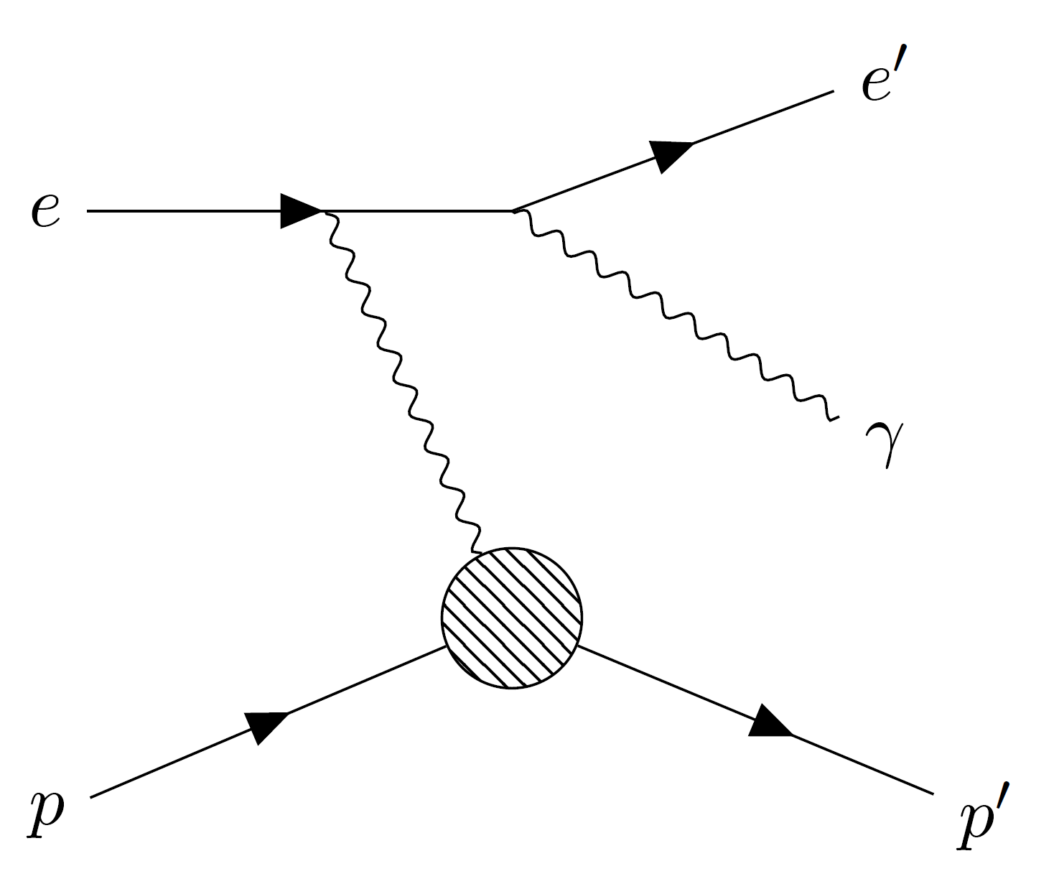
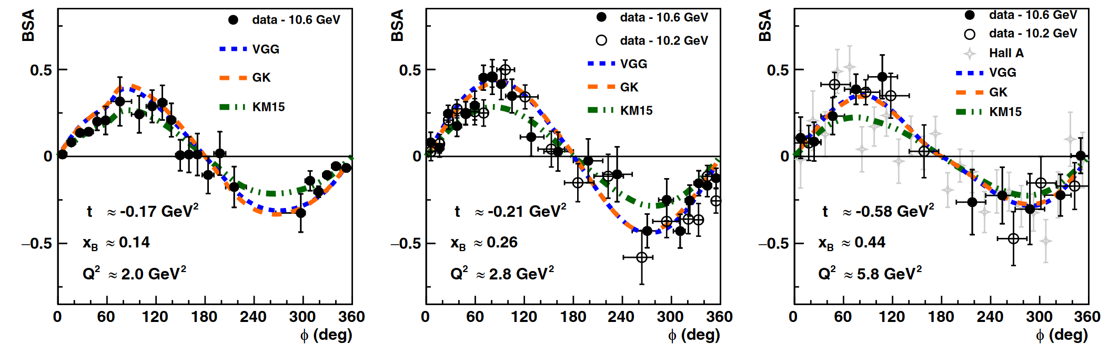
First CLAS12 measurement of DVCS beam-spin asymmetries in the extended valence region
DVCS measurements ●● ● ●● ●●●●● ●● ●●●●● ●●● ●
Lead analyzers: G.Christiaens/M.Defurne (CEA Saclay)
Published results
Deeply Virtual Compton Scattering: the golden process to access GPDs
Beam spin asymmetry extracted in wide phase space
1600 new data points
Based on 25% of the total beam time allocated to CLAS12 DVCS experiment on unpolarized proton
Reaction of interest: ep → e’p’γ
In the factorization regime , GPD describe the soft structure of the proton
DVCS
BH
Figures in First CLAS12 Measurement of Deeply Virtual Compton Scattering Beam-Spin Asymmetries in the Extended Valence Region, G. Christiaens et al. (CLAS Collaboration) Phys. Rev. Lett. 130, 211902
Published in PRL (2023)

Slide 9

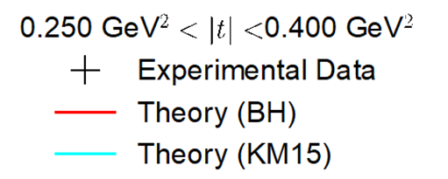
Measurement of pDVCS cross-section
DVCS measurements ●● ● ●● ●●●●● ●● ●●●●● ●●● ●
Lead analyzer: S. Lee (ANL)
Motivations
Cross section sensitive to both Im( ) and Re( )
Crucial measurement to completely understand DVCS and GPDs
Normalization under scrutiny by the collaboration
Preliminary
Internal review

Slide 10
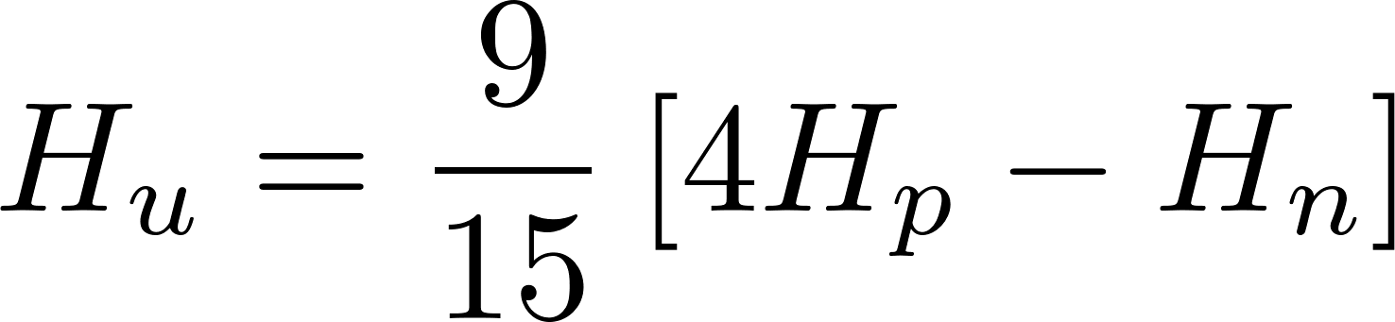
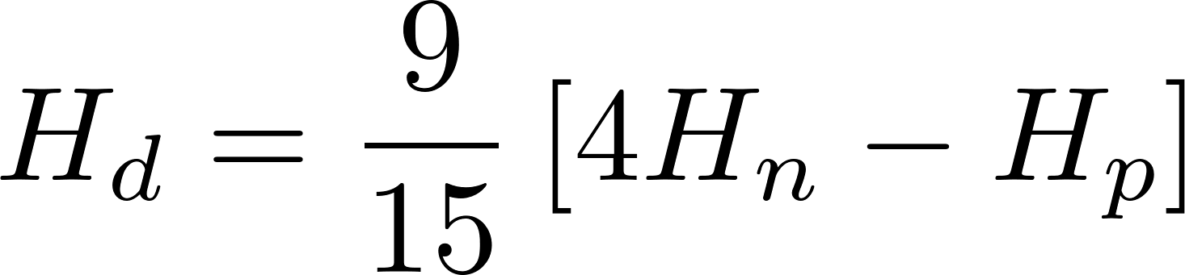
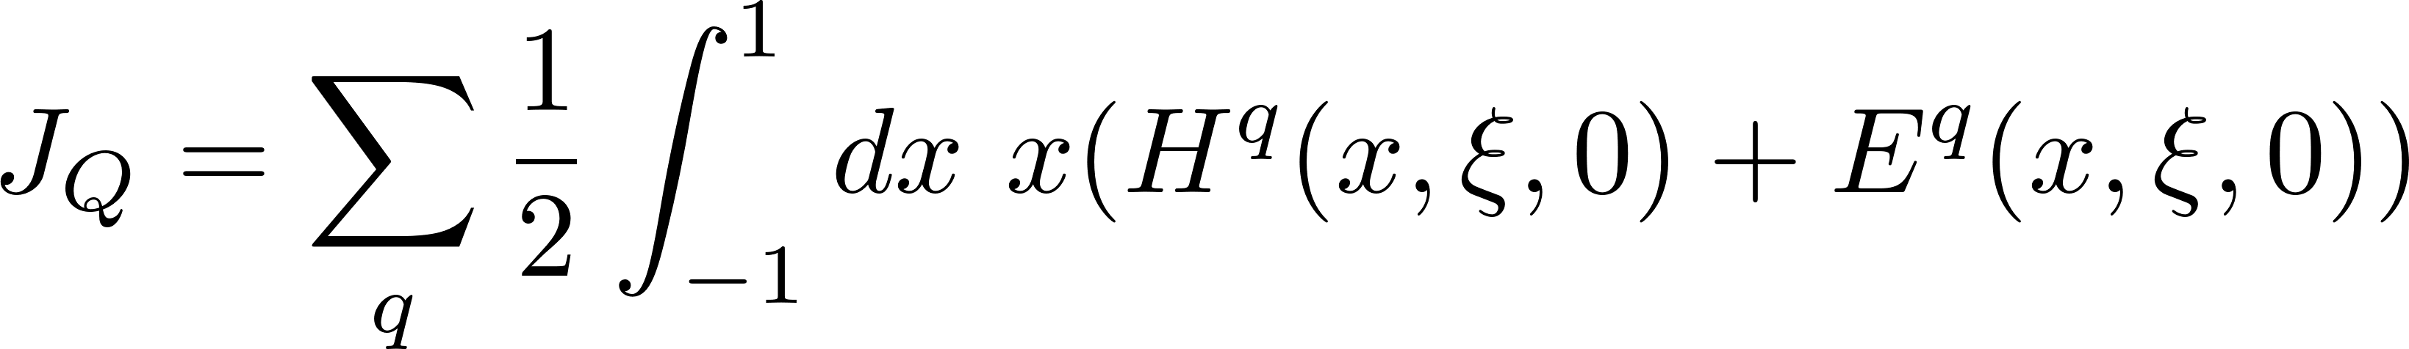
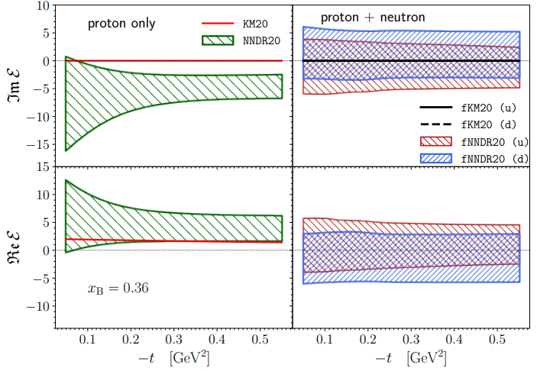
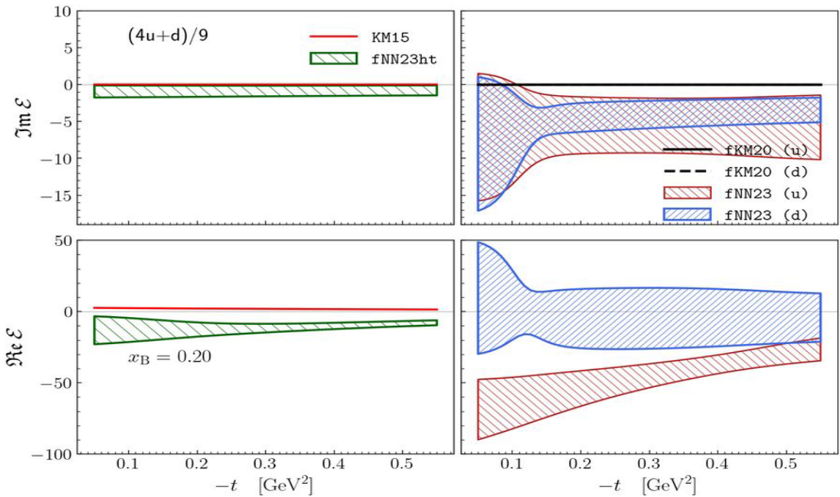
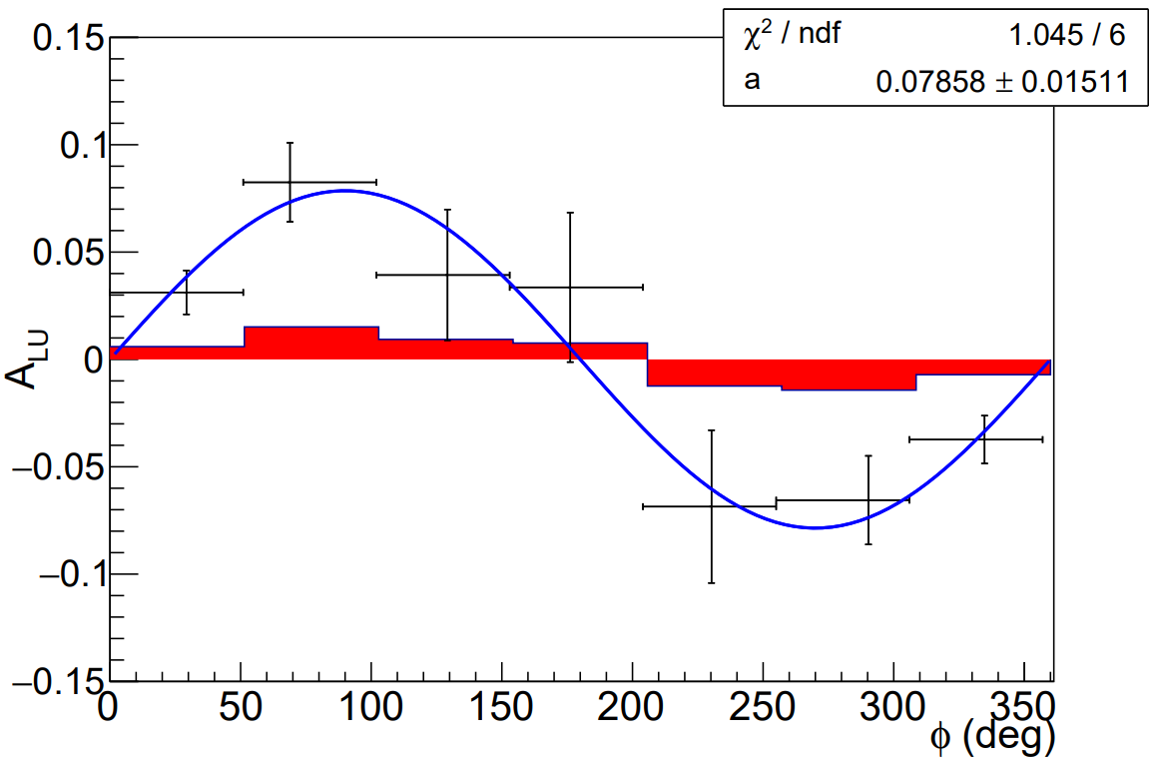
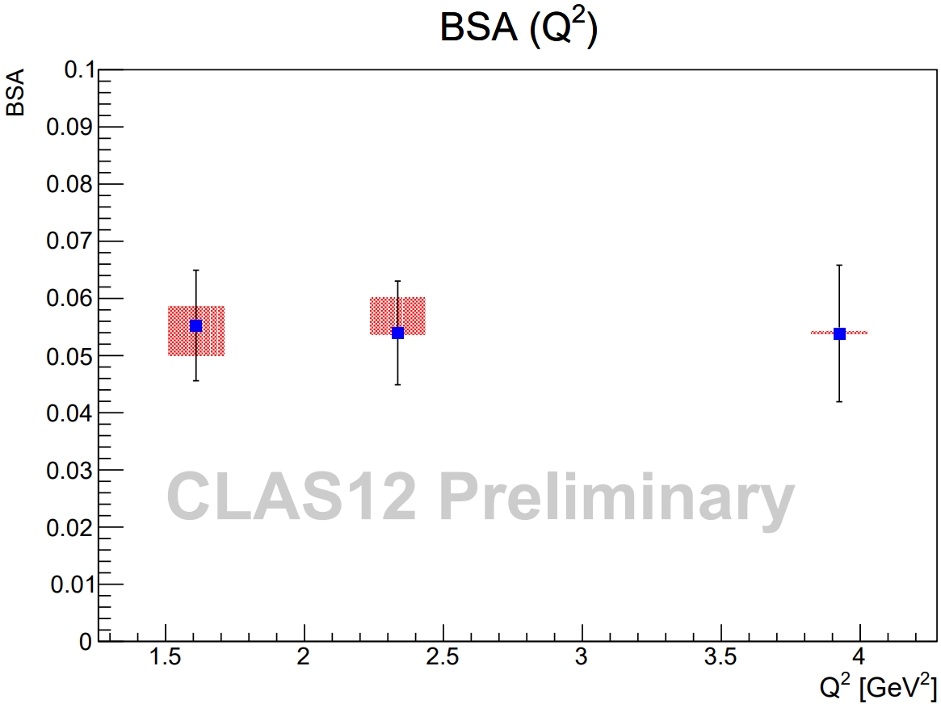
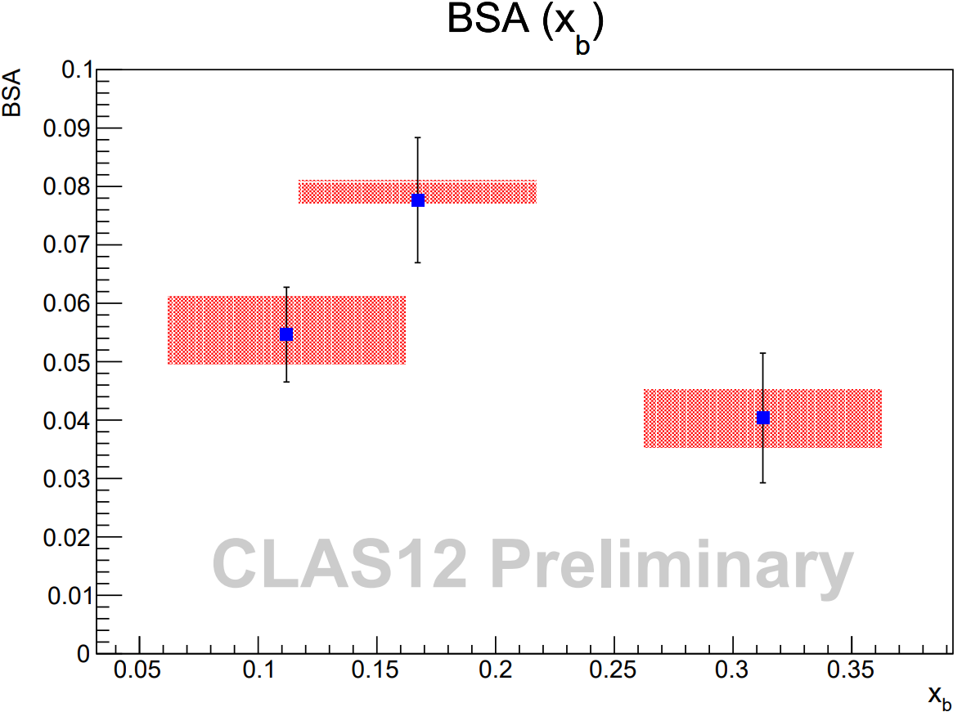
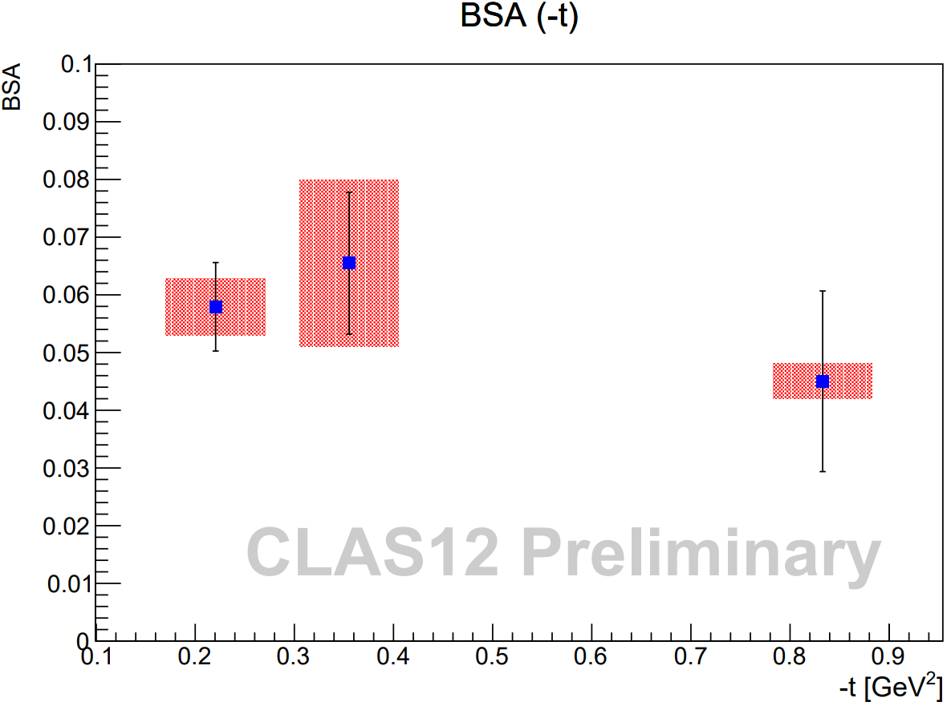
Measurement of nDVCS beam spin asymmetry
DVCS measurements ●● ● ●● ●●●●● ●● ●●●●● ●●● ●
Lead analyzers: A.Hobart/S.Niccolai (IJCLab Orsay)
Impact on CFF extraction and flavor decomposition
Preliminary BSA results
Measuring nDVCS and pDVCS allows for a flavor separation of the GPDs
Impact of the new nDVCS data have been tested on a NN fit to the data
nDVCS BSA is mostly sensitive to the GPD E…
… which is a key ingredient to understand the spin composition of the nucleon
CLAS6 and Hall A data only
Including new nDVCS CLAS12 data
Preliminary
Credit: Marija Čuić and Krešimir Kumerički
Parallel measurement of bound proton DVCS
Internal review

Slide 11
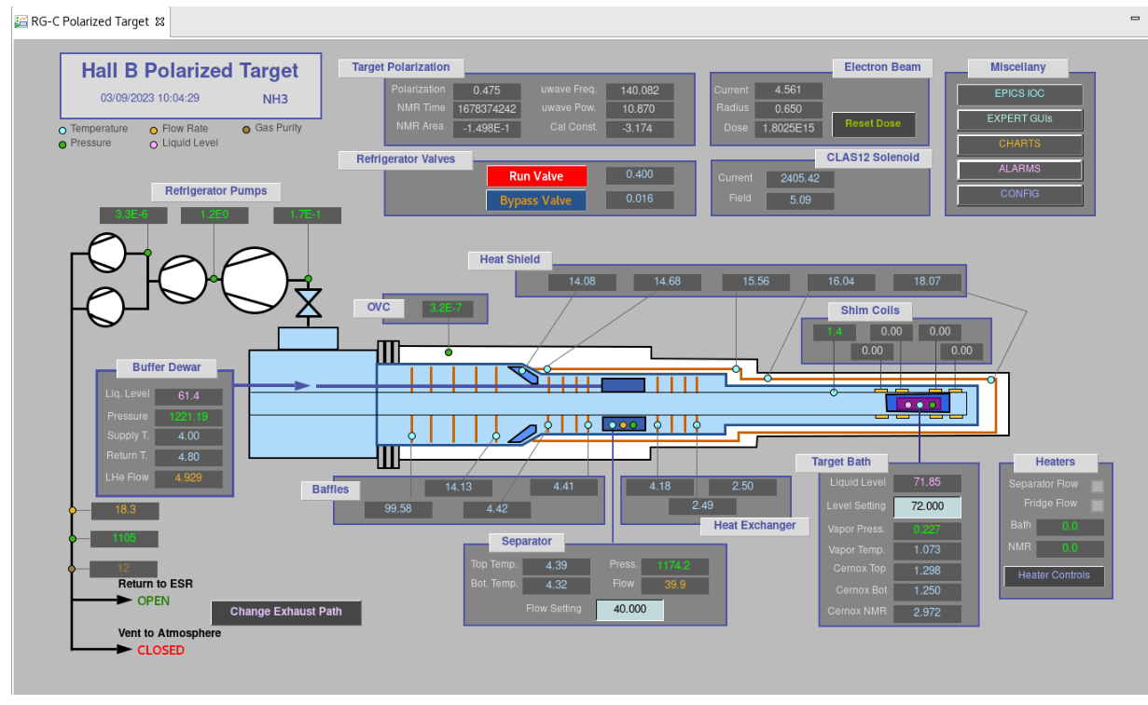
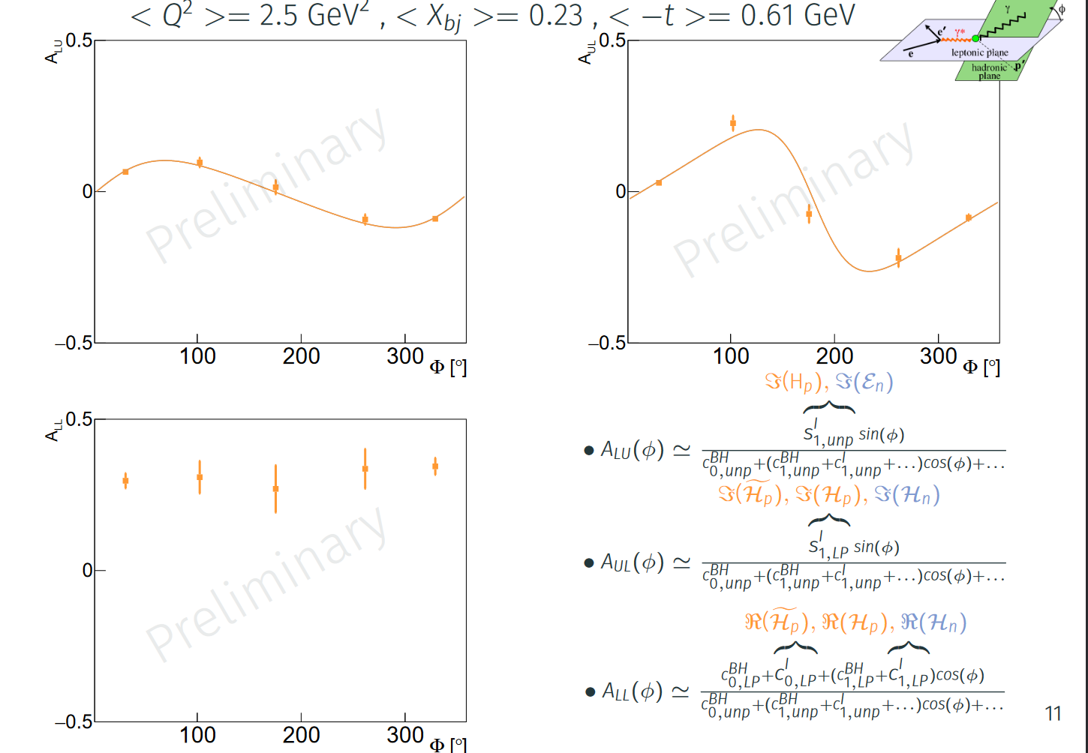
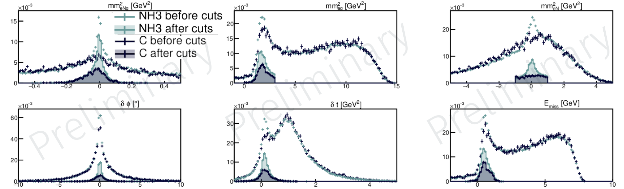
Proton and neutron DVCS BSA and TSA on a longitudinally polarized target
DVCS measurements ●● ● ●● ●●●●● ●● ●●●●● ●●● ●
Lead analyzers: N. Pilleux (IJCLab) / S.Polcher (CEA Saclay)
Preliminary results for pDVCS
Longitudinally polarized target for CLAS12 (RG-C)
Based on only ~6% of the total dataset
With incomplete calibration
Target cell under 5T solenoid magnetic field, in a 1K cryostat.
Samples are polarized using microwaves
Target samples: NH₃, ND₃, C, CH₂, CD₂
Data taken from June 2022 to March 2023
Background suppression method using carbon data
Figures from N. Pilleux
Ongoing analysis

Slide 12
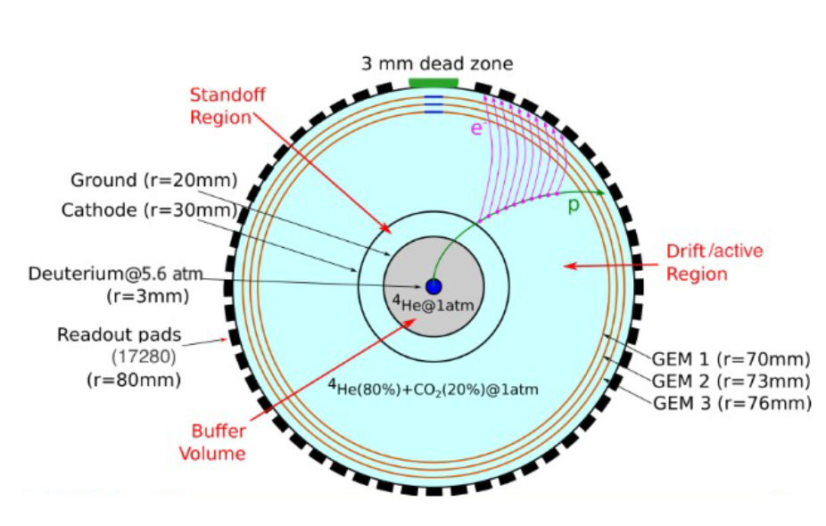
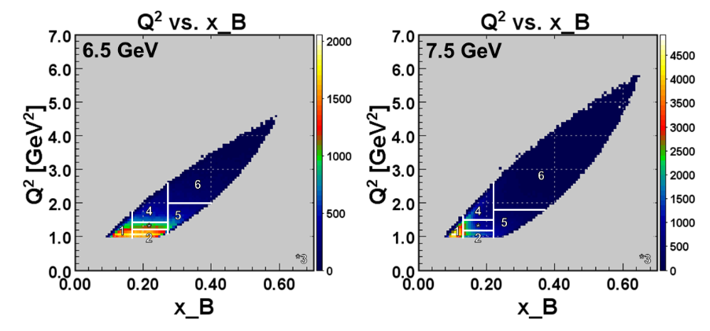
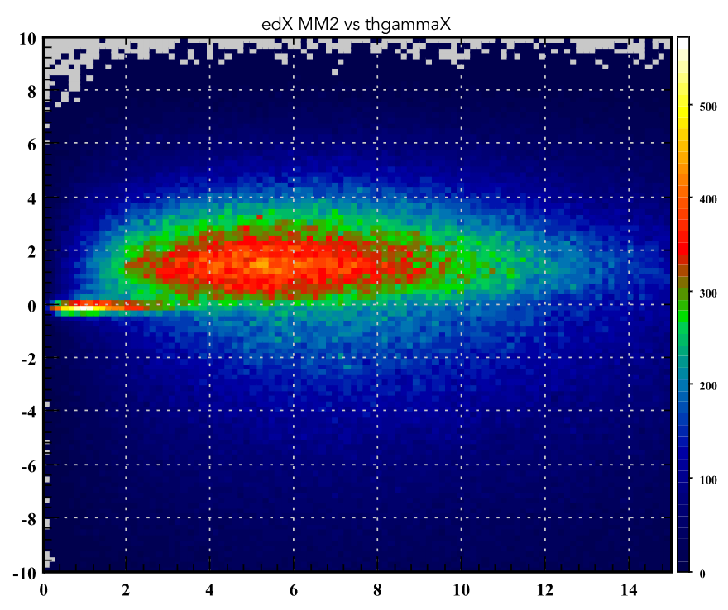
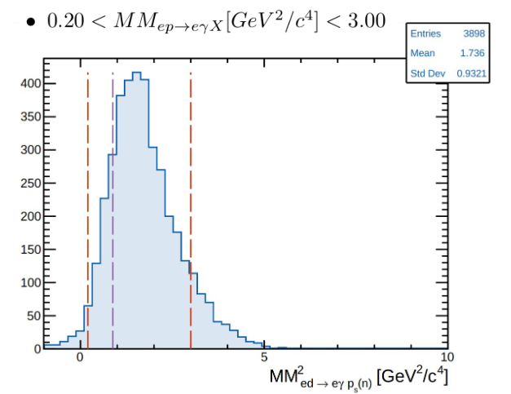
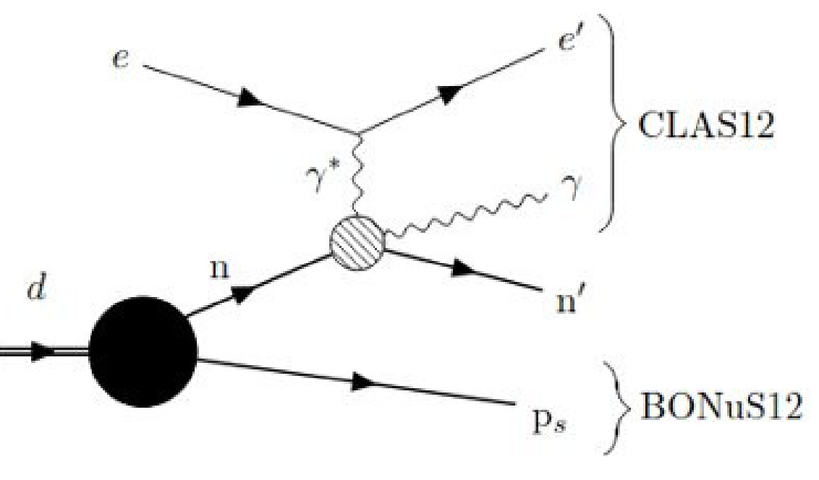
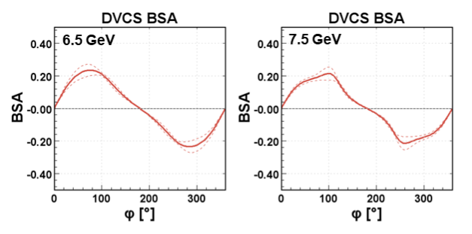
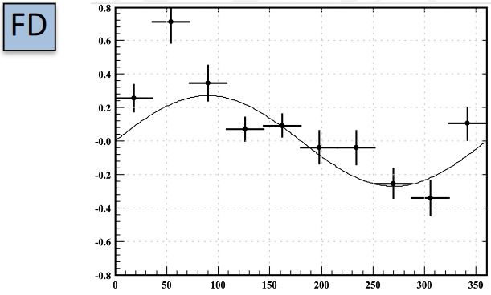
Other DVCS measurements: tagged nDVCS, DVCS on deuterium and more
DVCS measurements ●● ● ●● ●●●●● ●● ●●●●● ●●● ●
Tagged neutron DVCS with Bonus12
Coherent DVCS on Deuterium
DVCS on the proton at 6.5 and 7.5 GeV
Lead analyzers: M.Ouillon (IJCLab) / M. Hattaway (ODU)
Lead analyzer: A. Bisseli (Fairfield U.)
Lead analyzer: J. A. Tan (Kyungpook National U.)
Deuterium is a spin-1 particle, with 9 GPDs
Pioneering measurement, with low statistics
Similar phase space as CLAS6 with better precision
Use the BONuS12 TPC to detect spectator proton
2 topologies are explored (proton-tagged and fully tagged)
Preliminary
Preliminary
Missing mass photon (GeV)
Preliminary
Proton-tagged analysis by M.Ouillon
Cone angle difference (º)
Ongoing analysis
Ongoing analysis
Ongoing analysis

Slide 13
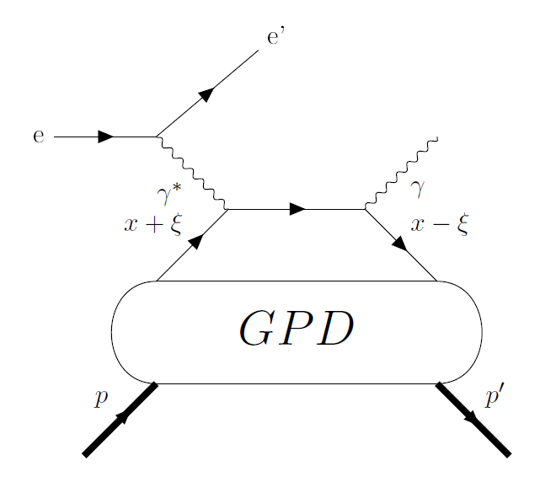
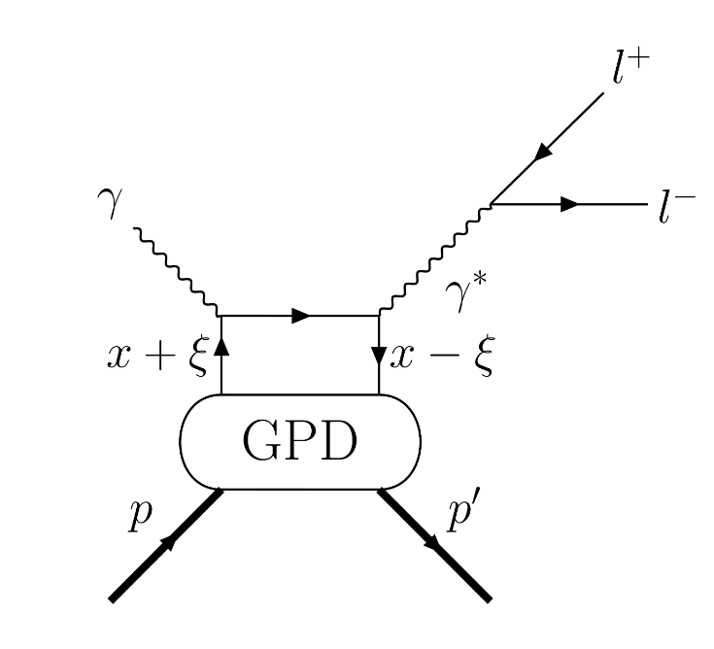
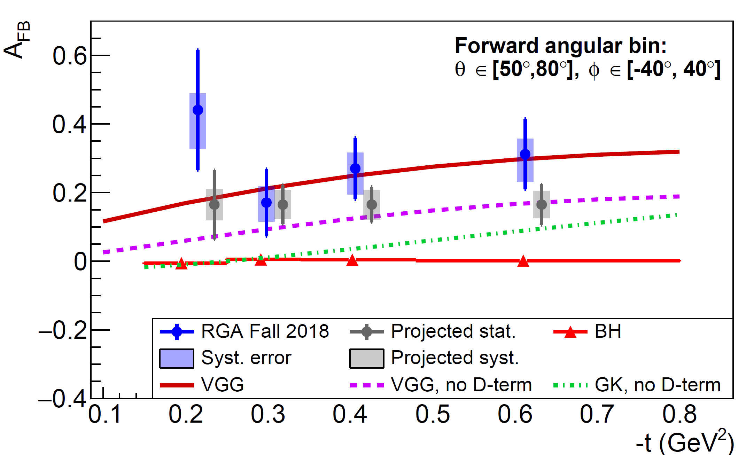
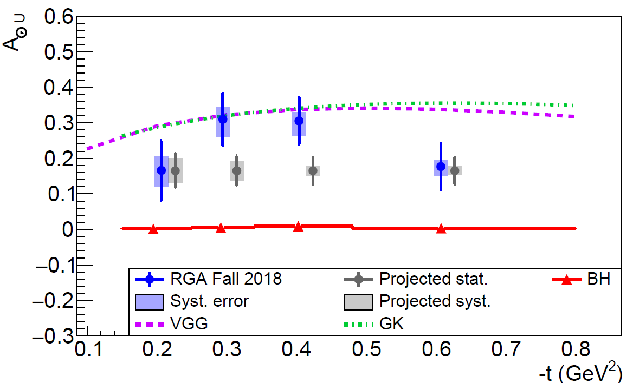
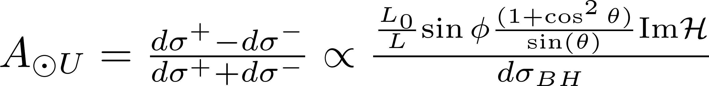

Timelike Compton Scattering on the proton
TCS measurements ●● ● ●● ●●●●● ●● ●●●●● ●●● ●
Lead analyzer: P. Chatagnon (JLab)
Analysis strategy
The Timelike Compton Scattering reaction
Use quasi-photoproduction events: ep→(e’)p’e⁺e⁻
The TCS reaction is the symmetric from the DVCS one.
Two main motivations for the measurement:
  Test of the GPD universality, via the BSA measurement
  Access to Re( ), via the forward/backward asymmetry
Projections for the full proton target dataset (RG-A)
DVCS
TCS
Only a fraction of RG-A dataset was used for in the PRL article (1/3)
New significant improvement on the tracking software have been done since 2020 → 50% more efficiency for the 3-particle final state
Results from First Measurement of Timelike Compton Scattering, P. Chatagnon et al. (CLAS Collaboration), Phys. Rev. Lett. 127, 262501 (2021)
Published in PRL (2021)

Slide 14







Timelike Compton Scattering on a polarized proton target
TCS measurements ●● ● ●● ●●●●● ●● ●●●●● ●●● ●
Lead analyzer: K. Gates (Glasgow)
Very preliminary results
Motivations
Use quasi-photoproduction event: ep→(e’)p’e⁺e⁻
Only ~6% of the total dataset shown
TCS spin asymmetries provide a complementary way to access CFFs to DVCS
RG-C data will allow to access 3 spin-polarization observables of TCS
  BSA:
  TSA:
  DSA:
Model predictions show significant asymmetries:
Figures in Boër, M., Guidal, M., Vanderhaeghen, M. Timelike Compton scattering off the proton and generalized parton
distributions. Eur. Phys. J. A 51, 103 (2015)
Ongoing analysis

Slide 15






Beam Spin Asymmetry Measurements of Deeply Virtual π⁰ Production with CLAS12
DVMP measurements ●● ● ●● ●●●●● ●● ●●●●● ●●● ●
Lead analyzer: A. Kim (Connecticut)
Results
Analysis strategy
Multidimensional extraction of the BSA
Comparison with model predictions (GK and JML) has been performed
Models seem to underestimate the data
sin(φ) of the BSA is sensitive to H_{T}, E_{T}, H̃_{T}
Reaction selected in the full final state topology:
ep → e’p’γ γ
To be submitted to PLB

Slide 16




Hard exclusive π⁺ electro-production off protons in the GPD regime
DVMP measurements ●● ● ●● ●●●●● ●● ●●●●● ●●● ●
Lead analyzer: S. Diehl (Giessen/Connecticut)
Published results
Analysis strategy
Very first multidimensional measurement of the π⁺ electro-production BSA
Comparison with various model predictions (JML and GK)
sin(φ) of the BSA is sensitive to H_{T}
Avoid resonance region:
W > 2 GeV
Reaction extracted in the ep → e π⁺(n) topology
Figures in A multidimensional study of the structure function ratio σLT′/σ0 from hard exclusive π+ electro-production off protons in the GPD regime, S. Diehl et al. (CLAS Collaboration), Phys.Lett.B 839 (2023) 137761
Published in PLB (2023)

Slide 17




π−∆++ electroproduction beam-spin asymmetries off the proton
DVMP measurements ●● ● ●● ●●●●● ●● ●●●●● ●●● ●
Lead analyzer: S. Diehl (Giessen/Connecticut)
Analysis strategy and results
ep → e’ p π ⁻(π ⁺) topology
Avoid resonance region
BSA fitted with a sin(φ) shape
Transition GPDs
16 transition GPDs, generalizing the GPDs to N → Δ processes
No experimental data
Figures in arxiv:2303.11762
Exploratory measurement which needs a strong theoretical support
Accepted in PRL last week

Slide 18





J/ψ photoproduction near threshold on proton and neutron
DVMP measurements ●● ● ●● ●●●●● ●● ●●●●● ●●● ●
Lead analyzers: P. Chatagnon (JLab) / M. Tenorio Pita (ODU) / R. Tyson (Glasgow)
Quasi-photoproduction events ( ep→(e’)p’e⁺e⁻ or ep→(e’)p’μ⁺μ⁻ )
Motivations
Expected statistical error bars for the full proton dataset
Comparison of proton/neutron target
Probe the gluon content of the proton (under 2-gluon exchange assumption and no open-charm)
PRELIMINARY
Analysis by P.C.
Analysis by R. Tyson
The t-dependence of the cross-section allow to access gluon Gravitational Form Factors (GFFs), mass radius of the nucleon
Model-dependent limit on the branching ratio of the Pc pentaquark
Tagged-photoproduction ( ep → e’(p’)e⁺e⁻ )
Scattered electron detected in the Forward tagger
Other topologies and muon final state to be tested
PRELIMINARY
Analysis by M. Tenorio Pita
Ongoing analysis

Slide 19







Other DVMP measurements
DVMP measurements ●● ● ●● ●●●●● ●● ●●●●● ●●● ●
ρ DVMP on proton
φ DVMP
π⁰ DVMP on proton cross section measurement
Lead analyzer: N. Trotta (Connecticut)
Lead analyzers: P. Moran (MIT) / N. Ram (CEA Saclay)
Lead analyzer: R. Johnston (MIT)
Reaction reconstructed in the ep → e’ π⁺π⁻(p) channel
Preliminary BSA is extracted
Cross-section extraction on proton target data
Significant extension of CLAS6 kinematic reach
Signal band
Hyperon resonances
Figures by P. Moran
BSA measurement on neutron
Preliminary
Figures by N. Ram
Ongoing analysis
Ongoing analysis
Ongoing analysis

Slide 20


A mid-term perspective with CLAS12: Luminosity upgrade
Some perspectives ●● ● ●● ●●●●● ●● ●●●●● ●●● ●
Exclusive reaction have typically a low cross-section
Each additional detected track/particle comes with a detection efficiency “penalty”
These measurement require large luminosity, which is mostly limited by DC occupancies in CLAS12
A potential solution
μRwell-based detector in front of DC region 1…
… combined with increased efficiency of AI tracking, already in place for the current data-processing
Goal: doubling the luminosity
Figures courtesy of R. Paremuzyan

Slide 21



A long term perspective: Double DVCS measurement
Some perspectives ●● ● ●● ●●●●● ●● ●●●●● ●●● ●
Capturing the complete kinematic dependence of GPDs
Re(H)
DDVCS
Im(H)
→ Allow to completely map the kinematic dependence of the GPDs

Slide 22



A long term perspective: Double DVCS measurement
Some perspectives ●● ● ●● ●●●●● ●● ●●●●● ●●● ●
Two main challenges for DDVCS measurement:
  Low x-section: requires high-luminosity
  Muon detection needed
Kinematic reach for DDVCS with μCLAS12
2 GeV² < Q² < 3 GeV²
0.8 GeV² < Q^{'2} < 1.6 GeV²
1.6 GeV² < Q^{'2} < 2.4 GeV²
2.4 GeV² < Q^{'2} < 3.2 GeV²
3.2 GeV² < Q^{'2} < 4. GeV²
A potential solution: μCLAS12
Luminosity increase by a factor 100
Shielding to reduce DC occupancy and pion background
Additional calorimeter for electron ID
New tracking system around the target
μCLAS12 (Hall B)
(10³⁷cm⁻²s⁻¹)
Figures courtesy of Rafayel Paremuzyan
Material from LOI-12-16-004 (Stepanyan, Paremuzyan, Baltzell, De Vita,Ungaro et al.)

Slide 23
Summary and outlook
Summary and outlook ●● ● ●● ●●●●● ●● ●●●●● ●●● ●
CLAS12 is the ideal detector for exclusive reaction measurement with its large acceptance able to detect multi-particle final state
Multiple dataset with different beam energies and targets allow to explore a large range of reactions and kinematics
The exclusive reaction program of CLAS12 is vibrant:
  ~15 ongoing analysis
  Already some impactful results have been published (DVCS, TCS, Transition GPDs)
  Some results are well advanced, stay tuned for more results !
Many very exciting plans to extend this program in the future: HL-CLAS12, μCLAS12, and positron beam (see E. Voutier’s presentation on Wednesday)

