Slide 1
JLAB User Meeting
June 27, 2023
Dr. Timothy J. Hallman
Associate Director, Office of Science for Nuclear Physics
Office of Science (SC)
U.S. Department of Energy (DOE)

Slide 2
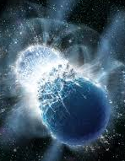
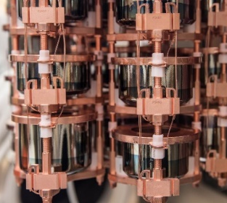
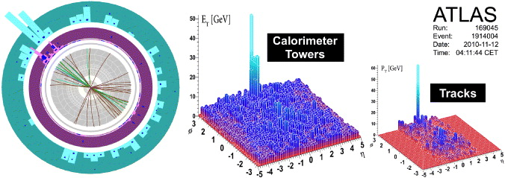
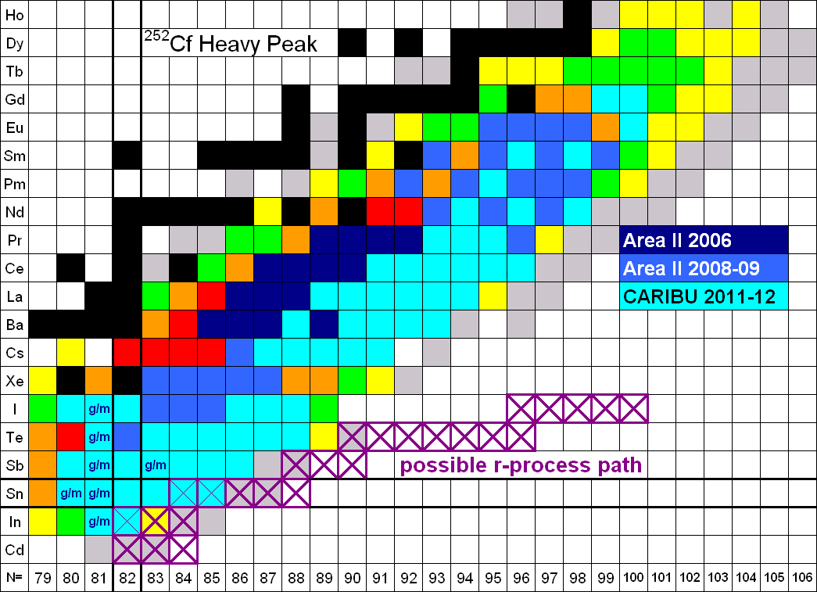
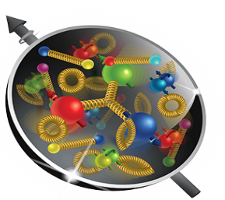
Nuclear Physics
Discovering, exploring, and understanding all forms of nuclear matter
      Understanding why matter takes on the specific forms observed in nature and how that knowledge can benefit energy, commerce, medicine, and national security, by:
  Mapping the quantum cosmos inside the proton using the future Electron-Ion Collider
  Discovering the properties of the novel quark-gluon plasma RHIC, LHC
  Exploring the mechanism underlying the confinement of quarks and gluons via CEBAF and RHIC
  Searching for new exotic particles and violations of nature’s symmetries at CEBAF, FRIB, ATLAS
  Determining the limits of nuclear existence and how are heavy elements made via FRIB and ATLAS
  Searching for lepton number violation and other sources of time-reversal asymmetry via Neutrino-less Double Beta Decay and Electric Dipole Moments.
  Exploring the strong force in many-body systems via SciDAC, Core Research, QIS/QC, AI/ML
  Advancing Nuclear Data for Space, Energy, and Research through Nuclear Data and AI/ML

Slide 3
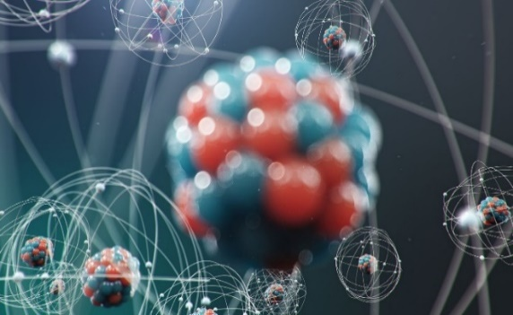
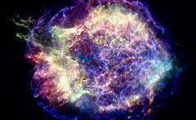
A Prime Deliverable: Basic Nuclear Physics R&D
Discovering and understanding new forms of nuclear matter
        Quark-Gluon Plasma at RHIC
        Four new Super-Heavy Nuclei
New discoveries
        Natural radiation frustrates quantum coherence times
        Direct production of matter from an electro-magnetic field (e⁺e⁻ pairs)
        Neutron skins exist on heavy nuclei
New technology important for national needs
        First ever demonstration of accelerator bunched-beam cooling
        FEL ERL development for the Navy using LERF
R&D integration that enables important applications (prospecting, isotopes)
Nuclear data & knowledge for a suite of applications
        Space exploration
        Reactor design
        Nuclear forensics / Nonproliferation
A highly trained, “nuclear-literate”, workforce with specialized skills
The Structure of the Atomic Nucleus
The Birth of Nuclei in Astronomical Processes
Probing Universal Laws in Nuclear Decays
SBIR/STTR PI Meeting
3

Slide 4
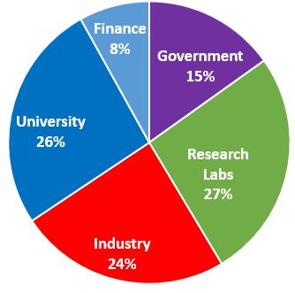
A Second Very High priority: Training in Nuclear Science
Highly Specialized Technical skills
Creative problem analysis/solving ability
Scientific communication skills
Resilience/perseverance despite set-backs
Self confidence
Time management ability
Project planning skills
Ability to work within a large collaboration
Leadership development
The result is an essential national core competency useful not only for “things nuclear”, but for a variety of other challenging pursuits as well
Where NP PhDs go
U.S. science, commerce, medicine, defense —all benefit, in part, from a stable level of sustained competence, capability, capacity, and leadership in nuclear physics;
SBIR/STTR PI Meeting
4

Slide 5
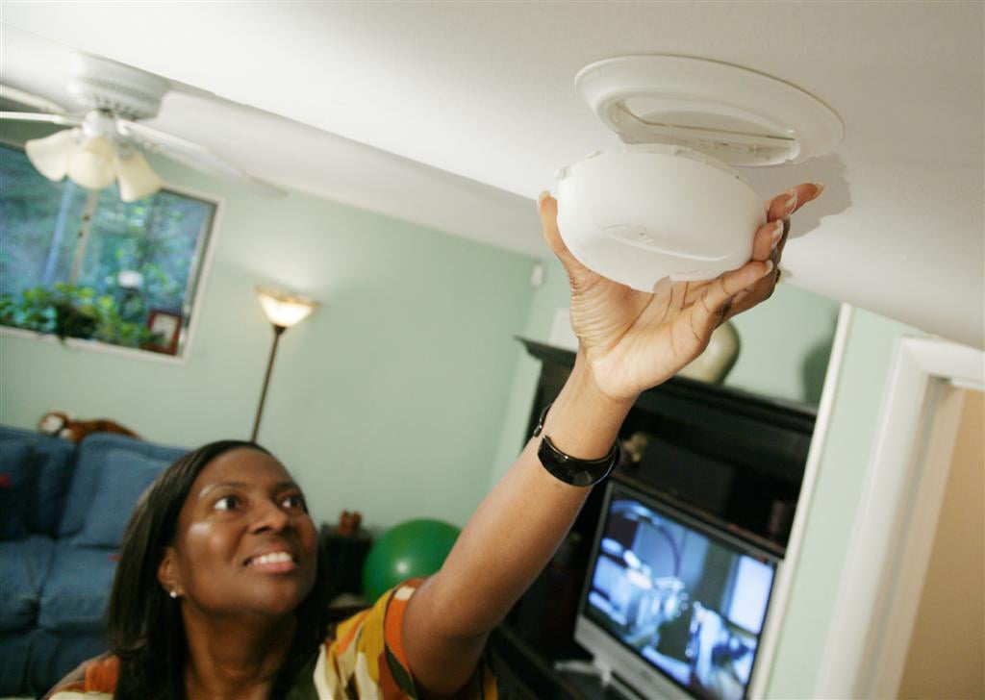
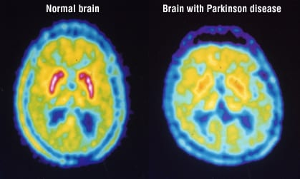
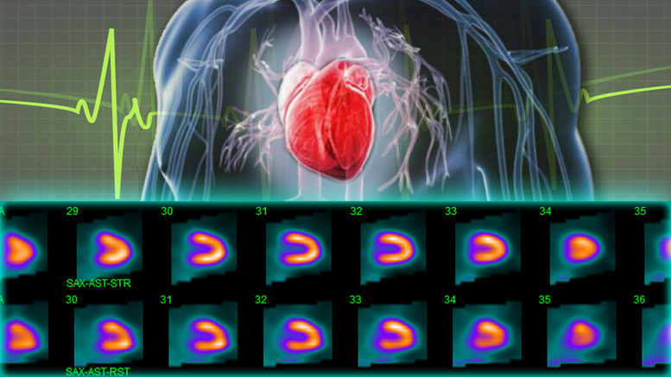
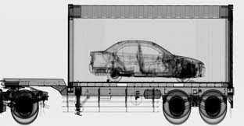
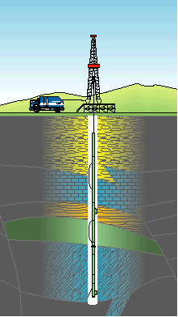
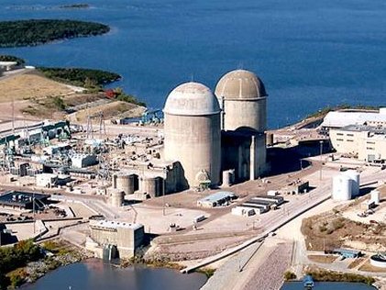
A Third Priority: Better Living Through Apps of Nuclear Physics
Fire safety in your house
Heart Health
Food safety
Medical Diagnosis
Carbon free electricity generation
Port of entry security
Metastasized cancer treatment
Oil and gas prospecting
Deep space exploration
Lasting joint replacements
National Security
SBIR/STTR PI Meeting
5

Slide 6
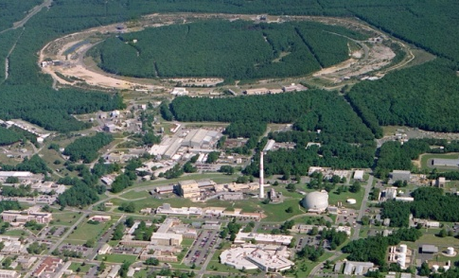
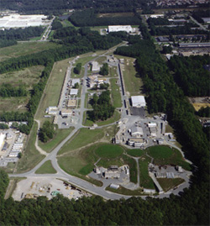
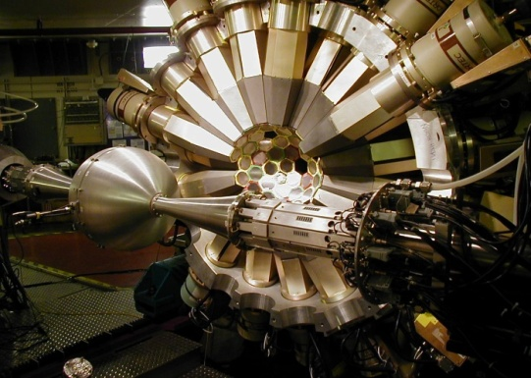
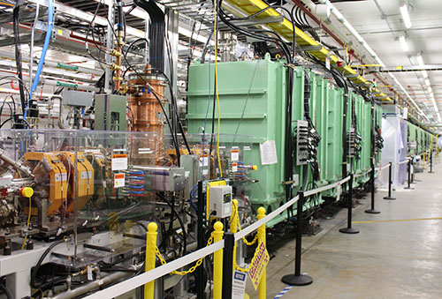
The Four World-Leading National User Facilities That Help Drive Advances
ALS 1993
Relativistic Heavy Ion Collider
Continuous Electron Beam Accelerator Facility
CEBAF
Argonne Tandem Linac System
Facility for Rare Isotope Beams
Are “Microscopes” with Complementary Resolving Power

Slide 7
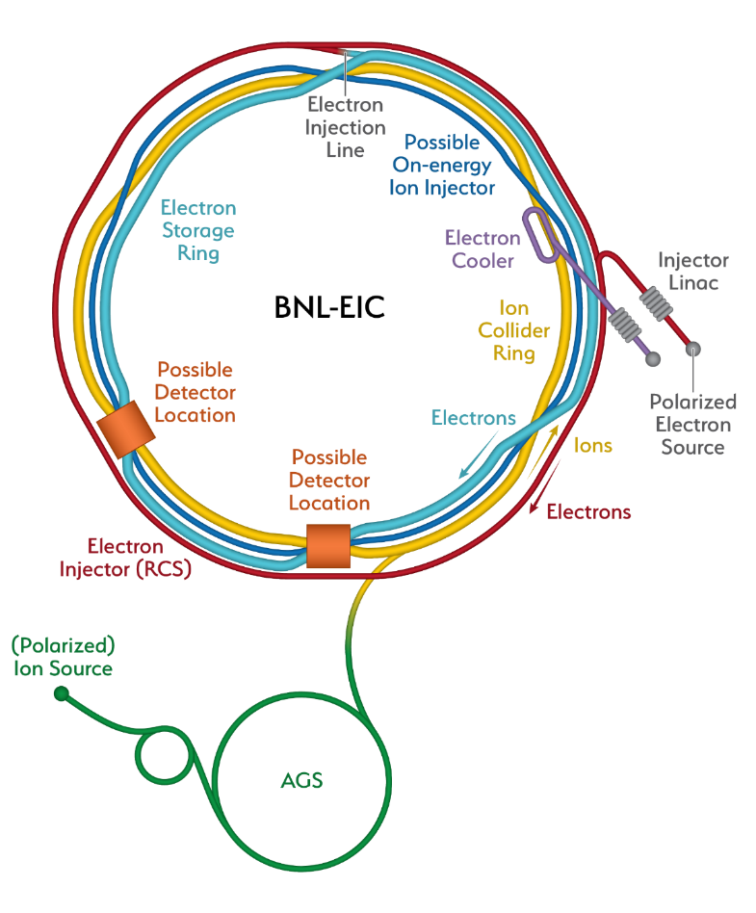
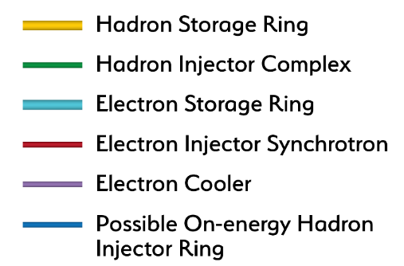
Constructing Capability to Maintain World Leadership Throughout The Century: the Future Electron-Ion Collider
Recent Progress
Successful OPA Progress Review 1/ 2023
Significant Project staffing increases via IRA
Pursuing Long Lead (CD3a) followed by CD-2
Project Detector Location
The EIC will be the most advanced accelerator in the world and the only new collider built for decades. It will keep US capability in accelerators physics number one
7
SBIR/STTR PI Meeting

Slide 8
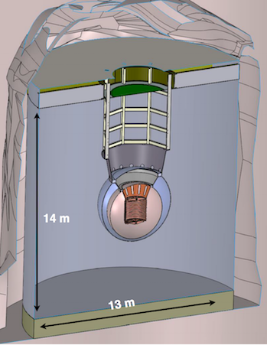
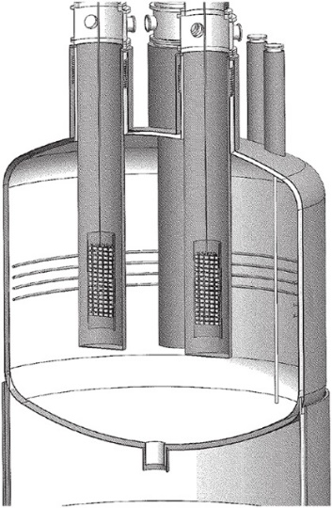
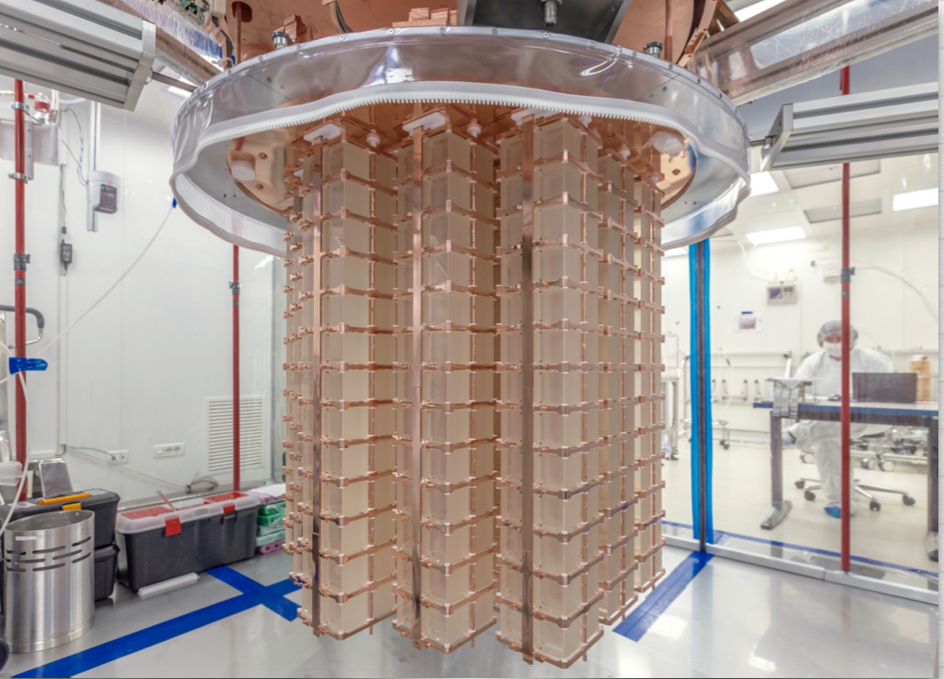
The Other Priority of the 2015 Long Range Plan for Nuclear Science: Neutrinoless Double Beta Decay
Between IRA funding and NP Program Funding, approximately $12.8 M allocated to the three technologies being explored LEGEND 1000, nEXO, and CUPID since FY 2020.
Additional resources provided by international partners
Inability to procure isotopes from Russia is having a severe, existential impact
The next DBD international occurred on April 27, 2023 at SNOLab in Canada. A Virtual Global DBD Observatory is being established.
NP is thinking about options to demonstrate a proof-of-principle isotope procurement test
Three Proposed Technologies
  Scintillating bolometry (CUPID, ¹⁰⁰Mo enriched Li₂Mo₄ crystals)
  Enriched ⁷⁶Ge crystals (LEGEND-1000, drifted charge, point contact detectors)
  Liquid Xenon TPC (nEXO, light via SiPM, drifted ionization)
TeO₂ Crystals from CUORE
Potential Partners:
Italy, Canada, and Germany
SBIR/STTR PI Meeting

Slide 9
Snapshot of the Status of NP Projects
Project | Location | Status | Cost | CPI | SPI | CD-4 | Operation cost plan
Construction Projects
Facility for Rare Isotope Beams (FRIB) * | MSU | CD-4 | $730M | 1.00 | 1.00 | 6/2022 | Included in NP budget formulation
Electron-Ion Collider (EIC) | BNL | CD-1 | $1.7B to $2.8B |  |  | Q4 FY33 | RHIC operations funds redirected to EIC project recovered for EIC operations
Major Items of Equipment
Gamma Ray Energy Tracking Array (GRETA) ^{FF} | LBNL | CD-2/3 | $58.3M | 1.00 | 1.01 | 4/2028 | Mostly covered by host laboratory operations experimental support
Super Pioneering High Energy Nuclear Interaction Experiment (sPHENIX) * | BNL | PD-4 | $26.5M | 1.00 | 1.00 | 12/2022 | Covered by RHIC operations experimental support
Measurement of Lepton-Lepton Electroweak Reactions (MOLLER) ^{FF} | TJNAF | CD-1 | $45.8M to $56.6M |  |  | Q4 FY27 | Covered by TJNAF operations experimental support
High Rigidity Spectrometer (HRS) | MSU | CD-1 | $85.0M to $111.4M |  |  | Q2 FY29 | Covered by FRIB operations experimental support
Ton Scale Neutrinoless Double Beta Decay (TS-NLDBD) | TBD | CD-0 | $215M to $250M |  |  | TBD | TBD
Blue (*) indicates “Completed”, green (^{FF}) “Fully Funded”, and purple italic “Substantially Funded”
Smaller NP Projects are being “cleared off the books”

Slide 10
Planned NP Research Horizons in FY24 and Beyond
Search for anomalous atomic electric-dipole moments at FRIB as a signal of new physics using laser trapped isotopes
Search for anomalous parity violation in electron scattering as a signal of new physics using MOLLER at JLAB
Search for the next superheavy nucleus (A = 120) at the LBNL 88 inch cyclotron
Understanding the equation of state of the quark-gluon plasma using sPHENIX at RHIC
Expanding the boundary of present knowledge of how heavy elements are produced in the cosmos via never-before-produced heavy neutron-rich nuclei at FRIB
Discovering ways to suppress the effects of natural radiation on quantum coherence times
Quantum step improvement in rare search capability via AI/ML pattern recognition software
Significantly advancing imaging technology for the physical sciences.
Comprehensive tomography of the proton

Slide 11
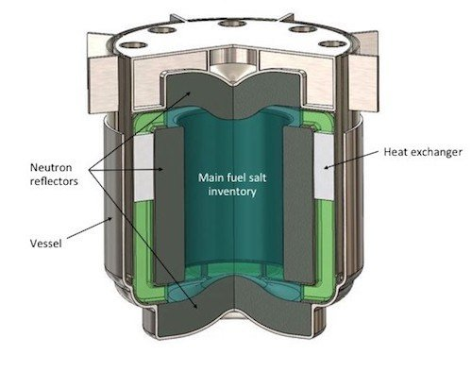
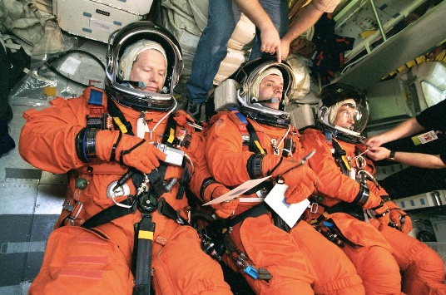

NP Broader Impacts & Applications For Other Missions:
Nuclear Data
NP is providing new and updated nuclear data to existing customers
  Working to identify impactful nuclear data needs and leverage resources
    Ex: Data for next generation molten salt reactors with DOE/NE, ARPA-E
NP is reaching out to new nuclear data application customers
  Electronics protection (NASA, Missile Defense Agency, Federal Aviation Administration)
  Human safety (NASA [spaceflight], NIH [ion beam therapy])
  Advanced reactors (ARPA-E, NASA)
NP is exploring a mechanism for Rapid Response Nuclear Data
  Many federal agencies have projects with nuclear data shortfalls
  USNDP is investigating a process where performers can submit requests for urgent, high impact nuclear data needs

Slide 12
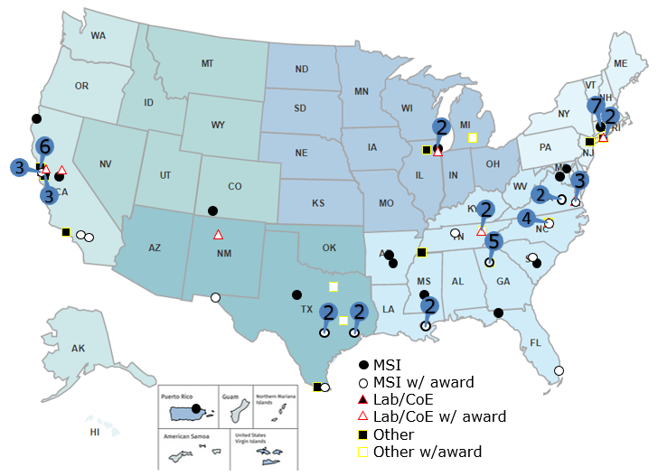
NP Helped Pioneer An Early Initiative As Part of SC’s Development of RENEW
110 NP traineeship award recipients include:
  18 MSIs,
  10 other colleges/universities,
  5 DOE laboratories
MSI award recipients include:
  9 Hispanic Serving Institutions (HSIs),
  8 HBCUs,
  5 Asian/Native American, and Pacific Islander Serving Institutions (AANAPISI),
  1 Predominantly Black Institution (PBI)
Other institutions on the map are involved in the traineeship program as recruitment sites (38), Co-Is (9), and/or hosts (7).
Of the funds awarded, ∼ 70% went to MSIs, MSI faculty, or MSI students. About 50% of trainees awarded continued on to Graduate Programs in Science or Engineering

Slide 13
SBIR Value Added: NP Phase II Example:
Lead-glass Scintillator for Nuclear Physics Detectors
STTR award to Scintilex/Catholic University of America
New material isi being developed due to the expense and difficulty in obtaining the PbWO₄ often used in electromagnetic calorimeters, a component of current and future NP detectors
Currently crystals come from the Czech Republic; LHC is buying up all material for next few years
“SciGlass” will be ~ 5x cheaper in volume than PbWO_{4.} This development is essential for the Electron-Ion Collider (EIC)
The Company received a Phase IIA award to finish R&D and scale up production.
2×2×40 cm³ bars – full scale PbWO₄ replacements
SBIR/STTR PI Meeting

Slide 14
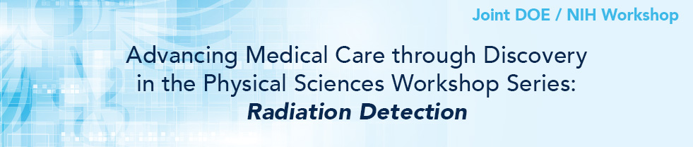


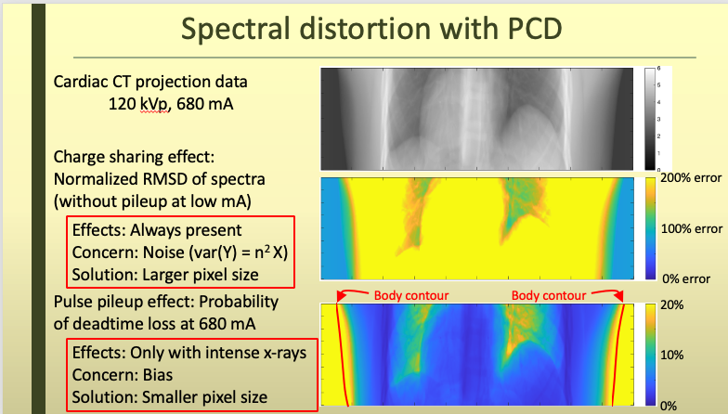
March 15, 2023 to March 17, 2023 at the Thomas Jefferson National Accelerator Facility
89 participants from DOE, NCI, NIBIB, universities, clinics
Second workshop (this time focused on radiation detection) in an ongoing series
Unmet goals: Small pixels, less noise, good spectral information
Unmet need: Address both charge sharing and pulse pileup
SBIR/STTR PI Meeting

Slide 15
Ideas From the Joint Workshop to Stimulate Thought
Ultra-low Temperature Calorimetry Sensors for Discovery Science Ultra-low temperature, superconducting sensors promise a critical, inherent, physics-based signal-to-noise advantage that may promote both high precision nuclear science as well as new biological discovery with medical implications.
The 10 ps Challenge: Needed for high rate (such as the luminosity frontier at JLab) and high volume (such as the EIC) nuclear science experiments, the continued development of these techniques may also directly pave the path for addressing the 10 ps challenge in time-of-flight (TOF) PET.
Enabling Multi‑institutional, Multi-agency Collaborations with Scalable Federated Learning: Federated learning (FL) is a distributed machine learning method that allows a network of participants to collaboratively train a shared model without exchanging their data
Non-imaging and Imaging Detector Technologies for Enabling Nuclear Science and Customized Dosimetry-based Cancer Treatment Planning: The goal of this topic is to develop and validate cost-effective, potentially small cross-section, detector technologies that will enable radiation monitoring for personnel, equipment, and/or personalization of radiation therapy treatment planning. It could be achieved by combining high-resolution, hyper-sensitive radiation detectors
Compton Scattering-based Detectors and Systems: Compton scattering-based detectors can resolve much lower radiation emissions than standard sensors, and can do so more rapidly, as compared for example to PET or other sources and therefore offer great promise in medical and other applications
SBIR/STTR PI Meeting

Slide 16
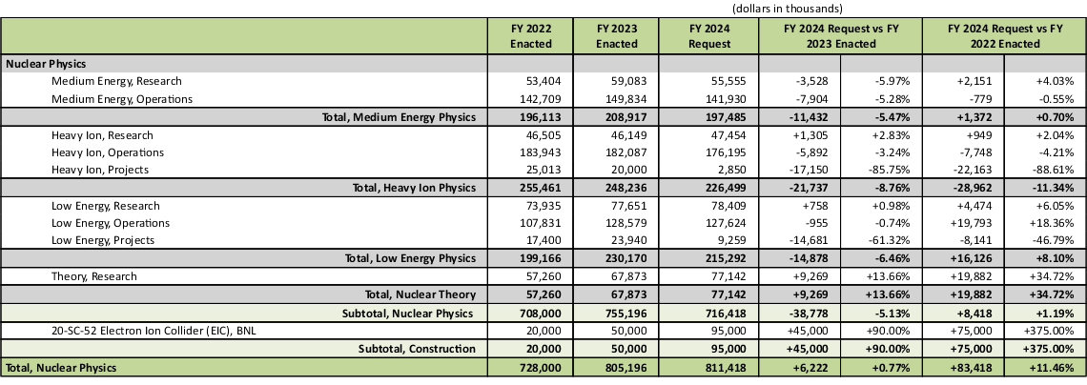
NP - FY 2024 President's Request
The FY 2024 Request for $811.4 million supports high priority efforts and capabilities in fundamental nuclear physics research; operations, maintenance, and upgrades of scientific user facilities; and projects

Slide 17
Summary of 2024 PR Changes Relative to FY 2023 Enacted
Research
FY 2022 Enacted | FY 2023 Enacted | FY 2024 PR
Core research in Medium Energy, Heavy Ions, and Theory is increased by 7.5% from FY21 Enacted. The Fundamental Symmetries and Nuclear Structure and Nuclear Astrophysics portfolios are increased by 10.5% over FY21 Enacted. | Core Research in Medium Energy, Heavy Ions, Nuclear Theory, Fundamental Symmetries and Nuclear Structure and Nuclear Astrophysics is ~6.1% above the FY22 Enacted Level. | Core Research in Medium Energy, Heavy Ions, Nuclear Theory, Fundamental Symmetries and Nuclear Structure and Nuclear Astrophysics is ~flat with the FY23 Enacted Level.
LHC M&O commitments are met. | LHC M&O commitments are met. | LHC M&O commitments are met.
FRIB Research is increased. | FRIB Research is increased. | FRIB Research is increased.
nEDM supported significantly below planned profile. | nEDM is supported below the planned profile at $1M for the GPP effort for minor construction. | nEDM is supported below the planned profile at $1M for the GPP effort for minor construction.
SciDAC funding is increased to support SciDAC-5 (+$600k). | SciDAC is modestly reduced by from the FY22 Enacted. | SciDAC is modestly increased from the FY23 Request to support SciDAC-5 activities.
Nuclear Data increased $2.8M from FY21 Enacted to support the expansion of experimental efforts. | Nuclear Data is flat with the FY22 Enacted level. | Nuclear Data is modestly increased above the FY23 Enacted level.
Accelerator R&D held flat with the FY21 Enacted level. | Accelerator R&D is reduced by 4.5% from the FY22 Enacted. | Accelerator R&D is flat with the FY23 Enacted.

Slide 18
Summary of 2024 PR Changes Relative to FY 2023 Enacted
Initiatives
FY 2022 Enacted | FY 2023 Enacted | FY 2024 PR
QIS increased to $10.9M. | QIS is flat with FY22 Enacted. | QIS is flat with FY23 Enacted ($10.9M).
AI/ML Initiative support flat with FY21 Enacted ($4M). | AI/ML is increased to $8M (+$4M) | AI/ML is flat with the FY23 Enacted ($8M).
Three new initiatives are supported: Reaching a New Energy Sciences Workforce (RENEW) - $3M Accelerator Science and Technology - $1M Microelectronics - $518k | Two of the FY22 Enacted new initiatives are supported in FY 2023: Reaching a New Energy Sciences Workforce (RENEW) - $6M (+$3M) Microelectronics - $518k Accelerator Science and Technology Initiative is paused | Initiatives are continued in FY 2024: Accelerate Innovations in Emerging Technologies - $4M Microelectronics - $518k Accelerator Science and Technology Initiative is paused
 | Two new cross cutting initiatives are supported: Funding to Accelerated, Inclusive Research (FAIR) - $2M Accelerate Innovations in Emerging Technologies - $4M | The FAIR and RENEW initiatives are increased: Reaching a New Energy Sciences Workforce (RENEW) - $11.5M (+$5.5M) Funding to Accelerated, Inclusive Research (FAIR) - $5M (+$3M)

Slide 19
Summary of 2024 PR Changes Relative to FY 2023 Enacted
Facility Operations and Projects
FY 2022 Enacted | FY 2023 Enacted | FY 2024 PR
Facility operations supported at >90% of optimal. RHIC operates 20 weeks (90 % maximum) CEBAF operates 31 weeks (90 % optimal) ATLAS operates 39 weeks (93 % optimal) FRIB operates 12 weeks (100% of optimal) | All NP user facilities operate at >90% of optimal in FY 2023. RHIC operates 25 weeks (96 % optimal) CEBAF operates 33 weeks (96 % optimal) ATLAS operates 40 weeks (96 % optimal) FRIB operates 26 weeks (99% of optimal) | All NP user facilities operate at roughly 90% of optimal funding in FY 2024. RHIC operates 20 weeks (94 % optimal funding) CEBAF operates 27 weeks (88 % optimal funding) ATLAS operates 39 weeks (94 % optimal funding) FRIB operates 24 weeks (91% of optimal funding)
FRIB Operations increased, but still slightly below planned levels ($77M in PR vs $82M planned) | FRIB Operations increased to near optimal level. | FRIB Operations slightly reduced, and below optimal levels ($96.2M in Request vs $102.4M optimal)
EIC construction at TEC of $20M and OPC of $24.8M in annual appropriation, and TEC of $128.24M and OPC of $10M in the Inflation Reduction Act. | EIC construction at TEC of $50M and OPC of $20M | EIC construction at TEC of $95M and OPC of $2.9M
Ongoing Major Items of Equipment are supported with both the annual appropriation and Inflation Reduction Act funds: GRETA above baseline level ($16.7M) sPHENIX at baseline level in final year ($0.2M) MOLLER above planned level ($36.2M) TSNLDBD at $8.4M HRS at $34.84M | Ongoing Major Items of Equipment: GRETA at optimal level, providing the project with the final year of funding ($15.5M) MOLLER receives the final $4M of planned TEC funding TSNLDBD at $1.44M TEC HRS at $3M TEC | Ongoing Major Items of Equipment: GRETA and MOLLER at received full TPC amount in FY 23 Request. Progress continues, but no new funding requested in FY24. TSNLDBD at $3M TEC HRS at $6.3M TEC

Slide 20
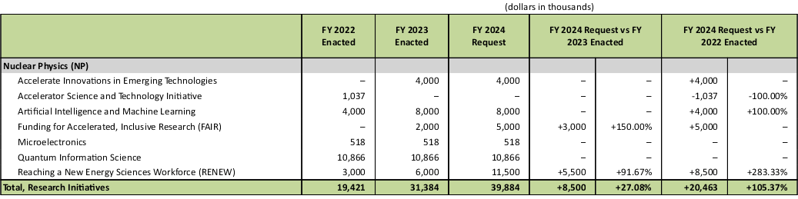
NP - Research Initiatives

Slide 21
House Mark: General Provisions Potentially Affecting NP
 | FY 2022 |  | FY 2023 | FY 2024 | FY 2024 | FY 2024 House Mark vs FY 2024 President's Request |  | FY 2024 House Mark vs FY 2023 Enacted
 | Enacted |  | Enacted | President's Request | House Mark
 | Regular | IRA Supp. | Regular | Regular | Regular
Advanced Scientific Computing Research (ASCR) | 1,035,000 | 163,791 | 1,068,000 | 1,125,973 | 1,016,213 | (109,760) | -9.75% | (51,787) | -4.85%
Basic Energy Sciences (BES) | 2,308,000 | 294,500 | 2,534,000 | 2,692,858 | 2,587,053 | (105,805) | -3.93% | 53,053 | 2.09%
Biological and Environmental Research (BER) | 815,000 | - | 908,685 | 931,700 | 827,000 | (104,700) | -11.24% | (81,685) | -8.99%
Fusion Energy Sciences Research (FES) | 713,000 | 280,000 | 763,222 | 1,010,496 | 778,000 | (232,496) | -23.01% | 14,778 | 1.94%
High Energy Physics (HEP) | 1,078,000 | 303,656 | 1,166,000 | 1,226,334 | 1,192,334 | (34,000) | -2.77% | 26,334 | 2.26%
Nuclear Physics (NP) | 728,000 | 217,000 | 805,196 | 811,418 | 800,000 | (11,418) | -1.41% | (5.196) | -0.65%
Isotope R&D and Production (IRP) | 82,000 | 157,813 | 109,451 | 173,051 | 140,400 | (32,651) | -18.87% | 30,949 | 28.28%
Accelerator R&D and Production (ARDAP) | 18,000 | - | 27,436 | 34,270 | 28,000 | (6,270) | -18.30% | 564 | 2.06%
Workforce Development for Teachers and Scientists (WDTS) | 35,000 | - | 42,000 | 46,100 | 32,000 | (14,100) | -30.59% | (10,000) | -23.81%
Science Laboratories Infrastructure (SLI) | 291,000 | 133,240 | 280,700 | 322,000 | 287,789 | (34,211) | -10.62% | 7,089 | 2.53%
Safeguards and Security (S&S) | 170,000 | - | 184,099 | 200,000 | 200,000 | - | - | 15,901 | 8.64%
Program Direction (PD) | 202,000 | - | 211,211 | 226,200 | 211,211 | (14,989) | -6.63% | - | 0.00%
Total, Office of Science | 7,475,000 | 1,550,000 | 8,100,000 | 8,800,400 | 8,100,000 | (700,400) | -7.96% | - | 0

Slide 22
House Mark: General Provisions Potentially Affecting NP
Low Energy Projects, MIEs, GRETA 17N2 | 9,000 | 7,700 | 15,500 |  |  | (15,500) | -100.0%
Low Energy Projects, MIEs, HRS 19N2 | 3,000 | 31,840 | 3,000 |  | 6,259 | 3,259 | 108.6%
Low Energy Projects, MIEs, MOLLER 20N1 TEC | 5,000 | 31,100 | 4,000 |  |  | (4,000) | -100.0%
Low Energy Projects, MIEs, MOLLER 20N1 OPC | ... | 120 | ... |  |  | - | #DIV/0!
Low Energy Projects, MIEs, TS-NLDBD 20N2 | 400 | 8,000 | 1,440 |  | 3,000 | 1,560 | 108.3%
20-SC-52 Electron Ion Collider, BNL | 20,000 | 128,240 | 50,000 |  | 95,000 | 45,000 | 90.0%
Heavy Ion Projects, OPCs, EIC LIC 20-SC-52 | 24,800 | 10,000 | 20,000 |  | 2,850 | (17,150) | -85.8%
Heavy Ion Projects, MIEs, sPHENIX 19N1 | 213 |  | ... |  |  | - | #DIV/0!
Subtotal, Nuclear Physics Research | 62,413 | 217,000 | 93,940 |  | 107,109 | 13,169 | 14.0%

Slide 23
House Mark: General Provisions

Slide 24
House Mark: General Provisions Potentially Affecting NP

Slide 25
House Mark: General Provisions Potentially Affecting NP
…

Slide 26
House Mark: General Provisions Potentially Affecting NP

Slide 27
House Mark: General Provisions Potentially Affecting NP
The FY24 HEWD mark is $8.1B, which is flat at FY23 enacted funding levels.
SC’s program direction was held flat at FY23 levels. If this funding level were enacted it may require SC implementing a hiring freeze and doing a reprogramming.
Section 308 creates limitations by requiring that new university awards $5M or under be fully funded before being awarded. SC currently fully funds awards $1M or less. To implement the new requirement, SC would have to reduce number of research awards.

Slide 28
Amendments Offered Prior to Passage of the House Mark
OE-related amendments that were adopted include:
  Rep. Fleishmann– managers amendment
  Rep. Newhouse – prohibits DOE from finalizing, implementing or administering the proposed gas stoves efficiency standards rule
  Rep. Moolenaar – prohibits DOE from finalizing, implementing or administering the washing machine efficiency standards rule
  Rep. Stewart – prohibits funds from being used for any diversity, equity and inclusion office, program or training across the Department
  Rep. Moolenaar – bans DOE funding to a company that enters into an agreement or partnership with China.
  Rep. Cline – seeks to prevent IP from going to adversaries by banning DOE funding from going to an entity controlled or owned by a corporation in a non-market / priority foreign country (e.g. China).
DOE-related amendments not adopted include:
  Rep. Kaptur – strikes IRA rescissions
  Rep. Espillat - strikes General Provisions in the bill related to diversity, equity, inclusion, and marriage

Slide 29
NP Outlook
In FY 2024, NP continues stewardship of a world-leading program in nuclear physics that delivers new science, operates unique leadership user facilities, supports and enhances a diverse workforce, and delivers impactful applications
The EIC Project is making steady progress, towards CD3a (Long Lead Procurement), and the next DOE gateway CD-2 (Approve Performance Baseline). Although not yet baselined, increased support from annual appropriations is essential to enable timely progress and a smooth transition of workforce from the Relativistic Heavy Ion Collider in FY 2025.
The FY 2024 Request is greatly appreciated, allowing NP National User Facilities to operate at or above 90% of optimal funding
NP Research funding allows for a compelling program of science but continues to be constrained due to the priority of increased funding for FRIB Operations and EIC construction

Slide 30

What To Do Now?
Key Points:
In turbulent, challenging times it is crucial to Keep One’s Eye On The Ball—keep delivering the knowledge, discoveries and training that are valued outcomes for the U.S.
Articulate the value of Nuclear Physics
Mutual Respect among scientific sub-disciplines
Commitment To The Greater Good of nuclear science as a discipline
Meticulously Level Playing Field leading to respect for process and outcomes
The community MUST REMAIN UNIFIED
Staying united we can accomplish great things together
Division will setback the entire field and is the last thing needed right now

Slide 31
Additional Information

Slide 32
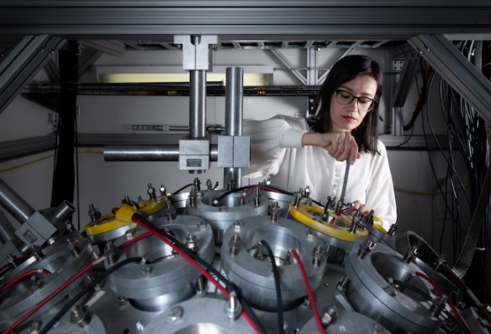
Beyond Assertion: How An NP Trained Workforce Benefits the Nation
Sample of Non-Defense Roles Based on Recent Breakthrough Prize Questionnaire
Sr. Chemist at a mining company
Sr. Research Scientist at a Fotune-100 conglomerate
Head of bioinformatics at a molecular therapy company
Director of Radiological Product Development of a global healthcare technology company
Vice President of Engineering of a software application development company
Chief Researcher at an international industrial research lab
Director of Innovation at a popular data science platform company
Senior Manager at an EU-listed company providing micro structuring equipment to the semiconductor industry.
Accelerator and materials technical lead at the radiation effects laboratory of a major Fortune-50 aerospace company.
Owner of a private technology/consulting company
President of a high-tech company that provides geotechnical monitoring solutions and instrumentation to mining and industry
CTO of a web design and software design company
Principal Scientist (Global Research and Technology) of a major international healthcare company
CEO of an international water purification technology company
Director of Information Systems of an international insurance company
Principal Scientist (electronics and software development) at a company that provides radiation and explosive solutions to homeland security and industry
Owner of a nuclear electronics, instrumentation and data analysis company
Manager of the R&D department of a FTSE-100 detection and screening technology company
Sr. Radiation Physicist, health science company that provides gamma technologies and medical isotopes
Sr. Scientific Director (R&D) at a radiation analytic company
President & CEO of an arboriculture company
SBIR/STTR PI Meeting

Slide 33
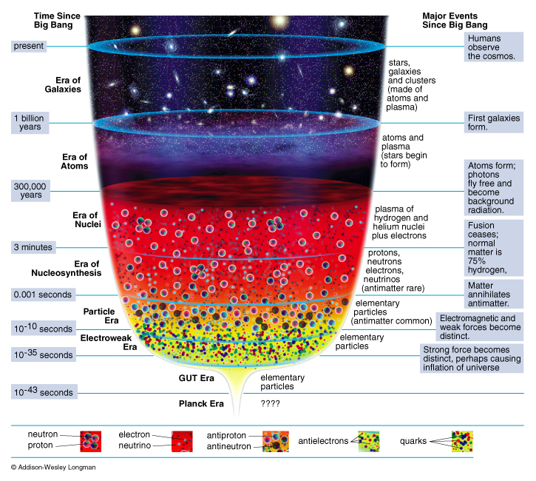
The Reason Complementary Capabilities are Required
Present Day
Evolution of the Universe
Present
Galaxies
NP
Discovery
Horizon
Atoms
Nuclei
Nucleo-Synthesis
Particles
The vast range of time (μsec to 13.8B years) and physical scales (quarks to galaxies) requires “microscopes” of varying, complementary resolving “powers”

Slide 34

The High-Level NP Work Plan
Operate and get science out from the Relativistic Heavy Ion Collider (RHIC),the Continuous Electron Beam Accelerator Facility (CEBAF), the Argonne Tandem Linac Accelerator System (ATLAS) and the Facility for Rare Isotope Beams (FRIB)
Make progress on a U.S.-led ton-scale neutrino-less double beta decay experiment.
Start construction of a high-energy high-luminosity polarized electron-ion collider (EIC)
Implement smaller scale instrumentation to take advantage of facility capabilities
The work plan centers on NP’s mission to understand all forms of nuclear matter to benefit energy, commerce, medicine, and national security. A new Long Range Plan is in development by NSAC.

Slide 35
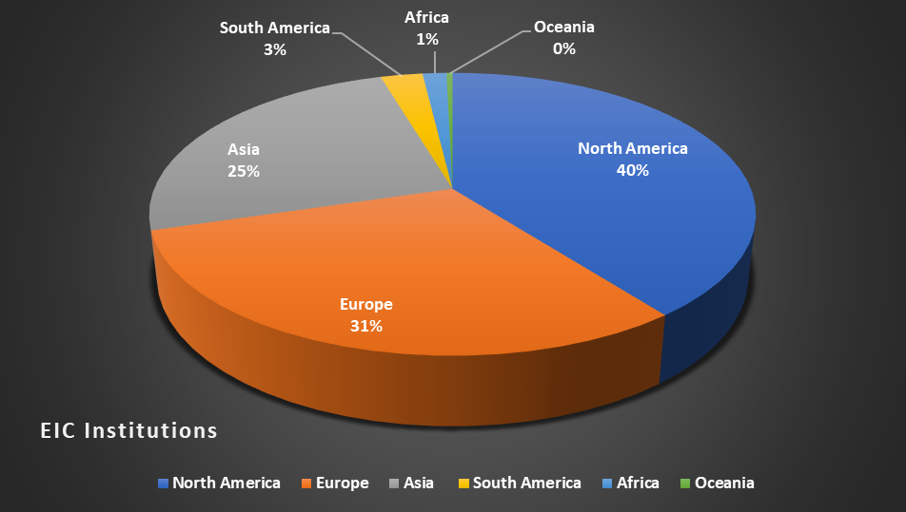
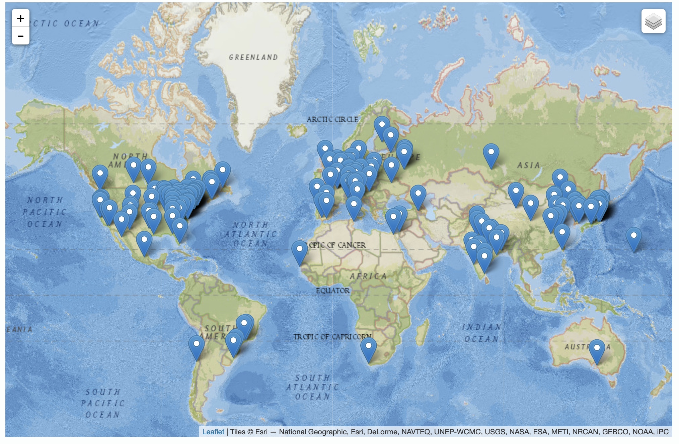
35
The EIC is International At Its Core
EIC Users Group Formed in 2016
EICUG.ORG
Status January 2023:
Collaborators 1379
Institutions 269
Countries 36

Slide 36
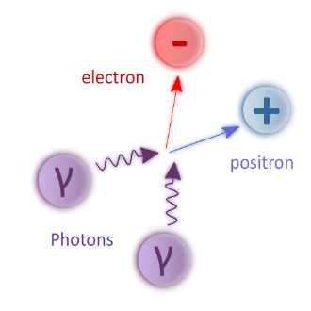
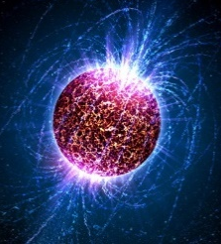
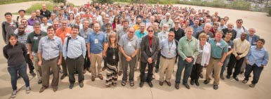
Recent Impactful Accomplishments
Discovery that ionizing radiation reduces coherence time for entangled quantum states
  Need new quantum materials or/and underground Quantum Computing
First known observation of the Breit-Wheeler two-photon process at RHIC
  Confirmation of Quantum Electro-Dynamic (QED) process; possibility of e⁺e⁻ pair production via lasers
Discovery that heavy nuclei have a neutron skin (CEBAF)
  New constraints on neutron star radii and their equation of state
Implementation of dynamical fermions and the real pion mass in Lattice QCD
  Major advance in fidelity of Lattice Quantum Chromodynamics calculations
Initiation of the FRIB science program
  Opening a new frontier to understand heavy element
  production in cosmos
Integration of AI technology at CEBAF to make it more fault tolerant
  Test-bed for use of Artificial Intelligence in accelerator control and optimization

Slide 37
The Newest SC User Facility: the Facility for Rare Isotope Beams
FRIB construction started in 2013 and finished in 2022, on cost and ahead of schedule
FRIB was constructed by DOE ($635M) and Michigan State University ($94.5M) under a unique Cooperative Agreement
Now complete, FRIB provides access to 80% of all isotopes predicted to exist in nature
ALS 1993
Facility for Rare Isotope Beams
 | PYs | FY 2017 | FY 2018 | FY 2019 | FY 2020 | FY 2021 | DOE Total | MSU | TOTAL
FRIB Funding Profile | 318,000 | 100,000 | 97,200 | 75,000 | 40,000 | 5,300 | 635,500 | 94,500 | 730,000
Secretary Granholm and MSU President Stanley “Cut the Ribbon” declaring FRIB open for scientific research on May 2, 2022
On May 19, 2022, first scientific results on isotopes never-before produced in sufficient quantity for scientific study are awaiting publication
CEBAF

Slide 38
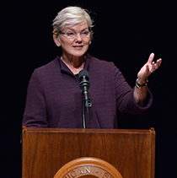
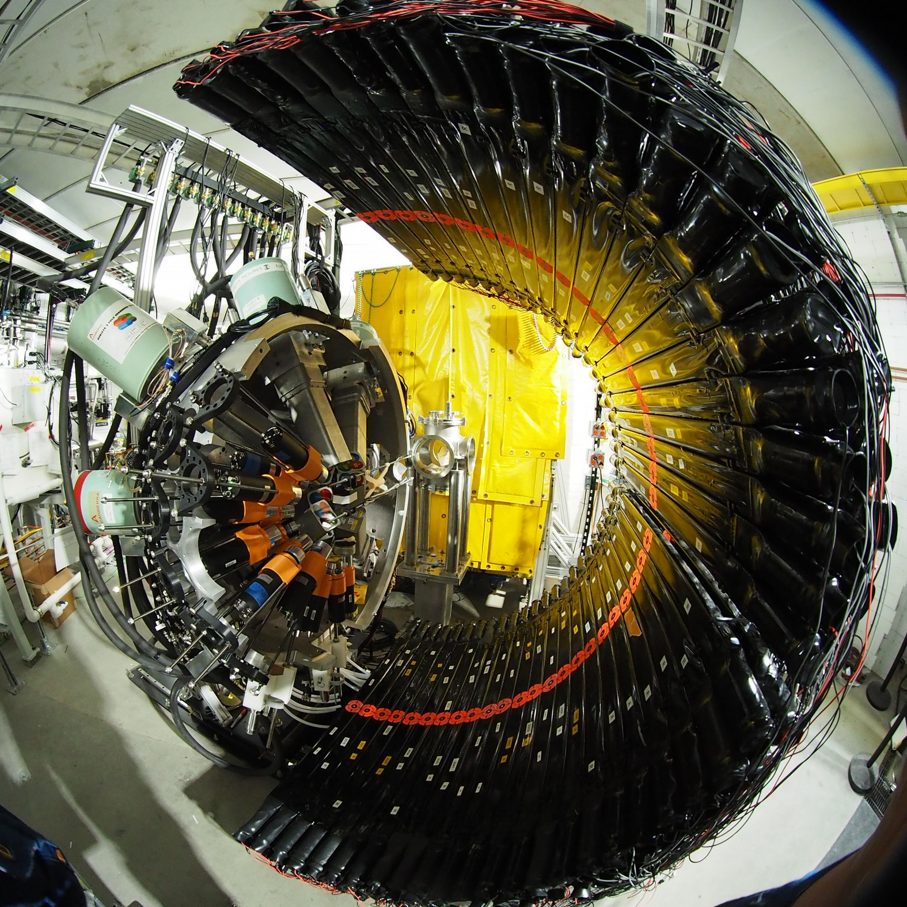
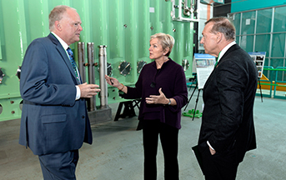
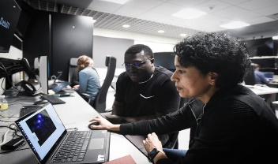
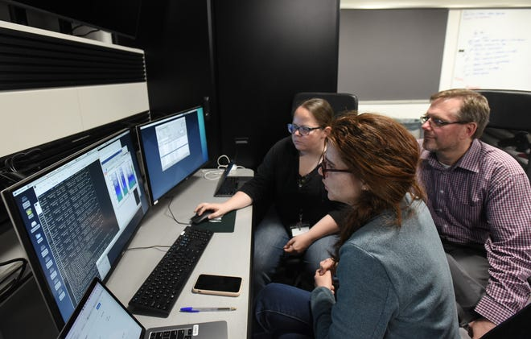
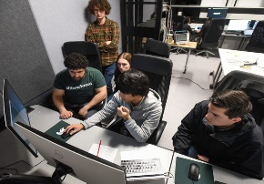
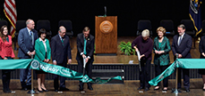
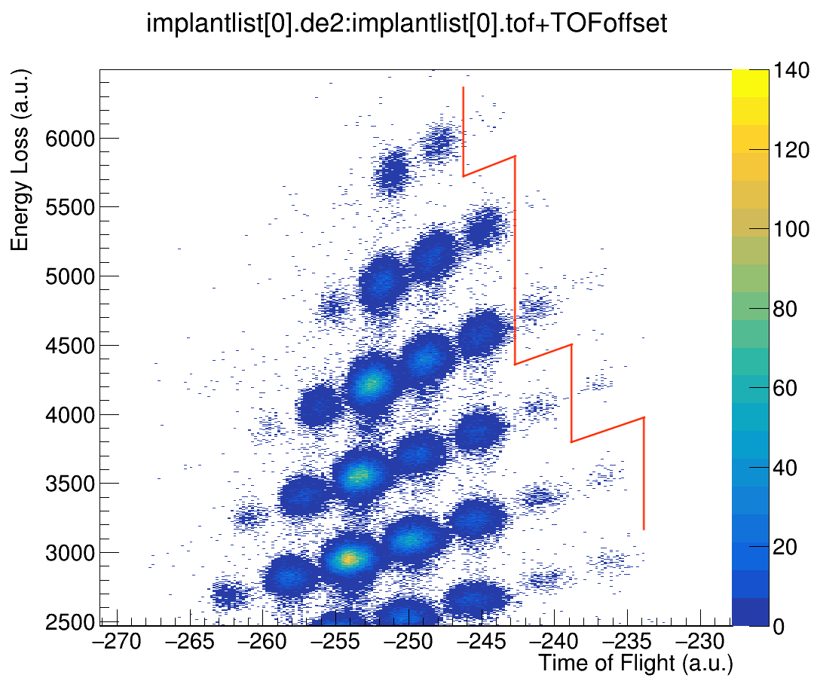
NP Highlight: The Opening of a New Horizon for Scientific Discovery
Secretary Granholm at the FRIB Ribbon Cutting
FRIB Experiment E21062
Spokespersons: J. Allmond (ORNL), H. Crawford (LBNL), B. Crider (Mississippi State University), R. Grzywacz (University of Tennessee Knoxville) and V. Tripathi (Florida State University)
May 2, 2022
May 19, 2022
The “never-been-done–before” line.: isotopes to the right of this line have never before been available for study
Multiple papers with first FRIB science now published

Slide 39
FY 2024 President's Request Highlights - NP
FRIB begins its third year of science research studying atomic number nuclei near the limit for nuclear existence, and initiating a world leading campaign of fundamental symmetries measurements
NP User Facilities (RHIC, CEBAF, ATLAS, and FRIB) are all at or above 90% optimal budget
The Electron-Ion Collider vets a list of CD3a long lead procurements and makes finalizes preparations for CD-2 Review, Approve Performance Baseline. EIC A/E design is begun subject to funding.
sPHENIX continues science research at RHIC to determine the novel properties of the quark-gluon plasma
LEGEND-200 continues initial search for new physics via the slowest rare decay ever attempted
A ton-scale neutrino-less double beta decay experiment finalizes preparation for a CD-1 review, “Approve Alternatives Selection and Cost Range”
The Gamma Ray Energy Tracking Array (GRETA) MIE and MOLLER are fully funded at the FY 2023 Request, and construction continues in accordance with their technically driven schedules
The High Rigidity Spectrometer for FRIB continues construction
NP investment in the AI/ML cross-cutting research continues and RENEW and EPSCOR investment increases
NP makes highly impactful awards in the new cross-cutting initiatives in Funding for Accelerated Inclusive Research (FAIR) and Accelerate Innovations in Emerging Technologies (Accelerate)

