Slide 1
Testing Survivability of Polarized Fusion Fuels in a Tokamak Plasma
Xiangdong Wei
(for the Spin-Polarized-Fusion (SPF) collaboration)
2023 JLUO Annual Meeting
06/26/2023-6/28/2023

Slide 2
Motivations
Power!
Clean Power!!
Sustainable Clean Power!!!
(with least environmental impact)
Fossil Fuels, Fission, Hydroelectric, Wind Turbine, Solar, Geothermal, Ocean Current, ……
and ultimately
Fusion
(Needs successful ignition!!!)

Slide 3
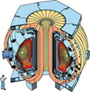
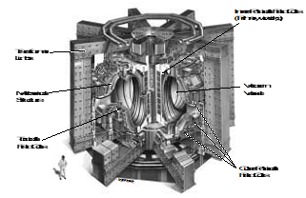
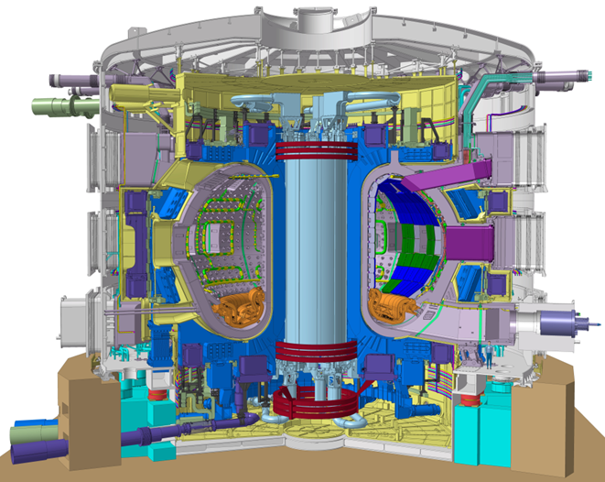
Tokamak Fusion Reactors
The intended reactions:
D + T → α + n and D + ³He → α + p
Most of research Tokamaks ever built (~180, and ~30 in operation today) were for studying D + D reactions.
The International Thermonuclear Experimental Reactor (ITER) will make harvesting fusion possible.
DIII-D (USA)
Best instrumented →most diagnostics
20m³, 2.1T, Q<<1
JET (UK)
Only one runs tritium
90m³, 3.8T, Q~2/3
Reactor V_{plasma}(m³) B_{c}(tesla) P(MW) Q = P_{out}/P^{in}) coils
DIII-­D 20 2.1 --- << 1 normal
JET 90 3.8 16 ~ 2/3 normal
ITER 700 5.3 500 > 10 superconducting
Superconducting coils are needed to reach high field over a large volume
⇔ concerns over potential field degradation from neutron flux.
ITER is to be a stepping-stone, requiring at least one more iteration to reach a viable fusion power plant.
The cost of a Tokamak is ∝ V_{plasma} x B².
⇒ 20~40 billion dollars to build a ITER size Reactor. ⇒ Save the cost by up to 20%.
ITER (France)
½ GW reactor
700m³, 5.3T, Q>10
(under construction)
Q ≡ P_{out}/P_{in}

Slide 4
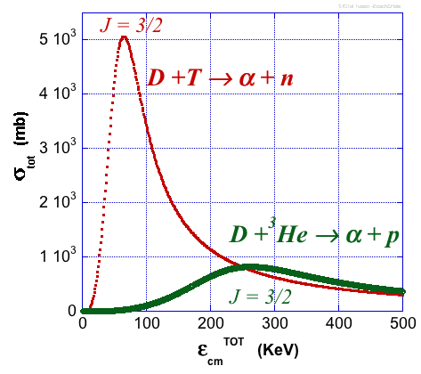
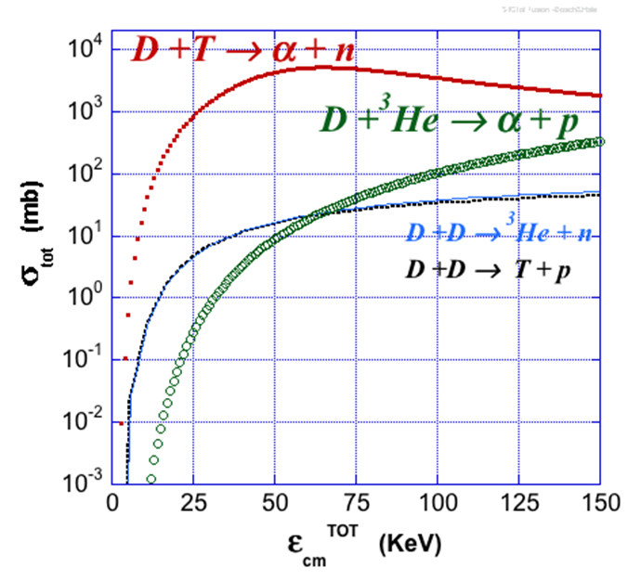
Fusion Channels and Potential of Spin
The intended reactions:
D + T → α + n and D + ³He → α + p
(the mirror reaction)
If fuels are polarized,
$$σ_{cm}A=σ_{0}\left\{\left.1+\frac{1}{2}\vec{P_{D}^{V}}∙\vec{P_{T}}\right\}\right.$$
R.M. Kulsrud, H.P. Furth, E.J. Valeo, M. Goldhaber, Phys. Rev. Lett. 49, 1248 (1982)
The cross section-enhancement: up to 50%.
For a fusion power reactor
⇒Power and Q increases by 75%.
⇒lower the magnetic field requirement
Since the preferred fusion reaction, D + T → ⁵He → α + $n,$and the mirror reaction, D + ³He → ⁵Li → α + $p,$have the same nuclear physics, we can use the latter to test polarization survivability in the fusion plasma.
"fusion resonances"
• Sun’s core peaks at 1.3 keV
• ITER plasma will peak at ~ 18 keV

Slide 5
Survived Mechanisms for Polarized Fusion
Potentially large benefits require fuel polarization to survive a 10⁸ K plasma for the energy containment time ~ a few second
Many mechanisms were invested in late last century and 2 still survived, which hinge on the wall recycling (of the fuels).
Kulsrud, Furth, Valeo & Goldhaber, Phys Rev Lett 49 (82) 1248
Lodder, Phys. Lett. A98 (83) 179
Greenside, Budny and Post, J. Vac. Sci Technol. A 2(2), (84) 619
Coppi, Cowley, Kulsrud, Detragiache & Pegoraro, Phys Fluids 29 (86) 4060
Kulsrud, Valeo & Cowley, Nucl Fusion 26 (86) 1443
Cowley, Kulsrud, Valeo, E.J. Phys. Fluids 29 (86) 1443
…
Needs only seconds of confinement time in hot plasma!

Slide 6
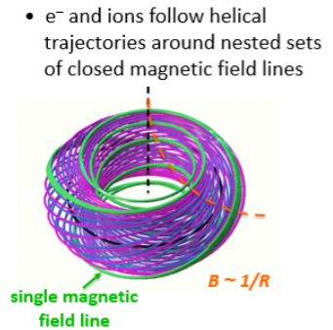
Wall Recycling at the ITER
after injection, a few % of the fuel undergoes fusion; the rest escapes the plasma.
escaping ions strike outer walls and are neutralized.
depending on wall conditions, ions could depolarize.
if reentering the plasma, they could dilute polarization of the core.
fuel leaving the plasma will eventually diffuse through the SOL and being pumped away.
cross section of inner vacuum chamber wall
last closed field line
nested sets of closed magnetic field lines
Scrape-Off layer
(SOL)
Divertor region to
remove “helium ash”
Vacuum Pumps
What’s new ?
- Plasma Simulations for ITER:
Pacher et al., Nucl. Fus. 48 (2008) 105003
Garzotti et al., Nucl. Fus. 52 (12) 013002
at ½ GW, the SOL is opaque to neutrals, which are swept to the divertor by convection
fuel recycling from the walls will be insignificant in ITER scale reactors

Slide 7
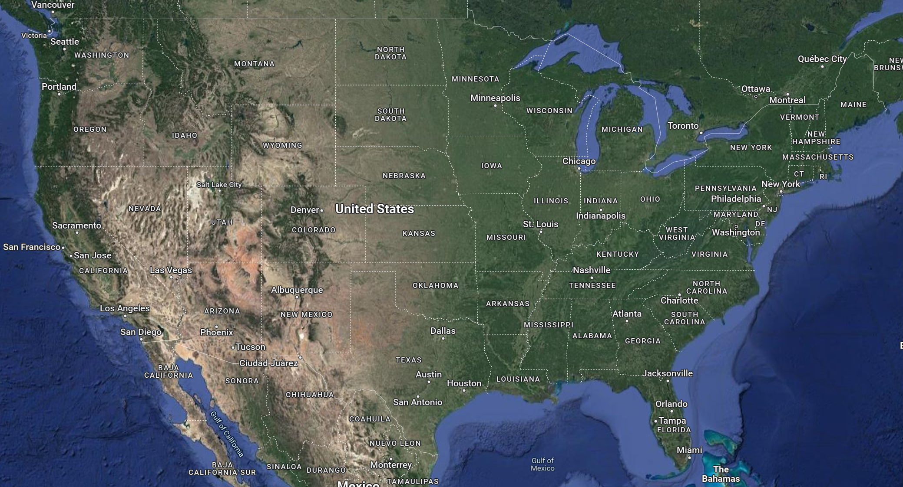
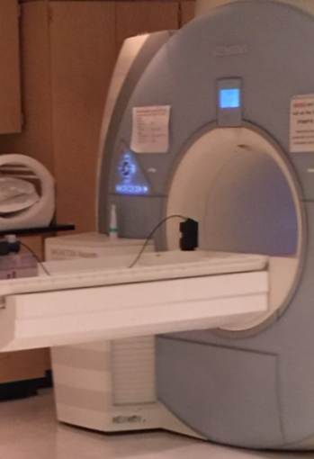
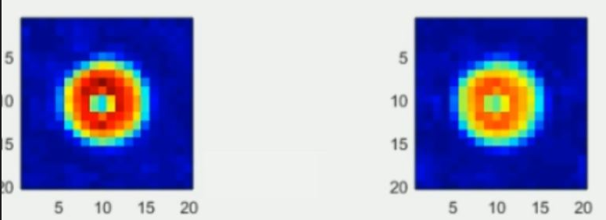
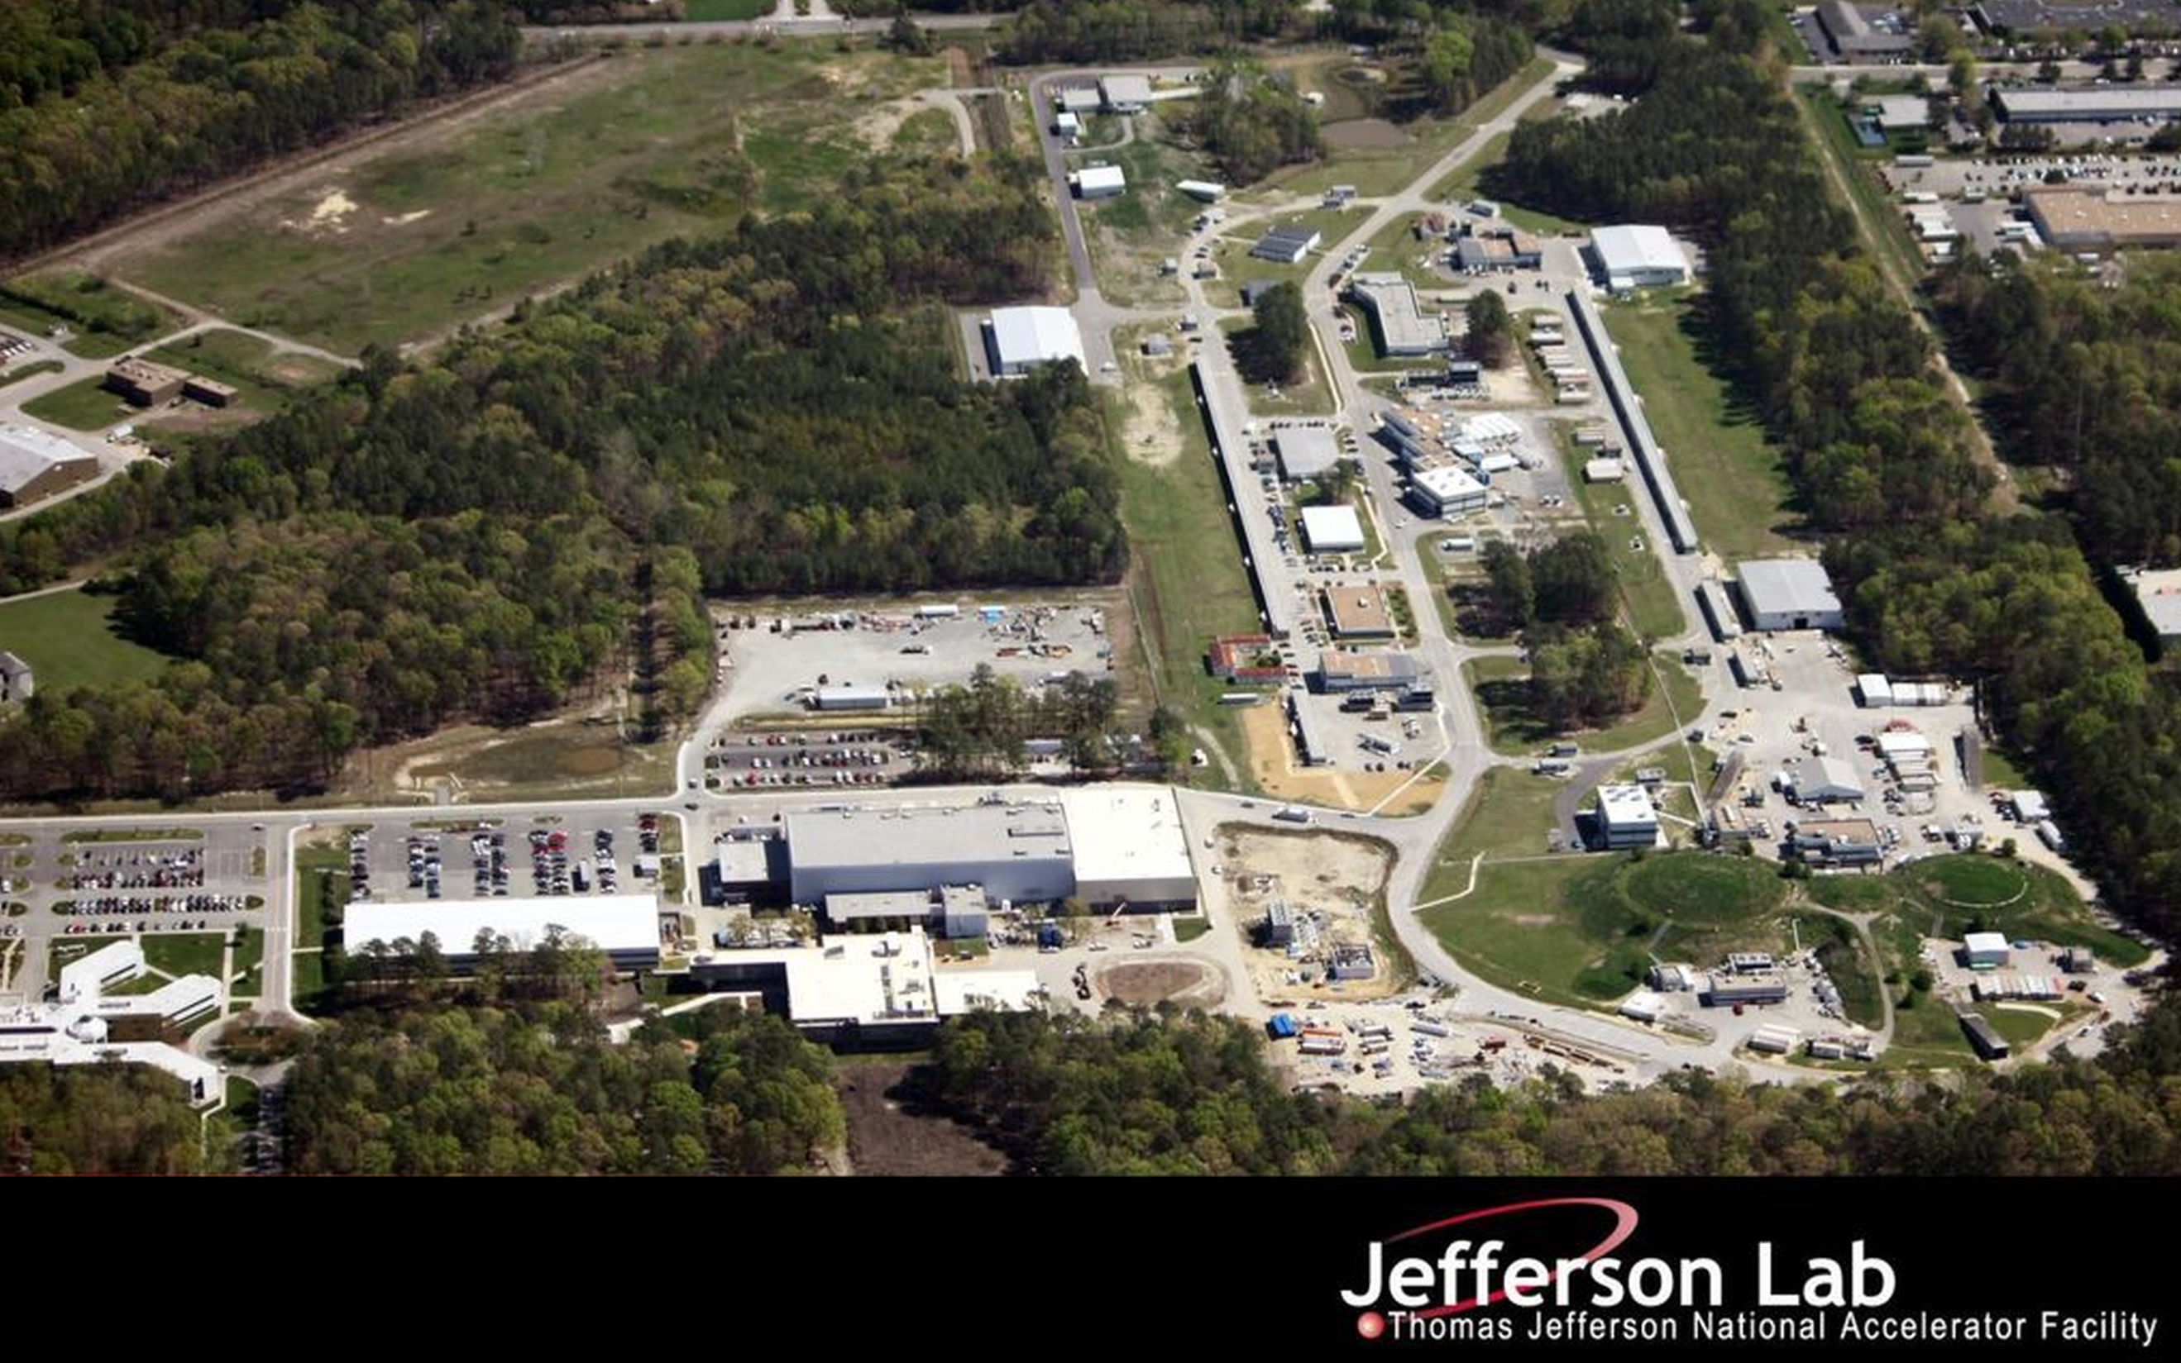
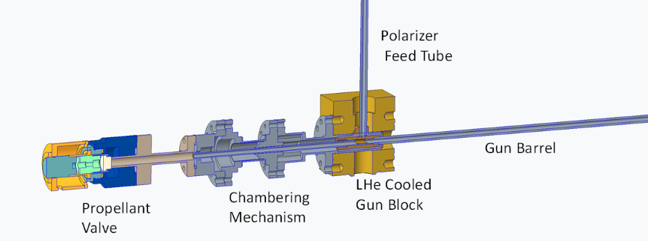
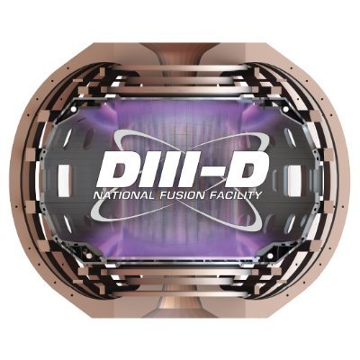
SPF Collaboration: Testing Fuel Polarization Survivability at DIII-D
In the past decade, a group of people from several institutions started some low-level activities towards testing survivability of polarized fuels in DIII-D Tokamak. (D + ³He → α + $p$)
Jefferson Lab:
(Polarized D Fuel, Fuel Shell Properties)
X. Wei, A. Deur, M.M. Lowry, A. M. Sandorfi
University of Virginia:
(Polarized ³He Fuel, Pellet Imaging)
J. Liu, G. W. Miller, S. Tafti, X. Zheng
Oak Ridge National Lab:
(Fuel Injection Guns) L. Baylor
University of California, Irvine:
(Fusion Product Detection)
A. Garcia, W. Heidbrink
University of Connecticut:
(Fuel Shell Properties)
K. Wei
General Atomics (DIII-D):
(Plasma Shots and Simulations)
N. Eidietis, A. Hyatt, G. Jackson, M. J. Lanctot, D. Pace, S. Smith

Slide 8
SPF Collaboration: Testing Fuel Polarization Survivability at DIII-D
In the past decade, a group of people from several institutions started some low-level activities towards testing survivability of polarized fuels in DIII-D Tokamak. (D + ³He → α + $p$) This effort is now on full gear after we were asked by the DOE Fusion Energy Science Office (FES) to respond to an FOA on ”Innovative Fusion Technology”.
Jefferson Lab:
(Polarized ⁷LiD Fuel)
X. Wei, …
University of Virginia:
(Polarized ³He Fuel)
G. W. Miller, A. M. Sandorfi, X. Zheng
Oak Ridge National Lab:
(Fuel Injection Guns) L. Baylor, S. Meitner
University of California, Irvine:
(Fusion Product Detection)
W. Heidbrink
Initial Goal: (1st funding cycle)
Prepare polarizable LiD pellets.
Build ³He polarizer.
Build 4K Injection Gun without magnetic element.
Ultimate Goal:
Run D + ³He → α + $p$ with polarized fuels at DIII-D in 3 Funding Cycles.
The proposal, Spin Polarized Nuclei for Injection into DIII-D, is currently under DOE review.

Slide 9
SPF Collaborators
Jefferson Lab:
X. Wei, JLab Engineer, JLab technician,
General Atomics:
N. Eidietis, A. Hyatt, D. Pace, S. Smith,…
Oak Ridge National Lab: L. Baylor, S Meitner
University of California, Irvine:
W. Heidbrink
University of Virginia:
G. W. Miller, A. M. Sandorfi, X. Zheng, UVa Postdoc, UVa Grad Student

Slide 10
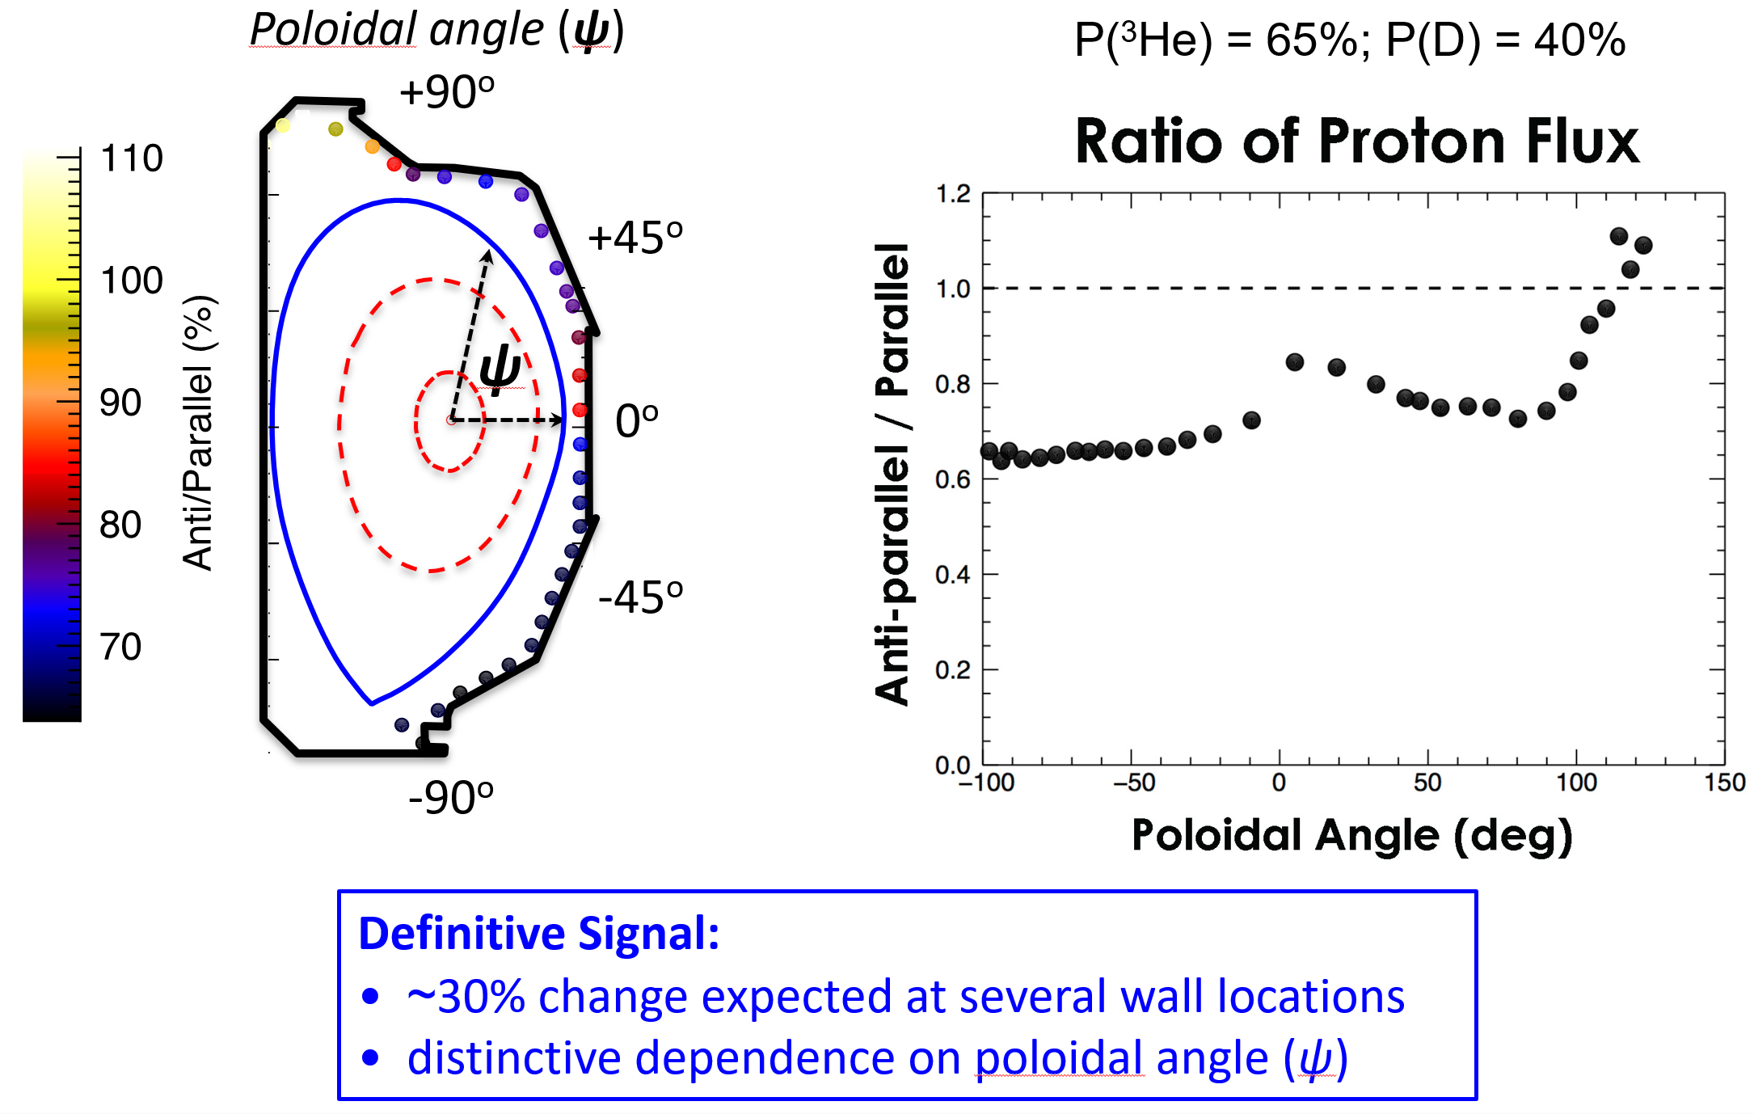
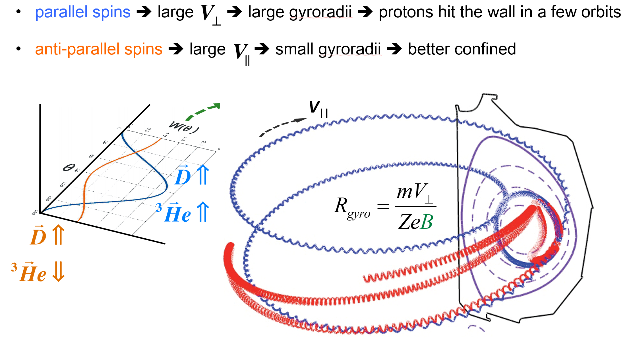
Proposed Tests: D + ³He → $α+p$
Placing detectors in favored locations will enhance the outcome.
• simulations follow secondary reactions to
estimate background yields:
³He + D a α + p (Q = +18.3 MeV) E(p) ~ 15 MeV
9 D + D a ³He+n (Q = + 3.3 MeV)
9 D + D a T + p (Q = + 4.0 MeV) E(p) ~ 3 MeV
9 D + T a α + n (Q = +17.6 MeV)
• 15 MeV protons from ³He + D a α + p provide a unique signature that is easily separated.
α and p loss-locations on the Tokamak wall depend upon the initial polarizations.

Slide 11
The Proposal: Spin Polarized Nuclei for Injection into DIII-D
Prepare fuels for running D + ³He → α + $p$ reaction inside tokamak plasma at DIII-D in later funding cycle.
Jefferson Lab
Produce polarizable ⁷LiD pellets for fusion experiment.
Design a dilution refrigerator (DF) based ⁷LiD polarizer, based on a specific refrigerator model.
Setup and test the DNP electronics without DF.
Design a component (to be installed in DF) to load 77K pellet to DF polarizing chamber and expend into Injection Gun after polarizing.
University of Virginia
Build a new ³He polarizer to produce 80% polarization, in order to get 65% inside the GDP shells.
Oak Ridge National Lab
Fabricate a 4 Kelvin Injection Gun to deliver ⁷LiD pellet from DF into DIII-D.
Design pellet guiding tube with magnetic field to maintain fuel polarization.
University of California-Irvine
Design a charged fusion product (CFP) diagnostic suitable for both routine D-D profile measurements and SPF measurements. (University of California-Irvine)

Slide 12
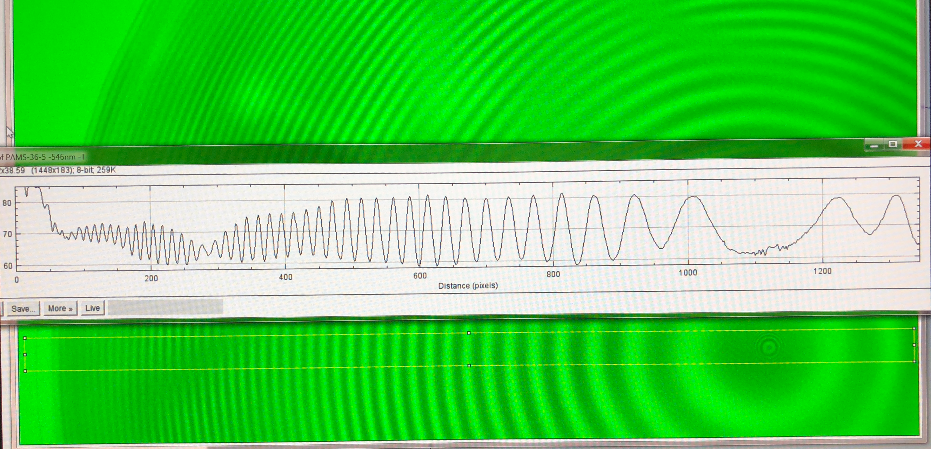
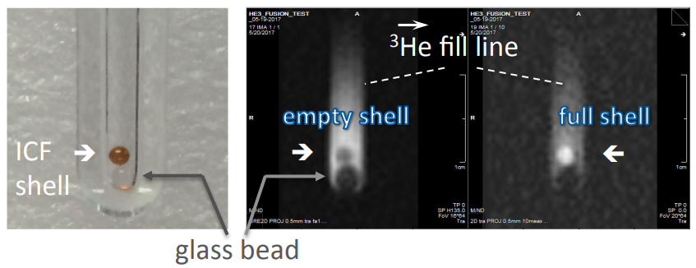
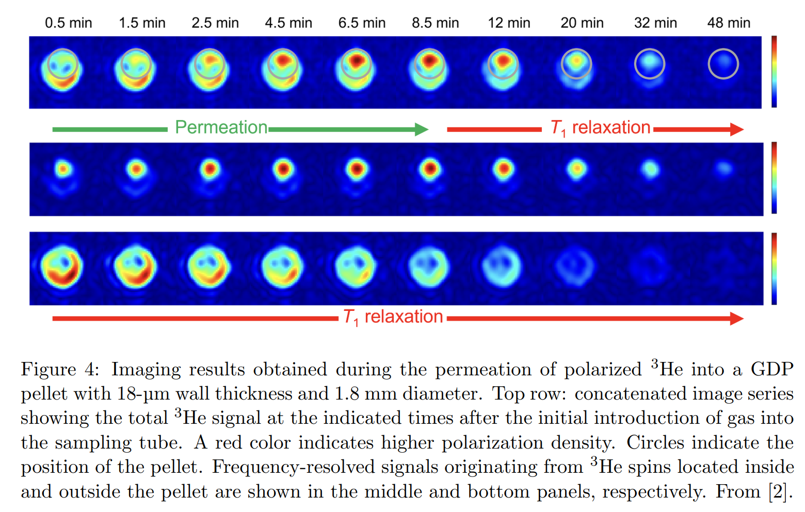
Component Readiness: Polarized ³He
Existing pellets (GDP shells) were well characterized at JLab (relevant permeation times, precise dimensions, etc.).
See ref. L. Baylor et al 2023 Nucl. Fusion 63 076009. Techniques obtained by studying ICF shells in 1990s.
The relaxation time of polarized ³He inside/outside fusion pellet were extensively studied using MRI imaging at 77K and room temperature. A paper submitted to Nature Physics – currently under peer review.
The existing ³He polarizer works. A new polarizer needs to be built to produce 80% polarization, in order to get 65% inside the GDP shells.
The pellet permeation and gas handling system needs to be upgraded for operating under higher pressure.
GDP Shell characterization
Image with polarized ³He
Relaxation Time across the Pellet Wall

Slide 13
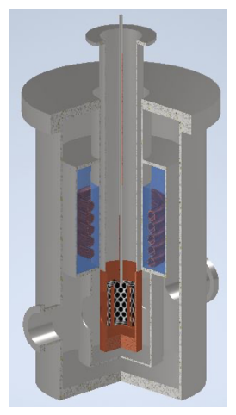
Component Readiness: Polarized ⁷LiD
The DNP polarized LiD targets have been used successfully for nuclear and particle physics experiments. It is a known technology.
JLab Target Group (TG) has built and operated DNP several polarized targets.
A great consultant for building a fusion DNP polarizer.
TG will produce polarized LiD targets for CLAS12 (RG-G)
2 teams developing LiD together ⇒ speeding up the process
⇒ Benefit to both NP and FES.
Concept of cryostat for irradiating LiD pellets at one of JLab’s electron machines has been developed.
Other polarized D for fueling the future power reactor:
High-flux laser-driven polarized D (could be for fueling the future power reactor): Commercial table-top lasers ⇒ 10²¹s⁻¹. Industrial scale lasers could exceed another order.---T.P. Rakitzis (University of Crete)
Stern–Gerlach based molecular-beam methods of producing polarized D₂ or HD that could in principle be utilize for D + ³He at DIII-D. R. Engels, M. Büscher, G. Giullo, etc. …
HDice target at JLab. (Mature technology but complicated, time, manpower and money consuming…)

Slide 14
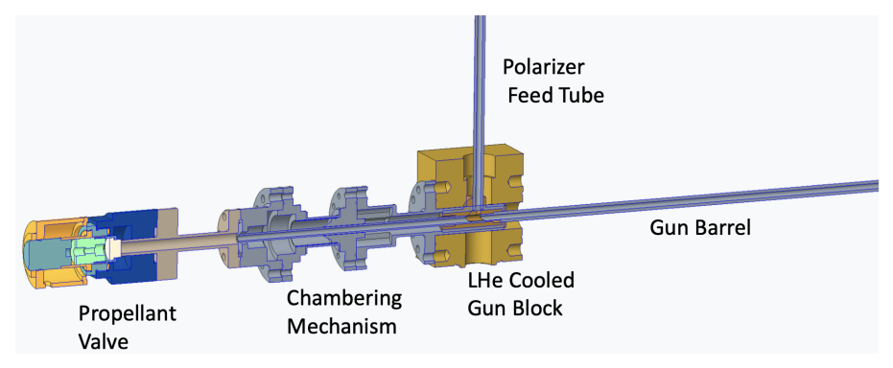
Component Readiness: Cryogenic Injection Gun
ORNL designed and fabricated a D2 pellet injector, which makes pellets at ~10K, for DIII-D Tokamak.
The concept of a new 4.5K injection gun for ⁷LiD pellet was developed.
(The 77K injection gun for ³He shells will use existing design with modification.)
Injection Gun Concept

Slide 15
Component Readiness: DIII-D Tokamak
to be reconfigured for the $D+3He→α+p$ run (in Funding Cycle 2 and/or 3)

Slide 16
Tracking “D + ³He → $α+p$” Product: 15 MeV proton
Relevant fusion products’ behavior in the DIII-D plasma will be continuously studied.

Slide 17
SPF Publications (June 2023)
4 papers from the SPF collaboration:
• “Controlling Fusion Yield in Tokamaks with Spin Polarized Fuel, and Feasibility Studies on the DIII-D Tokamak",
D. C. Pace, M. J. Lanctot, G. L. Jackson, A. M. Sandorfi, S. P. Smith, X. Wei,
Journal of Fusion Energy, V35, pages 54–62 (2016), https://doi.org/10.1007/s10894-015-0015-4.
• “Encapsulation of Spin-Polarized 3He in Tokamak Fusion Pellets”,
S. Tafti, J. Liu, A.M. Sandorfi, K. Wei, X. Wei, X. Zheng, and G. W. Miller,
Nature Physics (2023 – currently under peer review)
• “Polarized Fusion and Potential in situ Tests of Fuel Polarization Survival in a Tokamak Plasma”,
L. Baylor, A. Deur, N. Eidietis, W.W. Heidbrink, G.L. Jackson, J. Liu, M.M. Lowry, G.W. Miller, D. Pace, A.M. Sandorfi, S.P. Smith, S. Tafti, K. Wei, X. Wei and X. Zheng,
Nuclear Fusion, 63, 076009, https://doi.org/10.1088/1741-4326/acc3ae
• “Conceptual design of DIII-D experiments to diagnose spin polarized fuel",
A.V. Garcia, W.W. Heidbrink and A.M. Sandorfi,
Nuclear Fusion, 63, 026030, https://doi.org/10.1088/1741-4326/acaf0d

Slide 18
Timeline
Whence the proposal goes through, we are expecting to run the D + ³He test within 3 funding cycles. (We were asked by the FES program funding manager to list both short term and long term plans.)
Year 1: Acquiring LiD material, Fabricating (or purchase) LiD pellets, Designing/Building Irradiation Cryostat.
Year 2: Testing Irradiation Cryostat, Producing Irradiated LiD pellets.
In subsequent funding cycle:
Year 3-4: Finishing subsystem constructions and then production test.
Year 5-6: System integration and final assembly.
Running polarized D + ³He fusion at DIII-D.

