Slide 1
CEBAF Operations

Slide 2
Outline
About myself
CEBAF operations priorities
Current operations, downtime activities, and operational challenges
CEBAF Performance Plan (CPP)
Plasma processing
Injector upgrade
Operator Staffing
Conclusions

Slide 3
About Myself
Director of Accelerator Operations at Jefferson Lab, start date May 16th
Experience
30 years in the field of particle accelerators.
14 years of experience with DOE 413 projects.
Fermilab, FRIB/MSU, Brookhaven/RHIC, Jefferson Lab, Budker Institute.
Recent positions
PIP-II Project Lead Scientist (Fermilab).
FRIB Front End Dept. Manager and Accelerator Ops Dept. Manager (FRIB/MSU).

Slide 4
CEBAF Operations Priorities
Deliver beam (up) to four Halls for nuclear physics program safely and reliably
Execute the CEBAF Performance Plan Project
Extend CEBAF energy reach up to 12 GeV after 5.5 passes with margin
Improve hardware reliability through acquisition of critical spares and by addressing component obsolesce
Increase beam availability: reduce number of trips and unscheduled downtime
Improve CEBAF performance with a high current.
Improve startup and beam recovery procedures to give physics more time
Prepare for upcoming experiments to meet users’ requirements
Enhance CEBAF capabilities through AIPs

Slide 5
FY23 and FY 24 Operations
FY23
33 weeks of beam operations
Main challenges
Delivering beam to four halls beyond 800 kW was challenging. It will be a lesser problem for three halls.
Lower than optimal energy margin caused frequent RF trips.
Scheduled Accelerator Down, starting March 20
Shutdown extended due to safety pause
FY24
Expected challenges
CEBAF will operate with higher energy and current after scheduled accelerator shutdown
Increasing CEBAF energy reach will be critical
Scheduled Accelerator Down, starting March 20
Physics Run Dates | Halls | Energy Gain / Linac
Oct 1 – Dec 19, 2022 | A, B, C, D | 1047 MeV
Jan 9 – Mar 20, 2023
Scheduled Accelerator Shutdown
Jul 21* – Sep 30, 2023 | A, B, C | 1047 MeV
Physics Run Dates | Halls | Energy Gain / Linac
Oct 1 – Dec 18, 2023 | A, B, C | 1047 MeV
Jan 11 – Mar 18, 2024
Scheduled Accelerator Shutdown
Jul 20 – Sep 30, 2024 | A, B, C, D | 1100 MeV

Slide 6
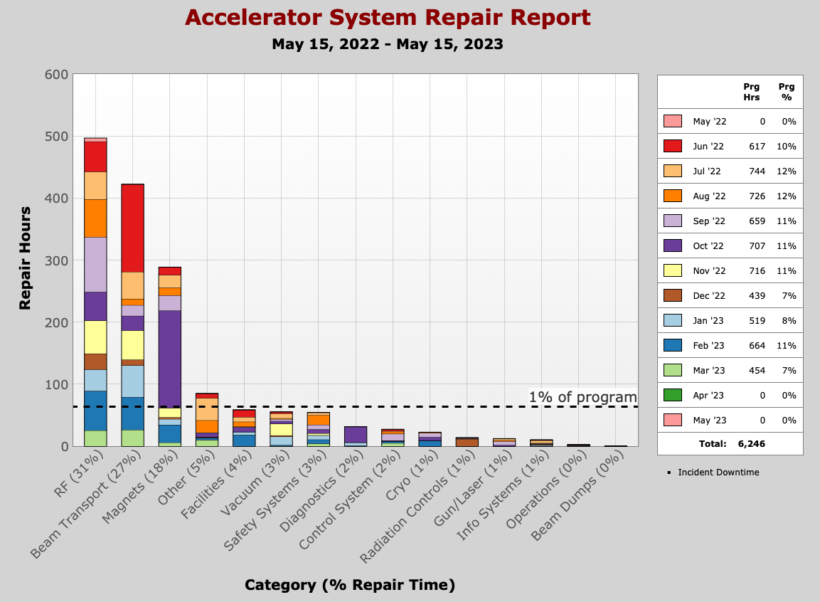
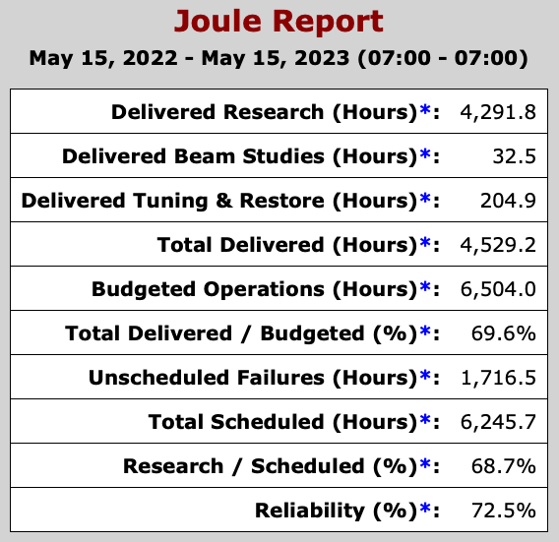
Last Run (07/2022 – 03/2023) Beam Availability and Reliability

Slide 7
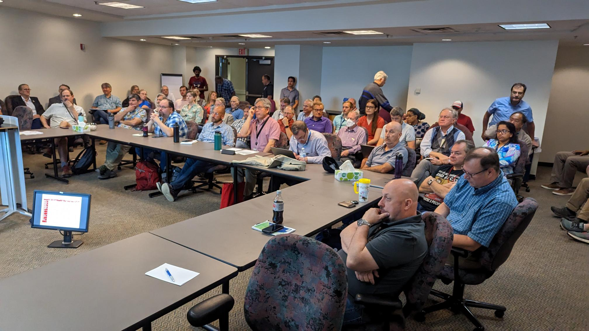
Main Sources of Downtime And Path Forward
RF trips and repairs are the largest contributors to downtime (31%)
Increase energy margin
Beam losses and unscheduled tuning responsible for ~27% of downtime
Assess calibration of BLMs (LDRD)
Conduct a mini-workshop to develop path forward with BLM system upgrade
Assess the need to optimize cavity loading for high current beam
Reliability of magnets and other hardware remains a major contributor
Deliver on CPP Reliability subproject
Preventive maintenance
2023 StayTreat (/06/06/2023) assessed acc. performance,
discussed lessons-learned, and provided recommendations

Slide 8
FY23 Scheduled Accelerator Downtime (SAD)
New Injector will reduce helicity correlated asymmetries for MOLLER.
Installed cryomodules and plasma processing will increase energy reach.
Personnel Safety System upgrade, once a year certification is considered
All SAD scheduled major activities completed, hot checkout in progress.
Booster
C100-10R
98 MV
PSS Upgrade
North linac
energy gain +98 MV
0L02
1L26
Drift tube
New Injector Phase 2
Installed
2L22
C100
84 MeV
2L23
C100
80 MeV
2L24
C100
82 MeV
2L25
C100
90 MeV
2L26
C100
76 MeV
South linac
energy gain +50-60 MV
SAD start date 3/21/2023
C100-05R
98 MV
Plasma processing

Slide 9
CEBAF Performance Plan (CPP)
Goal: ensure CEBAF reaches 12 GeV in 5.5 passes and sustains reliable operations to meet physics program requirements
Energy Reach Project, manager – Tony Reilly
C75 program
C100 rebuild program
Plasma processing
Reliability Project, manager – Randy Michaud
Critical Spares
Klystrons
Obsolescence

Slide 10
CPP: Energy Reach Progress
Cryomodules refurbished and installed at CEBAF to date
(2) C75s, (4) C100s, (1) C50, (1) 7-cell P1
Plasma processing can accelerate progress of Energy Reach project
Path forward:
Most energy will be gained by refurbishing C20s into C75s
Refurbish one C20 to C75 and one C100 CM per year
 | Cryomodules Installed | Cryomodules Removed | Energy Gain (NL/SL), MV
FY23 | C100, C100 | C100 | 98 / 22
FY24 | C100, C75, C75 | F100, C20, C20 | 24 / 97
FY25 | C100, C75 | C100, C20 | 75 / 0
FY26 | C100, C75 | C100, C20 | 0 / 75
FY27 | C100, C75 | C100, C20 | 75 / 0
FY28 | C100, C75 | C100, C20 | 0 / 75
FY29 | C100, C75 | C100, C20 | 75 / 0
FY30 | C100, C75 | C100, C20 | 0 / 75

Slide 11
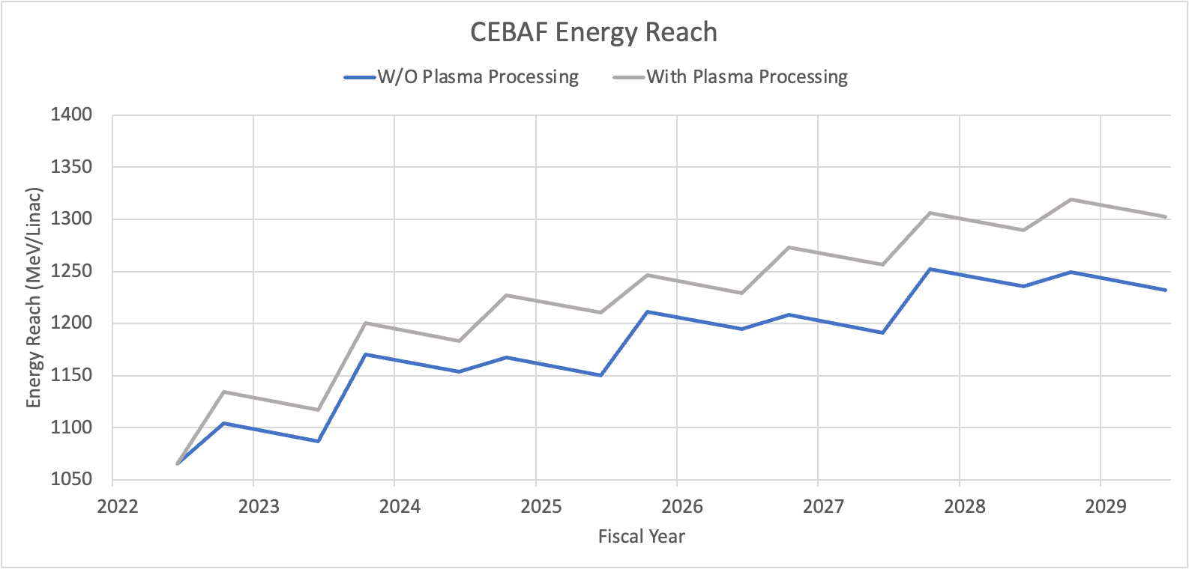
CPP: Energy Reach Progress
1090+100
CEBAF
energy reach
in 03/2023
1090 (12 GeV)
✽
FY23
FY24
FY25
FY26
FY27
FY28
FY29
FY30
Assumptions
“W/O plasma processing”: (1) C100 is refurbished and (1) C75 installed instead C20 per year after FY24
“With plasma processing”: no C100 are pulled out and (1) C75 installed instead C20 per year after FY24

Slide 12
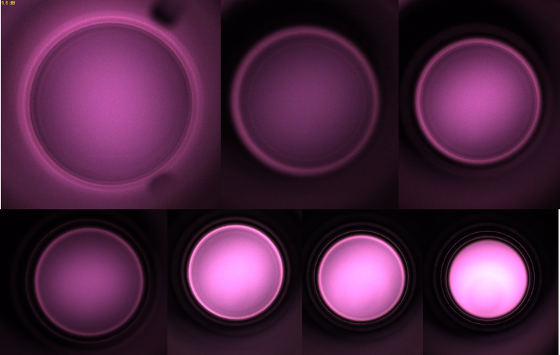
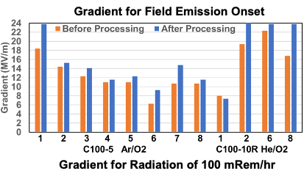
Plasma Processing Can Mitigate Field Emission
Gained significant experience with processing at VTA and CMTF
31 cycles VTA, plasma processing, VTA
2.5 cryomodules (20 cavities) processed in the CMTF
Expected Field Emission free gradient increase of 1.7 MeV per cavity (2.4 MV/m)
C100-5 CMTF Test Results
Plasma discharge in different cells

Slide 13
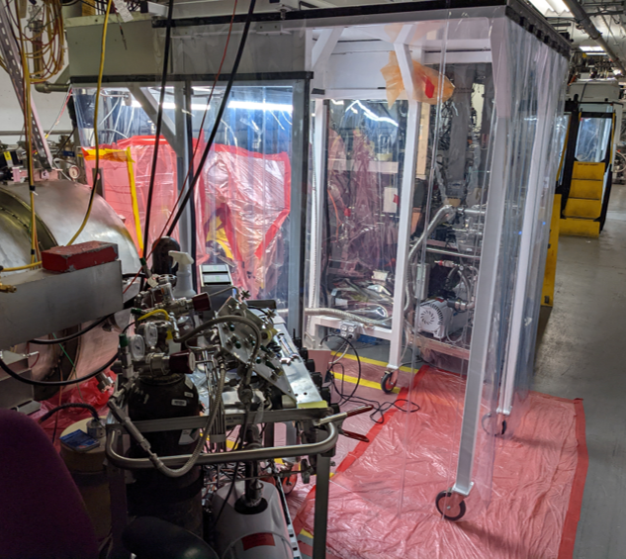
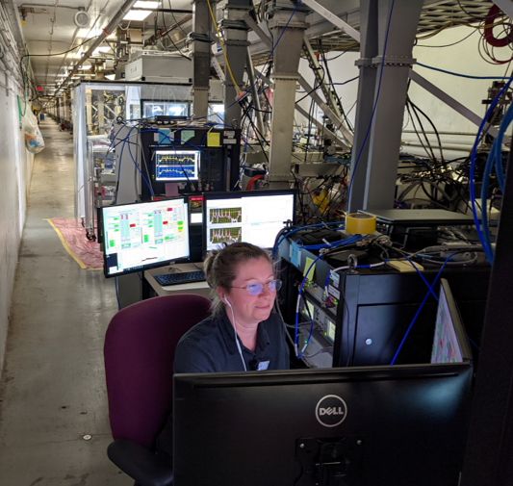
Four Cryomodules Were Plasma Processed In CEBAF Tunnel May-June 2023
2L22 - 2L25 cryomodules (all cavities) were plasma-processed in situ in the tunnel
It took six weeks to process 4 CMs
Three weeks to deploy and prepare
4 days per cryomodule
Process cavities twice
Measure field emission and Q₀ at 2K before run
Path Forward
Extend plasma processing to C75 cavities.
Process 3 to 4 C100 and C75 cryomodules during accelerator shutdowns.

Slide 14
CPP: Reliability Progress
Klystrons (as of 03/2023)
(17) 8 kW, correspond to 57 weeks of Ops
(6) 13 kW, correspond to 150 weeks of Ops
Critical spares procured. Inventory updated yearly
Impact: from month-long delays and program changes to day-long delays
Before CPP: 2016, PS failure, no spares, change of program, only one hall operations
After CPP initiated: 2021, PS failure, spare PS available, repair 1 week
Obsolescence
Required to maintain the machine running not to fix issues.
Obsolete systems approaching end-of-life faster than the CPP program can compensate (LLRF, CAMAC, BPMs, BLMs, etc.).
Limitations are not only funding but limited downtime and available, experienced staff

Slide 15
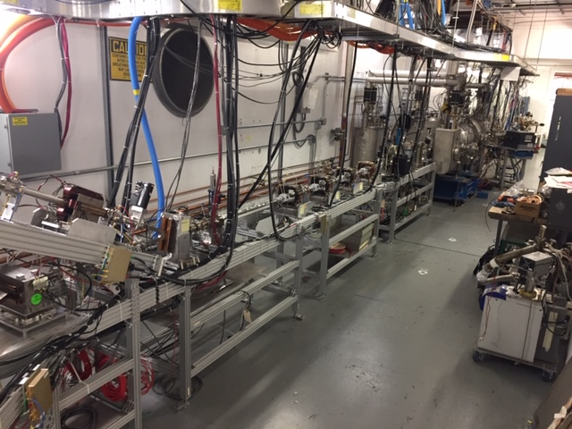
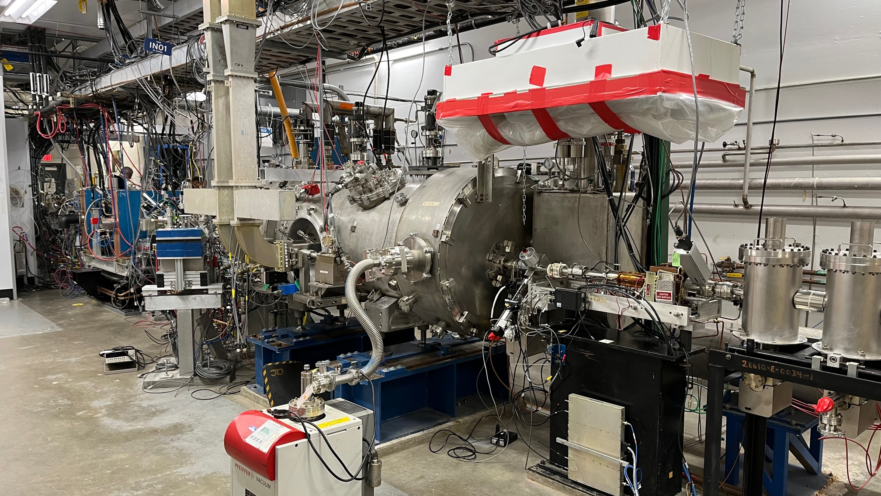
Injector Upgrade Installed, Ready for Beam
The upgrade reduces helicity correlated asymmetries for the Parity Quality Beam program (MOLLER).
Scope
Increase gun voltage to 200 keV.
Upgrade Wien filters.
Install solenoids with a larger aperture.
Install new SRF Booster cryomodule with reduced deflection and coupling.
Injector was successfully commissioned at UITF 2021/22 with beam.
The injector was installed at CEBAF during FY23 SAD. It will be commissioned at CEBAF this run.
UITF
2022
booster
CEBAF, Tunnel
06/21/2023
200 kV photogun
200 kV photogun
booster

Slide 16
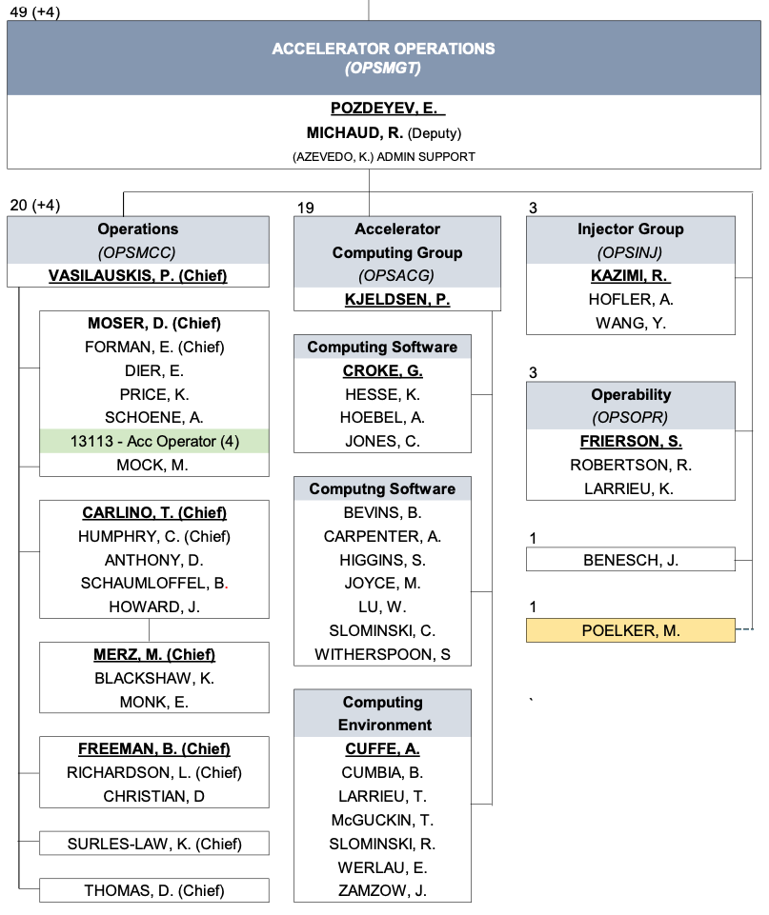
Operator Staffing Increase
Present operations group staffing (21) is suboptimal.
Path Forward: Four more operator positions approved, bringing Ops group staffing to 25.

Slide 17
Conclusions
Difficult but successful physics run
All major planned SAD activities are completed, including installation of the injector and plasma processing of 4 cryomodules. Checkouts are in progress.
Delivering on CPP to increase energy reach and improve reliability is critical for meeting program goals.
Need to examine sources of beam loss trips at a high current.
Operator staffing needs were addressed.
Looking to another year of operations.

Slide 18
Questions?

