Slide 1
Jefferson Laboratory Science and the Future
David J. Dean
Deputy Director
Presented To:
JLab Users Organization
June 26, 2023

Slide 2
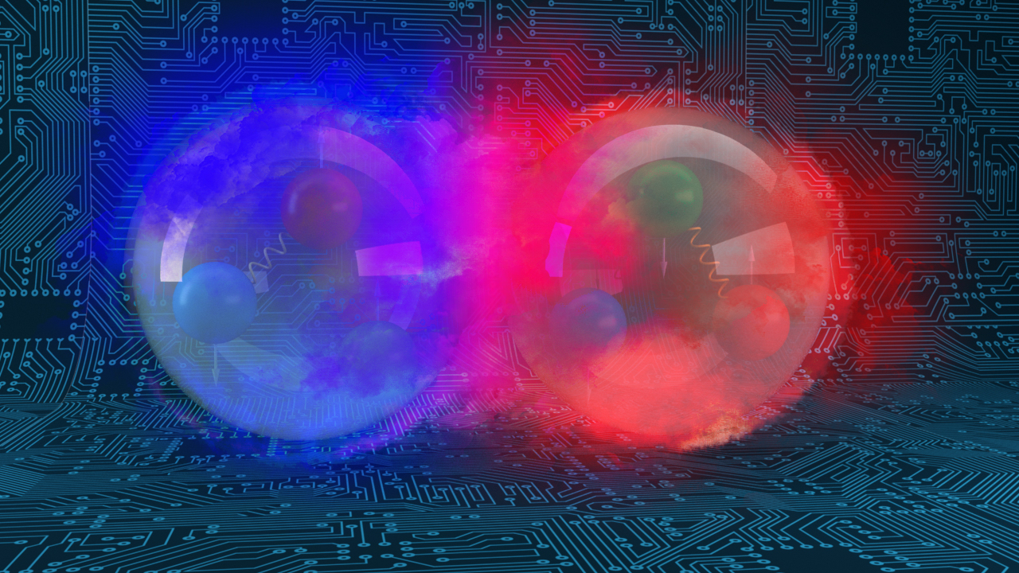
Outline
QCD Research with CEBAF
  Science highlights
  CEBAF Status
CEBAF with 12 GeV positrons and 22 GeV electrons
Pursuing the High-Performance Data Facility (HPDF)

Slide 3
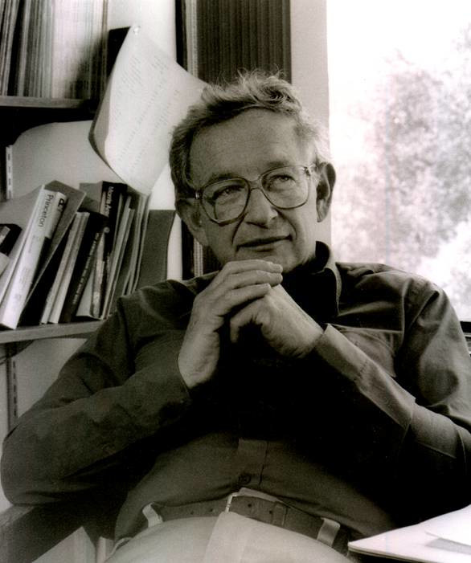
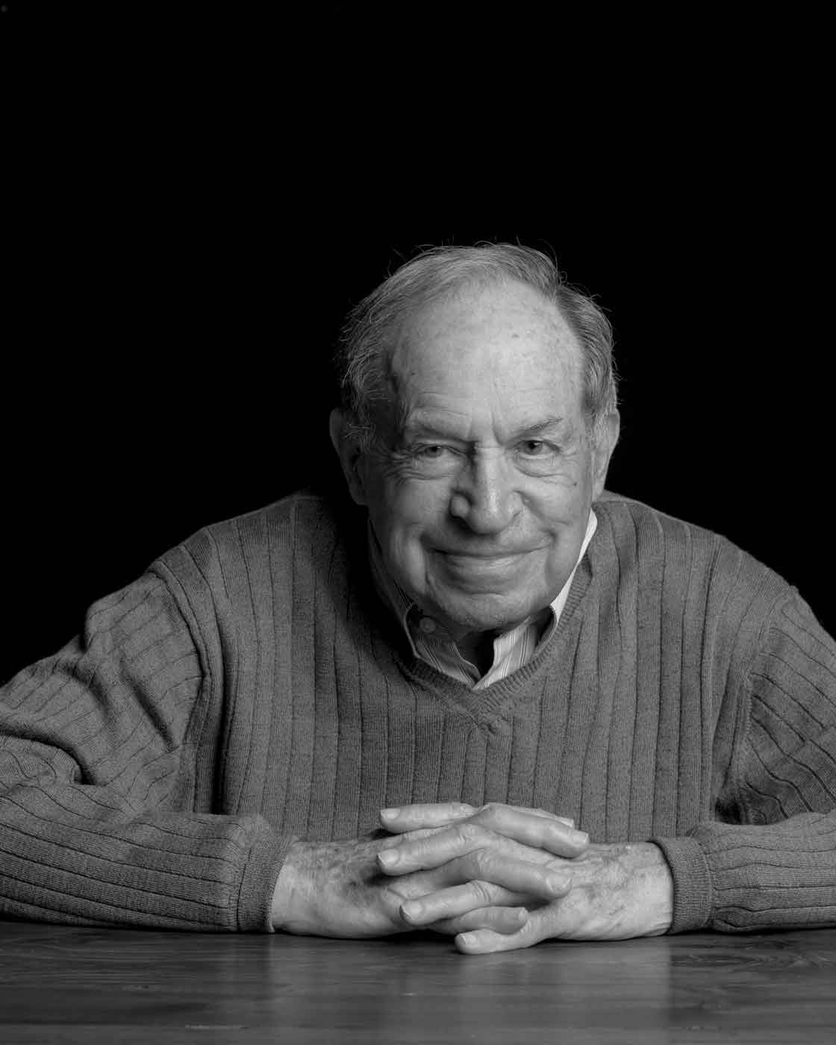
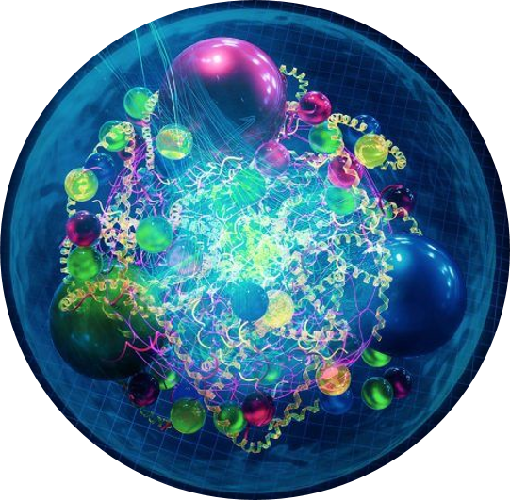
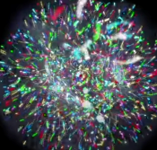
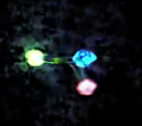
Emergent phenomena in QCD
“The ability to reduce everything to simple fundamental laws does not imply the ability to start from those laws and reconstruct the universe.” -- More is different, P. W. Anderson [Science 177, 393 (1972)].
“When electrons or atoms or individuals or societies interact with one another or their environment, the collective behavior of the whole is different from that of its parts. We call this resulting behavior emergent. Emergence thus refers to collective phenomena or behaviors in complex adaptive systems that are not present in their individual parts.” -- D. Pines, Foundations & Frontiers in Complexity (2014)
x

Slide 4
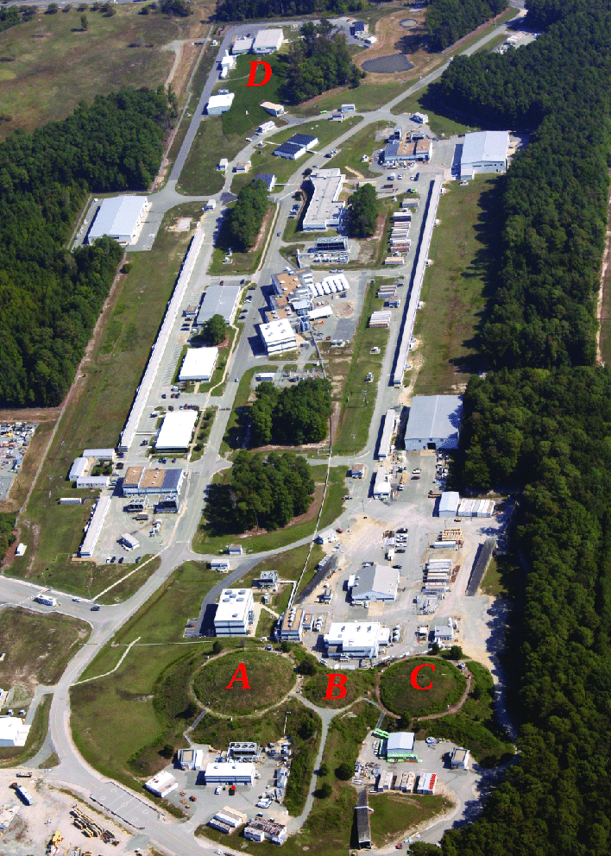
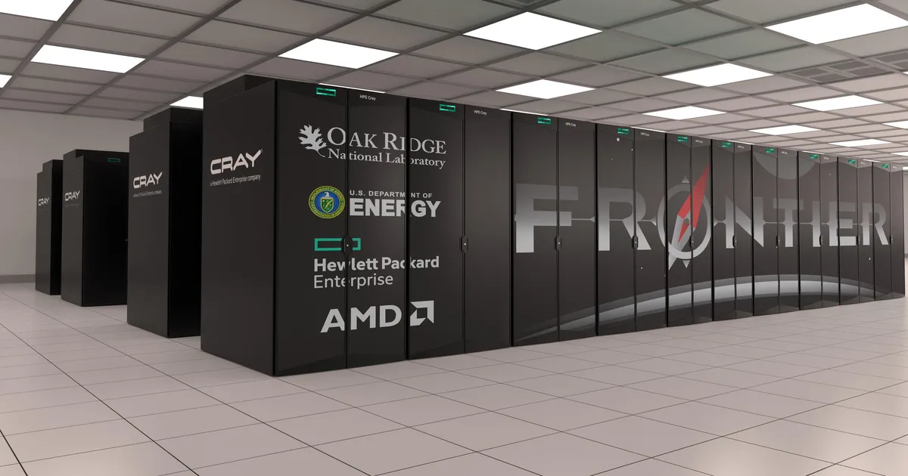
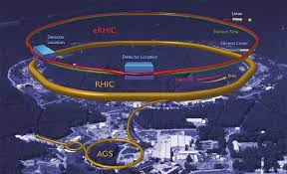
Several open QCD questions
How does QCD generate the masses of the baryons and mesons?
Why is the spin of the nucleon ‘1/2’?
What are emergent properties of dense systems of gluons?

Slide 5
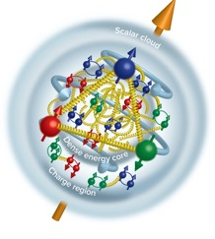
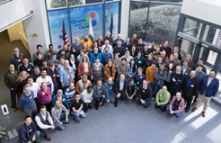
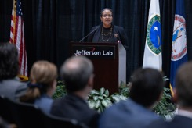
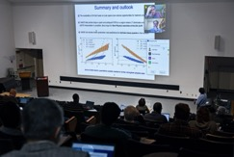
JLab News and Highlights
High-Impact scientific results are flowing from CEBAF 12 GeV Program
Very extensive upgrades and improvements carried out in complex Scheduled Accelerator Downs
  Installation of the C100-9R/2L26 C100-5R
  Implementation of plasma processing for cryomodules
January 9-11 EPIC Collaboration meeting (EIC detector)
Electron-Ion Collider OPA Status Review held January 31 – February 2 at JLab
MOLLER CD-3A/Status review January 10-12, 2023. CD-3A approved on March 27, 2023
Dr. Berhe visits the Laboratory and kicks of the BRIC
Actively pursuing diversification of Jefferson Lab’s mission and planning for the CEBAF future
  CEBAF Science at the Luminosity Frontier, January 23-25, 2023
  HPDF Proposal
EPIC Collaboration meeting
SC Director Berhe Visit
Science of 22 GeV

Slide 6
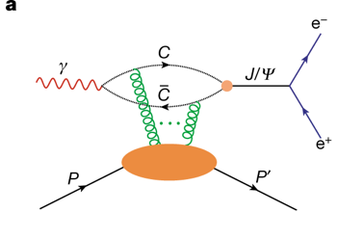

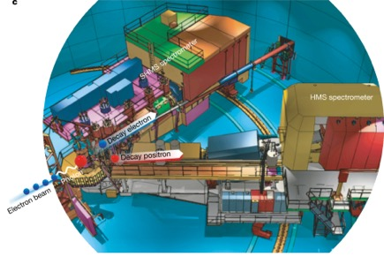
CEBAF Experiment Finds Gluon Mass in the Proton
Near threshold J/psi photoproduction experiment.
Inner Gluon radius: 0.52 +/- 0.03 fm
Charge radius: ~0.84-0.88 fm
Scalar gluon rad: 1.069+/-0.056 fm
measured in Hall C
“Determining the gluonic gravitational form factors of the proton, Duran et al, Nature 615, 813 (2023)

Slide 7
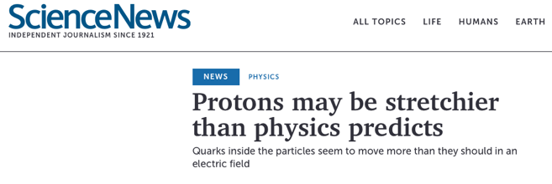
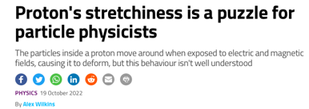
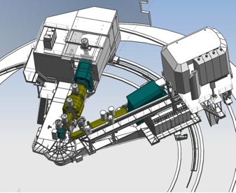
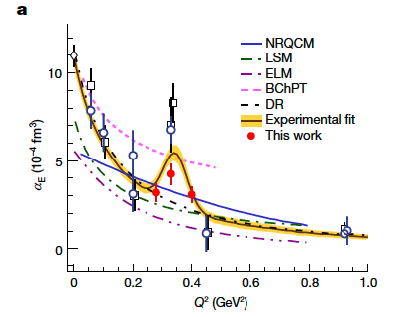
Protons Offer Surprises in Electromagnetic Structures
“Although steady progress has been made in recent years, we have yet to achieve a good understanding of how the nucleon properties emerge from the underlying dynamics of the strong interaction.”

Slide 8
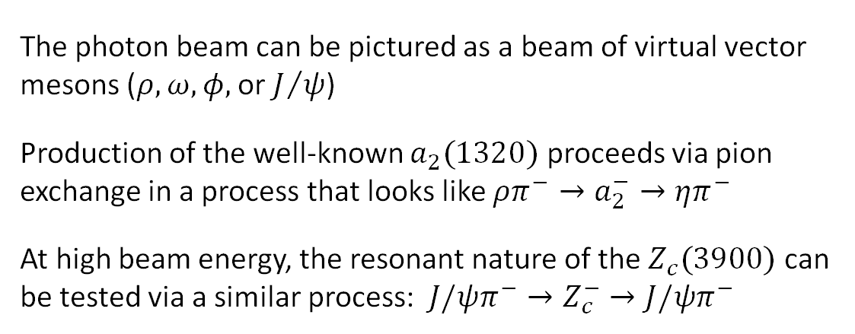
Results on Path Toward Exotic Searches: a₂(1320)
The photon beam can be pictured as a beam of virtual vector mesons ($ρ,ω,φ,$ or $J/ψ$)
Production of the well-known $a_{2}(1320)$ proceeds via pion exchange in a process that looks like $ρπ^{−}→a_{2}^{−}→ηπ^{−}$
At high beam energy, the resonant nature of the $Z_{c}(3900)$ can be tested via a similar process: $J/ψπ^{−}→Z_{c}^{−}→J/ψπ^{−}$
J/ψ photoproduction paper on arXiv

Slide 9
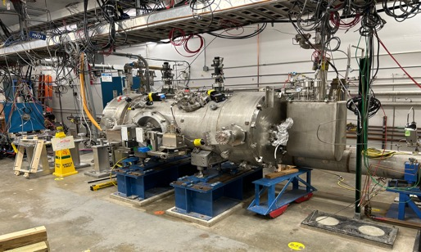
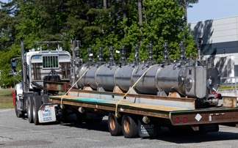
CEBAF Status: FY22/23 Physics Run
FY22: ran from start of FY into February, with short holiday break
  For FY22 achieved 3790.8 delivered operating hours and had 1291.8 unscheduled failure hours; reliability ~76.5%
FY23: ran from start of FY into March, with short holiday break
  For FY23 to-date achieved 2451.7 delivered operating hours and had 975.6 unscheduled failure hours: reliability to-date ~72.1%
Startups have been smooth after holiday shutdown period
Continuing to improve our safety posture – will cause some schedule delays
Ongoing effort to get to desired beam current at the higher energy (CEBAF Performance Plan)

Slide 10
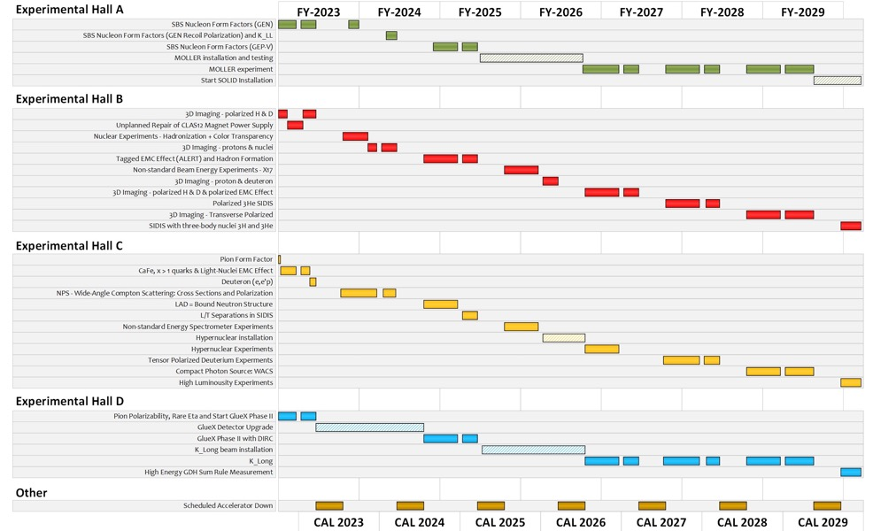
Extended Experimental Schedule
205 completed experiments to-date (28 full; 28 partial in 12 GeV era)
51 experiments remaining
~7 years at ~30 weeks/year
…not including SoLID
…not including new proposals

Slide 11
Outline
CEBAF with 12 GeV positrons and 22 GeV electrons

Slide 12
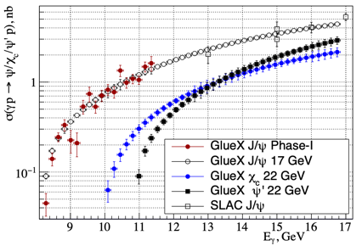

Scientific Vignettes for the 22 GeV Upgrade
How does QCD generate hadrons?
Are there pure exotic states?
Can we harness threshold charmonium production to probe proton/gluon properties?
Q² evolution of the γ_{v}pN* electrocouplings could offer an insight into hadron mass generation and the emergence of the N* structure from QCD
Simulations indicate JLab22 is the only foreseeable facility to extend these measurements up to 30 GeV² and down to α_{s}/π=0.15 where non-and perturbative QCD coexist.
Direct (photon) probe of the
$Z_{c}→J/ψπ$ coupling without rescattering effects provides unique complementary data to constrain interpretation of $e^{+}e^{−}$ data.
Exclusive charmonium production near threshold probes gluon/mass properties of proton (mass radius, gravitational form factors, D-term, anomalous contribution to proton mass), however
  assuming factorization
  assuming two-gluon exchange

Slide 13
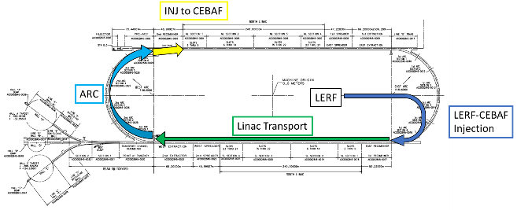
Technically feasible, cost effective, and innovative path
Capitalizing on recent science insights and US-led accelerator science and technology innovations, develop a staged program at the luminosity frontier
Positrons (e+) in the LERF (former FEL) with transport to CEBAF (validation of the scattering formalism)
Energy Upgrade for 650 MeV Electron (e-) Injection in the LERF
Replace arcs on each side with new FFA permanent magnet arcs to upgrade to 22 GeV

Slide 14
Notional CEBAF & Upgrade Schedule (FY24 – FY42)
Accelerator team has worked up an early schedule and cost estimate
  Schedule assumptions based on a notional timing of when funds might be available (near EIC ramp down based on EIC V3 profile)
  For completeness, Moller and SoLID (part of 12 GeV program) are shown; positron source dev shown
Activities | Fiscal Year
 | 24 | 25 | 26 | 27 | 28 | 29 | 30 | 31 | 32 | 33 | 34 | 35 | 36 | 37 | 38 | 39 | 40 | 41
Moller (413.3B)
SoLID (science rev)
Positron Source Dev
Pre-Project Dev
Upgrade Phase 1
Transport comm/e+
Upgrade Phase 2
CEBAF Up
FY23 $$
Phase 1: tie LERF to CEBAF & injector for e+ $101M ($78M – $152M)
Phase 2: High Energy Upgrade (includes FFAs) $244M ($188M – $366M)
Total cost (Class 4 estimate) $345M ($265M – $517M)

Slide 15
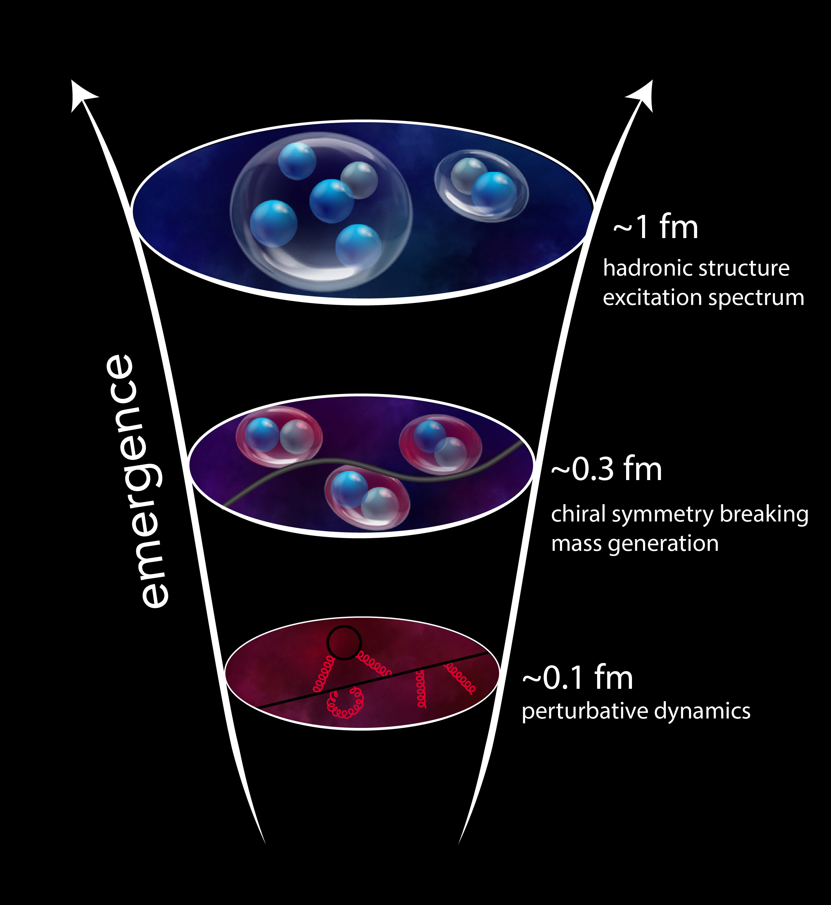
JLab provides unmatched capability in the QCD valence region (larger x)
QCD manifests fascinating complexity (‘more is different’)
  Large research facilities like CEBAF are required to understand the implications of QCD in experiments
  CEBAF has a long program ahead that is complementary to the envisioned EIC program (science case)
CEBAF will remain the prime facility for fixed target electron scattering at the luminosity frontier
  A groundbreaking experimental program has been developed stretching into the 2030s
  Moller is fully funded, and SOLID enables CEBAF to reach its full intensity capability
We developed an exciting technical path toward e+ @ 12 GeV and e- @ 22 GeV

Slide 16
Outline
Pursuing the High-Performance Data Facility (HPDF)

Slide 17
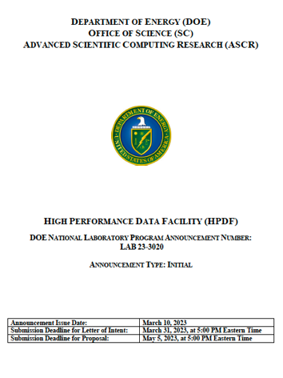
DOE National Laboratory Program Announcement LAB 23-3020
Published on March 10, 2023
Letter of Intent due on March 31, 2023
Full proposal due on May 5, 2023
  And it is short: 15 pages ($300M)
  One key appendix: facilities & other resources
From the Announcement
  The High Performance Data Facility (HPDF) will serve as a foundational element in enabling the DOE Integrated Research Infrastructure.
  The mission of the High Performance Data Facility is to enable and accelerate scientific discovery by delivering state-of-the-art data management infrastructure, capabilities, and tools.
  HPDF is envisioned as a new SC User Facility with a Hub-and-Spoke model that fits within and adds world-class capabilities to the ASCR and SC User Facilities ecosystems. [The proposal is mostly about the Hub.]

Slide 18







JLab brings great value to HPDF
Greenfield: it is harder for established facilities to pivot
The data science work with CEBAF provides foundational strengths:
  Streaming data capability at CEBAF
  Data stewardship at CEBAF
JLab stewardship of an 1,800 member user community
R&D leadership in processing real time data in partnership with ESNet
Tremendous team working with us to establish the HPDF
The Commonwealth’s $49M investment in infrastructure
We bring University (including HBCU and MSI) partners
 | POCs | Resources
JLab | Lead Lab (Amber Boehnlein, PI) | See Differentiators
ANL | Ian Foster | GLOBUS
ORNL | Arjun Shankar | Storage
LBNL | Chin Guok, ESNet; Debbie Bard, NERSC; Kjiersten Fagnan, JGI | Super facility APIs, ESNet interface; BER data
SLAC | Jana Thayer | Proto-spoke big data from LCLS-II HE
BNL | Eric Lancon | NSLS-II and EIC
PPPL | Bill Tang | Burning Plasmas for fusion energy

Slide 19
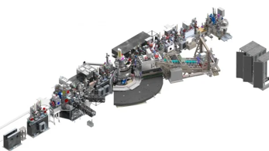

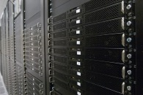
HPDF Will Provide Frictionless Access to Data Capabilities
The Hub enables:
  Driving experiments in real time
  Data combination and analysis from different sources.
  Sustained long-term data campaigns
  Spokes are the data sites (to be defined later)
qRIXS@LCLS II

Slide 20
We are developing partnerships to establish the HPDF ecosystem
HPDF Hub
In partnership with the DOE Office of Science ASCR Program
National Laboratory Partners
Virginia Partnership
University Partners
Create the Student pipeline
Create joint research faculty in Data Science with JLab
Develop the workforce
Computational facility partners provide valuable technical and management resources in initial growth phase of project
SLAC, NSLS-II, and JGI provide a data testbed
Early access testbed system
Building the JLab Data Center (JLDC)
Laboratory Directed R&D to establish new R&D positions
Industrial partners for the hardware
National Labs continue to address Data Science challenges locally as the ecosystem evolves
Continued support from the Commonwealth to generate positions for HPDF as appropriate
Continued support of the Commonwealth toward the Virginia Data Science Ecosystem
Partnerships with HBCUs to drive diversity in Data Science
HPDF Ecosystem

Slide 21
Summary and Outlook
CEBAF provides a strong and enduring future for scientific exploration of mesoscopic QCD
  The 12 GeV program is in full swing
  Many fascinating results generated
22 GeV upgrade provides a rich, one-of-a-kind capability for QCD science
  Opportunity to explore e+ at high luminosity (12 GeV) and 22 GeV e-
  Enables high-luminosity science complementary to EIC
HPDF will provide an exciting new venue for science at JLab with benefits to the CEBAF and EIC programs
QUESTIONS?

