Slide 1
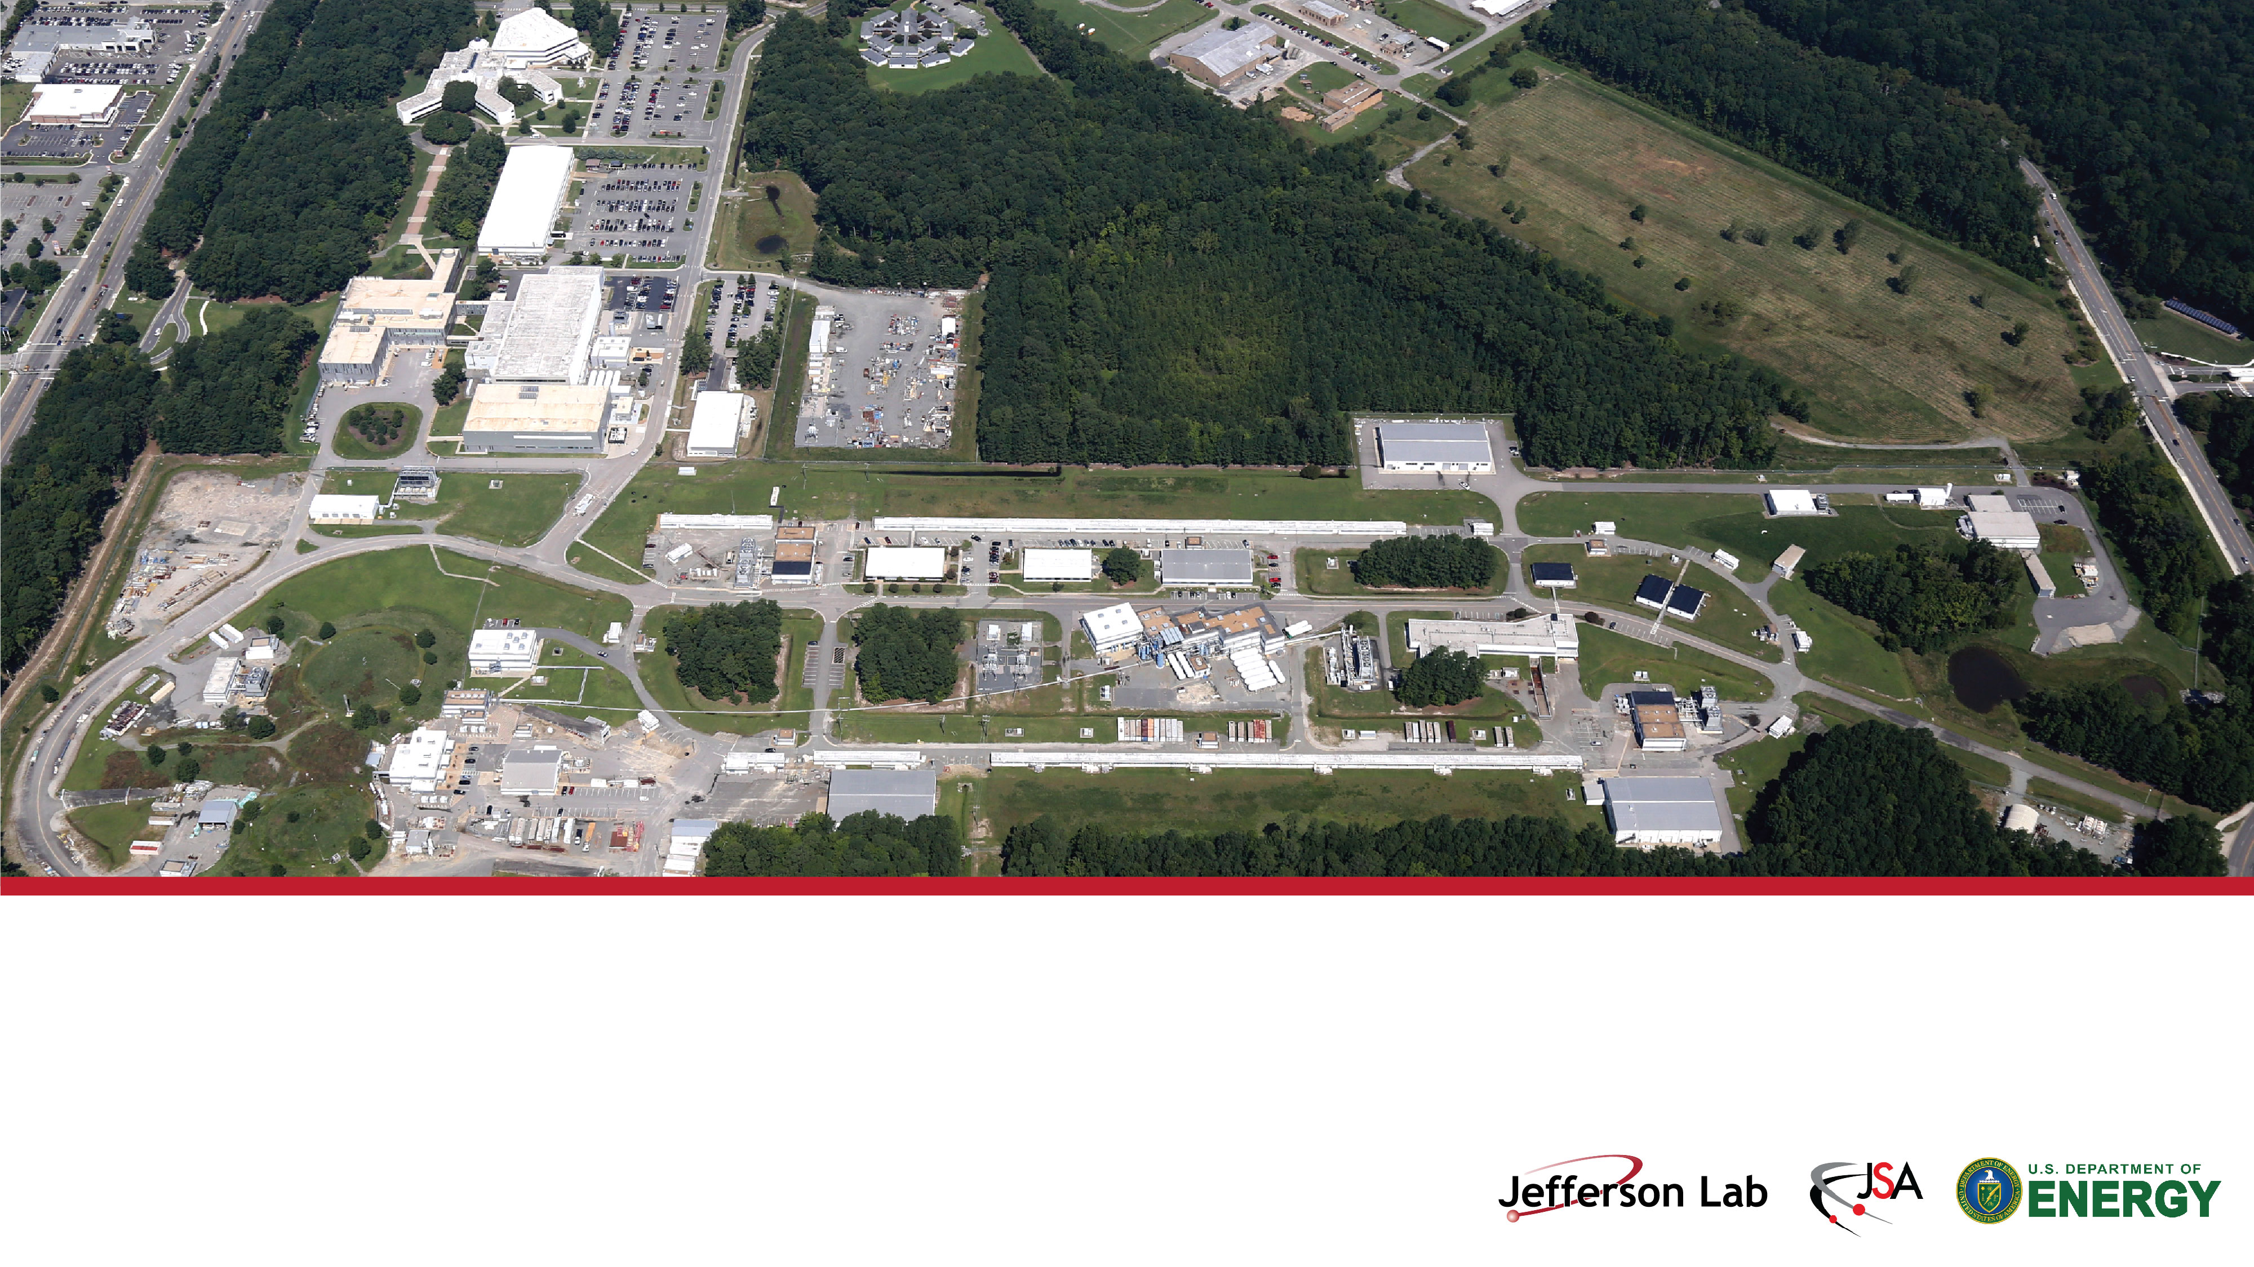
Jefferson Lab User’s Meeting
Jefferson Lab Status: News from the Lab
Stuart Henderson
Director, Thomas Jefferson National Accelerator Facility
June 26, 2023

Slide 2
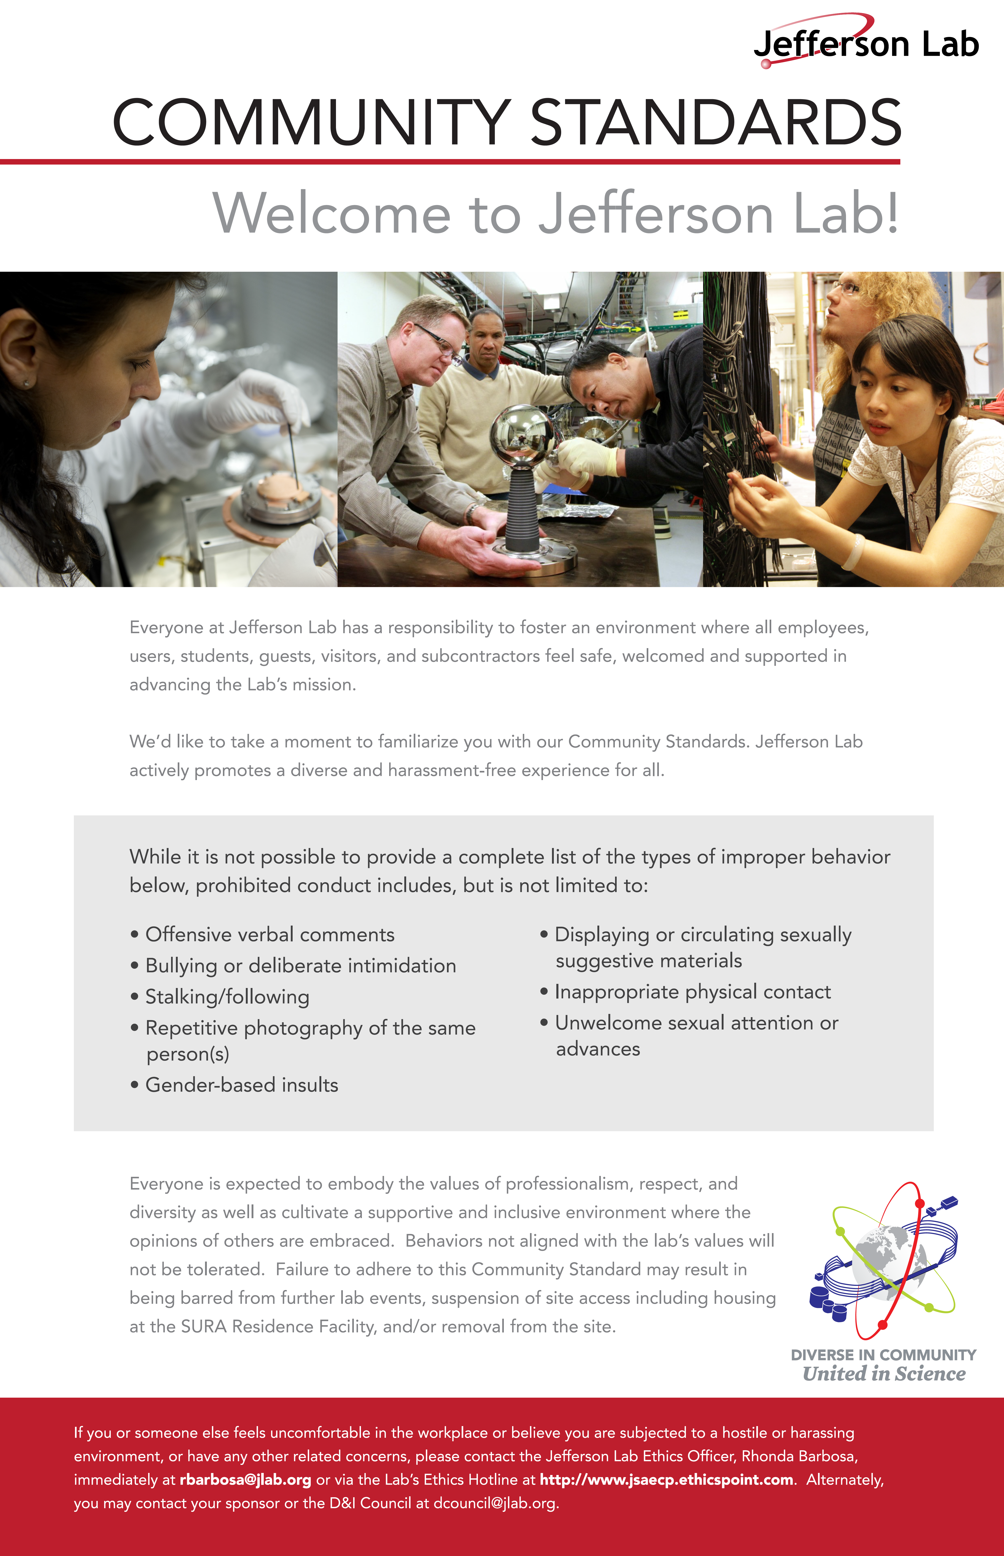
Reminder: Community Standards

Slide 3
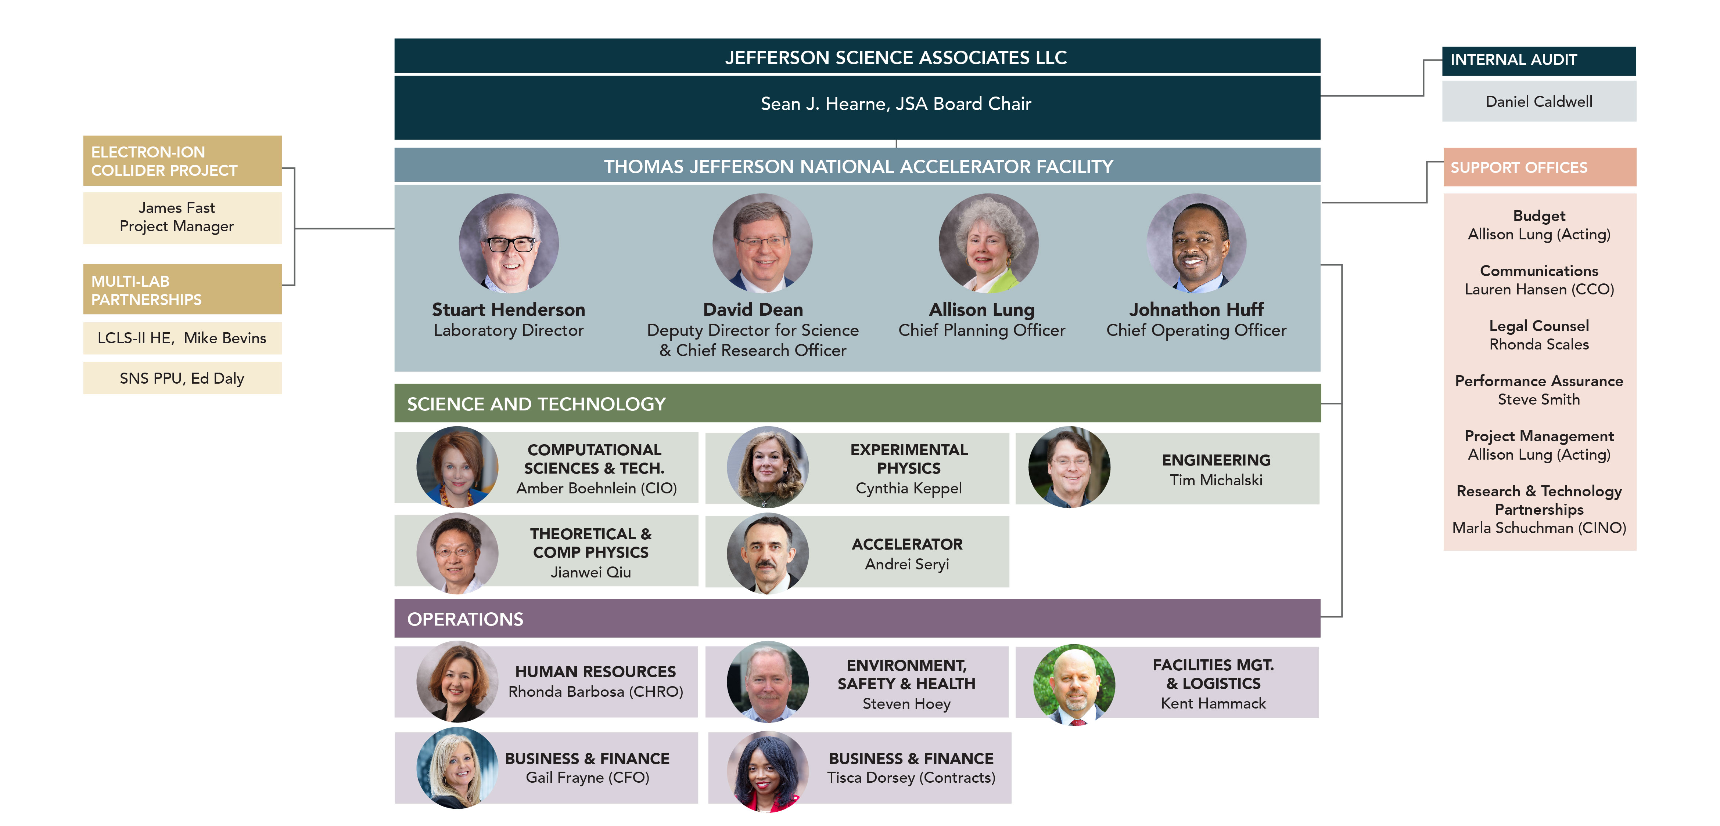
Jefferson Lab Organization and Leadership Team

Slide 4
Jefferson Lab’s Budget is Growing as our Mission Expands
Inflation Reduction Act Funding (Sept 2022) included
$31M MOLLER
$33M EIC
$10M CRE
$2M Laydown Yard Expansion
Debt Ceiling crisis was avoided

Slide 5
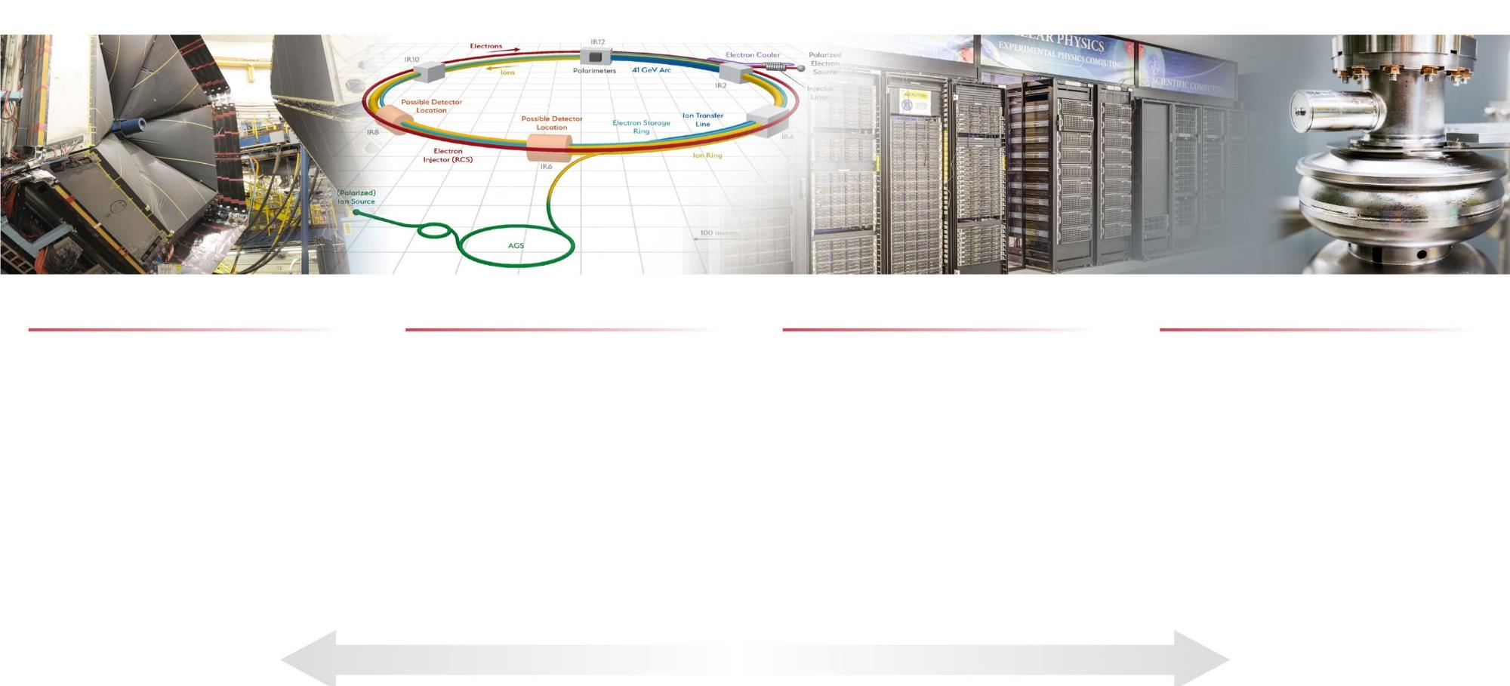
Jefferson Lab’s Science and Technology Vision
Nuclear Physics at CEBAF
Electron-Ion Collider
Computational Science &
Technology
Accelerator Science & Technology
Vibrant 12 GeV research program, operating >30 weeks/yr, supporting 1,900 annual users
MOLLER Project & SoLID proposal
Future opportunities with an upgraded CEBAF
Theory and computation supporting NP goals
Partnering with BNL in the management, design, and construction of the Electron-Ion Collider Project
Leadership in EIC scientific program
Vision for world-leading computational program
Proposed High Performance Data Facility focused on the unique challenges and opportunities for data-intensive applications and near real-time computing needs
Computational Nuclear Physics
Accelerator component production for DOE/SC projects, including LCLS-II and LCLS-II-HE at SLAC, and
SNS-PPU at ORNL
Develop CEBAF upgrade concepts
R&D in accelerators, detectors and applications

Slide 6
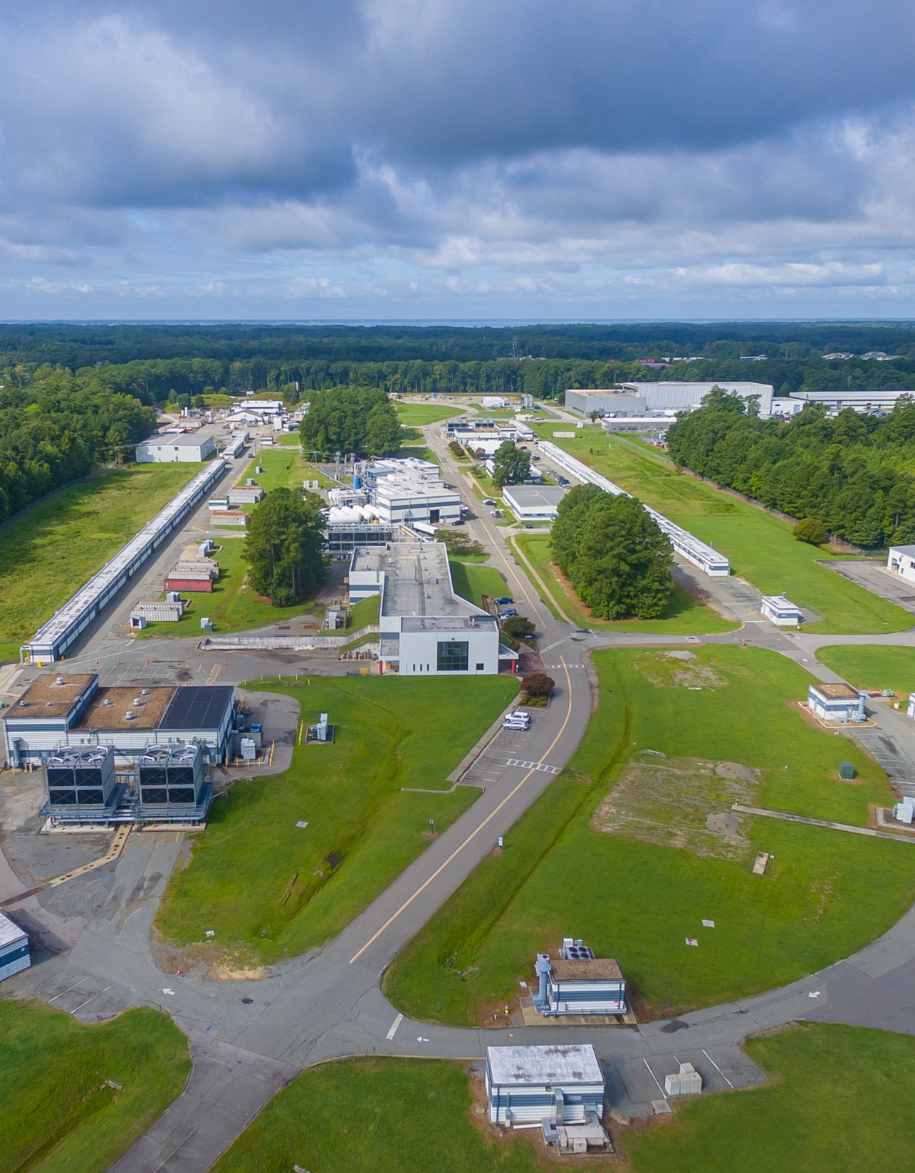
The Jefferson Lab Of The Future
We are entering a new era at Jefferson Lab. We are reinventing Jefferson Lab to take on a more significant role with a diversified mission – with a goal of delivering even greater impact for the Nation
We are facing a time of change, opportunity and challenge, unprecedented since the Lab’s founding
This transformation requires
  Staffing up to fulfill the mission
  Improving our processes to ensure scalability
  Developing new skills and talent pipelines
  Designing organizations that scale with growing portfolios
  Scaling-up Mission Support capabilities to enable this growth in scope, staff, budget, expectations and risks
This reinvention is underway
It is a time of change and opportunity for Jefferson Lab

Slide 7
Changes in the S&T Organization
We are looking at all aspects of how the Lab is organized and managed. We are evaluating the best practices we need to incorporate to enable this transformation.
We are entering an era in which over the next 10 years we will
  Run CEBAF full-out for our 12 GeV experimental program
  Deliver on a very significant DOE construction project portfolio, dominated by EIC Project
To better enable us to simultaneously deliver on these two major initiatives we are implementing a re-organization of responsibilities between Accelerator and Engineering Divisions.
The goals for this re-organization are two-fold:
Align resources, responsibility and accountability for CEBAF operations, maintenance and improvements within a single organization: Accelerator Division
  We will move Electrical Engineering Systems Department (DC Power, RF, I&C, Safety Systems, Support Services) to Accelerator Division
Strengthen our engineering capabilities to ensure success in meeting the demanding needs of the EIC and other projects
  We are building out staff to support EIC
  We are standing up a Systems Engineering Function with responsibility for Lab-wide Engineering Standards and Processes, including Document Control, Engineering tools, etc

Slide 8

Jefferson Lab Operational Excellence 2025
Leadership Development
& Engagement
Build Workforce/
Facilities Of The Future
Continuously Improve
Our Culture
Develop Missions
Of The Future
Digital Transformation
• Individual Career Profile
• Directors Safety Council Improvements
• Supervisor Fundamentals Program
• Management Safety Discussions
• Wellness Programs
• Job Structure and Compensation
• Hybrid Work Evolution
• CEBAF Renovation and Expansion, Thomas Jefferson Infrastructure Improvement
• ES&H Hazard Identification and Control Improvements
• Site-wide information system
• Inclusion Survey #1 Corrective Actions
• Inclusion Survey #2 & Corrective Actions
• Carbon Pollution Free Electricity
• Jefferson Lab Data Center / High Performance Data Facility
• High Bay Space to support science mission
• DOE Integrated Contractor Project
• Human Capital Management Enterprise Software
• IT Governance Process
Operations Integration to support S&T Vision
8

Slide 9
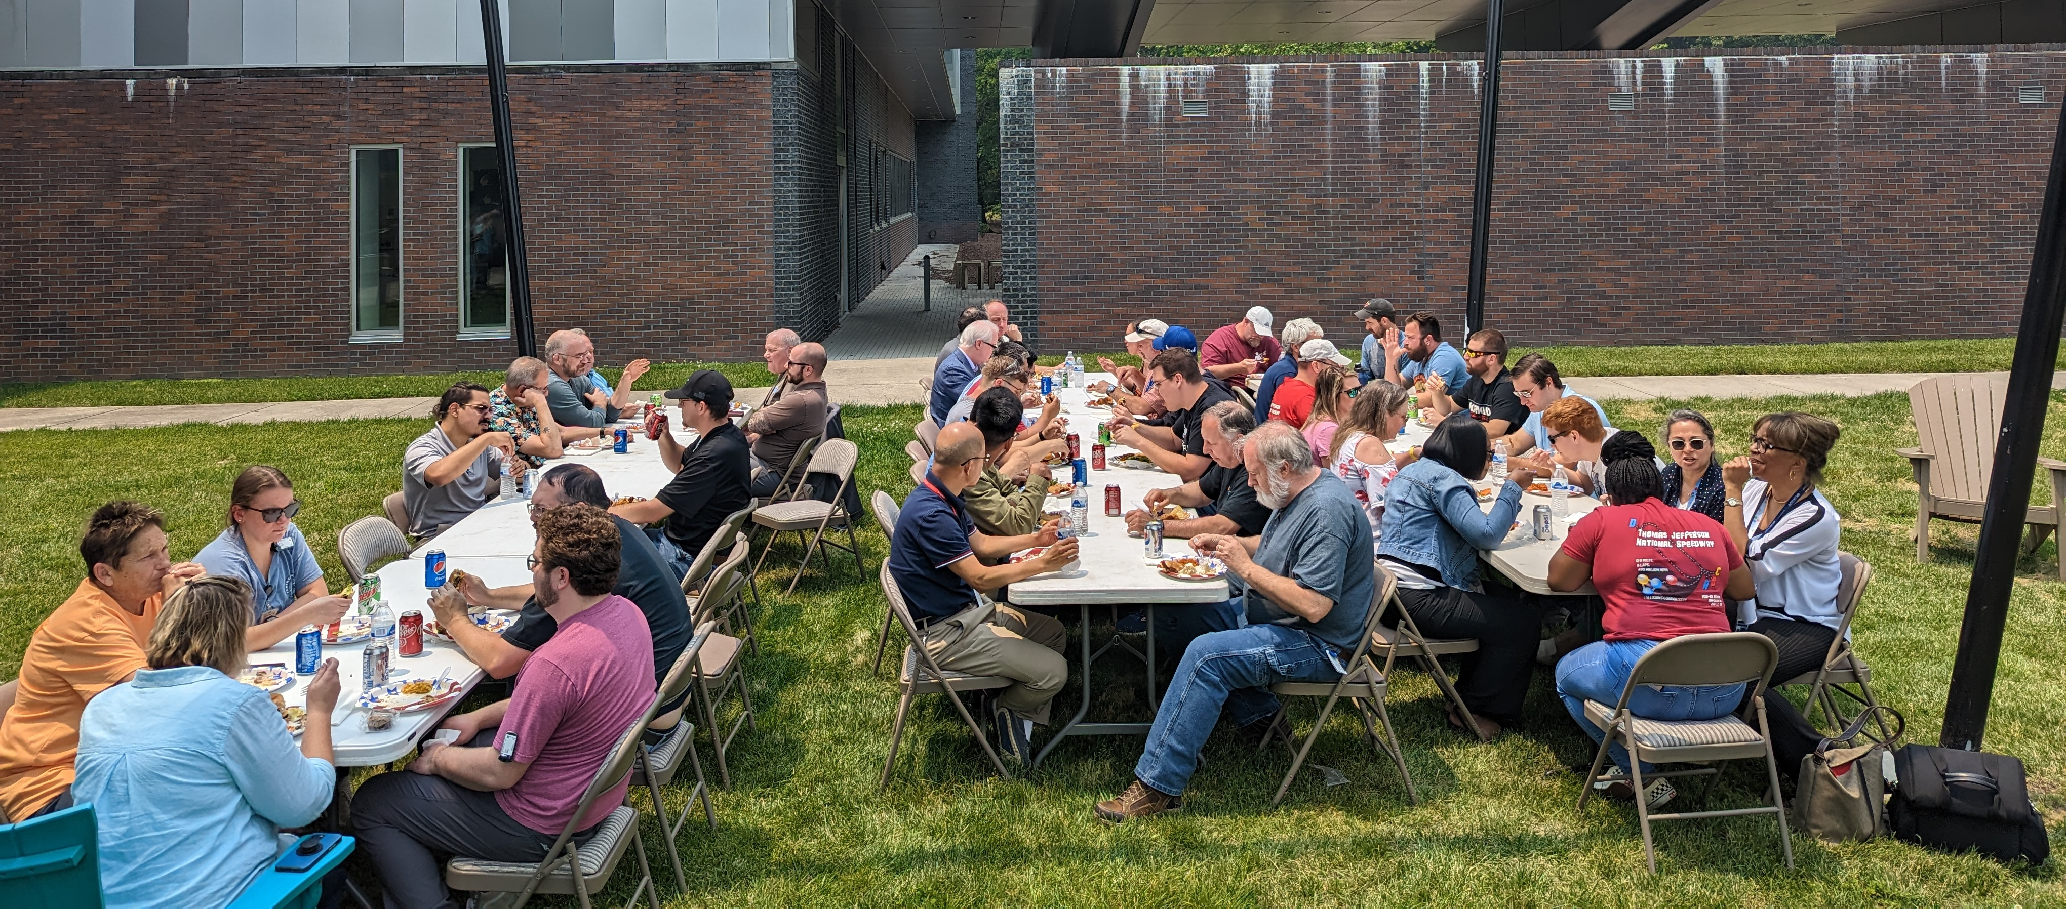
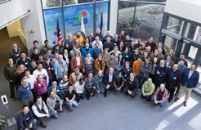
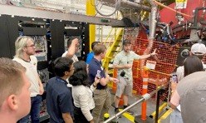
Recent Safety Events Demand our Collective Attention
DOE Labs have experienced a rash of safety events: SLAC and Fermilab
We have had our own very serious and disturbing events in the last six weeks
We’ve implemented three processes in order to ensure that we are working safely:
  Lockout-Tagout pause/restart process
  After-hours work restrictions
  Pause and restart of high hazard work
Bottom line:
If we don’t work safely, we won’t be able to work at all, and won’t deliver our mission
Look out for yourselves and your co-workers, your students: you’re doing this for you, your teammates and your families

Slide 10
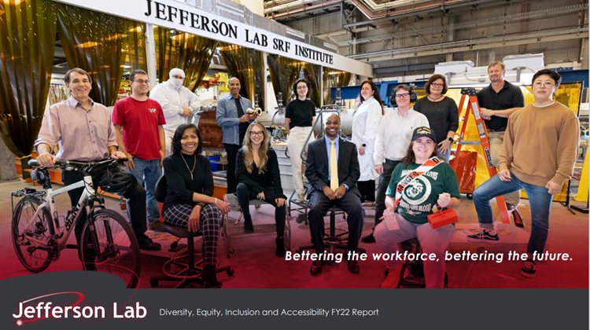
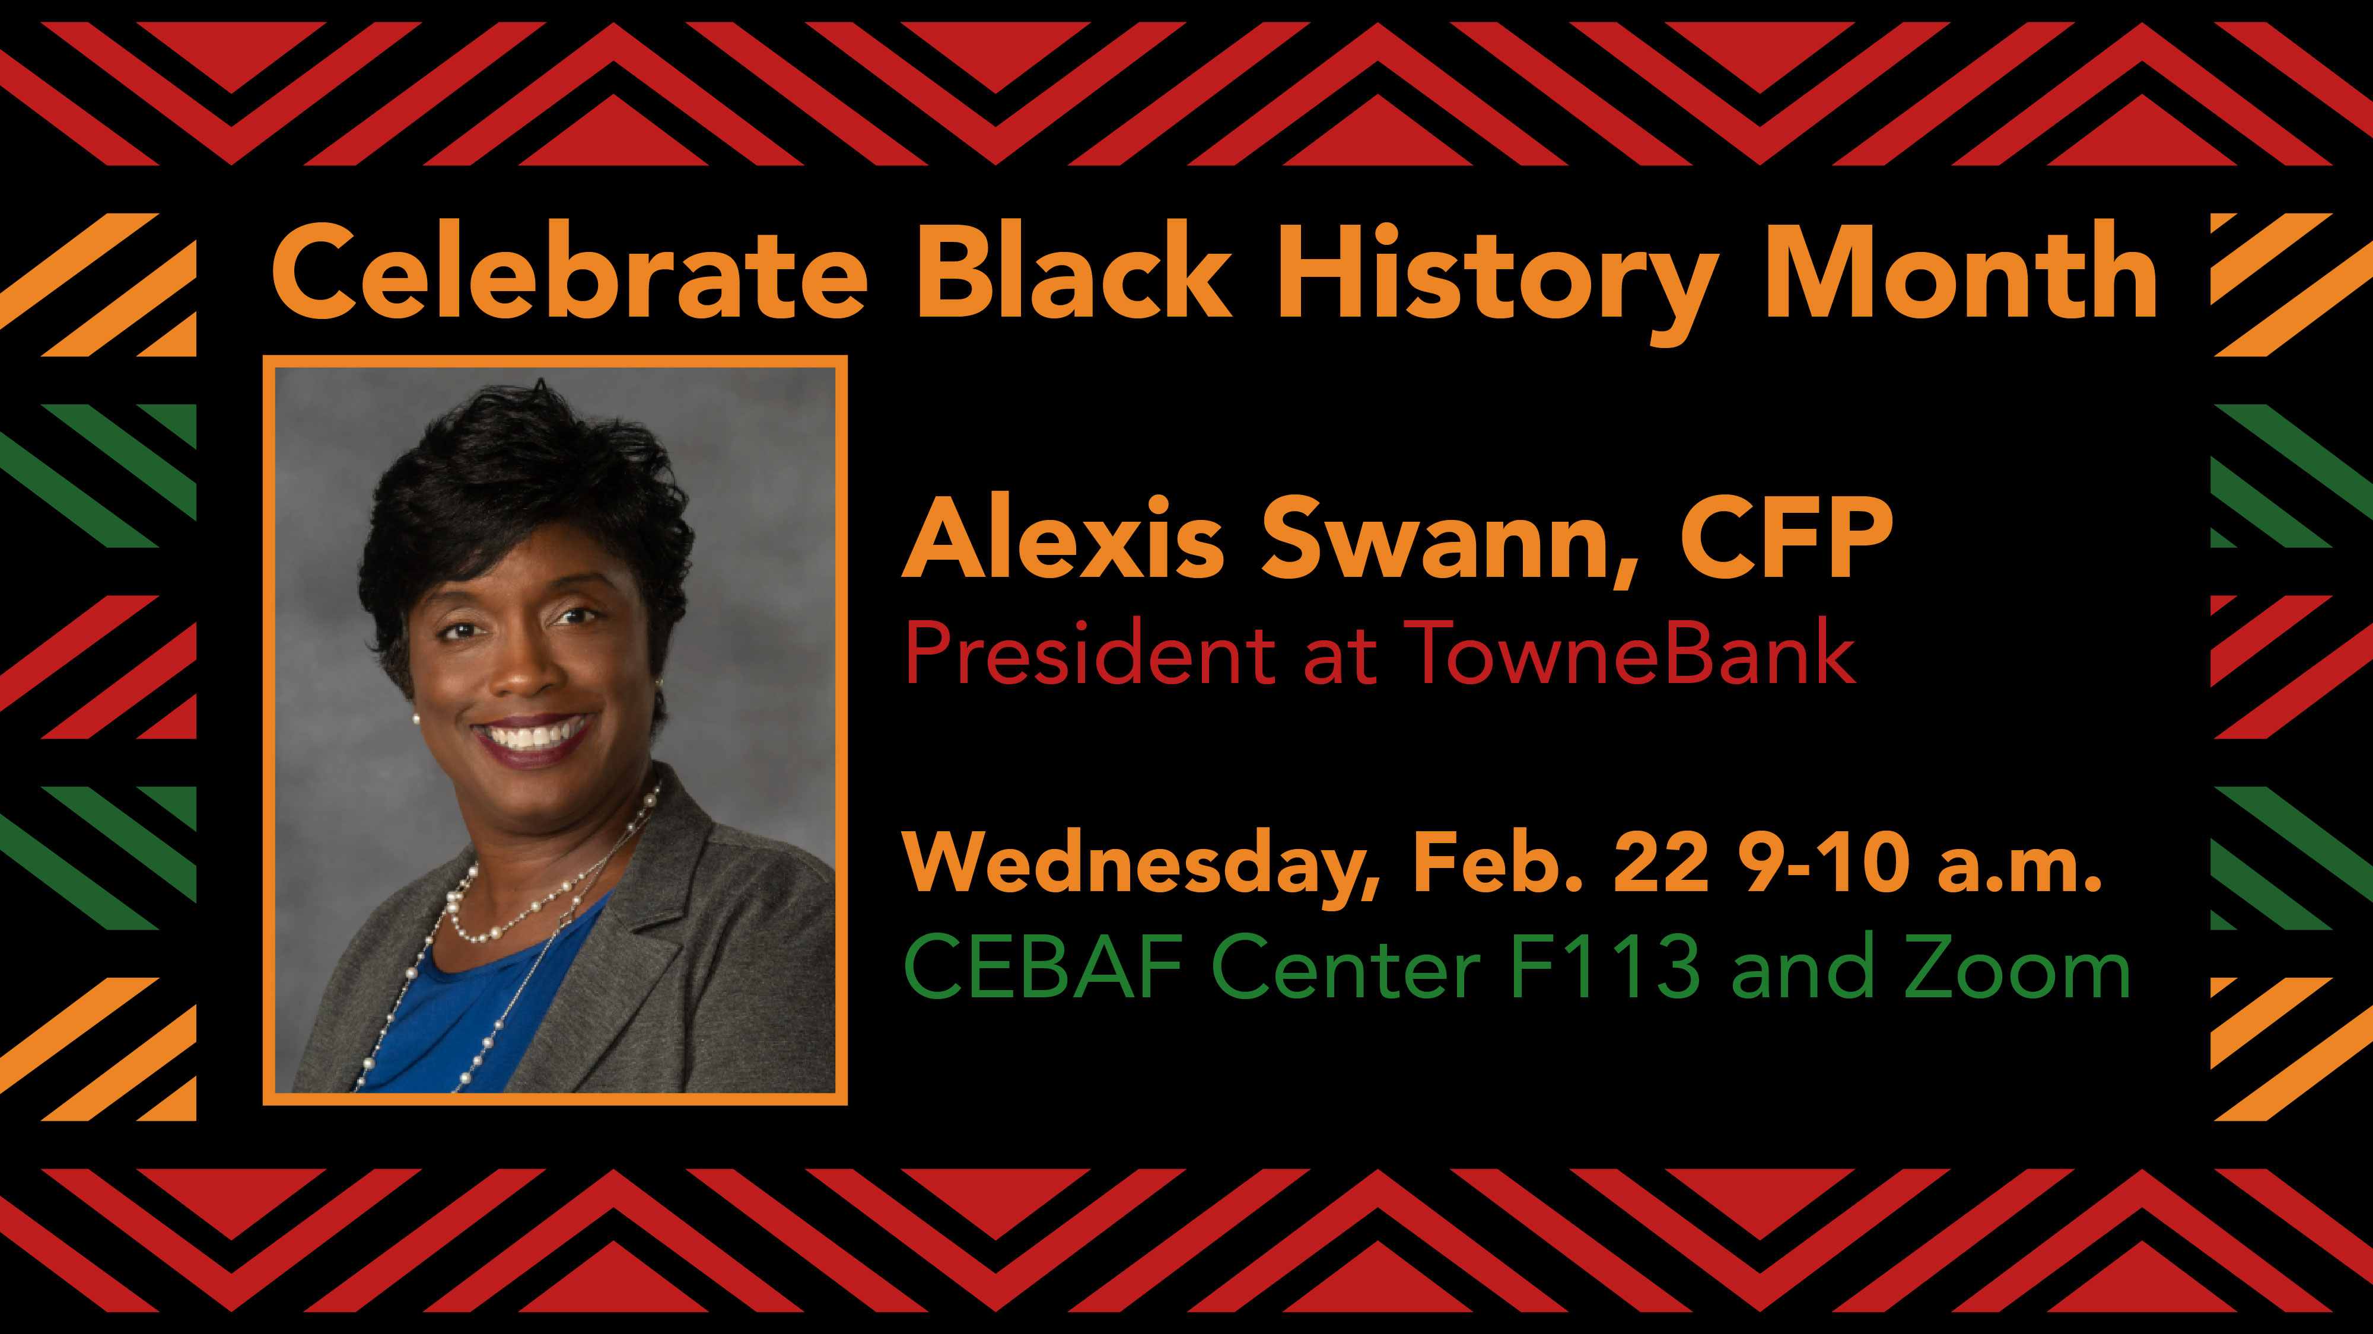
Diversity, Equity, Inclusion and Accessibility are Uncompromising Values
Status Update
Completed second Inclusion Survey with ~70% staff participation and 17% user participation
Identified areas of focus, in particular:
  Recognition & Rewards – Enhancing and reintroducing an employee recognition and rewards program
  Communication & Voice – Having Regular All-Hands and Division meetings to deliver more timely communication
  Decision Making –Piloting Just a Cup mentoring program to promote networking, skill development and information sharing, that supports decision making.
Each Division and DEIA Focus Group Leader will have meetings to provide further insights into their results
Developed and published the lab’s first diversity, equity, inclusion and accessibility (DEIA) report, which provided an overview of the DEIA program, FY22 accomplishments and planned initiatives going forward
For more information on DEI initiatives, visit the DEI website https://www.jlab.org/human_resources/diversity
These activities are making Jefferson Lab a more inclusive and welcoming workplace
10

Slide 11
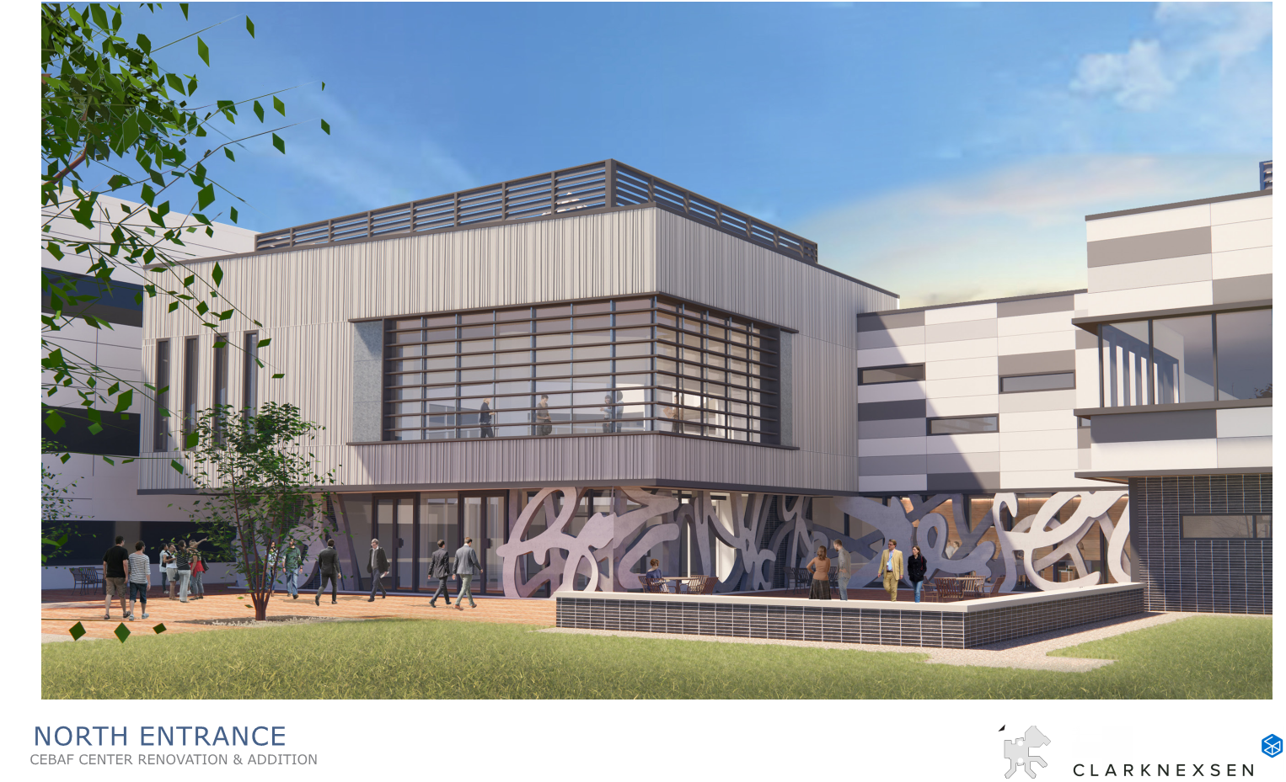
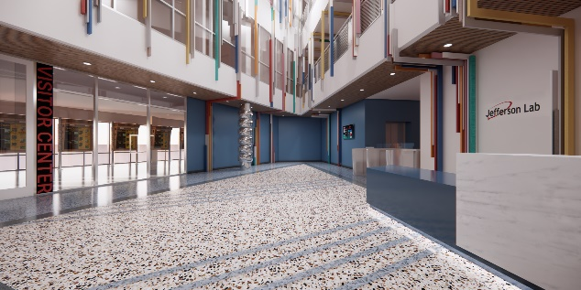
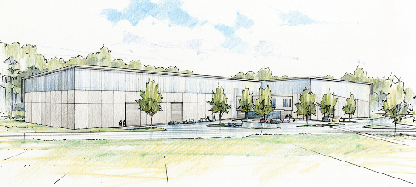
Two Significant Building Projects Are Moving Ahead
CEBAF Center Renovation and Expansion
  Modern and sustainable home for our growing staff
  Expanded collaboration spaces
Acquisition and renovation of the Applied Research Center
  Highly cost effective consolidation of administrative and support staff
  Room for expanded STEM education and public visitor center
CD-1 approved: $90.3M
CD-2/3A target 2Q FY24
Thomas Jefferson Infrastructure Improvement Project
New Test Lab High Bay Annex
  Provides needed high bay space for Physics and relieves space for SRF production
  Improves operability, safety, and security by consolidating like functions
CD-0: $98M
CD-1 target 4Q FY24
Notes:
A question I’m asked sometime is why we’re investing in buildings and Facilities when we need more funding for CEBAF?
It’s important to understand that the lab’s funding for these building projects is out of a different DOE program entirely. So this does not come out of money that we might otherwise spend on CEBAF. Another way to think about it is if we said no thanks we don’t need this funding, then that would just mean another new fancy building would be built at Berkeley, for example. It doesn’t mean we’d get that money for CEBAF.

Slide 12
Perspective
We’re making excellent progress on our nuclear physics mission with exciting science ahead. Thank you!
Our priorities are clear:
  Ensuring that the 12 GeV program is successful in all facets
  Diversifying Jefferson Lab’s scientific mission with a significant role in Advanced Computing
  Moving EIC forward aggressively
  Laying the groundwork for an exciting role for CEBAF in the EIC era
Thank you for your continued enthusiasm and support for Jefferson Lab and your partnership in the lab’s future

