Slide 1

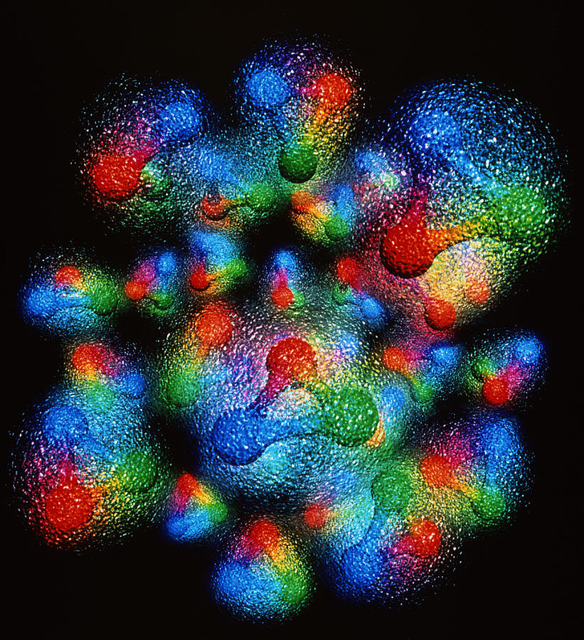


CNF GPD Workshop
Outlook and Path Forward

Slide 2
Two days of intense discussions on the path forward for extracting GPDs from data:
56 registered participants
16 talks
4 discussion sessions on intersections and open questions in:
    Experiment
    Theory/Phenomenology
    Lattice QCD
    Machine Learning

Slide 3
A vibrant community is emerging with several collaborative efforts in DOE funded programs
SCIENTIFIC DISCOVERY THROUGH ADVANCED COMPUTING (SCIDAC): PARTNERSHIP IN NUCLEAR ENERGY
TOPICAL COLLABORATIONS IN NUCLEAR THEORY
ARTIFICIAL INTELLIGENCE AND MACHINE LEARNING FOR AUTONOMOUS OPTIMIZATION AND CONTROL OF ACCELERATORS AND DETECTORS
and
EUROPEAN COLLABORATIONS

Slide 4
Proposed Infrastructure:
Database
  experimental data,
  lattice QCD results,
  phenomenological model projections
Dedicated space/resources for smaller meetings on specific topics

Slide 5
C. Hyde
Short term goals in Theory/Experiment/ML:
How do we compare theory to experiment?
  Are we in a parton physics dominated region where factorization applies? DVCS vs. TCS tests
  UNCERTAINTY QUANTIFICATION!! (M. Almaeen, M. Schram and discussion led by A. Courtoy)
P. Chatagnon

Slide 6
Short term goals in Theory/Experiment/ML:
How do we include lattice QCD?
  What precision is needed?
  What value of ξ is best?
From form factors to x-dependent quantities:
  What value of ξ is best?
  Uncertainty treatment in combining lattice and experiment (M. Constantinou, J. Karpie)
H.-W. Lin
J. Karpie

Slide 7
More open questions: perturbatve evolution, best representation of images, ….
On live document
https://docs.google.com/document/d/1c22dq6Sd7fxxJJ6bAXVXeWZVwveyMiVgzroD1VbMUR8/edit

