Slide 1

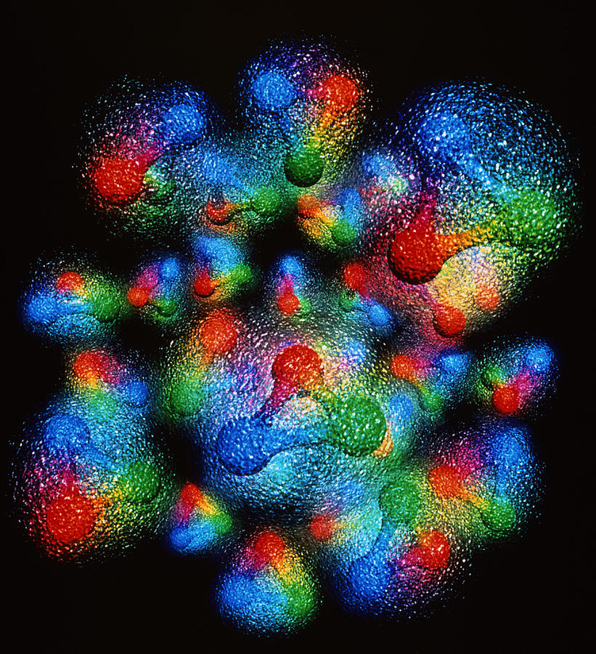


CNF GPD Workshop Discussion Session

Slide 2

Hall A DVCS results @12 geV
Charles Hyde
Helicity conserving terms e.g. $ℋ_{++}$ shown,
error bands include effects of $ℋ_{0+}$ and $ℋ_{−+}$

Slide 3
Zhite Yu

Slide 4
Y. Guo

Slide 5
P. Chatagnon

Slide 6
H. Dutrieux

Slide 7


Slide 8
B. Kriesten and S.L.
Flavor separation
ERBL
DGLAP
ERBL
DGLAP

Slide 9
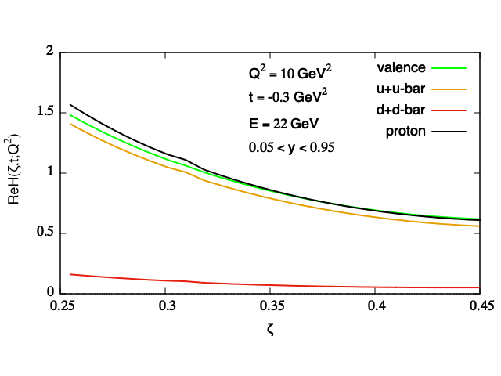
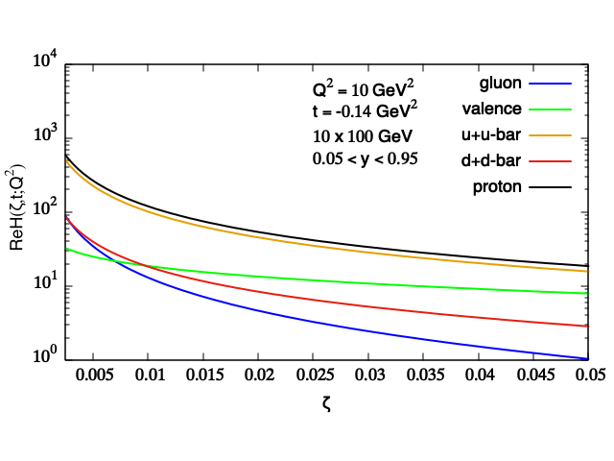
B. Kriesten and S.L.
Two different machines/two different regimes
Jlab
EIC

