Slide 1
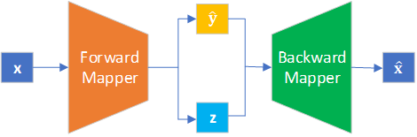
Unraveling inverse problems in QCD with ML algorithms
Yaohang Li
Department of Computer Science
Old Dominion University
yaohang@cs.odu.edu
6/13/2023 @CNF GPD and Global Analysis Workshop

Slide 2
Agenda
The Inverse Problem
Variational Autoencoder Inverse Mapper (VAIM) – an End-to-End Framework for Inverse Problem
  Fundamental Idea
  Toy Inverse Problems
  Extracting QCF from DIS Data
Point Cloud-based VAIM
  Extracting QCF from DIS Data
Extraction of Crompton Form Factor as an Inverse Problem

Slide 3
The Inverse Problem
The Forward Problem (Normal Problem)
  Use the model parameters to calculate the observables
The Inverse Problem
  Use the results of actual observables to infer the values of the parameters characterizing the system

Slide 4
The Challenges of Solving the Inverse Problem
Ill-posedness
  Different values of the model parameters may be consistent with the observables
Curse of Dimensionality
  Need to explore a huge, high-dimensional parameter space
  Finding a needle in a haystack

Slide 5
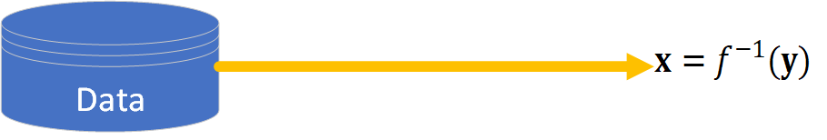
End-to-End Learning for Inverse Problems

Slide 6
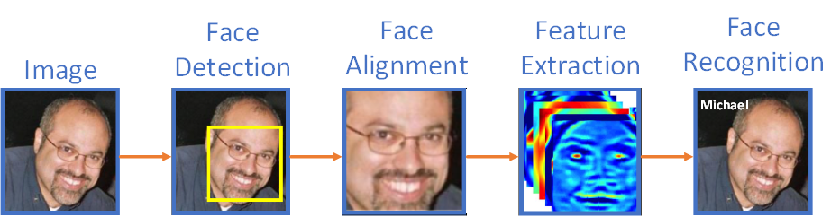
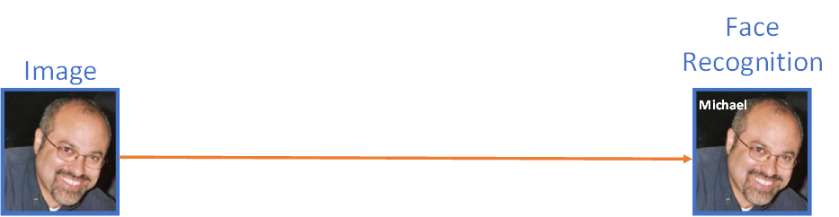
End-to-End Learning
End-to-End Learning
  Machine learning model automatically learns all features
  Directly convert input data into output prediction
Classical Machine Learning
End-to-end Learning

Slide 7
Agenda
The Inverse Problem
Variational Autoencoder Inverse Mapper (VAIM) – an End-to-End Framework for Inverse Problem
  Fundamental Idea
  Toy Inverse Problems
  Extracting QCF from DIS Data
Point Cloud-based VAIM
  Extracting QCF from DIS Data
Extraction of Crompton Form Factor as an Inverse Problem

Slide 8
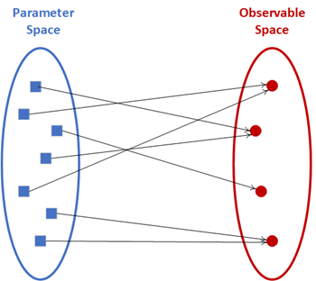
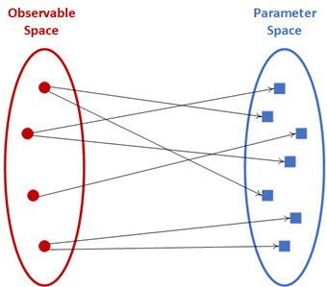



Ill-posedness of Inverse Problems
Forward Mapper
Backward Mapper
well-posed
ill-posed

Slide 9
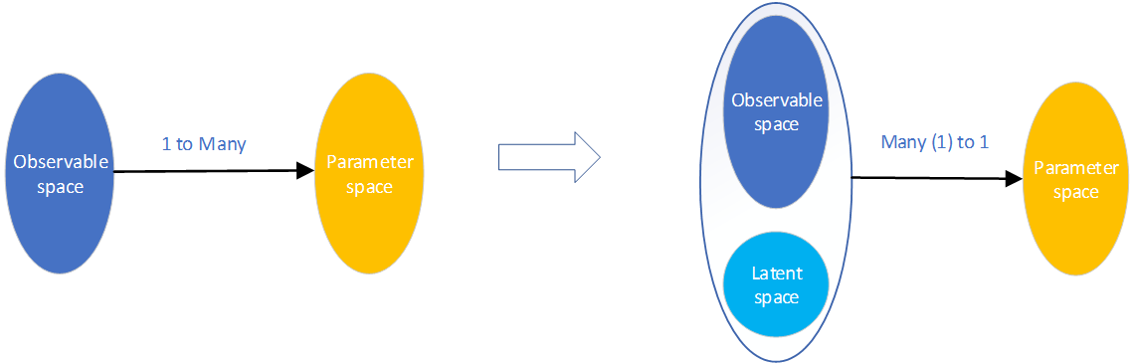
Fundamental Idea
Variational Autoencoder Inverse Mapper
Inverse Problem
VAIM
ill-posed
well-posed

Slide 10
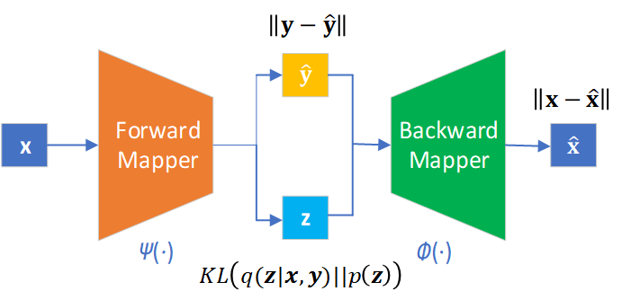
Machine Learning Architecture
Variational Autoencoder Inverse Mapper
Predicted Observables
Parameters
Reconstructed Parameters
Latent Variables

Slide 11
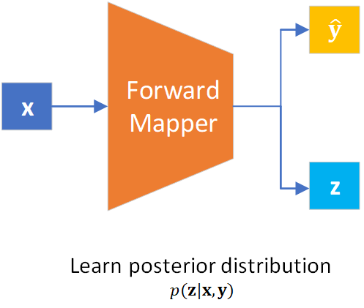
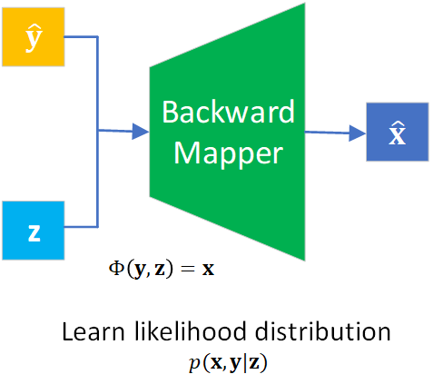

Forward Mapper and Backward Mapper

Slide 12
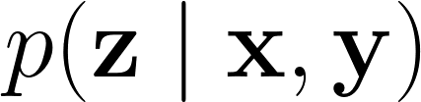
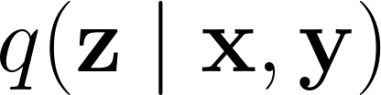
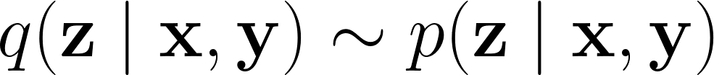
Math behind Variational Autoencoder Inverse Mapper
Approximate
True posterior distribution
Variational Inference
Learn an approximate distribution such that
Minimize the Kullback-Leibler (KL) divergence

Slide 13

Math behind Variational Autoencoder Inverse Mapper (cont.)
Variational Autoencoder Theory
Equivalent to
True prior distribution
  Select tractable distribution easy to generate
    Gaussian
    Uniform

Slide 14
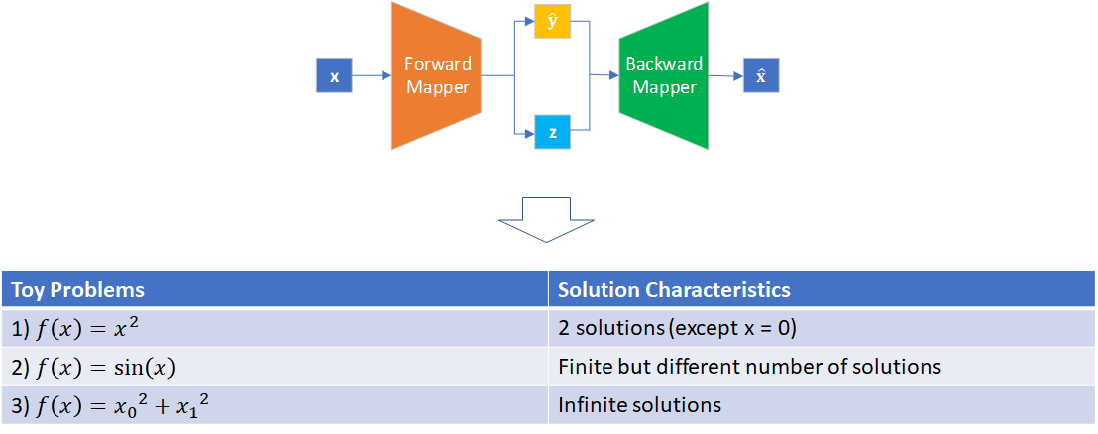
Toy Inverse Problems

Slide 15

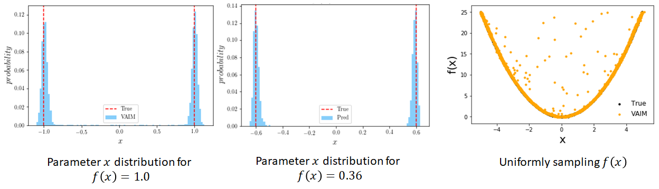
Toy Problem 1)

Slide 16
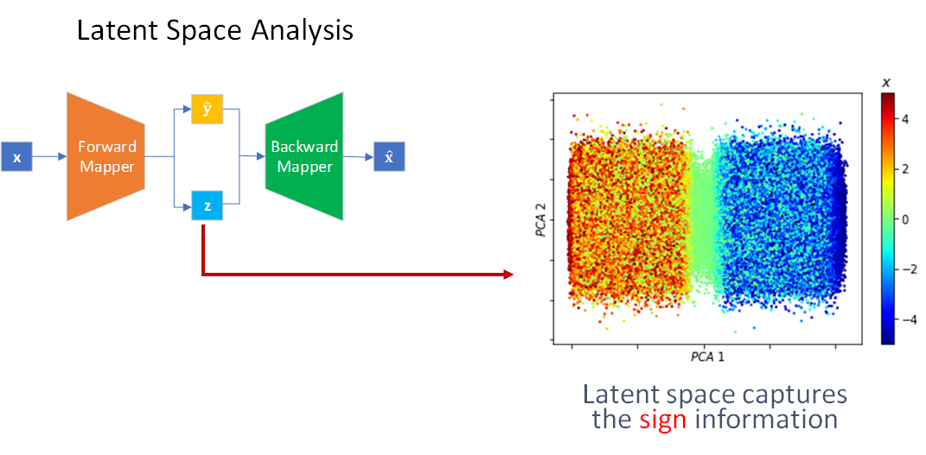
Toy Problem 1)

Slide 17
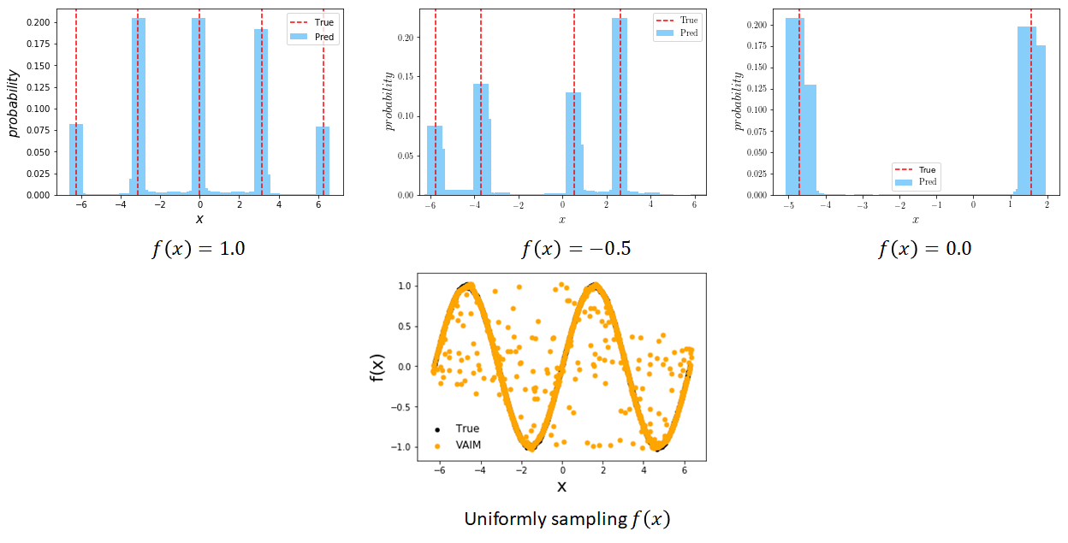
Toy Problem 2)

Slide 18
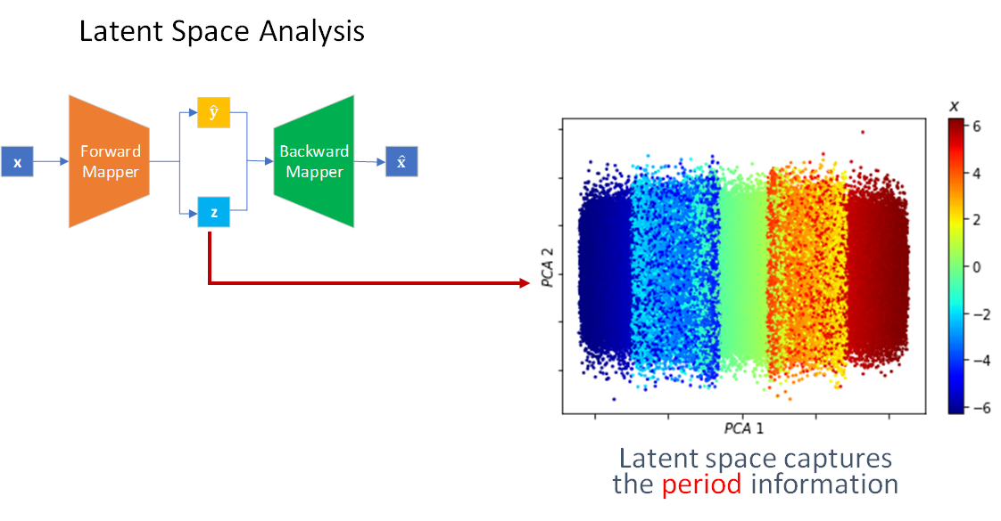
Toy Problem 2)

Slide 19

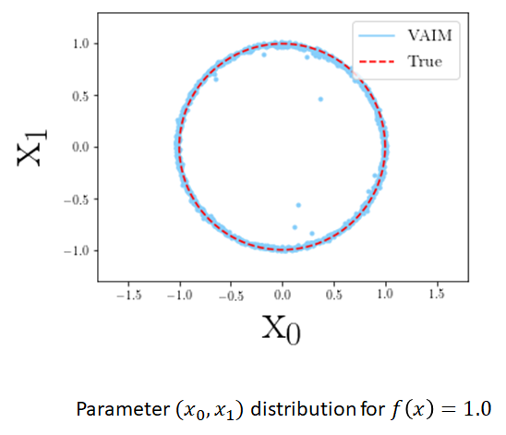
Toy Problem 3)

Slide 20
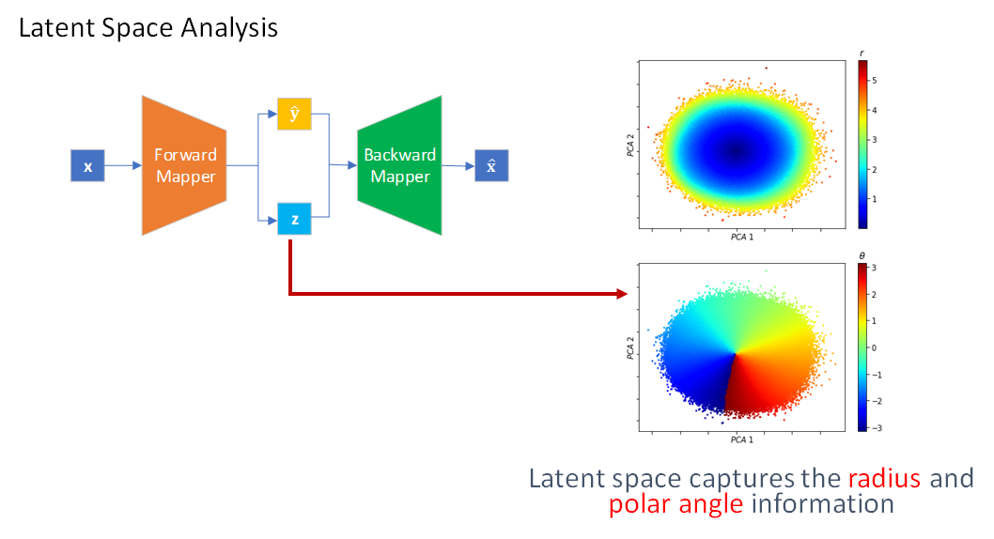
Toy Problem 3)

Slide 21
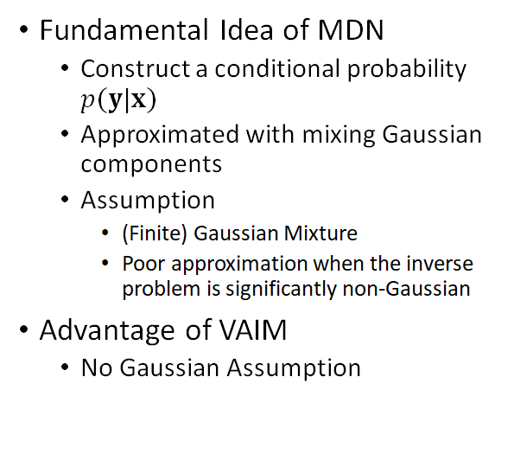
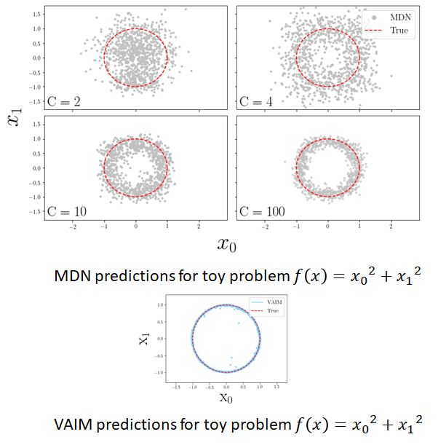
Comparison with Mixture Density Network (MDN)

Slide 22
Comparison with Invertible Neural Networks (INN)
Invertible Neural Networks (INN)
  Maximum Mean Discrepancy (MMD)
  Degrade polynomially at best as dimension increases
VAIM
  KL-divergence
  Degrade constantly as dimension increases
Ardizzone et al., arXiv:188.04730

Slide 23
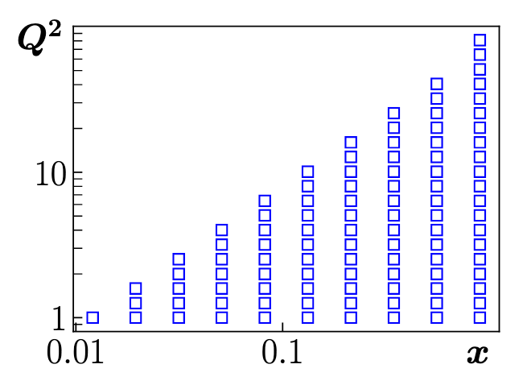
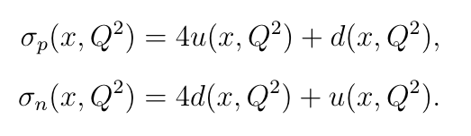
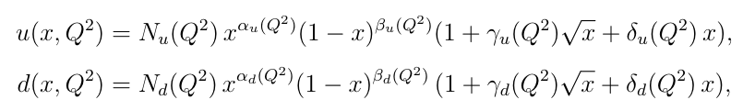


Extraction of Quantum Correlation Functions from Deep-inelastic Lepton-Nucleon Scattering (DIS) Data
Phase Space
Observables
PDFs with DGLAP like behavior
Shape parameters are parameterized as

Slide 24
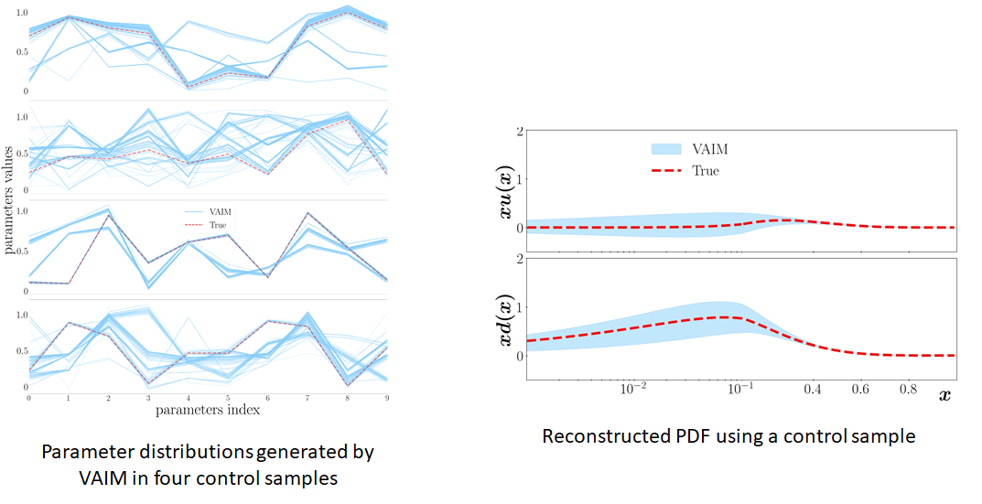
VAIM Results in Toy DIS Problem

Slide 25
Agenda
The Inverse Problem
Variational Autoencoder Inverse Mapper (VAIM) – an End-to-End Framework for Inverse Problem
  Fundamental Idea
  Toy Inverse Problems
  Extracting QCF from DIS Data
Point Cloud-based VAIM
  Extracting QCF from DIS Data
Extraction of Crompton Form Factor as an Inverse Problem

Slide 26
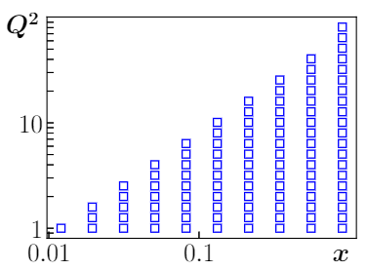
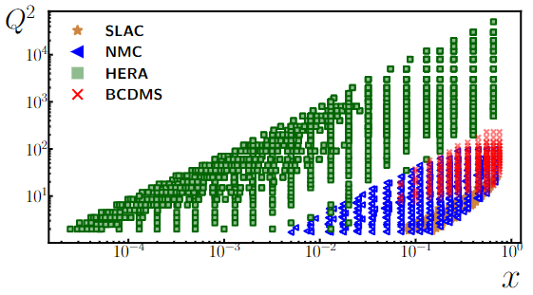
Point Cloud-based VAIM (PC-VAIM)
Limitation of VAIM: Observables across regular, discretized kinematic bins
Reality: Observables are ill-defined
Data in different experiments are observed on different kinematic bins
Regular, discretized kinematic bins of x and Q² where cross sections are evaluated
Kinematic bins of SLAC, NMC, HERA, and BCDMS experiments

Slide 27
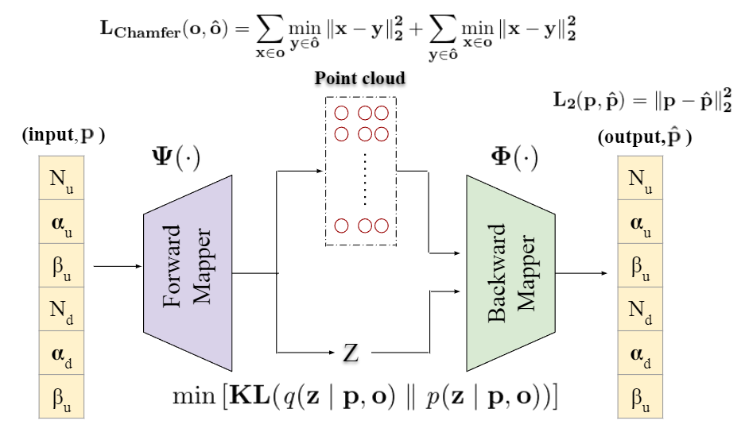
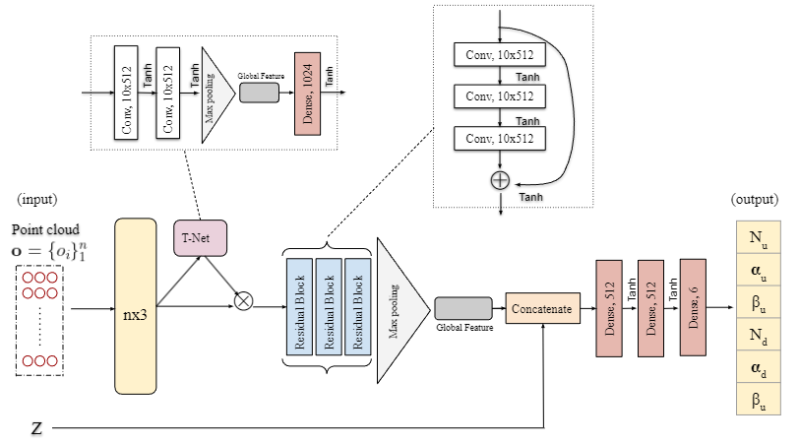
PC-VAIM Architecture
Overall Architecture
Backward Mapper: A PointNet-based architecture is used to handle the point cloud observable input

Slide 28
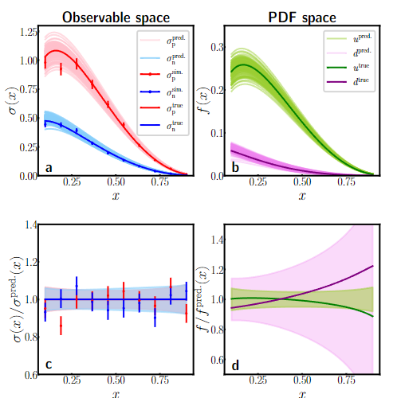
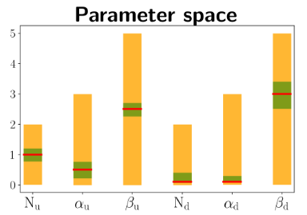
PC-VAIM on Extracting QCFs from Grid-Independent DIS data
PC-VAIM predictions on 1, 000 simulated control samples given by σ_{p}^{sim} and σ_{n}^{sim}. (a) Reconstructed observable σ_{p} and σ_{n} for the PC-VAIM predicted parameters using physics theory model. (b) PDFs for the “up” and “down” quarks produced by physics theory model corresponding to the predicted parameters. (c) Ratio of the reconstructed observables over the true observables. (d) Ratio of the reconstructed PDFs over the true. PC-VAIM correctly learns the mapping between the observable space and the PDF space.
Parameter regions from which the training samples are drawn (orange), the control data (red), and PC-VAIM predictions (green band)

Slide 29
Agenda
The Inverse Problem
Variational Autoencoder Inverse Mapper (VAIM) – an End-to-End Framework for Inverse Problem
  Fundamental Idea
  Toy Inverse Problems
  Extracting QCF from DIS Data
Point Cloud-based VAIM
  Extracting QCF from DIS Data
Extraction of Crompton Form Factor as an Inverse Problem

Slide 30
Extraction of Compton Form factors
Generalized Parton Distributions (GPDs)
  Multi-dimensional descriptions of proton structure
Deeply virtual exclusive scattering processes
  Golden channel for the extraction of information on partonic 3D dynamics in the nucleon
Compton Form Factors (CFFs)
  2D Slices of GPDs
  Measured in Deeply Virtual Compton Scattering (DVCS)
  Contain potentially new information on hadronic structure

Slide 31
Extraction of CFFs as an Inverse Problem
Extraction of 8 CFFs from a single polarization observable
  An inverse problem of extracting 8 unknowns from a single equation
  Quantification of information extracted from experiments
$$Re\left(H\right),Im\left(H\right),Re\left(\tilde{H}\right),Im\left(\tilde{H}\right),Re\left(E\right),Im\left(E\right),Re\left(\tilde{E}\right),Im\left(\tilde{E}\right)$$

Slide 32
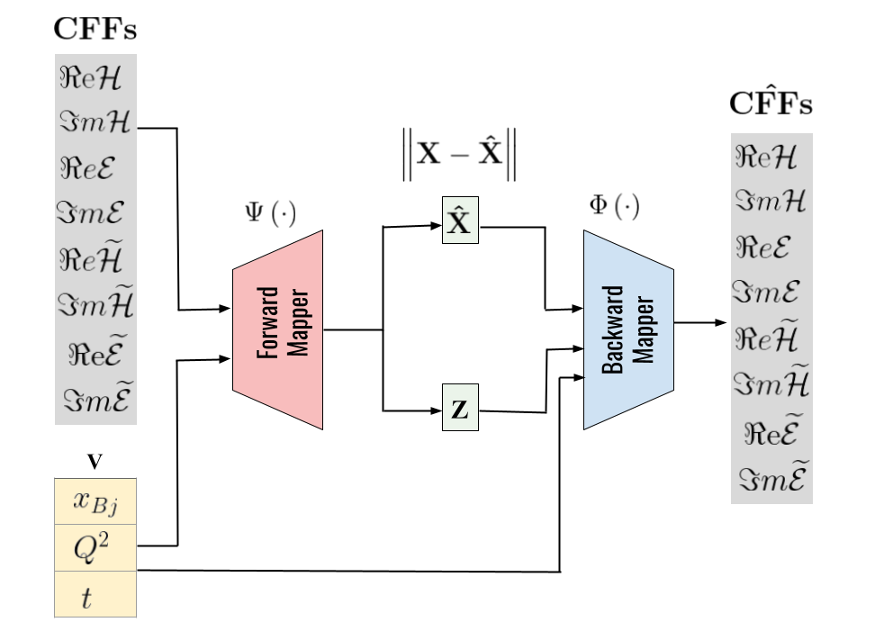
Conditional VAIM Architecture for CFF Extraction
Cross Sections

Slide 33
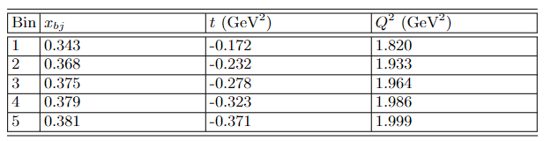
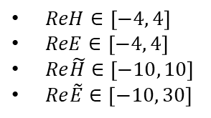
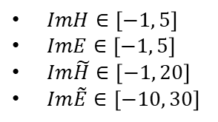
Training of Conditional VAIM
Training Data:
  Kinematics values
  Generate uniformly distributed CFFs
  Compute cross sections
    $ReH∈\left[−4, 4\right]$
    $ReE∈\left[−4, 4\right]$
    $Re\tilde{H}∈\left[−10, 10\right]$
    $Re\tilde{E}∈\left[−10, 30\right]$
    $ImH∈\left[−1, 5\right]$
    $ImE∈\left[−1, 5\right]$
    $Im\tilde{H}∈\left[−1, 20\right]$
    $Im\tilde{E}∈\left[−10, 30\right]$

Slide 34
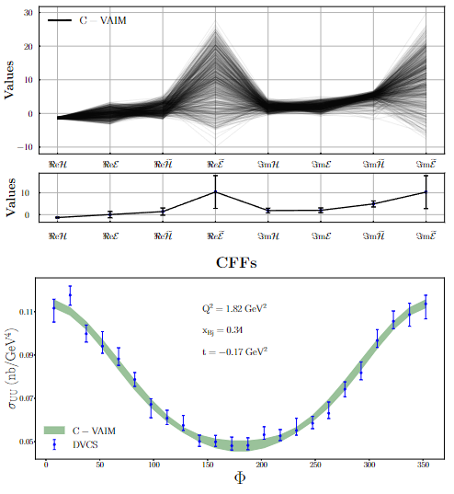
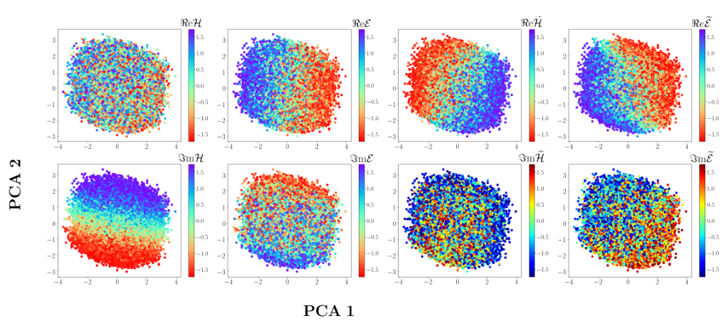
Prediction of CFFs
Predicted CFFs from VAIM-CFF
  X_{Bj} = 0.343
  t = -0.172 GeV²
  Q² = 1.820 GeV²
Latent Space Analysis

Slide 35
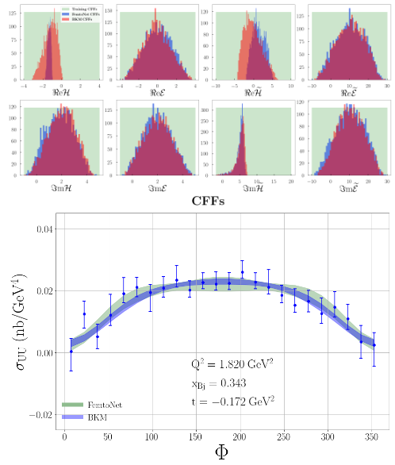
Training C-VAIM on Different Cross-section Formulations
Two Cross-section Formulations
  FemtoNet (UVA)
  BKM (Belitksy, Kirchner, Mueller)
Kinematics
  X_{Bj} = 0.35
  t = 0.172
  Q² = 1.9 GeV²
  Eb = 5.75 GeV

Slide 36
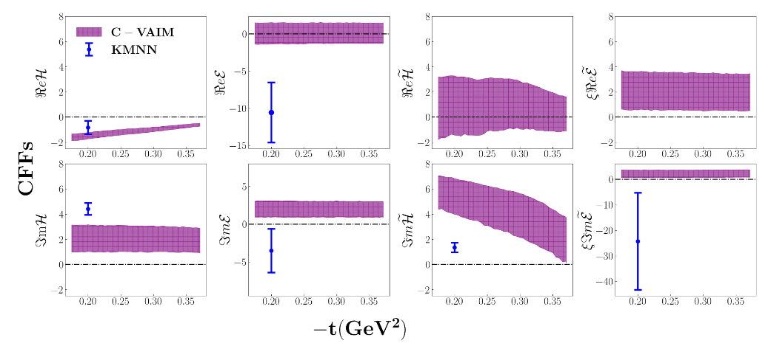
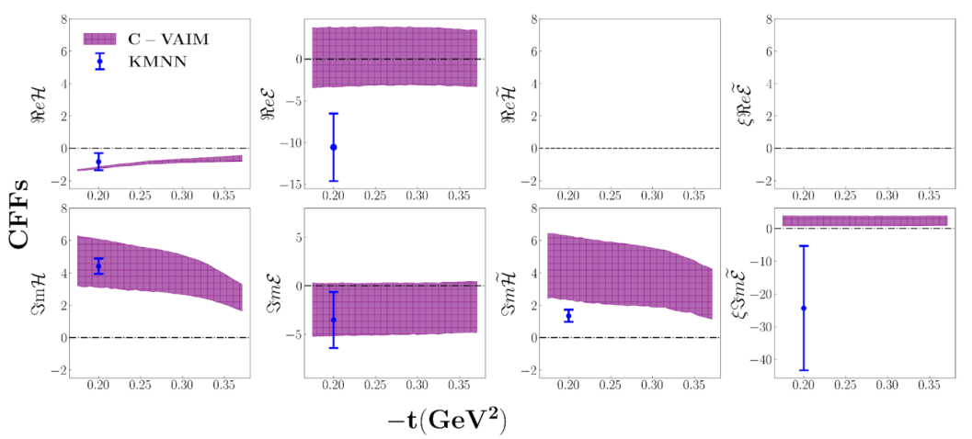

Prediction of CFFs w.r.t. t
Prediction of CFFs as a function of the Mandelstam variable t for Jlab 6GeV Kinematics
  X_{Bj} = 0.35
  Q² = 1.9 GeV²
All 8 CFFs
Fixing $Re\tilde{H}=0$, $Re\tilde{E}=0$

Slide 37
Summary
VAIM
  An end-to-end deep learning model works well in inverse problems with very different solution patterns
    A hybrid of supervised and unsupervised learning
  PC-VAIM is able to handle irregular observable inputs
  Applications in Extracting QCFs from DIS Data
  Applications in Extracting CFFs
Challenges
  Stability
  Robustness
  Programming physics into the deep learning framework

Slide 38
References
M. Almaeen, Y. Alanazi, N. Sato, W. Melnitchouk, M. P. Kuchera, Y. Li., “Variational Autoencoder Inverse Mapper: An End-to-End Deep Learning Framework for Inverse Problems.” Proceedings of International Joint Conference on Neural Networks (IJCNN2021), 2021.
M. Almaeen, Y. Alanazi, N. Sato, W. Melnitchouk, Y. Li, “Point Cloud-based Variational Autoencoder Inverse Mappers (PC-VAIM) - An Application on Quantum Chromodynamics Global Analysis,” Proceedings of IEEE International Conference on Machine Learning and Applications (ICMLA2022), 2022.
M. Almaeen, J. Grigsby, J. Hoskins, B. Kriesten, Y. Li, H-W. Lin, S. Liuti, “Benchmarks for a Global Extraction of Information from Deeply Virtual Exclusive Scattering,” arXiv:2207.10766, 2022.
M. Almaeen, J. Hoskins, B. Kriesten, Y. Li, H-W. Lin, S. Liuti, “VAIM - CFF: A variational autoencoder inverse mapper solution to Compton form factor extraction from deeply virtual exclusive reactions,” in preparation, 2022.

Slide 39
Acknowledgements
Collaborators
  VAIM, PC-VAIM, Extraction from DIS
    Nobuo Sato (JLab)
    Wally Melnitchouk (JLab)
    Manal Almaeen (ODU)
    Yasir Alanazi (JLab/ODU)
  CFFs Extraction
    Simonetta Liuti (UVA)
    Brandon Kriesten (CNF/UVA)
    Joshua Hoskins (UVA)
    H-W. Lin (MSU)
We thank Jianwei Qiu and Xiangdong Ji for helpful discussions.
This work was supported by the Center for Nuclear Femtography (CNF) 2020, 2021, and 2022 funds, and CNF Graduate Fellowship to Manal Almaeen.

