Slide 1


DVCS Experiments from Jefferson Lab to The EIC
Generalized Parton Distributions and Global Analysis
12-14 June 2023
Charles E. Hyde
Old Dominion University

Slide 2

Hall A/C DVCS & 𝜋⁰ at 12 GeV
E12-06-114
  DVCS: F.Georges et al, Phys.Rev.Lett. 128 (2022) 25, 252002
  Deep $π^{0}$ Phys.Rev.Lett. 127 (2021) 15, 152301
  50% complete, 38 PAC days added to Hall-C NPS in Jeopardy review
NPS Run August 2023-March 2024
  E12-13-010 Hydrogen (53 days)
  E12-22-006: Deuterium (44 days)
Future NPS runs on Wide Angle (real) Compton Scattering

Slide 3
Hall A/C Past, Present, and FUTURE DVCS
Mostly to be completed by 2024
  Possibly ~40 days still pending after first NPS run.
Some kinematic adjustments for actual beam energies (e.g. 10.4, 10.6 GeV, rather than 11 GeV)

Slide 4

Hall A 12 GeV DVCS results:
F.Georges et al, Phys.Rev.Lett. 128 (2022) 25, 252002
Analyzed in terms of W.Braun, et al formalism.
  Light cone defined by q & q’ (virtual photon and emitted real photon)
  Helicity CFFs: $H_{λ′λ}$. $E_{λ′λ}$. ${\tilde{H}}_{λ′λ}$. ${\tilde{E}}_{λ′λ}$
  Hypothesis: at fixed x_{B} , each CFF is independent of Q²
    Neglect QCD evolution
    All higher-twist effects are contained in helicity flip CFFs:
    Real & Imaginary parts of CFFs extracted from E_{e}, Q², $φ_{γγ}$ dependence of kinematic factors at fixed x_{B}

Slide 5

Hall A DVCS results @12 geV
Helicity conserving terms e.g. $ℋ_{++}$ shown,
error bands include effects of $ℋ_{0+}$ and $ℋ_{−+}$

Slide 6
Deep 𝜋⁰
Hall A 6 GeV L/T separations show Transverse-dominance
  T-enhancement from 𝜒SB: Liutti et al, Goloskokov &Kroll
    Access to Transversity GPDs
  Supported by 𝜀𝜎_{L}+𝜎_{T}, 𝜎_{TL ,} 𝜎_{TT} results from CLAS
  12 GeV L/T separations planned with NPS run 2023-2024
Flavor separations from D + H data and 𝜂-production (CLAS)

Slide 7
DVCS @ CLAS12
RG-A Hydrogen Target (200 days approved, plus RG-K)
  ~50% of data acquired
RG-B Deuterium Target (90 days approved)
  ~50% of data acquired
RG-C Longitudinally polarized LH₃ and LD₃ (80 days approved).
  100% data taking completed March 2023
RG-L “ALERT” active and/or spectator tagging for n/p DVCS and coherent DVCS on D, He targets.

Slide 8
CLAS12:
Run Group A:
H(e,e’p𝛾)
~50% of available statistics,
~25% of total projected statistics
CLAS 12 phase space and relative count rate.
(6 GeV in red)

Slide 9
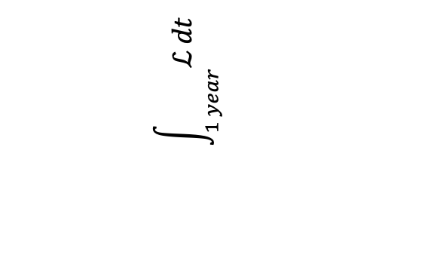
EIC Design ep Luminosity
D.Xu, et al, https://doi:10.18429/JACoW-IPAC2022-WEIXGD1
Full Luminosity with Strong Hadron Cooling (SHC)
https://doi.org/10.18429/JACoW-IPAC2022-WEIXGD1 “Collisions will occur at a range of center-of-mass energies between 29 GeV and 140 GeV”
100/fb
10x100
10x275
5x100
5x41
18x275
10/fb
$$\int_{1 year}{ℒ dt}$$

Slide 10
Proton DVCS @ EIC
ECCE Simulations ep→ep𝛾
  Acceptance in –t<0.25 GeV² is achieved with special “high acceptance” tune (larger 𝛽*) to reduce angular spread at target. Factor of ≥2 lower Lumi.
To my knowledge, no detailed simulations of CFF sensitivity yet.
Longitudinally & transversely polarized protons!

Slide 11
EIC ep and eA Luminosity
W.Fischer, IPAC2021
“High Acceptance” tune require to achieve low-t acceptance for DVCS

Slide 12
Neutron DVCS @ EIC
Polarized ³He (longitudinal & transverse, ~80%)
  Di-proton spectators from neutron DVCS in ³He emerge near 0deg with rigidity (P/Q) = 66% of beam→detected in “Off Momentum Trackers in far-forward region ≥ 20m from IP
  Active neutron detectable in ~4mr cone --> -D2<0.5 GeV2 at 183 GeV/n. Possible veto of breakup channels.
Un-polarized deuteron beams are a day-one feature
  Polarized d is an upgrade dream, but not impossible.

Slide 13
Nuclear DVCS @ EIC
The EIC ion storage ring determines the magnetic rigidity P₀ of a stored ion.
  Total ion momentum is ZP₀
  Final focus quads & emittance determine angular spread 𝜎(𝜃) ≈ 0.3 mrad at IP.
  Ion rms P_{T} = ZP₀ 𝜎(𝜃): Completely washes out diffraction patterns of nuclei.
  Reconstruct momentum transfer to nucleus without nuclear detection.
  Rapidly lose ability to detect recoil nuclei at reasonable Δ² values
Exclusive Vector meson production. Channels with all charged particles:
  (e,e’ 𝝆→𝜋⁺𝜋–), (e,e’ 𝜙→K⁺K–), (e,e’J/𝛹→e⁺e– or μ⁺μ–)
  Directly measure Δ^{μ}=(k–k’–V)^{μ} with central tracker
DVCS: ^{A}Z(e,e’𝛾) ^{A}Z feasible only with excellent 𝛾-resolution

Slide 14
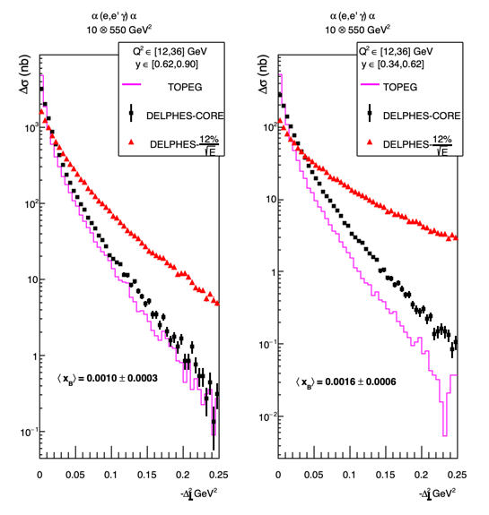
Nuclear DVCS with a 2nd EIC Detector
Downstream focus in ion beam line enables tagging/veto of all possible breakup nuclei of beams from D to Zr, and all A-2 daughters up to U.
2nd detector offers opportunity for high resolution EMCal in barrel
  Black points show PbWO₄ resolution

Slide 15
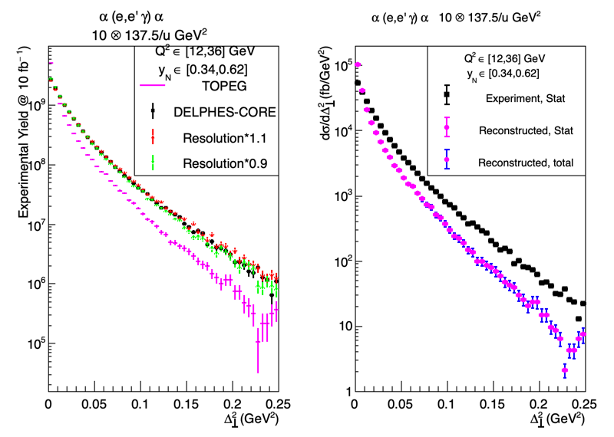
𝛼dvcs
TOPEG event generator
https://gitlab.in2p3.fr/dupre/nopeg
10 GeV e–⊗ 137.5 GeV per nucleon
DELPHES FastMC: hypothetical PbWO₄ EMCal for 𝜂<0
Systematic uncertainty in reconstructed cross section estimated by varying EMCal resolution by ±10%
Error bars from uncertainty of bin-migration remain small.

Slide 16
Nuclear DVCS Simulations
Need new MC event generators
  TOPEG is great, but infinitely slow if Re[CFF] is included
Need generators (even simplistic) for a range of nuclei
  ¹²C, ¹⁶O, … ^{40,48}Ca, … Zr, Pb
  The significance of the veto powers of the 2nd focus in IR-8 (2nd Detector) grows rapidly with Z.

Slide 17

Double DVCS
Severely Count Rate limited
  Best case (my opinion) low Q², “measure” slightly off diagonal, i.e. x=±(𝜉-𝜀):
  $GPD(ξ^{−},ξ,t)±GPD(−$ $\left(ξ^{−}\right),−ξ,t)$
  GPD has discontinuity in slope at x=±𝜉 (D-term)

Slide 18
Conclusions
Need to understand/control impact of higher-twist observables
We will always only have a discrete number of local averages of CFFs from experiments
  Need a realistic assessment of possible constraints on GPDs from data, Lattice QCD, etc.
  Also consider the physics content of the CFFs themselves:
  Transitions amplitudes (not probabilities) of x+𝜉 → x–𝜉

Slide 19
More Slides

Slide 20

Forward Tagging in EPIC
Proton DVCS detected by insertable `Roman Pot’ (RP) trackers, fixed `Off Momentum Detectors’ (OMD), and/or B0 (dipole) tracker
Spectator protons from e.g. ³He in RP or OMD
IP

Slide 21
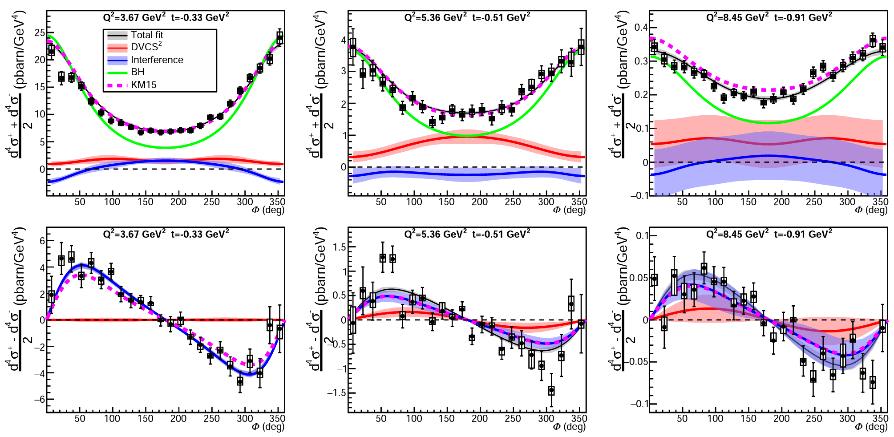
Hall A 12 GeV DVCS: cross sections
x_{B}=0.36 x_{B}=0.48 x_{B}=0.60
Dataset sample - multidimensional binning:
3 x_{B} bins ×
2-4 Q² bins ×
3-5 t bins ×
24 φ bins
More than 2000 data points in Q², x_{B}, t and φ

