Slide 1

Center for Nuclear Femtography (CNF)
Generalized Parton Distributions and Global Analysis – Workshop
Latifa Elouadrhiri
Acting Director
Newport News, Virginia
June 12, 2023

Slide 2
Mission
Supported by the Commonwealth of Virginia
Hosted at Jefferson Lab and supported SURA

Slide 3
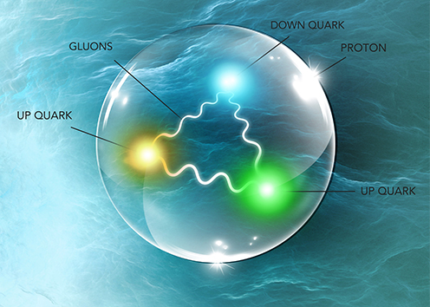
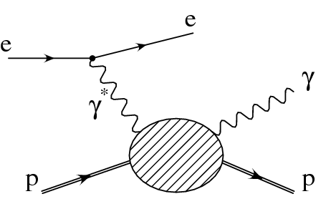
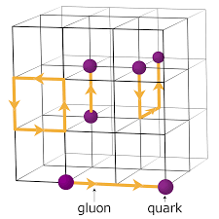
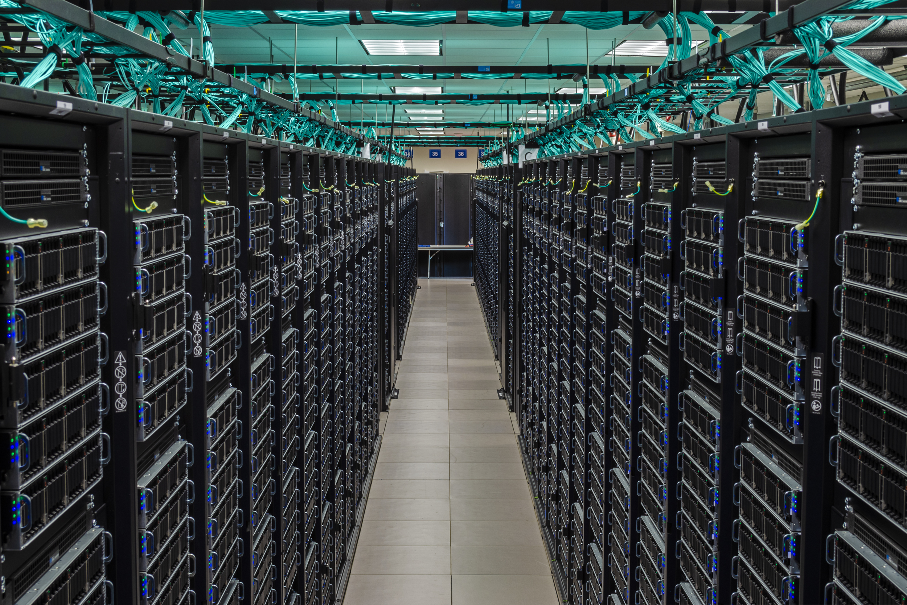
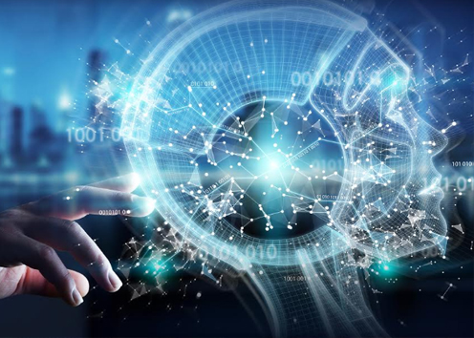
Research directions:
Imaging & Mechanical Structure of the Nucleon
Large-scale simulations of the proton structure:
Generalized parton distributions (GPDs) can be probed through processes like deeply virtual Compton scattering and provide an important tool to visualize the proton.
QCD is the fundamental theory of strong interactions. It is a field theory that can be approximated on a four-dimensional Euclidean lattice, allowing researchers to use supercomputers to simulate this theory on lattice
Machine Learning/Artificial Intelligence in Femtography
Many intermediate steps in experiment and theory involve large amounts of data and computer simulations
Using ML/AI techniques and in collaboration with computer scientists and mathematicians, nuclear physicists will be able to obtain results in a timely and resource-saving manner.

Slide 4
CNF Workshops

Slide 5
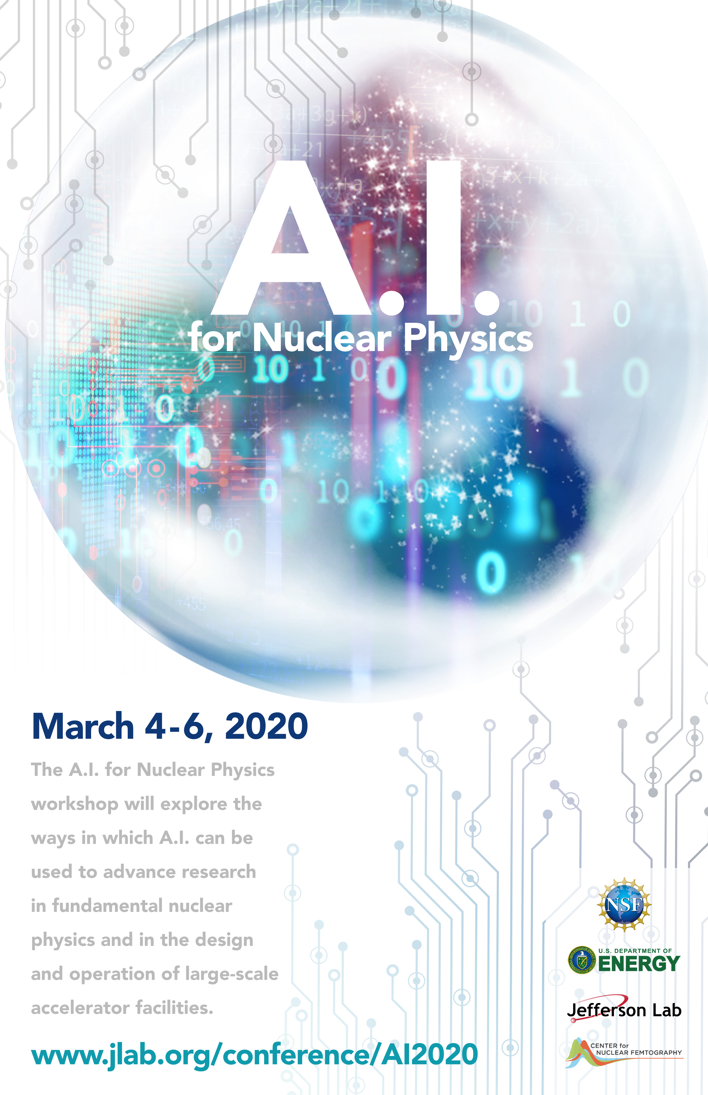
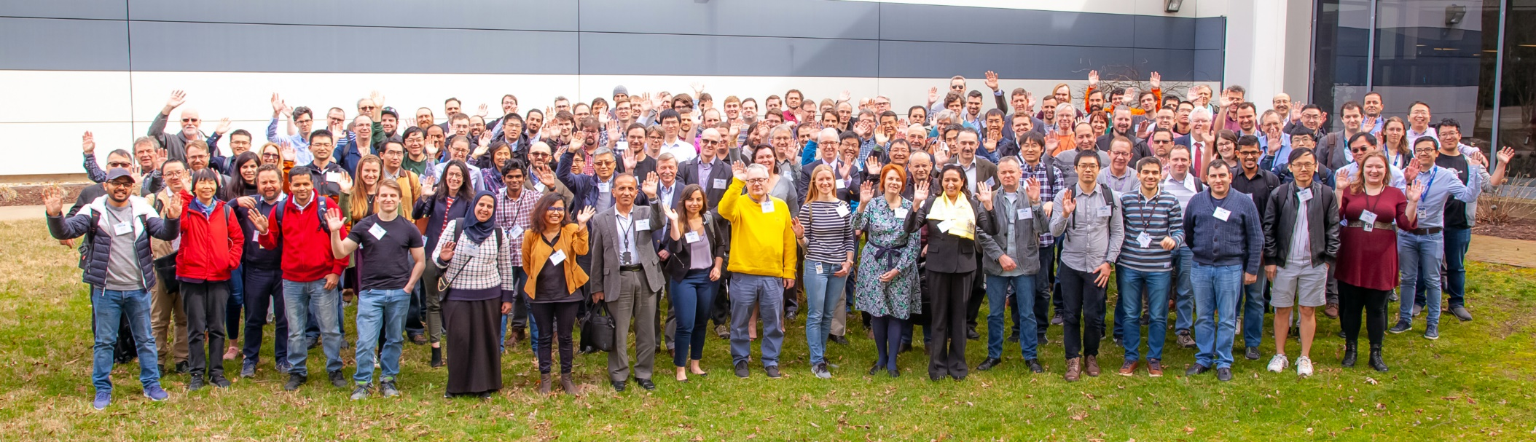
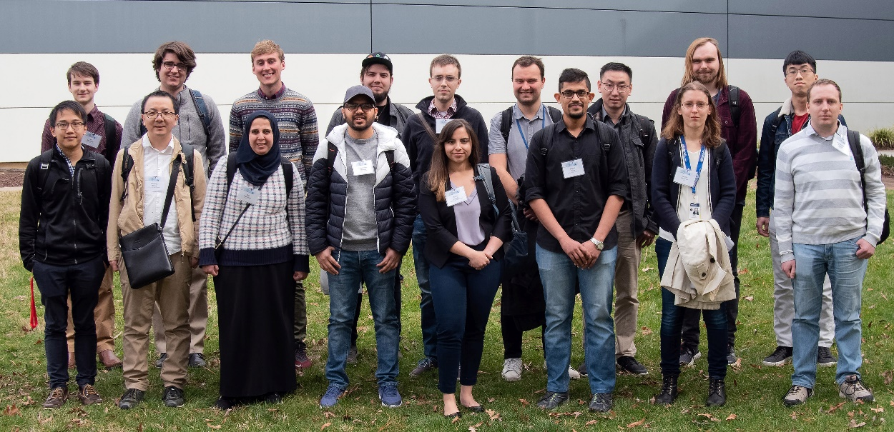
Above: 184 participants attended the March 3-6, 2020 AI Workshop for Nuclear Physics hosted Jefferson Lab and supported by NSF
Right: NSF funded travel grants for 18 students and early career professionals to attend the Workshop
Eur. Phys. J. A (2021) 57:100
Publication in RMP
Supported by ONP and NSF as well

Slide 6
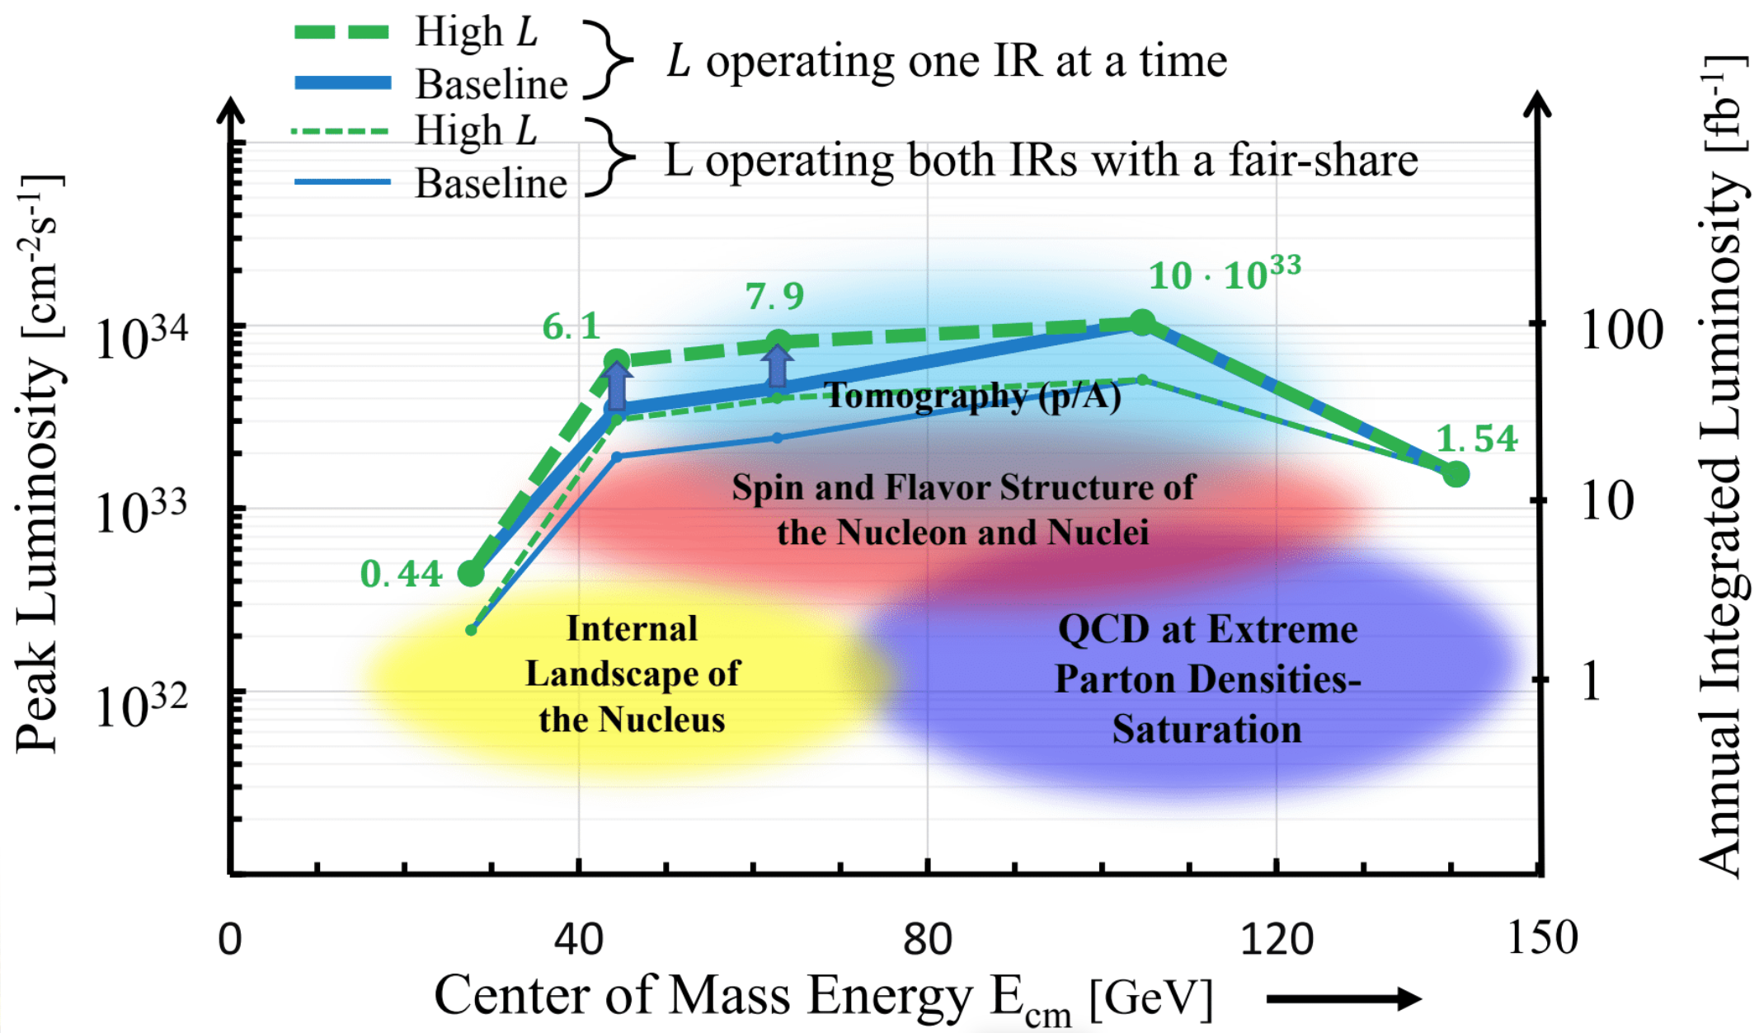
Precision Studies of QCD - IR2@EIC
The challenge of precision QCD at the EIC
Stitching together a 5D image of the proton - exclusive & semi-inclusive processes (GPDs and TMDs)
Open problems in nuclear science – confinement, emergent hadron masses, force distribution on partons
Understanding the new particle zoo – exotic particles with heavy quarks
High luminosity operation at low CM energies
Detector collaborations
➔ Many programs require energies at the low end of the EIC range.
Preparatory WS: Talks
8 invited talks
8 contributions
Reg: 192
WS-1: Invited speakers
25 plenary talks
13 parallel talks
Reg: 417
WS-2: Invited speakers
30 plenary speakers
14 invited contributions
10 panelists
Reg: 198

Slide 7

PSQ@EIC Series of Workshops
Preparatory
Coordination Meeting
For the Series of the 3 workshops
Workshop I (PSQ@EIC)
ANL/CFNS/CNF
Focus on
Science
Detector concept(s)
(virtual)
IR2@EIC Proposal
Submitted to CFNS
YR-Meeting
Presentation
Documentation
White Paper
Published/Summer 2023
Proposal Approved
July 19-23 2021
June 1, 2020
July 15, 2020
Nov. 2020
Dec. 2020
Mar 17-19 2021
Workshop II (PSQ@EIC)
APCTP/CFNS/CNF
Focus on
PSQ New Science
Detector proposals
International Engagement
Preparatory coordination meeting: https://indico.bnl.gov/event/9794/
1st PSQ@EIC - Science and Instrumentation of the 2nd IR for the EIC: https://indico.bnl.gov/event/10677/
2nd PSQ@EIC – Precision studies on QCD at the EIC https://indico.bnl.gov/event/11669/

Slide 8
Generalized Parton Distributions and Global Analysis
Jun 12 – 14, 2023
Jefferson Lab Center for Nuclear Femtography
The aim of this workshop is to bring together interdisciplinary experts to assess the current status of the 3D internal structure of the nucleon, and to identify the requirements and to develop a coherent approach to the extraction of the salient physics quantities. The workshop includes plenary talks, with dedicated time for working group discussions.

