Slide 1
Introduction
2023 Ops Retreat
Eduard Pozdeyev

Slide 2
About Myself
Director of Accelerator Operations at Jefferson Lab.
Previously worked at Fermilab, FRIB/MSU, Brookhaven/RHIC, Jefferson Lab (2004-2006), Budker Institute (Novosibirsk, Russia).
Experience:
30 years in field, including accelerator projects, operations, and R&D.
14 years of experience with DOE 413 projects.
Design and construction of proton and electron linear and circular accelerators and their components.
Positions held:
PIP-II Project Lead Scientist (Fermilab).
FRIB Front End Dept. Manager and Accelerator Ops Dept. Manager (FRIB/MSU).

Slide 3
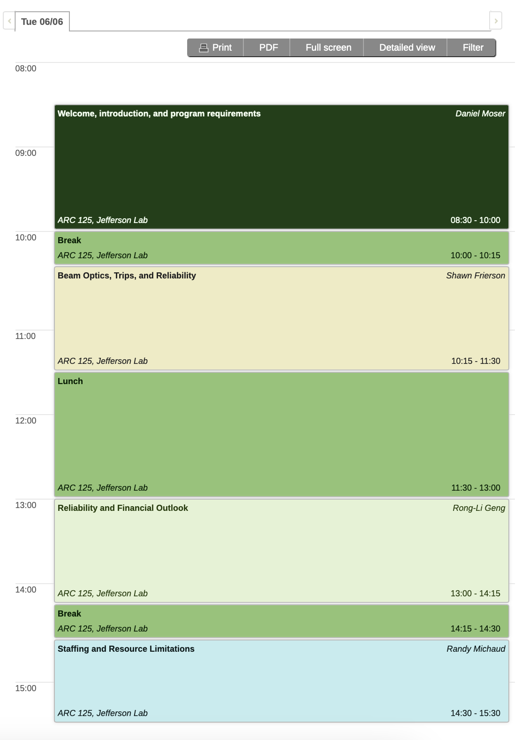
Retreat Outline
Upcoming experiment and program expectations
Current state of operations
Reliability, trips, beam optics
Reliability and financial outlook:
Energy reach, reliability, sustainability, and obsolescence
Resources and work planning

Slide 4
Important Matters To Discuss
Understand technical limitations of CEBAF performance and identify what needs to be improved.
This information will be used for continuing improvement and future upgrades.
Can our planning and coordination of work activities be improved?
Planning for future experiments.
Experimental requirements and expectations.
Is CEBAF ready to meet those requirements?
Longer term plan for Accelerator Operations.
Address energy reach.
Improve reliability.
Long term sustainability of operations, obsolescence, etc.
Develop plan and treat it as a project with milestones and risks
Director’s review.

Slide 5
Let’s Do It
Looking forward to useful presentations, open discussions, and lessons learned.
Retreat is an opportunity to look critically and constructively at our present performance and plans and learn lessons.
We should continue this tradition and plan for a retreat next year.

