Slide 1
CEBAF Work Planning and Expectations
Shawn Frierson

Slide 2
CEBAF Performance Plan goals (2020)
Reliability: > 80%
Optimal Weeks: 37wk/yr
Beam Tuning: < 8h/wk
Peak Hall Multiplicity
12 GeV Program Expected Duration: 20yrs
Linac Design Energy: 1090MeV
Required Linac Energy Margin at start of FY: >100MeV
Overall FSD Trip rate: <15 trips/hr
Overall FSD Trip Downtime: < 5 min/hr
RF Trip rate: < 10 trips/hr
Beam Loss Trip rate: < 5 trips/hr

Slide 3
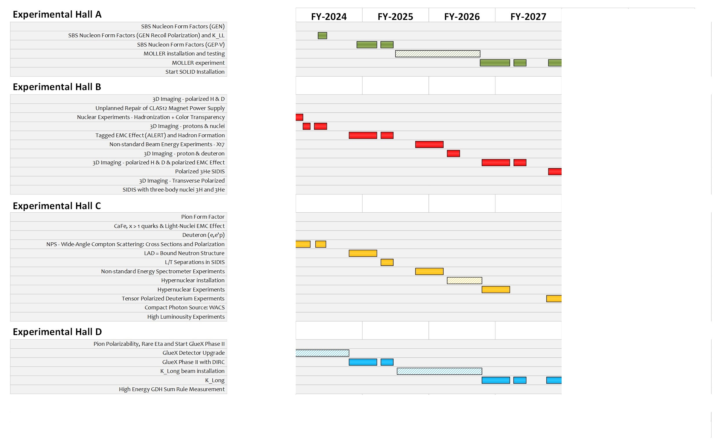
Physics program by FY

Slide 4
A look at our past runs
12GeV CEBAF Goals |  | FY20 | FY22 | Last run
Reliability (%): |  | 68.60% | 76.50% | 72.20%
Run wks/yr: |  | 33 | 34 | 36
Peak Hall Multiplicity |  | 4 | 4 | 4
Linac Energy (MeV): |  | 1050* | 1050* | 1047
Overall FSD Trip rate trips/hour < 15 |  | 13.5 | 12.5 | 13.7
Overall FSD Trip Downtime min/hour < 5 |  | 6.3 | 5.4 | 5.5
RF Trip rate trips/hour < 10 |  | 6.8 | 5.9 | 7
Beam Loss Trip rate trips/hour < 5 |  | 4.1 | 4.4 | 5
*Numbers used to illustrate peak energy during the FY

Slide 5
Work planning for the next FYs?
Prioritize preventive maintenance (PM) tasks
  Continue to avoid AFS (Arsonist Fireman Syndrome)
  Starts with our “utilities” at CEBAF
  Continue to identify (critical) system failure points to inform group task lists
    Yearly
Needed machine changes
  Informed by CPP/Experiments
  Readiness reviews can be helpful
  Lean on the SAD Oversight Committee for guidance
Continue using available tools
  DTM
  ATLis
  SAD Calendar
  HCO (ACC network access required)

Slide 6
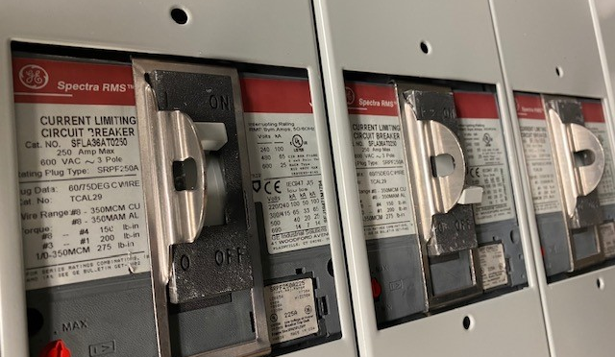
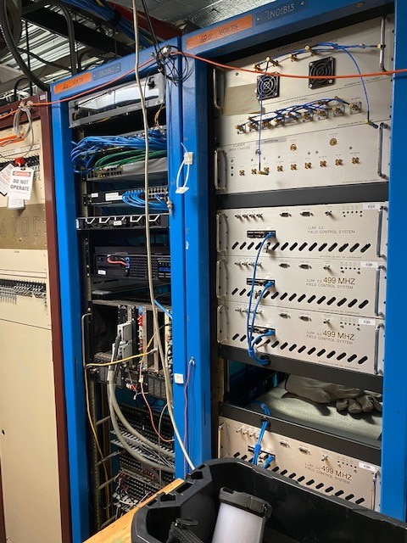
What “Utilities”?
Infrastructure
  Facilities (FML)
  58.4hrs (3.8%) of accrued downtime last run
  Area of concern
    LCW*
    Space Cooling
    Site Power*
ACC Network
  Software (Sys Admin)
  0.2hrs (negligible) of accrued downtime last run
  Area of concern
    Reboot time availability
      Cautionary tale: Network failure

Slide 7
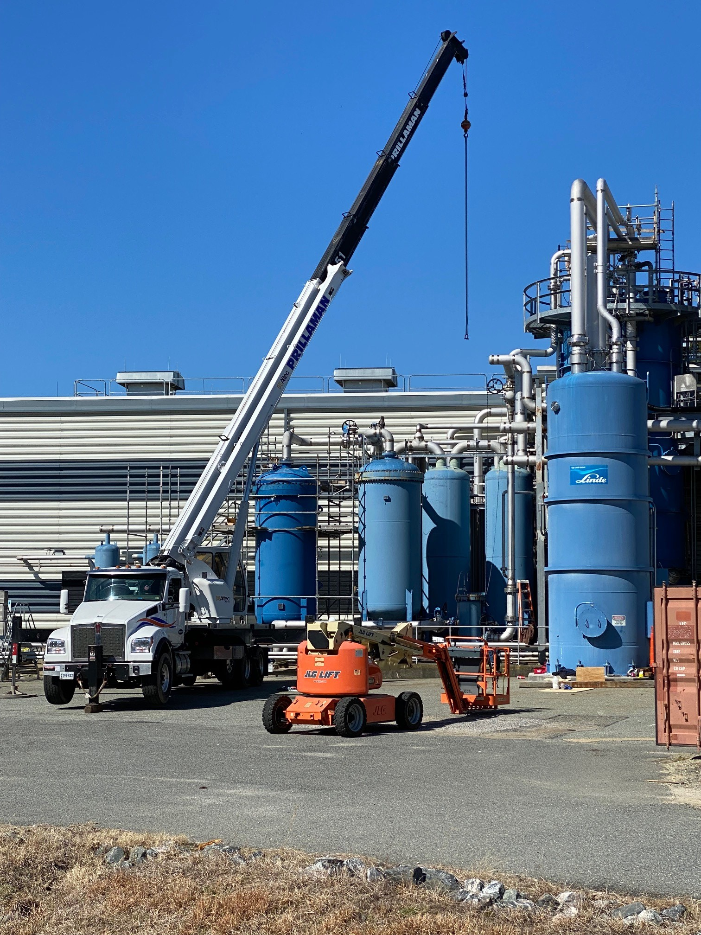
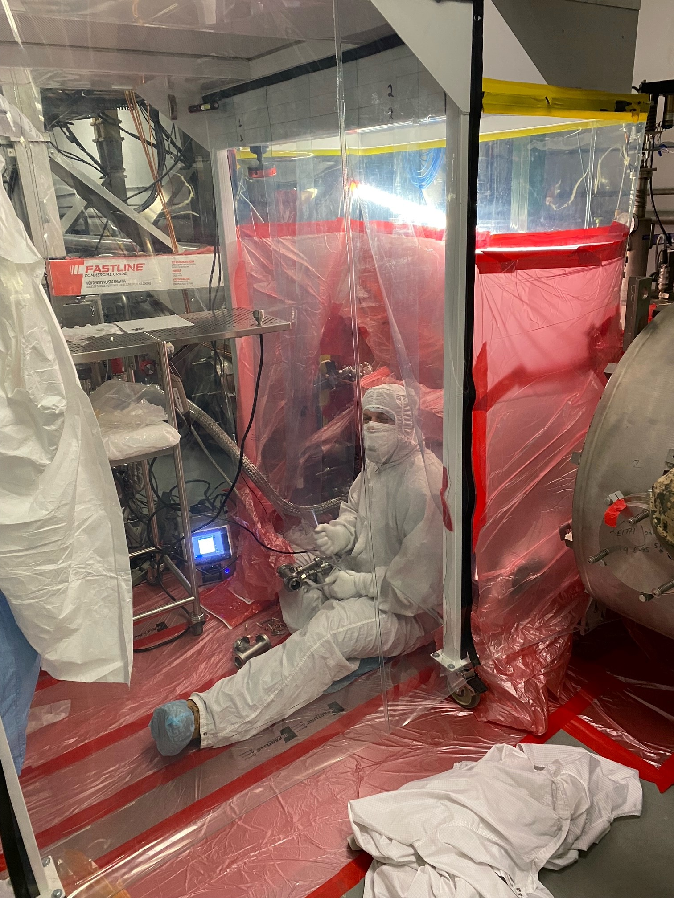
What “Utilities”?
Refrigeration
  Cryogenics
  22.3hrs (1.4%) of accrued downtime last run
  Area of concern
    CHL hardware
Vacuum
  Vacuum/SRF
  55.1hrs (3.6%) of accrued downtime last run
  Area of concern
    Vacuum hardware
    CM insulating vacuum

Slide 8
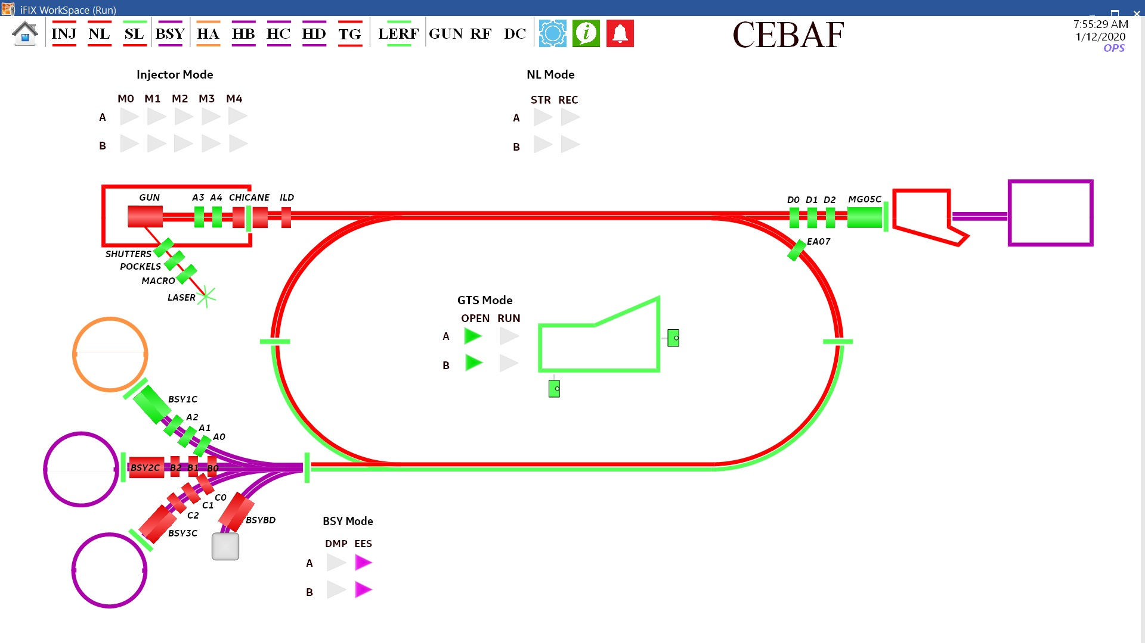
What “Utilities”?
Personal Safety
  Safety Systems
  54.3hrs (3.5%) of accrued downtime last run
  Area of concern
    ‘Passivated’ PSS modules
    RF HV interlock

Slide 9
System Failure Points
We all know about the critical system failure components
  Described in the CPP
  Ex. Klystrons and magnet coils
There are other systems that need periodic PMs or updates
  Examples
    CAMAC crate
      Card to backplane connection (NL03)
      Cleaning/reseating card contacts added to yearly PM
    LCW hoses
      ZA magnet hoses
        Change out campaign during SAD
        Aging hoses in RSEP8A overheating event; investigation ongoin
      RF klystron hoses
        2L05
          Not once but twice

Slide 10
Machine changes (upgrades)
Informed by CPP/Experiments
  Examples
    CM swaps
    INJ upgrade
Other changes being planned (considered)
  Infrastructure
    Space cooling assessments (INJ/Box PS rooms)
    Hall D LCW system (XP magnet clogs)
  Beam Transport (30.4% of downtime last run)
    Beam loss monitor review (TBA)
    BPM system discussion (ongoing)
    MO system upgrades (ongoing)
Readiness reviews can be helpful
  Ex. Plasma Processing, 20A trim update (Wien system)
  Operations Readiness (AOD 4.2.2)
Lean on the SAD Oversight Committee for guidance

Slide 11
Down Time Manager (DTM)
Main application to track machine down time at the component level (AOD 4.2.10)
Expectations
  Data is as accurate as the user using the tool
    Ops: Event/Incident should include the correct component and a brief summary of the interruption.
    If the component is not listed under any system/component; it is ok to place it under ‘unknown/missing’.
    Attach Elog entries for context; very helpful
    Crew Chiefs should be reviewing their shift DTMs for accuracy.
    SME: Incidents should be reviewed weekly (if not daily) for accuracy.
      Last run was not great (mostly lv 1&2)
    When working on down components, please make an elog.
    SME system/component lists have been updated
  EES leadership continues to scrutinize the data w/ Operability
    Very appreciated
  Data will be used to plan future SADs
Contact me if assistance is needed

Slide 12
Accelerator Task List (ATLis)
Main work planning tool for CEBAF (AOD 4.2.2)
Expectations
  Tasks concerning main accelerator and #C components; write an ATLis
  In addition to a duration, put a start date
    Why 100s of hours instead of weeks?
    If a start date can not be adhered to, change it
    If there is no start date, SAVE is your friend
  Use the ‘Project(s)’ field
    Ex. SAD 23
    Operability will handle creation
  Resubmit previously approved tasks; no continuing
    Comments section is hard to follow
  If outside group resources and needed, select that group in the ‘System’ section under ‘Tags’
User guide
  Please contact me if assistance is needed

Slide 13
SAD Calendar
Main tool to display the scheduled day-to-day tasks during maintenance periods.
Used to communicate tasks to all groups to assist with coordination of tasks.
Expectations
  Will continue to be the day-to-day communication tool…for now
    Looking into other tools (Ex. MS Planner/Projects)
  SC is tightly integrated with the ATLis tool.
    Very helpful when tracking work. Refer to ATLis slide.
Request
  Designated POC from each group for work planning/tracking
    Some groups already do this (some even send morning emails!)

Slide 14
System Readiness Tool (HCO)
Tool displaying a component’s (and therefore system’s) readiness for beam ops.
  Mostly used coming out of (long) maintenance periods
Expectations
  Groups should be using the tool when working on components
    During the SAD; not the run necessarily
    Submit mask requests
  Ops uses this tool daily during beam ops.
    The state of the components leading to the beam destination should be up to date.
    SMEs and Crew Chiefs should be changing the component’s readiness state per the AOD (4.2.6)
      When coming out of maintenance, Ops should not be making changes until the system has been fully turned over by the SME
Request
    During the HCO period, use it to make entries
      Checklist feature could replace HCO ATLis task

Slide 15
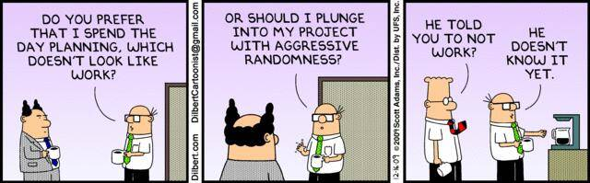
Shawn Frierson
Operability Manager
Frierson@jlab.org x7296

