Slide 1
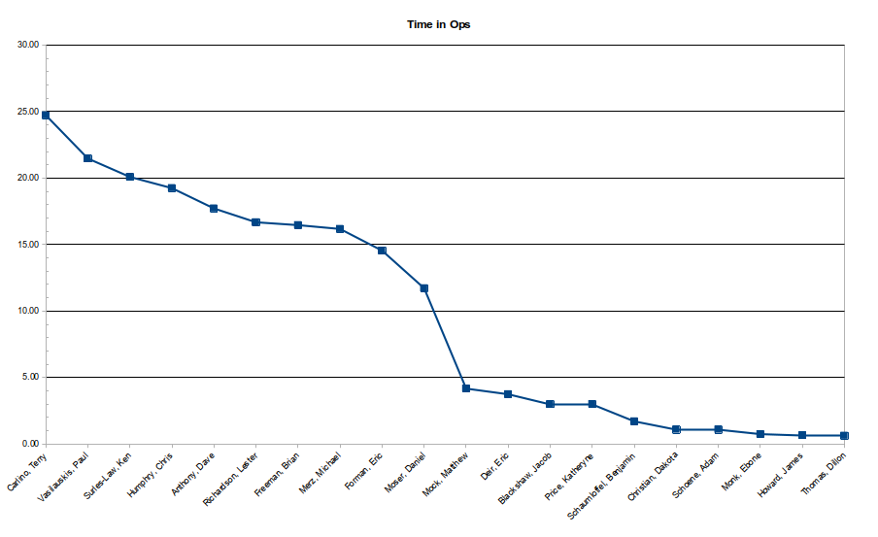
Operations Staffing
Retaining Crew Chiefs levels
Vasilauskis / Freeman

Slide 2
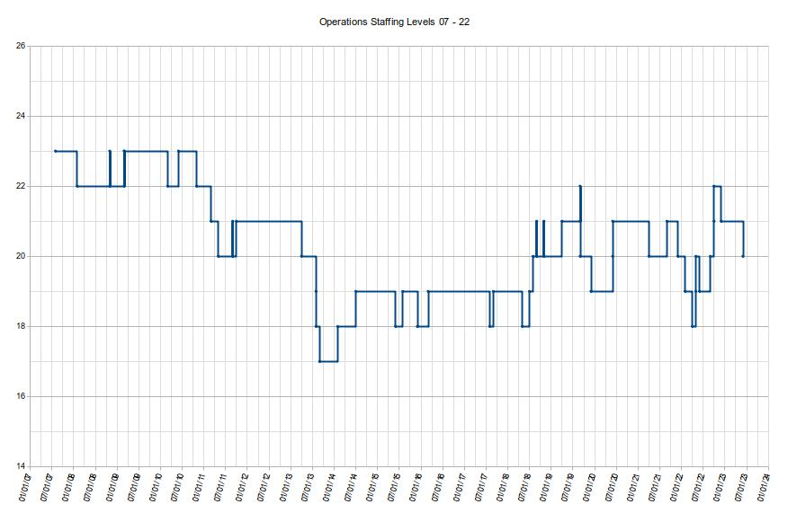
In the beginning...
2013 Lab-wide RIF dropped Ops staff levels from 21 to 17.
2014 – 2018 we bounced between 18 – 19 staff hiring only replacements.
Late 2018 we were able to hire 2 new Operators.

Slide 3
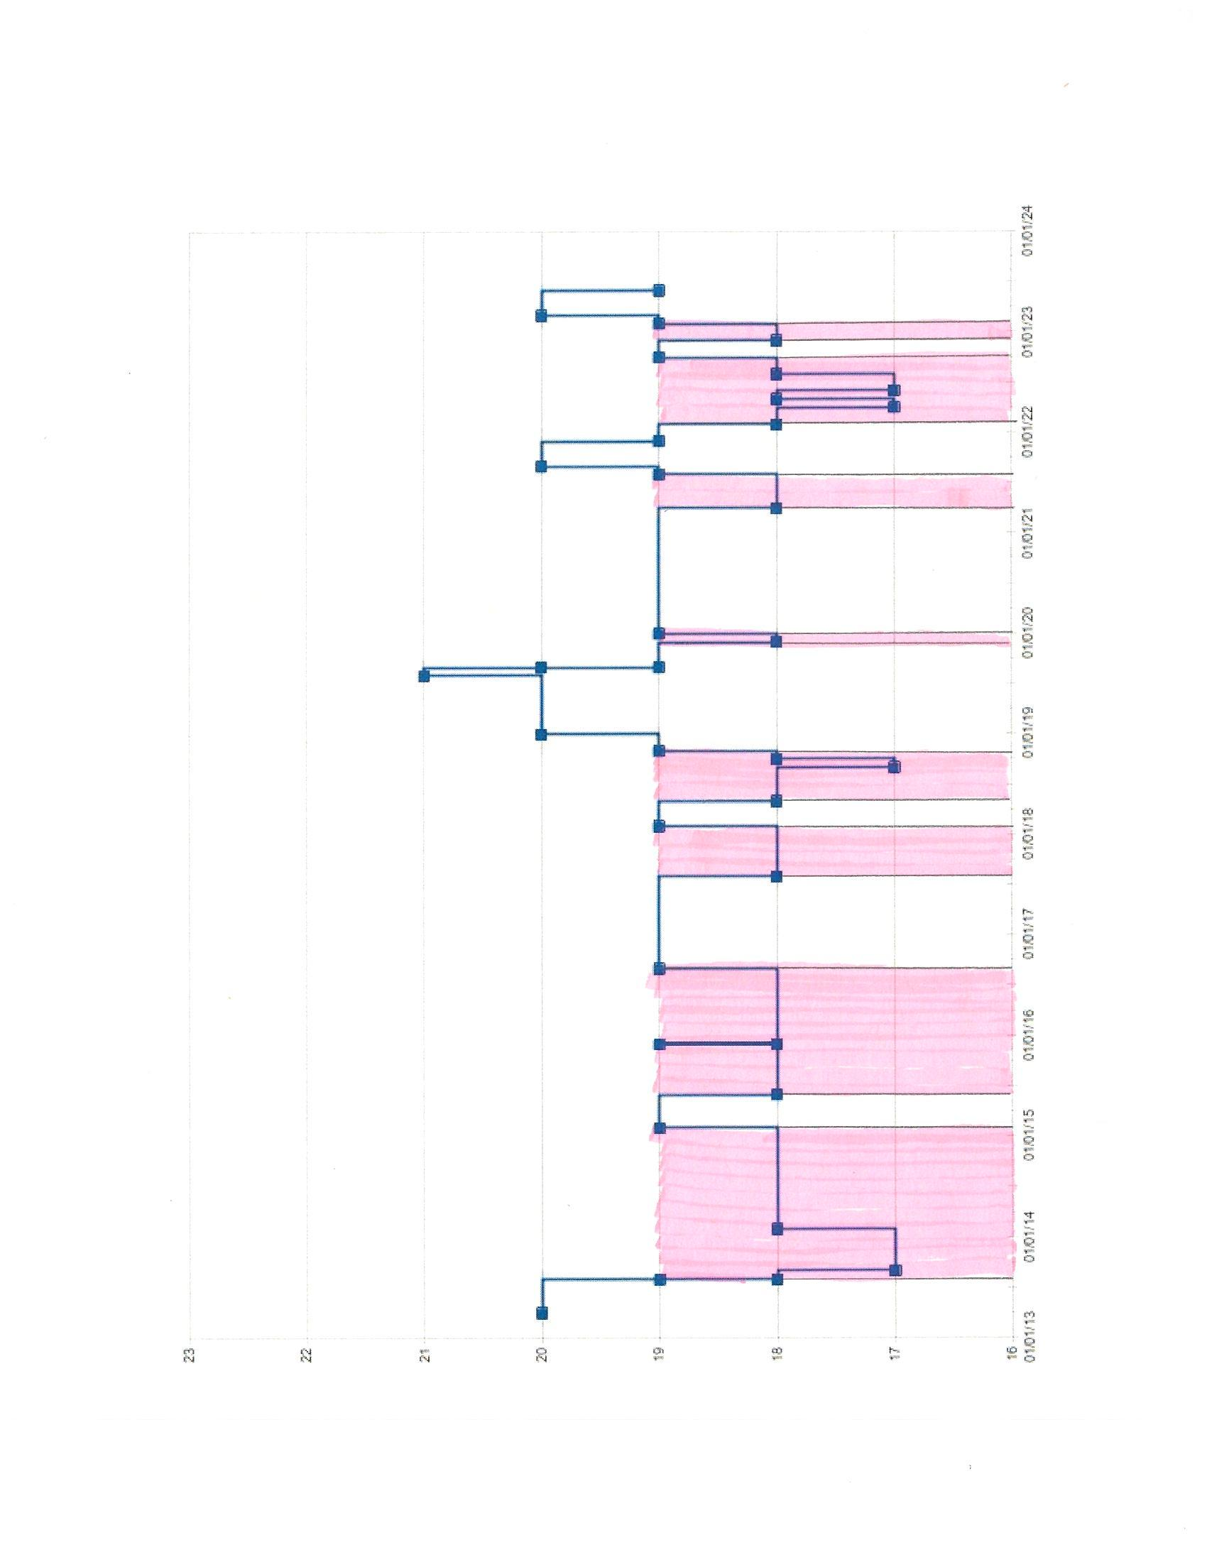
Qualified staff levels
Early on there were less than 18 qualified staff available to stand shifts.
This resulted in staff standing their shifts plus filling in the holes.
2018 we allowed to hire 2 new Operators.
Before we could enjoy the benefit of additional staff, COVID hit.
This put qualification for 2 new hires on hold.
Made many reconsider their time off shift and covet it even more.

Slide 4
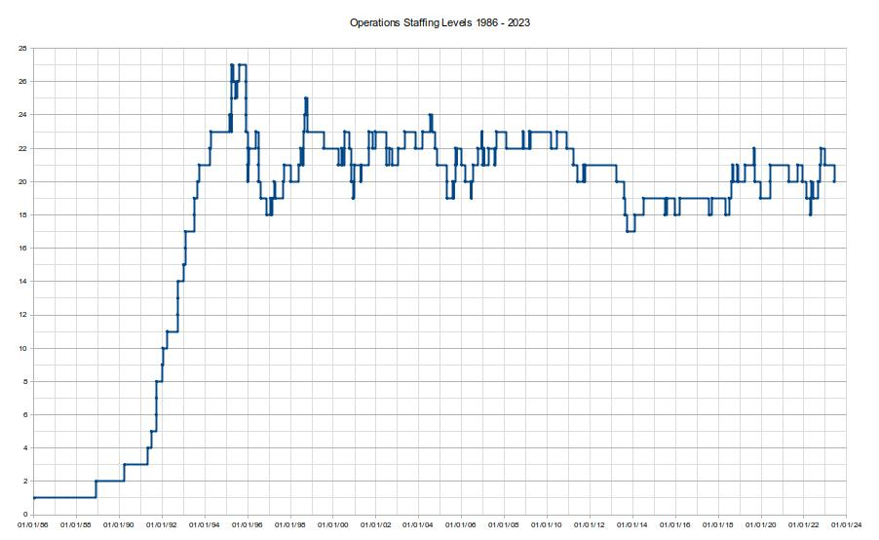
The dynamics of Ops staff over the years

Slide 5
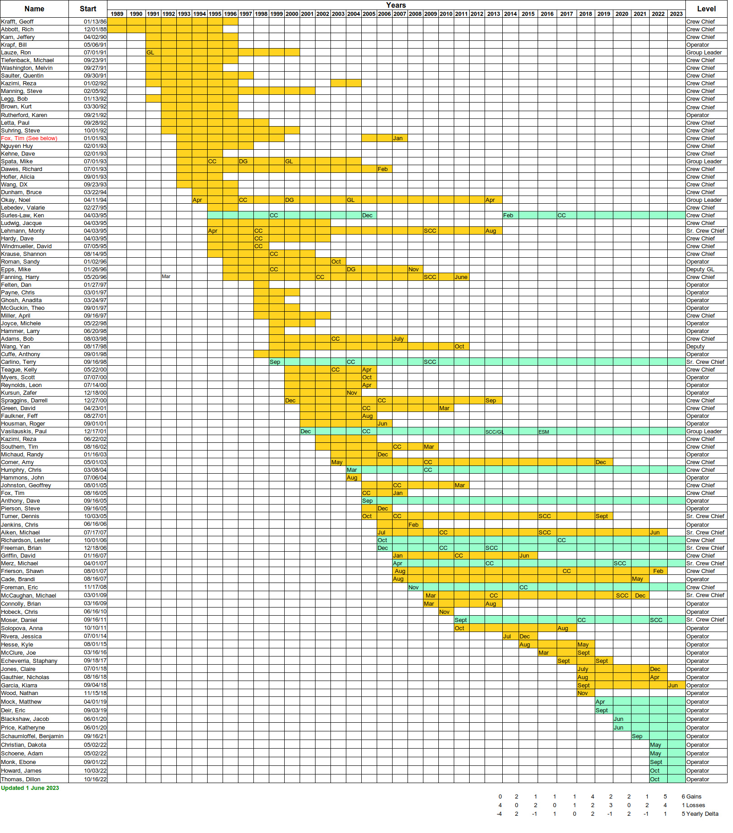
How long do they stay in Ops?
New Operators were not staying long enough to make Crew Chief.

Slide 6
Time in Ops
Half of Ops has been here less than 5 years.
All the Crew Chiefs are >10 yrs, all except 2 are >15 yrs.
Average time to make Crew Chief is 4.75 yrs.

Slide 7
Crew Chief Reclassification
In 2022, the Crew Chiefs who were not supervisors (all Senior Crew Chiefs are supervisors) were reclassified as Tech IV.
The experience level required for the new Tech IV is 12 years.
Since 2013, all new Operators have had at least a BS degree. A few had a MS.
Most are fresh out of college with little other experience.
The lab allows 4 yrs experience for a BS, 6 for a MS.
This would require 6 to 8 yrs as an Operator to make Crew Chief.
With Operators leaving before 5 yrs, maintaining Crew Chiefs became unsustainable.

Slide 8
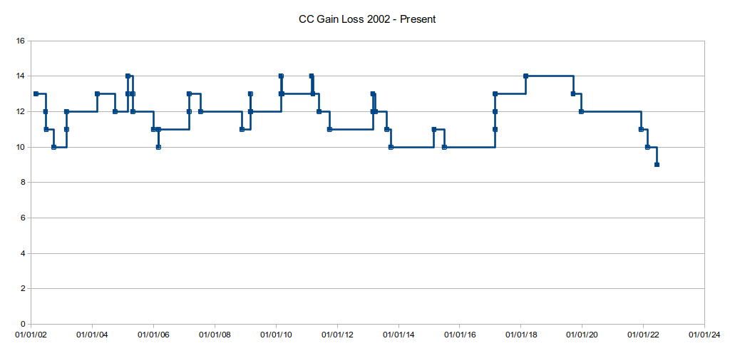
Crew Chief levels

Slide 9
How can we turn Operators into Crew Chiefs?
Issue brought to the attention of HR.
Eventual solution, Crew Chief Tech IV experience level changed to 4 yrs but...
  All Operator hires must have a BS in a STEM field.
  The "or equivalent experience" no longer applied.
  Operator qual path formally documented.
  Crew Chief qual path formally documented.
Operator:
Complete 50+ Moodle training modules
Pass Final Moodle exam
Qualify SSO or ARM
Two senior operator or Crew Chiefs give satisfactory performance evaluations
Crew Chief:
Complete 20+ Moodle training modules
Pass Final Moodle exam
Crew Chief in Training (CCiT) for at least 3 Maintenance Days.
Group Leader observes CCiT on a Maintenance Day and gives a satisfactory performance evaluation

Slide 10
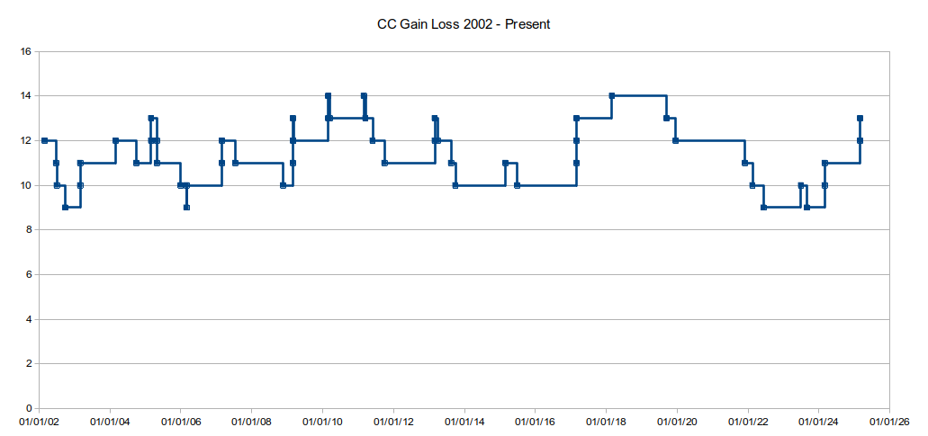
Predicted Crew Chief levels
Crew Chiefs in Training:
Matthew Mock
Katheryne Price
Dillon Thomas
Eric Deir
Jacob Blackshaw

Slide 11
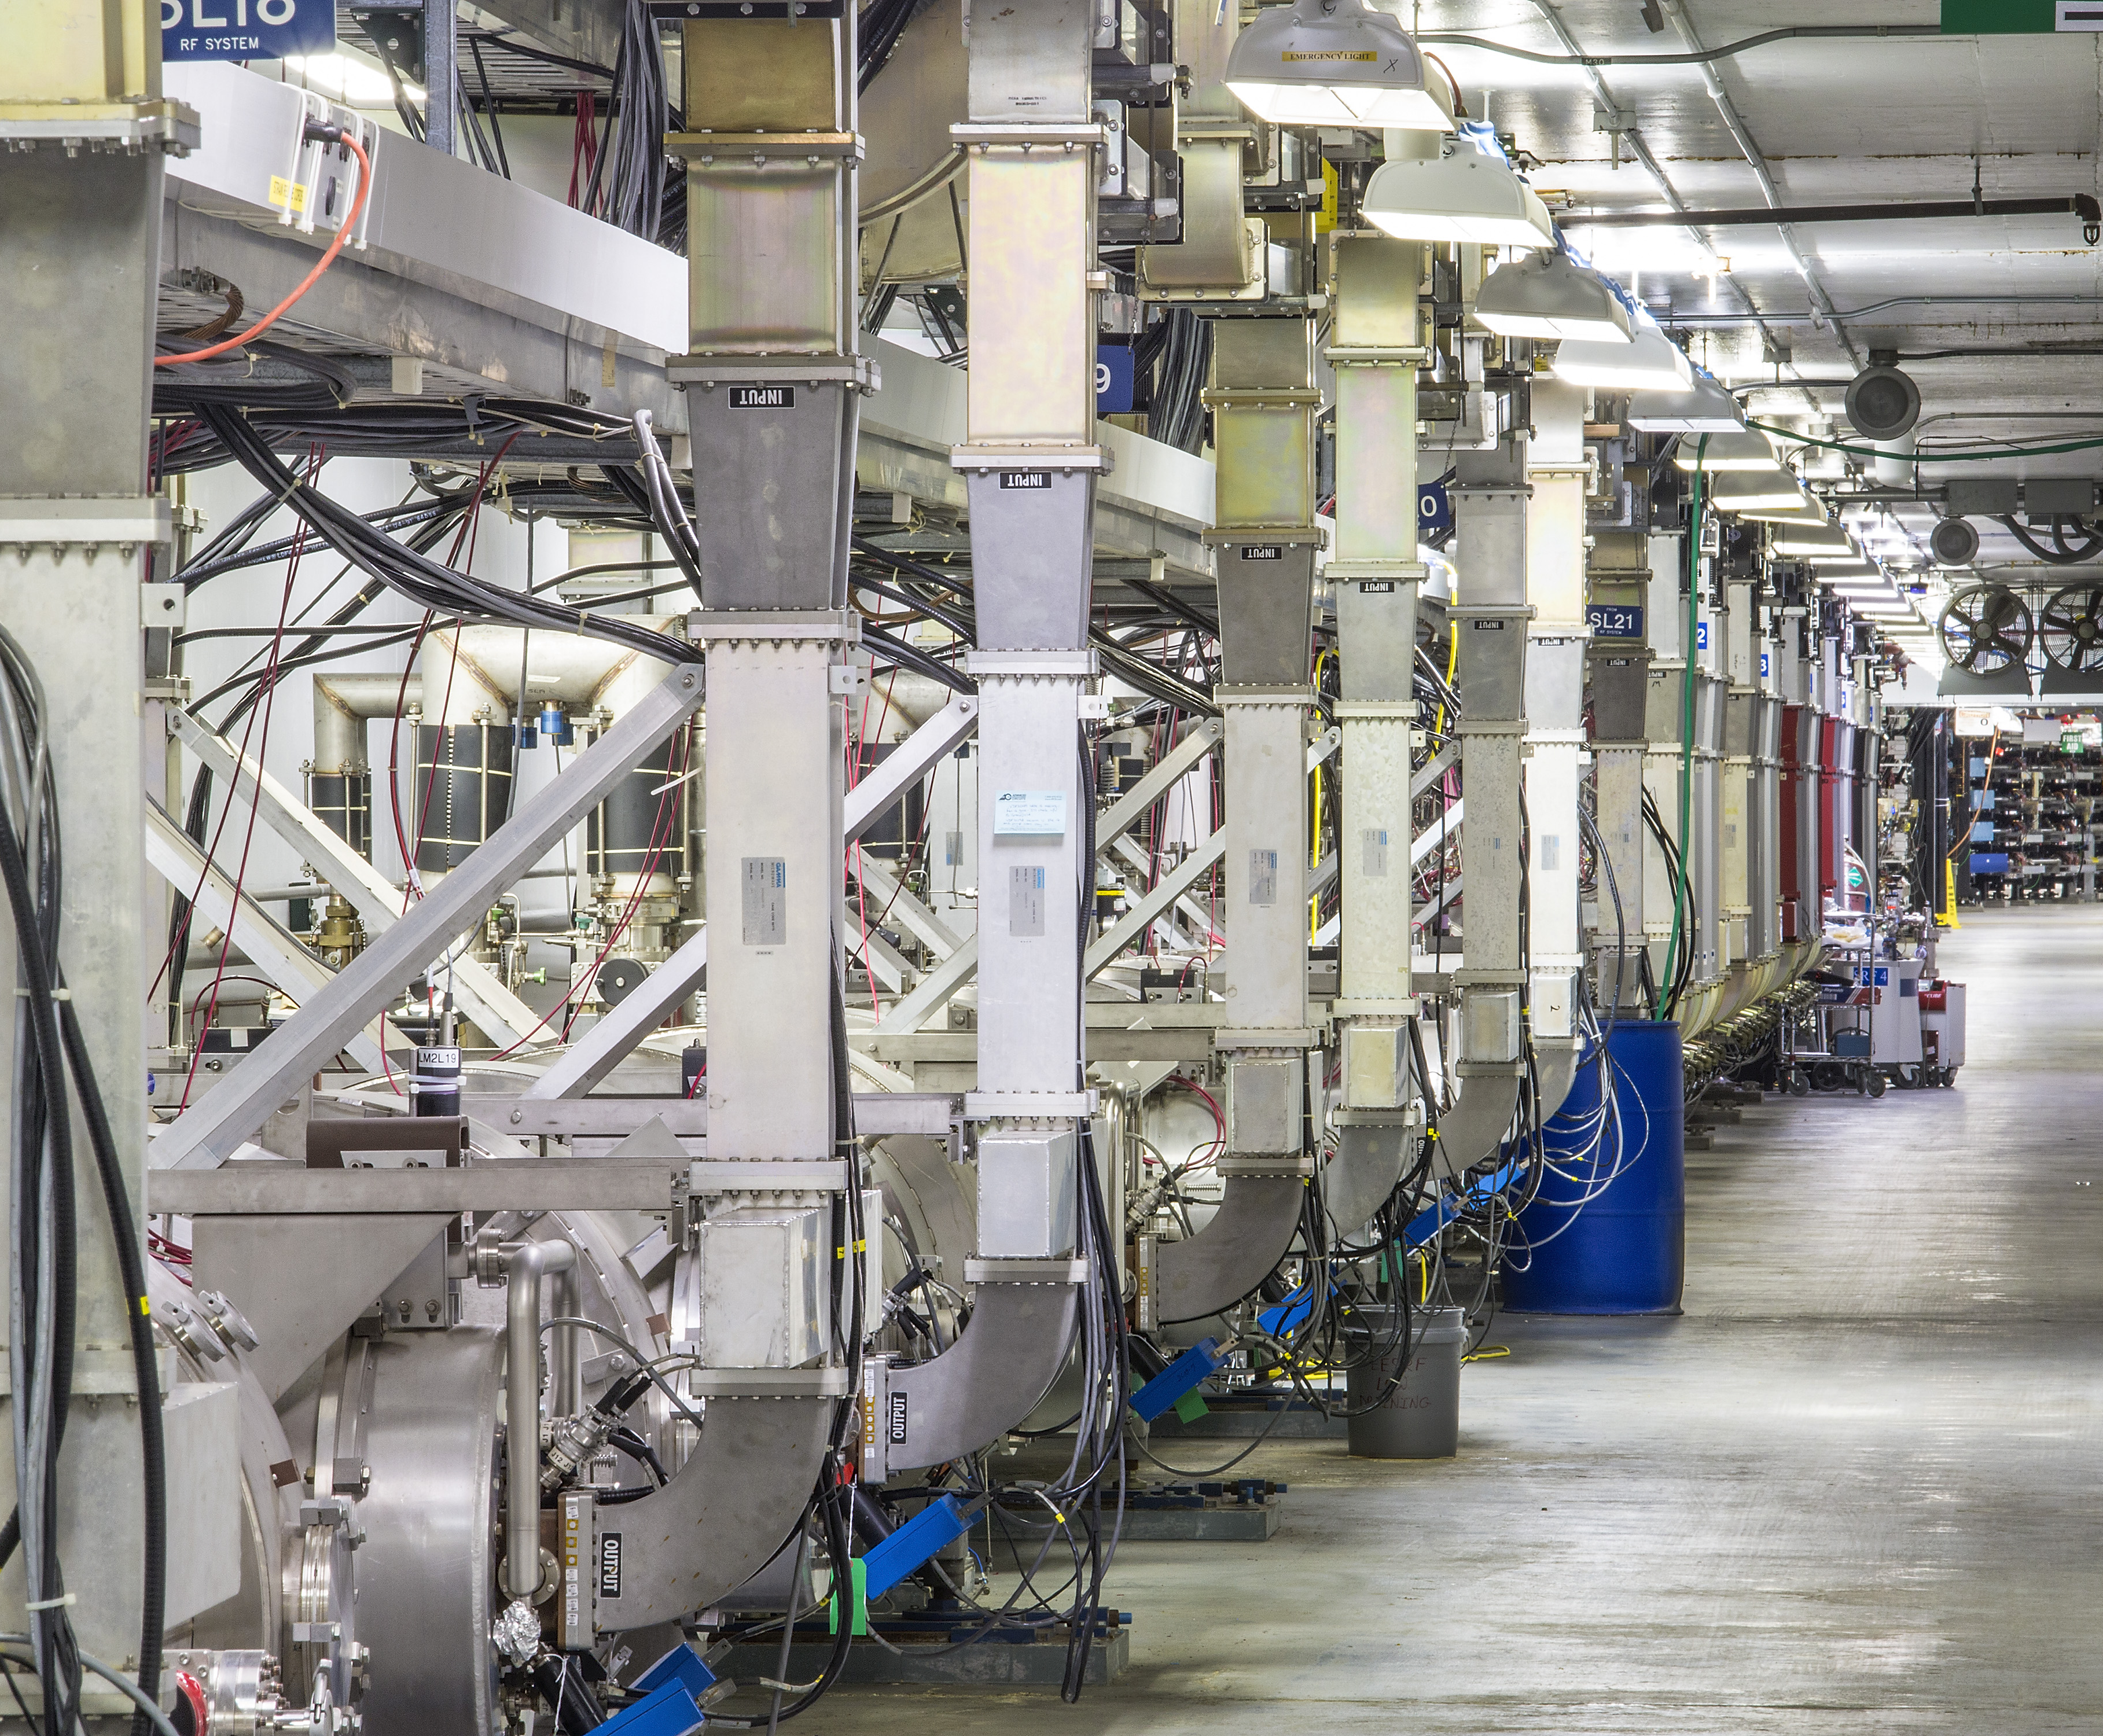
Vasilauskis / Freeman
Vasilaus@jlab.org
Ups and downs of Ops staffing
Losing Crew Chiefs
Unable to make more
Concessions made
Future Crew Chiefs

