Slide 1
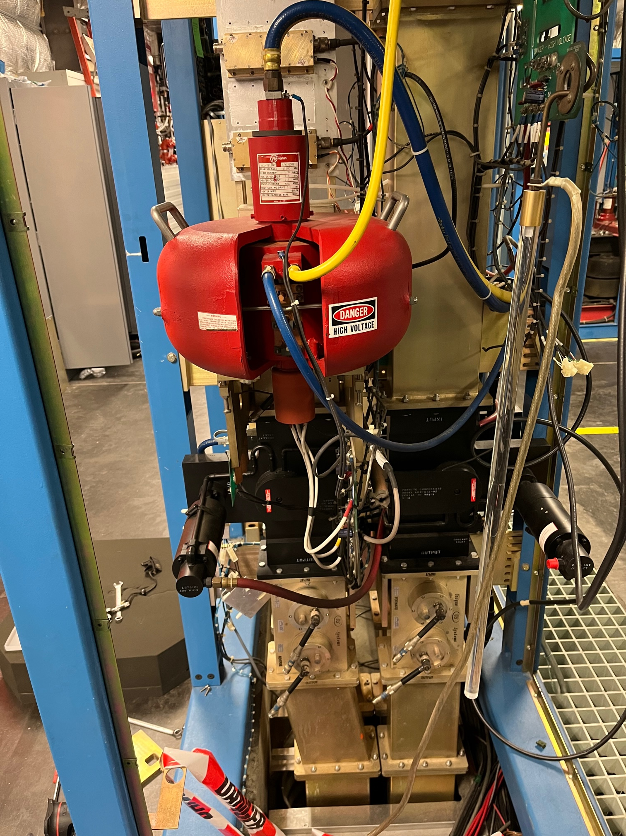
RF Systems
RF Components and Systems that are Actively Being Worked On to Increase RF Availability
Curt Hovater for the RF Group
Booster Klystron

Slide 2
Agenda
RF Power Sources
Klystrons
SSAs
LLRF
LLRF 3.0
SELAP
RF vs. Thor
DAQ AI/ML System
Transformers & Isolators
750 MHz Separator SSA
Summary

Slide 3
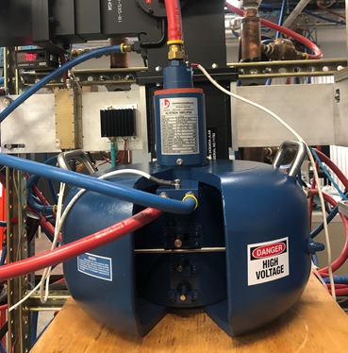
Klystron Failures, Spares, and Issues
5-8 kW: Have a failure rate of 0.3 per week of running.
Presently we have 12 spares or 40 weeks of running
8 tubes are being refurbished by Klystron vendor (Stellant)
12 new tubes are being ordered (Stellant)
5 tubes will be rebuilt by another company at a potentially much lower cost
13 kW: unknown
Since 2012: 5 failures, but small sample size, random failures make it harder to predict future failures
Presently we have 7 spares
3 tubes are being rebuilt by the Klystron Vendor(Stellant)
Ongoing study of why some tubes do not make 13 kW
New Stellant (L3) 8 kW Klystron

Slide 4
8 kW Klystron History and Costs
Initial klystron purchase (‘90-’92) was for 350 at $9,000/tube
Four cell tube with ~ 32% efficiency
Last quote we have (January ‘’23) is for $85k/tube and that’s using magnets from older damaged tubes
Overall CEBAF klystrons have been reliable, some with over 170,000 hours
Industry is changing
Design experience is aging out
Solid State becoming much more prevalent in the last 10 years
Klystron cost is creeping up to $10/Watt which now makes SSAs very competitive.
And this does not include the HVPS!
Other Cost Issues
High Voltage Power Supply
Transformer are being replaced
Klystron Control Electronics
Filament boards and Mod-Anode boards are in continuous repair
$10/Watt

Slide 5
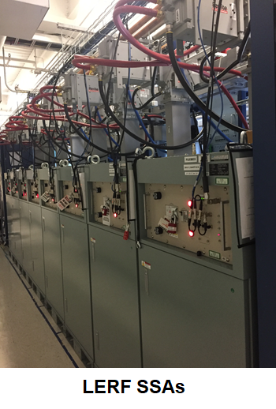
Solid State Amplifiers (SSA) are on the Horizon
Solid State Amplifiers have made great strides as a reliable RF power source in the last 20 years.
Viable alternative to tubes in the 100 MHz – 2 GHz range.
SSA efficiency > 40% for class A/B…potentially a lot more for class F
SSA Cost is in $8-$10/Watt range which is competitive with tube costs
Klystrons and microwave tubes are losing their technology base to retirements and trends in the industry
Considering the above replacement klystron costs are increasing.

Slide 6
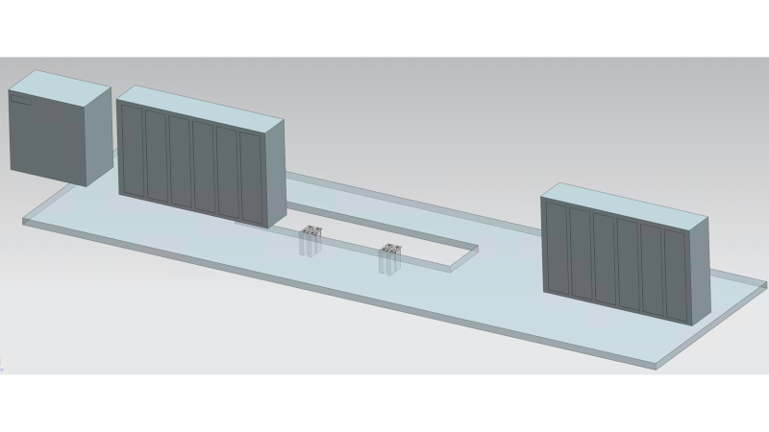
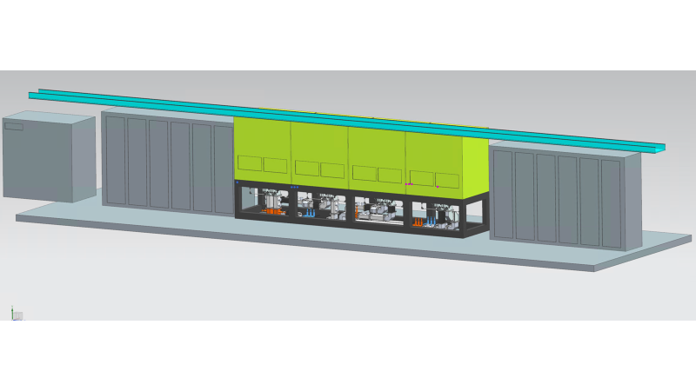
SSA Concept Fitment in a Linac Zone
View of a current RF zone with the Klystron racks and HVPS removed
View of an RF zone with eight 8 kW SSAs
SSAs sit on platform above the waveguide penetrations

Slide 7
SSA Concept Fitment in a Linac Zone
Waveguide components are beneath the SSAs
Single directional coupler monitoring the reverse power
Isolators and Load
Dual Directional Coupler
Three Stub waveguide tuner

Slide 8
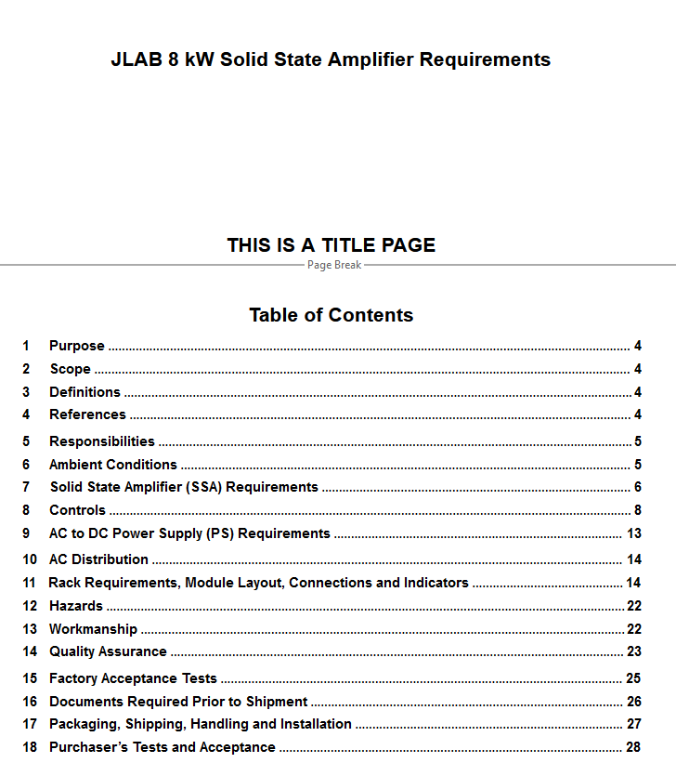
Present 8 kW SSA Status
A Tech Note on replacing Klystrons with SSAs has been published
https://jlabdoc.jlab.org/docushare/dsweb/Get/Document-250949/21-049.pdf
We have written a 8 kW SSA requirement document
We are finishing a “Vendor” presentation to discuss implementation, environment and fitment into existing klystron and HVPS space.
We have developed a prototype mock up of what an “8 seat” SSA installation may look like.
We have developed an preliminary SSA budget for the AIP

Slide 9
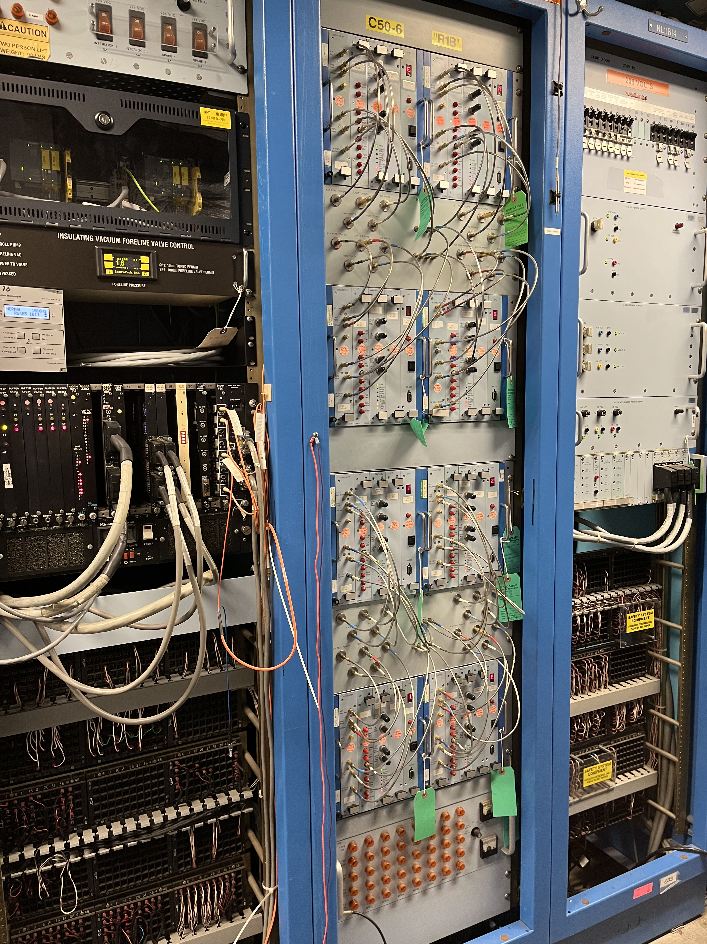
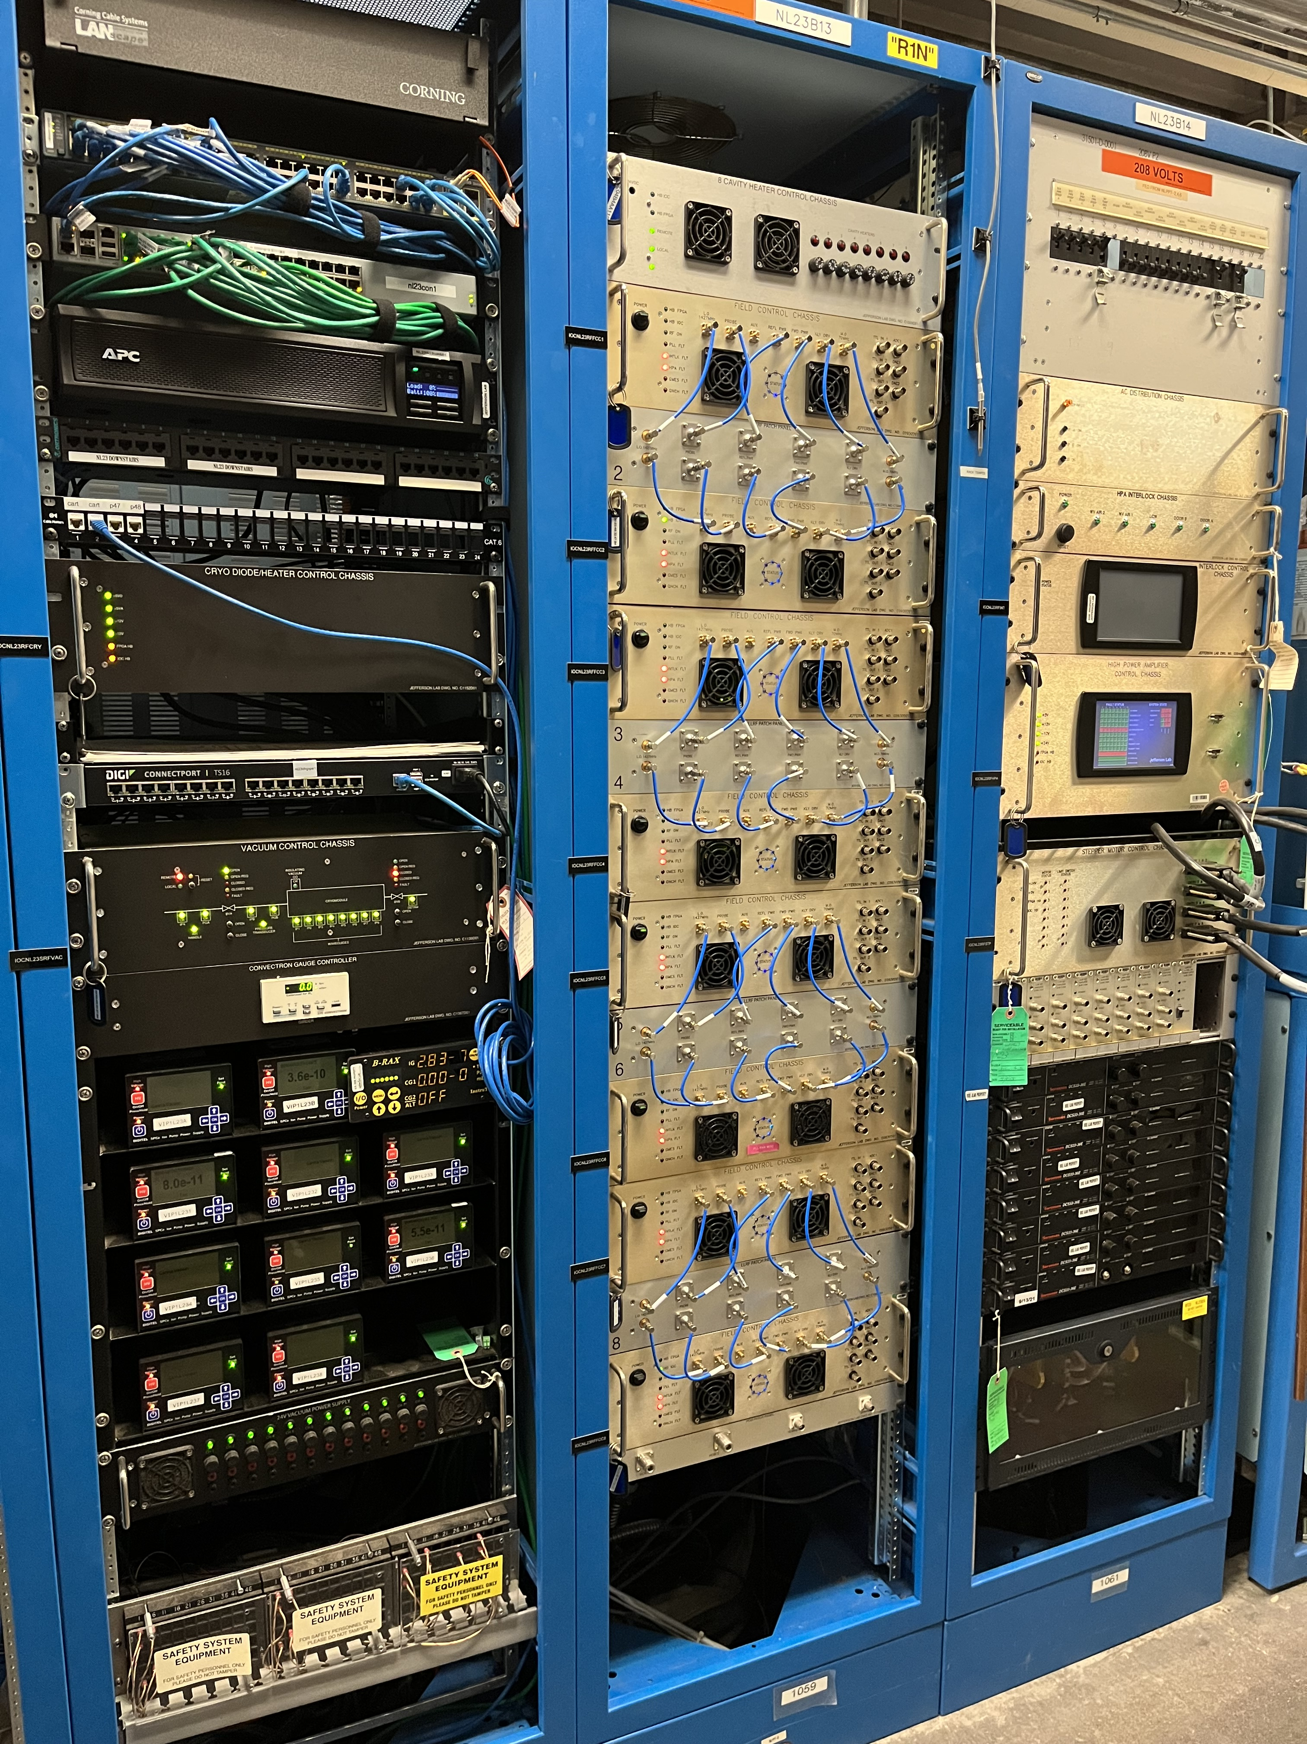
Tres Generations of LLRF...3.0 is the smoothest yet!
LLRF 1.0
LLRF 2.0
LLRF 3.0
Vintage 1990
38 zones ...and slowly dying
Vintage 2008
12 Zones including Separators
Vintage 2021
Two zones including bunchers, choppers, & 0L02

Slide 10
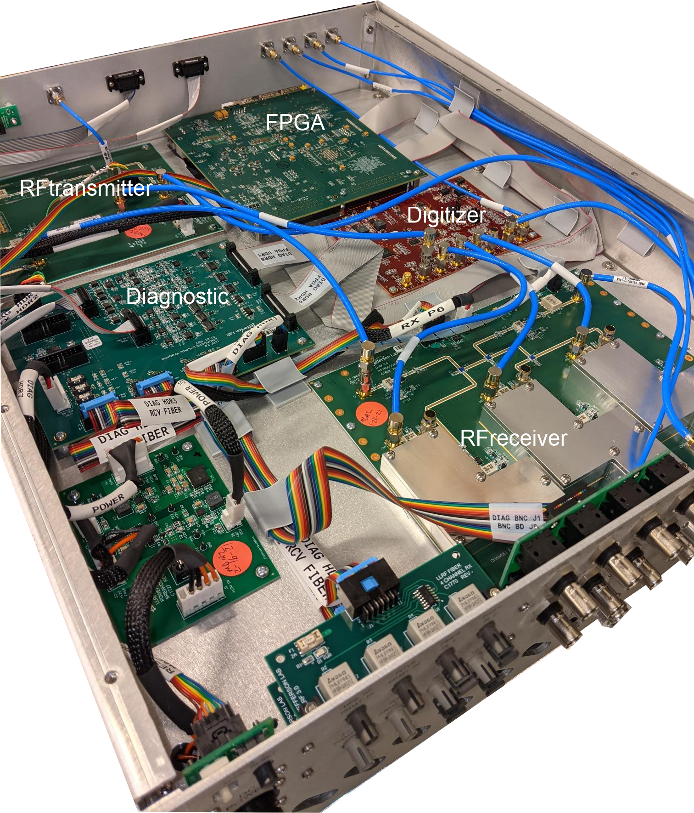
LLRF 3.0 Progress
AIP project to populate C75 zones with modern Digital LLRF controls
Installed in Bunchers, Choppers, 0L02, 1L05 and 1L10
It's being rolled out in incremental productions. Four zones over 2-3 years followed by another four zones in 4-6 years.
Fortunately, the modular design allows for IC obsolesce, so new ICs can be designed into the system.
From a "Value" engineering perspective this is very costly way to procure electronic systems.
LLRF 3.0 Chassis

Slide 11
SELAP
SELAP (Self Excited Loop Amplitude and Phase request mode)
Cavity is in SELAP request mode all the time
Gradient is regulated all the time
Phase is out of regulation and locks back once the microphonics subside
Power required is more than the klystron can provide
–Beam FSD is pulled
Xpower – power required for gradient
Pkly = L * GSET^2/(4*Qext*r/Q)
Xpowerbeam
Pklybeam = L*(GSET+(I0*Qext*r/Q))^2/(4*Qext*r/Q)
Ypower – reactive power available for detuning
Pklydf = Pkly * tan(dA) * tan(dA)
Total power no beam = Xpower + Ypower
Total power with beam = Xpowerbeam + Ypower
Resultant voltage vector for the power
GASK, PASK

Slide 12
SELAP implementation and Operational Challenges
Installed in the following zones
1L05, 1L10 (llrf 3.0 hardware)
1L22, 2L22, 2L26 (llrf 2.0 hardware)
Implementation during the SAD
2L23, 2L24, 2L25 (llrf 2.0 hardware)
Needed for post plasma processing
0L02 (llrf 3.0 hardware)
Planning to implement rest of the zones in the first few weeks of the run
1L07, 1L23, 1L24, 1L25, 1L26 (llrf 2.0 hardware)
0L04 (llrf 2.0 hardware)
This zone will be implemented as the last one
Need time to test with beam before implementing everywhere
No defined detuning allowance
Use all the available klystron power
Working on the firmware to use all the available power without tripping the cavity
Reliable klystron phase push measurement
Implementing the klystron phase look up table

Slide 13
Thor vs. RF
Introduction
A high-performance, low-phase-noise PLL-based clock synchronizer in the digital LLRF system requires a stable external reference. We use a 70 MHz signal, generated in the MCC and distributed along a coaxial cable.
We believe that the RF coaxial cables between the MCC and SL/W1 buildings (installed in ~1991) are failing.
Thunderstorm lightning in the vicinity of the CEBAF can cause electromagnetic interference (EMI) or radio frequency interference (RFI) strong enough to trigger a PLL clock system error, which consequently causes an RF trip.
Thunderstorm lightning as far as 100 miles away can cause a local oscillator (LO) transient, which can lead to a gradient transient and, consequently, a beam trip.

Slide 14
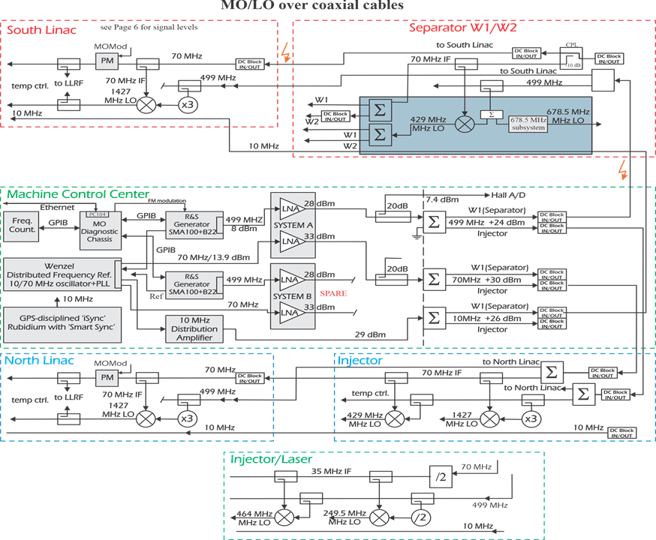
Existing Master Oscillator and Reference Distribution System

Slide 15
What Has Been Done to Understand and Mitigate the Issue
Additional DC blocking filters between the MO/LO MCC system and local subsystems (W1, SL) were installed, but this did not resolve the issue
Ground inspection/improvement for W1 and SLSB – no improvement
RF cables integrity check – no problem has been detected
MO level increased – no improvement
SL MO separation – PLL errors stop occurring in SL but intensify in LLRF W1/W2 systems
W1/W2 PLL error mask – solve problem, separator is not tripping!
10 MHz over fiber to SLSB and local MO generation – Proof of concept
70 MHz fiber link between MCC and SLSB – no trip in SL during the recent thunderstorm but W1 PLL systems tripped
Fiber Transmitter vendor has stopped producing the product we are using. Working with another vendor on a replacment

Slide 16
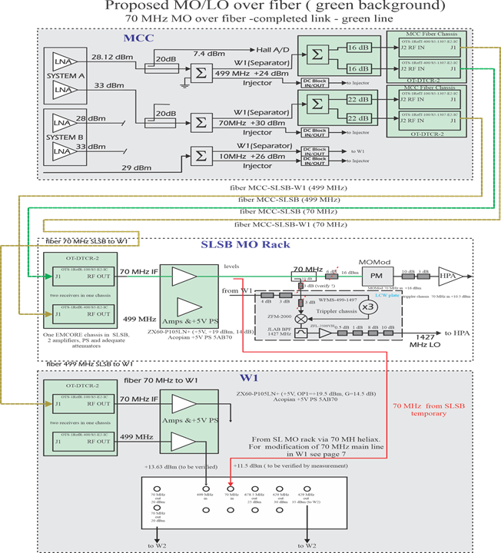
Next Steps to Defeat Thor
70 MHz fiber link between MCC and W1 - unmask PLL errors there
499 MHz fiber link between MCC and SLSB
499 MHZ fiber link between MCC and W1
LLRF test before power permit + thunderstorm
Test with energize cavity + thunderstorm

Slide 17
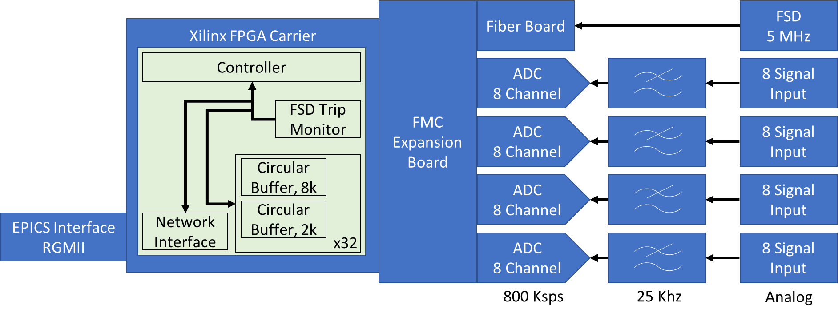
AI/ML DAQ Project
LLRF Group is supporting the JLAB AI/ML initiative
Designed multichannel ADC chassis to monitor older LLRF 1.0 signals. Cavity gradient, Klystron Drive, cavity Phase and Klystron Drive phase
7 Chassis have been installed. By the end of the SAD all North LINAC LLRF 1.0 zones will have a DAQ installed.
Several ‘roll around’ zone independent racks are being assembled which can be used to monitor South LINAC zones.
DAQ Hardware Design

Slide 18
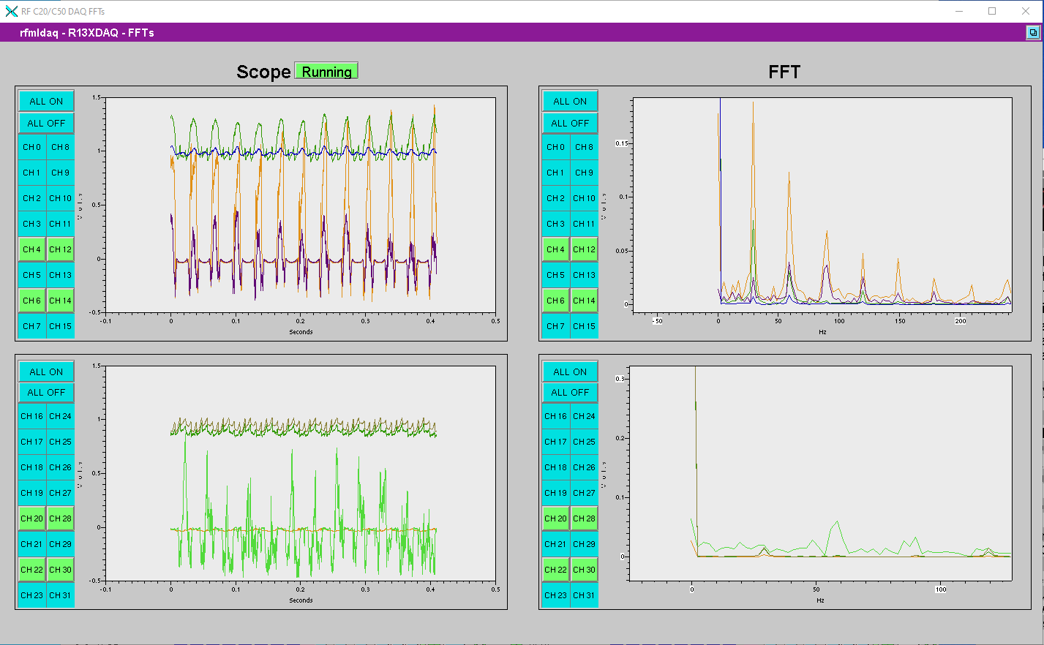
AI/ML DAQ Project
Increased sample rate of chassis led to Clyde Mounts identifying and detecting cavity instability in NL03.
Shown here is 30 Hz noise source (and its harmonics).
These would have been invisible given the legacy cavity controls.
Dennis Turner and company are designing ML based tools that use these waveforms to predict cavity instability. They expect to have tools available to operators at the beginning of 2023 startup.
DAQ EPICS Screen​

Slide 19
HV Transformers and RF Isolators
HV Transformers
The last vendor has had multiple failures (4) over 10 delivered.
Negotiating now between the company and JLAB for compensation.
New vendor set to deliver the first article next week.
We will put it on a "roll-around" for immediate test and use.
The order for 10 should be complete by the end of the summer so we should have spare issues for the next run.
Isolators
We discovered last summer that the present isolators in the C20/50/75 zones are only rated to 5 kW.
We had a catastrophic failure of a new 8 kW tube and 5 kW isolator last summer in 1L10.
We have 52 eight kW isolators on order.
First article tests last week indicated a ferrite heating issue. The vendor is re-designing this part.
Next high-power tests start this Thursday

Slide 20
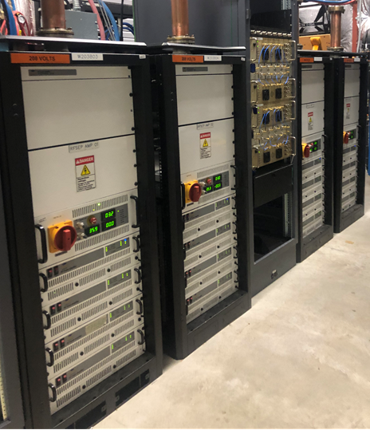
750 MHz Separator SSAs Coming Next Year!
Replaces IOT and vector sum RF control with individual solid state amplifier for each 750 MHz separator cavity
RF system will be like the four vertical 499 MHz separators in front of the Lamberston
This will allow more efficient gradient adjustments and phasing to the cavities enabling better beam separation.
Turn on and recover will be faster too!

Slide 21
C. Hovater
hovater@jlab.org
Special Thanks to
Tomasz, Rama, James, Dave, Rick, Clyde, Sam, Tim, Bill, Xavier, Mark, Manny, Moe Larry, Curly, Evonda, and Chris

