Slide 1
Accelerator System - Reliability
System reliability is an important consideration for any system that is critical to the success of an organization. By understanding the factors that affect reliability and taking steps to improve it, organizations can reduce the risk of system failures and improve the uptime of their critical systems.
    Primary Systems
Beam Dumps
Beam Transport
Control Systems
Cryogenic Systems
Diagnostics
Facilities
Gun/Laser
Information Systems
Magnet Systems
Operations
Others
Radio Frequency Systems (RF)
Radiation Controls
Safety Systems
Vacuum Systems
O. Garza

Slide 2
Examples of Primary Sub-System DT Categories
Beam Dumps
  Stationary Dumps - Insertable Dumps – etc.
  Beam Transport
    Optics - Beam Loss - Beam Instability – Orbit – Config. Change – etc.
    Control Systems
      IOCs – CAMAC Crates – Reboot Switches – etc.
Cryogenic Systems
  CHL1 – CHL2 – Linacs – ESR – etc.
Diagnostics
  Harps – Viewers – BPMs – etc.
Facilities
  AC Distribution – Chiller Loop – Fire Protection – etc.
Gun/Laser
  Laser Table – Gun HV – Laser RF – etc.
Information Systems
  Low Level Applications – Network – UNIX Apps – File Servers – etc.

Slide 3
Examples of Primary Sub-System DT Categories
Magnet Systems
  Box Supplies – Trim Racks – Dipoles – Quads – Shunts – etc.
Operations
  Operations Personnel – Operator Staffing – Operator Training – Operator Error – etc.
Others
  Weather – Unknown/Missing – Hall Downtime – etc.
Radio Frequency Systems (RF)
  Cryo-modules – RF Cavities – RF Separators – MO System – etc.
Radiation Controls
  Radiation Monitors/PSS Interlocked – etc.
Safety Systems
  Access Controls – FSD – Beam Stoppers – ION Chambers – MPS BLM – etc.
Vacuum Systems
  Beam Valves – Ion Pumps SRF – Ion Pumps EE – SRF Insulating Vacuum – Turbo Pumps – Beamline Instrumentation - etc.

Slide 4
Annual Availability for Beam Transport

Slide 5
Annual Availability for Controls

Slide 6
Annual Availability for RF Systems

Slide 7
Annual Availability for Vacuum Systems

Slide 8
Annual Availability for Safety Systems

Slide 9
Annual Availability for Magnet Systems

Slide 10
Annual Availability for Facilities

Slide 11
DT – Operations – Info Systems – Cryogenics - Diagnostics

Slide 12
DT - Other

Slide 13
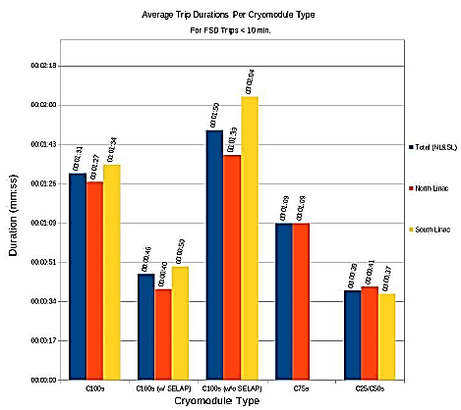
DT – Trip Durations Per Cryomodule
The data used for the figure above was retrieved from the Downtime Manager’s FSD Trip Summary tool. All trips greater than ten minutes were excluded. Ideally, any trips longer than five minutes are taken into consideration in the downtime manager. In addition, all trips that occurred when all four Hall statuses were set to OFF (i.e. maintenance days) were excluded. The C25/C50s are the quickest to recover, on average, at about 40s per FSD trip, C100s (non-SELAP) around 110s per FSD trip, and C100s (SELAP) around 45s per FSD trip.

Slide 14
Energy Reach vs. True Arc Faults
The figures for Energy Reach vs True Arc Faults were created with data taken from the RF Dashboard and the RF Fault Viewer. Values were recorded for energy reach and true arc faults for each linac on a daily basis for the entirety of last run and superimposed on two graphs, one for the north linac and one for the south linac.
We use the energy reach here as some quantification of the amount of headroom that we have in each linac. It’s pretty easy to see that as headroom decreases the number of true arc faults also increases, leading to an increase in time lost due to FSD trips.

Slide 15
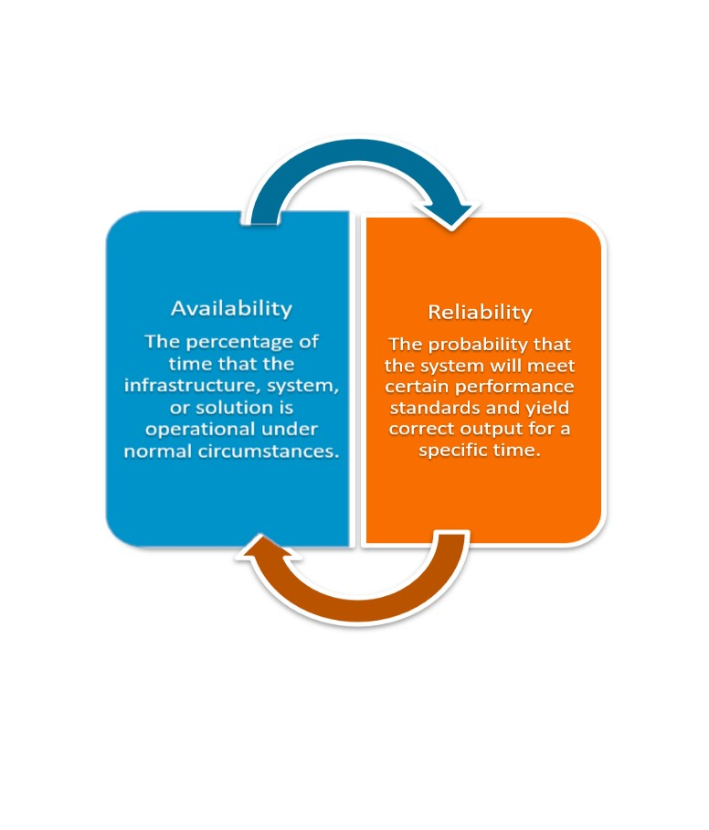
Questions???
Authors:
O. Garza
E. Deir
Improving Reliability
Using good design practices
Using high-quality components
Operating and maintaining the systems properly
Protecting the system from environmental hazards
Conduct regular inspections and maintenance to identify and fix potential problems.
Improve system monitoring and alarms to identify problems early on
Have a well-trained staff
Keep systems up-to-date.
Do not exceed design parameters – know your systems limits

