Slide 1
CEBAF tune time and setup
Yves R. Roblin

Slide 2
FY2022 in numbers

Slide 3
Planning for machine startup and setup
Cold startup process, underpinned by a project management approach, identify resources, needs and timeline. Resulting in consistent time of 5 to7 days to setup CEBAF from scratch (cold setup+ORFP)
Optics Restoration and Finalization Procedure. Refined over the years to allow for a systematic approach to machine setup. Its goal is to get the machine to beam physics quality. It addresses, steering, transport and envelope matching as well as procedures such as beam extraction and pass change.
Optics on call to address situations where events not covered by the latter impede beam delivery.
Setup time is consistent and a small fraction of the total time

Slide 4
Restoration planning

Slide 5
Typical emittance evolution in machine after ORFP

Slide 6
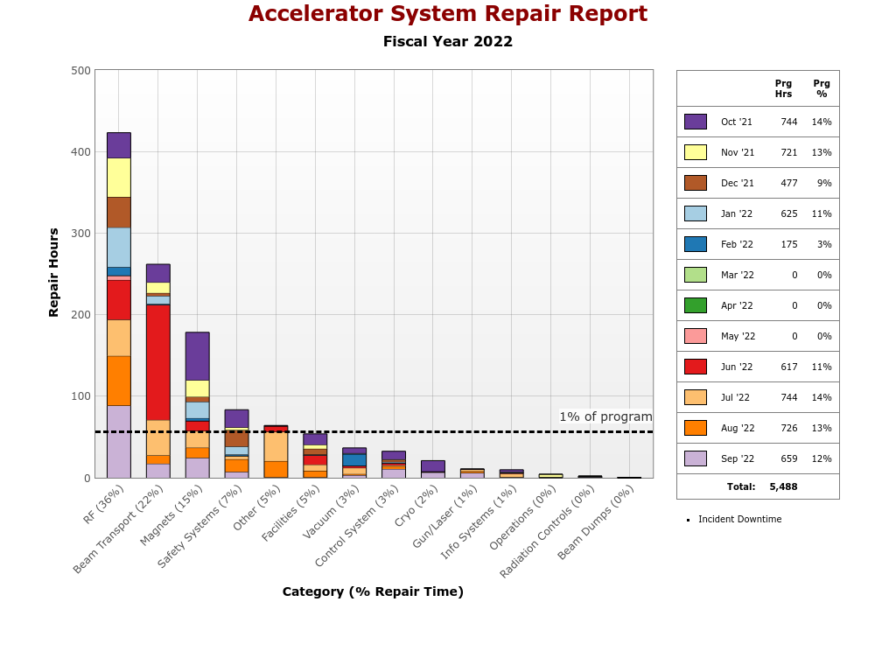
Reliability at CEBAF and contributors
FY | % Reliability
FY22 | 72.0%
FY21 | 70.3%
FY20 | 68.3%
FY19 | 81.3%
FY18 | 76%

Slide 7
Model driven setup
The machine is setup from a design model which takes into account synchrotron radiation, machine layout, envelope requirements.
After the initial download, we follow the cold startup and then the ORFP.
Not perfect because:
variance between components in the same family (quads)
Stray fields
Effect of gradient profiles on focusing
Variance in incoming beam from injector (laser, bunch formation, current etc..)
Reproducibility of the transport matching process

Slide 8
Tuning quad adjustments, June 2022 setup
design
machine
diff
percent
Relatively small adjustment for match into NL and then 1E match. This indicates
the modeling of the focusing in the linac is well understood.
Same pattern for 2E. Mainly two quads (S06/S10) to adjust the phase advance
for the match.

Slide 9
Tune time
This includes a variety of situations such as:
Beam checks
Machine steering due to component drifts (injector for example)
Pathlength corrections
Experimental hall requests for a different beam position/envelope.
Anytime there is an issue for which we do not know the underlying cause and requiring stoppage of physics beam delivery and investigation (for example, chronic beam loss)
Operational errors
Optics errors (wrong setpoints, incorrect match, faulty locks)

Slide 10
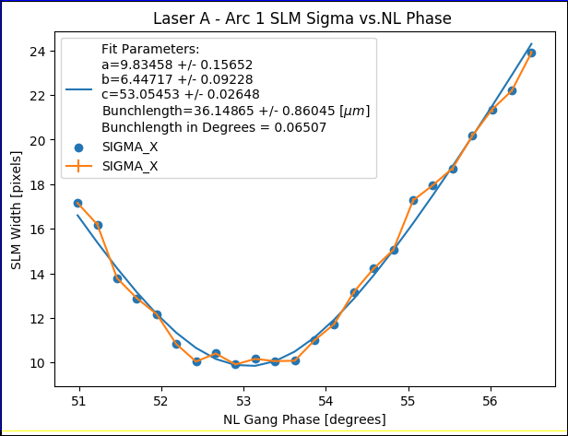
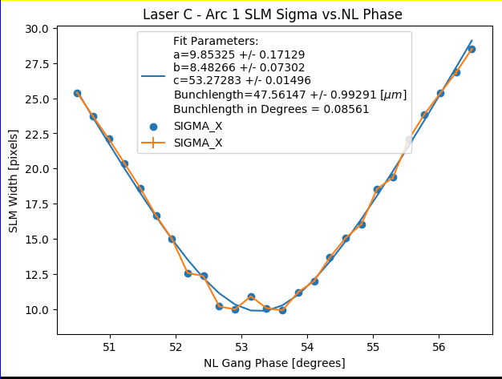
Bunchlength measurement at 1A, laser comparison
Both lasers produce similar bunchlength, well within specifications.
We usually expect around 100 microns.

Slide 11
Tune comparison

Slide 12
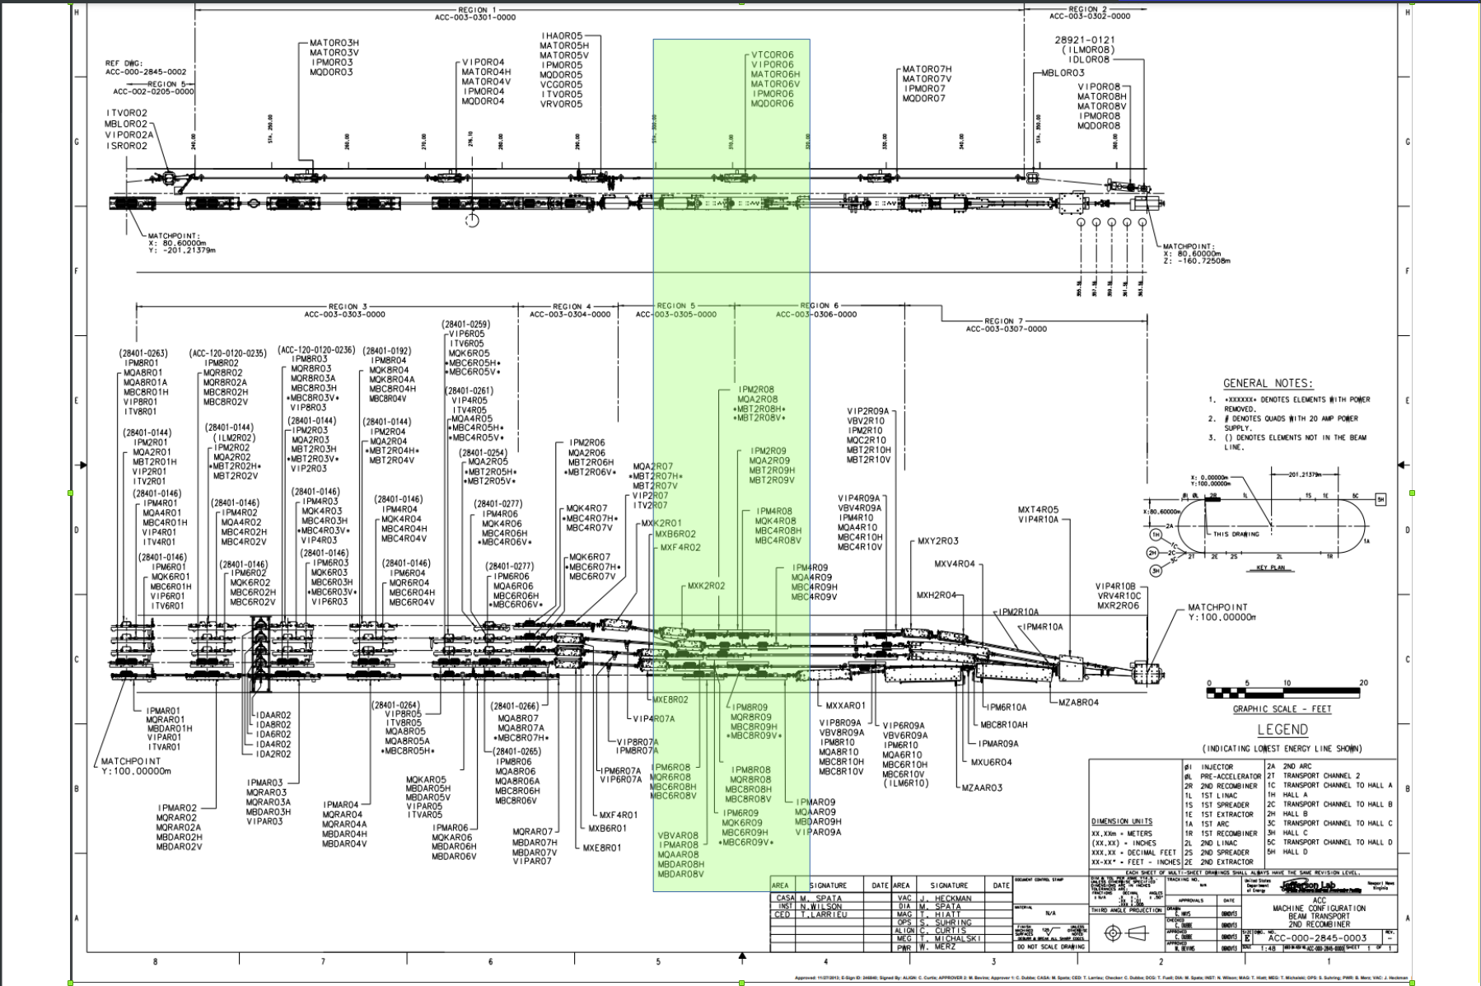
Case study, chronic beam loss at 0R06 (and 8E02) for C beam

Slide 13
Root Cause Analysis
Unable to locate a specific area with beam loss.
After several days and adjusting:
Pathlength
Aperture scans
Orbits in spreader/recombiners
RF gradient profile
Recombiner match in 8R
We recovered the high current capabilities.
Need more diagnostic BLMS that can be correlated with other signals.

Slide 14
Root cause analysis (cont)
Beam loss is correlated with RF stability, especially when trying to push higher currents.
RF trips characterization is critical. There is a dedicated DAQ and an AI classifier which are in use to do so.
The fast RF DAQ allows for reviewing signals prior to a trip on a very short time scale (100ms buffer I think)
The correlation to orbits via the bpm system can only be done via a FFT. Only possible at some of the machine locations (SEE) and not easy to use
Better integration of diagnostics between BPM/RF/FSD would be very beneficial.

Slide 15
Adequacy of the BLM system
The BLM system was designed to quickly shutdown the beam via the FSD (5 Mhz). Its initial specifications were drafted to protect against catastrophic failures (at this time, damaging RF cavities, hitting the nose of the YA separator magnets, etc..)
There are questions about the calibration. Is it sensitive enough, is it too sensitive at certain locations ?
Measurements were done recently with beam, showing that as little as a few nA (secondary e- from harp wire) could trip a blm all the way on the other side of the machine.
A review of the system would be useful to gain insight and assess whether or not it needs upgrade.

Slide 16
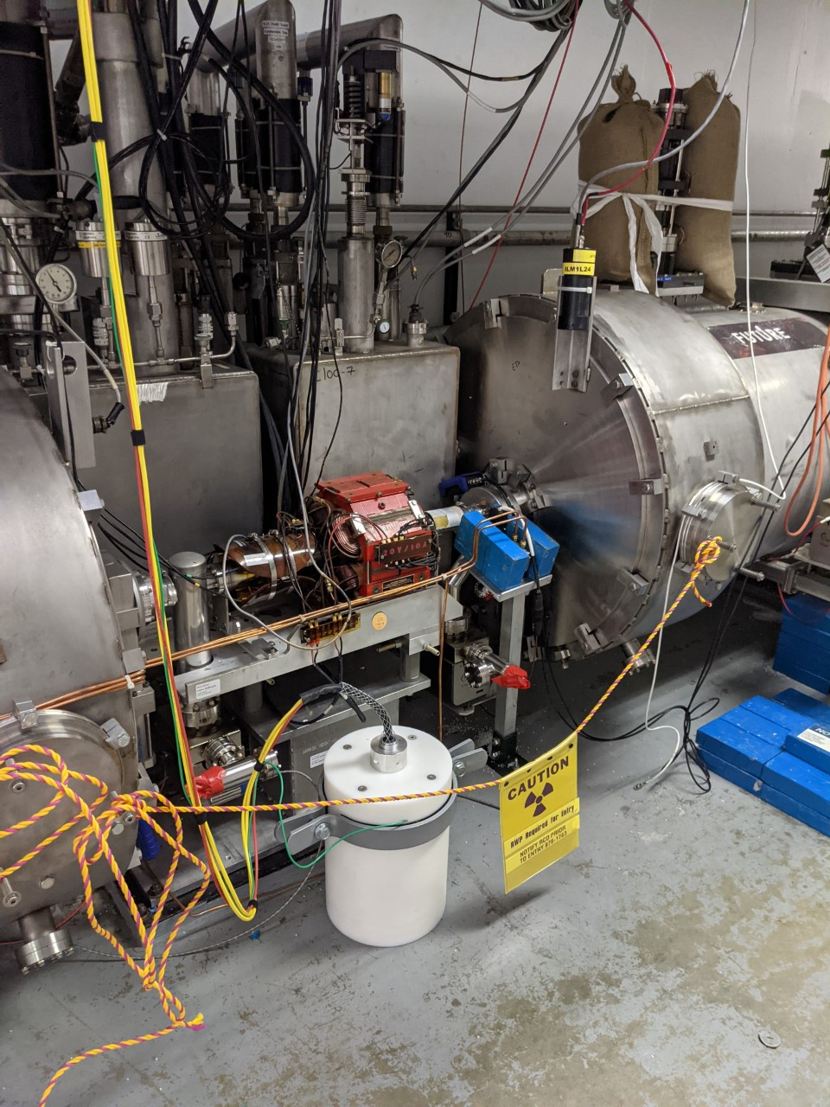
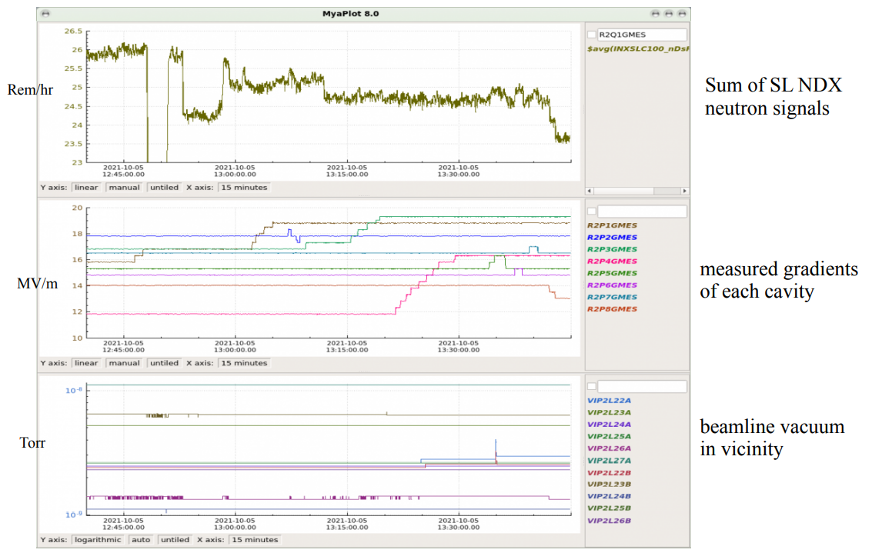
Improving reliability: Optimizing for reduced radiation
NDX (neutron) detectors were installed in the accelerator enclosure.
They inform gradient redistribution with the aim of reducing the radiation induced field emission.
Designed and build by the Rad. Control group.
Gradient / radiation reduction moving toward AI optimization.
Currently the focus of efforts from the Radiation control group, Operations and CASA.

Slide 17
Consequence of radiation damage on bpms

Slide 18
Global synchronized locks
We currently do no have that capability. This led to several incidents with beam excursions propagating all the way to experiment halls.
Will be addressed with the new bpm system which will provide synchronized readings.
FOA in collaboration with SLAC to develop AI driven global orbit locks

Slide 19
Human performance Improvement
Aim at reducing operator errors or miscommunication between operation and physics
Target incident, December 14, 2022. Beam excursion in Hall A caused target destruction. Detailed report found cause ( stray field when cycling a magnet ) and also identified issues with the software interface for the FSD system which made it more likely that one could mistakenly disable the FSD protection.
Improved training modules, better software interfaces for critical components
Provide dedicated machine time for staff training

Slide 20
Looking ahead: Future experiments
Interfacing with physics ahead of the scheduled experiment is critical.
APELs play an important role
Feedback given to physics when they submit new proposals (TAC meeting ahead of PAC)
Close collaboration with physics to help schedule experiments in a manner that is compatible with machine capabilities (spin transport, beam control etc..)
Identify new needs and develop capabilities, test them with beam studies ahead of time (Moller experiment)

Slide 21
Backup slides
BACKUP SLIDES

Slide 22
Optical matching around the machine
INJ-NL | Emitx | Betax | Alphax | Emity | betay | alphay
meas | 6.27e-9 | 43.45 | -1 | 3.55e-9 | 17.7 | -0.92
design | 3.25e-9 | 28.1 | -0.53 | 3.25e-9 | 8.16 | +0.33
1E | Emitx | Betax | Alphax | Emity | betay | alphay
meas | 7.42e-10 | 46.3 | 2.79 | 5.39e-10 | 52.2 | -13.2
design | 3.29e-10 | 21.9 | 1.48 | 3.33e-10 | 39.4 | -10.3
Getting expected emittance damping, beam still close to match when reaching 1E.
Indicates that we are modeling the linac focusing correctly.

Slide 23
Machine matching
2E | Emitx | Betax | Alphax | Emity | betay | alphay
meas | 7.42e-10 | 46.3 | 2.79 | 5.39e-10 | 52.2 | -13.2
design | 3.29e-10 | 21.9 | 1.48 | 3.33e-10 | 39.4 | -10.3
3E | Emitx | Betax | Alphax | Emity | betay | alphay
meas | 1.17e-09 | 528 | -45 | 2.26e-10 | 46.4 | -6
design | 1.37e-10 | 86.7 | -6.99 | 1.56e-10 | 73.8 | -10.3
4E | Emitx | Betax | Alphax | Emity | betay | alphay
meas | 8.71e-10 | 204.8 | 23.37 | 1.88e-10 | 62.54 | -11.13
design | 1.27e-10 | 59.8 | 7.46 | 1.45e-10 | 118.5 | -20.3
5E | Emitx | Betax | Alphax | Emity | betay | alphay
meas | 4.67e-10 | 9.91 | -0.7 | 4.65e-10 | 56.8 | -10.11
design | 1.36e-10 | 142.8 | -20.67 | 2.23e-10 | 82.43 | -14.8

Slide 24
Machine matching (cont)
6E | Emitx | Betax | Alphax | Emity | betay | alphay
meas | 7.90e-10 | 44.27 | 2.013 | 3.86e-10 | 23.17 | 0.66
design | 2.20e-10 | 68.64 | 3.18 | 2.21e-10 | 48.93 | 1.11
7E | Emitx | Betax | Alphax | Emity | betay | alphay
meas | 9.25e-10 | 18.62 | -2.53 | 5.35e-10 | 70.1 | -12.4
design | 5.20e-10 | 119.3 | -11.12 | 3.62e-10 | 51.4 | -9.33
9E | Emitx | Betax | Alphax | Emity | betay | alphay
meas | 2.72e-09 | 65.93 | -3.06 | 1.30e-09 | 254.7 | -2.59
design | 1.33e-09 | 119.37 | -3.26 | 5.83e-10 | 158.6 | -3.40
AE | Emitx | Betax | Alphax | Emity | betay | alphay
meas | 3.82e-09 | 57.88 | -18.72 | 1.48e-09 | 205.8 | -21.1
design | 2.60e-09 | 54.13 | -17.61 | 6.40e-10 | 57 | -5.5

Slide 25
Machine matching (cont)
5C | Emitx | Betax | Alphax | Emity | betay | alphay
meas | 4.1e-09 | 175.8 | -2.982 | 2.33e-09 | 118.1 | -12.94
design | 3.49e-09 | 121.7 | -2.607 | 1.01e-09 | 184.2 | -20.07

