Slide 1
Upcoming Experiment Schedule and Machine Expectations
Douglas Higinbotham
Physics Division

Slide 2
High Level View of the JLab Experiment Process
Experiments Proposed to the Program Advisory Committee ( PAC51 last week in July )
Approved Experiments (typically 1/3 of proposed) Enter A Readiness Review Process
For an experiment using just standard equipment rather simple/straight forward process
For a major experiment using non-standard equipment MANY reviews (e.g. Moller)
Experiment Spokespersons Request To Hall Leaders To Be Considered For Scheduling
We are showing schedules that go further out in time then in the past, so not everything shown has passed all reviews and just being on the schedule isn’t any kind of guarantee.
Experiments must pass their readiness reviews prior to the beginning of the experiment (no pass, no run certificate)
NPES Committee Works On Making Schedules
Balancing Energy, Polarization, Power/Current, Targets, etc.
Limited human resources must also taken into account as well as limited beam time.
Schedules are reviewed and approved by the director
Experiments Finally Get To Run
Minor Schedule Adjustments Made At 8am & 1:30 meetings ( Doug as physics referee )
Experimental Data Stored To Magnetic Tape For Off-line Analysis
Jefferson Lab prides itself on providing the data for approximately 1/3 of all PhD’s in experimental nuclear physics.

Slide 3
Nuclear Physics Experiment Scheduling Committee https://www.jlab.org/physics/experiments/NPEScommittee
Deputy Director for Research | David Dean | deandj@jlab.org
Physics Division AD | Thia Keppel | keppel@jlab.org
Physics Division Deputy AD | Patrizia Rossi | rossi@jlab.org
Director of Physics Operations (chair) | Douglas Higinbotham | doug@jlab.org
Halls A & C Leader | Mark Jones | jones@jlab.org
Hall B Leader | Patrick Achenbach | patricka@jlab.org
Hall D Leader | Eugene Chudakov | gen@jlab.org
Accelerator Division Deputy AD | Mike Spata | spata@jlab.org
Director of Accelerator Operations | Eduard Pozdeyev | pozdeyev@jlab.org
Center for Injector Studies Leader | Joe Grames | grames@jlab.org
Input is taken from MANY other groups!
Many thanks to Randy Michaud who served on the committee as interim accelerator operations director during the last planning cycle.

Slide 4
Machine Expectations
The machine was pushed very hard last run period and though very challenging, we actually got done an amazing amount of high impact science! Thank you!
After the current SAD (i.e. July 2023)
Continue To Run Same Energy As Last Year (i.e. 1047 MeV/linac)
Backup Plan is 1026 MeV/linac which isn’t ideal, but we could run the planned program
Old fashioned three Hall running with 500 MHz beam to Halls A/B/C
After the next SAD (i.e. July 2024)
Back to four hall running (i.e. 250 MH beam to Halls A/B/C & D)
Would love to be able to push the energy beyond 1047 MeV/linac especially for Hall D GlueX
A & C pushing the limits of cryo-power (as noted already by Jonathan)
Looking towards Moller in ~2026 and beyond.
Must deliver beam energies around 10.8 GeV (+/- 0.2 GeV) to Hall A (~1070 MeV/linac)
Must deliver parity quality beam while still running other halls.
It is understood that running K-Long and Moller together could be problematic.

Slide 5
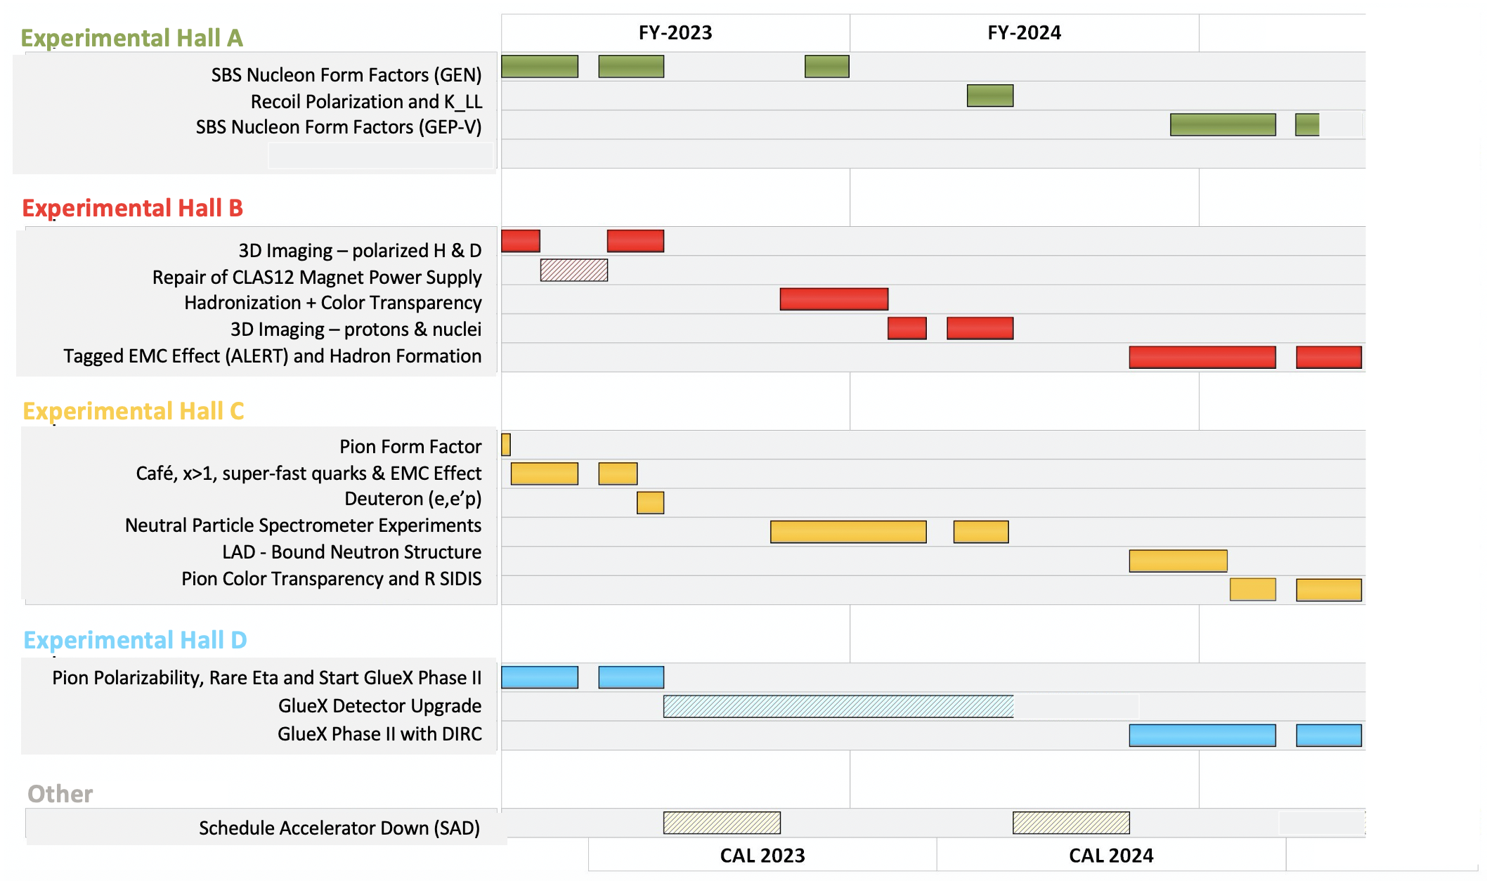

Slide 6
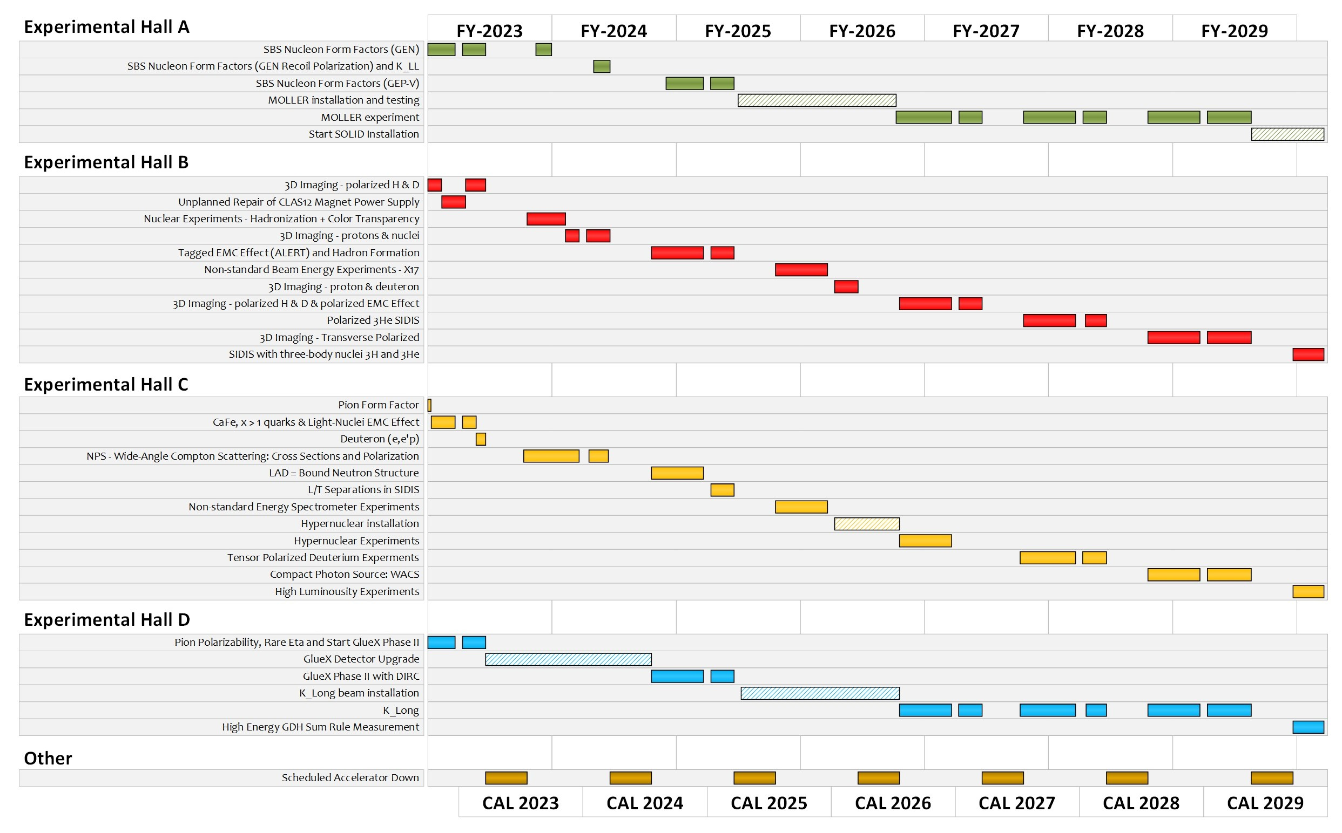
Extended Experimental Schedule
205 completed experiments to-date (28 full; 28 partial in 12 GeV era)
51 experiments remaining
~7 years at ~30 weeks/year
…not including SoLID
…not including new proposals

Slide 7
Useful Links
Scheduling Memo (LOTS OF IMPORTANT DETAILS!)
https://www.jlab.org/physics/experiments/schedule
Note the text on priority halls completely changed to be simpler first among equals.
Feedback on the posted schedule is welcome!
Approved Experiment Lists
https://www.jlab.org/physics/experiments

