Slide 1
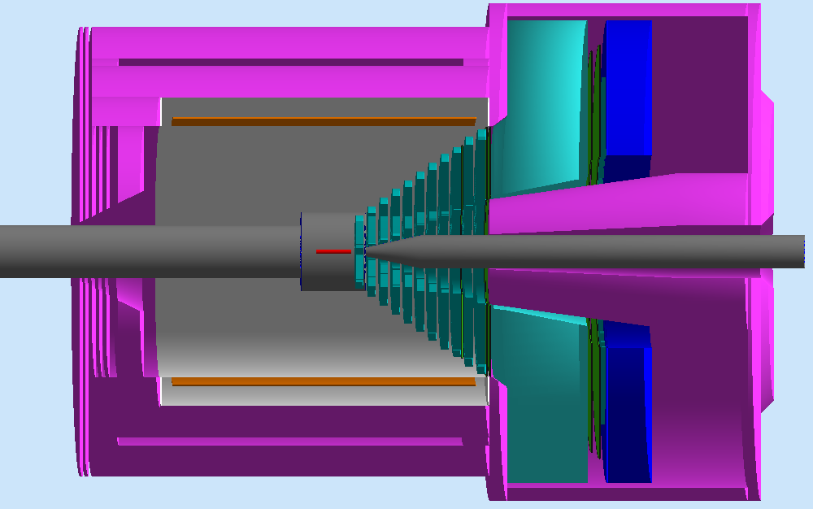
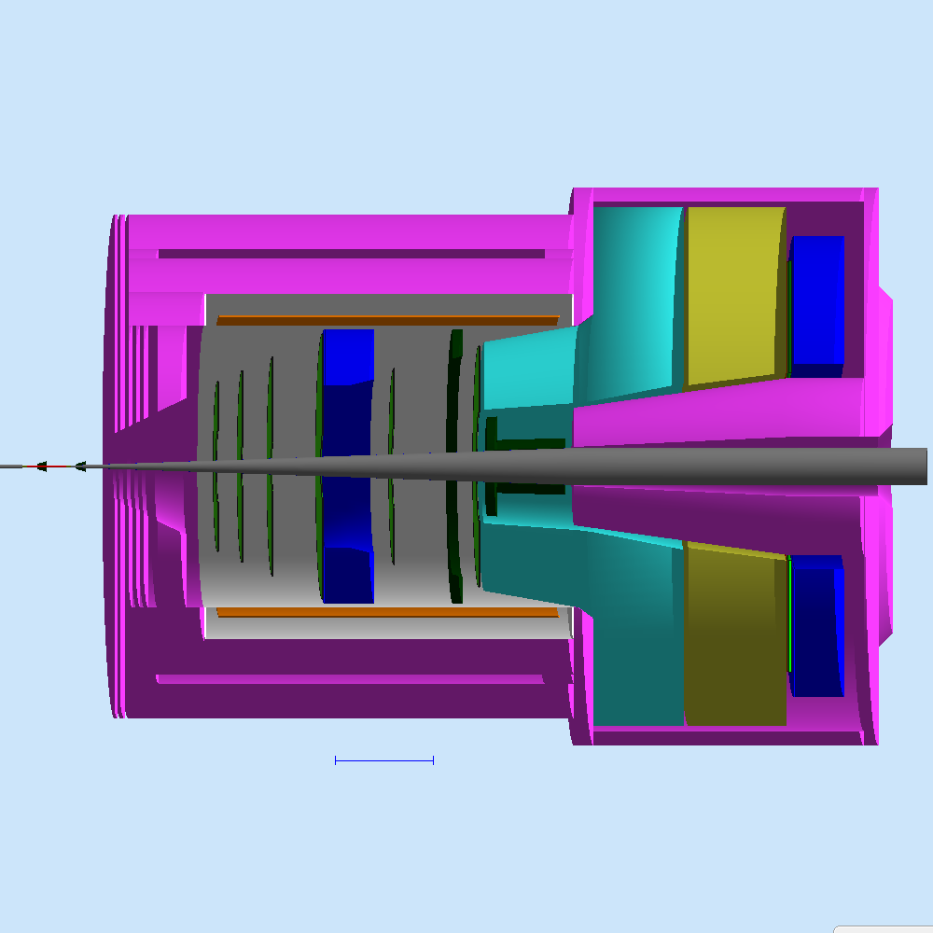

Parity Violation with SoLID:
PVDIS & PVEMC
erhtjhtyhy
Paul E Reimer
30 June 2023
JLab, Newport News, VA
This work was partially supported under grant DE-AC02-06CH11357 from the US Department of Energy, Office of Nuclear Physics

Slide 2
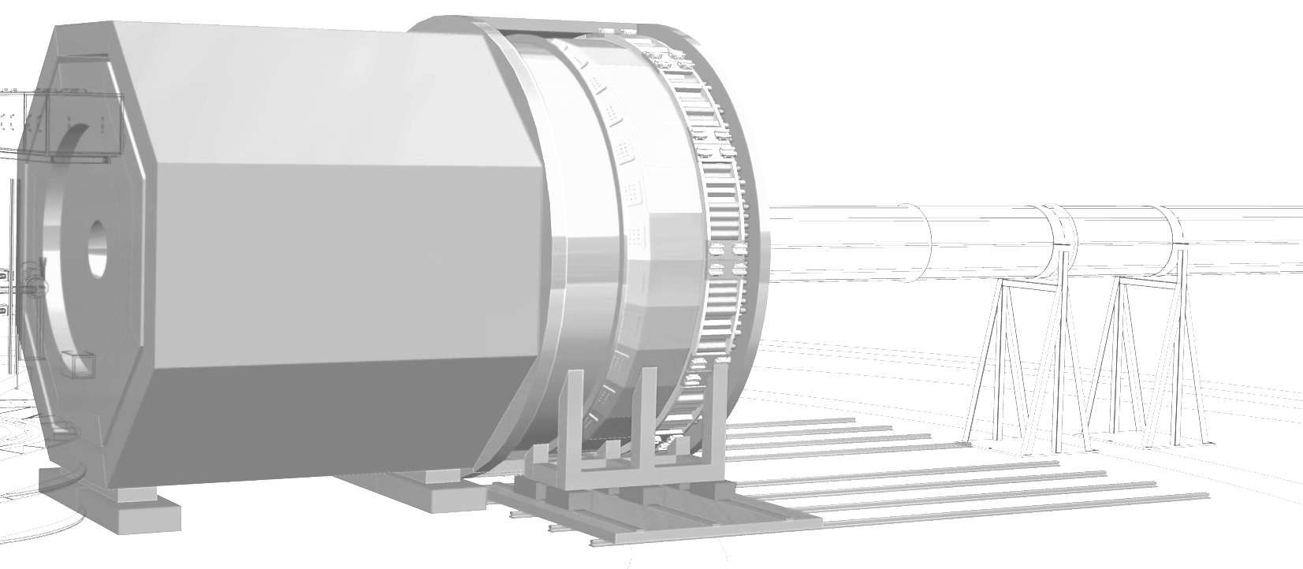
SoLID – The Next-Gen Spectrometer at JLab
Solid
  Solenoidal Large Intensity Device
Rich physics program including
  SIDIS
  J/𝜓 production
  Parity Violation
For an overview, see Xiaochao Zheng’s talk at the JLab User’s Meeting

Slide 3
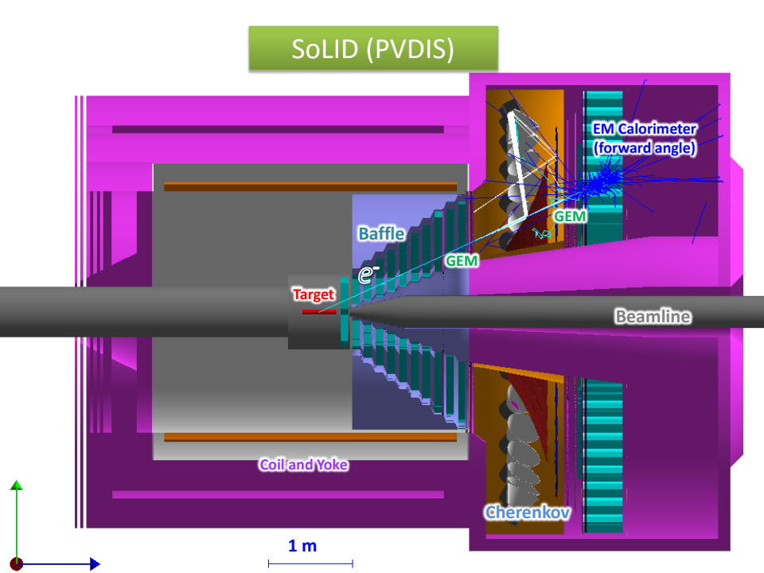
SoLID Apparatus for PVDIS
What do you need for to measure parity violation in DIS?
DIS experiment: W² > 4 GeV² Isolate DIS events. Only electron is detected.
PV experiment: High Luminosity with E ~ 11 GeV, stable systematics
What do you need to address the physics?
Wide x-range: 0.25-0.75:
  untangle physics.
  Large scattering angles ~22°<𝜃<~35°
Large azimuthal acceptance.
Better than 1% statistical errors for small bins
Large Q² range: Measure Higher Twist.
2 GeV < E’< 6 GeV: Low background
Around 2% Momentum resolution

Slide 4
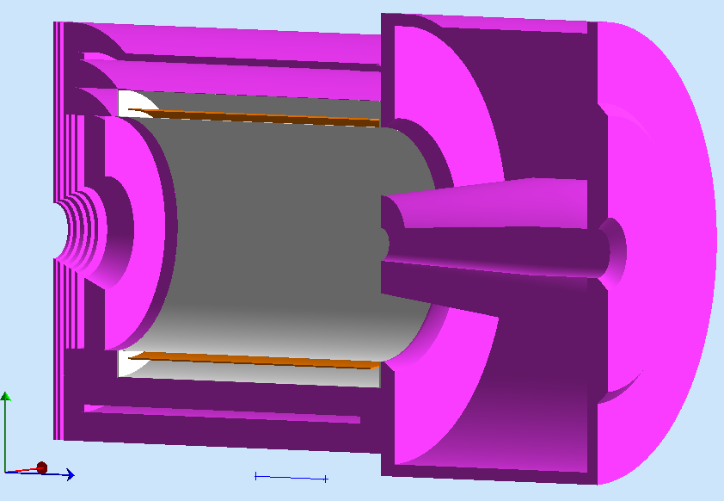
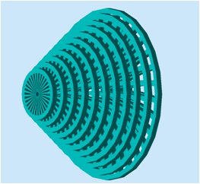
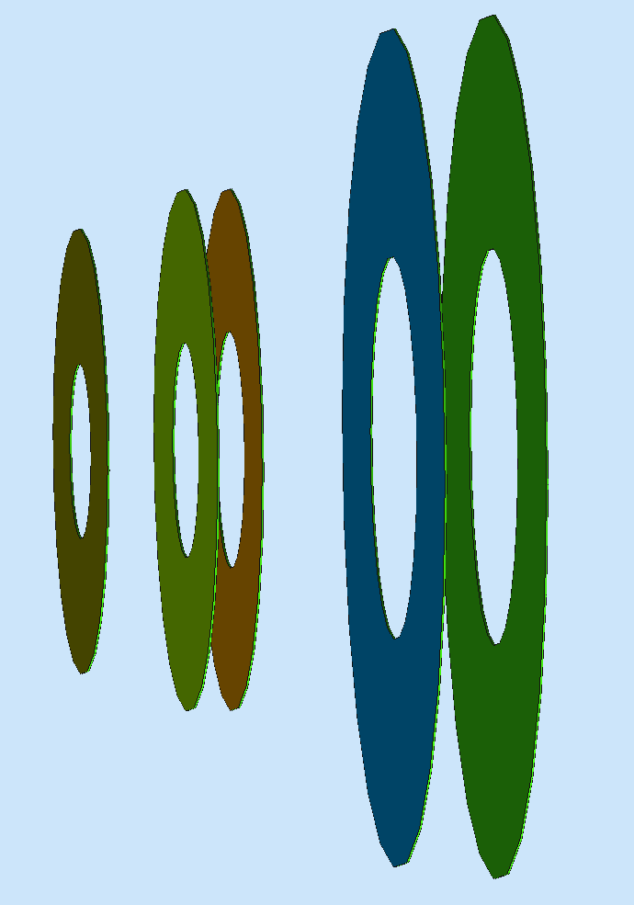
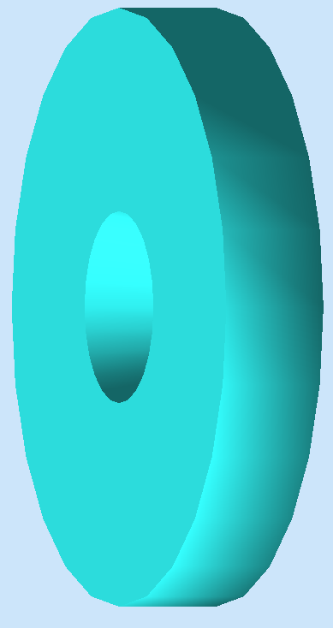
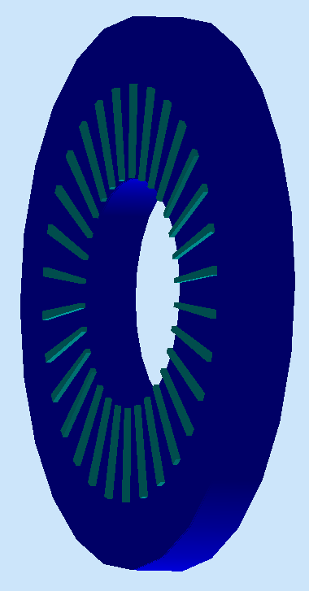
SoLID Apparatus
Baffles to reject wrong momentum background
Light Gas Cerekkov: identify electrons for trigger; reject pions.
Shashlyk electromagnetic calorimeter (Ecal) : coincident trigger and further particle identification.
With tracking, tight E/p cuts reduce pion backgrounds.
Baffle 5xGEMs EC
LGC

Slide 5
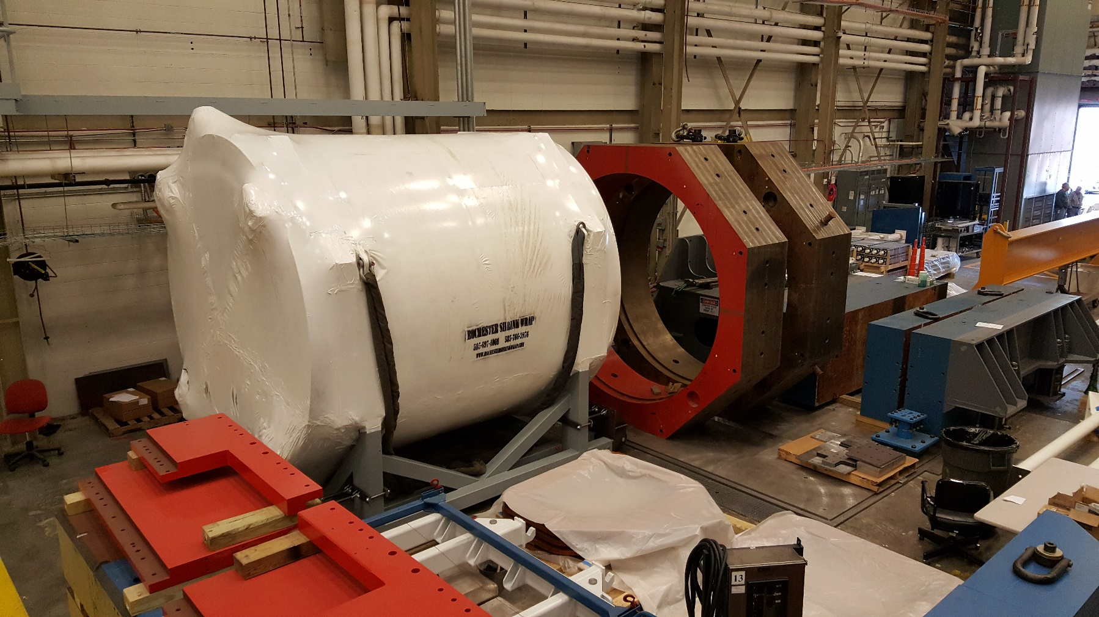
Latest – CLEO-II Magnet Cold Test at JLab

Slide 6
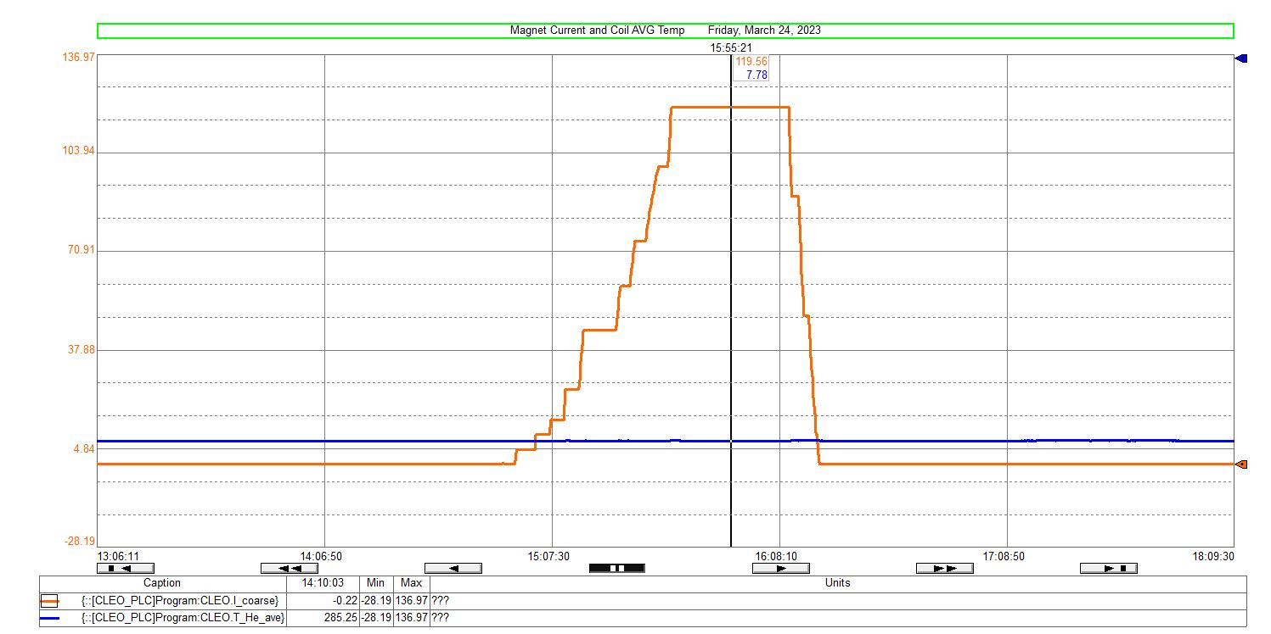
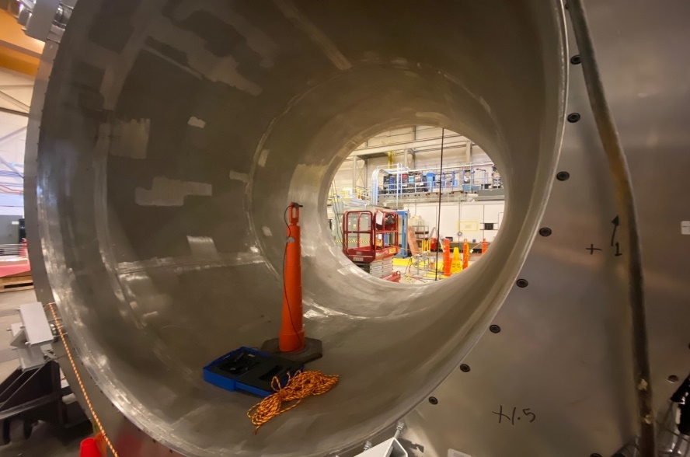
Latest – CLEO-II Magnet Cold Test at JLab
A low current test on March 24th.
3-axis Hall probe data matched TOSCA model well.
Coil average temperature remained constant during test.
Success!!
content from W. Seay and X. Zheng

Slide 7
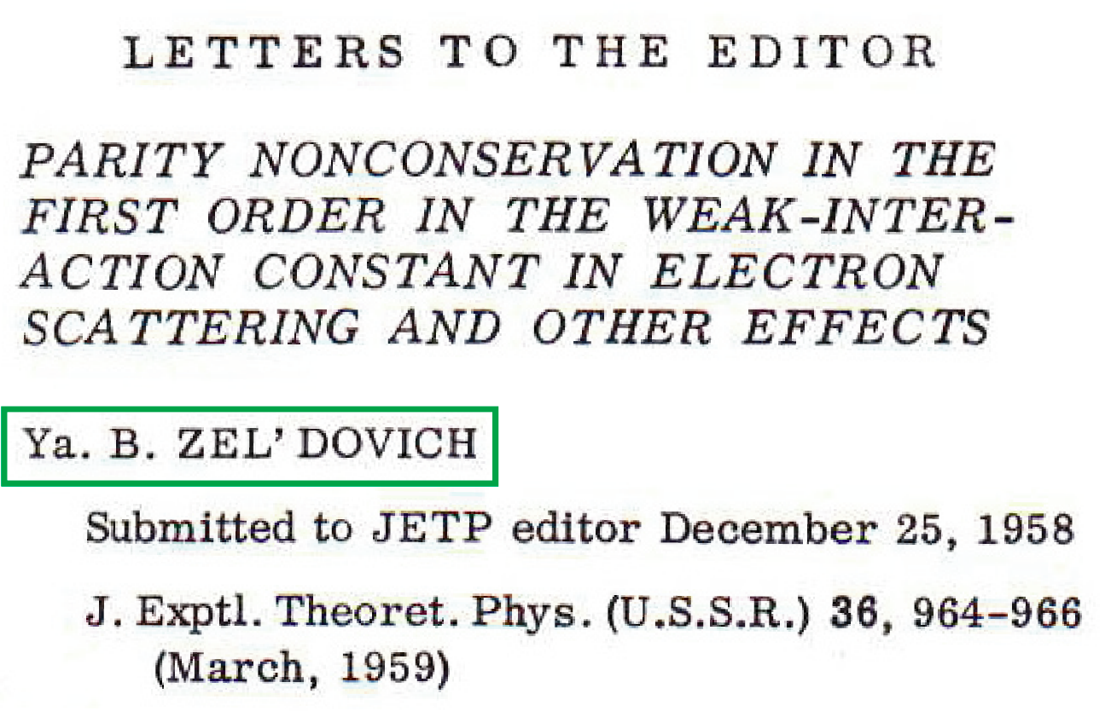
Parity NonConservation and Electron Scattering
Proposes that electron scattering should have measurable parity violating asymmetry
Proposes interaction like that responsible for β decay to occur in electron scattering
Argues cross sections for scattering left- and right-handed electrons could differ
ν
e
e
e
G_{F}
G_{F}
n
p
p
p

Slide 8
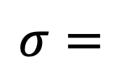

Zel’dovich
2
e
e
e
e
$$σ=$$
+
$$γ$$
Z

Slide 9
Zel’dovich
2
e
e
e
e
$$σ=$$
+
$$γ$$
Z
Tiny
Large,
but equal

Slide 10
Zel’dovich
2
e
e
e
e
$$σ=$$
+
$$γ$$
Z
Tiny
Large,
but equal

Slide 11
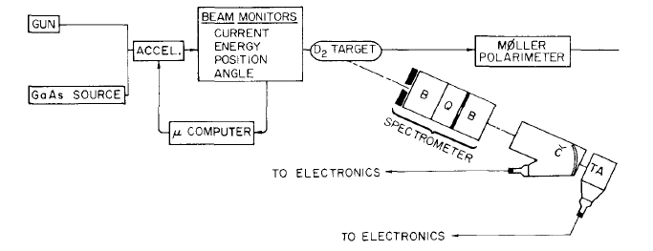
SLAC E-122
Prescott et al SLAC E-122
Scatter left and right polarized electrons from target
Count/measure (frequently integrating) number scattered into specific solid angle
Keep systematic effects in control
Form asymmetry and publish

Slide 12
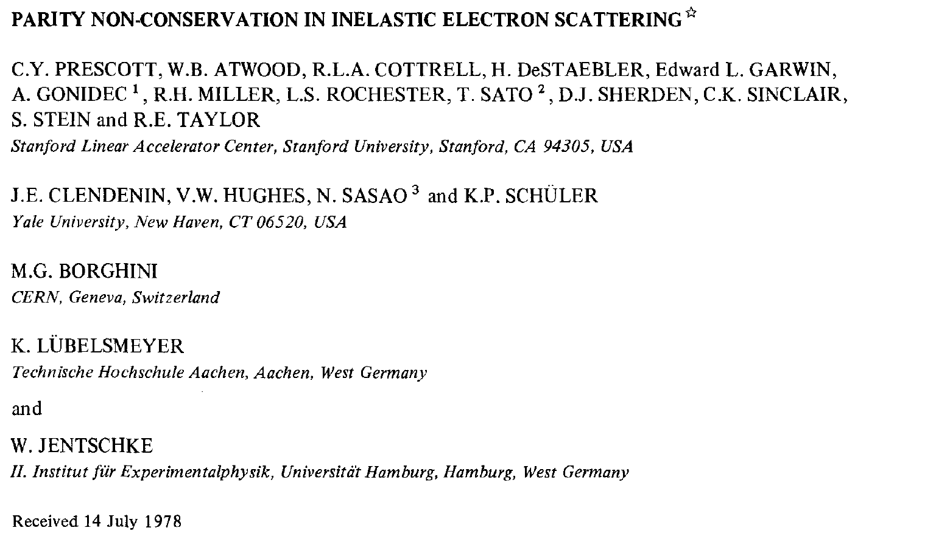
1st Generation PV experiment in 1977
Phys. Lett. 77B, 347 (1979)
Abstract
We have measured parity violating asymmetries in the inelastic scattering of longitudinally polarized electrons from deuterium and hydrogen. For deuterium near Q² = 1.6 (GeV/c)² the asymmetry is (-9.5×10⁻⁵)Q² with statistical and systematic uncertainties each about 10%
sin²θ_{W} = 0.20±0.03
This experiment convinced the world that the Z-boson violated parity.

Slide 13
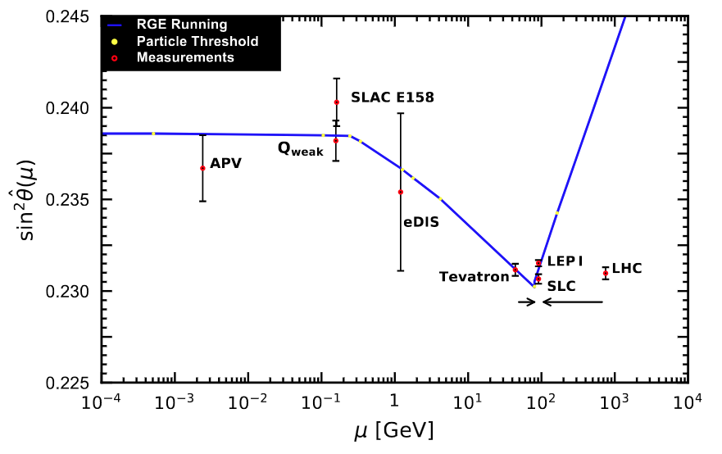
Probing the Standard Model
What we know:
The Standard Model is extremely accurate
  annoyingly so in some cases.
But there are slight disagreements
What we don’t know:
Exactly what is missing

Slide 14
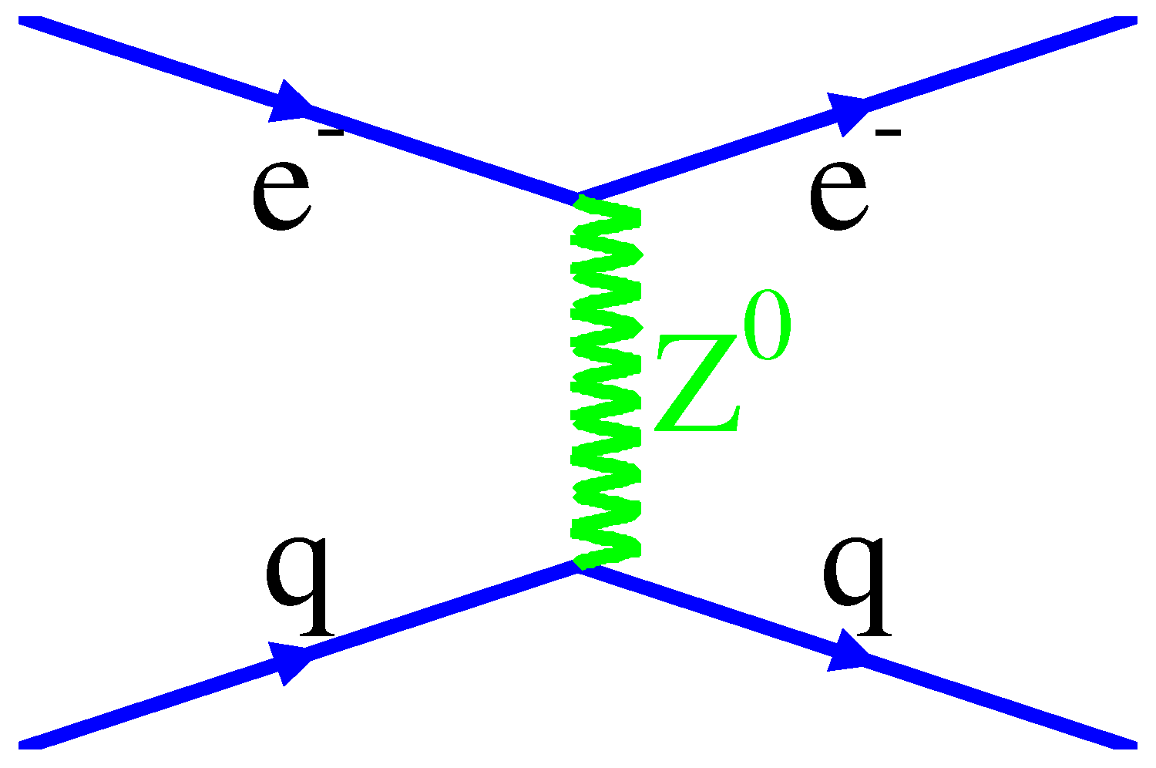


PVDIS Variables
Cahn and Gilman, PRD 17 1313 (1978) polarized electrons on deuterium
A
V
V
A
QCD
Parton distributions (u, d, s, c)
Charge Symmetry (CSV)
Higher Twist (HT)
Nuclear Effects (EMC)

Slide 15
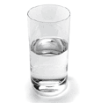
PVDIS Variables
Cahn and Gilman, PRD 17 1313 (1978) polarized electrons on deuterium
A
V
V
A
QCD
Parton distributions (u, d, s, c)
Charge Symmetry (CSV)
Higher Twist (HT)
Nuclear Effects (EMC)
Half full or half empty

Slide 16
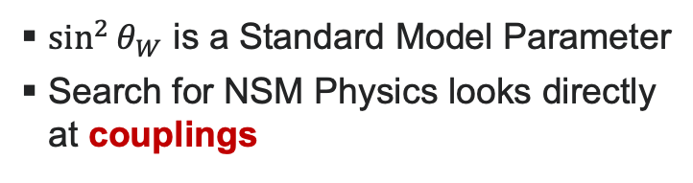


Parity Violation as a Tool to Investigate the Standard Model
2
e
e
e
e
e
e
$$σ=$$
$$γ$$
+
Z
+
?
A
V
V
A
$\sin^{2}{θ_{W}}$ is a Standard Model Parameter
Search for NSM Physics looks directly at couplings
2023 Particle Data Group

Slide 17
Extracting the Physics
Half full or half empty
11 GeV
Cleanest BSM search
Most sensitive to CSV
Kinematic dependence of physics topics:
6.6 GeV
 | x | Y | Q²
New Physics | none | yes | small
CSV | yes | small | small
Higher Twist | large? | no | large
Most sensitive to HT

Slide 18
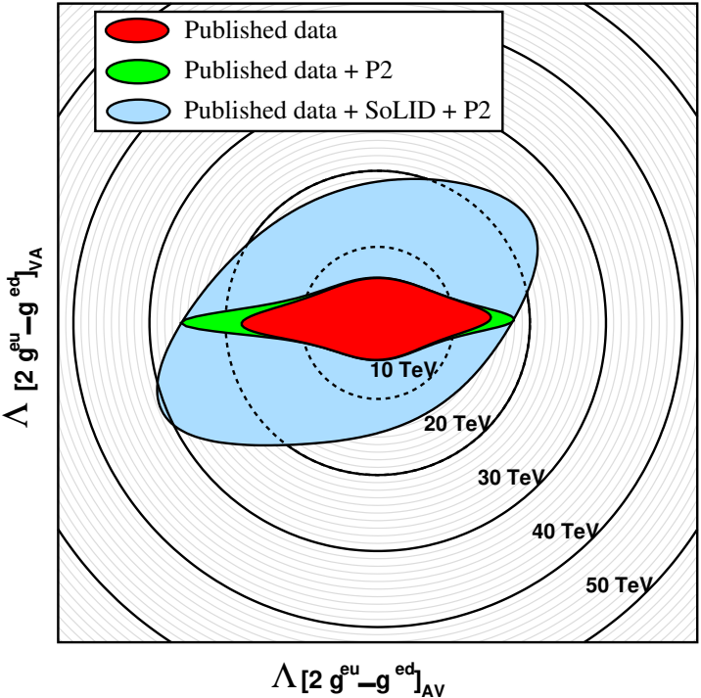
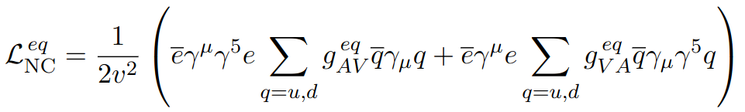
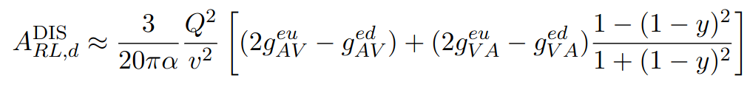
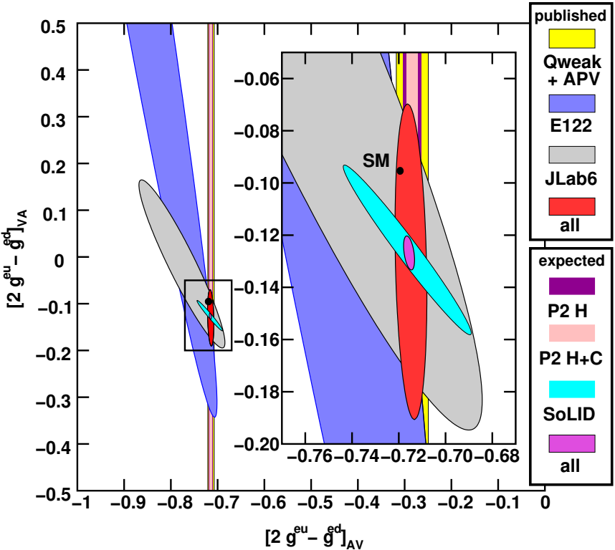
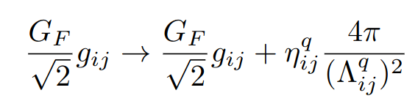
SoLID PVDIS Impact
BSM physics probed: leptophobic Z’, dark Z, strong PV (https://arxiv.org/abs/2306.04704)
Slide: P. Souder, PAC50

Slide 19

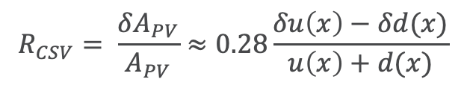
Hadronic Physics: Charge Symmetry Violation
$$R_{CSV}= \frac{δA_{PV}}{A_{PV}}≈0.28\frac{δu\left(x\right)−δd(x)}{u\left(x\right)+d(x)}$$
Slide Credit: P Souder, JLab Director’s Review, Feb 2021

Slide 20
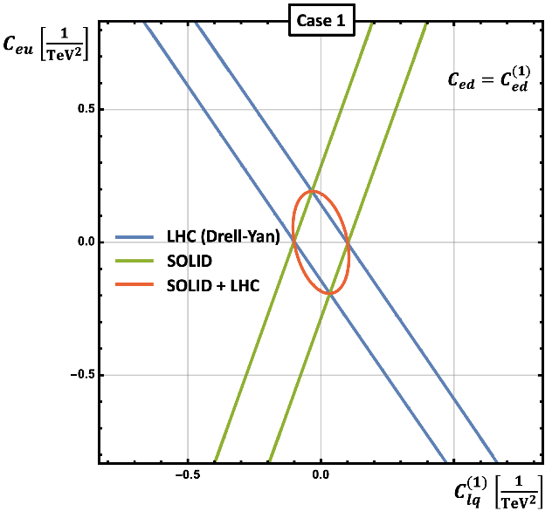
Standard Model Effective Field Theory (SMEFT)
BSM Physics has large phase space
PVDIS deuteron measurement access effective electron-quark couplings
SMEFT identifies
all possible BSM physics
84 d=6; 993 d=8 independent couplings
Goal: Measure each C_{d}^{ij} as precisely as possible
(Nobody really knows where the new physics is.)
Thanks to F. Petriello
See Euler and Su, Prog. Part. Nucl. Phys. 71 (2013) 119–149
Slide Credit: P Souder, JLab Director’s Review, Feb 2021

Slide 21
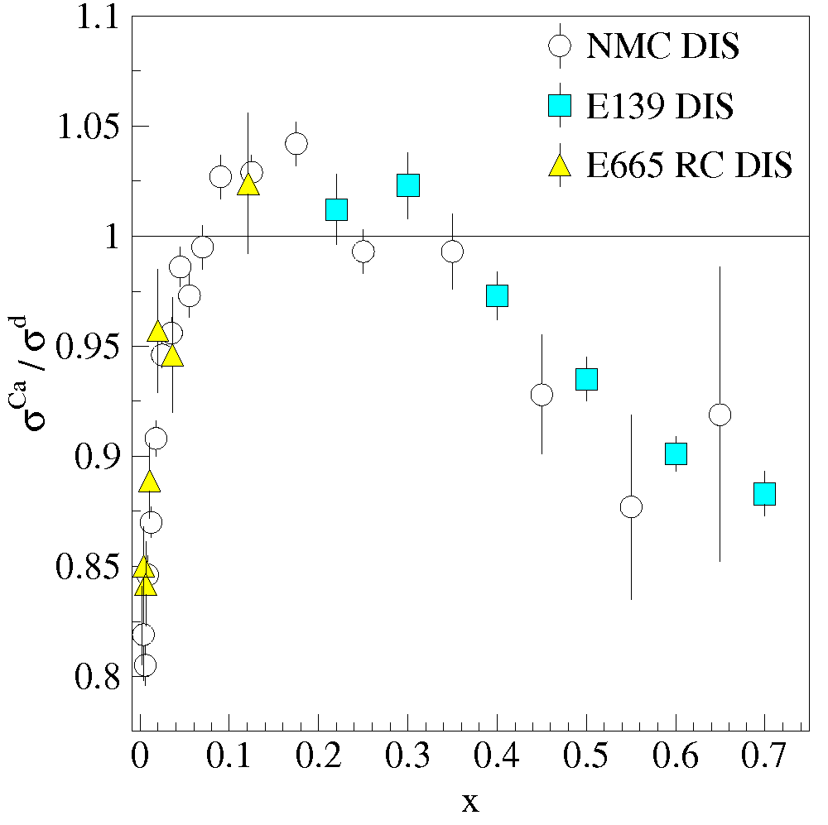
Probing the EMC Effect
Backup Slides
What we know:
Parton distributions in nuclei appear different than those in nucleons
What we don’t know:
Is the sea quark effect absent?
  see Drell-Yan from SeaQuest
Is there a flavor dependent effect?
  c.f. Cloët PRL 102 252301 (2009)
Why does the effect exist at all?

Slide 22
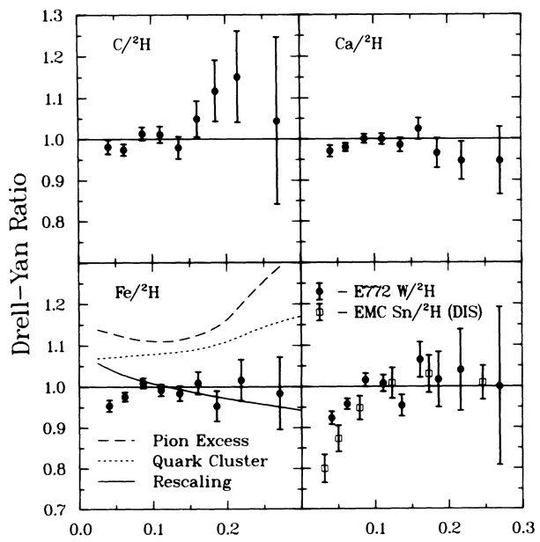
Probing the EMC Effect
Backup Slides
What we know:
Parton distributions in nuclei appear different than those in nucleons
  except, possibly for sea quarks
What we don’t know:
Is the sea quark effect absent?
  see Drell-Yan from SeaQuest
Is there a flavor dependent effect?
  c.f. Cloët PRL 102 252301 (2009)
Why does the effect exist at all?
Alde et al (Fermilab E772)
Phys. Rev. Lett. 64 2479 (1990)

Slide 23
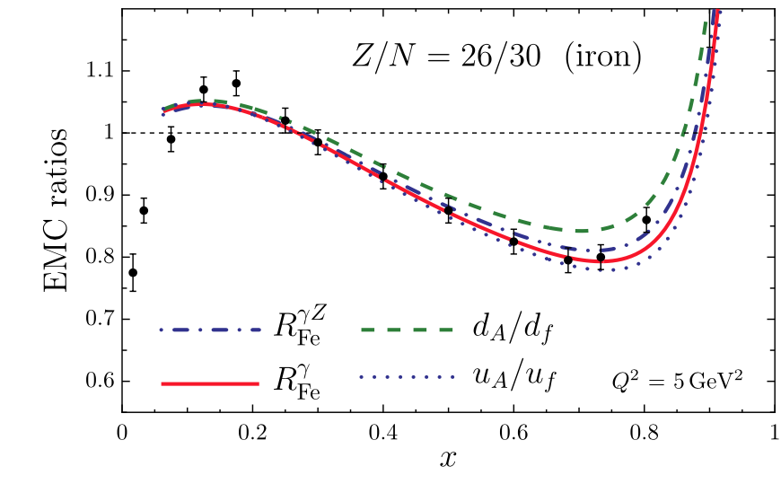
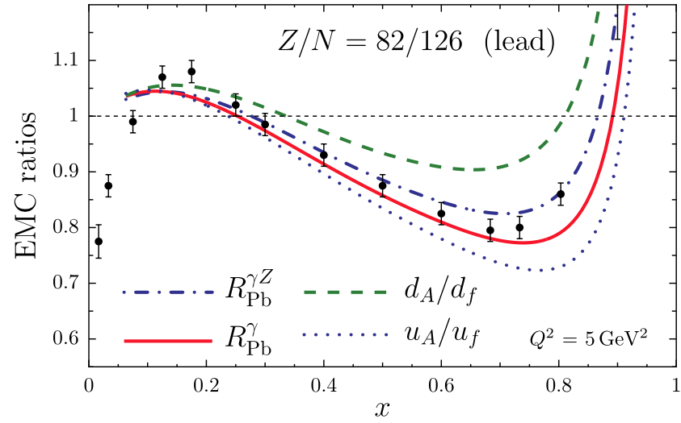
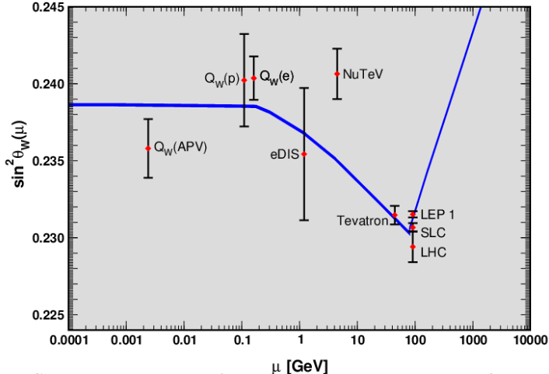
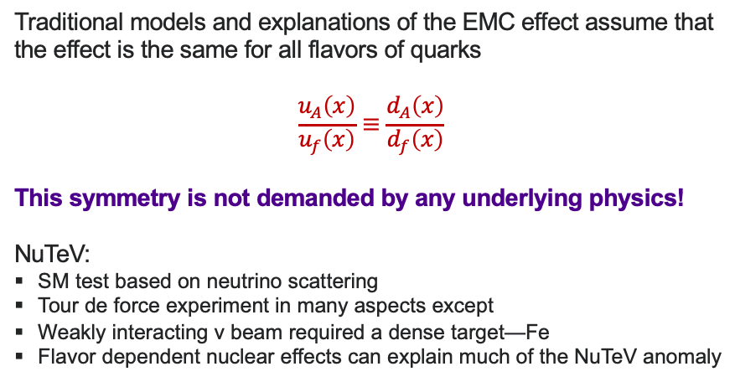
Flavor Dependent EMC a la Cloët
Traditional models and explanations of the EMC effect assume that the effect is the same for all flavors of quarks
$$\frac{u_{A}\left(x\right)}{u_{f}\left(x\right)}≡\frac{d_{A}\left(x\right)}{d_{f}\left(x\right)}$$
This symmetry is not demanded by any underlying physics!
NuTeV:
SM test based on neutrino scattering
Tour de force experiment in many aspects except
Weakly interacting ν beam required a dense target—Fe
Flavor dependent nuclear effects can explain much of the NuTeV anomaly
2014 Particle Data Group

Slide 24
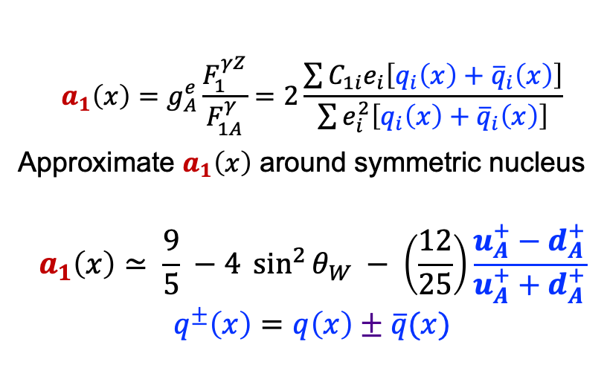
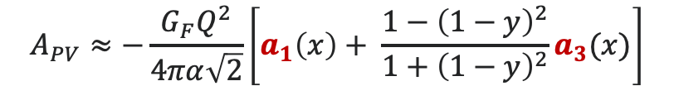
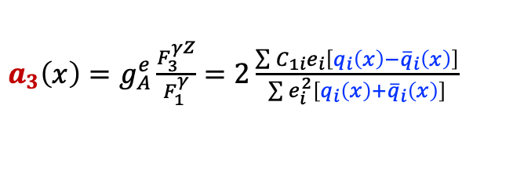
PVEMC
$$A_{PV}≈−\frac{G_{F}Q^{2}}{4πα\sqrt{2}}\left[a_{1}\left(x\right)+ \frac{1−{\left(1−y\right)}^{2}}{1+{\left(1−y\right)}^{2}}a_{3}(x)\right]$$
$$a_{1}\left(x\right)=g_{A}^{e}\frac{F_{1}^{γZ}}{F_{1A}^{γ}}=2\frac{\sum{C_{1i}e_{i}\left[q_{i}\left(x\right)+{\overline{q}}_{i}\left(x\right)\right]}}{\sum{e_{i}^{2}\left[q_{i}\left(x\right)+{\overline{q}}_{i}\left(x\right)\right]}}$$
Approximate $a_{1}\left(x\right)$ around symmetric nucleus
$$a_{1}\left(x\right)≃ \frac{9}{5} −4 \sin^{2}{θ_{W}} − \left(\frac{12}{25}\right)\frac{u_{A}^{+}−d_{A}^{+}}{u_{A}^{+}+d_{A}^{+}}$$
$$q^{±}\left(x\right)=q\left(x\right)±\overline{q}(x)$$
$a_{3}\left(x\right)=g_{A}^{e}\frac{F_{3}^{γZ}}{F_{1}^{γ}}=2\frac{\sum{C_{1i}e_{i}\left[q_{i}\left(x\right)−{\overline{q}}_{i}\left(x\right)\right]}}{\sum{e_{i}^{2}\left[q_{i}\left(x\right)+{\overline{q}}_{i}\left(x\right)\right]}}$
Measures flavor differences!

Slide 25
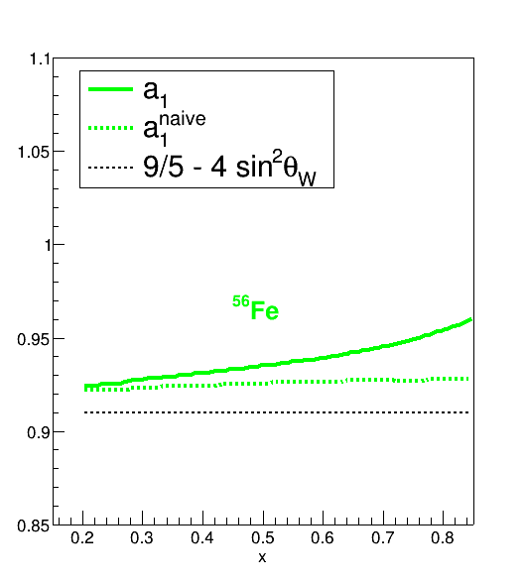
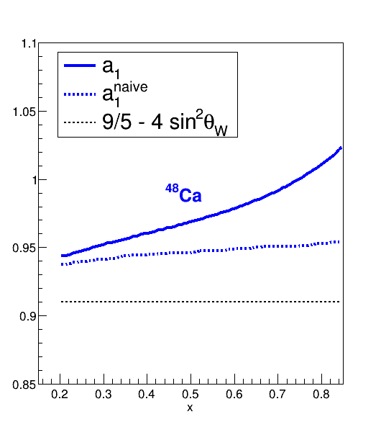
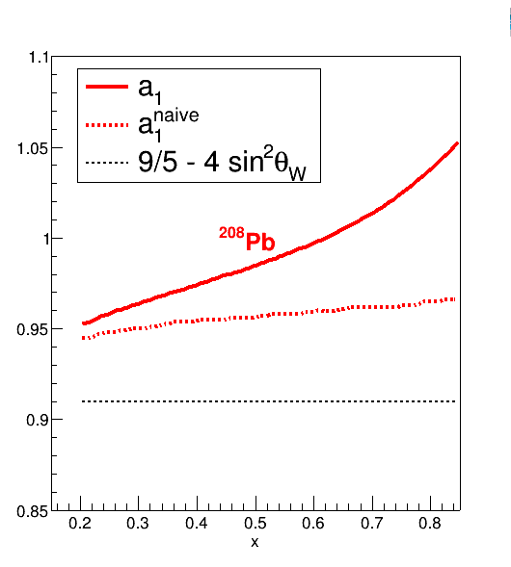
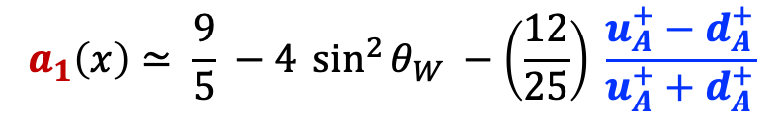
$a_{1}\left(x\right)$ for Nuclei
$$a_{1}\left(x\right)≃ \frac{9}{5} −4 \sin^{2}{θ_{W}} −\left(\frac{12}{25}\right) \frac{u_{A}^{+}−d_{A}^{+}}{u_{A}^{+}+d_{A}^{+}}$$

Slide 26
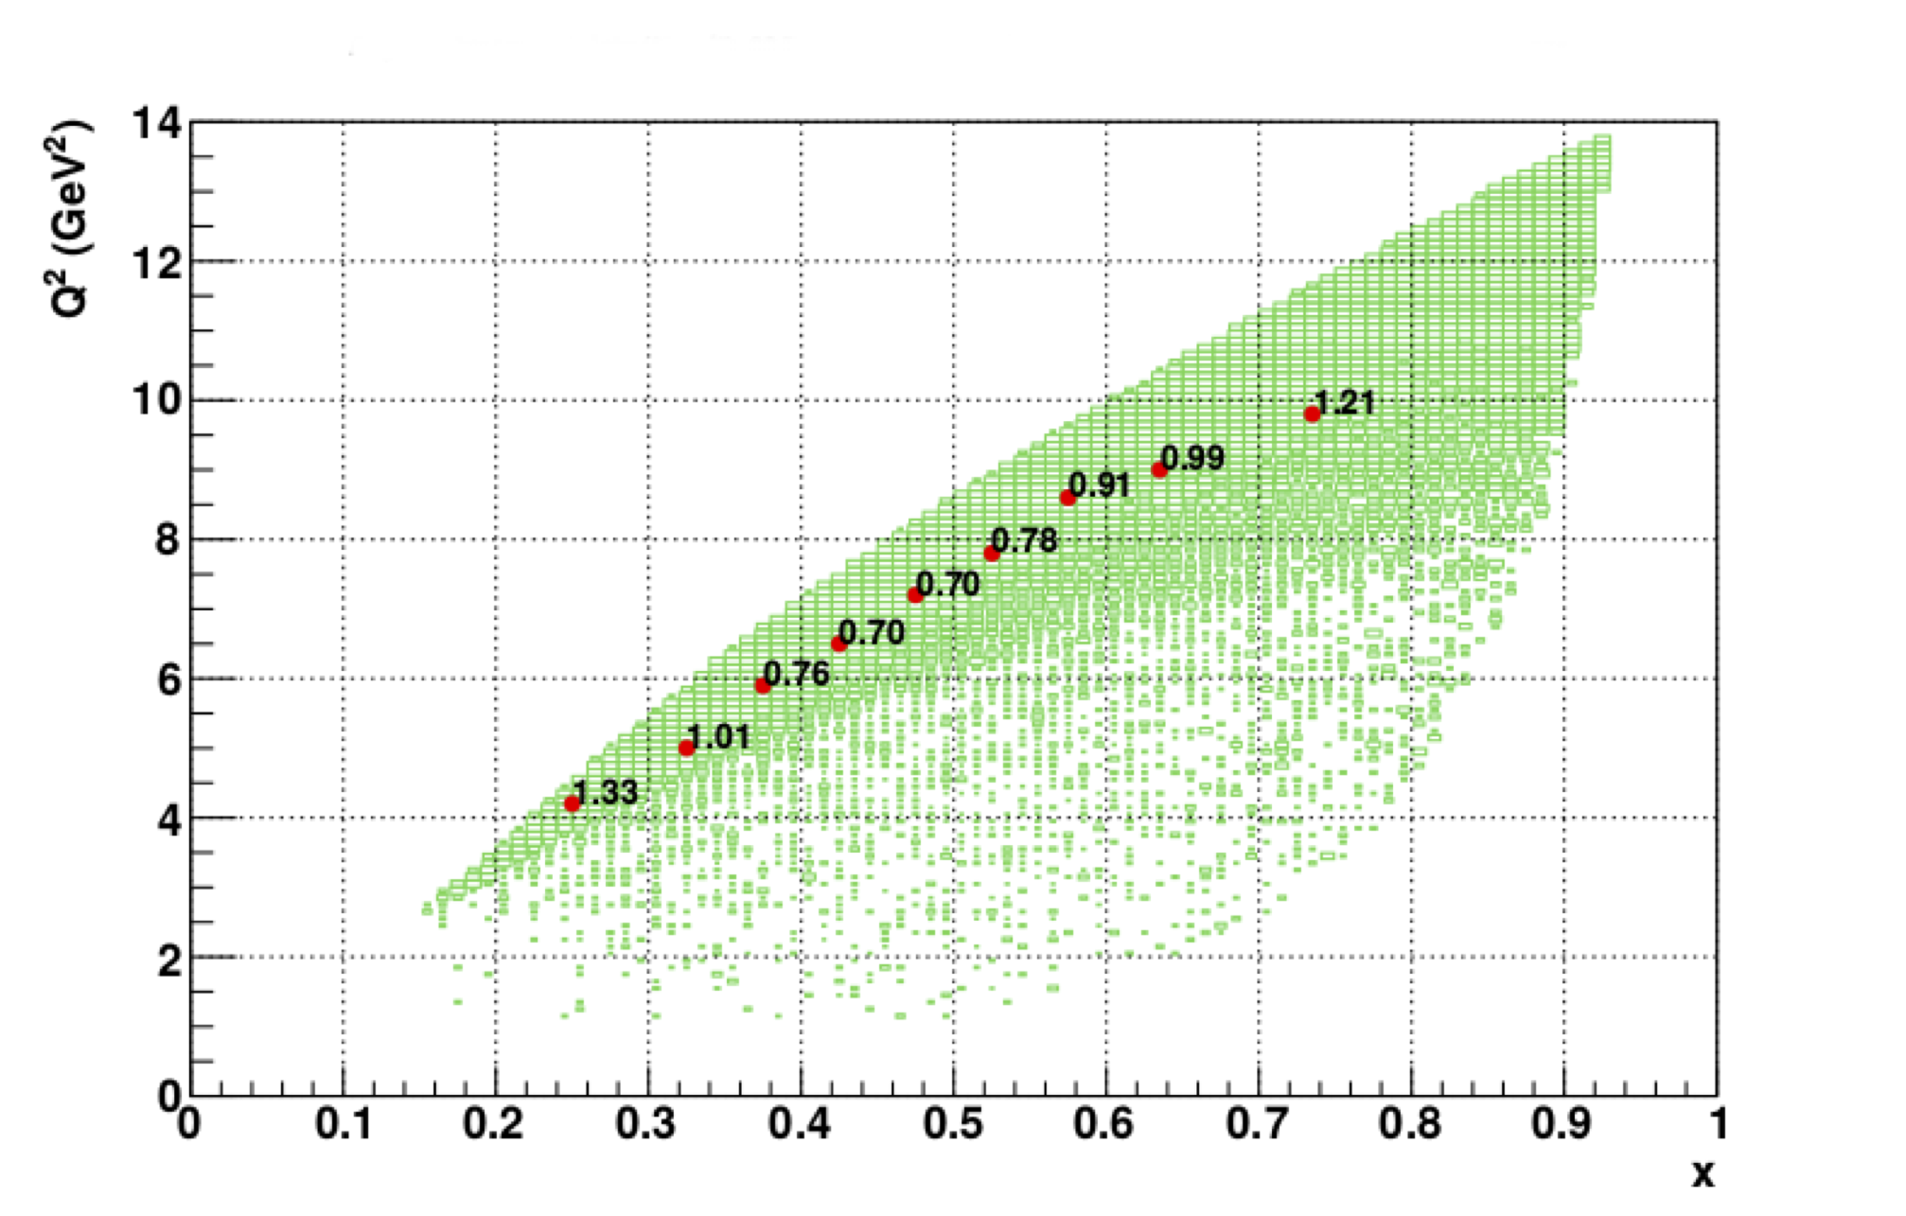
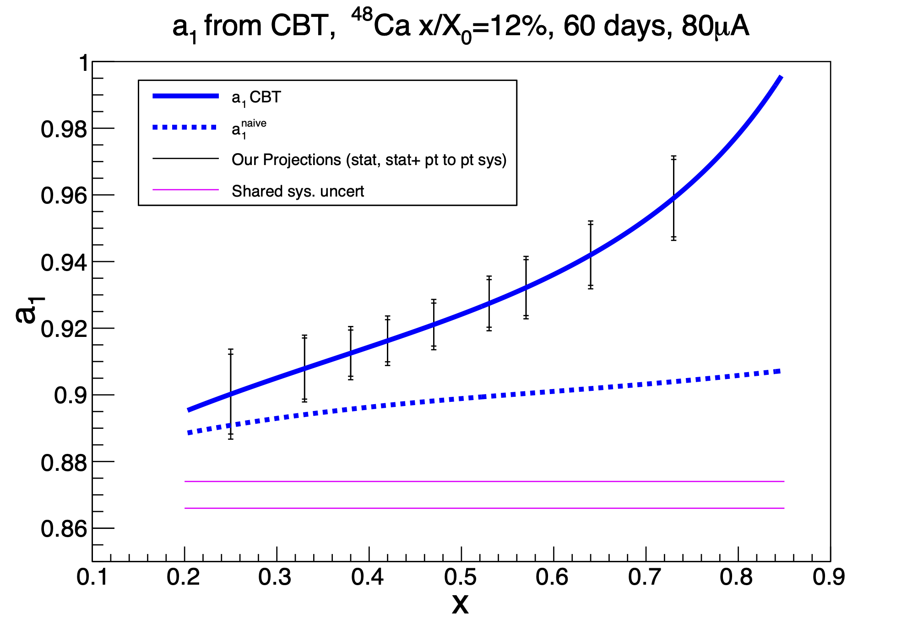
Expected Results

Slide 27
Recap
Parity violation in DIS enables electroweak and QCD exploration
SoLID mission (one of several) is to used PVDIS for electroweak and QCD study
Half full or half empty
Baffle 5xGEMs EC
LGC

Slide 28
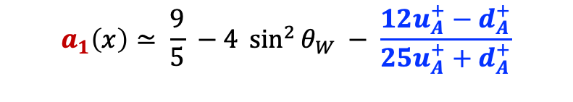
Recap
SoLID PVDIS has significant reach to explore the SM
SoLID flavor-dependence in the EMC Effect
$$a_{1}\left(x\right)≃ \frac{9}{5} −4 \sin^{2}{θ_{W}} − \frac{12u_{A}^{+}−d_{A}^{+}}{25u_{A}^{+}+d_{A}^{+}}$$

Slide 29
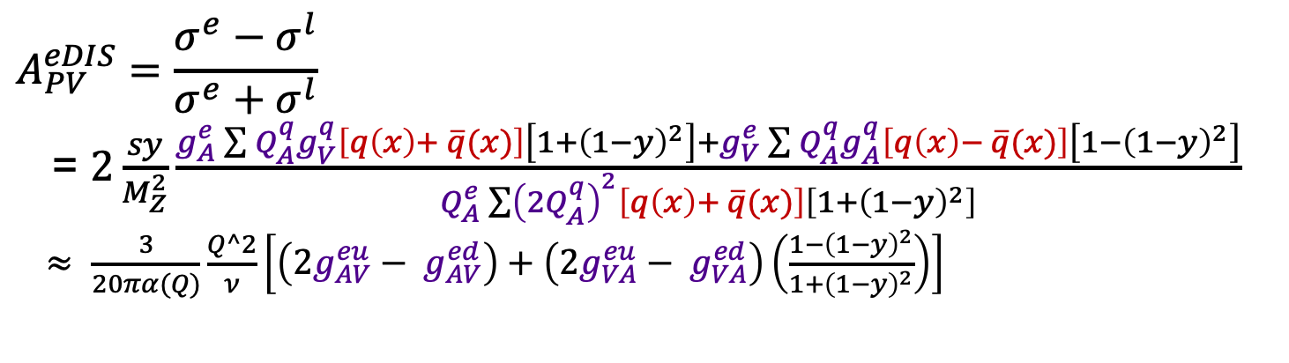
$$A_{PV}^{eDIS}=\frac{σ^{e}−σ^{l}}{σ^{e}+σ^{l}}$$
= $2\frac{sy}{M_{Z}^{2}}\frac{g_{A}^{e}\sum{Q_{A}^{q}g_{V}^{q}\left[q\left(x\right)+ \overline{q}(x)\right]}\left[1+{\left(1−y\right)}^{2}\right]+g_{V}^{e}\sum{Q_{A}^{q}g_{A}^{q}\left[q\left(x\right)− \overline{q}(x)\right]}\left[1−{\left(1−y\right)}^{2}\right]}{Q_{A}^{e}\sum{{\left(2Q_{A}^{q}\right)}^{2}\left[q\left(x\right)+ \overline{q}(x)\right]\left[1+{\left(1−y\right)}^{2}\right]}}$
$≈ \frac{3}{20πα(Q)}\frac{Q^2}{ν}\left[\left(2g_{AV}^{eu}− g_{AV}^{ed}\right)+\left(2g_{VA}^{eu}− g_{VA}^{ed}\right)\left(\frac{1−{\left(1−y\right)}^{2}}{1+{\left(1−y\right)}^{2}}\right)\right]$

Slide 30
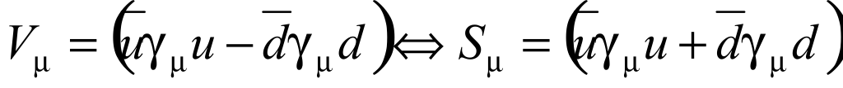
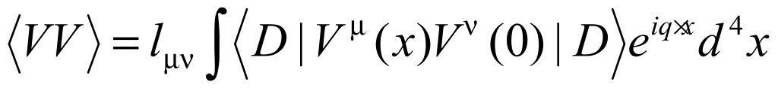


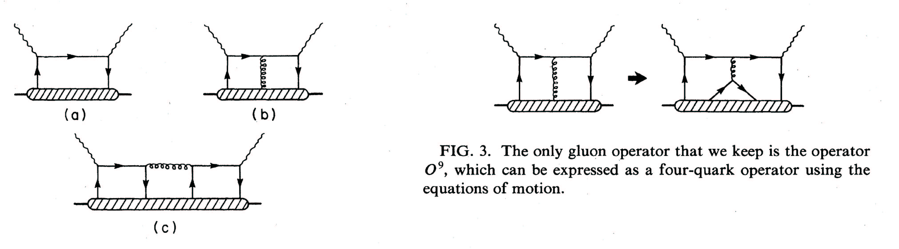
Unique Higher Twist Contribution
The observation of Higher Twist in PV-DIS would be exciting direct evidence for diquarks
following the approach of
Bjorken, PRD 18, 3239 (78),
Wolfenstein, NPB146, 477 (78)
Isospin decomposition
before using PDF’s
Higher-Twist valence quark-quark correlation
Zero in quark-parton model
(c) type diagram is the only operator that can contribute to a(x) higher twist: theoretically very interesting!
u
d
σ_{L} contributions cancel
Slide Credit: P Souder, JLab Director’s Review, Feb 2021

Slide 31
Why use Parity Violation?
⁴⁸Ca/⁴⁰Ca ratio (E12-10-008)
  will be less than fully conclusive
³H/³He (MARARHON)
  more sensitive to neutron structure function than flavor dependence
π⁺/π⁻ from ³H/³He (12-21-004 Hall B)
  Conditional approval
  PAC “The physics programme is very rich, but the extraction of the underlying physics observables is very challenging”
No Flav. Dep.
Cloët
Common Syst.

Slide 32
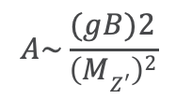
Possible Lepto-Phobic Z’; Example at lower energy
Motivation for introducing new particle:
C2
Baryon number is a global symmetry in the SM (bad).
Theories of local baryon number symmetry are attractive.
They predict a lepto-phobic boson.
They also predict a dark matter candidate.
$$A\sim \frac{(gB)2}{\left(MZ^{′}\right)2}$$
Perez, Phys. Rept. 597, (2015) 1-30
Modifies mainly C₂’s
in PVES
Perez, et al.,
JHEP 07 (2020) 087
Limits depend on branching ratios.
Plot shows that the LHC is interested in Leptophobics

Slide 33

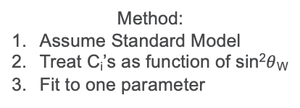
Dark Boson Z_{d} and sin²$θ$_{W}
C2
Davoudiasl, et al. Phys.Rev.D 92 (2015) 5, 055005
Method:
Assume Standard Model
Treat C_{i}’s as function of sin²$θ$_{W}
Fit to one parameter
PVES is the only way to see Z_{d} if
decay is dominated by invisible
particles

