Slide 1
PREX/CREX and Astronomical Observations of Neutron Stars
Cole Miller
University of Maryland

Slide 2
Plan of Talk
Why NS are wonderful!
Astronomical observations and implications for EOS: NS masses, tidal deformabilities, radii
What do PREX/CREX measurements have to say about neutron star properties?
NICER results from Miller et al. 2019, 2021; see also
Riley et al. 2019, 2021 and Raaijmakers et al. 2019, 2021

Slide 3

Why Study Neutron Stars?
Frontiers in particle,
nuclear, condensed
matter, plasma,
hydro, QED, and
general relativity
Core composition
is unknown:
Nucleons?
Hyperons?
Quark matter?
Let’s dive into NS!
Figure:
Dany
Page
http://www.astroscu.unam.mx/neutrones/NS-picture/NStar/NStar-I.gif

Slide 4
A Special State
Matter in NS cores reaches several times nuclear density
It is very neutron rich, unlike nuclei
It is also very cold: kT<<E_{F} T~10⁹ K is cold!
We can’t access this state in laboratories
How can NS observations help? And how do the PREX/CREX results improve our understanding of neutron stars?

Slide 5
A Confession
There is excitement about the composition of NS core matter...but most things we can observe depend only on the equation of state, P(ε)
An exception might be cooling of NS, but that’s difficult to measure at this time and even it doesn’t point uniquely to a composition
NS measurements that pertain to the EOS include masses, tidal deformability, and radii
Let’s explore these in turn

Slide 6
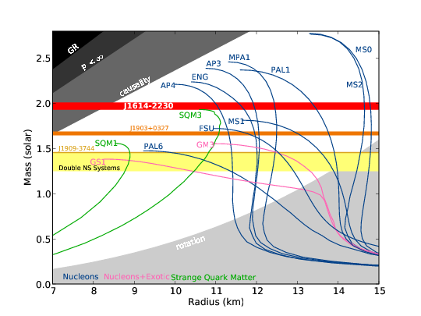
NS masses
A given equation of state (EOS) P(ε)
(P is pressure, ε is total mass-energy density) predicts M(R)
Assume equilibrium
Also predicts maximum mass
Viable EOS must accommodate largest measured mass
Demorest et al. 2010

Slide 7
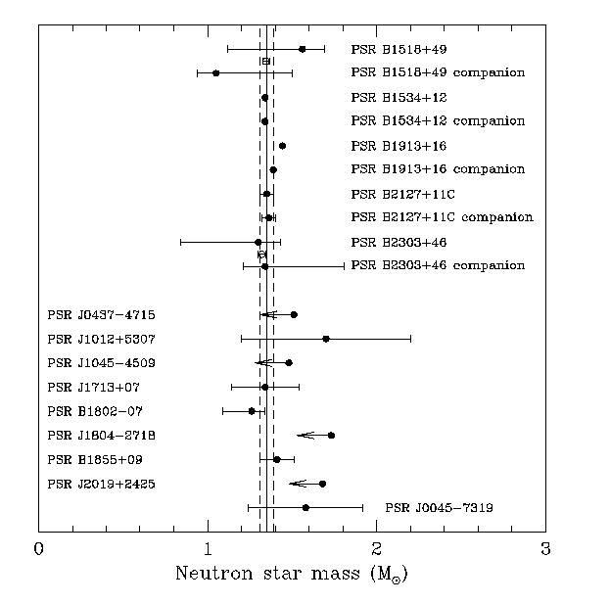
Double NS Masses
Very tightly clustered M=1.35+−0.1 M_{sun}
Does this indicate a very low upper limit on masses?
Or are formation conditions just similar?
http://www.lsw.uni-heidelberg.de/users/mcamenzi/NS_Mass.jpg

Slide 8
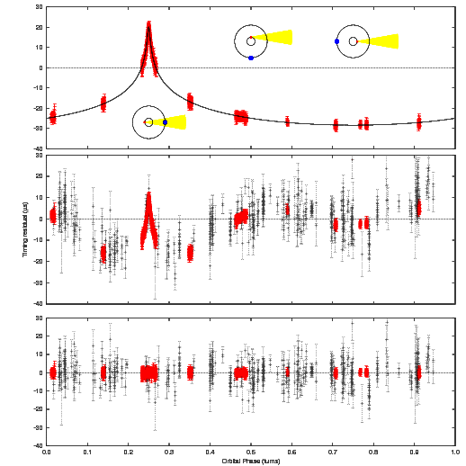
~2 M_{sun} Neutron Stars
J1614−2230, 1.908+−0.016
Demorest et al. 2010
J0348+0432, 2.01+−0.04 M_{sun}
Antoniadis et al. 2013
J0740+6620, 2.08+−0.07
Cromartie et al. 2019
Eliminate EOS that are too soft, i.e., whose pressure is too low at the relevant densities
Demorest et al. 2010

Slide 9
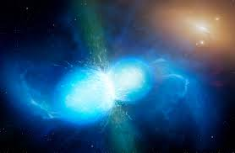
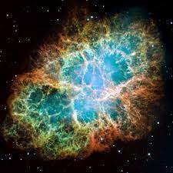
Gravitational Waves and NS
GW come from mass motions, so bulk of NS is involved
GW can tell us about cold matter (NS pre-merger) or hot (post-merger, SN)
Various quantities matter for different GW observations; all depend on the EOS, so this gives us self-consistency checks
Both images from Wikipedia

Slide 10
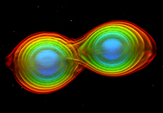
NS tides from GW
Tides take energy from orbit
Changes waveform
A bigger NS will be deformed more
Thus measurement of tidal deformability Λ gives insight into structure
For GW170817, no clear evidence for deformation
Suggests R_{1.4}<13.5 km
Eliminates hardest EOS
Simulation: T. Dietrich et al.
(Albert Einstein Institute)

Slide 11
The Importance of Radii
Radius would provide
great EOS leverage
Wide range in models
But tough to measure
Measurements that use just flux and spectra are susceptible to huge systematic error
One reason: NS atm are fully ionized
NICER X-ray pulse modeling can help
Demorest+ 2010

Slide 12
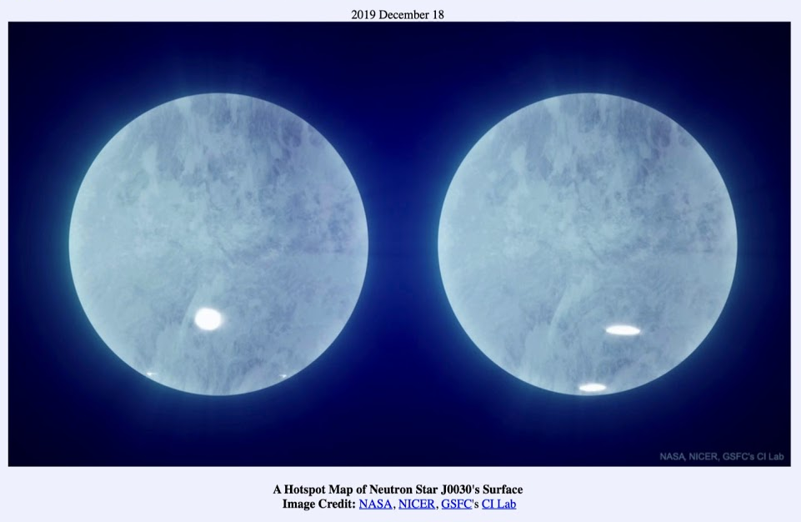
The NICER Idea in Brief
Bayesian fits: trace rays from hot spots on NS
surface, compare with energy-dep waveform

Slide 13
Mass-Radius Posteriors for J0030
Left: M-R posterior for NICER J0030 data, two ovals
Right: M-R posterior for NICER J0030 data, three ovals

Slide 14
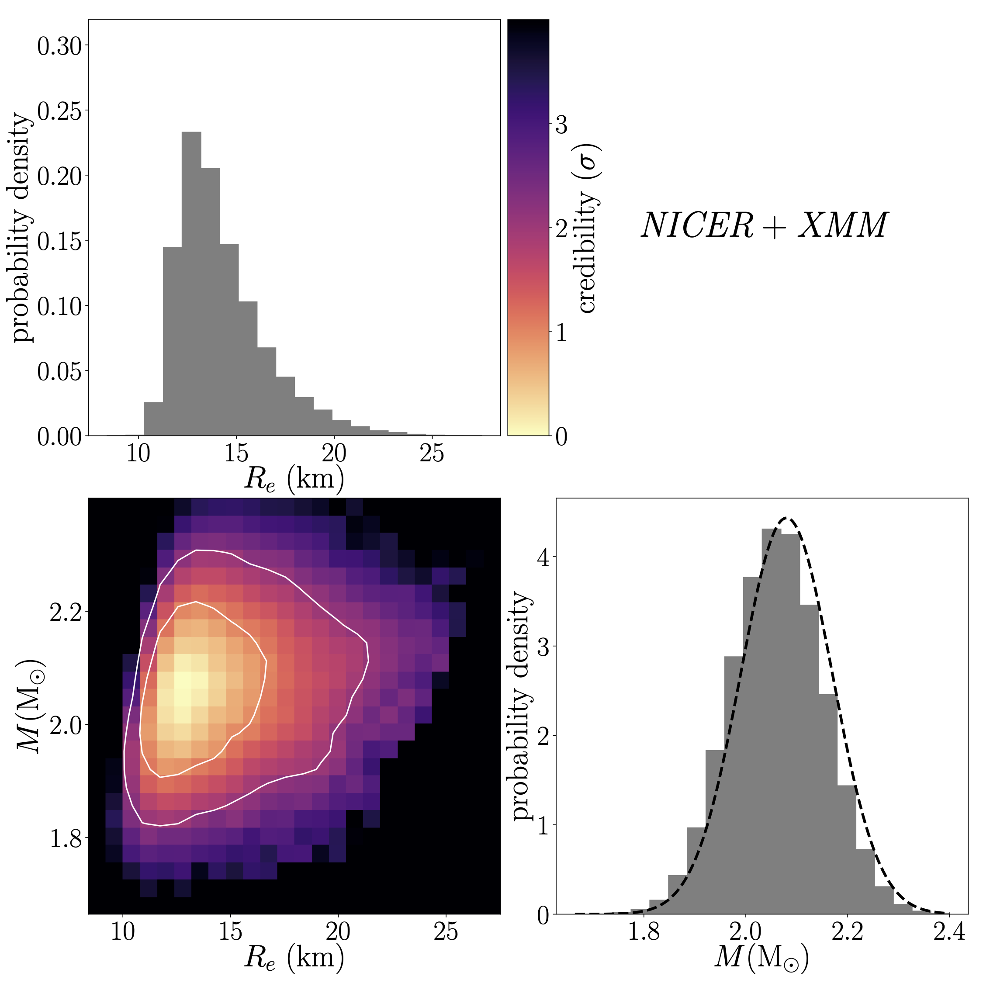
J0740 NICER+XMM: M and R
10x fainter than J0030; need radio, XMM data as well
Radius of PSR
J0740+6620:
13.7^{+2.6}_{–1.5} km (1σ)
Dashed line: prior on
mass from NANOGrav
and CHIME/Pulsar data

Slide 15
Information about the EOS
Many recent sources of information about dense matter
Binding energy of nuclei (~n_{sat}~0.15-0.16 fm⁻³)
PREX/CREX (isospin asymmetry near n_{sat})
cEFT (up to ~1.5-2 n_{sat})
Radius, tidal deformability of 1.4 M_{sun} NS
(~2 n_{sat})
Existence, radius of ~2 M_{sun} NS (~4-6 n_{sat})
pQCD (down to ~40 n_{sat}; influence at NS den?)

Slide 16
Inferring the EOS
Standard approach: assume that we know EOS to threshold density (QHC19, n_{sat}/2~crust/core)
Apply a framework for extrapolating to high n
We use several; feature Gaussian processes
Bayesian analysis, sequence of measurements
Prior with framework; pre-NICER (high masses, GW tidal deformability); J0030; J0740
Output is posterior on P vs n, or M vs R

Slide 17
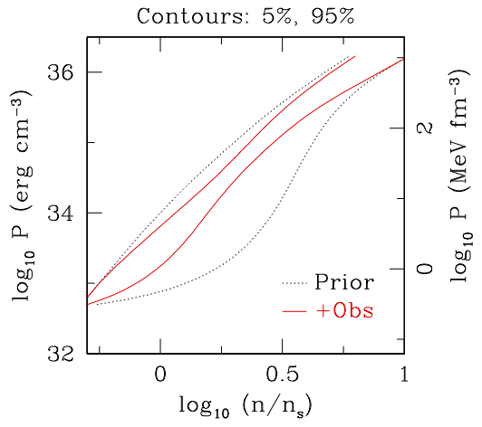
J0030, J0740, Other Measurements Provide Tight EOS Constraints
Assume knowledge of EOS
to half nuclear saturation
density, extrapolate using
Gaussian processes. Other
extrapolations give similar
answers.
Good EOS convergence
in ~ 1.5 – 5 ρ_{sat} range

Slide 18
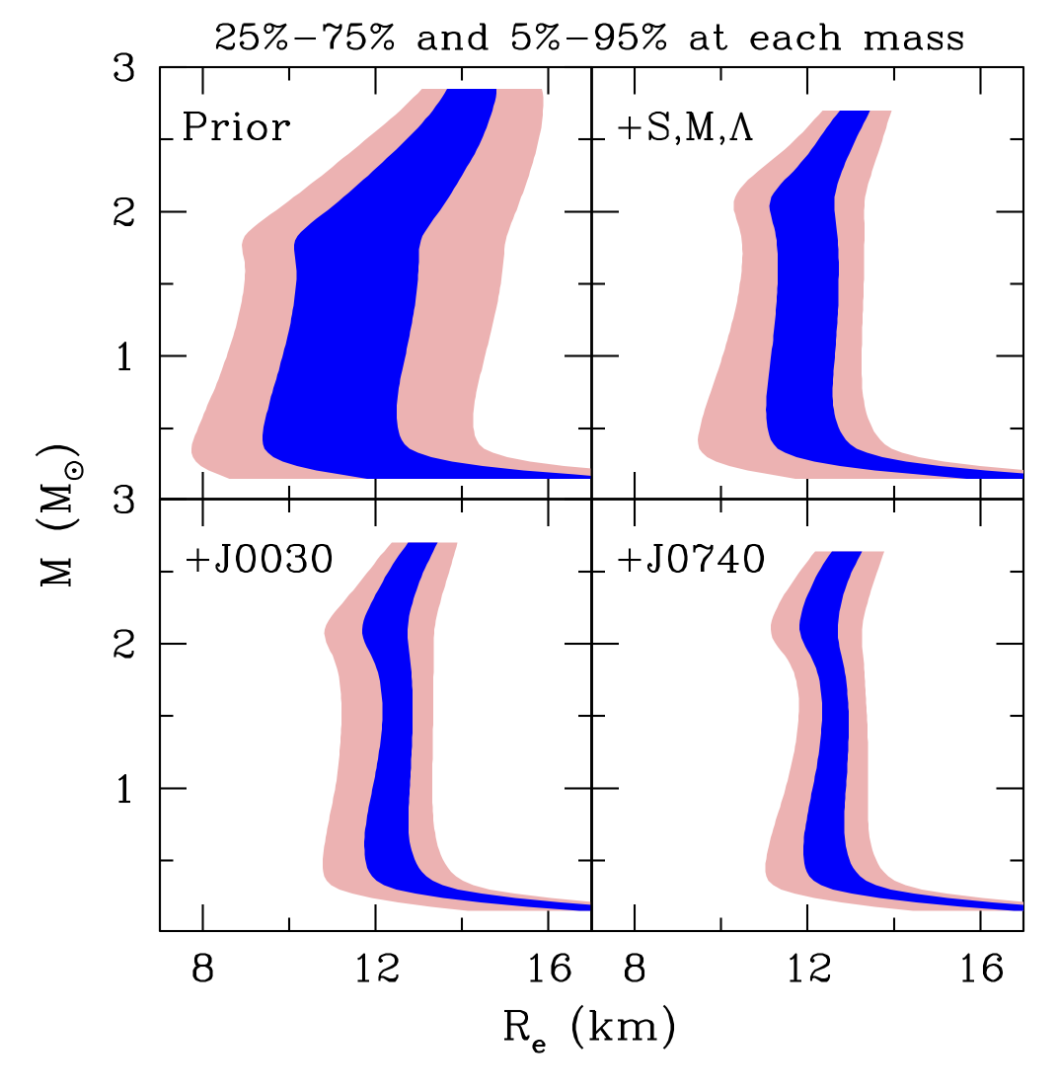
Tight Mass-Radius Constraints
Sequence:
Priors
Pre-NICER observations
+PSR J0030+0451
+PSR J0740+6620
1σ radius: 11.8 – 13.1 km
for 1.4 M_{sun} spanning all
three EOS models.
+− 5% Pretty impressive!

Slide 19
Impact of PREX/CREX
How do the PREX/CREX measurements affect our understanding of NS?
In the following we show +−1σ range for several quantities. As proxy, we use inferred slope of symmetry energy L(n_{sat}) (Lattimer 2022). L=121+−47 MeV from PREX; −5+−40 MeV from CREX;
53+−13 MeV when both are combined

Slide 20
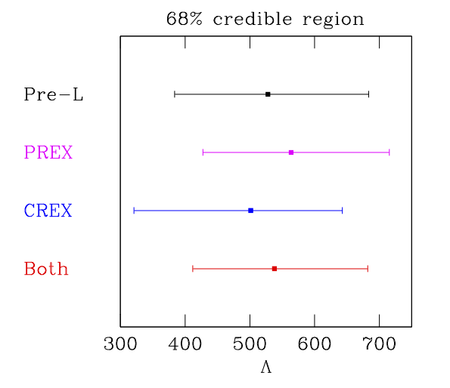
Tidal Deformability at M=1.4M_{sun}

Slide 21
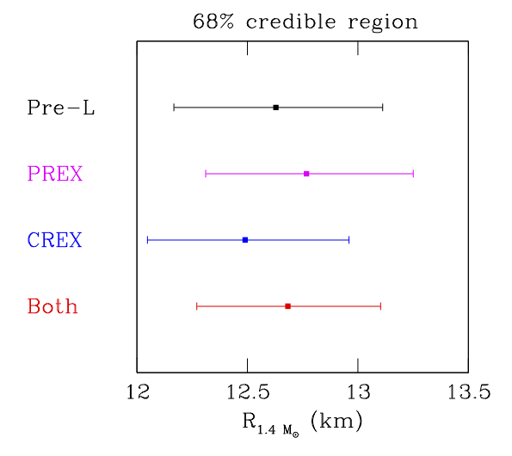
Radius at M=1.4 M_{sun}

Slide 22
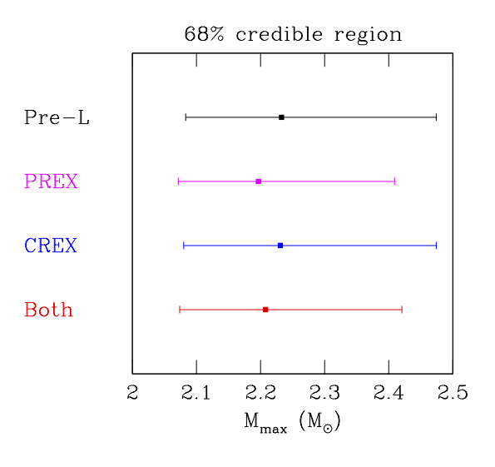
Maximum Mass

Slide 23
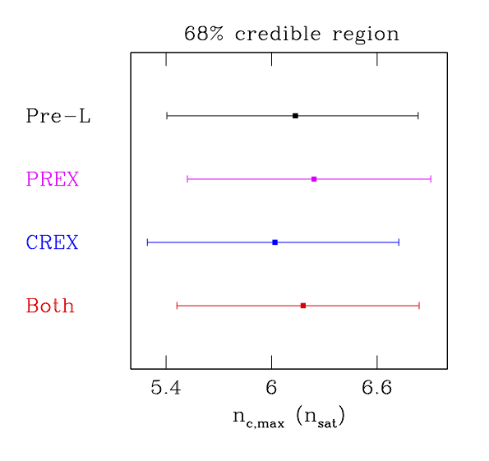
Maximum Central Density

Slide 24
Conclusions and Future Work
Many recent developments in studies of cold dense matter
Future astronomical prospects: more tidal deformabilities (LIGO O4 run started in May); better NICER measurements
Future nuclear prospects: you tell me! I’m excited for the astro/nuclear partnership

