Slide 1

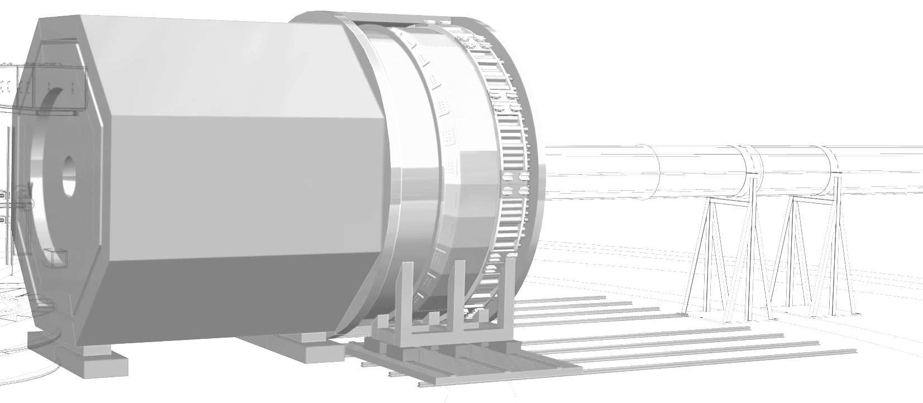

SIDIS and Exclusive Program
with SoLID at Jefferson Lab
Zhiwen Zhao
SoLID Collaboration
Summer Hall A/C Meeting 2023/06/29

Slide 2
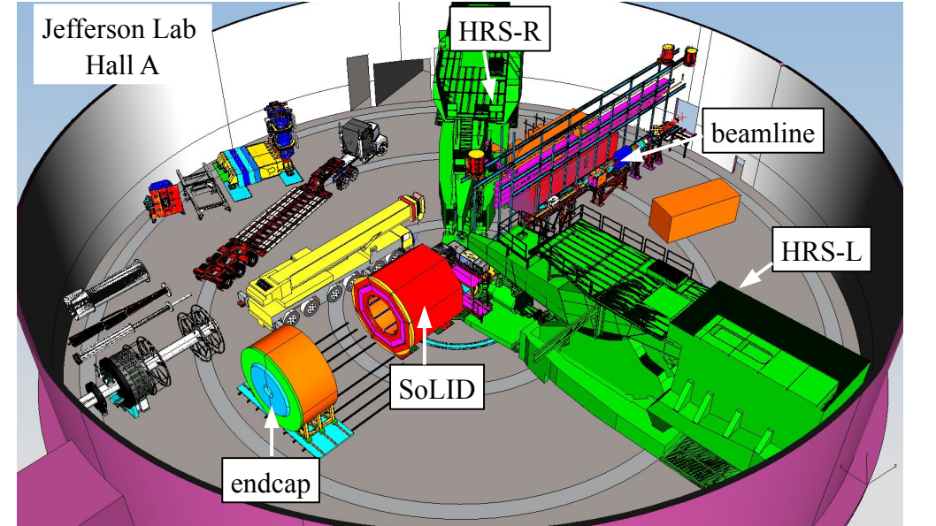
SoLID in the Future of Hall A

Slide 3
SoLID (Solenoidal Large Intensity Device)
Full exploitation of JLab 12 GeV upgrade with broad physics program
Lumi ~1e³⁹/cm²/s (baffled geometry)
Standard Model test and hadron structure
  PVDIS on both deuterium and hydrogen
Lumi ~1e³⁷/cm²/s (open geometry)
3D hadron imaging
  TMD (SIDIS on both neutron and proton)
  GPD (DVCS,DEMP,TCS,DDVCS)
proton mass and gluonic interaction
  J/ψ production at threshold
High Luminosity
Large Acceptance
https://solid.jlab.org/experiments.html

Slide 4
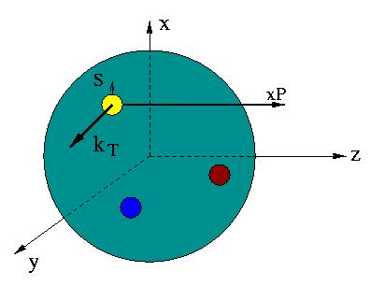

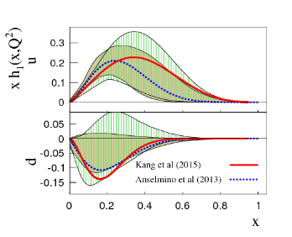
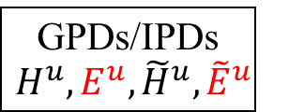
Nucleon’s 3D Structure
4
W_{p}^{u}(x,k_{T},r_{T} ) Wigner distributions
5D
d²k_{T}
(X. Ji, D. Mueller, A. Radyushkin)
d²r_{T}
TMD
f₁^{u}(x,k_{T}), h₁^{u}(x,k_{T}),…‏
GPDs/IPDs
$$H^{u},E^{u}, {\tilde{H}}^{u},{\tilde{E}}^{u}$$
3D
d²k_{T}
d²r_{T}
dx & Fourier Transformation
Accardi et. al.
Phys. Rev. D 93, 114017 (2016)
PDFs
f₁^{u}(x), g₁^{u}(x), h₁^{u}(x)‏,…
Form Factors
G_{E}(Q²),
G_{M}(Q²)‏
1D
Z. Ye, et. al. Phys. Lett. B 777 8-15 (2018)

Slide 5
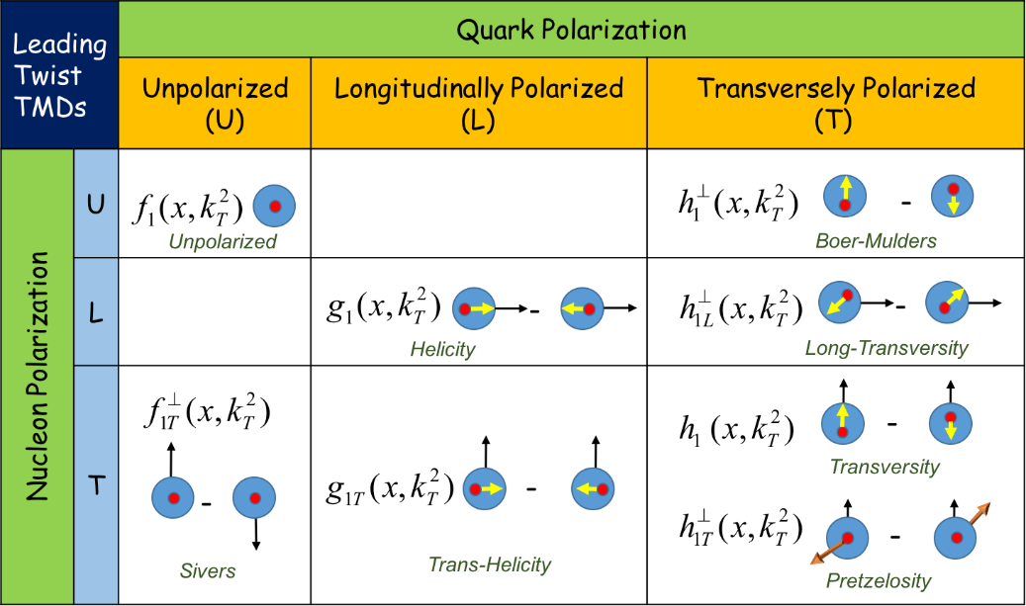
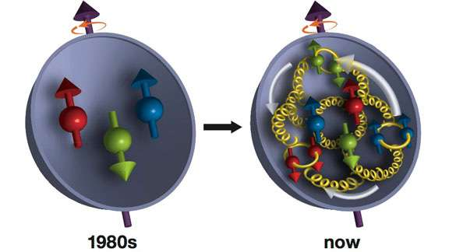
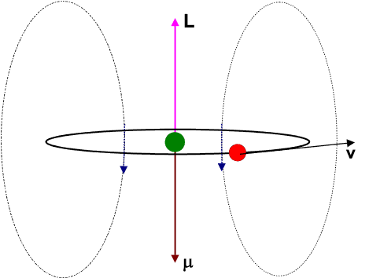
Transverse Momentum Distributions
Transverse Momentum Distribution Functions (TMDs) → describe 3D motion in momentum space of all quarks & gluons in a nucleon
8 Quark-TMDs (leading twist)
3D = 1D Longitudinally Momentum + 2D Transverse Momentum
Spin contributions from valance quarks, sea quarks and gluons
Other TMDs are ZERO after integrating over k_{T}
Also contributed by quarks & gluons’ orbital angular momenta (OAM)
Unpolarized Density Function:
Key Features of TMDs:
Represent the intrinsic confined motion of quark & gluons
Off-Diagonal TMDs vanish if no orbital angular momentum
Most of TMDs are due to the spin-orbit correlations
Helicity Function:
Transversity Function:

Slide 6
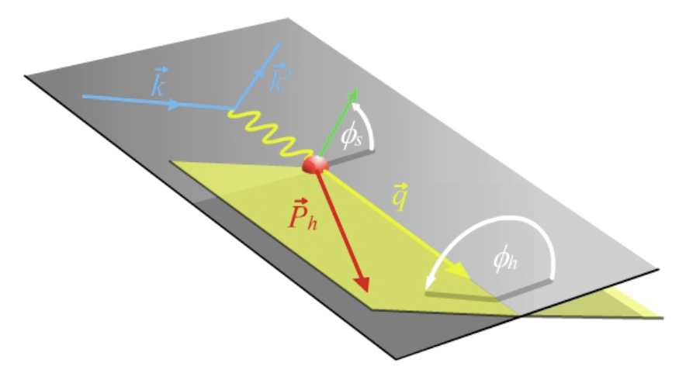

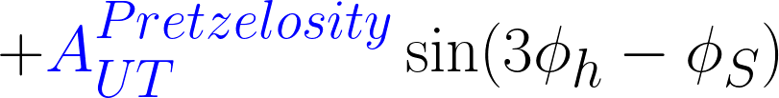




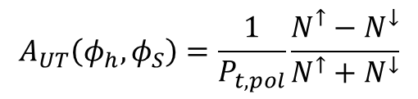

Separation of Collins, Sivers and Pretzelosity through angular dependence
(2$π azimuthal coverage)$
SIDIS SSAs depend on 4-D variables (x, Q², z, P_{T}) and small asymmetries demand large acceptance + high luminosity allowing for measuring symmetries in 4-D binning with precision!
$$A_{UT}\left(φ_{h},φ_{S}\right)=\frac{1}{P_{t,pol}}\frac{N^{↑}−N^{↓}}{N^{↑}+N^{↓}}$$
Leading twist formulism
(higher-twist terms can be included)
Collins fragmentation function from e⁺e⁻ collisions
Unpolarized fragmentation function

Slide 7
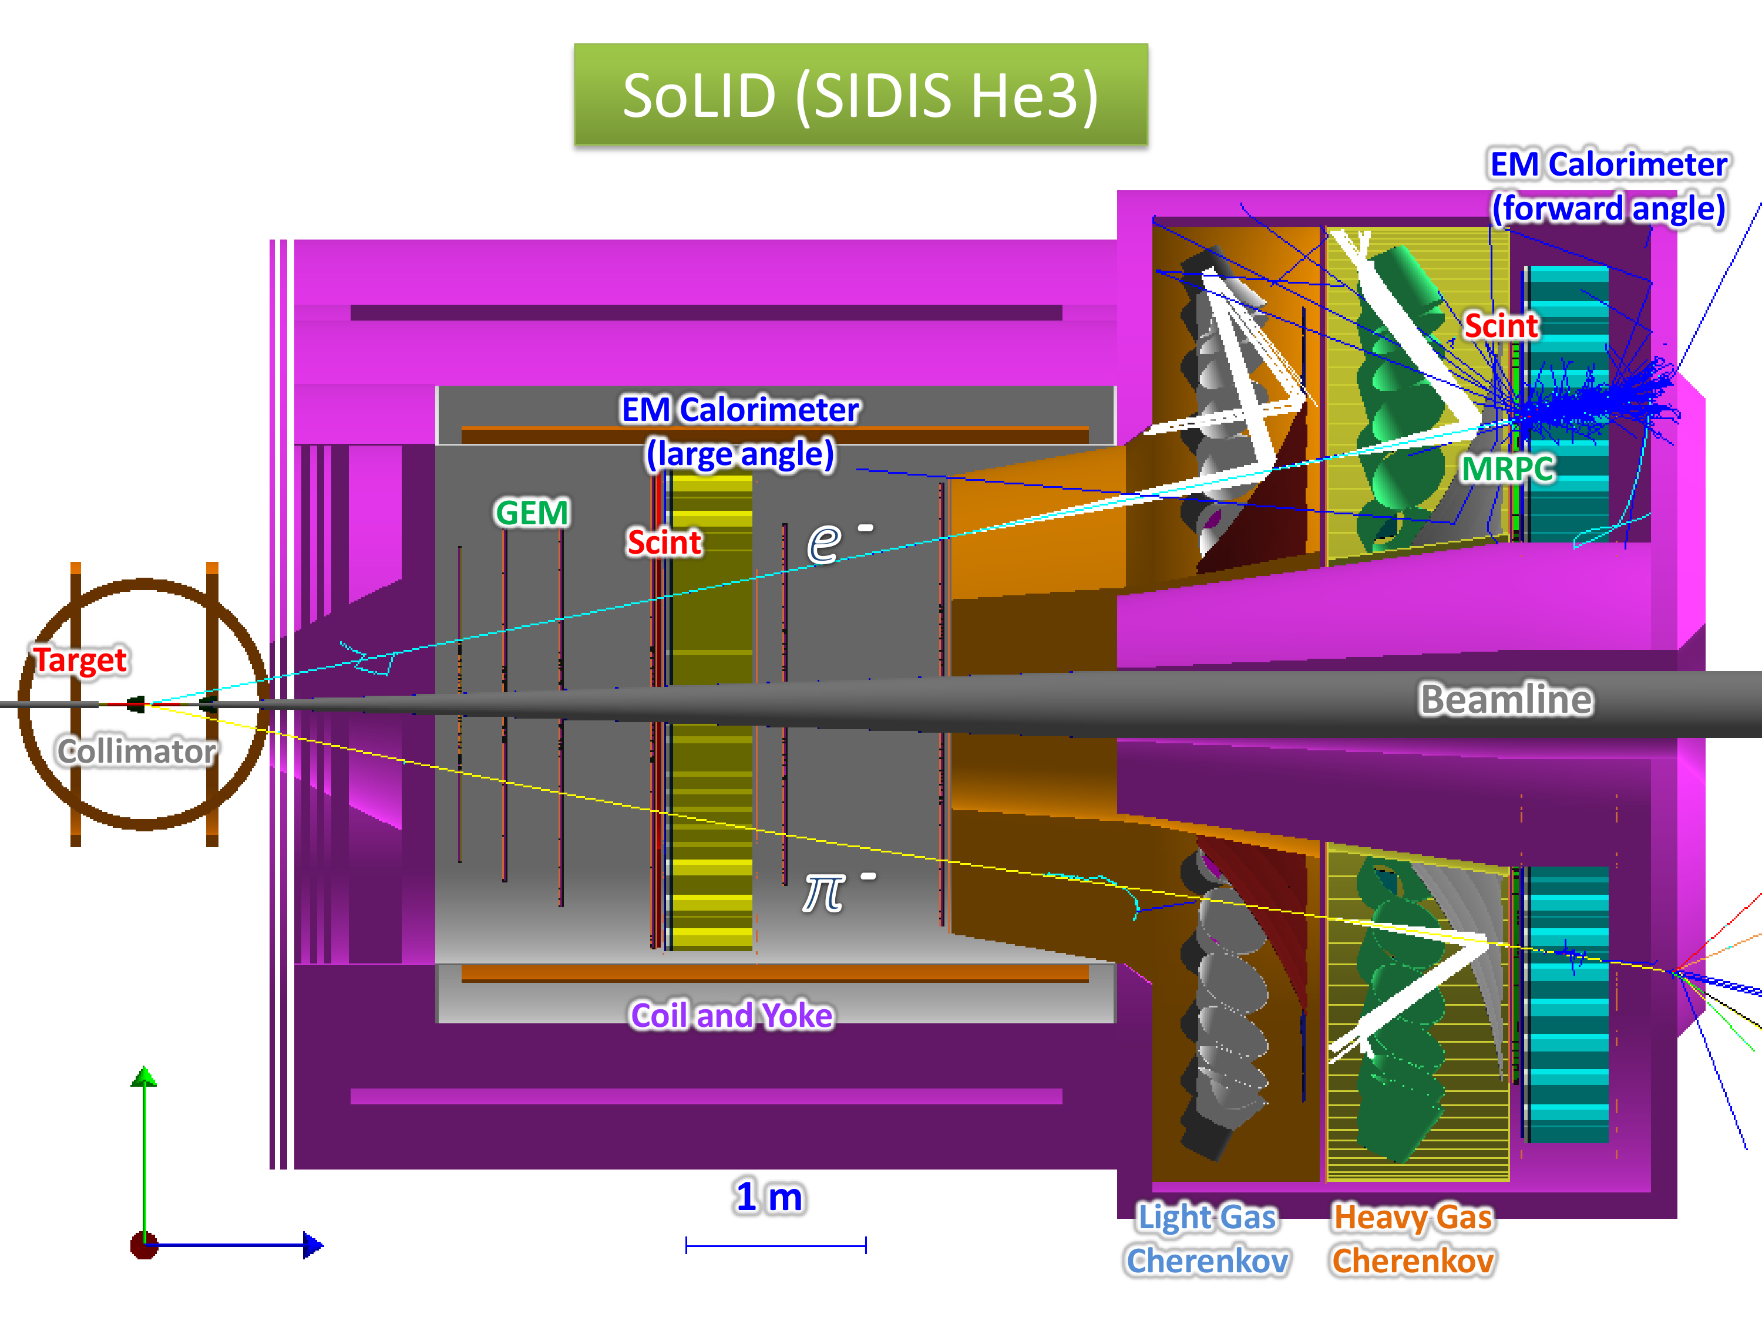
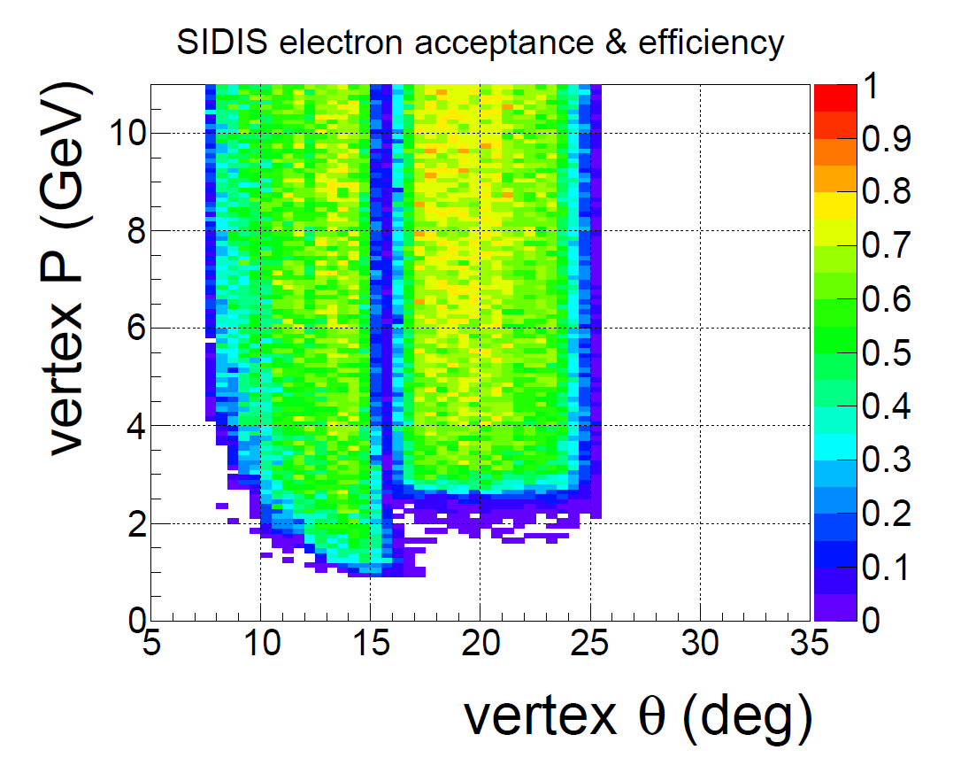
SoLID He3 Setup
E12-10-006: SIDIS pion on transversely polarized ³He, 90 days, rated A
E12-11-007: SIDIS pion on longitudinally polarized ³He, 35 days, rated A
SIDIS kaon and dihadron as run groups
Detection
e- at forward angle with EC and Cerenkov to reject pions
e- above 3GeV detected at large angle with EC to reject pions
pions detected at forward angle with TOF and Cerenkov to suppress kaons
Polarized lumi ~1e³⁶/cm²/s
Unpolarized lumi ~1e³⁷/cm²/s
Coverage
Polar angle: e⁻ 8-24 deg, π⁻/π⁺ 8-15deg
Azimuthal angle: full

Slide 8
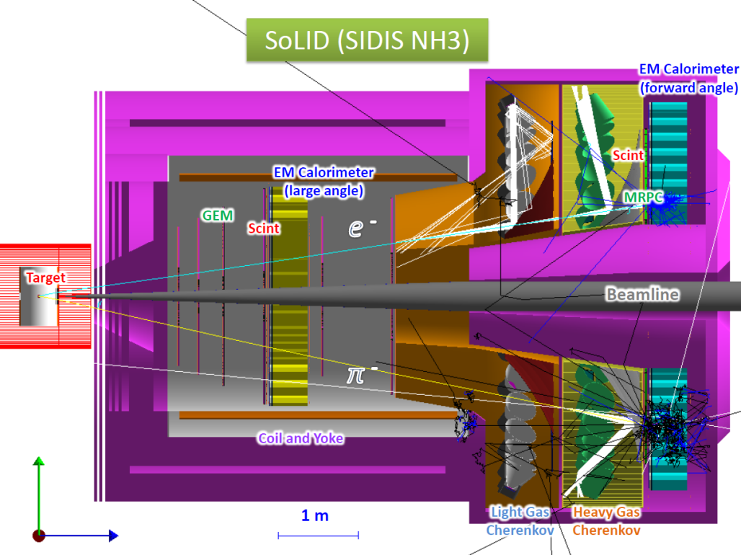
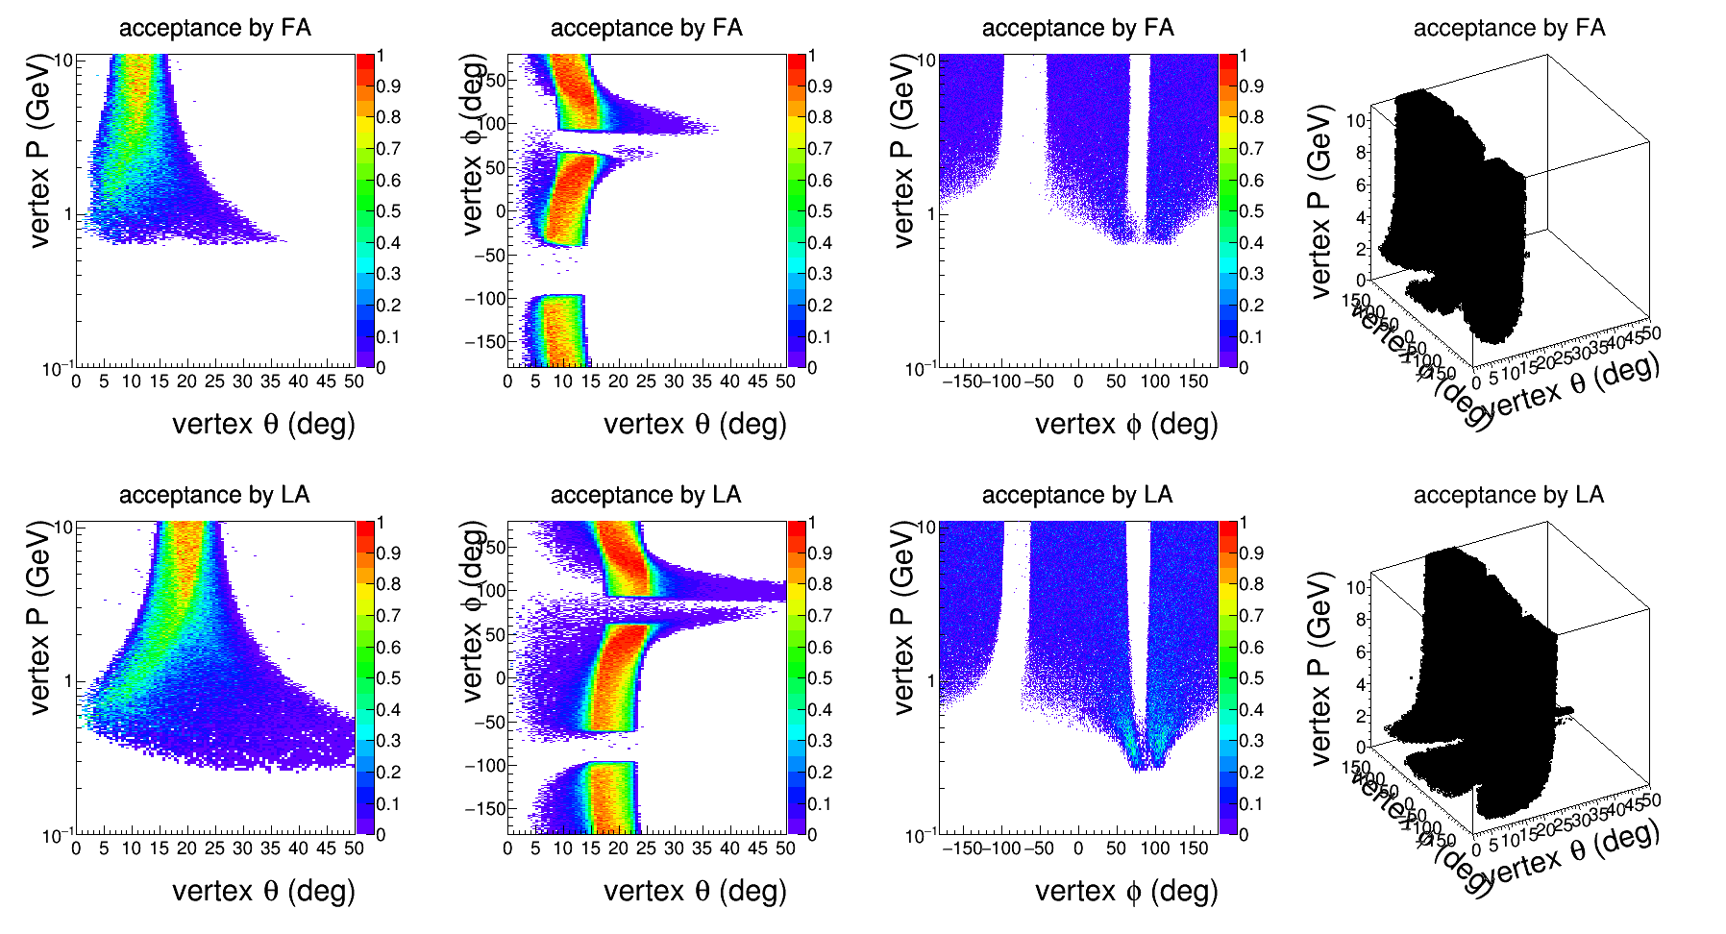
SoLID NH3 Setup
E12-10-008: SIDIS pion on transversely polarized proton (NH3), 120 days, rated A
Detection is similar to He3 setup
Coverage is similar to He3 setup except some distortion from the target field
5T transverse target field
High radiation sheet of flame areas need to be cut away or shielded
Polarized lumi ~1e³⁵/cm²/s
Unpolarized lumi ~6e³⁵/cm²/s
e- acceptance shown
π⁻ acceptance is similar
π⁺ acceptance is reversed
along phi=0 plane

Slide 9
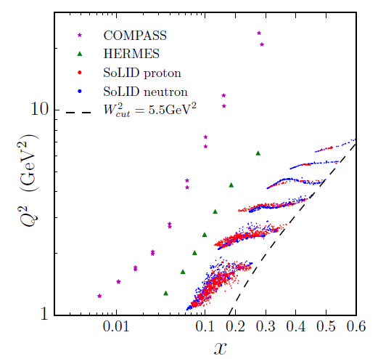
SoLID SIDIS Kinematic Coverage
0.05 < x < 0.6
1GeV < Q² < 8GeV
0.3 < z < 0.7
0 < PT < 1.6GeV
~ 2000 bins for n
~ 1000 bins for p
large acceptance and high luminosity enable wide coverage in all 4 kinematic bins with well controlled systematics

Slide 10
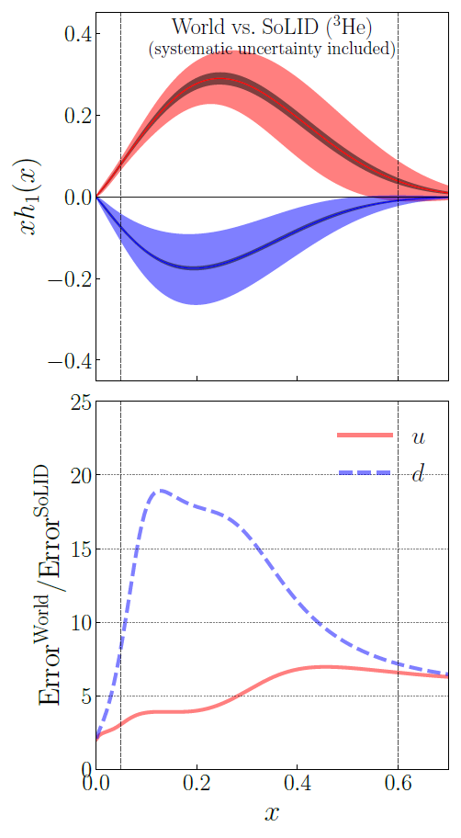
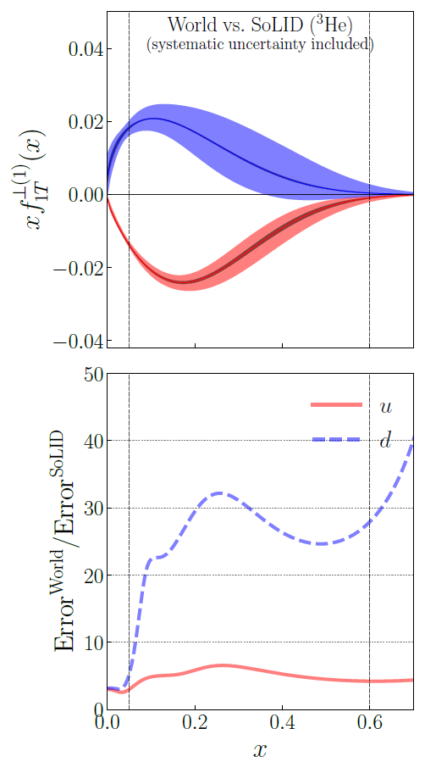
SoLID SIDIS Projection
​Compare SoLID ³He with
World Data​
Transversity
Sivers
Fit Collins and Sivers asymmetries
in SIDIS and e⁺e⁻ annihilation
World data from HERMES, COMPASS
e⁺e⁻ data from BELLE, BABAR, and BESIII
Monte Carlo method is applied
Including both systematic and statistical uncertainties
D'Alesio et al., Phys. Lett. B 803 (2020)135347
Anselmino et al., JHEP 04 (2017) 046

Slide 11
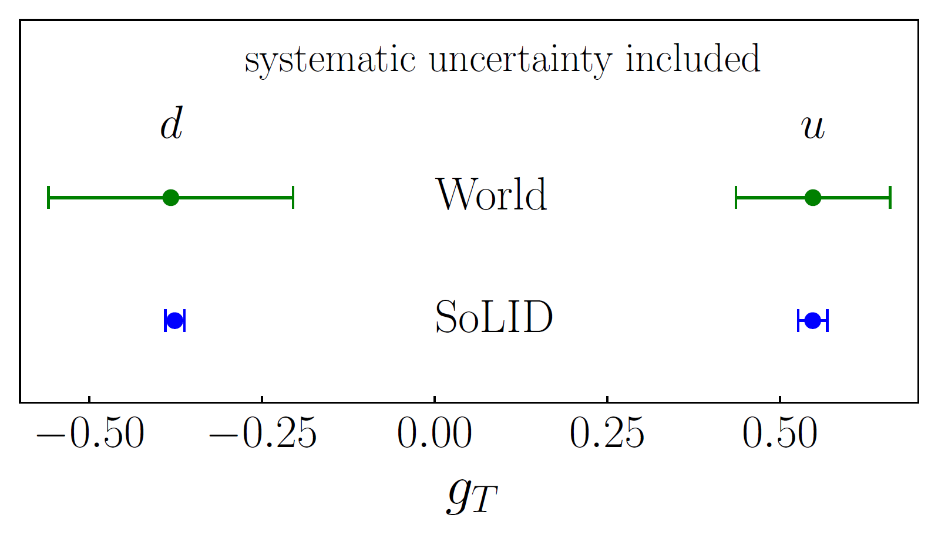
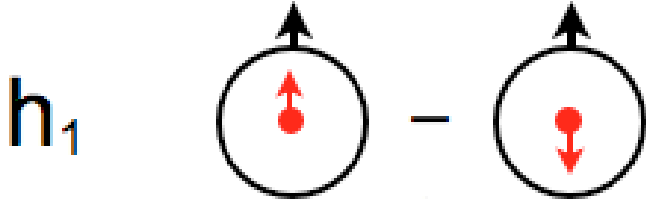
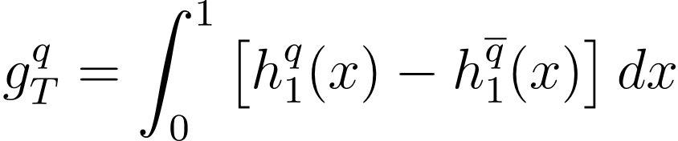

Transversity and Tensor Charge
Transversity distribution
(Collinear & TMD)
Chiral-odd, unique for the quarks
No mixing with gluons, simpler evolution effect
Tensor charge:
  A fundamental QCD quantity dominated by valence quarks
  Precisely calculated on the lattice
  Difference from nucleon axial charge is due to relativity
g_{T} Flavor separation | World data | SoLID
u / d value | 0.548 / -0.382 | 0.547 / -0.376
u / d error | 0.112 / 0.177 | 0.021 / 0.014
SoLID projection: statistical and
systematic uncertainties included
  Tensor charge also connected to neutron and proton EDMs, unique opportunity for SM tests and new physics
Z. Ye et al, Phys. Lett. B 767, 91 (2017)
H. Gao, T. Liu and Z. Zhao, PRD 97, 074018 (2018)

Slide 12
Transversity and Tensor Charge
Transversity distribution
(Collinear & TMD)
Chiral-odd, unique for the quarks
No mixing with gluons, simpler evolution effect
Tensor charge:
  A fundamental QCD quantity dominated by valence quarks
  Precisely calculated on the lattice
  Difference from nucleon axial charge is due to relativity
  SoLID measurements allows for high-precision test of LQCD predictions
  Global analysis including LQCD (PRL 120 (2018) 15, 152502
Combining E12-10-006 & E12-11-108
SoLID projection: statistical and
systematic uncertainties included
(shifted for visibility)
J. Cammarota et al, PRD 102, 054002 (JAM20+)
L. Gamberg et al., PRD 106, 034014 (JAM22)

Slide 13
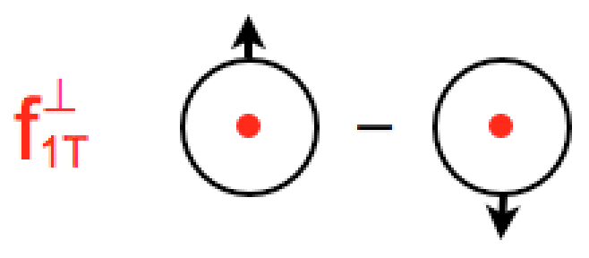
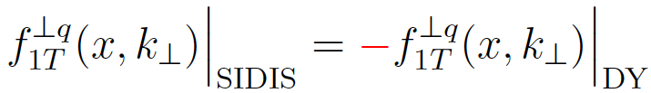
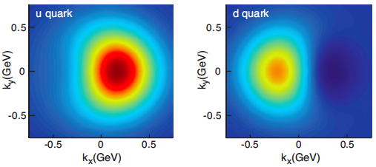
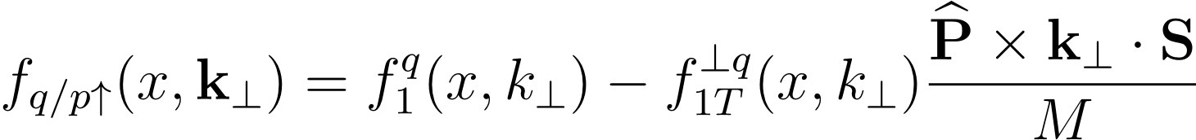
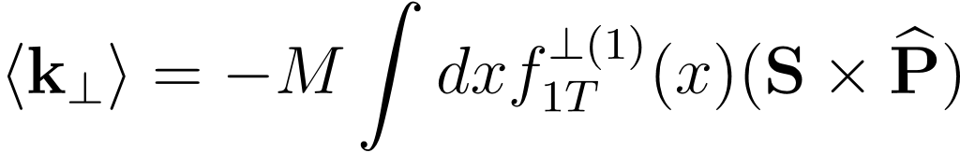







TMDs – confined motion inside the nucleon
Sivers distribution
naively time-reversal odd
Parametrization by M. Anselmino et al., EPJ A 39, 89 (2009)
SoLID projection with transversely polarized n/p
Nucleon spin - quark orbital angular
momentum (OAM) correlation
– zero if no OAM (collinear, massless quarks)
Combining E12-10-006 & E12-11-108
Exact finding is model dependent but SoLID impact is model-independent!

Slide 14


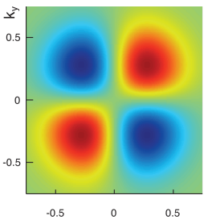
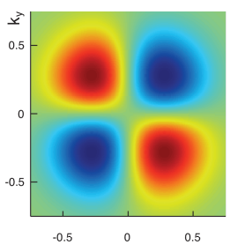
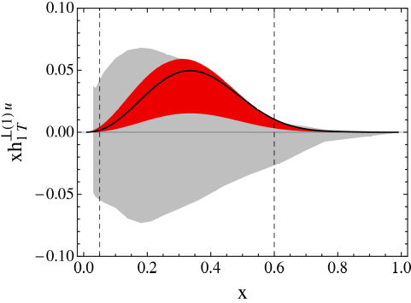
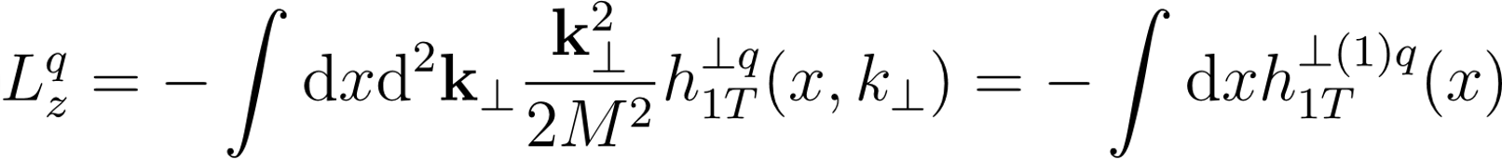
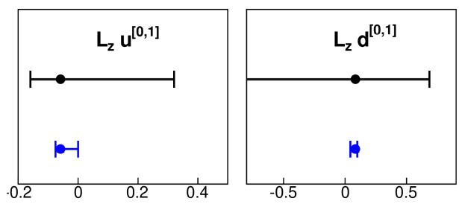
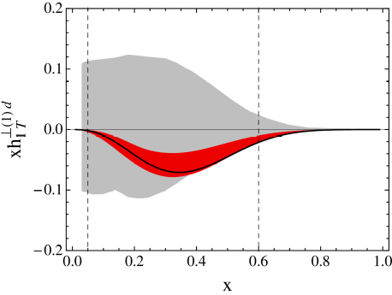
TMDs – confined motion inside the nucleon
u
d
Pretzelocity distribution
Chiral-odd, no gluon analogy
Quadrupole modulation of parton density in the distribution of transversely polarized quarks in a transversely polarized nucleon
Measuring the difference between helicity and transversity (relativistic effects)
Images from PRD 91 034010 (2015)
Parametrization by C. Lefky et al., PRD 91, 034010 (2015)
SoLID projection with transversely polarized n and p data
Relation to OAM (canonical)
Lefky and Prokudin
PRD 91, 034010 (2015)
SoLID projection
Combining E12-10-006 & E12-11-108

Slide 15
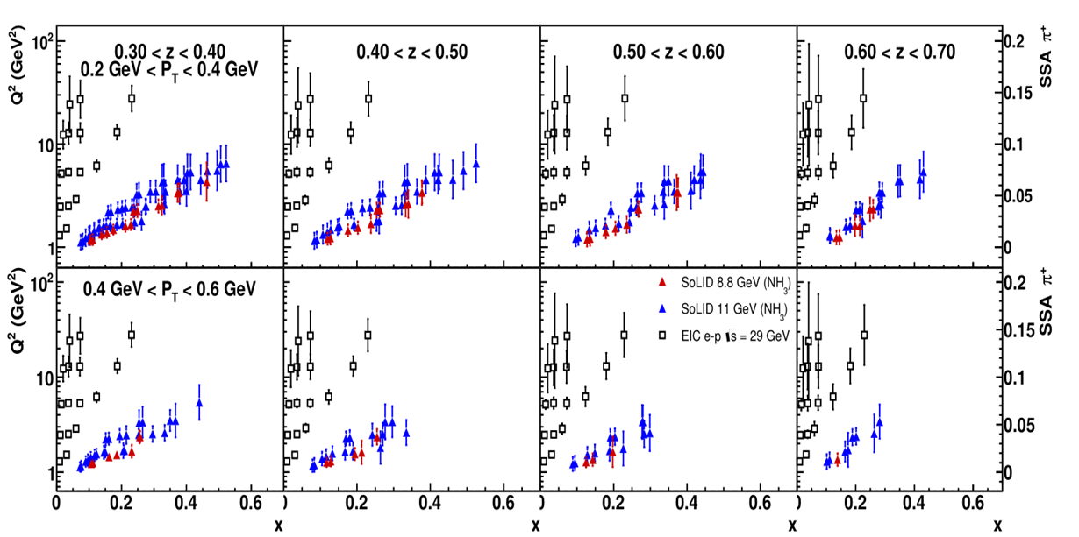
Transverse SSA projections: Complementarity to EIC
SoLID SIDIS projections of A_{UT} in various 4-D bins at 11 / 8.8 GeV beam energies
Projections at EIC kinematics for the same observable at 29 GeV center-of-mass energy
SSA scale and uncertainties shown on the right-side axis of the right two figures
SoLID and EIC projections synergistic towards each other, by covering different x and Q² ranges

Slide 16
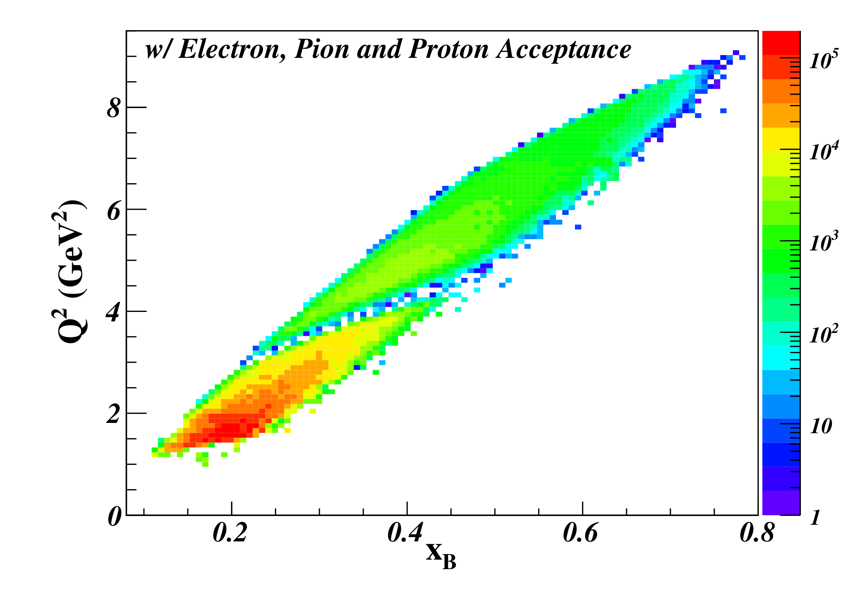
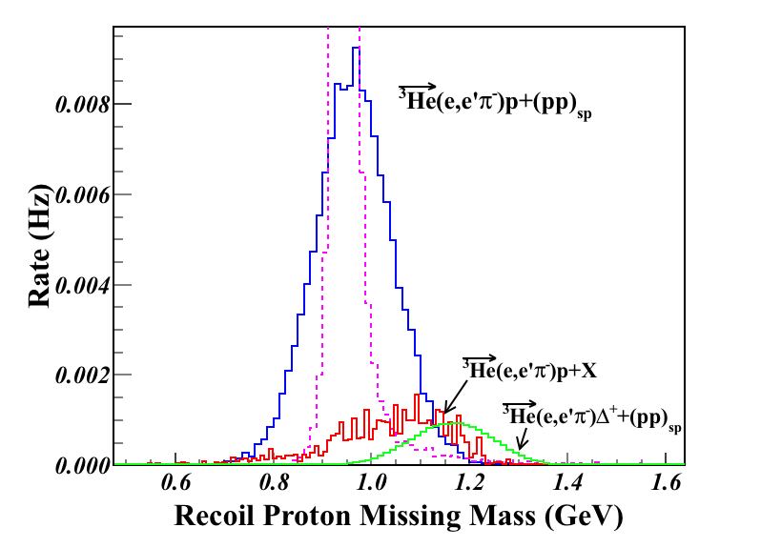
E12-10-006B: Deep Exclusive π– from Transversely Polarized n
  Run group with SIDIS He3
Need high luminosity
Azimuthal modulations of Transverse Single Spin Asymmetry allow access to different GPDs:
  sin(β=φ-φ_{s}) moment sensitive to helicity-flip GPD
  sin(φ_{s}) moment sensitive to transversity GPDs
Q²>1 GeV² W>2 GeV | Q²>4 GeV² W>2 GeV
DEMP: n(e,e’π–p) Triple Coin (Hz)
4.95 | 0.40
SIDIS: n(e,e’π–)X Double Coin (Hz)
1425 | 35.8
with transversely polarized ³He
Large kinematic coverage and well controlled background
Garth Huber, U. of Regina

Slide 17
SoLID J/ψ and TCS
  E12-12-006: Near Threshold J/ψ production on LH2 target 60 days, rating A
  run group E12-12-006A: TCS
  Letter of Intent: DDVCS
Unpolarized lumi ~1e³⁷/cm²/s

Slide 18
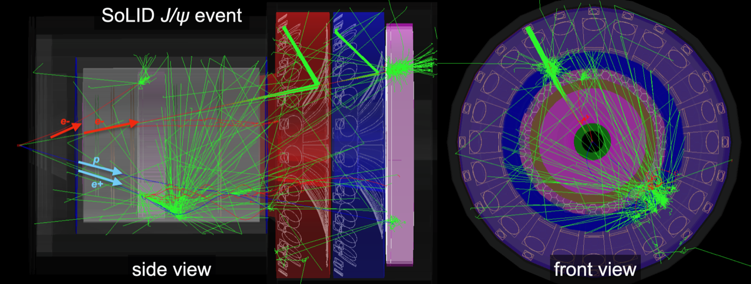
E12-12-006: Near Threshold J/ψ production on LH2 target
Ultimate factory for near-threshold J/ψ
50+10 days of 3µA beam on a 15cm long LH2 target (10³⁷/cm²/s)
Ultra-high luminosity: 43.2ab⁻¹
e p → e′ p′ J/ψ(e⁻ e⁺)
Measurements
Electro-production:
  4-fold: detect decay e⁻ e⁺ pair, scattered e– and recoil proton
  3-fold: detect decay e⁻ e⁺ pair, scattered e– or recoil proton
Photo-production:
  3-fold: detect decay e⁻ e⁺ pair and recoil proton
Trigger on decay e⁻ e⁺ pair only
Wide kinematic coverage
γ p → p′ J/ψ(e⁻ e⁺)

Slide 19
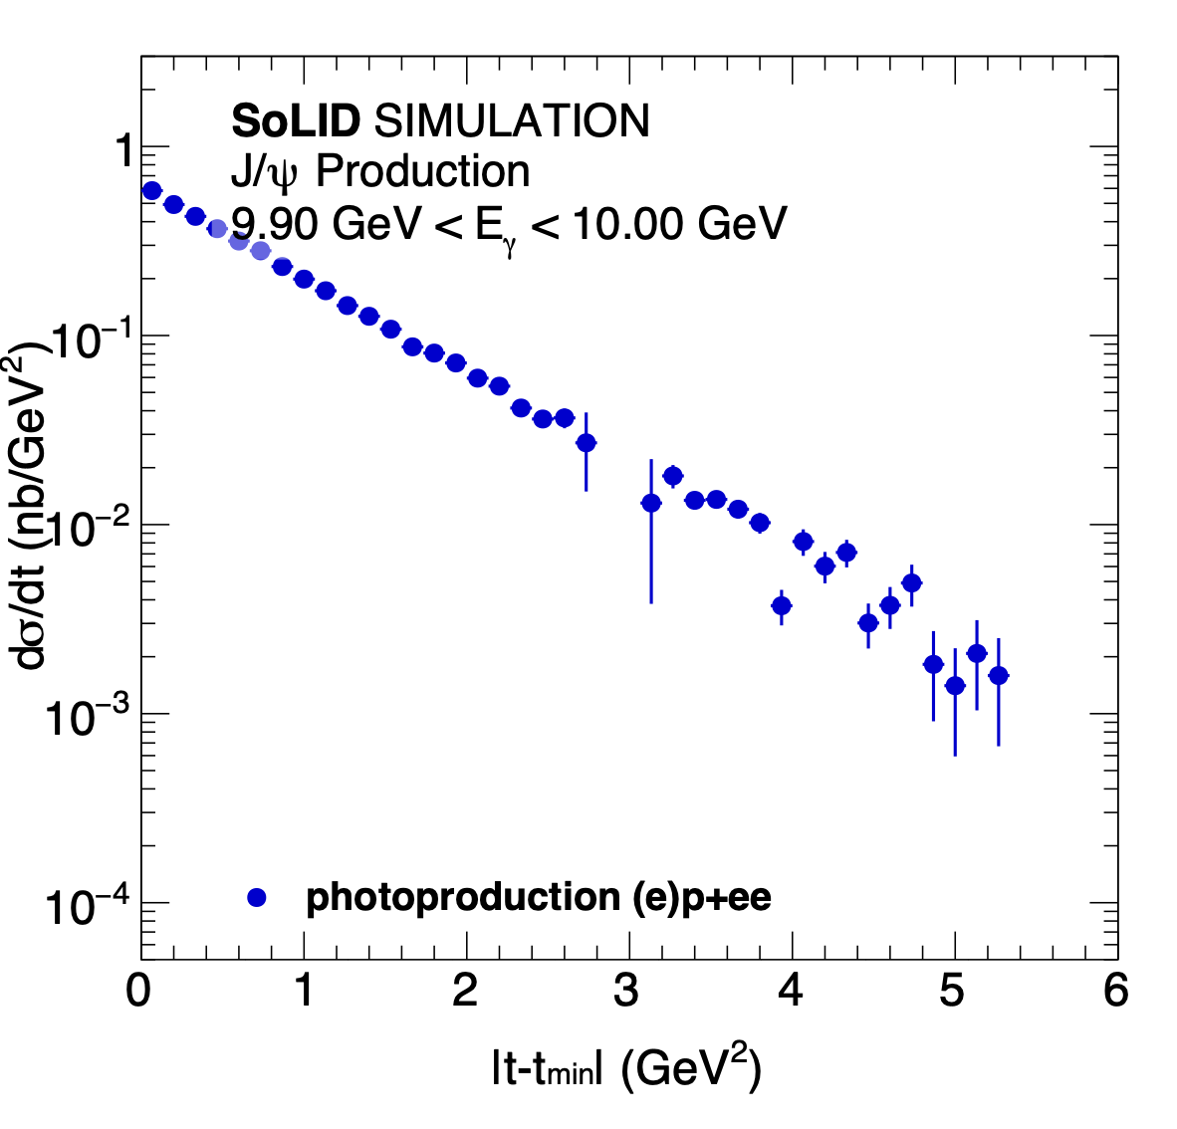
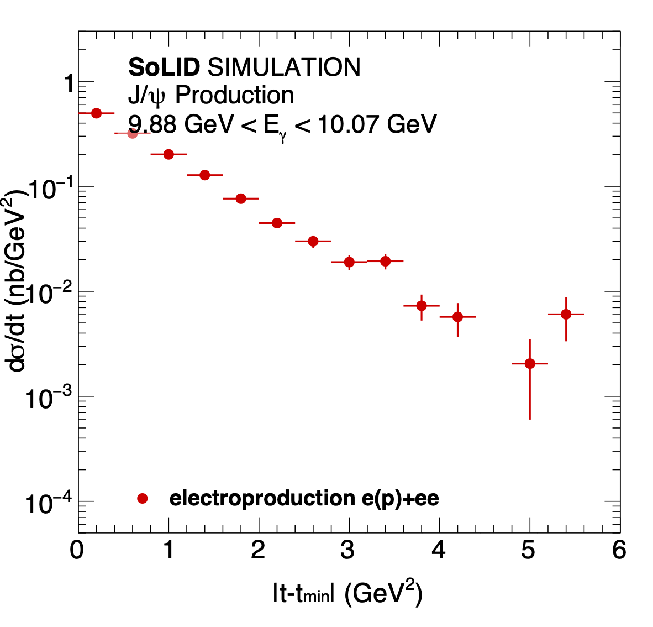
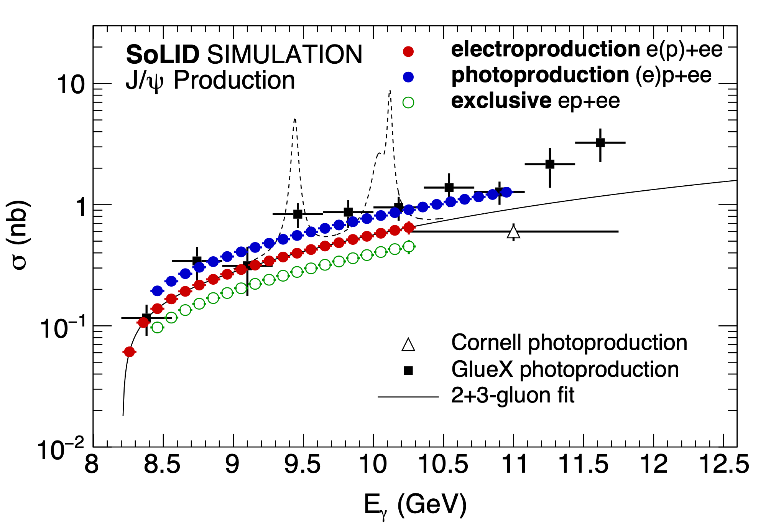
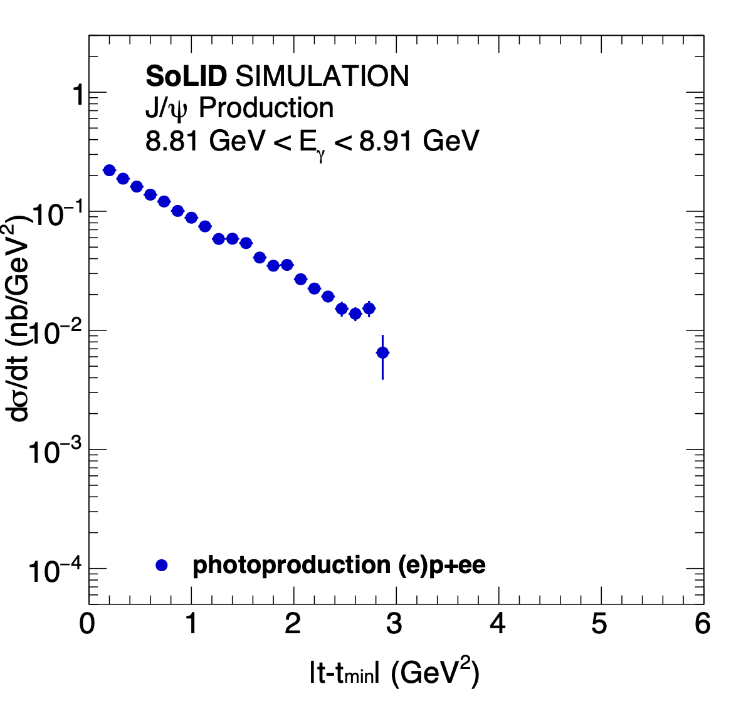
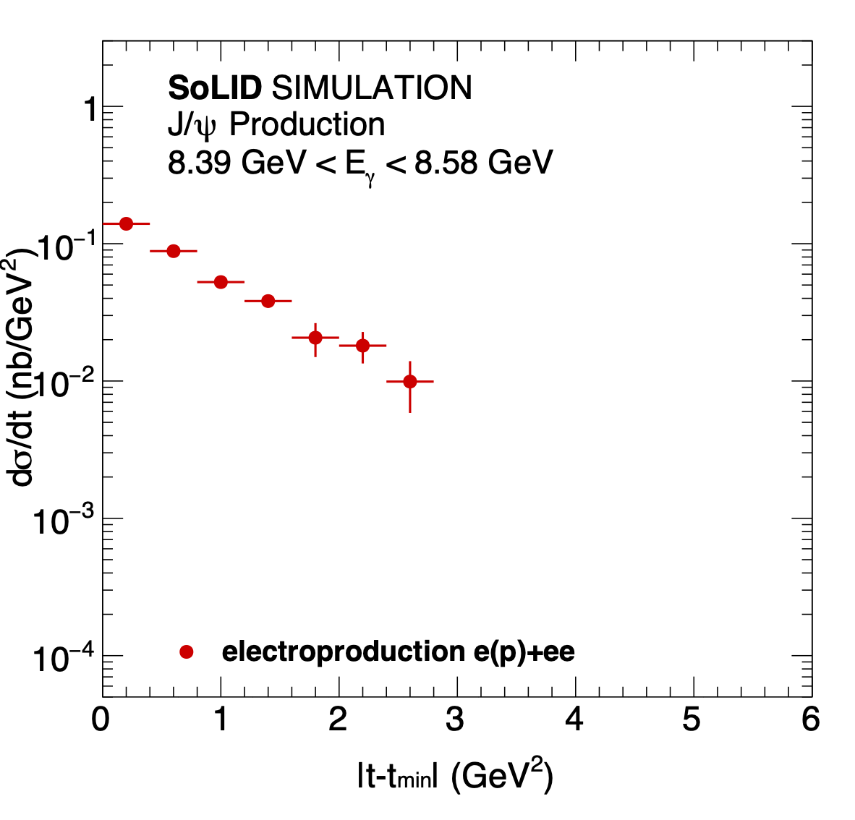
SoLID J/ψ projection
Precision at high t crucial for extrapolations to the forward limit
(exponential, dipole, triple, …)
19

Slide 20
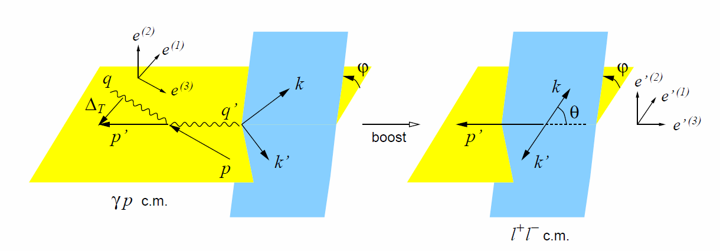
E12-12-006A: TCS with circular polarized beam and LH2 target
sharing beam time with J/psi run using same trigger on decay e⁻ e⁺ pair only
γ p → γ*(e⁻ e⁺) p′
Motivation
    Timelike Compton Scattering (TCS) access the same GPDs like DVCS and test universality
    Access real and imaginary part of GPD H through CFF
    New observables for global GPD fits
Status
    exploration at CLAS 6GeV
    First result at CLAS12 published at PRL, 127, 262501 (2021) obtain nonzero beam polarized asymmetry A_{LU} and forward backward asymmetry A_{FB}
      Limited by low statistics
TCS
BH
Kinematics
CLAS12 result

Slide 21
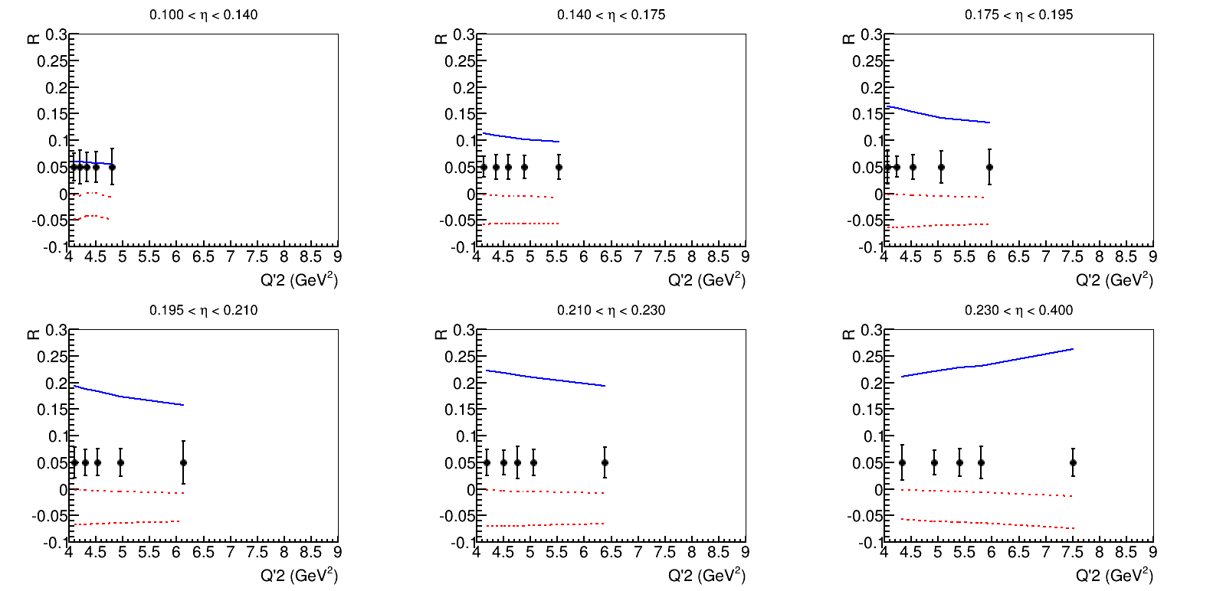
E12-12-006A: TCS with circular polarized beam and LH2 target
SoLID TCS will have at least 1 order higher statistics than CLAS12 and usher TCS study into precision era with multi-dimensional binning
    SoLID has 250 times more integrated luminosity than the CLAS12 TCS published result
    SoLID acceptance to TCS events is about ¼ of CLAS12. But with full azimuthal coverage, (ideal for the forward backward asymmetry)
    Crosssection measurement (moment)
SoLID TCS could lead to study of NLO correction
SoLID TCS coverage

Slide 22
DDVCS with circular polarized beam and LH2 target
Letter of Intent 2015 and 2023
e⁻ p → e⁻ γ*(μ⁻ μ⁺) p′
Double Deeply Virtual Compton Scattering (DDVCS) explores wide off-axis kinematic region of GPDs, beyond DVCS and TCS
SoLID with muon detectors at forward angle, enables DDVCS measurements with both polarized electron and positron beams at 11GeV
Sharing running time and increase statistics for J/ψ and TCS
EPJA 57, 240 (2021)

Slide 23
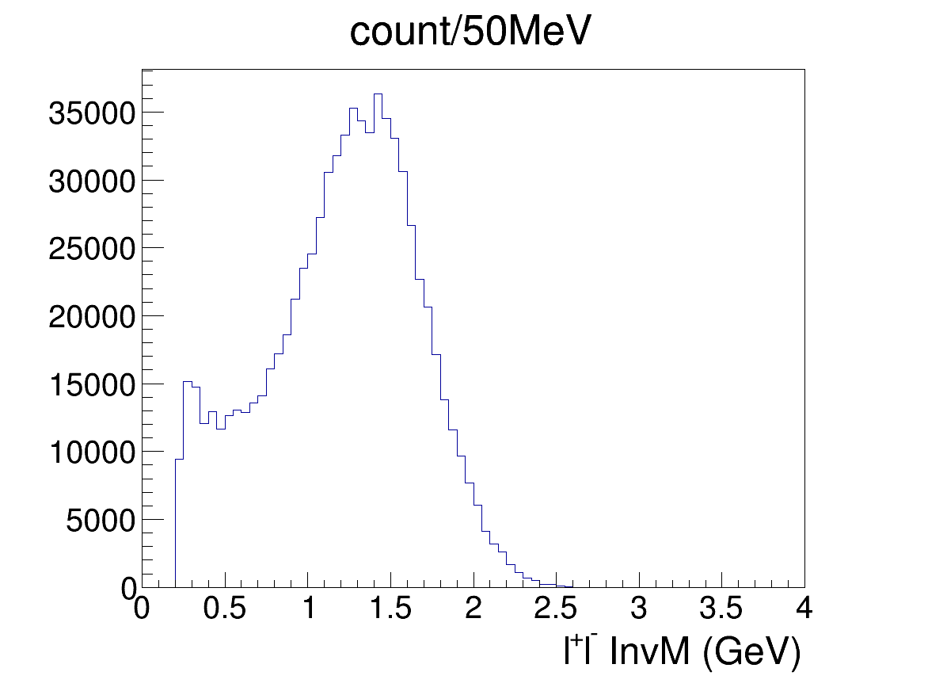
DDVCS with circular polarized beam and LH2 target
coverage
projection
Iron plate to block pion,
straw tube for tracking and scintillator for trigger

Slide 24
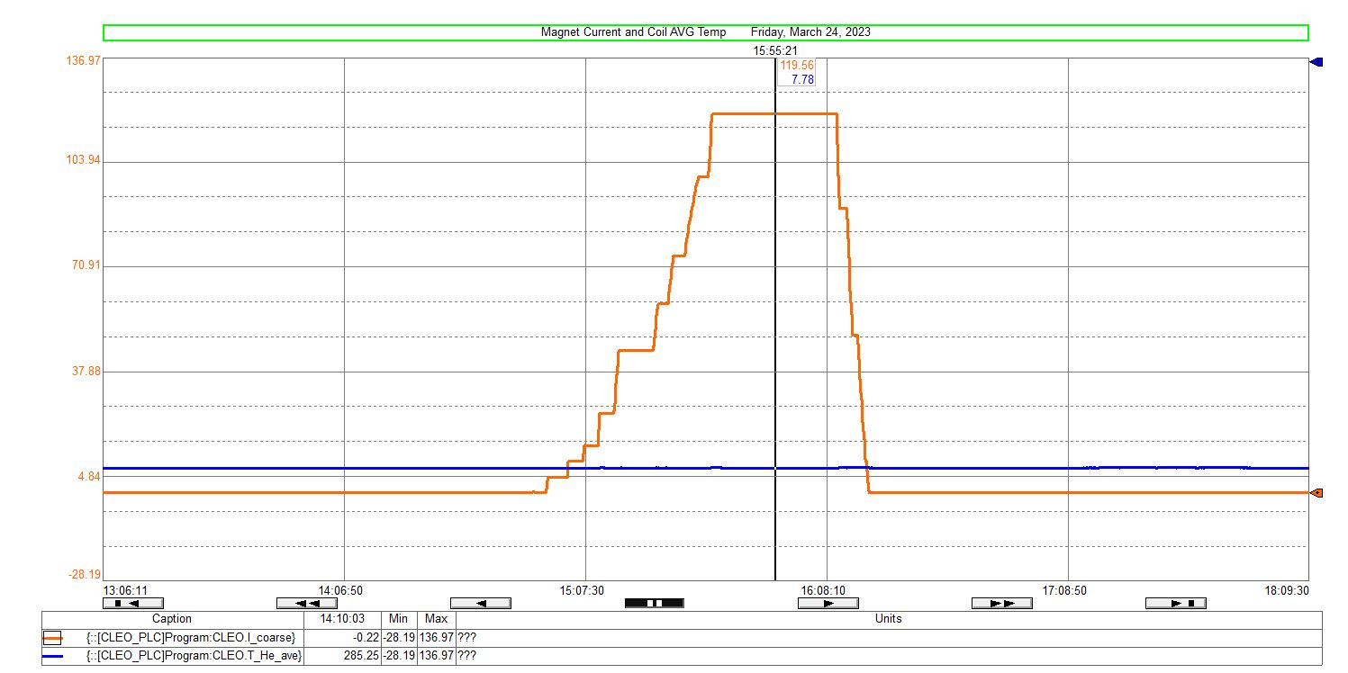
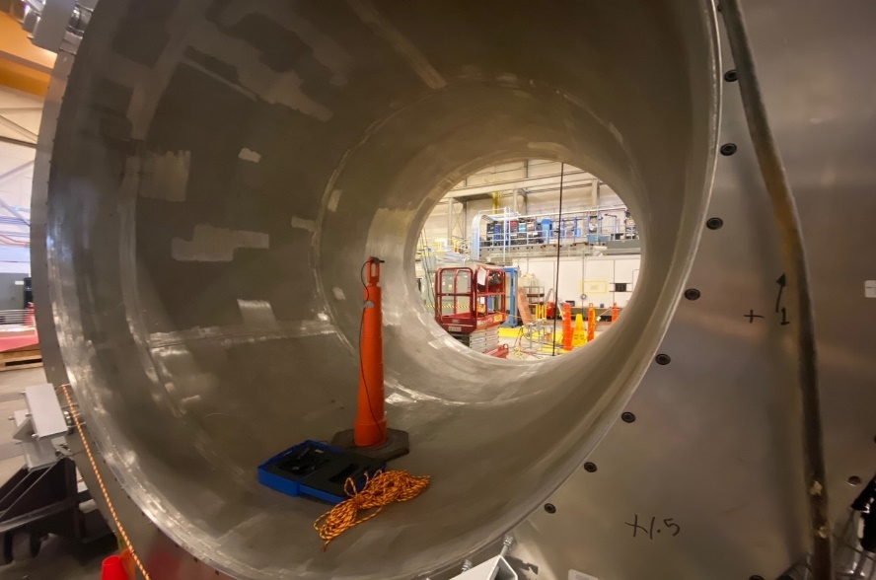
SoLID Update: CLEO-II Magnet Cold Test
A low current test conducted on March 24th. The current for this test was ramped up to 120A and was held for 30 mins.
PSU output voltage ~ 1.15V during ramp up at 0.5A/s.
No increase in coil voltages observed during ramp up or while at 120A for 30 minutes.
Coil believed to be superconducting with flat lined nature of temp curves during test.
A 3 axis Hall probe was installed in the bore of the magnet for each of the tests. Data matched TOSCA model well.
Coil average temperature remained constant during test.
slide from W. Seay

Slide 25
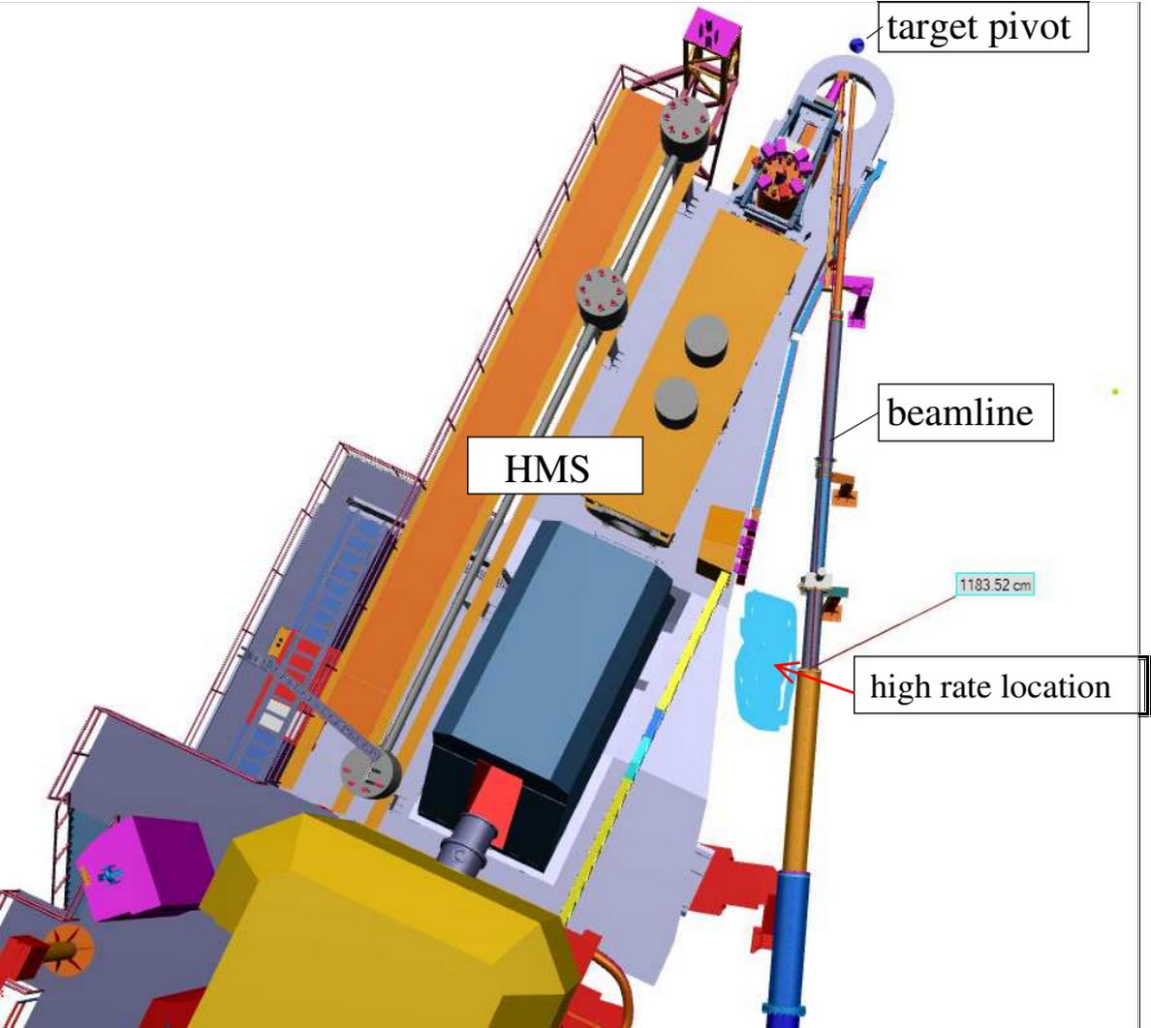
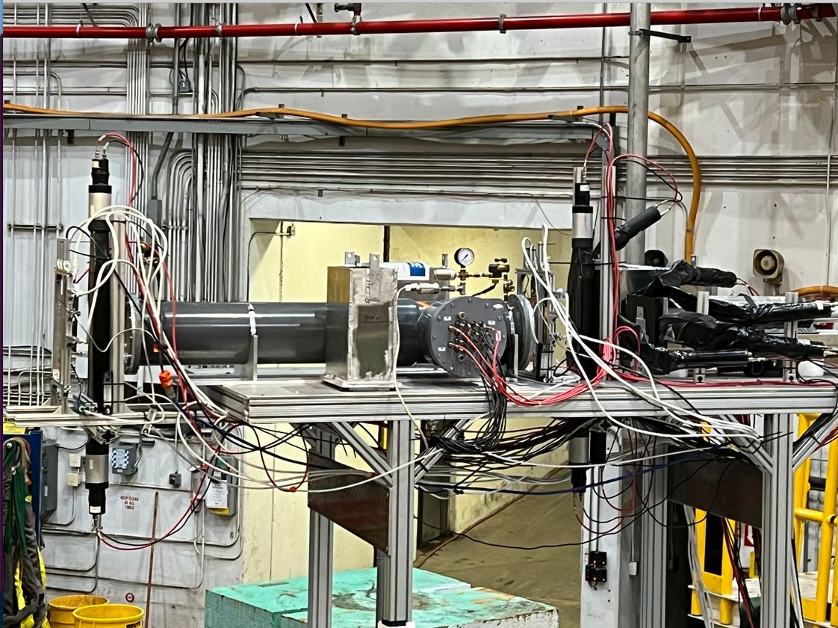
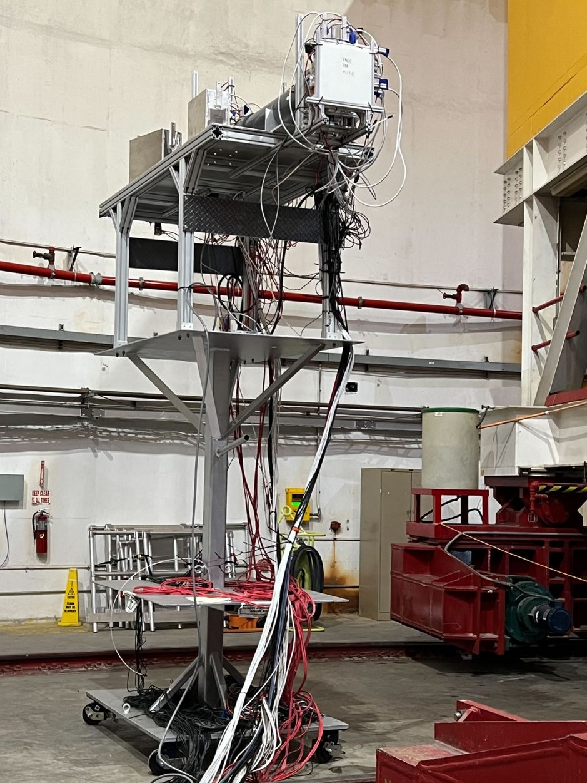
SoLID Update: Detector Beam Test (2022-23 Hall C)
slide from M. Nycz
slide from M. Nycz
frontview
sideview
prelead
Preshower
GEM1,2
GEM3,4
top
Cherenkov
Shower
left
right
SC-C
SC-D
SC-B
SC-A
LASPD
Three stages:
June 2022: install at (L) 82º
  X’mas 2022: cosmic
Jan 2023: moved to (R) 7º
Feb 2023: moved to (R) 18º
Similar detector setup as SoLID (1/600), no magnet, ~10² krad
Extensive simulation, PID study with both classical and AI/ML
Collective effort of: X. Bai, A. Camsonne, J. Caylor, C. Hedinger, T. Holmstrom, M. Nycz, C. Peng, Y. Tian, D. Upton, Z. Ye, J. Zhang, Z. Zhao, JLab DAQ group, and Hall C(A) tech/staff

Slide 26
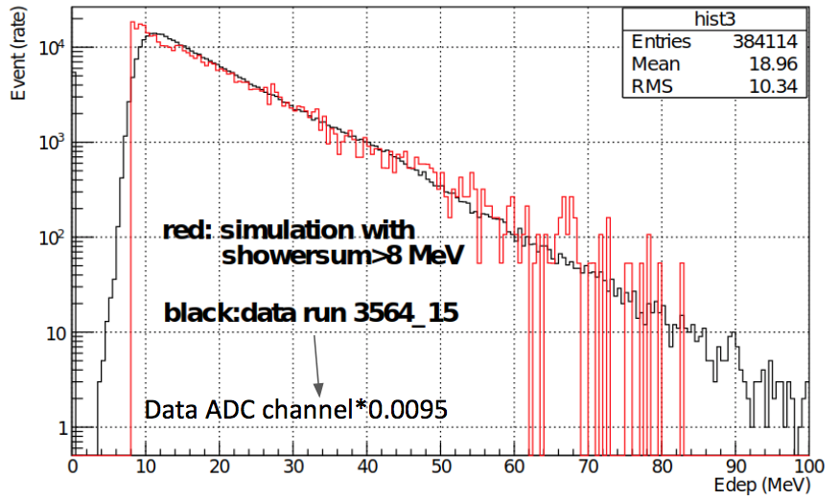



SoLID Update: Detector Beam Test (2022-23 Hall C)
Preliminary
82 deg: Shower MIP not visible, calibrate sim/data using spectrum slope
slide from Y. Tian & D. Upton
7 and 18 deg:
  detectors calibrated with sim using MIP location
  rates agree with simulation to within (10-15)%
ML vs. classical PID with “pencil sim”:
LASPD photon rej ~ (6-7):1

Slide 27



https://indico.mit.edu/event/538/
NSAC 2023 LRP Town Meetings – QCD
https://arxiv.org/abs/2303.02579

Slide 28
SoLID info
https://solid.jlab.org
PreCDR 2019 https://solid.jlab.org/DocDB/0002/000282/001/solid-precdr-2019Nov.pdf
Whitepaper 2022
https://arxiv.org/abs/2209.13357 (accepted by J. Phys. G)

Slide 29
Summary
SoLID with open geometry has a broad physics program
  TMD (SIDIS)
  GPD (DEMP, TCS, DDVCS)
  J/ψ near threshold
High luminosity and large acceptance are keys to make those next generation experiments possible with multidimensional binning
More ideas (e.g. deuterium and other nuclei target)
Thank you!
Supported in part by U.S. Department of Energy under contract number DE-FG02-03ER41231

