Slide 1
Grant no. 12135007
Craig Roberts … http://inp.nju.edu.cn/
Emergence of Hadron Mass and Structure
Notes:
20+5

Slide 2
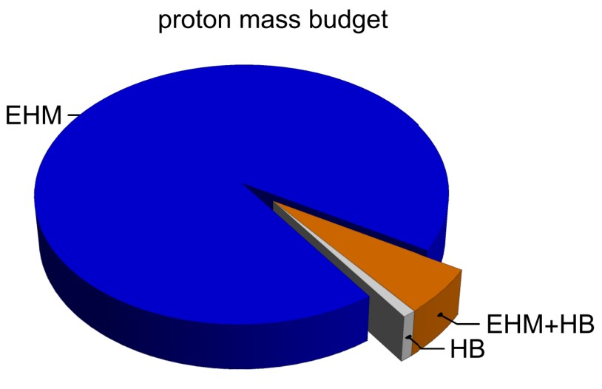
Emergence of Hadron Mass
Standard Model of Particle Physics has one obvious mass-generating mechanism
= Higgs Boson … impacts are critical to evolution of Universe as we know it
However, Higgs boson alone is responsible for just ∼ 1% of the visible mass in the Universe
Proton mass budget … only 9 MeV/939 MeV is directly from Higgs
Evidently, Nature has another very effective mechanism for producing mass:
Emergent Hadron Mass (EHM)
Alone, it produces 94% of the proton’s mass
Remaining 5% is generated by constructive interference between EHM and Higgs-boson

Slide 3
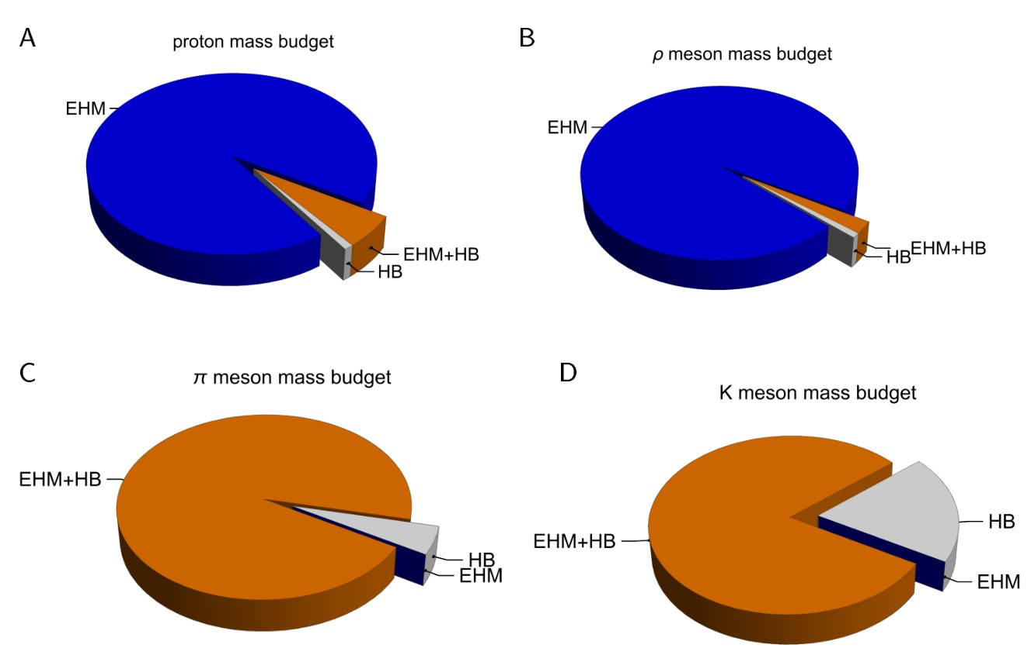
Emergence of Hadron Mass - Basic Questions
What is the origin of EHM?
Does it lie within QCD?
What are the connections with …
Gluon and quark confinement?
Dynamical chiral symmetry breaking (DCSB)?
Nambu-Goldstone modes = π & K?
What is the role of Higgs in modulating observable properties of hadrons?
Without Higgs mechanism of mass generation, π and K would be indistinguishable
What is and wherefrom mass?
Proton and $ρ$-meson mass budgets are practically identical
$π$- and $K$-meson mass budgets
are essentially/completely different from those of proton and $ρ$

Slide 4
Quantum Chromodynamics
$$L= \frac{1}{4}G_{μν}^{a}\left(x\right)G_{μν}^{a}\left(x\right)+\overline{ψ}\left[γ⋅∂_{x}+m+ig \frac{λ^{a}}{2}γ⋅A^{a}\left(x\right)\right]ψ\left(x\right)$$
$$G_{μν}^{a}\left(x\right)=∂_{μ}A_{ν}^{a}(x)−∂_{ν}A_{μ}^{a}(x)−f^{abc}A_{μ}^{b}{(x)A}_{ν}^{c}(x)$$
One-line Lagrangian – expressed in terms of gluon and quark partons
Which are NOT the degrees-of-freedom measured in detectors
Questions
What are the asymptotic detectable degrees-of-freedom?
How are they built from the Lagrangian degrees-of-freedom?
Is QCD really the theory of strong interactions?
Is QCD really a theory? $⇒$ Implications far beyond Standard Model

Slide 5
Strong Interactions in the Standard Model
Only apparent scale in chromodynamics is mass of the quark field
Quark mass is generated by Higgs boson.
In connection with everyday matter, that mass is 1/250th of the natural (empirical) scale for strong interactions,
viz. more-than two orders-of-magnitude smaller
Plainly, the Higgs-generated mass is very far removed from the natural scale for strongly-interacting matter
Nuclear physics mass-scale – 1 GeV – is an emergent feature of the Standard Model
No amount of staring at L_{QCD} can reveal that scale
Contrast with quantum electrodynamics, e.g., spectrum of hydrogen levels measured in units of m_{e}, which appears in L_{QED}

Slide 6
Whence Mass?
Classical chromodynamics … non-Abelian local gauge theory
Remove the current mass … there’s no energy scale left
No dynamics in a scale-invariant theory; only kinematics … the theory looks the same at all length-scales … there can be no clumps of anything … hence bound-states are impossible.
Our Universe can’t exist
Higgs boson doesn’t solve this problem …
normal matter is constituted from light-quarks
the mass of protons and neutrons, the kernels of all visible matter, are 100-times larger than anything the Higgs can produce
Where did it all begin? … becomes … Where did it all come from?

Slide 7
Trace Anomaly
In a scale invariant theory
the energy-momentum tensor must be traceless: T_{μμ} ≡ 0
Regularisation and renormalisation of (ultraviolet) divergences in Quantum Chromodynamics introduces a mass-scale
… dimensional transmutation:
Lagrangian’s constants (couplings and masses) become dependent on a mass-scale, ζ
α → α(ζ) in QCD’s (massless) Lagrangian density, L(m=0)
⇒ ∂_{μ}D_{μ} = δL/δσ = αβ(α) dL/dα = β(α) ¼G_{μν} G_{μν} = T_{ρρ} =: Θ₀
Quantisation of renormalisable four-dimensional theory forces nonzero value for trace of energy-momentum tensor
Trace anomaly
QCD β function … specifies how the coupling “runs”

Slide 8
Trace Anomaly
Knowing that a trace anomaly exists does not deliver much
… Indicates only that a mass-scale must exist
Key Question: Can one compute and/or understand the magnitude of that scale?
One can certainly measure the magnitude … consider proton:
In the chiral limit the entirety of the proton’s mass is produced by the trace anomaly, Θ₀
… In QCD, Θ₀ measures the strength of gluon self-interactions
… so, from one perspective,
m_{p} is (somehow) completely generated by glue.

Slide 9
On the other hand …

Slide 10
Trace Anomaly
In the chiral limit, pion is massless Nambu-Goldstone boson:
⇒
Does this mean that the scale anomaly vanishes trivially in the pion state, i.e. gluons contribute nothing to the pion mass?
Difficult way to obtain “zero”!
Easier to imagine that “zero” owes to cancellations between different operator contributions to the expectation value of Θ₀.
Of course, such precise cancellation should not be an accident.
It could only arise naturally because
of some symmetry and/or symmetry-breaking pattern.

Slide 11
Whence “1” and yet “0” ?
No statement of the question
“How does the mass of the proton arise?”
is complete without the additional clause
“How does the pion remain massless?”
Natural visible-matter mass-scale must emerge simultaneously with apparent preservation of scale invariance in related systems
Expectation value of Θ₀ in pion is always zero,
irrespective of the size of the natural mass-scale for strong interactions = m_{p}

Slide 12
Whence “1” and yet “0” ?
No statement of the question
“How does the mass of the proton arise?”
is complete without the additional clause
“How does the pion remain massless?”
Natural visible-matter mass-scale must emerge simultaneously with apparent preservation of scale invariance in related systems
Expectation value of Θ₀ in pion is always zero,
irrespective of the size of the natural mass-scale for strong interactions = m_{p}
Modern Physics must
Expose the entire array of Empirical Consequences
of the Mechanism responsible
so that the Standard Model can be Validated

Slide 13
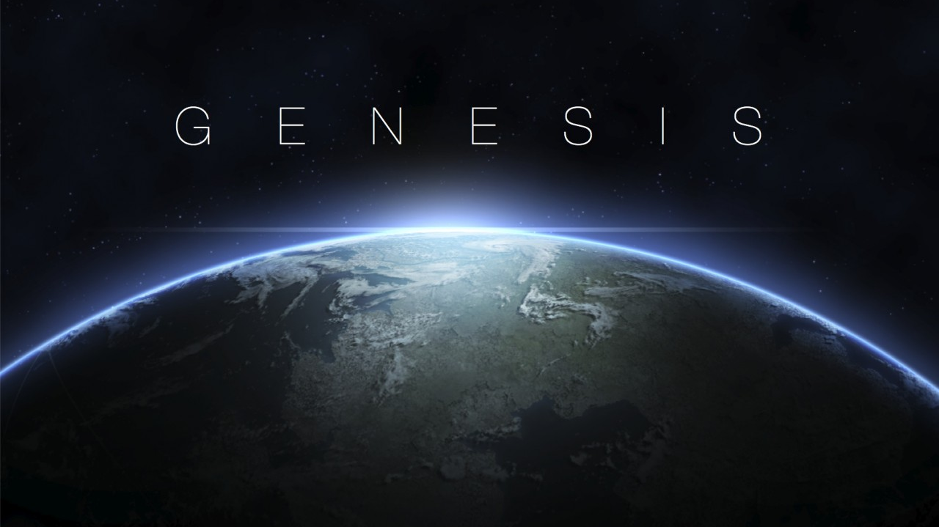

Slide 14
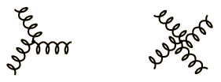
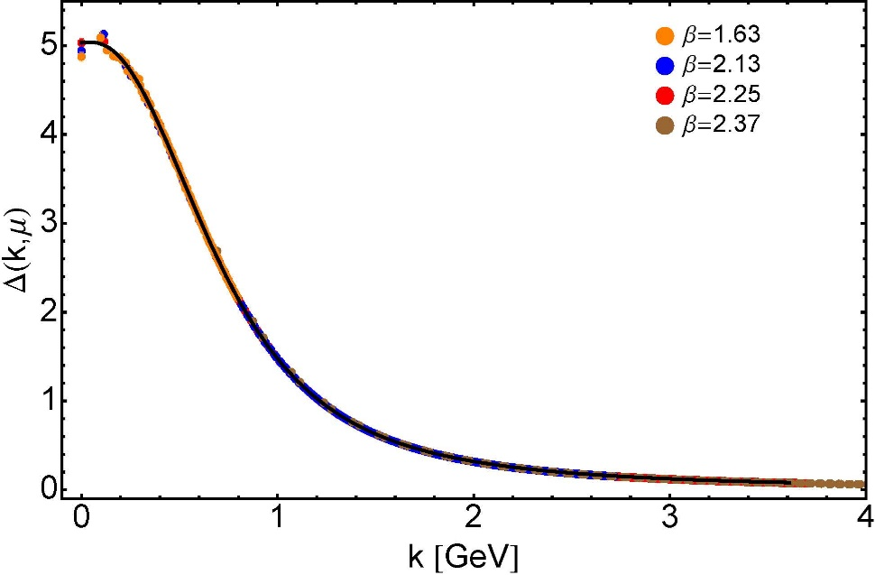
Modern Understanding Grew Slowly from Ancient Origins
More than 40 years ago
Dynamical mass generation in continuum quantum chromodynamics,
J.M. Cornwall, Phys. Rev. D 26 (1981) 1453 … $∼1100$ citations
Owing to strong self-interactions, gluon partons $⇒$ gluon quasiparticles,
described by a mass function that is large at infrared momenta
3-gluon vertex
4-gluon vertex
$$\frac{1}{m_{g}^{2}}$$
Truly mass from nothing
An interacting theory, written in terms of massless gluon fields, produces dressed gluon fields that are characterised by a mass function that is large at infrared momenta
Gluon propagator … continuum and lattice QCD agree
QCD fact
Continuum theory and lattice simulations agree
Empirical verification?

Slide 15
Modern Understanding Grew Slowly from Ancient Origins
EHM means
Gluons are massive
More than 40 years ago
Dynamical mass generation in continuum quantum chromodynamics,
J.M. Cornwall, Phys. Rev. D 26 (1981) 1453 … $∼1050$ citations
Owing to strong self-interactions, gluon partons $⇒$ gluon quasiparticles,
described by a mass function that is large at infrared momenta
3-gluon vertex
4-gluon vertex
$$\frac{1}{m_{g}^{2}}$$
Truly mass from nothing
An interacting theory, written in terms of massless gluon fields, produces dressed gluon fields that are characterised by a mass function that is large at infrared momenta
Gluon propagator … continuum and lattice QCD agree
QCD fact
Continuum theory and lattice simulations agree
Empirical verification?

Slide 16
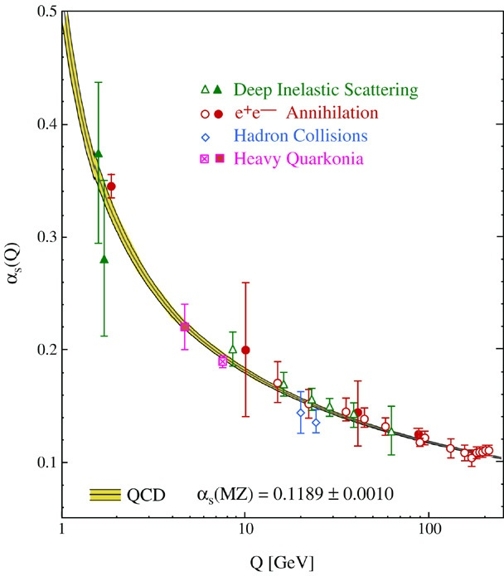
QCD’s Running Coupling
This is where we live
⇐
What’s happening
out here?!

Slide 17
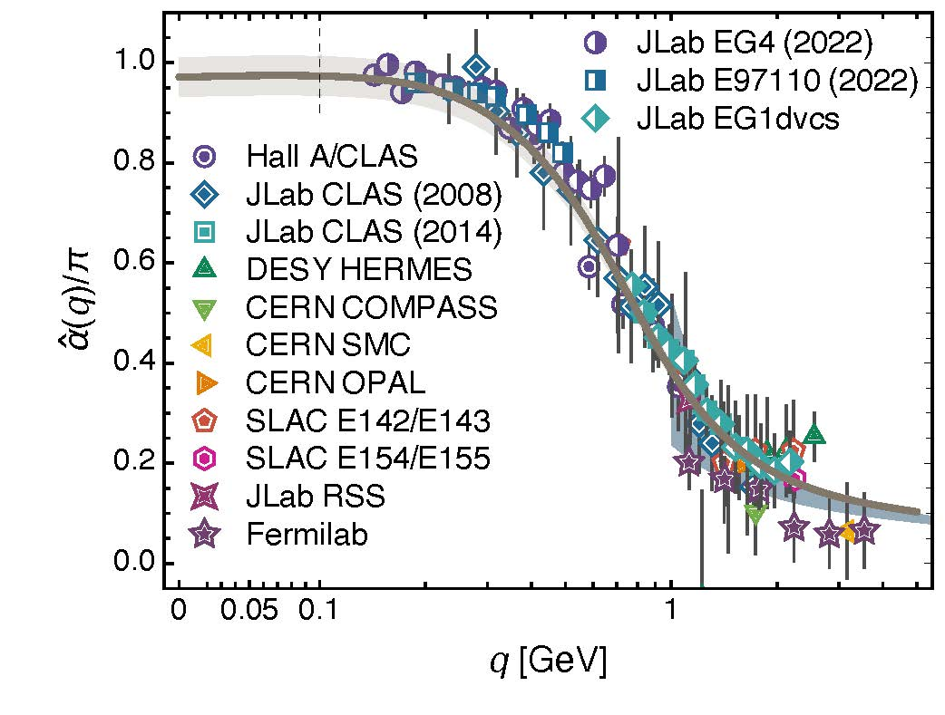
Process independent effective charge = running coupling
W orkshop on Dyson-Schwinger Equations in Modern Mathematics
and Physics (DSEMP2014) Trento, Italy, September 22-26, 2014
Modern theory enables unique QCD analogue of
“Gell-Mann – Low” running charge
to be rigorously defined and calculated
Analysis of QCD’s gauge sector
yields a parameter-free prediction
N.B. Qualitative change in α̂_{PI}(k) at k ≈ ½ m_{p}
No Landau Pole
“Infrared Slavery” picture – linear potential – is not correct explanation of confinement
Below $k∼{{\hat{m}}_{0}}_{ },$interactions become scale independent, just as they were in the Lagrangian; so, QCD becomes practically conformal again
The QCD Running Coupling,
A. Deur, S. J. Brodsky and G. F. de Teramond, Prog. Part. Nucl. Phys. 90 (2016) 1-74
Process independent strong running coupling
Daniele Binosi et al., arXiv:1612.04835 [nucl-th], Phys. Rev. D 96 (2017) 054026/1-7
Effective charge from lattice QCD, Zhu-Fang Cui et al., NJU-INP 014/19, arXiv:1912.08232 [hep-ph], Chin. Phys. C 44 (2020) 083102/1-10
QCD Running Couplings and Effective Charges, A. Deur, S. J. Brodsky, C. D. Roberts – arXiv:2303.00723 [hep-ph]

Slide 18
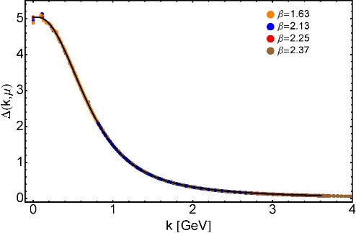
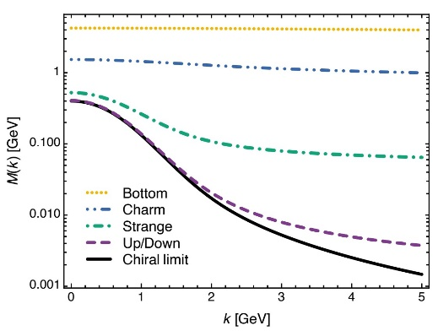
EHM Basics
Absent Higgs boson couplings, the Lagrangian of QCD is scale invariant
Yet …
Massless gluons become massive
A momentum-dependent charge is produced
Massless quarks become massive
EHM is expressed in
EVERY strong interaction observable
Challenge to Theory =
Elucidate all observable consequences of these phenomena
and highlight the paths to measuring them
Challenge to Experiment =
Test the theory predictions so that
the boundaries of the Standard Model can finally be drawn
Three pillars of EHM

Slide 19
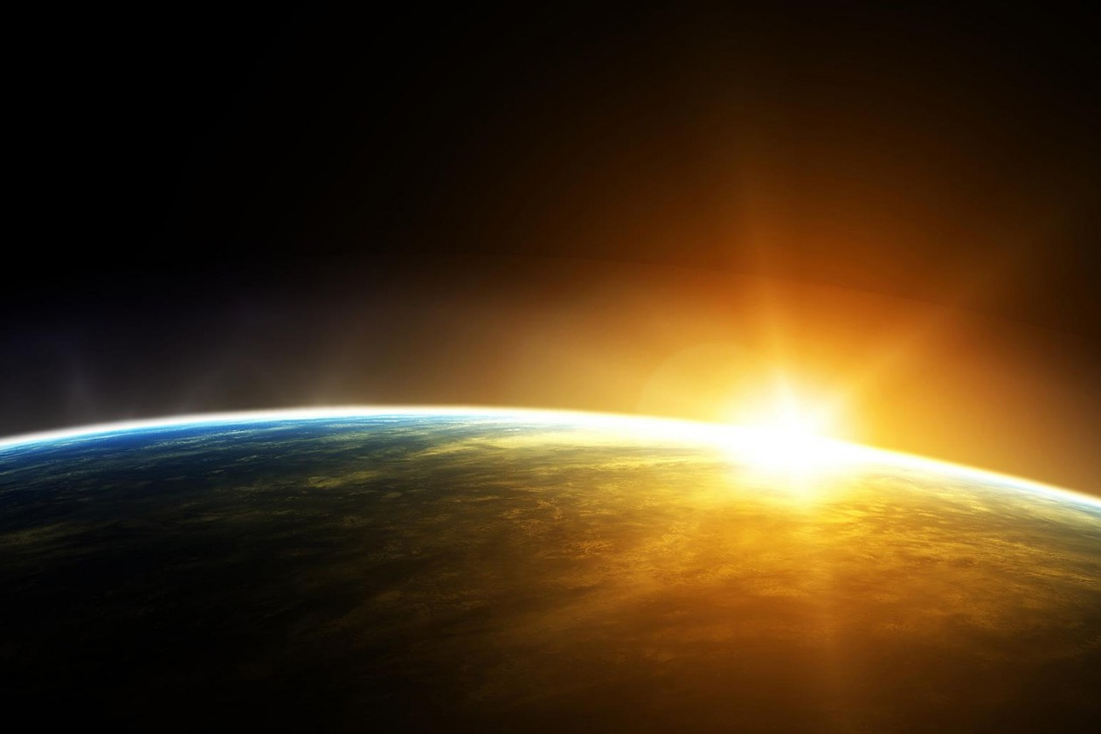
Exposing & Charting EHM
Proton was discovered 100 years ago
It is stable; hence, an ideal target in experiments
But just as studying the hydrogen atom ground state didn’t give us QED,
focusing on the ground state of only one form of hadron matter will not solve QCD
New Era dawning
High energy + high luminosity
$⇒$ science can expand horizons beyond 100-year focus on the proton
Enable precision studies of, e.g.,
Structure of Baryon excited states
Baryons are the most fundamental three-body systems in Nature
If we don’t understand how QCD, a Poincaré-invariant quantum field theory, builds each of the baryons in the complete spectrum, then we don't understand Nature.
Structure of Nature’s most fundamental Nambu-Goldstone bosons ($π$ & K)
Spectrum of mesons and their structure
JLab12 & JLab22
AMBER @ CERN
EIC
EicC

Slide 20
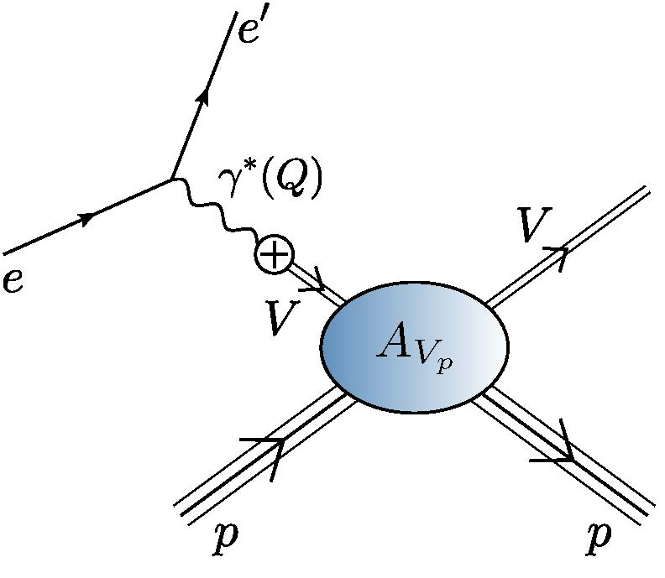
$m_{p}$, vector-meson production & vector meson dominance

Slide 21
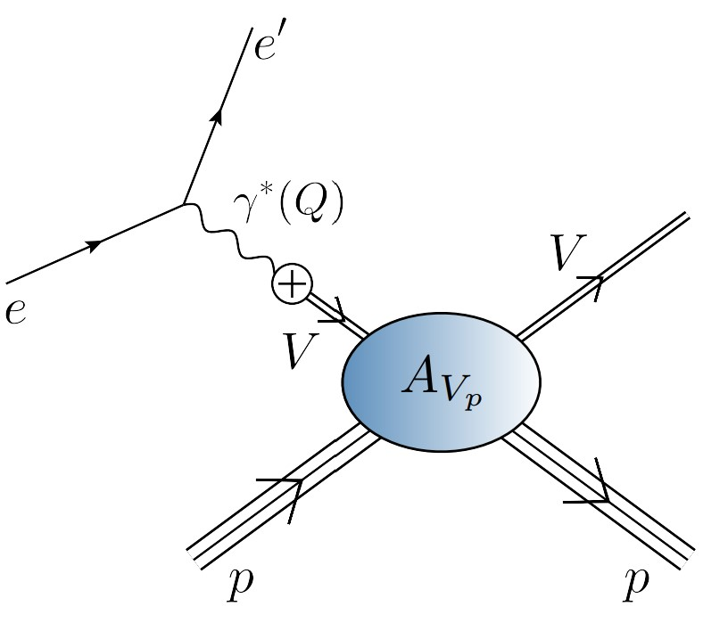
EHM Measurements: How does nucleon mass arise?
One perspective on the answer = QCD scale anomaly
Measurement = femtoscopic low-momentum correlation measurements
QCD multipole expansion … J/ψ and/or $Υ$ chromopolarisability relates forward scattering amplitude to a key matrix element in the origin of the nucleon mass problem
viz. the average chromoelectric gluon distribution in the nucleon:
Need to access purely hadronic process ($V=J/ψ, Υ$)
$$V+p→V+p$$
Once considered viable to do this using
electromagnetic vector-meson production reaction
$e+p→e^{′}+V+p$
VMD

Slide 22
EHM Measurements: How does nucleon mass arise?
Once considered viable …
Electromagnetic process ($V=J/ψ, Υ$) … $e+p→e^{′}+V+p$
to access purely hadronic process … $V+p→V+p$
But … contemporary theory explains …
Deciphering the mechanism of near-threshold J/ψ photoproduction, M.-L. Du, V. Baru, F.-K. Guo et al., Eur. Phys. J. C 80, 1053 (2020)
Vector-meson production and vector meson dominance, Yin-Zhen Xu (徐胤禛), Si-Yang Chen (陈斯阳), Zhao-Qian Yao (姚照千) et al., NJU-INP 044/21, arXiv:2107.03488 [hep-ph], Eur. Phys. J. C 81 (2021) 895/1-11
Near threshold heavy quarkonium photoproduction at large momentum transfer, Peng Sun, Xuan-Bo Tong, Feng Yuan, Phys.Rev.D 105 (2022) 5, 054032
Models of J/Ψ photo-production reactions on the nucleon, T.-S.H. Lee, S. Sakinah, Yongseok Oh, Eur. Phys. J. A 58 (2022) 12, 252
There is no objective, model-independent means by which to connect $e+p→e^{′}+V+p$ with $V+p→V+p$
Hence, vector meson photoproduction
does not provide a path to the QCD trace anomaly
Is there a viable alternative?
VMD

Slide 23
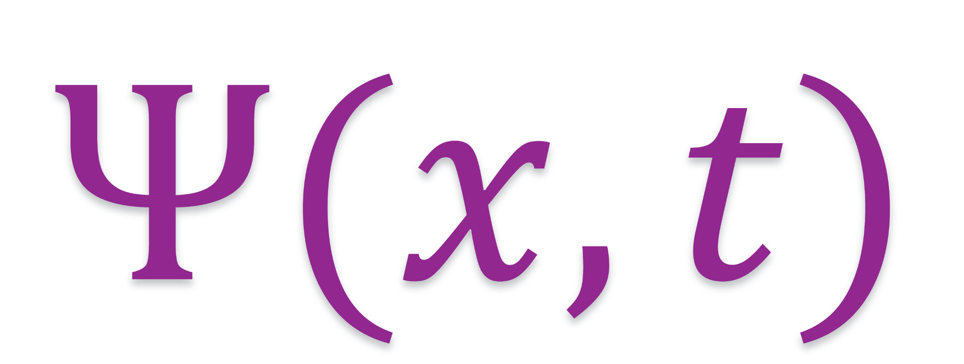
$π \& K$ DAs

Slide 24
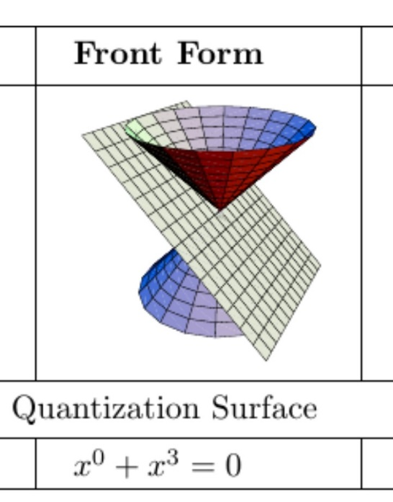
Wave Functions of Nambu Goldstone Bosons
DAs are 1D projection of hadron’s light-front wave function, obtained by integration $∼\int{d^{2}k_{⊥}Ψ(x,k_{⊥})}$
Physics Goals:
Pion and kaon distribution amplitudes (DAs – φ_{π,K})
Nearest thing in quantum field theory to Schrödinger wave function
Consequently, fundamental to understanding π and K structure.
Scientific Context:
For 40 years, the x-dependence of the pion's dominant distribution amplitude (DA) has been controversial.
Modern theory $⇒$EHM expressed in x-dependence of $φ_{π,K}\left(x\right)$
$φ_{π}\left(x\right)$ is direct measure of dressed-quark running mass in chiral limit.
Kaon DA = asymmetric around midpoint of its domain of support (0<x<1)
Degree of asymmetry is signature of constructive interference between EHM and HB mass-generating mechanisms
LF longitudinal direction
Insights into the Emergence of Mass from Studies of Pion and Kaon Structure, Craig D. Roberts, David G. Richards, Tanja Horn and Lei Chang, NJU-INP 034/21, arXiv: 2102.01765 [hep-ph], Prog. Part. Nucl. Phys. 120 (2021) 103883/1-65

Slide 25
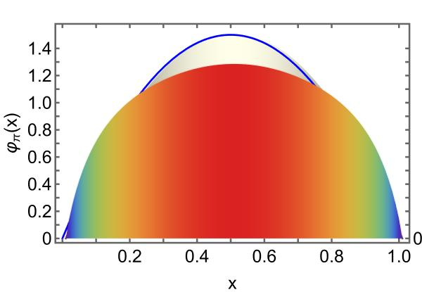
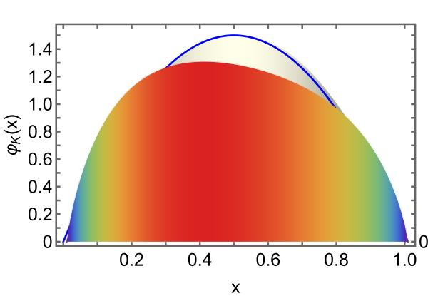
$π$ & K DAs cf. asymptotic profile
Exposing strangeness: projections for kaon electromagnetic form factors, Fei Gao et al., arXiv:1703.04875 [nucl-th], Phys. Rev. D 96 (2017) 034024/1-8
$$φ_{asymptotic}$$
These features have widespread impact in studies of (hard) exclusive processes.
Broadening can be verified, e.g., in $π$ and $K$ elastic form factor measurements at large $Q^{2}$
EHM generates broadening in both $π$ & K
EHM + Higgs-boson interference is responsible for skewing in kaon
HB-only $⇒$ peak shifted to $\frac{m_{u}^{HB}}{m_{s}^{HB}}×\frac{1}{2}≈0.02$ … wrong
Instead, EHM*HB for u and s quarks … $\frac{{EHM m_{u}→M}_{u}}{EHM m_{s}→M_{s}}×\frac{1}{2}≈0.4$

Slide 26
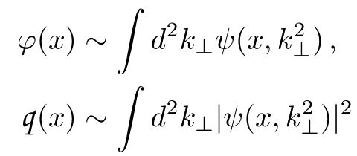
Hard Exclusive Processes, e.g., meson form factors
Normalisation of large Q² behaviour of meson form factors is largely determined by EHM, expressed in
$f_{M}$ = order parameter for DCSB (EHM)
$φ_{M}\left(x\right)$ = meson wave function
Parton distribution functions (PDFs) and parton distribution amplitudes (PDAs) are connected through the hadron’s light-front wave function
Hadron’s LFWF is the key.
EHM is expressed in every hadron LFWF
LFWF correlates all observables
$$g_{u}=\frac{1}{x}, { g}_{\overline{q}}=\frac{1}{1−x}$$
High-energy nuclear and particle physics have long focused on finding evidence for power-law scaling in experimental data.
Important first step;
BUT should be remembered that QCD is not found in scaling laws.
Instead, since quantum field theory requires deviations from strict scaling, then
QCD is found in the existence and character of scaling violations.

Slide 27
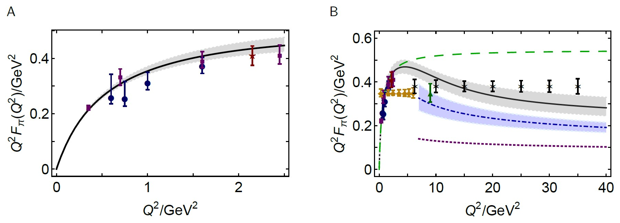
Wave Functions of Nambu Goldstone Bosons
📖 Pion and Kaon Structure at the Electron-Ion Collider, A.C. Aguilar et al., arXiv:1907.08218 [nucl-ex],
Eur. Phys. J. A 55 (2019) 190/1-15
Scientific Context:
Today, continuum and lattice are delivering consistent predictions for φ_{π,K}(x)
Can signature features of interference between EHM and HB, which are manifest in low-order Mellin moments of the DAs, be probed experimentally?
Measurement
Elastic electromagnetic form factors
Breakaway from scaling at $Q^{2}≈6 GeV^{2}$
Thereafter, $Q^{2}$ dependence
is largely described by hard-scattering formula with realistic DA
Reveal QCD scaling violations for 1st time in hard elastic scattering
monopole
CSM
CSM prediction
& existing JLab data
hs formula with realistic DA
hs formula with $φ_{asy}$
CSM prediction
& JLab + EIC projections

Slide 28
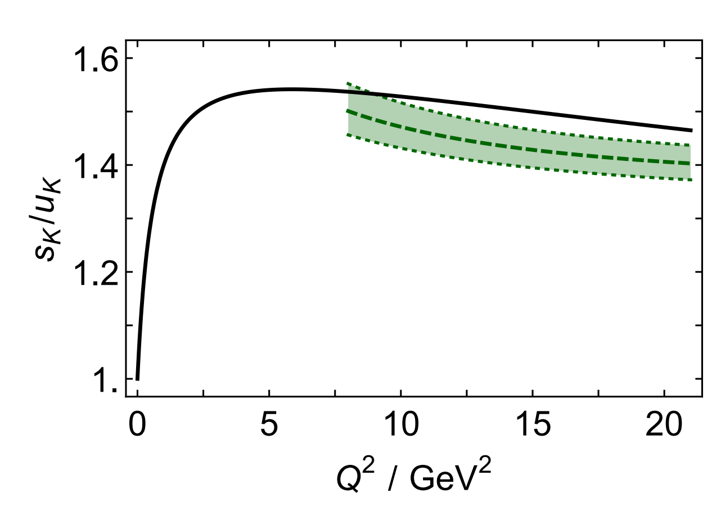
Hard Exclusive Processes
Insights into the Emergence of Mass from Studies of Pion and Kaon Structure,
Craig D. Roberts, David G. Richards, Tanja Horn and Lei Chang,
NJU-INP 034/21, arXiv: 2102.01765 [hep-ph], Prog. Part. Nucl. Phys. 120 (2021) 103883/1-65
Location of maximum points to beginning of pQCD evolution = scaling violations
Height of ratio measures relative strength of emergent- and Higgs-generated mass for s- and u-quarks
Considering hard exclusive processes & focusing on meson electromagnetic form factors, modern theory predicts that
scaling violations become apparent to experiment on $Q^{2}>10 GeV^{2}$
magnitude of any given form factor on a sizeable domain above $Q^{2}=10 GeV^{2}$determined by the physics of emergent hadronic mass (EHM)
$f_{M}$ & $φ_{M}\left(x\right)$
Experiments focused in this area are of the greatest importance.
Domain of high- sensitivity to meson PDA
Kaon Form Factor – flavour separation
Exposing strangeness: projections for kaon electromagnetic form factors, Fei Gao et al., arXiv:1703.04875 [nucl-th], Phys. Rev. D 96 (2017) 034024/1-8

Slide 29
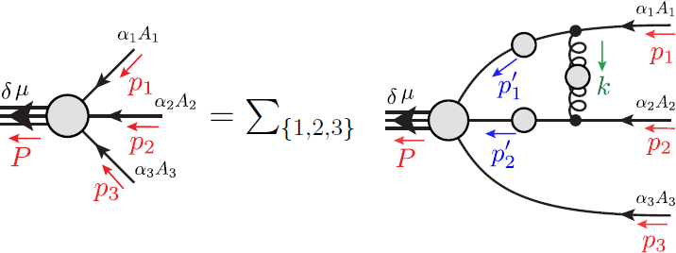
Faddeev Equation for Baryons
Nucleon mass from a covariant three-quark Faddeev equation
G. Eichmann et al., Phys. Rev. Lett. 104 (2010) 201601
Poincaré-covariant analysis of heavy-quark baryons
Si-Xue Qin (秦思学) et al., Phys.Rev. D 97 (2018) 114017/1-13
Unification of Weak and EM form factors of octet baryons
Zhao-Qian Yao (姚照千), et al. – nearing completion

Slide 30
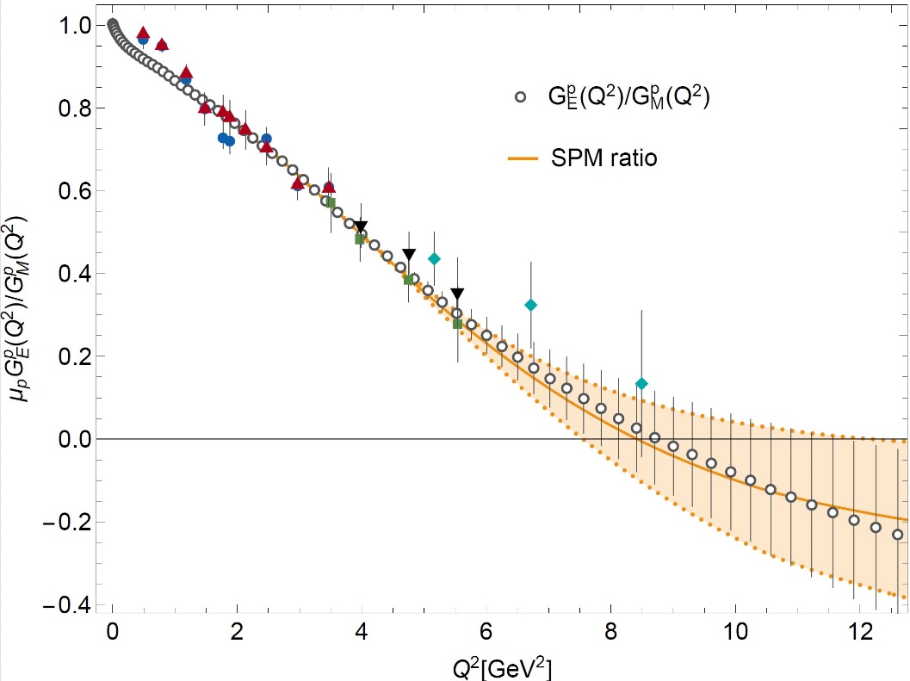
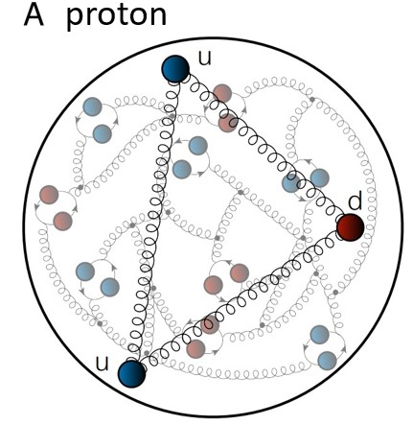
Structure of Baryons
Poincaré covariant Faddeev equation sums all possible exchanges and interactions that can take place between three dressed-quarks
Direct solution of Faddeev equation using rainbow-ladder truncation is now possible
Topical results becoming available with predictions that unify electroweak and electromagnetic structure
Unification of Weak and EM form factors of octet baryons Zhao-Qian Yao (姚照千), Daniele Binosi, et al. – nearing completion
Parameter-free prediction using solutions of 3-body Poincaré-covariant Faddeev equation
$$\frac{{μ_{p}G}_{E}^{p}}{G_{M}^{p}}=0 at Q^{2}={8.42}_{−0.86}^{+3.76}GeV^{2}$$
1st study of its kind to deliver prediction for location of zero

Slide 31
Structure of Baryons
Poincaré covariant Faddeev equation sums all possible exchanges and interactions that can take place between three dressed-quarks
Direct solution of Faddeev equation using rainbow-ladder truncation is now possible
Nevertheless, remains challenging problem – algorithms and numerical analysis

Slide 32
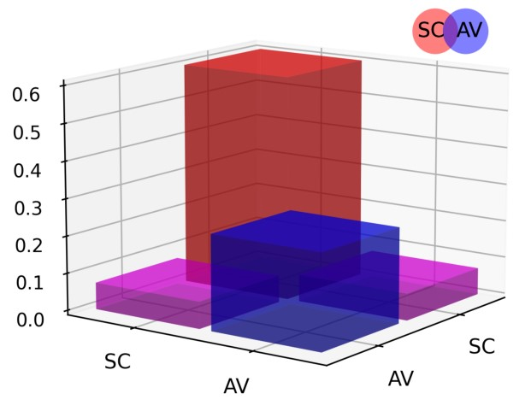
Structure of Baryons
Solution delivers
Poincaré-covariant
proton wave function
Poincaré covariant Faddeev equation sums all possible exchanges and interactions that can take place between three dressed-quarks
Direct solution of Faddeev equation using rainbow-ladder truncation is now possible, but remains challenging problem – algorithms and numerical analysis
For many/most applications, diquark approximation to quark+quark scattering kernel is used
Prediction: owing to EHM phenomena, strong diquark correlations exist within baryons
- proton and neutron … both scalar and axial-vector diquarks are present
CSM prediction = presence of axialvector (AV) diquark correlation in the proton
AV Responsible for $≈40\%$ of proton charge

Slide 33
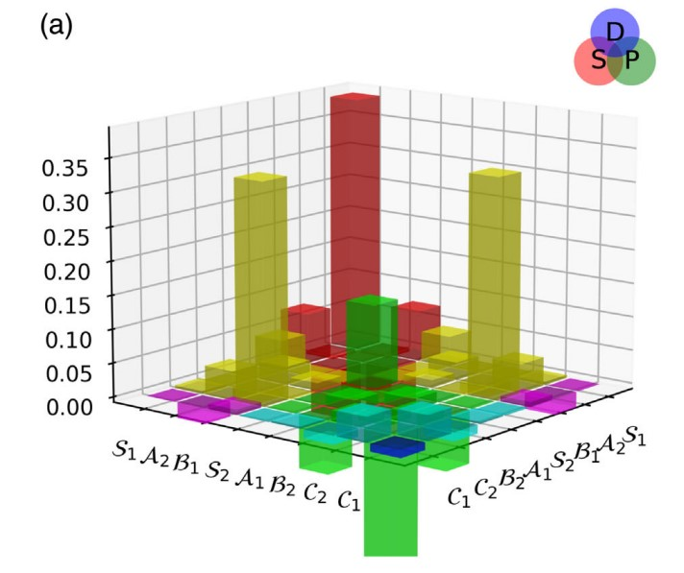
Structure of Baryons
Solution delivers
Poincaré-covariant
proton wave function
Poincaré covariant Faddeev equation sums all possible exchanges and interactions that can take place between three dressed-quarks
Direct solution of Faddeev equation using rainbow-ladder truncation is now possible, but numerical challenges remain
For many/most applications, diquark approximation to quark+quark scattering kernel is used
Prediction: owing to EHM phenomena:
proton wave function is not just S-wave, but contains strong P-wave contributions
CSM prediction = canonical normalization dominated by $S⊗S$, but receives large $S⊗P$ and $P⊗P$
contributions
Non-$S⊗S$make-up 6$0\%$ of proton charge

Slide 34
Diquarks - Facts
Theory predicts experimental observables that would constitute unambiguous measurable signals for the presence of diquark correlations.
Some connect with spectroscopy of exotics
tetraquarks and pentaquarks
Numerous observables connected with structure of conventional hadrons, e.g.
existence of zeros in d-quark contribution to proton Dirac and Pauli form factors
$Q^{2}$-dependence of nucleon-to-resonance transition form factors
$x$-dependence of proton structure functions
deep inelastic scattering on nuclear targets (nDIS) … proton production described by direct knockout of diquarks, which subsequently form into new protons

Slide 35
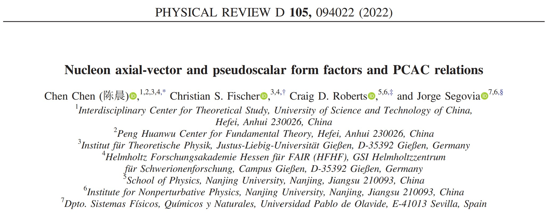

Slide 36
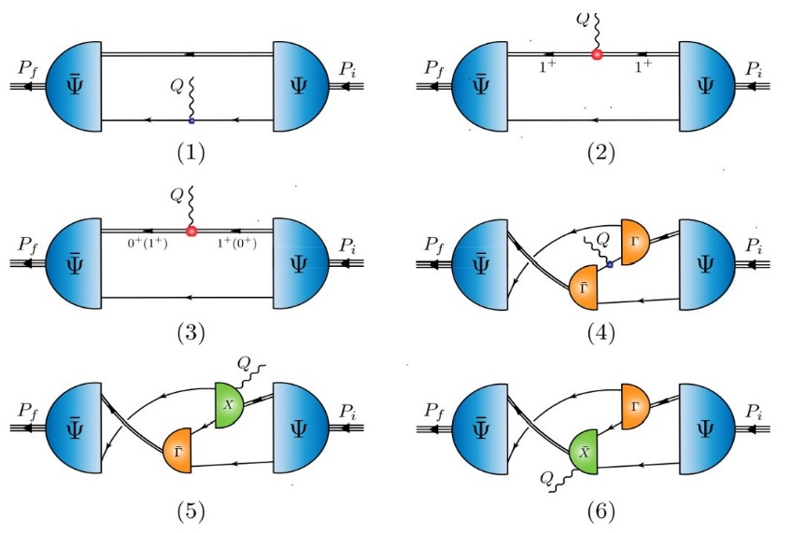
Nucleon axial form factor: $G_{A}(Q^{2})$
Parameter-free continuum quark+diquark prediction compared with up-to-date lattice result
Mean $χ^{2}$= 0.27
$Q^{2}$reach of continuum prediction is unlimited
Now have results to 10 Ge$V^{2}$
“Precision” lattice result is constrained to the modest $Q^{2}$-window shown
Contribution dissection:
29% from $\left(I,J^{P}\right)=(1,1^{+})$ diquarks

Slide 37
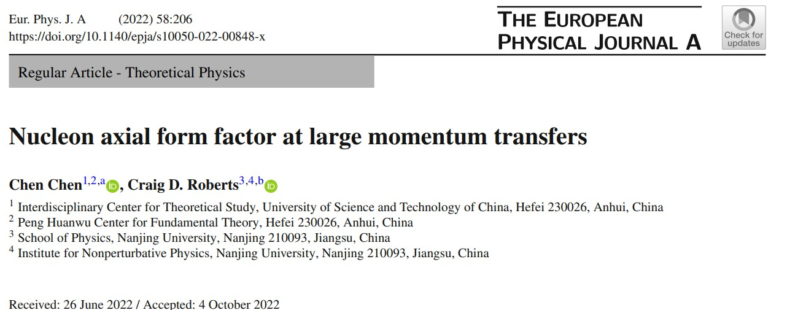

Slide 38
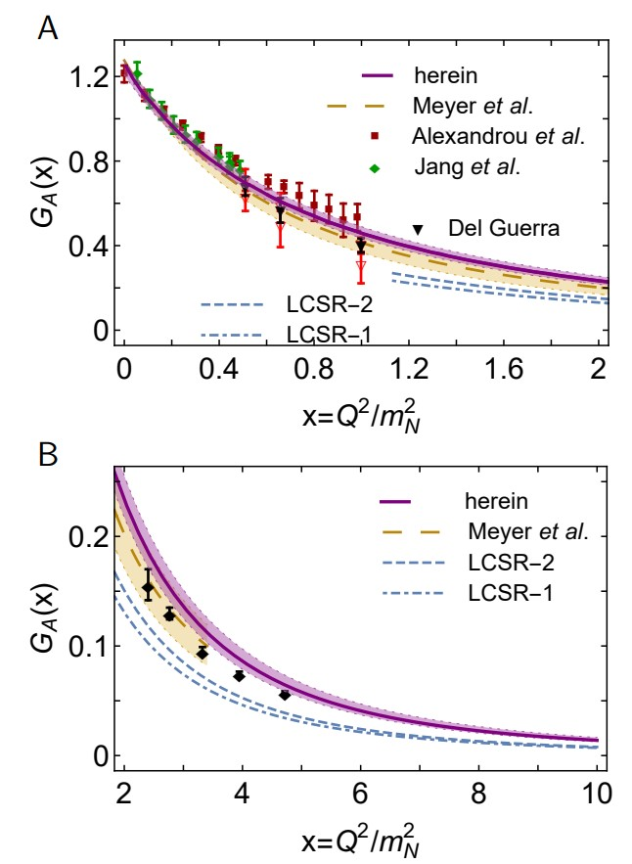
Large $Q^{2}$ Nucleon Axial Form Factor
Parameter-free CSM predictions to $Q^{2}=10 m_{p}^{2}$
One other calculation, viz. LCSRs using different models for proton DA ... Only available on $Q^{2}>1 m_{p}^{2}$
CSM prediction agrees with available data: small & larger $Q^{2}$
Larger $Q^{2}$ data from CLAS [K. Park et al., Phys. Rev. C 85 (2012) 035208], threshold pion electroproduction, extends $Q^{2}≈5{ m}_{p}^{2}$
This technique could be used to reach higher $Q^{2}$
Regarding oft-used dipole Ansatz,
Fair representation of G_{A}(x) on x ∈ [0, 3] = fitting domain
But outside fitted domain, quality of approximation deteriorates quickly
dipole overestimates true result by 56% at x = 10

Slide 39
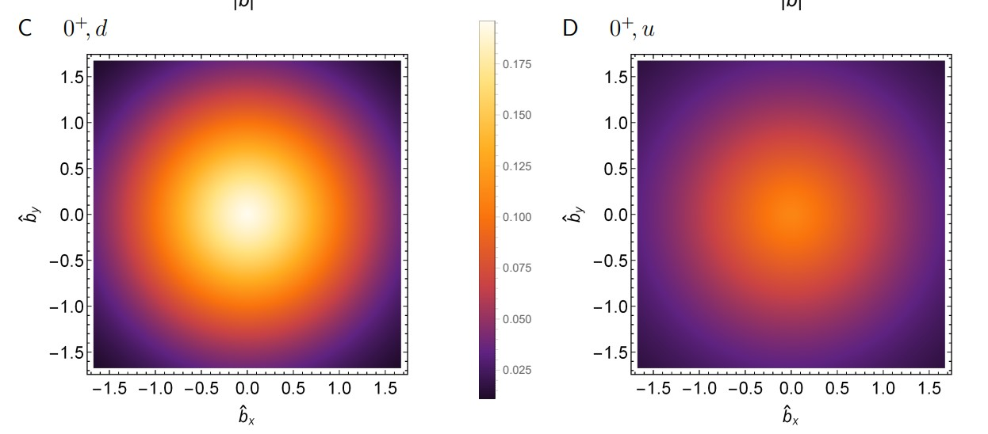
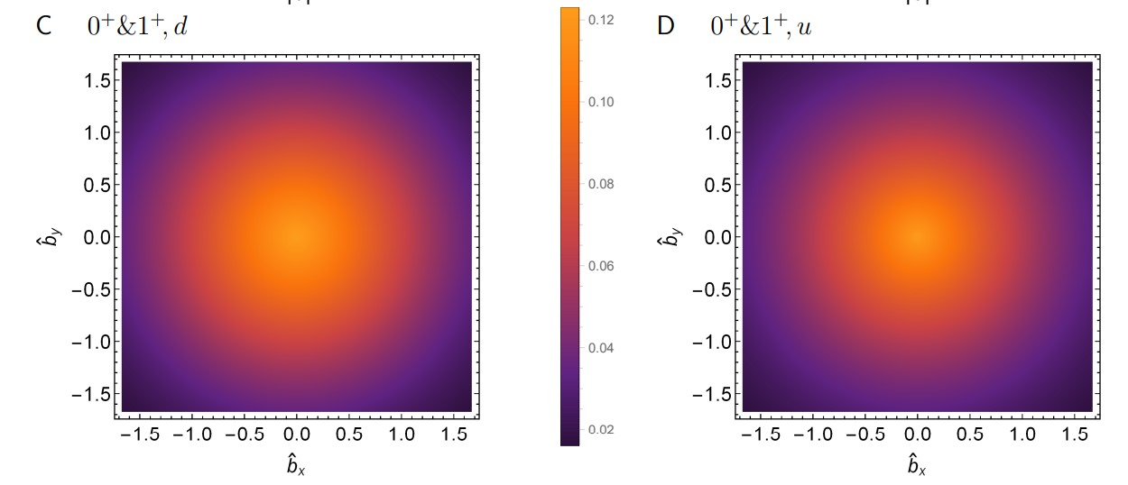
Large $Q^{2}$ Nucleon Axial Form Factor
Light-front transverse density profiles
Omitting axialvector diquarks
magnitude of the d quark contribution to GA is just 10% of that from the u quark
d quark is also much more localized
$$r_{A_{d}}^{⊥}≈0.5 r_{A_{u}}^{⊥}$$
Working with realistic axialvector diquark fraction
d and u quark transverse profiles are quite similar
$$r_{A_{d}}^{⊥}≈0.9 r_{A_{u}}^{⊥}$$

Slide 40
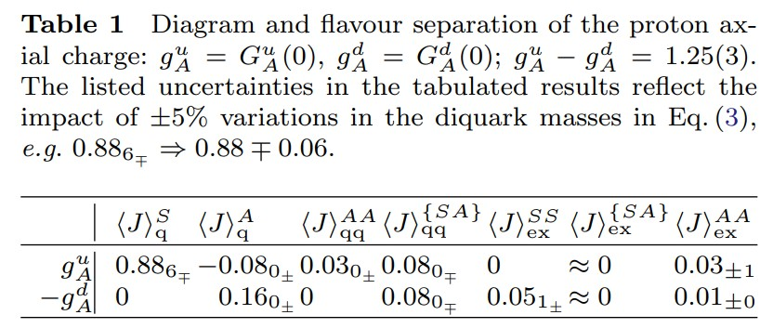
Proton Spin Structure
Flavour separation of proton axial charge
d-quark receives large contribution from probe+quark in presence of axialvector diquark
$\frac{g_{A}^{d}}{g_{A}^{u}}=^{0^{+}\&1^{+}}−0.32\left(2\right)$
$\frac{g_{A}^{d}}{g_{A}^{u}}=^{0^{+} only}−0.054(13)$
Probability that scalar diquark only picture of proton is consistent with data = 1/7,100,000
Experiment: $\frac{g_{A}^{d}}{g_{A}^{u}}=^{0^{+}\&1^{+}}−0.27\left(4\right)$ $⇐$ strong pointer to importance of AV correlation
Hadron scale: $g_{A}^{u}+g_{A}^{d }(+g_{A}^{s}=0)=0.65\left(2\right)⇒$ quarks carry 65% of the proton spin
Poincaré-covariant proton wave function: remaining 35% lodged with quark+diquark orbital angular momentum
Extended to entire octet of ground-state baryons: dressed-quarks carry 50(7)% of baryon spin at hadron scale
Contact interaction analysis of octet baryon axialvector and pseudoscalar form factors, Peng Cheng (程鹏), Fernando E. Serna, Zhao-Qian Yao (姚照千) et al., NJU-INP 063/22, e-Print: 2207.13811 [hep-ph], Phys. Rev. D 106,(2022) 054031

Slide 41
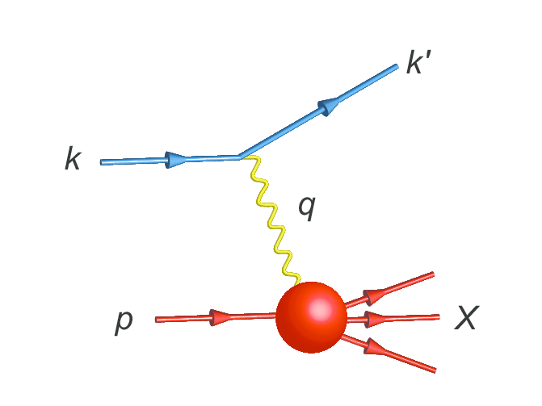
Parton Distribution Functions

Slide 42
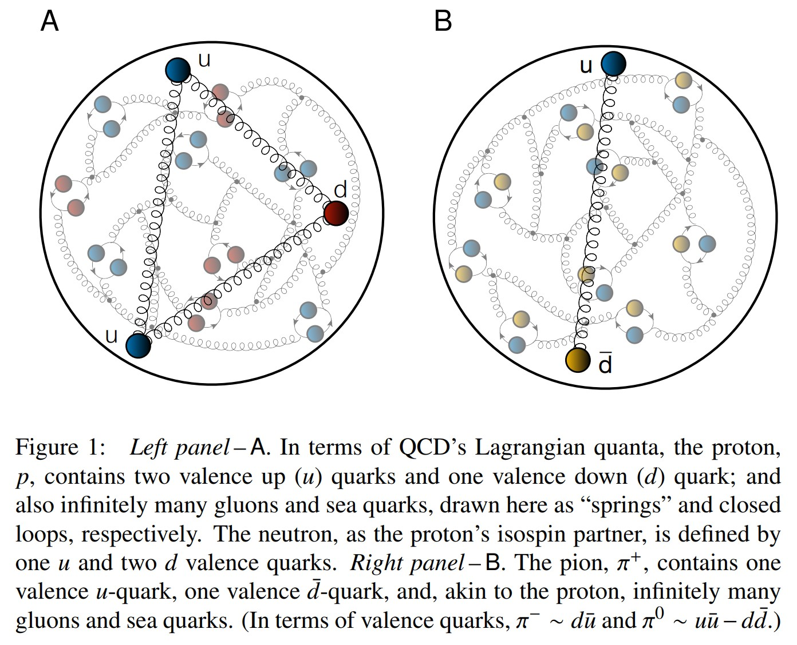
Proton and pion distribution functions in counterpoint
massive
almost massless
Today, despite enormous expense of time and effort, much must still be learnt before proton and pion structure may be considered understood in terms of DFs
Most simply –
What are the differences, if any, between the distributions of partons within the proton and the pion?
The question of similarity/difference between proton and pion DFs has particular resonance today as science seeks to explain EHM
How are obvious macroscopic differences between protons and pions expressed in the structural features of these two bound-states?
proton
pion

Slide 43
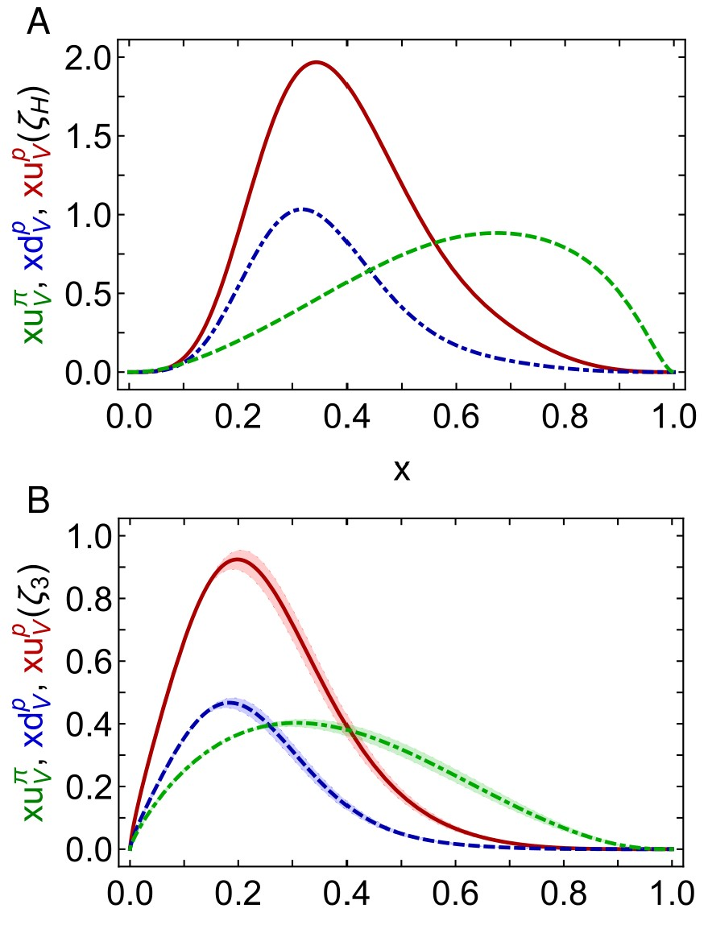
Proton and pion distribution functions in counterpoint
Proton and pion distribution functions in counterpoint, Ya Lu (陆亚) et al.,
NJU-INP 056/22, e-Print: 2203.00753 [hep-ph], Phys. Lett. B 830 (2022) 137130
Symmetry-preserving analyses using continuum Schwinger function methods (CSMs) deliver hadron scale DFs that agree with QCD constraints
Valence-quark degrees-of-freedom carry all hadron’s momentum at $ζ_{H}$:
Diquark correlations in proton, induced by EHM
${⇒u}_{V}(x)≠2d_{V}\left(x\right)$
Proton and pion valence-quark DFs have markedly different behaviour
$u^{π}(x;ζ_{H})$ is Nature’s most dilated DF
“Obvious” because ${\left(1−x\right)}^{2}$ vs. ${\left(1−x\right)}^{3}$ behaviour & preservation of this unit difference under evolution
Also “hidden” = strong EHM-induced broadening
dilation
u in proton
d in proton
u in pion
dilation

Slide 44
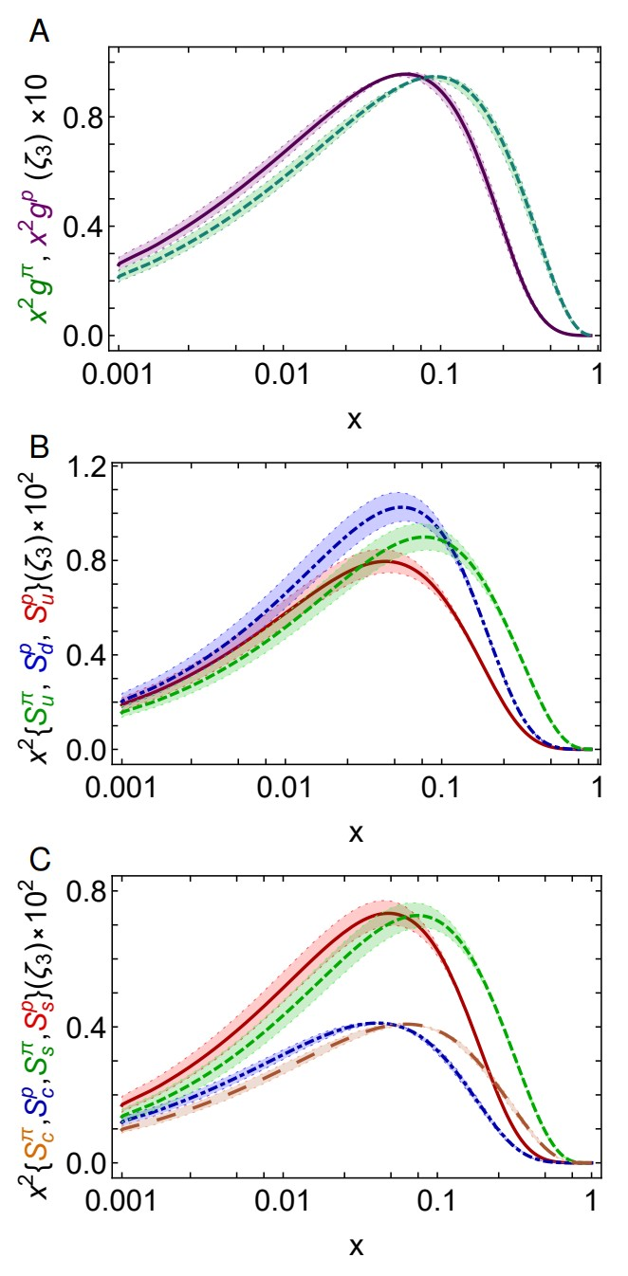
Proton and pion distribution functions in counterpoint – glue and sea
Predicted CSM glue-in-pion DF is confirmed by recent lQCD calculation
[Regarding the distribution of glue in the pion, Lei Chang (常雷) and Craig D Roberts, e-Print: 2106.08451 [hep-ph], Chin. Phys. Lett. 38 (8) (2021) 081101/1-6]
Glue-in-π DF possess significantly more support on the valence domain than the glue-in-p DF
Sea-in-π DF possess significantly more support on the valence domain than sea-in-p DFs.
s and c sea DFs are commensurate in size with those of the light-quark sea DFs
For s-and c-quarks, too, the pion DFs possess significantly greater support on the valence domain than the kindred proton DFs.
These outcomes are measurable expressions of EHM

Slide 45
“Intrinsic” Charm
Proton and pion distribution functions in counterpoint, Ya Lu (陆亚) et al.,
NJU-INP 056/22, e-Print: 2203.00753 [hep-ph], Phys. Lett. B 830 (2022) 137130
CSM ${\left\langle x\right\rangle }_{c}^{ζ_{2}}=1.32\left(05\right)\%$, ${\left\langle x\right\rangle }_{c}^{ζ_{3}}=1.86\left(06\right)\%$
cf. Phen. fits ${\left\langle x\right\rangle }_{c}^{ζ_{2}}=1.7\left(4\right)\%$, ${\left\langle x\right\rangle }_{c}^{ζ_{3}}=2.5\left(4\right)\%$
$ζ_{H}=$ scale whereat valence quasiparticle degrees-of-freedom carry all measurable hadron properties
At $ζ_{H}$, Fock space components, which might be interpreted as intrinsic charm, are sublimated into nonperturbatively computed $ζ=ζ_{H}$ Schwinger functions
Significant $c$ quark momentum fraction obtained under nonperturbative evolution from $ζ_{H}$without recourse to “intrinsic charm”
Outcome largely independent of explicit form of nonperturbative effective charge $=α_{1ℓ}(k^{2})$
Recent claims of “intrinsic charm discovery” might be overstated
Notwithstanding size of predicted fractions, CSM $S_{c}^{π,p}(x)$ have sea quark profiles.
One is thus led to re-evaluate what is meant by intrinsic charm in any hadron

Slide 46
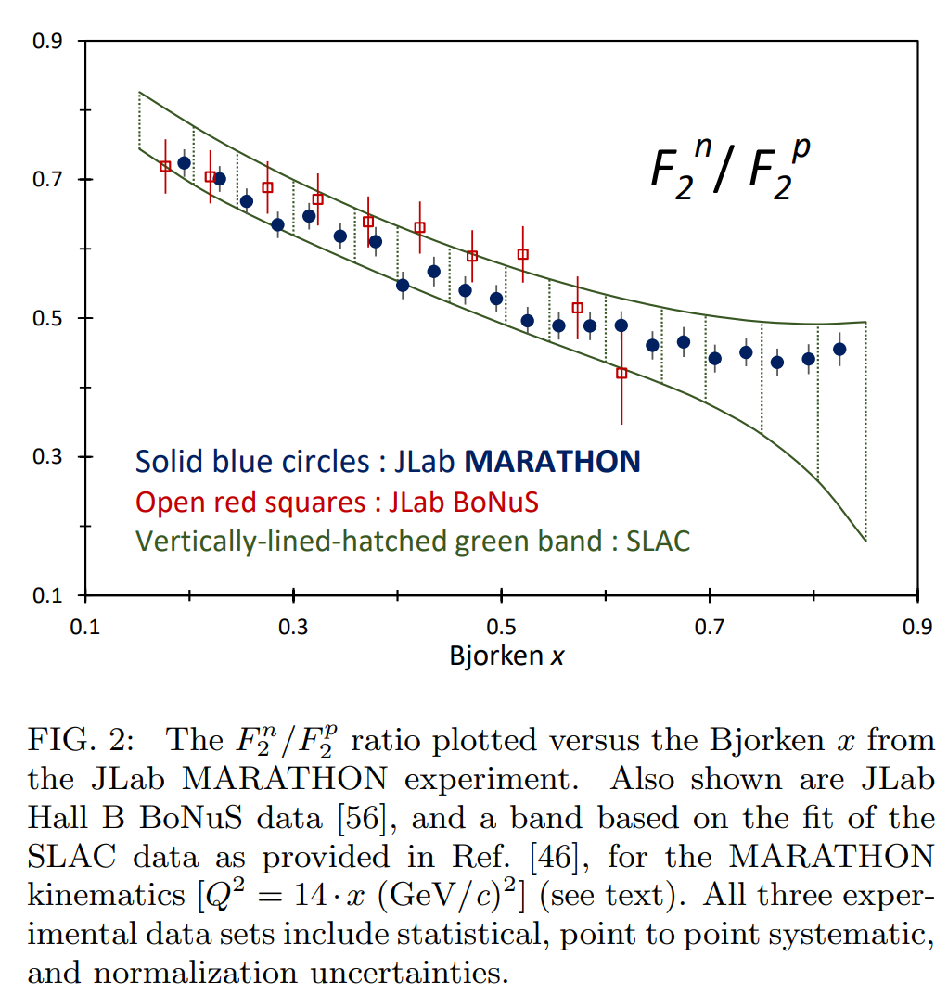
Diquarks & Deep Inelastic Scattering
The ratio of neutron and proton structure functions at large $x$ is keen discriminator between competing pictures of proton structure
Example:
Only scalar diquark in the proton (no axial-vector): ${\lim_{x→1}{\frac{F_{2}^{n}\left(x\right)}{F_{2}^{p}\left(x\right)}=\frac{1}{4}} }_{ }^{ }$
No correlations in the proton wave function (SU(4) spin-flavour) $\lim_{x→1}{\frac{F_{2}^{n}\left(x\right)}{F_{2}^{p}\left(x\right)}=\frac{2}{3}}$
Experiments have been trying to deliver reliable data on this ratio for fifty years!
MARATHON – more-than ten-year effort, using tritium target at JLab Hall A, has delivered precise results
$0^{+}$only
D. Abrams, et al., Measurement of the Nucleon Fn2/Fp2 Structure Function Ratio by the Jefferson Lab MARATHON Tritium/Helium-3 Deep Inelastic Scattering Experiment – arXiv:2104.05850 [hep-ex],
Phys. Rev. Lett. (2022) iPhys. Rev. Lett. 128 (2022) 132003.

Slide 47
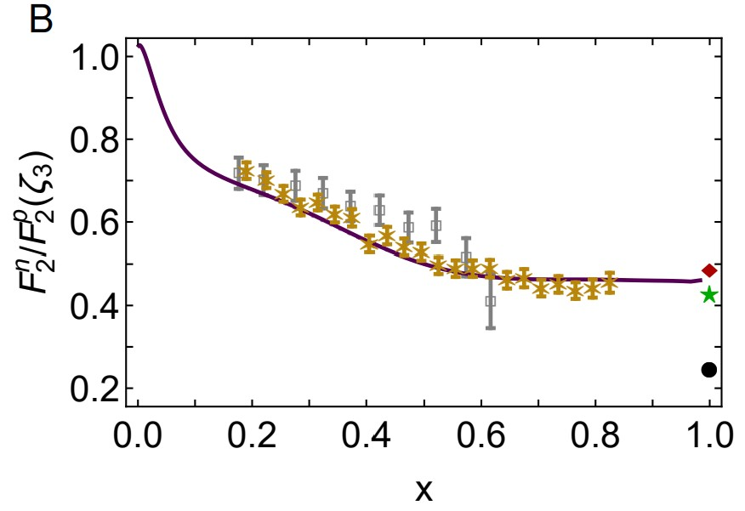
Neutron/Proton structure function ratio
CSM prediction = presence of axial-vector diquark correlation in the proton
Responsible for $≈40\%$ of proton charge
Ratio $1^{+}/0^{+}$ diquarks in proton wave function
is measure of EHM
Structure function ratio is clear window onto $d_{V}(x)/u_{V}(x)$
$U\left(x;ζ\right)=u\left(x;ζ\right)+\overline{u}\left(x;ζ\right)$, $D\left(x;ζ\right)=d\left(x;ζ\right)+\overline{d}\left(x;ζ\right)$
$Σ\left(x;ζ\right)=s\left(x;ζ\right)+\overline{s}\left(x;ζ\right)$+ $c\left(x;ζ\right)+\overline{c}\left(x;ζ\right)$
Comparison with MARATHON data
[D. Abrams, et al., Measurement of Nucleon $F_{2}^{n}/F_{2}^{p}$Structure Function Ratio by the Jefferson Lab MARATHON Tritium/Helium-3 Deep Inelastic Scattering Experiment – arXiv:2104.05850 [hep-ex], Phys. Rev. Lett. 128 (2022) 132003]
Agreement with modern data on entire x-domain – parameter-free prediction
Sea quark dominance on x<0.2
Valence quark dominance on x>0.2
🎆 Valence quark ratio in the proton, Zhu-Fang Cui, (崔著钫), Fei Gao (高飞), Daniele Binosi, Lei Chang (常雷), Craig D. Roberts and Sebastian M. Schmidt, NJU-INP 049/21, e-print: 2108.11493 [hep-ph], Chin. Phys. Lett. Express 39 (04) (2022) 041401/1-5: Express Letter
Probability that scalar diquark only models of nucleon might be consistent with available data is 1/141,000
Notes:
journal = "Phys. Rev. Lett.",
volume = "128",
number = "13",
pages = "132003",

Slide 48
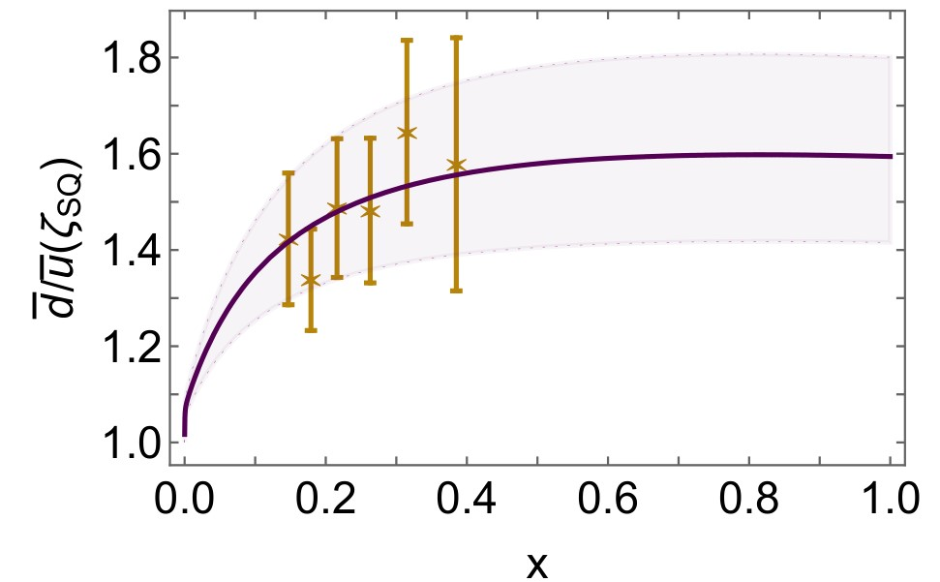
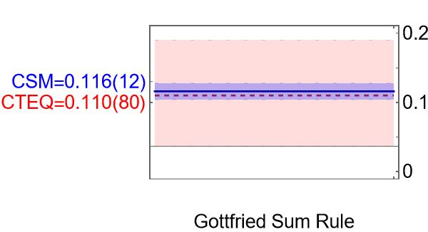
Asymmetry of antimatter in the proton
Proton = u + u + d
$⇒$ Pauli blocking: gluon splitting produces
$d+\overline{d}$ in preference to $u+\overline{u}$
Comparison with SeaQuest data
[J. Dove, et al., The asymmetry of antimatter in the proton, Nature 590 (7847) (2021) 561–565.]
Gottfried sum rule
Most recent result from global fits [CT18]: 0.110(80)
$ζ=2 GeV…{\left\langle x\right\rangle }_{\overline{u}}↓25\% \& {\left\langle x\right\rangle }_{\overline{d}}↑25\%$
Proton and pion distribution functions in counterpoint, Ya Lu (陆亚), Lei Chang (常雷), Khépani Raya, Craig D. Roberts and José Rodríguez-Quintero, NJU-INP 056/22, e-Print: 2203.00753 [hep-ph], Phys. Lett. B 830 (2022) 137130/1-7
Parton distributions of light quarks and antiquarks in the proton, Lei Chang (常雷), Fei Gao (高飞) and Craig D. Roberts, NJU-INP 055/22, e-Print: 2201.07870 [hep-ph], Phys. Lett. B 829 (2022) 137078/1-7

Slide 49
Polarised quark distribution functions at $ζ_{H}$
True in general: at hadron scale, $ζ_{H}$ … $Δq\left(x;ζ_{H}\right)=f\left(x\right)q(x;ζ_{H})$ … what is $f\left(x\right)$?
Constraints from pQCD
At low-$x$: $∃$ no correlation between helicity of struck quark and that of parent proton
$⇒$ polarised:unpolarised ratio of DFs must vanish
$\frac{Δq\left(x\right)}{q\left(x\right)}→0$as $x→0$
Regge phenomenology: $Δq\left(x\right)∝\sqrt{x} q(x)$
At high-$x$, polarised and unpolarised valence quark distributions possess the same power-law behaviour, viz.
$\frac{Δq\left(x\right)}{q\left(x\right)}→$ constant $≠0$ as $x→1$
All-Orders Evolution of Parton Distributions: Principle, Practice, and Predictions, Pei-Lin Yin (尹佩林), Yin-Zhen Xu (徐胤禛) et al., NJU-INP 075/23, e-Print: 2306.03274 [hep-ph]
Polarised parton distribution functions and proton spin, Peng Cheng (程鹏), Yang Yu (俞杨), Hui-Yu Xing (邢惠瑜), NJU-INP 073/23, e-print: 2304.12469 [hep-ph]

Slide 50
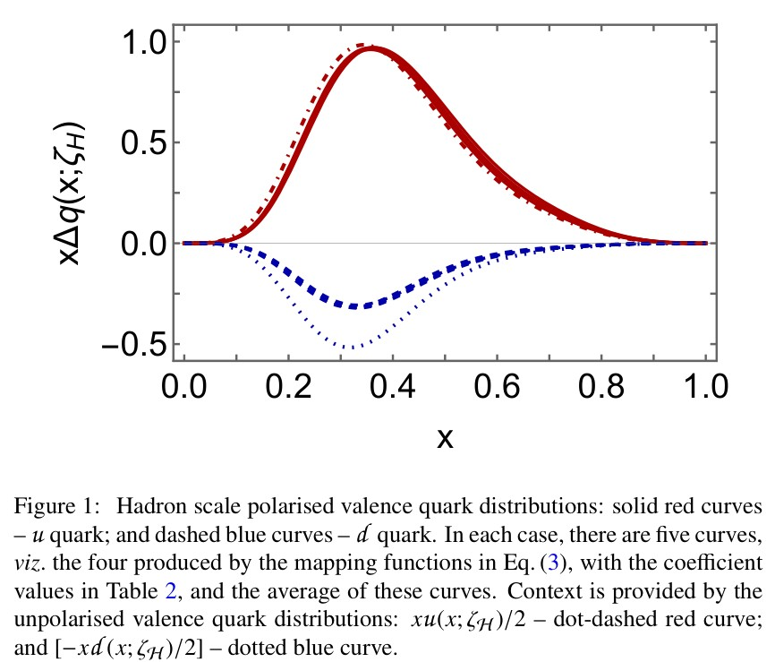
Polarised quark distribution functions at $ζ_{H}$
Implement constraints ($s_{u}=1=−s_{d}$):
$$Δq\left(x;ζ_{H}\right)=s_{q}r_{i}\left(x,γ_{i}^{q}\right)q\left(x;ζ_{H}\right)$$
In each case, $γ$ chosen to ensure $\int_{0}^{1}{dx Δq\left(x;ζ_{H}\right)=g_{A}^{q}}$

Slide 51
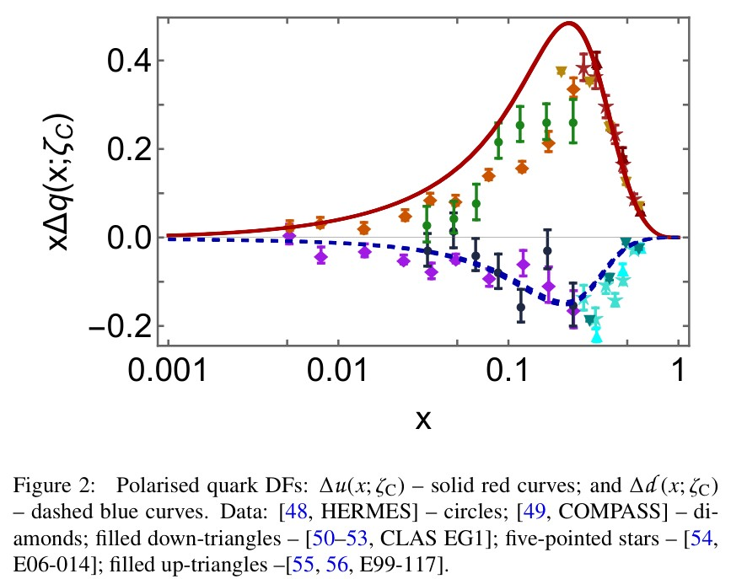
Polarised quark distribution functions at $ζ=\sqrt{3}$GeV
Predictions deliver quantitative agreement with all available world data
COMPASS $Δu(x)$ lead to underestimate of $g_{A}$ by 25%
Consistent with COMPASS data lying below prediction

Slide 52
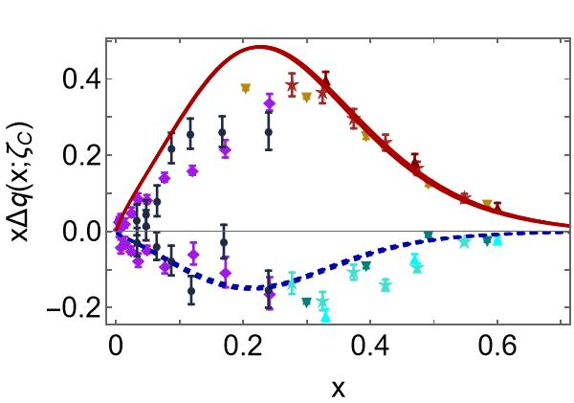
Polarised quark distribution functions at $ζ=\sqrt{3}$GeV
Predictions deliver quantitative agreement with all available world data
COMPASS $Δu(x)$ lead to underestimate of $g_{A}$ by 25%
Consistent with COMPASS data lying below prediction
Predictions for sea are consistent with available data

Slide 53
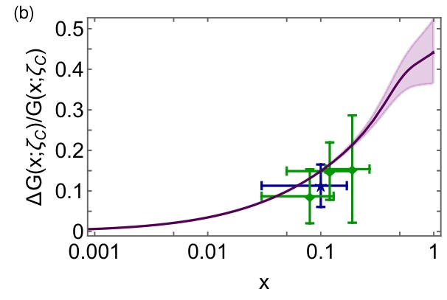
Polarised glue distribution functions at $ζ=\sqrt{3}$GeV
Parameter-free CSM prediction
compared with COMPASS data
C. Adolph, et al., Leading-order determination of the gluon polarization from semi-inclusive deep inelastic scattering data, Eur. Phys. J. C 77 (4) (2017) 209
e.g. average value over data window
$0.167{\left(3\right)}_{CSM}$ cf. $0.113±0.038±{0.036}_{COMPASS}$
Comparison with phenomenological global fits
$$\int_{0.05}^{1}{dx ΔG(x;ζ=10GeV)}=0.199{\left(3\right)}_{CSM}$$
cf. DSSV14: $0.19(6)$
Polarised parton distribution functions and proton spin,
Peng Cheng (程鹏) et al., NJU-INP 073/23, e-print: 2304.12469 [hep-ph]

Slide 54
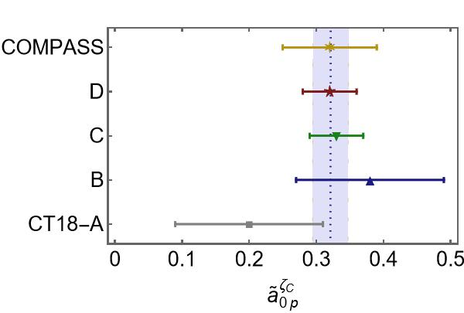
Proton Spin
All-Orders Evolution of Parton Distributions: Principle, Practice, and Predictions
Pei-Lin Yin (尹佩林), NJU-INP 075/23, e-Print: 2306.03274 [hep-ph]
CSM study of proton axial and pseudoscalar charges
$⇒a_{0}≈65\%$of proton spin
carried by valence quark
quasiparticle degrees of freedom at the hadron scale.
Under evolution, this value is independent of scale.
Measurements of the proton spin are sensitive to
non-Abelian anomaly corrected combination $\left(n_{f}=4\right)$
CSM prediction: $a_{0}^{E}\left(ζ=\sqrt{3}GeV\right)=0.32(3)$
COMPASS: $a_{0}^{COMPASS}\left(ζ=\sqrt{3}GeV\right)=0.32(7)$
Parameter-free explanation
of proton spin measurement
Algebraic formula for Glue contribution to proton spin
$ΔG_{p}$ necessarily positive
$ΔG_{p}$Grows faster than 1/${\left\langle x\right\rangle }_{valence}^{2}$

Slide 55
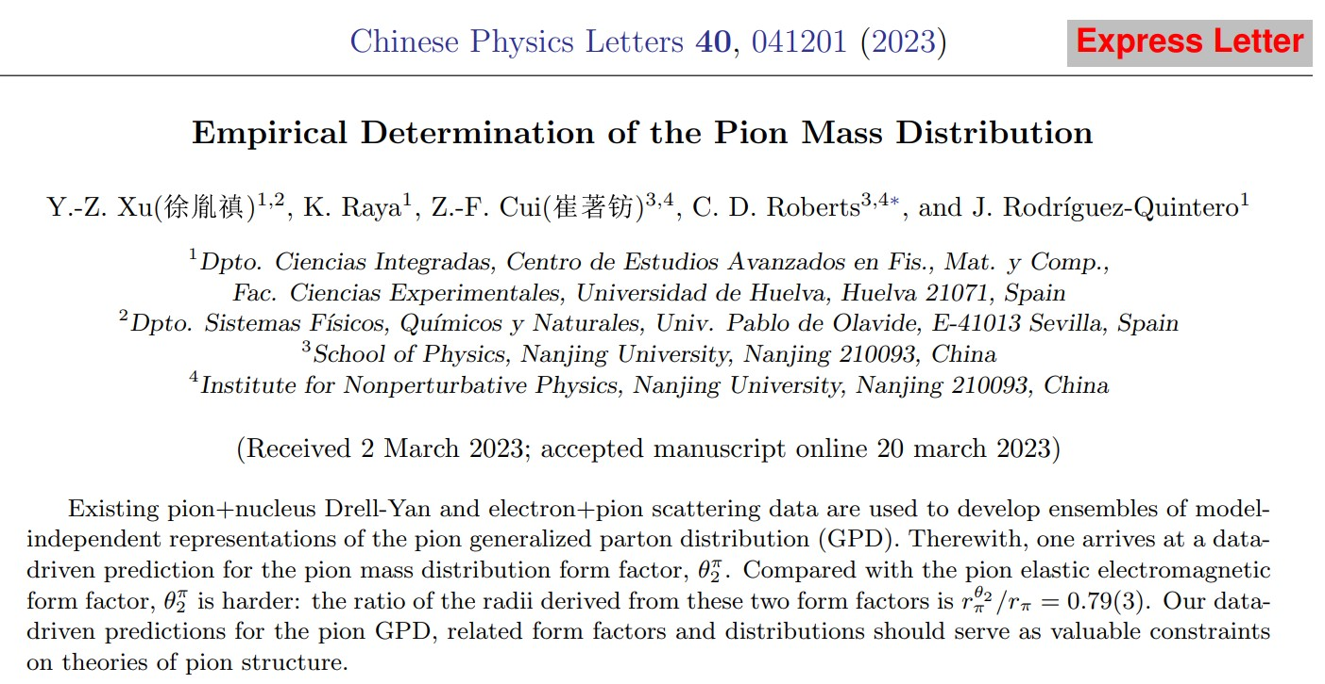

Slide 56
Generalised Parton Distributions
“Standard” parton DFs
1D picture – dependence of in-hadron parton properties on the light-front (LF) fraction, $x$, of the hadron’s total momentum
Generalised parton distributions (GPDs)
Provide extension of 1D parton distribution functions into 3D images
Also describe hadron’s distributions of partons in plane perpendicular to bound-state's total momentum, i.e., within the light front itself.
LF longitudinal direction
LF transverse plane
Data relating to GPDs
deeply virtual Compton scattering
$γ^{∗}(q)T\left(p\right)→γ^{∗}\left(q^{′}\right)T(p^{′})$ – so long as at least one photon possesses large virtuality
deeply virtual meson production
$γ^{∗}(q)T\left(p\right)→M\left(q^{′}\right)T(p^{′})$, where $M$ is a meson
GPDs connect DFs with hadron form factors because
any DF may be recovered as forward limit $(p^{′}=p)$ of relevant GPD
any elastic form factor can be expressed via a GPD-based sum rule
GPD measurement … numerous experimental programmes – underway or planned at JLab, EIC, and EicC

Slide 57
$π$ mass distribution
Expectation value of the QCD energy-momentum tensor in the pion
= pion gravitational current
Contract with $δ_{μν}$: $Λ_{μμ}^{g}\left(K,0\right)=2m_{π}^{2}θ_{2}^{π}(Q^{2})$
$θ_{2}^{π}\left(Q^{2}=0\right)=1$ (canonical mass-normalisation)
$θ_{2}^{π}(Q^{2})$ measures mass distribution in $π$
$θ_{2}^{π}$ can be obtained as the first Mellin moment of the pion GPD
Zero owing to energy+momentum conservation
Pion GPD

Slide 58
Empirical determination of the pion mass distribution
Can reconstruct $π$ GPD from data on
$π$ em form factor
$π$ valence quark DF
GPDs connect DFs with hadron form factors because
any elastic form factor can be expressed via a GPD-based sum rule
any DF may be recovered as forward limit $(p^{′}=p)$ of relevant GPD
Working solely with
electron+pion scattering data
CERN – 1984, 1986
JLab 2000, 2006, 2007, 2008
existing pion + nucleus Drell-Yan data (CERN and FNAL – 1989)
two phenomenological fits to this data [Aicher:2010cb, Barry:2021osv] … use both
Used a $χ^{2}$-based selection procedure to develop ensembles of model-independent representations of the three-dimensional pointwise behaviour of the pion generalised parton distribution (GPD).
These ensembles yield data-driven prediction for pion GPD

Slide 59
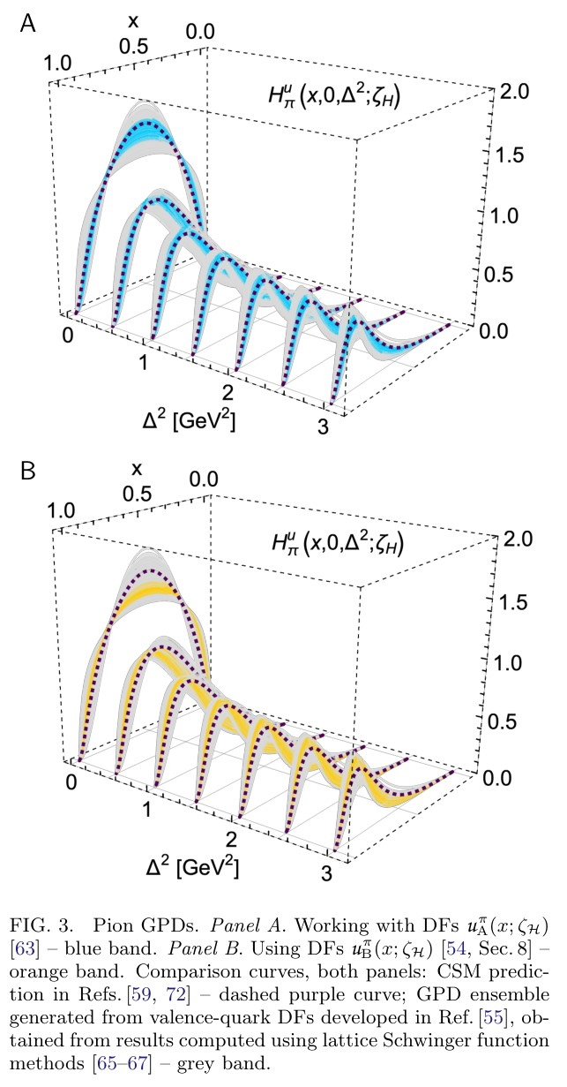
Pion Generalised Parton Distribution
Pion GPDs, reconstructed from available analyses of relevant Drell-Yan and electron+pion scattering data
Different ensembles only marginally compatible, owing to differences between analyses in
A = Aicher:2010cb; B = Barry:2021osv
Yet, both agree with lQCD based ensembles, within mutual uncertainties, because lQCD-constrained ensemble has large uncertainty – improvement of lQCD results useful
CSM prediction favours $u_{A}^{π}\left(x;ζ_{5}\right)$ensemble
In all cases, support of valence-quark GPD becomes increasingly concentrated in neighbourhood $x≃1$ with increasing $Δ^{2}$
Namely, greater probe momentum focuses attention on domain whereupon one valence-quark carries a large fraction of pion's light-front momentum
Revealing pion and kaon structure via generalised parton distributions, K. Raya, Z. –F. Cui (崔著钫) et al.,
NJU-INP 051/21, e-Print: 2109.11686 [hep-ph], Chin. Phys. C 46 (01) (2022) 013107/1-22

Slide 60
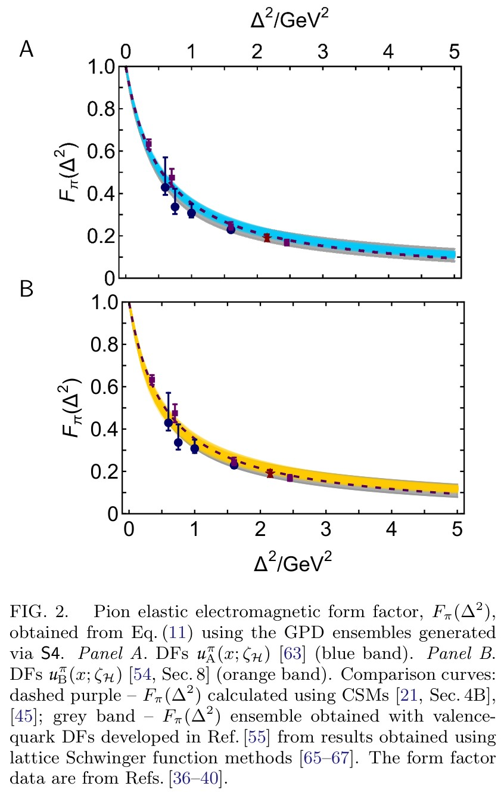
Pion charge distribution form factor
0th Moment of
pion GPD
All ensembles reproduce empirical $F_{π}\left(Δ^{2}\right)$
Blue – based on $u_{A}^{π}\left(x;ζ_{5}\right)$ ensembles
Orange – based on $u_{B}^{π}\left(x;ζ_{5}\right)$ ensembles
Comparison curves
dashed purple – CSM prediction for $F_{π}\left(Δ^{2}\right)$
grey band – Ensemble of $F_{π}\left(Δ^{2}\right)$results developed from DFs based on lattice-QCD results
Again, data-driven results in accord with modern theory predictions.
See, e.g., Sec. 4B in
📖 Insights into the Emergence of Mass from Studies of Pion and Kaon Structure,
C.D. Roberts, D.G. Richards, T. Horn and L. Chang,
NJU-INP 034/21, arXiv: 2102.01765 [hep-ph], Prog. Part. Nucl. Phys. 120 (2021) 103883/1-65

Slide 61
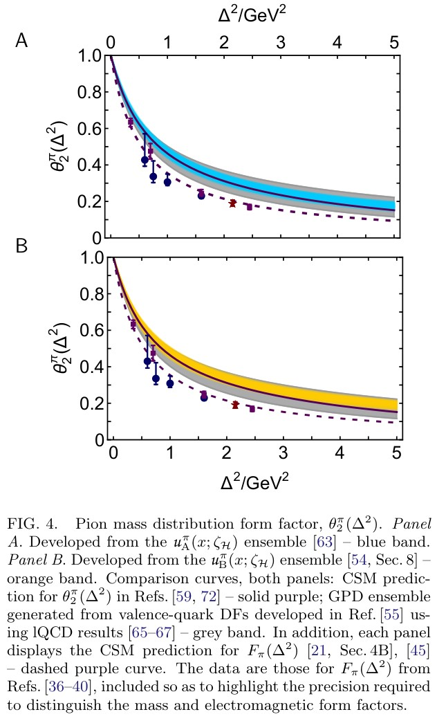
$π$ mass distribution
Expressed as $1^{st}$ Mellin-moment of pion GPD
Principal, dynamical coefficient in expectation value of the QCD energy-momentum tensor in the pion
= pion gravitational current
Plainly … $θ_{2}(Δ^{2})$ is harder than $F_{π}(Δ^{2})$
i.e., the distribution of mass in the pion is more compact than the distribution of electric charge.
This is an empirical fact

Slide 62
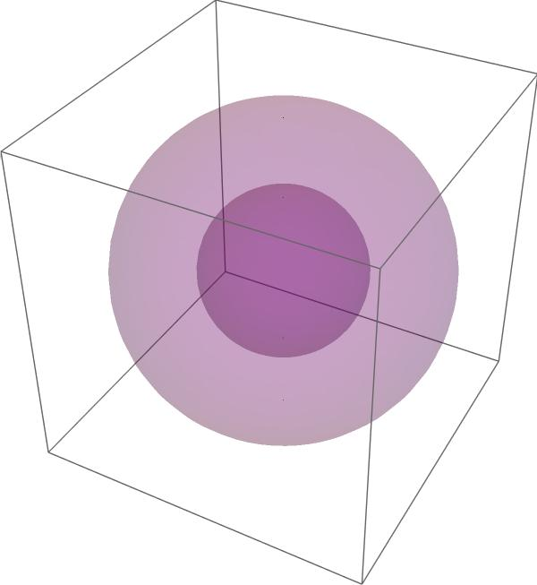
$π$ mass radius
Comparison value for charge radius: $r_{π}=0.64(2)$
Data-driven prediction: $\frac{r_{π}^{θ_{2}}}{r_{π}}=0.79(3)$
Translates into spacetime volume ratio = $0.40(6)$
Pion mass distribution is concentrated within
just 40% of the spacetime volume of the charge distribution
charge
mass

Slide 63
$π$ mass distribution is harder
Empirical fact is readily understood physically
Pion wave function (hence, pion GPD) is independent of the probe.
It's the same whether 1 photon or 2 photons or graviton is the probing object.
However, probe itself focuses on different features of the target constituents
Target quark carries same charge, irrespective of its momentum.
So, pion LFWF alone controls distribution of charge.
Gravitational interaction of target quark depends on its momentum.
(The current = the energy momentum tensor)
Pion effective mass distribution therefore depends on interference between quark momentum growth and LFWF momentum suppression with increasing $Δ^{2}x^{2}$.
This pushes support to a larger momentum domain in the pion = smaller distance domain.
“Is there a specific aspect of the pion GPDs driven by the data which is responsible?”
Yes. EHM induced broadening of pion LFWF = GPD.
Given GPD overlap representation, they’re the same thing.

Slide 64
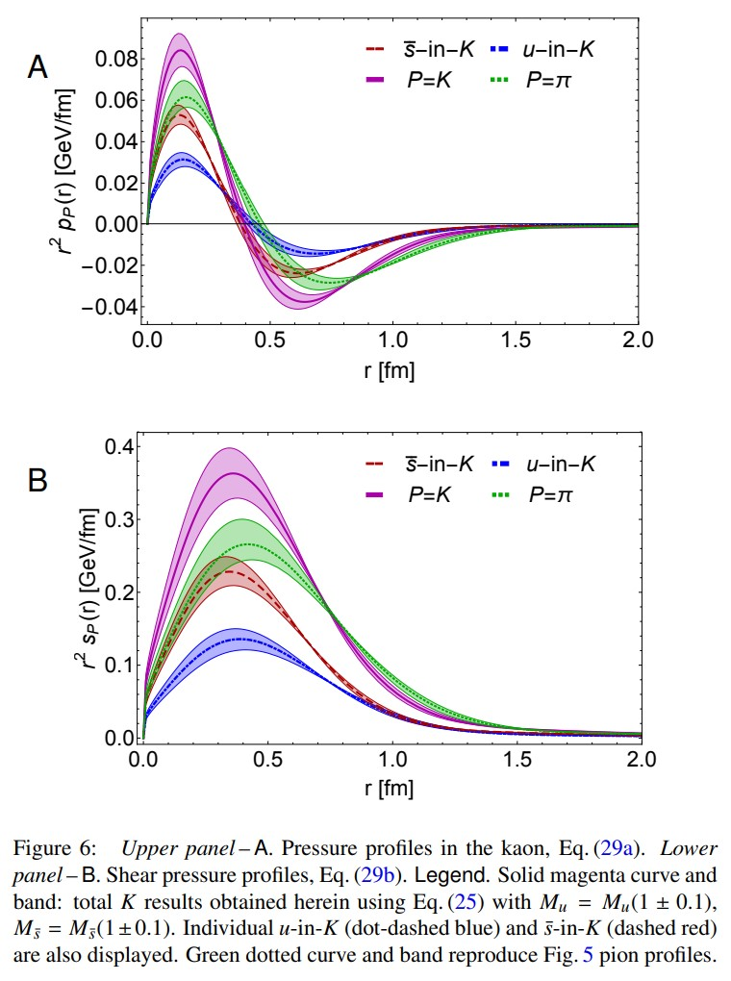
Predictions for $π$ & K pressure profiles
Kaon and pion pressure & sheer-force profiles
Need $θ_{2}$ and $θ_{1}$: $θ_{1}$ requires knowledge of ERBL region
Pressure is positive and large in neighbourhood $r≃0$
Meson’s dressed-valence constituents are pushing away from each other at small separation
Pressure switches sign as separation becomes large, indicating transition to domain whereupon confinement forces exert their influence on the pair
Analogous profiles can be drawn for neutron stars.
$r≃0$pressures therein of $≈0.1$GeV/fm
Meson & neutron star core pressures are on same scale.
Revealing pion and kaon structure via generalised parton distributions, K. Raya, Z. –F. Cui (崔著钫) et al.,
NJU-INP 051/21, e-Print: 2109.11686 [hep-ph], Chin. Phys. C 46 (01) (2022) 013107/1-22

Slide 65
Predictions for $π$ & K pressure profiles
Kaon and pion pressure & sheer-force profiles
Need $θ_{2}$ and $θ_{1}$: $θ_{1}$ requires knowledge of ERBL region
Shear force measures strength of forces within meson which work to deform it.
These forces are maximal where pressure changes sign
i.e., where forces driving quark and antiquark apart are overwhelmed by attractive confinement pressure.
Pressure-based confinement radius
$r_{π}^{c}=0.45(3)$fm,
i.e., $0.70\left(4\right)r_{π}$
Revealing pion and kaon structure via generalised parton distributions, K. Raya, Z. –F. Cui (崔著钫) et al.,
NJU-INP 051/21, e-Print: 2109.11686 [hep-ph], Chin. Phys. C 46 (01) (2022) 013107/1-22

Slide 66
Predictions for $π$ & K pressure profiles
Kaon and pion pressure & sheer-force profiles
Need $θ_{2}$ and $θ_{1}$: $θ_{1}$ requires knowledge of ERBL region
Measured by pressure radius
K is $≈15$% smaller than $π$
K core pressure is 20% larger
Kaon’s $\overline{s}$-quark cf. partner $u$-quark
contributes a greater fraction of the total K pressure
peak/trough intensities are greater
associated distributions are localised nearer to $r = 0$.
Mapped to proton (q+qq) $⇒$ similar effects in flavour separation of proton profiles, with $u^{p}↔{{\overline{s}}^{K}}_{ }$and $d^{p}↔u^{K}$
Revealing pion and kaon structure via generalised parton distributions, K. Raya, Z. –F. Cui (崔著钫) et al.,
NJU-INP 051/21, e-Print: 2109.11686 [hep-ph], Chin. Phys. C 46 (01) (2022) 013107/1-22

Slide 67
Emergent Hadron Mass
Grant no. 12135007
QCD is unique amongst known fundamental theories of natural phenomena
The degrees-of-freedom used to express the scale-free Lagrangian are not directly observable
Massless gauge bosons become massive, with no “human” interference
Gluon mass ensures a stable, infrared completion of the theory through the appearance of a running coupling that saturates at infrared momenta, being everywhere finite
Massless fermions become massive, producing
Massive baryons and simultaneously Massless mesons
These emergent features of QCD are expressed in every strong interaction observable
They can also be revealed via
EHM interference with Nature’s other known source of mass = Higgs
We are capable of building facilities that can validate these concepts, proving QCD to be
the 1st well-defined four-dimensional quantum field theory ever contemplated
This may open doors that lead far beyond the Standard Model

Slide 68
Emergent Hadron Mass
Grant no. 12135007
QCD is unique amongst known fundamental theories of natural phenomena
The degrees-of-freedom used to express the scale-free Lagrangian are not directly observable
Massless gauge bosons become massive, with no “human” interference
Gluon mass ensures a stable, infrared completion of the theory through the appearance of a running coupling that saturates at infrared momenta, being everywhere finite
Massless fermions become massive, producing
Massive baryons and simultaneously Massless mesons
These emergent features of QCD are expressed in every strong interaction observable
They can also be revealed via
EHM interference with Nature’s other known source of mass = Higgs
We are capable of building facilities that can validate these concepts, proving QCD to be
the 1st well-defined four-dimensional quantum field theory ever contemplated
This may open doors that lead far beyond the Standard Model
$${\text{L}}_{Nature}= ?$$
There are theories of many things,
But is there a theory of everything?

Slide 69
Thankyou
$${\text{L}}_{Nature}= ?$$
There are theories of many things,
But is there a theory of everything?

Slide 71
All-orders evolution
All-Orders Evolution of Parton Distributions: Principle, Practice, and Predictions
Pei-Lin Yin (尹佩林), NJU-INP 075/23, e-Print: 2306.03274 [hep-ph]
P1 – In the context of Refs. [73, 74], there exists at least one effective charge, $α_{1ℓ}(k^{2})$, which, when used to integrate the leading-order perturbative DGLAP equations, defines an evolution scheme for parton DFs that is all-orders exact.
CSM Process-Independent charge serves this purpose
Hadron scale, $ζ_{H}$
Scale at which all properties of a given hadron are carried by valence degrees-of-freedom

