Slide 1
Peter Carney
Results of First Test Beam of SiPM-on-Tile Calorimeter Insert

Slide 2
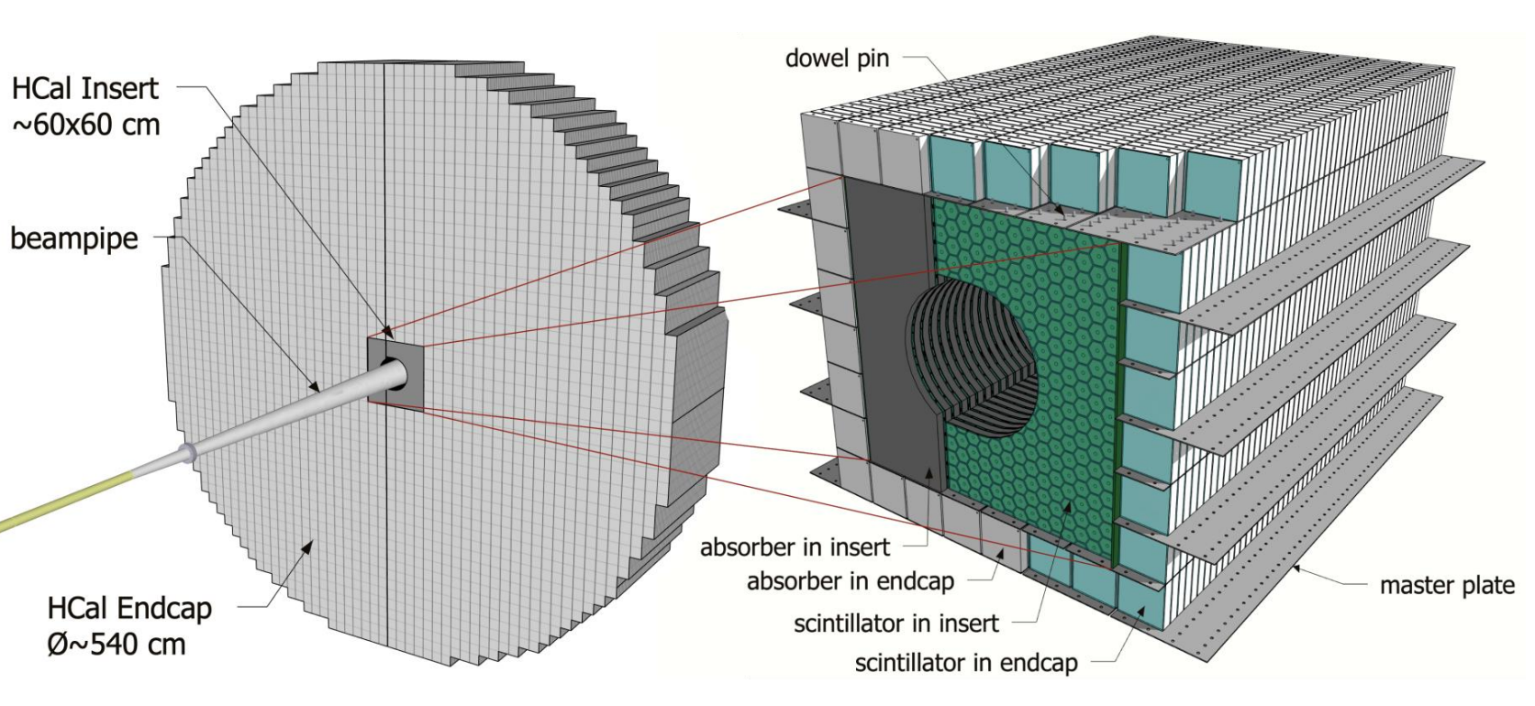
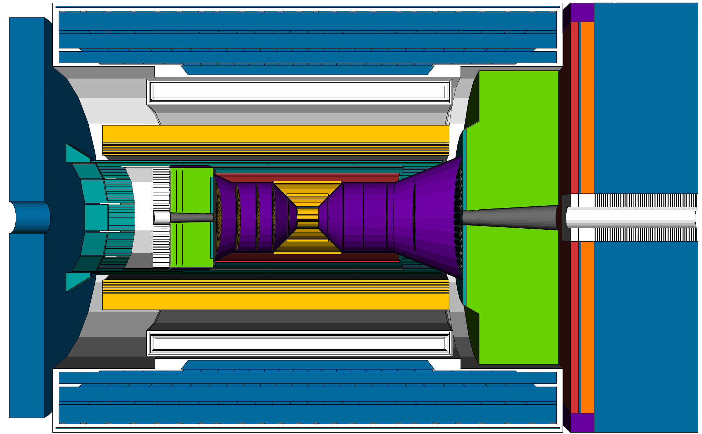
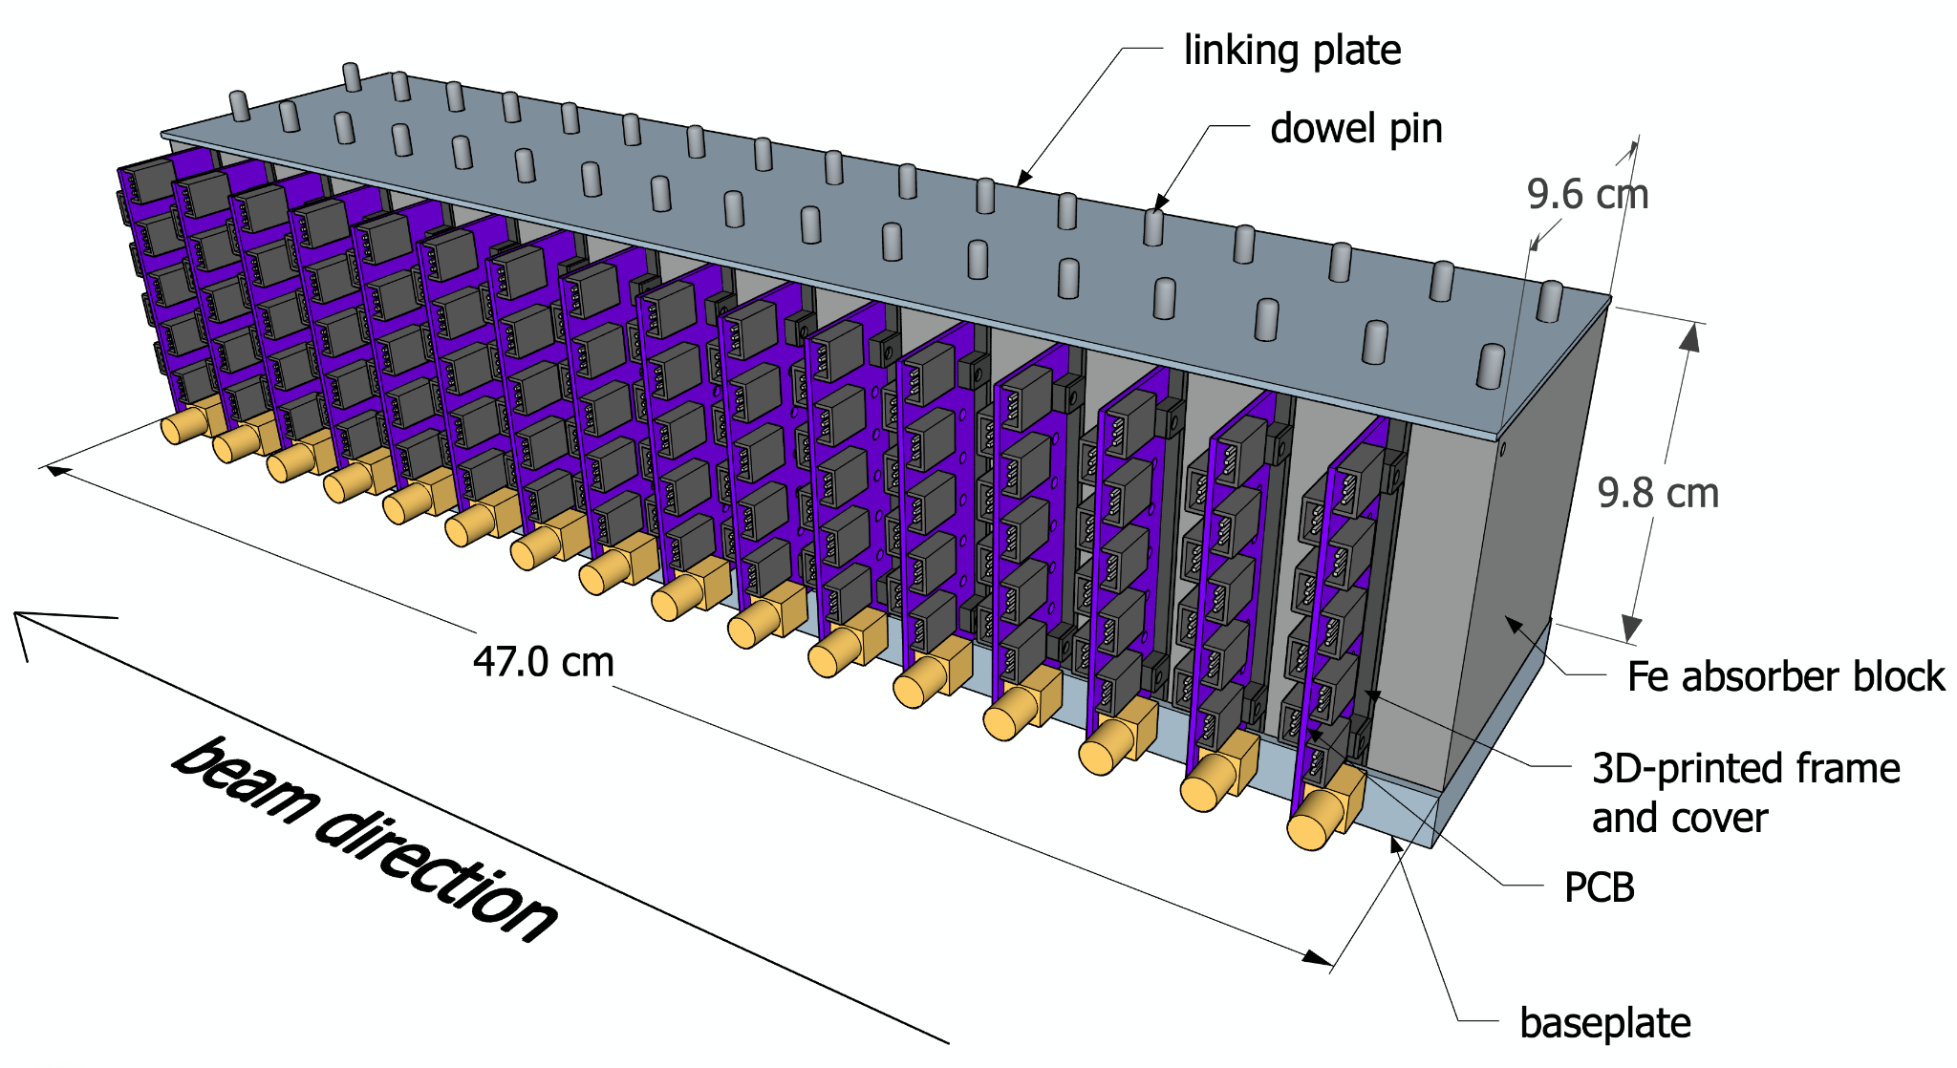
Forward Calorimeter Prototype Design
Forward HCal Insert Concept
Calorimeter insert will be placed near the beampipe: 3.2 < 𝜂 < 4
Prototype constructed to resemble a small section of insert.
Prototype Concept
1

Slide 3
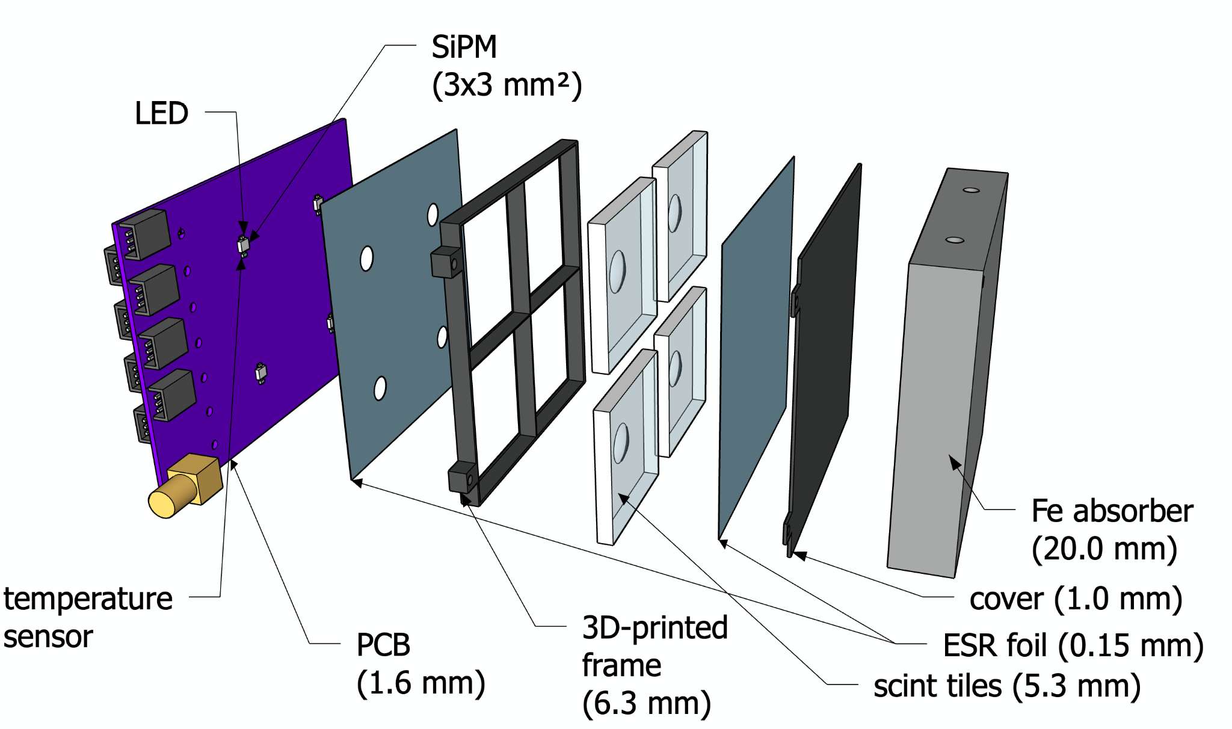
Prototype Layer Design: SiPM-on-Tile
2

Slide 4
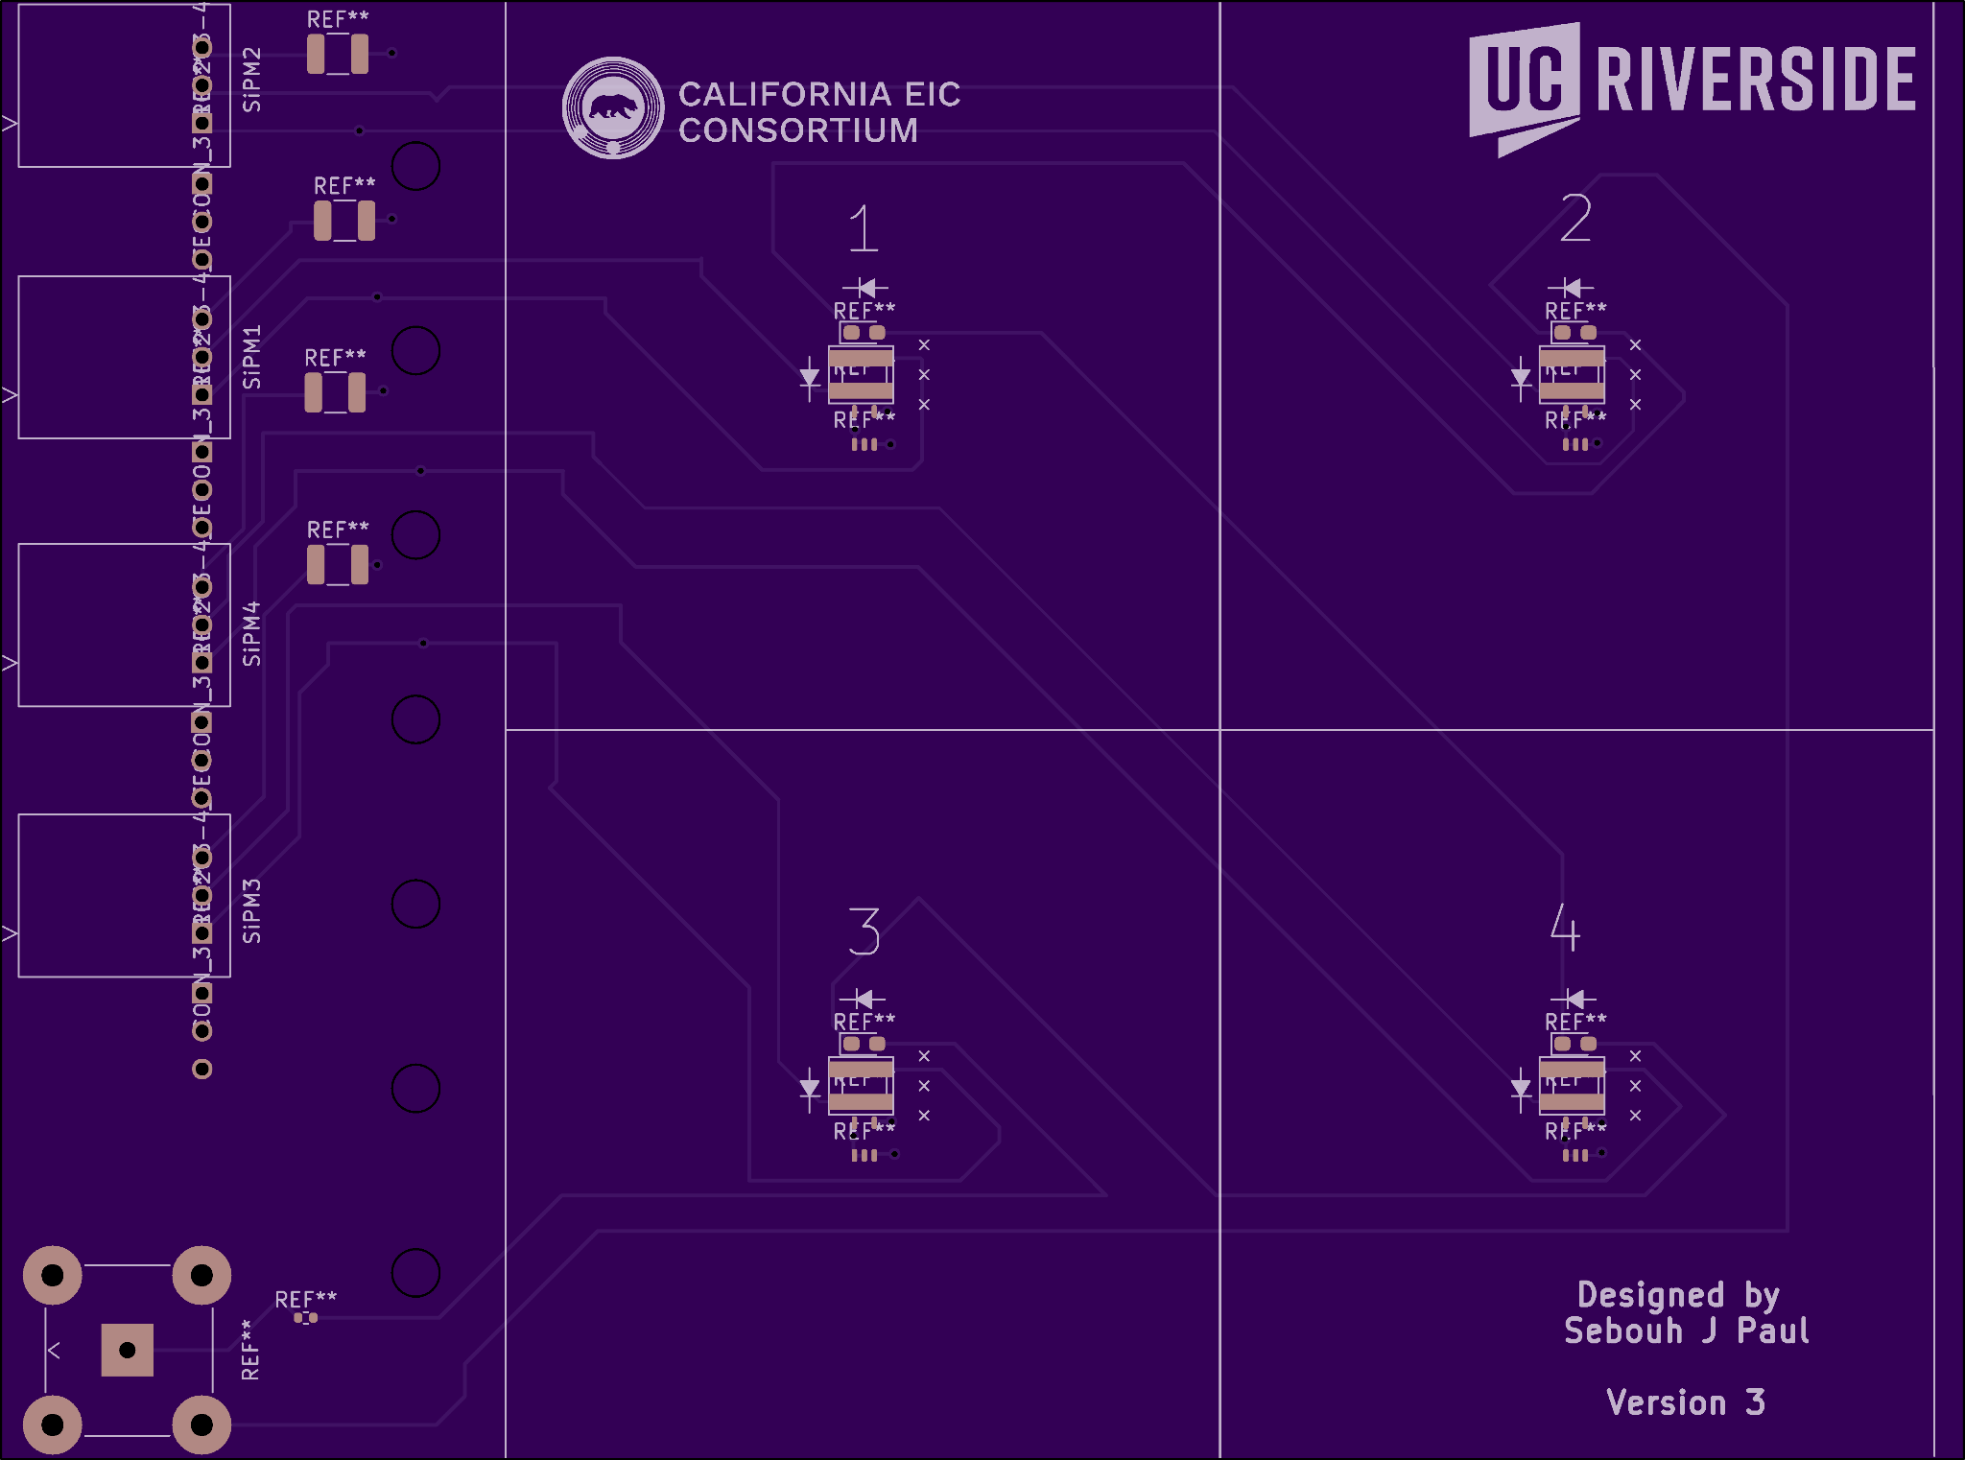
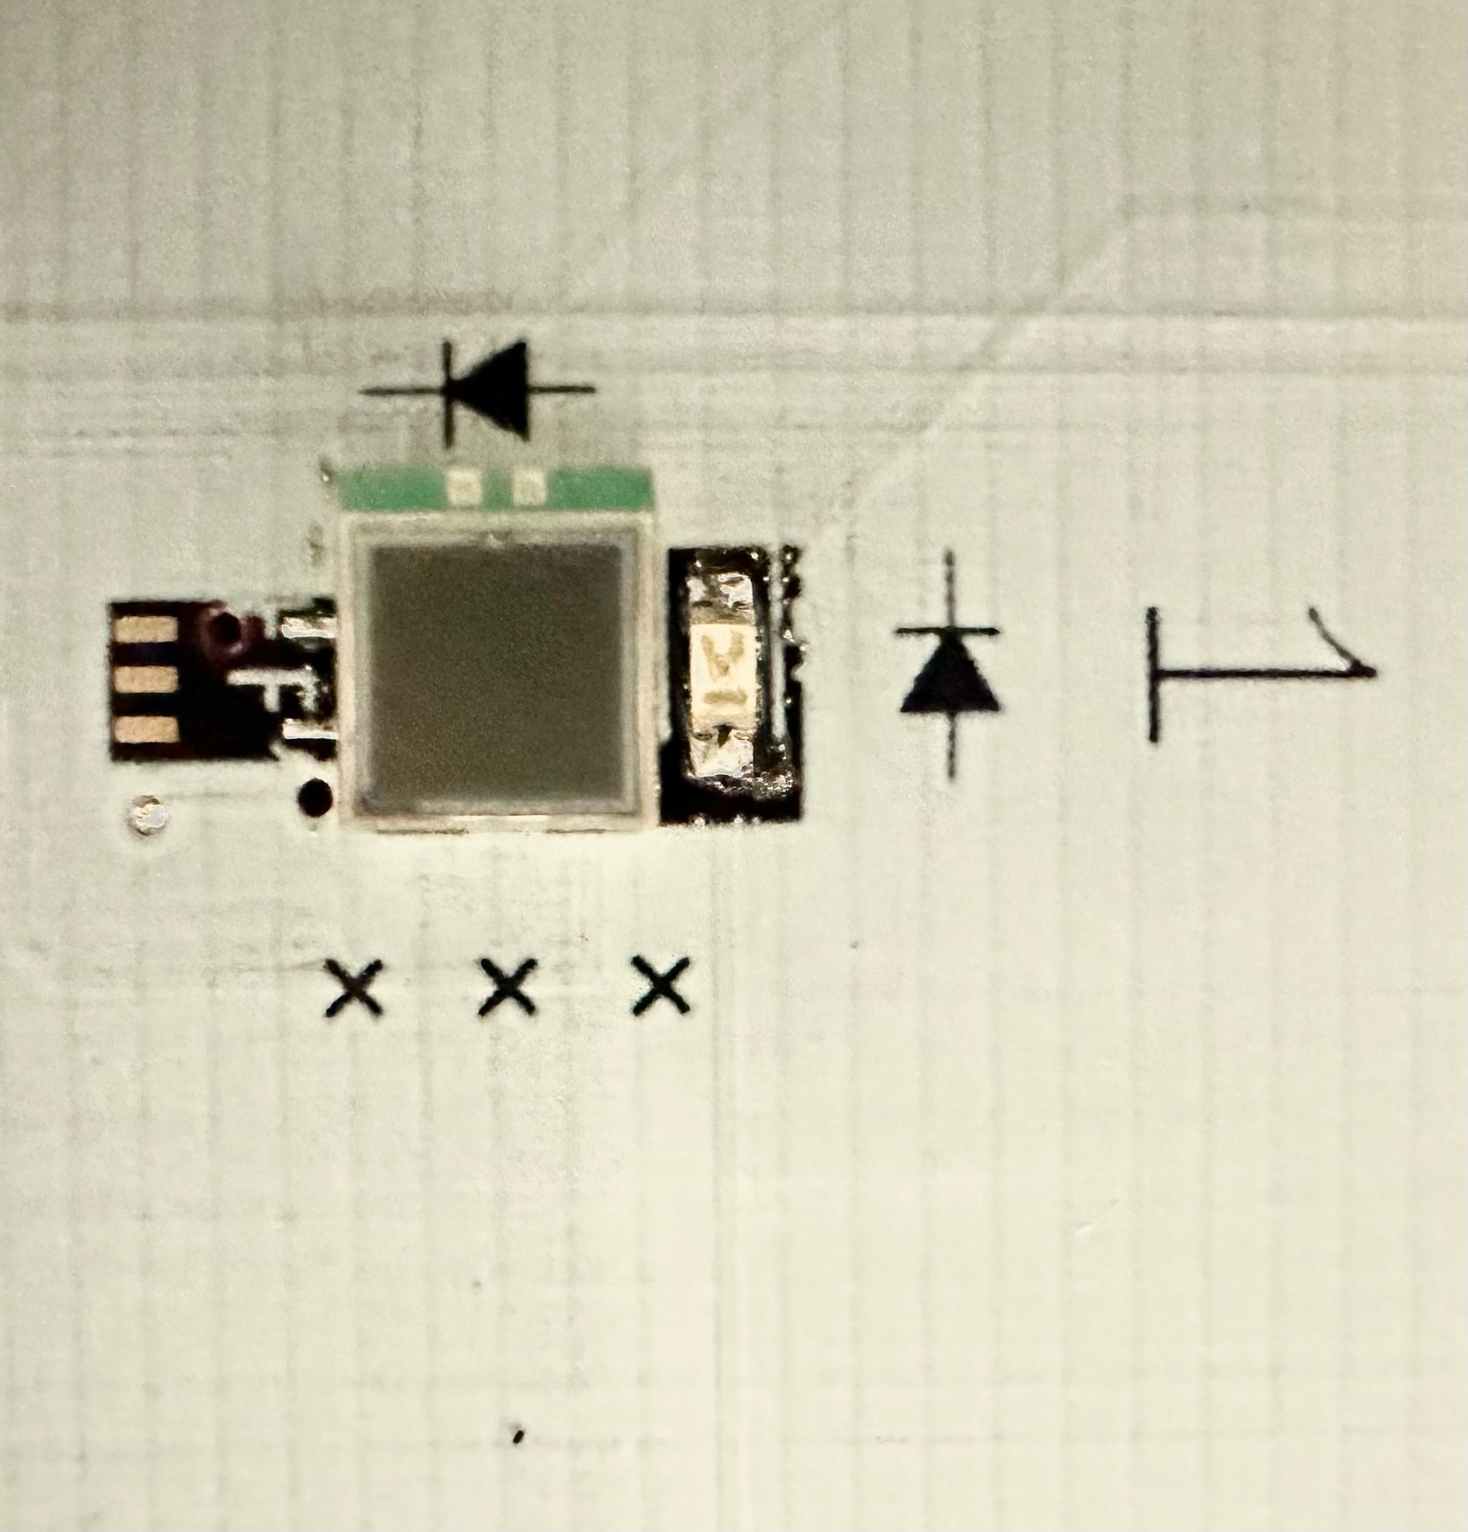
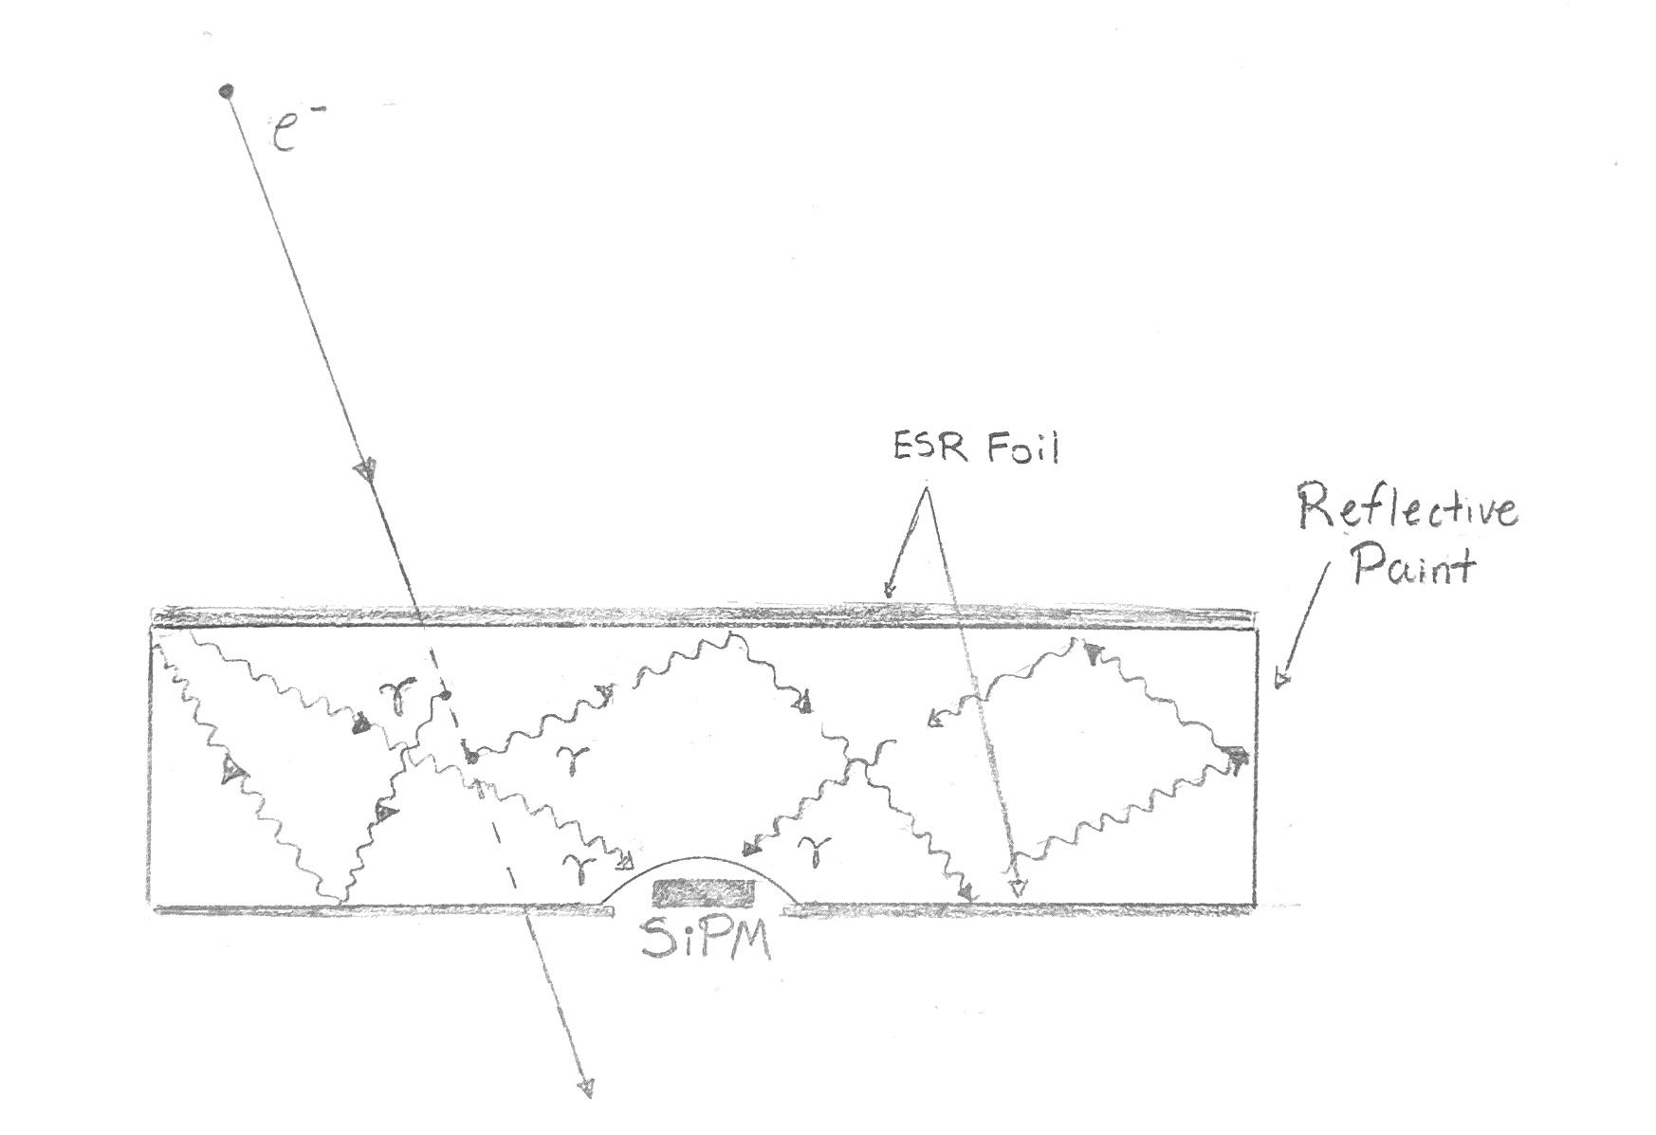
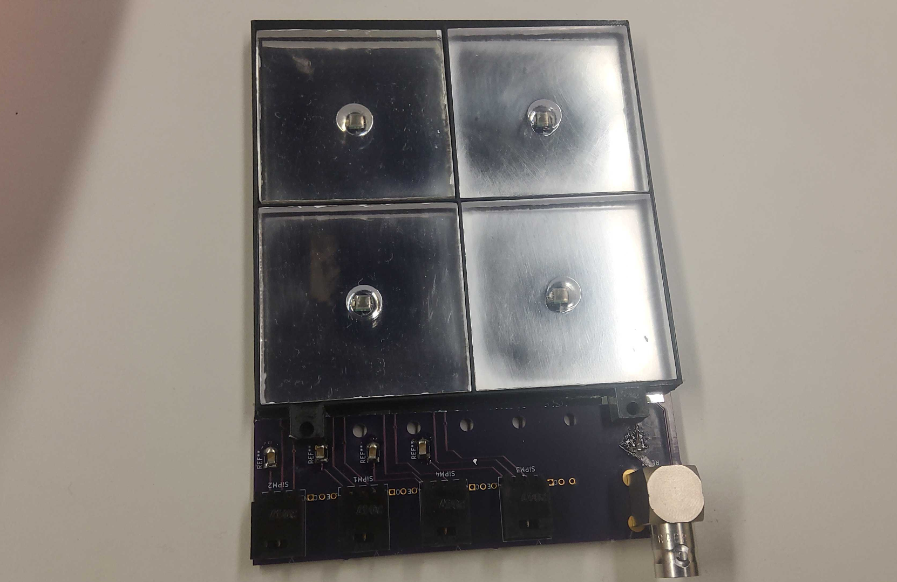
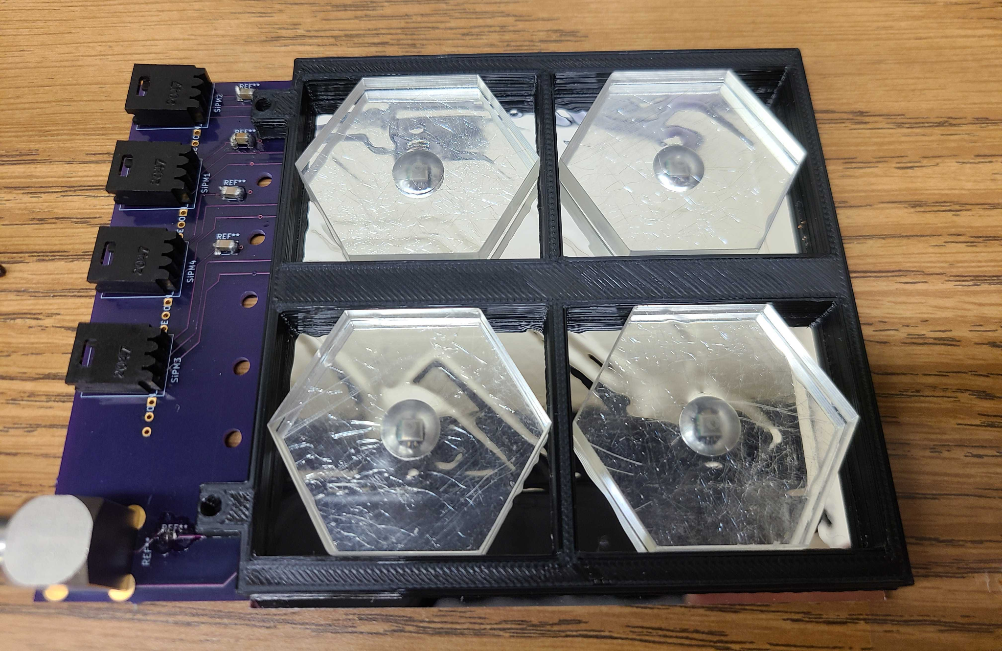
Prototype Layer Design
Printed Circuit Board Base
Light Yield Process
Foils + Frames + Scintillating Tiles
First 4 layers
Last 6 layers
3

Slide 5
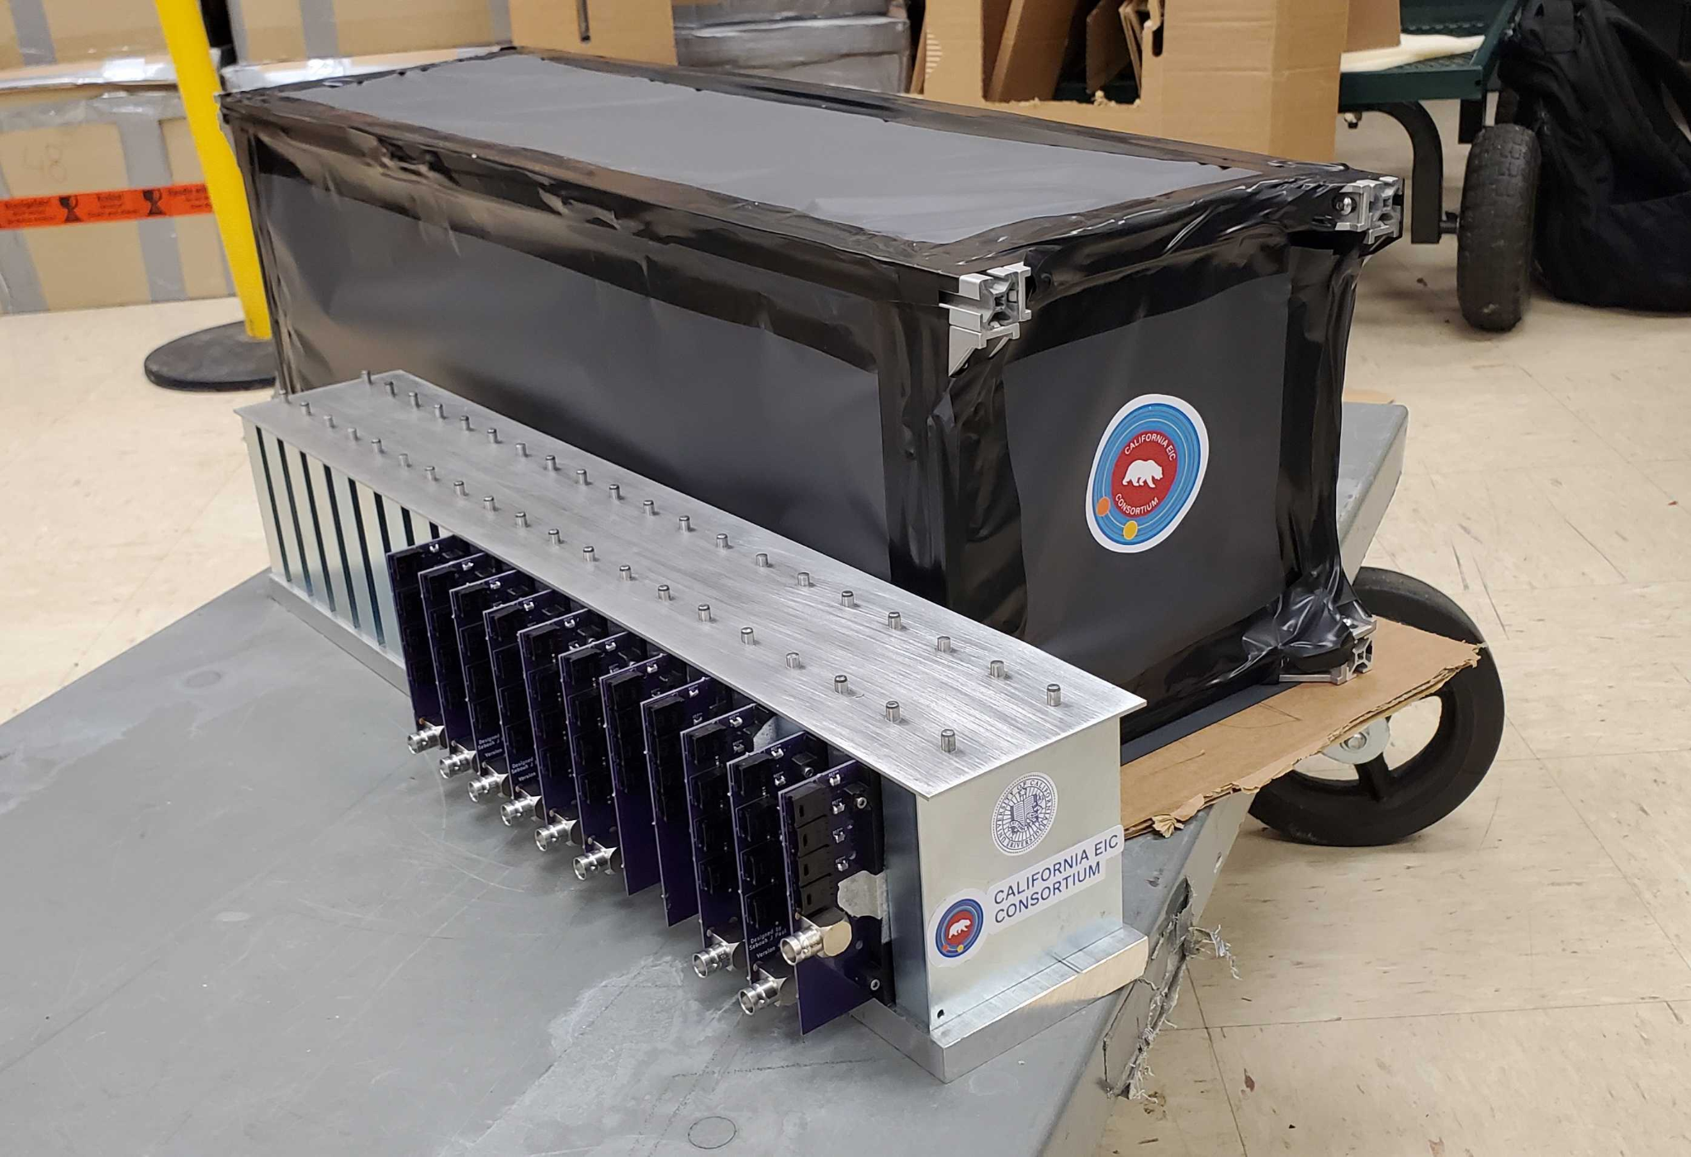
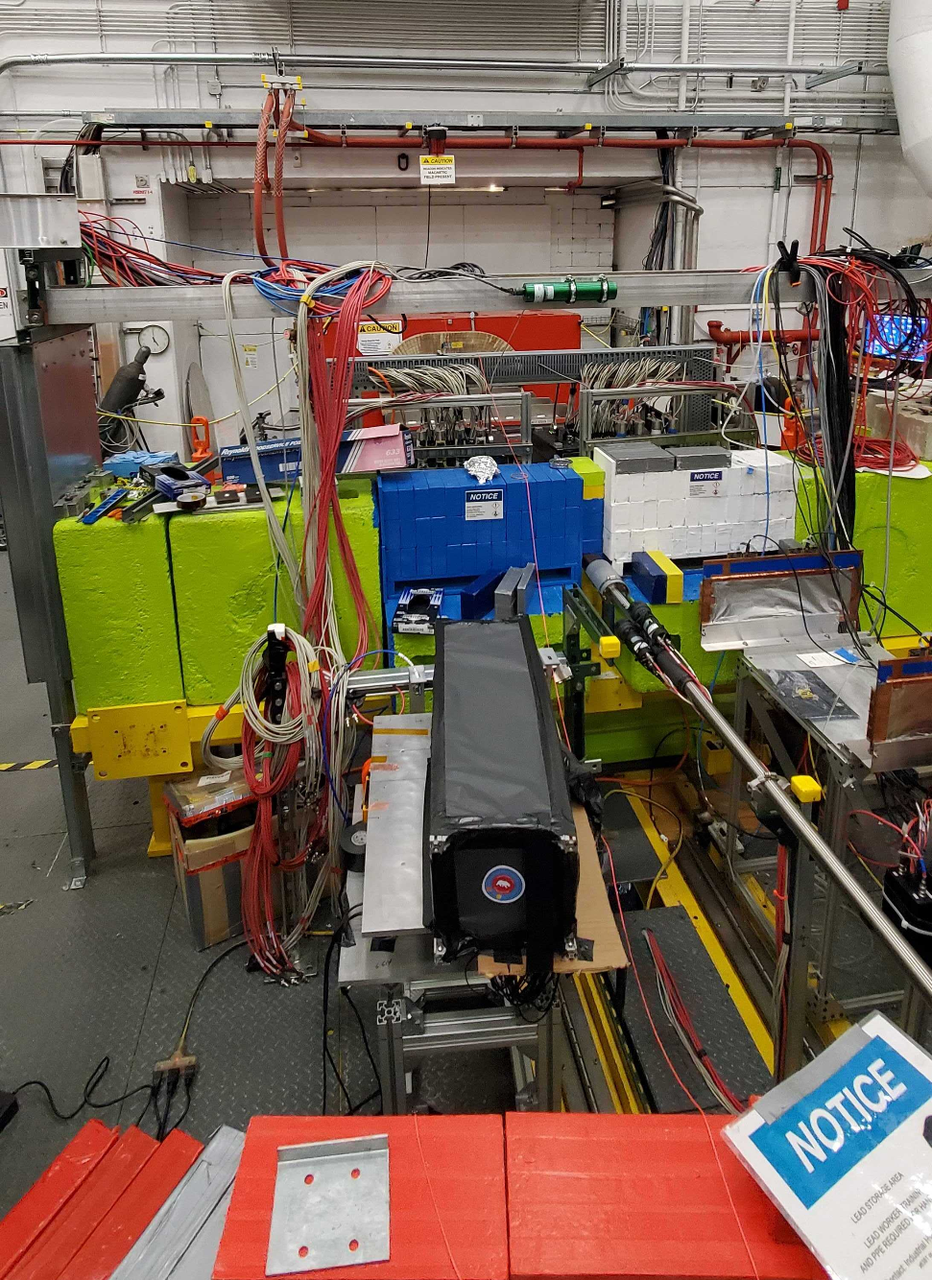
Prototype Jefferson Lab Test
Prototype consists of 10 layers: 30cm in beam direction.
11.7 Effective Radiation Lengths
Test conducted in Hall D of JLab. January 2023
Exposed to:
~ 4 GeV positrons
~ 3 kHz bunch rate
4

Slide 6
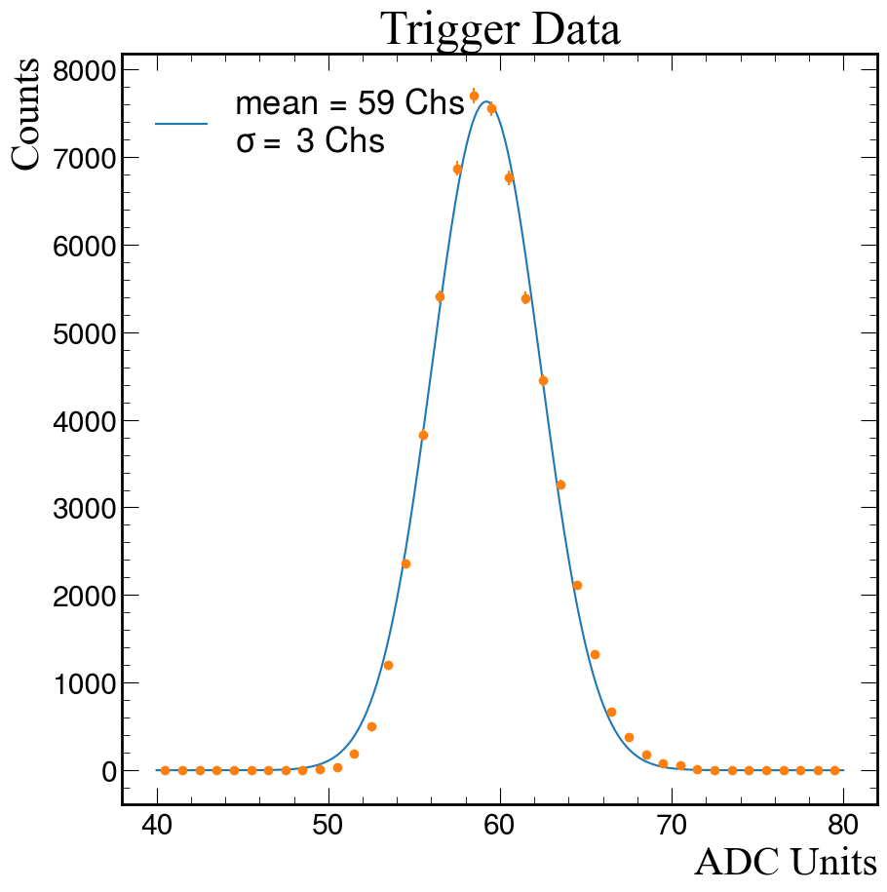
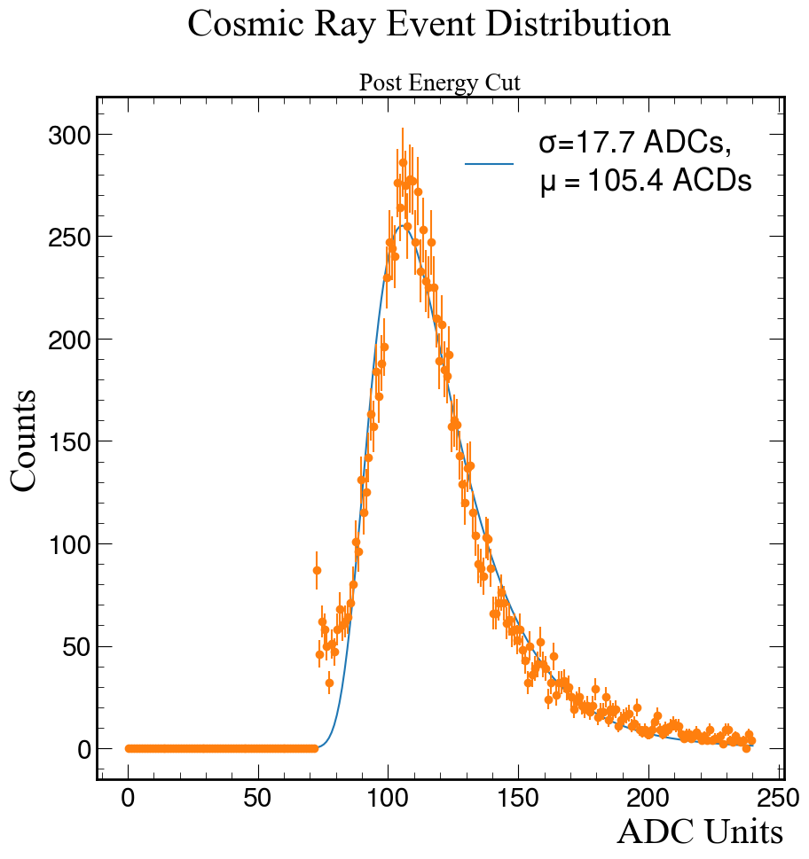
Data Analysis Procedure
Take random trigger data to determine noise level → Pedestal
Take cosmic ray data to determine how many ADC units corresponds to a MIP
Collect JLab Beam Data in the form of events
Add up all of the energy deposits for each layer
Apply a Pedestal cut for all data going forward
Convert data from ADC Units → MIPs
Add up all energy deposits to find total energy
5

Slide 7
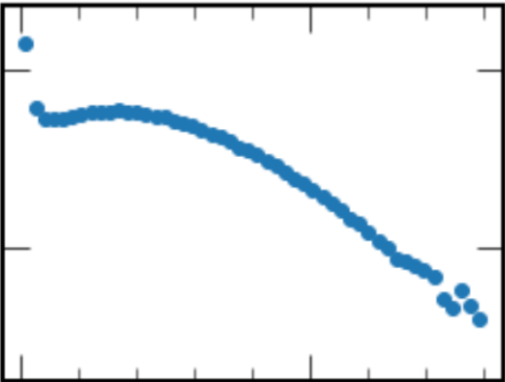
Energy Distribution for a Single Channel
MIP Distribution. Channel 4
10⁵
10²
Counts
20 40
MIPS
6

Slide 8
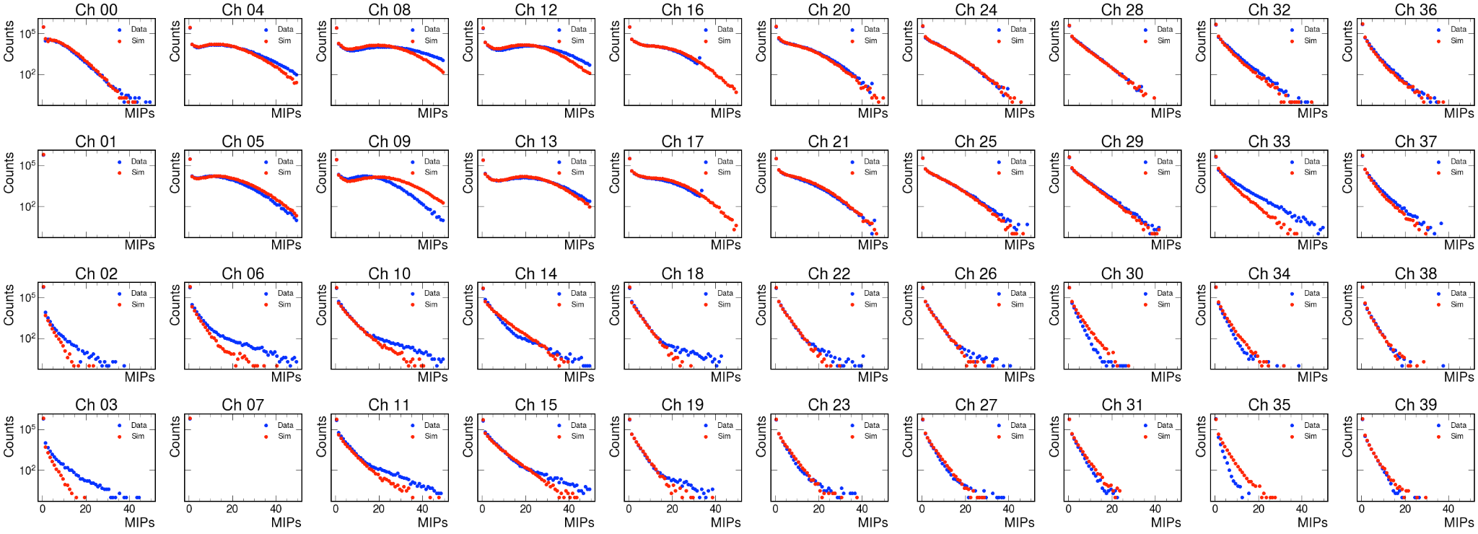
Energy Distribution for all Channels
Layer 1 Layer 2 Layer 3 Layer 4 Layer 5 Layer 6 Layer 7 Layer 8 Layer 9 Layer 10
— Simulation
— Data
Beam Direction
7

Slide 9
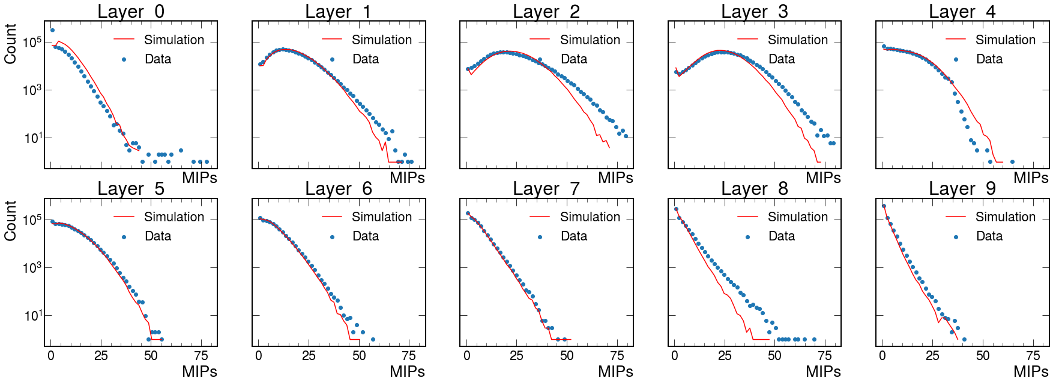
Energy Distribution for Each Layer
8

Slide 10
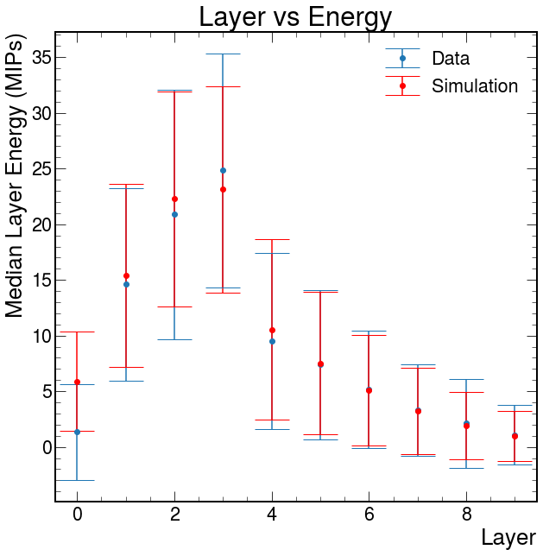
Average Energy Deposited in Each Layer
First 4 Layers used Square Scintillating Tiles
Last 6 Layers used Hexagonal Scintillating Tiles
9

Slide 11
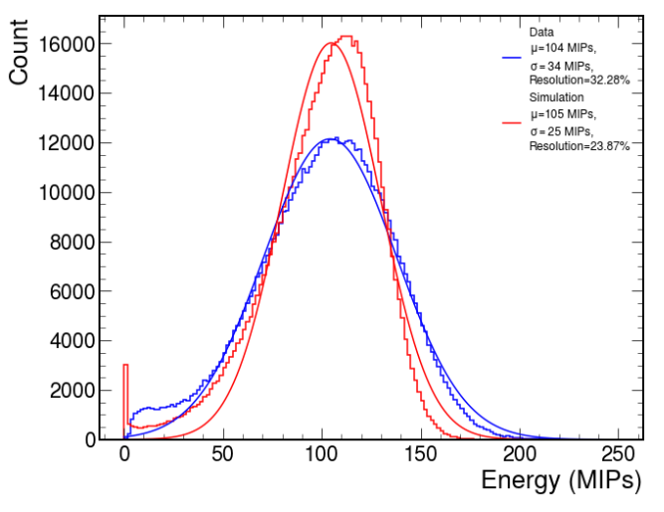
The Total Energy
Total Summed Energy
Reasons for uncertainty:
Large dead space in hexagonal cells
MIP values may have needed more calibration
Scintillating Tiles are recycled → optical loss
Prototype aligned slightly below positron beam → some events don’t traverse full prototype
10

Slide 12
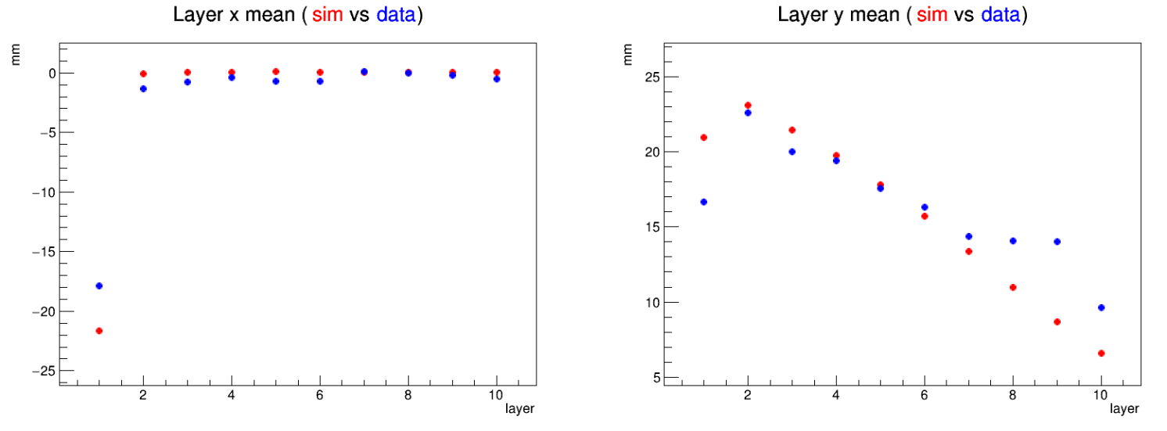
Energy Distribution for Each Layer
11

Slide 13
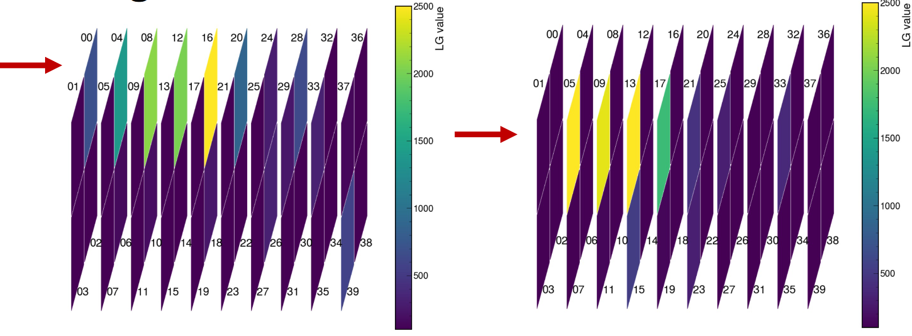
Single Event Reconstruction
12

Slide 14
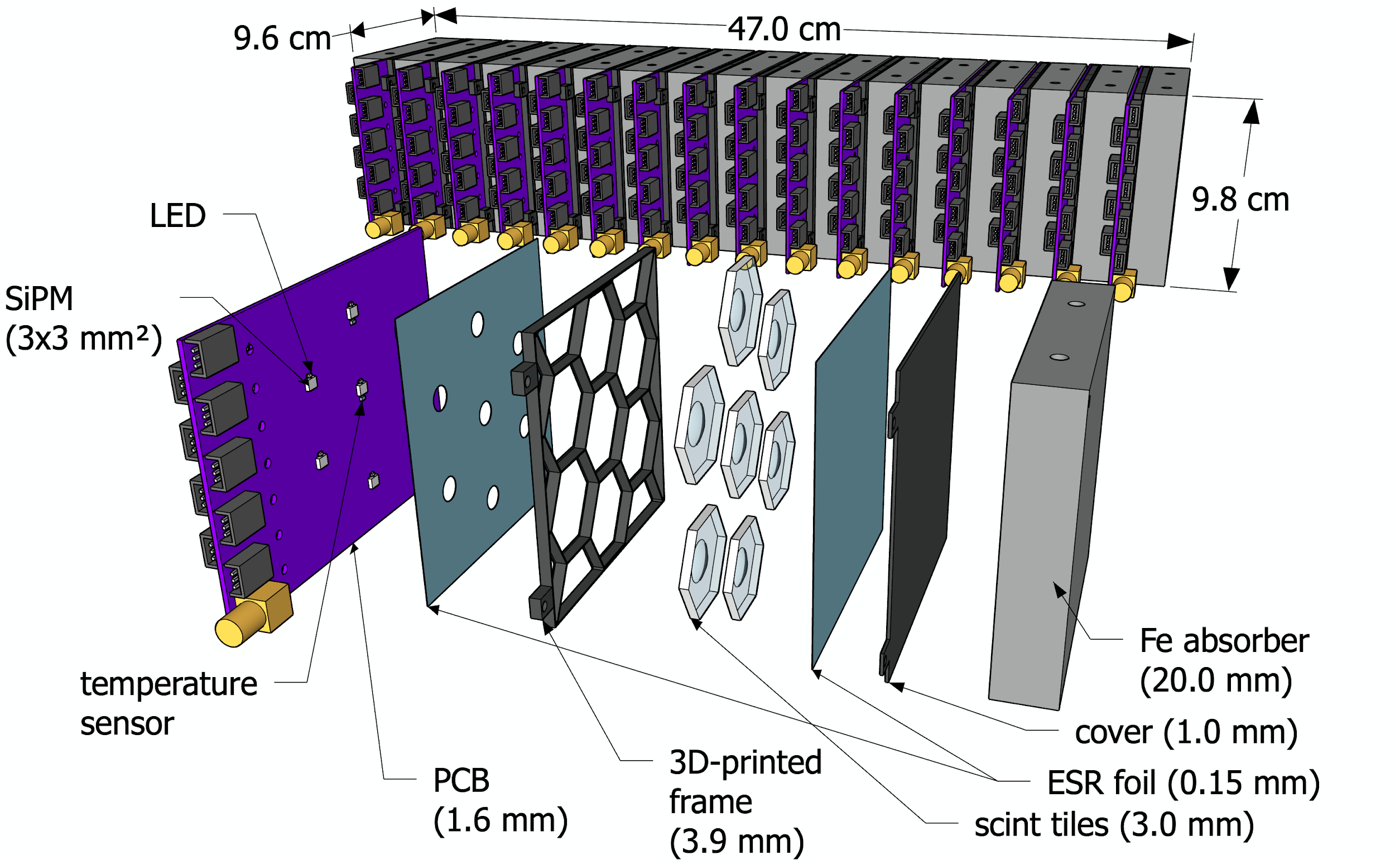
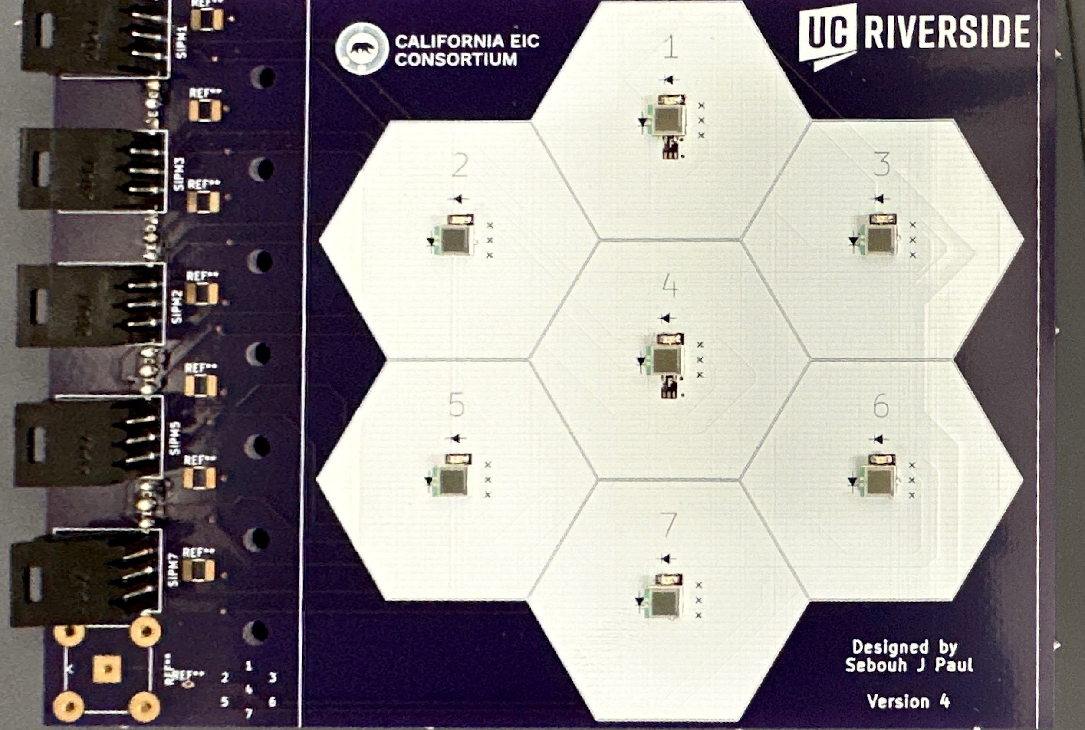
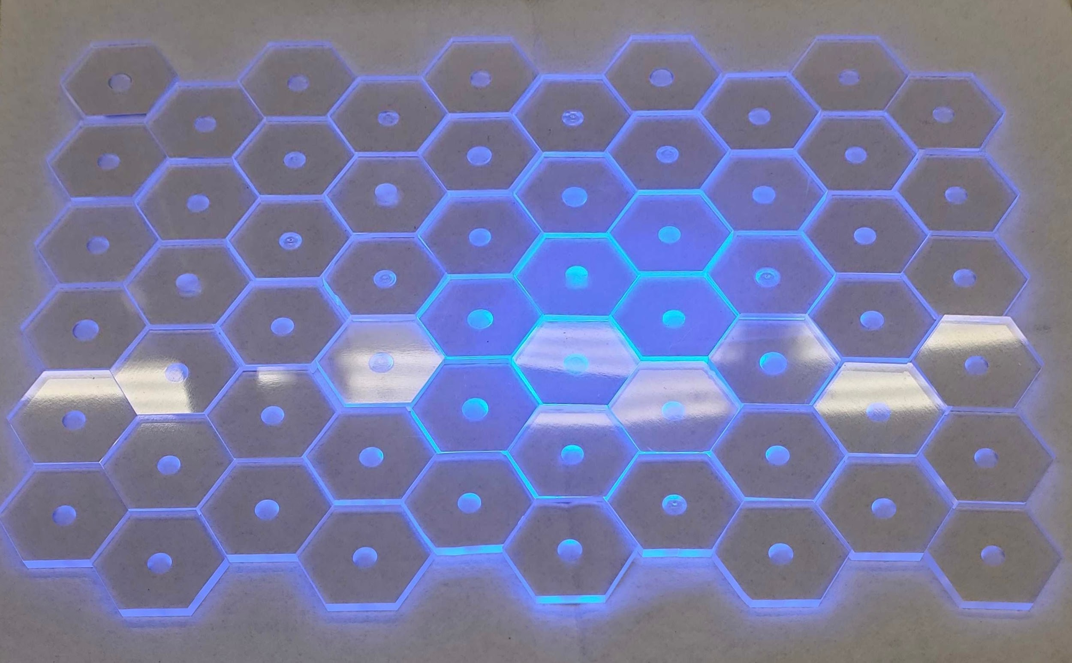
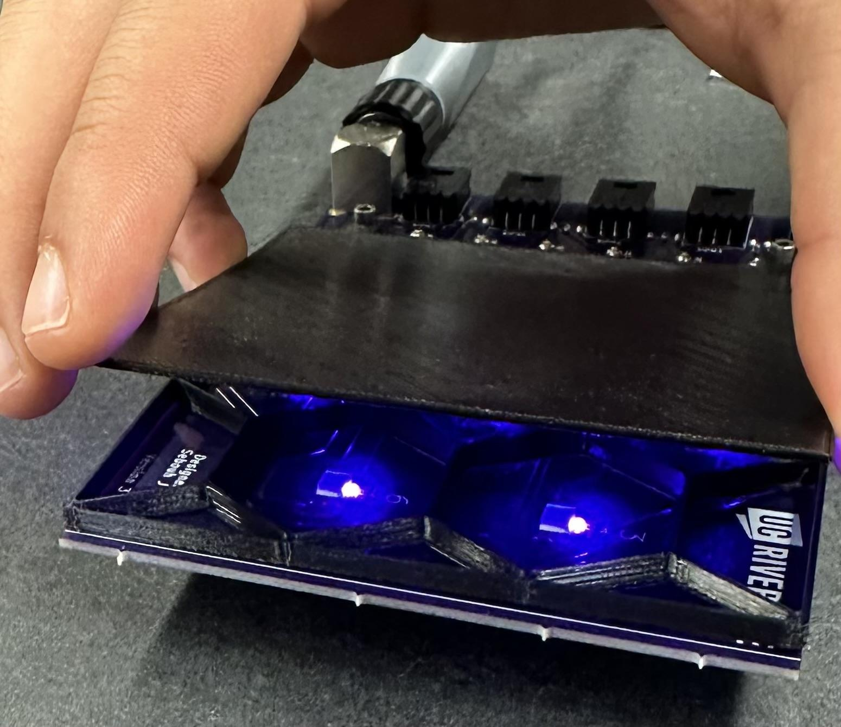
We’re Not Done!
Upgrades for next beam test
10 layers → 16 layers
4 cell square tiles → 7 cell Hexagonal tiles
Recycled scintillating tiles → Fermilab tiles
UV Light SiPM calibration
13

Slide 15
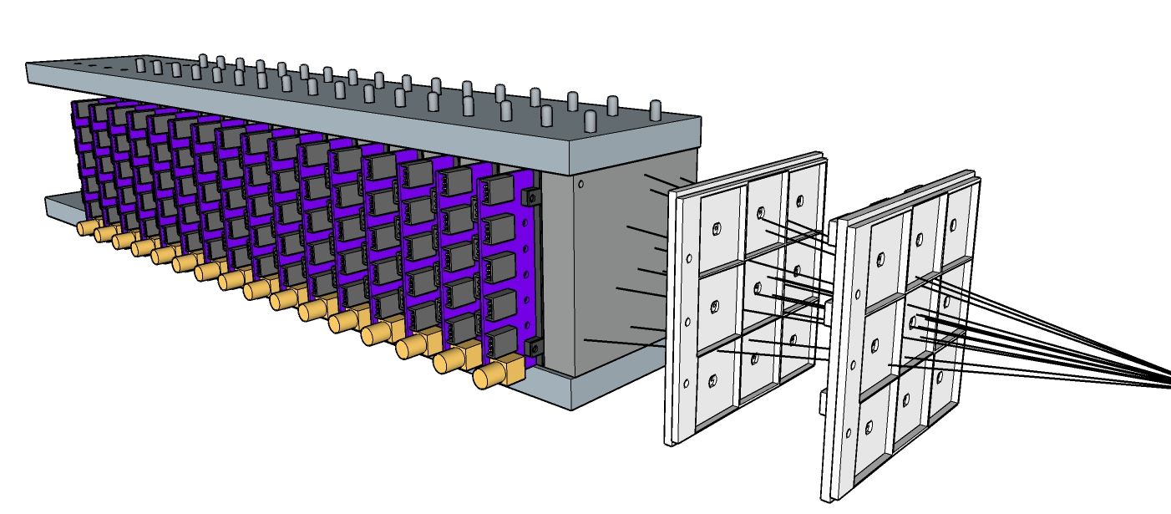
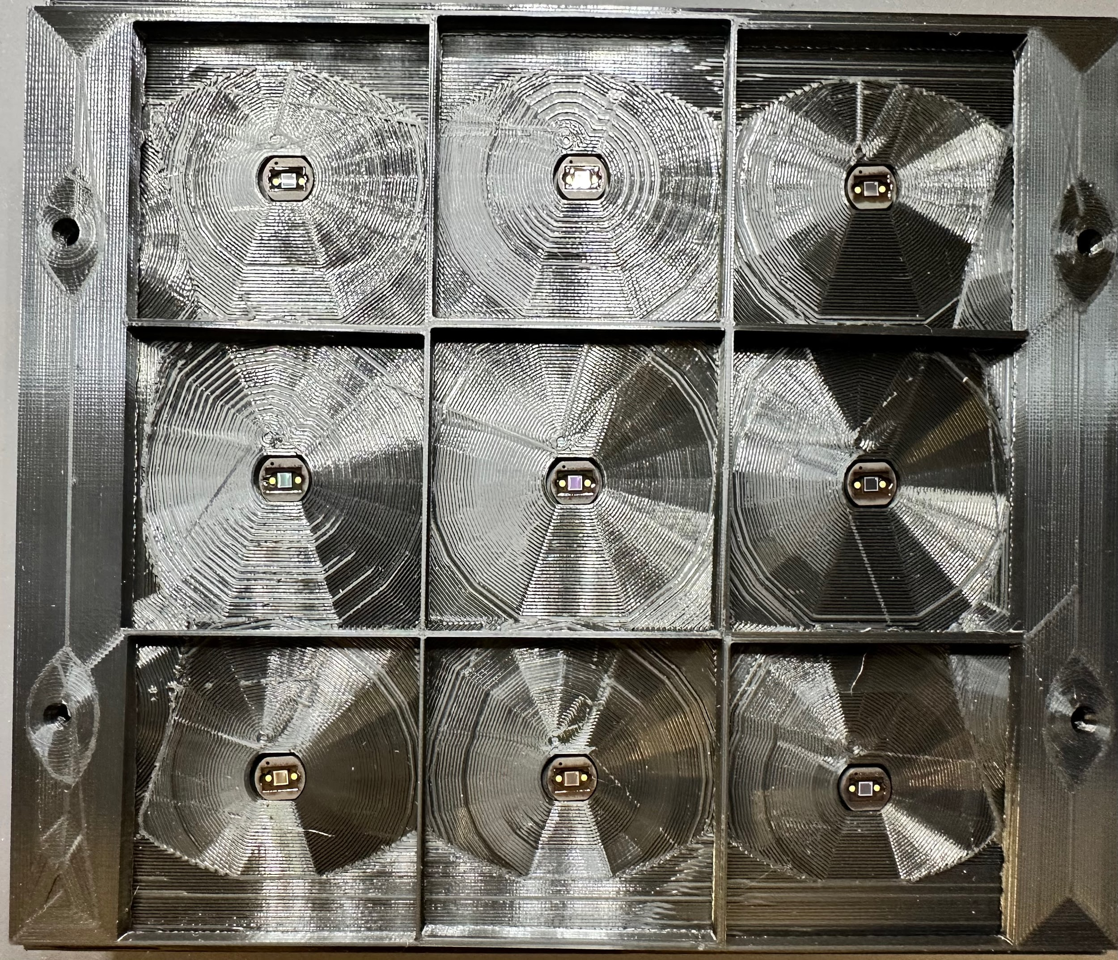
Addition of the Hodoscope
Tracking system implemented before prototype → Hodoscope
Localizes beam / determines trajectory before it enters calorimeter
14

Slide 16
Where do we go from here?
Finish prototype construction
Test/Calibrate SiPM
Refine Scintillator polishing process
Finish Hodoscope
Add extra layer
Determine timing resolution
Determine testing site/conditions
JLab or Fermilab early 2024
Implement Simulation
Simulate expected data using pre-known factors
Use simulation to optimize construction / train data analysis
15

Slide 17
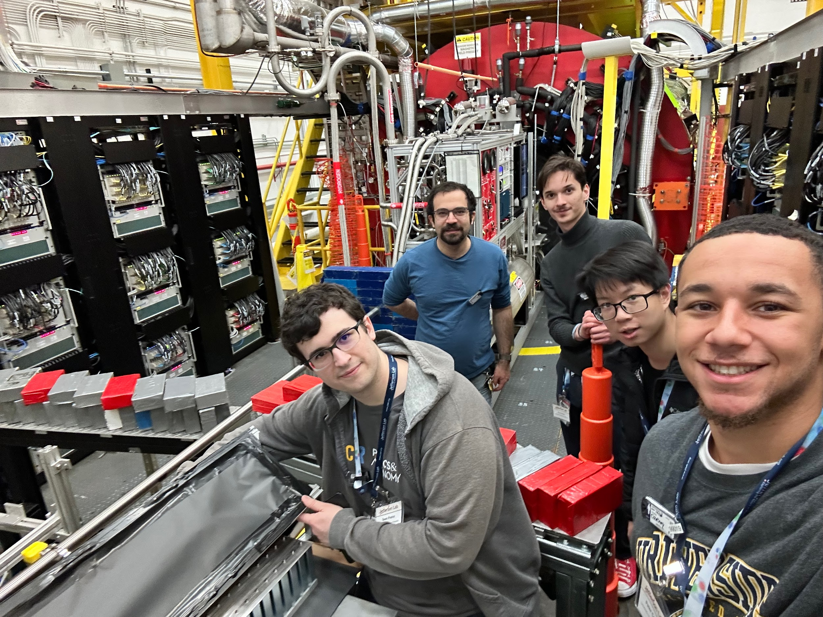
Thank you / Dziękuję !
Sources
Studies of time resolution, light yield, and crosstalk using SiPM-on-tile calorimetry for the future Electron-Ion Collider. Miguel Arratia et. al. https://iopscience.iop.org/article/10.1088/1748-0221/18/05/P05045
A high-granularity calorimeter insert based on SiPM-on-tile technology at the future Electron-Ion Collider. Miguel Arratia et. al. https://www.sciencedirect.com/science/article/abs/pii/S0168900222011585
New paradigms for the CMS Phase-2 Upgrades https://cms.cern/news/new-paradigms-cms-phase-2-upgrades
Detectors. Summer Student Lecture Programme 2023.Werner Riegler.
16

